Slide 1
Inborn Errors of Metabolism

Slide 2
Topic 6: Inborn Errors of Metabolism Objectives
Describe the most common findings in cystinuria.
Differentiate between cystinuria and cystinosis.
Differentiate the following aminoacidurias including the defect, lab assessment and significant findings;
phenylketonuria
alkaptonuria
maple syrup urinary disease
Define the term glycogen storage disease and list at least one disease within this category.
Explain why urines from young children and infants are screened for reducing sugars.
Define the term lipid storage disease.
Discuss the enzyme defect, accumulation product, and significant findings for the following:
Gaucher's disease
Niemann-Pick disease
Tay-Sach's disease
Describe the substances measured and the procedures for assessing fetal lung maturity. Given results of tests for fetal lung maturity, determine the risk to the fetus if delivery were to occur.
List reasons for performing a gastric analysis. Describe the procedure for performing a gastric analysis.

Slide 3
Introduction
One in 600 infants has an inborn error of metabolism, and newborn screening (NBS) will pick up the most common and the most treatable of these conditions
Physicians must be familiar with the panel of disorders detected by the local NBS program
Each NBS lab must have the testing capacity to diagnose quickly and guide treatment for potentially life-threatening genetic illnesses that may be present in neonatal period.
Testing is usually a public health activity that was first began by Dr. Robert Guthrie in the early 1960’s

Slide 4
Components of a Newborn Screening Program
1. Screening
Sample Collection and delivery
Lab testing
2. Follow-up of
Incomplete demographic information
Unsatisfactory specimens
Abnormal screening results
3. Diagnosis
Confirmatory tests
Clinical consultation
4. Clinical Management
5. Education of
Healthcare professionals
parents
6. Quality Assurance
Analytical: proficiency testing, quality controls, standards
Efficiency of follow-up system
Efficacy of treatment
Long-term outcome

Slide 5
Panels of disorders screened varies among the states: Recommendations by the American College of Medical Genetics (ACMG) include:
Five Fatty-acid oxidation disorders
Nine organic acidemias
Six aminoacidopathies
Three hemoglobinopaties
Six other disorders
* Tietz Table 44-1 page 827

Slide 6
Methodology Tietz Pages 133-136
Some of these disorders can be tested by Tandem mass
spectrometry (MS/MS) but a number of conditions are still tested using traditional methods:
* immunoassay technology
* isoelectric focusing
Advantage of Tandem mass spectrometry :
* multiple metabolites can be detected simultaneously in the same spot
* allows the identification of several disorders at once
This ability allows use of ratios of metabolites to define whether an elevated value is due to a metabolic derangement or to the clinical and nutritional status of the newborn.
The development of tandem mass spectrometry screening in the early 1990s led to a large expansion of potentially detectable congenital metabolic disease that affect blood levels of organic acids.

Slide 7
Definition
Inborn Errors of metabolism: affect the conversion of nutrients into one another or into energy
Caused by: Impaired enzyme activity or impaired transporter or cofactor
Results in: accumulation of abnormal metabolites proximal to the metabolic block followed by a deficiency of another necessary product

Slide 8
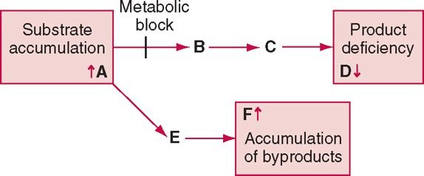
Figure 44-3 A block in a metabolic pathway results in accumulation of substance A, deficiency of product B, and accumulation of byproduct F (Tietz Page 828)

Slide 9
Classes of Disorders
Disorders of metabolism of amino acids
Disorders of metabolism of fats
Disorders of metabolism of carbohydrates

Slide 10
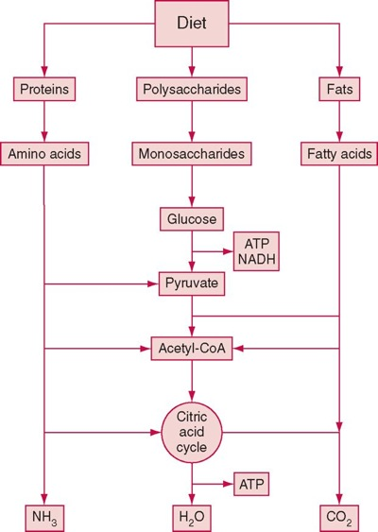
Tietz Page 828

Slide 11
Genetics
Caused by mutations in the genes that code for specific enzymes involved in metabolic pathways
Majority are autosomal recessive: affect boys and girls equally
Affected individuals have a mutation in both alleles encoding for a specific enzyme/transporter
When Parents are carriers of the condition (one normal and one mutant allele) they show no clinical signs

Slide 12
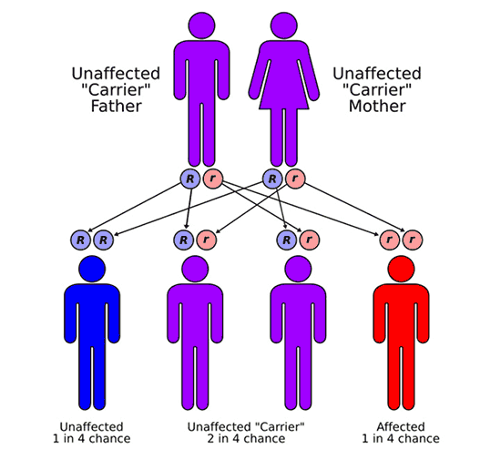
Autosomal Recessive Inheretance

Slide 13
Medical Consequences
Failure to thrive
Acute illness leading to: Brain damage (encephalopathy), coma, death
Acute presentation preceded by a symptom-free period

Slide 14
Treatment
Special diet lacking specific nutrients that cannot be metabolized, in addition to vitamins and other cofactors
Effective if begun early

Slide 15
Common Lab Presentations
Neonatal hypoglycemia
Jaundice
Metabolic acidosis
Lactic acidosis
Severe Hyperammonemia ( >150μmol/L ) which may be caused by a urea cycle disorder, other inborn errors of metabolism, or transient Hyperammonemia of the new born

Slide 16
Amino Acid Metabolism Disorders
Almost all transmitted as autosomal recessive traits
Caused by a lack of a specific enzyme in the metabolic
pathway of an amino acid
Buildup of parent the amino acid or by the byproducts or
the catabolic products
Collectively (all different a.a.) they affect 1 in 8000 newborns

Slide 17
Amino Acid Metabolism Disorders
Aminoacidopathies
Organic Acidemias
Parent amino acid accumulation in excess in the blood and spills over into urine
1.PKU-phenylketonuria
2.Maple syrup urine disease
3.Homocystenuria
4.Type I Tyrosinemia
5.Alkaptonuria
6.Cystinuria
Products in the catabolic pathway of certain amino acids accumulate
1.Glutaric Acidemia Type I
2.Isovaleric acidemia
3.Methylmalonic Acidemia
4.Propionic Acidemia

Slide 18
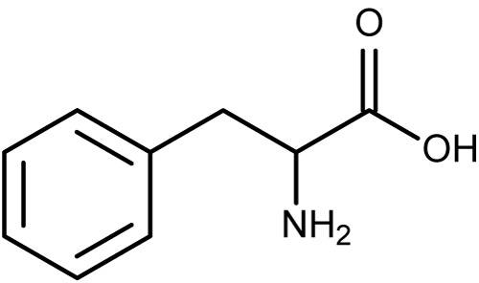
Phenylketonuria/ Hyperphenylalaninemia
A disorder of phenylalanine metabolism
Phenylalanine is an essential amino acid, constituting 4 to 6 % of all dietary protein.
Phenylalanine that is not used in protein synthesis is converted to tyrosine by the enzyme phenylalanine hydroxylase and further degraded via a ketogenic pathway.
Several forms of the disorder exist with a frequency of 1:10,000 to 1:20,000 live births

Slide 19
PKU
Classic or Primary
98% of all cases
Caused by mutations in
the phenylalanine hydroxylase
gene
Secondary
Remaining 2% of all cases
Caused by defects in biosynthesis
or recycling of tetrahydrobiopterin
(BH₄) which is the cofactor for
phenylalanine hydroxylase

Slide 20
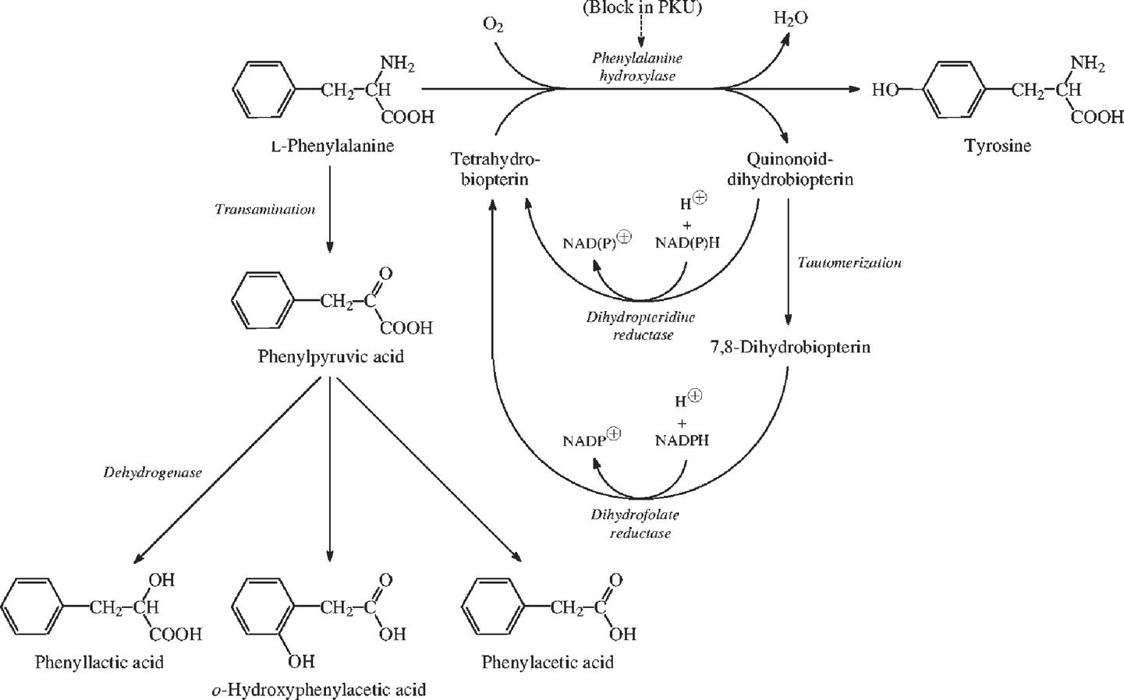

Slide 21
PKU Lab Tests
Plasma: showing elevated phenylalanine and phenylalanine/tyrosine ratio
Urine: elevated phenylketones (hence the name phenylketonuria)
Enzymatic phenylalanine hydroxylase confimation: not usually performed (the enzyme is only expressed in liver)
Mutation analysis of gene: increasingly used because there is a correlation between severity of mutaion & phenylalanine tolerance
BH₄: all children with hyperphenylalaninemia should be screened for defects in BH₄ synthesis or recycling

Slide 22
The Guthrie test
A microbiological assay developed by Dr. Guthrie.
Involves the incorporation of bacterium Bacillus subtilis and the growth antagonist beta-2-thienylalanine into agar.
Dried blood spot is placed on the agar
If there is a normal concentration of phenylalanine in the sample, bacterial growth will be inhibited.
Excess phenylalanine will counteract the antagonist and restore growth of bacterium around the spot.
Test is sensitive to phenylalanine conc. of >4mg/dL
Allows for testing of other amino acid disorders using different growth antagonists

Slide 23
Tetrahydrobiopterin (BH₄)
Also a cofactor for tyrosine hydrolase, tryptophan hydrolase, and nitric oxide synthase
Affects the synthesis of several neurotransmitters (dopamine & serotonin)
Defects in synthesis or recycling lead to neurological symptoms & developmental regression in the first few months of life
Patients can develop seizures
Patients may or may not require low phenylalanine diet once BH₄ therapy is initiated

Slide 24
Maple syrup urine disease (MSUD)
Caused by a gene defect
Can’t break down branched-chain leucine, isoleucine, and valine which leads to buildup of in the blood
MSUD can damage the brain in most severe cases during times of physical stress (Ex: infection, fever, or not eating for along time)
MSUD also occurs in an intermittent & a mild form
Even in the mildest form, repeated periods of physical stress can cause high levels of leucine

Slide 25
Symptoms of MSUD
Avoiding food, coma, feeding difficulties, lethargy
seizures, urine that smells like maple syrup, and vomiting
Exams and Tests
Plasma Amino Acid Test
Urine Amino Acid Test
There will be signs of ketosis and excess acid in blood (acidosis)

Slide 26
Treatment of MSUD
When the condition is diagnosed, and during episodes, treatment involves eating a protein-free diet. Fluids, sugars, and possibly fats are given through a vein (IV).
Peritoneal dialysis or hemodialysis can be used to reduce the level of amino acids.
A special diet free of branched-chain amino acids is started when amino acid levels are normal.
Long term treatment requires a special diet with low levels of the amino acids leucine, isoleucine, and valine. Persons with this condition must remain on this diet permanently.
Following this diet will prevent neurological damage.
This requires frequent blood tests and close supervision.

Slide 27
Alkaptonuria
Alkaptonuria is a rare condition in which a person's urine turns a dark brownish-black color when exposed to air. Autosomal recessive.
Causes
A defect in the HGD gene causes alkaptonuria.
The gene defect makes the body unable to properly break down tyrosine and phenylalanine.
Causes a buildup of homogentisic acid in the skin and other body tissues.
Acid leaves the body through the urine
Urine turns brownish-black when it mixes with air

Slide 28
Alkaptonuria
Symptoms:
Urine in infants diaper may turn almost black after several hours
Many individuals do not know they have this condition until adulthood.
Arthritis ( especially of the spine)
Darkening of the ear
Dark spots on the sclera and the cornea
Exams and Tests:
Urinalysis: Ferric Chloride added to urine of individuals with this condition will turn a black color.
Treatment:
High doses of Vitamin C.
Possible Complications:
Buildup of Homogentisic acid in heart valves may lead to need for valve replacement
Coronary Artery Disease- may develop earlier
Kidney and prostate stones are more common.

Slide 29
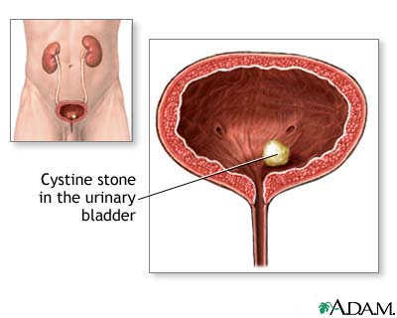
Cystinuria
Cystinuria is a disorder characterized by cystine stones in the kidney, ureter, and bladder. A genetic abnormality results in abnormal transport of amino acids in the kidney.
The high levels of the amino acid cystine in the urine lead to stone formation.
While this disease only accounts for 1-2 % of urinary tract stones in the general population, it is the most common cause among children.

Slide 30
Cystinuria
Symptoms
Blood in the urine
Flank pain or pain in the side or the back
Usually on one side; rarely felt on both sides
Often severe
May get increasingly worse over days
Pain may also be felt in the pelvis, groin, genitals, or between the
upper abdomen and the back.
Exams and Tests
Usually diagnosed after an episode of kidney stones.
Analysis of the stones shows they are made of cystine.

Slide 31
Cystinuria
Tests that may be done to detect stones and diagnose this condition include:
Abdominal CT scan, MRI, or ultrasound
Intravenous pyelogram
Urinalysis (may show cystine crystals)
24-hour urine collection (shows high levels of cystine)
Treatment:
Drink plenty of fluids (IV therapy may be needed)
Medications to dissolve Cystine crystals; eat less salt.
Pain relievers for relief of passage of stones
Surgery may be needed if a stone cannot pass

Slide 32
Cystinosis:
Condition in which the body accumulates Cystine within cells.
Caused by mutations in the CTNS gene.
Most common cause of Fanconi syndrome in pediatric population
Buildup of cystine damages cells in the kidneys, eyes and other
organs.
Three types:
1) Nephropathis Cystinosis
2) Intermediate Cystinosis
3) Non-Nephropathic or Ocular cystinosis

Slide 33
Inborn Errors of Carbohydrate Metabolism
Deficiency or absence of an enzyme that participates in
Carbohydrate metabolism may result in the accumulation
of monosaccharides in the urine
The urinary sugars of clinical interest are glucose and
galactose.
Testing of urine from infants and children by both the
glucose oxidase and the copper reduction tests will identify
individuals with inborn errors of carbohydrate metabolism.

Slide 34
Glycogen Storage Disease (GSD):
Absence or deficiency of enzymes responsible for either the formation of glycogen or breakdown of glycogen
Causes either an increase or decrease in glycogen and affects blood glucose levels
11 known types
Most often deal with liver, kidney, or both
Most common type = Type 1: Von Gierke Disease
Deficiency of glucose-6-phosphatase
Cannot produce glucose via glycogenolysis or gluconeogenesis
Hypoglycemia, Increased triglycerides and lactate, enlarged liver

Slide 35
Lipid Storage Disease
Group of inherited metabolic disorders; harmful amounts of lipids accumulate in body's cells and tissues
Either caused by lack of production of enzymes needed to metabolize lipids or production of enzymes that don't work properly
Causes permanent cellular and tissue damage particularly in the brain, peripheral nervous system, liver, spleen, and bone marrow
Autosomal Recessive

Slide 36
Sphingolipidoses
Group of lipid storage diseases that result in buildup of sphingolipids
Niemann-Pick
Deficiency of sphingomyelinase
Gaucher Disease
Deficiency of glucosylceramidase
Tay-Sach’s Disease
Deficiency of hexosaminidase A

