Slide 1
Reproductive Disorders
Northside Hospital

Slide 2
Lecture Objectives
Topic 11: Endocrinology: Reproductive
Describe the synthesis of steroid hormones including the name of a precursor molecule, metabolic products and the glands in which they are synthesized.
Differentiate androgens, estrogens and progesterone in terms of their metabolism and gland of origin.
Describe the hormonal regulation of the male and female reproductive systems.
Differentiate estradiol and estriol.
Discuss the change in hormonal effects during pregnancy.
Differentiate pretesticular, testicular, and posttesticular causes for male infertility.
List the causes, clinical symptoms, and laboratory findings in precocious puberty.
Differentiate the causes of hirsuitism.
Identify the major causes of amenorrhea.

Slide 3
Male Reproductive Biology
The function of the testes is to synthesize both sperm & androgens (steriods that masculinize)

Slide 4
Histology
Sertoli cell
1- In the seminiferous tubules- play a crucial role in sperm maturation
2-Secrete inhibin which inhibits the pituitary secretion of FSH
Leydig cells
1-Surrounding the seminiferous tubules-produces testicular androgens(testosterone)
2-necessary for sperm maturation

Slide 5
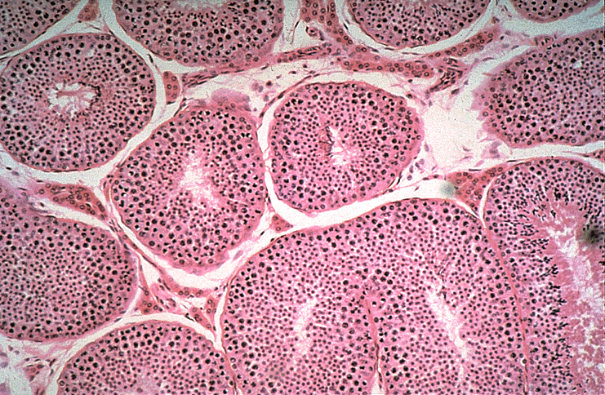

Slide 6
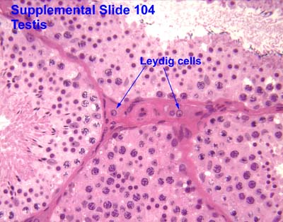

Slide 7
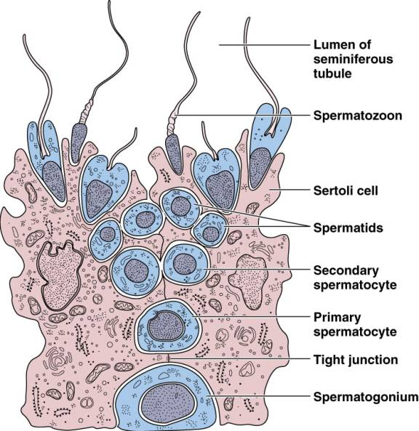
Spermatogenesis

Slide 8
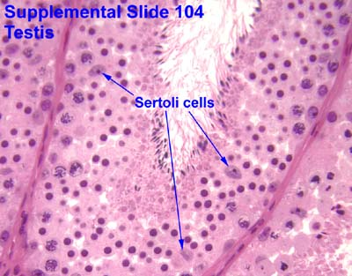

Slide 9
Role of Hypothalamic-Pituitary-Gonadal Axis
Gonadotropin-releasing hormone(GnRH) is synthesized in the hypothalamus and transported to the anterior pituitary
GnRH stimulates the release of FSH & LH
LH acts on Leydig cells to synthesize testosterone.
FSH is known to act on Sertoli cells to stimulate gametogenesis & the synthesis & release of inhibin.
Sex steriods & inhibin together provide negative feedback control of LH & FSH secretion, respectively.

Slide 10
Figure 42-1 Summary of the endocrine control of the testis. Dashed lines indicate inhibitory effects, and solid lines stimulatory effects. FSH, Follicular-stimulating hormone: GnRH, gonadotropin –releasing hormone; LH, Luteinizing hormone Tietz Page 781

Slide 11
Loss of Negative Feedback
FSH
LH
Disorders in which Sertoli cell numbers are reduced
which causes a decrease in inhibin concentrations
Disorders in which leydig cell numbers are reduced which causes a decrease in testosterone concentrations

Slide 12
Androgens
Group of C19 steroids
Function:
1-cause masculinization of the genital tract
2- development & maintenance of male secondary sex characteristics
3-contribute to muscle bulk, bone mass, libido (refers to a person's sex drive or desire for sexual activity )
and sex performance in men

Slide 13
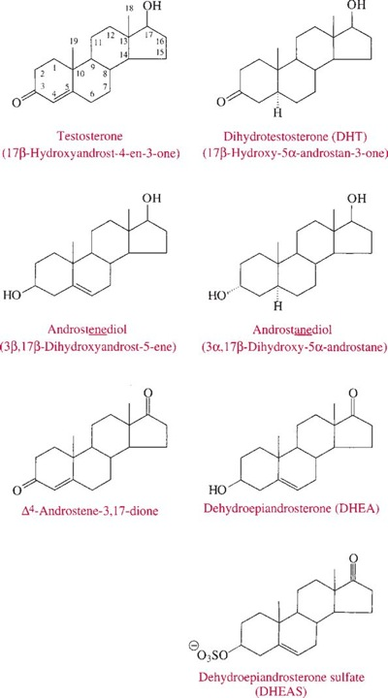
Chemical Structure of Androgens Tietz Page 781

Slide 14
Androgen Transport in Blood
Free
2%-3%
Initially thought to represent the biologically active fraction
SHBG sex hormone biding globulin
Low capacity
High affinity
Albumin
High capacity
Low affinity

Slide 15
Androgen Transport in the Blood
Bio-available Testosterone= 35% of total=
free + albumin bound (also called the weakly bound fraction)

Slide 16
Androgens
Leydig Cells of Testes
Adrenal Gland
Produce:
testosterone
(women produce about 5%-10% as much testosterone as do men)
Produces :
1-dehydroepiandrosterone
(DHEA)
2-dehydroepiandrosterone
(DHEA-S)
3-androstenedione
4-androstenediol

Slide 17
Male reproductive Abnormalities
Hypogonadism:
Condition caused by a decreased function
of the testes leading to retardation of sexual
development if manifested early in life
Two Types
1-Hypogonadotropic: LH & FSH are: Low
2-Hypergonadotropic: LH & FSH are: High

Slide 18
Hypogonadotropic
Caused by defects in the hypothalamus or pituitary which prevent normal gonadal stimulation.( decreased testosterone & gonadotropin)
Causative Factors:
1- congenital or acquired panhypopituitarism
2-hypothalamic syndromes
3-GnRH deficiency
4-hyperprolactinemia
5-malnutrition or anorexia
6-iatrogenic causes (a disease that is caused by medical treatment )

Slide 19
Kallmann Syndrome
Most common form of Hypogonadotropic hypogonadism resulting from a deficiency of GnRH in the hypothalamus during embryonic
development (congenital defect)

Slide 20
Hypergonadotropic
Gonadal dysfunction (primary testicular failure)
LH & FSH are high , whereas testosterone is low
Causes:
1- testicular damage (irradiation, disease, or drugs)
2-chromosomal defects
3-enzymatic defects in androgen synthesis
4-testicular agenesis (atrophy of the testis)
5-seminiferous tubular disease
6-other miscellaneous causes 7- aging

Slide 21
Male reproductive Abnormalities
Defects in Androgen Action
The most common and severe is testicular
feminization syndrome
Patients have female habitus and develop
breasts. Vagina ends in a blind pouch and male
testes are present. Might a rise from a defect in
the androgen receptor.
Testosterone levels are normal to high

Slide 22
Male reproductive Abnormalities
Impotence
Persistant inability to develop or maintain a penile erection that is sufficient for intercourse & ejaculation in 50% or more of attempts.
Causes:
1- Psychogenic 2-vascular disease
3-diabetes mellitus 4- hypertension
5-uremia 6-neurological disease
7-hypogonadism 8- hyperthyroidism
9-Hypothyroidism 10-neoplasms
11- drugs

Slide 23
Male reproductive Abnormalities
Gynecomastia
Benign growth of glandular breast tissue in men.
Associated with increased (estrogen: androgen )ratio
Prolactin plays an indirect role

Slide 24
Gynecomastia
Newborns-transient (60%-90%) | Caused by high estrogen concentrations that cross the placenta
Puberty-self limited (50%-70%) | Caused by low testosterone, low DHT, or, high estrogen: androgen ratio
Adult (50-80 Year old men) | Caused by testicular failure( which leads to high estrogen: androgen ratio) , or increased body fat (increased peripheral aromatization of testosterone to estradiol)

Slide 25
Female Reproductive Biology

Slide 26
Physiology
During the reproductive life span of an adult woman, 300-400 follicles will reach maturity
A single mature follicle is produced during each normal menstrual cycle at approx. day 14
After ovulation the granulosa & thecal cells of the follicle become the corpus luteum
Ovulation is also associated with a rapid rise in body temperature, by 0.5 °C , which persists through the luteal phase
The luteal cells produce estrogen &progesterone

Slide 27
If fertalization & pregnancy occur
The corpus luteum persists & continues to produce estrogen
&progesterone
If pregnancy does not occur
The corpus luteum regresses & is eventually replaced by scar tissue

Slide 28
The uterine cavity is lined by the endometrium which undergoes cyclical changes in preparation for implantation & pregnancy.
luteal phase
the endometrial lining increases in thickness & vascularity
Menstration
The endometrium is shed

Slide 29
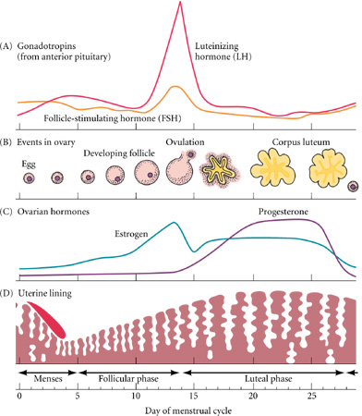
Normal Menstrual Cycle (Measurement of LH Serge is indicative of the occurrence of ovulation)

Slide 30
Hypothalamic- Pituitary-Gonadal Axis Figure 42-6 Tietz Page 788

Slide 31
Estrogens
Female sex hormones that are responsible for the development & maintenance of female sex organs & female secondary sex characteristics.
They also help regulate the menstrual cycle & breast & uterine growth.
They also help maintain pregnancy
Have a beneficial effect on bone mass : decrease bone resorption (loss), accelerated linear bone growth and causes epiphyseal closture in prepubertal girls
Long term decresed levels would cause: loss of bone mineral content, an increase in stress fractures, and postmenopausal osteoporosis
They increase conc. of sex hormone binding globulin SHBG, corticosteriod-BG, and thyroxine-BG (adult men have ½ SHBG conc. of women)
During pregnancy, estrogens are produced by the placenta as well
Adrenals & testes are also believed to secrete minute quantities of estrogens

Slide 32
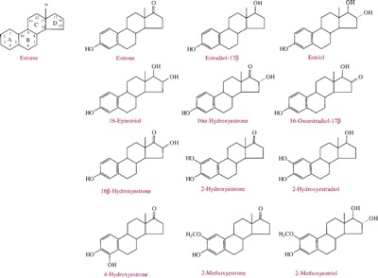
Structural Formulas of important Estrogens (Tietz Page 788)

Slide 33
Estrogens
During Pregnancy
Source: Placenta
Quantity: in the mg’s
Major Type: estriol
Estriol formed from DHEA-S through the action of sulfatase & aromatase
Serum estriol measurements are commoly used for Down Syndrome screening
Nonpregnant woman
Source: Ovaries
Quantity: in the μg’s
Major Type: Estradiol
Estriol measurement has little clinical value, Why? …… Because estriol is derived almost exclusively from estradiol
Estradiol measurement is sufficient to evaluate ovarian function

Slide 34
Progesterone (pregnancy Hormone)
Helps regulate the accessory organs during the menstrual cycle.
Especially important in preparing the uterus for the implantation of the blastocyte & in maintaining pregnancy
During pregnancy, progesterone is produced mainly by the placenta
In a nonpregnant women progesterone is produced and secreted by the corpus luteum
Minor sources are the adrenal cortex in both sexes & the testes in men

Slide 35
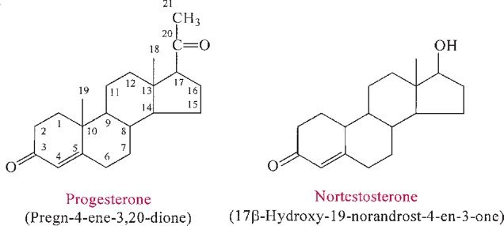
Structural Formula of Progesterone & 19-Nortestosterone (Tietz page790)

Slide 36
Female Reproductive Abnormalities
Precocious Puberty (early Puberty)
Development of secondary sexual characteristics in girls < 8 years old & boys< 9 years old
Examples of secondary sexual characteristics include:
1-premature breast development
2-premature sexual hair development
3-phallic enlargement

Slide 37
Precocious Puberty
GnRH dependent
Precocious activation of Hypothalamic- Pituitary-Gonadal Axis
GnRH independent (or
psuedoprecocious
puberty)
Caused by tumors of the adrenal gland, ovaries, & testes
( tumors secrete sex
steriods)

Slide 38
Diagnosis of Precocious Puberty
Based on:
1-Clinical presentation
2-Thorough pubertal history
3-Bone age determinations
laboratory test: to assess gonadotropin conc.&
response to exogenous GnRH
(GnRH stimulation test)

Slide 39
Irregular Menses & Amenorrhea Causes Tietz Page 795
Primary Amenorrhea
The failure to establish spontaneous periodic menstruation by the age of 16 regardless of whether secondary sex characteristics have developed
40% have Turner Syndrome or pure gonadal dysgenesis
2nd most common manifestation is Mϋllerian duct agenesis or dysgenesis with absence of vagina or uterus
3rd most common is testicular feminization also called complete androgen insensitivity syndrome
Secondary Amenorrhea
An absence of periodic menstruation for at least 6 months in women who have previously experienced menses, or for 12 mths in a woman with prior oligomenorrhea (infrequent menstration)
Pregnancy is the most common cause
Increased prolactin, which inhibits the release of LH & FSH

Slide 40
Hirsutism
The excessive growth of terminal hair in women & children in a distribution similar to that occurring in postpubertal men
Has to be distinguished from hypertrichosis which is excessive growth of vellus or non-androgen-responsive hair (fine, usually unpigmented downy hair)

Slide 41
Causes of Hirsutism
Ovarian Ex: Androgen producing ovarian tumors
Adrenal Ex: Androgen producing adrenal tumors
Familial (genetic)Hirsutism
Endocrine Disorders Ex: Polycystic ovary syndrome, Acromegaly
Idiopathic Hirsutism
Iatrogenic Ex: Drugs including: Androgens, Progestogens, Dilantin &
Cyclosporine

