Slide 1
Tumor Markers
Northside Hospital

Slide 2
Lecture Objectives
Topic 14 Tumor Markers
List the characteristics of an ideal tumor marker. Identify an ideal tumor marker.
Identify the most common uses for tumor markers.
Categorize the most well-known tumor markers. Identify the most significant tumor markers within each category and discuss their applications.

Slide 3
Leading causes of death in the United States
Source: National Vital Statistics Report (1999 data)

Slide 4
Atumor marker is a substance:
Prodused by a tumor
Or by the host in response to a tumor
,that is used to differentiate a tumor
from normal tissue or to determine the
presence of a tumor based on
measurements in the blood or secretions.

Slide 5
An ideal tumor marker should be:
Specific for a given type of cancer
Sensitive enough to detect small tumors to allow early diagnosis or use in screening.
Unfortunately,
Few markers are specific !!!!
(tumor- specific markers versus tumor-associated
markers)
In practice, tumor markers are most useful
in evaluating the progression of disease
status after the initial therapy and
monitoring subsequent treatment modalities
(Table 20-2) Page340

Slide 6
Marker concentration
-
+
Disease

Slide 7
List of Marker Categories
Enzymes
Hormones
Oncofetal antigens: Proteins produced during fetal life that decrease to low or undetectable concentrations after birth. They reappear in some forms of cancer because of the reactivation of a gene in the transformed malignant cells.
Carbohydrate markers
Blood group antigens
Proteins
Receptors
Genes

Slide 8
Enzymes
Spectrophotometric
determination
Measuring enzyme
activity (reaction
producing a color
proportional to
enzyme
concentration)
Immunoassay
determination
Enzyme content
measured as a protein
antigen mass instead
of its catalytic
activity

Slide 9
Prostate-Specific Antigen PSA
The most promising tumor marker available
One of the few organ-specific tumor markers
Prostate cancer is the leading cancer in older men; when detected early (organ confined), it is potentially cured by radical prostatectomy.
Produced exclusively by the epithelial cells of the acini and ducts of the prostate gland
It cleaves a seminal vesicle-specific protein into several low molecular weight proteins as part of the process of liquefaction of the seminal coagulum

Slide 10
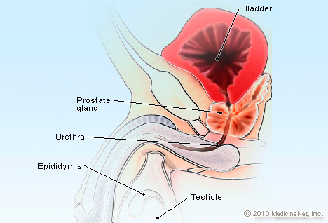
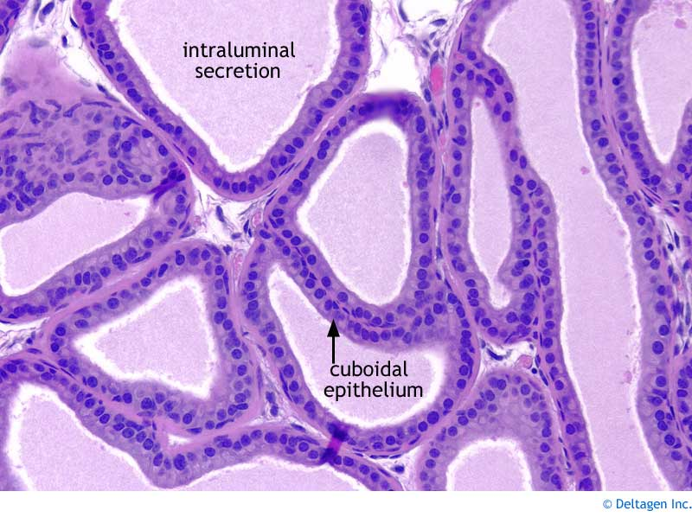
Prostate Gland

Slide 11
Clinical Applications of PSA
PSA is used to:
Screen for prostate cancer
Stage (organ confined/metastases)
Monitor treatment & recurrence
of prostate cancer

Slide 12
Clinical Applications of PSA
Early Detection of Prostate Cancer
The use of serum PSA together with digital rectal examination followed by transrectal ultrasonography provides a more accurate and sensitive diagnosis than digital examination alone.

Slide 13
Clinical Applications of PSA
Staging of Prostate Cancer
- Higher PSA conc., and higher percentages of patients with elevated PSA are associated with more advanced stages
- PSA concentration can serve as a guide & is more useful in evaluating the presence of metastasis
- Organ-confined versus bone metastasis
seldom > 50 μg/L < 20 μg/L rarely have
bone metastasis

Slide 14
Clinical Applications of PSA
Monitoring Therapy (greatest clinical use)
Radical prostatectomy
Radiation Therapy
Anti-androgen Therapy

Slide 15
Clinical Applications of PSA
Monitoring Therapy
Radical prostatectomy: Removal of all prostatic tissue.
-PSA level should fall below the detection limit
(0.1 μg/L ) of traditional assays 2-3 weeks after the
procedure.
-80% of patients have a PSA < 0.01 μg/L & 20% have
a PSA <0.001 μg/L
-Must use ultrasensitive assays (detection levels of
0.01 -0.001 μg/L )
-All patients with the recurrence of cancer had
elevated PSA concentrations

Slide 16
Clinical Applications of PSA
Monitoring Therapy
-Radiation Therapy
Majority of patients show an initial decrease of PSA
PSA is better than digital rectal examination for detecting residual cancer after radiation therapy
- Anti-androgen Therapy ( LH-RH analogues)
The concentration of PSA is inversely proportional to survival time and increases with cancer progression, decreases in remission, and remains unchanged in stable disease.

Slide 17
Measuring PSA Levels in Women
Ultrasensitive methods are also useful in measuring PSA in women because normal PSA concentrations in women are ≤ 0.01 μg/L
An increased PSA in women is seen during pregnancy and in breast cancer patients

Slide 18
Alkaline Phosphatase ALP
May rise from liver, bone, or placenta.
Increased in primary or secondary liver cancer
Helpful in evaluating metastatic cancer with liver or bone involvement.
Greatest elevations seen in patients with osteoblastic lesions (Ex: prostatic cancer with bone metastasis)
Minimal elevations are seen in patients with osteolytic lesions (Ex: breast cancer with bone metastasis)
To assess liver metastasis other liver enzymes must be used to increase specificity

Slide 19
Lactate Dehydrogenase LD
Released as a result of cell damage
Tumor associated marker (Low specificity)
Increased in many cancers including liver, non Hodgkin lymphoma, acute leukemia, and carcinoma

Slide 20
Neuron-Specific Enolase NSE
Found in tumors associated with a neuroendocrine origin, including small cell lung cancer, neuroblastoma, pheochromocytoma, carciniod , medullary carcinoma of the thyroid, melanoma, and pancreatic endocrine tumors.
When elevated in children with stage IV neuroblastoma poorer outcome

Slide 21
Hormones as Tumor Markers
ACTH (Adrenocorticotropic Hormone)
A polypeptide hormone produced by the corticotropic cells of the anterior pituitary gland
Elevated serum concentrations of ACTH could be the result of pituitary or ectopic production.
A high concentration of >200 ng/L is suggestive of an ectopic origin.
Half of the ectopic production is a result of small cell carcinoma of the lung.
Other conditions including: pancreatic, breast, gastric, and colon cancer.
Benign conditions include: chronic obstructive pulmonary disease, mental depression, obesity, hypertension, diabetes mellitus, and stress.

Slide 22
Hormones as Tumor Marker
Calcitonin
A polypeptide produced by the C cells of the thyroid gland.
Normally, secreted in response to increased serum calcium.
Function: inhibits the release of Ca ⁺² from bone and thus lowers the serum calcium concentration.
An elevated conc. (>0.1 μg/L )is usually associated with medullary carcinoma of the thyroid.
Also elevated in some patients with carcinoid and cancer of the lungs, breast, kidney, and liver.
Nonmalignant conditions including: pulmonary disease, pancreatitis, hyperparathyroidism, pernicious anemia, Paget disease of bone, and pregnancy.

Slide 23
Hormones as Tumor Marker
Human Chorionic Gonadotropin hCG
A glycoprotein secreted by the syncytiotrophoblastic cells of normal placenta.
Elevated levels are seen in pregnancy, trophoblastic diseases, and germ cell tumors.
Also a useful marker for tumors of the placenta (trophoblastic tumors) and tumors of the testes.

Slide 24
hCG Biochemistry
α-subunit
β-subunit
Common to several other hormones including: LH, FSH, TSH.
Unique to hCG , and the 28-30 amino acids composing the carboxyl terminal are antigenically distinct.

Slide 25
hCG in Pregnancy
The production of the α and β –subunits are under separate genetic control.
In early pregnancy, the free β-subunit is produced together with intact hCG.
In late pregnancy, the free α-subunit predominates.
Most cancer patients produce both free β-subunit and intact molecules.

Slide 26
Clinical applications (hCG)
hCG is elevated in nearly all patients with trophoblastic tumors(>1 million IU/L)
Also elevated in 70% of those with nonseminomatous testicular tumor, and less frequently in those with seminoma.
Because hCG does not cross the blood brain barrier, the normal CSF: serum ratio is 1:60.
Higher conc. In CSF may indicate metastases to the brain.
Measuring CSF hCG conc. helps monitor response to therapy in patients with CNS metastases.

Slide 27
hCG & Trophoblastic disease
A patient with an initial hCG of > 400,000 IU/L is considered at high risk for treatment failure.
Slowly decreasing or persistent conc. of hCG after removal of the tumor suggest residual disease.
After remission, yearly hCG measurement is recommended to detect relapse.

Slide 28
Analytical Methodology (hCG)
The total β-hCG assay measures both the intact hCG and free β-subunit. As a tumor marker , a total assay may be preferred because cancer patients produce notable amounts of the free β-subunit
(Ordered as T-hCG here at WHC)

Slide 29
hCG to Detect Pregnancy
hCG appears in the blood and urine of pregnant women as early as 10 days after conception.
Qualitative, which measures whether the HCG hormone is present (ABG bench) in serum or urine
Quantitative, which measures how much HCG is present (Vista) – serum only
HCG levels should almost double every 48 hours in the beginning of a pregnancy. HCG levels that do not rise appropriately may indicate a problem with the pregnancy; include miscarriage & ectopic (tubal) pregnancy

Slide 30
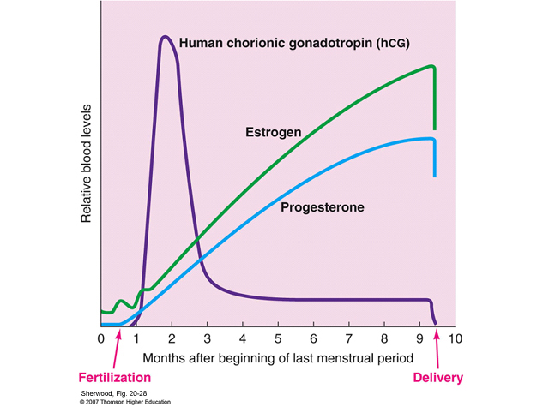
hCG to Detect Pregnancy hCG Peaks during the 1st trimester of pregnancy

Slide 31
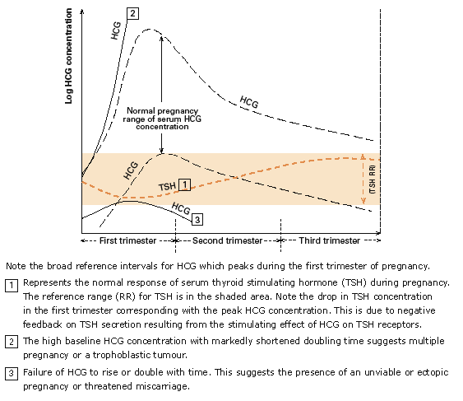
hCG to Detect Abnormalities in Pregnancy

Slide 32
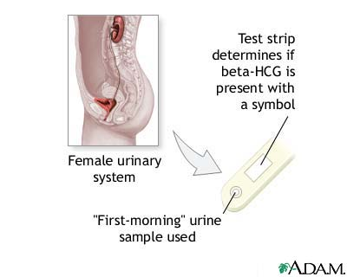
hCG to Detect Pregnancy

Slide 33
Oncofetal Antigens as Tumor Markers
Alpha Fetoprotein (AFP)
One of the major proteins in the fetal circulation.
Closely related both genetically and structurally to albumin.
As albumin synthesis increases during later fetal development, AFP conc. begins to decline.
They finally reach the trace concentrations Found in normal adults 18 months after birth.

Slide 34
Clinical Applications (AFP)
< 10 μg/L is normal for healthy adults
Elevated conc. Could be associated with benign liver conditions such as hepatitis & cirrhosis
(< 200 μg/L)
Except in the pregnant patient, AFP conc. > 1000 μg/L are indicative of hepatocellular carcinomas
To detect small tumors, the cutoff conc. Has to be set at a low value EX 10-20 μg/L (Rule out hepatitis & cirrhosis)

Slide 35
Combined AFP/hCG
Useful for differentiating germ cell tumors
 | AFP | hCG
Yolk sac tumors | ↑ | nl
Choriocarcinoma | nl | ↑
Embryonal carcinoma | ↑ | ↑
Seminomas | nl | ↑
Teratoma | nl | nl
Nonseminomatous testicular tumor | ↑ | ↑

Slide 36
Oncofetal Antigens as Tumor Markers Carcinoembryonic Antigen CEA
Family of up to 36 large, cell-surface glycoproteins
Elevated in . . .
  70% of colorectal cancers
  45% of lung cancers
  50% of gastric cancers
  40% of breast cancers
  55% of pancreatic cancers
  25% of ovarian cancers
  40% of uterine cancers

Slide 37
Carcinoembryonic Antigen CEA
Discovered by Gold & Freeman in 1965 by immunizing rabbits with extracts of human colon cancer tissue
The resultant antisera were absorbed with extracts of human colon
Some antisera reacted with the tumor extracts, but not with the extracts of normal tissue
The antigen, which was also found in embryonic tissue was named CEA

Slide 38
Use of CEA
Elevated in non-malignant conditions:
  Cirrhosis, emphysema, rectal polyps, benign breast disease, ulcerative colitis
Most useful in staging and monitoring recurrence of disease

Slide 39
Carbohydrate Markers
High molecular weight mucins or blood group antigens, more specific than enzymes & hormones
Antigens on the tumor cell surface
Secreted by the tumor cells

Slide 40
Carbohydrate Markers
Mucin (glycoproteins)Tumor Markers
Name | Type of Cancer
CA 125 | Ovarian, endometrial
CA 15-3 Episialin Epitope | Breast, ovarian
CA 549 Episialin Epitope | Breast, ovarian
CA 27.29 Episialin Epitope | Breast
MCA | Breast, ovarian
DU-PAN-2 | Pancreatic, ovarian, GI, lung

Slide 41
Episialin Antigen Epitopes
Epitope | Clinical Application
CA 15-3 | Incidence of elevation is low 23%; shouldn’t be used to diagnose primary breast cancer. Most useful in monitoring therapy & disease progression in metastatic breast cancer patients
CA 549 | Incidence of elevation is low 23%; shouldn’t be used to diagnose primary breast cancer. An increasing value after initial decrease or stabilization indicates development of metastasis
CA 27.29 | Has been approved by the FDA for clinical use in the detection of recurrent breast cancer in patients with stage II or III disease

Slide 42
CA 125
High MW glycoprotein recognized by monoclonal Antibody OC125
  Ab Isolated from a patient with serous ovarian tumor
most useful for ovarian cancer
Elevated in 50% of stage I ovarian cancer
Elevated in 90% of stage II, >90% III, and IV

Slide 43
DU-PAN-2
100-500 kd mucin (80% carbohydrate)
Found mainly in pancreatic and biliary epithelium
  Also in breast, bronchi, salivary glands, stomach, colon, intestine
60% sensitivity for pancreatic cancer
45% sensitivity for biliary tract cancer
44% sensitivity for hepatocellular carcinoma

Slide 44
Blood group antigens blood group carbohydrates identified by monoclonal antibodies; used as tumor markers as follows
CA 19-9 | Sensitivity 80% for pancreatic cancer;, 30% for colorectal cancer
CA 19-5 | GI, pancreatic, ovarian cancer
CA 50 | Sensitivity 90% for pancreatic cancer; as high as 73% for Duke’s stage C or D colon cancer. Also elevated in esophageal, liver, gastric cancer
CA 72-4 | Sensitivity 40% in GI cancer, 40% in lung cancer, 36% in ovarian cancer
CA 242 | Sensitivity 75% for pancreatic cancer, 70% for colorectal cancer, 44% for gastric cancer

Slide 45
Proteins as Tumor Markers
Immunoglobulins
Monoclonal immunoglobulins has been used as marker for multiple myeloma (MM) for > 100 years
Monoclonal paraproteins appear as sharp bands in the globulin area of the SPE patterns
More than 95% of patients with MM have these abnormal high bands (M-spike)
Bence Jones protein is a free monoclonal immunoglobulin in the urine
Lower Bence Jones protein concentrations are associated with more favorable outcome of treatment success

Slide 46
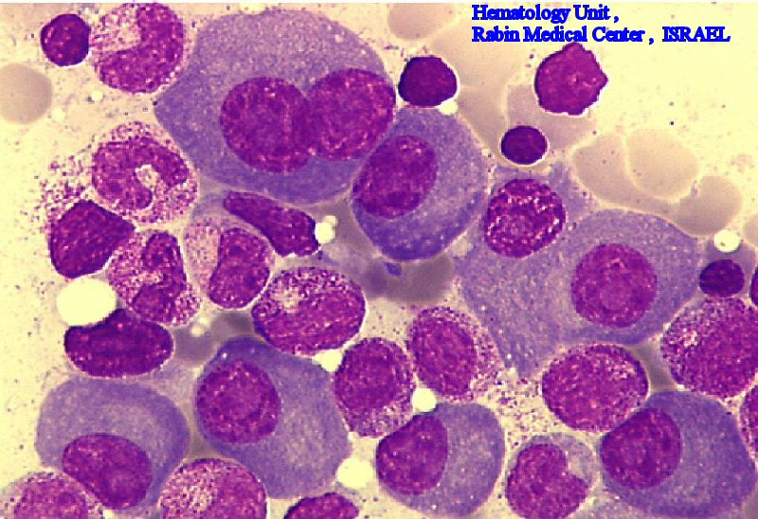
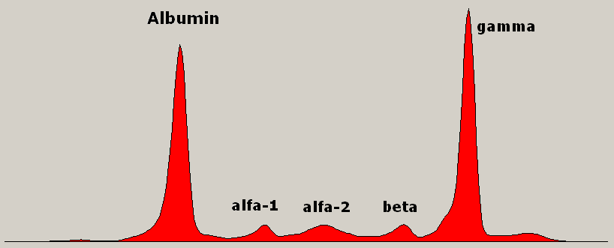
Proteins as Tumor Markers

Slide 47
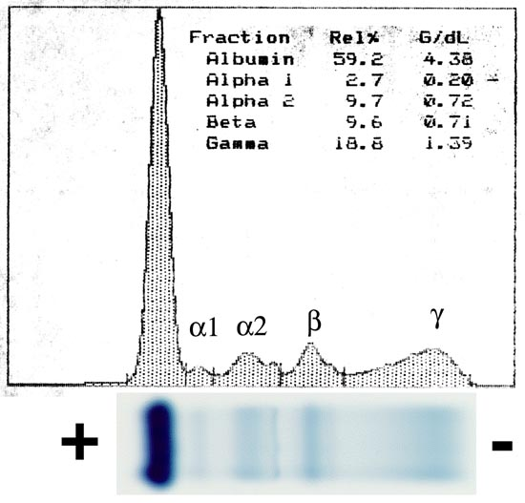
Normal Serum Electrophoresis

Slide 48
Other tumor markers
Oncogenes (A mutated normal cellular gene that causes the malignant transformation of normal cells when activated)
  ras, HER-2/neu, bcl-2, c-myc
Tumor Suppressor genes ( A gene involved in the regulation of cellular growth: loss of a tumor-suppressor gene has the potential to allow autonomous growth)
  Retinoblastoma, p53, BRCA1 and 2
Receptors
  Estrogen & Progesterone Receptors are used in breast cancer as indicators for hormonal therapy(patients with positive estrogen & progesterone receptors tend to respond to hormonal therapy where as patients who don’t have to be treated using other therapies- Ex: chemotherapy). Patients with positive receptors have a better prognosis
Cell-free Nucleic Acids
Circulating DNA & RNA could be used as tumor
marker. However, there must be a mechanism to
differentiate normal DNA from neoplastic DNA
Detecting mutations in the circulating DNA that are
present in the cancer cells.

Slide 49
Oncogene associations
N-ras | AML, neuroblastoma
K-ras | Leukemia, lymphoma
c-myc | B, T-cell lymphoma, small cell lung cancer
HER-2/neu | Breast, ovarian, GI cancer
bcl-2 | Leukemia, lymphoma

