Slide 1
Body Iron/Bilirubin
Northside Hospital

Slide 2
Iron
Average adult male 4 g of body iron; 65-75% in hemoglobin, 10% in myoglobin and other iron containing enzymes and proteins. Remaining 20-25% stored.
Average adult woman 2-3g of body iron; lower hemoglobin, smaller vascular volume, and small iron reserves.
Normally there are very small amounts of iron in most cells of the body, in plasma, and in other extracellular fluids.
8 mg in “tissue iron compartment”:
Tissue iron in porphyrin ring of heme proteins such as catalase, peroxidase, cytochromes,
Tissue iron in iron-inorganic sulfur clusters such as NADH dehydrogenase, succinate dehydrogenase, aconitase and ferredoxin
Myoglobin
Approximately 2g are in the form of hemoglobin iron
the labile iron pool” 80 mg – it exists but not know where
In all of these proteins, iron interacts reversibly with oxygen and functions in electron transfer reactions, making it biologically indispensible

Slide 3
Iron loss & recycling
The body conserves/recycles the iron
Less than 0.1% (1 mg) of iron is lost daily
Normal skin epithelial cell shedding, GI and UA tract lining cells
Absorption of 1 mg of iron daily is sufficient for men and postmenopausal women
Pregnant/menstruating women lose more and need more.
“Only about 5-10% of the 10-15mg iron (as heme proteins, hemoglobin, and myoglobin in meat) taken in daily in a healthy N.A. diet is actually absorbed:
in upper small intestine (duodenum)
in Fe³⁺ state; must be converted to Fe²⁺ before it can enter the intestinal cell
Transported into the cell by a DMT1 (divalent metal transporter)

Slide 4
IRON TRANSPORT/ Absorption “Transferrin Cycle”
Iron is toxic to cells & biomolecules; thus, it travels through the body bound to specific proteins
Dynamic process; circulating iron pool turns over 10-20x/day, so average iron in plasma only 2 hours.
Plasma iron transport protein = apotransferrin
Apotransferrin –Fe3+ complex is called transferrin
Binds to transferrin receptor- each of which has 2 binding sites for Fe³⁺
Transferrin /receptor complex internalized into the endosome of the intestinal cell
acidified, iron released from transferrin, and reduced to ferrous Fe2+
Fe2+ transported into cell via DMT1 (divalent metal transporter) where iron is used for erythropoeisis, heme, etc or goes to the storage pool
Apotransferrin back to the cell surface to do it’s job again

Slide 5
Iron Absorption cont…
Ingested iron into soluble solutions increase iron absorption
Gastric acid and dietary components that form soluble iron chelates
Ascorbic acid, sugars, amino acids
Insoluble iron complexes decrease iron absorption
Phosphates (eggs, cheese, milk)
Oxalates and phytates (vegetables)
Tannates (tea)
Heme iron from meat and fish absorbed differently
Released from polypeptide chain, heme is absorbed intact by the intestinal cell
Porphyrin ring is split and iron is released
More efficient than absorption of non-heme iron; not affected by dietary factors
Most of the iron (20-25mg/day) comes from recycling iron from senescent RBCs
Primarily in spleen
Heme oxygenase breaks open the porphyrin ring, releasing the iron
Macrophages transfer most of iron to transferrin -> BM
RE system recycles

Slide 6
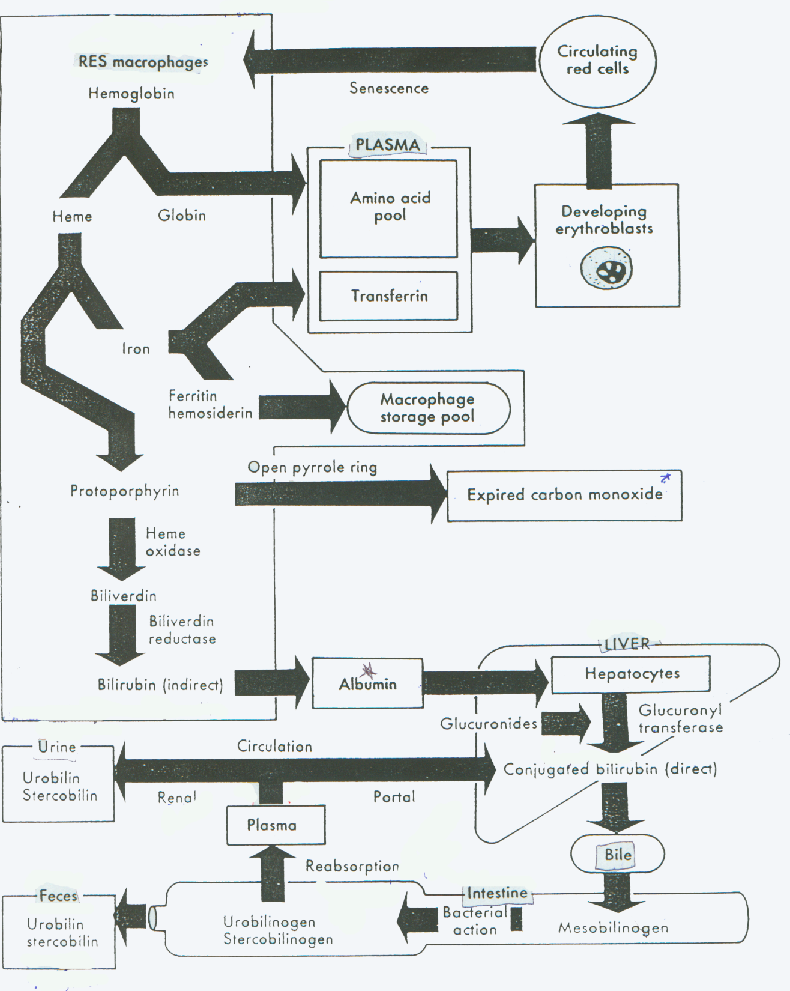
The Normal Erythrocyte
EXTRAVASCULAR HEMOLYSIS
The major pathways of red cell destruction and hemoglobin degradation involving the Reticuloendothelial System . It takes place primarily in the Spleen.

Slide 7
IRON STORAGE POOL- general
Iron Stored in macrophages as Ferritin and Hemosiderin:
Prussian Blue Dye – granules 1-2 um in diameter/light microscope
Ferritin – a protein shell (apoferritin) surrounding an iron core
Hemosiderin – is formed when ferritin is broken down in secondary lysosomes; end point of the intracellular storage iron

Slide 8
FERRITIN
Found in nearly all cells of the body
Reserve of iron readily available for hemoglobin and other HEME proteins
Hepatocytes of liver
Macrophages especially spleen and BM
Non-ionized form (ferric oxyhydroxide crystalline core) so no oxidative damage
More in men (800mg) than women (200mg)
Minute quantities in serum normally
Soluble in aqueous solutions

Slide 9
HEMOSIDERIN
Aggregated, partially deproteinized ferritin; insoluble in aqueous solutions
Like ferritin, found primarily in liver (1/3), BM(1/3), spleen and other tissues
Higher iron concentration than ferritin, but releases iron more slowly.

Slide 10
Control of Iron Balance
Iron Balance is largely controlled by changes in absorption; body iron stores vs rate of erythropoiesis
Efficiency of absorption can be increased by 3x or more
Iron Deficiency, pregnancy, accelerated erythropoiesis in some anemias all stimulate increased absorption
Absorption is reduced after large amounts of iron have been consumed (ex. dietary supplements, iron poisoning)
Hepcidin – produced by liver in response to iron needs
Binds with ferroportin to inhibit iron release
Low levels of hepcidin promotes iron release into the circulation
High levels of hepcidin restricts iron release into the circulation
When RBC destruction exceeds the rate of production, iron accumulates in storage pool.
When RBC production exceed destruction, iron is released from the storage pool
Infection, inflammation, and malignancy interfere with the release of iron from macrophagesand may result in a drop in RBC production despite adequate iron stores

Slide 11
Clinical Significance/Pathological Conditions
Iron Deficiency
Iron Overload – hemosiderosis & hemochromatosis
Abnormal distribution of iron; primary or secondary role
Hyperferritienemia with cataracts
Aceruloplasminemia
GRACILE syndrome (gr retard, aminoaciduria, cholestasis, iron overload, lactacidosis, and early death)
Neuroferritinopathy
Atransferinemia
Neurodegenerative diseases (Parkinson’s, Hallervorden-Spatz syndrome, & Alzheimer)

Slide 12
Iron Deficiency
When iron intake falls below the amount needed for RBC production, iron stores become depleted, iron studies abnormal, and anemia develops
Develops in stages
Prolonged negative iron balance -> depletion of iron stores; no stainable iron in BM
Biochemical tests of iron metabolism then become abnormal
Then a drop in hgb
Red cells become micro/hypo; decreased MCV, MCH, MCHC; aniso, poikilo
One of the most common nutritional disorders of all ages and social strata
Children – milk has a low iron content/increased demand
Young women – chronic blood loss/childbearing 10% USA
Older people
2% of adult men USA – often GI tract bleeding
Numbers much higher In pregnant women (increased demand) and low socioeconomic status
Impaired absorption of iron after GI surgery, chronic diarrhea, or malabsorption

Slide 13
Laboratory Tests for Iron Status
To distinguish iron deficiency from other causes of micro/hypo anemia
Tests for diagnosis of iron deficiency- none by itself superior and differing opinions on which combination works best.
Hgb/RBC indices originally
Staining of BM for iron – BM is invasive
Serum Iron concentration - decreases
Total Iron Binding Capacity = capacity of transferrin for iron- increases
Transferrin Saturation = iron/TIBC is well decreased
Serum Ferritin = reflection of iron stores – decreased * most reliable indicator of iron deficiency
Free Erythrocyte protoporphyrin – increased, but not specific for iron deficiency
Circulating transferrin receptor
Reticulocyte hemoglobin values – Sysmex new parameter

Slide 14
Lab Tests/Reference Range Kaplan p 759 table 39-2
Hemoglobin – 1 – WHO anemia <13 g/dl men, < 12 g/dl women – does not contribute to dx of hemochromatosis
Serum Iron- 3
Males: 65-175 ug/dl
Females: 50-170 ug/dl
Total Iron-Binding Capacity – 250-450 ug/dL
UIBC (calculation) = (TIBC – IRON)
Transferrin Saturation (calculation):- 4
ISAT = 100 (IRON/TIBC)
Serum Ferritin - 2
Males 26-388 ng/mL
Females 8-252ng/mL

Slide 15
Iron Overload
Hemosiderosis
Iron overload without associated tissue injury
Occurs locally in sites of bleeding or inflammation
May be widespread in patients given large amounts of iron as medication or as blood transfusions
Hemochromatosis
Body accumulates large amounts of iron leading to organ impairment and damage

Slide 16
Iron Overload –Hemochromatosis
Hereditary Hemochromatosis/ Primary Hemochromatosis /Classic
Inherited abn of proteins that regulate iron hemostasis – 80% HFE protein (C282Y mutation); 20% other mutations
Autosomal recessive, N. European descent 10% (0.3% homozygous)
Not all homozygotes have full blown disease
Men > women (menstrual loss/pregnancy)
Symptoms not usually apparent until 40 yrs
May absorb a healthy amount of iron in diet but deposited directly to parenchymal cells of the liver, pancreas, heart, and other organs. It accumulates for years resulting in tissue damage and ultimately organ failure (20 g iron limit)
Liver enlarged -> cirrhosis -> liver CA
Pancreas islet cells-> Diabetes
Increased melanin & iron in the skin ->Increase in skin pigmentation ; bronzing of the skin
Cardiac -> CHF or arrythmias
Iron in pituitary gland -> testicular atrophy due to decrease gonadotropins
Joints -> arthritis
–

Slide 17
Iron Overload –Hemochromatosis
Juvenile Hematochromatosis
rare, ressembles hereditary clinically but occurs at a much younger age
More endocrine and cardiac involvement
Secondary Hemochromatosis - acquired
Blood transfusions and diet -> excess iron in RE cells of the liver, spleen, and BM
As iron load increases, the distribution changes -> parenchymal cells of liver, pancreas, heart, and other organs.
Clinical picture then ressembles the hereditary hemochromatosis
May be a complication of anemias with ineffective erythropoiesis; iron absorption is increased and patients treated with multiple blood transfusions
Thalassemia major (B- Thal most common),
acquired MDS,
Sideroblastic anemias (def of D-ALA synthase),
congenital dyserythropoietic anemia,
RBC enz def such as PKU
Alcoholics with chronic liver disease may develop an increase in iron stores (if massive overload probably genetic hemochromatosis).
Medicinal iron supplements do not, on their own, cause hemochromatosis

Slide 18
Serum Iron - general
fluctuates, even with healthy individuals
Momentary imbalances of iron inflow and outflow
Diurnal variations – decrease in the evening
Day to day variations significant
Therefore, a single serum iron is not useful
Interpret in combination with other iron studies

Slide 19
Serum Iron Test Principle
Fe³⁺ Iron released from transferrin:
decreasing the pH using ascorbic acid reduces Fe3+ to Fe2+)
Fe³⁺ - transferrin -> Fe³⁺ + transferrin
2Fe³⁺ + ascorbic acid -> 2 Fe²⁺ + dehyrdroascorbic acid + 2H+
Complex with a chromogen
Bathophenanthroline
Ferrozine* (Ferene used at WHC with thiourea (carcinogenic) added to minimize the interference of copper)
Fe²⁺ + 3 Ferene -> Fe²⁺ - Ferene₃ complex (absorbs at 600nm)
Such iron-chromogen complexes have an extremely high absorbance at the appropriate wavelength (which is proportional to iron concentration )
The absorbance of the complex is directly proportional to the concentration of transferrin-bound iron ( in Fe³⁺⁾ in the sample; it does not include the iron contained in serum as free hemoglobin
Bichromatic endpoint technique (600/700 nm)

Slide 20
Serum Iron- abnormal values
Decreased serum iron:
in many (not all )iron deficiency anemias
chronic inflammatory disorders such as acute infection, immunization,
MI
Increased serum iron:
Iron-loading disorders (ex. hemochromatosis)
Aplastic anemia
Acute iron poisoning in children
After ingestion of iron medication (oral or parenteral)
Acute hepatitis

Slide 21
Serum TIBC & unsaturated IBC
Measures the max amount of iron that serum proteins can bind; indirectly assess transferrin levels
Add sufficient Fe3+ to saturate iron binding sites on transferrin
Excess Fe3+ is photometrically determined (instead of removal)
Assay for serum iron repeated
From this measurement, the TIBC is obtained; the maximum conc of iron that transferrin binds
Normally, 1/3 of the iron-binding sites of transferrin are occupied by Fe3+. The other 2/3 is a reserve or unsat’d IBC
TIBC is often increased in iron deficiency and decreased in chronic inflammatory disorders or malignancies, and hemochromatosis

Slide 22
Transferrin Saturation
Transferrin Saturation (%) = 100 x (serum iron/TIBC)
Low serum iron/high TIBC = low transferrin saturation
Pregnancy and chronic disease
High transferrin saturation
Iron overload/hemochromatosis *
Thalassemia major
Sideroblastic anemia
Acute iron poisoning
Transferrin can also be directly measured by immunoassay
Serum Iron, TIBC, and Transferrin Saturation should be reported and evaluated together.

Slide 23
Serum Ferritin
A small amount circulates as iron-free apoferritin
In equilibrium with tissue iron stores, and usually refects the amount of storage iron
Low in iron deficiency
Drops early, before serum iron and transferrin saturation
Increase in Ferritin may be first indication of iron overload
Damaged tissues in hepatitis, acute inflammation, and a variety of tumors also significantly increase the serum ferritin
False indication of iron overload
Mask iron deficiency

Slide 24
Serum Ferritin Test
Ferritin method is a homogeneous, sandwich chemiluminescent immunoassay based on LOCI technology.
2 synthetic beads
1st bead reagent (Sensibeads) is coated with streptavidin and contains a photosensitizer dye.
2nd bead reagent (Chemibeads) is coated with a second anti-ferritin monoclonal Ab and contains a chemiluminescent dye
Biotinylated anti-ferritin monoclonal antibody fragment.
Sample is incubated with biotinylated Ab and Chemibeads to form a particle/ferritin/biotinylated Ab sandwich
Sensibeads are added and bind to the biotin to form bead pair immunocomplexes.
Illumination of the complex at 680nm generates singlet oxygen from Sensibeads, which diffuses into the Chemibeads , triggering a chemiluminescent reaction.
The resulting signal is measured at 612 nm and is a direct function of the ferritin concentration in the sample.

Slide 25
Free Erythrocyte Protoporphyrin
In normal HEME synthesis, small number of protoporphyrin molecules bind Zn ²⁺ instead of Fe ²⁺ to produce zinc protoporphyrin which circulates in the mature rbc
Increase in Zn Protoporphyrins
In iron deficiency (absolute lack of iron)
chronic disease (impaired utilization of iron)
lead poisoning – large increases of Zn protoporphyrin
Protoporphyria (hereditary deficiency of ferrochelatase) – very high levels of Zn protoporphyrins
Measuring Zn Protoporphyrins – not specific for iron status but used as screening in children
Measured as FEP (free erythrocyte protoporphyrin)
Measured as (ZnPP/H) Zinc protoporphyrin:heme ratio (1 drop of blood)

Slide 26
Testing Interferences – Serum Iron, TIBC, transferrin
Serum Iron
Recommended serum sample, complete clot formation before centrifugation, cells & serum separated with max of 2 hrs after collection. Good for 4ºC for up to 7 days and may be frozen at -20ºC for up to 6 months.
EDTA, chelator of metal ions – do not use
Sodium citrate, or combination of potassium oxalate and sodium fluoride- do not use.
Hemolysis – little effect because hgb iron is not released from heme by acid treatment
Marked hemolysis – some iron may be released from hemoglobin – should not be used.
Diurnal variation – N in am, low mid afternoon, very low near midnight

Slide 27
Testing Interferences – Serum Iron, TIBC, transferrin cont….
TIBC
May be inaccurate if performed within 14 days of IV iron dextran administration
Ferrous sulfate at 250 ug/dl increases TIBC results by 17%.
Hemoglobin at 200 mg/dl increases TIBC results by 13% at TIBC concentrations of 416 ug/dl
Serum Ferritin
Recommended serum sample, complete clot formation before centrifugation, cells & serum separated with max of 2 hrs after collection. Good for 4ºC for up to 7 days and may be frozen at -20ºC for up to 6 months.
Avoid using grossly hemolyzed samples.

Slide 28
 | Normal Range | Iron Def. | ACD | Thal trait | Sidero- Blastic anemia | Hemochrom-atosis
Serum Iron ug/dl | 65-75men 50-175 women | DEC | DEC | Norm | INCR | INCR
TIBC ug/dl | 250-450 | INCR | DEC | Norm | Norm | DEC
Transferrin Saturation % | 20-50men 15-50 women | DEC | DEC | Norm | INCR | INCR
Serum Ferritin ug/L | 20-250men 10-120 women | DEC | Norm or INCR | Norm | INCR | INCR
Free Erythrocyte Protoporphyrin ug/L | 170-770 | INCR | INCR | Norm | Norm or INCR | Norm

Slide 29
Bilirubin
Orange-yellow pigment from senescent RBCs biotransformed in the liver, and excreted in bile and urine.
Tetrapyrolle
Insoluble in water
Soluble in several non-polar solvents
Cis and trans isomers
When exposed to light, trans -> cis, more water soluble
Basis of light treatment for neonates with sign clin jaundice; to reduce plasma unconjugated bilibrubin concentrations

Slide 30
Bilirubin cont…
Biochemistry:
85% of senescent RBCs catabolised this way
by the RE system of the liver, spleen, and Bone Marrow; remaining 15% from other heme-containing proteins such as myoglobin, cytochromes, peroxidases.
Protoporphyrin IX catabolised by enz. heme Oxygenase
Tetrapyrolle ring opened at the a-methene bridge -> green pigment biliverdin,
Biliverdin is reduced to unconjugated pre-hepatic bilirubin by biliveridin reductase
For each mole of heme catabolised this way, one mole each of carbon monoxide, bilirubin, ferric iron is produced
Ave 250-300 mg

Slide 31
Bilirubin cont..
Bilirubin bound to albumin
Transported to the liver
Dissociates from the albumin at the hepatocyte membrane
Inside the liver cells, bilirubin becomes reversibly bound to soluble proteins known as ligandin or protein Y
Rapidly conjugated by g Microsomal enz, bilirubin UDP – glucuronyltransferase to produce the conjugated direct bilirubins: monoglucuronide and diglucuronide which are then excreted into the bile.
In the intestines, B-glucuronidase from the liver, intestinal epithelial cells, and bacteria, hydrolyze the bilirubin glucuronides.
Reduced by intestinal flora to three colorless tetrapyrolles collectively known as UROBILINOGENS.
Stercobilinogen
Mesobilinogen
Urobilinogen
Some of the urobilinogens are reabsorbed from the intestine, taken up by the liver , and rexcreted in the bile.
A small fraction enters the general circulation and appears in urine.
In the lower intestinal tract, the 3 urobilinogens are oxidized to the corresponding bile pigments which are orange brown and the major pigments of stool
Stercobilin
Mesobilin
urobilin

Slide 32
The Normal Erythrocyte
EXTRAVASCULAR HEMOLYSIS
The major pathways of red cell destruction and hemoglobin degradation involving the Reticuloendothelial System . It takes place primarily in the Spleen.

Slide 33
Bilirubin cont…
Clinical Significance:
Defects in bilirubin metabolism results in Jaundice
Such defects are known to occur at each step in the metabolic pathway
Elevations in either conjugated or unconjugated bilirubin in the absence of other abnormal liver tests
Only time bilirubin fractionation is clinically useful
familial hyperbilirubinemia
hemolysis
Disorders – Classification:
Inherited disorders
Jaundice of the newborn

Slide 34
Bilirubin – Inherited Disorders
Gilbert Syndrome
Crigler-Jajjar(Type 1)
Crigler-Jajjar (Type II)
Lucy- Driscoll
Dubin-Johnson
Rotor Syndromes

Slide 35
Gilbert Syndrome
Benign
Mild increase unconjugated bilirubin
3-5% of population
Autosomal recessive
Serum conc of bilirubin fluctuates between 1.5 and 3 mg/dL (26-54 umol/L) and increases with fasting
Easily distinguished from chronic hepatitis; no anemia, no bilirubin in urine, and normal liver function tests.
No treatment

Slide 36
Crigler-Jajjar(Type 1)
Rare
Complete absence of UDP-glucuronyltransferase
High concentrations of unconjugated bilirubin (25-50 mg/dl)
Autosomal recessive
Kernicterus (encephalopathy due to increased bilirubin leading to permanent brain damage) within 1st year of life
Phlebotomy and plasmapheresis reduce the serum bilirubin but early liver transplant is the only effective therapy.

Slide 37
Crigler-Jajjar (Type II)
Rare
Autosomal dominant
Partial deficiency of UDP-glucuronlytransferase
Unconjugated bilirubin in 5-20 mg/dl (85-340umol/L
Treatment – phenobarbitol – good response and normal life

Slide 38
Lucy- Driscoll Syndrome
Familial
Mild unconjugated hyperbilirubinemia
Lasts first 2-3 weeks of life
Circulating inhibitor of bilirubin conjugation

Slide 39
Dubin-Johnson and Rotor Syndromes
Both -Benign
Both -autosomal recessive
Both -Jaundice due to elevated conjugated bilirubin with a minor elevation of unconjugated bilirubin
Dubin-Johnson syndrome has a black pigment in the liver but Rotor syndrome does not.

