Slide 1
Porphyrias
Northside Hospital

Slide 2
Porphyrias
Def: a group of metabolic disorders involving defects in heme synthesis. Most are inherited in an autosomal dominant pattern, some are recessive, and others acquired through exposure to porphyrinogenic drugs and chemicals. Porphyrias are relatively rare.
A linked group of diseases, often called porphyrinurias, are not porphyrias but have in common, alterations of heme synthesis (lead poisoning, alcohol, iron deficiency anemia, and liver disease). They are also called Secondary Porphyrias.
HEME, an iron-porphyrin complex, is central to all biologic oxidation reactions in the body.

Slide 3
HEME
Primary site of Heme synthesis is the erythroid BM which is responsible for 85 % of the daily Heme requirement.
Heme is preserved as hemoglobin in circulating rbcs for approx 120 days. There is a relatively slow response to fluctuations in intracellular heme levels (days).
Heme is also produced by the Liver (15%) ; this heme is also sensitive to fluctuation in intracellular heme levels but responds quickly to the needs for synthesis (hours).

Slide 4
Porphyria cont…
There are 8 enzymatic reactions in the biosynthetic pathway of heme.
In humans, mutations affecting the 1st enzyme of the heme biosynthetic pathway produces sideroblastic anemia.
Errors at subsequent enzymatic sites in this pathway usually result in porphyrias.
Trivia note: British Royal family and Van Gogh family have porphyrias in their family history.

Slide 5
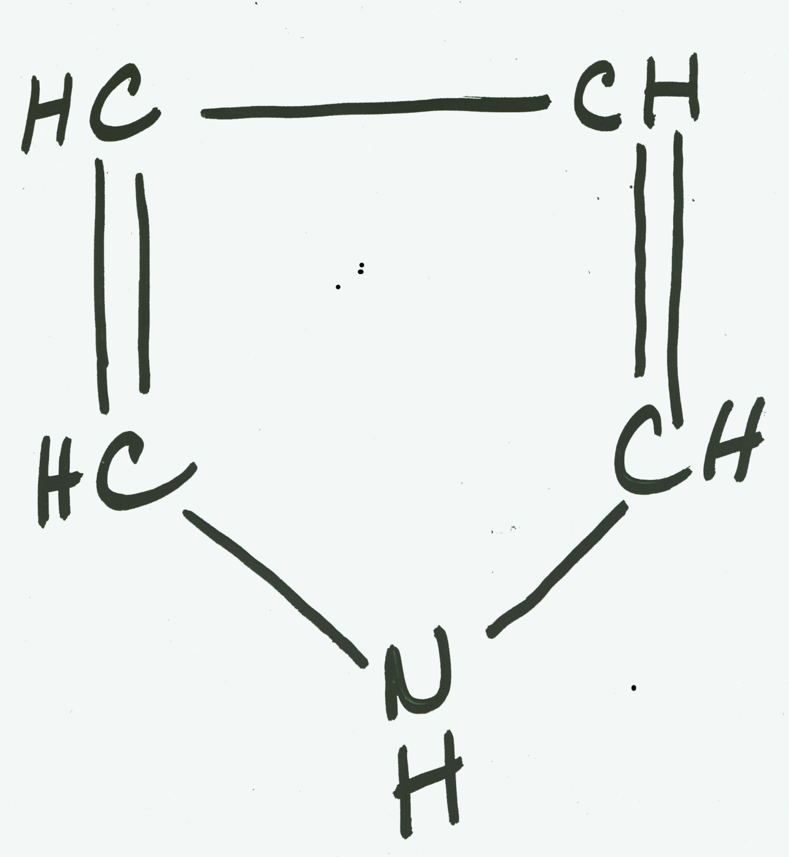
Pyrrole Ring

Slide 6
Porphyrins
The porphyrins are a class of molecules which have in common a central, macrocyclic ring consisting of 4 pyrrole units joined by METHENYL (=CH-) bridges.
The cyclic network of alternating single and double bonds causes porphyrins to absorb visible light (gives red color to hgb).
Fluoresce a reddish-pink under long wavelength UV light 610-640 nm (useful property for detecting and measuring them)
4 Nitrogens at the center of the ring, enables porphyrins to chelate metal atoms (such as iron).

Slide 7
Steps in Heme Biosynthesis
Mitochondria vs cell cytoplasm
Enzymes, substrates, and products at each step
Corresponding genes have been determined for all 8 of the enzymes of heme biosynthesis

Slide 8
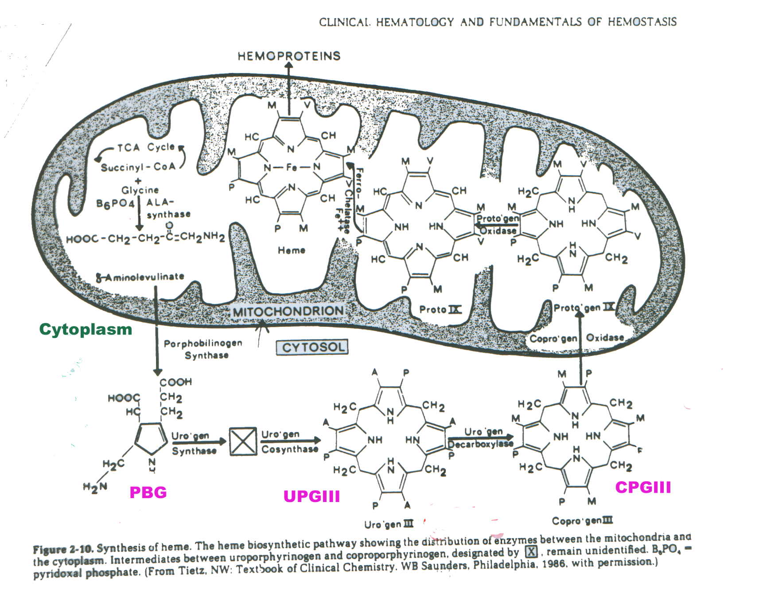

Slide 9
HEME Biosynthesis
An essential pathway
Occurs in all metabolically active cells that contain mitochondria.
Most active in erythropoietic tissue in the Bone Marrow (85% of daily Heme requirement), where it is required for hemoglobin synthesis, and in hepatic tissue, where the heme forms the basis of various heme-containing enzymes such as the cytochromes P450(primary) catalase, cytochrome oxidase, tryptophan pyrrolase, nitric acid synthetase, and myoglobin.
Heme complexed with globin is preserved in circulating rbcs for about 120 days, whereas heme produced in the liver is subject to much more rapid turnover (hours).

Slide 10
Beginning of HEME PATHWAY
Condensation of glycine and succinyl CoA to form delta-aminolevulinate (ALA)
Enzyme mitochondrial enzyme ALA synthase (ALAS)
Pyridoxal phosphate (B6) as a cofactor
Rate limiting step
Under negative-feedback control by heme
Coupled to iron availability
Deficiency -> Sideroblastic Anemia (only one of the 8 enzymes whose deficiency is not a porphyria).

Slide 11
The 3 porphyrins of Clinical Significance.
Differences in porphyrin structure depends on the type and position of side chains located at the corners of the pyrrole rings.
URO = UROPORPHYRINOGEN– 4 propionate and 4 acetate side chains
COPRO= COPROPORPHYRINOGEN- 4 propionate and 4 methyl side chains (3 isomers but only III in RBCs)
PROTO = PROTOPORPHYRINOGEN- 2 propionate and 2 vinyl, and 4 methyl (15 diff isomers but only IX in humans)

Slide 12
Porphyrias cont…..
The excretions of excess porphyrins and their precursors is the basis for diagnosing the porphyrias.
Porphyrin precursors (ALA and PBG) and the more water soluble porphyrins (with multiple carboxyl groups) are excreted mainly in Urine -> urine PORPHYRINURIA Other porphyrins are mainly excreted in the feces by way of the bile.
The routes of excretions is a function of solubility;
URO , with 8 carboxyl groups, is the most water-soluble and is excreted almost entirely in urine
COPRO, with 4 carboxyl groups, is excreted by either urine or feces.
PROTO, with only 2 carboxyl groups, is excreted exclusively in feces.

Slide 13
Porphyrins vs Porphyrinogens
Protoporphyrinogen IX vs Protoporphyrin IX
All have Methyl, Propionate, and Vinyl groups
More double bonds in protoporphyrin than in protoporphyrinogen
Porphyrins are the oxidized forms of porphyrinogens

Slide 14
Porphyrias
Diagnostic Approach to screening for and differentiating
Each of the different type of porphyria is linked to a reduced activity or deficiency of a specific enzyme in the heme biosynthetic pathway.
The enzyme deficiency impairs the production of the end product HEME and there is overproduction and increased excretion of the heme precursor formed by the steps BEFORE the enzyme defect.
Also a compensatory increase in the activity of the initial and rate limited enzyme ALAS.
Deficiencies in seven of the eight enzymes involved in heme synthesis, each leading to a distinct form of porphyria, have been described.

Slide 15
Porphyrias cont…
Most of the porphyrias are inherited as an autosomal dominant trait
Since the heterozygous patient with porphyria has only one gene producing a functionnal enzyme, about 50% of normal enzyme activity takes place. This does not cause a deficiency of heme in rbcs so the patients are not anemic.
Porphyrins and their precursors build up behind the deficient enzyme and accumulate in body tissues and fluids.

Slide 16
Porphyrias cont….
The photosensitizing properties of porphyrins are responsible for the cutaneous signs and symptoms seen in some of the patients with these disorders.

Slide 17
Neurologic, Cutaneous, Secondary Porphyrias…….
Porphyrias, in the past, have been classified as either erythropoietic or hepatic, based on the site of overproduction.
Currently, they are classified:
as Acute vs Non-acute Porphyrias and/or
neurological vs cutaneous - by signs and symptoms
(clinical presentation)
Note: The clinical symptoms of different porphyrias significantly overlap; therefore, they cannot be used alone for identification.

Slide 18
Different Porphyria Classification OLD- FYI
Erythropoietic
Erythropoietic porphyria
Erythropoietic protoporphyria
Erythropoietic coproporphyria
Hepatic
Acute Intermittent porphyria
Variegate porphyria
Hereditary coproporphyria
ALA dehydratas deficiency porphyria
Porphyria cutanea tarda
Hepatoerythropoietic
Hepatoerythopoietic porphyria

Slide 19
Different Porphyria Classification NEW
Porphyrias with Neurological manifestations (no cutaneous)
(ALA and PBG are not photosensitizing)
Acute intermittent porphyria – Acute (AD)
ALA dehydratase deficiency – Acute (AR)
Porphyrias with cutaneous manifestations
Hereditary coproporphyria – neurological and cutaneous – Acute (AD)
Porphyria cutanea tarda – non-acute (AD)
Erythropoietic protoporphyria – non-acute (AD)
Congenital erythropoietic porphyria – non-acute (AR)
Variegate porphyria – neurological and cutaneous – Acute (AD)
Secondary (Porphyrinurias)

Slide 20
Neurologic Porphyrias - general
Neurological – overproduction of all the porphyrins and porphyrin precursors proximal to the enzyme defect. Increased excretion of porphyrin precursors is caused by decreased activity of PBGD.
The decreased activity of PBGD can be cause by genetic mutation of the enzyme (acute intermittent porphyria) or inhibition of PBGD by Protoporphyrinogen(variegate porphyria) or coproporphyrinogen (hereditary coproroporphyria).

Slide 21
Neurologic Porphyrias general cont…
General Symptoms – there are 3or 4 neurological porphyrias characterized by acute attacks of abdominal pain, neurological signs and symptoms, and psychiatric disturbances.
The acute attacks last from days to weeks and are accompanied by in increase in the excretion of ALA and PBG in urine. The finding of a ALA and PBG in the urine during acute attacks establishes the presence of neurological porphyria. Urine may turn dark red/brown due to increased excretion of ALA, PBG, and other porphyrins. The excretion of ALA and PBG usually decreases with clinical improvement.

Slide 22
Neurologic Porphyrias- general…..
Signs and symptoms usually begin during adolescence or early adulthood (Autosomal dominant).
Women>men (2nd ½ of woman’s menstrual cycle)
Abdominal pain, constipation, nausea, and vomiting
Tachycardia, hypertension, sweating, and urinary retention.
Sensory and motor dysfunction -> pain in the extremities, areas of reduced or altered sensation, muscle weakness, and paralysis.

Slide 23
Neurologic Porphyrias cont..
Visual disturbances, seizures, and coma may also occur
Increase demand on the liver for heme which in turn induce heme synthesis
Inappropriate secretion of antidiuretic hormone may contribute to a low serum sodium concentration.
Bizarre psychotic behavior often suggests a primary psychiatric illness

Slide 24
Neurologic Porphyrias general….
Neurologic Porphyrias, precipitating an attack:
List of drugs/hormones (barbiturates/ oral contraceptives with synthetic estrogen) /stress, which can precipitate an attack.
Fasting, alcohol consumption, infections, environmental chemicals can precipitate an attack.
Between attacks, the signs and symptoms of porphyria are usually absent.
Most of the people who carry the gene for one of these porphyrias never have an attack and their disease remains clinically latent.

Slide 25
Neurologic Porphyria 1-Acute Intermittent Porphyria
Most common of the neurologic porphyria
(1-10/100,000)
50% deficiency of porphobilinogen deaminase, the enzyme that joins four PBG molecules to form uroporphyrinogen.
Most severe of the acute porphyrias.
After puberty and attacks in young adults ( less frequent after menopause.
ALA and PBG accumulate, inducing the activity of ALA synthase
ALA and PBG are excreted in the largest amounts in this porphyria in urine.
Since the defect does not involve the porphyrinogen portion of the pathway, porphyrins are not produced in excess and photosensitivity does not occur.

Slide 26
Neurologic Porphyria 1– Acute Intermittent Porphyria cont..
Main lab findings: increase in urine ALA and PBG concentrations during acute attacks. Between attacks, normal.
PBG present at high concentrations in the urine -> spontaneous condenses and cyclizes to form uroporphyrinogen (type 1 isomer) which oxidizes to URO.
Large increase in URO present in all neurological porphyrias, especially this one.
Fecal porphyrinogens will be normal.
Treatment: High carbohydrate diet( i.v. glucose) and hematin, and avoidance of the precipitating factors.

Slide 27
2-Neurological Porphyria ALA DEHYRATASE DEFICIENCY
Hereditary near complete deficiency
Homozygotes have neurological symptoms but no photosensitivity; diffuse abdominal pain, peripheral neuropathies, and mental disturbances.
(Heterozygotes = asymptomatic)
Increase ALA , PBG, and COPRO isomers in urine.
ALA-D activity in RBCs

Slide 28
Cutaneous Porphyrias
There is an overproduction of all porphyrinogens formed before the enzyme but NO overproduction of porphyrin precursors (ALA or PBG).
Cutaneous porphyrias have in common an excess of porphyrins in body tissues, including skin.
Porphyrin molecules absorb light at about 400 nm -> electrons to higher energy state. As electrons to ground state, some of the energy they release may be transferred to oxygen that can react with membranes and other cellular constituents.
The release of proteolytic enzymes from damaged lysosomes may be responsible for cell injury, and ultimately the photosensitivity and skin lesions seen in these disorders.

Slide 29
Neurologic & Cutaneous Porphyria 1-Variegate Porphyria
Acute neurological attacks, sensitivity of skin to sunlight and/or mechanical trauma.
Partial deficiency of protoporphyrinogen oxidase.
PROTO and COPRO accumulate in the body -> photosensitivity and cutaneus lesions.
Common – Dutch descendants in S. African
The finding of ALA and PBG in the urine during acute attacks establishes the presence of a neurological porphyria.
Variegate Porphyria is distinguished from the other 2 neurological by the increased excretion of PROTO and COPRO in the feces.
Management – avoid precipitating drugs and protect from sunlight.

Slide 30
Neurological & Cutaneous Porphyria 2-Hereditary Coproporphyria
A partial deficiency of coproporphyrinogen oxidase in this disease causes COPRO to accumulate. In addition to the acute attacks, photosensitivity and skin lesions may occur (less often than Variegate).
Urinary levels of ALA and PBG are increased during acute attacks. The key diagnostic find in COPRO in the feces.

Slide 31
CutaneousPorphyrias 3- Porphyria cutanea tarda
Skin disorder which appears in adulthood, esp elderly men.
Most common porphyria
Partial deficiency of uroporphyrinogen decarboxylase (UROD).
Some hereditary, but most acquired deficiency of the hepatic enzyme.
Fragile skin, blister formation, thickening and scarring of sun-exposed skin, and areas of hyperpigmentation
The disease remains dormant until some liver dysfunction (hemachromatosis or alcoholic liver disease or hepatitis C).
Estrogen therapy may activate skin lesions

Slide 32
Cutaneous Porphyrias 3 - Porphyria cutanea tarda…..
Rare Homozygous – hepatoerythropoietic porphyria ➔severe photosensitivity
URO as well as porphyrins with 7,6,5 carboxyl groups accumulate in the urine. Fecal porphyrins only mildly elevated.
Presence of isocoproporphyrin (COPRO isomer) is distinctive for this disorder.
Most treatable porphyria; stay away from sun, alcohol, estrogens, certain chemicals, and phlebotomy weekly or bi-weekly.

Slide 33
Cutaneous Porphyrias 4- Erythopoietic Protoporphyria
Partial deficiency of ferrochelatase, the last enzyme in the heme pathway.
Accumulation of PROTO -> photosensitivity starting in childhood or adolescence.
Sunlight ➔ burning, itching, swelling, and redness of the skin but skin changes are mild and scarring uncommon.
Patients tend to develop liver disease of protoporphyrin-containing gallstone since the liver must excrete the really high amount of PROTO.
Concentration of free erythrocyte protoporphyrin is greatly elevated as is fecal PROTO.
Urine porphyrins and their precursors are normal.

Slide 34
Cutaneous Porphyrias 5- Congenital erythropoietic porphyria
Rare autosomal recessive
Deficiency of uroporphyrinogen III synthase
Enough uroporphyrinogen IIl is made for metabolic needs.
Large amounts of an isomer is formed which eventually oxidizes to form URO I and COPRO I (which have no role in Heme Synthesis)
Early childhood; usually discovered soon after birth due to red urine
Extreme photosensitivity
Light exposed areas scarred and as older, extensive scarring and mutilation of the fingers, nose, and ears may occur.
Erythrodontia = reddish-brown staining of teeth caused by porphyrin deposition.
Patients develop hemolytic anemia with splenomegaly
Worst prognosis of all porphyrias!

Slide 35
Cutaneous Porphyrias 5 Congenital erythropoietic porphyria cont….
Urine is pink or red due to URO and COPRO (I isomers?)
RBCs contain large amounts of URO and COPRO and fluoresce when examined microscopically under ultraviolet light.
Fecal porphyrins also increase.
ALA and PBG are normal.
Management: splenectomy, avoid sunlight, and treatment of secondary skin infections.

Slide 36
Secondary Disorders of Porphyrin Metabolism -Porphyrinurias
Lead Poisoning
Children eating chips of lead paint
“moonshine” made in lead-containing equipment
Abdominal pain and neurological abnormalities that may mimic an acute attack of porphyria.
Lead inhibits 2 enzymes – ALA dehydratase and ferrochelatase ➔ increase in urine ALA but not PBG. Increase of zinc protoporphyrin in erythrocytes. Urine COPRO also increased.
(zinc replacement of iron since iron transport affected)
Diagnosis based on increased lead in the blood

Slide 37
Secondary Disorders of Porphyrin Metabolism - Iron Deficiency
Iron Deficiency➔ an imbalance between protoporphyrin (normal amounts) and iron (decreased amounts)➔zinc protoporphyrin accumulating in the erythrocytes at a higher than normal level.
Because iron deficiency is so common, it is the most common cause of increased rbc porphyrins.
Measurement of zinc protoporphyrin is a useful screening for iron deficiency, but the diagnosis is confirmed by studies of serum iron, TIBC, and ferritin.

Slide 38
Secondary Disorders of Porphyrin Metabolism- Coproporphyrinuria
Coproporphyrinuria
Increased urinary COPRO = most common abnormal lab result when urine is screened for porphyrins.
May indicate a porphyria, but more likely caused by problems unrelated to heme synthesis; if isolated non-specific
Liver disease
Acute illness
Exposure to toxic compounds

Slide 39
Screening Tests for Initial Evaluation of Porphyrias
The laboratory workup depends on the clinical presentation
Screening tests are used to identify increases in PBG and in urine and fecal porphyrins.
Positive screening tests should be confirmed by quantitative measures on a 24-hr urine or random feces, as well as which porphyrins are elevated.
Negative screening require no further analysis.

Slide 40
Screening Tests for Initial Evaluation of Porphyrias cont…
The interpretation of results – both require subjective judgment as to whether the expected color if present:
Porphyrins are extracted into an acidified organic solvent, and a positive result is a reddish-pink fluorescence of the extract under long-wavelength ultraviolet light.
The qualitative screening test for PBG is based on its reaction with p-dimethyl-aminobenzaldehyde (Ehrlich reagent) to form a reddish-purple color.
Specificity has been improved in the Watson-Schwartz test using chloroform and n-butanol to remove interfering substances.

Slide 41
Screening Tests for Initial Evaluation of Porphyrias cont…
Interfering substances may cause both false positives and false negatives.
Newer screening tests – spectrophotometry and spectrofluorometry have eliminated the interferences and provide a numerical value for the amount of PBG or porphyrin present in the sample on a 24 hr. urine.
Urine, fecal, and red blood cell porphyrins are typically increased by 5-10x in patients with porphyria. Also, ALA and PBG in acute phase of neurological porphoryia.
Isolated non-specific increase in urine, feces, and rbcs in people who do not have a porphryia.

Slide 42
Screening Tests for Initial Evaluation of Porphyrias cont…
Porphobilinogen (PBG)
Elevated in acute intermittent porphyria, variegate porphyria, and hereditary coproporphyria.
Postive during acute attacks; may be negative between attacks.
Positive screen is confirmed by a quantitative PBG analysis, done on a 24 – hr urine.

Slide 43
Screening Tests for Initial Evaluation of Porphyrias cont…
Delta –Aminolevulinic Acid (ALA)
Runs parallel to PBG in the acute neurological porphyrias.
Also increased in lead poisoning and hereditary tyrosinemia, therefore, a less specific indicator of porphyrias than PBG.
Measurements on a 24 hr urine.
Chromatographic separation from other components, then reacted to acetylacetone to form a pyrrole, with then react with the Ehrlich reagent.

Slide 44
Screening Tests for Initial Evaluation of Porphyrias cont…
Urine Porphyrins
Usually positive for all porphyrias except for protoporphyria
Positive screens confirmed by 24 hr urine quantitative measurement and identification of the porphyrins that are elevated.
A slight to moderate increase of COPRO is seen in liver disease, lead poisoning, alcohol ingestion, and acute illness. Larger increases of COPRO and URO are more likely to indicate a porphyria.

Slide 45
Screening Tests for Initial Evaluation of Porphyrias cont…
Huge amounts of URO and COPRO in patients with congenital erythopoietic porphyria.
In cutanea tarda, excretion of URO and 7, 6,5 carboxyl porphyrins and COPRO isomer is diagnostic.
Variegate porphyria and hereditary coproporphyria are characterized by excess of COPRO in the feces.
Patients with acute intermittent porphyria sometimes excrete high levels of URO, produced by the nonenzmatic condensation of PBG molecules in urine.
Increase URO in the other neurological porphyrias for the same reason.

Slide 46
Screening Tests for Initial Evaluation of Porphyrias cont…
Fecal Porphyrins – COPRO , PROTO, and several dicarboxylic porphyrins
The amount excreted by this route is a function of diet and anaerobic flora of the colon.
Therefore, increases in fecal porphyrin up to 3x may be seen in normal, healthy individuals.
Increase in all the porphyrias except acute intermittent porphyria (and ALA dehydatase def)
Most important use: variegate porphyria (PROTO AND COPRO both elevated) but in hereditary coproporphyria (only COPRO elevated)

Slide 47
Screening Tests for Initial Evaluation of Porphyrias cont…
PROTO increase seen in Erythropoietic protoporphyria
(COPRO increase in Congenital erythropoietic porphyria)
Fecal porphyrins may be within the reference range or only slightly increased in porphyria cutanea tarda, but fractionation ➔range of porphyrins including URO, 7 carboxy porphyrin, and isocoproporphyrin, not normally found in feces.

Slide 48
Screening Tests for Initial Evaluation of Porphyrias cont…
Red Blood Cell Porphyrins
Rbc porphyrins other than heme are measured as free erythrocyte protoporphyrin (FEP). Under normal conditions, FEP reflects zinc protoporphyrin.
Greatly increased in congenital erythopoietic porphyria (URO and COPRO) and protoporphyria (PROTO) but normal in the other porphyrias. These 2 disorders can be differentiated by urine porphyrin assays and clinical presentation.

Slide 49
Screening Tests for Initial Evaluation of Porphyrias cont…
Enzyme Assays
Only 1 enzyme in the heme pathway , porphobilinogen deaminase, is routinely measured in the lab.
Activity < 50% with acute intermittent porphryia
Drawback
Overlap with normal at the lower end of the reference range.
Small # of patients with the disease have normal PBG deaminase in rbcs.

Slide 50
Screening Tests for Initial Evaluation of Porphyrias cont…
Molecular Genetics
All the genes that encode enzymes of the heme synthetic pathway have now been identified and their coding sequences determined. This work has led to the discovery of mutation that cause each of the porphyrias.
DNA based testing for the mutation can now be offered to family members.
A positive test does not predict whether the course of the disease will be asymptomatic, mild, or severe.
Since the mutations are limited to only one or several families and the search for them is labor-intensive, it is not yet possible to offer it routinely and it is available only in a limited number of research and specialty laboratories.

Slide 51
Specimens handling requirements
Excess PBG in urine is nonenzymatically converted to uroporphyrin 1.
This process may be slowed by refrigeration and alkalinization of the urine specimen to pH8-9.
“Please use a dark plastic jug for collecting the 24 hr urine. The urine should be protected from light during collection and during shipping. Add 5 grams of sodium carbonate to the jug, which is a powder that will readily dissolve in the urine. This adjusts the acidity of the urine and helps preserve the things the lab will be measuring. It is not toxic or irritating.”

Slide 52
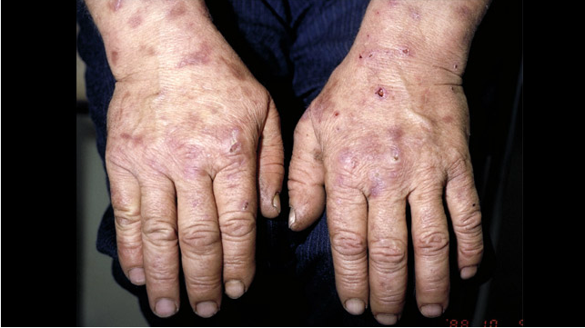

Slide 53
Works Cited
Wiley, James S. and Moore, Michael R. “Heme Biosynthesis and Its Disorders”. Hematology Basic Principles and Practises 4th edition. Philadelphia: Elsevier, 2005.
Schreiber, William E. “Iron, Porphyrin, and Bilirubin Metabolism”. Clinical Chemistry Theory, Analysis, Correlation 4th edition. Mosby,2003.
Abel, Gyorgy and Parwani, Anil. “ Disorders of Porphyrin Synthesis and Iron Metabolism” Clinical Chemistry Laboratory Management and Clinical Correlations. Lippincott, 2002.
Parnas, M.Laura and Frank, Elizabeth L. “Porphyrias” A guide to laboratory assessment “ Clinical Laboratory News, 2010.

