Slide 1
Adrenal Gland
Northside Hospital

Slide 2
Objectives
Topic 12: Endocrinology: Adrenal Gland
Identify the hormones produced by the adrenal cortex.
Describe the classification, regulation, and functions of cortisol and aldosterone.
Discuss the procedure for the ACTH stimulation test and the dexamethasone suppression test including the interpretation.
Describe the deficiency, clinical and laboratory findings of congenital adrenal hyperplasia.
Describe the causes, symptoms, and laboratory findings for Cushing's syndrome and disease.

Slide 3
Objectives Cont….
Differentiate primary adrenal insufficiency and Addison's disease by cause, symptoms, and laboratory findings.
Differentiate primary and congenital primary hypoaldosteronism.
Differentiate Conn's syndrome and secondary hyperaldosteronism.
List the catecholamine hormones and briefly describe their synthesis and metabolism.
For the hormones dopamine, norepinephrine and epinephrine, list their functions and metabolites which may be found in urine and/or blood.
Describe the tumors pheochromocytoma and neuroblastoma including laboratory abnormalities.

Slide 4
Adrenal Gland
Composed of outer adrenal cortex (90 % )& inner adrenal medulla
Cortex produces steroid hormones (mineralocorticoid, glucocorticoid, and androgens- progesterone & estrogen)
Medulla secretes catecholamines (epinephrine, nor epinephrine, and dopamine)
Conditions affect blood pressure, and electrolyte balance.
Hypofunction is treated with exogenous hormone replacement, hyperfunction with pharmacologic suppression or surgery.
Pyramid-shaped, located just above & medial to kidneys
Highly vascular with a complex venous circulation (play a role in regulating steroid hormone synthesis
Notes:
4

Slide 5
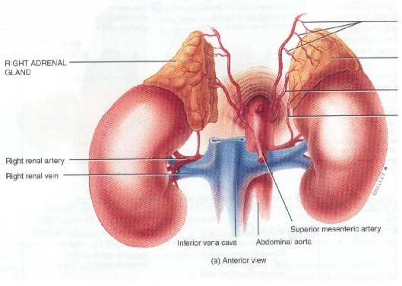
Adrenal Gland

Slide 6
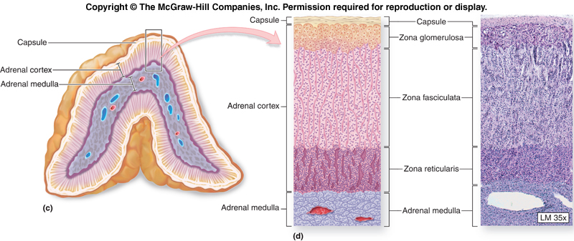

Slide 7
The Adrenal Cortex by Zone
Zona Glomerulosa (G-Zone) Cells (outer 10%)
  Synthesize mineralocorticoids critical for Na⁺ retention, K⁺ & acid–base homeostasis
Zona Fasciculata (F-Zone) Cells (middle 75%)
  Synthesize glucocorticoids critical to blood glucose homeostasis & blood pressure
  Adrenal androgens
Zona Reticularis (R-Zone) Cells (inner 10%)
  Synthesize glucocorticoids critical to blood glucose homeostasis & blood pressure
  Adrenal androgens

Slide 8
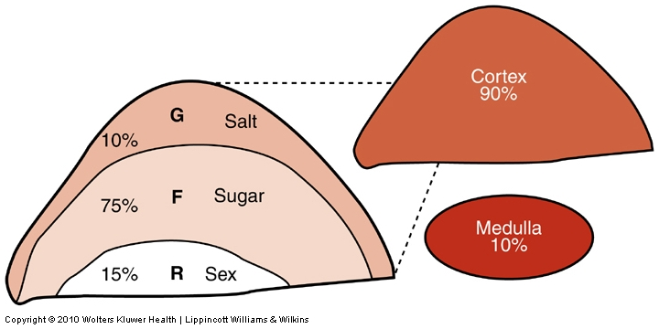
Adrenal Gland
Cortex
  High lipid content
  Produces steroid hormones derived from cholesterol
Medulla
  Chromaffin cells
  Synthesizes catecholamine hormones: norepinephrine and epineprine

Slide 9
The Adrenal Cortex by Zone (cont’d)
Cortex Steroidogenesis
  All adrenal steroids are derived by sequential enzymatic conversion of a common substrate, cholesterol( LDL –in most cases).
  Cholesterol can also be made from acetyl coenzyme A to ensure continuous supply of free cholesterol for steroid synthesis
  Only free cholesterol can enter steroidogenic pathways in response to ACTH.
  Conversion of cholesterol to pregnenolone is a rate-limiting step in steroid biosynthesis.
  Decreased activity of any enzymes required for biosynthesis can occur as an acquired or inherited trait.
  Evaluation of adrenal function requires measuring relevant adrenal hormones, metabolites , or both .

Slide 10
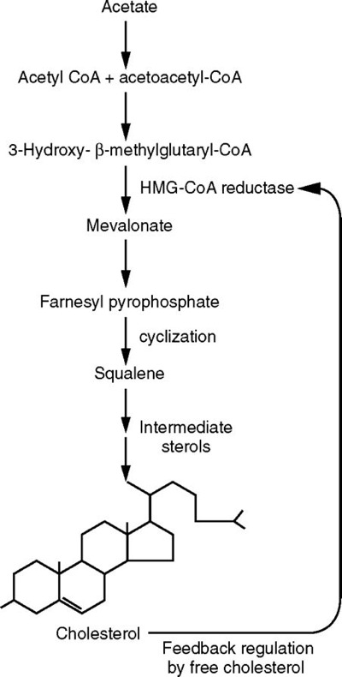
10

Slide 11
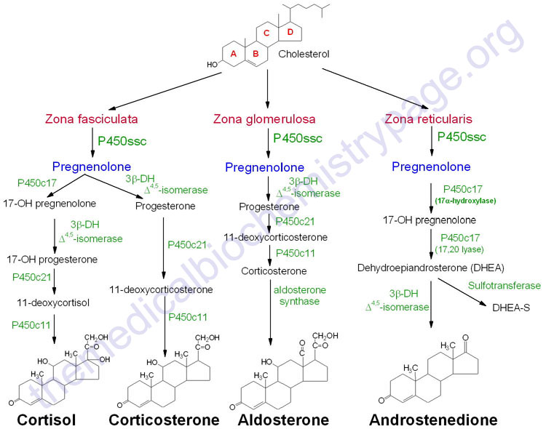
Cortex Steroidogenesis
Occurs in Mitochondria
←Under control of ACTH

Slide 12
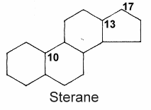
Basic Steroid Nucleus
Consisting of 3 six-carbon hexane rings & one five-carbon pentane rings

Slide 13
Adrenal Cortical Hormones
Glucocorticoids( primarily cortisol in humans)
  Under adrenocorticotropic hormone (ACTH) control
  Hypthalamus produces corticotropin releasing Hormone (CRH) which stimulates ACTH. ACTH stimulates cortisol release
  Negative feedback from cortisol to the pituitary gland.
  90% of secreted cortisol is bound to transcortin (cortisol binding globulin) or albumin and has a half life of 90 min.

Slide 14
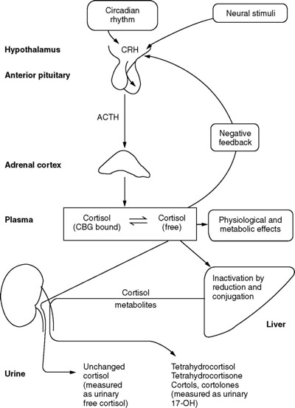
Control & Metabolism of glucocorticoids
Kaplan Page 1007

Slide 15
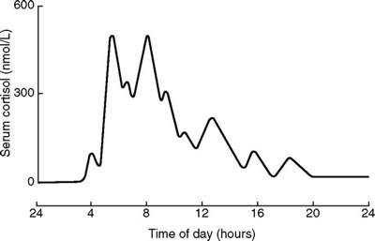
Diurnal Cortisol Variations
Kaplan Page 1007
    Peak: 6-8am
    Trough: 6pm-12am

Slide 16
Adrenal Cortical Hormones
Laboratory measurement of Cortisol
  Sleep patterns or stress can cause alterations in cortisol and ACTH circadian pattern.
  RIA and Fluorescence Polarization Immunoassay( FPIA) commonly used.
  HPLC, GC-MS , and LC-MS
  Serum samples collected at both 8am and 4 pm
  Reference ranges: 8am= 5-23 ug/dL, 4pm= 3-16ug/dl
  Urine testing: cortisol metabolites (17-hydroxycorticosteroids (Porter Silber color reaction) and 17-ketogenic steroids (Zimmerman chromogenic reaction) Both replaced with immunoassays

Slide 17
Adrenal Cortical Hormones
Cortisol Functions
  Essential for life and a catabolic hormone
    Promotes protein and lipid breakdown (lipolysis)
    Inhibits protein synthesis
    Stimulates gluconeogenesis and glycogenolysis in liver; increasing glucose levels (antagonistic to insulin)
    Inhibit glucose uptake in peripheral tissues –muscles
    Promotes glucose uptake in essential tissues- brain & RBC
    Decreased absorption of calcium from intestines
    Immunosuppression and anti-inflammatory effect if in high concentrations (used to treat inflammatory conditions such as arthritis)

Slide 18
Adrenal Cortical Hormones
Cortisol Functions
At high levels cortisol also contributes to maintenance of blood
pressure through:
Stimulating glomerular filtration rate (GFR) and decreasing H₂O reabsorption
At high concentrations cortisol affects cardiac output through increasing vascular reactivity to vasoconstrictors (epinephrine)

Slide 19
Mineralocorticoids : Aldosterone
How is aldosterone level regulated in the body?
Answer: under control of renin-angiotensin system

Slide 20
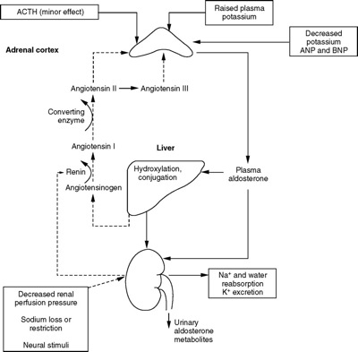
Control and Metabolism of Aldosterone
Kaplan Page 1008

Slide 21
Renin-angiotensin system
A drop in blood pressure or serum Na⁺ concentration results in the release of renin
Renin (proteolytic enzyme) cleaves a protein secreted by liver to produce at the end a potent vasoconstrictor (Angiotensin II)
Angiotensin II increases blood pressure & stimulates aldosterone release
Aldosterone works on receptors within kidney tubular cells to facilitate Na⁺ retention & K⁺ loss

Slide 22
Adrenal Cortical Hormones
Aldosterone: function
  Regulation of extracellular fluid volume and body Na⁺ and K⁺
  by stimulating the distal convoluted tubule and collecting
  ducts to reabsorb Na⁺ and secrete K⁺ and H⁺
  Laboratory measurement of Aldosterone
    Serum, plasma or urine by RIA
    Posture of the patient may affect values

Slide 23
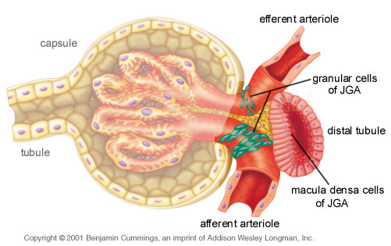
Juxtaglomerular Apparatus ( JGA)
1)Macula densa cells: columnar epithelial thickening of distal tubule (senses amount of NaCl inside renal distal convoluted tubule)
2)Juxtaglomerular cells
or granular cells
(secrete renin)
3)Extraglomerular
mesangial cells

Slide 24
Renin-Angiotesin Control System
A drop in blood pressure or serum Na⁺ concentration results in the release of renin
Renin (proteolytic enzyme) cleaves a protein secreted by liver to produce at the end a potent vasoconstrictor (Angiotensin II)
Angiotensin II increases blood pressure & stimulates aldosterone release
Aldosterone works on receptors within kidney tubular cells to facilitate Na⁺ retention & K⁺ loss

Slide 25
The Adrenal Cortex: Clinical Significance
Congenital Adrenal Hyperplasia
  An inherited family of enzyme disorders causing decreased cortisol & aldosterone production
  Characterized by a decrease or absence of the enzymes necessary to synthesize one or more adrenal hormones
  Decreased cortisol level leads to and increased ACTH and hyperplasia of the adrenal cortex
  Accumulation of progesterone
  Most common enzymes found to be deficient are 21-hyroxylase and 11-hydroxylase

Slide 26
The Adrenal Cortex: Clinical Significance
Hypercortisolism: Cushing’s syndrome
  Elevated cortisol due to autonomous excessive ACTH production cause adrenal hyperplasia
  Other causes: adenoma, carcinoma, nodules on adrenal gland, exogenous administration of glucocorticoids or ACTH, ectopic ACTH secreting tumors
  Symptoms: “moon” face, truncal obesity, or hirsuitism (excessive body hair), hypertension, CHO intolerance, hypokalemic (low K⁺)metabolic alkalosis, and neuropsychiatric symptoms
  Laboratory findings: Glucose intolerance, increased Na⁺, decreased K⁺ and loss of cortisol diurnal variation
  Dexamethasone test and ACTH useful

Slide 27
Adrenal Cortex Function Tests
Dexamethasone Suppression Test
Dexamethasone is an analog of cortisol that suppresses the secretion of ACTH from the pituitary gland
Used to evaluate patients with Cushing’s syndrome
Patient given dexamethasone
Cortisol levels drawn next day at 8am
Normal: ACTH is suppressed and cortisol level drops
Abnormal: increase in cortisol = problem with adrenal gland

Slide 28
The Adrenal Cortex: Clinical Significance
Hypocortisolism (adrenal insufficiency)
  Primary: acute or life-threatening, arises from sudden decrease in cortisol caused by trauma, hemorrhage, thrombosis, or infection of adrenal cortex
  Ex: Addison’s disease (chronic primary adrenal sufficiency)
  Secondary: due to decreased ACTH secretion; symptoms similar to Addison’s
  Diagnosis based on ability of the adrenal gland to release cortisol in an ACTH stimulation test.

Slide 29
The Adrenal Cortex: Clinical Significance
Hyperaldosteronism
Conn’s disease
  May be due to adrenal adenoma or non-malignant hyperplasia
  Patient develops hypertension, muscle weakness, polyuria and polydipsia
  Plasma aldosterone increases leading to increased Na⁺ retention and K⁺ secretion.
Secondary hyperaldosteronism
  Result of kidney lesions
  Renin levels are very high leading to excess stimulation of aldosterone synthesis and release.

Slide 30
The Adrenal Cortex: Clinical Significance
Adrenal androgens (progesterone & estrogen)
Also produced by gonads
Include: dehydro epiandro sterone (DHEA), (DHEA-S) in the highest concentration
Also include: andro stene dione, testosterone, estradiol, estrone, and progesterone-at low concentrations
The liver is the principle site for the transformation and conjugation of steroid hormones
Metabolites are excreted in urine

Slide 31
The Adrenal Medulla
Functions
  Secretes catecholamines directly into circulation in lieu of transmitting messages via efferent axons
  Acts as first responder to stress (within seconds) to promote
  fight-or-flight response

Slide 32
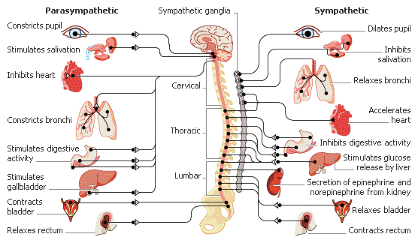
The Sympathetic Nerves
Innervates all the smooth muscles and the various glands of the body, and the striated muscle of the heart. Both the sympathetic & parasympathetic nervous systems are part of the autonomic nervous system- works to maintain a stable internal environment.

Slide 33
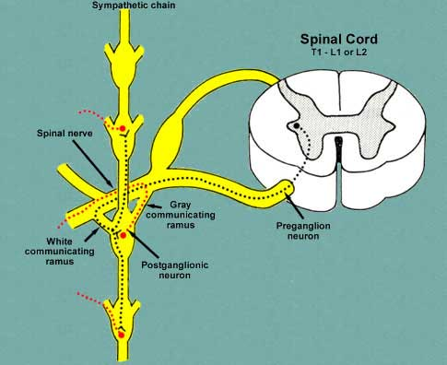
Fight-or-flight response
Automatic (without thinking), quick reflex ( protects you), controlled by spinal cord (not brain)

Slide 34
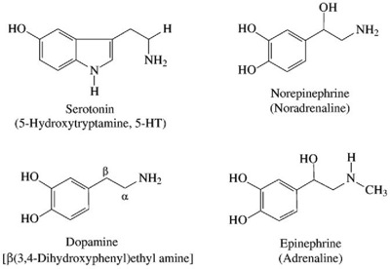
Catecholamines : Biogenic amines that serve as neuronal or hormonal signals in a wide range of physiological responses

Slide 35
Adrenal Medulla Hormones
Catecholamine Hormones
  Synthesized from amino acid L-tyrosine by a series of enzymatic steps
  Norepinephrine and epinephrine
  Have short half life (1-2min) and removed from circulation by liver, kidney or sympathetic nerves.
  Degraded by 2 enzymes: monoamine oxidase (MAO) and catechol-O-methyl transferase (COMT) before release
  Major metabolites are metanephrine and normetanephrine, which are then conjugated and excreted into urine and the final metabolite of both is vanillymandelic acid (VMA)
  Urine VMA testing maybe useful in the diagnosis of adrenal medullary disease

Slide 36
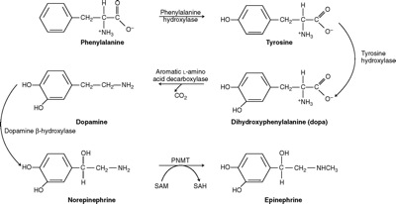
Synthesise of Medullary Hormones
Kaplan Page 1005

Slide 37
Adrenal Medulla Hormones
Dopamine
  Highest concentration in CNS where is functions as a neurotransmitter
  Inhibits synthesis and secretion of prolactin from the pituitary gland
  Also synthesized in the adrenal gland
  Metabolized into homovanillic acid
  Dopamine difficult to measure (veniputure cause catecholamines to increase) HVA levels commonly measured
  HVA measurement: 24hr Urine kept at 4°C with 10ml HCl. Homovanillic acid extracted from sample by gas chromotography or HPLC

Slide 38
Adrenal Medulla Hormones
Norepinephrine
  High concentrations in brain and acts as neurotransmitter.
  Found in sympathetic nervous system
  Produced by neurons in hypothalamus
  Causes vasoconstriction of small vessels in skin and relaxation of smooth muscle in GI tract
  Final metabolite is vanillymandelic acid (VMA)
  Norepinephrine, normetanephrine, and VMA can be measured in urine

Slide 39
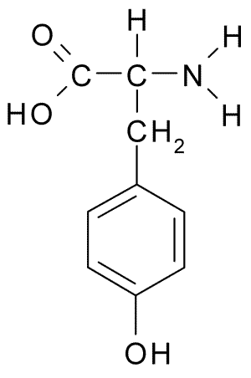
Adrenal Medulla Hormones
Epinephrine
(Functions as a circulating hormone & is released directly from the adrenal medulla into the blood stream)
  Major catecholemine produced by chromaffin cells in adrenal medulla
  Final hormone produced in the synthetic pathway beginning with L-tyrosine (amino acid)
  Causes “fight or flight response: increase heart rate, blood pressure, respiration, metabolic rates
  Stimulates glycogenolysis in liver and skeletal muscle leading to increased plasma glucose.
  Metabolized to metanephrine and VMA
  Serum and urine measurement similar to dopamine. VMA is measured

Slide 40
The Adrenal Medulla: Clinical Significance
Pheochromocytoma
  Rare usually benign tumor of chromaffin cells secretes large amounts of epinephrine, norepinephrine or both
  Some tumors found in other locations
  Symptoms: hypertension, tachycardia, sweating, headaches
  Hypermetabolic symptoms similar to hyperthyroidism
  Easily treated surgically if caught early
  Diagnosis requires measurement of:
    Plasma epinephrine
    Norepinephrine
    Urine metanephrines or VMA
    Elevations are diagnostic

Slide 41
The Adrenal Medulla: Clinical Significance
Treatment of Pheochromocytoma
  Surgery, following appropriate medical preparation
  Removal is a high-risk procedure.
  Catecholamines fall to normal within 1 week of resection.
  Preoperative alpha blockade is widely recommended.
Outcome and Prognosis
  Patients with familial pheochromocytomas are more likely to have recurrence.
  Long-term monitoring is indicated in all patients.

Slide 42
The Adrenal Medulla: Clinical Significance
Neuroblastoma
  Malignant tumor of neuron precursor cells in children
  Primary tumor near adrenal gland
  Usually not found until it has metastasized to another site such as the liver.
  Catecholamines are secreted giving rise to sporadic measurable increases
  Symptoms are similar to pheochromocytoma, only sporadic
  Measurements of urine VMA and homovanillic acid may be helpful but are not always conclusive
    Hormone release is sporadic and many patients show only slight increases in VMA.
    Difficult to obtain 24hr urine from children and infants.

