Slide 1
Thomas • Murphy-Johnson
Clinical Laboratory Immunology
1. Principles of Immunology

Slide 2
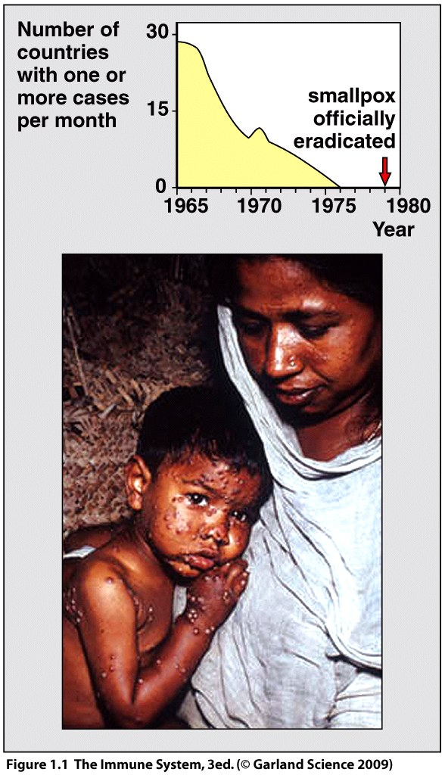
Microbe vs. Man
Microbes are ubiquitous.
Exposure is continuous.
The immune system is a big investment.
Vaccination is a medical manipulation.
Success story is smallpox.
vaccinate with related vaccinia virus.

Slide 3
Microbes live within us to obtain nutrients and protection from the environment.
Commensals – have established a non-pathogenic ‘treaty’ with humans and may even offer the host an advantage.
Vitamins, colicins and site protection by normal flora.
In absence of normal flora pathogens may invade, opportunistic disease causing bacteria e.g Clostridium difficile.

Slide 4
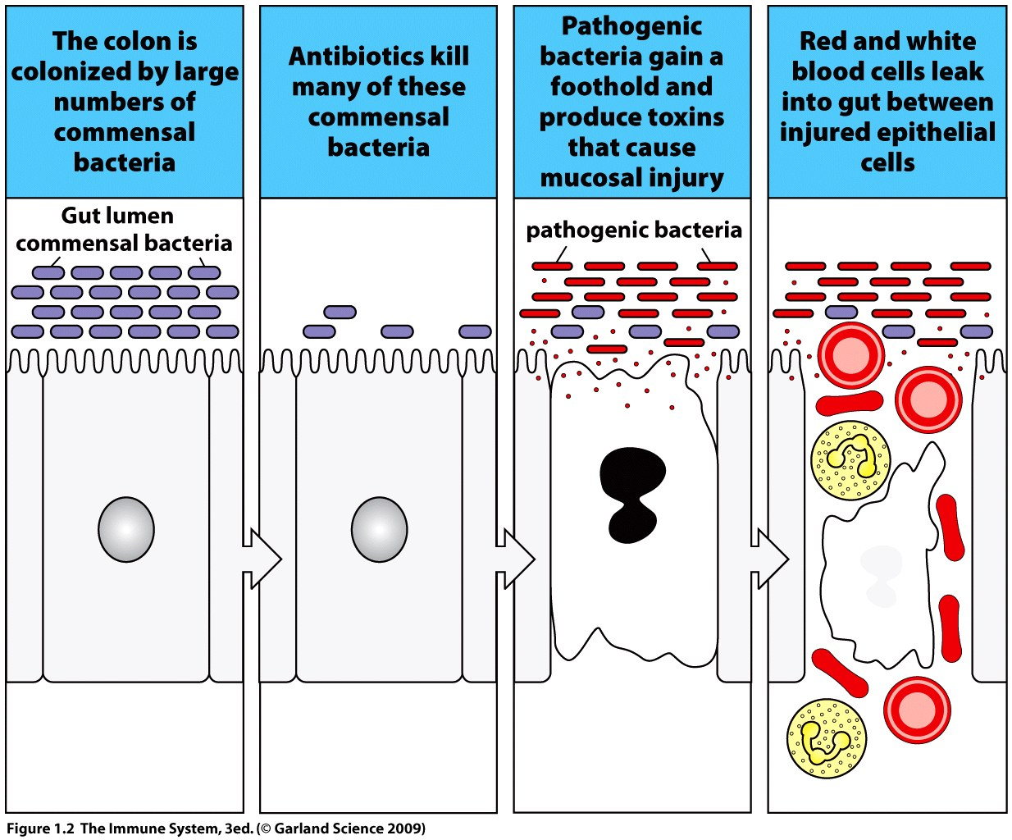

Slide 5
Pathogen – potential to cause disease.
4 kinds; bacteria, viruses, fungi and parasites (generalized term).
The immune system limits the population size and location of pathogens.

Slide 6
Pathogens evolve and adapt to enable them to infect, reproduce and transmit from a host.
A POORLY ADAPTED MICROBE KILLS ITS HOST.
Pathogens can adapt quickly to circumvent immunological memory. e.g., Influenza.

Slide 7
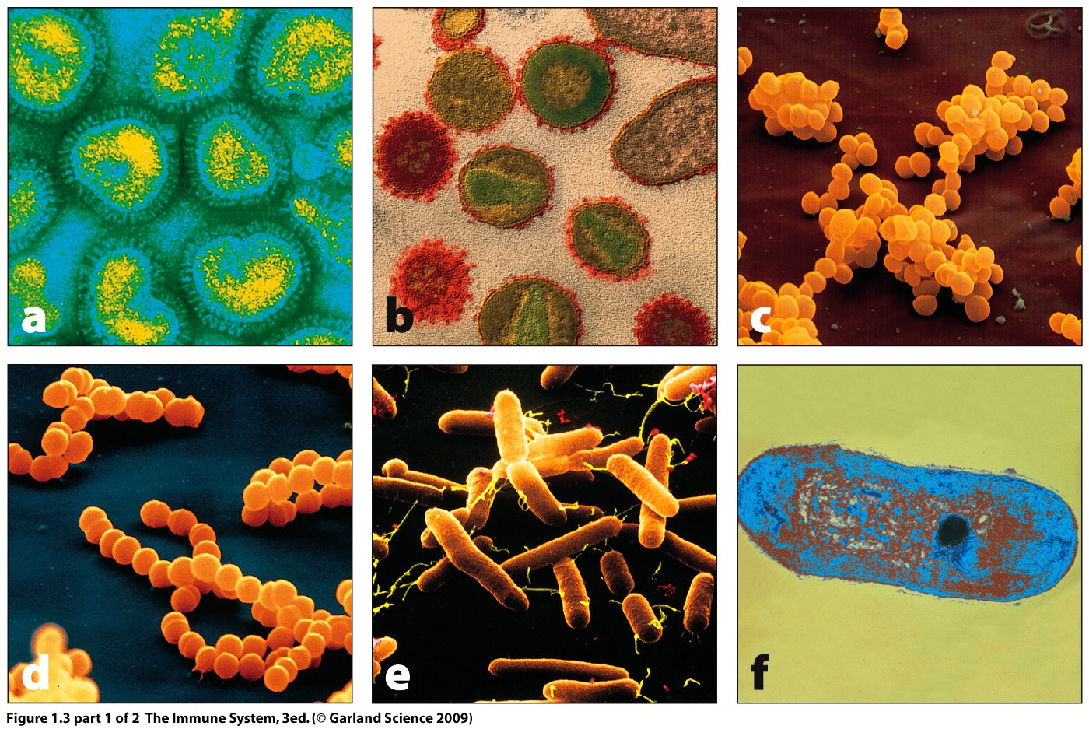
HIV Influenza S. aureus
Strep. pyogenes Salmonella M. tuberculosis

Slide 8
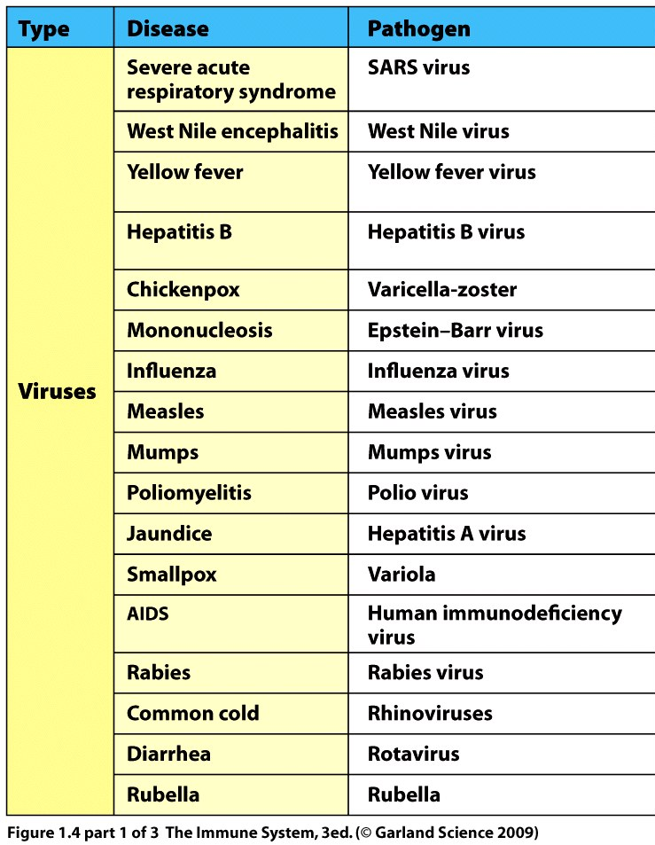
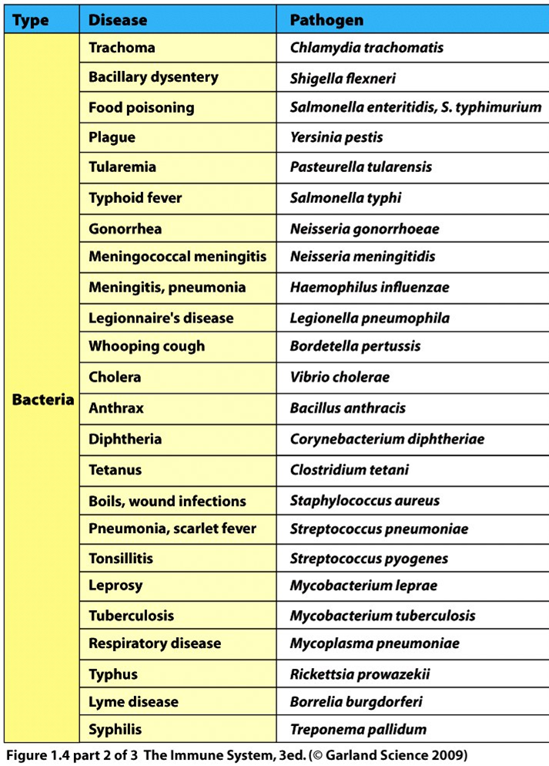

Slide 9
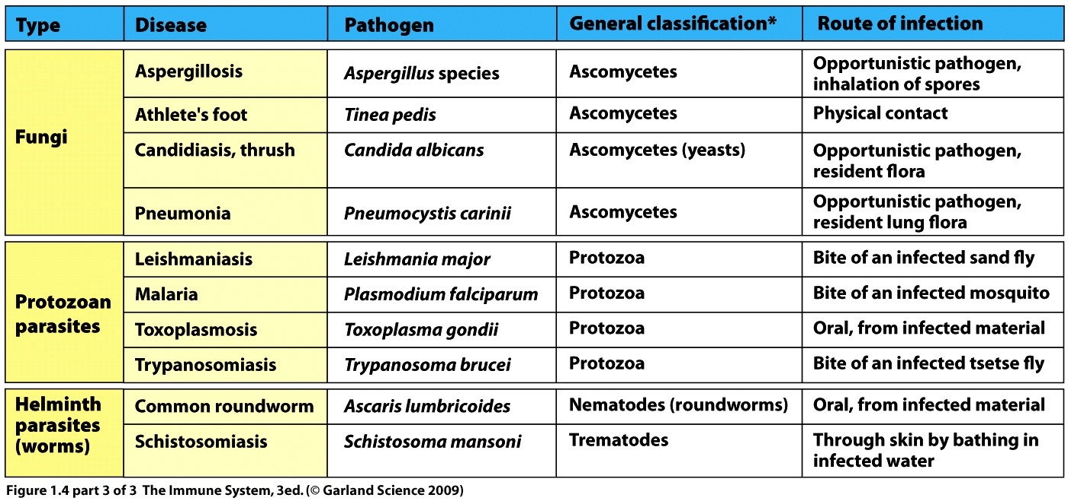

Slide 10
Anatomical barrier against infection – skin
Keratinized cells are physically tough and form the outer epithelium.
Epithelial cells cover all outer surfaces and line inner cavities.
Skin breached by wounds, surgery, burns - leaves soft tissue open to infection.
Death in surgery historically due to introduction of pathogens.

Slide 11
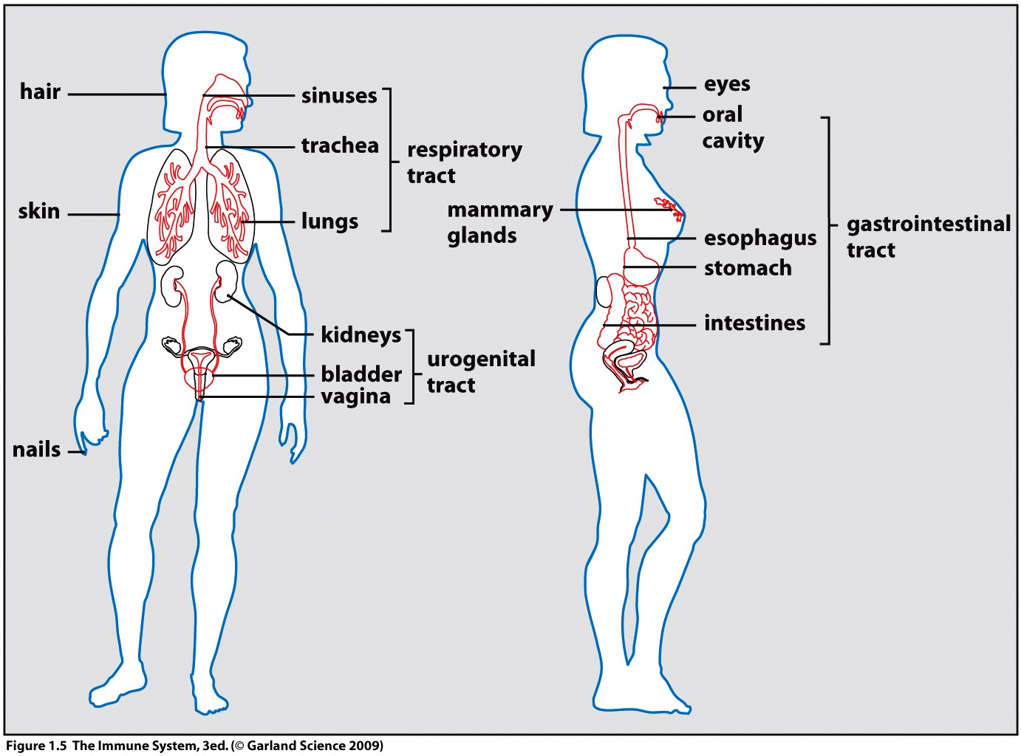
Skin is continuous with respiratory, gastrointestinal and urogenital tracts.

Slide 12
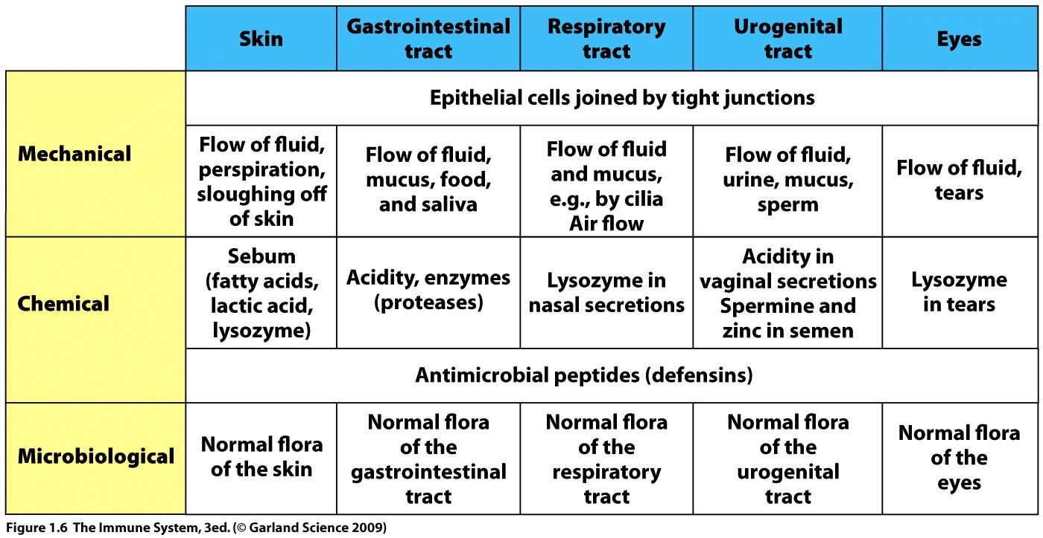

Slide 13
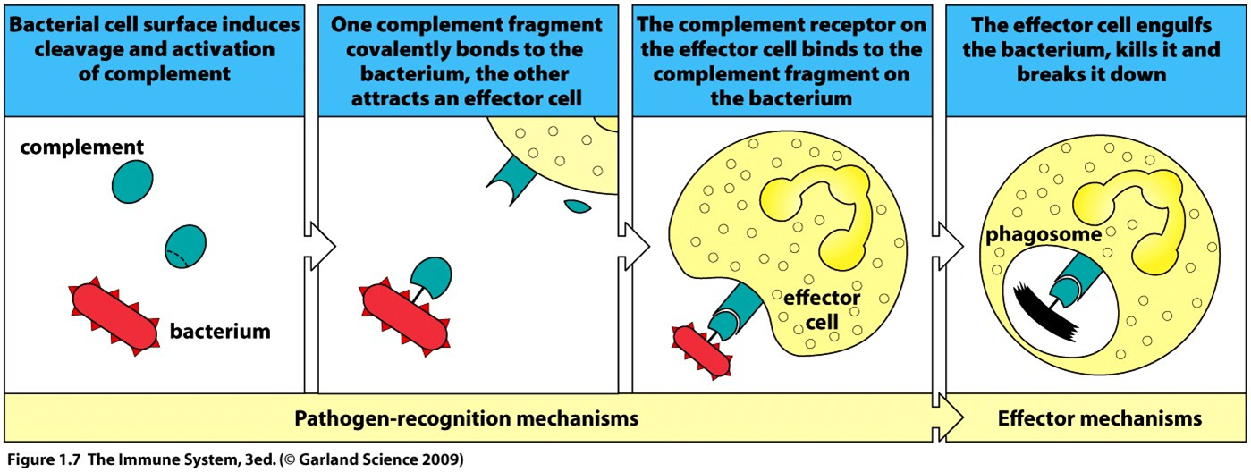
The innate response acts upon most infections to localize and eliminate them without symptoms developing
The innate system first recognizes a pathogen is present using receptor proteins then eliminates it by recruitment of effector cells (phagocytes) and activation of complement.

Slide 14
The innate system can also be triggered by secreted proteins (cytokines) sent out by infected and damaged cells.
Inflammation is thus induced.
ACUTE INFLAMMATION 2009 – YouTube
Heat, pain, redness and swelling all result from the action of the innate response.
Heat and redness result from increased blood flow, pain and swelling due to the influx of immune cells.

Slide 15
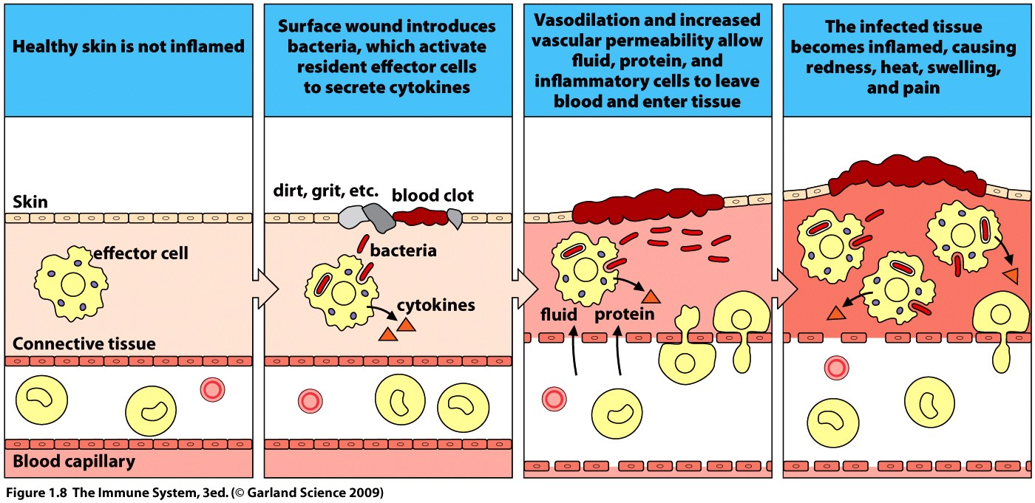
The immune system acts in a cascade – one event triggers the next leading to amplification of the response.

Slide 16
The innate response removes the majority of pathogens from the host
If the innate can only slow the progress of an infection but not clear it the adaptive response will be triggered
Adaptive response involves the actions of lymphocytes
The adaptive arm of the immune system adds power and specificity to the attack on the pathogen

Slide 17
The adaptive response is specific to the individual pathogen and will not usually cross react with a second infection.
Cell surface receptors of the innate and adaptive arms vary.
Innate has varied receptors which bind common features in multiple pathogens.
Adaptive has a single molecular receptor type which recognizes a specific pathogen.
An infinite number of different adaptive receptors can theoretically be produced by cutting and splicing the transcripts from a group of receptor genes.

Slide 18
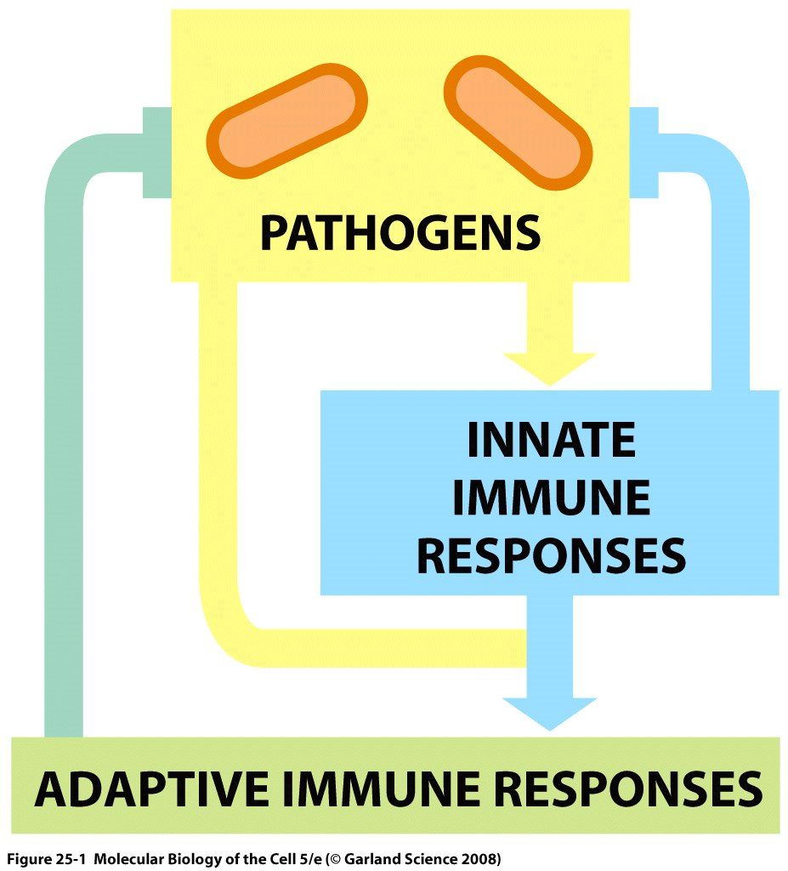
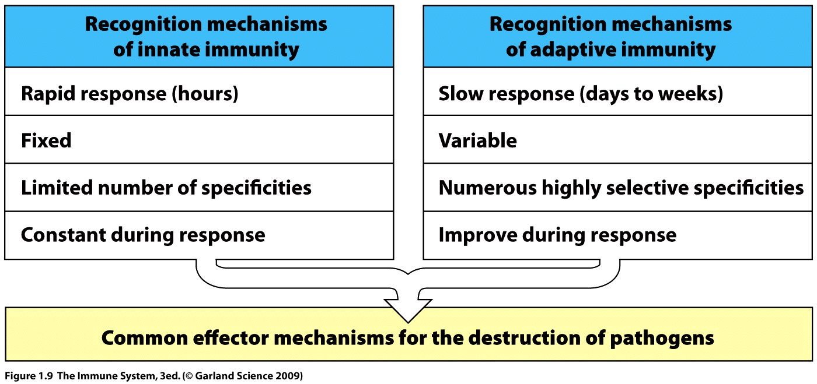

Slide 19
Infection will select for only the lymphocytes which bear the receptor which recognizes the pathogen.
Selected lymphocytes proliferate and differentiate to amplify the adaptive response.
Clonal selection
Clonal expansion
The selection and expansion of the lymphocyte population takes time and results in a lag between the innate and adaptive responses which we experience as symptoms of disease.

Slide 20
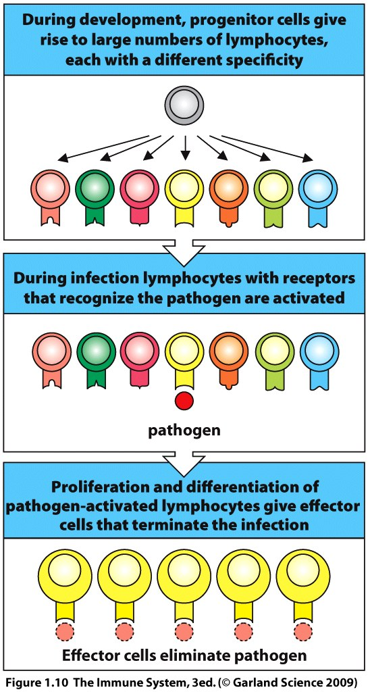

Slide 21
Some cells from the pool of expanded lymphocytes will differentiate to form memory cells which can respond rapidly and more strongly if the host is re-exposed.
Remember memory only works if the pathogen fails to adapt.
Primary response = first exposure
Secondary response = all subsequent exposures

Slide 22
Vaccination mimics first exposure and stimulates a primary response which leads to development of memory
Poor stimulation of the primary response may not result in adequate development of memory.
Memory can fade.
Booster may be required to re-establish memory.

Slide 23
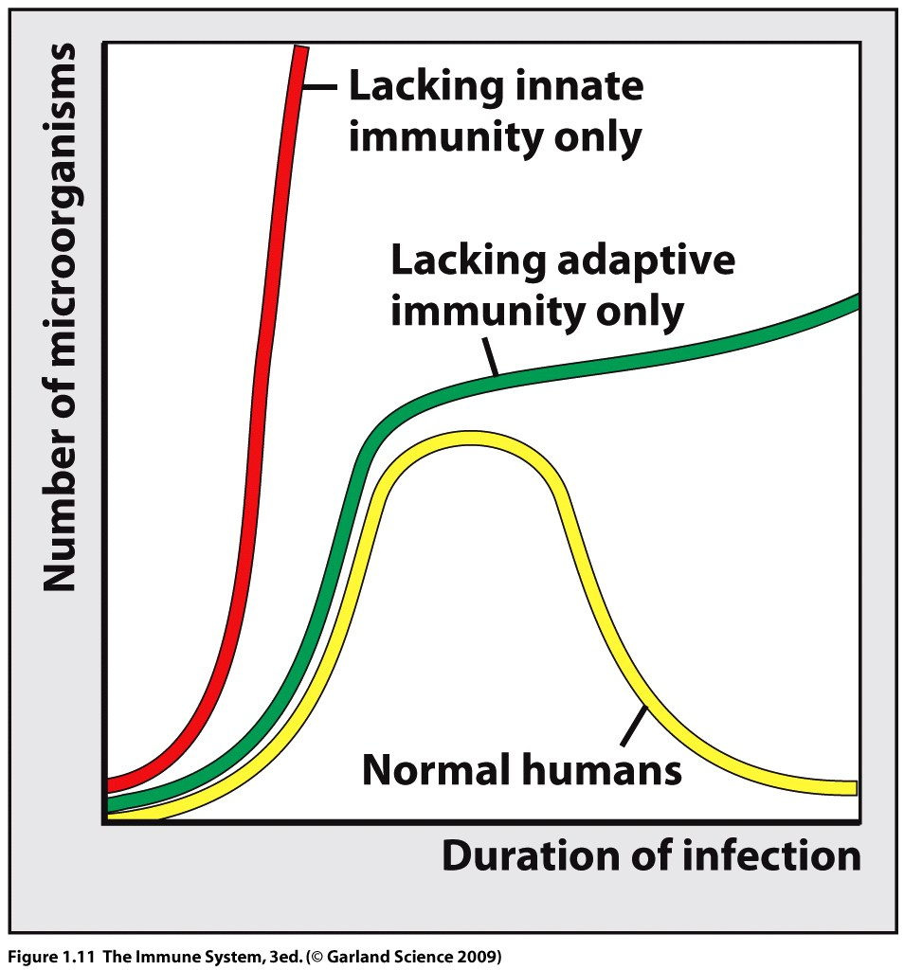
A lack of innate immunity will have serious consequences.
Genetic mutations which disrupt the innate system are not well tolerated

Slide 24
Leukocytes are white blood cells.
Cells of the immune system are generated continually through life – hematopoiesis.
All cells (leukocytes, erythrocytes and megakaryocytes) arise from pluripotent hematopoietic stem cell which are self renewing though cellular division.
Hematopoiesis starts in the fetal liver moves to the fetal spleen and finally moves to the bone marrow where it continues throughout life.
All blood cells are short lived and must be continually generated.

Slide 25
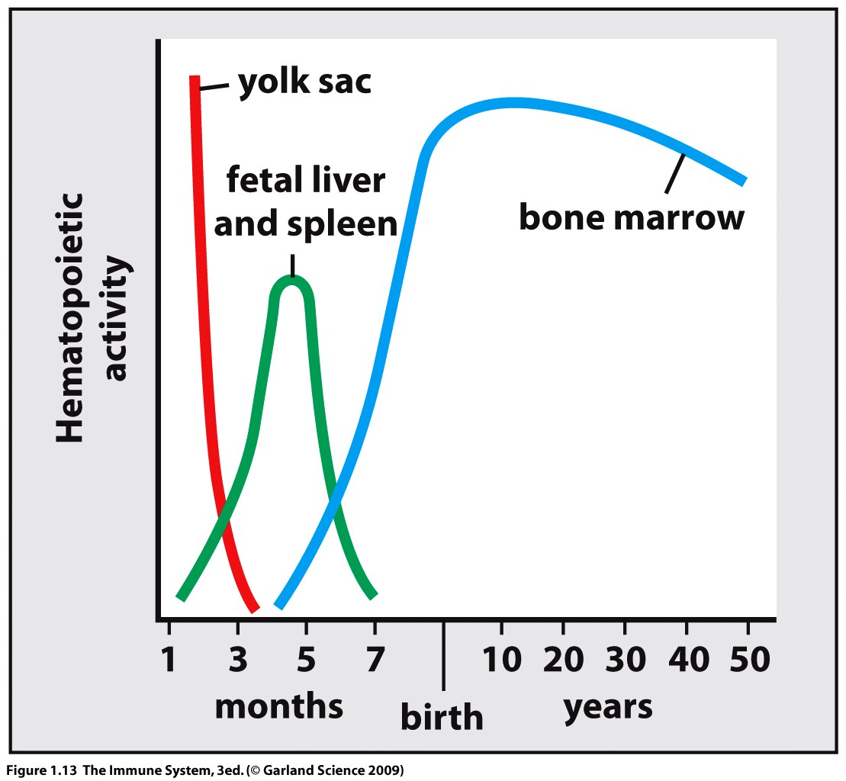

Slide 26
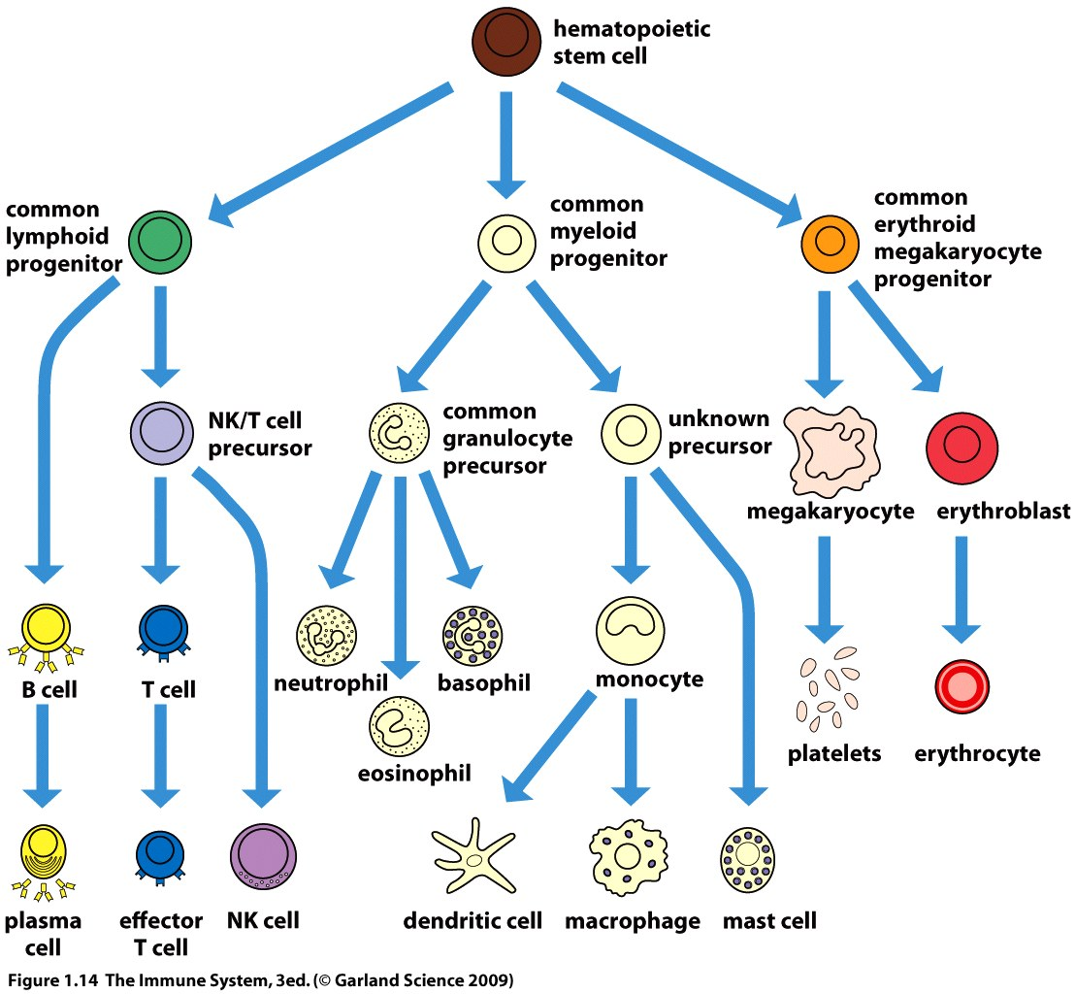
ADAPTIVE
INNATE

Slide 27
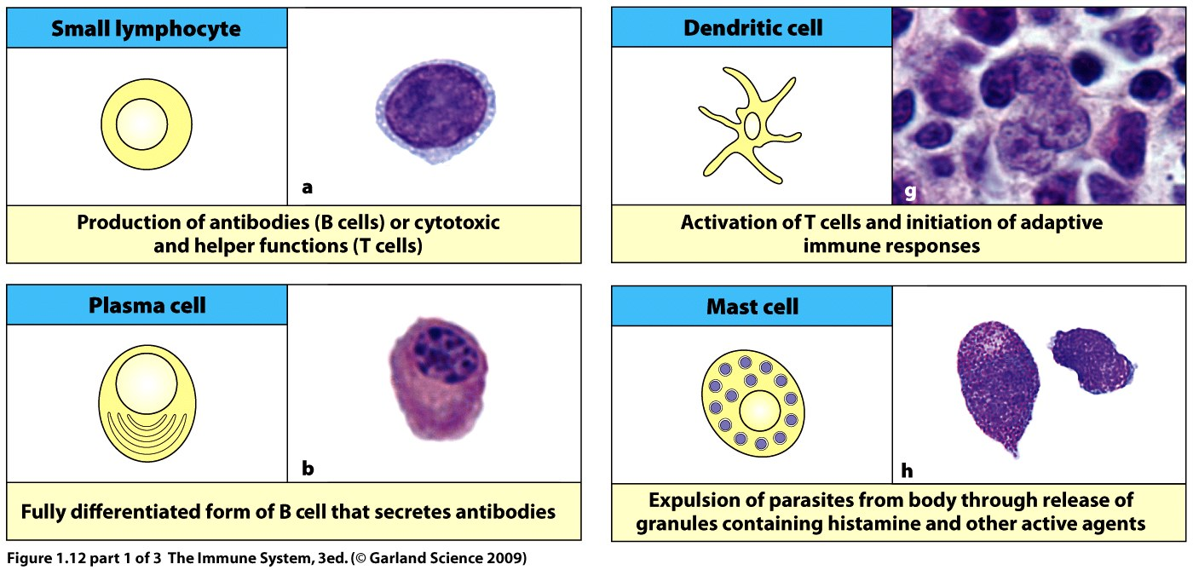

Slide 28
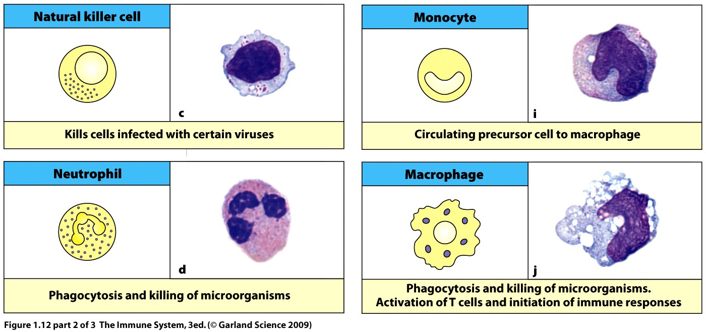

Slide 29
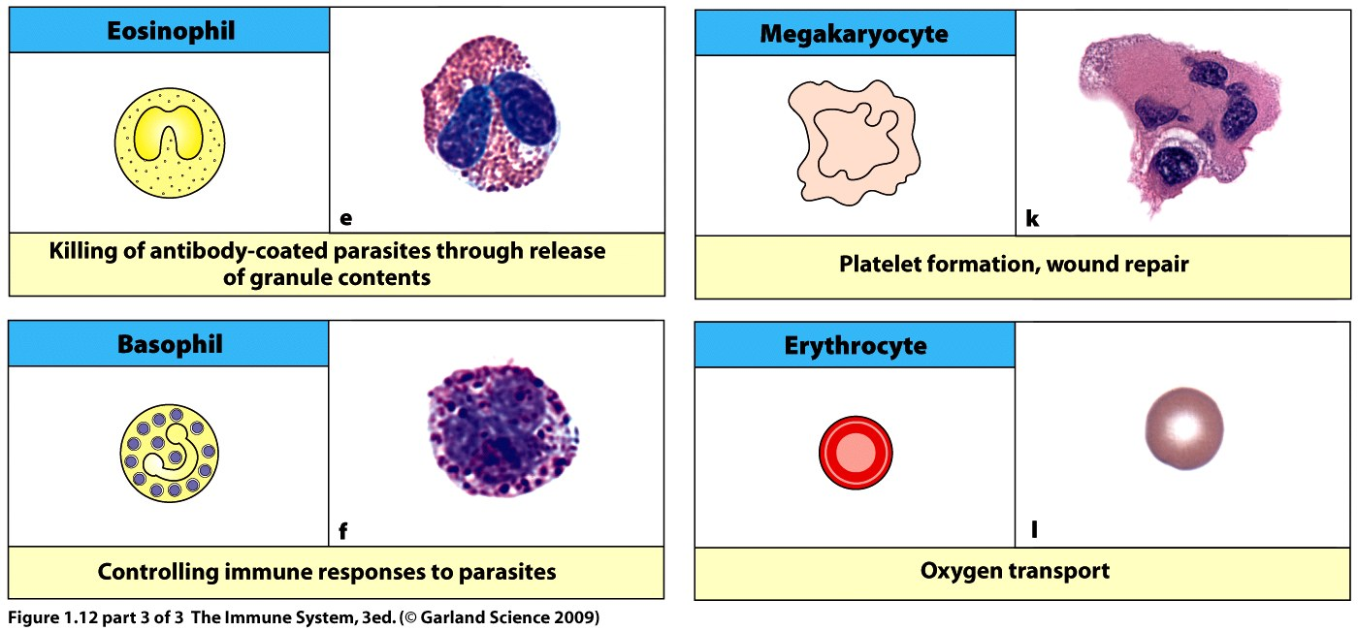

Slide 30
MYLOID LEUKOCYTES
Granulocytes contain reactive molecules and enzymes used to directly kill pathogens.
Alt. name PMN or polymorphonuclear leukocyte(s).
3 types:
Neutrophils – phagocytic granulocytes, first and most abundant responder in innate system, short lived, die and form puss.
Eosinophil – intestinal parasites
Basophils – parasites

Slide 31
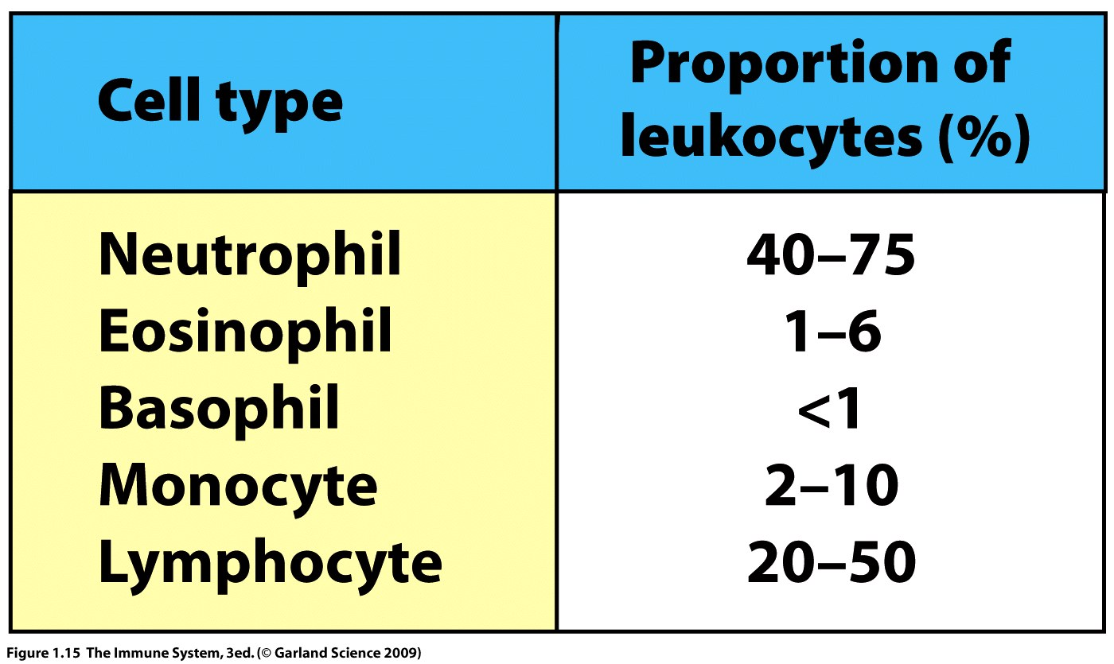

Slide 32
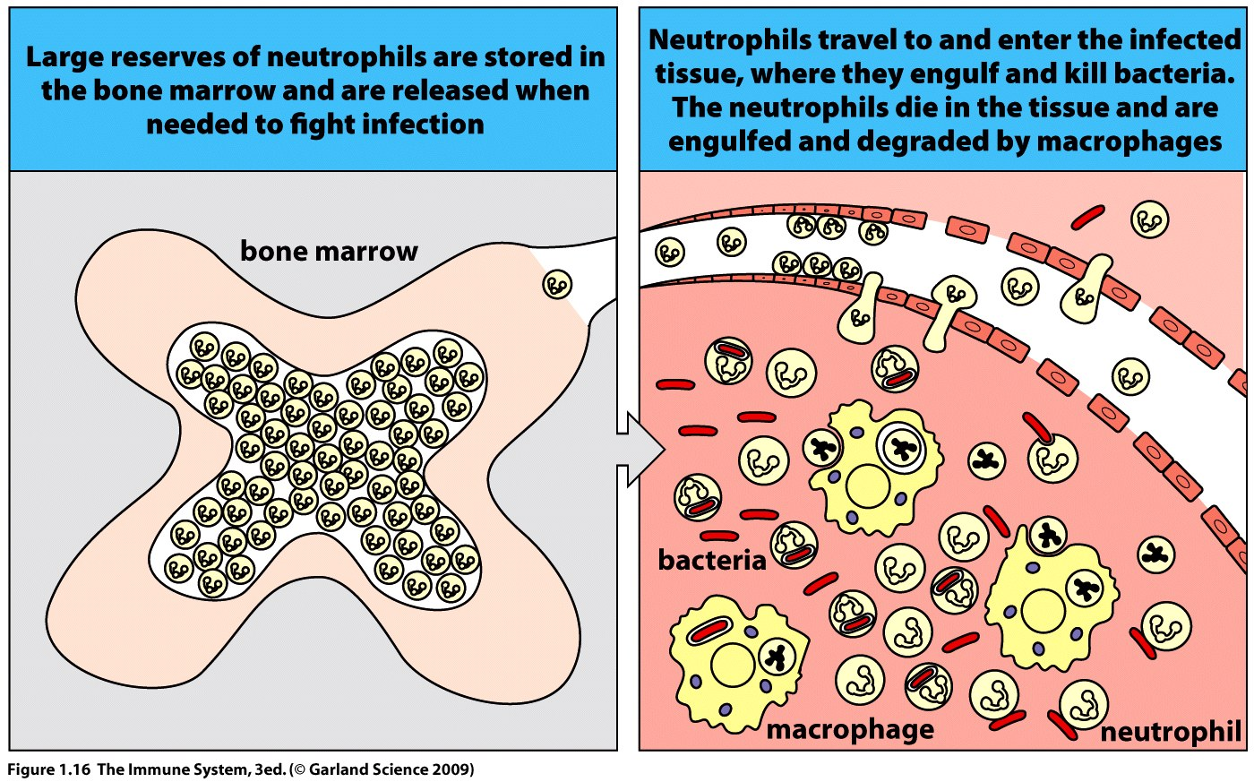

Slide 33
Monocytes, macrophages and dendritic cells.
Bigger than granulocytes.
Monocytes circulate in the blood and differentiate into macrophages when they enter tissue.
Macrophages phagocytose pathogens, dead cells and debris and are relatively long lived.
Macrophages are a first alert cell which secretes cytokines and chemokines to recruit other cells such as PMNs.

Slide 34
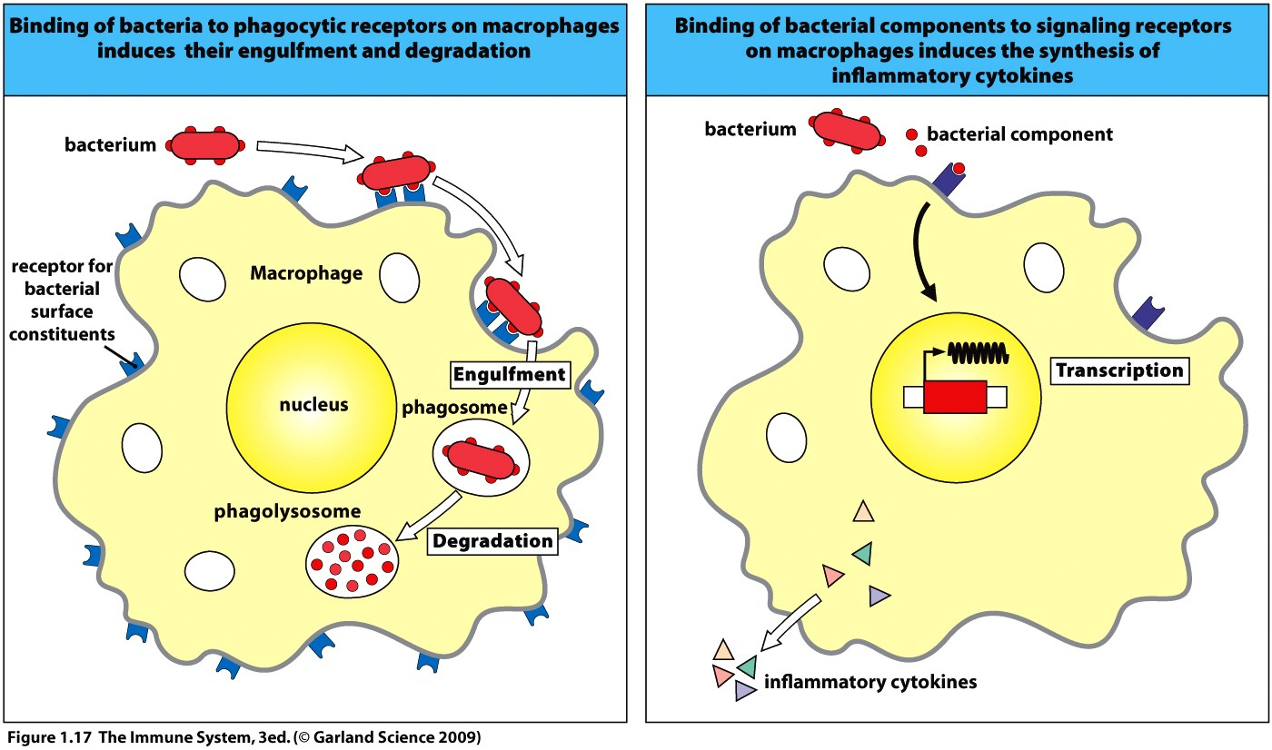

Slide 35
Dendritic cells sit in the tissue to survey for pathogens, once found these cells move to the lymphatics to alert the cells of the adaptive system – antigen presenting cell (APC).
Mast cells, resident in all connective tissue contribute to inflammation when activated.
Associated with allergic response.

Slide 36
LYMPHOID LYMPHOCYTES
Large granular lymphocyte = Natural killer cells are part of innate system, involved in viral defense, secrete cytokines and interferons.
Small lymphocytes = B and T cells adaptive response.
B cells have a surface immunoglobulin receptor while T cells have T cell receptor.
Both types of receptor are structurally similar and each cell expresses only one type of receptor which permits antigen specificity.
Each human contains a population of T and B cells with many millions of different receptors.

Slide 37
Cytotoxic T cells (CD8) kill viruses and bacteria which replicate inside human cells – over lap in function with NK cell.
T helper cells (CD4) secrete cytokines which activate other cells of the immune system e.g. B cell to plasma cell. Subsets of T-helper cells—
Th1 – these T-cells recognize antigen processed by mononuclear phagocytes that release cytokines that activate monocytes and macrophages.
Th2 – these T-cells release the required cytokines that initiate B-cell development and differentiation into plasma cells (antibody secreting cells).
Th17 – these T-cells promote initial inflammatory responses by acting on neutrophils.

Slide 38
Lymphoid tissues and organs.
Organs: Bone marrow, thymus, adenoids, tonsils, appendix, lymph nodes and peyers patches.
Tissues line respiratory, gastrointestinal and urogenital tracts.

Slide 39
Primary/central lymphoid tissues.
Here lymphocytes develop and mature.
T and B cells arise in bone marrow where B cells also mature.
Immature T cells migrate from the bone marrow via the blood to the thymus for maturation.

Slide 40
ALL OTHER LYMPHOID TISSUE IS KNOWN AS SECONDARY or PERIPHERAL LYMPHOID TISSUE
These are the sites where mature lymphocytes sit waiting to be stimulated by antigen from a pathogen.
A key site for T and B cell interaction with the antigen is the lymph node.
Lymph nodes lie at junctions of the lymphatics.
Lymphatics originate in the connective tissue and form a net-work of branching and reconnecting vessels throughout the body.

Slide 41
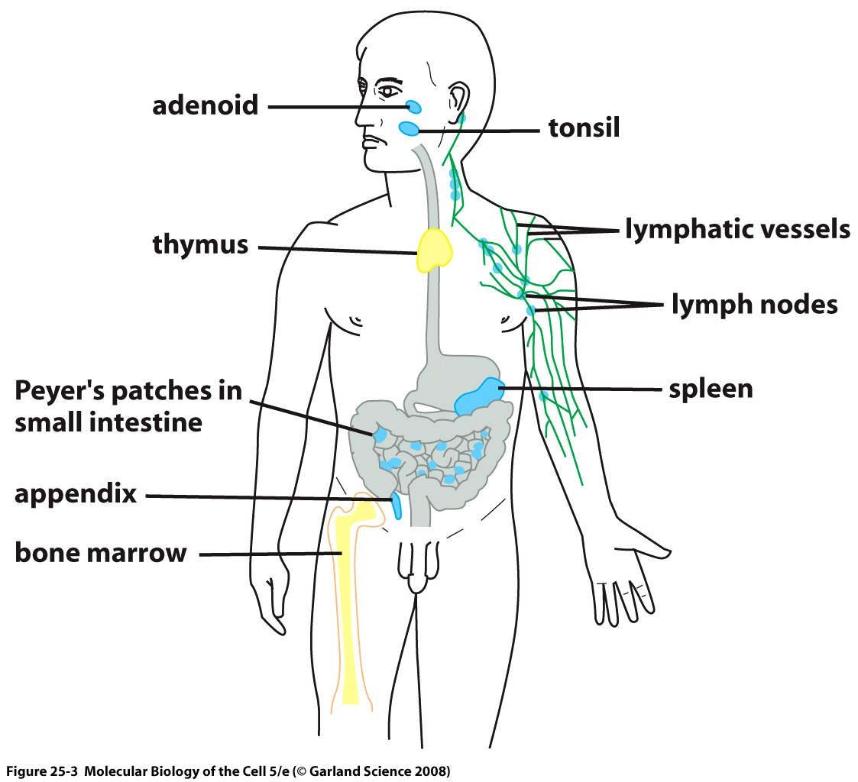
Primary Lymphoid Tissue
Secondary
Lymphoid Tissue

Slide 42
Lymphatics collect lymph fluid which leaks from the blood and forms extracellular fluid.
Lymph is not pumped but flows slowly through valves which maintain the direction of flow back to the thoracic duct where it returns to the blood.
If you stop moving for an extended period lymph will pool to form edema.

Slide 43
Innate cells may enter the lymph nodes but usually circulate only in the blood.
T and B cells circulate in both the blood and lymph.
T and B lymphocytes enter lymph nodes and tissue through small blood capillaries.
If the lymphocyte is activated it remains in the node if not it will return to circulate in the lymphatics then re-enter the blood.
This system ensures that the population of lymphocytes in the node is continually changing.
Lymphatic recirculation permits continual survey for infection.
Exception – spleen in and out via the blood.

Slide 44
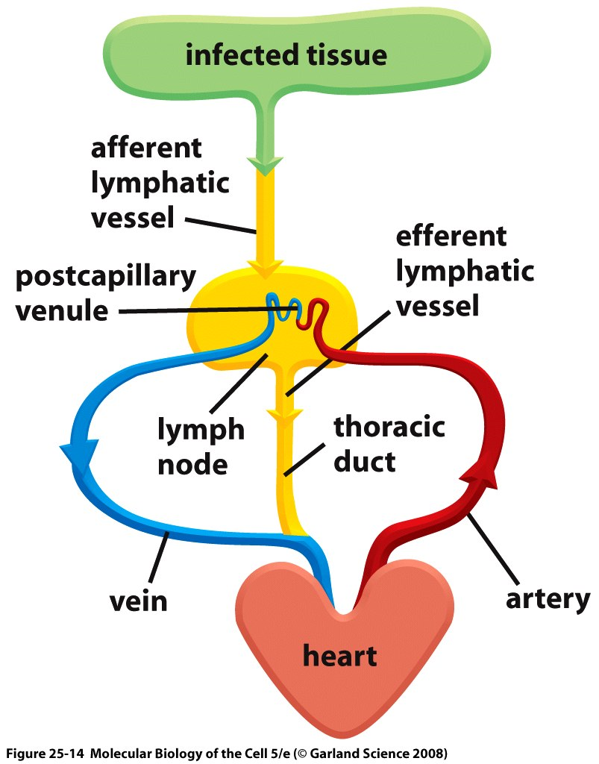

Slide 45
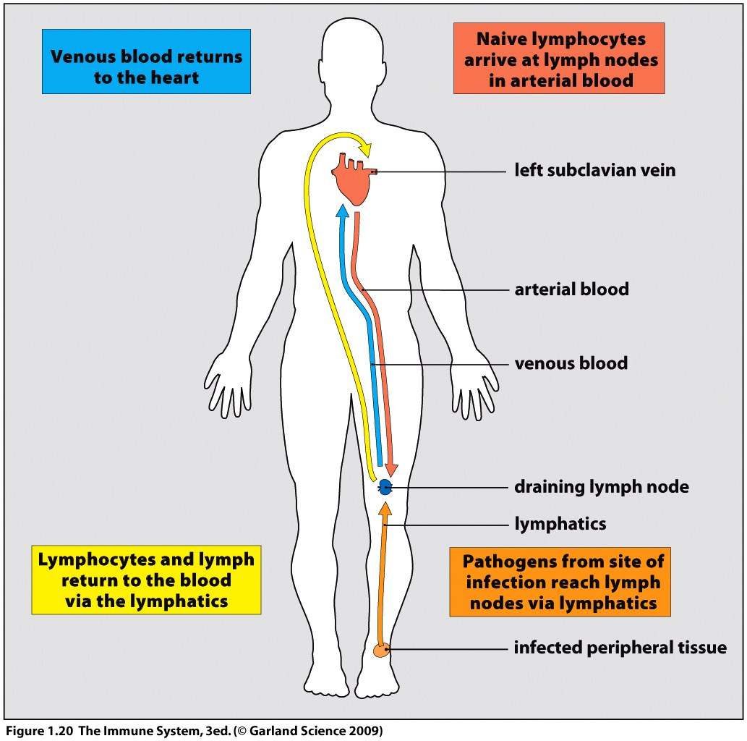

Slide 46
Draining lymph node receives innate cells carrying pathogens and debris from an infection in the tissues.
The lymph node structure provides sites where lymphocytes may interact with the antigens from the pathogen.
T and B cells remain separated in the node with B cells confined to the lymphoid follicles.
The macrophages within the node filter out pathogens from the lymph and dendritic APC cells migrate from site of infection to settle in the node.
Antigen is then surveyed by the lymphocytes.

Slide 47
Upon activation a pathogen specific B cell will form a germinal center in the follicle where the B cells proliferate and differentiate to become effector cells – swollen glands.
Activated T cells may enter the B cell follicle to help stimulate the B cell to become plasma cells.
Other effector T cells and antibody leave the node in the efferent lymph vessel and enter the blood to circulate to the site of infection.
At infection site the innate and adaptive cells interact to clear the infection and repair tissue.

Slide 48
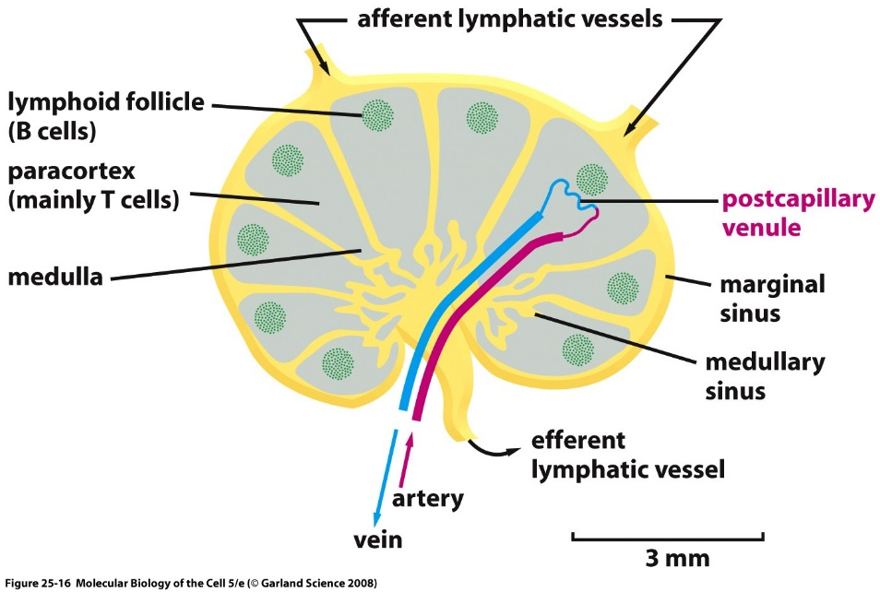
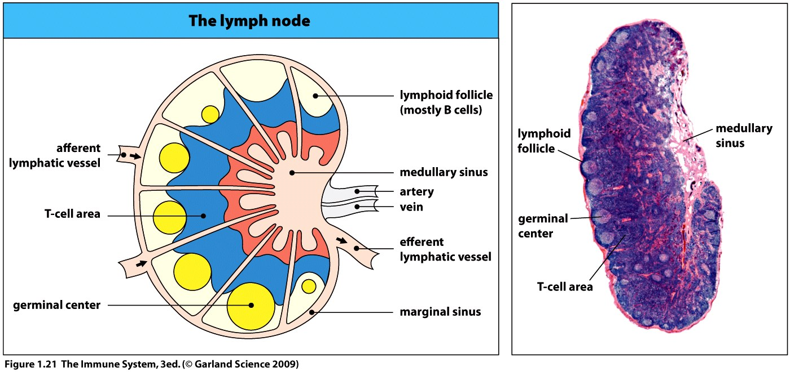

Slide 49
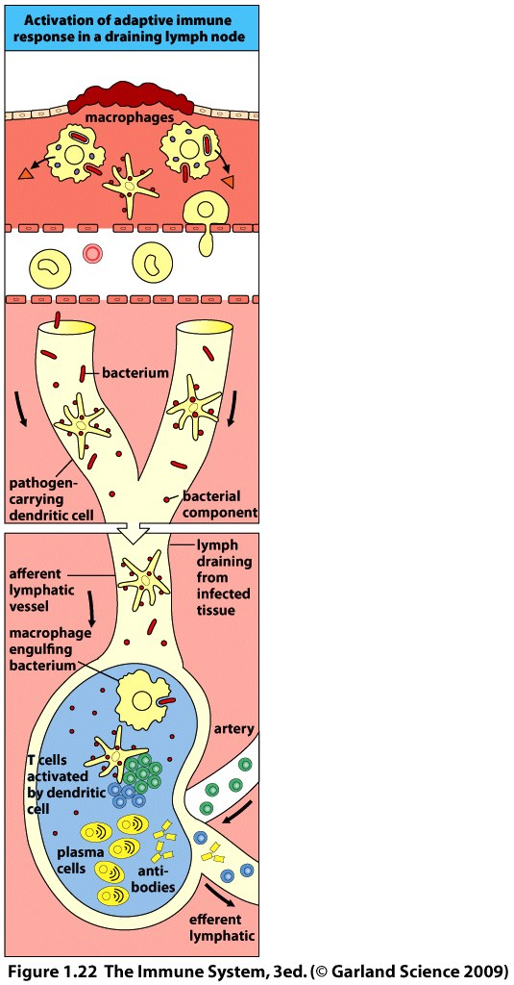
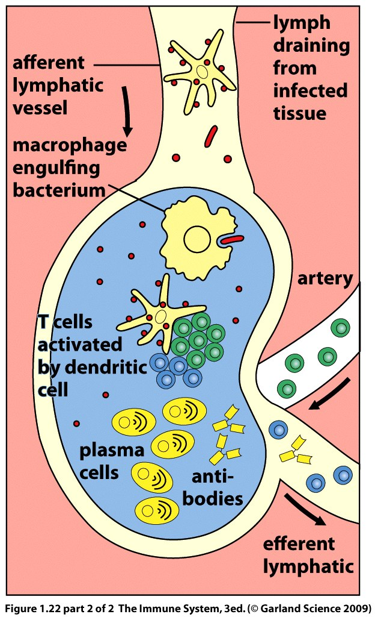

Slide 50
The spleen filters pathogens from the blood that have entered directly or failed to be captured by the lymph node.
The red pulp of the spleen removes dead red blood, the white pulp acts like a lymph node bringing lymphocytes into contact with a pathogen to permit stimulation.
Loss or absence of a spleen makes an individual more susceptible to certain bacterial infections.

Slide 51
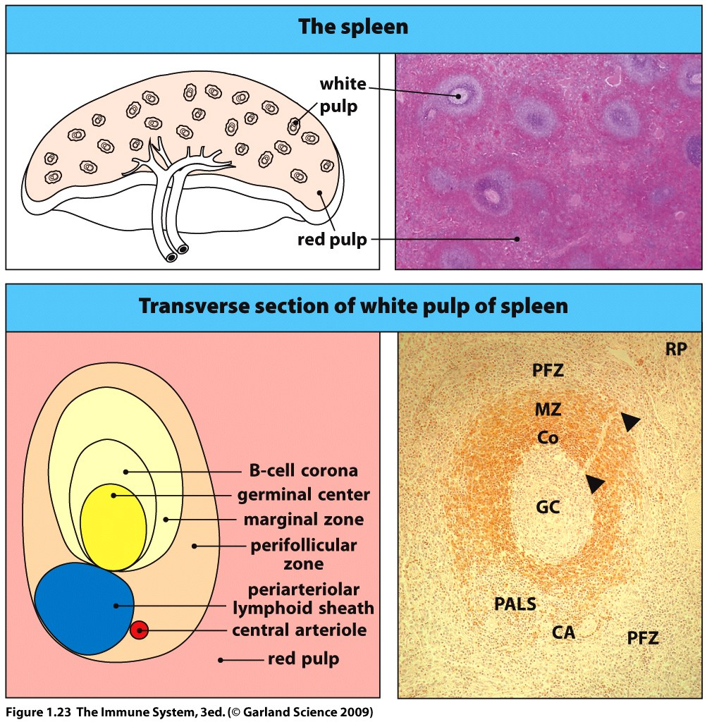
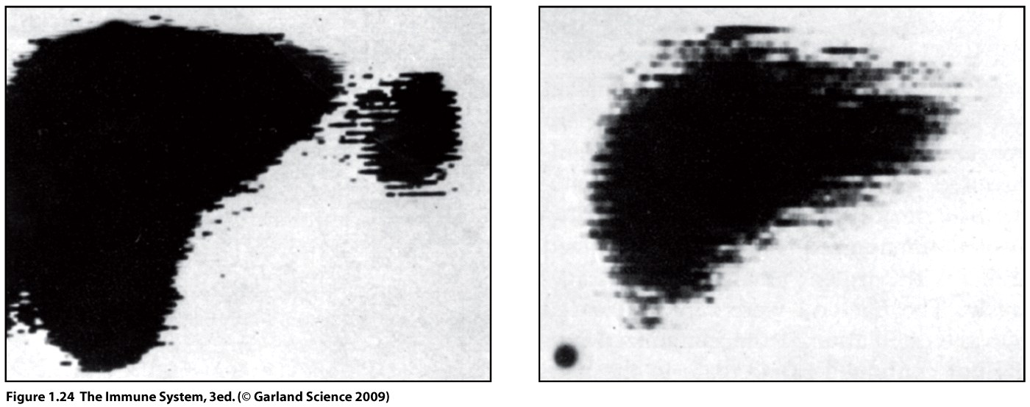

Slide 52
The majority of microbes interact with the body at a mucosal surface.
LOCATION LOCATION LOCATION
The gut, respiratory and urogenital mucosa are thus, under constant pressure as secondary lymphoid tissue.
GALT = gut associated lymphoid tissue, tonsils, adenoids, appendix and peyers patches (line small intestine).
BALT = bronchial associated lymphoid tissue, line respiratory epithelium.
MALT = mucosal associated lymphoid tissue, more diffuse tissue.
NALT = nasopharyngeal-associated lymphoid tissue, upper respiratory tract.

Slide 53
Similar structure and function to lymph node – trap pathogens and expose/activate lymphocytes.
Pathogens cross the mucosal epithelium directly through M cells not via lymph.
Lymphocytes enter mucosa from the blood and leave via lymphatics.
Upon activation lymphocytes can directly enter the mucosal tissue as effector cells.

Slide 55
Remember, it takes time for the adaptive response to mount a defense against a pathogen and this is the period when the microbe is advancing infection and you experience disease.
A consequence of clonal expansion during the adaptive response is the production of memory cells.
A secondary immune response is faster and more aggressive – symptoms of disease do not usually have time to arise.
Secondary responses are highly specific.
This is what makes vaccination possible.

Slide 56
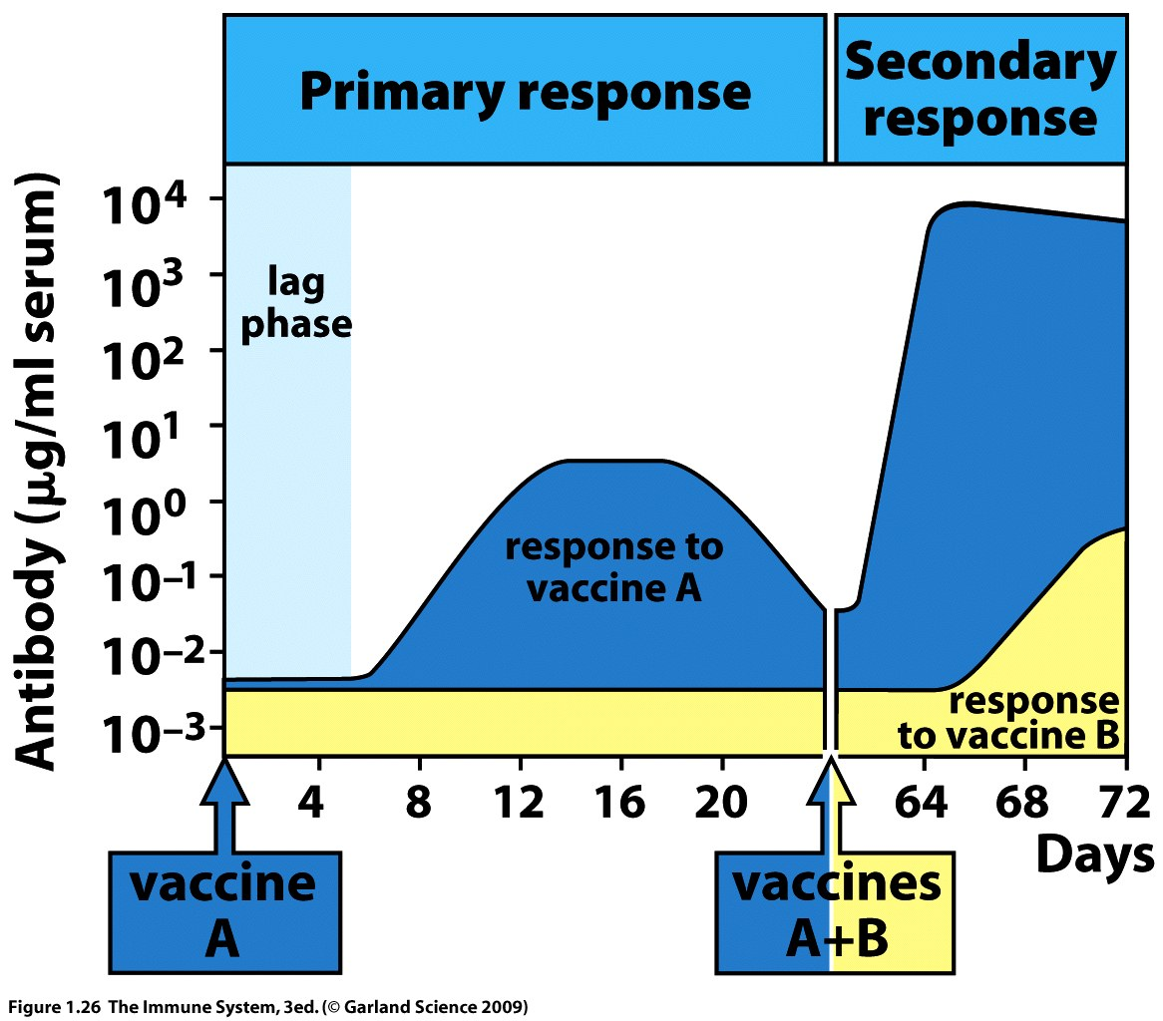

Slide 57
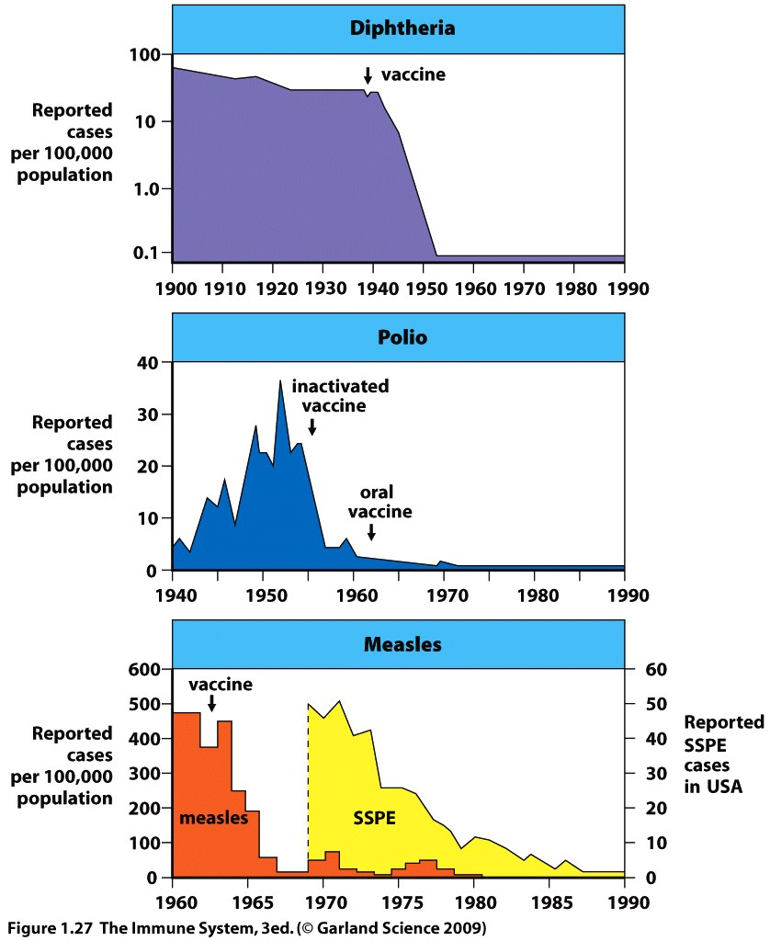
Importance of herd immunity
Sub-acute sclerosing panencephalitis due to viral mutation.

Slide 58
Defects in the immune system may be inherited, spontaneous mutations or acquired through infection, e.g. HIV.
Bone marrow transplantation may offer a cure but is an aggressive treatment.
HIV infects T helper cells and disrupts the adaptive immune response. Patients with AIDS become increasingly susceptible to infection by pathogens and opportunistic microbes over the years that they have the syndrome.
33 million cases of HIV world wide.

Slide 59
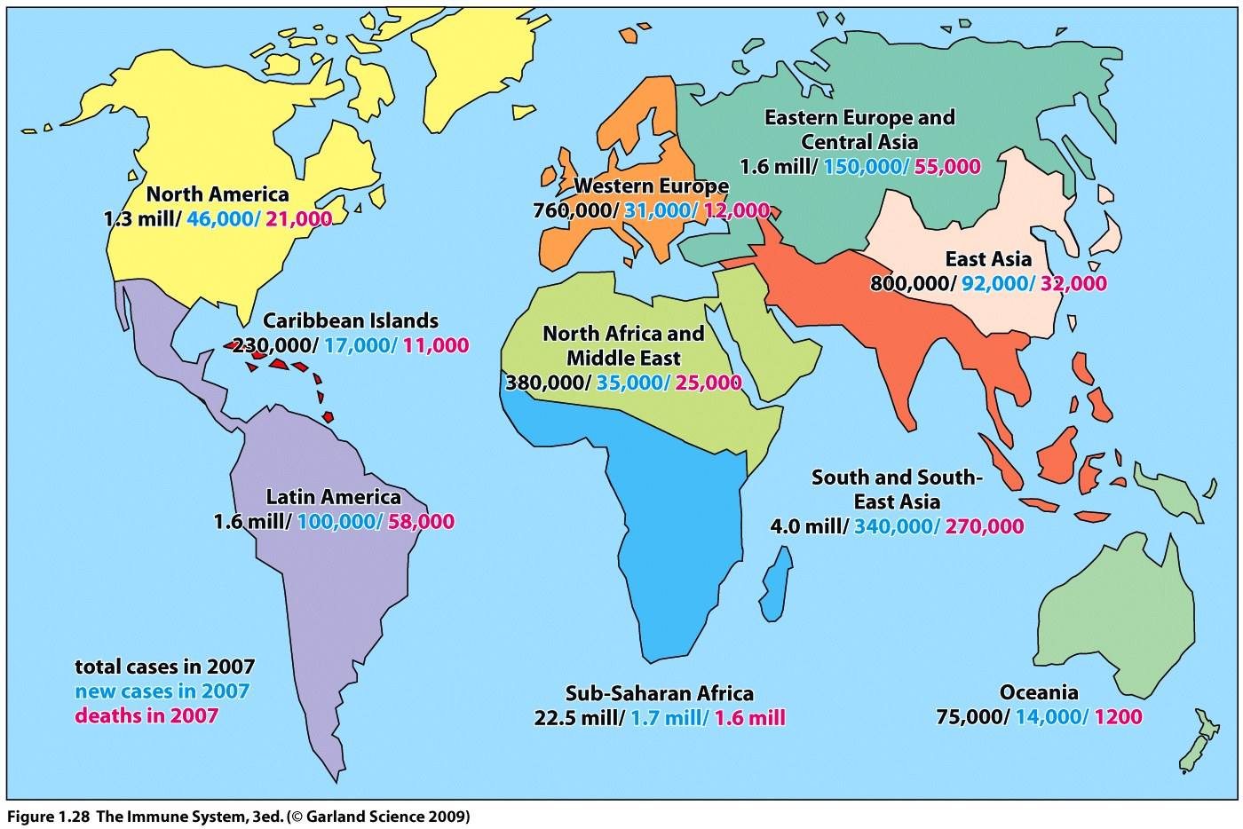

Slide 60
Neutrophil chasing bacteria
Crawling Neutrophil Chasing a Bacterium - YouTube

Slide 61
Blood cell bakery
Blood Cell Bakery--Introduction - YouTube

