Slide 1
Part I
Introduction to Immunity and the Immune System

Slide 2
Chapter Overview
Immunity and immunization
Innate versus adaptive immunity
Cells of the innate and adaptive immune systems
Organs of the immune system

Slide 3
Immunology
Antigens
Foreign substances that induce a host response
All around us in nature
Immunity
Condition of being resistant to infection
Attenuation
Making a pathogen less virulent
Takes place through heat, aging, or chemical means

Slide 4
Innate Immunity
Also known as natural immunity
The ability to resist infection by means of normally present body functions
Considered nonadaptive or nonspecific; responses are the same for all pathogens or foreign substances to which one is exposed

Slide 5
Adaptive Immunity
A type of resistance characterized by specificity for each individual pathogen, or microbial agent, and the ability to remember a prior exposure

Slide 6
Cells of the Innate Immune System
Leukocytes (white blood cells [WBCs])
Found in peripheral blood
Play a key role in both innate and adaptive immunity
Types
Neutrophils
Eosinophils
Basophils
Monocytes
Lymphocytes
Notes:
Neutrophils represent approximately 50% to 75% of the total peripheral WBCs in adults.
The main function of neutrophils is phagocytosis, resulting in the destruction of foreign particles
Eosinophils are approximately 12 to 15 μm in diameter and normally make up between 1% and 3% of the circulating WBCs in a nonallergic person. Their number increases in an allergic reaction or in response to certain parasitic infections.
Basophils are the least numerous of WBCs found in peripheral blood, representing less than 1% of all circulating WBCs.
Constituents of basophils include histamine, cytokines, growth factors, and a small amount of heparin, all of which have an important function in inducing and maintaining allergic reactions.
Monocytes are the largest cells in the peripheral blood, with a diameter that can vary from 12 to 22 μm (the average is 18 μm). They then migrate to the tissues and become known as macrophages.
Lymphocytes are also involved in adaptive immunity.

Slide 7
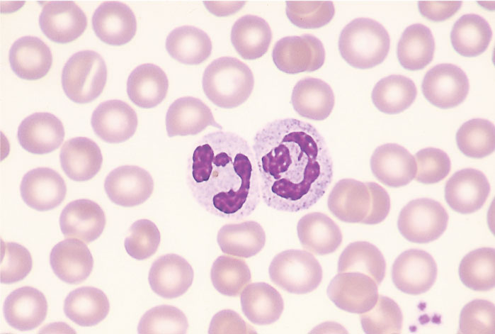
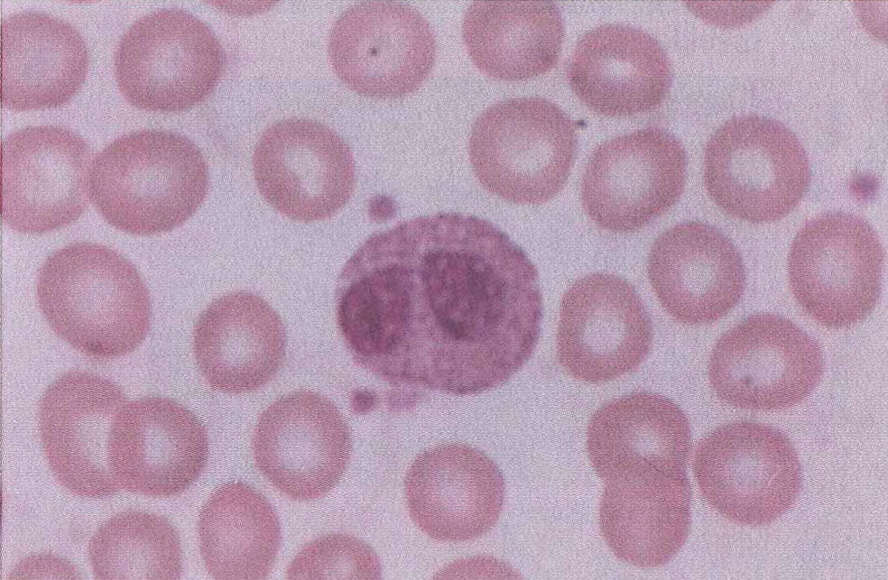
Cells of the Innate Immune System
Neutrophils
Eosinophils

Slide 8
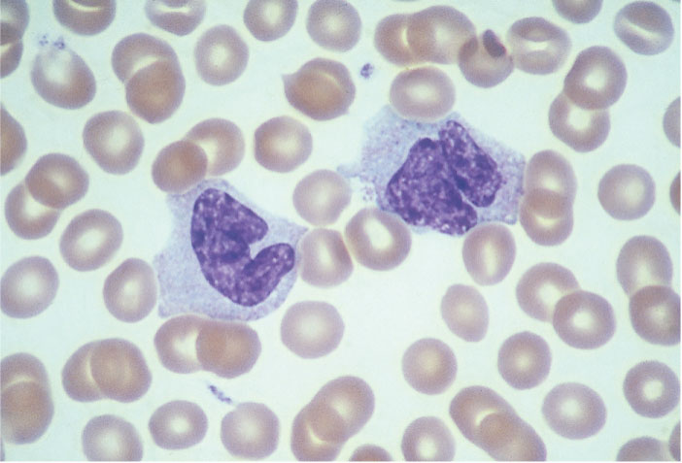
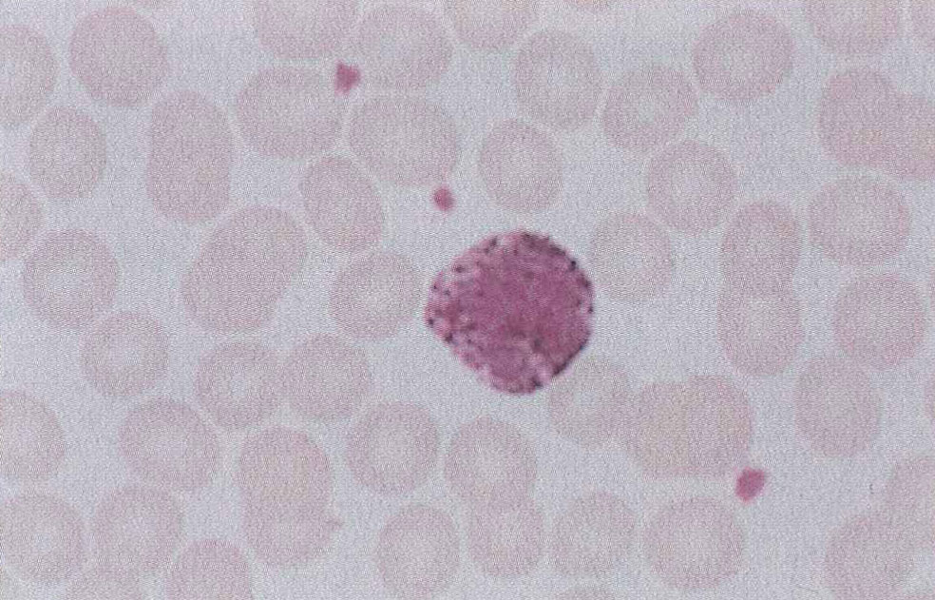
Cells of the Innate Immune System
Monocytes
Basophil

Slide 9
Cells of the Innate Immune System
Tissue cells
Macrophages
Play a role in initiating and regulating innate and adaptive immune responses
Innate immune functions
Microbial killing
Anti-tumor activity
Intracellular parasite eradication
Phagocytosis
Secretion of cell mediators

Slide 10
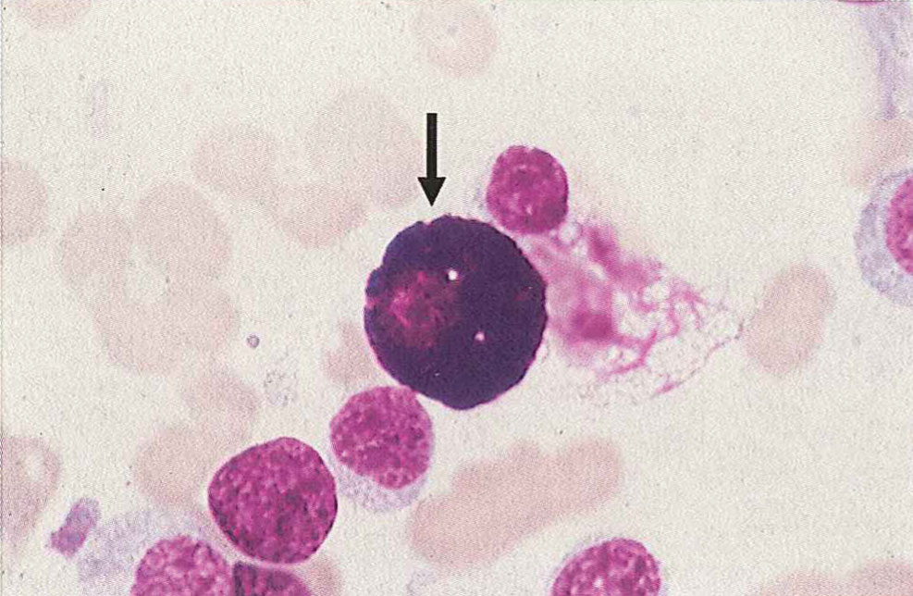
Cells of the Innate Immune System
Mast cells
Resemble basophils but come from a different lineage
Play a role in allergic reactions
Can also function as APCs
Can enhance and suppress the adaptive immune response
Notes:
APC = antigen-presenting cells.

Slide 11
Cells of the Innate Immune System
Dendritic cells
Covered with long membranous extensions that make them resemble nerve cell dendrites
Are considered the most effective APC in the body and the most potent phagocytic cell

Slide 12
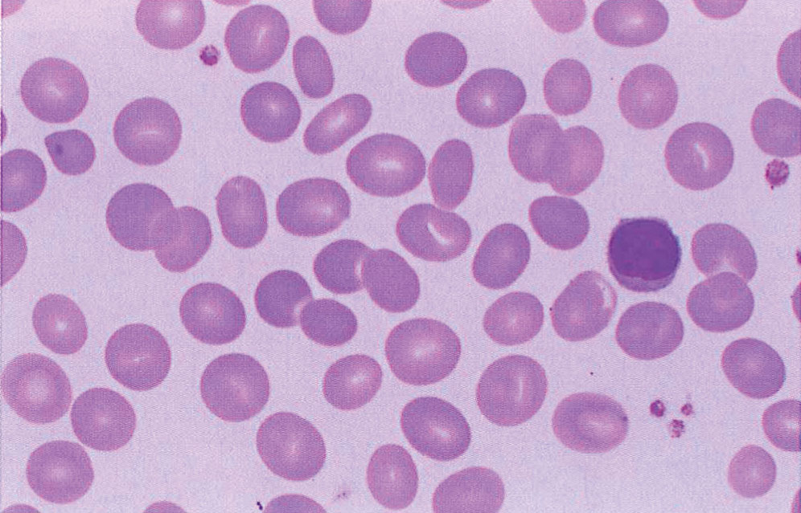
Cells of the Adaptive Immune System
Lymphocytes
Represent between 20% and 40% of the circulating WBCs
Types
B cells
T cells
Natural killer (NK) cells
Notes:
B cells are derived from a lymphoid precursor that differentiates to become either a T cell, B cell, or NK cell depending on exposure to different cytokines.
T cells express unique surface markers that allow them to recognize foreign antigens bound to cell membrane proteins called major histocompatibility complex (MHC) molecules.
NK cells have the ability to kill target cells without prior exposure to them.

Slide 13
Organs of the Immune System
Primary lymphoid organs
Bone marrow
One of the largest tissues in the body
Fills the core of all long flat bones
Main source of hematopoietic stem cells, which develop into erythrocytes, granulocytes, monocytes, platelets, and lymphocytes
Thymus
Small, flat, bilobed organ found in the thorax
Location for maturation of T lymphocytes
Notes:
T-cell maturation takes place over a 3-week period as cells filter through the thymic cortex to the medulla. Different surface antigens are expressed as T cells mature.
Two subtypes of T cells are CD4+, which are mainly helper or regulatory T cells, and CD8+, which are cytotoxic T cells.

Slide 14
Organs of the Immune System
Secondary lymphoid organs
Function as potential sites for contact with foreign antigens
Increase the probability of an immune response
Include:
Spleen
Lymph nodes
Mucosal-associated lymphoid tissue (MALT)
Cutaneous-associated lymphoid tissue (CALT)

Slide 15
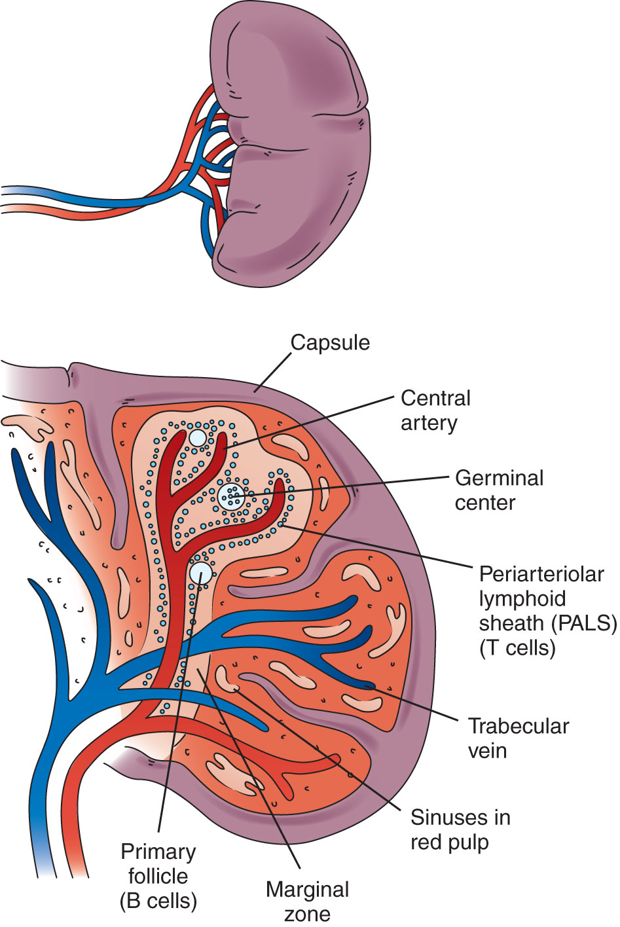
Spleen
Red pulp
Splenic tissue that makes up more than one-half of the total volume
Destroys old red blood cells (RBCs)
Notes:
Blood flows from the arterioles into the red pulp and then exits by way of the splenic vein.

Slide 16
Spleen
White pulp
Comprises about 20% of the total weight of the spleen
Contains lymphoid tissue arranged around arterioles in a periarteriolar lymphoid sheath containing T cells

Slide 17
Spleen
Primary follicles
Contain B cells not yet stimulated by antigens

Slide 18
Lymph Nodes
Central collecting points for lymph fluid
Lymphocytes and any foreign antigens enter nodes via afferent lymphatic vessels
Secondary follicles
Consist of antigen-stimulated proliferating B cells
Location where transformation of B cells takes place
Form plasma cells and memory cells when exposed to an antigen

Slide 19
MALT and CALT
MALT
Found on mucosal surfaces of the gastrointestinal, respiratory, and urogenital tracts
A main port of entry for foreign antigens
Numerous macrophages and lymphocytes present
CALT
T cells, monocytes, macrophages, and dendritic cells found on skin

Slide 20
Summary
Innate immunity is the ability of the body to resist infection through means of normally present, nonspecific body functions.
Adaptive immunity is characterized by specificity, memory, and dependence upon lymphocytes.
All blood cells arise from hematopoietic stem cells in the bone marrow.

Slide 21
Summary
The five principal types of leukocytes are neutrophils, eosinophils, basophils, monocytes, and lymphocytes.
Tissue cells involved in immunity include mast cells, dendritic cells, and macrophages.
Cells that are involved in the innate immune response and are actively phagocytic include neutrophils, monocytes, macrophages, and dendritic cells.

Slide 22
Summary
Lymphocytes are the key cells involved in the adaptive immune response.
B cells are a type of lymphocyte that develop in the bone marrow and are capable of secreting antibody when mature.
T cells acquire their specificity in the thymus and consist of two subtypes: CD4 and CD8+.

Slide 23
Summary
NK cells kill virally infected or cancerous target cells without previous exposure to them.
The bone marrow and the thymus are considered primary lymphoid organs.
Secondary lymphoid organs include the spleen, lymph nodes, MALT, and CALT.

