Slide 1
Thomas • Murphy-Johnson
Clinical Laboratory Immunology
2. Innate Immunity & Complement

Slide 2
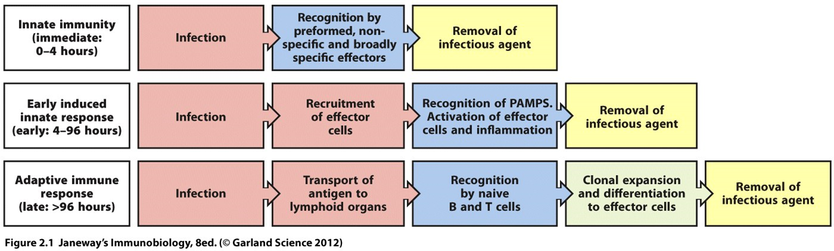
Innate is always in place.
Some mechanisms within the innate must first be triggered by the presence of a pathogen to become active and express genes which produce proteins capable of killing pathogens.
The innate system can be activated within hours of detecting a pathogen and will peak in response within 4 days.

Slide 3
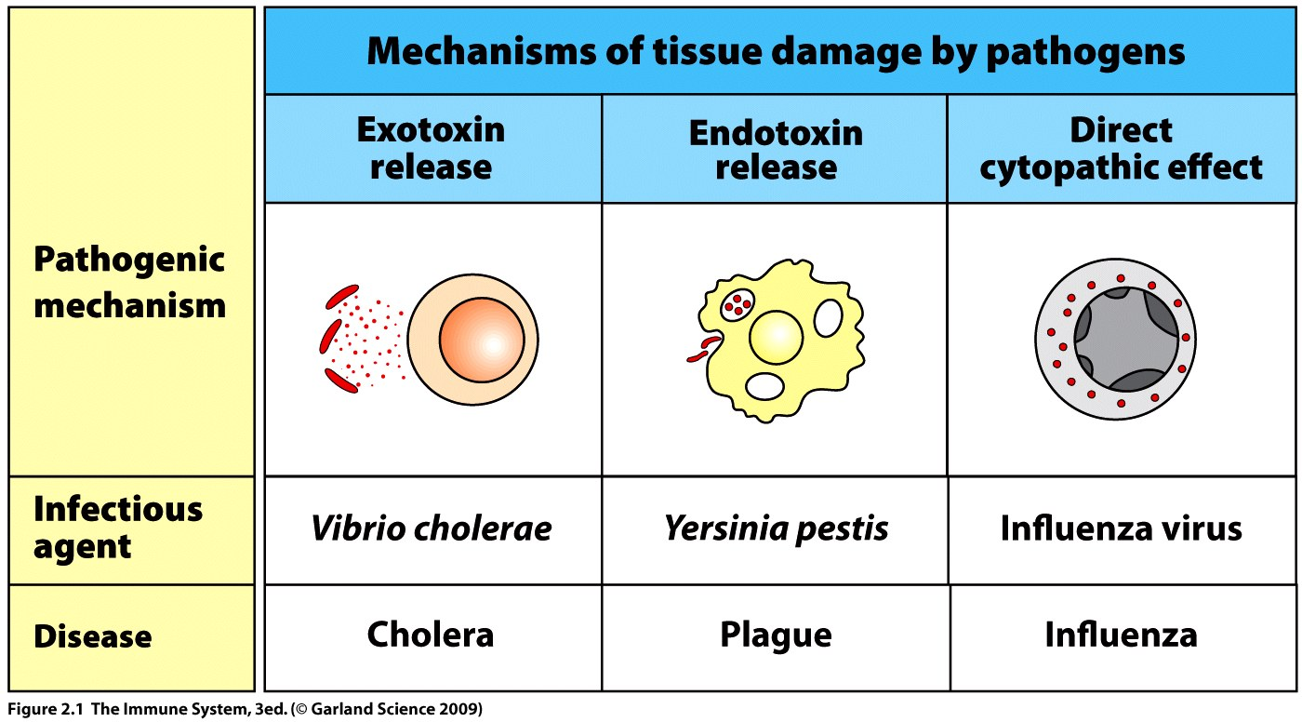
The type of infection and organism will determine the exact pathway of response by the innate system.

Slide 4
Extracellular and intracellular infections will produce a different innate response.
Most pathogens spend time in and replicate in the extracellular spaces and are exposed to soluble molecules of the innate system.
Intracellular pathogens will trigger the innate system to kill the host cell which will expose the pathogen to the extracellular killing mechanisms and thus remove the infection.

Slide 5
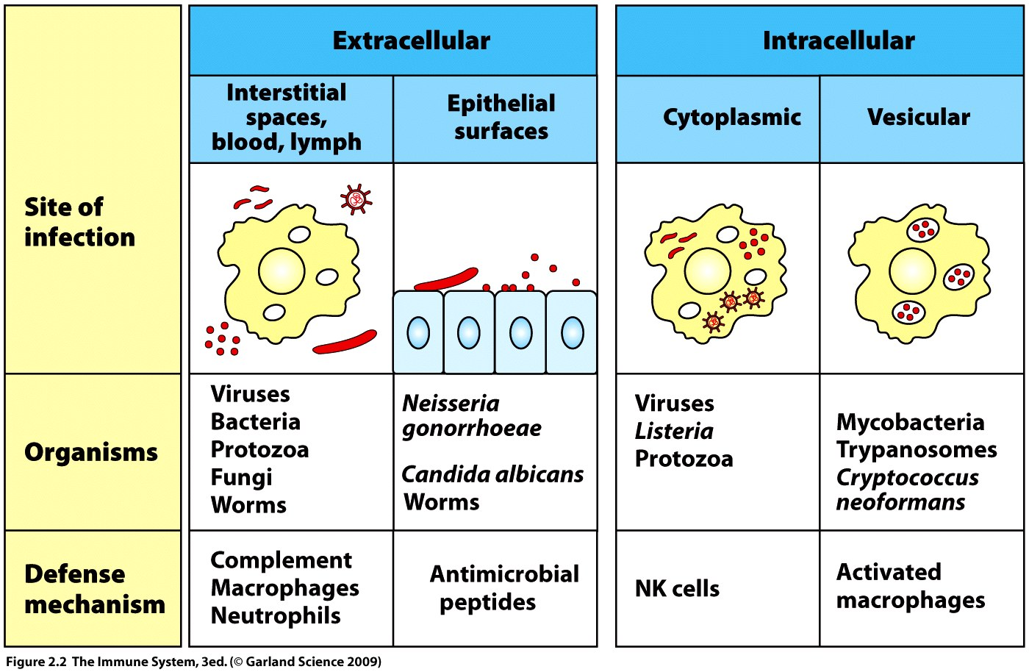

Slide 6
~30 complement proteins are made constitutively in the liver and are present in blood, lymph and extracellular fluid.
A pathogen infecting the body will be immediately exposed to soluble complement proteins.
Complement coats the surfaces of extracellular viruses and bacteria and tags them for phagocytosis.
Proteolytic enzymes of complement are normally circulating in an inactive form (zymogens) - control mechanism.
Infection triggers complement activation – a cascade of protein interaction where complement proteases cleave subsequent complement proteins into active forms.

Slide 7
Cleavage is highly specific at only one site on one protein member of complement – control mechanism.
C3 is the most important member of complement - demonstrated by failure of innate in mutated patients.
Activation cleaves C3 into C3a (small) and C3b (large fragment).
C3b will covalently bind to pathogen surface and tag it for phagocytosis – complement fixation or start the membrane attack complex (MAC).
C3a is chemoattractant for phagocytic effector cells.

Slide 8
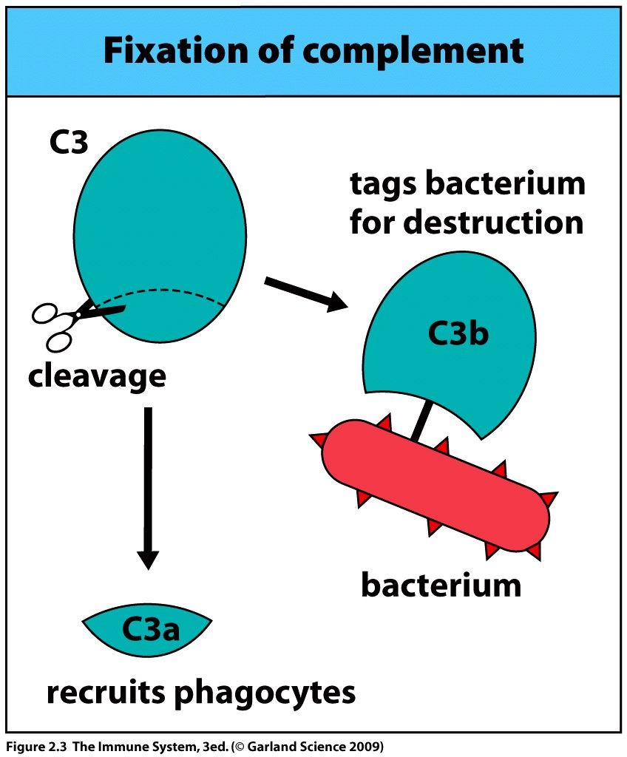

Slide 9
Complement may be activated in three different ways.
They differ in the first few steps of the cleavage cascade but all progress to the cleavage of C3 to C3a and C3b.
Initial infection triggers the alternative pathway or the lectin pathway but the latter takes longer to react.
The lectin pathway is triggered by carbohydrates found on pathogens.
The classical pathway is part of both the innate and adaptive system and requires a pathogen to be tagged by either antibody (adaptive), serum amyloid protein, or C-reactive protein (innate).

Slide 10
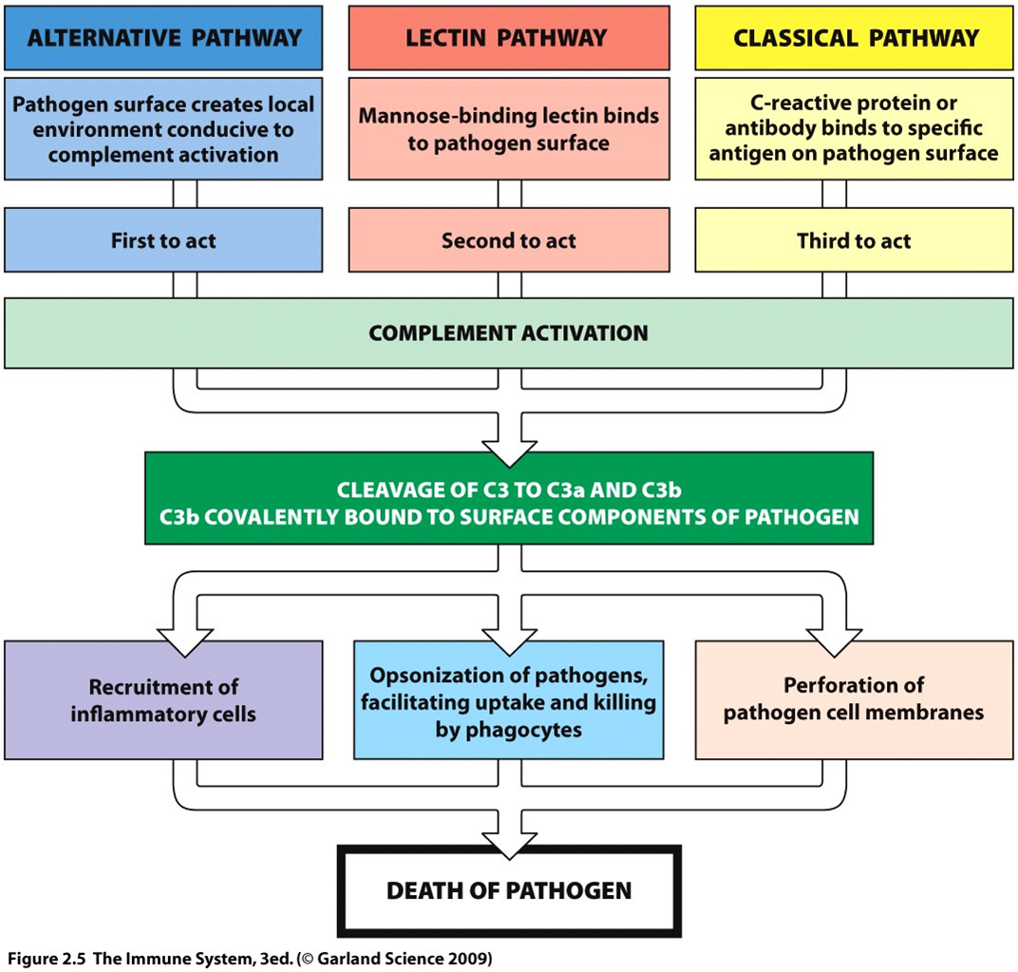

Slide 11
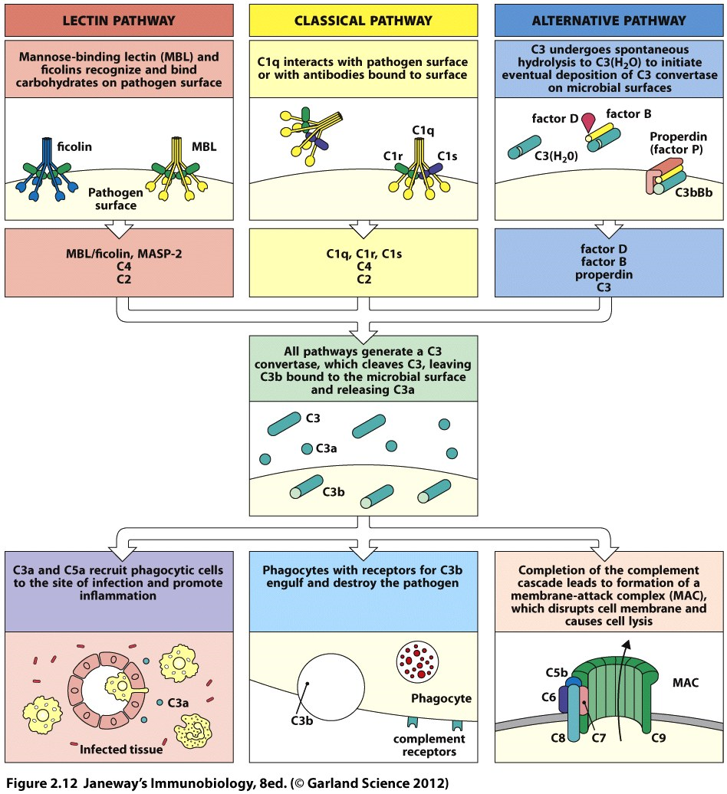
1st 2nd 3rd
3 ways to trigger complement
Events common to all 3 pathways

Slide 12
Alternative pathway—
Proteases which cleave C3 are called C3 convertases.
The C3 convertase is generated at the surface of the pathogen and binds and cleaves more C3 at this location.
The resultant C3b then immediately adheres to the pathogen surface.
C3 convertase remains bound at the pathogen surface and generates more molecules of itself.
This is a positive feedback mechanism which propagates further C3 cleavage.

Slide 13
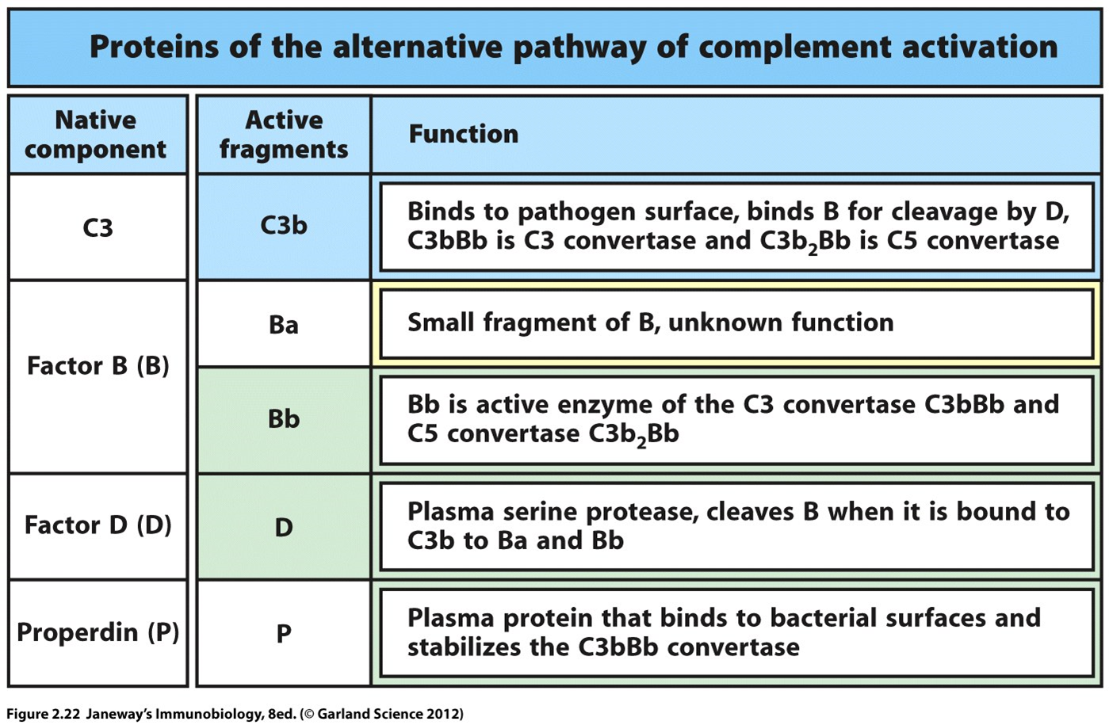

Slide 14
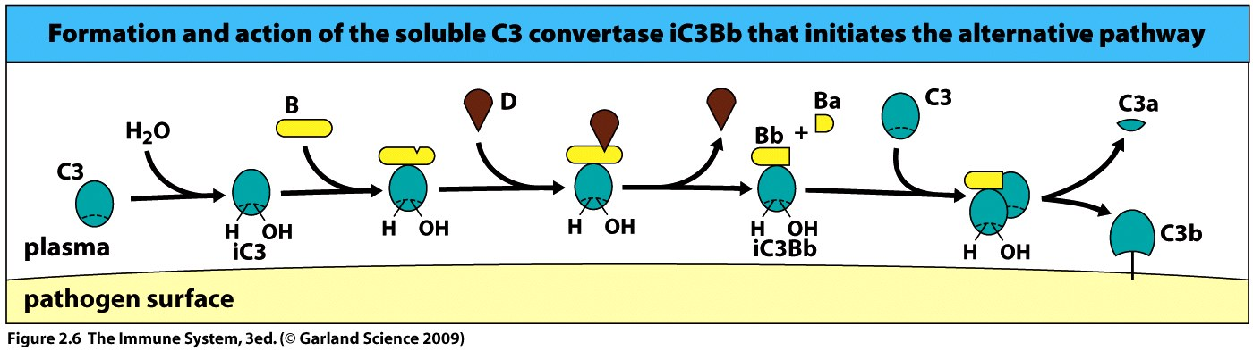
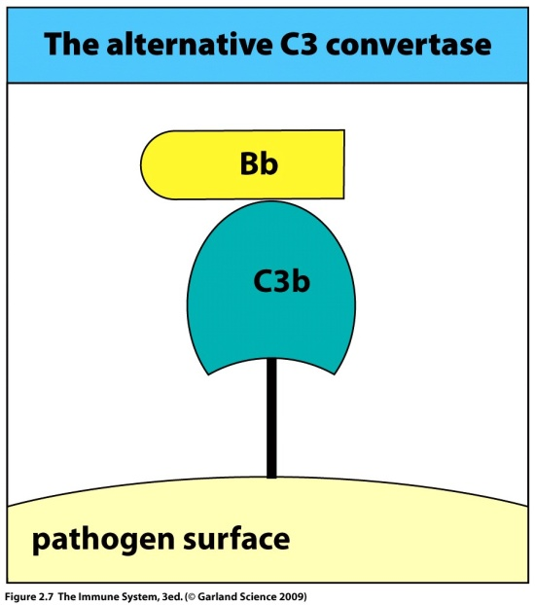
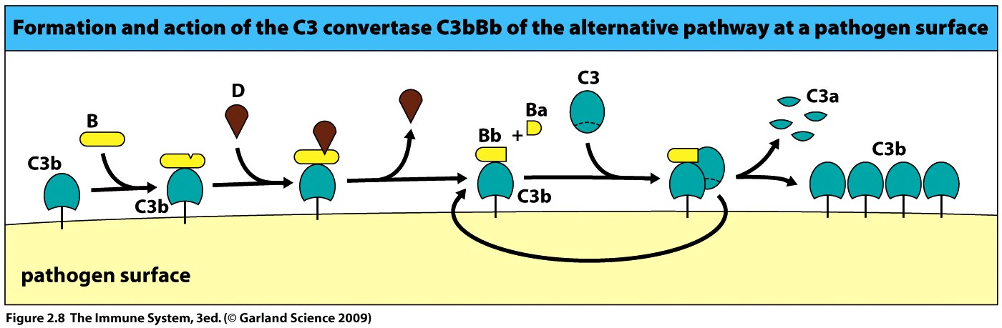
Soluble C3 convertase must cleave C3 to make it stick to pathogen.

Slide 15
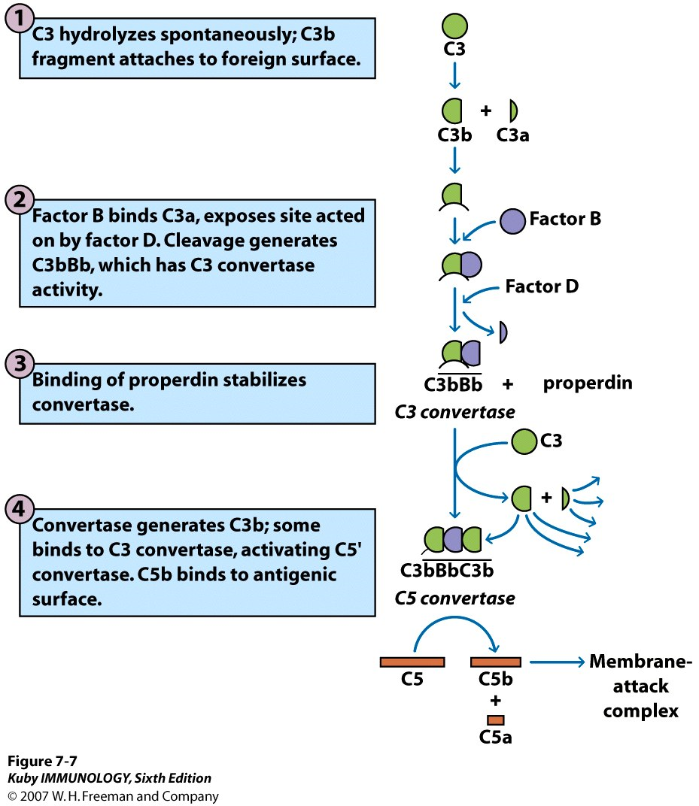

Slide 16
The rapid amplification of active complement components must be regulated and controlled to protect self.
Soluble complement control proteins stabilize or degrade proteins within the complement cascade to regulate the reaction.
Membrane bound proteins on human cells block complement fixation and activation upon the host.

Slide 17
CONTROL of COMPLEMENT
Properdin stabilizes C3 convertase.
Factors H and I lead to C3b cleavage to a form which can no longer make the C3 convertase.
The membrane protein decay accelerating factor (DAF) binds to C3b causing it to dissociate and inactivate at the surface of a human cell.
Membrane co-factor protein (MCP) has a similar function.
See next slide for detailed list of control mechanisms and pathways.

Slide 18
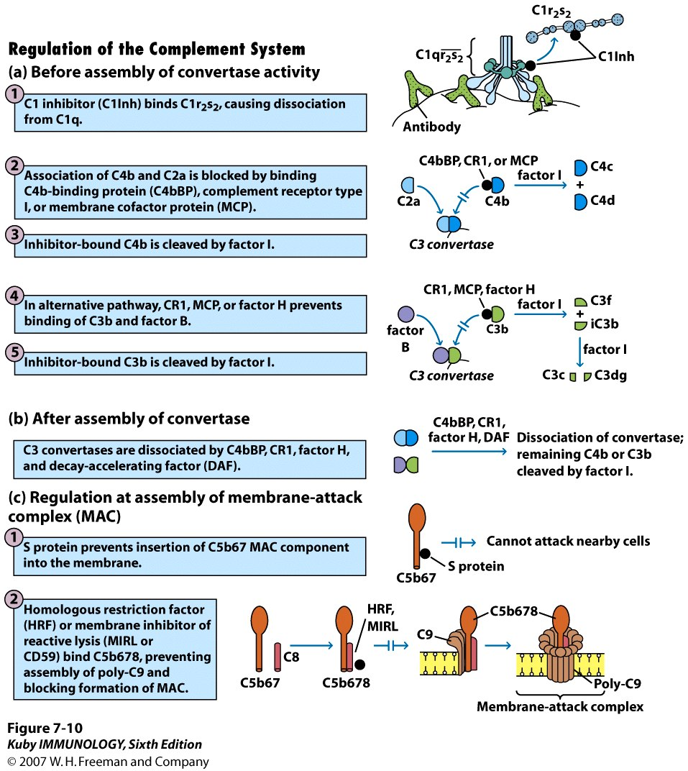

Slide 19
First effector cell of innate is the macrophage.
Mature monocyte resident in tissue.
Common in connective tissue, and lining of gastrointestinal and respiratory tract and liver.
Known as Kupffer cells in the liver.
Long lived phagocytic cells of the innate system which interact with the adaptive system.

Slide 20
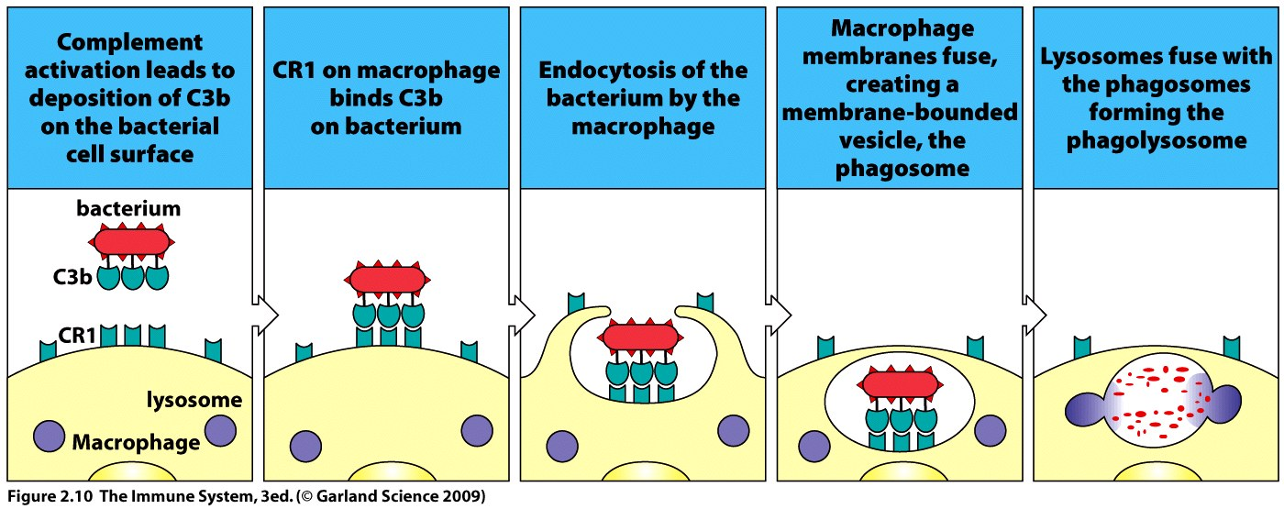
MØ express CR1, complement receptor 1 which binds to C3b on the surface of a pathogen.
Cross-linking of multiple ligands and receptors will trigger phagocytosis of an opsonized pathogen.
Macrophages also express CR3 and CR4 which improve interaction between cell and pathogen thus improving. .phagocytic efficiency

Slide 21
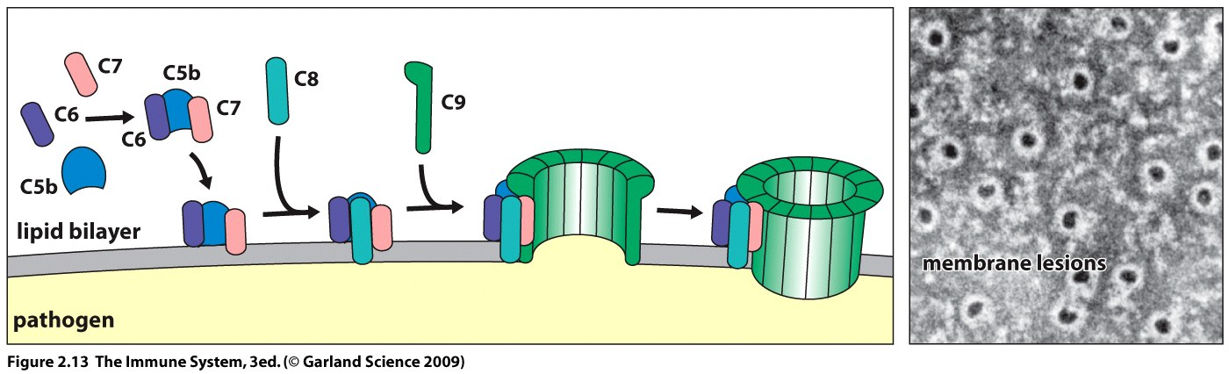
Five more complement proteins form the membrane attack complex
C5 – C9
These proteins are cleaved into active forms which can insert into bacterial and eukaryotic membranes to produce pores leading to cell lysis.
Proteolytic cascade = Molecular hole punch!

Slide 22
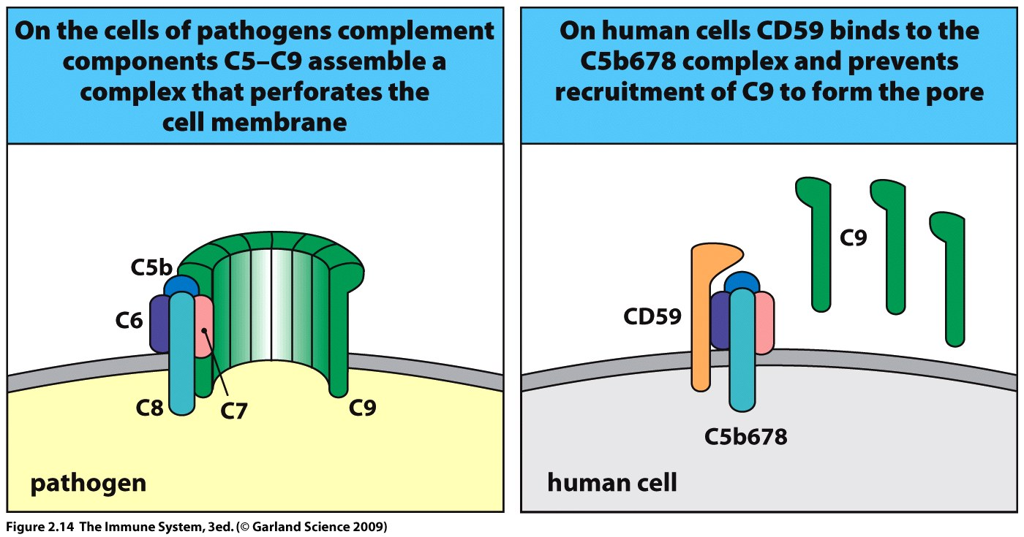
Host cells are protected from attack by CD59 (protectin (sometimes called MIRL))which inhibits the insertion of C9 into the membrane.

Slide 23
Cleavage of C3 and C5 yield small fragments which play a role in inflammation.
C3a and C5a are anaphylatoxins.
Phagocytes, endothelial cells and mast cells have membrane bound C3a and C5a receptors.
Binding of C3a and C5a results in smooth muscle contraction and degranulation of mast and basophil cells.
Vasoactive substances such as histamine are released leading to increased permeability in capillaries and local blood vessels allowing increased flow of plasma proteins and cells to the site of infection.
C5a acts on neutrophils and monocytes as a chemoattractant, to increase phagocytosis and blood vessel adhesion.

Slide 24
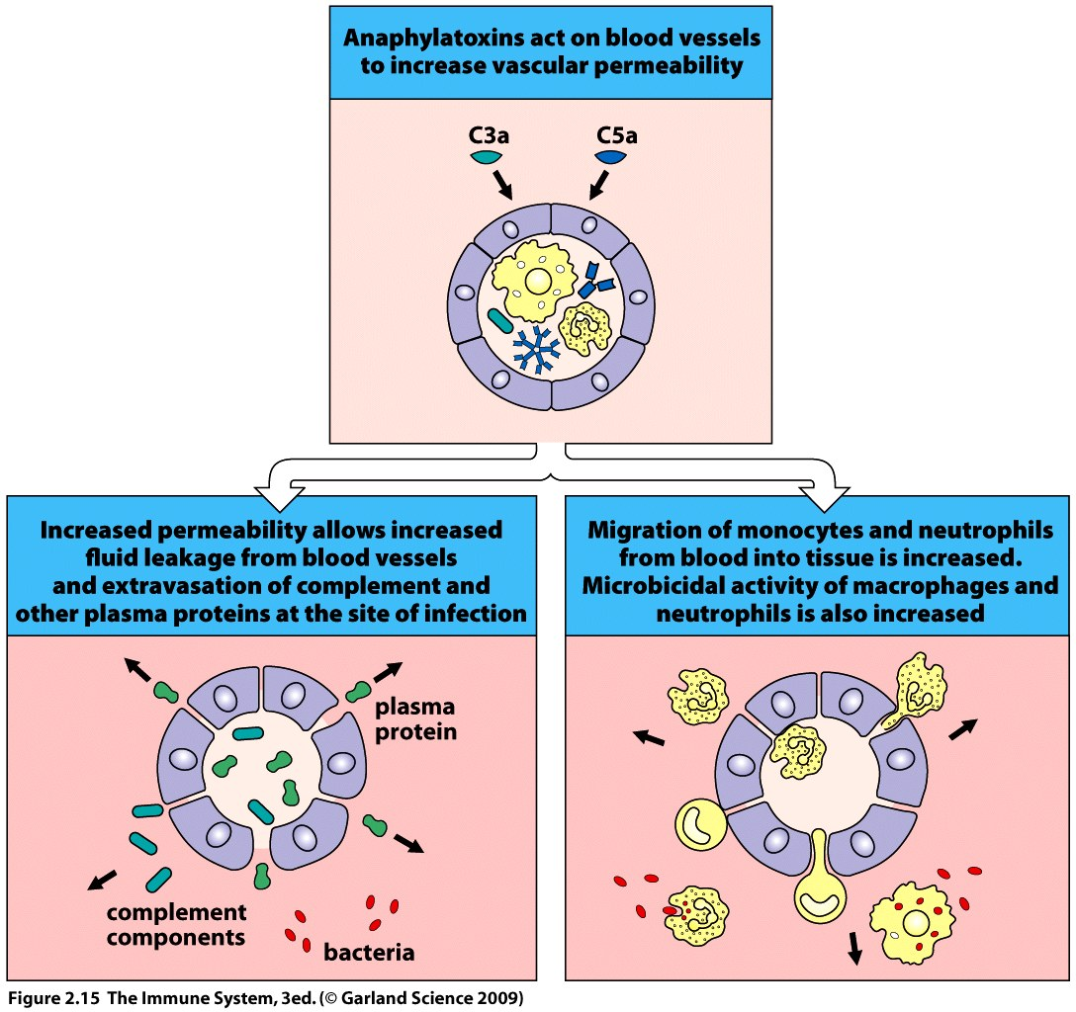
Over-response = anaphylactic shock

Slide 25

The Complement System
Complement System.avi - YouTube

Slide 26
Other plasma proteins play a role in the innate response.
Damage to blood vessels triggers the immuno-coagulation cascade.
A cascade of enzymes which form blood clots which block microbes from entering the blood and lymph and slow the loss of fluid.
Platelets release enzymes and growth factors that stimulate wound healing and inflammation.
Bradykinin is a vasodilatory peptide produced by the enzyme cascade of the kinin system.

Slide 27
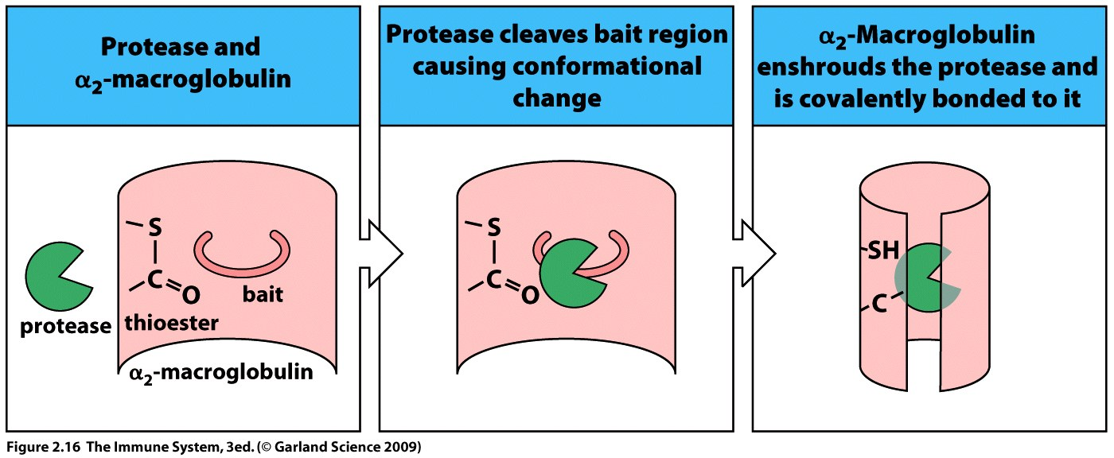
Pathogens which utilize proteases to damage and enter tissue can be controlled by protease inhibitors in the serum.
E.g. α₂-macroglobulin.
Bait and trap mechanism.

Slide 28
Mannose binding lectin (MBL) binds to mannose containing carbohydrates on pathogens and is a member of the collectins.
  MBL has a complex structure with multiple carbohydrate-recognition domains.
  Multipoint attachments are made between MBL and the pathogen increasing the overall strength of binding.
  Mannose on human cells is not available in terms of conformation for multiple interactions with MBL and thus binding is weak.
  Control in recognition of pathogen!

Slide 29
When MBL or ficolins binds to a pathogen the Lectin complement pathway is triggered.
MBL serves as a opsonin for monocytes which lack the mannose receptor of the macrophage but have a MBL receptor.
MBL : Three identical polypeptides make up one region or domain of the molecule.
2 - 6 of these units may comprise one MBL molecule
15-18 binding sites total – i.e. lots of attachment sites!!!

Slide 30
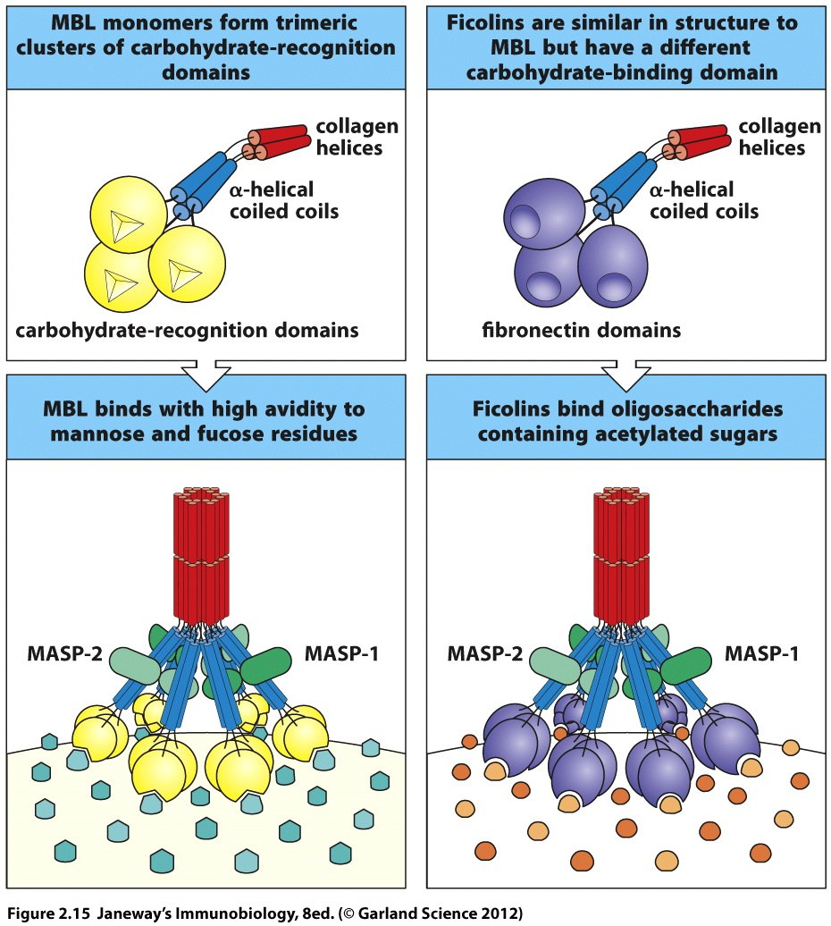
e.g. Bacterial cell e.g. Human cell

Slide 31
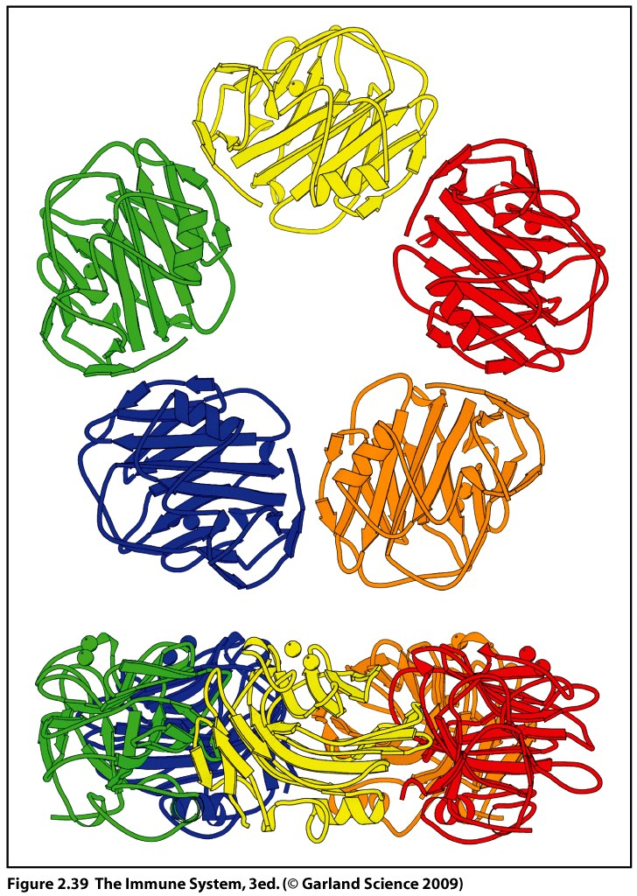
C-reactive protein (CRP)
A pentraxin – 5 identical subunits form a pentamer.
Binds to lipopolysaccharides in bacterial cell walls.
Mean CRP—
  Bacterial infections ~32 mg/L.
  Fungal infections ~ 9 mg/L
Acts as an opsonin and triggers the classical complement pathway in the absence of antibody.

Slide 32
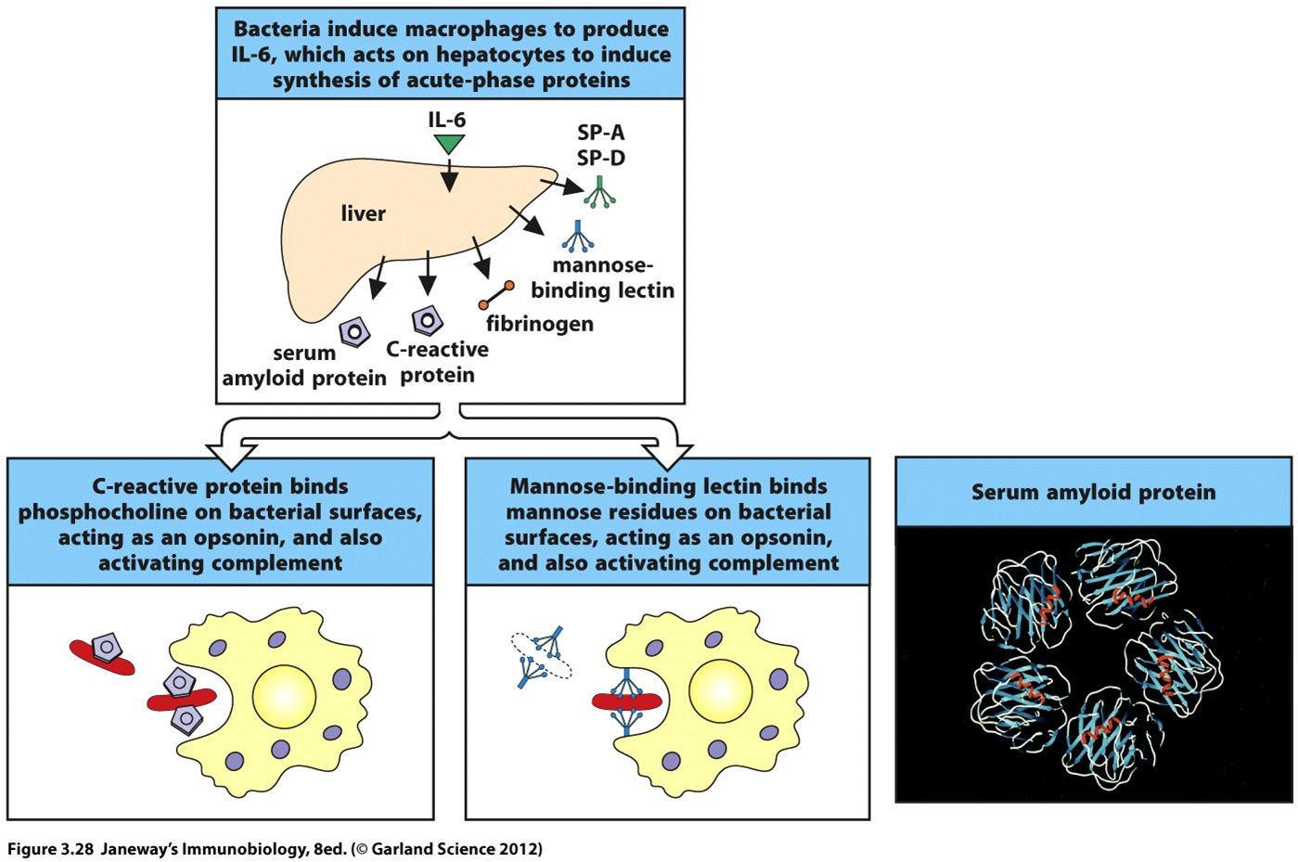
Pyrogen(s) → Acute phase proteins
Opsonization
Complement activation

Slide 33
MBL and CRP are present at only low levels normally but are elevated 1000-fold during the acute phase response (2 days post infection).
Both MBL and CRP distinguish self from foreign.

Slide 34
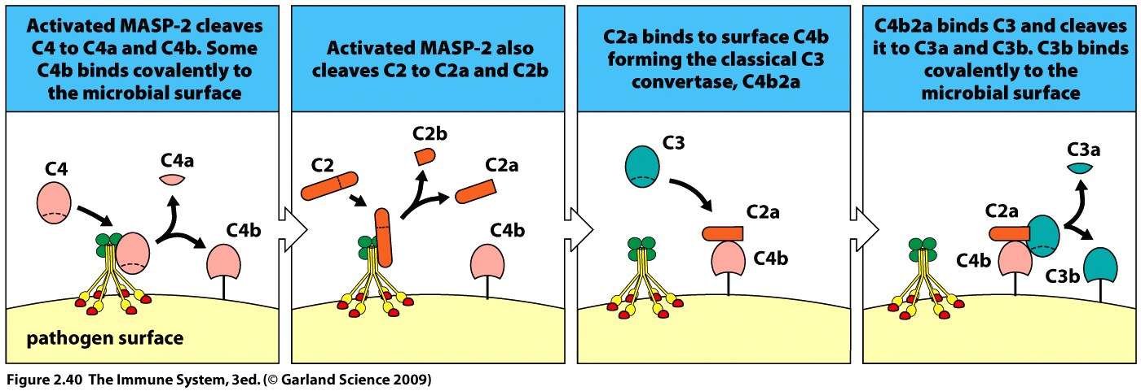
Mannose binding lectin in the serum associates with two protease zymogens.
Upon binding a pathogen the proteases become active and cleave C4 and C2 of complement.
C4a is an anaphylotoxin
C4b and C2a associate at the pathogen surface to form a C3convertase > C3a and C3b.
At this step the cascade takes the route of the alternative pathway generating more C3bBb convertase and more C3b.

Slide 35
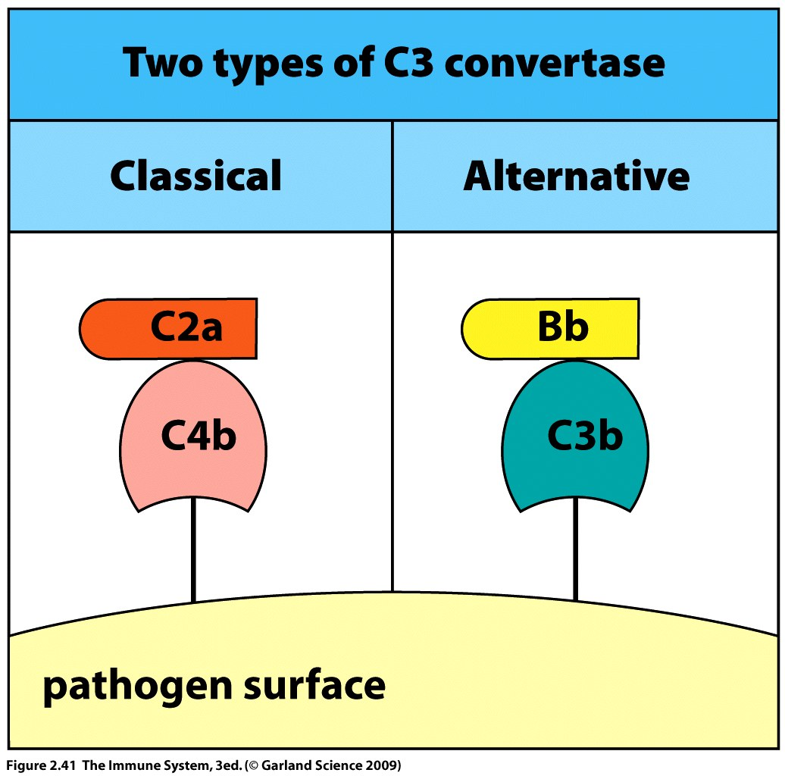
& Lectin

Slide 36
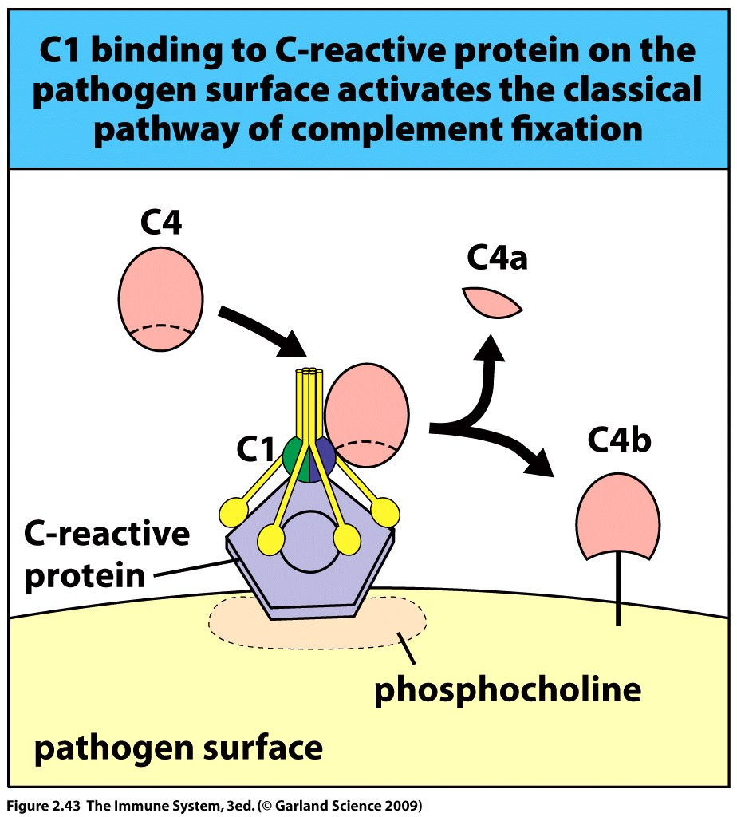
Antigen-antibody complexes AND/OR C-reactive protein triggers the classical complement pathway
CRP bound to a bacterium interacts with C1 and triggers its protease activity.
Active C1 cleaves C4 and C2.
C4b attaches to the bacterial surface
and interacts with C2a to form a
C3 convertase (C4bC2a).
C4bC2a can combine with a cleaved
C3b to form a bi-functional
C3/C5 convertase (C4bC2aC3b).
At this step the classical and lectin
complement pathways converge.
See next few slides for Ag-Ab initiation.

Slide 37
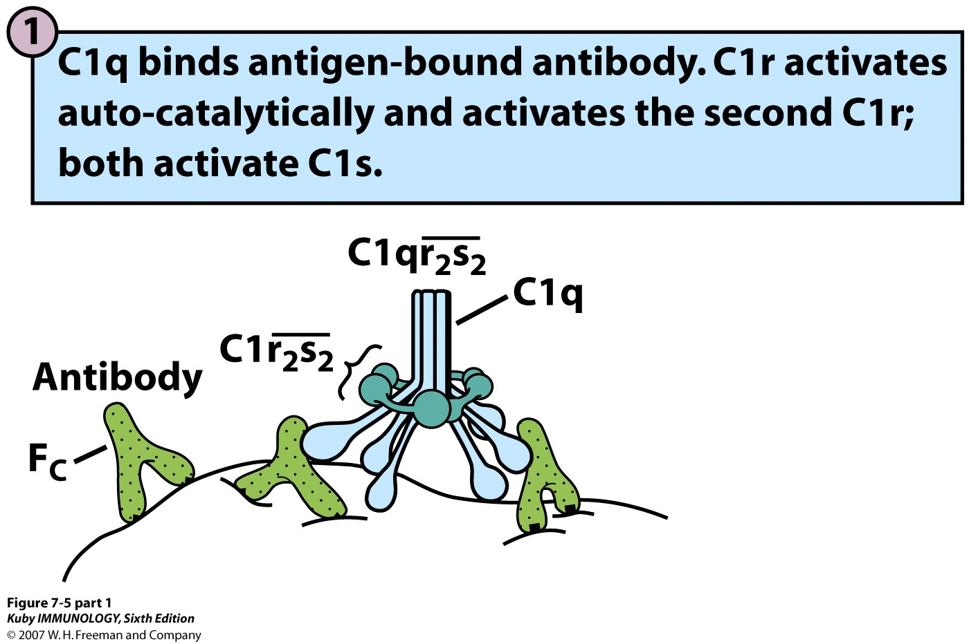

Slide 38
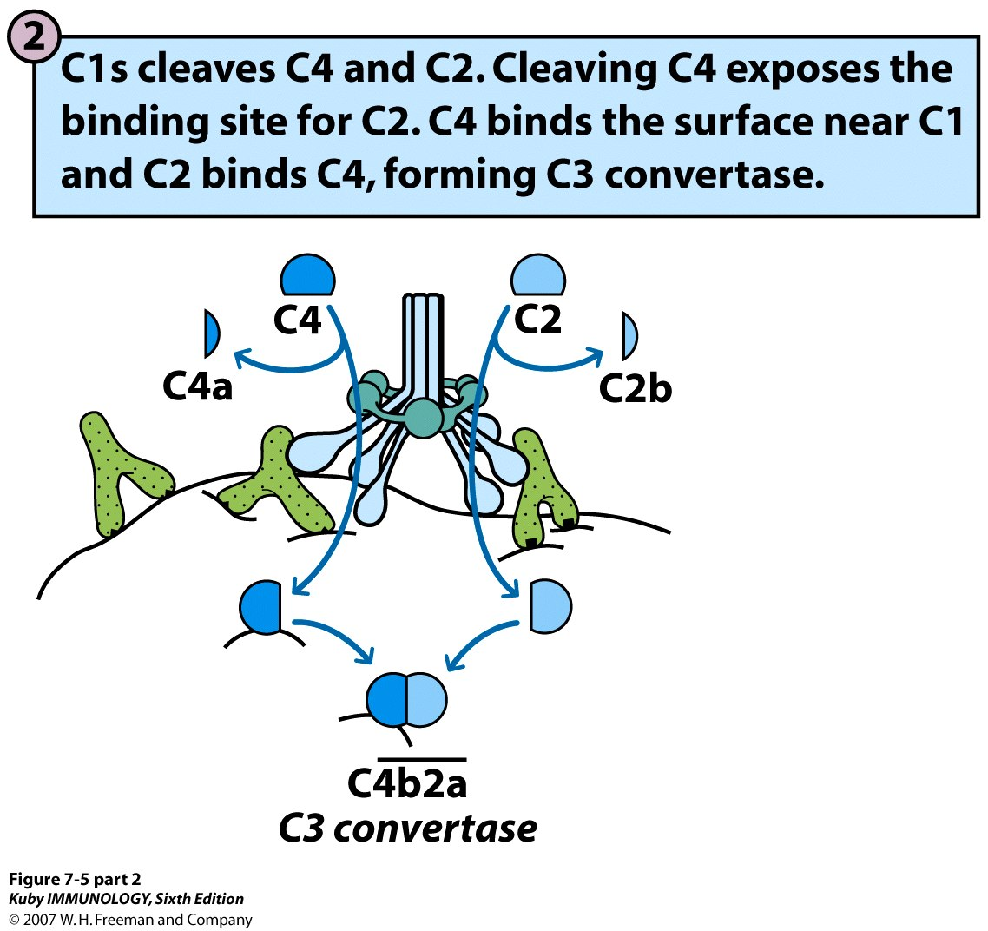

Slide 39
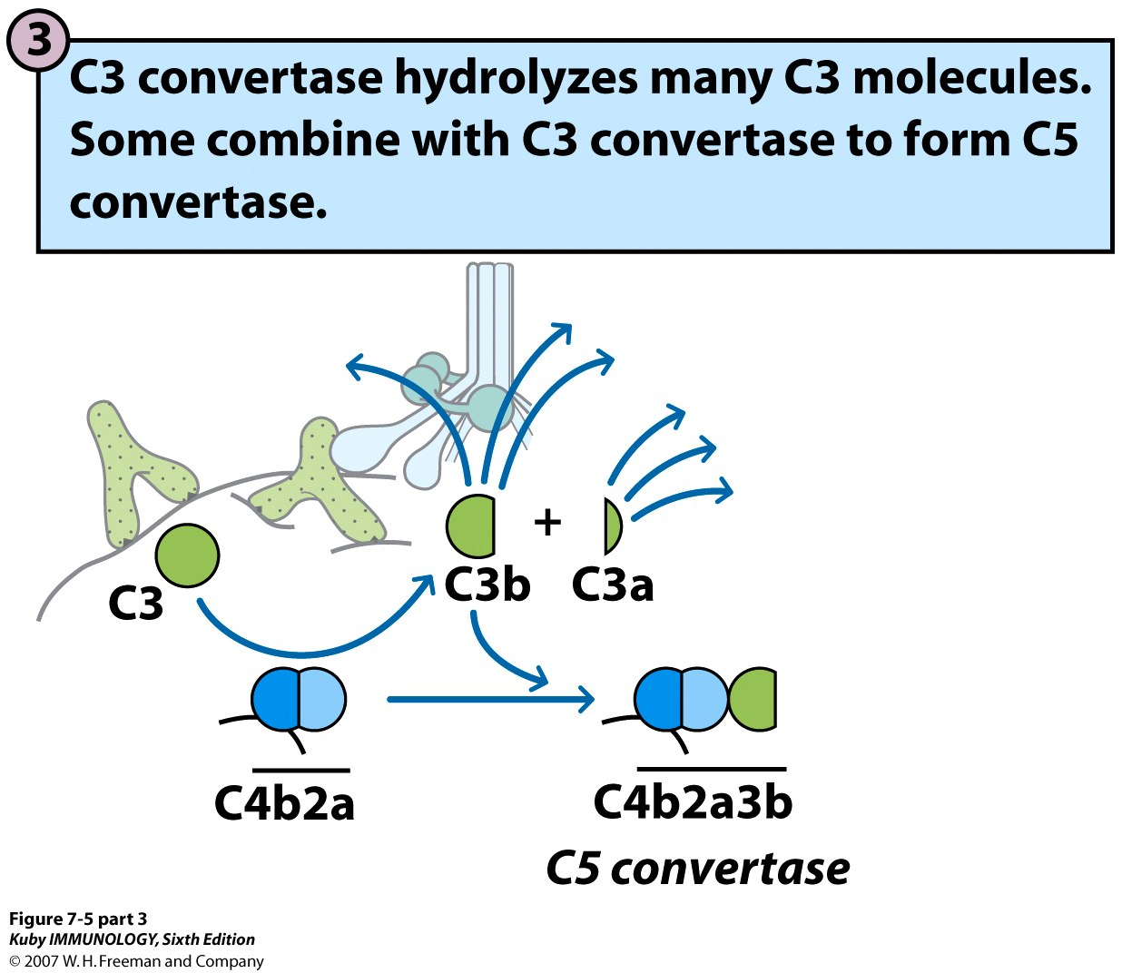

Slide 40
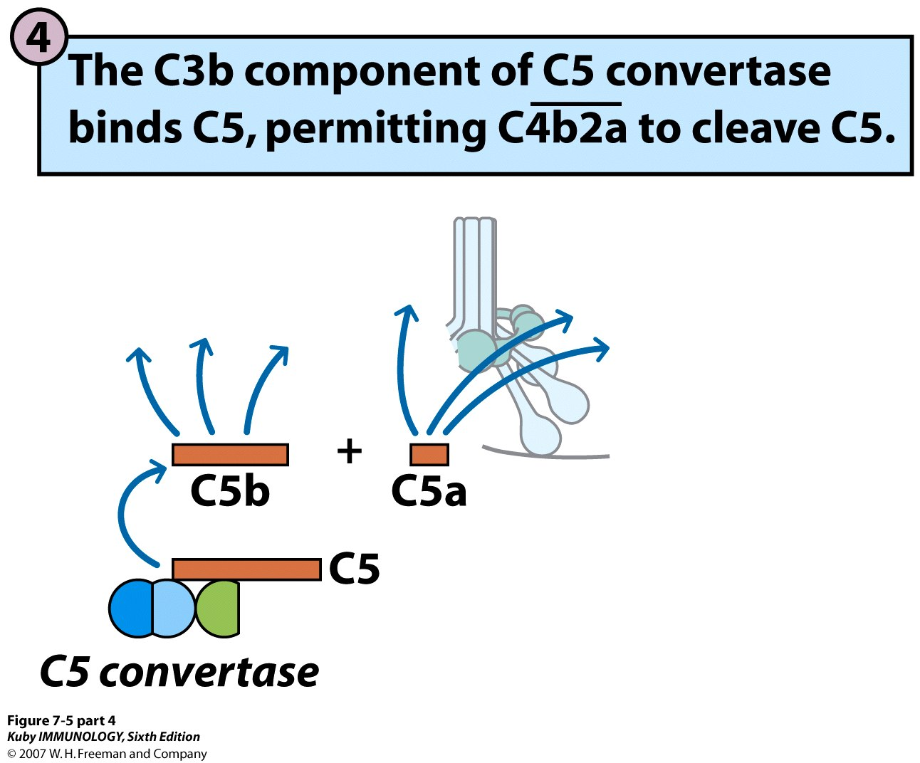

Slide 41
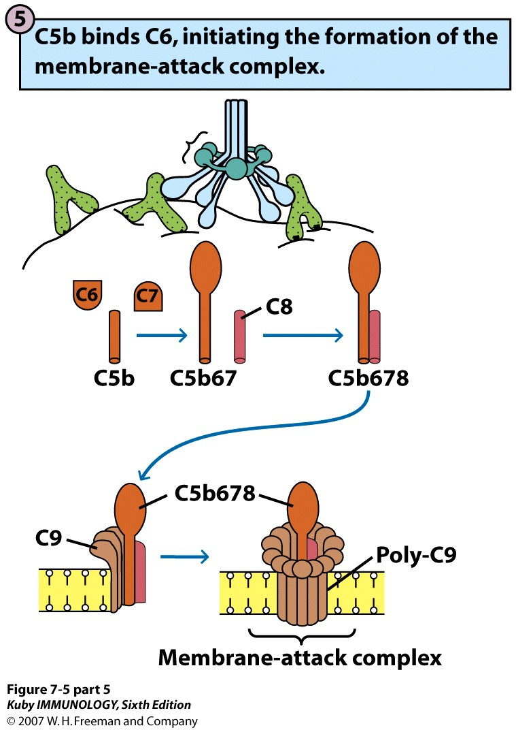

Slide 42
The alternative complement pathway is the first to be activated but once the inflammatory response develops the acute phase is entered.
Acute phase proteins lead to an amplification of the complement cascade through its activation via the classical and lectin pathways.
All three pathways contribute to innate immunity and work together to produce C3b and the C3 convertase at the pathogen surface.

Slide 43
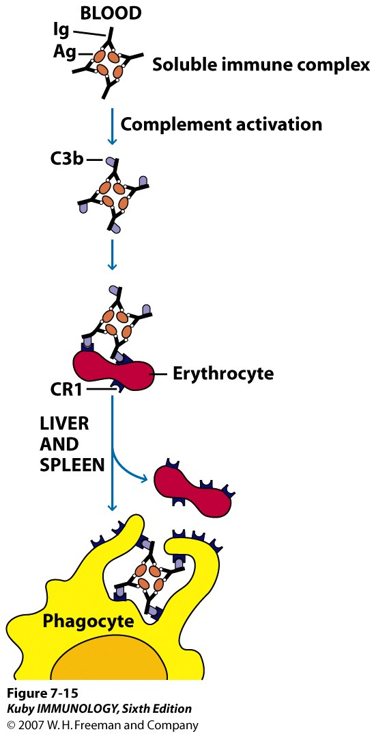
Complement Clearance
Complement receptors like CR1 on RBCs (erythrocytes) can bind immune complexes.
These are transported to the liver and spleen for phagocytosis by macrophages.
RBCs have fewer receptors than macrophages—easier to remove complexes from RBCs as they travel to the liver and spleen.
Defects in this process leads to deposition and ineffectual clearing of immune complexes in the kidneys leading to type III systemic hypersensitivity reactions (e.g., pSS (primary Sjögren’s Syndrome).

Slide 44
Review: Complement
The 333 rule….
3 PATHWAYS 3 OUTCOMES C3
Alternative
Lectin
Classical
Opsonization (tagging)
Membrane attack
Inflammation
2 Convertases
C3b
Anaphylatoxins
“Control Amplification Communication”

Slide 45
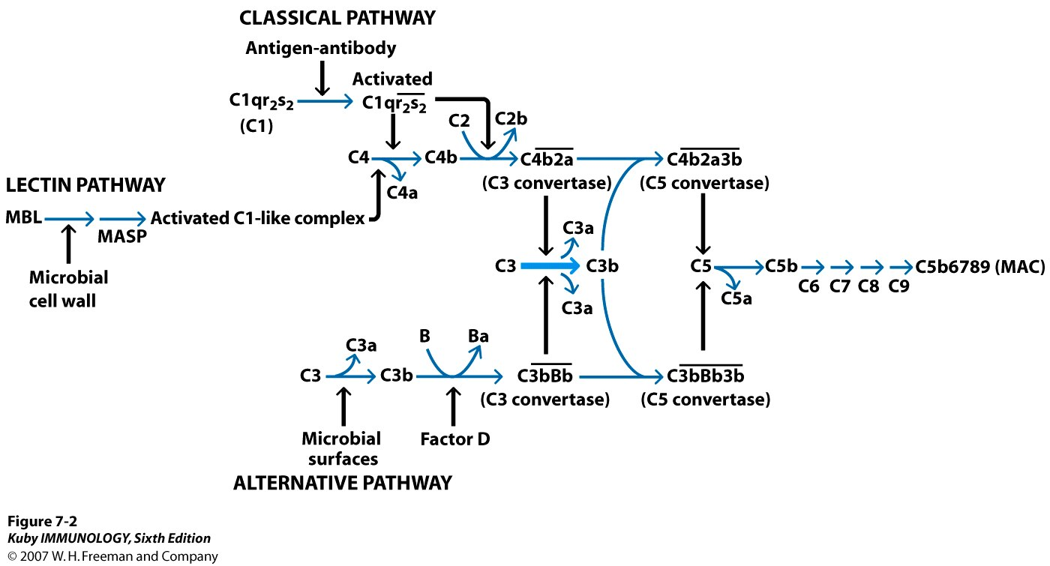
Review: Complement
/C-reactive protein + phosphocholine

Slide 46

Review: Complement

Slide 47
Laboratory Measurement of Complement
Two assays—
1. Functional—
  CH50 assay – measures complement initiation through the classical pathway.
  Ab-coated sheep RBCs are lysed—hemoglobin released is measured and compared to a standard.
  AH50 assay – measures complement initiation through the alternative pathway.
  Rabbit RBCs are mixed with patient serum—hemoglobin released ∝ alternative pathway activity.
  New methods rely on neoantigen formation with MAC.

Slide 48
Laboratory Measurement of Complement
2. Antigenic—
  Serologic measurement of protein C4a – measurement of activation through classical and lectin pathways.
  C3Bb – measurement of the alternative pathway.
  Terminal pathway activation via serologic analysis of anaphylatoxins C3a/C5a, and SC5b-9.
  Radial-immunodiffusion can measure individual complement proteins
  Collect in RED Top SST. Why?
  EDTA chelation (plasma) of divalent cations (Ca2++ and Mg2++) inhibits factor B in complement activation, and non-covalent interactions between C1q,r,s and classical pathway activation by C2. Centrifuge and store serum separately @ -70°C until analysis.

Slide 49
Defensins are antimicrobial peptides (35-40 a.a.).
Amphipathic in nature—they can insert into microbial membranes causing disruption – bacteria, fungi and enveloped viruses.
Alpha and beta forms—
α-defensin is secreted by neutrophils and Paneth cells (small intestines in crypts).
β-defensin secreted by epithelial cells.

Slide 50
Defensins are only active within the physiological conditions of the phagosome and in sweat, tears (along with lysozyme) and the gut lumen.
In this way host cell membranes are not attacked.
Humans vary in the defensin gene set which they carry and pathogen adaptation drives the rapid evolution of new defensins.

Slide 51
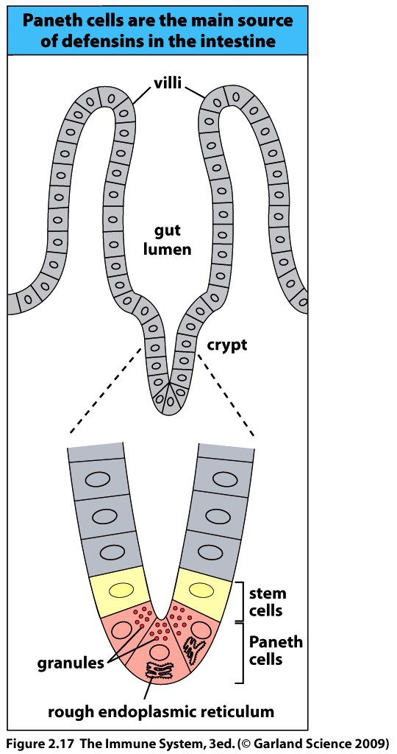

Slide 52
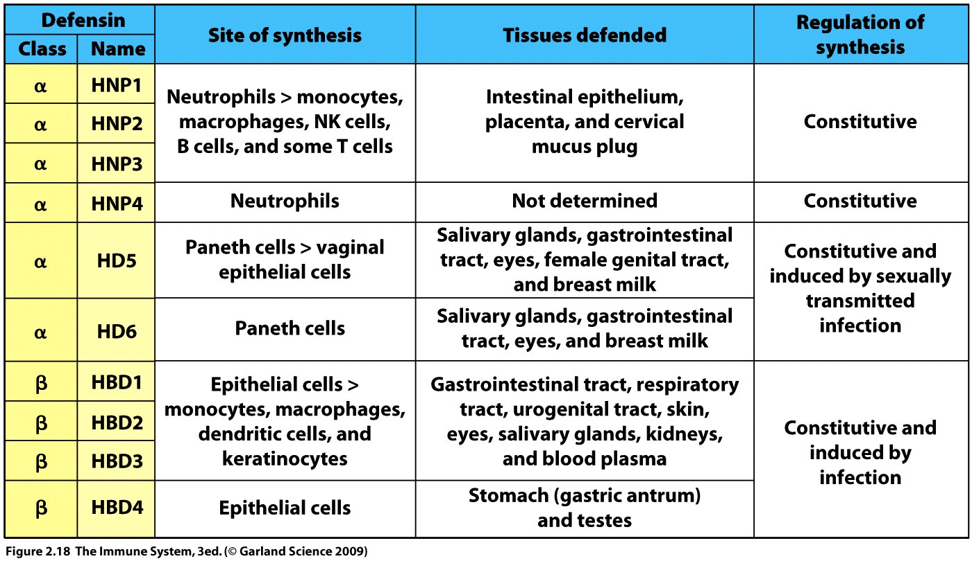
Don’t try to learn the specific names.

Slide 53
Microbes differ from animal cells in structure and biochemistry.
Plasma proteins and receptors on our cells recognize these differences.
Macrophages express many of the receptors which work with complement to eliminate the pathogen.
Microbial ligands may be carbohydrates or lipids which are recognized by lectins (mannose and glucan receptors).
Bacterial lipopolysaccharide (LPS) is recognized by complement receptors CR3 and CR4.

Slide 54
Binding of macrophage receptors to the microbial ligand initiates receptor mediated endocytosis.
The pathogen is then destroyed within the phagolysosome.
Macrophages also express Toll-like receptors (TLRs) which trigger secretion of cytokines when pathogens are bound by the cell.
The innate “sees” generic differences
between self and pathogen.

Slide 55
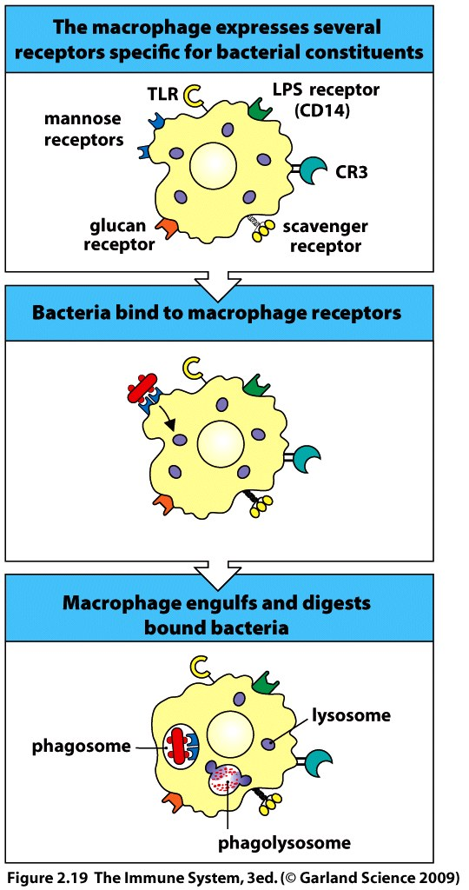
Results in
cytokine release

Slide 56
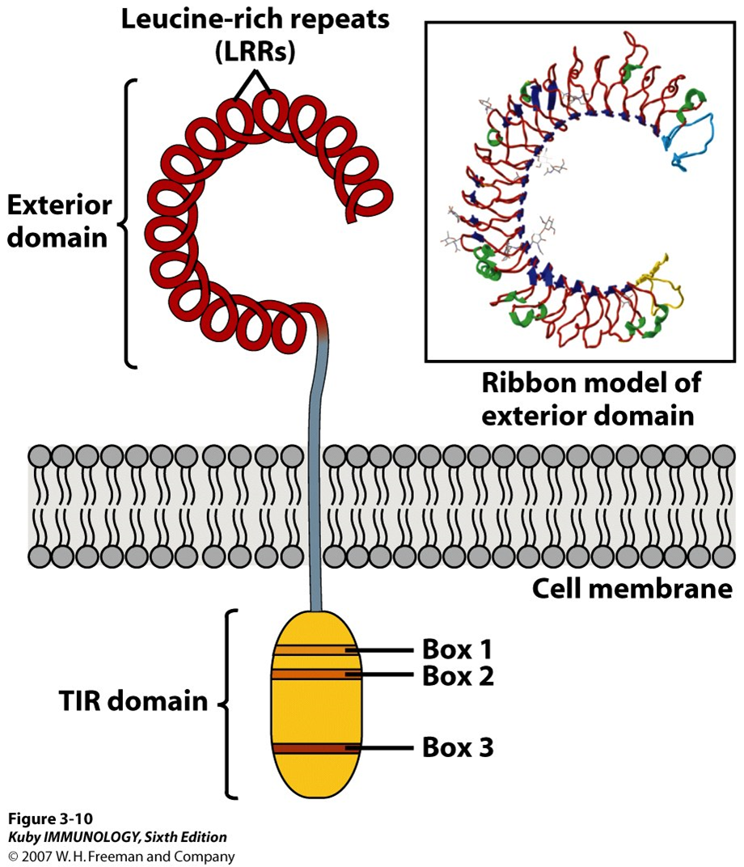
TLRs are a family of signaling receptors which recognize different microbial products.
Expressed on various cell types.
E.g., Macrophages – TLR4 specific for bacterial LPS stimulates cytokine secretion.
TLRs are transmembrane proteins with extracellular domain for recognition of pathogen and cytoplasmic signaling domain.

Slide 57
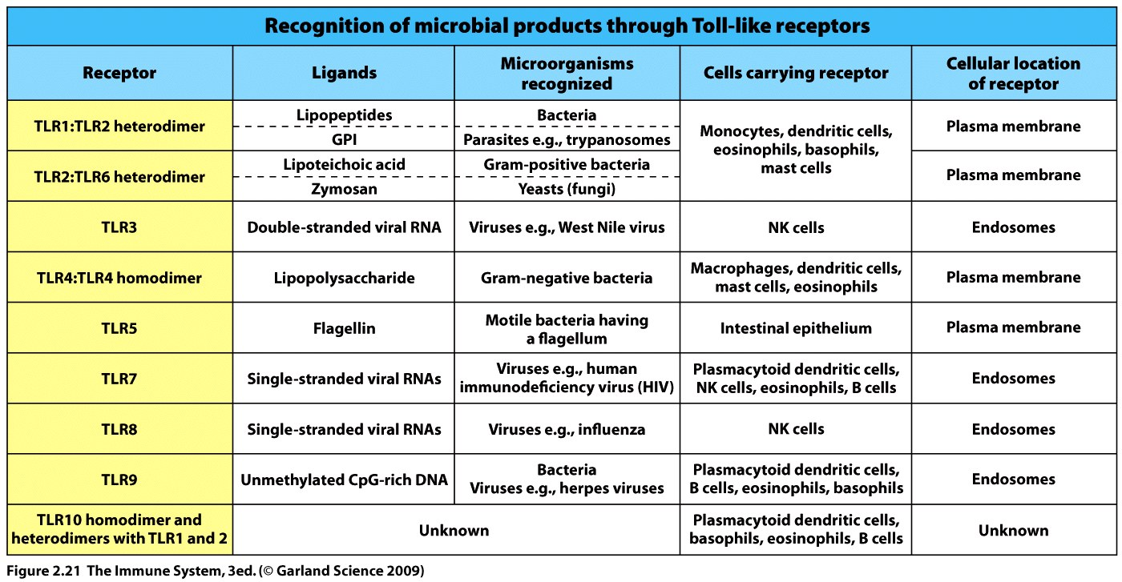
Humans have 10 different TLR genes
TLRs are a trigger for rapid cytokine production which amplifies the
inflammatory response.
=Internal

Slide 58
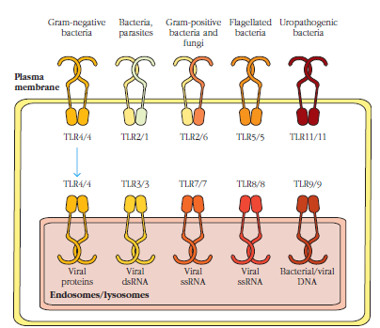
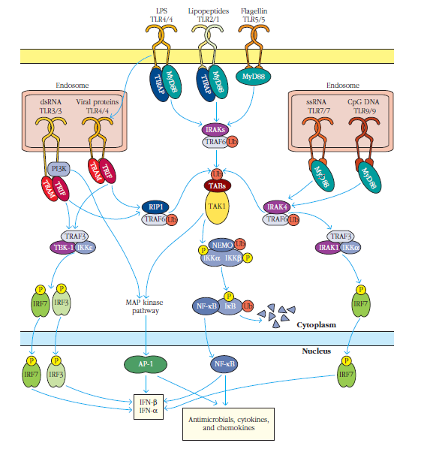

TLRs exist as either homodimeric or heterodimeric complexes that recognize pathogen-associated molecular patterns (PAMPs) or danger-/damage-associated molecular patterns (DAMPs) on pathogen surfaces.
Adaptor proteins release transcription factor(s) → translocation to nucleus → transcription of antimicrobial factors/proteins, cytokines and chemokines.

Slide 59
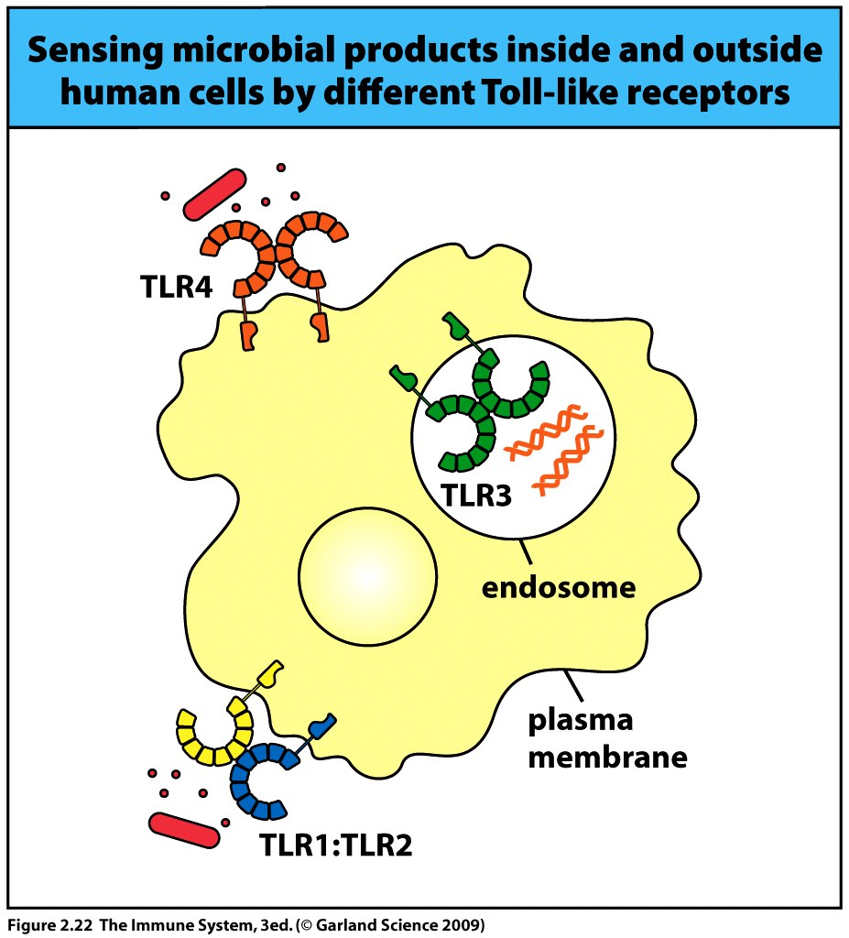

Slide 60
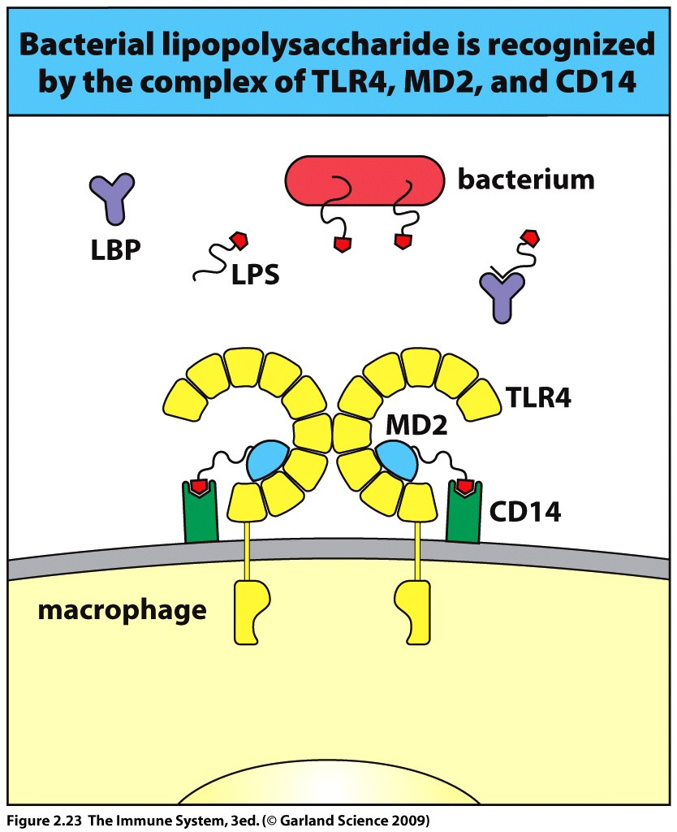
TLRs may require co-receptors to bind the microbial component first and form a recognition complex with the TLR.
= CONTROL

Slide 61
When a TLR is triggered it leads to the activation of a transcription factor.
Nuclear factor κB (NFκB) is stored in the cytoplasm of cells in an inactive form (complexed with inhibitor of κB (IKK)).
The cytoplasmic domain of the TLR initiates the release of NFκB from the inhibitor through the action of adaptor proteins.
The transcription factor then translocates into the nucleus.
Within the nucleus NFκB initiates transcription of genes encoding inflammatory cytokines.

Slide 62
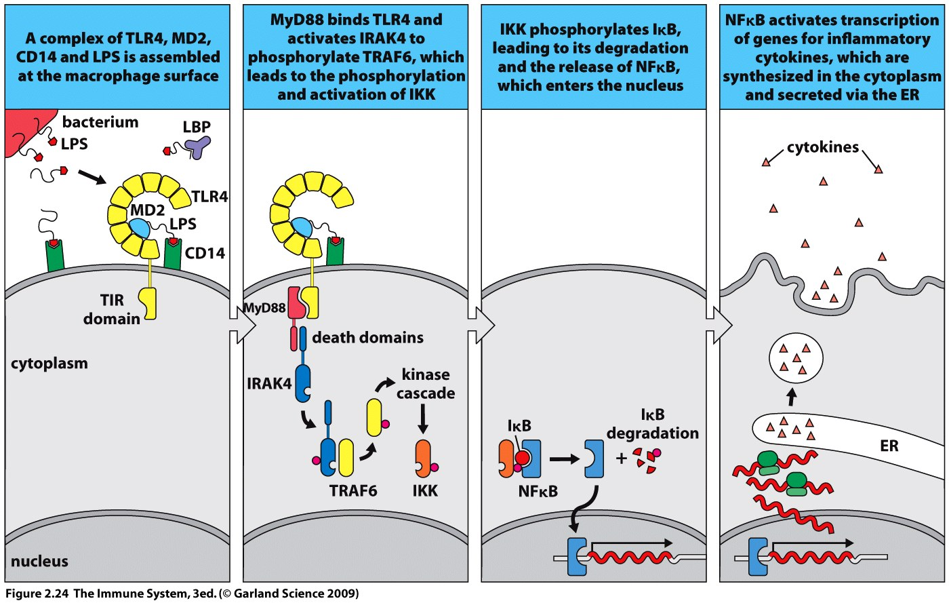
Again—learn the BIG picture….
Adaptor proteins release transcription factor(s) translocation to nucleus transcription of cytokines.

Slide 63
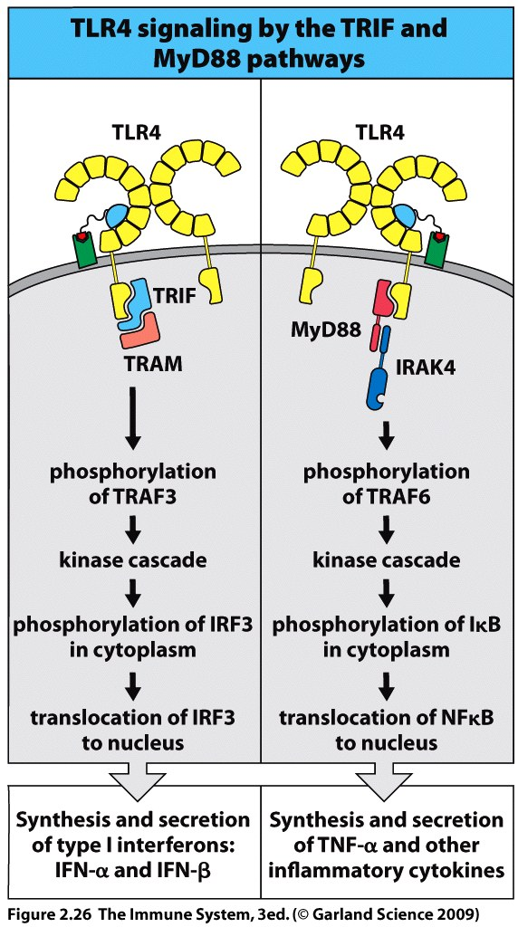
TLR 3 and 4 also direct the synthesis of interferons through translocation of the interferon response factor 3, IRF3 (another transcription factor).

Slide 64
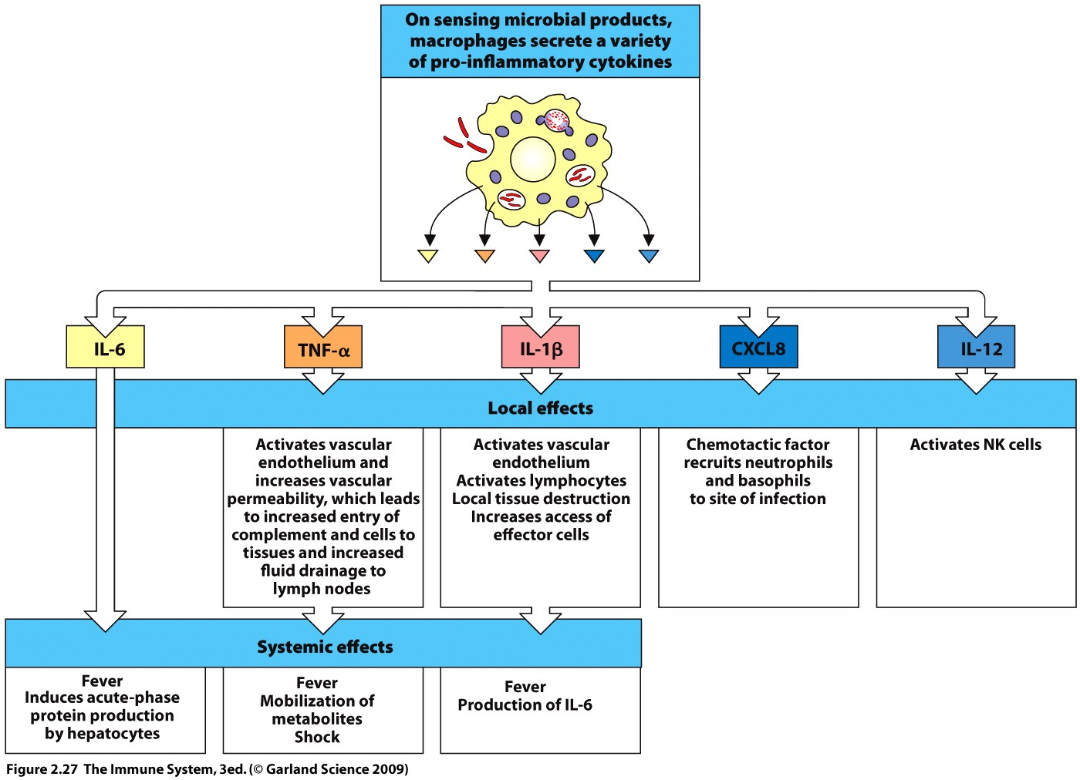
Cytokine release leads to inflammation.
swelling
reddening
pain
vasodilation
increased permeability
fluid and cell influx
Cytokines are small proteins, produced in response to external stimuli, which bind to other cell surface receptors to cause stimulation – effect may be local or systemic.

Slide 65
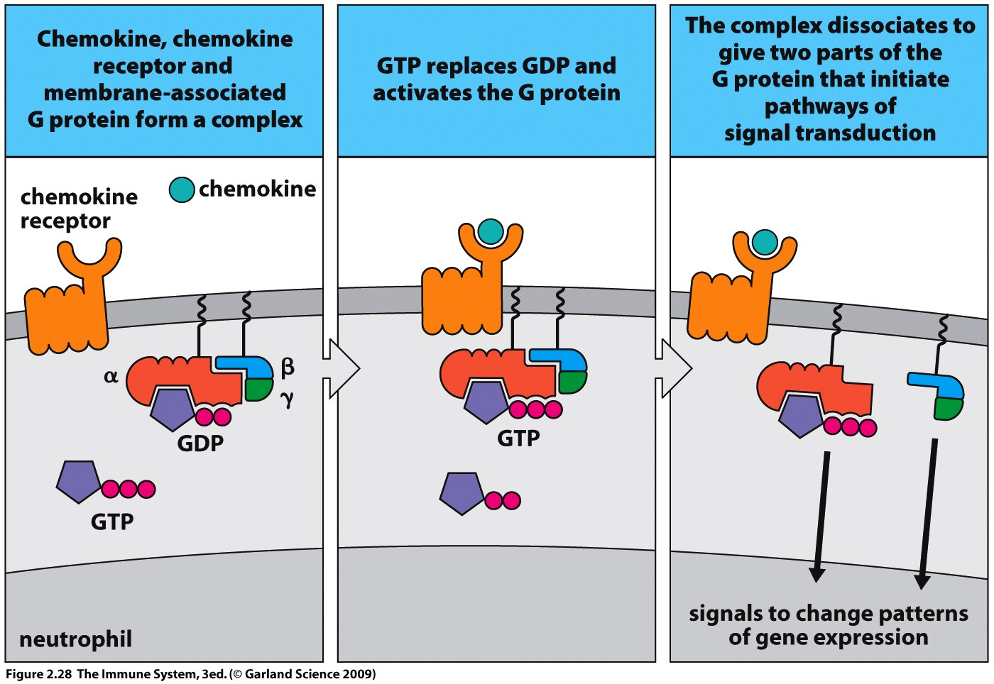
Chemokines are chemoattractant cytokines which direct the migration of leukocytes along a concentration gradient.
Their production is tissue or cell specific.
Chemokines only attract cell types which express the appropriate receptor.

Slide 66
Neutrophils are attracted from the blood to the site of infection by the chemokine CXCL8.
CXCL8 binds to the neutrophils surface receptor and increases the cells adherence to the walls of blood vessels (this slows the cell down).
The neutrophil then moves up the concentration gradient of the chemokine.
NK cells are activated by the cytokine IL-12 to kill virus infected cells.
Cytokines and chemokines are inflammatory mediators.

Slide 67
Inflammatory mediators can cause host damage if not controlled.
During Septic shock a systemic bacterial infection induces the release of large amounts of TNF-α by macrophages in the liver, spleen and tissues.
  dilation of the blood vessels leads to massive fluid leakage into the tissues throughout the body.
  Widespread blood clotting in capillaries leading to disseminated intravascular coagulation (DIC)—depleting clotting factors.
  Failure of vital organs compromised by a lack of normal blood supply.
  Often caused by Gram negative bacteria (or LPS).
  100,000 deaths per year in USA

Slide 68
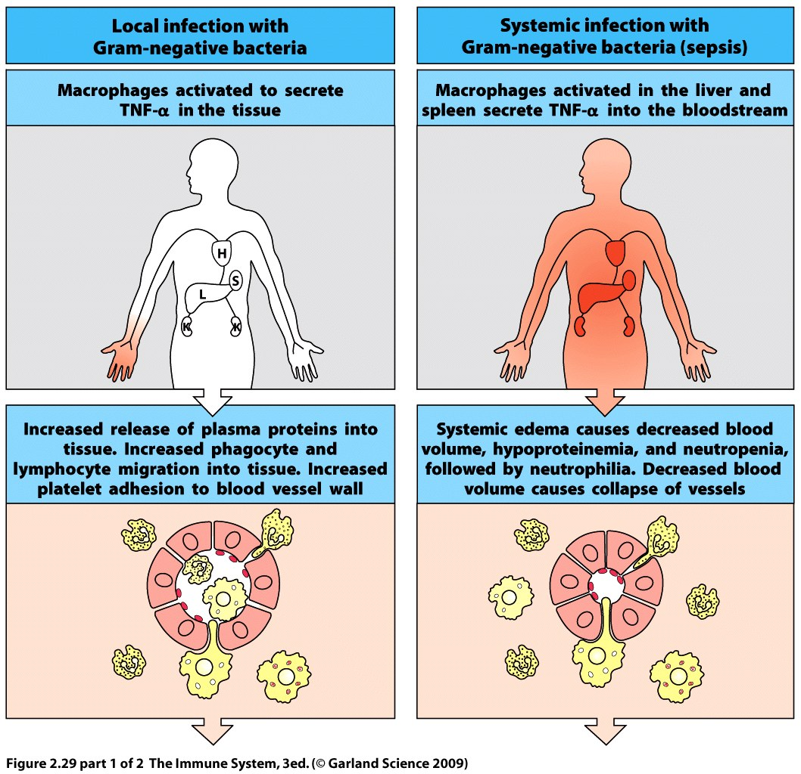

Slide 69
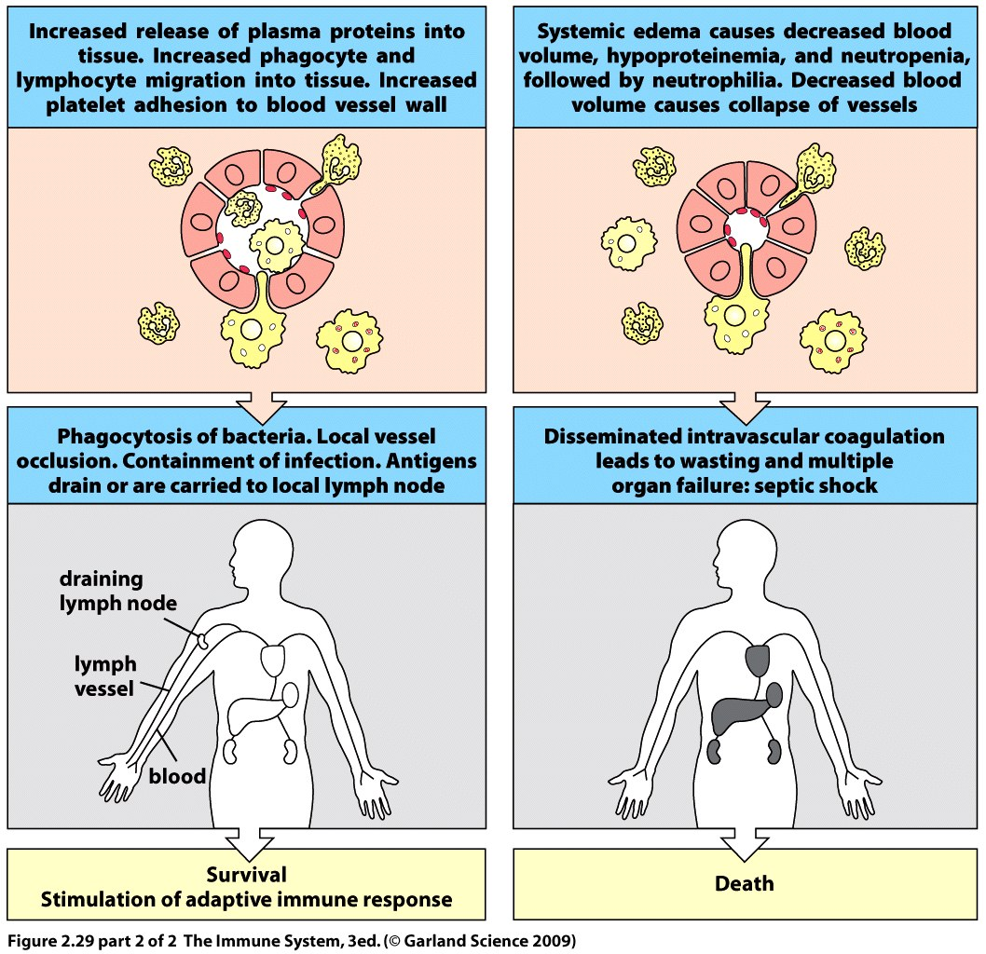

Slide 70
A defect in TLR4 on the macrophage leads to increased susceptibility to septic shock.
The receptor can only bind weakly to LPS from Gram negative bacteria and this reduces the effectiveness of the innate system at the site of infection.
The infection thus, has an increased probability of becoming systemic and triggering septic shock through TNF-α production.

Slide 71
Neutrophils and macrophages are the principal phagocytic cells of the innate immune system.
Each cell has distinct and complementary properties.
Macrophages, long lived, reside in tissues, work at the start of the infection, APC.
Neutrophils, short lived, circulate in the blood, recruited to the site of infection in large numbers.

Slide 72
Neutrophils, granulocyte polymorphonuclear leukocyte.
Most abundant white blood cell (50 Billion circulate when healthy).
Live for less than two days.
Large burden on the hematopoietic stem cells of bone marrow.
Mature in bone marrow and remain stored for 5 days – act as reserve which can be released upon infection.

Slide 73
Neutrophils do not enter healthy tissue and require the release of inflammatory mediators to permit the cell to enter a site of infection – CONTROL.
The presence of neutrophils marks the start of the inflammatory cascade – cells and molecules of the innate system are recruited to the site of infection.
Neutrophils can work under the anaerobic conditions of a wound and contribute to the production of pus upon their death.

Slide 74
Neutrophil homing describes the ability of the cell to recognize chemokine signals from an infection site.
Neutrophils respond by altering surface receptors which slow the cell down and permit entry into the tissues.
Neutrophils use adhesion molecules to home.

Slide 75
Adhesion molecules come in complementary pairs.
One type expressed on the neutrophil and the partner expressed on the vascular endothelial cell.
When two adhesions interact a temporary bond is formed between cells.
Adhesion molecules provide anchor points for the neutrophil (like Velcro).

Slide 76
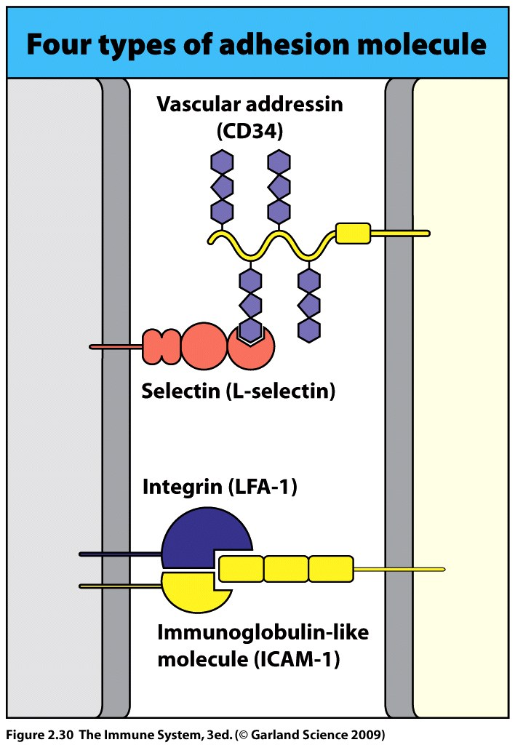
~4 structural classes of adhesion molecules:
Selectin
Mucins = vascular addressins
Integrins
Members of immunoglobulin super family.

Slide 77
Selectin
  Carbohydrate binding proteins (lectins).
  Specificity for oligosaccharide of various vascular addressin (mucins).

Slide 78
Integrins
  Large family of proteins, example includes CR3 and CR4.
  Specificity for proteins including many members of immunoglobulin super family.
Adhesion molecules are not constitutively expressed on either the neutrophil or the vascular endothelium and must be induced by either bacterial components or inflammatory mediators to produce activated cells.

Slide 79
Neutrophil activation – stimulated by bacteria specific peptide N-formylmethionine (fMET), complement anaphylatoxin C5a, and chemokine CXCL8.
These ligand – receptor interactions lead to adhesion molecule expression.
Vascular endothelial cell activation (surrounding the infection) - by inflammatory mediators which in turn lead to production of ligands for the neutrophil adhesion molecules.
This process permits migration (extravasation) of the neutrophil from the blood to the site of infection in the tissue.

Slide 80
Extravasation of neutrophils occurs in four steps:
Rolling – slows down cell.
Tight binding – attaches cell to vascular surface.
Diapedesis – cell crawls between vascular endothelial cells.
Migration – movement through tissue to infection site.

Slide 81
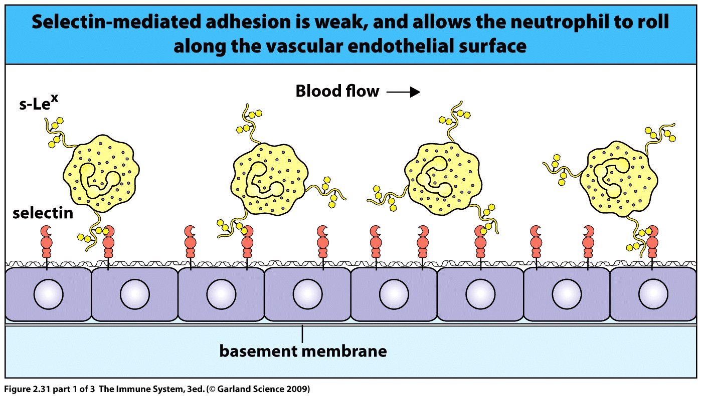
P-selectin stored in Weibel-Palade bodies is transported to surface of
vascular endothelium after exposure of cell to leukotriene, C5a and histamine.
E-selectin also expressed on VE after exposure to LPS or TNF-α.
Selectins bind in a reversible manner to carbohydrate rich sialyl-Lewis^{x} side chains on the surface glycoproteins/lipids (vascular addressin) on the neutrophil.
The neutrophil rolls breaking and making adhesion molecule connections.

Slide 82
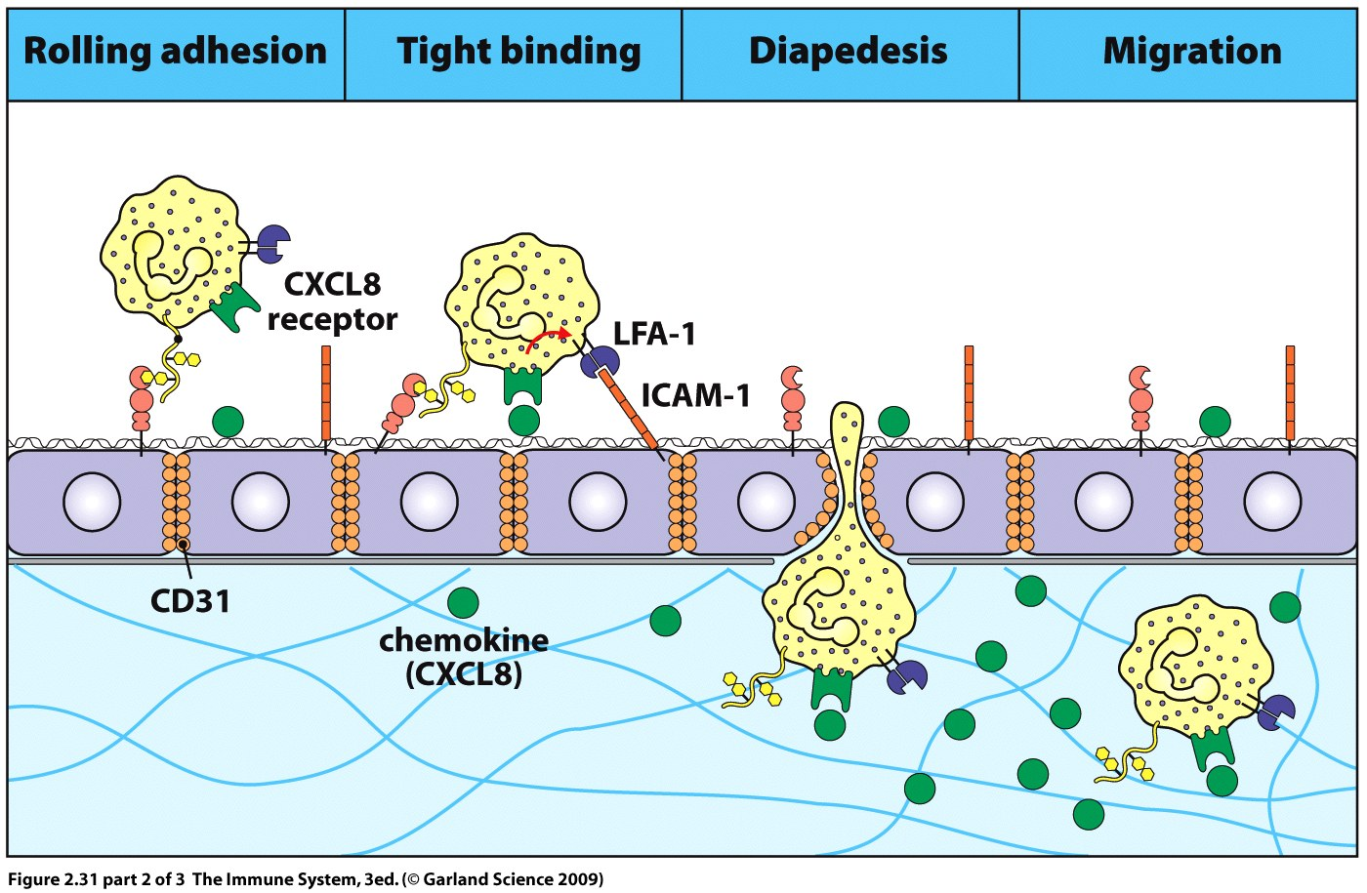
Integrins, LFA-1 and CR3 on the neutrophil undergo a conformational change when exposed to the chemokine CXCL8 from the site of infection and binds tightly to adhesion molecule ICAM-1 (immunoglobulin super family) on the wall of the blood vessel.
The neutrophil stops rolling.

Slide 83
The neutrophil crosses the vessel wall with the aid of the adhesion molecules including CD31 (immunoglobulin superfamily protein) which is expressed at the junction of the endothelial cells.
Diapedesis is the action of squeezing between vessel walls to reach the basement membrane.
The neutrophil secretes proteases to break down the membrane and gain access to the underlying tissue.
The neutrophil then travels along the CXCL8 gradient to the infection site.

Slide 84
Chemokines and cytokines direct the homing of all white blood cells by inducing changes in adhesion molecules in a similar manner as those described for the neutrophil.

Slide 85
Leukocyte Rolling
Leukocyte Rolling - YouTube

Slide 86
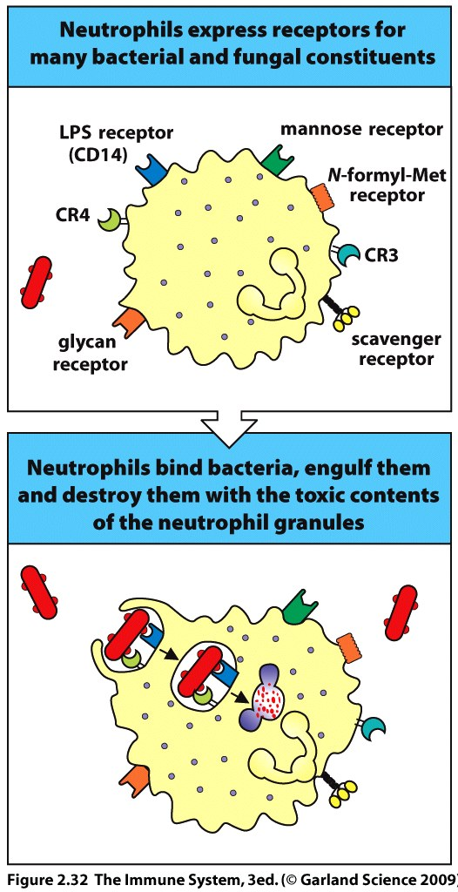
Neutrophils express a variety of receptors which recognize microbes
Also express complement receptors to recognize opsonized pathogens
Store degradative enzymes and toxic substances in inactive forms within low pH of granules
  Azurophilic granules
  Specific granules
Granules fuse with the phagosome and start the process of breaking down the macromolecules of the pathogen.

Slide 87
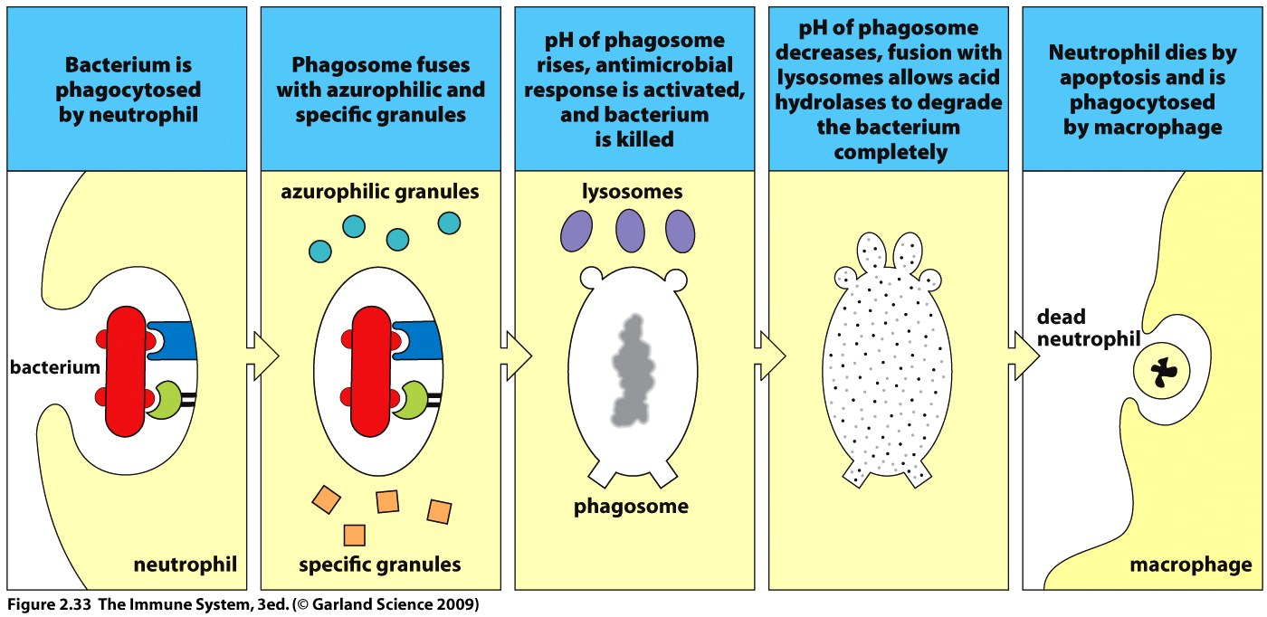

First raise the pH of the neutrophil phagosome by using up hydrogen ions
Contents of the granules become active and destroy pathogen
Last reaction removes toxic hydrogen peroxide to protect host.

Slide 88


The neutrophil killing power requires an increase in oxygen consumption called the ‘respiratory burst’.
This produces reactive oxygen species (ROS) and/or reactive nitrogen species (RNS) which must be eliminated to prevent host cell damage.
Neutrophils limit damage to host cells by producing catalase and superoxide dismutase.

Slide 89

Schematic of NAD(P)H/phagocyte oxidase ‘respiratory burst’.

Slide 90
A mature neutrophil can not regenerate granules.
Once all the granules are used the cell undergoes apoptosis.
Apoptotic neutrophils undergo NETosis (neutrophil extracellular traps) by releasing nuclear chromatin to trap and sequester pathogens. ROS/RNS also needed for this process. (Think of it as the last hoorah!)
Dead neutrophils are phagocytosed by macrophages.

Slide 91
Pro-inflammatory cytokines and fever.
IL-1, IL-6 and TNF-α
Act on temperature control sites in the hypothalamus and on muscle and fat cells to release proteins and energy.
Pyrogens are molecules which induce fever.
  Pathogens induce fever by stimulating the production of pyrogenic cytokines.
Fever slows pathogen replication, speeds the immune response.

Slide 92


Slide 93
Pyrogens also induce production of acute-phase proteins by the hepatocytes of the liver
  soluble plasma proteins
  include mannose-binding lectin and C-reactive protein
  both enhance fixation of complement on the pathogen surface.

Slide 94
Type I interferon: IFN-α and IFN-β
Made by virus infected cells.
Interferes with virus replication.
Signals to neighboring cells to resist infection.
Alerts cells of immune system that infection is present.

Slide 95
Makes virus infected cells more vulnerable to attack by cytotoxic lymphocytes (NK and T cells).
Nearly all cell types can make interferon and its receptors.
Receptors are expressed constitutively – immediate response.

Slide 96
Type 1 IFN production is induced by events specific to viral infection
    dsRNA sensed by TLR3
TLR3 binding leads to IRF3 translocation into nucleus and transcription of IFN-β genes.
IFN-β is secreted and binds to the original cells surface and neighboring cell surfaces via IFN receptor.

Slide 97
This sends a signal into the cell to change gene expression and initiates the interferon response.
Interferon response:
  Transcription factors are produced including IRF7 which leads to production of IFN-α.
  Enzymes are produced by the cell which degrade viral RNA and block viral protein synthesis.

Slide 98


Slide 99

Type 1 IFNs binds to receptors on NK cells leading to activation
Interferon also makes cells a better target for NK cells by up-regulating ligands which bind NK receptors.
Viral infections also trigger IFN production by specialized cells in the plasma. IPC, interferon producing cells, resemble plasma cells and secrete 1000-fold more IFN than other cell types.

Slide 100
Natural killer cells
Contain cytotoxic granules (e.g., granzyme)
Migrate from the blood to tissue in response to inflammatory cytokines
An absence of NK cells leads to persistent viral infections despite a normal adaptive response
Two types of effector function; cell killing and cytokine secretion
Compare to the cytotoxic T cell of the adaptive system

Slide 101
NK cells are triggered to proliferate by IFN and are activated by IFN, TNF-α and IL-12
IFN develops the cells killer function while IL-12 stimulates the cell to secrete cytokines
NK cells secrete the cytokine IFN-γ (type II interferon)
IFN-γ activates macrophages to secrete IL-12 which initiates a positive feedback loop
This increases the activation of both NK cells and Macrophages at the site of infection.

Slide 102
Macrophages secrete cytokines which recruit and activate T cells
T cells enter the site of infection and start to secret IFN-γ and kill cells
The T cells then secrete IL-10 which shuts down the NK cells
NK cells either clear a viral infection or contain it until a cytotoxic T cell response can form

Slide 103


Slide 104

NK cells respond quickly to viral infection because they circulate in a partially activated state.
NK cells have cell surface receptors which deliver both activating and inhibitory signals – control of NK cell.

Slide 105
When an NK cell interacts with another cell a variety of ligands will bond to the NK receptors.
If interaction is with a healthy cell the net effect of ligand interaction with both activating and inhibitory receptors on the NK cell will be to inhibit the cytotoxicity of the NK cell.
Abnormal and infected cells express new ligands or increase the number of an existing ligands which interact with activating receptors on the NK cell.
If the cell is abnormal, cancerous or infected the net effect will be to stimulate killing by the NK cell.
Think of NK cells as ‘utilitarian’ (sacrifice a few to save the many).

Slide 106

Always
Net Effect

