Slide 1
Thomas • Murphy-Johnson
Clinical Laboratory Immunology
3. Adaptive Immunity, Immunogens and Antigens

Slide 2
Compounds that invoke an immune response are termed antigens (Ag) or immunogens.
Antigens -ligands that specifically bind to immune effector cells (cell-surface receptors) and or soluble antibodies/immunoglobulins (Ab).
Immunogens - induce an immune response (artificial or natural compounds, some ligands).
All immunogens are antigens, but not all antigens are immunogens
Immune responses can be generated against all biochemical compound members (carbohydrates, proteins, lipids, nucleic acids), but also drugs, food additives, cosmetics, and other synthetic molecules.
These are termed haptens—small molecules that are incapable of eliciting an immune response, only when coupled/conjugated with a carrier do they induce an immune response.
4 requirements for immunogenicity—
(1) foreignness, (2) high molecular weight, (3) chemical complexity, (4) degradability/interactions with MHC/HLA.

Slide 3
Adaptive immunity (cell-mediated immunity)
B and T lymphocytes plus the same types of molecules used by the innate (effector mechanisms).
Mechanism of pathogen recognition differ from the innate system.
Innate recognizes structures common to many different microbes or recognizes alteration of self due to infection.
Innate uses a fixed repertoire of cellular receptors and soluble effector molecules.
B and T cells have a surface receptor of just one type.

Slide 4
The B cell receptor and T cell receptor can be made in an infinite number of different versions.
Each different B or T receptor binds a different ligand (Ag).
During infection only the cells with receptors which can bind the pathogen will be stimulated to divide, proliferate and differentiate into effector cells.

Slide 5
Adaptive immunity is unique to vertebrate animals.
It complements the innate system.
Adaptive immunity
increases specificity of the immune attack.
Permits the development of memory.
Enables the host to defend against rapidly evolving microbes (the innate cannot change in specificity only the adaptive).

Slide 6
B cells
B cell receptor = immunoglobulin
A surface protein which is the recognition receptor for a pathogen
Effector B cells = plasma cells
Secrete soluble immunoglobulin = antibody
T cell
T cell receptor
A surface protein which is the recognition receptor for a pathogen.
Surface expressed never secreted as a soluble protein.

Slide 7
The ligands for T or B cells are termed antigens
T cell receptor has a more limited range of ligands than the B cell receptor.

Slide 8
Both receptor types are structurally related
Immunoglobulins
Two different polypeptide chains; heavy and light chain.
Two identical copies of each polypeptide form a “Y” shaped molecule.
Both the heavy and the light chain molecules have amino-terminal variable regions.
The variable regions of two different Immunoglobulin molecules vary in amino acid sequence and provide binding specificity for the antigen.

Slide 9
Immunoglogulins
The remainder of the molecule is termed the constant region and is similar in sequence between immunoglobulin molecules (defines the Ig class).
Different classes of Ig have different effector functions and target different regions of the body
Anchored in the cell membrane by the carboxyl end of the heavy chain.
This is missing from the secreted antibody form

Slide 10
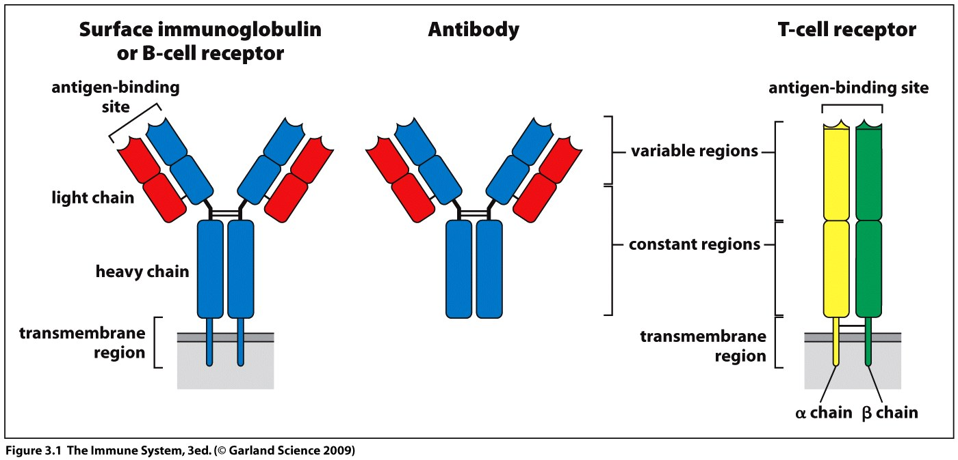

Slide 11
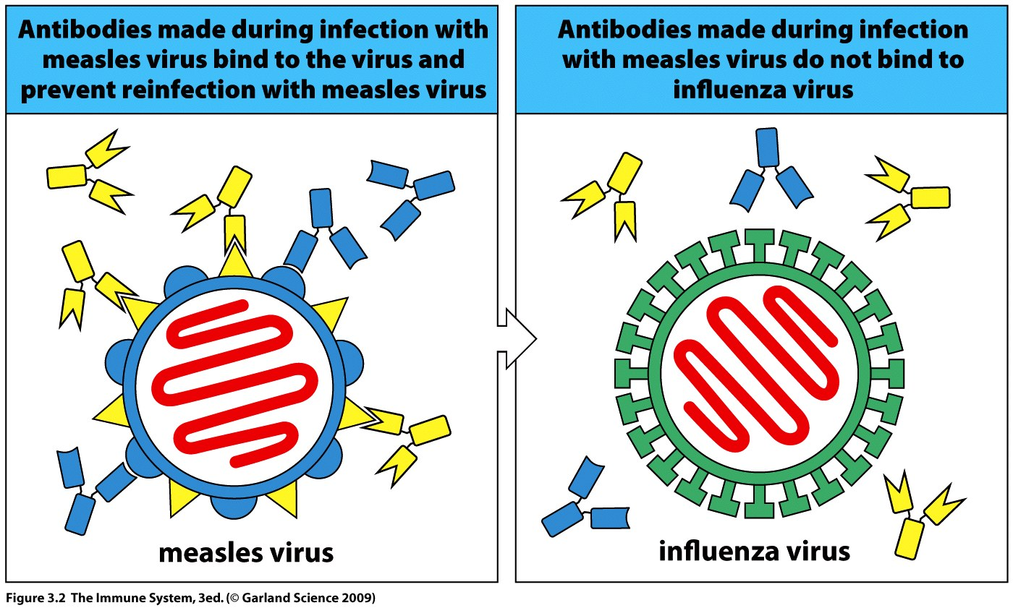
T cell receptor
α chain and β chain anchored in the cell membrane
Both chains have a variable and constant region
Variable region forms the antigen binding site
T and B cell specificity is restricted to an individual pathogen – no cross reaction between microbial species.

Slide 12
The constant region of the immunoglobulin molecule contains binding sites for:
cellular receptors on inflammatory cells
complement
Immunolglogulin acts like a “molecular bridge” connecting pathogen and effector cell/molecule.

Slide 13
Somatic recombination
Diversity of antigen receptors is generated at the genetic level
The variable regions of both the B and T cell receptors are coded for in segments
Variable segment = V
Joining segment = J
Diversity segment = D
Each segment sequence is derived from the splicing of a different set of tandem repeat genes separated by introns.

Slide 14
Variable region heavy chain or β chain = segments V, D and J.
Variable region light chain or α chain = segments V and J only.
Gene rearrangement must first occur to randomly select a V, D and J gene then splice out all other tandem genes and introns – enzyme catalyzed
T and B cell genetic mechanism is the same but there are separate T cell and B cell gene loci.

Slide 15
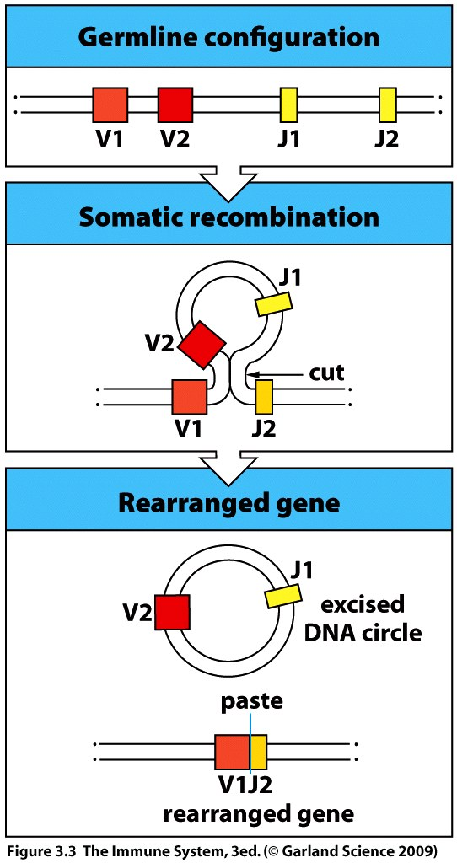
Occurs within the developing B or T cell;
Genes are inactive in the germ line configuration.
One V segment and one J segment gene is randomly selected and recombination excises the other genes.
V and J are spliced together to make a functional gene which will transcribe for a single mRNA.

Slide 16
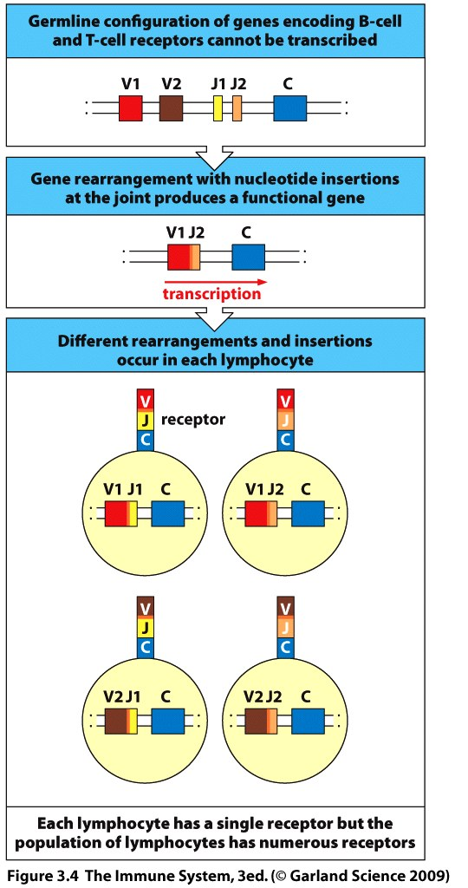
Variability of receptor specificity is mainly due to the different combinations of V, D and J (or V and J) regions brought about by gene rearrangement.
Further diversity arises from errors in cutting and splicing of the genes by enzymes – additional nucleotides can be introduced between the genes.
Diversity is also created by the different combinations of heavy and light or α chain and β chain which may associate to produce the final receptor.

Slide 17
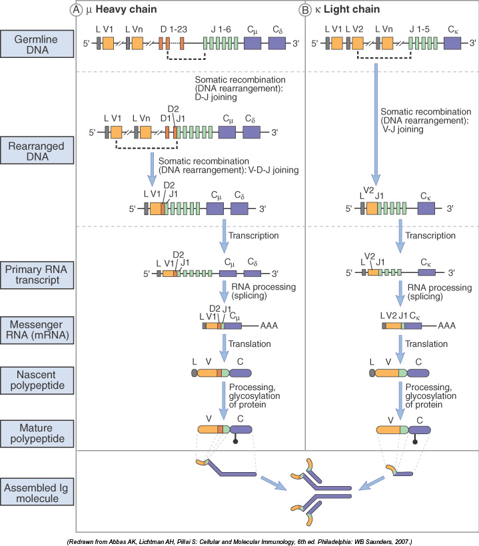

Slide 18
3-4
Each T or B cell expresses receptors with a single specificity
Each T or B cell within the host population of cells has the
potential to express a different receptor
This diversity allows for the selection of only those cells which recognize a pathogen and then permits these cells to tailor the immune response specifically for that pathogen
During a primary infection a small percentage of the T and B cell population is selected by the pathogen (clonal selection) and numbers of these cells are increased by proliferation (clonal expansion)
It takes a few days for cell numbers to reach an effective level

Slide 19
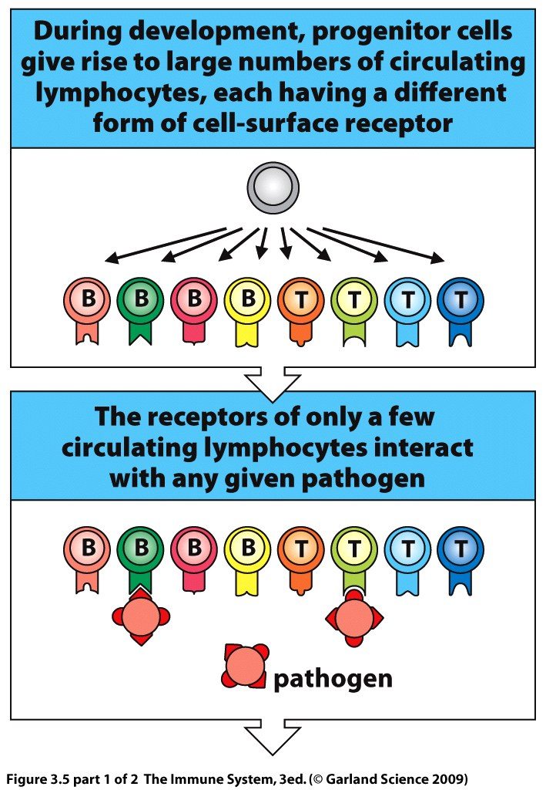
Clonal selection
by pathogen

Slide 20
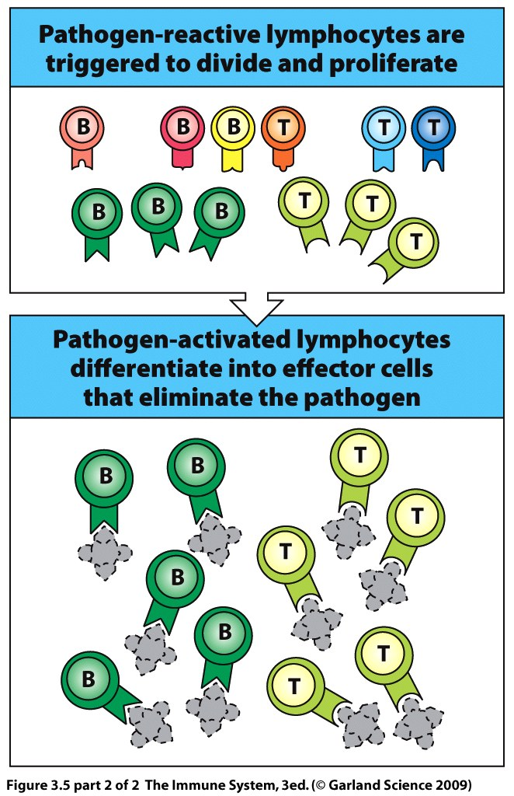
Clonal expansion
of T and B cells

Slide 21
Unlike the innate system the adaptive immune response is not initiated at the site of the infection but in specialized lymphoid tissues and organs throughout the body
Lymph nodes, white pulp of spleen, Peyer’s patches.
Phagocytic dendritic cells engulf antigen at the site of infection and transport it through the lymphatic system.
Dendritic cells enter the secondary lymphoid tissue and interact with T cells.
Circulating naïve T cells enter a lymph node from the blood and survey the dendritic cell for antigen recognition
If there is not recognition a cell continues out of the lymph node.

Slide 22
T-cell receptor:
Discovery of T-cell Receptors - YouTube

Slide 23
Somatic Recombination
Gene Recombination - YouTube

Slide 24
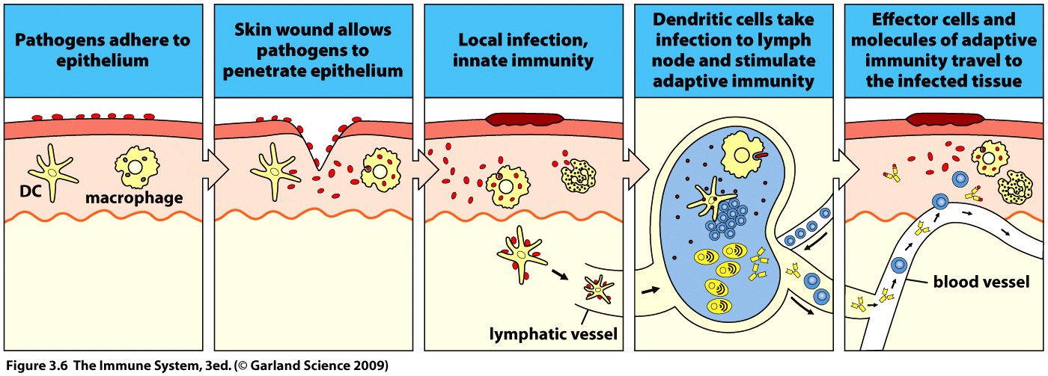
T cell selection
The small fraction of cells which bind the antigen stay in contact with the antigen presenting dendritic cell.
This leads to T cell proliferation and differentiation into effector cells.
Effector T cells may now help to activate B cells.

Slide 25
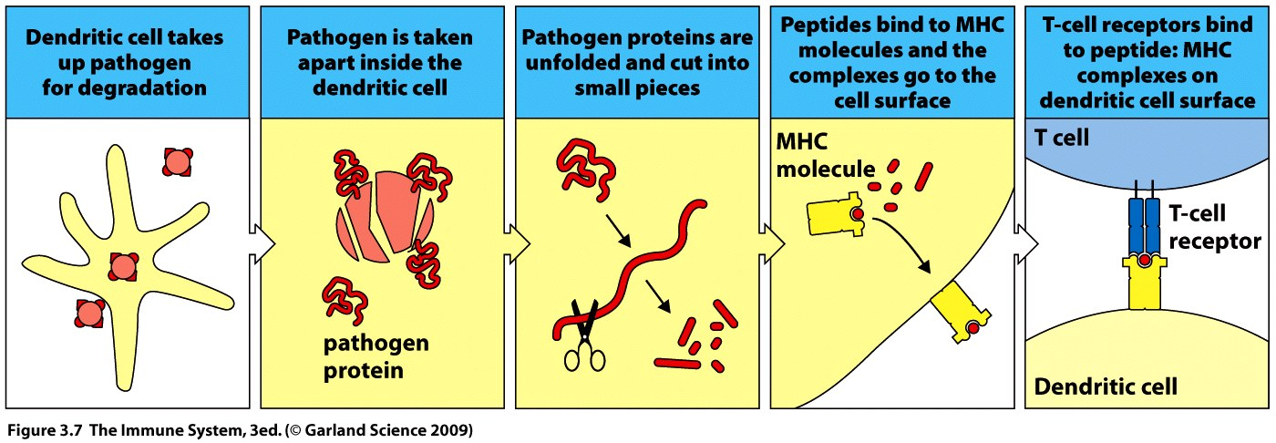
T cells do not recognize the pathogen as a whole but only a short peptide (8-25 a.a.) of pathogen origin.
Dendritic cells enzymatically degrade and process the pathogen into a form which may be viewed by the T cell.
Multiple antigens can be produced from the pathogen.
Dendritic cells present the antigenic peptides at their surface held in an MHC molecule = antigen processing and presentation.

Slide 26
Processed antigen within the dendritic cell is bound by a glycoprotein MHC (major histocompatibility complex) and stretched out into a linear form for presentation
The MHC-peptide complex is transported to the cell surface where the entire complex acts as the ligand for the T cell receptor
The antigen must be presented in the context of the
MHC molecule to be recognized by the T cell.
The dendritic cell is termed an antigen presenting
cell

Slide 27
MHC molecules can only bind to peptides of a certain length and so not every breakdown product from the pathogen will be presented to T cells.
Different forms of MHC have different specificities and are encoded for by different genes (a gene family).
Different alleles of the MHC genes are present within the human population and an individual is usually heterozygous for MHC genes.

Slide 28
Dendritic cells can produce a variety of MHC glycoproteins and therefore present a range of different pathogen derived antigens.
MHC polymorphism is the basis for tissue typing –
If the MHC molecules of a donor tissue do not match those of the recipient they are seen as foreign and rejection occurs.

Slide 29
There are two classes of MHC molecule
Extracellular and intracellular pathogens will be presented by different classes
Extracellular pathogens are phagocytosed and degraded within a vesicle while intracellular are degraded in the cytoplasm.
MHC I is located in the ER
binds peptides delivered from the cytosol
T cytotoxic cells bind peptide-MHC I complexes (intracellular pathogen).
MHC II enters the endocytic vesicle
to bind peptides degraded during phagocytosis
T helper cells bind peptide-MHC II complexes (extracellular pathogen).

Slide 30
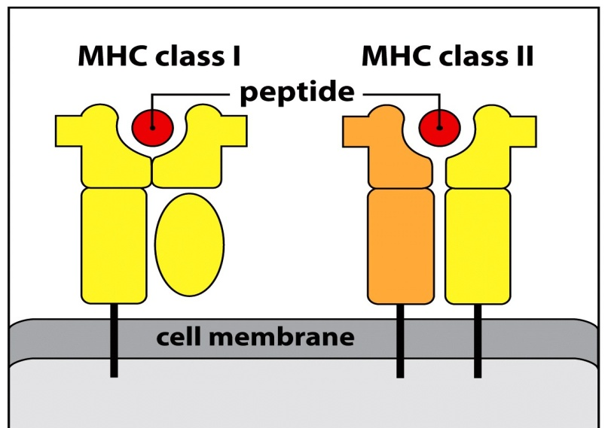
MHC I
Intracellular
pathogen presentation
e.g. virus
MHC II
Extracellular
pathogen presentation
e.g. bacteria

Slide 31
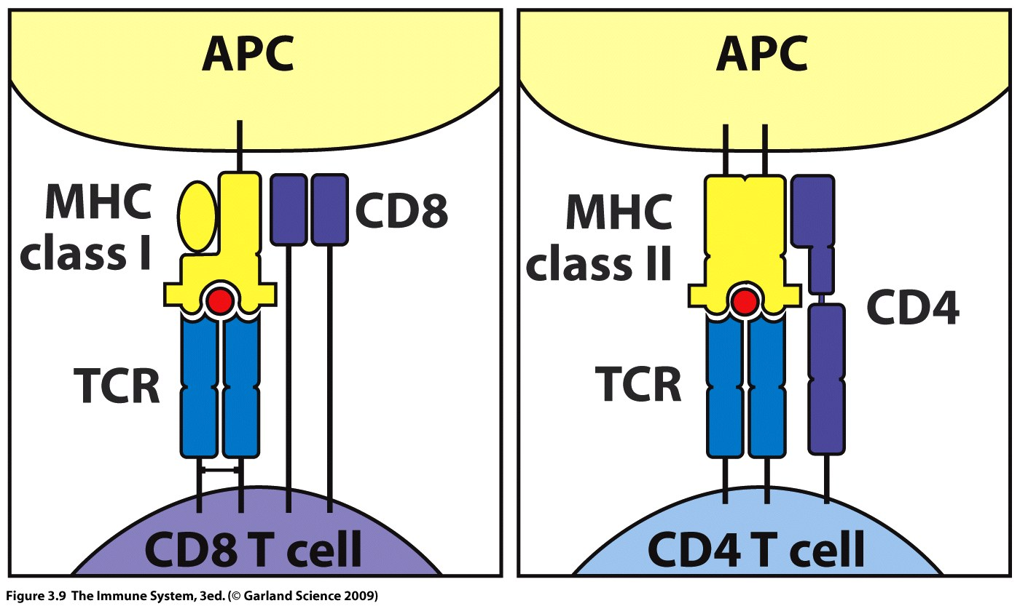
Cytotoxic Helper
e.g. viral bacterial/etc
Co-receptors CD8 or CD4 on the T cell, bind specifically to either MHC I or MHC II to ensure that the appropriate T cell for the pathogen type is activated – control and specificity
Any receptor denoted as CD, clusters of differentiation, is used to mark the cell type

Slide 32
T-cell - APC
TCR-APC Interaction - YouTube

Slide 33
T cytotoxic cells become effector cells capable of directly killing an infected cell
T helper cells either bind directly to cells or secrete cytokines
Cytokines then enhance phagocytosis by neutrophils and macrophages and antibody production by B cells
T cells express either CD4 or CD8 NEVER both.

Slide 34
Once activated the effector T cells must be able to interact with target cells
infected cells
phagocytic cells
they achieve this by looking for the correct class of MHC molecules expressed on the surface of the cells.
The target cells must also contain the pathogen peptide complexed in the MHC molecule
This is not an APC but an infected cell

Slide 35
MHC I, presents peptides derived from intracellular pathogens to cytotoxic CD8 T cells
CD8 T cells induce apoptosis
MHC I is expressed by nearly all cell types and is upregulated by inflammatory cytokines.

Slide 36
MHC II, presents peptides derived from extracellular pathogens to helper CD4 T cells
CD4 T cells produce a variety of cytokines and are active against all pathogens present in the extracellular fluid (inc. virus)
Effector CD4 T cells recruit neutrophils and monocytes (macrophages) to the site of infection and interact via MHC II on the macrophages to increase their killing power
Another subset of T helper cells remains at the secondary lymphoid tissue to stimulate antibody production by B cells.

Slide 37
The main function of a B cell is to make antibody.
Activation of B cells leads to differentiation into Plasma cells
Antibodies are released into circulation or at the mucosal surface during infection
Antibodies bind to pathogens,
this action alone may halt infection - neutralization of viruses.
Coating may also target pathogen for degradation by effector cells.

Slide 38
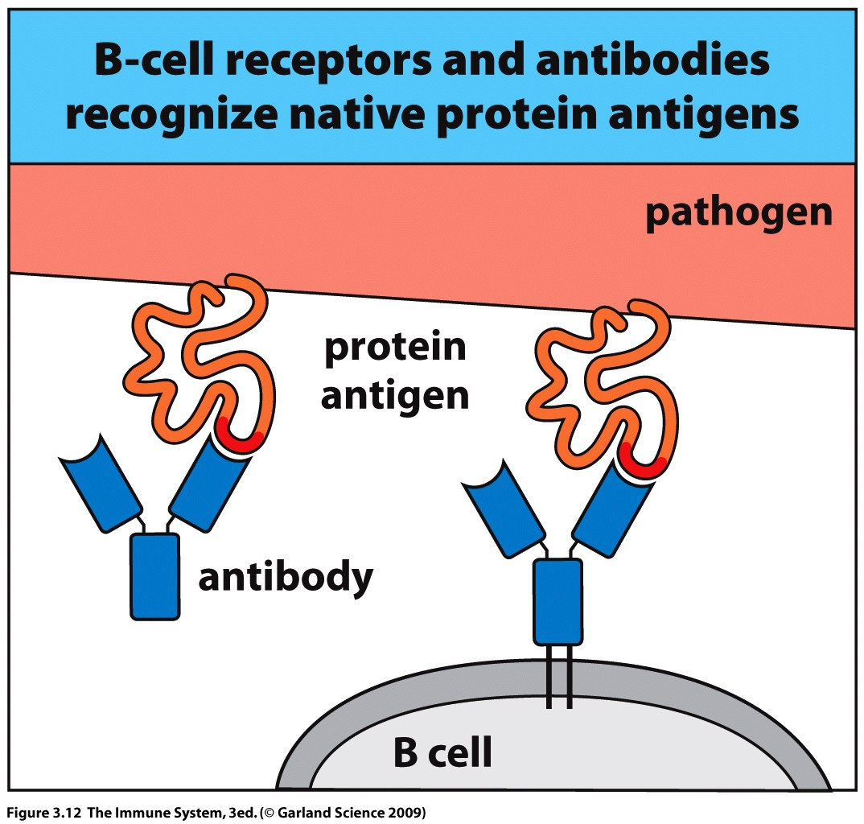
Unlike the T cell receptor, antibodies can recognize their epitopes within the native protein on the surface of the pathogen.
Peptide processing is not required by the B cell receptor.

Slide 39
Antigen is presented to the B cell within the lymphoid tissue by dendritic cells.
Naïve B cells which do not interact with the antigen continue in circulation.
Binding of a bacterium or protein to a B cell triggers receptor mediated endocytosis.

Slide 40
Bacteria are thus engulfed within an endocytic vesicle of the B cell and degraded.
Resultant peptides are bound by MHC II molecules and presented back at the B cell surface.
The peptide is then presented to the T helper cell and this interaction leads to differentiation of the B cell into a plasma cell.

Slide 41
This is why the T cells are presented the antigen first.
B cells must interact with effector T helper cells in order to differentiate to plasma cells.
The T helper cell secretes cytokines to the B cell which stimulate differentiation.
Example of cellular co-operation.
Both T and B cells must be triggered by the same pathogen but not necessarily the same epitope.

Slide 42
B and T cell co-operation lead to differentiation into plasma cell

Slide 43
Clonal Selection
Clonal Selection

Slide 44
Antibodies are divided into 5 classes or isotypes according to the structure of the heavy chain constant region.
IgA, IgD, IgE, IgG and IgM
Naive B cells express IgM and IgD
IgM is the first immunoglobulin to be secreted in response to
infection
As the immune response progresses other antibody classes are produced by the B cell
Antibodies circulate in the bloodstream and enter the site of infection through the more permeable areas of the blood vessels.

Slide 45
Antibodies bind extracellular pathogens and the protein toxins they secrete
IgA is made in the lymphoid tissues below the mucosal surfaces and is selectively transported through the epithelial layer to act against mucosal infections
Antibodies bound to a pathogen/toxin can act to:
Inhibit growth and replication
Interfere with binding to the host cell
- neutralization of virus or toxin

Slide 46
IgG has an important role in the killing of extracellular pathogens and neutralization of toxins – Opsonization
Neutrophils and macrophages express receptors for the constant region of IgG but not IgM.
Opsonization can also be achieved by coating with complement.

Slide 47
IgM interacts with complement and initiates the classical pathway leading to pathogen coating with C3b.
C3b tags the pathogen for destruction by macrophages which express complement receptors.
Maximum phagocytic stimulation is achieved by coating the pathogen in both IgG and complement.

Slide 48
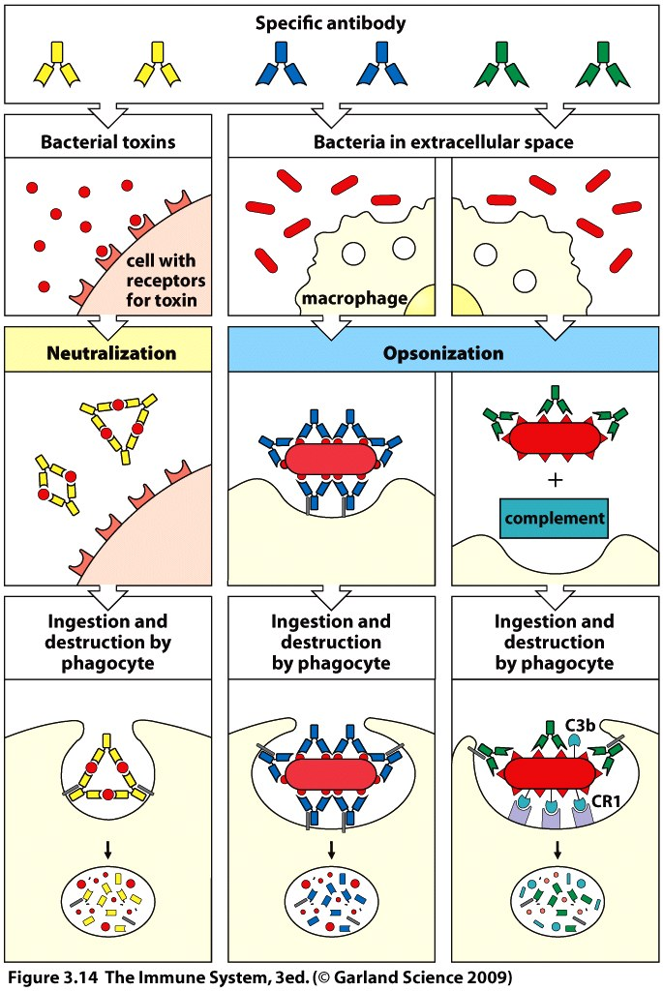

Slide 49
IgE does not freely circulate but is mostly found bound to Mast cells via the constant region.
IgE is active against parasites and helminths and triggers the Mast cell to release inflammatory mediators.
IgE is also involved in allergic reactions.
Do not involve an infectious organism.
Antigen may be to pollen etc.

Slide 50
Antibodies act as a bridge between pathogen and effector molecule or cell.
All naïve B cells have IgM receptors and this is the first isotype of antibody which is secreted upon activation.
As the B cell clone expands in the germinal center of the secondary lymphoid tissue 2 mechanisms within the B cell modify the antibody it is secreting.
Somatic hypermutation
Isotype switching
Remember somatic recombination randomly generated the receptor the first time.

Slide 51
1) somatic hypermutation;
introduces nucleotide substitutions into the variable regions of the rearranged immunoglobulin heavy and light chain genes.
This randomly generates new variants of the antibody
Some may bind more tightly than the original version
Specificity is not changed just binding affinity
Cells with successful mutations will be preferentially selected to become plasma cells.

Slide 52
2) Isotype switching;
also called class switch recombination, changes the isotype of the antibody but not the antigen binding site.
The coding regions for the constant IgG, IgA and IgE
chains lie downstream of the gene for IgM
The coding region for the IgM constant chain is spliced out and the gene for the new class is brought into position next to the variable chain coding region.

Slide 53
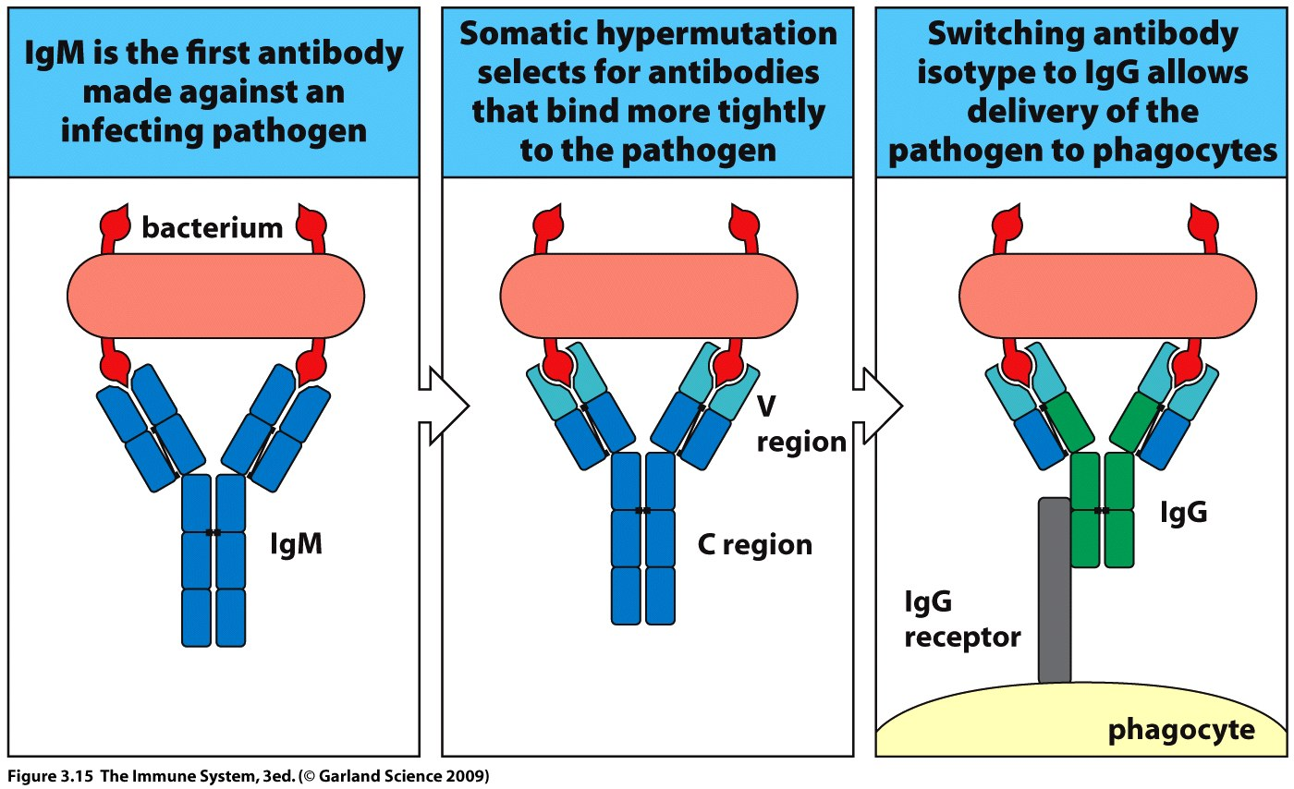
The site and type of infection will determine which class of antibody is switched
Mucosal Peyers patches IgM to IgA
Lymph nodes IgM to IgG
Parasitic infection IgM to IgE

Slide 54
The combined effect of somatic hypermutation and antibody class switching is the selection of antibodies which;
bind more tightly to the pathogen
are delivered more efficiently to the site of infection
are better at interacting with effector cells
These high affinity antibodies are the ones which will be retained in the immunological memory

Slide 55
During the course of an infection clones of pathogen specific T and B cells are expanded to generate effector cells
Once the infection is eliminated the immune response must be terminated
Regulatory mechanisms reduce inflammation and permit repair of damaged tissue.
Effector T cells are signaled to die
Plasma cells are allowed to persist and continue to generate pathogen specific antibodies which circulate in the blood for years in anticipation of a secondary infection.

Slide 56
Clonal expansion during infection also generates memory T and B cells which can persist for the life of the host
The secondary adaptive immune response is faster and stronger than the primary response because;
Specific memory cells out number the naïve cells of the primary infection.
Memory cells are more quickly activated than naïve.
Memory cells can patrol non-lymphoid tissue and therefore detect infection earlier.
Memory B cells make higher affinity antibodies than the naïve ones they originated from.

Slide 57
The secondary immune response is so efficient that if memory cells are activated by an infection the system for activating naïve cells is shut down.

Slide 58
The key to the effectiveness of the adaptive immune response is versatility.
Because T and B cell receptors are randomly generated specificities can be created that recognize self.
Cells carrying such receptors have the potential to attack the host and must be eliminated.
Several mechanism have evolved to control this leading to immunological tolerance towards self.
Self is defined as the entire molecular constituents of the healthy human body.

Slide 59
Tolerance can be generated at the time of lymphocyte development in the bone marrow or thymus (T cells).
Immature T cells (thymocytes) are subjected to two rounds of clonal selection.

Slide 60
First, positive selection:
T cells are selected which can interact efficiently with the individuals profile of MHC molecules.
Remember the T cell receptor only recognizes antigen in the context of MHC presentation.
There are a 1000 possible MHC molecules within the human population but an individual expresses only about 20.
T cells which recognize irrelevant MHC are given a signal to die by apoptosis.
T cells which survive positive selection now undergo negative selection.

Slide 61
Second, negative selection:
T cells which bind too strongly to self MHC are eliminated via apoptosis.
If an effector cell binds with too great an affinity to a host cell via an MHC molecule it could attack that cell in the absence of antigen.
T cell selection is so stringent that only 1% of thymocytes make it through the process – EXTREME CONTROL.
Surviving T cells are non-responsive to self and said to be self-tolerant.

Slide 62
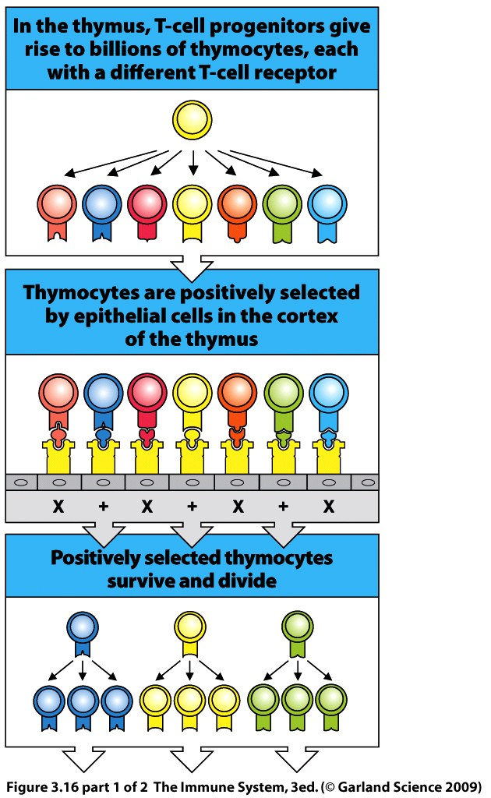
Must recognize MHC ~high affinity.

Slide 63
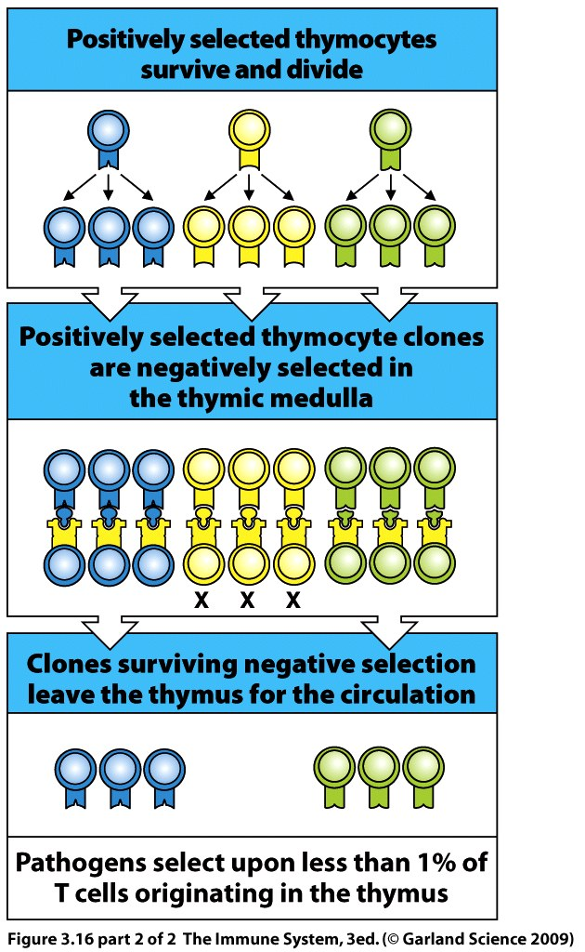
Can not bind MHC
too tightly ~ low avidity

Slide 64
B cell activation is dependent upon helper T cells which recognize the same antigen as the B cell
Thus, T cell selection is effective on B cells
If all self reacting T helper cells are eliminated no self reacting B cell can be activated by that T cell.
Therefore B cell selection is not as stringent as for T cells.

Slide 65
B cell selection;
In the bone marrow negative selection is used to eliminate cells which could make self reactive antibodies (auto-antibodies)
B cells which bind strongly to any component of the bone marrow are triggered to die by apoptosis.

Slide 66
Tolerance which arises in the primary lymphoid tissue is called central tolerance
Mechanisms for Peripheral tolerance occur in the circulation, secondary lymphoid tissue and the rest of the body
Include regulatory T cells,
A subset of CD4 T cells that suppress effector T cells reactive against healthy cells.

Slide 67
If the immune response is triggered against an antigen from a non-infectious source or self, disease may result.
The adaptive immune response can become chronically misdirected towards self and damage healthy host tissue.
Autoimmune disease results from an immune response against a normal component of the healthy body.
E.g. Insulin-dependent diabetes mellitus (type I). Here the immune system targets and destroys insulin secreting β cells of the islets of Langerhans in the pancreas.
Autoimmunity can be triggered when T and B cells selected against pathogens cross react with self components.

Slide 68
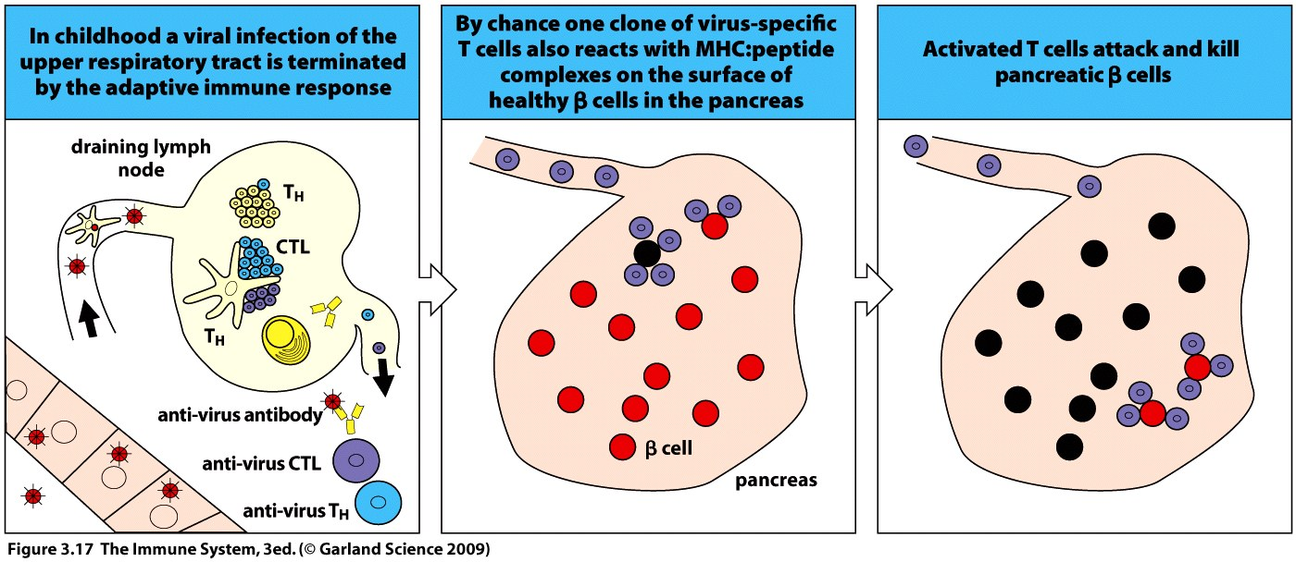
Remember the B cell receptor is modified after pathogen selection and this can also accidently lead to cross reaction with self, auto-antibodies.

Slide 69
Allergy and hypersensitivity arise when the immune system reacts against molecules from a non-infectious source.
Food, grass, pollen, dust and dander.
Non-infectious antigens are termed allergens.

Slide 70
IgE antibodies can be generated upon first exposure to the allergen
These circulate and bind to mast cells via constant region
At re-exposure the allergen binds to the variable region of the IgE coating the Mast cells which immediately triggers inflammatory mediator release.
Can cause dangerous asthmatic or systemic anaphylatic response.

Slide 71
