Slide 1
Part III
Innate Immunity

Slide 2
Chapter Overview
External defense system
Internal defense system
Pathogen-recognition receptors
Acute-phase reactants
Inflammation
Phagocytosis
Natural killer (NK) cells

Slide 3
Innate Immune System
Defenses against infection that immediately act when a host is attacked by a pathogen
Composed of two systems that work to promote phagocytosis
External defense system—anatomical barriers designed to keep microorganisms from entering the body
Internal defense system—includes cellular responses that recognize specific molecular components of pathogens
Notes:
Components of innate immunity can be thought of as the first responders because they react immediately to infectious agents.
Phagocytosis is the engulfment and destruction of foreign cells or particulates by leukocytes, macrophages, and other cells.
The innate immune system is so efficient that most pathogens are destroyed before they ever encounter cells.

Slide 4
External Defense System
Composed of physical, chemical, and biological barriers that work together to prevent infection from entering the body

Slide 5
External Defense System
Skin
Physical barrier with secretions that discourage microorganism growth
Epidermis: Tightly packed epithelial cells coated in keratin
Dermis: Connective tissue with blood vessels, hair follicles, sebaceous glands, sweat glands, and WBCs
Notes:
WBCs = white blood cells.
The WBCs found in the dermis include macrophages, dendritic cells, and mast cells.

Slide 6
External Defense System
Skin
Lactic acid and fatty acids maintain the skin at a pH of approximately 5.6
Psoriasin, a small protein produced by skin cells, has antibacterial effects
Respiratory tract
Mucous secretions block bacteria from adhering to epithelial cells
Coughing/sneezing moves pathogens out of tract

Slide 7
External Defense System
Urine helps remove potential pathogens from the genitourinary tract
Digestive tract
Stomach’s hydrochloric acid keeps the pH as low as 1, prohibiting microorganism growth
Normal flora (microbiota) help to keep pathogens from establishing themselves in these areas

Slide 8
Internal Defense System
Internal defense system
Pathogen-recognition receptors
Acute-phase reactants
Inflammation
Phagocytosis
Natural killer (NK) cells

Slide 9
Pathogen-Recognition Receptors (PRRs)
Recognize molecules unique to infectious organisms
Found on:
Macrophages and dendritic cells, neutrophils, eosinophils, monocytes, mast cells, T cells, and epithelial cells
Notes:
Macrophages and dendritic cells are the most important cells involved in pathogen recognition.

Slide 10
PRRs
Encoded by host’s DNA to sense extracellular infection
Recognize pathogen-associated molecular patterns (PAMPs) on microorganisms
When bound to a pathogen, activate phagocytic cells

Slide 11
Examples of PRRs
Toll-like receptors (TLRs)
10 types found in humans
Some on cell surfaces
Some in cytoplasm
Notes:
Instructors may choose to refer to Table 3-1 in the book.

Slide 12
Characteristics of TLRs
TLRs
Are glycoproteins that bind to particular substances, activating cytokine and chemokine production and other processes to enhance phagocytosis
Can destroy most pathogens that humans are exposed to before disease sets in

Slide 13
Other PRRs
Other receptors
C-type lectin receptor (CLR)
Binds to mannan and β-glucans found in fungal cell walls to activate cytokine and chemokine production
Retinoic acid–inducible gene-I-like receptor (RLR)
Nucleotide-binding oligomerization domain (NOD) receptor

Slide 14
Acute-Phase Reactants
Soluble factors found in serum
Increase rapidly in response to infection, injury, or tissue trauma
Facilitate contact between microbes and phagocytic cells
Mop up and recycle important proteins after phagocytosis

Slide 15
Types of Acute-Phase Reactants
PROTEIN | RESPONSE TIME (HOURS) | NORMAL CONCENTRATION (MG/DL) | INCREASE | FUNCTION
C-reactive protein | 4–6 | 0.5 | 1,000X | Opsonization, complement activation
Serum amyloid A | 24 | 5 | 1,000X | Activates monocytes and macrophages
Alpha₁-antitrypsin | 24 | 200–400 | 2–5X | Protease inhibitor
Fibrinogen | 24 | 200–400 | 2–5X | Clot formation
Haptoglobin | 24 | 40–290 | 2–10X | Binds hemoglobin
Ceruloplasmin | 48–72 | 20–40 | 2X | Binds copper and oxidizes iron
Complement C3 | 48–72 | 60–140 | 2X | Opsonization, lysis

Slide 16
Process of Inflammation
The body’s overall reaction to injury or invasion by an infectious agent
Cardinal signs and symptoms
Redness (erythema)
Swelling (edema)
Heat
Pain

Slide 17
Inflammation
Notes:
Figure 3-4. Major events involved in local inflammation.

Slide 18
Phagocytosis
Cells most involved
Neutrophils
Monocytes
Macrophages
Dendritic cells

Slide 19
NK Cells
First line of defense against:
Cells that are virally infected
Cells infected with other intracellular pathogens
Tumor cells
Recognize any damaged cell and can eliminate it without prior exposure to it, giving immune system time to activate adaptive response of specific T and B cells

Slide 20
NK Cells
Stimulated by exposure to cytokines
When activated, produce additional cytokines and colony-stimulating factors
Influence innate and adaptive immunity

Slide 21
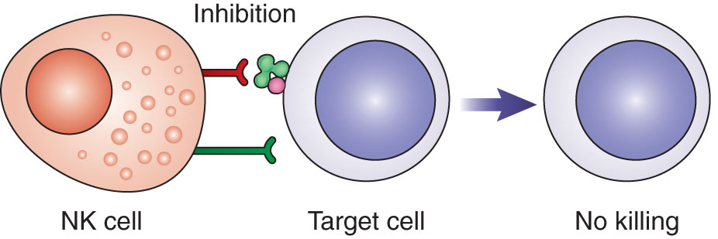
NK Cells
Mechanism of cytotoxicity
Notes:
Figure 3-7. Actions of NK cells. NK cells are constantly surveying cells. (A) If class I MHC protein is present and there are no foreign or stress proteins, then an inhibitory signal is sent to the NK cell, no killing occurs, and the normal cell is released. (B) If an activating receptor is engaged by a foreign or stress protein and class I MHC is altered or missing (“missing self”), then no inhibitory signal is given, granzymes and perforins are released, and the infected or diseased cell is eliminated by apoptosis. (C) Alternatively, infected cells may express foreign proteins on their surface that are recognized by antibody. NK cells express CD16 receptors that bind the immobilized antibody and activate the release of perforins and granzymes (antibody-dependent cell-mediated cytotoxicity).

Slide 22
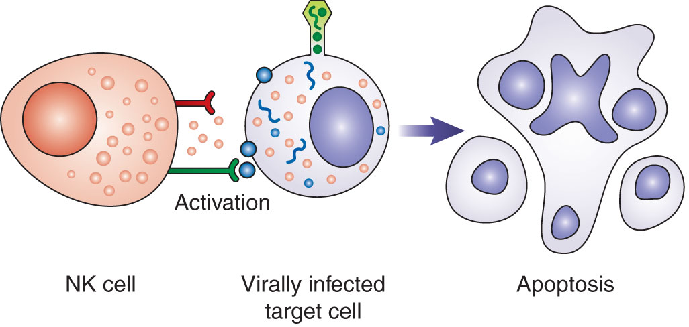
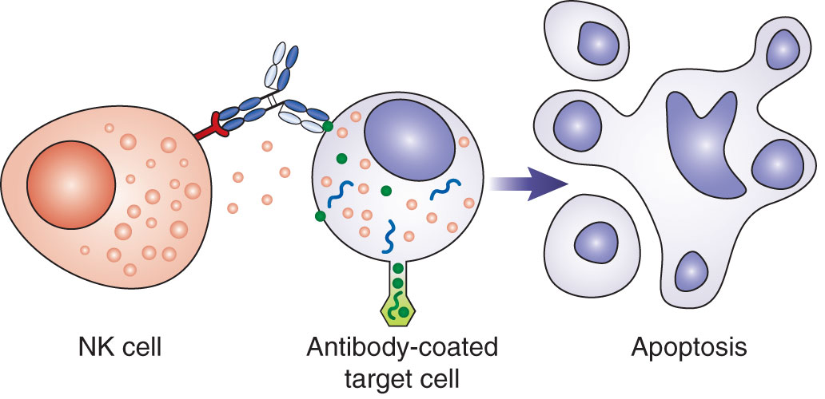
NK Cells
Notes:
Figure 3-7. Actions of NK cells. NK cells are constantly surveying cells. (A) If class I MHC protein is present and there are no foreign or stress proteins, then an inhibitory signal is sent to the NK cell, no killing occurs, and the normal cell is released. (B) If an activating receptor is engaged by a foreign or stress protein and class I MHC is altered or missing (“missing self”), then no inhibitory signal is given, granzymes and perforins are released, and the infected or diseased cell is eliminated by apoptosis. (C) Alternatively, infected cells may express foreign proteins on their surface that are recognized by antibody. NK cells express CD16 receptors that bind the immobilized antibody and activate the release of perforins and granzymes (antibody-dependent cell-mediated cytotoxicity).

Slide 23
Summary
Innate immunity encompasses the body’s normally present defense mechanisms.
Innate immunity is characterized by:
Lack of specificity
No need for a prior exposure
A similar response with each exposure
External defenses are structural barriers and secretions that keep microorganisms from entering the body.

Slide 24
Summary
Internal defenses include:
Cells capable of phagocytosis
Acute-phase reactants that enhance phagocytosis
PRRs are molecules on host cells that recognize substances found only on pathogens. Once receptors bind a pathogen, phagocytosis can take place.

Slide 25
Summary
PAMPs are molecules found only on pathogens, which allow host cells to distinguish them from self.
Acute-phase reactants are serum proteins that increase rapidly in response to infection or injury.
Inflammation is the body’s response to injury or invasion by a pathogen.

Slide 26
Summary
NK cells kill target cells that are infected with a virus or other intracellular pathogen without prior exposure.
NK cells are a link between the innate and adaptive immune systems.

