Slide 1
Thomas • Murphy-Johnson
Clinical Laboratory Immunology
4. Antibody Structure & Generation of B-cell Diversity

Slide 2
Antibodies (Ab)
Made by B cells and plasma cells
Circulate in in blood and lymph
Can recognize all types of macromolecules
Binding of antibody either inactivates or tags a pathogen for destruction
Specific
Antibody repertoire – all the different antibodies made by an individual (10⁹ in circulation)

Slide 3
Antibody membrane bound in naïve B cell
Secreted upon activation and from plasma cell
Antibody production is the only effector function of the B cell
Antibody forms a bridge between pathogen and effector cell
An inability to make antibody makes an individual susceptible to infection, agammaglobulinemia.

Slide 4
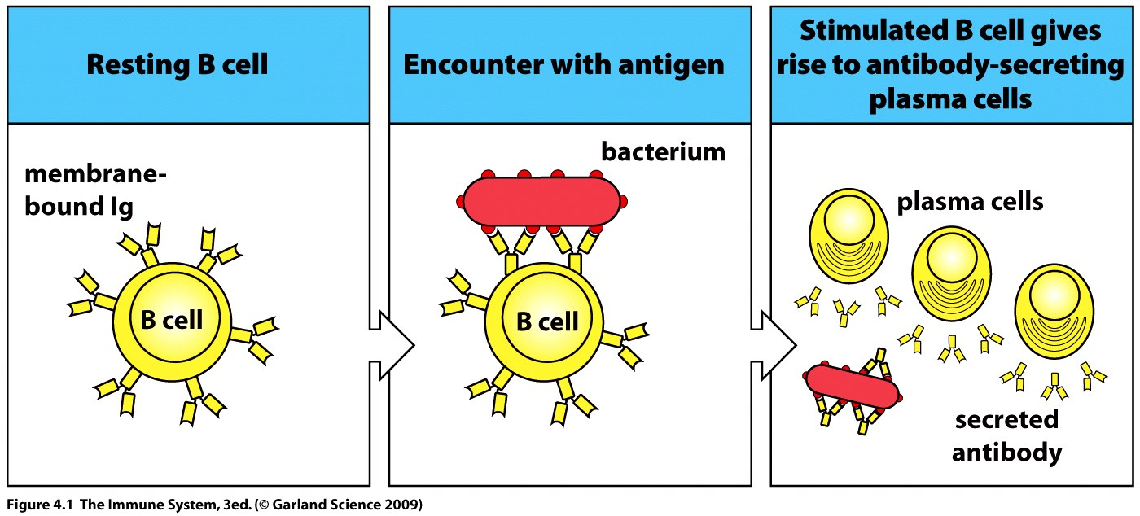

Slide 5
Antibodies are glycoproteins containing 4 polypeptide chains
2 identical heavy chains, 2 identical light
Structure resembles letter “Y”
Each arm of the “Y” is made from a complete L chain covalently linked by a disulphide bonds to the amino terminal of the H chain.
The stem of the “Y” consists of the carboxy-terminal regions of the H chains linked by a disulphide bond.

Slide 6
Sequence differences in the polypeptide chains of differing antibodies are concentrated in the variable region (V region)
Variability leads to specificity
The paired variable regions of H and L chains form the antigen binding site
Each “Y” shaped antibody has two binding sites with the same specificity
Less variation between antibodies appears in the constant region, C region.

Slide 7
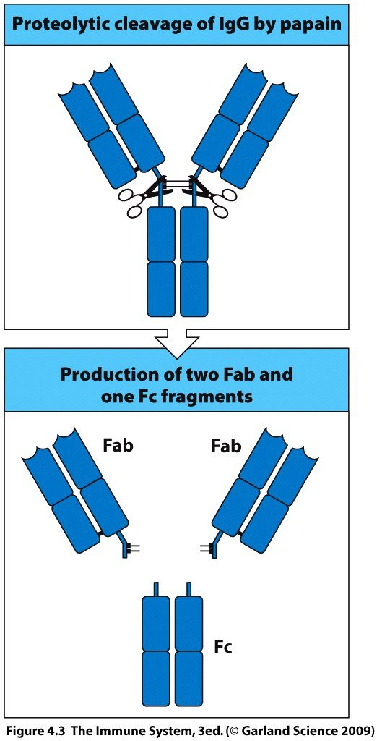
IgG can be cleaved into antibody fragments
Plant protease papain used to digest antibody at hinge region and define the functions of the different antibody portions
3 fragments produced = two arms + a stem
Arms = Fab, fragment antigen binding
Stem = Fc, fragment crystallizable

Slide 8
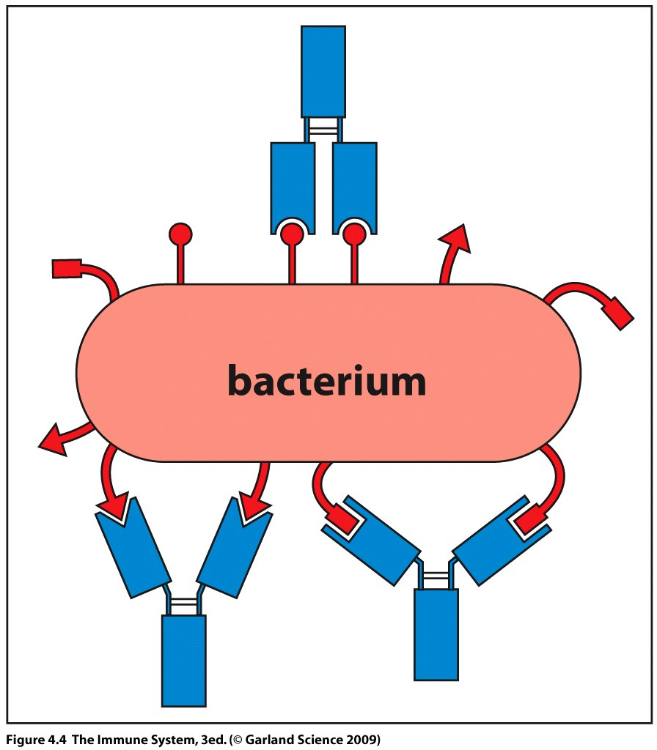
Antibody hinge in IgG permits rotation and reorientation of the arms to ensure good attachment to the surface of a pathogen.

Slide 9
5 isotypes defined by heavy chain C region.
Different functions
Heavy chain denoted by Greek letter
Light chain has only 2 isotypes, kappa (κ) and lambda (λ)
Both types associate with all 5 heavy chains
An antibody will only contain one heavy and one light chain type.

Slide 10
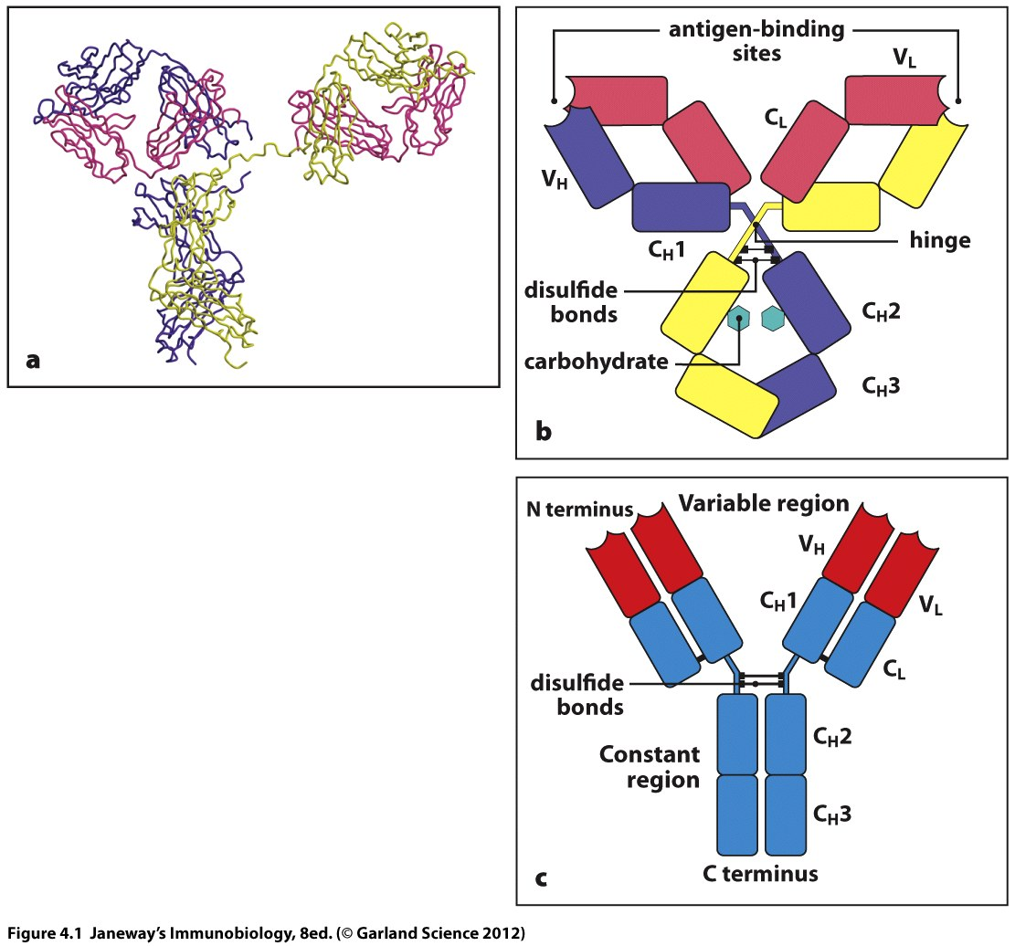
Antibody structure protects against denaturation in the working environment (oxidizing).
Heavy and light chains consist of a series of similar sequence motifs of 100-110 a.a. long.
Folds into compact, stable protein domain – immunoglobulin domain.
Each Ig chain is formed by a linear series of domains.

Slide 11
V region of heavy or light chain consists of one Variable domain.
C region of light chain consists of one constant domain.
C region of heavy chain consists of 3 or 4 constant domains depending upon the isotype.
V_{H} and V_{L.}
C_{L} and C_{H}1, C_{H}2, C_{H}3 and possibly C_{H}4.

Slide 12
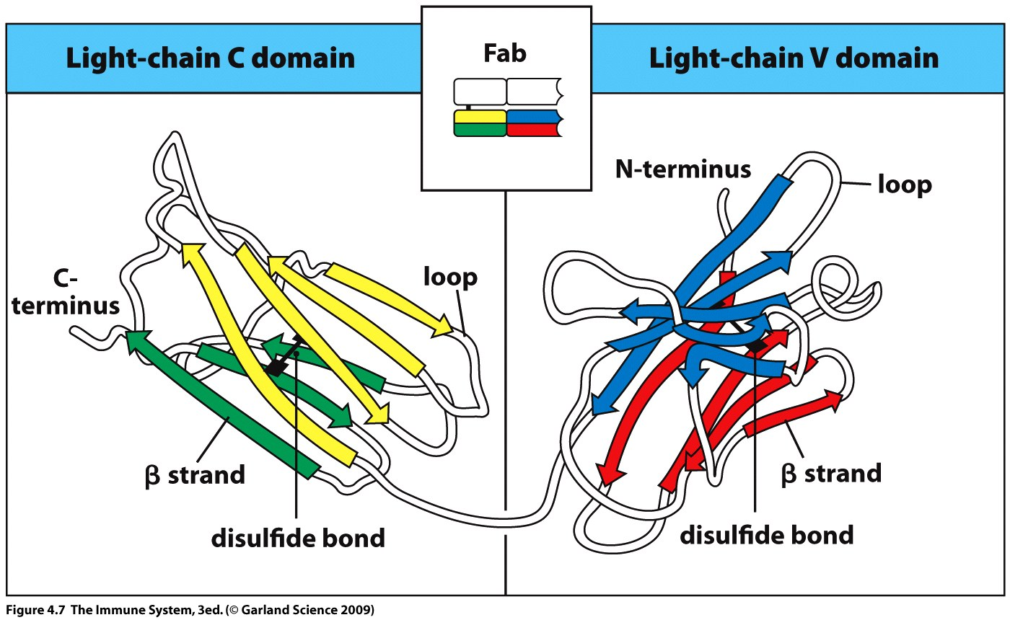
Structure of domain includes two beta sheets held together by disulfide bonds.
Beta sheet provide stability to the structure and the loop regions may vary to exhibit different binding properties (V domain).

Slide 13
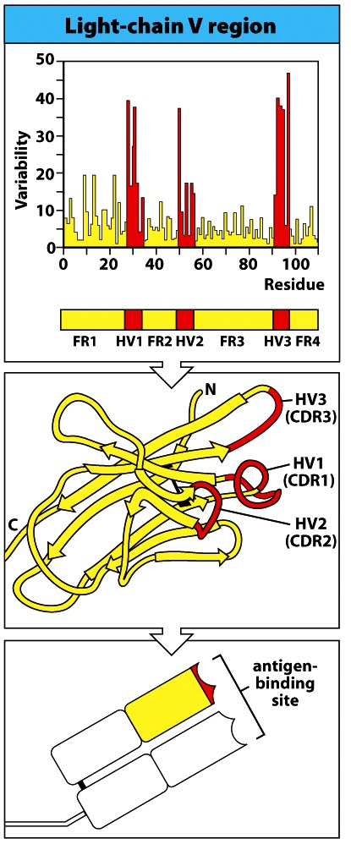
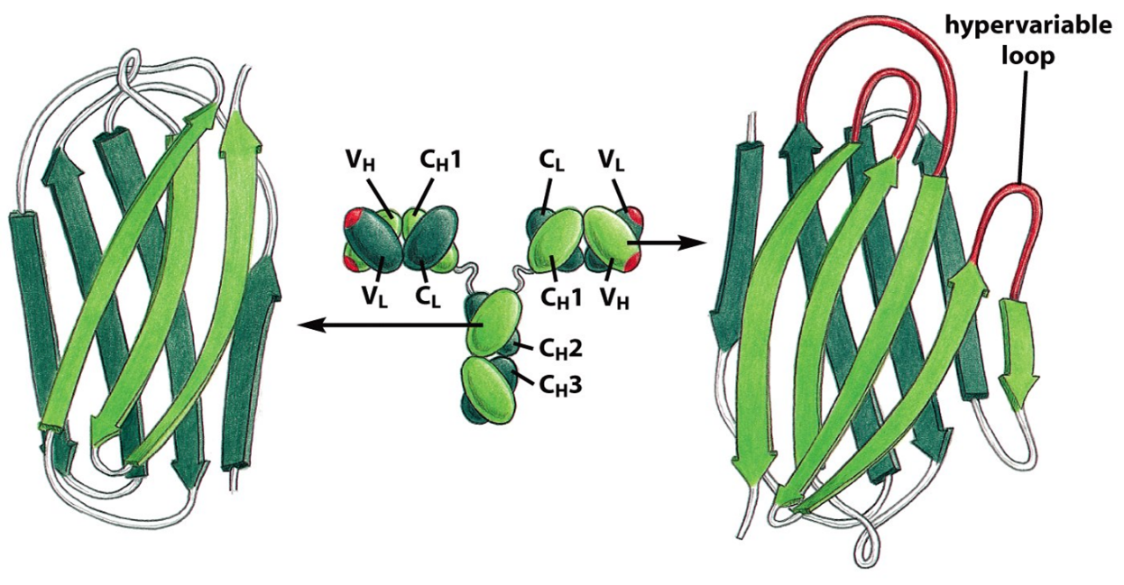
Antibody V domains contain hypervariable regions flanked by framework regions.
Hypervariable regions map to the 3 loops at the end of the domain.
Framework regions map to the beta sheets and remaining loops.
This permits local variation within a structurally constant framework.
The hypervariable regions of both the L and H chains combine to form the antigen binding site – complementarity-determining region (CDR).

Slide 14
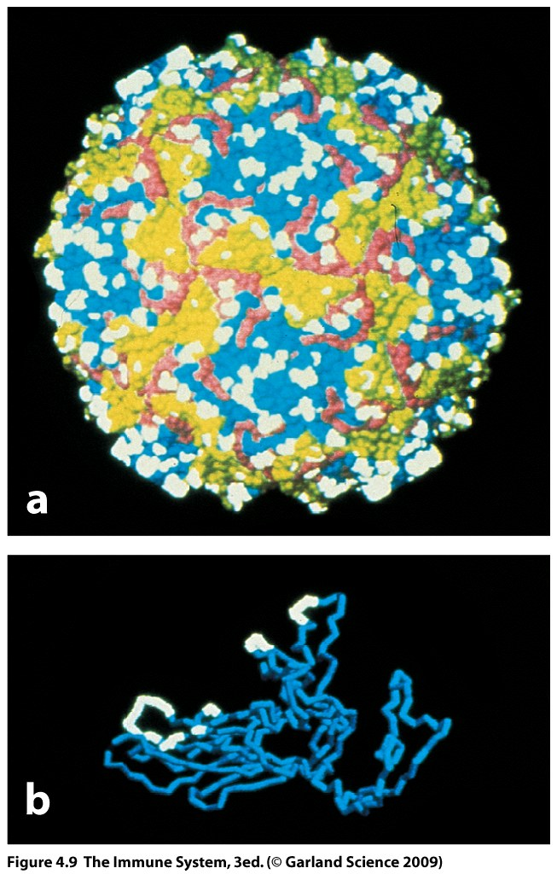
Effective antibodies bind to the exposed molecules on the surface of a pathogen.
Antibodies bind to a short epitope region or antigenic determinant
Usually proteins or carbohydrates
Molecules can contain multiple epitopes – multivalent.

Slide 15
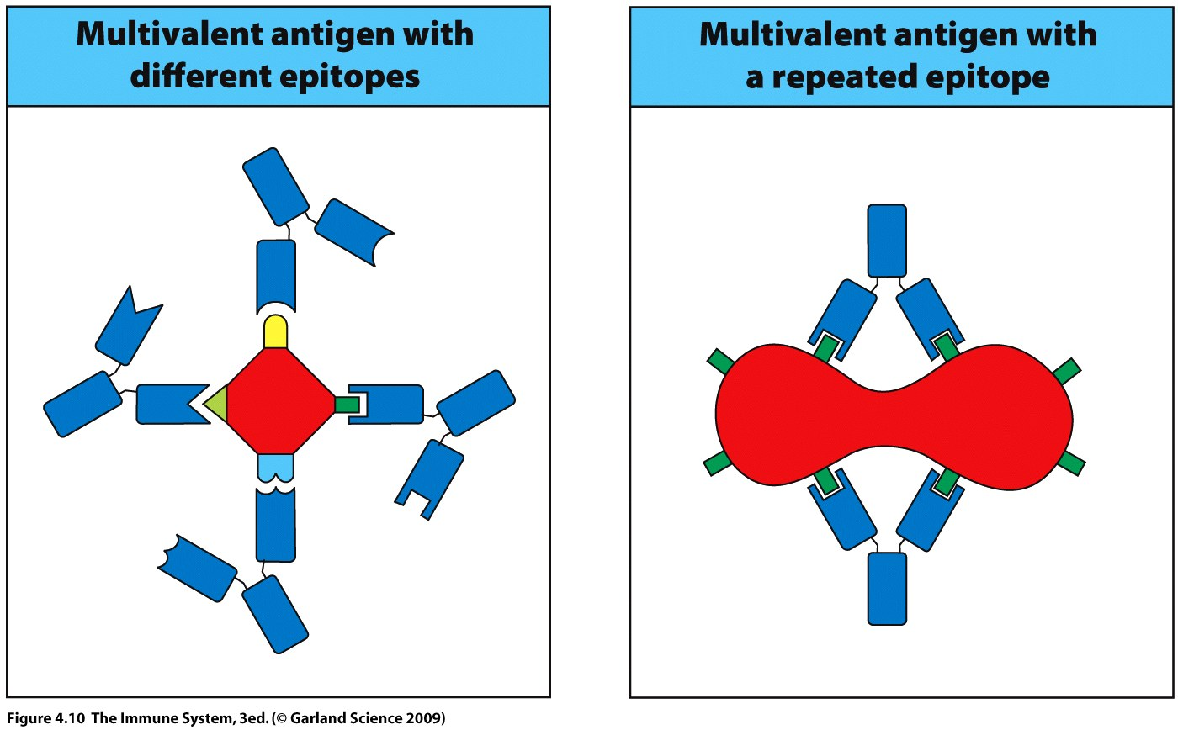
Recognized by more than one antibody.
Recognized by multiple copies of the same antibody.

Slide 16
Antibodies are not just made against proteins and carbohydrates.
Allergy – antibodies against organic molecules, drugs and antibiotics.
Autoimmunity – e.g. antibodies against DNA, Lupus.
Antibody binding is by noncovalent forces such as, hydrogen bonding, van der Waals forces and electrostatic forces.
These short range forces work best when antibody and antigen surfaces fit together well.
Binding strength = binding affinity.

Slide 17
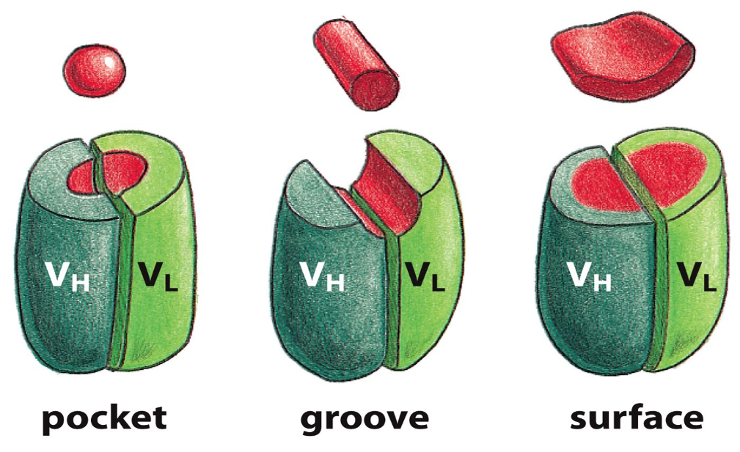
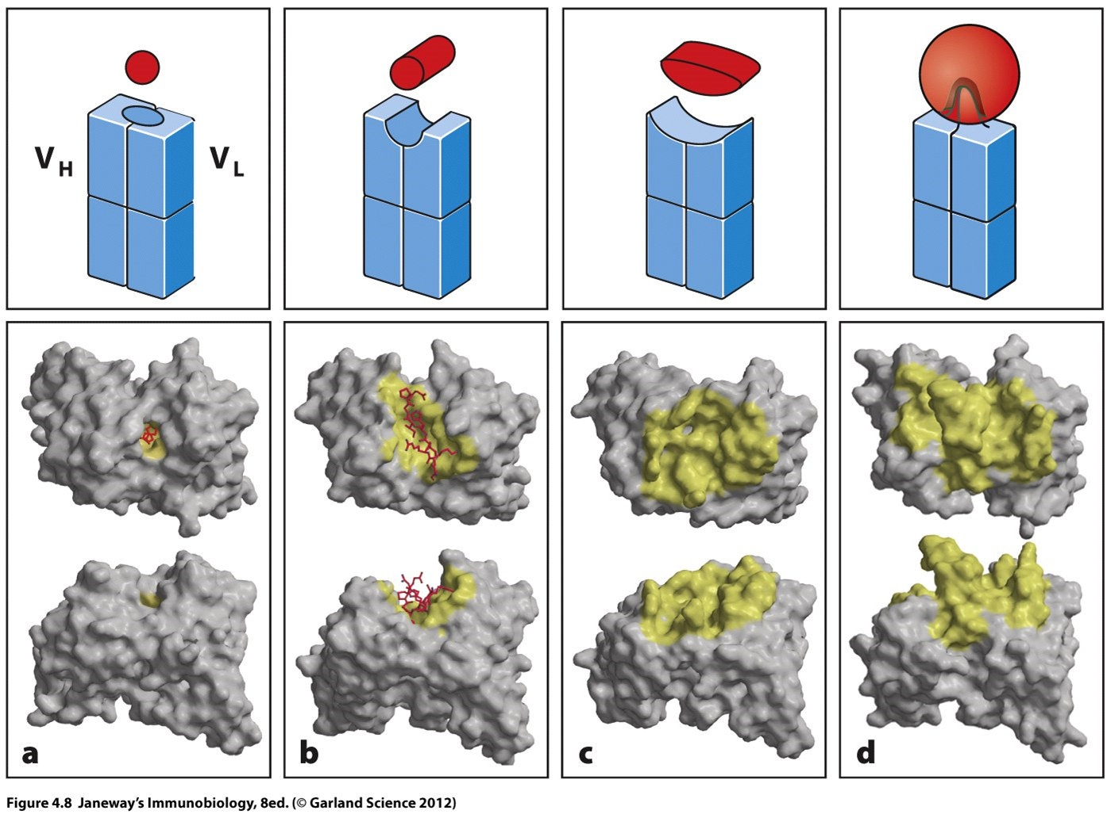
Antibody binding is determined by the epitope conformation.
Not all of the amino acids of the CDR have to be involved in the interaction.
Figure 25-35 Molecular Biology of the Cell (© Garland Science 2008)

Slide 18
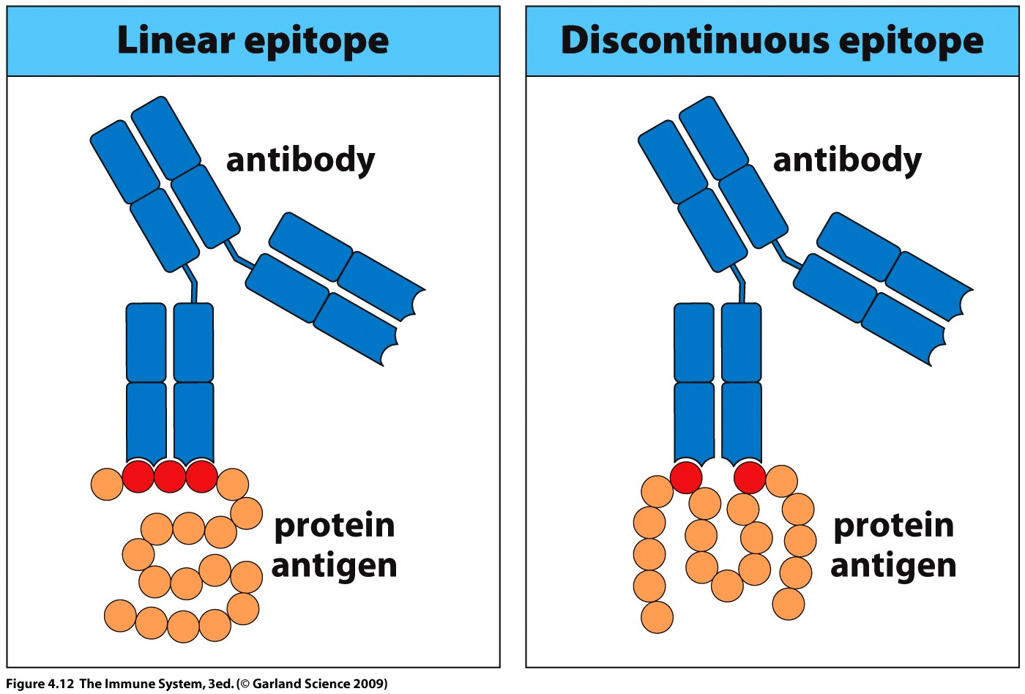
Antibody binds to parts of a molecule which are adjacent = linear epitope.
Antibody binds to parts of a molecule which are separated by a.a. sequence but adjacent due to protein folding = discontinuous epitope or conformational epitope.

Slide 19
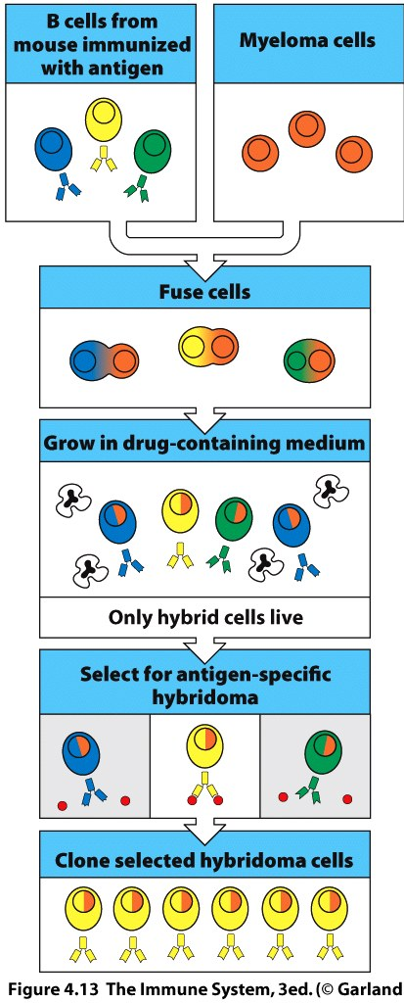
Antibodies traditionally obtained by immunizing animals and collecting antisera.
Requires a purified antigen.
Now hybridomas produced by fusion of immunized animals spleen cells with a tumor cell – hybridoma cells.
Hybridoma cells are separated and those secreting the antibody of desired specificity are selected and cloned.
Clone produces one specificity of antibody – monoclonal antibody.

Slide 20
Chimeric monoclonal antibodies combine mouse V regions with human C regions for therapeutic use.
mouse Fc generates antibodies which neutralize monoclonal.
Humanized antibodies only the CDR loops are of mouse origin.
Omalizumab, used to target IgE in treatment of allergic asthma, by blocking mast cell, eosinophil and basophil recruitment.
Human mAb produced in mice engineered to carry human Ig genes or completely human hybridomas grown in tissue culture.
Adalimumab used against TNF-α for treatment of rheumatoid arthritis.

Slide 21
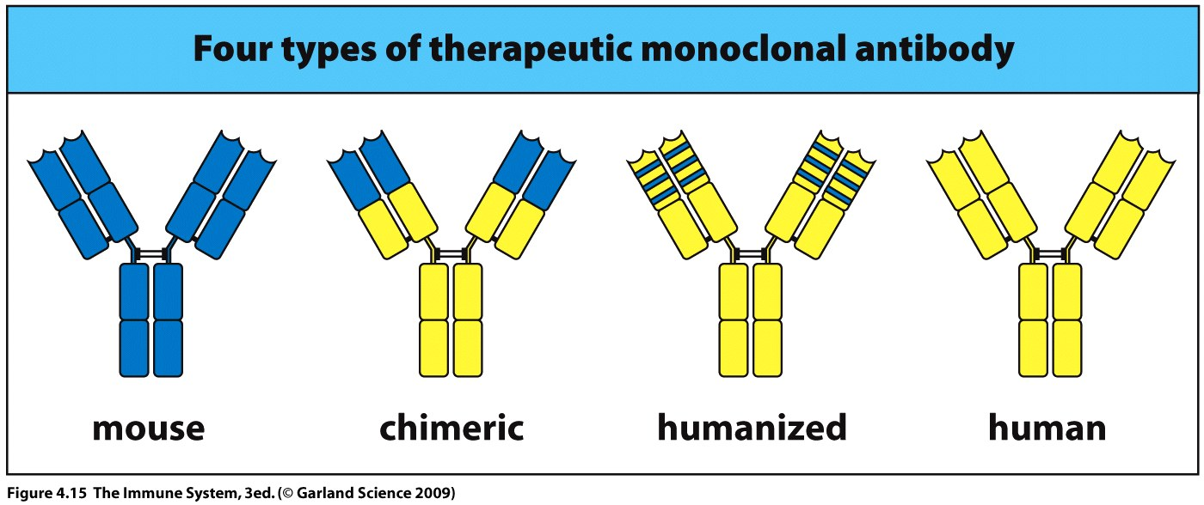

Slide 22
Antibody
(Click to play)

Slide 23
Diversity of B cell before antigen recognition
Number of different antibodies produced by the body is limitless.
The immunoglobulin genes are organized differently from other genes.
In all cells except the B cell these genes are in a fragmented form and so cannot be expressed.

Slide 24
Normally one gene = one protein.
But in the B cell the genes for the heavy and light chains consist of families of gene segments.
The segments are arranged sequentially along the chromosome.
Each set of gene segments contains alternative versions of parts of the immunoglobulin V region.
This is the germline configuration.

Slide 25
For Ig expression, gene segments must be rearranged to form a functional gene.
This process only occurs in the developing B cell.
Once gene rearrangement is complete heavy and light chain mRNA are transcribed and the proteins translated.
A membrane bound immunoglobulin is then expressed on the surface of the B cell.
Rearrangement is key to antibody diversity.

Slide 26
Immunoglobulin genes are found at different chromosome locations
Heavy chain locus on chromosome 14
κ light chain locus on chromosome 2
λ light chain locus on chromosome 22
Different gene segments encode the leader peptide, variable region and constant region of the heavy and light chain
Within the heavy chain locus are gene segments encoding all the heavy chain isotypes.

Slide 27
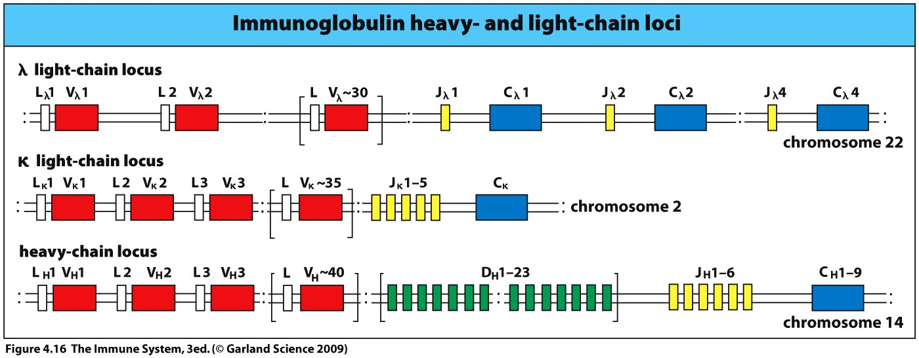
5 isotypes
L, leader peptide V, variable region C, constant region
Gene segments encoding the L and C region consist of exons and introns and are ready to be transcribed
The V regions are encoded for by 2 or 3 gene segments that require rearrangement to produce an exon that can be transcribed.
Light chain = Variable (V) and Joining (J)
Heavy chain = Variable (V), Diversity (D) and Joining (J).

Slide 28
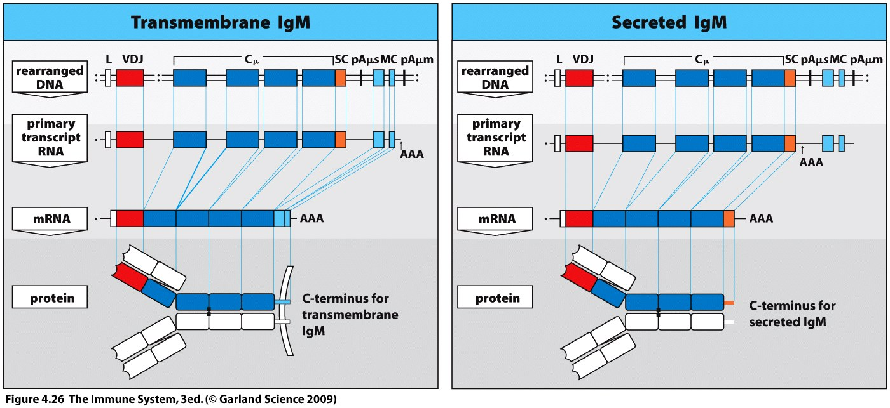
Each box = an exon
Step 1 build variable region gene (one exon)
Step 2 add constant region gene (multiple exons)
Step 3 transcribe genes to mRNA and translate to protein
Step 4 join light and heavy chain proteins

Slide 29
V region of the Light chain is composed of one V and one J segment.
C region of the light chain composed of a single C exon.
V gene segments vary in the sequences that encode the first and second hypervariable regions in the V domain.
The third hypervariable region is determined by the junction between the V and J segments
Either the κ or the λ loci is used to generate the light chain, NOT BOTH.

Slide 30
V region of heavy chain is composed of one V, one D and one J segment.
First two hypervariable regions of the V domain are encoded for by the V gene segments.
The third is encoded by the D gene segment and the junctions it makes with the V and J segments.
C region of heavy chain is encoded by multiple C exons of one isotype (µ(M),γ(G),α(A),ε [E],δ (D)).

Slide 31
Somatic recombination is the cutting and splicing together of different arrays of V,D and J segments.
A single gene segment from each type is combined to form a DNA sequence encoding the V region of the immunoglobulin chain.

Slide 32
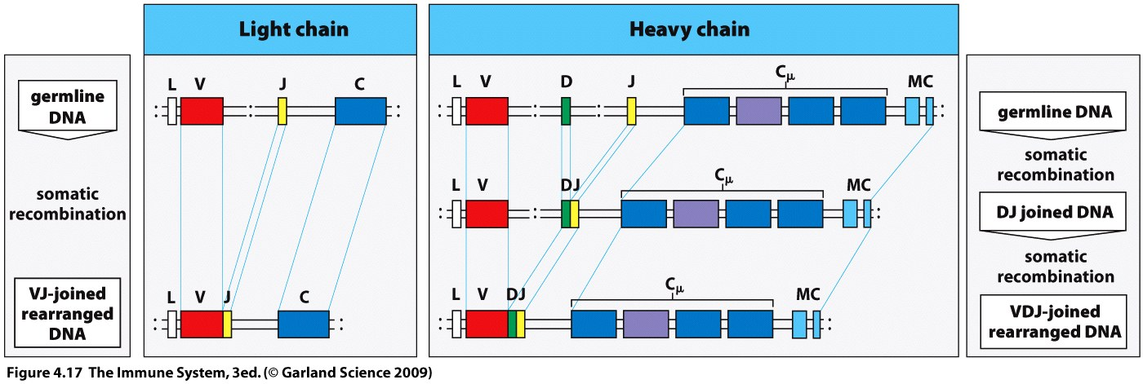
Light chain – single recombination between a V_{L} and J_{L} segment.
Heavy chain – two recombinations required, first to join D and J_{H} segment, second to join the now DJ segment to the V_{H} segment.
For both heavy and light chains the V, D and J segments are selected at random.
The many possible combinations contribute to B cell diversity.

Slide 33
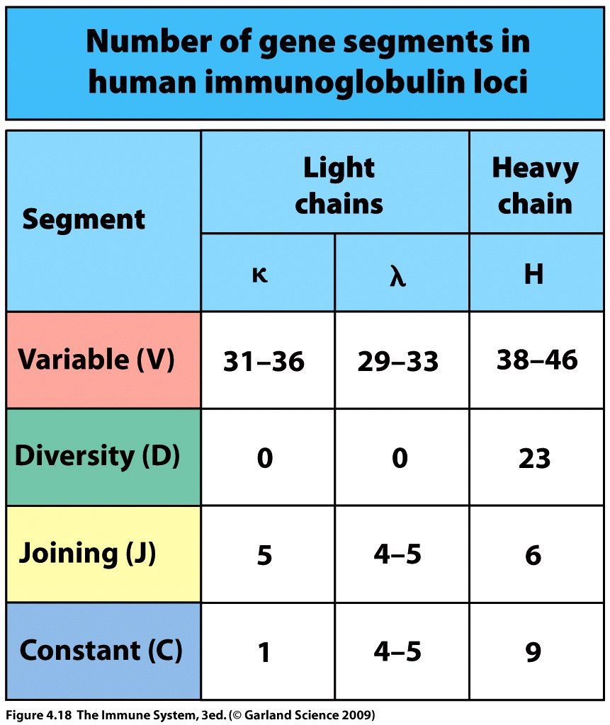
κ locus: 35V gene segments and 5J segments
can combine in 35 x 5 = 175 different combinations
λ locus: 30V x 4J = 120 combinations
Heavy chain locus:
40V x 23D x 6J = 5520
Combinations
Total: 295 Light chains
5520 Heavy chains
Random combination of these gives 1.6 million different antibodies.

Slide 34
Somatic recombination is performed by enzymes that cut and rejoin DNA.
Enzymes are directed by recombination signal sequences (RSS) which flank the 3’ side of V segment, both sides of D segment and 5’ end of J segment.
Two types of RRS work together to ensure the correct order of joining is maintained i.e., V to D to J in heavy chain.

Slide 35
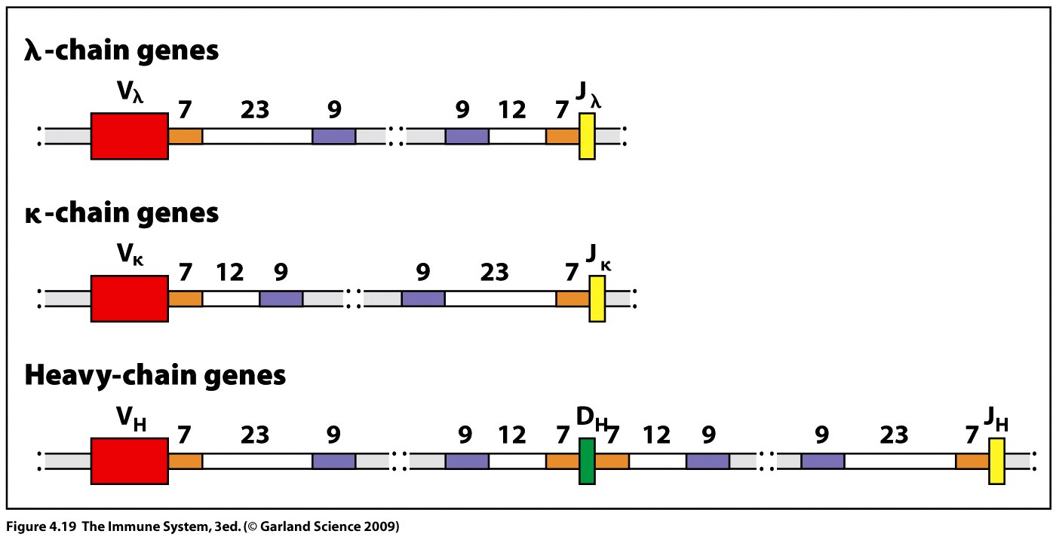
RSS either:
heptamer (7 bp CACAGTG) 12bp nonamer (9 bp ACAAAAACC) or:
heptamer (7 bp CACAGTG) 23bp nonamer (9 bp ACAAAAACC)
Only two different RSSs can join – thus in heavy chain rearrangement V must join D must join J.
X
+

Slide 36
VD and J are recombined using a set of enzymes known as the V(D)J recombinase.
These include
RAG-1 and RAG-2 (unique to lymphocytes)
DNA ligase IV
DNA-dependent protein kinase (DNA-PK)
A nuclease called Artemis
Ku protein
Expression of recombination-activating genes RAG-1 and RAG-2 is restricted to lymphocytes – control mechanism.

Slide 37
RAG or RAG
Meaning?
gene or protein?

Slide 38
RAG-1 and RAG-2 combine with high mobility proteins to form a complex.
These RAG complexes bind to one of each type of RSS.
Interaction between the complexes aligns the sequences and cleaves the DNA.
The ends are rejoined by DNA repair enzymes to form a coding joint.
The excised DNA is formed into a circle with a signal joint – circle has no further function.

Slide 39
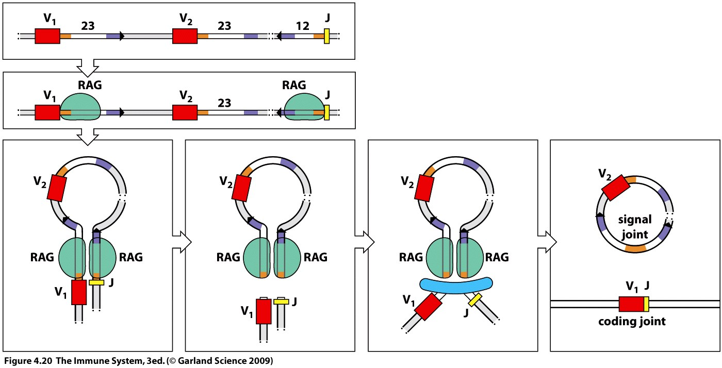
When the coding joint is formed it requires enzymatic repair of the cleaved DNA - this action can introduce further variation into the sequence.
This diversity occurs in the third hypervariable region of the domain and is termed junctional diversity.
Overall diversity is thus increased by a factor of up to 3x10⁷.

Slide 40
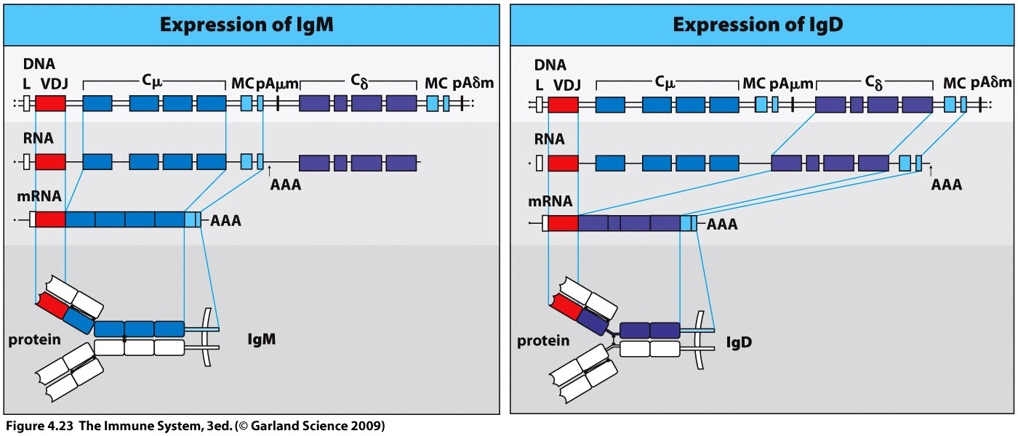
Naïve B cells can only make µ and δ heavy chains (IgM and IgD).
µ and δ are made from the differential splicing of a single RNA transcript, this does not require rearrangement.
Start End
Transcript
processing

Slide 41
Each B cell produces antibody of a single specificity – monospecific.
Allelic exclusion ensures that only one heavy chain and one light chain gene is expressed.
i.e., only one allele is rearrange for the Light and one for the heavy chain.
Different combinations of light and heavy chains add to overall antibody diversity.

Slide 42
Immunoglobulin is first made in a membrane bound form.
Immunoglobulin chains enter the ER as soon as they are synthesized.
The chains associate with each other to form a molecule which is attached to the ER membrane via the hydrophobic C terminus of the heavy chain.

Slide 43
For transport to the cell surface the immunoglobulin molecule forms a complex in the ER with two other transmembrane proteins.
Igα and Igβ
If the complex contains IgM it forms the B cell receptor.
The function of the IgD complex is unknown.

Slide 44
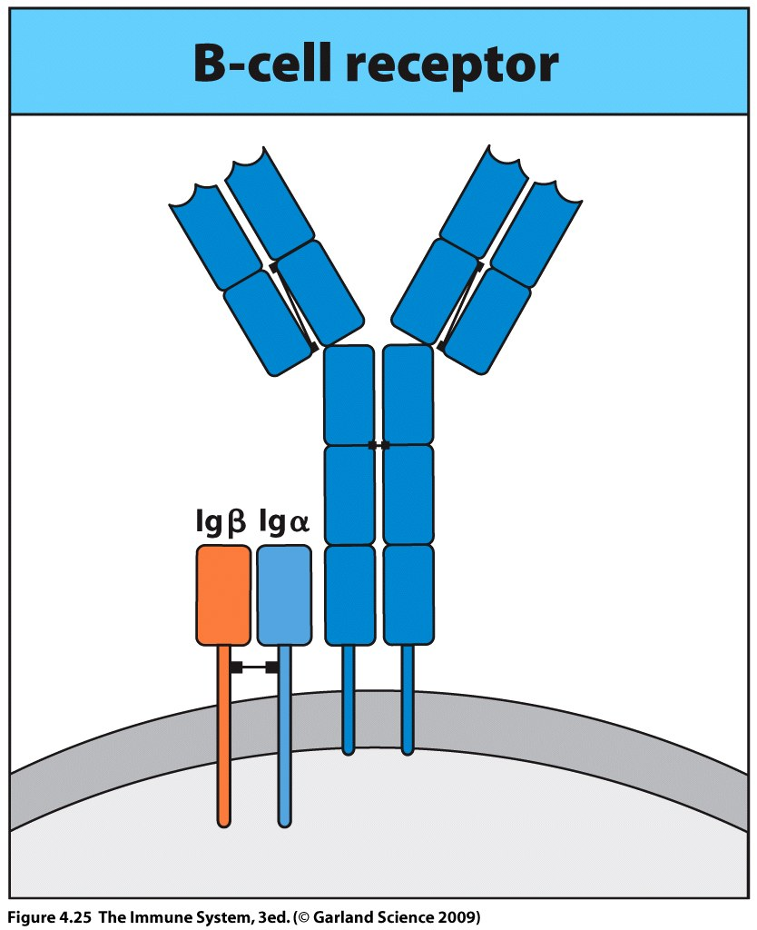
The long cytoplasmic tails of Igα and Igβ interact with intracellular signaling proteins.
Binding to antigen triggers a signal transduction pathway which results in cellular division and differentiation.

Slide 45
Somatic (VDJ) Recombination – YouTube

Slide 46
Diversity of B cell after antigen recognition
Binding of antigen to a mature naïve B cell causes proliferation and differentiation.
This results ultimately in the secretion of antibody.
Structural and functional changes can then take place in the antibody.

Slide 47
B cell receptor is membrane bound IgM and IgD.
Upon antigen interaction these are secreted as antibody.
IgM is produced in large amounts and aids protective immunity.
IgD is produced in small amounts but has no known effector function.

Slide 48
All 5 isotypes of Ig can be made in the membrane bound and secreted forms.
B cells change from making membrane bound forms to secreted forms during differentiation into plasma cells.
Membrane associated Ig has a hydrophobic sequence at the carboxy terminus of the heavy chain.
Secreted Ig has a hydrophilic sequence.

Slide 49
The difference is produced by RNA splicing and processing of the same primary RNA transcript.
No rearrangement of genomic DNA is involved.
Hydrophobic anchor is encoded by 2 small exons downstream of 4th exon of C-region domain which encodes hydrophilic µ chain – must splice out opposing region.

Slide 50
Somatic hypermutation brings about changes in the entire variable domain of the light and heavy chains.
Random introduction of point mutations (single nucleotides).
Constant region is not effected.
Other B cell genes are not affected by somatic hypermutation.
Mutation rate in the variable region is a million times greater than the ordinary mutation rate of a gene.

Slide 51
High
Low

Slide 52
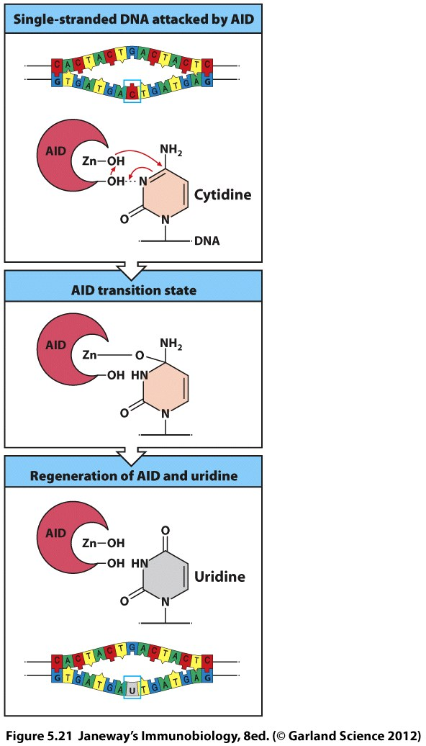
Enzyme required for mutation
activation-induced cytidine deaminase (AID).
Only made in proliferating B cells = control
AID converts cytosine in ssDNA to uracil (normally only present in RNA) during transcription.
DNA repair enzymes then correct the U to any one of the four other bases normally found in DNA.

Slide 53
Somatic hypermutation results in the expression of mutant Ig molecules at the B cell surface.
Some mutations occur in the antigen-binding site and increase affinity for the antigen.
Mutant high affinity Ig receptors will be better at competing to bind antigen and will thus be preferentially selected.
These are the B cells which will mature into plasma cells.

Slide 54
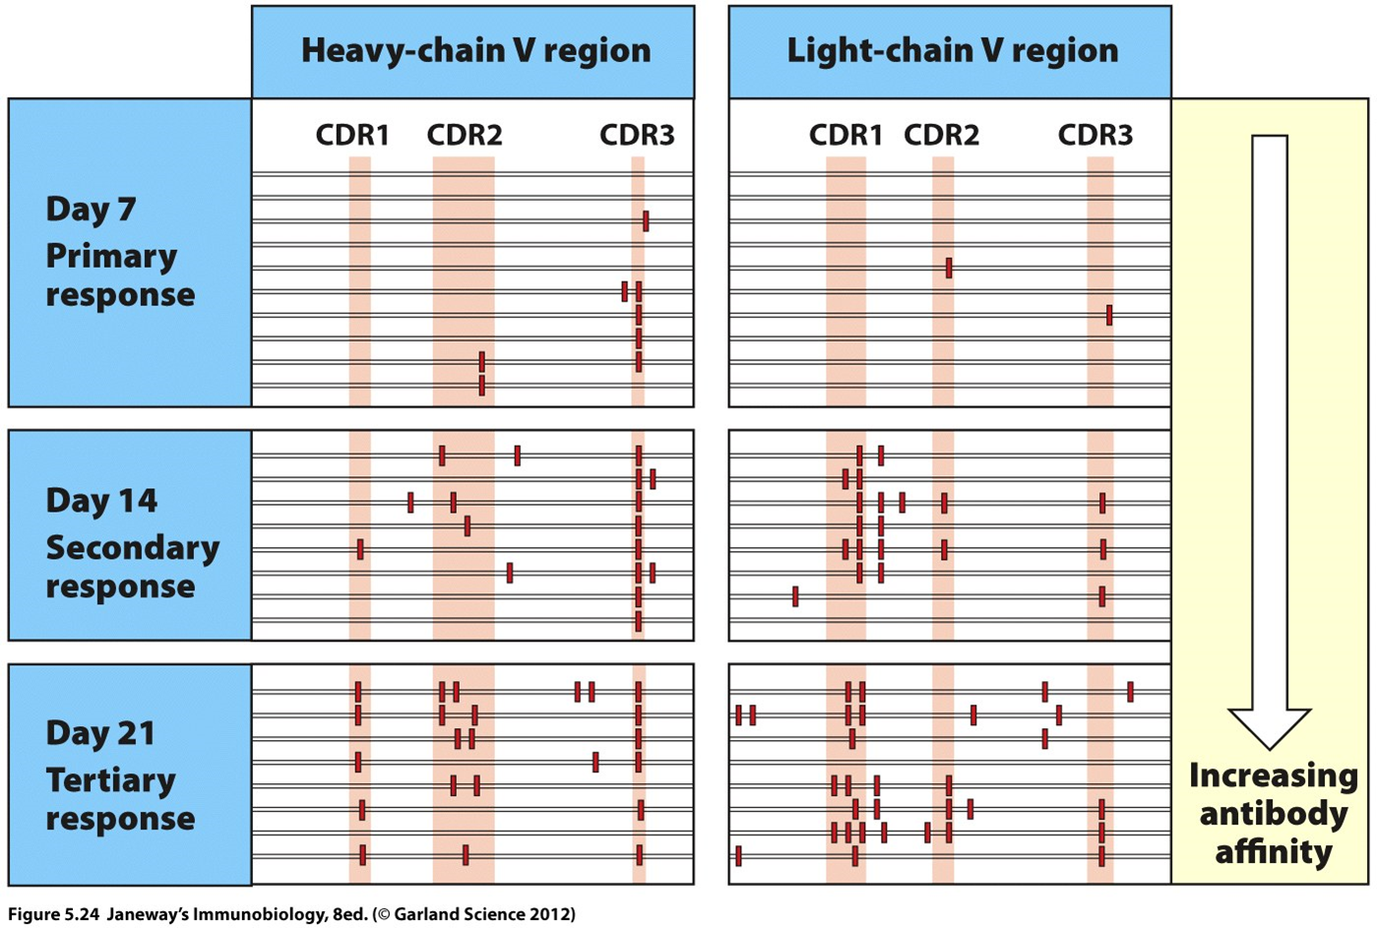
If the distribution of mutation is examined in the selected antibodies it is found that changes are concentrated within the CDR loops
This is the site that directly binds the antigen
Somatic hypermutation
As the adaptive response proceeds, antibodies of progressively greater affinity for the pathogen are produced – affinity maturation

Slide 55
Somatic hypermutation/Affinity maturation
Somatic hypermutation - YouTube

Slide 56
Affinity maturation
“A process of evolution in which variant immunoglobulins generated in a random manner are subjected to selection for improved binding to the pathogen”.
This allows the host to keep pace with faster evolving pathogens.

Slide 57
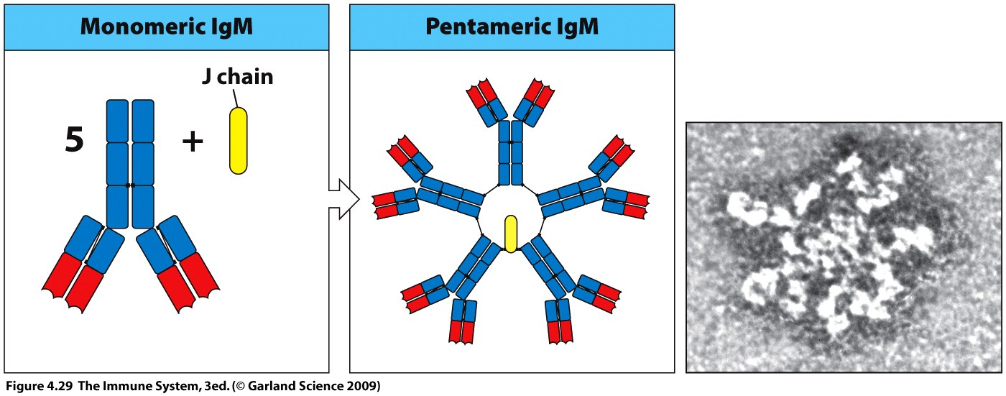
IgM is first class of antibody made in the primary immune response.
When secreted it forms a pentamer held together by disulfide bonds and a J chain, resulting in 10 antigen binding sites per molecule.
IgM can thus bind strongly to a pathogen which expresses multiple repetitive epitopes.
IgM is unable to bind directly to effector cells such as neutrophils and macrophages but can be bound by complement.

Slide 58
Isotype switching leads to production of antibodies with different effector functions.
DNA recombination events enable the rearranged V-region coding sequence to be used with a new heavy chain C gene.
Process requires enzyme AID and thus only occurs in B cells proliferating in response to antigen.

Slide 59
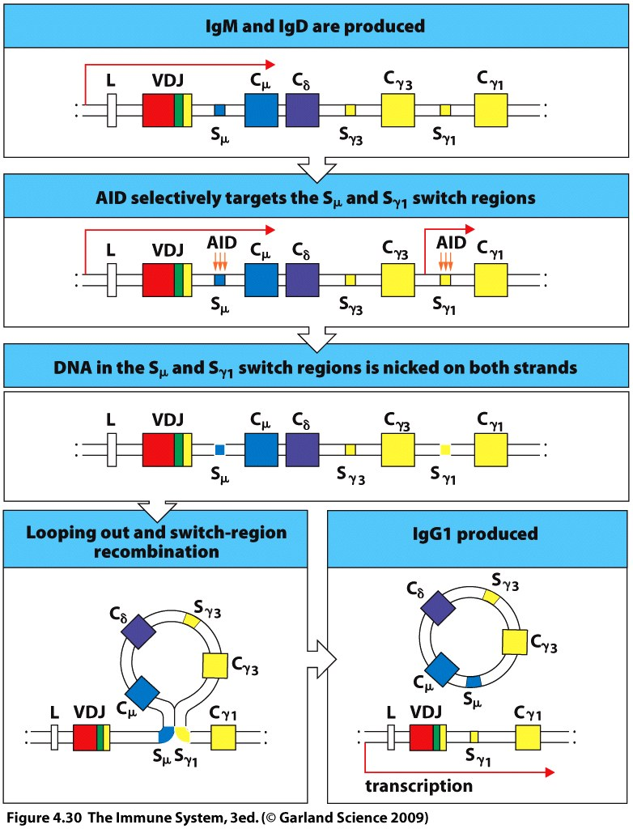
C genes are flanked by repetitive switch regions (s)
AID brings two switch regions together and excises the unwanted C genes
The newly selected C gene is brought into juxtaposition with the assembled V region sequence
The V region is unaffected by this recombination
Antigen binding specificity remains the same
The pattern of isotype switching is regulated by cytokines secreted by antigen-activated T cells

Slide 60
The importance of antibody class switching is demonstrated in patients lacking a functional gene for the enzyme AID.
These people produce only IgM at an elevated level
Hyper IgM immunodeficiency
Can not fight infections with pyogenic bacteria (pus forming bacteria - neutrophils).
IgM does not directly upregulate phagocytosis - IgG needed
These patients have sinuses, ear and lung infections but usually respond to antibiotics.
Patients also given regular immunoglobulin injections purified from blood donors – passive immunization.

Slide 61
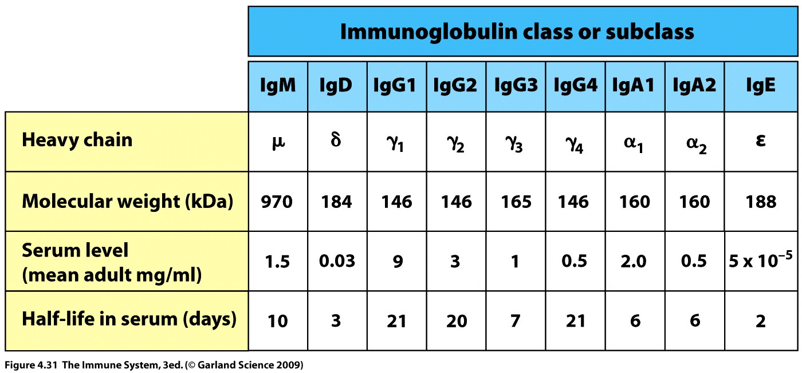
Antibody classes and subclasses
α, δ, and γ heavy chain constant region each contain 3 domains
µ and ε have 4 domains
Each domain is encoded for by a separate exon within the C gene segment
Additional exons encode the hinge region and carboxy terminus.

Slide 62
Antibody function is related to class
IgM is produced first and generally binds with low affinity to the pathogen.
Pentameric structure of secreted IgM increases the number of binding sites and leads to a tighter hold on the pathogen.
Avidity is the combined strength of multiple binding sites.
IgM constant region can be bound by complement which can then directly kill the pathogen or increase the likelihood of phagocytosis.

Slide 63
Somatic hypermutation then occurs resulting in the production of higher affinity antibodies.
Two binding sites are now sufficient to produce the same level of strong binding to the pathogen and class switching can occur.
IgM synthesis ends and IgG begins.

Slide 64
IgG is the most abundant antibody in internal fluid
Smaller and more flexible than IgM
aids access to pathogen at site of infection.
Hinge region permits Fab arms to move relative to one another and bind repeated epitopes on a pathogen.
IgG1 and IgG3 can be bound by phagocytes and complement.
IgG crosses the placenta.

Slide 65
IgA may be made as a dimer of 2 IgA molecules joined by a J chain
Dimeric IgA occurs in the lymphoid tissue underlying mucosal membranes
It is secreted into the gut, saliva, sweat, tears and milk
Keeps normal flora in
check and defends the
large surface area of
intestines against attack.

Slide 66
IgE is specialized towards recruitment of effector cells:
mast cells in the epithelium
Eosinophils in the mucosal surfaces
Basophils in the blood
These cells have a high affinity receptor for IgE in the absence of antigen.
If antigen binds to IgE a strong inflammatory response is triggered.
Parasites and allergy.

Slide 67
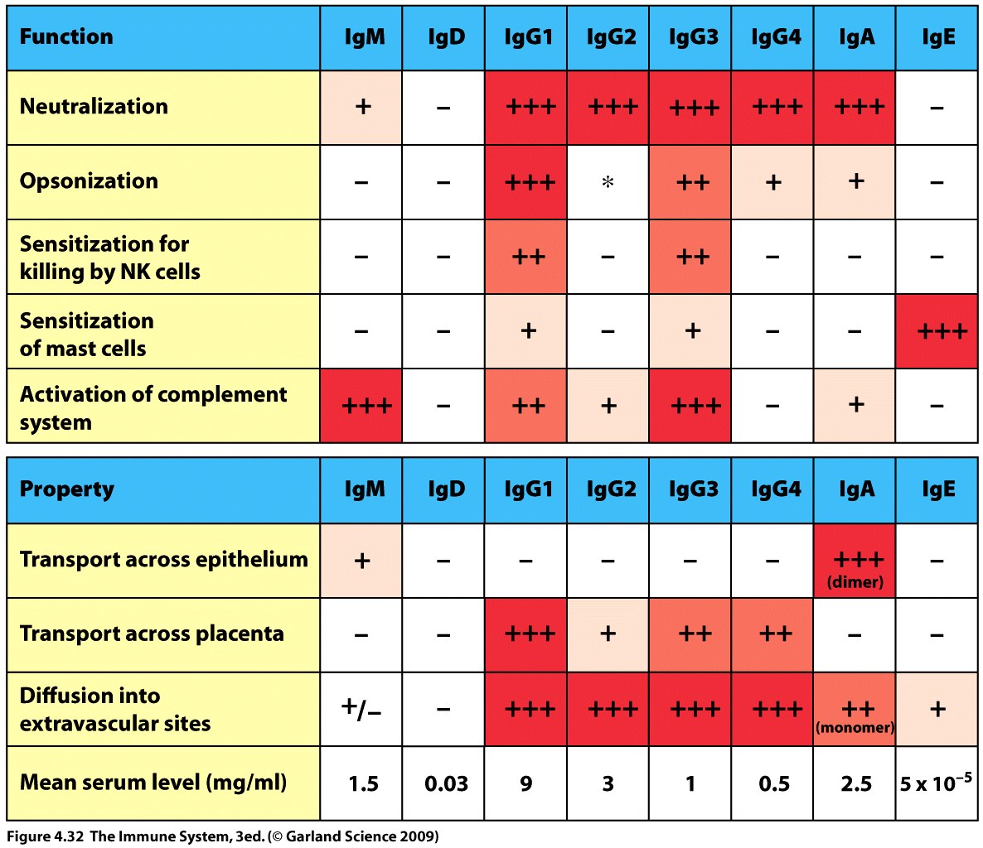
Neutralizing antibodies – directly inactivate pathogen or toxin by blocking interaction with cellular receptors.
Opsonization – coating of pathogen to enhance phagocytosis (requires appropriate Fc receptor on cell).

