Slide 1
Part IV
Adaptive Immunity

Slide 2
Chapter Overview
T-cell differentiation
Stages in B-cell differentiation
Role of T cells in adaptive immune response
Role of B cells in adaptive immune response
Laboratory identification of lymphocytes

Slide 3
Adaptive Immunity
Is specific to each pathogen or microbial agent
Remembers prior exposure
Increases response to a pathogen upon repeated exposure
Takes longer to become activated but is longer lasting
Involves T and B lymphocytes

Slide 4
T-Cell Differentiation: Double-Negative Stage
Chemokines drive differentiation process
Thymocytes undergo rearrangement of genes coding for T-cell receptors (TCRs)
Notes:
Thymocytes = precursors that are committed to becoming T cells.

Slide 5
T-Cell Differentiation: Double-Negative Stage
CD3/TCR complex
Alpha and beta chains that recognize antigen
Six other chains in three pairs that assist with signaling when antigen binds to T cells

Slide 6
T-Cell Differentiation: Double-Positive Stage
Thymocytes express CD4 and CD8 and rearrange gene coding for the alpha chain
Positive selection if functional TCR
MHC restriction: only cells that react with host MHC survive
Negative selection: cells that react with self-antigen are destroyed

Slide 7
T-Cell Differentiation: Mature T Cells
Survivors of positive and negative selection exhibit either CD4 or CD8
CD4 T cells are T helper cells—assist in antibody production
CD8 T cells are cytotoxic T cells—kill target cells

Slide 8
T-Cell Differentiation: Mature T Cells
T helper (Th) cells
Have CD4 receptor
Recognize antigen and class II MHC protein
Account for two-thirds of peripheral T cells

Slide 9
T-Cell Differentiation: Mature T Cells
Th1 cells:
Produce interferon gamma, interleukin-2, tumor necrosis factor-β
Activate cytotoxic lymphocytes and macrophages
Th2 cells:
Produce interleukins 4, 5, 6, 9, 10, 13
Help B cells produce antibodies
Regulate B-cell activity

Slide 10
T-Cell Differentiation: Mature T Cells
Other Th subpopulations
T regulatory (Treg) cells
Have CD4 and CD25
Suppress the immune response to self-antigens
Secrete inhibitory cytokines to inhibit proliferation of other T-cell populations

Slide 11
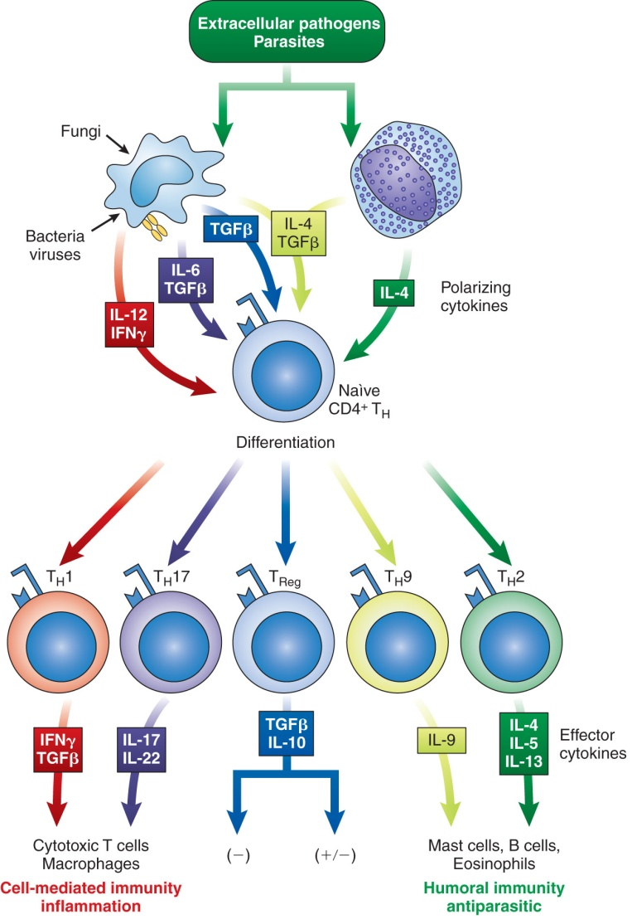
Th Subsets

Slide 12
B-Cell Differentiation
Occurs in bone marrow
Starts with a hematopoietic stem cell that develops into an early lymphocyte progenitor
Involves:
Development of mature immunocompetent B cells
Activation of B cells by antigen
Differentiation of activated B cells into antibody-producing plasma cells

Slide 13
B-Cell Differentiation
Antigen-independent phase
Pro-B cells
Pre-B cells
Immature B cells
Mature B cells

Slide 14
B-Cell Differentiation: Pro-B Cells
Develop from rearrangement of genes that code for heavy and light chains of antibody molecules
Made specific for certain antigens by variable regions
Must successfully rearrange one set of heavy-chain genes to become pre-B cells

Slide 15
B-Cell Differentiation: Pre-B Cells
Heavy μ chains of IgM class
Accumulate in cytoplasm
Can express on cell surface with a surrogate light chain
Short chains Ig-α and Ig-β

Slide 16
B-Cell Differentiation: Immature B Cells
Have complete IgM antibody molecules on cell surfaces that serve as antigen receptors
Have variable regions that determine specificity for antigen
Include other surface proteins:
CD21
CD40
Class II MHC molecules
Notes:
CD21 promotes contact between B cells and antigens.
CD40 and class II MHC molecules are important for interaction of B cells with T cells.

Slide 17
B-Cell Differentiation: Immature B Cells
The process of central tolerance involves elimination of B cells that have self-reactive receptors
If immature B cells survive central tolerance, they move to the spleen

Slide 18
B-Cell Differentiation: Mature B Cells
Develop in the spleen
Marginal B cells
Remain in spleen
Respond quickly to bloodborne pathogens
Follicular B cells
Migrate to lymph nodes and other secondary organs
Recirculate

Slide 19
B-Cell Differentiation: Mature B Cells
Exhibit IgM and IgD
Surface immunoglobulins provide activating signal to B cells when contact with antigen occurs
When stimulated, enter antigen-dependent phase, forming:
Memory cells
Antibody-secreting plasma cells

Slide 20
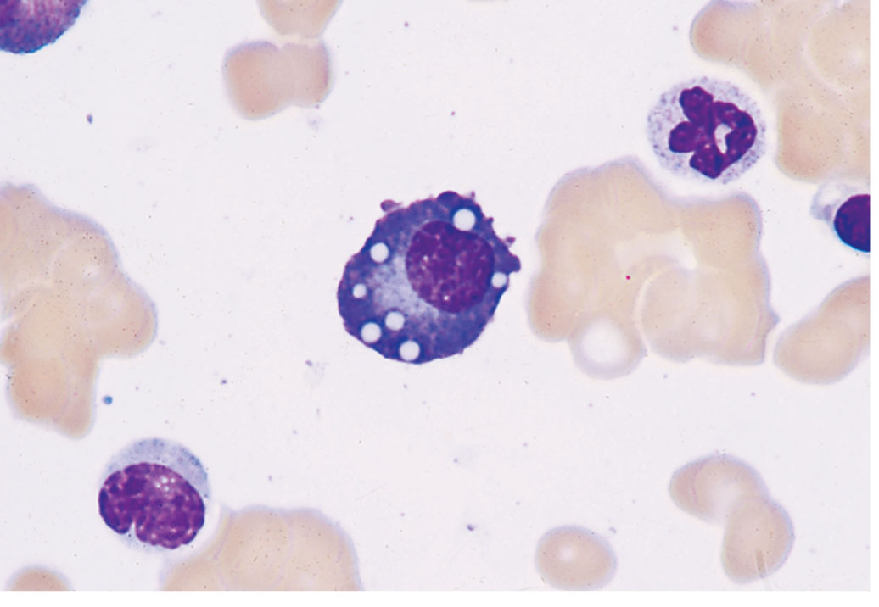
B-Cell Differentiation: Plasma Cells
Have a lot of cytoplasmic immunoglobulin but little or no surface immuno-globulin

Slide 21
B-Cell Differentiation: Plasma Cells
Produce antibodies
Found in peripheral lymphoid organs and bone marrow
Notes:
Stromal cells stimulate plasma cells with cytokines, promoting a long cell life and continuous antibody production.

Slide 22
Role of T Cells in Adaptive Immune Response
APCs are activated during innate immune response
T cells interact with APCs to initiate adaptive immune response
T cells circulate throughout the bloodstream, lymph nodes, and secondary lymphoid tissue, looking for antigens
Notes:
APC = antigen-presenting cell.

Slide 23
Action of Th Cells
Notes:
Figure 4-10. Activation of Th cells. Exposure to antigen presented by macrophages causes production of CD25 receptors for interleukin-2 (IL-2). IL-2 causes sensitized CD4+ T cells to secrete cytokines, resulting in CD4+ effector cells that have various functions. Some CD4+ cells secrete interleukins that recruit macrophages, whereas others activate CD8+ T cells to increase cytotoxicity against virally infected cells. Activated Th cells also enhance antibody production by B cells.

Slide 24
Action of Tc Cells
Notes:
Figure 4-11. Activation of cytotoxic T cells. The CD8+ T cell recognizes foreign antigen along with class I MHC. When binding occurs, granules move toward the point of contact with the target cell. Granules fuse with the membrane and release perforin. Perforin inserts itself into the target cell membrane and polymerizes to form a pore. Contents of the granules are released, triggering apoptosis of the target cell.

Slide 25
The Role of B Cells in the Adaptive Immune Response
Response to T-dependent antigens
Notes:
Figure 4-12. Activating signals for T-dependent and T-independent antigens. (A) T-dependent antigens bind to immunoglobulin receptors on B cells. The antigen is processed and delivered to CD4+ T cells. The Th cell binds by means of its CD3-TCR complex and delivers further activating signals through binding of CD40 on the B cell to the CD40L receptor on the Th cell. Cytokines are released from the T cell, which enhance B-cell transformation to plasma cells. (B) T-independent antigens can bind to B cells through immunoglobulin receptors and trigger B-cell transformation directly. Several antigen receptors must be cross-linked in order to activate a B cell directly. Antigens can also be bound to B cells’ innate immune receptors, such as TLRs.

Slide 26
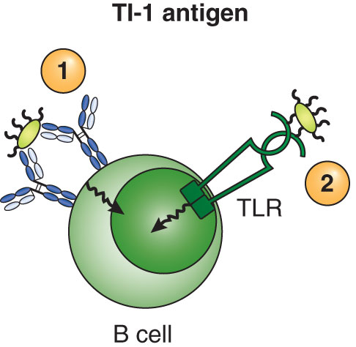
The Role of B Cells in the Adaptive Immune Response
Response to T-independent antigens
Notes:
Figure 4-12. Activating signals for T-dependent and T-independent antigens. (A) T-dependent antigens bind to immunoglobulin receptors on B cells. The antigen is processed and delivered to CD4+ T cells. The Th cell binds by means of its CD3-TCR complex and delivers further activating signals through binding of CD40 on the B cell to the CD40L receptor on the Th cell. Cytokines are released from the T cell, which enhance B-cell transformation to plasma cells. (B) T-independent antigens can bind to B cells through immunoglobulin receptors and trigger B-cell transformation directly. Several antigen receptors must be cross-linked in order to activate a B cell directly. Antigens can also be bound to B cells’ innate immune receptors such as TLRs.

Slide 27
Laboratory Identification of Lymphocytes
Helps diagnose:
Malignancies
Immunodeficiency diseases
AIDS
Uses cell flow cytometry
Segregates lymphocytes into subsets
Uses monoclonal antibodies

Slide 28
Summary
Adaptive immunity is characterized by specificity, ability to remember a prior exposure to an antigen, and an increased response upon reexposure to that same antigen.
B cells mature in bone marrow during the antigen-independent stage and in secondary lymphoid organs during the antigen-dependent phase.

Slide 29
Summary
T cells acquire their specificity in the thymus.
T cells with CD4 are helper/inducer cells.
T cells with CD8 are Tc cells that destroy cells by producing perforins and granzymes.
CD3/TCR is the T-cell receptor for antigen. The alpha and beta chains have variable regions that bind to only certain antigens.
T cells are responsible for cell-mediated immunity.

Slide 30
Summary
B cells markers include CD19, class II MHC proteins, and surface immunoglobulins.
Specificity for the receptor immunoglobulins is built in as the B cell matures.
Class II MHC proteins allow B cells to interact with T helper cells in the production of antibodies.

Slide 31
Summary
When contact with a specific antigen occurs, B cells differentiate into plasma cells that produce antibodies and memory cells that are able to respond more quickly the next time the same antigen is encountered.
Production of antibodies is known as humoral immunity.

Slide 32
Summary
Lymphocytes are identified using monoclonal antibodies directed against specific surface antigens.
Use of cell flow cytometry categorizes cells on the basis of light scattering.

