Slide 1
Thomas • Murphy-Johnson
Clinical Laboratory Immunology
5. Antigen Recognition by T-Cells

Slide 2
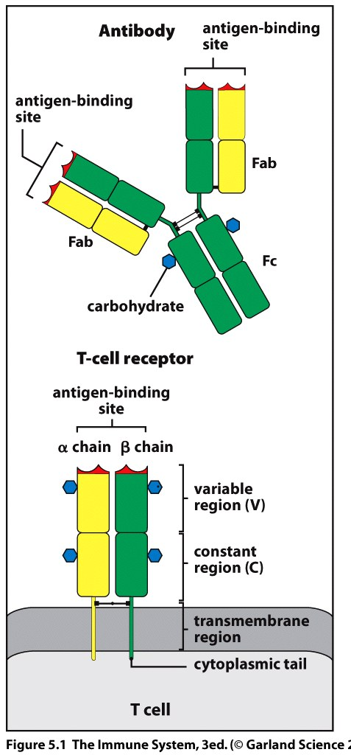
The T cell receptor resembles a membrane bound Fab fragment of immunoglobulin
2 different polypeptide chains, TCRα and TCRβ
The genes for each chain have a germline organization similar to that of the Ig genes
Gene recombination must occur to produce functional genes for both the α and β chains
Together the α and β chains define a unique T cell receptor
T cells have a single antigen-binding specificity

Slide 3
α and β chains have a variable and constant region
The chains are folded into domains, amino-terminal V domain , C domain and membrane–anchoring domain
The antigen recognition site is formed by the V_{α} and V_{β} domains
Sequence variation is clustered into regions of hyper variability
These correspond to the loops of the polypeptide chain at the end of the domain farthest from the T cell membrane.
Loops = CDR (Complementarity determining regions)

Slide 4
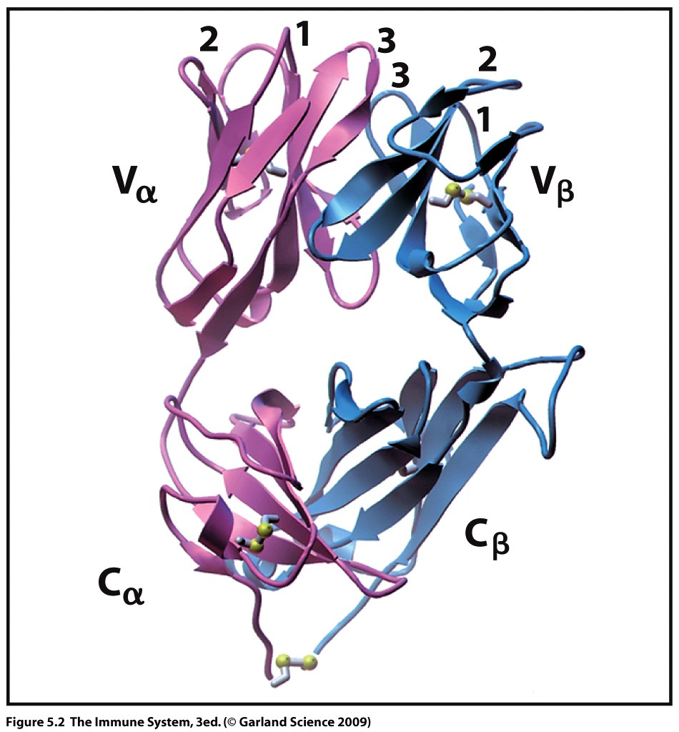
V domains of α and β chains each have 3 CDRs
Variable
domains
Constant
domains

Slide 5
T cell receptor has a single antigen binding site
TCR is always membrane bound
The TCR can only bind to antigen presented in the context of an MHC molecule expressed on the surface of another cell.
Multiple copies of the TCR bind to multiple copies of the antigen:MHC complex on the opposing cell
This achieves multipoint attachments which increase the strength of the bond between the two cells

Slide 6
TCR diversity achieved by gene segment recombination
The mechanism for somatic recombination is the same as that used by the B cell
T cells do not undergo further variation after antigen recognition
NO somatic hypermutation or class switching is needed
The TCR is used only for recognition and has no individual effector function like that of the B cell receptor.

Slide 7
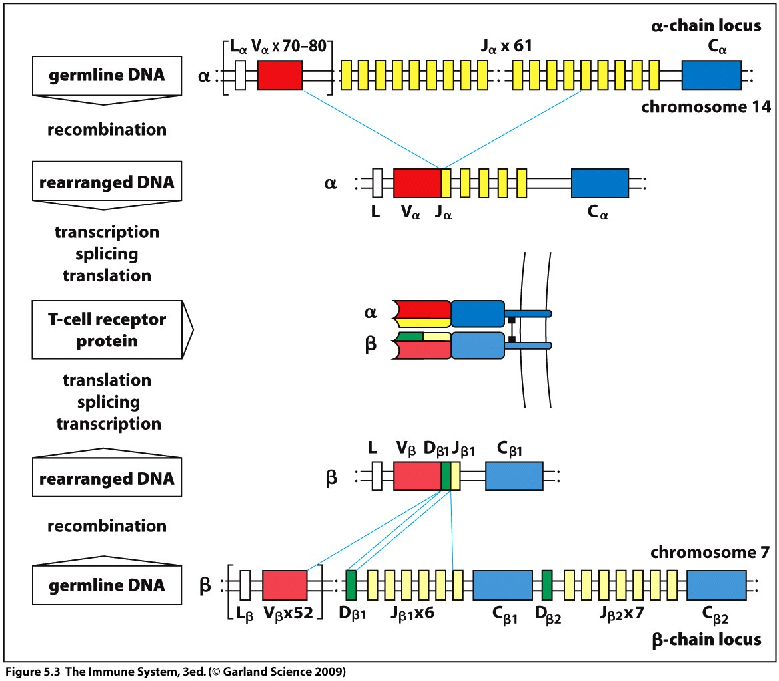
α chain locus on chromosome 14
β chain locus chromosome 7
Only one C region gene is necessary (no functional difference between C_{β1} and C_{β2})
Compare to Ig light chain
Compare to Ig heavy chain

Slide 8
TCR α functional gene requires a V and J segment
TCR β functional gene requires a V, D and J segment
Gene segments are flanked by RAG recognized gene recombination signal sequences (RSS)
Same DNA modifying enzymes work on TCR and B cell receptor
Junctional diversity thus occurs in CDR3 by insertion of new nucleotides
TCR rearrangement takes place in thymus

Slide 9
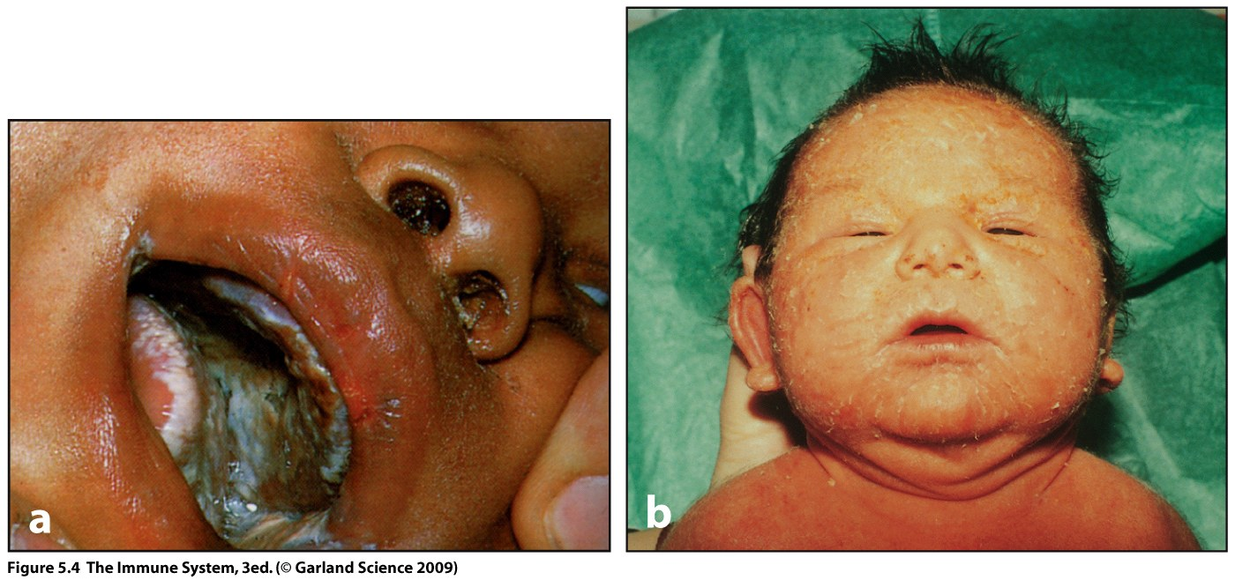
A genetic defect which result in the absence of RAG proteins causes rare conditions:
SCID (severe combined immunodeficiency disease) (left panel)
Omenn syndrome (right panel)
Functional B and T cells can not be made
Bone marrow transplantation is necessary or child will die.
Candidiasis
Chronic inflammation

Slide 10
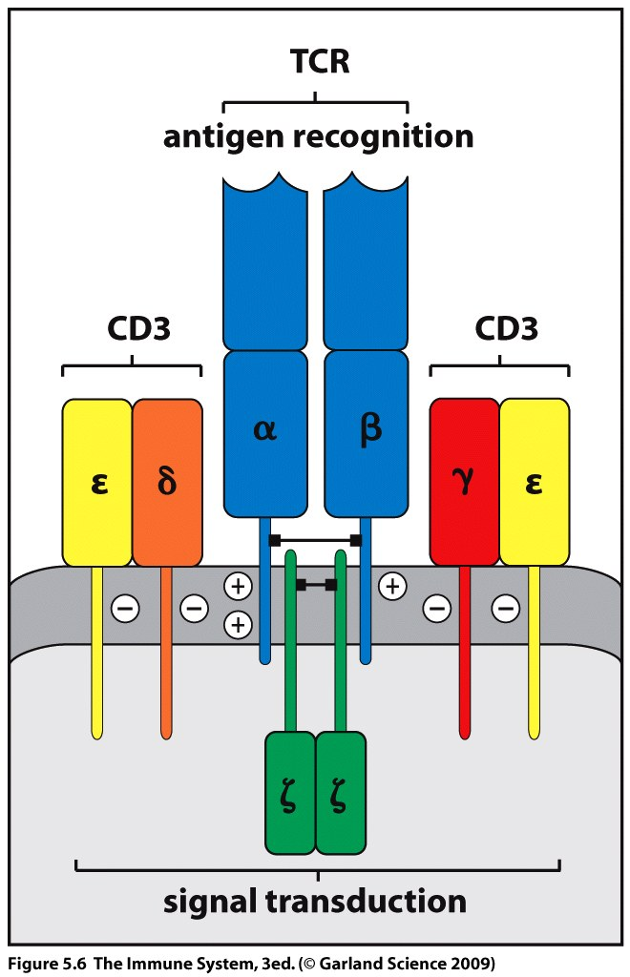
The α:β heterodimer can not leave the ER to be expressed at the cell surface unless it associates with 4 invariant proteins
CD3 comprises of three of these proteins (CD3γ, CD3δ, and CD3ε)
The forth is known as the Zeta (ζ) chain
At the cell surface the CD3 and ζ chain remain associated with the TCR and form a functional T cell receptor complex which can transmit cytoplasmic signals.

Slide 11
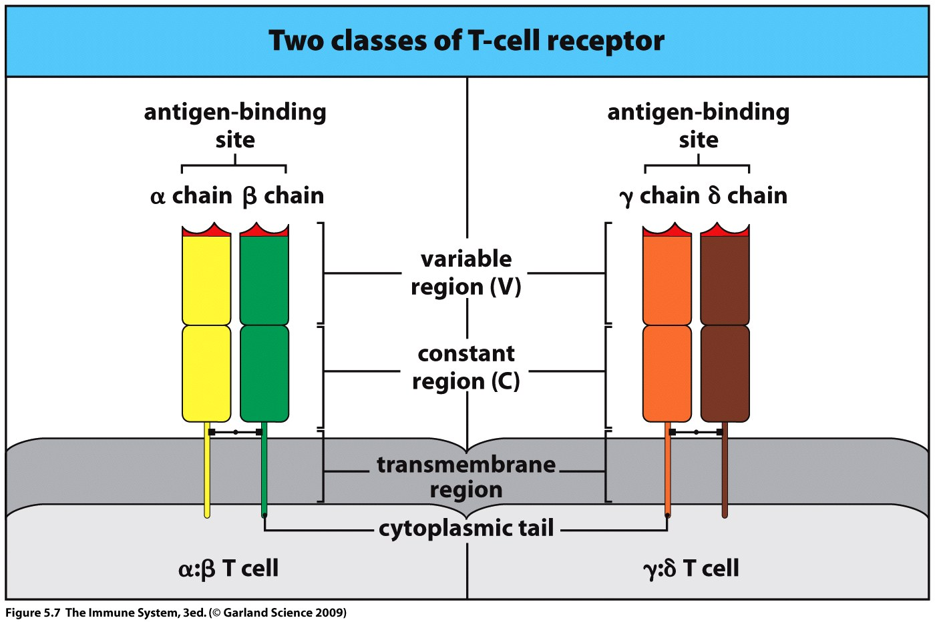
Second type of TCR formed with γ:δ chains
T cells either express α:β or γ:δ TCRs never both
γ:δ TCRs are expressed on only a small subset of T cells
γ:δ T cells are not restricted to recognition of antigen in the context of MHC
Their function is not well defined outside of pro-inflammatory pathways.

Slide 12
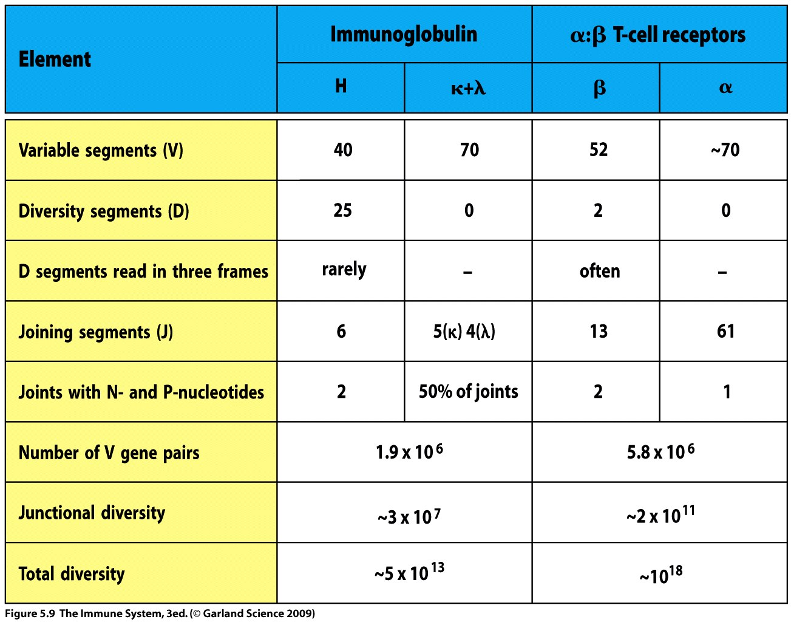

Slide 13
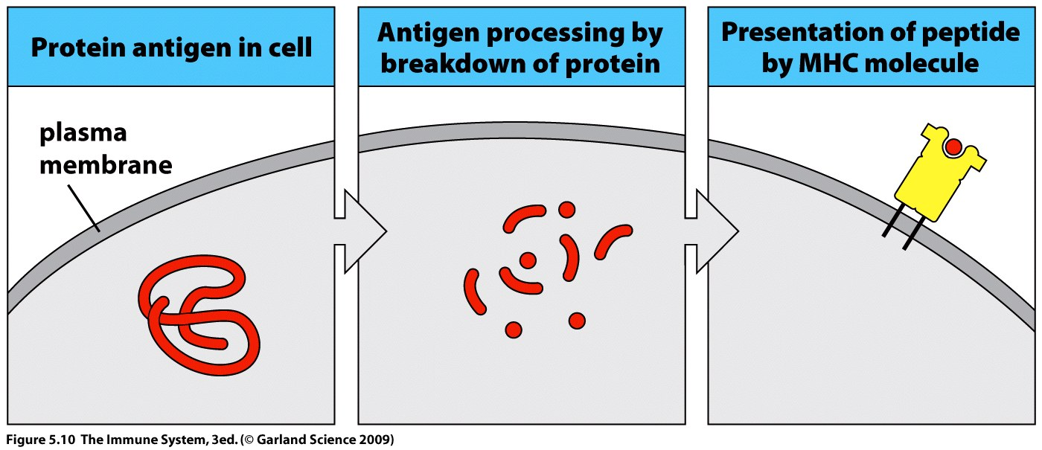
Antigen processing and presentation
T cells can recognize antigen only in the form of a peptide bound to an MHC molecule at the surface of a cell
Thus antigen processing and antigen presentation are required

Slide 14
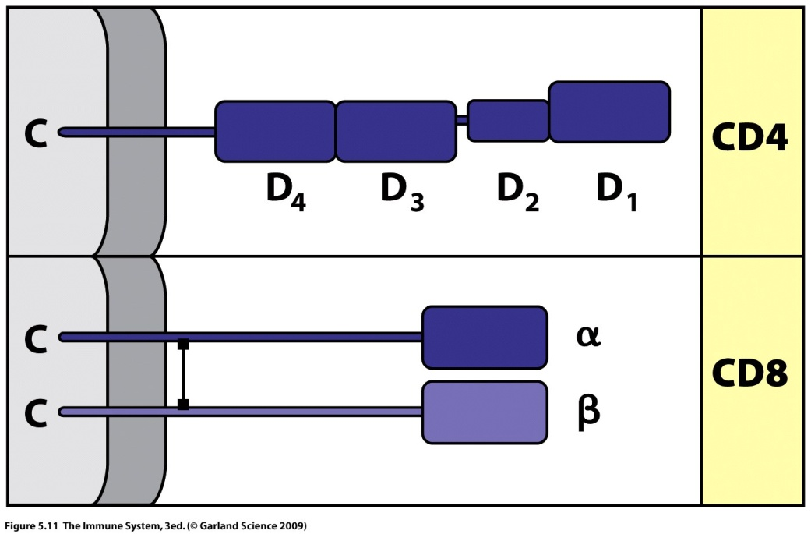
T cell population is subdivided into cells which fight intracellular pathogens and cells which fight extracellular pathogens (bacteria and released viral progeny)
T cells express either a CD4 or CD8 co-receptor which defines which class of pathogen they will defend against
CD8 is on the cytotoxic T cell – kill infected cells
CD4 is on the helper T cell – stimulate B cells and macrophages.

Slide 15
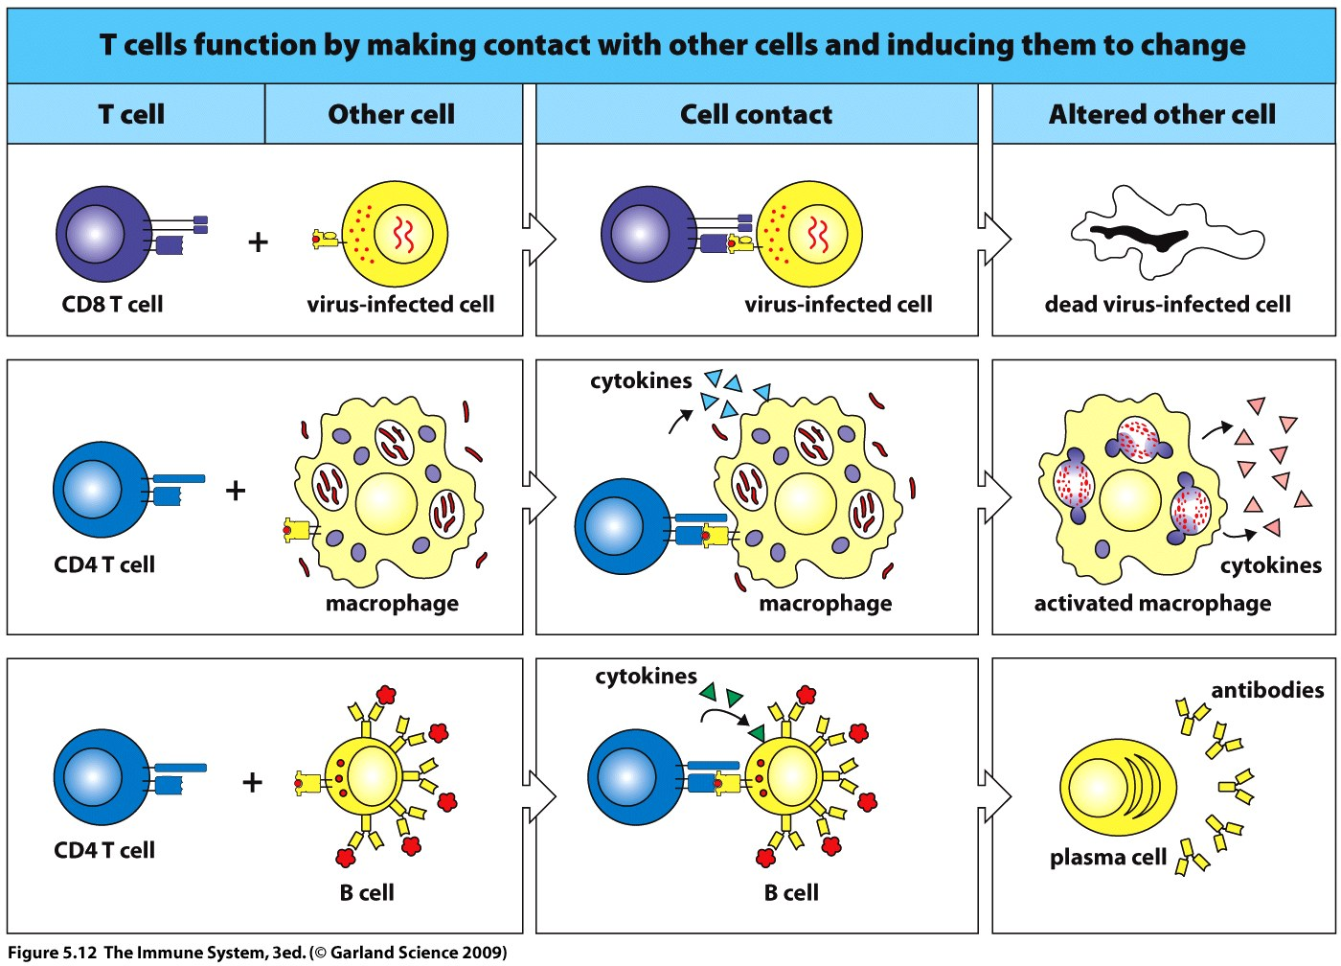

Slide 16
HIV uses CD4 as an entry receptor.
As disease progresses replication within the CD4 T cell kills the cell and reduces the size of the circulating population
The loss of T cells eventually reduces the effectiveness of the adaptive immune response to other types of infection
Consequences can be fatal

Slide 17
MHC is responsible for ensuring that the correct class of T cell is activated by an infection.
MHC I presents antigen of intracellular origin to CD8 T cells
MHC II presents antigen of extracellular origin to CD4 T cells

Slide 18
Structure of MHC
Membrane glycoproteins
Function - bind peptide antigens and present to T cells
MHC class I
Transmembrane heavy chain (α)
Complexed with small protein, β₂-microglobulin
Peptide binding site formed by folding of α chain
MHC class II
Two transmembrane chains (α and β)
Both contribute to formation of peptide binding site
The support domains of the molecules provide a specific binding site for either CD4 or CD8

Slide 19
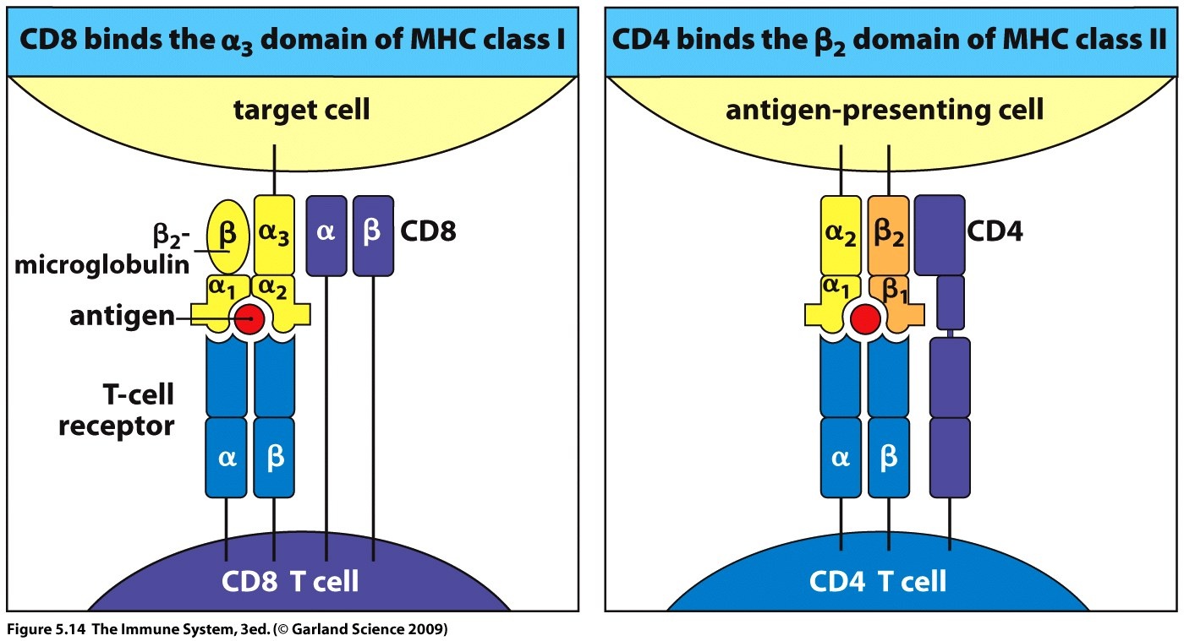
The sites on an MHC molecule that interact with the TCR and co-receptor are separate
Both sites must be engaged for T cell activation to occur.

Slide 20
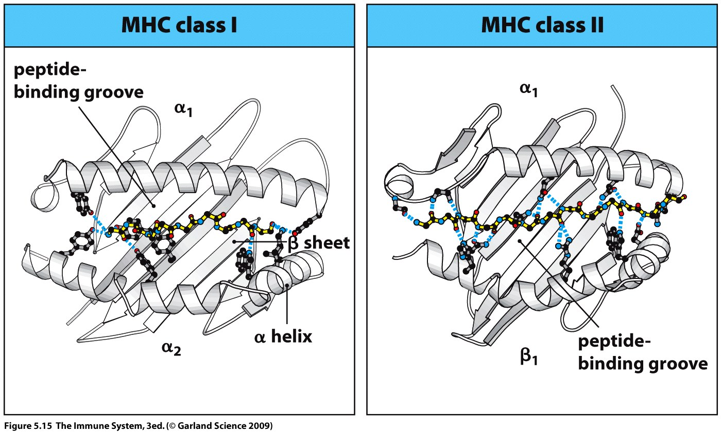
MHC molecules exhibit promiscuous binding specificities – i.e. not restricted to binding to an individual antigen epitope
The peptide binding site is a deep groove on the surface of the MHC
A single peptide is held tightly within the groove by non-covalent bonds.
Peptide length restricted due to pockets at end of groove
Longer peptides extend out passed the ends of the groove

Slide 21
MHC Class I →
(Click to play)
MHC Class II →

Slide 22
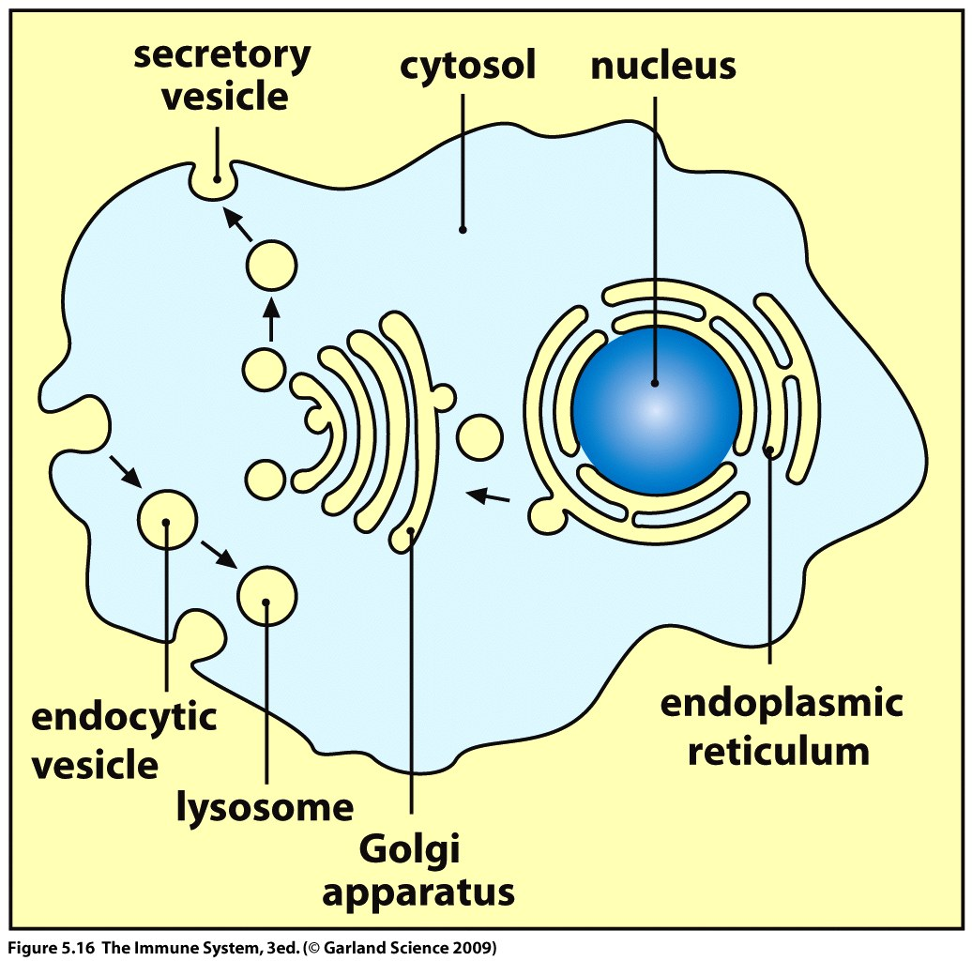
Peptides result from breakdown of antigen within different types of intracellular compartments
Peptides from intracellular pathogens form in the cytosol and are transported to ER where they are bound by MHC class I molecules
Extracellular antigen taken up by phagocytosis or endocytosis are degraded in lysosomes where they are bound by MHC class II molecules
Thus MHC molecules can label a
peptide as intracellular or
extracellular in origin

Slide 23
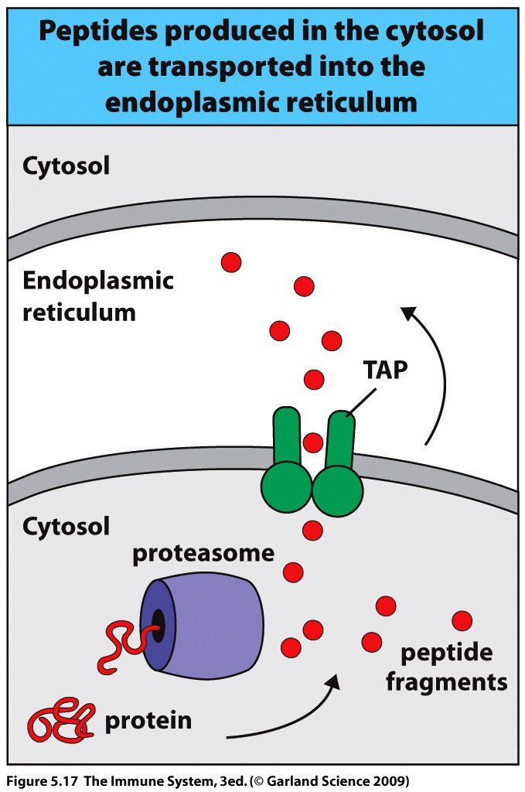
Viral proteins are synthesized in the cytosol where the ribosomes are situated
Dysfunctional host proteins are normally broken down for recycling by the proteasome and presented as self by MHC = tolerance, prevent immune response
IFN-γ modifies the proteasome (immunoproteasome) to target viral proteins and produce peptides of the correct length to bind MHC I.
Peptides are transported across ER membrane by TAP (transporter associated with antigen processing).

Slide 24
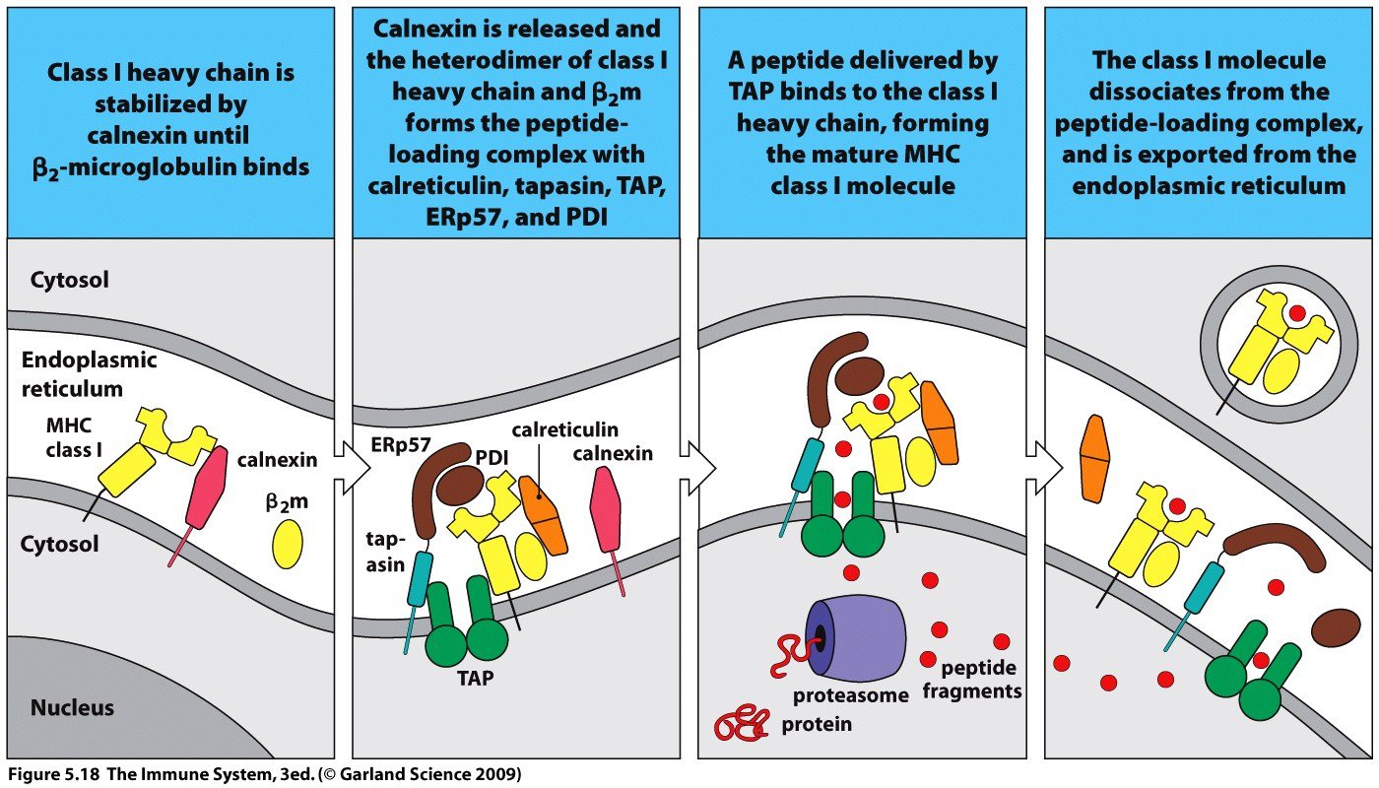
MHC is delivered to the ER in an immature form
Peptide is bound and the MHC molecule completes its folding.

Slide 25
Extracellular antigens are engulfed into vesicles
These membrane bound vesicles become part of a transport network moving from the plasma membrane to the interior of the cell
On route the vesicles become acidified and fuse with the lysosome that contain proteases
Peptides are produced
Macrophages, dendritic cells and B cells all process antigen inside vesicles

Slide 26
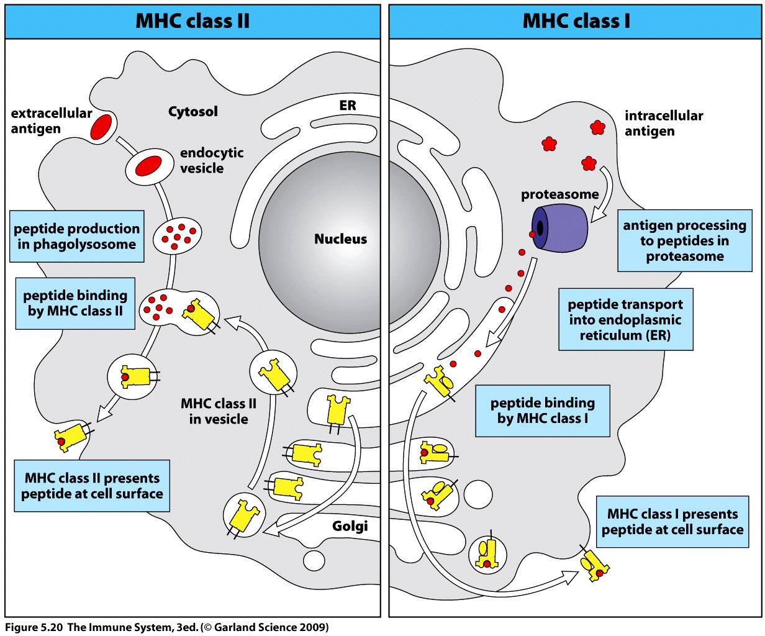
MHC class II is also contained in the vesicle system and when vesicles fuse the peptide can be loaded onto the MHC molecule.
Mycobacteria prevent fusion of the phagosome with the lysosome and thus avoid digestion and MHC association of its antigens –immune evasion.

Slide 27
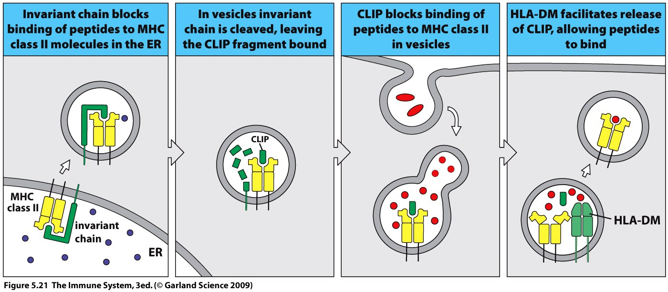
MHC II is blocked from binding inappropriate peptides in the ER by an invariant chain (common to all individuals).
The invariant chain also delivers the MHC II to a vesicle where the chain is reduced to a CLIP (class II associated invariant chain peptide).
CLIP can only be removed by MHC association with HLA –DM which permits replacement with the strongest binding peptide.

Slide 28
During antigen recognition the TCR binds to both the peptide and the MHC molecule.
The peptide:MHC complex forms the TCR ligand.

Slide 29
The grove of the MHC molecule is formed by 8 antiparallel β strands and 2 α helices
The peptide lies between the helices forming a nearly flat surface for TCR interaction.
The CDR3 loops of the TCR binds to the peptide and is the most variable portion of the TCR.
CDR1 and CDR2 bind at either side of the peptide and to the MHC molecule holding it.
During infection MHC expression is up regulated by cytokines to increase the efficiency of antigen presentation.

Slide 30
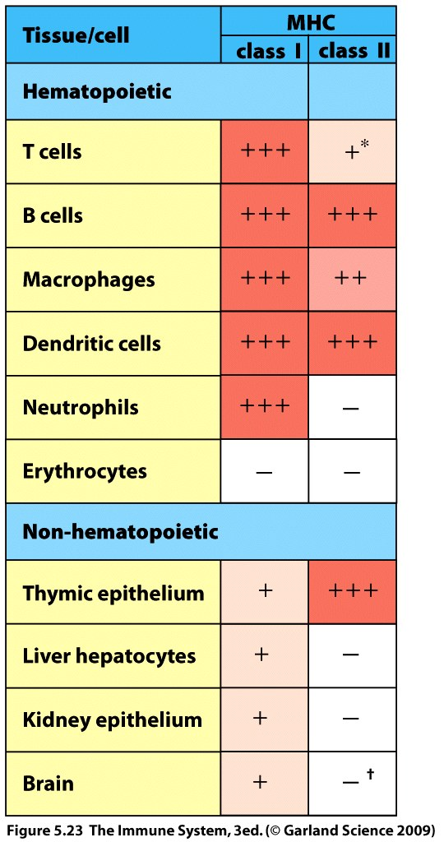
MHC class I and II are expressed differentially
MHC I is expressed at all times (constitutively) on nearly all of the cells within the body.
This allows for comprehensive surveillance by CD8 T cells.
RBC do not express MHC.
MHC II is constitutively expressed on a limited number of cell types, the professional antigen presenting cells.
Why the difference?
All cells vulnerable to intracellular infection but only phagocytic cells can engulf and present extracellular antigen.

Slide 31
Human MHC = HLA, human leukocyte antigen complex
Named because, when originally discovered they were found on white blood cells (leukocytes) not RBCs.
HLA class I and HLA class II are the MHC class I and MHC class II molecules in humans
Unlike the genes encoding the BCR and TCR the HLA genes undergo NO recombination.

Slide 32
Diversity of HLA is due to
Genetic polymorphism
multiple alternative forms of the gene within the population
Gene families
within an individual multiple similar genes are present encoding the MHC I heavy chain, MHC II α chain and MHC II β chain.

Slide 33
An isotype usually refers to any related proteins/genes from a particular gene family.
The 2 different forms of a HLA gene inherited from each parent are known as gene alleles and the encoded protein is an allotype.
This diversity results in most humans being heterozygous for a particular HLA gene.
Humans have 6 MHC I isotypes and 5 MHC II isotypes.
Some isotypes are more polymorphic in their genes than others.
This relates to function
HLA-DM used to remove CLIP has few alleles.
HLA –A presents antigen to T cells and has many alleles.

Slide 34
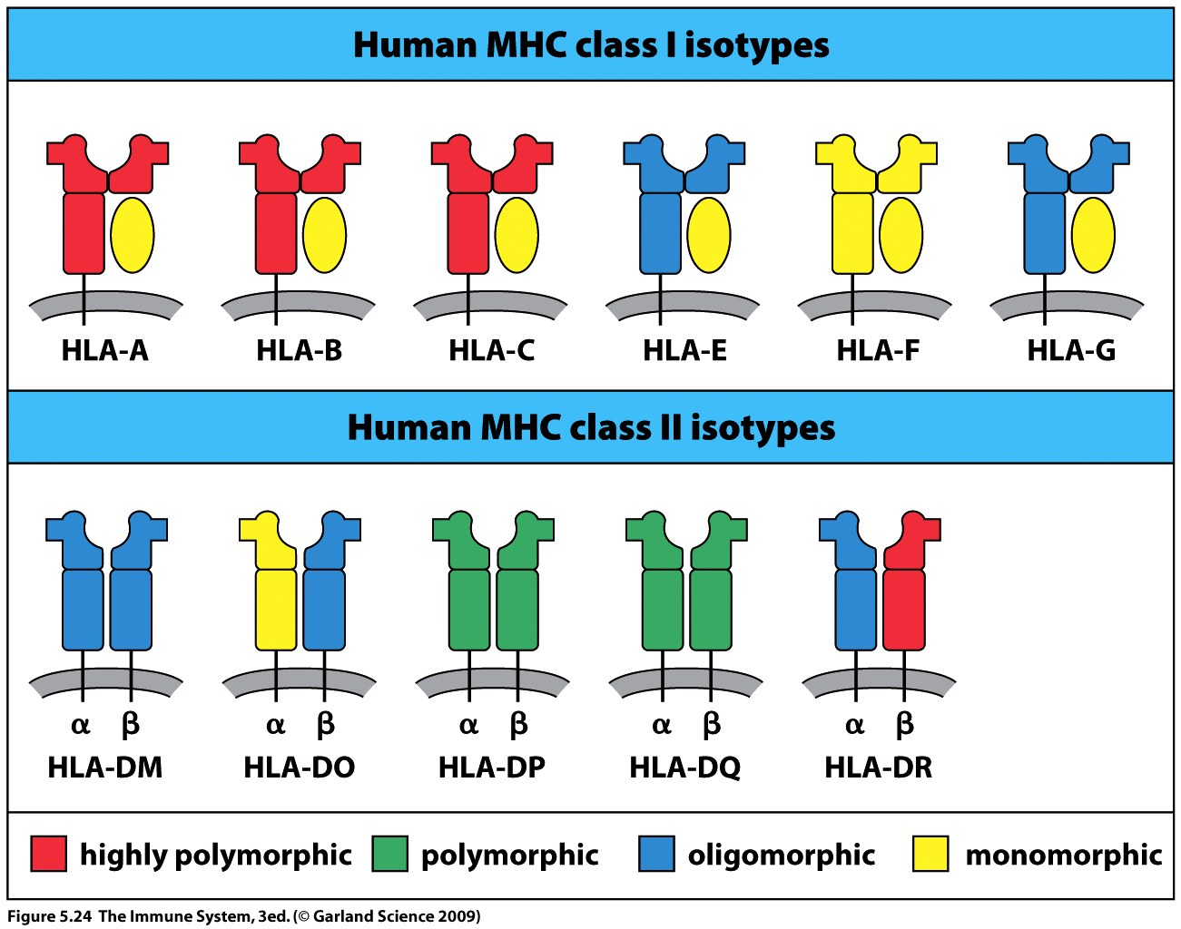
MHC I :
HLA-A, HLA-B and HLA-C present peptide to CD8 T cells
HLA-E and HLA-G interact with NK cells
HLA-F unknown function
MHC II:
HLA-DP, HLA-DQ and HLA-DR present to CD4 T cells
HLA-DM and HLA-DO regulate peptide loading onto the other HLAs.

Slide 35
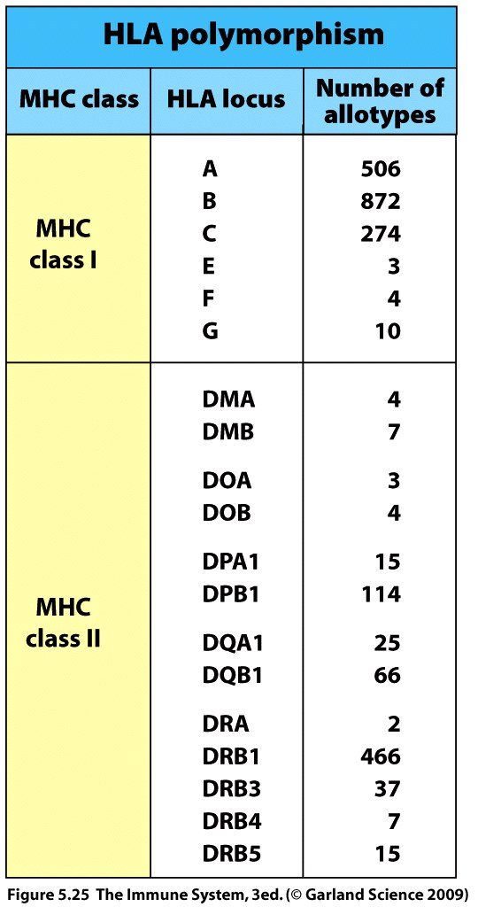
HLA complex – region of 4 million bp on chromosome 6
Sequence is divided into three regions
Class I – six functional genes
Class II – five functional genes
Class III – divides the other two
The invariant light chain of MHC I (β₂₋microglobulin) is carried on Chromosome 15.
One of each of these
is on chromosome 6

Slide 36
The particular combination of HLA alleles found on chromosome 6 is known as the haplotype.
An individual has two copies of chromosome 6 (diploid) and thus has two HLA haplotypes.
Diversity resulting from the combination of multiple genes and multiple alleles of these genes means that millions of different HLA isoforms are possible.
The advantage of having multiple HLA genes is that they contribute different peptide-binding specificities which allows a greater variety of pathogen derived peptides to be presented and activate more T cells.

Slide 37
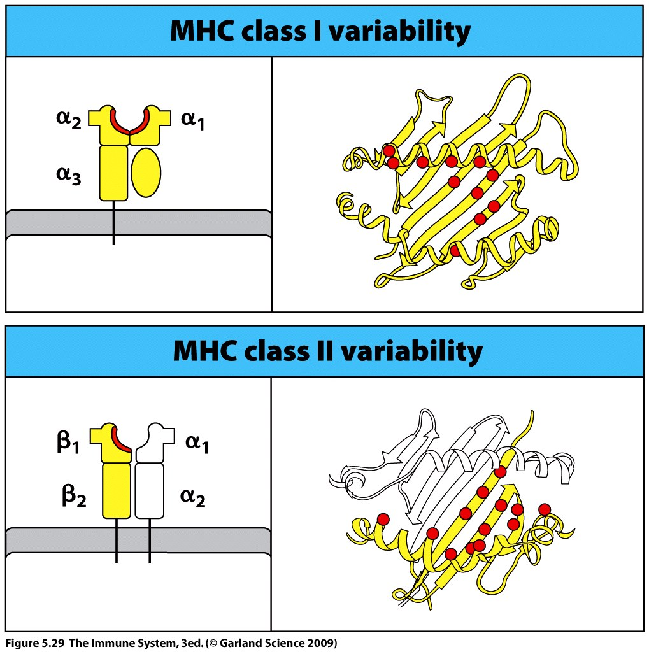

Slide 38
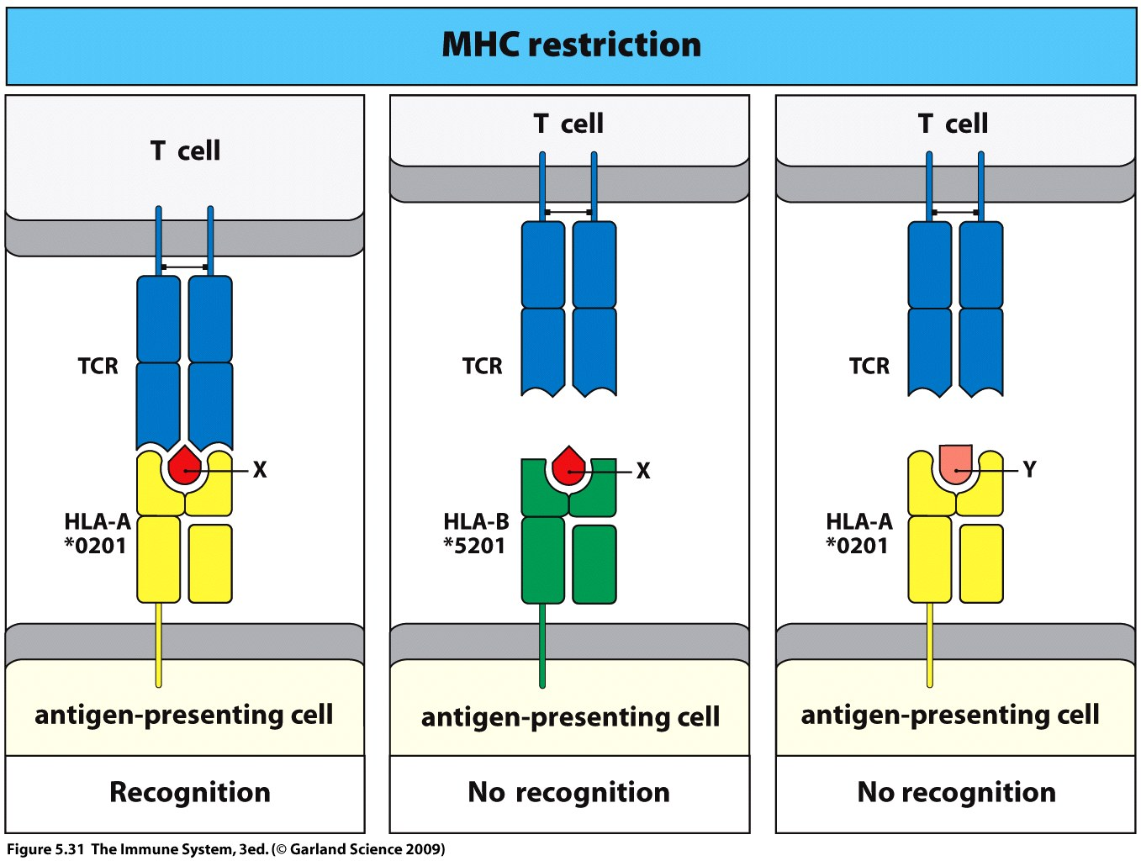
MHC restriction arises due to the nature of TCR binding.
The TCR must interact with both the peptide and the MHC molecule
to trigger recognition and the effector function.
This increases specificity on the part of the T cell.

Slide 39
MHC polymorphism triggers T cell reaction that can reject transplanted organs.
During T cell maturation tolerance is generated by deleting cells which bind too tightly to self MHC expressed in the thymus.
Remaining T cells can not react against self MHC isoforms (autologous isoforms).
However alloreactive T cells may react against any isoform which is not present in the individual (allogeneic isoforms).

Slide 40
During transplantation of a kidney an alloreaction may occur if T cells of the recipient patient react against the HLA molecules on the donor kidney leading to destruction of donor tissue
HLA types must be matched closely and immunosuppressive drugs used to guard against rejection.

Slide 41
Cytotoxic T-cells
Killer T Cell - YouTube

