Slide 1
Part V
Antibody Structure and Function

Slide 2
Chapter Overview
Tetrapeptide structure of immunoglobulins
Light and heavy chains
Three-dimensional structure of antibodies
Characteristics of specific immunoglobulins
Antibody diversity theories
Genes coding for immunoglobulins
Monoclonal antibody

Slide 3
Antibodies
Are immunoglobulins
Glycoproteins found in the serum
82% to 96% polypeptide and 2% to 14% carbohydrate
Five major classes: IgG, IgM, IgA, IgD, IgE
Are the key element of the humoral immune response

Slide 4
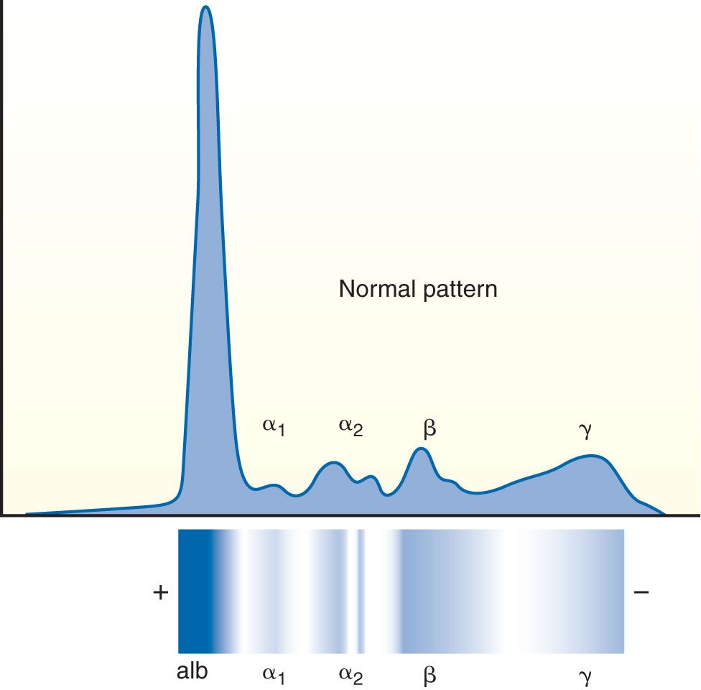
Antibodies
Appear primarily in the gamma (γ) band with serum electrophoresis at pH 8.6

Slide 5
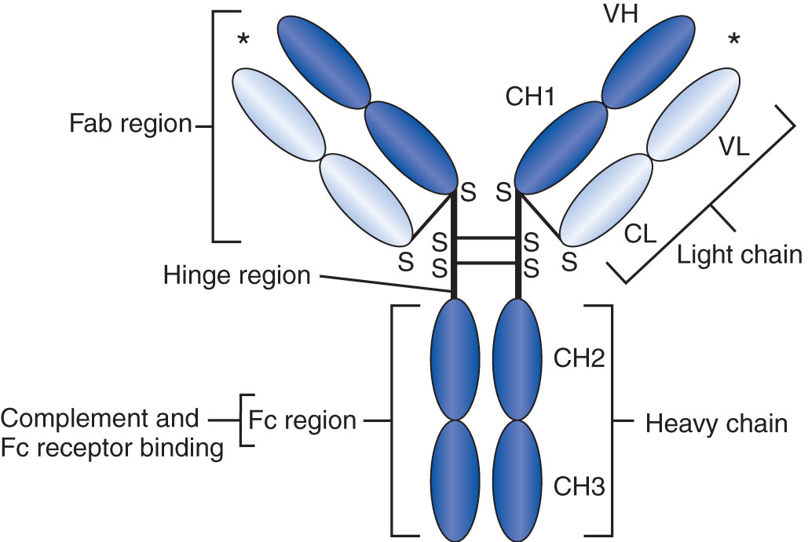
Tetrapeptide Structure of Immunoglobulins
Basic four-chain polypeptide
Two large heavy (H) chains
Two small light (L) chains
Held together by noncovalent forces and disulfide interchain bridges

Slide 6
Tetrapeptide Structure of Immunoglobulins
Single, unique variable region (amino-terminal end)
One or more constant regions (carboxy-terminal end)

Slide 7
Tetrapeptide Structure of Immunoglobulins
Fc fragment
Has no antigen-binding ability
Represents the carboxy-terminal halves of two H chains
Held together by S–S bonding
Important in effector functions of immunoglobulin molecules
Opsonization
Complement fixation
Notes:
Fc = fragment crystallizable.

Slide 8
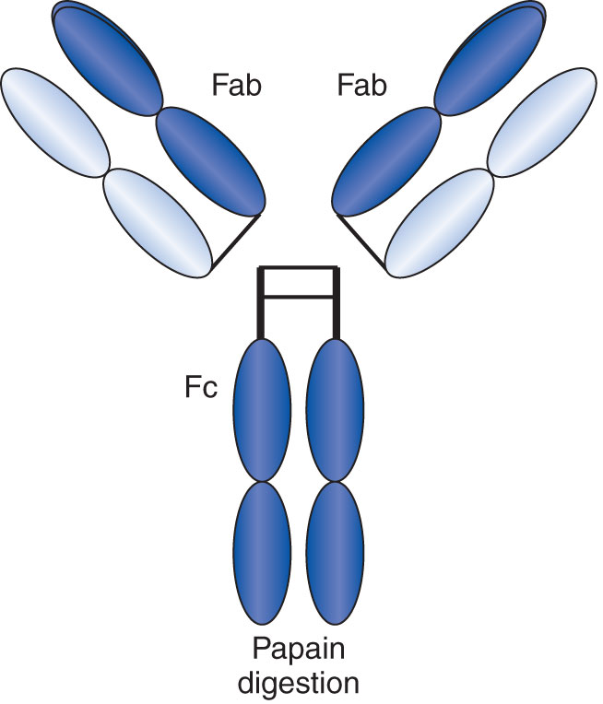
Tetrapeptide Structure of Immunoglobulins
Fab fragment
One L chain
One-half of an H chain
Held together by disulfide bonding
Obtained by papain digestion of an immunoglobulin
Notes:
Fab = fragment antigen-binding.

Slide 9
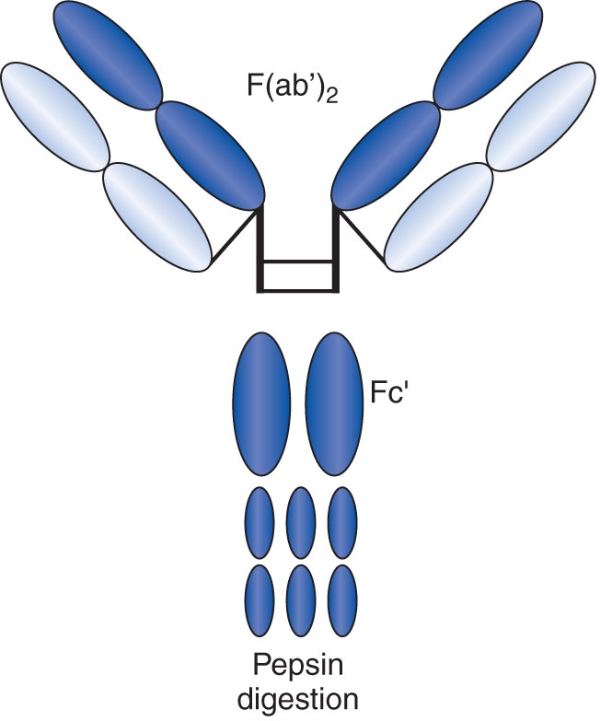
Basic Structure of immunoglobulins
F(ab’)₂
Obtained by pepsin digestion
Two antigen-binding sites together
Fc’ portion in pieces

Slide 10
Light Chains (Bence Jones Proteins)
Discovered in 1845 by Dr. Henry Bence Jones
L chains secreted by malignant plasma cells
Two types
Kappa (κ)
Lambda (λ)
Contain between 200 and 220 amino acids
Constant region
Variable region
Notes:
The difference between the κ and λ chains lies in the amino acid substitutions at a few locations along the chain.
Both κ and λ chains are found in all five classes of immunoglobulins, but only one type is present in a given molecule.

Slide 11
Heavy Chains
Variable region
First approximately 110 amino acids
Constant regions
Remaining amino acids
Three or more regions with very similar sequences designated CH1, CH2, and CH3

Slide 12
Heavy Chains
Are unique to each class and give each immunoglobulin type its name
IgG: γ chain
IgM: μ chain
IgA: α chain
IgD: δ chain
IgE: ε chain

Slide 13
Heavy Chains
Isotype: A unique amino acid sequence that is common to all immunoglobulin molecules of a given class in a given species
Allotypes: Minor variations of isotype sequences that are present in some individuals but not others
Idiotype: Variations in variable regions that give individual antibody molecules specificity

Slide 14
Hinge Region
The segment of H chain located between the CH1 and CH2 regions
Has a high content of proline, allowing flexibility, and hydrophobic residues
Flexibility
Allows two antigen-binding sites to operate independently
Assists initiation of complement cascade
Notes:
Gamma, delta, and alpha chains all have a hinge region, but mu and epsilon chains do not.
The CH2 domains of mu and epsilon chains are paired in such a way as to confer flexibility to the Fab arms.

Slide 15
Carbohydrate Portion
Found in all types of immunoglobulins
Localized between the CH2 domains of the two H chains
Increases the solubility of immunoglobulin
Provides protection against degradation
Enhances functional activity of the Fc domains

Slide 16
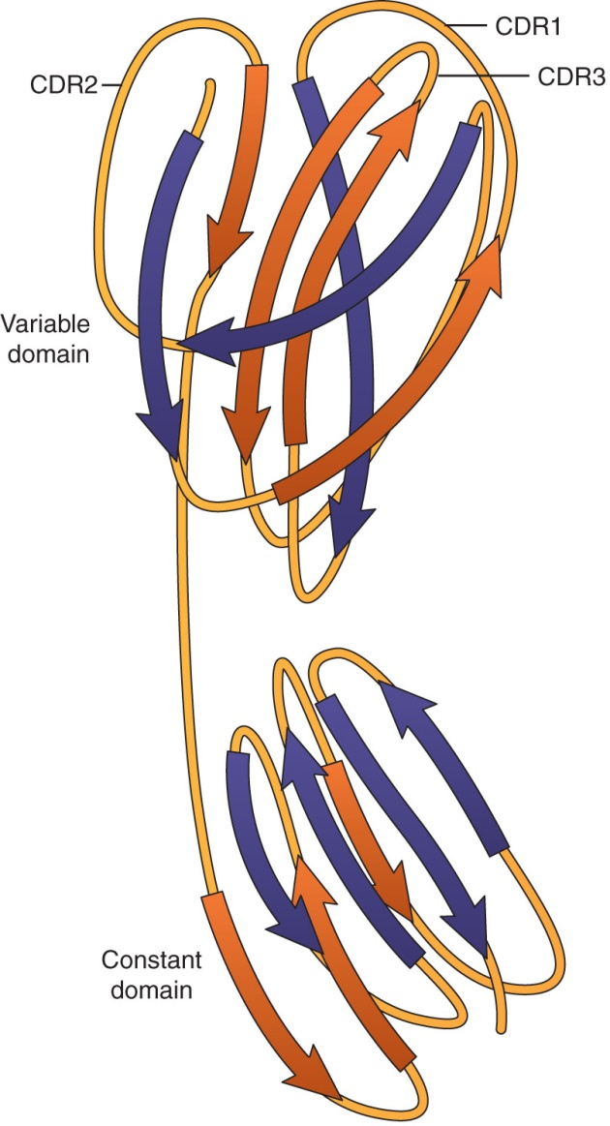
Three-Dimensional Structure of Antibodies
Folded into compact globular subunits stabilized by intrachain disulfide bonds
Immunoglobulin fold

Slide 17
IgG
Predominant immunoglobulin in humans (75% to 80% of the total serum immunoglobulins)
Has the longest half-life of any immunoglobulin class (23 days, predominance in serum)
Notes:
Refer to Table 5-1 in the text.

Slide 18
IgG
Four subclasses:
IgG1: 66%
IgG2: 23%
IgG3: 7%
IgG4: 4%
Differ in number and position of the disulfide bridges between the γ chains
Notes:
Refer to Table 5-1 in the text.

Slide 19
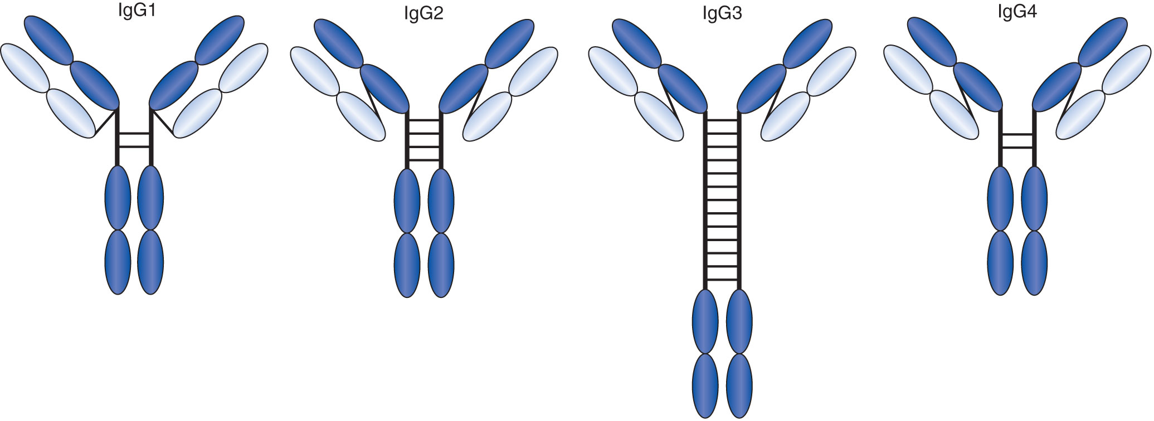
IgG
Notes:
Refer to Table 5-1 in the text.

Slide 20
IgG
IgG3
Has the largest hinge region
Has the largest number of interchain disulfide bonds
Is the most efficient at binding complement
Is induced in response to protein antigens

Slide 21
IgG
IgG2 and IgG4
Have shorter hinge segments
Are poor mediators of complement activation
Are involved in responses to polysaccharide antigens

Slide 22
Major Functions of IgG
Providing immunity for the newborn (because IgG can cross the placenta)
Fixing complement
Coating antigen for enhanced phagocytosis (opsonization)
Neutralizing toxins and viruses
Participating in agglutination and precipitation reactions

Slide 23
IgG
All subclasses can cross the placenta
Macrophages, monocytes, and neutrophils have Fc receptors specific to the Fc region of IgG, increasing the efficiency of phagocytosis
A high diffusion coefficient allows IgG to enter extravascular spaces more readily than other immunoglobulin types
IgG plays a major role in neutralizing toxins and viruses
Notes:
IgG2 is the least efficient at crossing the placenta.

Slide 24
IgG: Laboratory Testing
Agglutination and precipitation reactions take place in vitro
IgG is better at precipitation reactions than at agglutination
Precipitation involves small soluble particles, which are more easily brought together by the relatively small IgG molecule

Slide 25
IgM
Known as a macroglobulin
Has a molecular weight of about 900,000 d
Accounts for 5% to 10% of all serum immunoglobulins
Has half-life of 6 days (much shorter than that of IgG)
Can exist as:
Monomer (on surface of B cells)
Pentamer (found in secretions)
Notes:
Refer to Table 5-1 in the text.

Slide 26
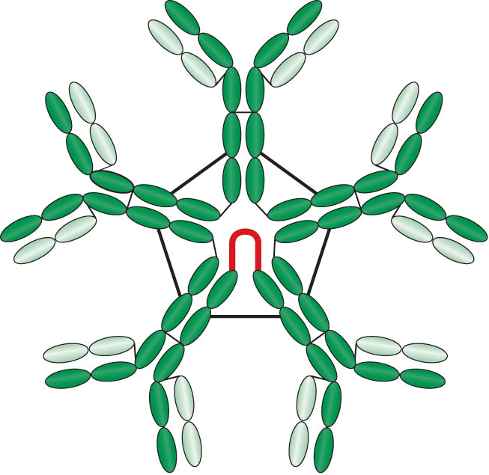
IgM
Pentamer form
Held together by J chains, which are linkage points for disulfide bonds between two adjacent monomers
Has a star-like shape with 10 antigen-binding sites
Notes:
Only approximately 5 of the 10 binding sites are used unless the antigen is extremely small.

Slide 27
IgM
Has a high valency
Found mainly in the intravascular pool
Cannot cross the placenta
Known as the primary response antibody
Appears first after antigenic stimulation and in the maturing infant
Synthesized only as long as antigen remains present
No memory cells

Slide 28
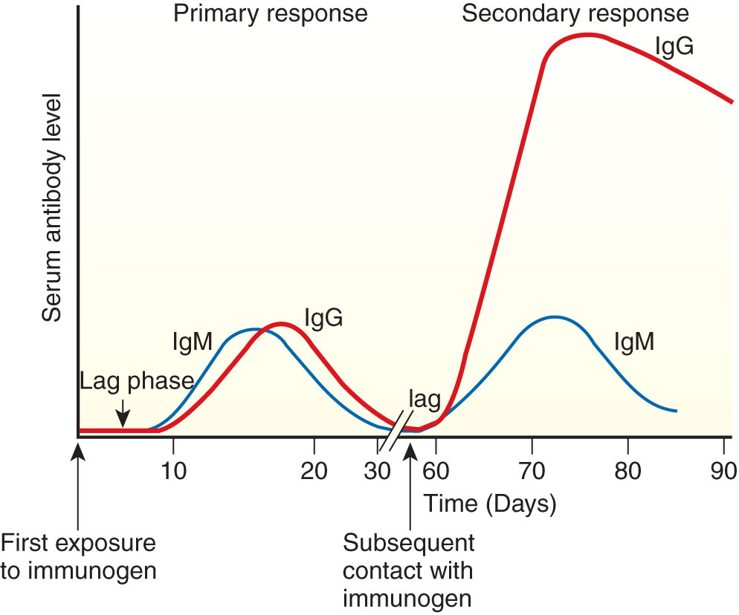
IgM
Primary versus secondary response
Notes:
The primary response is predominantly IgM.
The secondary response is mainly IgG.
The primary response is characterized by a long lag phase, whereas the secondary response has a shortened lag period and a much more rapid increase in antibody titer.
The secondary response is also known as the memory or anamnestic response, and the high serum levels persist for a long period.

Slide 29
Functions of IgM
Complement fixation
Agglutination
Opsonization
Toxin neutralization
Notes:
IgM is the most efficient immunoglobulin in triggering the classical complement pathway.
The larger number of binding sites makes IgM more efficient at agglutination reactions, defending against bacterial diseases.

Slide 30
IgA
Accounts for 10% to 15% of all circulating immunoglobulins in serum
One variable and three constant regions
Serum IgA: Appears as a monomer with a molecular weight of approximately 160,000

Slide 31
Subclasses of IgA
IgA1
Mainly found in serum
Acts as antiinflammatory agent
Downregulates IgG-mediated phagocytosis, chemotaxis, bactericidal activity, and cytokine release
Notes:
IgA1 and IgA2 differ in content by 22 amino acids, 13 of which are located in the hinge region and are deleted in IgA2.

Slide 32
Subclasses of IgA
IgA2
Predominantly found in secretions at mucosal surfaces
Is a dimer along the respiratory, urogenital, and intestinal mucosa
Keeps antigen from penetrating farther into the body
Is more resistant to some bacterial proteinases that are able to cleave IgA1
Notes:
IgA2 can be found in milk, saliva, tears, and sweat.

Slide 33
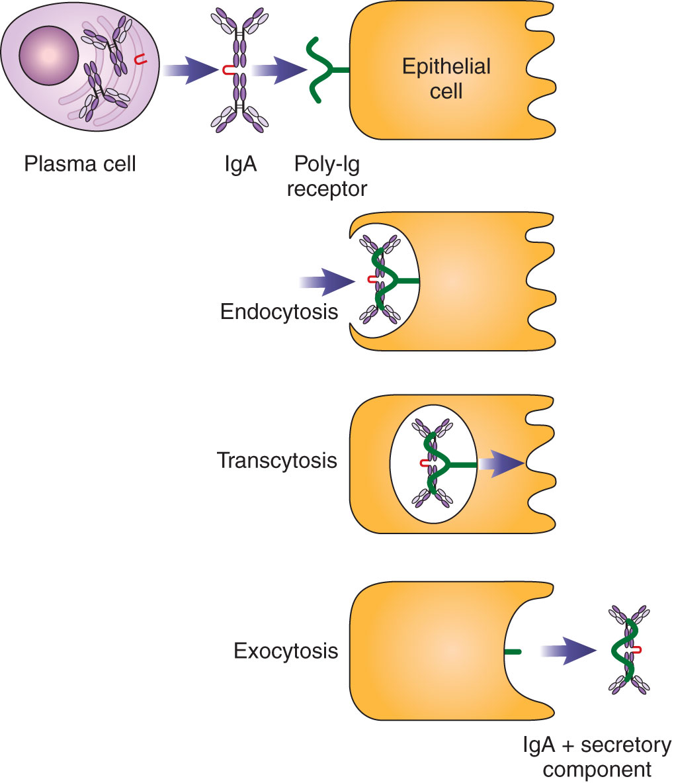
Secretory IgA
Is synthesized in plasma cells found mainly in mucosal-associated lymphoid tissue
Is released in dimeric form
Is captured by secretory component (SC) on epithelial cells
Notes:
Secretory component has a molecular weight of about 70,000. It attaches to the Fc region around the hinge portion of the α chains.
Secretory IgA consists of five immunoglobulin-like domains derived from epithelial cells
Secretory IgA serves as a specific receptor for IgA.
The SC facilitates transport of IgA to mucosal surfaces and makes the dimer more resistant to enzymatic digestion.

Slide 34
Secretory IgA Functions
Patrols mucosal surfaces and acts as a first line of defense
Neutralizes toxins produced by microorganisms
Prevents bacterial adherence to mucosal surfaces
Passively transfers immunity to newborn during breastfeeding

Slide 35
Secretory IgA Functions
Complexes of IgA and antigen are easily trapped in mucus and eliminated by the ciliated epithelial cells of the respiratory and intestinal tracts
Aggregation of IgA immune complexes may trigger the alternate complement pathway

Slide 36
Secretory IgA Functions
Neutrophils, monocytes, and macrophages possess specific receptors for serum and secretory IgA
Binding to these sites triggers a respiratory burst and degranulation of the cells involved
Both forms of IgA can thus act as opsonins, or promoters of phagocytosis

Slide 37
IgD
Extremely scarce in the serum
Less than 0.001% of total immunoglobulins
Has a molecular weight of approximately 180,000
The δ H chain
Has a molecular weight of 62,000
Appears to have an extended hinge region consisting of 58 amino acids

Slide 38
IgD
Is more susceptible to proteolysis than other immunoglobulins
Has a short half-life (1 to 3 days)
Found on the surface of immunocompetent but unstimulated B lymphocytes
Appears second (after IgM)
May play a role in B-cell activation
Plays a role in regulating B-cell maturation and differentiation
Notes:
The high level of surface expression and its intrinsic flexibility make IgD an ideal early responder to antigen.

Slide 39
IgD
Secreted form in serum does not appear to serve a protective function
Does not bind complement
Does not bind to neutrophils or macrophages
Does not cross the placenta
Notes:
Those with both IgM and IgD receptors are capable of responding to T-cell help and switching to synthesis of IgG, IgA, or IgE.
B lymphocytes bearing only IgM receptors appear to be incapable of an IgG response.

Slide 40
IgE
0.0005 % of total serum immunoglobulins
Has an ε H chain composed of around 550 amino acids that are distributed over one variable and four constant domains
Produced by plasma cells that are located primarily in the lungs and skin
Notes:
Each mast cell may have several hundred thousand receptors, each capable of binding an IgE molecule.

Slide 41
IgE
Does not participate in complement fixation, agglutination, or opsonization
Is incapable of crossing the placenta
Attaches to basophils, eosinophils and tissue mast cells through high-affinity Fc ε RI receptors

Slide 42
IgE Function: Allergic Reactions
Two adjacent IgE molecules on a mast cell bind a specific antigen
Cascade of cellular events results in degranulation of mast cells and release of vasoactive amines (such as histamine and heparin)

Slide 43
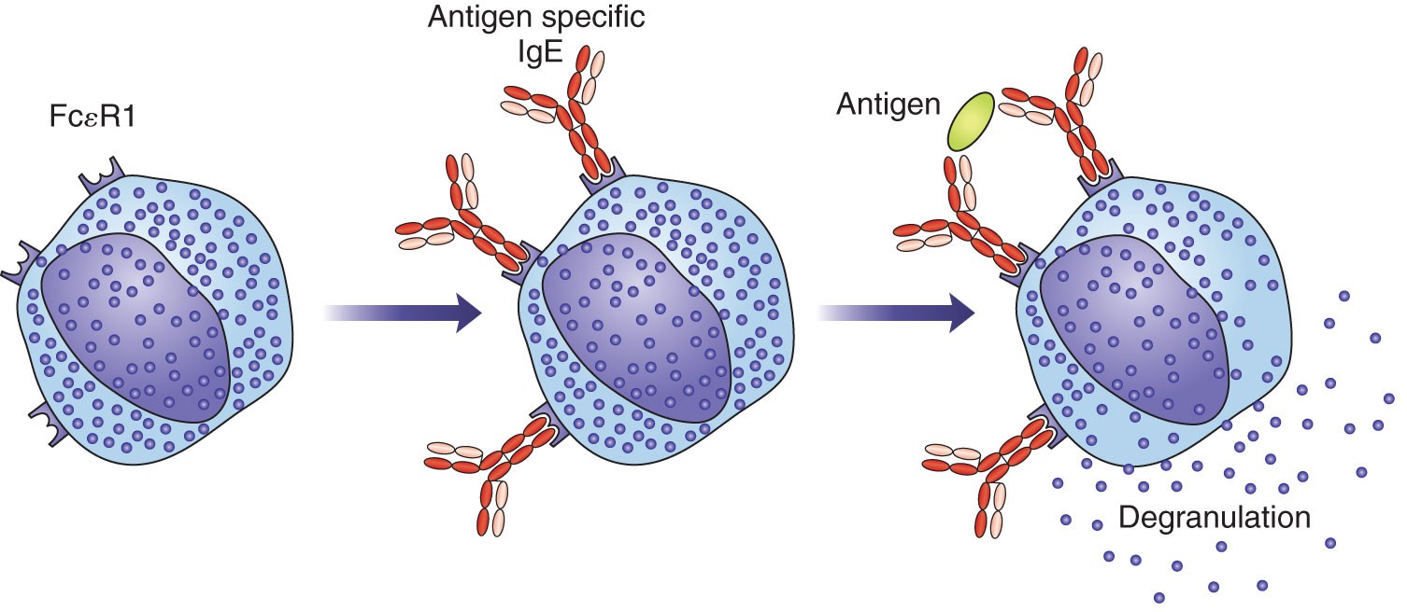
IgE Function: Allergic Reactions

Slide 44
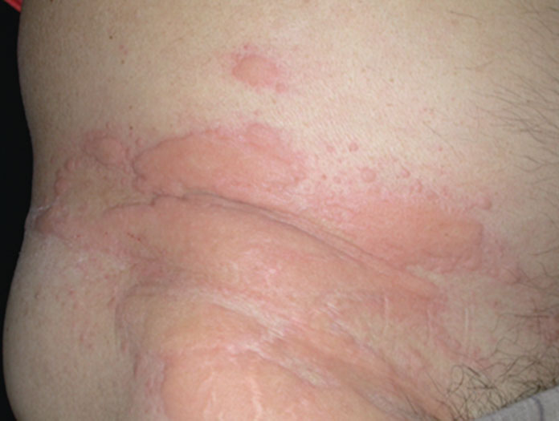
IgE Function: Allergic Reactions
Type I immediate hypersensitivity results
Hay fever, asthma, vomiting and diarrhea, hives, life-threatening anaphylactic shock

Slide 45
IgE Function: Parasitic Infections
Eosinophils play a major part in the destruction of large antigens, such as parasitic worms, that cannot be easily phagocytized
Notes:
IgE may serve a protective role by triggering an acute inflammatory reaction that recruits neutrophils and eosinophils to the area to help destroy invading antigens that have penetrated IgA defenses.

Slide 46
Antibody Diversity Theories
Side-chain theory
Established by Paul Ehrlich in the early 1900s
Postulated that certain cells had specific surface receptors for antigen that were present before contact with antigen occurred
If antigen introduced, combines with the proper receptors to break off and enter the circulation as antibody molecules
Postulated that process could be repeated with further contact with antigens
Notes:
The receptors Ehrlich originally postulated are the surface immunoglobulins IgM and IgD.

Slide 47
Antibody Diversity Theories
1950s: Jerne and Burnet’s clonal selection for antibody formation
Lymphocytes are genetically preprogrammed to produce one type of immunoglobulin
A specific antigen finds the particular cells capable of responding to it, causing them to proliferate
Would require a large number of genes
1965: Dryer and Bennett
Constant and variable portions of immuno-globulin chains are coded for by separate genes

Slide 48
Genes Coding for Immunoglobulins
Chromosomes contain building blocks from which genes can be assembled
Human immunoglobulin genes are found in three unlinked clusters:
H chain genes on chromosome 14
κ chain genes on chromosome 2
λ chain genes on chromosome 22
Rearrangement is needed for genes to become functional antibody molecules

Slide 49
Genes Coding for Immunoglobulins
More than one gene controls synthesis of a particular immunoglobulin
H chains
Variable-region genes: V_{H}, D, and J
Constant-region genes: set of C genes
L chains: lack a D region
Through a random selection process, these individual segments are joined to commit that lymphocyte to making antibody of a single specificity
Notes:
V_{H} = variable.
D = diversity.
J = joining.

Slide 50
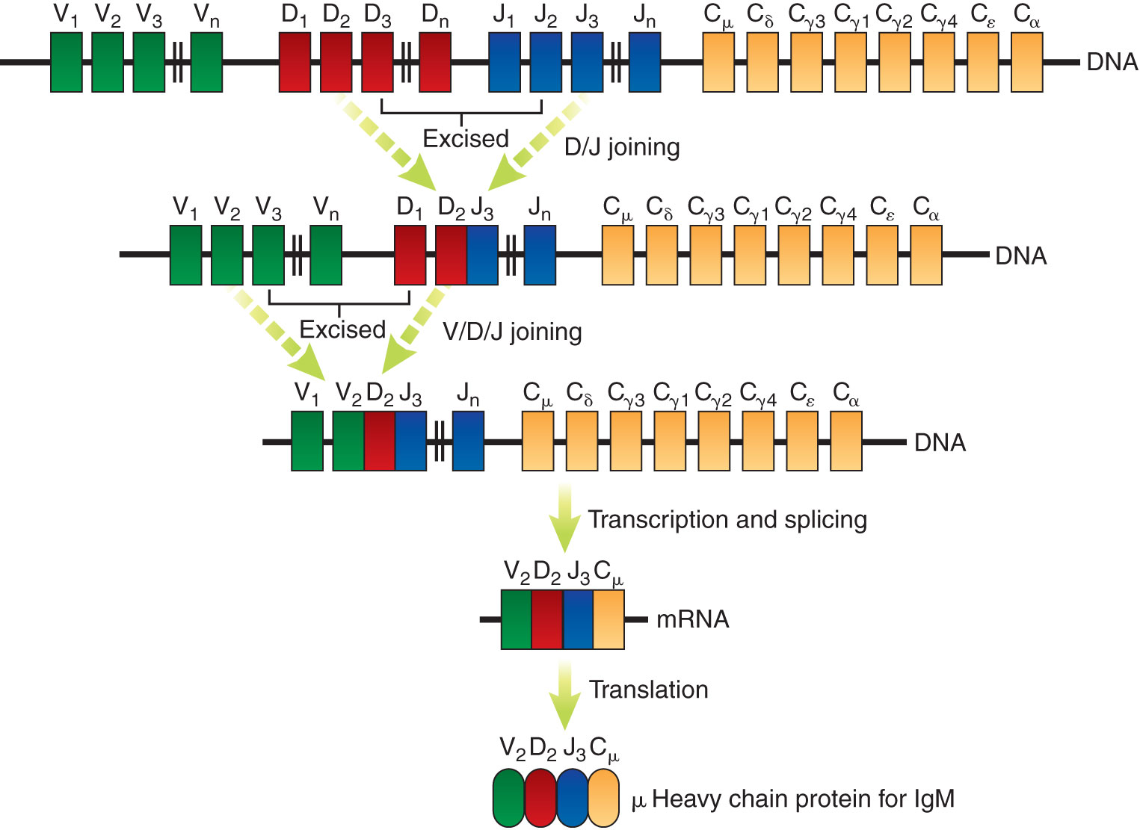
Genes Coding for Immunoglobulins
Heavy-chain rearrangement
Notes:
Figure 5-10. Immunoglobulin heavy chains: Four separate regions on chromosome 14 code for H chains. DJ regions are spliced first, and then this segment is joined to a variable region. When RNA synthesis occurs, one constant region is attached to the VDJ combination. μ H chains are made first, but the cell retains its capacity to produce immunoglobulin of another class.

Slide 51
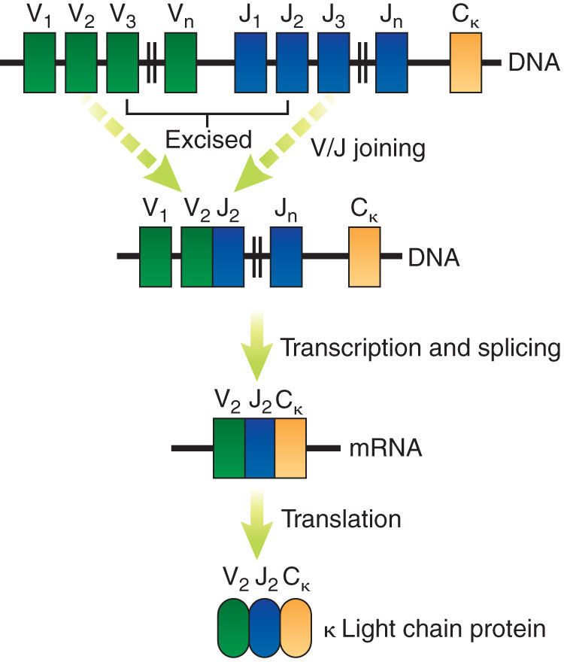
Genes Coding for Immunoglobulins
Light-chain rearrangement
Notes:
Figure 5-11. Assembly and expression of the κ L chain locus. A DNA rearrangement fuses one V segment to one J segment. The VJ segment is then transcribed along with a unique C region to form mature κ mRNA. Unarranged J segments are removed during RNA splicing.

Slide 52
Monoclonal Antibodies
Mainly used for diagnostic testing and therapeutic purposes
In vitro diagnostic testing
Delivery of therapeutic agents in diseases
Developed based on knowledge that B cells are genetically preprogrammed to synthesize very specific antibody
Are derived from a single parent antibody-producing cell that has reproduced many times

Slide 53
Monoclonal Antibodies
Hybridoma
Fusion of an activated B cell with a laboratory-grown myeloma cell that cannot make its own DNA because of deficiency of HGPRT
Production involves:
Immunizing a mouse with a certain antigen
Harvesting spleen cells
Combining spleen cells with myeloma cells in the presence of PEG
Selecting fused cells and screening for presence of desired antibody
Notes:
HGPRT = hypoxanthine guanine phosphoribosyl transferase.
PEG = polyethylene glycol.

Slide 54
Summary
The basic structural unit for all immunoglobulins is a tetrapeptide composed of two L and two H chains joined together by disulfide bonds.
The five classes of antibodies are IgM, IgG, IgA, IgD, and IgE.
Kappa and lambda (L chains) are found in all types of immunoglobulins, but the H chains differ for each immunoglobulin class.

Slide 55
Summary
Each immunoglobulin molecule has constant and variable regions.
Variable region (Fab fragment) determines the specificity of that molecule for a particular antigen.
Constant region (Fc fragment) is responsible for binding to effector cells.
The five different types of heavy chains are called isotypes.

Slide 56
Summary
Minor variations in a particular type of heavy chain are called allotypes.
The variable portion of L and H chains unique to a particular immunoglobulin molecule is known as the idiotype.
IgG is small and easily penetrates into tissues.
IgM is large and excels at complement fixation.

Slide 57
Summary
IgA has an SC that protects it from enzymatic digestion while it patrols mucosal surfaces.
An extended hinge region gives IgD an advantage as a surface receptor for antigen.
IgE binds to mast cells to initiate a local inflammatory reaction.
The primary response to an antigen takes 5 to 7 days before antibody can be detected.

Slide 58
Summary
The secondary response to antigen occurs more rapidly and persists for a longer time.
Ehrlich’s side-chain theory is based on the antigen selecting the correctly programmed B lymphocyte.
The clonal selection hypothesis postulated that lymphocytes are generally pre-endowed to respond to one antigen or a group of antigens.

Slide 59
Summary
Several genes code for a particular immunoglobulin; through a random selection process, these individual segments are joined to make antibody of a single specificity.
Monoclonal antibodies are made when a cancerous cell or myeloma is fused with an antibody-producing cell to form a hybridoma.

