Slide 1
Part VI
Cytokines

Slide 2
Chapter Overview
Introduction to cytokines
Cytokines in the innate immune response
Cytokines in the adaptive immune response
TH17 cytokines
Hematopoietic growth factors
Cytokine and anticytokine therapies
Clinical assays for cytokines

Slide 3
Introduction to Cytokines
Small soluble proteins that regulate:
  Innate immunity
  Adaptive response to infection
Induced in response to specific stimuli
  Bacterial lipopolysaccharides
  Flagellin
  Other bacterial products
  Ligation of cell-adhesion molecules

Slide 4
Introduction to Cytokines
Different ways cytokines act:
  Synergy—cytokines act together
  Pleiotropy—one cytokine has many actions
  Redundancy—different cytokines have the same function
  Antagonism—cytokines counteract each other

Slide 5
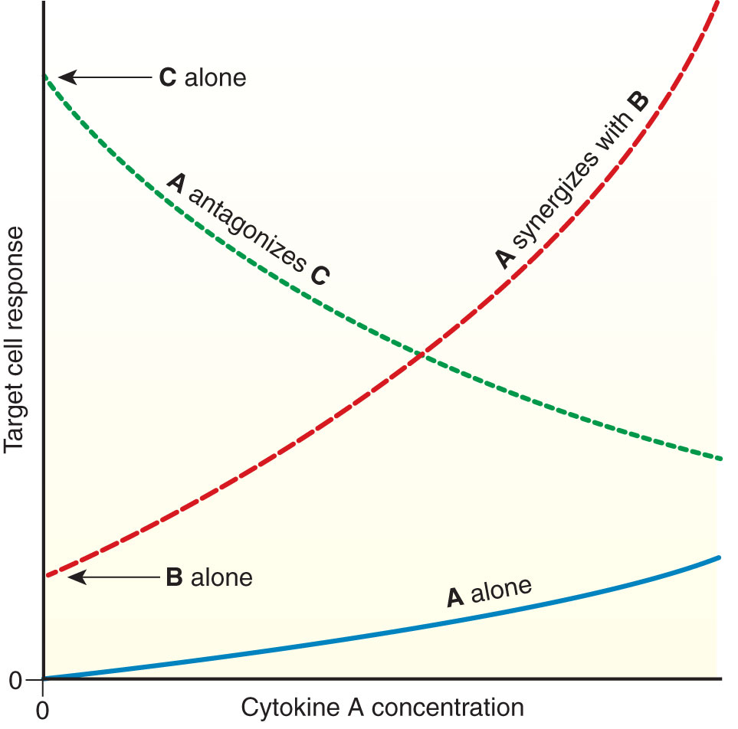
Introduction to Cytokines

Slide 6
Introduction to Cytokines
In vivo effects of cytokine expression on
leukocytes and other cells
  Regulation of growth
  Differentiation
  Gene expression

Slide 7
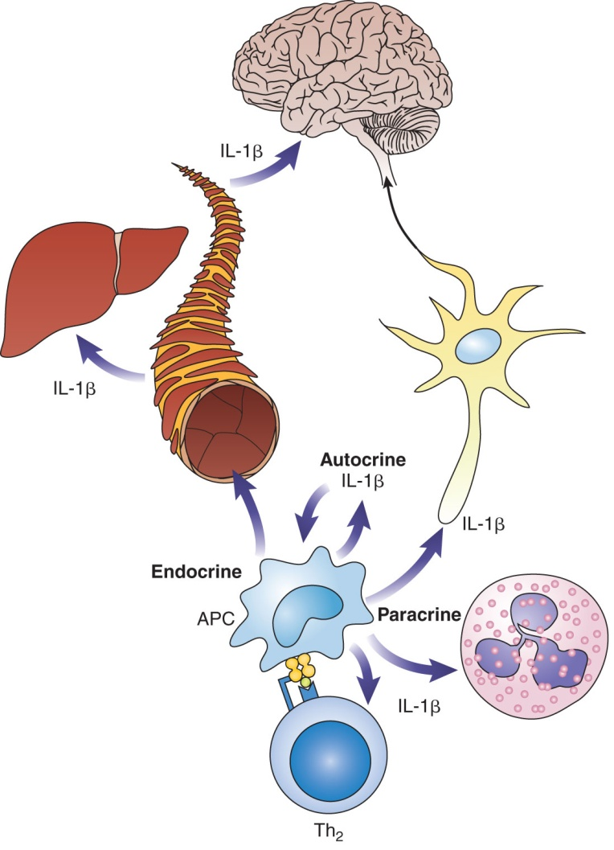
Introduction to Cytokines
Exert effects through:
  Autocrine stimulation
  Paracrine stimulation
  Systemic or endocrine activities (occasionally)
Notes:
Figure 6-1. Range of cytokine actions. Autocrine: Cytokine acts on the cell that secreted it (e.g., IL-1β increases activation of APC). Paracrine: Cytokine acts on nearby cells (e.g., IL-1β stimulates Th cells, activates neutrophils, depolarizes neurons). Endocrine: Cytokine travels through blood vessels to distant cells (e.g., IL-1β stimulates acute-phase protein synthesis in the liver, as well as fever induction in the hypothalamus).

Slide 8
Introduction to Cytokines
Have multiple actions due to:
  Widespread distribution of receptors on many cell types
  Ability to alter expression of numerous genes
May share properties and receptors
May have overlapping effects
Can determine whether the host will be able to mount an effective defense

Slide 9
Introduction to Cytokines
Major cytokine families
  Tumor necrosis factors (TNFs)
  Interferons (IFNs)
  Chemokines
  Transforming growth factors (TGFs)
  Colony-stimulating factors (CSFs)

Slide 10
Cytokines in the Innate Immune Response
Cytokines involved in triggering recruitment of effector cells
  Interleukin-1 (IL-1)
  Tumor necrosis factor (TNF)-α
  Interleukin-6 (IL-6)
  Chemokines
  Transforming growth factor-β
  Interferons α and β

Slide 11
Cytokines in the Innate Immune Response
IL-1
  Acts as an endogenous pyrogen
  Induces fever in the acute-phase response through its actions on the hypothalamus
  Induces the production of:
    Vascular cell-adhesion molecules
    Chemokines
    IL-6
  Includes IL-1α, IL-1β, and IL-1RA
Notes:
IL-1RA = IL-1 receptor antagonist.

Slide 12
Cytokines in the Innate Immune Response
IL-1α and IL-1β are proinflammatory cytokines produced by monocytes, macrophages, and dendritic cells
IL-1β is responsible for most of the systemic activity attributed to IL-1
  Fever
  Activation of phagocytes
  Production of acute-phase proteins

Slide 13
Cytokines in the Innate Immune Response
IL1RA is produced by monocytes and macrophages
It acts as an antagonist to IL-1 by blocking the IL-1 receptor and limiting the availability of the receptor for IL-1

Slide 14
Cytokines in the Innate Immune Response
TNF-α
  Is most prominent of TNF family
  Exists in membrane-bound and soluble forms
  Causes vasodilation and increased vasopermeability
  Is triggered by presence of lipopolysaccharide (found in gram-negative bacteria)
Notes:
TNFα is the central mediator of pathological processes in rheumatoid arthritis and other inflammatory illnesses, such as Crohn’s disease.
TNFα and IL-1 are both present in the rheumatoid synovial fluids and synovial membranes of patients with rheumatoid arthritis.

Slide 15
Cytokines in the Innate Immune Response
TNF-α
  Is secreted by activated monocytes and macrophages
  Can activate T cells through its ability to induce expression of MHC class II molecules, vascular adhesion molecules, and chemokines, in a similar manner to IL-1

Slide 16
Cytokines in the Innate Immune Response
IL-6
  Is a single protein produced by lymphoid and nonlymphoid cells
  Is part of the cytokine cascade released in response to lipopolysaccharide
  Is pleiotropic and plays a role in acute-phase reactions
  Is triggered by IL-1

Slide 17
Cytokines in the Innate Immune Response
IL-6
  Stimulates B cells to proliferate and differentiate into plasma cells
  Induces CD4+ T cells to produce greater quantities of both pro- and anti-inflammatory cytokines

Slide 18
Cytokines in the Innate Immune Response
Chemokines
  Enhance motility and promote migration of many types of white blood cells toward the source of the chemokine (chemotaxis)
  Are classified into four families based on the position of N-terminal cysteine residues:
    Alpha (CXC)
    Beta (CC)
    C
    CX3C
Notes:
CXC chemokines contain a single amino acid between the first and second cysteines.
CC chemokines have adjacent cysteine residues.
C chemokines lack one of the cysteines.
CX3C has three amino acids between the cysteines

Slide 19
Cytokines in the Innate Immune Response
Chemokines
  Are involved in the initiation and development of inflammatory responses in numerous disease processes
  Combined with cell-adhesion molecules, facilitate the extravasation of leukocytes into the tissues in areas of inflammation

Slide 20
Cytokines in the Innate Immune Response
TGF-β
  Composed of three isoforms:
    TGF-β1
    TGF-β2
    TGF-β3
  Induces antiproliferative activity in many cell types
  Regulates cell growth, differentiation, apoptosis, migration, and the inflammatory response
  Helps down-regulate the inflammatory response when no longer needed

Slide 21
Cytokines in the Innate Immune Response
TGF-β
  Inhibits activation of macrophages and the growth of different somatic cell types
  Functions as an anti-inflammatory factor for mature T cells
  In activated B cells:
    Inhibits proliferation
    May function as an autocrine regulator to limit the expansion of activated cells

Slide 22
Cytokines in the Innate Immune Response
Type I IFNs (IFN-α and IFN-β)
  Interfere with viral replication
  Are produced by dendritic cells
  Induce production of proteins and pathways that interfere with viral replication and cell division
  Activate natural killer cells
  Enhance the expression of MHC class I proteins
  Are active against certain malignancies and other inflammatory processes

Slide 23
Cytokines in the Adaptive Immune Response
Are mainly secreted by T cells, especially T helper (Th) cells
Affect T- and B-cell function more directly than cytokines involved in the innate immune response
Three main subclasses of CD4+ T cells:
  Th1
  Th2
  T regulatory cells (Tregs)

Slide 24
Cytokines in the Adaptive Immune Response
When the T-cell receptor (TCR) on a CD4+ T helper cell captures antigen, clonal expansion of the T cell occurs
Differentiation into Th1, Th2, or Treg cell lineages is influenced by the spectrum of cytokines expressed in the initial response

Slide 25
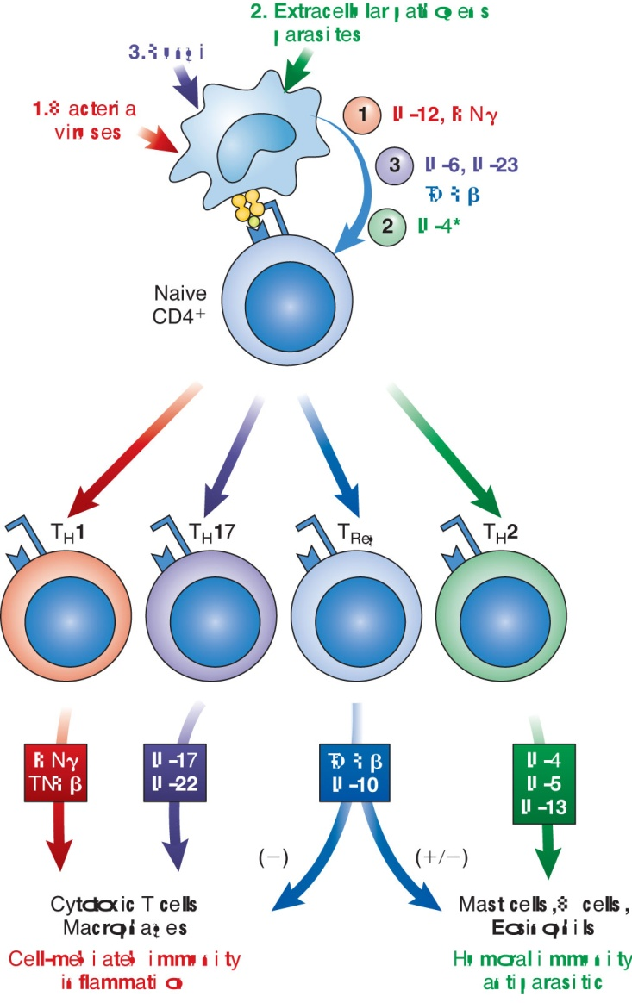
Cytokines in the Adaptive Immune Response

Slide 26
Cytokines in the Adaptive Immune Response
Th1 cytokines
  Interferon γ
    Affects RNA expression levels of more than 200 genes
    Stimulates antigen presentation by class I and class II MHC molecules
    Activates macrophages to stimulate phagocytic and cytotoxic abilities
    Regulates action of CD4+ Th cells, CD8+ cytotoxic lymphocytes, natural killer (NK) cells
Notes:
The Th1 lineage is expressed (along with other genes) when IL-12 binds to its receptor on naïve T cells.

Slide 27
Cytokines in the Adaptive Immune Response
Th1 cytokines
  IL-2
    Known as the T-cell growth factor
    Drives the growth and differentiation of T and B cells
    Induces lytic activity in NK cells
    Can activate proliferation of Th2 cells
    Helps to generate IgG1- and IgE-producing cells

Slide 28
Cytokines in the Adaptive Immune Response
Th2 cytokines
  IL-4
    Helps drive antibody responses in various diseases:
      Allergies
      Autoimmune diseases
      Parasitic infections
    Receptor expressed on lymphocytes and various nonhematopoietic cell types
Notes:
Th2 cytokines are primarily responsible for antibody-related immunity and regulating many aspects of the immune response to conditions such as allergies, autoimmune diseases, and parasites.

Slide 29
Cytokines in the Adaptive Immune Response
Th2
  IL-10
    Has anti-inflammatory and suppressive effects on Th1 cells
    Is produced by monocytes, macrophages, CD8+ T cells, and Th2 CD4+ T cells
    Inhibits antigen presentation by macrophages and dendritic cells
    Serves as an antagonist to IFN-γ to down-regulate the immune response

Slide 30
Cytokines in the Adaptive Immune Response
Tregs
  Are CD4+ CD25+ T cells
  Help establish peripheral tolerance to various self-antigens, allergens, tumor antigens, transplant antigens, and infectious agents
  Produce TGF-β that suppresses other T cells
  Induce IL-10 and TGF-β expression in adaptive Tr1 cells in the peripheral circulation
Notes:
Tr1 = T regulatory 1 cells.

Slide 31
Cytokines in the Adaptive Immune Response
T-cell suppression occurs through:
  IL-10 inhibition of proinflammatory cytokines
  Inhibition of costimulatory molecule expression on APCs
TGF-β down-regulates APC function and blocks proliferation and cytokine production by CD4+ T cells
The immune response is down-regulated, and chronic inflammation is prevented

Slide 32
Th17 Cytokines in Innate and Adaptive Immunity
Have a role in host defense against bacterial and fungal infections at mucosal surfaces
Involves Th17 cells secreting IL-17 family of cytokines to promote continuous recruitment of neutrophils
Promote release of antimicrobial peptides
When dysregulated, have been implicated in pathogenesis of multiple inflammatory diseases and several autoimmune conditions

Slide 33
Colony-Stimulating Factors (CSFs)
Include:
  IL-3
  Erythropoietin (EPO)
  Granulocyte (G-CSF)
  Macrophage (M-CSF)
  Granulocyte-macrophage (GM-CSF)
Stimulate growth of hematopoietic cells in the bone marrow in response to inflammatory cytokines such as IL-1

Slide 34
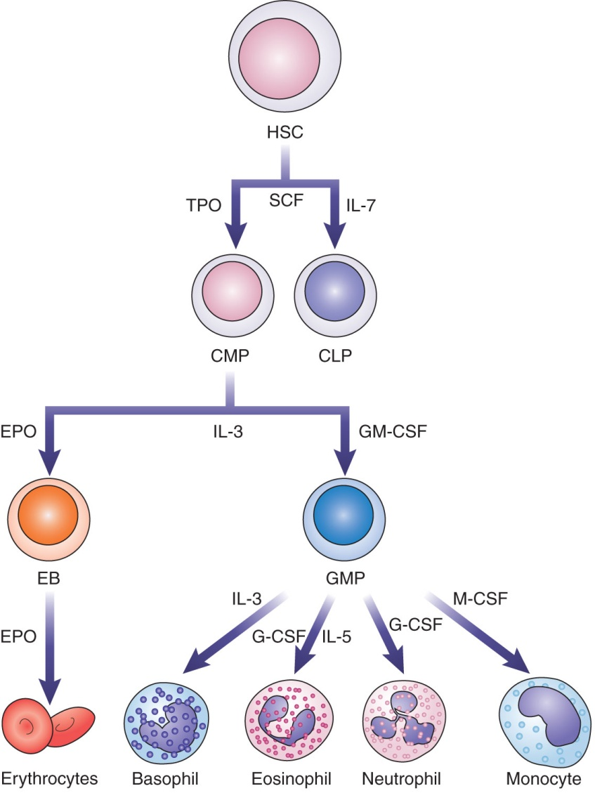
Colony-Stimulating Factors (CSFs)
Notes:
Figure 6-6. Influence of colony-stimulating factors on growth and differentiation of blood cells. Growth of hematopoietic stem cells (HSCs) requires stem cell factor (SCF) with differentiation determined by IL-7 or thrombopoietin (TPO). Growth of common myeloid progenitors (CMPs) depends upon IL-3. Differentiation is driven by granulocyte-macrophage colony-stimulating factor (GM-CSF) or erythropoietin (EPO). Common granulocyte/monocyte precursors (GMPs) differentiate into granulocytes in response to granulocyte-CSF. Further specificity is provided by IL-3 or IL-5. Macrophage-CSF (M-CSF) promotes development of monocytes. CLP = common lymphoid progenitor, EB = erythroblast.

Slide 35
Colony-Stimulating Factors (CSFs)
EPO
  Is primarily produced in the kidneys
  Regulates RBC production in the bone marrow
    RBC proliferation induced by EPO improves oxygenation of the tissues and eventually switches off EPO production
Notes:
RBC = red blood cell.

Slide 36
Cytokine and Anticytokine Therapies
Various therapy approaches
  Disrupt the interaction between cytokines and their cognate receptors (e.g., infliximab)
  Some use monoclonal antibodies that function as cytokine agonists
  Some use hybrid proteins containing cytokine receptor binding sites attached to immunoglobulin constant regions to block cytokine activity (e.g., etanercept)
  Some block IL-17 function (e.g., ixekizumab)

Slide 37
Clinical Assays for Cytokines
ELISpot assay
  Employs the ELISA technique on in vitro-activated peripheral WBCs
Multiplexed ELISAs
  Can detect 12 to 25 pro- and anti-inflammatory cytokines in one reaction
Microbead assays
  Allow for the simultaneous detection of multiple cytokines in a single tube
Notes:
ELISA = enzyme-linked immunosorbent assay.
WBC = white blood cell.

Slide 38
Summary
Cytokines act as chemical messengers to regulate the immune system.
They are induced in the response to specific stimuli, such as bacterial lipopolysaccharides, flagellin, or other bacterial products.
The effects of cytokines in vivo include regulation of growth, differentiation, and gene expression by many different cell types.

Slide 39
Summary
Working together, cytokine activity leads to the rapid generation of innate and adaptive immune responses.
The major cytokines involved in the initial stages of the inflammatory response are IL-1, IL-6, TNF-α, and the chemokines. These cytokines are responsible for many of the physical symptoms attributed to inflammation.

Slide 40
Summary
Naïve T cells can differentiate into Th1, Th2, or Treg cell lineages, with the help of cytokines involved in the adaptive immune response.
The Th1 lineage is driven by the expression of IL-12 by dendritic cells and is primarily responsible for cell-mediated immunity.
Th2 cells drive antibody-mediated immunity and are regulated by IL-4.

Slide 41
Summary
Treg cells are derived from naïve T cells in response to IL-10 and TGF-β and help to regulate the activities of Th1 and Th2 cells.
Th17 cells produce IL-17, a proinflammatory cytokine that induces expression of TNF-α, IL- 1β, and IL-6. Forms of IL-17 also recruit neutrophils to an infected area.
CSFs are responsible for inducing differentiation and growth of all WBC types.

Slide 42
Summary
Anticytokine therapies are aimed at disrupting the interaction between cytokines and their specific receptors in diseases.
Cytokine assay formats include ELISpot assays, multiplexed ELISAs, and microbead assays.

