Slide 1
Part VII
The Complement System

Slide 2
Chapter Overview
Pathways of the complement system
System controls
Complement receptors and their biological roles
Biological manifestations of complement activation
Complement and disease states
Complement deficiencies and laboratory detection of abnormalities

Slide 3
Complement
Complement is a series of more than 30 soluble and cell-bound proteins that interact to enhance host defense mechanisms against foreign cells
Most plasma complement proteins are synthesized in the liver
Exceptions:
C1 components (produced by intestinal epithelial cells)
Factor D (made in adipose tissue)
Notes:
Instructors may choose to refer to Table 7-1 from the text.

Slide 4
Complement
White blood cells are additional sources of early complement components:
C1, C2, C3, C4
Most of these proteins are zymogens that are converted to active enzymes in a very precise order

Slide 5
Complement Fragments/Components
Act as opsonins
Specific receptors are present on phagocytic cells
Metabolism and clearance of immune complexes are enhanced
Increase vascular permeability
Recruit monocytes and neutrophils to the area of antigen concentration
Trigger secretion of immunoregulatory molecules that amplify the immune response

Slide 6
Complement System Activation
Three pathways:
Classical pathway
Lectin pathway
Alternative pathway
Multiple pathways can be involved
End product: Lysis of the invading cell

Slide 7
The Classical Pathway
Has three stages
Activated by IgM, IgG1, IgG2, and IgG3
IgM: Most efficient due to multiple binding sites
Notes:
It takes only one IgM molecule attached to two adjacent antigenic determinants to initiate the cascade.
Within the IgG group, IgG3 is the most effective, followed by IgG1 and then IgG2.
Two IgG molecules must attach to antigen within 30 to 40 nm of each other before complement can bind.
Each stage of complement activation is dependent on the grouping of certain reactants as a unit.

Slide 8
The Classical Pathway
Also activated by substances that bind complement directly:
C-reactive protein
Certain viruses
Mycoplasmas
Certain gram-negative bacteria
Some protozoa

Slide 9
The Classical Pathway: Recognition Unit
C1
First complement component to bind
Consists of three subunits:
One Clq
Two Clr
Two Cls
Stabilized by calcium
Notes:
The sequence of binding is Cls-Clr-Clr-Cls.
Figure 7-2. When two or more globular heads of C1q attach to bound immunoglobulin molecules, the collagen-like stalks change their configuration. The resulting shape change causes C1r to become a serine protease, which cleaves a small fragment of C1s, uncovering the C1s protease, whose only targets are C4 and C2.

Slide 10
The Classical Pathway: Recognition Unit
Clq “recognizes” the Fc region of two adjacent antibody molecules
At least two of the globular heads of Clq must be bound to initiate the classical pathway
The zymogens Clr and Cls are converted into active enzymes as binding of Clq occurs
Autoactivation of Clr results from a change that takes place as Clq is bound

Slide 11
The Classical Pathway: Recognition Unit
When activated, Clr cleaves a thioester bond on Cls, which activates it
Cls has a limited specificity, with its only substrates being C4 and C2
When Cls is activated, the recognition stage ends

Slide 12
The Classical Pathway: The Activation Unit
Begins when Cls cleaves C4 to create C4b and C2 to create C2a
C3 convertase is formed
Ends with production of C5 convertase
Notes:
Figure 7-3. Formation of the activation unit. (A) Activated C1qrs cleaves C4 and C2, with the larger pieces, C4b and C2a, binding to the target cell surface and forming the enzyme C3 convertase. (B) Each C3 convertase cleaves ~200 C3 molecules into C3a and C3b. C3b is a powerful opsonin that binds to the target in many places. (C) Some C3b associates with C4b2a, forming C4b2a3b, also known as the C5 convertase. This convertase cleaves C5 into the anaphylatoxin C5a and C5b, which binds to the target cell.

Slide 13
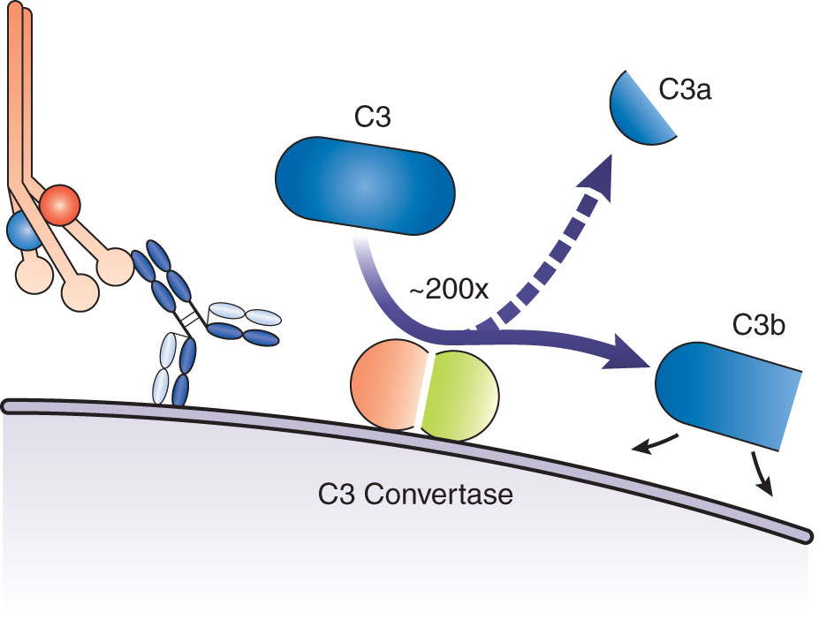
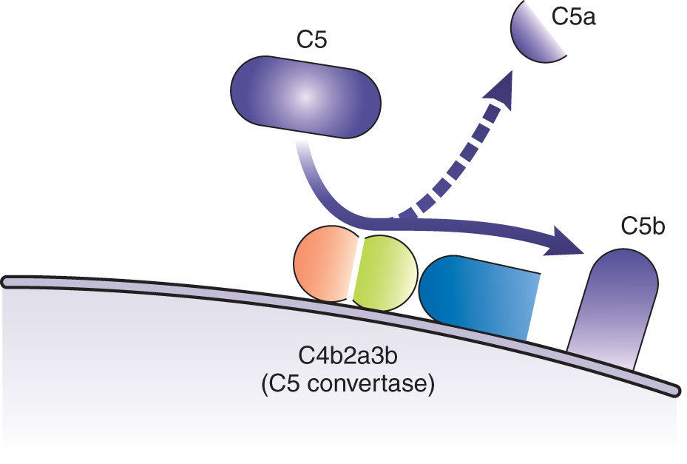
The Classical Pathway: The Activation Unit
Notes:
Figure 7-3. Formation of the activation unit. (A) Activated C1qrs cleaves C4 and C2, with the larger pieces, C4b and C2a, binding to the target cell surface and forming the enzyme C3 convertase. (B) Each C3 convertase cleaves ~200 C3 molecules into C3a and C3b. C3b is a powerful opsonin that binds to the target in many places. (C) Some C3b associates with C4b2a, forming C4b2a3b, also known as the C5 convertase. This convertase cleaves C5 into the anaphylatoxin C5a and C5b, which binds to the target cell.

Slide 14
The Classical Pathway: Membrane Attack Complex
The process is initiated when C5 convertase splits C5 into C5a and C4b
C5b attaches to the cell membrane to initiate formation of the MAC (C5b6789)
Notes:
The level of MAC is an indicator of the amount of terminal pathway activation that is occurring.
Figure 7-4. Formation of the membrane attack unit. C5b binds to the target cell, whereas C6 and C7 attach to it. C8 binds to these associated molecules and begins (along with C7) to penetrate the cell membrane. Multiple C9 molecules bind to C5b678 and polymerize to form a transmembrane channel, the membrane attack complex, which causes lysis of the cell.

Slide 15
The Lectin Pathway
Activates complement by recognizing carbohydrates on microbial cell walls
Serves as a defense mechanism in infancy in between loss of maternal antibody and development of full antibody response
Involves three classes of recognition molecules (lectins, ficolins, CL-L1)
After cleaving of C4 and C2, is identical to the classical pathway

Slide 16
The Lectin Pathway
Mannan-binding lectin (MBL)
An acute-phase protein
Binds to mannose or related sugars in a calcium-dependent manner to initiate pathway
MBL-associated serine proteases (MASPs)
MASP-1, MASP-2, MASP-3
Play enzymatic roles

Slide 17
The Alternative Pathway
Acts mainly as an amplification loop for classical or lectin pathways
Can be activated on its own by bacterial or fungal cell walls, viruses, tumor cells, or some parasites
Notes:
Figure 7-5. The activation loop.

Slide 18
Convergence of Pathways
Notes:
Figure 7-6. Convergence of the classical, alternative, and lectin pathways. The binding of C1qrs to two antibody molecules activates the classical pathway, whereas the alternative pathway is started by hydrolysis of C3. The lectin pathway is triggered by binding of MBP to mannose on bacterial cell walls. MASP-1, MASP-2, and MASP-3 bind to form an activated C1-like complex. MASP-2 cleaves C2 and C4 and proceeds like the classical pathway. Factor B and factor D operate in the alternative pathway. Although C3 convertase is formed differently in each pathway, C3 is a key component in each one. The C5 convertase in the alternative pathway consists of C3bBb3bP. In the classical pathway, C5 convertase is made up of C4b2a3b. After C5 is cleaved, the pathway is common to all.

Slide 19
System Controls in Plasma
SERUM PROTEIN | MOLECULAR WEIGHT (KD) | CONCEN-TRATION (MG/DL) | FUNCTION | INVOLVED PATHWAYS
C1-INH | 105 | 240 | Dissociates C1r and C1s from C1q | Classical Lectin
Factor I | 88 | 35 | Cleaves C3b and C4b | Classical Lectin
Factor H | 150 | 300–450 | Cofactor with I to inactivate C3b; prevents binding of B to C3b | Alternative
C4BP | 520 | 250 | Acts as a cofactor with I to inactivate C4b | Classical Lectin
S protein (vitronectin) | 84 | 500 | Prevents attachment of C5b67 complex to cell membranes | Classical Lectin Alternative
Notes:
Plasma proteins in this table act as system regulators to ensure that infectious agents, not self-antigens, are destroyed and that the reaction remains localized.
Most control proteins are aimed at halting accumulation of C3b.

Slide 20
System Controls
Notes:
Figure 7-8. Complement controls in the alternative pathway. CR1 receptor acts as a cofactor in the inactivation of C3b. Factor I cleaves C3b to form C3dg and C3c. C3dg is not an effective opsonin and is not capable of further participation in the complement cascade.

Slide 21
Cellular Complement Controls
RECEPTOR | LIGAND | CELL TYPE | FUNCTION
DAF (CD55) | C3b, C4b | RBCs, neutrophils, platelets, monocytes, endothelial cells, fibroblasts, T cells, B cells, epithelial cells | Dissociates C2b or Bb from binding sites, thus preventing formation of C3 convertase
MIRL (CD59) | C8 | RBCs, neutrophils, platelets, monocytes, endothelial cells, epithelial cells | Prevents insertion of C9 into cell membrane
MCP (CD46) | C3b, C4b | Neutrophils, monocytes, macrophages, platelets, T cells, B cells, endothelial cells | Cofactor for factor I cleavage of C3b and C4b
Notes:
RBC = red blood cell.

Slide 22
Biological Roles of Complement Receptors
RECEPTOR | LIGAND | CELL TYPE | FUNCTION
CR1 (CD35) | C3b, iC3b, C4b | RBCs, neutrophils, monocytes, macrophages, eosinophils, B and T cells, follicular dendritic cells | Cofactor for factor I; mediates transport of immune complexes
CR2 (CD21) | C3dg, C3d, iC3b | B cells, follicular dendritic cells, epithelial cells | B-cell co-receptor for antigen with CD19
CR3 (CD11b/CD18) | iC3b, C3d, C3b | Monocytes, macrophages, neutrophils, NK cells | Adhesion and in-creased activity of phagocytic cells
CR4 (CD11c/CD18) | iC3b, C3b | Monocytes, macrophages, neutrophils, NK cells, activated T and B cells, dendritic cells | Adhesion and increased activity of phagocytic cells
Notes:
NK = natural killer.

Slide 23
Biological Manifestations of Complement Activation
Amplifies inflammatory response
Facilitates recognition and destruction of antigen by phagocytic cells
Has a role in uptake and presentation of antigens so a specific immune response can occur
Facilitates B-cell activation

Slide 24
Biological Manifestations of Complement Activation
Links innate and adaptive immunity
Amplifies the inflammatory response
Effector molecules
Anaphylatoxins
Chemotaxins
Opsonins

Slide 25
Complement and Disease States
Complement can be harmful if:
It is activated systemically on a large scale, as in gram-negative septicemia
It is activated by tissue necrosis, as in myocardial infarction
Lysis of RBCs occurs

Slide 26
Complement Deficiencies
DEFICIENT COMPONENT | ASSOCIATED DISEASE
C1 (q, r, or s) | Lupus-like syndrome; recurrent infections
C2 | Lupus-like syndrome; recurrent infections; atherosclerosis
C3 | Severe recurrent infections; glomerulonephritis
C4 | Lupus-like syndrome
C5–C8 | Neisseria infections
C9 | No known disease association
C1-INH | Hereditary angioedema
DAF | Paroxysmal nocturnal hemoglobinuria
MIRL | Paroxysmal nocturnal hemoglobinuria
Factor H or factor I | Recurrent pyogenic infections
MBL | Pneumococcal diseases, sepsis, Neisseria infections
Properdin | Neisseria infections
MASP-2 | Pneumococcal diseases

Slide 27
Laboratory Detection of Complement Abnormalities
Techniques involve:
Measurement of components as antigen in serum
Measurement of functional activity
Immunologic assays of individual components
Radial immunodiffusion (RID)
Nephelometry
Notes:
Assays for individual components give quantitative results and are relatively easy to perform but do not distinguish whether the molecules are functionally active. Test results must be interpreted carefully.

Slide 28
Laboratory Detection of Complement Abnormalities
Classical pathway assays
Measure lysis
Include:
Hemolytic titration (CH50) assay
CH50 test for lysis of liposomes
Radial hemolysis in agarose plates
Alternative pathway assays
AH50
ELISA
Test systems addressing all three pathways

Slide 29
Interpretation of Laboratory Findings
IMPAIRED FUNCTION OR DEFICIENCY | CLASSICAL PATHWAY | LECTIN PATHWAY | ALTERNATIVE PATHWAY
C1q, C1r, C1s | Low | Normal | Normal
C4, C2 | Low | Low | Normal
MBL, MASP2 | Normal | Low | Normal
B, D, P | Normal | Normal | Low
C3, C5, C6, C7, C8, C9 | Low | Low | Low
C1-INH | Low | Low | Low
Factor H and I | Low | Low | Low
Improperly handled sera | Low | Low | Low
Adapted from Seelen MA, et al. An enzyme-linked immunosorbent assay-based method for functional analysis of the three pathways of the complement system. In: Detrick B, Hamilton RG, and Folds JD, eds. Manual of Molecular and Clinical Laboratory Immunology. 7th ed. Washington, DC: ASM Press; 2006:124.

Slide 30
Summary
The complement system is a series of more than 30 soluble and cell-bound proteins that interact with the innate and adaptive immune systems to enhance host defenses against infection.
Complement activities include lysis of foreign or damaged cells, opsonization, increase in vascular permeability, and attraction of monocytes and macrophages to areas where needed.

Slide 31
Summary
The classical complement pathway is triggered by IgG or IgM binding to the surface of pathogens.
Three distinct units are involved in the classical pathway:
Recognition unit, consisting of C1qrs
Activation unit, consisting of C2, C4, and C3
MAC, consisting of C5, C6, C7, C8, and C9

Slide 32
Summary
The lectin pathway is activated by carbohydrates present in microbial cell walls.
Molecules distinct to the lectin pathway include mannose-binding lectin (MBL), MASP-1, MASP-2, and MASP-3.
The alternative pathway is triggered by bacterial and fungal cell walls, yeast, viruses, tumor cells, and certain parasites.

Slide 33
Summary
Plasma protein regulators allow for control of the complement system.
Soluble regulators include C1-INH, C4BP, factor H, factor I, and S protein.
Cell-bound regulators include CR1, MCP, and DAF.
Specific complement receptors on host cells enhance phagocytosis and stimulate other accessory cells.

Slide 34
Summary
Effector molecules play a major role in recognition and presentation of antigens, activation of B cells, and maintenance of immunologic memory.
Anaphylatoxins increase vascular permeability.
Chemotaxins attract phagocytic cells to a specific area.
Opsonins coat damaged or foreign cells to enhance phagocytosis.

Slide 35
Summary
Complement deficiencies can place an individual at risk for certain infections.
Laboratory assays for individual complement components include radial immunodiffusion and nephelometry.
The hemolytic titration or CH50 assay measures lysis.
The AH50 assay measures the activity of the alternative pathway.

