Slide 1
Part VIII
Principles of Serological Testing

Slide 2
Chapter Overview
Blood specimen preparation and measuring
Simple dilutions
Compound dilutions
Testing parameters

Slide 3
Blood Specimen Preparation and Measuring
Serology
Study of fluid components in the blood, especially antibodies
Serum
Liquid portion of blood minus coagulation factors
Most frequently encountered specimen in immunologic testing
Separated from other components of a blood specimen via centrifuge

Slide 4
Blood Specimen Preparation and Measuring
Ideally, use fresh serum that has not been heated
For certain tests, complement may need to be inactivated
Complement may interfere with test results
Heat sample to 56°C for 30 minutes

Slide 5
Blood Specimen Preparation and Measuring
Storage (if testing is delayed)
Between 2°C and 8°C for up to 72 hours
Frozen at –20°C or below
Pipettes
Volumetric—deliver only one volume
Graduated—marked to allow for varying amounts
Serological
Blowout
Micropipettes—deliver small volumes

Slide 6
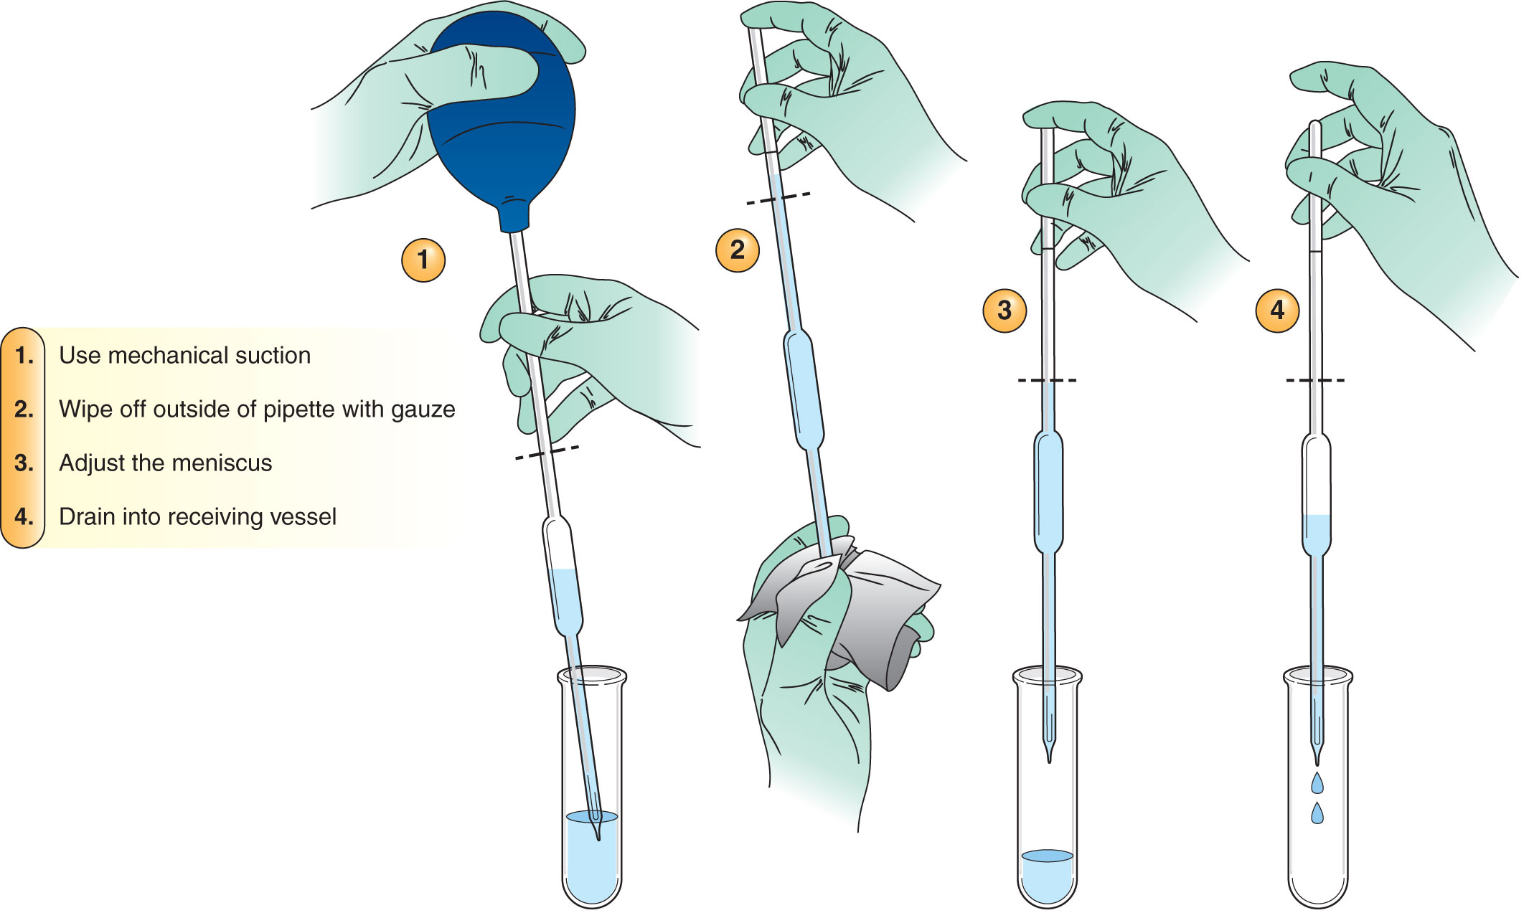
Blood Specimen Preparation and Measuring
Notes:
Figure 9-3. (A) Steps in accurately measuring a liquid with a serological pipette. (B) How to read a meniscus.

Slide 7
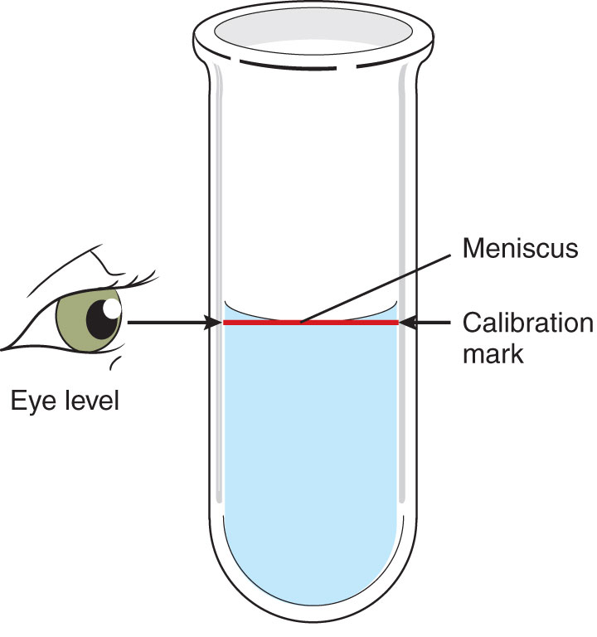
Blood Specimen Preparation and Measuring
Notes:
Figure 9-3. (A) Steps in accurately measuring a liquid with a serological pipette. (B) How to read a meniscus.

Slide 8
Dilutions
Solute is the material being diluted
Diluent is the medium making up the rest of the solution
Relationship between the two is expressed as a ratio or fraction
Equations are used to determine:
Total volume of a solution
Amount of solute needed
Amount of diluent needed

Slide 9
Simple Dilutions
1/Dilution = Amount of Solute/Total Volume
1/(Dilution – 1) = Amount of Solute/Amount of Diluent
Notes:
The instructor may choose to include class-specific examples.

Slide 10
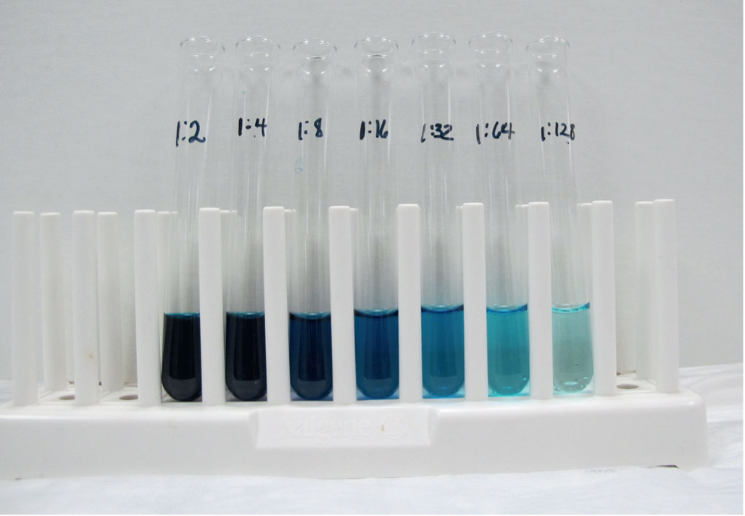
Compound Dilutions
Are made when large dilutions are needed
Require several steps of making several smaller dilutions (serial dilutions)
Notes:
Figure 9-6. Serial dilution. Each tube contains the same amount of diluent and a blue dye (food coloring). Each time a dilution is made, the amount of dye is cut in half in each successive tube. The final volume of each tube should be exactly the same. The color becomes visibly lighter with each dilution.

Slide 11
Compound Dilutions
Plan the number and size of simple dilutions necessary to reach the desired end point
Calculate each simple dilution, keeping the dilution factor the same at each step
Set up the series of tubes
Obtain the final dilution
Count the number of tubes used
Set up a multiplication series in which the original dilution factor is raised to a power equal to the number of tubes

Slide 12
Compound Solutions
Titer
The last tube in which a positive reaction is visible
An indicator of an antibody’s strength

Slide 13
Test Parameters
Sensitivity
Proportion of people who have a disease or condition and who have a positive test
Indicates how small an amount can be measured and still produce a positive test result
% = $\frac{True Positives}{True Positives + False Negatives}$ × 100

Slide 14
Test Parameters
Specificity
Proportion of people who do not have a disease or condition who have a negative test
Measures the substance that it is designed to measure, not interfering substances
% = $\frac{True Negatives}{True Negatives + False Positives}$ × 100

Slide 15
Test Parameters
Positive predictive value
The probability that a person with a positive screening test actually has the disease
% = $\frac{True Positives}{True Positives + False Positives}$ × 100

Slide 16
Test Parameters
Negative predictive value
Probability that a person with a negative screening test does not have the disease
% = $\frac{True Negatives}{True Negatives + False Negatives}$ × 100

Slide 17
Summary
Serum for serological testing is obtained by allowing a sterile tube to clot at either room temperature or 4°C and then removing the serum from the clot after centrifugation.
Pipette types include volumetric, graduated, serological, and micropipettes.
A dilution is the addition of a liquid to make a weaker solution of either a reagent or a patient specimen.

Slide 18
Summary
Patient serum, the solute, is made weaker by adding diluent so that the antibody present is not as concentrated.
The relationship between the serum and the total volume can be expressed as a ratio or as a fraction.
A serial dilution involves making several dilutions in which the dilution factor is the same.

Slide 19
Summary
Serial dilutions are used to determine the titer, or strength, of an antibody.
Sensitivity is the proportion of people who have a specific disease or condition and have a positive test for that disease or condition.
Specificity is the proportion of people who do not have the disease or condition and who have a negative test for that disease or condition.

Slide 20
Summary
The positive predictive value is the likelihood that a person with a positive screening test actually has the disease.
The negative predictive value is the probability that a person with a negative screening test does not have the disease.

