Slide 1
Part IX
Precipitation and Agglutination Reactions

Slide 2
Chapter Overview
Antigen–antibody binding
Precipitation curve
Light-scattering techniques
Passive immunodiffusion techniques
Electrophoretic techniques
Agglutination reactions
Instrumentation
Quality control and quality assurance

Slide 3
Antigen–Antibody Binding: Affinity
Is the initial attraction force between a Fab site on an antibody molecule and an epitope or determinant site on an antigen
The strength of attraction depends on the specificity of the antibody for a particular antigen

Slide 4
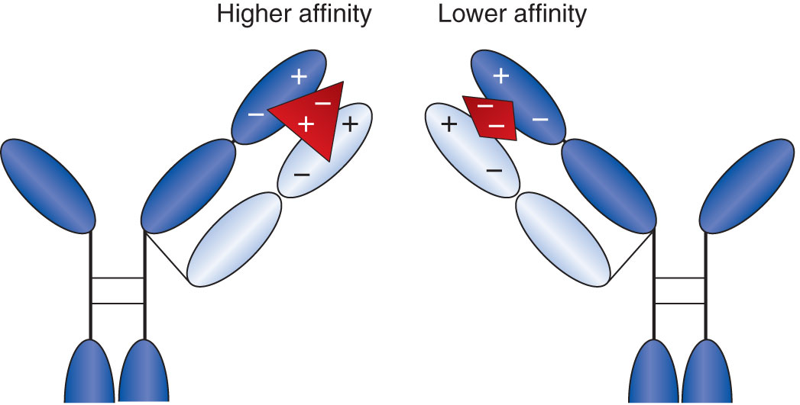
Antigen–Antibody Binding: Affinity
The more the cross-reacting antigen resembles the original antigen, the stronger the bond will be between the antigen and the binding site

Slide 5
Antigen–Antibody Binding: Avidity
Is the sum of the attractive forces between an antigen and an antibody that keeps the molecules together
Involves the strength with which a multivalent antibody binds a multivalent antigen
Is a measure of the overall stability of an antigen–antibody complex

Slide 6
Antigen–Antibody Binding: Law of Mass Action
K = [AgAb]/[Ab][Ag]
Free reactants are in equilibrium with bound reactants
Value of K depends on the strength of binding between antibody and antigen
The higher the value of K:
The larger the amount of antigen–antibody complex
The more visible or easily detectable the reaction
Notes:
K = equilibrium constant.
[AgAb] = concentration of the antigen–antibody complex (mol/L).
[Ab] = concentration of free antibody (mol/L).
[Ag] = concentration of free antigen (mol/L).
The higher the affinity and avidity values for an antibody and the more antigen–antibody complexes that are formed, the more sensitive is the test.

Slide 7
Precipitation Reactions
Involve combining soluble antigen with soluble antibody to produce insoluble complexes that are visible
Require antigen and antibody to have:
Multiple binding sites for one another
Equal relative concentration of each

Slide 8
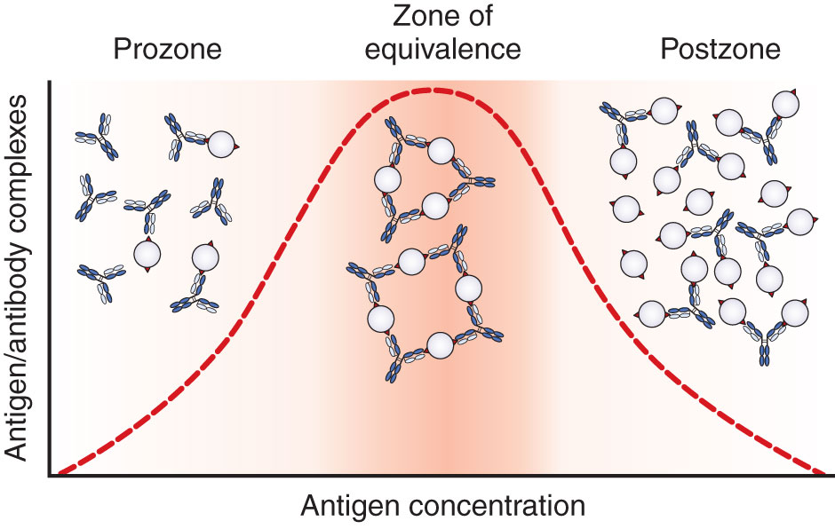
Precipitation Curve: Zone of Equivalence
Number of multi-valent sites of antigen and antibody are approximately equal
To be detectable, precipitation reactions must be run in the zone of equivalence
Notes:
When increasing amounts of soluble antigen are added to fixed amounts of specific antibody, the amount of precipitation increases up to the zone of equivalence.
When the amount of antigen overwhelms the number of antibody combining sites present, precipitation begins to decline.

Slide 9
Precipitation Curve: Prozone
Prozone phenomenon (antibody excess)
Antigen combines with only one or two antibody molecules
No cross-linkages are formed
False-negative reactions may occur as a result of high antibody concentration
If a false-negative reaction is suspected, diluting out the antibody and performing the test again may produce a positive result

Slide 10
Precipitation Curve: Postzone
Postzone phenomenon (antigen excess)
Small aggregates are surrounded by excess antigen
No lattice network is formed
The presence of a small amount of antibody may be obscured, causing false-negative results
Test is repeated about a week later with a specimen to give time for further production of antibody
If the test is negative again, it is unlikely that the patient has the antibody

Slide 11
Precipitation Reaction Techniques
TECHNIQUE | APPLICATION | SENSITIVITY (μg AB/ML) | PRINCIPLE
Nephelometry | Immunoglobulins, complement, C-reactive protein, other serum proteins | 1–10 | Light that is scattered at an angle is measured, indicating the amount of antigen or antibody present.
Radial immunodiffusion | Immunoglobulins, complement | 10–50 | Antigen diffuses out into gel that is infused with antibody. Measurement of the radius indicates concentration of antigen.
Ouchterlony double diffusion | Complex antigens, such as fungal antigens | 20–200 | Both antigen and antibody diffuse out from wells in a gel. The lines of precipitate formed indicate the relationship of antigens.

Slide 12
Precipitation Reaction Techniques
TECHNIQUE | APPLICATION | SENSITIVITY (μg AB/ML) | PRINCIPLE
Immunoelectrophoresis | Differentiation of serum proteins | 20–200 | Electrophoresis of serum is followed by diffusion of antibody from the wells.
Immunofixation electrophoresis | Over- or underproduction of antibody | Variable | Electrophoresis of serum is followed by direct application of antibody to the gel.

Slide 13
Precipitation Reactions: Radial Immunodiffusion
Radial immunodiffusion (RID) is a single-diffusion technique
Antibody is in the support gel, and antigen is applied in a well cut in the gel
Antigen diffuses out until the point of equivalence is reached (end-point method)
The square of the diameter is proportional to the antigen concentration

Slide 14
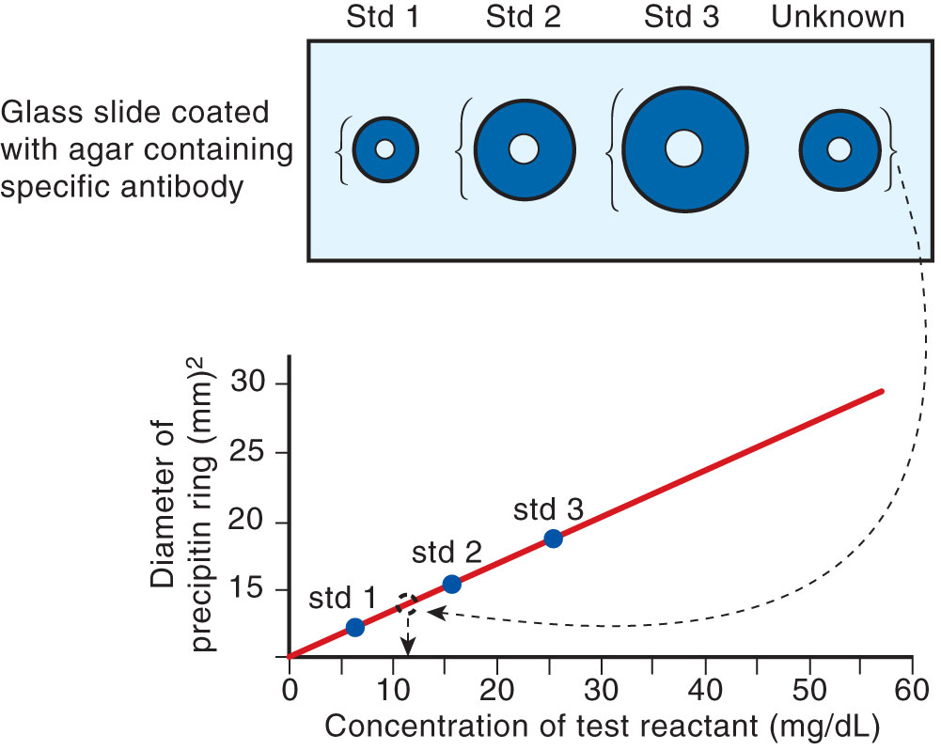
Precipitation Reactions: Radial Diffusion

Slide 15
Precipitation Reactions: Ouchterlony Diffusion
Ouchterlony diffusion is a double-diffusion technique
Wells are cut in a gel, and both antigen and antibody diffuse out radially
A line of precipitate forms where antigen and antibody meet
Three possible patterns: identity, partial identity, nonidentity

Slide 16
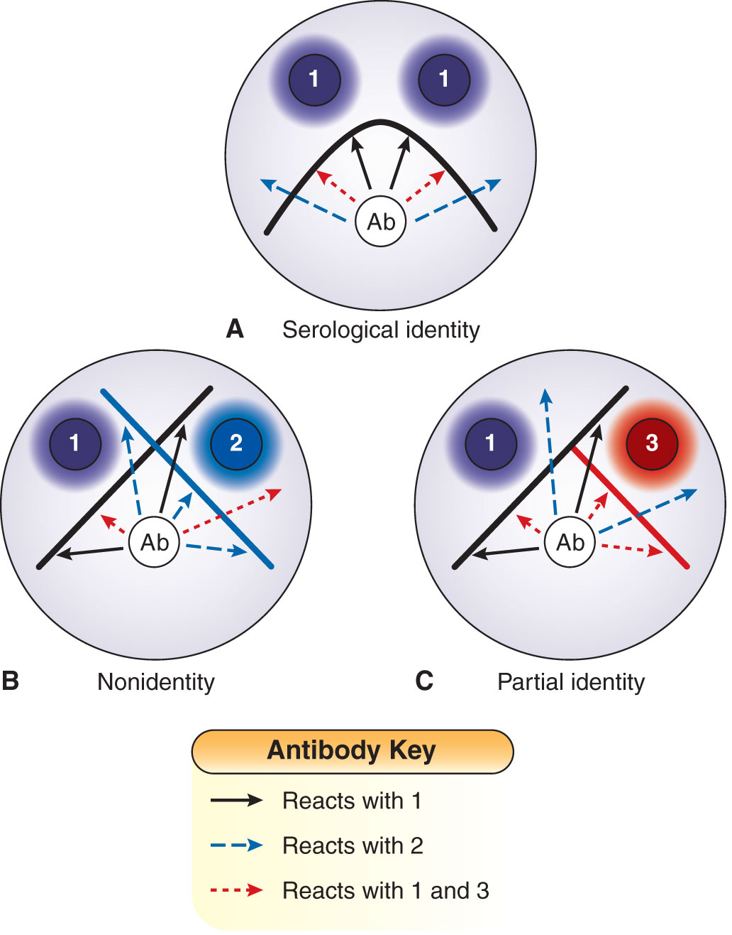
Precipitation Reactions: Ouchterlony Patterns

Slide 17
Precipitation: Immunofixation Electrophoresis
Immunofixation electrophoresis (IFE) is a double-diffusion technique
Unknown antigen is electrophoresed, and then antibody is applied directly to the gel
Precipitates form where antigen–antibody combination has taken place in the gel
Technique is used with serum as the antigen to determine over- or underproduction of antibody types

Slide 18
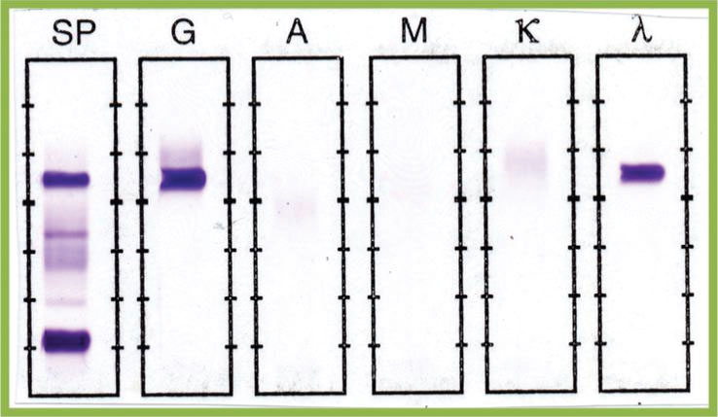
Precipitation: Immunofixation Electrophoresis

Slide 19
Agglutination
Is the visible aggregation of particles resulting from combination with specific antibody
Is a two-step process
Sensitization (initial binding)
Antigen and antibody unite through antigenic determinant sites
Lattice formation (formation of large aggregates)
Rearrangement of antigen and antibody bonds to form a stable lattice
Produced by antibodies called agglutinins

Slide 20
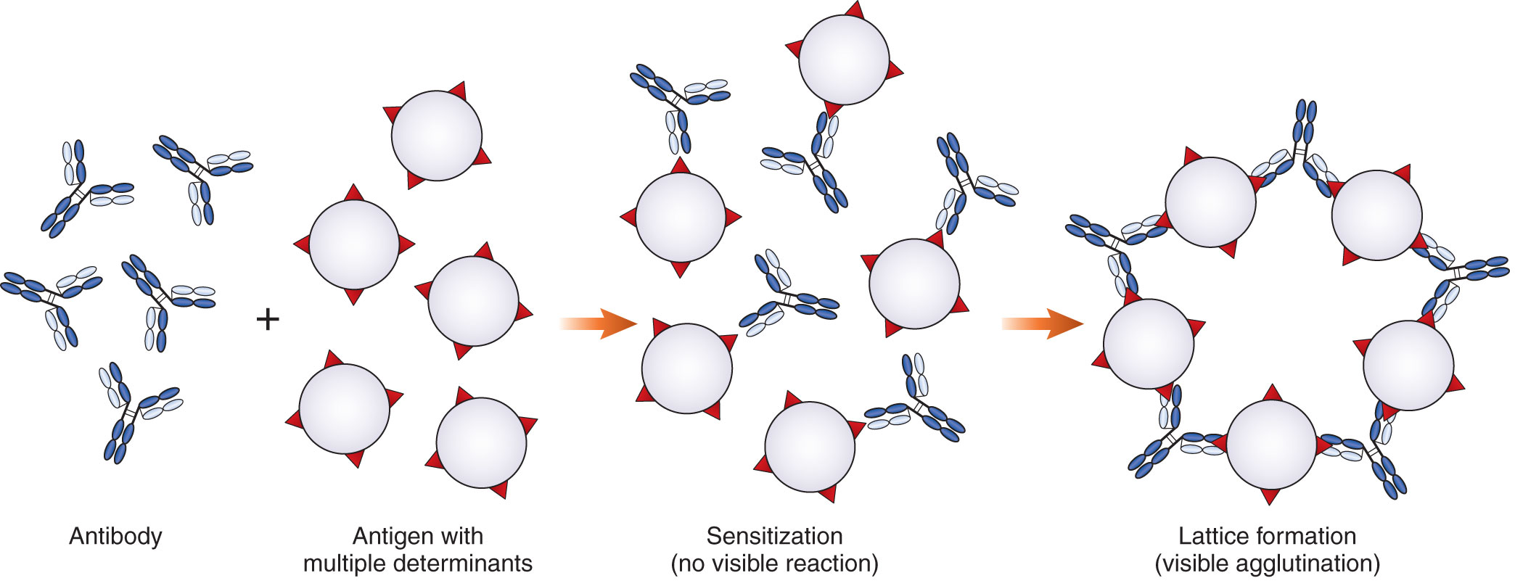
Agglutination

Slide 21
Types of Agglutination Reactions
Direct agglutination
Uses known bacterial antigens to test for the presence of unknown antibodies in the patient
Widal test
A rapid screening test used to determine the possibility of typhoid fever
Uses Salmonella O (somatic) and H (flagellar) antigens

Slide 22
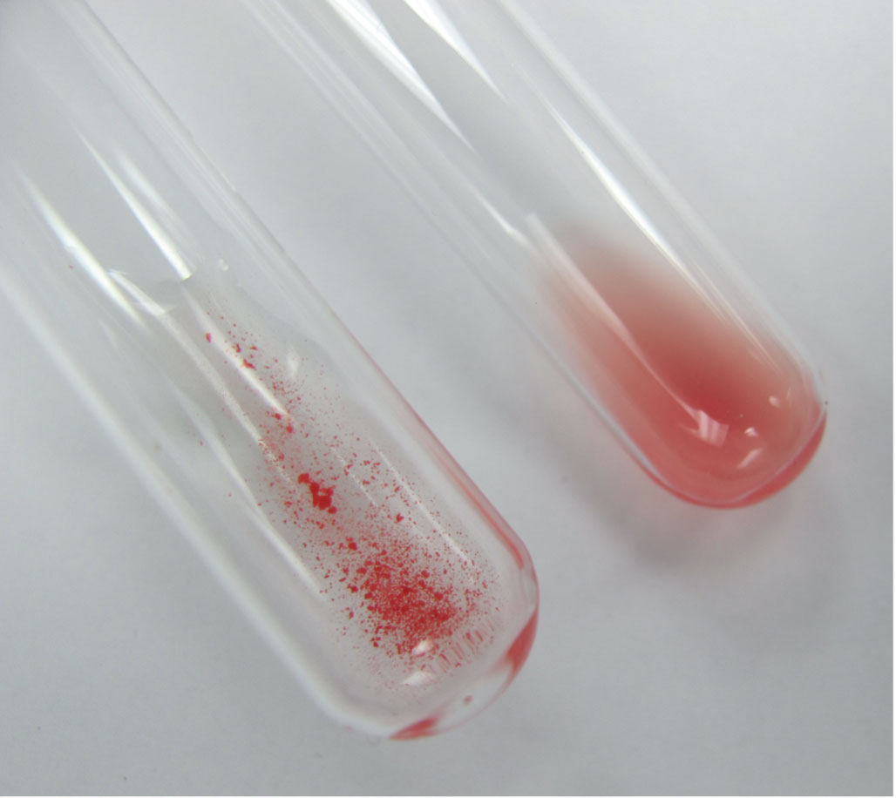
Types of Agglutination Reactions
Direct agglutination
Hemagglutination
Involves red blood cells
ABO blood group typing

Slide 23
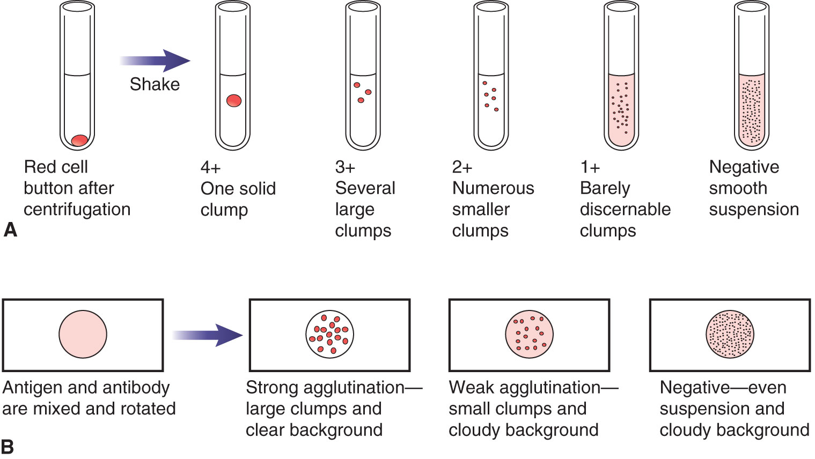
Types of Agglutination Reactions
Notes:
Figure 10-11. Grading of agglutination reactions: tube method. If tubes are centrifuged and shaken to resuspend the button, reactions can be graded from negative to 4+, depending on the size of the clumps observed.

Slide 24
Types of Agglutination Reactions
Passive agglutination
Employs particles that are coated with antigens not normally found on their surfaces
Erythrocytes, latex, gelatin, silicates
Synthetic beads or particles (provide consistency, uniformity, and stability)

Slide 25
Types of Agglutination Reactions
Passive agglutination
Used to detect:
Rheumatoid factor
Antibodies to Group A Streptococcus antigens
Antibodies to viruses such as rotavirus, cytomegalovirus, rubella, and varicella-zoster
Antibodies to hepatitis viruses and HIV
Process
Antigen is attached to the carrier particle
Agglutination occurs if patient antibody is present

Slide 26
Types of Agglutination Reactions
Reverse passive agglutination
Used to detect microbial antibodies
Common applications
Rapid identification of antigens from infectious agents (e.g., Group B Streptococcus, Staphylococcus aureus, streptococcal groups A and B, rotavirus, and Cryptococcus neoformans)
Detecting soluble antigens in urine, spinal fluid, serum
Process
Antibody is attached to the carrier particle
Agglutination occurs if antigen is present in patient sample

Slide 27
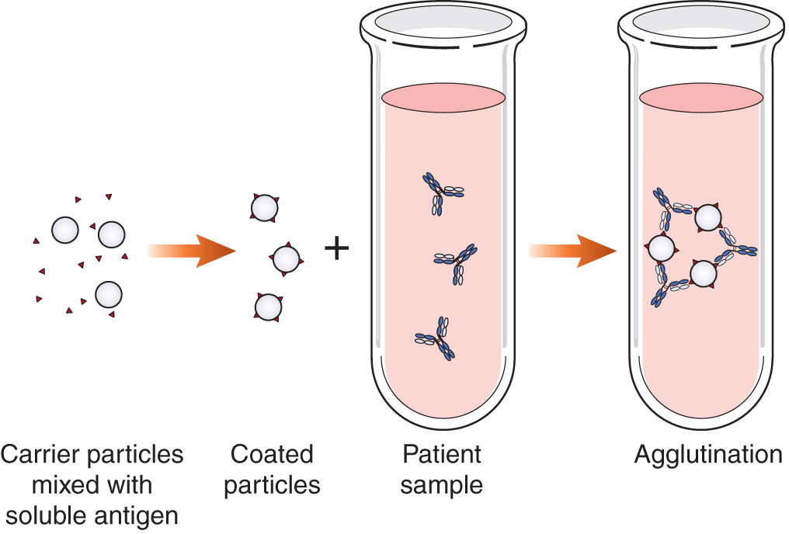
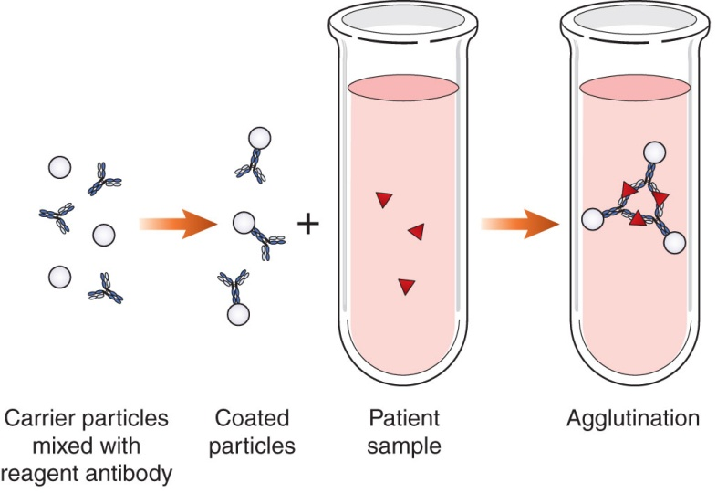
Types of Agglutination Reactions
Comparison of passive and reverse passive agglutination

Slide 28
Types of Agglutination Reactions
Agglutination inhibition
Is based on competition between particulate and soluble antigens for limited antibody-combining sites
Lack of agglutination = positive reaction
Used to detect antibodies to certain viruses, such as rubella, mumps, measles, influenza, parainfluenza, HBV, herpes virus, respiratory syncytial virus, and adenovirus

Slide 29
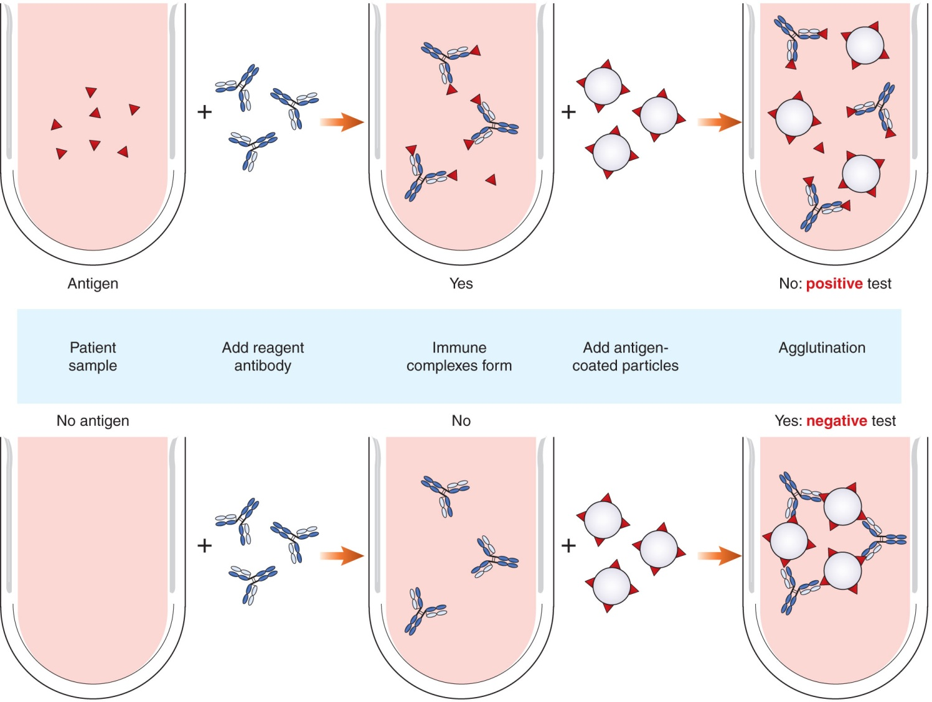
Types of Agglutination Reactions
Notes:
Figure 10-13. Agglutination inhibition. Reagent antibody is added to the patient sample. If patient antigen is present, antigen–antibody combination results. When antigen-coated latex particles are added, no agglutination occurs, which is a positive test. If no patient antigen is present, the reagent antibody combines with latex particles, and agglutination results, which is a negative test.

Slide 30
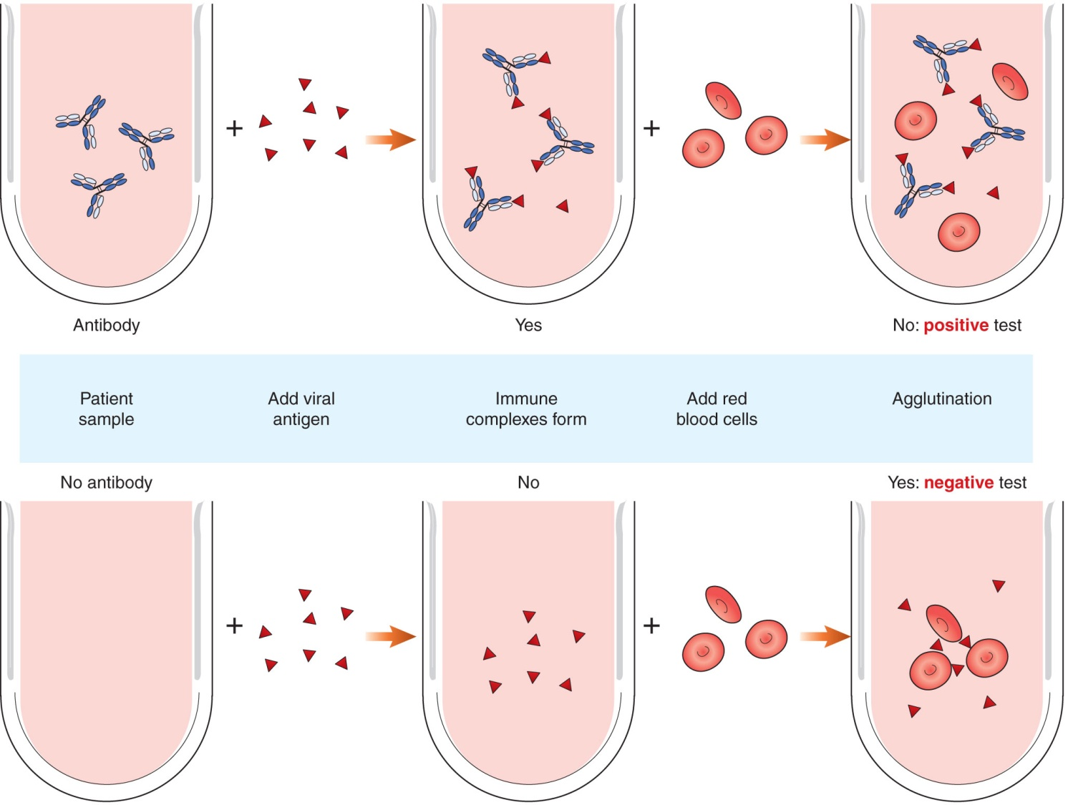
Types of Agglutination Reactions
Notes:
Figure 10-14. Hemagglutination inhibition. In the presence of certain viruses, RBCs spontaneously agglutinate. However, if patient antibody is present, then agglutination is inhibited. Thus, a lack of agglutination indicates the presence of antibody.

Slide 31
Comparison of Agglutination Reactions
TYPE OF REACTION | PRINCIPLE | RESULTS
Direct agglutination | Antigen is naturally found on a particle. | Agglutination indicates the presence of patient antibody.
Indirect agglutination | Particles are coated with antigens not normally found on their surfaces. | Agglutination indicates the presence of patient antibody.
Reverse passive | Particles are coated with reagent antibody. | Agglutination indicates the presence of patient antigen.
Agglutination inhibition | Haptens are attached to carrier particles. Particles compete with patient antigens for a limited number of antibody sites. | Lack of agglutination is a positive test, indicating the presence of patient antigen.
Hemagglutination inhibition | Red blood cells spontaneously agglutinate if viral particles are present. | Lack of agglutination is a positive test, indicating the presence of patient antibody.

Slide 32
Instrumentation
Particle-counting immunoassay (PACIA)
Uses nephelometry
Involves a laser in an optical particle counter to measure the number of residual nonagglutinating particles in a specimen
Measures serum proteins, therapeutic drugs, tumor markers, and certain viral antigens

Slide 33
Quality Control and Quality Assurance
Avoid cross-reactivity by using a monoclonal antibody directed against an antigenic determinant unique to a particular antigen
Store reagents properly, and check expiration dates
Account for sensitivity and specificity of specific test kits used
Be aware that a negative result does not rule out presence of the disease or antigen

Slide 34
Summary
Precipitation involves the combination of soluble antigen with soluble antibody to produce insoluble complexes that are visible.
Union of antigen and antibody depends on the affinity between one antibody-binding site and a single epitope on an antigen.
Avidity is the sum of all attractive forces occurring between multiple binding sites on antigen and antibody.

Slide 35
Summary
Concentrations of antigen and antibody that yield maximum binding represent the zone of equivalence (where the multivalent antigen and antibody sites are approximately equal).
In the prozone, antibody is in excess; precipitation or agglutination cannot be detected.
In the postzone, antibody has been diluted out, and antigen is in excess.

Slide 36
Summary
Precipitation techniques include nephelometry, passive immunodiffusion techniques (radial immunodiffusion and Ouchterlony double diffusion), and electrophoretic techniques (immunofixation electrophoresis and immunoelectrophoresis).
The process of agglutination can be divided into two steps: (1) sensitization and (2) lattice formation.

Slide 37
Summary
In direct agglutination, antigens are found naturally on the indicator particle.
In passive agglutination, antigens are artificially attached to such a particle.
Reverse passive agglutination is so called because antibody is attached to the indicator particle.

Slide 38
Summary
Agglutination inhibition is based on competition between antigen-coated particles and soluble patient antigen for a limited number of antibody sites. It is the only instance in which agglutination represents a negative test.
PACIA looks at residual nonagglutinating particles by means of nephelometry.

