Slide 1
Part X
Labeled Immunoassays

Slide 2
Chapter Overview
Formats for labeled assays
Heterogenous vs. homogenous assays
Radioimmunoassay
Enzyme immunoassays
Fluorescent immunoassays
Chemiluminescent assays

Slide 3
Labeled Immunoassays
Are designed for antigens and antibodies that may be small in size or present in very low concentrations
Use a labeled reactant to monitor the amount of specific binding that has taken place
Measure for analytes such as bacterial antigens, hormones, drugs, tumor markers, and specific immunoglobulins

Slide 4
Competitive Immunoassays
All the reactants are mixed together simultaneously
The labeled antigen competes with unlabeled patient antigen for a limited number of antibody-binding sites
The amount of bound label is inversely proportional to the concentration of the labeled antigen

Slide 5
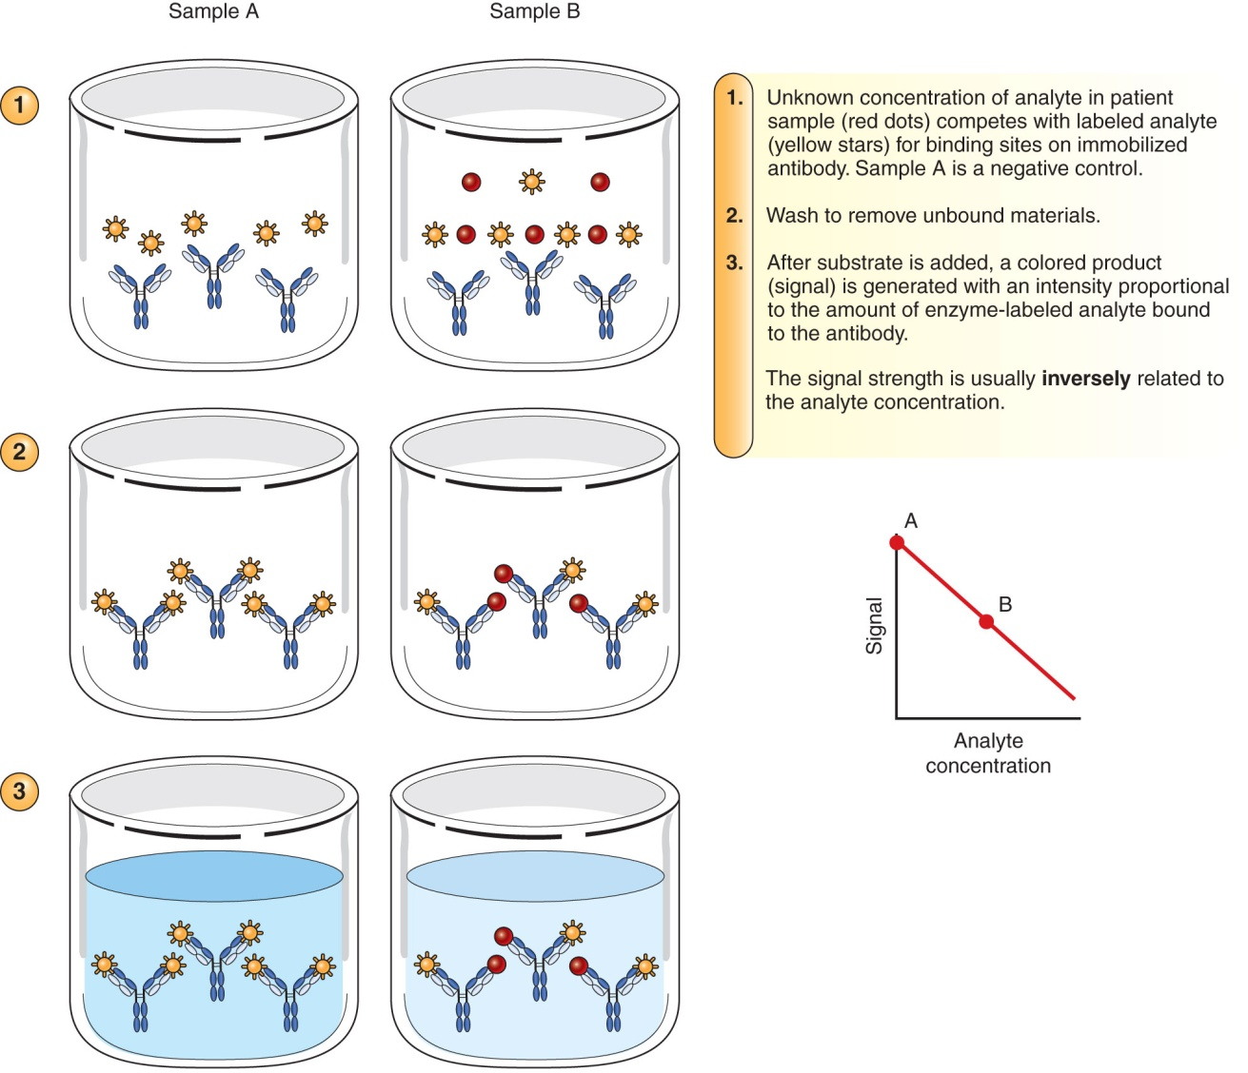
Competitive Immunoassays

Slide 6
Noncompetitive Immunoassays
Antibody is first passively absorbed to a solid phase
Unknown patient antigen is allowed to react with and be captured by the antibody
After washing to remove unbound antigen, a second antibody with a label is added to the reaction

Slide 7
Noncompetitive Immunoassays
The amount of label measured is directly proportional to the amount of patient antigen
Radioactive substances, enzymes, fluorescent compounds, and chemiluminescent substances have all been used as labels

Slide 8
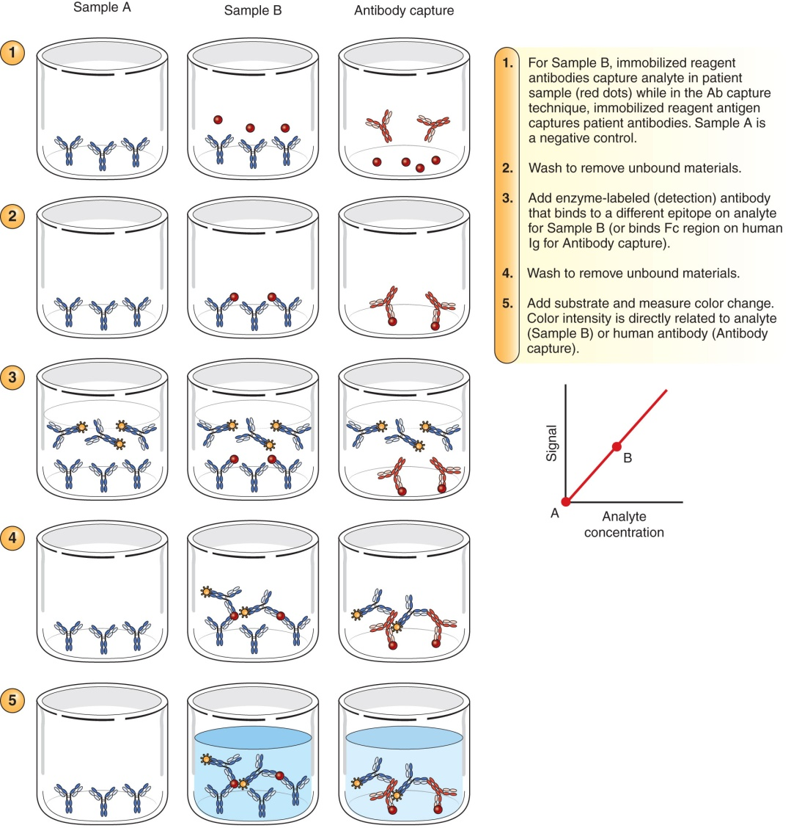
Noncompetitive Immunoassays

Slide 9
Radioimmunoassay (RIA)
The first immunoassay developed
Uses radioactive labels (¹²⁵I most popular)
Emits gamma radiation, which is detected by a gamma counter
Is extremely sensitive and precise
Measures trace amounts of analytes (such as hormones, serum proteins, and vitamins) that are small in size

Slide 10
Radioimmunoassay (RIA)
The amount of label in the bound phase is indirectly proportional to the amount of patient antigen present
Disadvantages:
Working with radioactive substances (physically dangerous)
Disposal of low-level radioactive waste
Short shelf life of some reagents

Slide 11
Enzyme Immunoassays (EIAs)
Use enzymes as labels, which react with suitable substrates to produce breakdown products that may be chromogenic, fluorogenic, or luminescent
Alkaline phosphatase and horseradish peroxidase
Have the highest turnover (conversion of substrate) rates
Have high sensitivity and are easy to detect
Notes:
Typical enzymes include horseradish peroxidase, glucose-6-phosphate dehydrogenase, alkaline phosphatase, and β-D-galactosidase.

Slide 12
Heterogeneous EIAs
Require a step to physically separate free analyte from bound analyte
Competitive assays
Involve enzyme-labeled antigen competing with unlabeled patient antigen for binding sites on antibody molecules
Used for measuring small antigens that are relatively pure (e.g., drugs and hormones)
Have high specificity
Notes:
The enzyme activity of competitive assays is inversely proportional to the concentration of the test substance. The more patient antigen is bound, the less enzyme-labeled antigen can attach.

Slide 13
Heterogeneous EIAs
Noncompetitive enzyme immunoassays
Offer high sensitivity and specificity, simplicity, and low cost
Enzyme-linked immunosorbent assay (ELISA)
Used to measure antibody production to infectious agents that are difficult to isolate and for autoantibody testing
HIV
Hepatitis B and hepatitis C
Is easily applied to point-of-care and home testing

Slide 14
Heterogeneous EIAs: ELISA
Antigen is bound to the solid phase
Patient serum with unknown antibody is added and given time to react
After a wash step, an enzyme-labeled antiglobulin (secondary antibody) is added
The second antibody reacts with any patient antibody that is bound to the solid phase

Slide 15
Heterogeneous EIAs: ELISA
If no patient antibody is bound to the solid phase, the second labeled antibody will not be bound
After a second wash step, enzyme substrate is added
The amount of color, fluorescence, or luminescence is measured; this amount is directly proportional to the amount of antibody in the specimen

Slide 16
Heterogeneous EIAs
Capture assays (sandwich immunoassays)
Are best suited to antigens that have multiple determinants
Antibodies
Cytokines
Proteins
Tumor markers
Microorganisms (especially viruses)
Also used in the measurement of immunoglobulins

Slide 17
Heterogeneous EIAs
Capture assays
Excess antibody attached to the solid phase is allowed to combine with the test sample to capture any antigen present
After an appropriate incubation period, enzyme-labeled antibody is added
The second antibody recognizes a different epitope or binding site than the solid-phase antibody and completes the “sandwich”

Slide 18
Heterogeneous EIAs
Capture assays
Either a colored or chemiluminescent reaction product is detected
Enzymatic activity is directly proportional to the amount of antigen in the test sample

Slide 19
Homogenous EIAs
These antigen–antibody systems do not require a washing or separation step
Enzyme activity is directly in proportion to the concentration of patient antigen or hapten present in the test solution
When antibody binds to specific determinant sites on the antigen, the active site on the enzyme is blocked, resulting in a measurable loss of activity

Slide 20
Homogenous EIAs
Are less sensitive than heterogenous assays
Are rapid and simple to perform
Are used to determine low-molecular-weight analytes in serum and urine
Hormones
Therapeutic drugs
Drugs of abuse

Slide 21
Rapid Immunoassays
Are membrane-based, single-use, and disposable assays
Involve antigen or antibody being coupled to the membrane
Are read by looking for a colored reaction
May require the separate addition of patient sample, wash reagent, labeled antigen or antibody, and the substrate

Slide 22
Rapid Immunoassays: Immunochromatography
Notes:
Figure 11-4. (A) Patient sample is added to a cassette containing antibody labeled with colloidal gold. (B) Sample combines with antibody and is moved along by capillary flow. (C) Monoclonal antibody to the analyte captures the patient antigen attached to gold-labeled antibody. (D) Control line has antibody that captures colloidal gold-labeled antibody.

Slide 23
Fluorescent Immunoassays
Immunofluorescent assay
Is restricted to qualitative observations involving the use of a fluorescence microscope
Involves grading the amount of fluorescence against a dark background
Is used for rapid identification of microorganisms in cell culture or infected tissue, tumor-specific antigens on neoplastic tissue, and transplantation antigens

Slide 24
Fluorescent Immunoassays
Direct immunofluorescent assay
Antibody that is conjugated with a fluorescent tag is added directly to unknown antigen that is fixed to a microscope slide
After incubation and a wash step, the slide is read using a fluorescence microscope
Technique demonstrates the presence of pathogens in patient samples

Slide 25
Fluorescent Immunoassays
Indirect immunofluorescent assay
Patient serum is incubated with a known antigen attached to a solid phase
The slide is washed, and then an anti-human immunoglobulin containing a fluorescent tag is added
A sandwich is formed with the first antibody, which localizes the fluorescence
Antibody can be identified

Slide 26
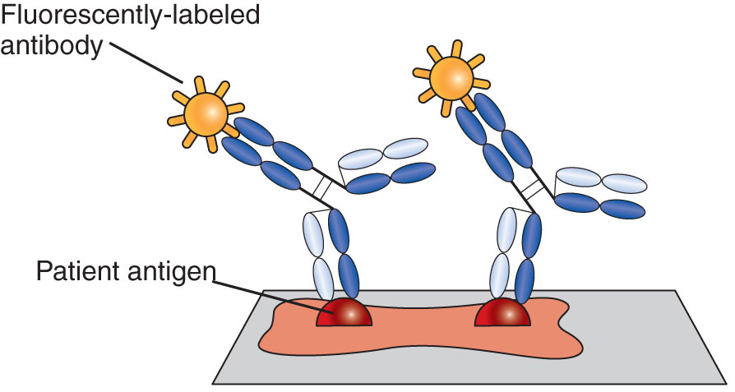
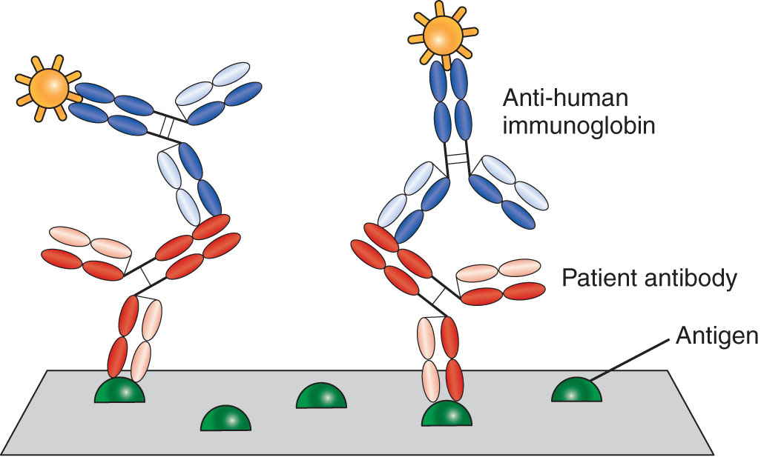
Direct vs. Indirect Immunofluorescent Assays
Notes:
Note that immunofluorescent assays in general face the problem of subjectivity in the reading of slides.
Figure 11-5. (A) In direct fluorescent assay, the patient antigen is fixed to a microscope slide and incubated directly with a fluorescent-labeled antibody. The slide is washed to remove unbound antibody. If specific antigen is present in the patient sample, fluorescence will be observed. (B) In indirect fluorescence, well-characterized tissues or cells are fixed to slides. Specific antibody in patient serum (in red) binds to the antigens on the slides. A wash step is performed, and a labeled anti-human immunoglobulin is added. After a second wash step to remove any uncombined anti-immunoglobulin, the fluorescence of the sample is determined. The amount of fluorescence is directly in proportion to the amount of patient antibody present.

Slide 27
Fluorescence Polarization Immunoassay (FPIA)
Used to determine concentrations of therapeutic drugs and hormones
Based on the change in polarization of fluorescent light emitted from a labeled molecule when it is bound by antibody
If the labeled molecule is bound to antibody, the molecule emits an increased amount of polarized light

Slide 28
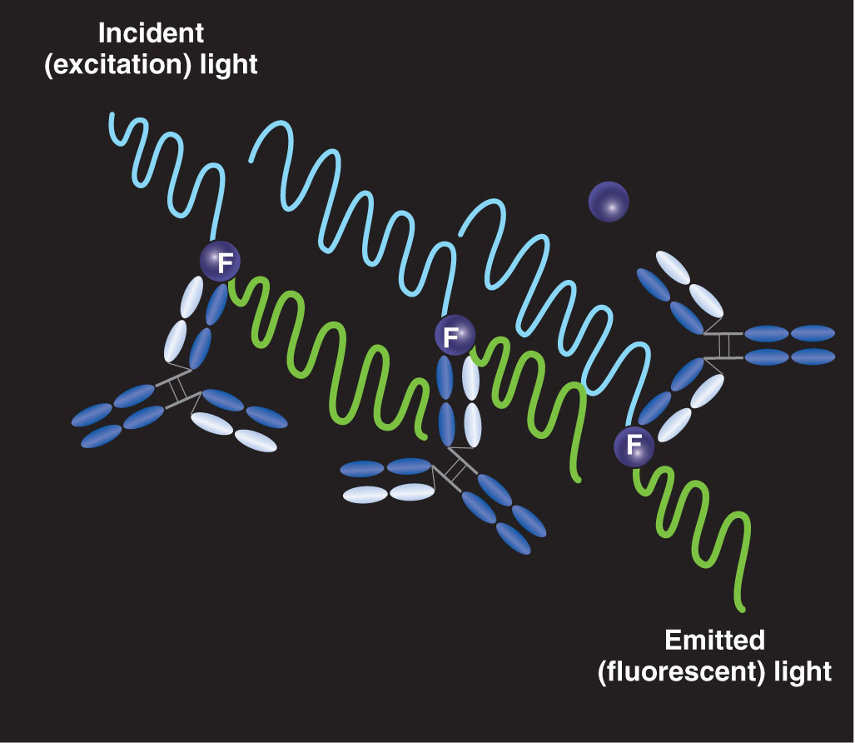
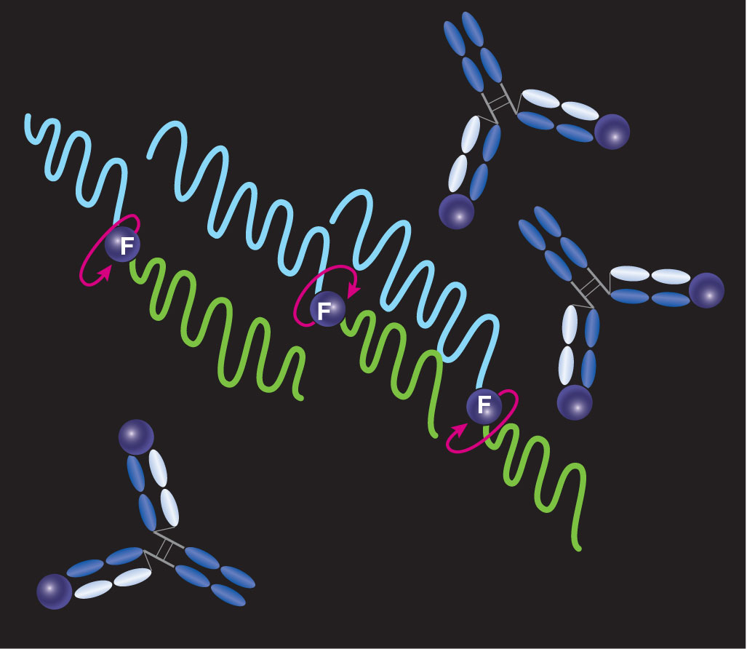
Fluorescence polarization immunoassay (FPIA)
Notes:
Figure 11-6. Fluorescence polarization immunoassay. Reagent antibody and fluorescently labeled analyte are added to the patient sample. (A) If sample analyte concentration is low, the antibody will bind most of the labeled analyte, restricting its rotation. When excited by polarized light, the emitted fluorescence will remain polarized (the light waves all oscillate with the same orientation). (B) If the patient sample has a high concentration of analyte, this unlabeled analyte will occupy most of the antibody-binding sites, leaving the labeled analyte free to rotate. The light waves emitted by the rotating labels will not be uniformly oriented (less polarization).

Slide 29
Chemiluminescent Immunoassays
Employed to follow antigen–antibody combination
Involve the emission of light caused by a chemical reaction, typically an oxidation reaction, producing an excited molecule that decays back to its original ground state
Can be used for heterogeneous and homogeneous assays because labels can be attached to either antigen or antibody

Slide 30
Summary
Labeled immunoassays measure small or low concentrations of antigens and antibodies.
Labeling techniques include radioactivity, enzymes, chemiluminescence, and fluorescence.
There are two major types of immunoassays: competitive and noncompetitive.
Immunoassays may be heterogenous (requiring separation) or homogenous.

Slide 31
Summary
Antibodies used must be specific and have a high affinity for the antigen in question.
Radioimmunoassay is based on competition between labeled and unlabeled antigen for a limited number of antibody-binding sites.
In noncompetitive indirect enzyme immuno-assays (e.g., ELISA), antigen is bound to the solid phase, and antibody is detected. After binding occurs, a second enzyme-labeled antibody is added.

Slide 32
Summary
In capture assays, the antibody is bound to the solid phase, and any patient antigen is allowed to bind or be captured. A second labeled antibody is added that also binds to patient antigen, making a “sandwich.”
Fluorochromes are fluorescent compounds that absorb energy from an incident light source and convert that energy to light of a longer wavelength.

Slide 33
Summary
Direct immunofluorescent assays involve antigen detection through a specific antibody that is labeled with a fluorescent tag.
In indirect immunofluorescent assays, the original antibody is unlabeled. Incubation with antigen is followed by addition of a second fluorescent-labeled anti-immunoglobulin that detects antigen–antibody complexes.

Slide 34
Summary
FPIA is a type of homogeneous fluorescent immunoassay based on the principle that when an antigen is bound to antibody, polarization of light increases.
Chemiluminescence is produced by certain compounds when they are oxidized and emit light as they return to their original ground state.

