Slide 1
Part XI
Hypersensitivity

Slide 2
Chapter Overview
Introduction to hypersensitivity
Hypersensitivity categories
Immunologic mechanisms, clinical examples, treatment, lab testing

Slide 3
Hypersensitivity
Exaggerated immune response to a typically harmless antigen
Results in tissue injury and disease
Four categories of hypersensitivity
Type I
Type II
Type III
Type IV
Notes:
British immunologists Gell and Coombs classified the hypersensitivity reactions into four types based on their immunologic mechanisms.
These are referred to as types I, II, III, and IV.

Slide 4
Hypersensitivity
Immediate reactions
Develop minutes to hours after antigen exposure
Type I, type II, type III
Delayed reactions
Develop 24 to 48 hours after antigen exposure
Type IV
Notes:
The hypersensitivity reactions can be further classified according to their timing into immediate and delayed hypersensitivity.
The immediate reactions are all antibody-mediated (types I, II, and III).
The delayed reaction (type IV) is T cell-mediated.

Slide 5
Type I Hypersensitivity
Also known as anaphylactic hypersensitivity
Typically thought of as “allergies”
Commonly occur within minutes after exposure to an allergen
Key components
IgE
Mast cells
Basophils
Eosinophils
Notes:
Allergen: an antigen that induces type I hypersensitivity.

Slide 6
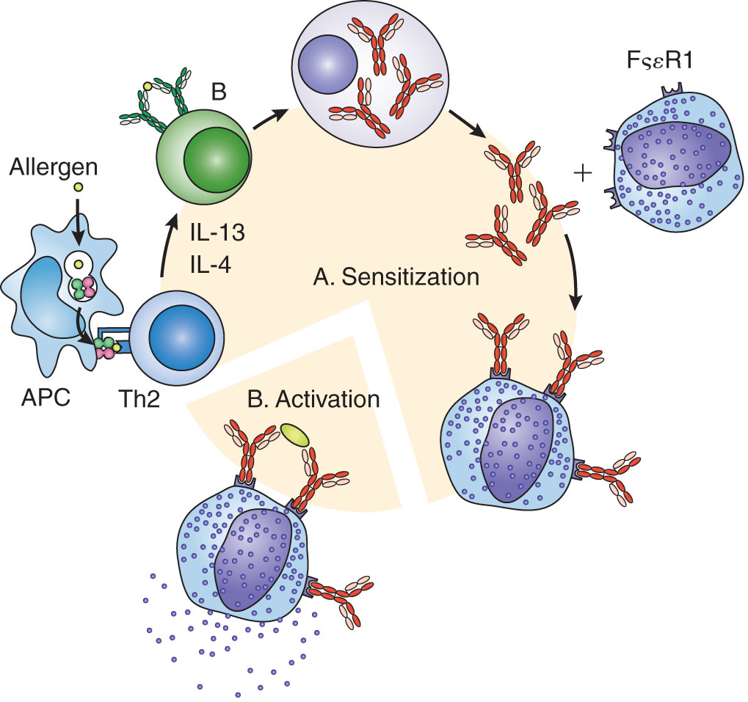
Sensitization Phase
APCs process allergens and present them to Th cells
Th2 cells induce production of allergen-specific IgE
IgE binds to FcεRI receptors on mast cells and basophils
Notes:
APCs = antigen-presenting cells, such as dendritic cells and Langerhans cells.
In people with allergies, the Th2 type of T helper cell predominates.
Th2 cells produce IL-4 and IL-13, which induce the transcription of IgE genes by Ig class-switching.
FcεRI receptors are high-affinity receptors that are abundant on mast cells and basophils; they bind the Fc portion of the IgE molecule.

Slide 7
Activation Phase
Allergen cross-links adjacent cell-bound IgEs
Mast cells and basophils degranulate
Chemical mediators are released and bind to target organs
Allergy symptoms are produced
Notes:
In cross-linking, a bivalent or multivalent allergen binds to adjacent cell-bound IgEs, causing them to aggregate and activate intracellular signaling pathways that trigger degranulation.
Primary mediators are preformed and already present in the granules. The most abundant primary mediator is histamine. Others include heparin and eosinophil chemotactic factor of anaphylaxis. These mediators cause early symptoms, which occur within 30 to 60 minutes after allergen exposure.
Secondary mediators, such as prostaglandin, leukotrienes, and cytokines, are synthesized after the cross-linking event and can cause a late-phase inflammatory reaction 6 to 8 hours after exposure to the allergen.
Target organs include the skin, respiratory tract, and gastrointestinal tract.

Slide 8
Common Allergens
Pollen
Mold spores
Animal dander
Dust mites
Insect venom
Certain foods (peanuts, shellfish, dairy products)
Certain drugs (penicillin)
Latex

Slide 9
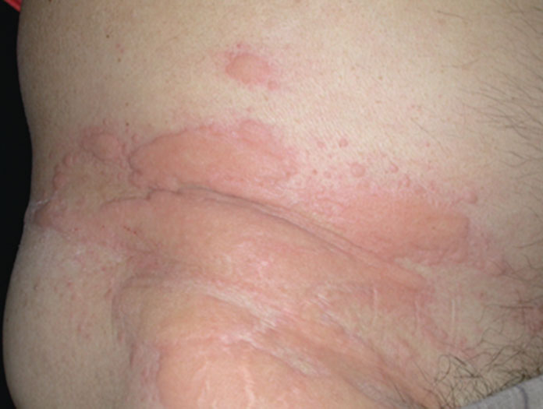
Clinical Manifestations of Type I Hypersensitivity
Rhinitis (“hay fever”)
Asthma
Food allergies
Urticaria (“hives”)
Wheal and flare
Eczema
Systemic anaphylaxis
A potentially fatal reaction
Notes:
Signs of systemic anaphylaxis include bronchospasm, laryngeal edema, vascular congestion, urticaria and angioedema, diarrhea and abdominal cramping, and shock.

Slide 10
Treatments for Type I Hypersensitivity
Avoidance of allergens
Drug therapy
Antihistamines, bronchodilators, mast cell stabilizers, corticosteroids, epinephrine
Monoclonal anti-IgE antibody
Allergy immunotherapy (AIT)
Administer gradually increasing doses of allergen
Notes:
Epinephrine, a powerful vasoconstrictor, is used to treat systemic anaphylaxis in emergency situations.
Omalizumab, a monoclonal anti-IgE antibody, binds to the Fc region of circulating IgE, preventing it from binding to mast cells and basophils.
AIT is believed to induce immune tolerance to an allergen by shifting the immune response to a Th1 type, inducing development of Treg cells, and inducing production of IgG4 antibodies that block binding of allergen to IgE.

Slide 11
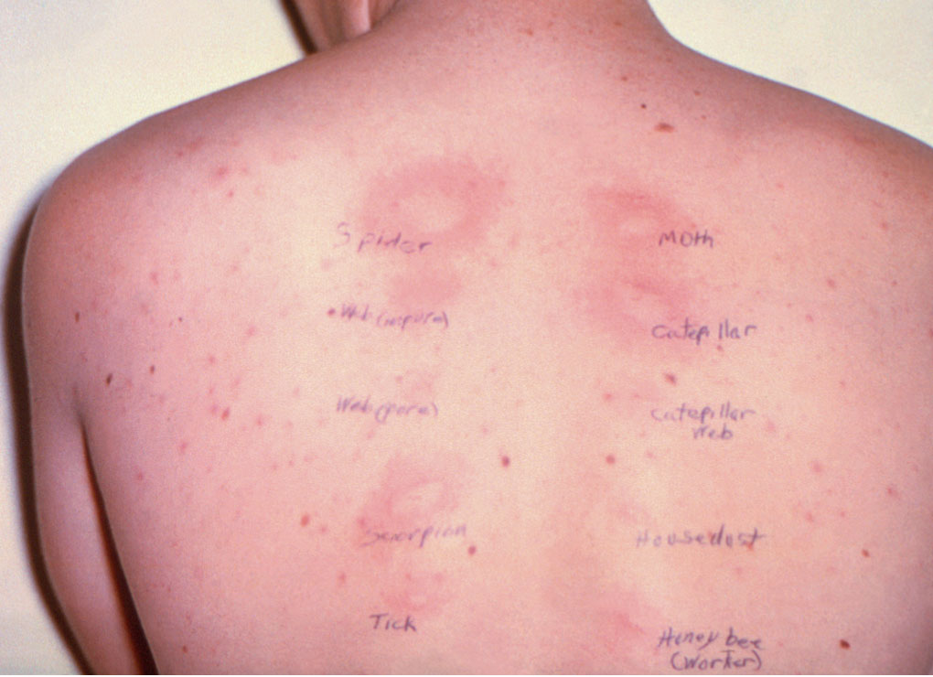
Testing for Type I Hypersensitivity: In Vivo Skin Tests
Percutaneous or intradermal
Process
Apply a panel of allergens to separate sites on the skin
Wait 15 to 20 minutes
Positive test = wheal and flare at the site of application
Notes:
Testing for allergies typically begins with skin testing because the procedure is less expensive and more sensitive than serologic testing and provides immediate results.
Percutaneous testing: allergens are applied to the upper layers of the skin with a needle or pricking device to the inner forearm or the back.
Intradermal testing: higher doses of allergens are injected between the layers of the skin in the inner forearm or upper arm. This method is more sensitive but has a greater risk of anaphylaxis.
Negative control = diluent; positive control = histamine.

Slide 12
Allergen-Specific IgE Testing
Used to detect IgE to a specific allergen in patient serum
Notes:
This test was formerly known as RAST (radioallergosorbent test).
It is more expensive than skin testing but safer and easier for some patients, especially children and apprehensive adults.
The method of choice is an automated, noncompetitive fluoroimmunoassay in which patient serum is incubated with a solid phase to which an allergen is bound, followed by addition of an enzyme-labeled anti-IgE.
Fluorescence is produced in proportion to the amount of allergen-specific IgE in the patient sample.
A positive test is 0.35 kUa/L, where 1 IU = 2.42 ng/mL of IgE.
A positive test indicates sensitization to the allergen.

Slide 13
Testing for Total IgE
Used to detect the total concentration of IgE in patient serum
Notes:
This test was formerly known as RIST (radioimmunosorbent test).
Patient serum is incubated with a solid phase to which an anti-IgE is bound, followed by addition of an enzyme-labeled anti-IgE.
Fluorescence is produced in proportion to the amount of allergen-specific IgE in the patient sample.
A cutoff value of 100 kU/L is considered the upper limit of normal.
Elevated IgE levels may not necessarily correlate with presence of clinical allergy.
This test is more beneficial in evaluating patients with other conditions in which IgE is elevated, such as helminth infections and certain immunodeficiencies.
Total IgE testing is also helpful in monitoring patients undergoing allergy immunotherapy or treatment with monoclonal anti-IgE.

Slide 14
Type II Hypersensitivity
Also known as antibody-mediated cytotoxic hypersensitivity
Key components = IgG and IgM directed against a cell surface antigen
Effects of the antibodies:
Cell destruction
Inhibition of cell function
Increase in cell function

Slide 15
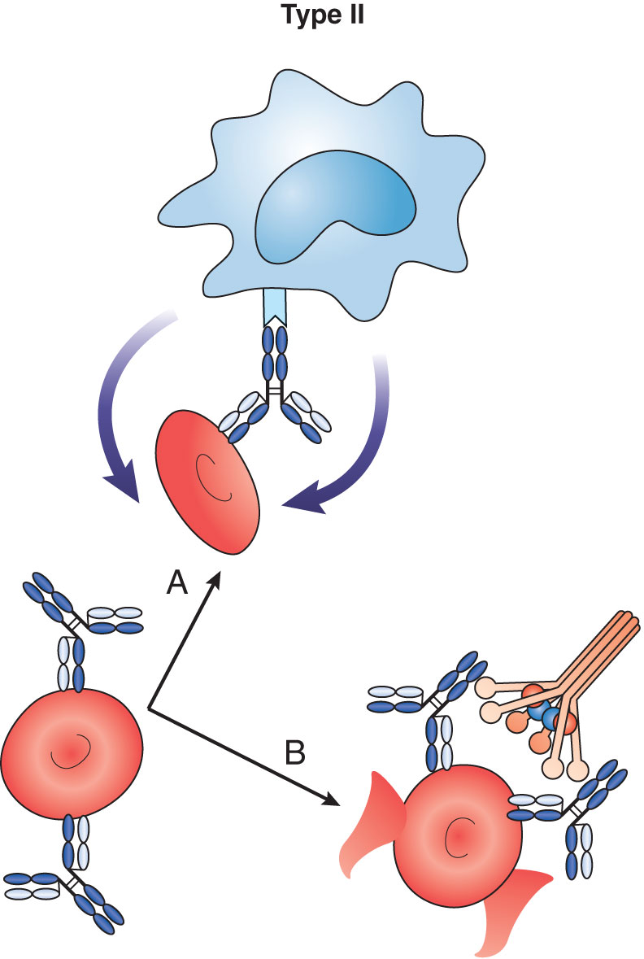
Cell Damage in Type II Hypersensitivity
Activation of classical pathway of complement and cell lysis
Opsonization and phagocytosis of the cell
ADCC
Notes:
ADCC = antibody-dependent cellular cytotoxicity.
Cell damage in type II hypersensitivity can occur by one of three mechanisms: C’-mediated lysis, opsonization, or ADCC.

Slide 16
Clinical Examples of Type II Hypersensitivity
Transfusion reactions
Hemolytic disease of the newborn (HDN)
Autoimmune hemolytic anemia
Warm reactive antibodies
Cold agglutinins
Paroxysmal cold hemoglobinuria
Goodpasture’s syndrome
Hashimoto’s disease
Notes:
There are two types of antibodies against RBCs: warm reactive IgG antibodies, which react at 37°C and mainly cause extravascular hemolysis; and cold agglutinins, IgM antibodies that are specific for the Ii blood group antigens and react below 30°C.
Polyclonal cold agglutinins are formed in response to certain infections, such as Mycoplasma pneumonia and infectious mononucleosis. Monoclonal cold agglutinins have been associated with B-cell lymphoproliferative disorders. Cold agglutinins can bind to RBCs to form lattices, which can obstruct small capillaries in the skin in areas exposed to the cold, such as the fingers and toes.
Paroxysmal cold hemoglobinuria is a transient condition in which patients produce an anti-RBC antibody after having certain viral infections. The antibody is biphasic, binding to RBCs at cold temperatures and activating C’ at 37°C to produce intermittent hemolysis. Hemoglobin can be seen in the urine.

Slide 17
Hemolytic Disease of the Newborn (HDN)
Caused by development of antibodies by a pregnant woman to red blood group antigens, usually Rh D, on the RBCs of the fetus
Notes:
The mother becomes exposed to RBC antigens of paternal origin during the delivery of her first child, when the fetal RBCs can leak into the mother’s circulation. As a result, the mother can develop memory B cells, which can be activated against the same RBC antigens on fetal cells during a second or subsequent pregnancy. These antibodies can cross the placenta and destroy the RBCs of the fetus, leading to fetal abortion, stillbirth, or HDN. In HDN, the baby’s RBCs are lysed, releasing free hemoglobin, which is converted to bilirubin. Excess bilirubin can result in jaundice and brain damage.
Production of Rh antibodies in this situation can be prevented by testing pregnant women to see if they are Rh(-) and administering an anti-D globulin called RhoGam during pregnancy and soon after delivery.

Slide 18
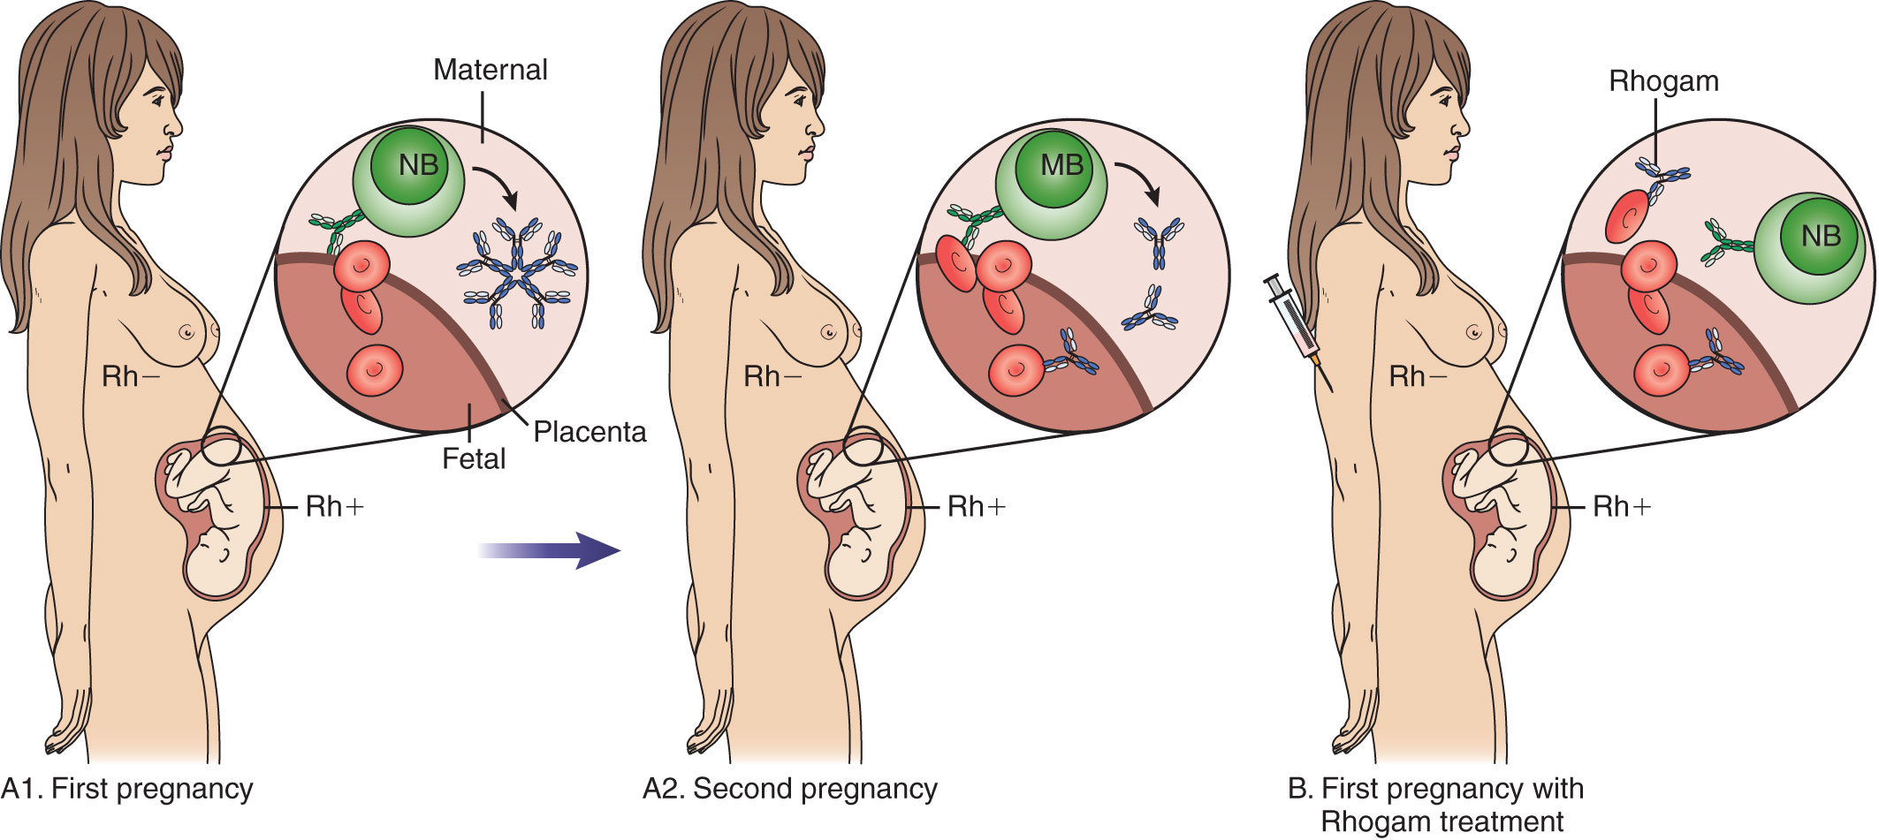
Hemolytic Disease of the Newborn (HDN)
Notes:
The mother becomes exposed to RBC antigens of paternal origin during the delivery of her first child, when the fetal RBCs can leak into the mother’s circulation. As a result, the mother can develop memory B cells, which can be activated against the same RBC antigens on fetal cells during a second or subsequent pregnancy. These antibodies can cross the placenta and destroy the RBCs of the fetus, leading to fetal abortion, stillbirth, or HDN. In HDN, the baby’s RBCs are lysed, releasing free hemoglobin, which is converted to bilirubin. Excess bilirubin can result in jaundice and brain damage.
Production of Rh antibodies in this situation can be prevented by testing pregnant women to see if they are Rh(-) and administering an anti-D globulin called RhoGam during pregnancy and soon after delivery.

Slide 19
Direct Antiglobulin Test (DAT)
Detects RBCs coated with complement components or IgG antibody by incubation with a poly-specific anti-human Ig directed against IgG and C’
If positive (agglutination), test is repeated with mono-specific anti-IgG, anti-C3b, and anti-C3d
Notes:
This test is performed to detect potential transfusion reactions, HDN, and autoimmune hemolytic anemia.

Slide 20
Indirect Antiglobulin Test
Coombs’ test
Tests patient serum for antibodies to RBC antigens
Process
Incubate reagent RBCs with patient serum at 37ºC; wash to remove excess
Add anti-human globulin
Positive test = RBC agglutination
Notes:
The test is performed in the cross-matching of blood to detect potential transfusion reactions.
The test can also be used to type patient RBCs for specific blood group antigens by incubation with antisera specific for RBC antigens.

Slide 21
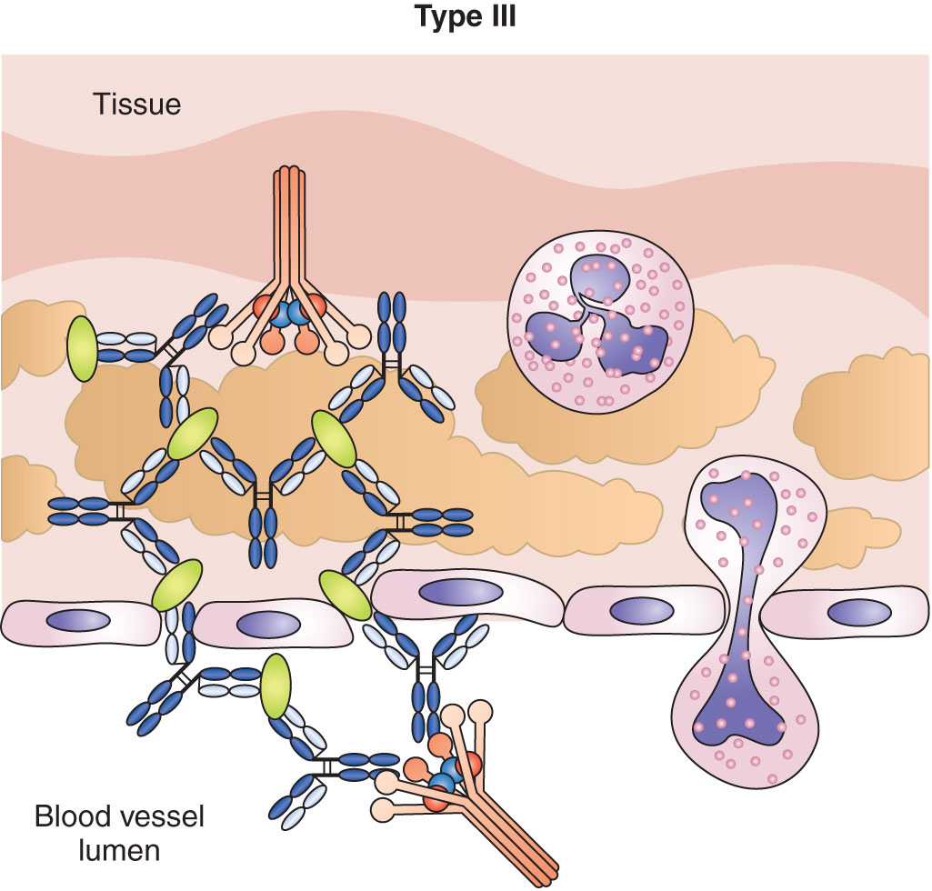
Type III Hypersensitivity
Complex-mediated hypersensitivity
Key components are IgG and IgM directed against a soluble antigen
Small antigen–antibody complexes precipitate out and deposit in tissues
C’ binds; vasodilation and vasopermeability increase
Macrophages and neutrophils migrate to the affected areas and release their lysosomal enzymes, resulting in tissue damage
Notes:
Precipitation of small immune complexes usually occurs under conditions of mild antigen excess. The areas most affected are the glomerular basement membrane, vascular endothelium, joint linings, and pulmonary alveolar membranes.
Complement components such as C5a cause chemotaxis of macrophages and neutrophils.
The reaction can be local or systemic.

Slide 22
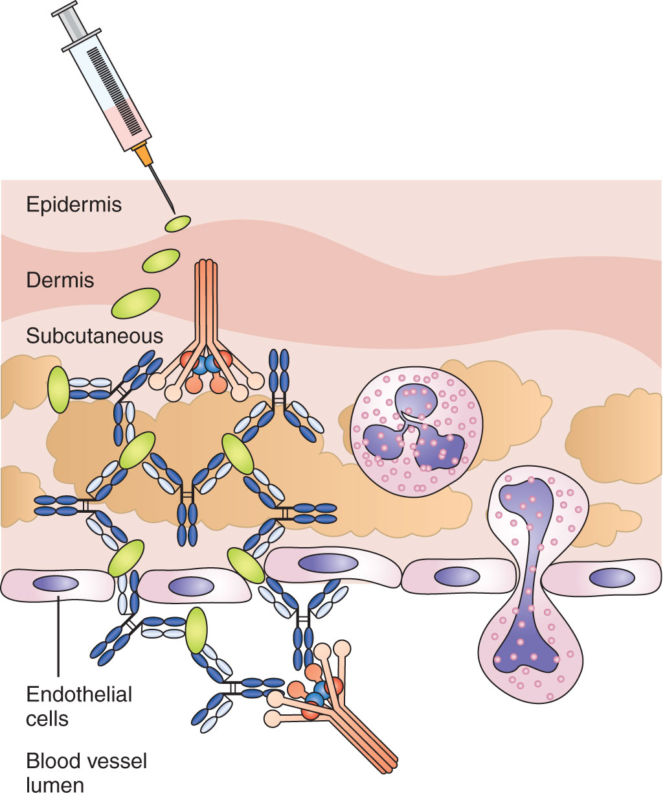
Arthus Reaction
Skin reaction caused by type III hypersensitivity
Localized inflammation characterized by redness and edema
Peaks at 3 to 8 hours
Notes:
Named after Maurice Arthus, who induced the reaction in laboratory rabbits in 1903.
Immune complexes form that deposit in the small blood vessels in the skin.
This reaction can sometimes be seen in humans after booster injections with the tetanus, diphtheria, or measles vaccines.

Slide 23
Serum Sickness
Generalized type III hypersensitivity reaction
Caused by passive immunization of humans with animal serum
Produces antibodies against the foreign animal proteins in patients
Causes immune complexes to form and deposit in tissues
Symptoms: headache, fever, nausea, joint pain, rashes, and lymphadenopathy
Notes:
Before the discovery of vaccines, horse antiserums were used to treat infections such as diphtheria and tetanus.
Horse antivenoms are used today to treat victims of snake bites.
Patients with cancer and other diseases may be treated with mouse monoclonal antibodies and produce antibodies to the mouse proteins.
Symptoms of serum sickness appear 7 to 21 days after injection of the animal serum.

Slide 24
Other Conditions Associated with Type III Hypersensitivity
Some autoimmune diseases (e.g., systemic lupus erythematosus and rheumatoid arthritis)
Reactions to bee stings
Drug reactions (e.g., penicillin)
Sequelae to infections (e.g., post-streptococcal glomerulonephritis)

Slide 25
Laboratory Testing
Testing for ANAs
Fluorescent staining of tissue sections to detect deposited immune complexes
Testing for rheumatoid factor (an anti-IgG)
Testing complement levels
May be decreased in the serum during periods of high disease activity
Notes:
ANA = antinuclear antibodies.
Complement levels may be decreased in the serum because C’ may be bound by antigen––antibody complexes.

Slide 26
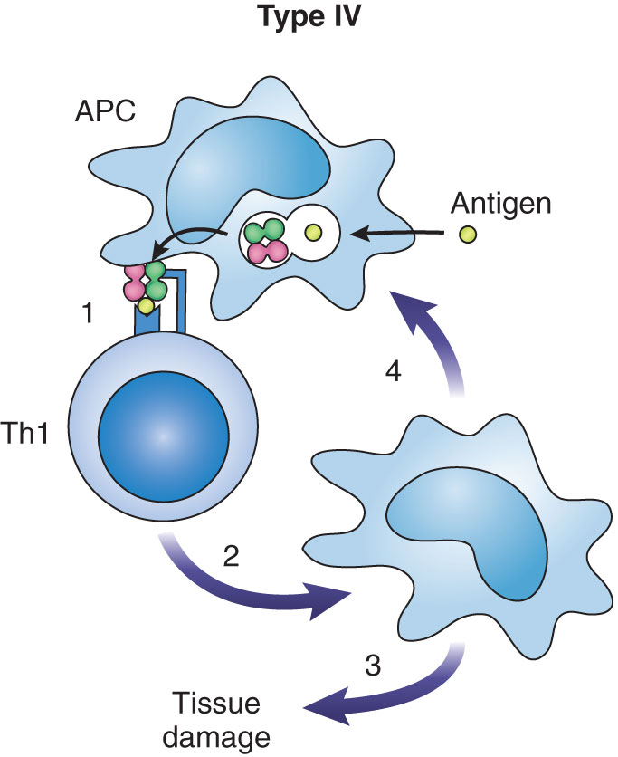
Type IV Hypersensitivity
Cell-mediated hypersensitivity
Th1 cells and macrophages are involved
APCs present antigen to naïve T helper cells, which differentiate into Th1 cells
Th1 cells release cytokines that attract and activate macrophages
Macrophages induce inflammation
Cytotoxic T lymphocytes are recruited and destroy target cells
Hypersensitivity peaks 48 to 72 hours after antigen exposure
Notes:
This is also known as delayed-type hypersensitivity.
The cytokines IL-3 and GM-CSF induce hematopoiesis of cells of the granulocyte–monocyte lineage; MCP-I recruits macrophages to the site; IFN-γ and TNF-β activate the macrophages.
Chronic persistence of antigen and inflammation leads to the formation of granulomas, cell clusters that consist of macrophages that have engulfed the antigen, lymphocytes, and other WBCs. The function of the granulomas is to wall off phagocytized organisms in a contained area to prevent spread to other parts of the body.

Slide 27
Clinical Examples of Type IV Hypersensitivity
Infections with intracellular pathogens
Myobacterium tuberculosis, Myobacterium leprae, Pneumocystis carinii, Leishmania species, herpes simplex virus
Contact dermatitis
Hypersensitivity pneumonitis
Allergic diseases of the lungs
Caused by inhalation of bacterial and fungal spores
Examples: Farmer’s lung disease, bird breeder’s lung disease, humidifier lung disease
Notes:
The infections with intracellular pathogens are characterized by the formation of granulomas.
Hypersensitivity pneumonitis is seen most often in individuals who work or have hobbies that involve exposure to the implicated antigen (e.g., moldy hay, pigeon droppings, compost). Inflammation of the alveoli and interstitial lung spaces causes a dry cough, shortness of breath, fever, chills, weight loss, and general malaise.

Slide 28
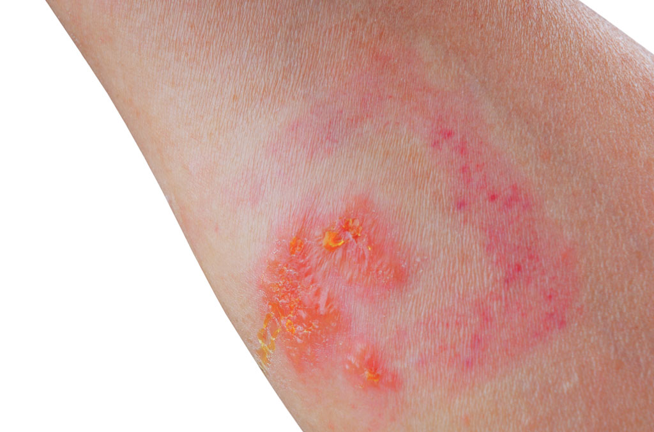
Contact Dermatitis
Low-molecular-weight compounds contact the skin and act as haptens to sensitize Th1 cells
Examples include poison ivy, poison oak, nickel salts, materials in cosmetics and hair dyes, and latex
Skin eruptions with erythema, swelling, and papules are produced
Notes:
Skin eruptions appear 6 hours to several days after exposure.
Papules become vesicular with itching, blistering, peeling, and weeping. The reaction can spread to adjoining areas and last for 3 to 4 weeks after the antigen has been removed.
Sensitization of Th can last for years because of immunologic memory.
Condition is usually treated with topical steroids to reduce the inflammation.

Slide 29
Skin Testing for Delayed Hypersensitivity
Patch test
Antigen applied to skin surface
Test for contact dermatitis
(+) test = redness with papules or tiny blisters
Mantoux method
Antigen injected intradermally
Test for tuberculosis exposure (PPD) or T-cell function
(+) test = induration
Notes:
Induration = a hardened, raised area. The diameter of the reaction is measured. A positive test in people with no risk factors is 15 mm or greater.
The skin reaction appears 48 to 72 hours after injection of antigen and results from a T-cell memory response in sensitized individuals.
A positive test indicates exposure but cannot differentiate between a recent or past exposure.
PPD = purified protein derivative from extracts of M tuberculosis.
To determine whether the cell-mediated arm of the immune system is functioning properly in persons with suspected immunodeficiencies, a panel of common antigens is used (e.g., Candida albicans, tetanus toxoid, streptococcal bacteria)

Slide 30
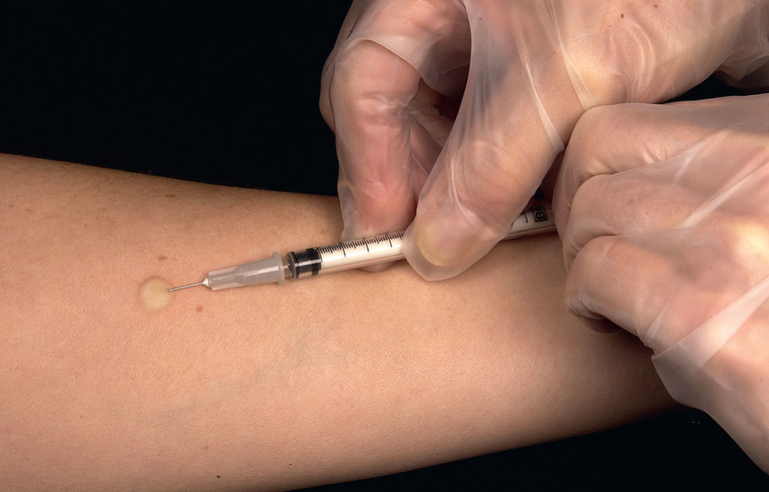
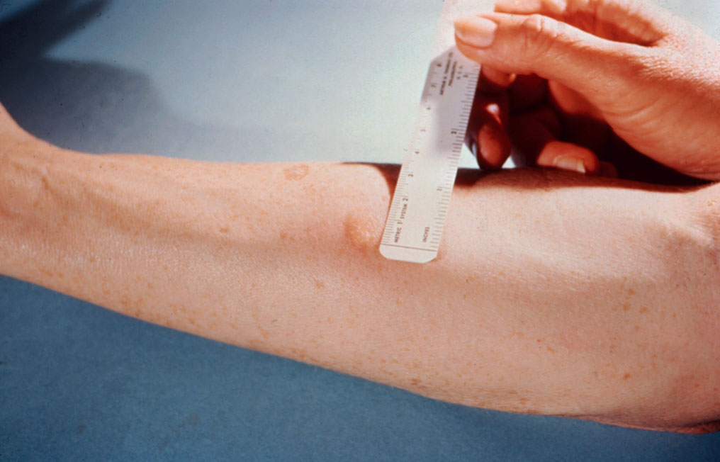
Skin Testing for Delayed Hypersensitivity
Notes:
Induration = a hardened, raised area. The diameter of the reaction is measured. A positive test in people with no risk factors is 15 mm or greater.
The skin reaction appears 48 to 72 hours after injection of antigen and results from a T-cell memory response in sensitized individuals.
A positive test indicates exposure but cannot differentiate between a recent or past exposure.
PPD = purified protein derivative from extracts of M tuberculosis.
To determine whether the cell-mediated arm of the immune system is functioning properly in persons with suspected immunodeficiencies, a panel of common antigens is used (e.g., Candida albicans, tetanus toxoid, streptococcal bacteria)

Slide 31
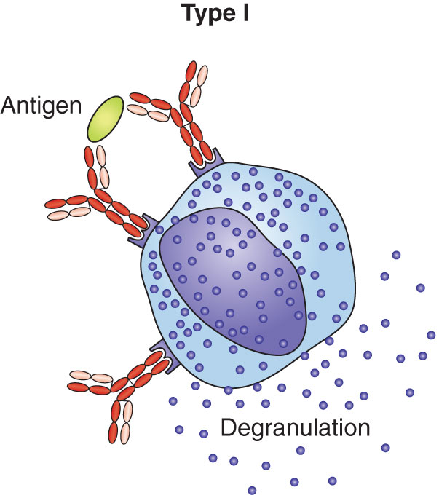
Summary
Notes:
Type I hypersensitivity: Exposure to an allergen induces production of specific IgE antibody, which binds to mast cells and basophils, inducing them to degranulate and release chemical mediators that cause vasodilation, vasopermeability, and other clinical symptoms associated with allergy.
Type II hypersensitivity: IgG and IgM antibodies react with cell surface antigens, causing cell damage by complement lysis, opsonization, or ADCC; cell dysfunction by blocking the binding of a ligand to a cell surface receptor; or overstimulation of a cell’s function.
Type III hypersensitivity: Small immune complexes containing IgG or IgM antibodies precipitate in the tissues and activate complement. Neutrophils are recruited to the sites of immune complex deposition, where they release lysosomal enzymes that cause inflammation and injury to the surrounding tissues.
Type IV hypersensitivity: Antigen-sensitized T cells release cytokines that induce inflammation and tissue damage.

Slide 32
Summary
Notes:
Type I hypersensitivity: Exposure to an allergen induces production of specific IgE antibody, which binds to mast cells and basophils, inducing them to degranulate and release chemical mediators that cause vasodilation, vasopermeability, and other clinical symptoms associated with allergy.
Type II hypersensitivity: IgG and IgM antibodies react with cell surface antigens, causing cell damage by complement lysis, opsonization, or ADCC; cell dysfunction by blocking the binding of a ligand to a cell surface receptor; or overstimulation of a cell’s function.
Type III hypersensitivity: Small immune complexes containing IgG or IgM antibodies precipitate in the tissues and activate complement. Neutrophils are recruited to the sites of immune complex deposition, where they release lysosomal enzymes that cause inflammation and injury to the surrounding tissues.
Type IV hypersensitivity: Antigen-sensitized T cells release cytokines that induce inflammation and tissue damage.

