Slide 1
Part XII
Autoimmunity

Slide 2
Chapter Overview
Mechanisms of autoimmunity
Immunologic tolerance
Genetic and environmental factors
Systemic autoimmune diseases
Systemic lupus erythematosus (SLE)
Rheumatoid arthritis (RA)
Granulomatosis with polyangiitis (GPA)
Associated laboratory testing
Organ-specific autoimmune diseases
Examples and associated laboratory testing

Slide 3
Autoimmune Diseases
Humoral and cell-mediated immune responses directed toward self antigens
Cause tissue and organ damage
Systemic or organ-specific
Due to loss of self-tolerance
Ability of the immune system to accept self antigens and not initiate an immune response against them

Slide 4
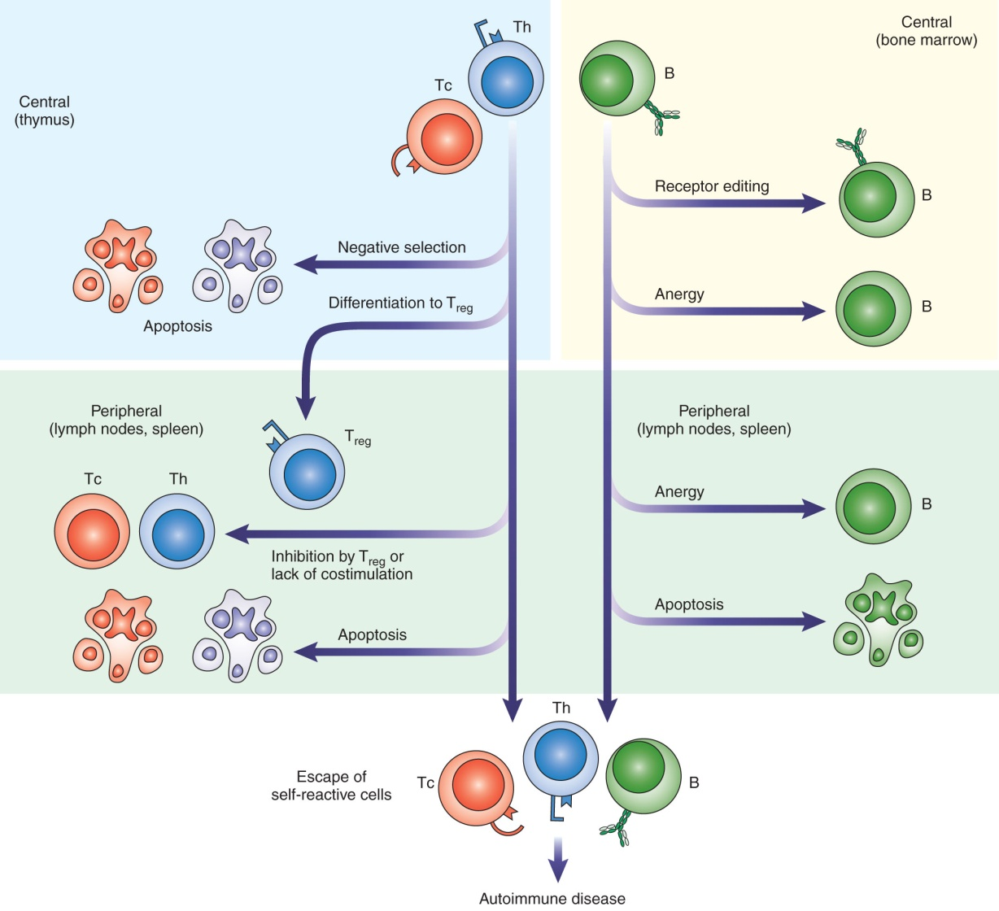
Mechanisms of Central and Peripheral Tolerance
Notes:
Central tolerance: Occurs in thymus and bone marrow as T and B lymphocytes mature.
If T cells possess TCRs that bind to self-antigen in the thymus, they are deleted by apoptosis. Alternately, they can differentiate into Treg cells that inhibit immune responses to self antigens.
If B cells possess BCRs that bind strongly to self-antigen in the bone marrow, they are deleted by apoptosis in a process known as negative selection. Alternately, they can edit their receptors so they are no longer antigen specific or down-regulate expression of their receptors to become unresponsive to an antigen (anergy).
Self-reactive T and B cells that have escaped to the secondary lymphoid organs like the lymph nodes and spleen may be removed by peripheral tolerance.
Peripheral tolerance of T cells can result from inhibition by Tregs, lack of a co-stimulatory signal from an APC, binding of inhibitory receptors like CTLA-4, or death by apoptosis.
Self-reactive B cells in the periphery can be deleted by apoptosis or rendered nonfunctional (anergic) by repeated stimulation with self-antigens, or receipt of inhibitory signals.
In some individuals, central or peripheral tolerance may fail to occur, and autoimmunity results.

Slide 5
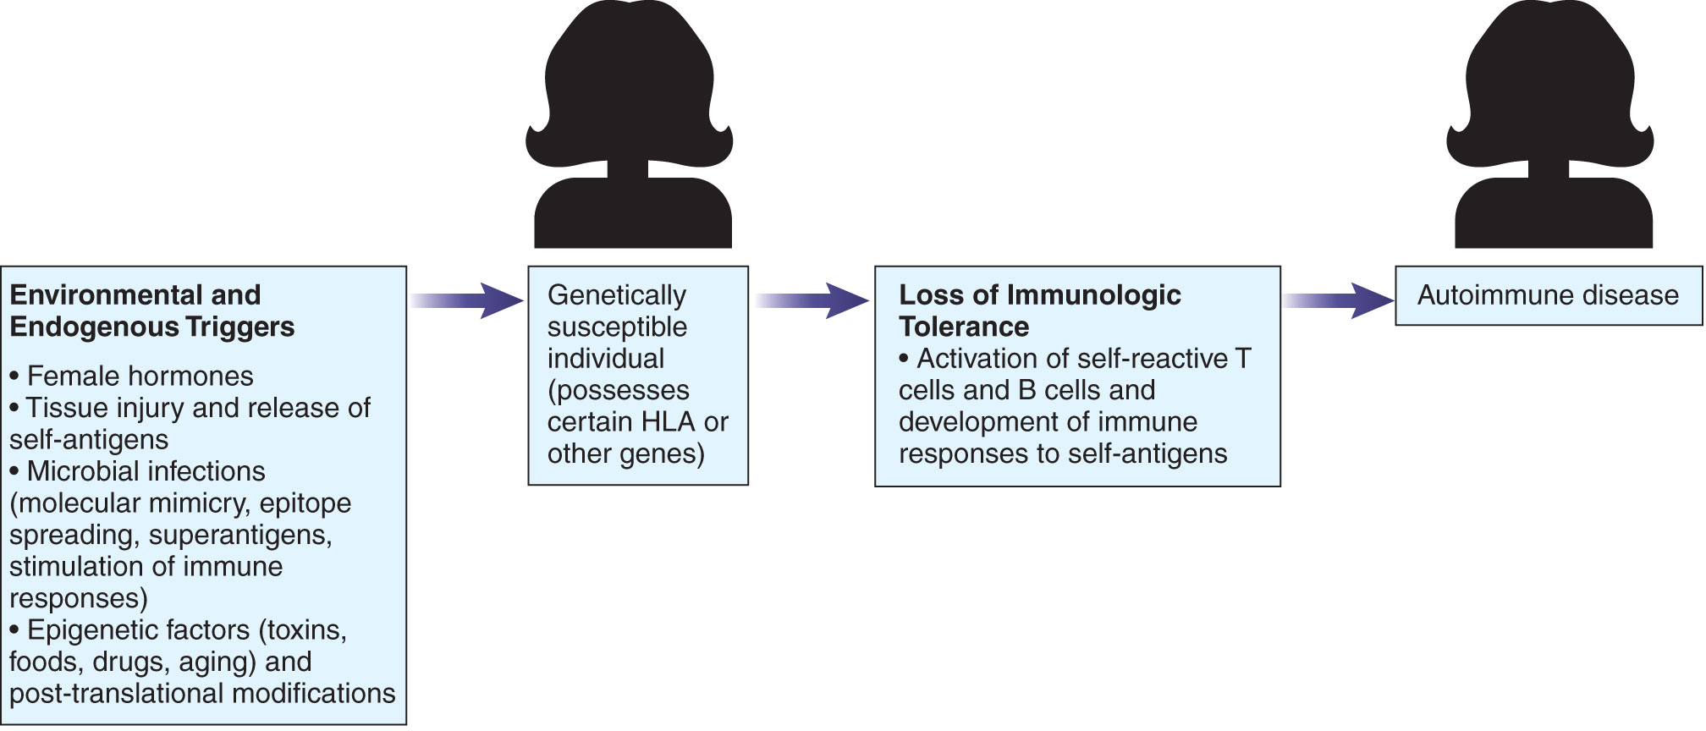
Genetic and Environmental Factors in Development of Autoimmunity
Notes:
Autoimmunity is thought to result from complex interactions between genetic and environmental factors.
Inheritance of certain genes may make some individuals more susceptible to particular autoimmune diseases, such as specific HLA types which can determine the effectiveness of antigen presentation, and non-MHC genes which influence development and regulation of immune responses.
Exposure of genetically susceptible individuals to endogenous and environmental factors can trigger autoimmune responses.
Hormones can influence autoimmunity; women are almost three times as likely to acquire an autoimmune disease as compared to men.
Tissue injury can lead to the release of cryptic antigens which can induce an autoimmune response. These self-antigens were hidden in the tissues of the host during early development of T and B cells so that tolerance was not developed against them.
Microbial infections may trigger autoimmunity in several ways. One way is through molecular mimicry, whereby bacteria or viruses possess antigens that are similar to a self antigen. A second way is through epitope spreading, where the immune response to a microbe expands to activate immune responses to other antigens, including self antigens. A third way is through superantigens, which can activate numerous clones of T cells, or through certain viruses, which can cause polyclonal B cell activation.
Epigenetic modifications due to exposure to environmental factors that can alter gene expression may also contribute to autoimmunity.

Slide 6
Autoimmune Diseases
More than 100 autoimmune diseases discovered
Systemic diseases
SLE, RA, GPA
Organ-specific
Autoimmune thyroid diseases, type I diabetes, celiac disease, autoimmune liver diseases, multiple sclerosis, myasthenia gravis, Goodpasture’s syndrome
Notes:
Autoimmune diseases can be directed against a particular organ in the body or involve pathology throughout the body.

Slide 7
Systemic Lupus Erythematosus (SLE)
A chronic systemic inflammatory disease that affects multiple organ systems
Patients develop numerous autoantibodies (e.g., to dsDNA and other nuclear components, lymphocytes, RBCs, platelets)
Immune complexes form, triggering C’ activation, chemotaxis of neutrophils, and inflammation
Notes:
Pathology is caused by a type III hypersensitivity reaction. Tissue damage occurs at the sites in the body where immune complexes have deposited.

Slide 8
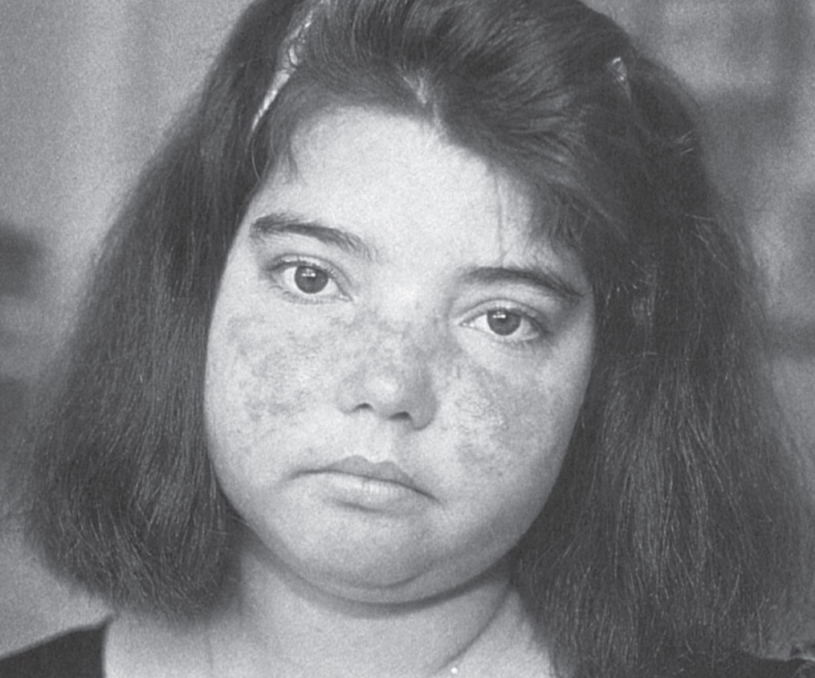
Clinical Symptoms of SLE
Joint involvement
Skin rashes
Renal involvement
Neurologic symptoms
Anemia, leukopenia, thrombocytopenia
Others
Notes:
Clinical symptoms are diverse and vary in patients.
The most commonly affected area is the joints, with polyarthralgias or arthritis.
Skin manifestations can vary and appear in approximately 80% of patients. The figure shows the classic butterfly rash of lupus, covering the nose and cheeks. This is where lupus derives its name (Latin for “red wolf”).
Kidney inflammation occurs in about half of all patients and can lead to renal failure.
Other symptoms include pericarditis, tachycardia, and pleuritis.

Slide 9
Laboratory Tests to Diagnose SLE
CBC
Urinalysis
CRP/ESR
Elevated during flare-ups
Complement quantitation
C3 levels can be decreased during inflammation
ANAs
Notes:
CBC = complete blood count
CRP = C-reactive protein
ESR = erythrocyte sedimentation rate
ANAs = anti-nuclear antibodies
C3 levels in the serum may be decreased because C’ is bound to immune complexes.

Slide 10
Antinuclear Antibodies (ANAs)
Directed against antigens in cell nuclei
Present in more than 95% of lupus patients
Include:
Anti-ds DNA (lupus-specific)
Anti-ss DNA
Anti-histones and nucleosomes
Antibodies to centromere or nucleolar components
Anti-ENA (e.g., anti-Sm, anti-RNP, anti- SS-A, anti-SS-B)
Notes:
ENA = Extractable Nuclear Antigens (isolated in saline extracts)
Anti-Sm (Smith antigen) is specific for SLE.
Anti-SS-A and SS-B are associated with neonatal lupus when they are present in the mother and cross the placenta.

Slide 11
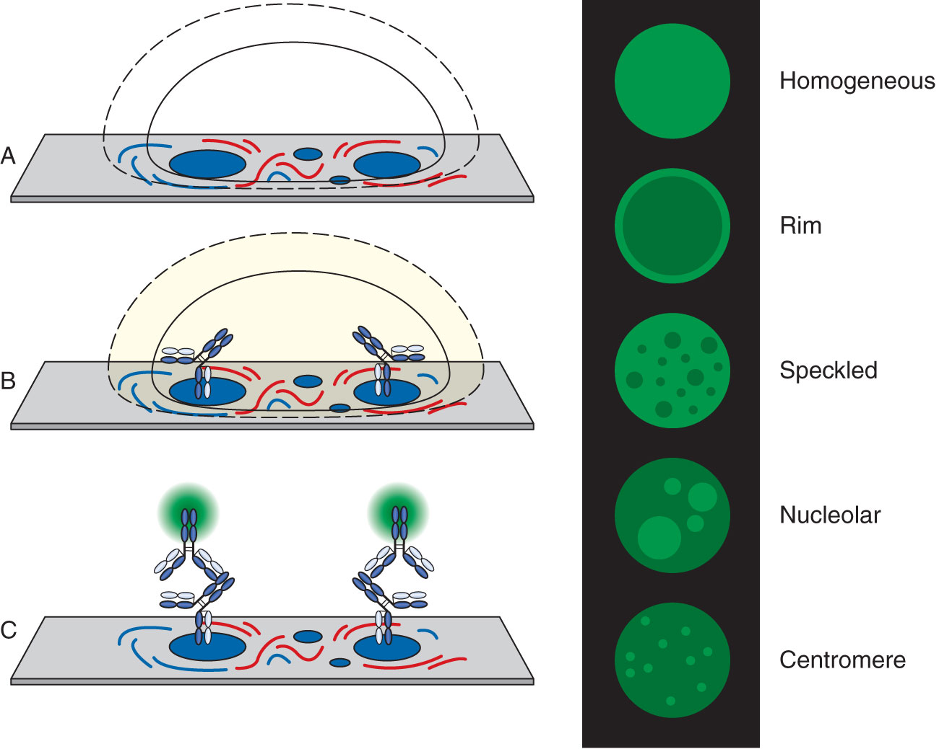
Fluorescent ANA Test Principle
Notes:
FANA is the most widely used and accepted test for anti-nuclear antibodies.
Incubate patient serum with microscope slide fixed with HEp-2 cells, wash, add fluorescent-labeled anti-human IgG, incubate and wash, read patterns under fluorescent microscope. In interphase cells:
Homogeneous (diffuse) pattern: uniform staining of entire nucleus; due to antibodies to dsDNA, histones, or DNP and seen in SLE, drug-induced lupus, and many other rheumatic autoimmune diseases.
Peripheral (rim, outline) pattern: diffuse staining of nucleus with greater intensity around circle surrounding the nucleus; due to antibodies to dsDNA and highly specific for SLE.
Speckled pattern: discrete fluorescent specks throughout the nuclei; due to anti-ENA and seen in patients with SLE, scleroderma, and other rheumatic autoimmune diseases.
Nucleolar pattern: a few large areas of fluorescence representing the nucleoli within the nuclei; due to antibodies to RNA and RNP and seen mainly in patients with scleroderma.
Centromere pattern: numerous discrete speckles (about 46) in the nuclei of each cell; due to antibodies to proteins in the centromeres of the chromosomes and seen mainly in patients with the CREST syndrome.

Slide 12
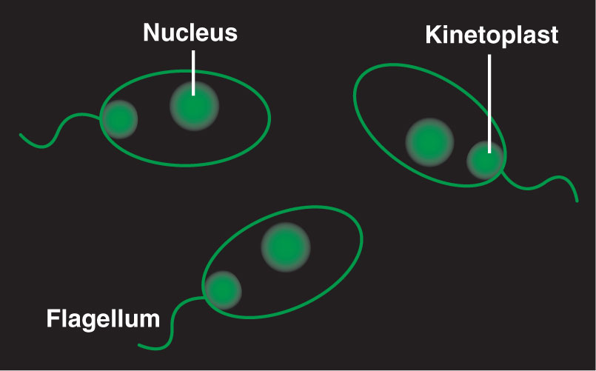
Immunofluorescence using Crithidia luciliae
An IIF using C. luciliae as the substrate
Contains a circular organelle called a kinetoplast (rich in ds DNA)
Used to detect antibodies to ds DNA

Slide 13
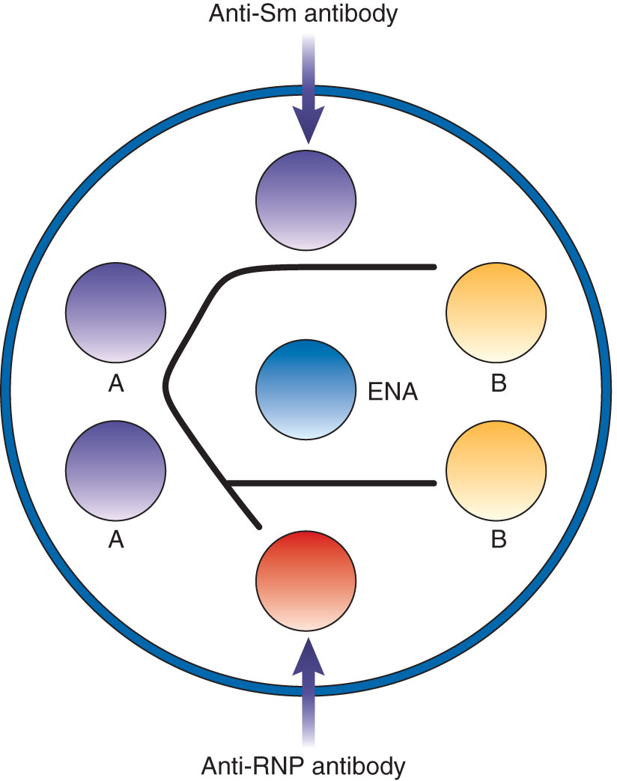
ENA Ouchterlony Test
Immunodiffusion test detects antibodies to specific ENA.
Patient serum or controls in outer wells react with ENA. antigens in center well
In this example, patient A has antibody to Sm.
Notes:
Patient A has anti-Sm because there is identity with the anti-Sm positive control. There is partial identity with the anti-RNP positive control because the center well contains free Sm antigen as well as Sm-RNP complexes, and both react with the anti-Sm in the patient serum

Slide 14
Phospholipid Antibodies
Found in approximately 60% of lupus patients
Associated with deep vein and arterial thrombosis
Increased risk of recurrent pregnancy loss
Can cause false-positive results in nontreponemal tests for syphilis
Example: the lupus anticoagulant (produces prolonged APTT and PT)
Notes:
APTT = activated partial thromboplastin time
PT = prothrombin time

Slide 15
Rheumatoid Arthritis (RA)
Chronic arthritis of the peripheral joints that can progress to joint deformity and disability
About 25% of patients have osteoporosis
Some patients also develop:
Subcutaneous nodules
Pericarditis
Interstitial lung disease
Vasculitis

Slide 16
Pathology and Treatment of RA
Inflammation destroys the bone and cartilage.
TNF-α plays a key role in the process.
Overly active osteoclasts absorb the bone.
Autoantibodies combine with antigens to form immune complexes.
Treatment:
NSAIDs
Disease-modifying anti-rheumatic drugs (DMARDs)
Biologic agents that target TNF-α
Notes:
Immune complexes form between autoantibodies produced in RA (e.g., RA and anti-CCP) and self antigens. These increase inflammation by causing type III hypersensitivity reactions.
DMARD such as methotrexate reduce inflammation and prevent disease progression.
Biologic agents that target TNF-a are (1) Monoclonal antibodies against TNF-α or (2) TNF-α receptors fused to an IgG molecule, which bind to circulating TNF-α.

Slide 17
Laboratory Testing for RA
Rheumatoid factor
Autoantibody (usually IgM) that reacts with Fc portion of IgG
Found in approximately 80% of patients with RA; not specific for RA
Anti-CCP
Autoantibody directed against cyclic citrullinated peptide (peptide containing a modified arginine)
Highly specific for RA
ANAs
ESR, CRP, C’
Notes:
Rheumatoid factor can also be found in patients with other connective tissue diseases like SLE, Sjögrens syndrome, scleroderma, and mixed connective tissue disease as well as people with some chronic infections.
Rheumatoid factor assays include latex agglutination, nephelometric methods, ELISA, and chemiluminescence immunoassay.
Citrulline is an atypical amino acid that is generated when peptidyl arginine deaminase modifies the amino acid, arginine, by replacing an NH2 group with a neutral oxygen. Anti-CCP assays are performed mainly by ELISA.
Antinuclear antibodies are found in approximately 40% of patients with RA, and are commonly directed against RNP, producing a speckled pattern in the FANA.
ESR, CRP, and C’ can be used as general indicators to monitor inflammation in patients with RA.

Slide 18
Granulomatosis with Polyangiitis (Wegner’s granulomatosis)
Rare autoimmune disease involving inflammation of small- to medium-sized blood vessels and respiratory tract
Progresses to more systemic disease involving other organs (e.g., kidneys, joints, skin)
Most patients have antibodies to neutrophil cytoplasmic antigens such as proteinase 3.
Neutrophil activation results in damage to vascular endothelium and a Th1 response.

Slide 19
Anti-Neutrophil Cytoplasmic Antibodies (ANCA)
Produced against proteins in neutrophil granules
Strongly associated with syndromes involving vascular inflammation
Detected by IIF on ethanol-fixed leukocytes, ELISA, or CLIA
Notes:
In the indirect immunofluorescence assay, patient serum is incubated with a microscope slide containing ethanol-fixed leukocytes. Following a wash step, a FITC-labeled anti-IgG conjugate is added. After a second incubation and wash, the slide is viewed under a fluorescent microscope for fluorescence in the neutrophils.
Two fluorescent patterns: Cytoplasmic (c-ANCA) and perinuclear (p-ANCA). Patients with GPA produce the c-ANCA pattern.
C-ANCA is caused by antibodies to proteinase 3 (PR3) and appears as diffuse, granular staining in the neutrophil cytoplasm. Staining is most intense in the center of the cell between the nuclear lobes.
In the p-ANCA pattern, fluorescence surrounds the nuclear lobes, blending them together. The antibodies responsible for this pattern are against positively-charged antigens such as myeloperoxidase (MPO) that migrate out of the granules toward the negatively charged nucleus.
P-ANCA can appear similar to a peripheral ANA pattern. To distinguish between these possibilities, one can: (1) Look for absence of staining in the lymphocytes, as seen with ANCA; (2) perform an ANA test on Hep-2 cells; (3) perform the IIF ANCA test on formalin-fixed leukocytes, which prevents migration of the antigens out of the granules, creating a cytoplasmic pattern of fluorescence; (4) perform another assay for ANCA, such as an ELISA for anti-PR-3.

Slide 20
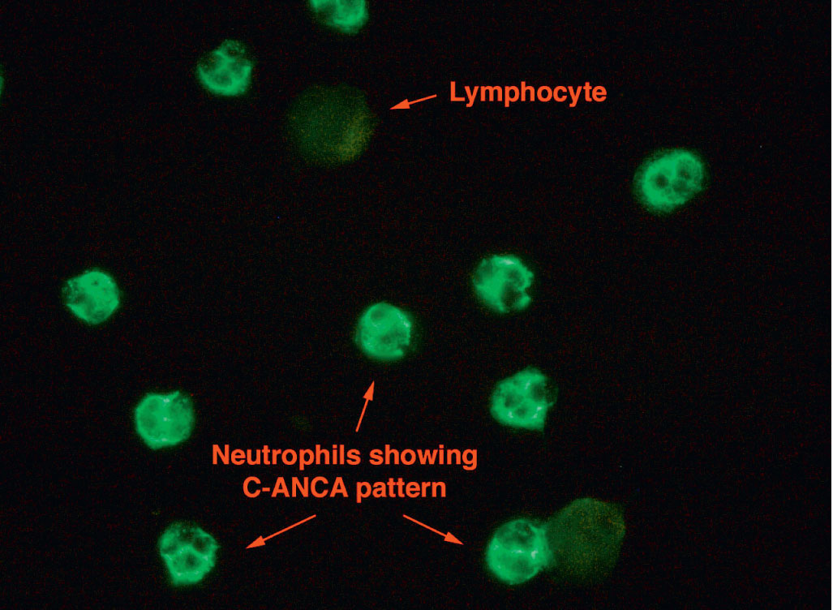
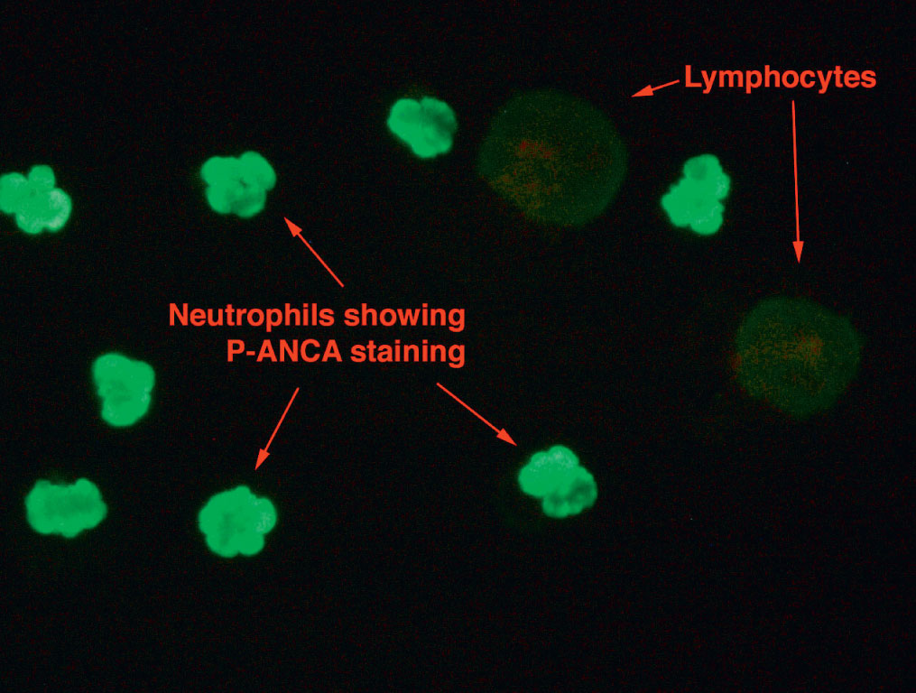
Anti-Neutrophil Cytoplasmic Antibodies (ANCA)
Notes:
In the indirect immunofluorescence assay, patient serum is incubated with a microscope slide containing ethanol-fixed leukocytes. Following a wash step, a FITC-labeled anti-IgG conjugate is added. After a second incubation and wash, the slide is viewed under a fluorescent microscope for fluorescence in the neutrophils.
Two fluorescent patterns: Cytoplasmic (c-ANCA) and perinuclear (p-ANCA). Patients with GPA produce the c-ANCA pattern.
C-ANCA is caused by antibodies to proteinase 3 (PR3) and appears as diffuse, granular staining in the neutrophil cytoplasm. Staining is most intense in the center of the cell between the nuclear lobes.
In the p-ANCA pattern, fluorescence surrounds the nuclear lobes, blending them together. The antibodies responsible for this pattern are against positively-charged antigens such as myeloperoxidase (MPO) that migrate out of the granules toward the negatively charged nucleus.
P-ANCA can appear similar to a peripheral ANA pattern. To distinguish between these possibilities, one can: (1) Look for absence of staining in the lymphocytes, as seen with ANCA; (2) perform an ANA test on Hep-2 cells; (3) perform the IIF ANCA test on formalin-fixed leukocytes, which prevents migration of the antigens out of the granules, creating a cytoplasmic pattern of fluorescence; (4) perform another assay for ANCA, such as an ELISA for anti-PR-3.

Slide 21
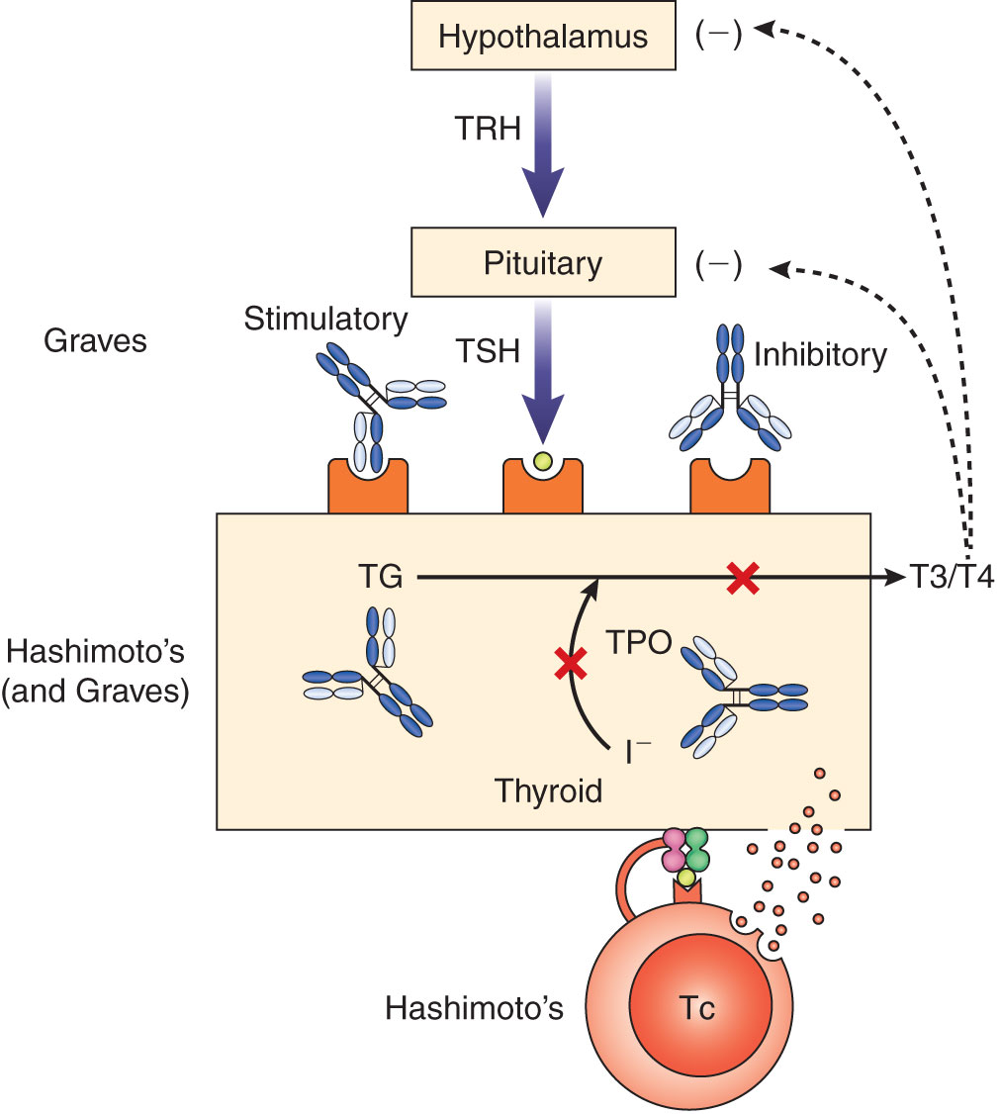
Autoimmune Thyroid Diseases (AITDS)
Thyroid hormone synthesis is carefully regulated by endocrine feedback loop.
Autoantibodies produced in AITDS can lead to decreased or increased production of thyroid hormones.
Notes:
Normally, the production of the hormones T3 and T4 by the thyroid gland is carefully regulated by a feedback loop called the thyroid axis.
The hypothalamus secretes thyrotropin-releasing hormone (TRH), which stimulates the pituitary gland to induce release of thyroid stimulating hormone (TSH). TSH stimulates the thyroid gland to produce T3 and T4 from the breakdown of thyroglobulin (TG). The enzyme, thyroid peroxidase (TPO) oxidizes the iodine ions that are incorporated into thyroglobulin. If the levels of T3 and T4 become too high, they inhibit release of TRH and TSH to decrease further thyroid hormone production.
In Graves disease, autoantibodies to TSH increase thyroid hormone synthesis by bypassing the thyroid axis.
In Hashimoto’s disease, autoantibodies to TG and TPO lead to a decrease thyroid hormone synthesis. Cytotoxic T cells can also damage the thyroid gland.

Slide 22
Hashimoto’s Thyroiditis
Immune destruction of the thyroid gland produces hypothyroidism
Symptoms include fatigue, dry skin, weight gain, brittle hair, formation of a goiter
Laboratory Results:
Normal or high TSH
Low Free T4
Anti-TPO
Anti-Tg
Notes:
Hashimoto’s is the most common autoimmune disease; it is mostly seen in middle-aged women.
Goiter= an enlarged thyroid gland; in this disease, it is irregular and rubbery.
Immune destruction occurs by CTL damage to thyroid cells and production of autoantibodies that induce inflammation by binding C’
FT4 = Free T4, unbound to protein
Anti-TPO is the best indicator of Hashimoto’s disease. Anti-Tg are less sensitive and specific, as they are found in fewer Hashimotos’ patients, and in healthy persons as well.

Slide 23
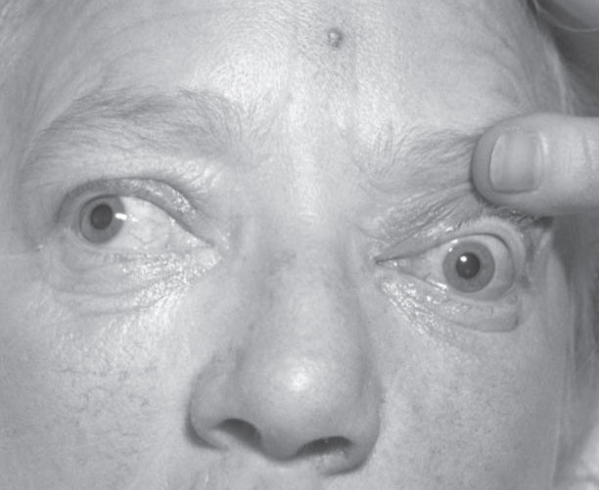
Graves Disease
An AITDS characterized by hyperthyroidism
Symptoms: nervousness, weight loss, rapid heart beat, goiter, exophthalmos
TRAbs produced
Low TSH and high FT4; antibodies to TPO and Tg
Notes:
Presents most often in women in their 50s and 60s.
Goiter in Grave’s disease is firm.
Exophthalmos = Hypertrophy of the eye muscles that causes the eyeball to bulge out. Orbital fibroblasts express TSH receptors that bind TSH.
TRAbs = Autoantibodies to thyroid stimulating hormone receptors. TRAbs bind to TSH receptors, mimicking the action of TSH on the thyroid gland, but since this bypasses the thyroid axis, excessive release of T3 and T4 results.
Presence of TRAbs is highly indicative of Graves disease. These antibodies can be detected by immunoassays or bioassays.

Slide 24
Type I Diabetes Mellitus (T1D)
Endocrine disorder characterized by hyperglycemia
Type 1 destruction of β cells in pancreas results in insulin deficiency
Long-term effects
Cardiovascular disease, kidney dysfunction, nerve damage, blindness, infections
Laboratory results
Increased glucose blood level
Elevated HbA1c
Autoantibodies to GAD and IA-2, ICA
Notes:
Hyperglycemia = high level of glucose in the blood
Type 1 is to be contrasted with Type 2, in which patients develop a resistance to insulin due to obesity or other factors. Type 1 was previously known as juvenile onset diabetes because it usually develops in children or young adults before the age of 30.
Insulin works by promoting absorption of glucose by skeletal muscles or fat tissue so it can be converted into energy.
Destruction of beta cells occurs via a Th1 response, release of cytokines, and inflammation. Autoantibodies can effect the regulation of pathways needed for insulin secretion.
Treatment = Daily insulin injections to control the level of blood glucose. Experimental treatments include immunosuppressive drugs, biologic agents, and transplantation of pancreatic beta islet cells or stem cells.
HbA1c = Hemoglobin A1c, a glycolated form of Hemoglobin made when the protein combines with glucose. The HbA1c level correlates with the average plasma glucose concentration over the previous 2 to 3 months
GAD = Glutamic acid decarboxylase-65 antigen; IA-2 = insulinoma antigen 2; ICA = islet cell antibodies. These antibodies can be tested for to confirm a suspected diagnosis of T1D in patients with elevated glucose and HbA1c levels.

Slide 25
Celiac Disease
Affects small intestine and other organs
Triggered by gluten
Autoantibodies form in HLA-DQ2 or HLA-DQ8- positive people to:
Gliadin (a component of gluten) and DGPs
Tissue transglutaminase (tTG) [IgA]*
Endomysium (EMA)
Symptoms
Diarrhea, abdominal pain and bloating, others
Treatment: follow a gluten-free diet
Notes:
Gluten is a protein complex found in wheat, barley and rye.
Gliadin is a component of gluten that is resistant to digestive enzymes in the stomach, pancreas, and small intestine. Undigested gliadin can trigger an autoimmune response if it passes through the epithelial barrier of the intestine.
tTG is an intestinal enzyme that converts the glutamine residues in gliadin to glutamic acid.
Celiac disease only occurs in people who are positive for HLA-DQ2 or HLA-DQ8, likely due to the way that the APCs process the gliadin peptides. CD4 T cells then produce cytokines that trigger an inflammatory response in the intestinal mucosa. HLA testing can be useful in excluding a diagnosis of celiac disease in individuals who do not possess HLA-DQ2 or HLA-DQ8.
Symptoms vary with age. Adults and older children or teens may also experience unclassic symptoms such as arthritis, neurologic symptoms, iron deficiency anemia, skin manifestations.
*Detection of IgA antibodies to tTG is the screening test of choice because it is highly sensitive and specific for celiac disease.
Serologic testing for gliadin antibodies was the first test developed but is not used commonly today because it is not specific. More recently, tests for deaminated gliadin peptides (DGPs) have been developed and are very sensitive in young children.
Tests for endomysial antibodies (EMA), which are directed against the layer of connective tissue surrounding the intestinal muscles), are very specific for celiac, but are costly IIFs.
Biopsy of the small intestine should be performed to confirm the diagnosis.

Slide 26
Autoimmune Liver Diseases
Immune-mediated liver diseases that can lead to end-stage liver failure if untreated
Clinical features: elevated liver enzymes, fatigue, nausea and vomiting, abdominal pain, itchy skin, jaundice
Autoimmune hepatitis (AIH)
Hepatocytes targeted
AIH-1- Positive for SMA, ANAs
AIH-2- Positive for LKM-1 or LC-1 antibodies
Primary biliary cirrhosis (PBC)
Destruction of intrahepatic bile ducts; cholestasis
Majority of patients produce mitochondrial Abs (AMAs)
Notes:
AIH formerly known as chronic active hepatitis. Two types: AIH-1 (2/3 of cases) and AIH-2 (seen mostly in female children)
SMA = smooth muscle antibodies; directed against actin or other components of the cytoskeleton and detected by IIF on rodent kidney, stomach or liver sections.
LKM-1 = liver-kidney microsomal antigens; LC-1 = liver cytosol type 1
Cholestasis - bile flow slowed or blocked
AMA = anti-mitochrondrial antibodies; detected by IIF on mitochondria-rich tissue substrates like rodent liver, kidney or stomach sections.

Slide 27
Multiple Sclerosis (MS)
This autoimmune disorder involves inflammation and destruction of the central nervous system.
Most patients produce antibodies against myelin basic protein.
Plaques form in white matter of brain and spinal cord, causing destruction of myelin sheath of axons.
Symptoms include visual disturbances, weakness in limbs, dizziness, sensory abnormalities.
Laboratory findings
Lesions seen on magnetic resonance imaging
Increased immunoglobulins in spinal fluid and increased IgG index
Oligoclonal bands on protein electrophoresis of CSF
Notes:
CSF = cerebrospinal fluid
Oligoclonal = Two or more distinct bands
IgG index = ratio of CSF IgG/albumin to serum IgG/albumin

Slide 28
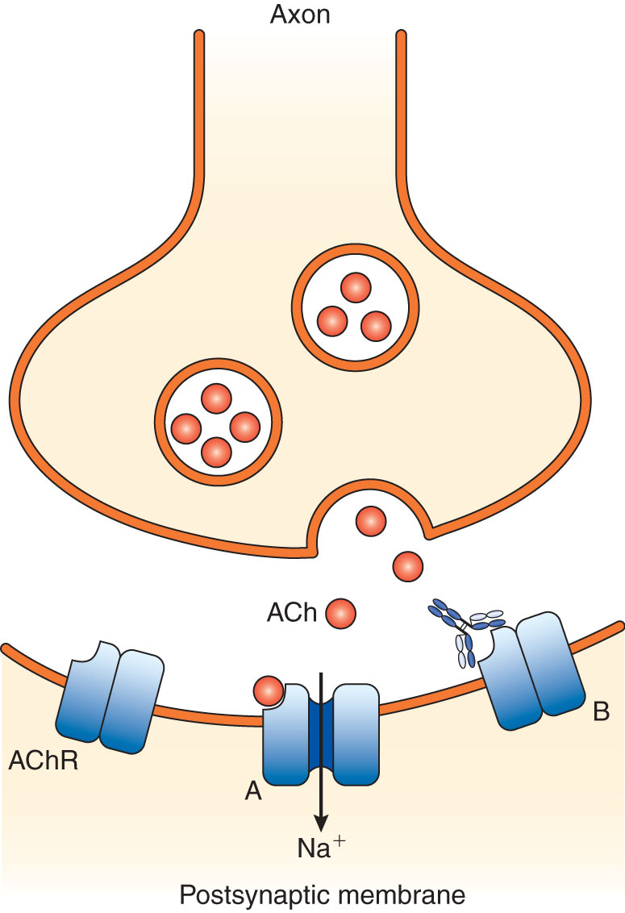
Myasthenia Gravis
Affects neuromuscular junction, resulting in weak skeletal muscles
Most patients have antibodies to ACHR
Block binding of ACH to its receptor and transmission of nerve impulses that activate muscles
Notes:
Symptoms include drooping of eyelids, double vision, inability to retract corners of mouth, muscle weakness especially in upper limbs, difficulty speaking and swallowing, inability to support head and trunk; can progress to affect respiratory muscles
ACHR = acetylcholine receptors; receptors on muscle cells that bind acetylcholine released from nerve endings, to cause muscle contraction.
Antibodies to ACHR traditionally detected by radioimmunoprecipitation, and more recently by ELISA or FIPA
A small percentage of patients produce antibodies to MuSK (muscle-specific kinase) or LRP4 (a lipoprotein)
Some patients develop a thymoma that contains autoreactive T cells.

Slide 29
Goodpasture’s Syndrome
Patients produce autoantibodies to basement membranes lining the renal glomeruli and lung alveoli (specifically directed against alpha-3 chain of type IV collagen).
Immune complexes bind to basement membranes, attract C’, and cause damage by Type II hypersensitivity.
Syndrome can progress to renal failure and respiratory problems (cough, shortness of breath, hemoptysis).
Antibodies to GBM found in most patients
Detected by IIF on frozen kidney sections or ELISA for antibody to α-3 subunit
Tissue-bound anti-GBM detected by direct immunofluorescence on kidney biopsy sections; produces a smooth, linear, ribbon-like fluorescence along the GBM
Notes:
GBM = glomerular basement membrane

Slide 30
Summary
Autoimmunity results from loss of central or peripheral tolerance.
Exposure to environmental factors (e.g., infections, tissue injury) may trigger development of autoimmune disease in genetically susceptible individuals.
Systemic autoimmune diseases include SLE, RA, and GPA.
Most patients with rheumatic autoimmune diseases such as lupus produce ANAs.
The gold standard in ANA testing is an IIF using HEp-2 cells.
Major patterns of fluorescence are homogeneous, peripheral, speckled, nucleolar, and centromere.
These patterns are produced by specific types of ANAs.

Slide 31
Summary
Rheumatoid factor is an autoantibody directed against the Fc portion of IgG, which is found in most RA patients and in many patients with other connective tissue autoimmune diseases.
ANCAs:
are associated with autoimmune syndromes involving vasculitis, such as GPA.
produce either a cytoplasmic (c-ANCA; seen in GPA) or perinuclear (p-ANCA) pattern of fluorescence in an IIF using ethanol-fixed leukocytes.

Slide 32
Summary
Organ-specific autoimmune diseases and their characteristic autoantibodies include:
Autoimmune hepatitis (smooth muscle)
Celiac disease (tTG, gliadin peptides, endomysium)
Goodpasture’s syndrome (GBM)
Graves disease (TSH receptor)
Hashimoto’s thyroiditis (TPO, Tg)
Multiple sclerosis (myelin basic membrane)
Myasthenia gravis (acetylcholine receptors)
Primary biliary cirrhosis (mitochondria)
Type I diabetes (pancreatic islet cells, IA-2, GAD)

