Slide 1
Part XIII
Tumor Immunology

Slide 2
Chapter Overview
Tumor biology
Tumor antigens
Clinically relevant tumor markers
Laboratory tests for tumors
Immune defenses against tumors
Immunoediting and tumor escape
Immunotherapy

Slide 3
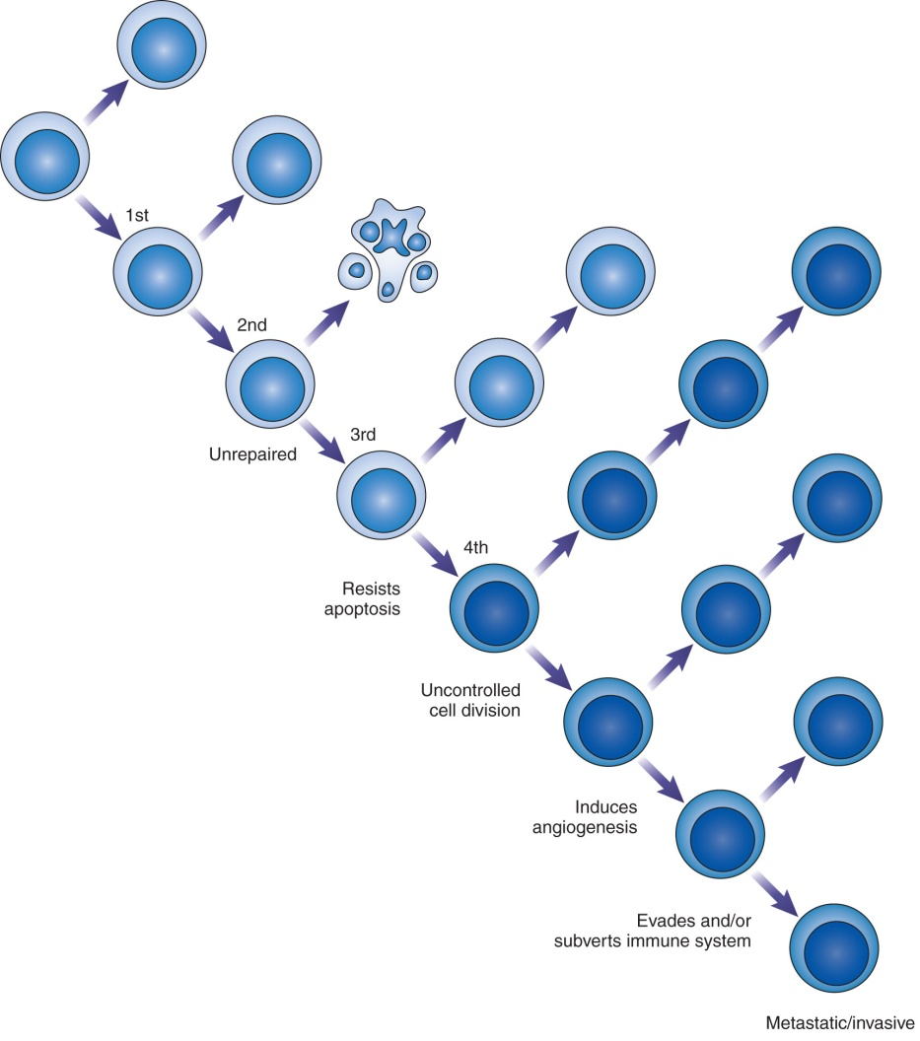
Introduction to Tumor Biology
Tumor (neoplasm) = an abnormal cell mass
Benign or malignant
Cancer = malignant tumor that can spread
Caused by mutations in proto-oncogenes and tumor-suppressor genes
Uncontrolled cell division and other characteristics
Notes:
Proto-oncogenes = normal genes that are necessary for cell proliferation and development. Mutations in proto-oncogenes can convert them into oncogene-like genes, resulting in continuous cell division.
Tumor-suppressor genes = normal genes that regulate the cell cycle and control cell division.
Cancer results from a series of mutations in proto-oncogenes and oncogenes that change the characteristics of the cells.

Slide 4
Characteristics of Cancer Cells
Sustained proliferation
Resist death
Induce angiogenesis
Immortality
Invasion and metastasis
Avoid suppressors of cell growth
Altered metabolism
Evasion of immune defenses
Genomic instability
Accelerated growth in presence of inflammation
Notes:
Classic characteristics of cancer cells defined by Hanahan and Weinberg in 2000 and 2011.

Slide 5
Tumor-Specific Antigens (TSAs)
Unique to the tumor
Coded by mutated proto-oncogenes or tumor-suppressor genes
Examples
BCR/ABL gene rearrangement in CML
Antigens coded for by cancer-causing viruses (e.g., EBV, HPV, HTLV-I)
Notes:
Tumor immunology is based on the concept that tumors possess antigens that are recognized as foreign by the immune system.
These antigens can be broadly classified as tumor-specific and tumor-associated antigens.
TSAs are unique to the tumor of an individual patient or are shared by a limited number of patients with the same type of tumor.
In the majority of CML patients, there is a rearrangement known as the Philadelphia chromosome that involves combination of the breakage cluster region (BCR) on chromosome 9 and the c-ABL gene on chromosome 22. This hybrid gene produces a fusion protein that results in uncontrolled cell proliferation.

Slide 6
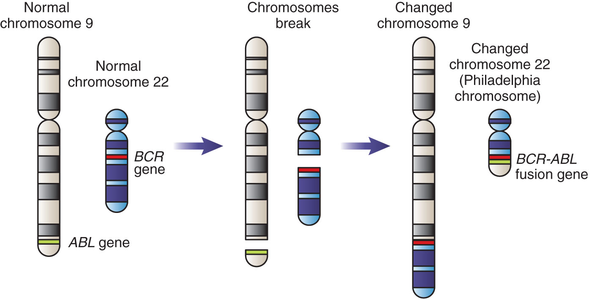
Tumor-Specific Antigens (TSAs)
Notes:
Tumor immunology is based on the concept that tumors possess antigens that are recognized as foreign by the immune system.
These antigens can be broadly classified as tumor-specific and tumor-associated antigens.
TSAs are unique to the tumor of an individual patient or are shared by a limited number of patients with the same type of tumor.
In the majority of CML patients, there is a rearrangement known as the Philadelphia chromosome that involves combination of the breakage cluster region (BCR) on chromosome 9 and the c-ABL gene on chromosome 22. This hybrid gene produces a fusion protein that results in uncontrolled cell proliferation.

Slide 7
Tumor-Associated Antigens (TAAs)
Expressed in tumor cells and normal cells
Shared tumor-specific antigens
On many tumors but not most normal tissues
e.g., MAGE proteins on melanoma tumors
Differentiation antigens
On immature cells of a particular lineage
e.g., CD10 (CALLA), CEA, AFP, PSA
Overexpressed antigens
Found in higher levels on malignant cells
e.g., HER2, CA- 125, CA 19-9
Notes:
CD10, previously known as the common acute lymphoblastic leukemia antigen (CALLA), is a marker for the pre-B cells in ALL.
HER2 = human epidermal growth factor receptor-2; amplified in a certain type of breast cancer.
CEA = carcinoembryonic antigen.
AFP = alpha-fetoprotein.
PSA = prostate-specific antigen.
CEA, AFP, and PSA are oncofetal antigens, which are normally expressed on cells of the fetus but not the adult.

Slide 8
Clinically Relevant Tumor Markers
Biologic substances found in increased amounts in blood, body fluids, or tissues of patients with a specific type of cancer
Concentration in serum depends on amount of tumor proliferation and tumor size
Elevated level indicates significant tumor mass
Notes:
Concentration of serum tumor marker also depends on proteolytic activities of tumor and release of the marker from dying tumor cells.

Slide 9
Clinical Uses of Tumor Markers
Population screening
To identify cancer in asymptomatic people (e.g., PSA)
May detect cancer at an early stage but can get false-positive or false-negative results
Diagnosis
Identifies cancer in a particular patient (e.g., PSA)
Patient prognosis
Predicts clinical outcome and aids in selection of therapy (e.g., HER2 in breast cancer)

Slide 10
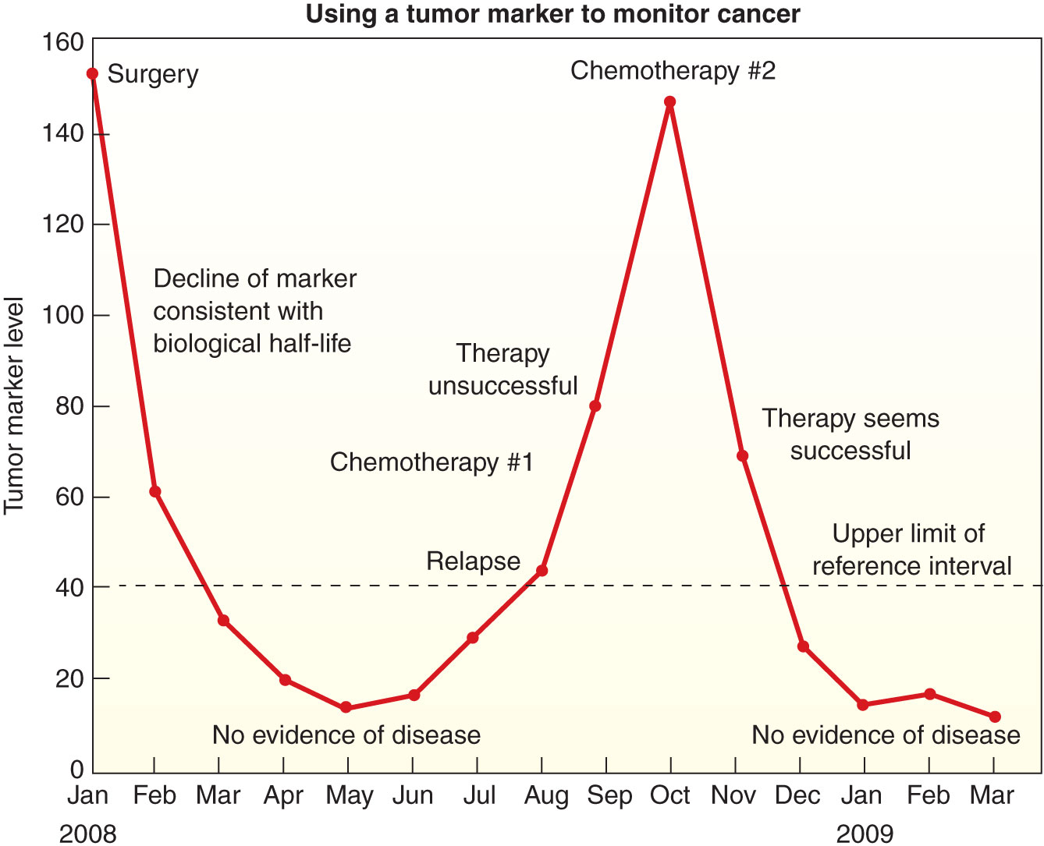
Clinical Uses of Tumor Markers
Monitoring response of cancer patient to therapy (e.g., CA 125)
Decreasing levels over time suggest effective treatment
Increasing levels indicate ineffective treatment or tumor recurrence
Notes:
CA 125 = cancer antigen 125

Slide 11
Common Serum Tumor Markers
Marker | Cancer(s) | Uses
AFP | Liver, testicular | S, D, P, M
CA 125 | Ovarian | S, D, P, M
CA 19-9 | Pancreatic | D, P, M
CEA | Colorectal, breast | P, M
hCG | Testicular, trophoblastic | D, P, M
PSA | Prostate | S, D, P, M
Notes:
S = screening.
D= diagnosis.
P = prognosis.
M = monitoring.
hCG = Human chorionic gonadotropin.

Slide 12
Laboratory Tests for Tumors
Immunohistochemistry
Uses labeled antibodies to detect tumor antigens in tissue biopsies
Immunoassays
Measure levels of circulating tumor markers
Molecular methods
Detect genetic mutations associated with cancer
e.g., PCR, FISH, microarray, DNA sequencing
Proteomics
Detects protein profile of a tumor population
e.g., antibody arrays
Notes:
FISH = fluorescent in situ hybridization.
PCR = polymerase chain reaction.

Slide 13
Immunoassays for Serum Tumor Markers
Sensitive, automated
Factors to consider:
Reagents may vary
Cross-reactivity can produce false positives
Antigen excess can produce false decrease (high-dose hook effect)
Interference by heterophile, anti-animal, or autoantibodies
Notes:
Heterophile antibodies in patient serum can result in false decreases or false increases. The figure shows a false increase resulting from the ability of the heterophile antibody to link the capture antibodies bound to the well to the labeled detection antibodies.

Slide 14
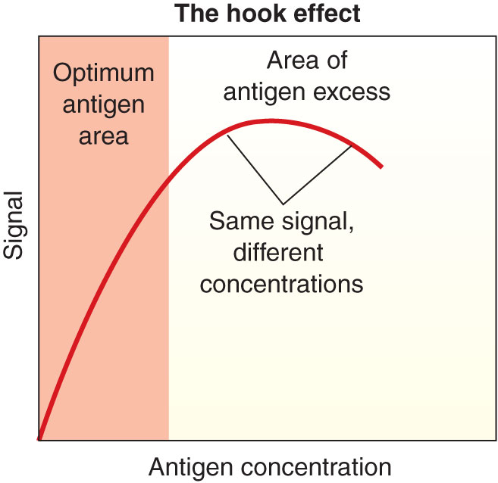
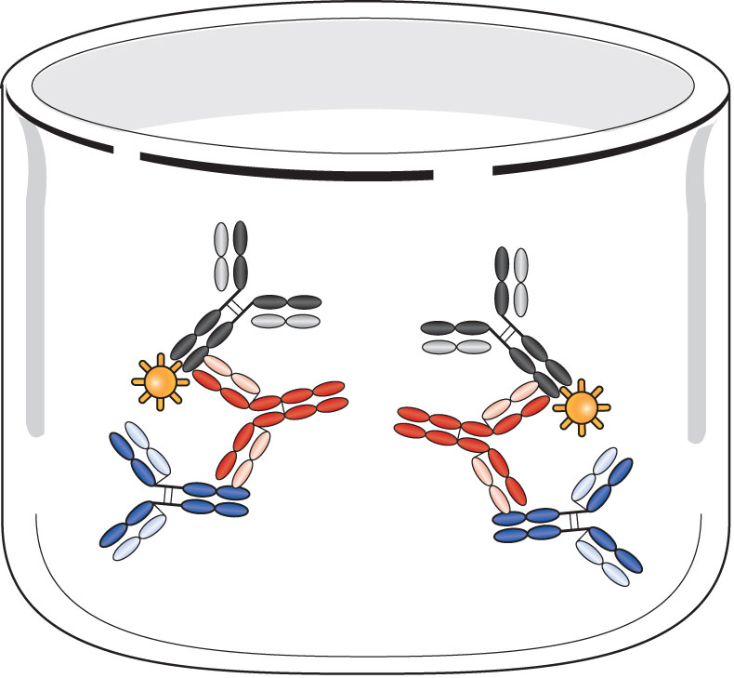
Immunoassays for Serum Tumor Markers
Notes:
Heterophile antibodies in patient serum can result in false decreases or false increases. The figure shows a false increase resulting from the ability of the heterophile antibody to link the capture antibodies bound to the well to the labeled detection antibodies.

Slide 15
Immune Defenses Against Tumor Cells
Immunosurveillance
Immune system patrols the body for cancer cells and destroys them before they become clinically evident
Innate defenses
NK cells, macrophages
Adaptive immune responses
CTLs, dendritic cells, cytokines, antibodies
Notes:
The theory of immunosurveillance was originally proposed by F. MacFarlane Burnet and Lewis Thomas in 1950s; it illustrates the importance of the immune system in defending the body against tumors.
NK= natural killer.
CTLs = cytotoxic T cells.

Slide 16
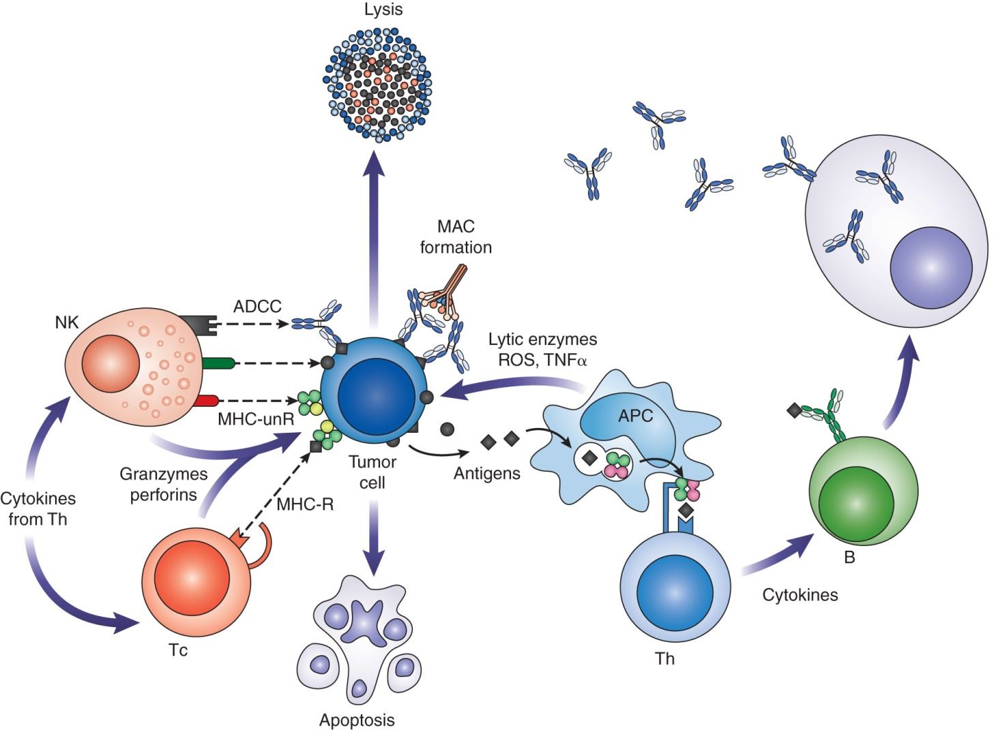
Immune Defenses Against Tumor Cells
Notes:
The immune defenses thought to play a role in defense against tumors are the same defenses involved in attacking pathogenic microbes. The various mechanisms are summarized in this figure. The cells of the immune system recognize tumor antigens or stress molecules on the tumor cell surface.

Slide 17
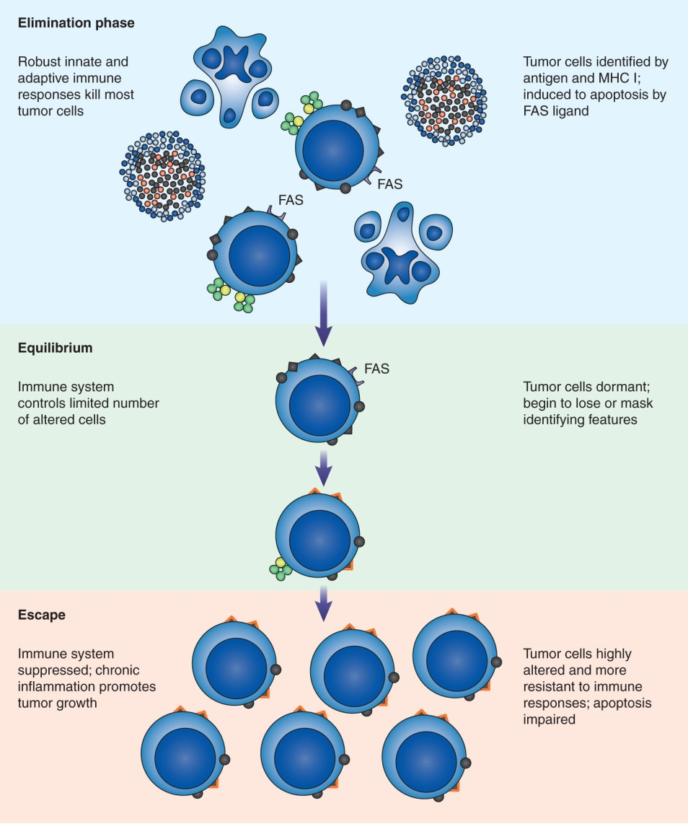
Relationship Between Immune System and Cancer
Notes:
Tumor cells may escape immune defenses and grow to form a clinically significant mass.
The relationship between the immune system and cancer is complex and has been explained as a process that consists of three phases:
1. Elimination (the same as immunosurveillance)
2. Equilibrium: some tumor cells escape the immunosurveillance mechanisms and may remain dormant or evolve slowly over time.
3. Escape: immunoediting has altered the phenotype of the cells, leading to reduced immunogenicity, masking of tumor antigens, resistance to immune defenses or suppression of immune defenses; development of such changes is enhanced in the inflammatory microenvironment of the tumor and promotes tumor growth.

Slide 18
Immunotherapy
Also known as biologic response modifier therapy
Uses ability of the immune system to destroy tumor cells
Active immunotherapy
Stimulates patient’s immune system to respond to tumor antigens
Nonspecific stimulation: Coley’s toxins, BCG
Cancer vaccines: preventative (HPV, HBV) or therapeutic (TSA-specific, Provenge)
Notes:
HPV = human papilloma virus.
HBV = hepatitis B virus.
Coley’s toxins were developed by Dr. William Coley in 1891 and consisted of a mixture of killed bacteria.
The vaccine for HPV is used to prevent cervical cancer. The vaccine for the HBV is used to prevent liver cancer caused by the virus.
Provenge is an FDA-approved vaccine for advanced prostate cancer. It uses patient immune cells stimulated by a fusion protein consisting of the prostatic acid phosphatase antigen and the cytokine GM-CSF to activate dendritic and T cells.

Slide 19
Passive Immunotherapy
Administration of soluble components of the immune system
Cytokines to nonspecifically boost the immune response and increase white blood cell production
e.g., GM-CSF, IL-2, IFN-α

Slide 20
Passive Immunotherapy
Monoclonal antibodies that target specific tumor antigens:
Surface antigens
Receptors
Angiogenesis factors
Molecules that block T-cell activation
Antibody–drug conjugates
Notes:
Monoclonal antibodies to cell surface antigens may destroy tumor cells by opsonization, C’ activation, or ADCC.
Monoclonal antibodies to cell surface receptors block signaling pathways for cell proliferation and survival.
Monoclonal antibodies to angiogenesis factors inhibit formation of blood vessels to the tumor.
Monoclonal antibodies to molecules such as CTLA-4 prevent inhibition of T-cell responses that could destroy the tumor.
Immunotoxins consist of a monoclonal antibody to a TSA conjugated to a potent toxic molecule, which would be delivered directly to the tumor cells.

Slide 21
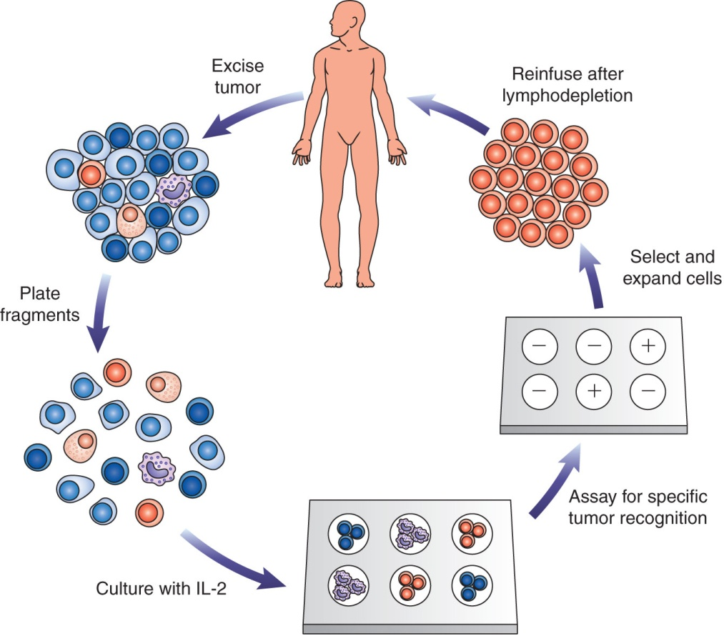
Adoptive Immunotherapy
Transfer of cells of immune system
TILs to melanoma patients
Genetically engineered T cells
Notes:
In the figure, TILs (tumor-infiltrating lymphocytes) are obtained from a tumor that has been surgically removed from a patient and subcultured. The cultures are individually tested for reactivity to the tumor, and only those cultures that show potent anti-tumor activity are selected for further expansion and infusion into the patient.

Slide 22
Summary
Development of a malignant tumor (cancer) results from exposure to environmental factors that induce mutations in proto-oncogenes and tumor-suppressor genes
Tumor cells possess altered properties, such as resistance to apoptosis, unregulated proliferation, invasion of nearby and distant tissues, genomic instability, and resistance to immune defenses
Immune cells recognize altered antigens on the tumor cell surface; these antigens can be tumor specific or tumor associated

Slide 23
Summary
The immune defenses that destroy tumor cells are the same mechanisms that attack pathogens
Innate defenses involve NK cells and macrophages
Adaptive defenses against tumors involve cytotoxic T cells, dendritic cells, and antibodies
Through immunosurveillance, the immune system can recognize and destroy tumor cells before they become clinically evident

Slide 24
Summary
Tumor cells can undergo genetic changes that allow them to change their phenotype to become less immunogenic (immunoediting); they can progress from a state of equilibrium to being able to escape immune defenses
Some tumor antigens circulate in the serum and can be used in cancer screening, diagnosis, prognosis, and patient monitoring; examples include AFP, CA 19-9, CA 125, CEA, hCG and PSA

Slide 25
Summary
Serum tumor markers are most often detected by sensitive, automated immunoassays; however, false positives can be caused by cross-reactivity or interference by heterophile antibodies, and false decreases can result from antigen excess
Immunotherapy harnesses the ability of the immune system to destroy tumors
Immunotherapy can be active (e.g., cancer vaccines), passive (e.g., cytokines and monoclonal antibodies), or adoptive (e.g., infusion of TILs).

