Slide 1
Part XV
Immunoproliferative Diseases

Slide 2
Chapter Overview
Intro to immunoproliferative diseases
Classification of hematologic malignancies
Leukemias
Lymphomas
Plasma cell dyscrasias
Related laboratory testing

Slide 3
Introduction to Immunoproliferative Diseases
Malignancies involving lymphoid cells
Leukemias
Malignant cells in bone marrow and peripheral blood
Lymphomas
Malignant cells arise in lymphoid tissues (e.g., lymph nodes, tonsils, spleen)
Plasma cell dyscrasias
Malignant or premalignant conditions of the plasma cells
Notes:
There can be overlap between the sites in the body affected by leukemias and lymphomas.

Slide 4
Classification of Hematologic Malignancies
WHO classification is the most widely accepted system
The system is based on:
Cell lineage
Immunologic markers
Genetic features
Morphology and cytochemical staining

Slide 5
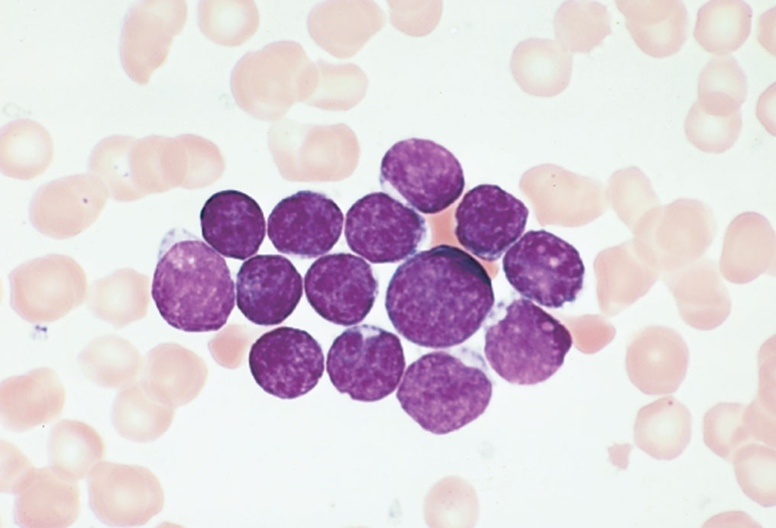
Acute Lymphocytic Leukemia (ALL)
Poorly differentiated lymphoid precursor cells (blasts) in bone marrow and peripheral blood
Pre-B-cell ALL expressing CALLA
Most common type of ALL
Positive for CD10
Most common genetic marker is TEL-AML-1 [t(12:21)(p13;q22)]
Hyperdiploidy associated with a good prognosis
Pre-B cell ALL without CALLA
T-cell ALL
Mature B-cell ALL (rare)
Notes:
CALLA = common acute lymphoblastic leukemia-associated antigen = CD10.
TEL-AML-1 is a translocation involving chromosomes 12 and 21. It is associated with an excellent prognosis in children.
Hyperdiploidy = more than the diploid number of chromosomes.

Slide 6
Chronic Lymphocytic Leukemia (CLL)
Most common leukemia in adults
Involves small, mature lymphocytes
Almost always of B-cell origin
Positive for CD19 and weakly expresses CD20

Slide 7
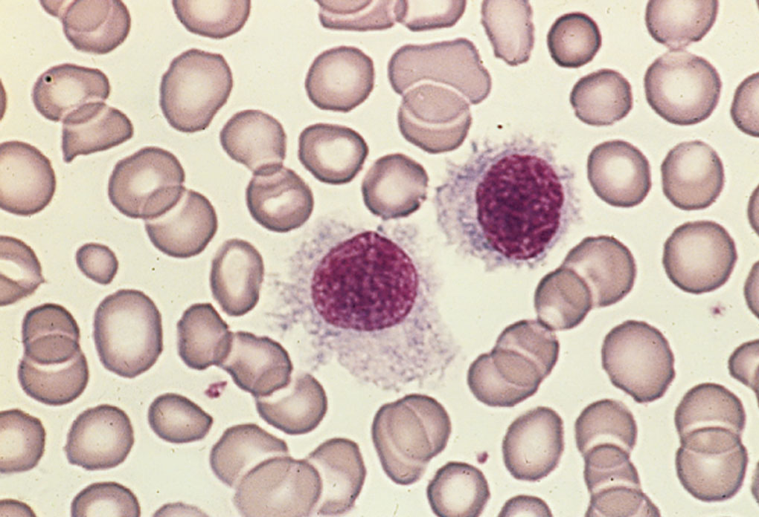
Hairy Cell Leukemia
Malignant lymphocytes with irregular cyto-plasmic projections
Mature B-cell neoplasm
Positive for CD19, CD20, CD22
CD103 = highly specific marker

Slide 8
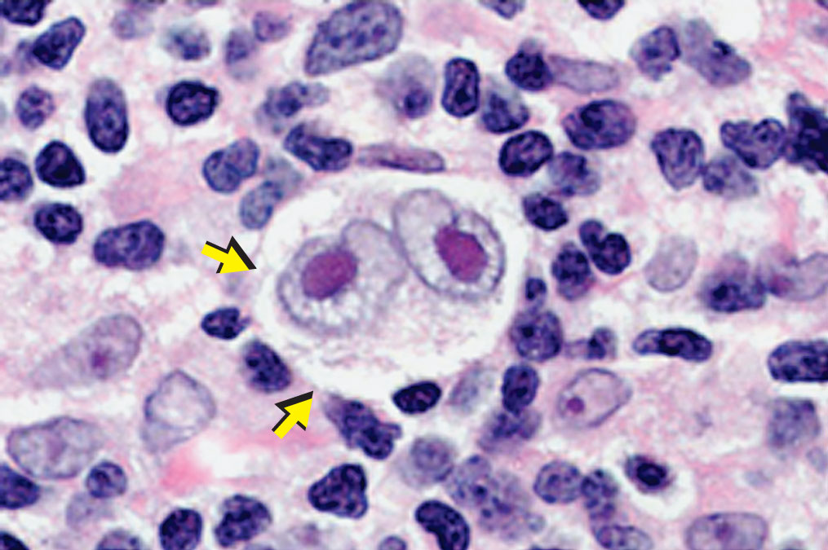
Hodgkin Lymphoma (HL)
Classic HL
Hodgkin and Reed-Sternberg (RS) cells in lymph nodes and other lymphoid organs
Positive for CD30 and mostly positive for CD15; CD20 weak or absent
Four subtypes
NLPHL
Large lymphocyte-predominant cells
Expresses CD19 and CD20
Notes:
NLPHL = nodular lymphocytic-predominant HL.
RS cells are large and have a bilobed nucleus with two prominent nucleoli (appear like “owl’s eyes”).
Hodgkin cells resemble RS cells except that nuclei are not bilobed and have a single nucleolus.
The four subtypes of classic HL are nodular sclerosis (most common subtype), mixed cellularity, lymphocyte rich, and lymphocyte depleted.

Slide 9
Non-Hodgkin Lymphoma (NHL)
Mostly in patients older than age 60 and associated with immunosuppression
Heterogeneous group of neoplasms
Most cases of B-cell origin (positive for surface Ig, CD19 or CD20, and rearranged Ig genes)
Small lymphocytic lymphoma/CLL
Follicular lymphomas
MALT lymphomas
Diffuse large B-cell lymphoma
Burkitt lymphoma
Mantle cell lymphoma
Lymphoblastic lymphoma
Some are T-cell or NK-cell lymphomas
Notes:
MALT = mucosa-associated lymphoid tissue.
NK = natural killer.

Slide 10
Plasma Cell Dyscrasias
Disorders involving an abnormal proliferation of the plasma cells
Also known as monoclonal gammopathies
Characterized by a clone of identical plasma cells and overproduction of a single immunoglobulin component (M protein or paraprotein)
Include MGUS, multiple myeloma, Waldenström macroglobulinemia, heavy chain diseases
Notes:
MGUS = monoclonal gammopathy of undetermined significance.

Slide 11
Monoclonal Gammopathy of Undetermined Significance
Premalignant condition
Present in 3% to 4% of people older than age 50
Production of a monoclonal Ig (low serum concentration, less than 3.0 g/dL)
Less than 10% bone marrow plasma cells
No clinical features of multiple myeloma
Approximately 1% of patients with MGUS will progress to multiple myeloma each year
Notes:
Clinical features of multiple myeloma are referred to as CRAB: increased serum calcium, renal failure, anemia, lytic bone lesions.

Slide 12
Multiple Myeloma
Malignancy of mature plasma cells
Plasma cells make up more than 10% of bone marrow
CD38+, CD56+, CD138+
Lytic bone lesions produce bone pain and hypercalcemia
Notes:
The malignant plasma cells (i.e., myeloma cells) progressively replace normal hematopoietic cells in the bone marrow, leading to anemia, thrombocytopenia, and neutropenia.
Lytic bone lesions are caused by increased osteoclast activity and decreased osteoblast activity of myeloma cells, leading to bone pain and fractures. As the bones break down, increased levels of calcium are released into the blood.

Slide 13
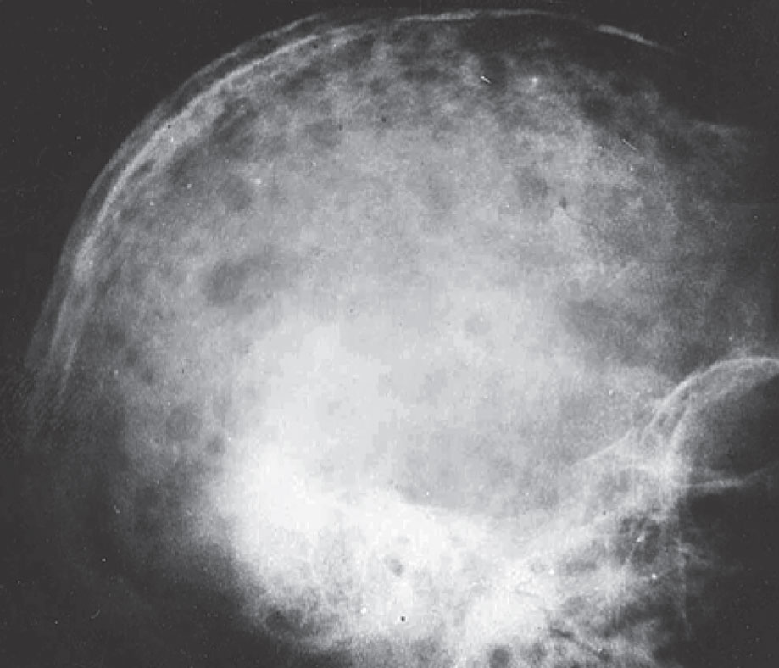
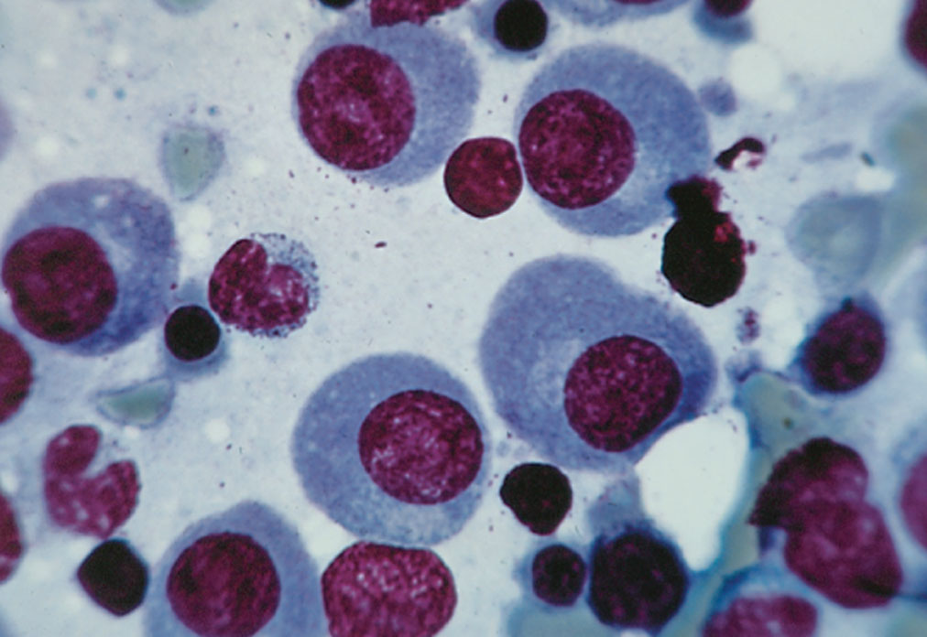
Multiple Myeloma
Notes:
The malignant plasma cells (i.e., myeloma cells) progressively replace normal hematopoietic cells in the bone marrow, leading to anemia, thrombocytopenia, and neutropenia.
Lytic bone lesions are caused by increased osteoclast activity and decreased osteoblast activity of myeloma cells, leading to bone pain and fractures. As the bones break down, increased levels of calcium are released into the blood.

Slide 14
Monoclonal Igs in Multiple Myeloma
Produced by clone of malignant plasma cells
Present in serum (greater than 3 g/dL) and/or urine
Monoclonal immunoglobulins:
IgG most common (about 50% of cases)
IgA
Light chains only (in urine, called Bence Jones proteins)
IgM, IgD, IgE rare
Notes:
High levels of monoclonal proteins can produce hyperviscosity and interfere with coagulation factors, leading to abnormal platelet aggregation and function.
Deposition of monoclonal proteins in the kidneys can lead to renal dysfunction.

Slide 15
Waldenström Macroglobulinemia
Malignant proliferation of IgM-producing B cells or plasma cells that infiltrate bone marrow, spleen, and lymph nodes
Also known as lymphoplasmacytic lymphoma
CD19+, CD20+, CD22+, CD79a+
Symptoms: fatigue, anemia, bleeding, plasma hyperviscosity, peripheral neuropathy

Slide 16
Waldenström Macroglobulinemia
Monoclonal IgM in serum
Bence Jones proteinuria in approximately 10% of cases
Cryoglobulins in approximately 20% of patients
Cold agglutinins in some patients
Notes:
In some patients, the monoclonal IgM behaves as a cryoglobulin (an Ig that precipitates upon exposure to cold temperatures and occludes small blood vessels in the extremities) or cold agglutinin (Ig against the I/i antigens of RBCs that can cause RBC agglutination or autoimmune hemolytic anemia).

Slide 17
Heavy Chain Diseases
Rare B-cell lymphomas characterized by production of free monoclonal heavy chains
Alpha heavy chain disease
Most common type
Seen mostly in Mediterranean region
Lymphoma that involves MALT (gastrointestinal, respiratory, or lymphomatous forms)
Gamma heavy chain disease
Disseminated and localized forms
Mu heavy chain disease
Most patients have a malignancy that resembles CLL
Notes:
Genetic mutations in affected B cells result in production of abnormal heavy chains that have a deletion and thus are unable to bind to Ig light chains.
The heavy chain diseases are classified according to the type of heavy chain produced.
MALT = mucosa-associated lymphoid tissue; GI tissues most commonly involved in alpha heavy chain disease.
Gamma chain disease: localized forms limited to bone marrow or areas outside of the lymph nodes, such as the skin.

Slide 18
Laboratory Evaluation of Immunoproliferative Diseases
Identification of malignant cell population
CBC and differential; cytochemical staining
Immunophenotyping by flow cytometry
Evaluation of immunoglobulins
Serum Ig levels
Serum protein electrophoresis
Immunofixation electrophoresis (serum and urine)
Immunosubtraction
Serum free light chain analysis
Assessment of gene and chromosome abnormalities
Cytogenetics
Molecular testing

Slide 19
Immunophenotyping by Flow Cytometry
Analyzes cell surface marker expression
Samples incubated with panels of fluorescent-labeled antibody reagents specific for cell surface markers
Examined by flow cytometry
Identifies lineage of malignant cell population by its immunophenotype
Abnormalities may be present (e.g., gain or loss of an antigen normally expressed by a cell type)
Notes:
Immunophenotype = the antigenic profile of a cell population (e.g., multiple myeloma cells are typically positive for CD38, CD56, and CD138).

Slide 20
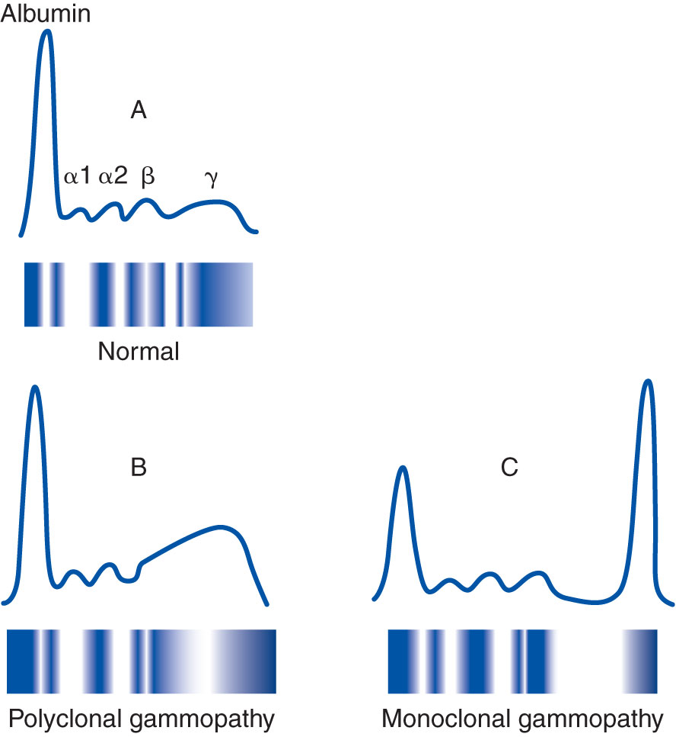
Serum Protein Electrophoresis (SPE)
Technique is used in initial identification of monoclonal Ig
Serum proteins are separated by size and charge
Most Igs migrate in gamma globulin region
Monoclonal Igs show limited mobility
Notes:
Serum proteins are separated by size and charge into five regions: albumin, alpha 1, alpha 2, beta, and gamma.
IgG, IgM, IgD, and IgE migrate to the gamma globulin region. IgA migrates as a broad band in the beta and gamma regions.
Polyclonal (normal) Igs show a range of mobilities because they are heterogeneous, being derived from many clones of plasma cells.
Monoclonal Igs have restricted mobility because they are homogeneous, being derived from a single clone of plasma cells.
Note the tall, narrow peak in the gamma region of panel C, which represents a monoclonal Ig (in contrast to the broad peaks seen in panels A and B).

Slide 21
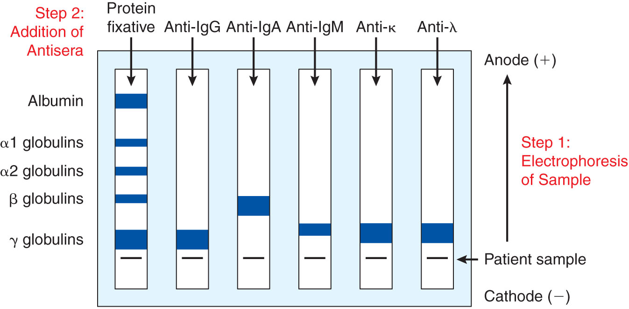
Immunofixation Electrophoresis (IFE)
Notes:
Note: the test can also be done on concentrated urine or CSF.
Electrophorese serum at pH 8.6.
Add antisera to each lane, stain, and view bands.
At pH 8.6, the proteins acquire a negative charge, migrate toward the positively charged anode, and separate into five distinct fractions as in SPE: albumin, alpha 1, alpha 2, beta, and gamma.
The antisera used are directed against the following: whole human serum (lane 1), anti-gamma (to detect IgG) (lane 2), anti-alpha (to detect IgA) (lane 3), anti-mu (to detect IgM) (lane 4), anti-kappa (to detect kappa light chains) (lane 5), anti-lambda (to detect lambda light chains) (lane 6). The antibodies combine with the Ig proteins in the sample to form complexes that precipitate to produce bands. The bands are visualized after treatment with a protein stain and a destaining step to remove background.

Slide 22
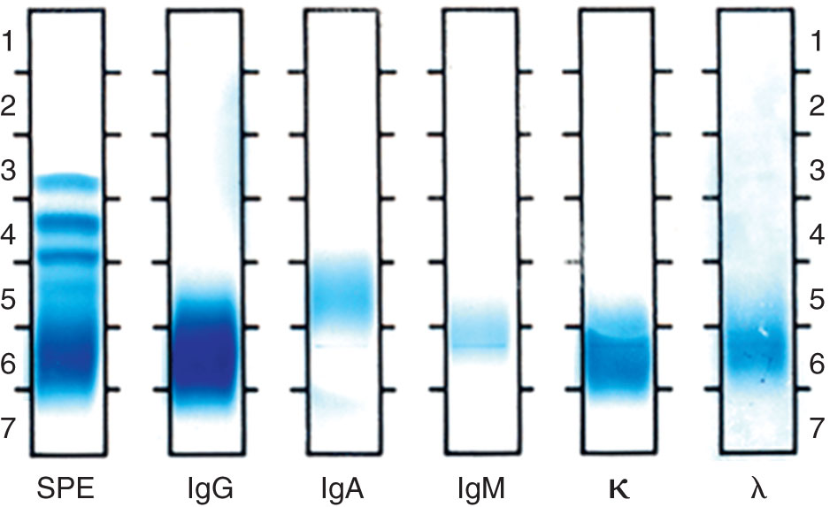
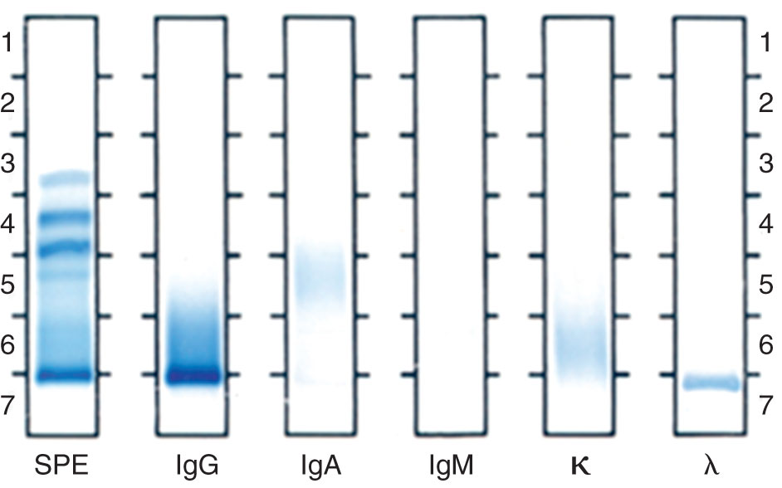
IFE Results: Normal Versus Monoclonal
Notes:
Figure on left represents normal polyclonal Igs. Note the broad, diffuse bands in all of the lanes.
Figure on right represents a monoclonal IgG, lambda antibody. Note the discrete, narrow bands in the IgG and lambda lanes. Such an antibody could be present in the serum of a multiple-myeloma patient.

Slide 23
Immunosubtraction (Immunotyping)
Technique uses capillary electrophoresis to identify monoclonal Ig
Antisera is added to patient serum
Binding of antisera to patient’s monoclonal Ig components changes electrophoretic mobility
Monoclonal peaks disappear
Notes:
This is a more sensitive variation of IFE.
The figure shows an example of a monoclonal IgG kappa protein detected by immunotyping. Arrows point to the pertinent peaks in the gamma region.

Slide 24
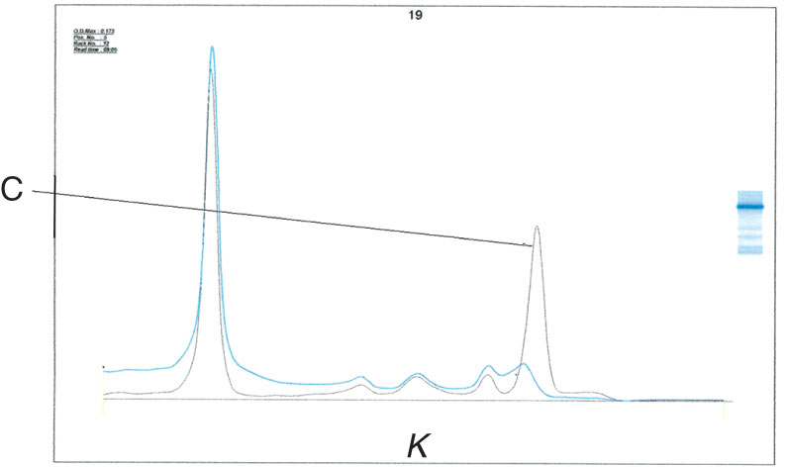
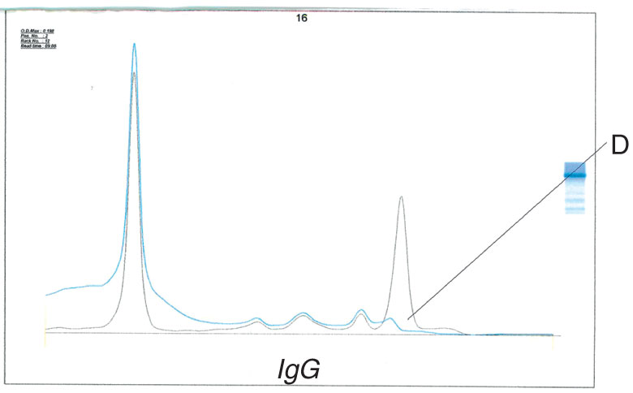
Immunosubtraction (Immunotyping)
Notes:
This is a more sensitive variation of IFE.
The figure shows an example of a monoclonal IgG kappa protein detected by immunotyping. Arrows point to the pertinent peaks in the gamma region.

Slide 25
Serum Free Light Chain Analysis (sFLC)
Automated, latex-enhanced immunoassays
Measure free κ and λ light chain concentrations in serum
Calculate κ/λ ratio (normal = 0.26–1.65)
Presence of malignant plasma cell clone indicated by abnormal ratio and increased κ or λ
Notes:
sFLCs are sensitive, quantitative assays that offer advantages over urine IFE, which requires urine collection over 24 hours and involves subjective determination, especially when there is a low level of free light chains in the presence of a high level of proteinuria.

Slide 26
Cytogenetics
Traditional karyotyping and FISH are used to identify chromosome abnormalities
In FISH, fluorescent-tagged probes bind to complementary DNA sequences
Notes:
FISH = fluorescence in situ hybridization.
Figure shows the 9, 22 chromosome translocation characteristic of CML. Green = BCR gene on chromosome 22; red = ABL1 gene on chromosome 9; yellow = BCR/ABL fusion caused by the 9,22 chromosome rearrangement.

Slide 27
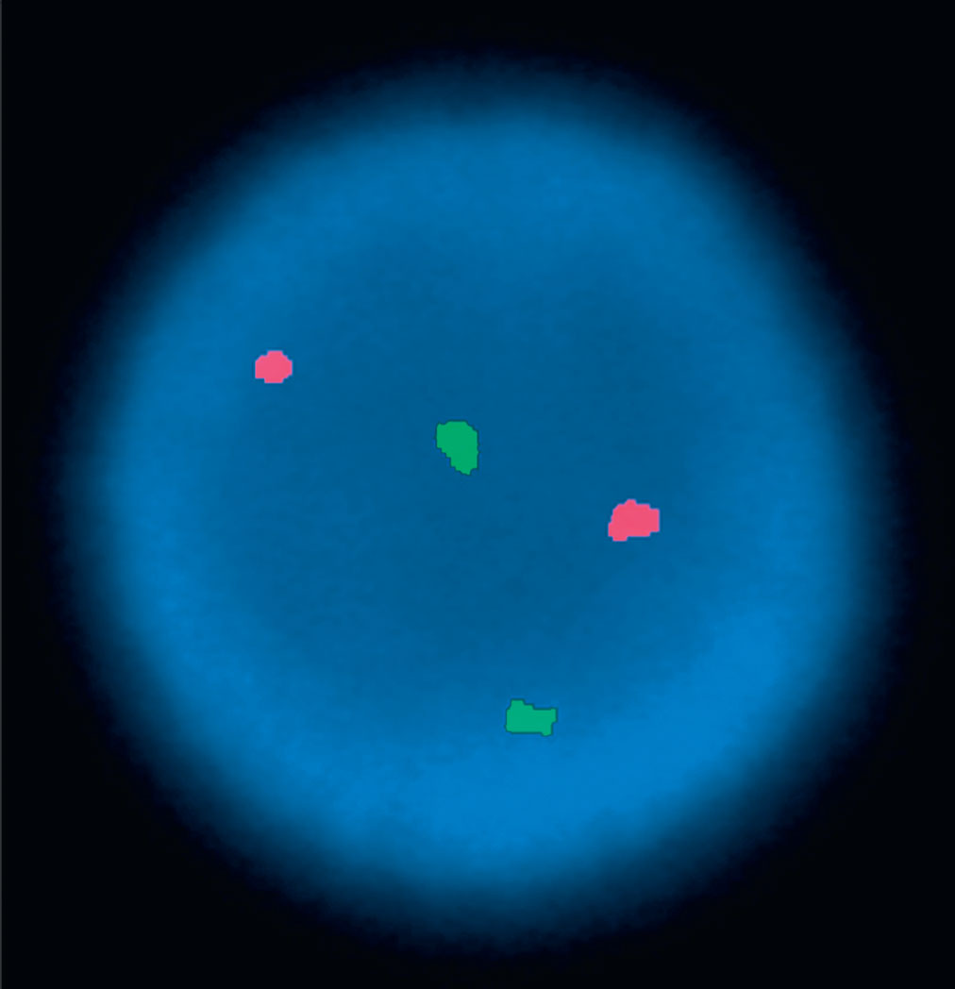
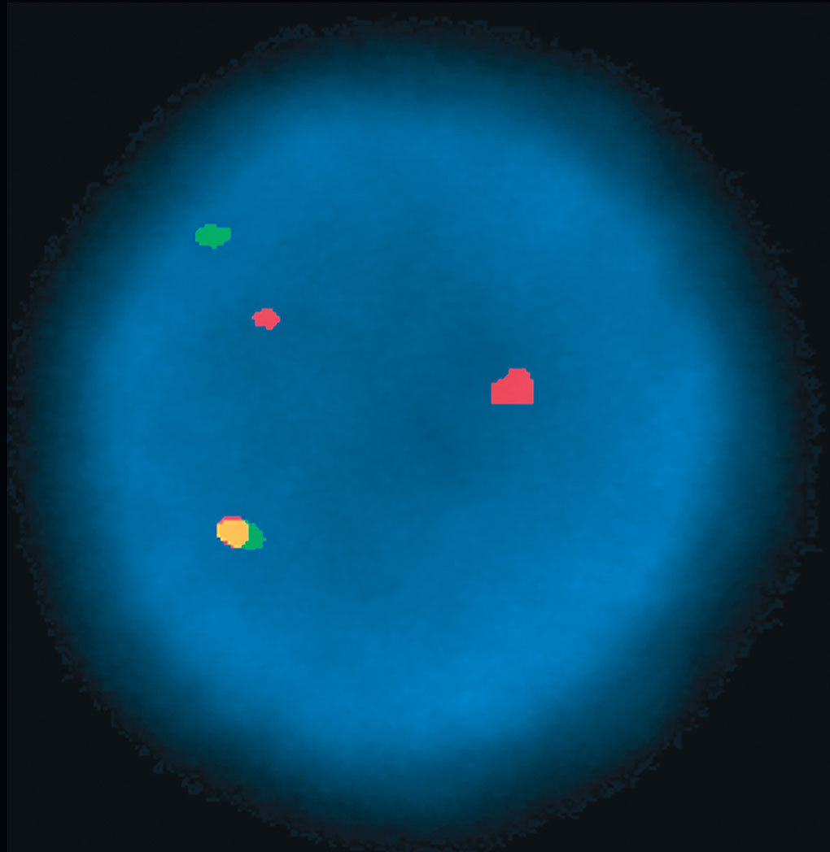
Cytogenetics
Notes:
FISH = fluorescence in situ hybridization.
Figure shows the 9, 22 chromosome translocation characteristic of CML. Green = BCR gene on chromosome 22; red = ABL1 gene on chromosome 9; yellow = BCR/ABL fusion caused by the 9,22 chromosome rearrangement.

Slide 28
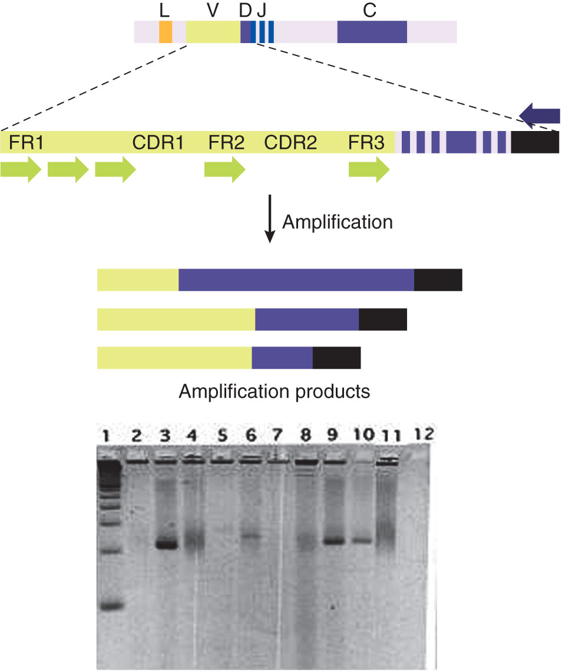
Molecular Testing
More sensitive than cytogenetics
Used to detect:
Microdeletions
Clonal rearrangements of Ig genes (B-cell malignancies)
Clonal rearrangements of TCR genes (T-cell malignancies)
Notes:
TCR = T-cell receptor.
Figure shows results of a polymerase chain reaction that amplified the variable (VDJ) region of the Ig heavy chain gene. Lanes 3, 6, 9, and 10 contain DNA from malignant B-cell clones, as seen by the sharp bands migrating to specific positions on the gel. Lanes 4, 8, and 11 contain DNA from polyclonal B cells, which produces a smear because of the diverse array of VDJ rearrangements, which migrate to different positions on the gel.

Slide 29
Summary
Immunoproliferative diseases are malignancies that involve lymphoid cells; they include the leukemias, lymphomas, and plasma cell dyscrasias
The WHO classification for hematologic malignancies is based on cell lineage, immunologic markers, genetic features, and morphology/cytochemical staining
Leukemias are malignancies that arise from cells in the bone marrow and peripheral blood; they include ALL (large blasts), CLL (mature lymphocytes), and hairy cell leukemia (small mature B cells with hairy projections)
Lymphomas consist of malignant cells that arise in lymphoid tissues; they can be classified as Hodgkin lymphomas and non-Hodgkin lymphomas

Slide 30
Summary
Plasma cell dyscrasias involve an abnormal proliferation of plasma cells and production of a monoclonal immunoglobulin; these disorders include MGUS, multiple myeloma, Waldenström macroglobulinemia, and the heavy chain diseases
MGUS is a premalignant condition in which a monoclonal Ig is produced but the plasma cell percentage in the bone marrow is less than 10%; a small percentage of MGUS cases will progress to multiple myeloma

Slide 31
Summary
Multiple myeloma is a malignancy of mature plasma cells, which can produce monoclonal IgG (most often), IgA, free Ig and light chains or, rarely, IgM, IgD, or IgE
Waldenström macroglobulinemia is a malignant proliferation of IgM-producing B cells or plasma cells
Free monoclonal kappa or lambda chains in the urine are called Bence Jones proteins
Heavy chain diseases are rare B-cell lymphomas in which free monoclonal heavy chains are made

Slide 32
Summary
A CBC and differential, morphologic analysis, cytochemical staining, and flow cytometry are used to identify the lineage of the cell population in hematologic malignancies
Flow cytometry analyzes the antigenic profile of a cell population after incubation with a panel of fluorescent-labeled antibodies
Igs in the immunoproliferative diseases are evaluated by serum Ig quantitation, SPE, IFE, immunosubtraction, and sFLC analysis
SPE separates serum into five major fractions (albumin, α1, α2, β, and γ globulins) on the basis of size and charge; it is used in initial identification of a monoclonal Ig

Slide 33
Summary
IFE further characterizes the Igs by precipitation of the electrophoresed proteins with specific antisera
Normal, polyclonal Igs are diverse and show a range of mobilities, producing diffuse bands
In contrast, monoclonal Igs, which are homogeneous, produce discrete, narrow bands
Immunosubtraction is a sensitive variation of IFE that uses capillary electrophoresis
sFLC measures serum free light chains to detect a malignant plasma cell clone; sFLC is more sensitive and quantitative than urine IFE.

Slide 34
Summary
Karyotyping and FISH can identify chromosome abnormalities in malignant plasma cells
Molecular tests such as PCR are used to detect microdeletions and clonal rearrangements in Ig or TCR genes, which are seen in B-cell or T-cell malignancies

