Slide 1
Part XVI
Immunodeficiency Diseases

Slide 2
Chapter Overview
Primary versus secondary immunodeficiencies
Classification of primary immunodeficiencies
Immunologic defects in selected immunodeficiency diseases
Laboratory testing for immunodeficiency

Slide 3
Immunodeficiencies
Disorders in which part of the immune system is missing or dysfunctional
Decreased ability to defend against infections and more susceptible to developing cancer
Primary immunodeficiencies (PIDs)
Inherited
X-linked, autosomal recessive, autosomal dominant
Secondary immunodeficiencies
Acquired as a result of other conditions, such as infection (e.g., HIV), autoimmune disease, malignancy, immunosuppressive therapy

Slide 4
Immune System Components Affected by PIDs
Humoral immunity
Caused by defects in B cells or Th cells
Patients susceptible to bacterial infections, especially sinusitis and otitis media
Cell-mediated immunity
Involves T-cell deficiencies
Patients susceptible to intracellular pathogens (e.g., viruses, fungi, some bacteria) and cancer
Innate immunity
Neutrophils or macrophages (bacterial infections)
Complement (bacterial infections and autoimmunity)

Slide 5
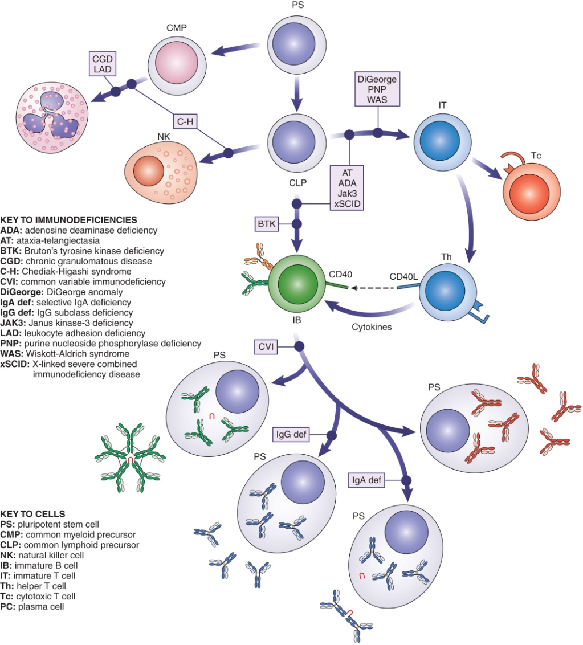
PID Examples and their Effects on WBC Function

Slide 6
Nine Categories of PIDs
Combined immunodeficiencies
Combined immunodeficiencies with associated or syndromic features
Predominantly antibody deficiencies
Diseases of immune dysregulation
Congenital defects of phagocyte number, function, or both
Defects in innate immunity
Autoinflammatory disorders
Complement deficiencies
Phenocopies of primary immunodeficiencies
Notes:
Classification by the International Union of Immunologic Societies (IUIS) in 2014

Slide 7
Predominantly Antibody Deficiencies
Low levels of serum Igs: agammaglobulinemia
Involve genetic defects in B-cell maturation or defective interactions between B and T cells
May involve all Ig isotypes or one (sub)class
Compare patient Ig levels with age-matched reference range
Notes:
This is category 3 in the IUIS classification system.

Slide 8
Predominantly Antibody Deficiencies
X-linked Bruton’s tyrosine kinase (Btk) deficiency
Arrested maturation at pre-B-cell stage
Lack of mature CD19+ B cells in blood and plasma cells in lymphoid tissues
Treated with gamma globulins
Common variable immunodeficiency
Heterogeneous group of disorders
Can be congenital or acquired; symptoms begin at 20 to 30 years of age
Failure of B cells to mature into plasma cells as a result of B-cell or Th-cell defects
Treated with gamma globulins
Notes:
Btk deficiency, because it is X-linked, is seen primarily in males.
Gamma globulin (standard immune serum globulin) is administered by regular intramuscular or intravenous injections to compensate for the low Ig levels.

Slide 9
Predominantly Antibody Deficiencies
Transient hypogammaglobulinemia of infancy
Delayed development in Ig production (especially IgG)
Normal numbers of B cells but delayed Th maturation
Selective IgA deficiency
Low IgA levels, perhaps because of impaired differentiation to IgA plasma cells
Patients may be asymptomatic or more susceptible to infections, allergies, and autoimmunity
IgG subclass deficiencies
Caused by mutations in IgG heavy chain genes
CD154 deficiency
Decreased levels of IgG, IgA, and IgE as a result of defect in B-cell switching
Notes:
Selective IgA deficiency is the most common PID, occurring in approximately 1/500 Americans. Patients cannot be treated with gamma globulins because they may develop anti-IgA antibodies and have an anaphylactic reaction. Also, IgA would not reach mucosa.
Symptoms in IgG subclass deficiencies vary, depending on the Ig subclass involved.
IgG1 or IgG3 deficiencies: reduced capability of responding to protein antigens such as toxins.
IgG2 deficiency: impaired responses to polysaccharide antigens such as those on encapsulated bacteria.

Slide 10
Combined Immunodeficiencies
Involve a T-cell deficiency
Complex; affect cell-mediated immunity and humoral immunity
Possible treatment: bone marrow transplant to reconstitute immune function
Notes:
Th cells are necessary for production of most antibodies; therefore, humoral immunity can be affected as well.
Includes diseases in IUIS categories 1 and 2.

Slide 11
Severe Combined Immunodeficiency Disease (SCID)
Group of very serious PIDs
All involve a defect in normal T-cell development
May affect B-cell and NK-cell development, depending on type
X-linked recessive form caused by IL2RG gene mutation (T–B⁺NK^{+/–} phenotype)
Autosomal recessive forms associated with various defects (T–B^{+/–}NK^{+/–} phenotype)
Notes:
NK = natural killer.
X-linked recessive is most common form of SCID. The IL2RG gene codes for the common gamma chain, which is part of the receptors for IL-2, IL-4, IL-7, IL-9, IL-15, and IL-21. Mutations in this gene cause defects in the normal cell signaling that is necessary for lymphocyte maturation.
Autosomal-recessive forms include defects in JAK3 (an intracellular kinase important in cell signaling), ADA deficiency (deficiency of the enzyme adenosine deaminase, which is involved in metabolism of purines; metabolites that are toxic to T and B cells accumulate), and RAG-1 or RAG-2 (recombinase activating genes that allow B and T cells to rearrange their Ig or TCR genes during maturation).
Bone marrow transplant, gene therapy, and ADA replacement therapy have been used to treat SCID.

Slide 12
Wiskott-Aldrich Syndrome
Rare, X-linked recessive PID
Characterized by:
Immunodeficiency
Eczema
Thrombocytopenia
Defective T-cell function
Decreased IgM, normal IgA and IgG, increased IgE
Defect in CD43, an integral membrane protein needed for signal transduction in lymphocytes

Slide 13
DiGeorge Anomaly
Developmental abnormality in third and fourth pharyngeal pouches in embryo
Most patients have deletion in chromosome 22
Results in:
Underdevelopment of thymus and decreased T cells
Hypoparathyroidism and hypocalcemia
Cardiac abnormalities
Mental retardation
Abnormal facial features
Notes:
May be treated with fetal thymus transplant

Slide 14
Ataxia-Telangiectasia (AT)
Rare autosomal-recessive syndrome
Ataxia: involuntary muscle movements
Telangiectasias: capillary swelling and red blotches on skin
Low number of T cells and defective antibody responses
Involves mutation in AT gene on chromosome 11, resulting in defective DNA repair and gene rearrangements in T and B cells

Slide 15
Defect in Phagocytic Cell Function: Chronic Granulomatous Disease (CGD)
Group of disorders inherited as X-linked recessive or autosomal recessive
Neutrophils unable to generate oxidative burst
Genetic defect in a component of the NADPH oxidase system
Decreased killing of catalase (+) organisms
Laboratory detection
Nitroblue tetrazolium (NBT) test
Dihydrorhodamine (DHR) assay
Notes:
This disorder is an example of the category 5 of the IUIS classification.
The nicotinamide adenine dinucleotide phosphate (NADPH) oxidase system generates H₂O₂ and other reactive oxygen molecules that work with myeloperoxidase to generate microbicidal activity.
NBT test: NBT reduction by reaction with H₂O₂ and other reactive forms of oxygen creates a blue precipitate that can be seen in the neutrophils on a microscope slide. (Formation of the blue precipitate is decreased in CGD.)
DHR: a flow cytometric assay in which mitogen-activated neutrophils are incubated with DHR. An oxidative burst will reduce the DHR, resulting in fluorescence. Less fluorescence is produced in patients with CGD compared with normal neutrophils.

Slide 16
Complement Deficiencies
Most are inherited as autosomal recessive
Deficiencies in early C’ components
Associated with a lupus-like syndrome
C2 deficiency most common
C3 deficiency associated with recurrent infections with encapsulated bacteria
Deficiencies in late C’ components
Associated with Neisseria meningitides infections
Deficiency in C1 esterase inhibitor
Causes hereditary neuroangioedema
Notes:
These disorders are classified in category 8 of the IUIS system.

Slide 17
Screening for Suspected Immunodeficiency
Patient history
CBC and WBC differential
Serum levels of IgG, IgM, IgA, and IgG subclasses
Isohemagglutinins (natural ABO antibodies)
Antibody response after vaccination
Delayed hypersensitivity-type skin reactions for cell-mediated immunity
CH50 assay for complement function
DHR assay for neutrophil function

Slide 18
Confirmatory Tests for Immunodeficiency
Immunophenotyping and flow cytometry to determine numbers of B cells, helper T cells, cytotoxic T cells, NK cells
Notes:
Note the absence of CD19+ cells (i.e., B cells) in the flow cytometry patient results in the figure.

Slide 19
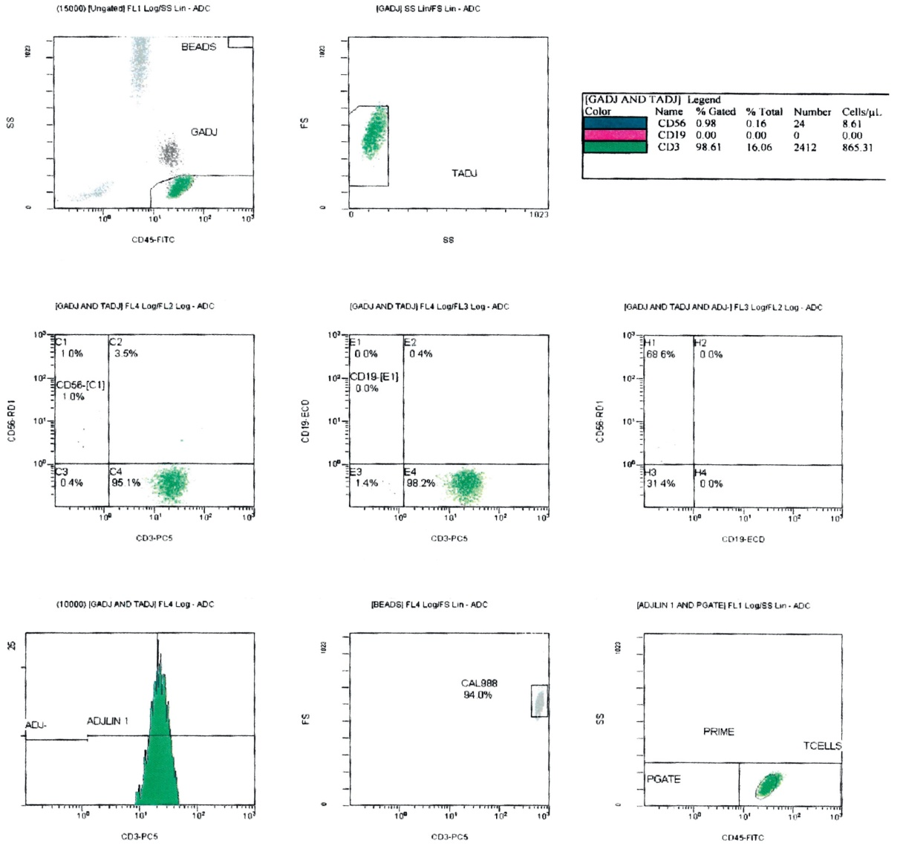
Confirmatory Tests for Immunodeficiency
Notes:
Note the absence of CD19+ cells (i.e., B cells) in the flow cytometry patient results in the figure.

Slide 20
Confirmatory Tests for Immunodeficiency
Genetic testing
Mitogen assays for T- or B-cell proliferation
Mitogen stimulates mitosis in all T cells or all B cells
T-cell mitogens include PHA and ConA
Other assays for T-cell activation
QuantiFERON TB and T-Spot
Measure IFN-gamma production by T cells activated by Mycobacterium tuberculosis
Cylex ImmuKnow assay
Measures ATP production from mitogen-activated T cells
Notes:
PHA = phytohemagglutinin.
Con A = Concanavalin A.

Slide 21
Evaluation of Immunoglobulins
Quantitative measurement by nephelometry or radial immunodiffusion (RID)
Serum protein electrophoresis (SPE)
Immunofixation electrophoresis (IFE)

Slide 22
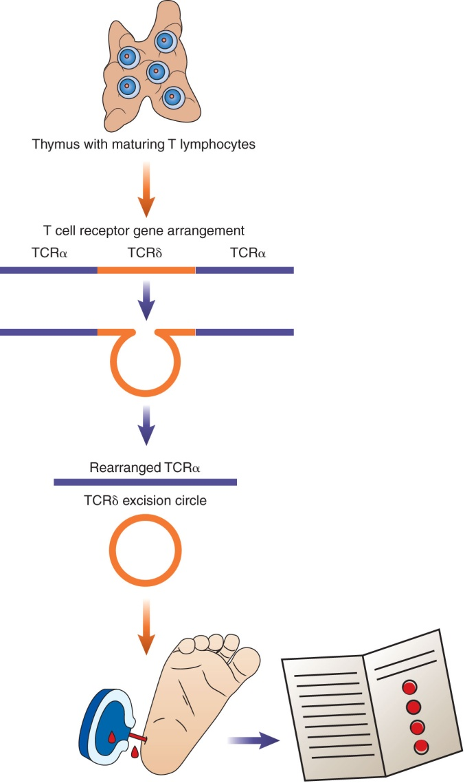
Newborn Screening for TRECs
TRECs = T-cell receptor excision circles
Produced as a by-product of TCR gene rearrangement
Quantitated by PCR
Reflect number of T cells
Mandated by many states
Used to screen for T-cell deficiencies (e.g., SCID)

Slide 23
Summary
Immunodeficiencies can be broadly classified as primary (inherited) or secondary (acquired due to HIV infection, etc.)
PIDs can affect humoral immunity, cell-mediated immunity, or components of the innate defense system
The International Union of Immunologic Societies has grouped PIDs into nine categories

Slide 24
Summary
Antibody deficiencies are characterized by low levels of serum immunoglobulins; they can be caused by defects in B-cell maturation or defective interactions between B cells and T cells
Antibody deficiencies include Btk deficiency, common variable immunodeficiency, transient hypogammaglobulinemia of infancy, selective IgA deficiency, IgG subclass deficiencies, and CD154 deficiency
Combined immunodeficiencies are complex disorders that involve a T-cell defect that can affect cell-mediated and humoral immunity
Combined immunodeficiencies include SCID, Wiskott- Aldrich syndrome, DiGeorge anomaly, and AT

Slide 25
Summary
CGD is a group of disorders affecting the neutrophil oxidative burst; patients with CGD have decreased NBT and DHR test results
Complement deficiencies are autosomal-recessive disorders that can affect the early or late components of the complement system
Initial laboratory tests in patients suspected of having an immunodeficiency include a CBC and differential, serum Ig levels, isohemagglutinins and antibody responses after vaccination, delayed hypersensitivity-type skin reactions, CH50 assay, and DHR assay

Slide 26
Summary
Confirmatory tests for immunodeficiencies include genetic testing, T- and B-cell mitogen tests, tests for T-cell activation, and evaluation of immunoglobulins by SPE and IFE
TRECs are T-cell receptor excision circles that are produced during TCR gene rearrangement
They reflect the number of mature T cells
Newborn screening for TRECs is mandated by many states to detect T-cell deficiencies such as SCID

