Slide 1
Part XVIII
Immunization and Vaccines

Slide 2
Chapter Overview
Types of immunity
Active immunization
History of vaccines
Vaccine types and examples
Advantages and limitations
Factors influencing immunogenicity
Passive immunization
Examples
Benefits and limitations
Adoptive immunity

Slide 3
Immunity and Immunization
Immunity: condition of being resistant to disease
Immunization: process by which immunity is acquired

Slide 4
Three Types of Immunization
Active
Passive
Adoptive

Slide 5
Active Immunization
Stimulation of a person’s own immune system to mount an adaptive immune response to an antigen
Natural exposure to infection
e.g., production of antibodies to group A streptococci
Administration of a vaccine
e.g., development of immunity to the measles virus after receipt of the measles vaccine

Slide 6
Passive Immunization
Transfer of antibodies from immunized hosts to a nonimmune individual
Transfer of mother’s antibodies to fetus or infant
IgG—through the placenta
IgA—through breast milk
Passive immunotherapy
Commercial antibody preparations
e.g., use of pooled human antibodies for a person with an immunodeficiency disease

Slide 7
Adoptive Immunization
Transfer of cells of the immune system (usually lymphocytes) from an immunized host to a nonimmune individual
e.g., adoptive immunotherapy of hematopoietic stem cells into leukemia patients who received high-dose irradiation or chemotherapy

Slide 8
Advantages and Limitations
Active immunity
Induces long-term protection
Takes time to develop
Passive immunity
Provides immediate protection
Is temporary; memory not produced
Can induce hypersensitivity
Adoptive immunity
Can transfer cell-mediated immunity
Patient’s own immune cells must be depleted
Possible rejection of allogeneic cells

Slide 9
Vaccine
An antigen suspension derived from a pathogen
Induces active immunity
A form of immunoprophylaxis or prevention of disease through immunization of healthy individuals

Slide 10
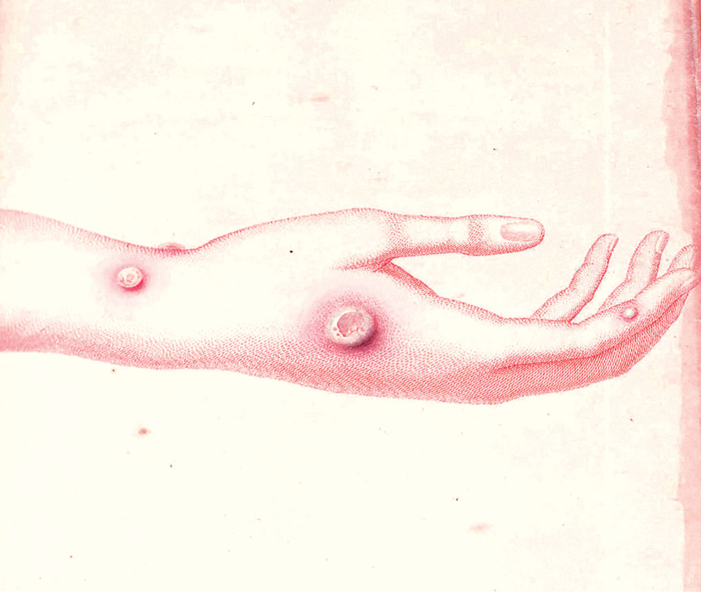
History of Vaccines
Ancient China: Variolation is performed to protect against smallpox
1796: Edward Jenner uses cross-reactive material from cowpox lesions to vaccinate against smallpox

Slide 11
History of Vaccines
1880s: Louis Pasteur uses attenuated organisms to develop vaccines against chicken cholera, anthrax, and rabies
Attenuation uses bacteria or viruses weakened by chemical treatment, growth at different temperatures, or repeated in vitro passage in cell culture

Slide 12
History of Vaccines: 20th Century
“Golden age of vaccine development”
New methods of attenuating organisms (TB, typhoid fever)
Development of toxoids (inactivated bacterial toxins; diphtheria, tetanus)
Attenuated viral vaccines (polio, measles, mumps, rubella, varicella)
Production of glycoconjugates (purified bacterial polysaccharides linked to a protein)
First recombinant (genetically engineered) vaccine produced; used against hepatitis B
Notes:
TB = tuberculosis.

Slide 13
History of Vaccines: Beyond the 20th Century
More live, attenuated vaccines (influenza, rotavirus, herpes zoster)
Multivalent glycoconjugates (pneumococcus, meningococcus)
Recombinant vaccine to prevent cervical cancer (HPV)
New technologies to develop “next-generation vaccines”
Notes:
HPV = human papilloma virus.

Slide 14
Antigen Preparations Used in Conventional Vaccines
Whole organism
Attenuated
Inactivated
Part of an organism (subunit)
Toxoids
Polysaccharides (glycoconjugates)
Purified or recombinant proteins

Slide 15
Attenuated Vaccines
Use live but weakened viruses or bacteria
Organisms are grown under abnormal culture conditions so that they are no longer pathogenic but are still capable of stimulating the immune response

Slide 16
Examples of Live, Attenuated Vaccines
Bacterial
Bacillus Calmette Guerin (BCG)
Mycobacterium bovis (adapted to grow under high concentrations of bile)
TB
Typhoid fever
Salmonella typhi (mutated strain)

Slide 17
Examples of Live, Attenuated Vaccines
Viral
Polio (Sabin)
Three polio virus serotypes; given orally
Each has unique antigens that can be identified by serologic typing
Influenza (nasal mist)
Two influenza A strains and two influenza B strains

Slide 18
Examples of Live, Attenuated Vaccines
Viral
Rubeola (measles)
Rubella (German measles)
Mumps
Varicella (chickenpox; shingles)

Slide 19
Advantages and Limitations of Live, Attenuated Vaccines
Stimulate both humoral and cell-mediated immunity
Cannot be administered to immunocompromised patients
Potential interference by maternal antibodies
Require careful handling and storage
On rare occasion, may revert to pathogenic form

Slide 20
Inactivated Vaccines
Intact viruses or bacteria that have been killed by treatment with chemicals or heat
Examples:
Intramuscular polio (Salk)
Influenza (intramuscular or intradermal)
Two influenza A strains and one to two influenza B strains
Hepatitis A

Slide 21
Advantages and Limitations of Inactivated Vaccines
Can safely be given to immunocompromised individuals
Stimulate humoral immunity but little or no cell-mediated immunity
May require two or more booster doses to produce protective immunity

Slide 22
Subunit Vaccines
One or more purified components of a pathogen:
Toxoids
Polysaccharides
Purified proteins
Recombinant proteins

Slide 23
Toxoids
Chemically inactivated bacterial toxins that are not pathogenic
Retain their ability to stimulate an immune response
Examples:
Diphtheria
Tetanus

Slide 24
Polysaccharides
Biochemically purified polysaccharide from bacterial capsules
Examples:
Streptococcal pneumonia (13 or 23 serotypes of Streptococcus pneumoniae)
Haemophilus influenza type b (Hib)
Neisseria meningitidis
Requires conjugation to a carrier protein (glycoconjugates) to induce IgG production and long-term immunity

Slide 25
Purified Proteins
Biochemically purified components of a microorganism
Example: Pertussis (whooping cough) vaccine
Contains two to five purified proteins from Bordetella pertussis, including the pertussis toxoid

Slide 26
Recombinant Proteins
Proteins produced by genetically modified nonpathogenic bacteria, yeast, or other cells
Examples:
Hepatitis B (hepatitis B surface Ag)
Human papilloma virus (L1 protein from high-risk HPV types)
Cannot be used to produce antigens other than proteins

Slide 27
Advantages of Subunit Vaccines
Induce an immune response to the pathogenic component(s) of a microorganism
Safety; avoid administration of intact organism

Slide 28
Limitations of Subunit Vaccines
Require two or more booster doses to produce protective immunity
Require an adjuvant to increase immunogenicity
Must be multivalent if a broad immune response is desired

Slide 29
Factors Influencing Immunogenicity
Age
Give vaccine to the youngest individuals at risk for the disease, as long as it is safe and effective for that age-group
Centers for Disease Control and Prevention recommended schedules:
http://www.cdc.gov/vaccines/schedules/hcp/imz/child-adolescent.html
http://www.cdc.gov/vaccines/schedules/hcp/imz/adult.html

Slide 30
Factors Influencing Immunogenicity
Immune status
Degree of host immunocompetence (can be influenced by many factors, including age and health of the host)
Vaccine composition
Live, attenuated vaccines: tend to be most immunogenic
Subunit vaccines: tend to be least immunogenic

Slide 31
Adjuvants
Substances that enhance the immune response when administered together with a vaccine antigen
Stimulate the innate immune system to induce release of cytokines that activate adaptive immunity
Antigen delivery systems
Enhance the uptake of antigens by antigen-presenting cells
Immunopotentiators
Activate dendritic cells to present antigens to T cells

Slide 32
Adjuvants
Examples
Alum
Oil-in-water emulsions (e.g., Freund’s complete and incomplete adjuvants)
Result in a faster, longer-lasting immune response
Increase antibody titers
May increase cell-mediated immunity
Reduce the dose of antigen and number of inoculations needed

Slide 33
Next-Generation Vaccines
New vaccine designs
Identify potent vaccine antigens by molecular methods
Reverse vaccinology: screening the entire genome of a pathogen to identify genes that code for good vaccine antigens
Try to induce broadly neutralizing antibodies
Discover new adjuvants
Try different routes of vaccine delivery
Use new methods to assess immunity

Slide 34
Benefits of Vaccines
The Impact of Vaccines in the United States
One of the greatest medical achievements of the 20th century
Reduction or elimination of many serious, potentially fatal diseases
Decreased morbidity and mortality
Community (herd) immunity
Protection extended to nearby persons who have not been immunized

Slide 35
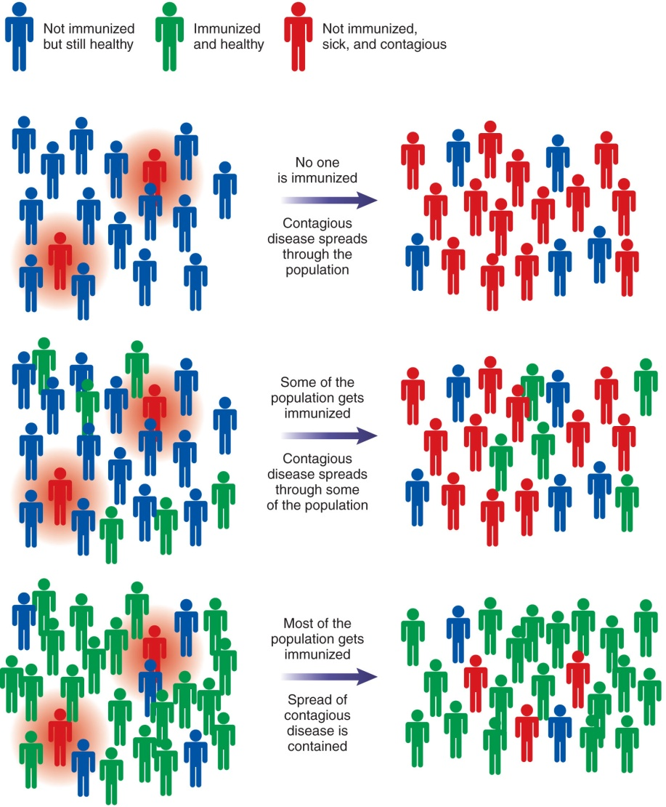
Benefits of Vaccines
The Impact of Vaccines in the United States

Slide 36
Adverse Effects of Some Vaccines
Local reactions
Swelling, tenderness at injection site
Generalized reactions
Low-grade fever and malaise; severe reactions are rare
Allergic reactions
Type I or type III hypersensitivity
Development of disease
When live, attenuated vaccine is accidentally given to immunocompromised individuals

Slide 37
Passive Immunity
Transfer of preformed antibodies to an unimmunized host
Can occur naturally or through administration of therapeutic agents

Slide 38
Passive Immunity
Natural transfer of immunity from mother to fetus or infant
IgG through the placenta
IgA through breast milk

Slide 39
Passive Immunity
Standard human immune serum globulin (HISG)
Also known as gamma globulin
Made from pooled serum of thousands of donors
Contains antibodies to numerous antigens
Prophylactic treatment for patients with deficiencies in antibody production

Slide 40
Passive Immunity
Specific human serum globulins
Made from pooled serum of donors with immunity to a particular pathogen
Examples:
Hepatitis A and hepatitis B
Varicella
Rabies
Tetanus
Respiratory syncytial virus
Used to treat unimmunized individuals who have potentially been exposed to a pathogen

Slide 41
Passive Immunity
Animal globulins
Usually prepared from horse serum
Anti-toxins
Antibodies to bacterial toxins
Used for tetanus, diphtheria, botulism
Anti-snake venom
Neutralize toxins or venom to prevent harm to host

Slide 42
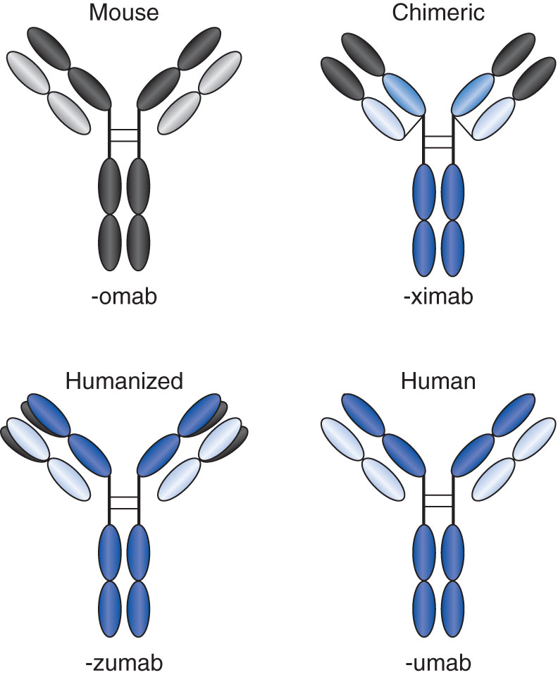
Passive Immunity
Monoclonal antibodies
Made by a single clone of B cells
Directed against a particular epitope of an antigen
Used to treat cancer, autoimmune diseases, and other disorders

Slide 43
Benefits of Passive Immunization
Provides immediate immunity
e.g., in a person who received a puncture wound containing potentially contaminated soil but who was not up to date with tetanus vaccination
Can be used as immunosuppressive therapy in selected situations
e.g., in an Rh– mother who gave birth to an Rh+ fetus to prevent hemolytic disease of the newborn in future births

Slide 44
Limitations of Passive Immunization
Short-lived immunity
Half-life of IgG = 23 days
Can induce type I or type III hypersensitivity
Especially to animal sera

Slide 45
Adoptive Immunity
Transfer of cells of the immune system
Performed to increase cell-mediated immunity
Examples:
Treatment of cancer patients with tumor-infiltrating lymphocytes (TILs) activated in vitro
Transplantation of hematopoietic stem cells into patients with immunodeficiency diseases

Slide 46
Summary
In active immunization, a person’s own immune system is stimulated to respond to an antigen
Examples of active immunization include immune responses induced by natural infection or treatment with vaccines
Passive immunization involves transfer of antibodies from immunized hosts to a nonimmune individual
Examples of passive immunization include transfer of mother’s antibodies to her fetus or infant and treatment with commercial antibody preparations
Active immunity takes time but induces long-term memory; passive immunity is immediate but short-lived
Adoptive immunization involves transfer of cells from an immunized host to a nonimmune individual (e.g., hematopoietic stem cell transplants)

