Slide 1
Part XVII
Laboratory Diagnosis of HIV Infection

Slide 2
Chapter Overview
Introduction
Modes of HIV transmission
Characteristics of HIV
HIV and the immune system
Clinical course of HIV infection
Treatment and prevention
Laboratory testing for HIV
Screening and diagnosis
Disease monitoring
Testing of infants

Slide 3
Human Immunodeficiency Virus (HIV)
Cause of AIDS
HIV-1
Cause of most HIV infections worldwide
Four groups (M, O, N, P)
Nine subtypes in group M (A, B, C, D, F, G, H, J, K)
HIV-2
Originated in West Africa
Causes fewer cases
Notes:
Two genetically related but distinct viruses have been discovered: HIV-1 and HIV-2.
Groups: M = major; O = outlier; N and P are more recently discovered groups.
Subtype C is the most predominant in the world, whereas subtype B is most prevalent in the United States.

Slide 4
Modes of HIV Transmission
Sexual contact
Intimate contact involving exchange of body fluids
Responsible for majority of cases
Contact with blood or other body fluids
IV drug use
Recipients of transfusions, other blood products
Occupational injury (direct needlestick or mucous membrane exposure)
Perinatal
Mother to child: before, during, or after birth (through breast milk)

Slide 5
Characteristics of HIV
Retrovirus
Contains two copies of ssRNA
Reverse transcriptase transcribes the viral RNA into DNA
Surrounded by protein coat (capsid)
Outer envelope of glycoproteins embedded in lipid bilayer
Notes:
Numbers indicate molecular weight of key proteins in kilodaltons.
ss= single-stranded.

Slide 6
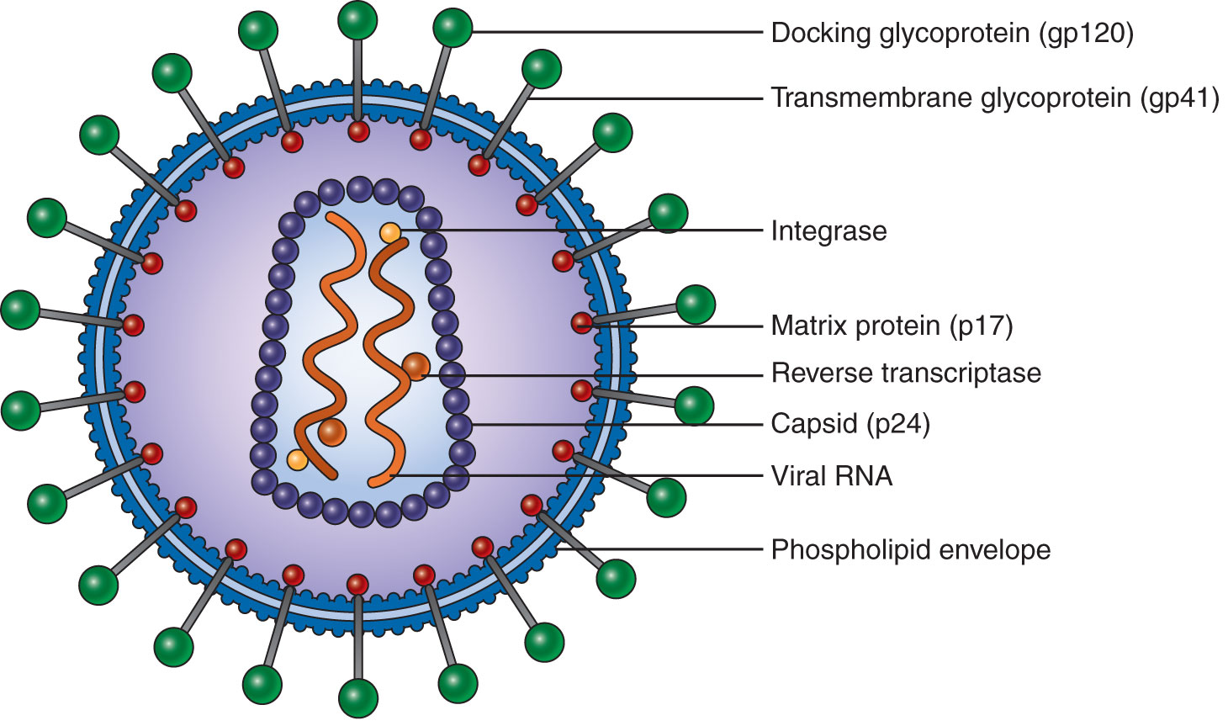
Characteristics of HIV
Notes:
Numbers indicate molecular weight of key proteins in kilodaltons.
ss= single-stranded.

Slide 7
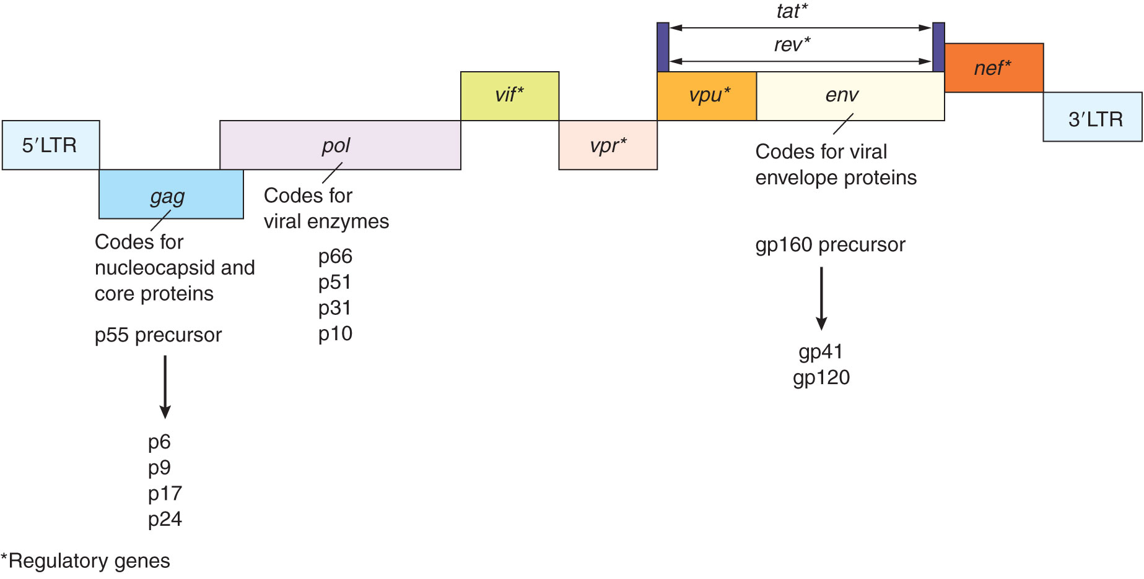
HIV Genome
Notes:
The HIV genome contains three principal genes:
gag, which codes for the nucleocapsid and core proteins such as p24
pol, which codes for the enzymes important to the virus, including reverse transcriptase (p51)
env, which codes for proteins in the viral envelope, such as glycoprotein 160, which is subsequently cleaved into gp 120 and gp 41
The rest of the genes code for proteins that regulate the expression of the other genes, thus regulating viral replication and infectivity.

Slide 8
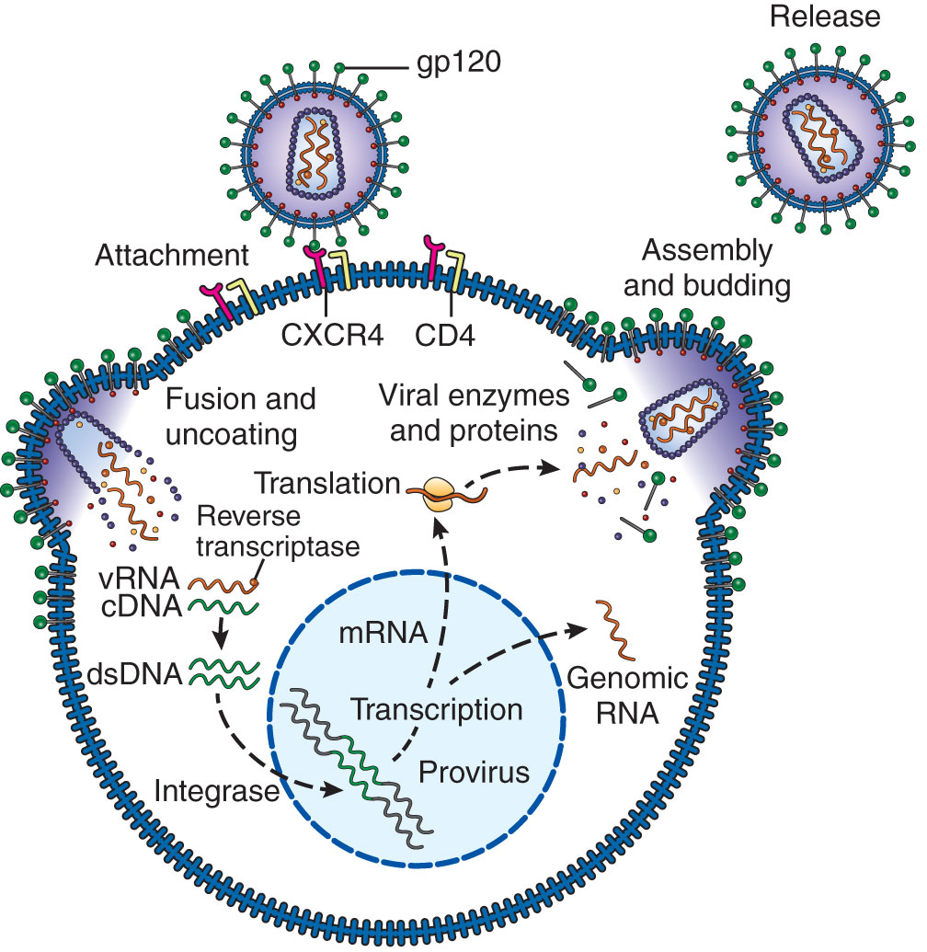
Replication of HIV
Attachment of HIV to host cell
Main target: CD4 Th
Coreceptor required
Fusion and uncoating
Reverse transcriptase converts viral RNA into complementary DNA
Notes:
CD4 is present in high density on T helper cells and in lower density on other cells, such as macrophages. It serves as the main receptor for HIV by binding to gp120.
The chemokine receptors CXCR4 (T cells) and CCR5 (macrophages) are also required for entry because they promote fusion of the HIV envelope to the host cell membrane.
Uncoating, or removal of the viral protein coat, exposes the HIV genome.

Slide 9
Replication of HIV
DNA integrated into host genome as a provirus
Viral DNA transcribed into viral RNA and proteins
Viral particles assembled
Intact virions bud out of host cell membrane
Notes:
The provirus can remain latent for a long period, during which viral replication does not occur.
Eventually, expression of the HIV genes is induced when the host cell is activated by cytokines or binding to antigen.
These genes code for viral RNA and proteins, which are assembled into viral particles. These, in turn, acquire their outer envelope when they bud out of the host cell membrane.
The cycle can then be repeated as these intact HIV virions go on to infect new host cells.

Slide 10
Immune Responses to HIV
Innate defenses
NK cells mediate cytolysis of HIV-infected cells
Dendritic cells stimulate release of cytokines that have antiviral effects
Humoral antibody production
Antibodies are detected by 6 weeks after infection
Antibodies produced later may prevent HIV from infecting host cells and participate in ADCC
Cell-mediated immunity
T cells produce cytokines with antiviral activity
CTLs destroy HIV-infected host cells
Notes:
NK = natural killer.
ADCC = antibody-dependent cell-mediated cytotoxicity.
CTL = cytolytic T cells.
The same types of immune responses elicited by other viral infections are stimulated against HIV.
The first antibodies to appear are anti-gp41, followed by anti-p24 and later antibodies to the env and pol proteins.
Interferons in particular have potent antiviral activity.

Slide 11
HIV Escape from Immune Responses
Genetic mutations rapidly occur, generating new viral mutants with altered antigens
HIV can downregulate expression of MHC-I molecules on infected host cells
HIV can survive as a latent provirus for prolonged periods
As a result, HIV persists and destroys the immune system
CD4 T cells are the prime targets of destruction, resulting in reduced effectiveness of antibody and cell-mediated immune responses
Notes:
HIV is a challenging infection because it has developed many escape mechanisms to evade the host’s immune responses, allowing the virus to persist in the body.
Downregulation of MHC-I expression can make infected host cells less likely to be recognized by CTLs.
In its proviral state, HIV is unable to replicate and induce immune responses.
CD4 T helper cells are a central component of the immune system; therefore, several types of immune responses are affected when these cells are destroyed. In addition to their destruction by CTLs and apoptosis, CD4 T cells can be rendered nonfunctional as a result of HIV infection.

Slide 12
Clinical Course of HIV Infection
Primary infection
Acute, early infection
May be asymptomatic or have a flu-like syndrome that resolves
High level of viremia and decrease in CD4 T-cell number
Clinical latency
Absence of clinical symptoms
Decrease in viremia and increase in CD4 T-cell number
AIDS
Resurgence of viremia and decrease in CD4 T-cell number
Profound immunosuppression, with appearance of life-threatening opportunistic infections and malignancies
Notes:
Untreated individuals infected with HIV typically progress through three phases: primary infection, clinical latency, and AIDS. The period of clinical latency can vary but has a median length of 10 years.
Viremia refers to the amount of HIV circulating in the bloodstream.
In clinical latency, the levels of viremia decrease and the CD4 T cells increase to slightly low or normal numbers as the immune system starts to attack the virus and keep it in check.
When the patient develops AIDS, the virus, which has been harbored in a latent state in the lymphoid tissues, becomes reactivated and overwhelms the immune system, resulting in a high level of viremia and a profound decrease in the CD4 T-cell number.
The 2014 Centers for Disease Control and Prevention definition of AIDS is based on either clinical evidence or laboratory criteria (positive test for HIV antibody/antigen and CD4 T-cell count).

Slide 13
Antiretroviral Therapy (ART)
Drugs that block various steps of the HIV replication cycle
Nucleoside analog reverse transcriptase inhibitors
Nonnucleoside reverse transcriptase inhibitors
Protease inhibitors
Integrase inhibitors
Fusion inhibitors
Entry inhibitors
Are most effective when used in combination (CART)
Have significantly improved morbidity and mortality of HIV-infected persons and have reduced the rate of perinatal transmission
Notes:
Combination antiretroviral therapy (CART) is most effective because it reduces the chances for drug resistance to develop. CART has significantly improved the quality of life of HIV-infected persons and has increased survival (50+ years).
Administration of ART to pregnant women and newborns born to HIV-infected mothers, in addition to avoidance of breastfeeding, has reduced perinatal infections to very low numbers in developed countries.
ART has also been used prophylactically to prevent HIV infection in those who have been potentially exposed to the virus (e.g., health-care workers with needlestick injuries, sexual partners of HIV-infected individuals)

Slide 14
Prevention of HIV Transmission
Screening blood/organ donors for HIV
Education of general public on HIV transmission, safety measures
Precautions for health-care workers
Vaccine—being researched

Slide 15
Laboratory Testing for HIV
Screening and diagnosis
Previous algorithm and test methods
Current algorithm and test methods
Disease monitoring
CD4 T-cell count
HIV viral load
Drug resistance testing
Testing of infants

Slide 16
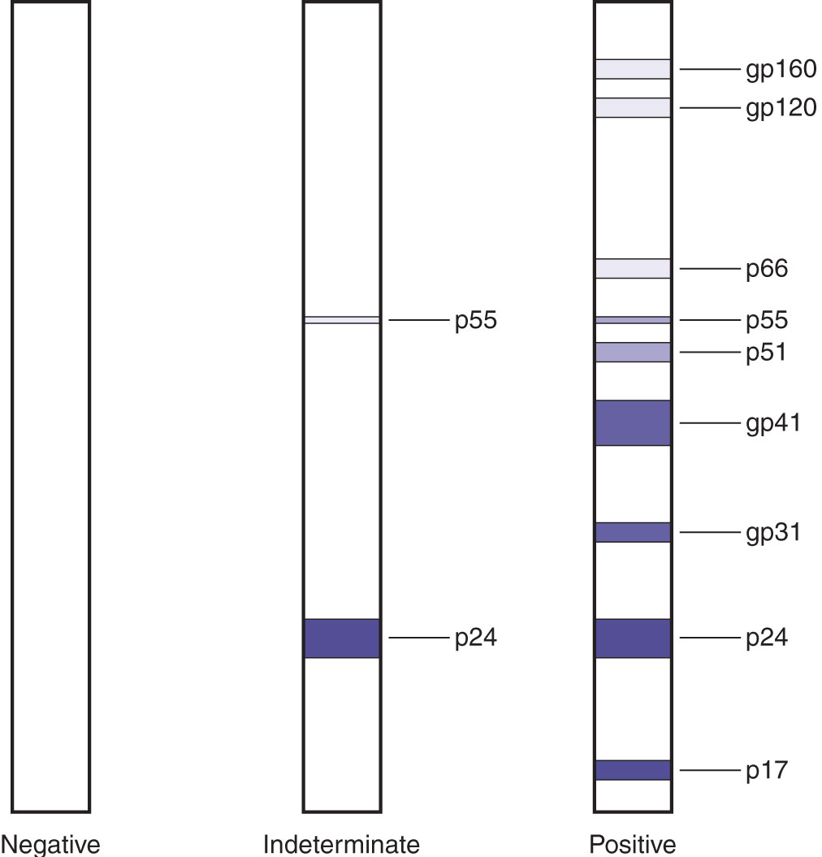
Previous Testing Algorithm
Screen for HIV-1/HIV-2 antibodies by ELISA or rapid EIA
Confirm positive test results by repeating ELISA, followed by Western blot
Notes:
ELISA = enzyme-linked immunosorbent assay.
EIA = enzyme immunoassay.
The third-generation ELISA test involved the following steps: (1) Incubate patient serum with recombinant HIV-1 and HIV-2 proteins coated onto a solid phase; wash off unbound materials. (2) Add enzyme-labeled HIV-1 and HIV-2 antigens; incubate and wash. (3) Add substrate, incubate, add stop solution, and measure color development. CLIA formats were also available.
Rapid EIAs are lateral flow or flow-through immunoassays that produce a colorimetric reaction for a positive result in a matter of minutes. They are especially suitable in certain situations, such as resource-limited settings in developing countries, where expensive instrumentation and skilled personnel are not available, and when results are needed quickly, as in occupational exposures, labor and delivery, or patients in STD clinics or the emergency department.
False-positive results can occur with the screening ELISA or EIA tests; therefore, positive results needed to be confirmed by the more specific Western blot test.
In the Western blot, antibodies directed against specific HIV proteins are detected. Patient serum is incubated with a test membrane onto which HIV proteins have been blotted after separation by electrophoresis on a gel. Following a washing step to remove unbound materials, an enzyme-labeled anti-human Ig is added. Following a second incubation and wash, a chromogenic substrate is added, and bands to proteins of specific molecular weight are visualized.
Interpretation of Western blot results (see figure): (1) negative = no bands; (2) positive = at least two of the following three bands are present: p24, gp41, gp120/160; (3) indeterminate = a different banding pattern.
The Western blot is no longer recommended for clinical use because of the incidence of indeterminate results and the insensitivity, technical difficulty, and long turnaround time of the test.

Slide 17
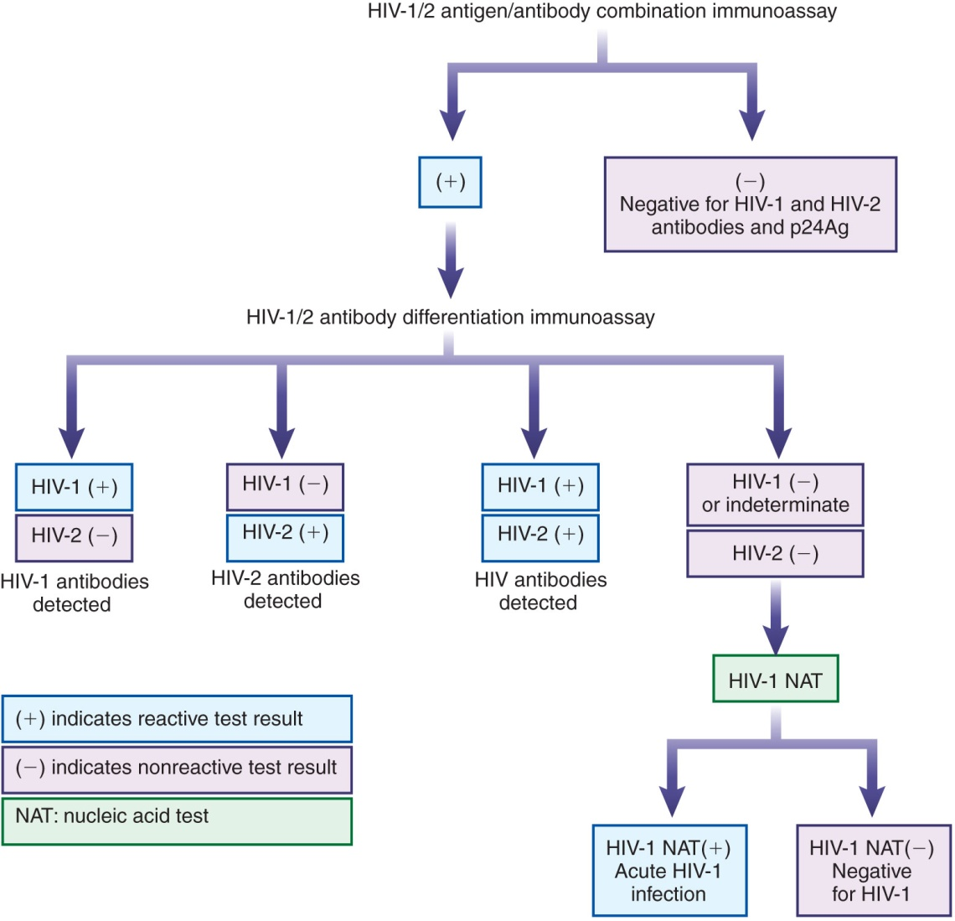
Current Testing Algorithm
Notes:
Perform initial screening with a combination immunoassay for HIV-1 and HIV-2 antibodies and p24 antigen.
Confirm positive results with a rapid immunoassay that differentiates between HIV-1 and HIV-2 antibodies.
Resolve discrepant results by performing a qualitative nucleic acid test (NAT) performed by polymerase chain reaction (PCR) or transcription-mediated amplification (TMA).
Results are more accurate and are obtained more rapidly (15 to 17 days) than with the previous testing algorithm.

Slide 18
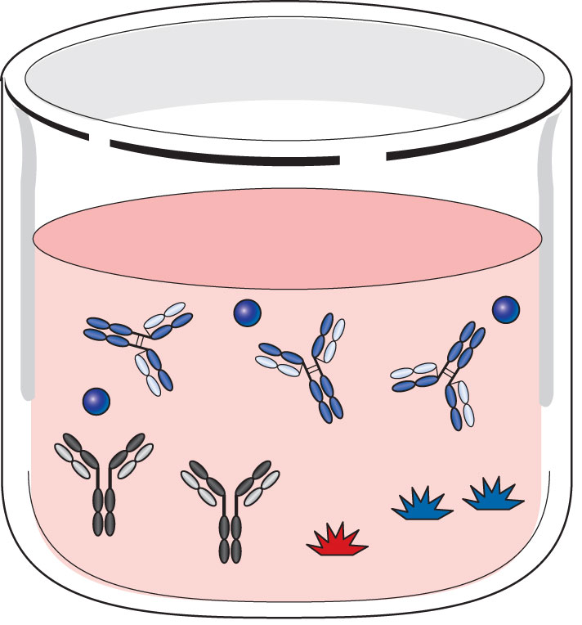
Principle of Fourth-Generation HIV-1 Antibody/HIV-2 Antibody/p24 Antigen Combination Immunoassay
Incubate patient serum with solid phase onto which HIV-1 antigens, HIV-2 antigens, and antibody to HIV-1 p24 have been bound

Slide 19
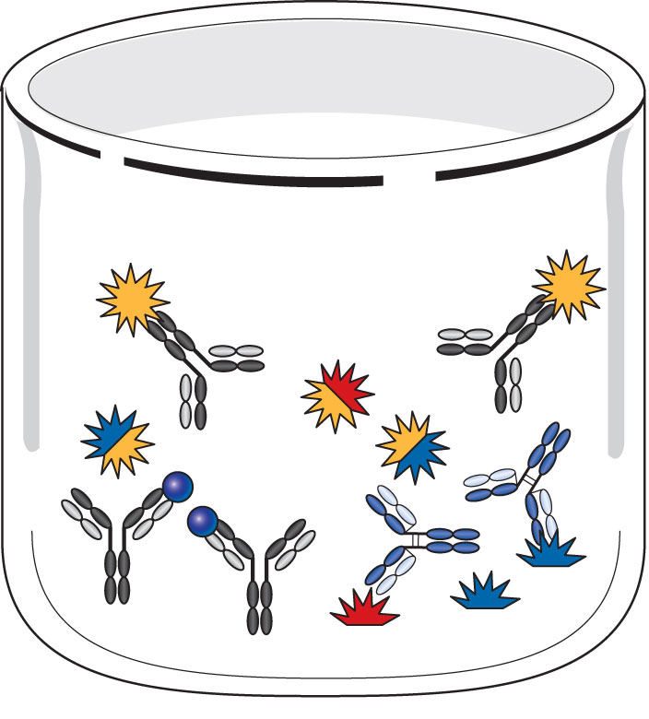
Principle of Fourth-Generation HIV-1 Antibody/HIV-2 Antibody/p24 Antigen Combination Immunoassay
Following incubation, HIV-1 or HIV-2 antibodies in the patient sample will bind to their respective antigens
HIV-1 p24 antigen in the patient sample will bind to anti-p24 on solid phase
Wash, then add conjugate consisting of labeled anti-p24 and labeled HIV-1/HIV-2 antigens
Notes:
The label can be either a chemiluminescent or an enzyme label, depending on the test method.

Slide 20
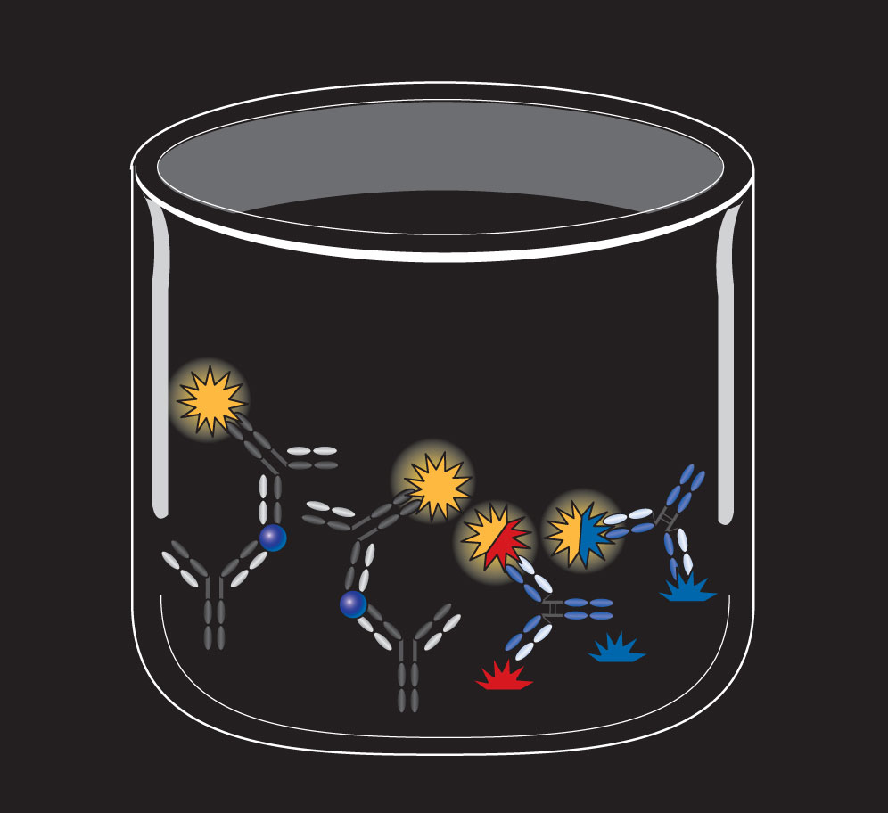
Principle of Fourth-Generation HIV-1 Antibody/HIV-2 Antibody/p24 Antigen Combination Immunoassay
Following an incubation, wash, and addition of trigger solution or substrate/stop solution, relative light units or optical absorbance are measured
Confirm positive results with rapid EIA
Notes:
More recently developed fifth-generation bead-based immunoassays can detect and differentiate between HIV-1 and HIV-2 antibody and p24 antigen using a single test.

Slide 21
Disease Monitoring
Peripheral blood CD4 T-cell counts
Quantitative viral load assays
Drug resistance testing

Slide 22
CD4 T-Cell Enumeration
These counts are the best indicator of immune function in HIV-infected individuals
Incubate peripheral blood with fluorescent-labeled anti-CD4; analyze results by flow cytometry
In untreated patients, CD4 T-cell number declines progressively, and CD4 T:CD8 T-cell ratio is less than 1:1
CD4 T-cell count of less than 200/μL indicates stage 3 infection (AIDS)
A significant decline in CD4 T-cell count over time may indicate a need to change CART or administer prophylactic therapy for certain infections
Notes:
Prophylactic treatment can include drugs for Pneumocystis jiroveci pneumonia and Mycobacterium avium complex.
Newer point-of-care devices have been developed for measuring CD4 T-cell counts in developing regions of the world.

Slide 23
Quantitative Viral Load Assays
Measure amount of HIV RNA circulating in patient plasma
Methods:
qPCR
bDNA
HIV RNA detectable about 11 days after infection
Notes:
qPCR = quantitative real-time PCR; use of fluorescent-labeled primers that target the HIV-1 gag or pol genes enables detection and quantification of the amplicons as they are produced; detects 20 to 10 million HIV RNA copies/mL of plasma.
bDNA = branched chain DNA; a solid-phase sandwich hybridization assay that incorporates multiple sets of probes and hybridization steps to create a series of branches. The amplification signal is detected by an enzyme-labeled probe and subsequent addition of a chemiluminescent substrate; detects from 75 to 500,000 HIV RNA copies/mL of plasma.
Alternative point-of-care methods (e.g., loop-mediated and helicase-dependent amplification) based on isothermal reactions with simpler instrumentation are being developed for use in resource-limited settings throughout the world.

Slide 24
Quantitative Viral Load Assays
Successful therapy with CART results in drop in viral load to an undetectable level
A significant increase in viral load indicates a need for drug resistance testing and a possible change in CART
Notes:
The change in viral load is considered to be significant if there is at least a threefold or 0.5 log10 increase or decrease in the number of HIV RNA copies/mL.

Slide 25
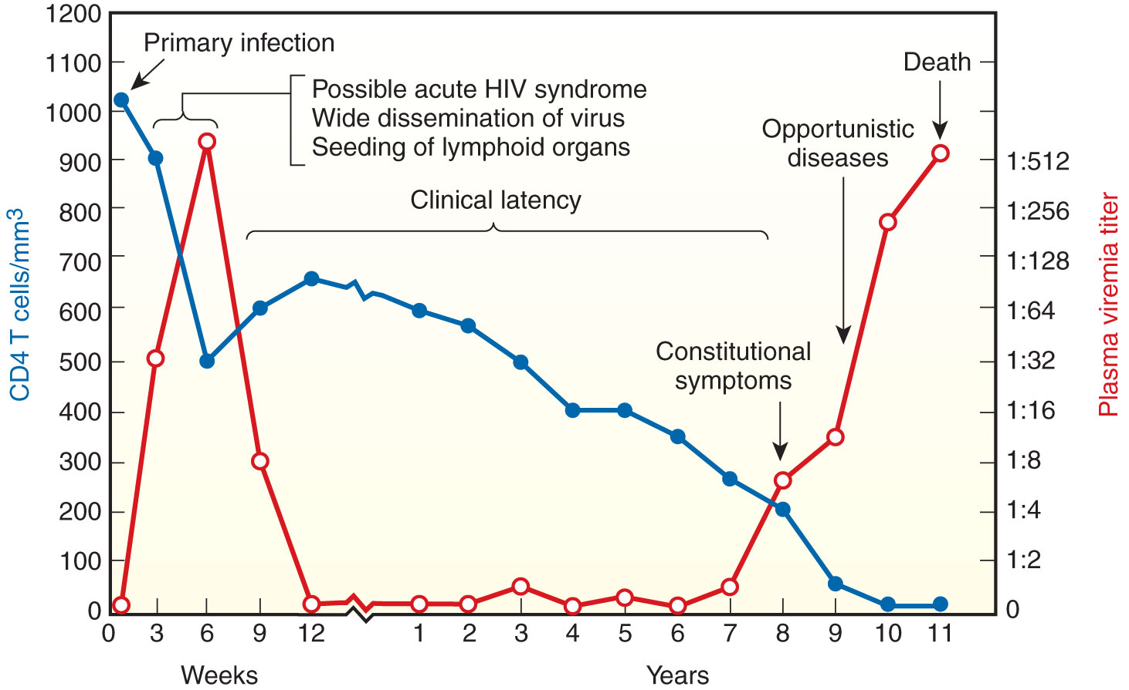
CD4 T-Cell Numbers and Plasma Viremia During HIV Infection
Notes:
The figure shows typical CD4 T-cell numbers and plasma viremia during the course of HIV infection in an untreated patient. The figure illustrates how monitoring these two parameters can be useful to evaluate immune status and viral load over time.
CD4 T-cell counts typically decrease rapidly at the onset of infection, and then rebound and decline more slowly during the latent period, when the immune system is keeping the virus in check. At the onset of AIDS, CD4 T-cell numbers begin to decline to very low levels.
Plasma viremia increases rapidly at the onset of infection, and then decreases to undetectable levels when the virus is being destroyed by the immune responses during clinical latency. At the onset of AIDS, viremia will increase as the virus becomes reactivated and profoundly destroys the immune system.
Effective antiviral therapy results in a prolonged latency period with higher CD4 T-cell numbers and, ideally, an undetectable level of viremia.

Slide 26
Drug Resistance Testing
Genotype resistance assays
Performed in clinical laboratory settings
HIV reverse transcriptase and protease genes from RNA in patient plasma amplified by RT-PCR
Products sequenced and analyzed with software for mutations
Results reported as:
Resistance
Possible resistance
No evidence of resistance
Notes:
Rapid replication of HIV can result in mutations that enable drug-resistant populations to emerge during the course of ART. To check for this issue, two types of methods have been developed: genotype resistance assays and phenotype resistance assays.
Genotyping is recommended by the U.S. Department of Health and Human Services before initiation of ART, in patients in whom CART has failed, and in all HIV-positive pregnant women.
Both genotype and phenotype assays require at least 500 to 1,000 copies of HIV RNA/mL in the test sample and for the resistant virus to constitute more than 25% of the total HIV population harbored by the patient. Despite these limitations, ART appears to be more successful in patients who have undergone drug resistance testing.

Slide 27
Drug Resistance Testing
Phenotype resistance assays
Determine ability of HIV from clinical samples to grow in presence of antiretroviral drugs
Involve sophisticated technologies only performed by specialized reference laboratories

Slide 28
Testing of Infants Younger Than 18 Months
Maternal antibodies in infant serum can complicate serologic test results
Molecular methods are used for diagnosis
Qualitative HIV-1 DNA PCR using infant’s peripheral blood mononuclear cells is the preferred method
Serologic testing at 12 to 18 months of age may be used to confirm diagnosis
Notes:
Remember that IgG can cross the placenta during pregnancy.
Nucleic acid tests for HIV should be performed in infants with known perinatal exposure at 14 to 21 days, 1 to 2 months, and 4 to 6 months of age. Positive tests should be confirmed by repeat testing on a second sample because false-positive results can occur.
Two or more negative test results at 1 month of age and older than 4 months of age provide evidence for absence of HIV infection.
Quantitative RNA assays may also be used but are not as sensitive as DNA assays.
There is also increased emphasis on screening pregnant women for HIV.
Early detection is important because infants have a better prognosis when CART is started early.

Slide 29
Summary
HIV-1 is the cause of the majority of AIDS cases throughout the world.
Transmission of HIV occurs:
By intimate sexual contact
By contact with contaminated blood or body fluids
Perinatally
HIV is a retrovirus with three structural genes:
gag
pol
env
The primary targets of HIV infection are CD4 T cells and macrophages; CD4 serves as the main receptor for entry of the virus into the host cells

Slide 30
Summary
Although the body mounts innate defenses and produces specific antibodies and cytotoxic T-cell responses against HIV, the virus has developed several escape mechanisms that allow it to persist
There are three phases in the natural course of HIV infection:
Primary infection
Latency
AIDS
Treatment with CART is recommended for all HIV-infected persons and has resulted in delayed disease progression, decreased mortality, and reduced perinatal transmission

Slide 31
Summary
The current Centers for Disease Control and Prevention testing algorithm for HIV infection consists of screening by a fourth-generation immunoassay that detects HIV-1 and HIV-2 antibodies and p24 antigen
Positive results are confirmed with a rapid EIA that distinguishes between HIV-1 and HIV-2
Discrepant results are resolved by nucleic acid testing
The current algorithm is more accurate and faster than screening with an ELISA and confirming positive results with a Western blot

Slide 32
Summary
Patients with HIV infection are routinely monitored by performing CD4 T-cell enumeration and viral load testing
Molecular methods play an important role in resolving discrepant screening results, monitoring patient viral load during CART, detecting antiviral drug resistance, and diagnosing infections in infants younger than 18 months of age

