Slide 1
Chapter 3
The Kidney

Slide 2
Kidneys
Anatomically distinct areas:
Cortex
Medulla
Glomeruli located in outer cortex; exclusive site of plasma filtration
Medulla consists of pyramid-shaped tissue
Each pyramid has a duct that enters a calyx
Calyces funnel urine from collecting tubules to renal pelvis

Slide 3
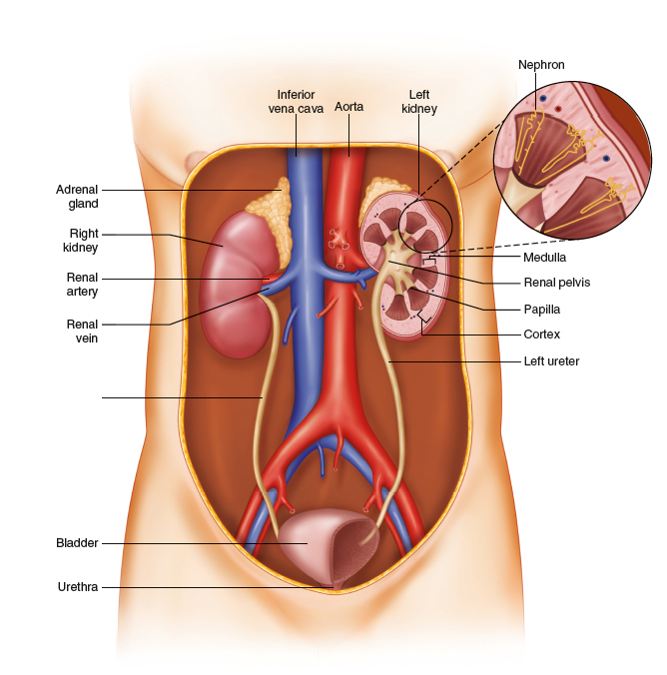

Slide 4
Flow of Urine
Urine from each renal pelvis enters a ureter, which is about 25 cm long
Urine passes from ureter to bladder, which serves as a holding area
When about 150 mL of urine accumulates, a nerve reflex signals an urge to urinate
Contraction of bladder and relaxation of urinary sphincter push urine into urethra (4 cm long in women, 24 cm in men) leading to outside of the body

Slide 5
Nephron: The Functional Unit
1.3 million nephrons in a kidney
Five distinct areas:
Glomerulus
Capillary tuft surrounded by Bowman’s capsule, where filtration occurs
Proximal convoluted tubule
Loop of Henle
Distal convoluted tubule
Reabsorption and secretion of small molecules take place in the tubules, also reabsorption of water to concentrate the urine
Collecting tubule

Slide 6
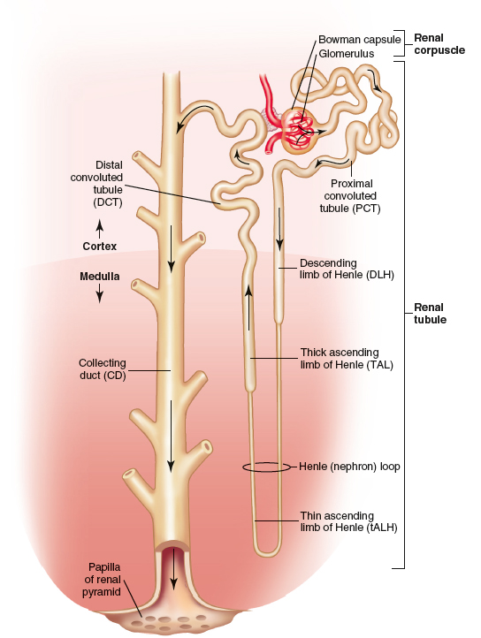
Modified from Patton KT, Thibodeau GA: Anatomy and physiology, ed 9, St Louis, 2016, Mosby.

Slide 7
The Glomerulus
An afferent arteriole supplies blood individually to the glomerulus of each nephron
Branches into a capillary tuft on entering
Capillaries come back together to form efferent arteriole on exiting
Efferent arteriole branches a second time into a capillary plexus
High hydrostatic pressure of afferent arteriole is driving force behind glomerular filtration

Slide 8
Figure 3-4. A schematic overview of a glomerulus. The afferent arteriole enters the glomerulus and the efferent arteriole exits the glomerulus at the vascular pole. Also at the vascular pole, a portion of the thick ascending limb of the distal tubule, the macula densa, is in contact with the glomerular mesangium. Bowman’s space is formed from specialized epithelial cells (Bowman’s capsule) at the end of a renal tubule. At the urinary pole, Bowman’s space becomes the tubular lumen of the proximal tubule. Podocytes are the epithelial cells that cover the glomerular capillaries and derive their name from their characteristic footlike processes. The glomerular capillaries are lined with fenestrated endothelial cells (i.e., epithelium with pores). The basement membrane, which separates the capillary endothelium and the podocytes (the epithelium of Bowman’s space), is continuous throughout the glomerulus. The basement membrane is absent between the capillary endothelium and the mesangium. The mesangial cells of the glomerular tuft form the structural core of the glomerulus and are continuous with the extraglomerular mesangial cells located at the vascular pole between the afferent and efferent arterioles. The secretory granules of the granular cells contain large amounts of renin. The afferent arteriole is innervated by sympathetic nerves.

Slide 9
Renin
Large amounts of secretory granules containing enzyme renin are present in afferent arteriole of juxtaglomerular apparatus
Renin is released in response to:
Decreased arterial blood pressure or volume
Decreased sodium (Na) or increased potassium (K)
Vascular hemorrhage
Renin causes angiotensin formation and aldosterone secretion
Aldosterone causes kidneys to retain sodium and water
Blood pressure will rise as a result

Slide 10
Urine Formation
180,000 mL of plasma is filtered each day producing a final urine volume of 600 to 1800 mL
Urine formation consists of:
Plasma filtration at glomeruli
Reabsorption and selective secretion by renal tubules
Kidneys play important roles in:
Removal of metabolic wastes
Regulation of water and electrolytes
Maintenance of body’s acid-base equilibrium

Slide 11
Glomerular Filtration
Three structures of glomerular filtration barrier:
Capillary endothelium with its large open pores
Trilayer basement membrane
Filtration diaphragms located between podocytes of Bowman’s space
Selectivity of barrier based on molecular size and charge, allowing water and small molecules to pass rapidly
Endothelium has a negative charge that large molecules have to overcome to pass

Slide 12
Figure 3-8. The general histologic characteristics of the renal tubular epithelium. Representative cross-sections of the various tubular segments roughly indicate their cellular morphology and the relative size of the cells, the tubules, and the tubular lumens.

Slide 13
Tubular Transport
Reabsorption and secretion mechanisms are same, differing only in direction of movement:
Reabsorption—back to blood
Secretion—to the urine
Tubular transport mechanisms are active or passive
Active—moves against a gradient, requires energy
Passive—movement from a higher concentration to an area of lower concentration
Each solute has a specific transport system that may differ by area of tubule where it occurs

Slide 14
Reabsorption and Secretion
Tubules selectively reabsorb substances necessary for body homeostasis and function, such as water, amino acids, salts, and glucose
Does not reabsorb waste products such as creatinine
Secretion occurs to:
Eliminate wastes and substances not normally present in plasma
Adjust acid-base status of body
Most substances secreted (other than hydrogen [H], ammonia [NH₃], and potassium [K]) are weak acids or bases from metabolic or exogenous sources

Slide 15
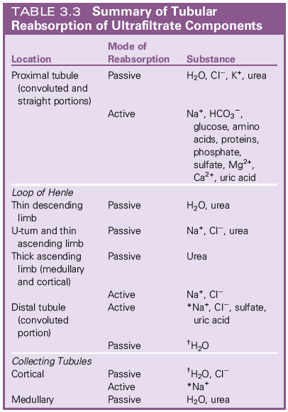

Slide 16
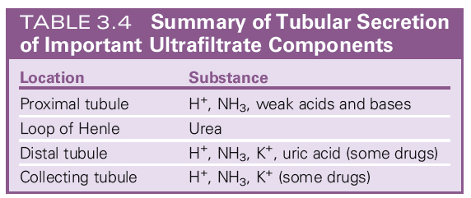

Slide 17
Regulation of Blood pH
Normal range 7.35 to 7.45
Three body systems involved in maintenance of pH:
Blood bicarbonate buffer system
Buffers prevent pH from changing
Pulmonary system
Lungs can exhale or retain carbon dioxide (an acid)
Renal system
Increases or decreases excretion of hydrogen (H) ions
Increases or decreases formation of ammonia
Increases or decreases reabsorption of bicarbonate

Slide 18
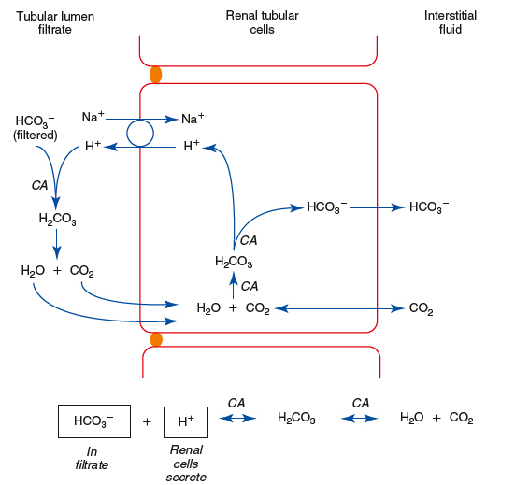

Slide 19
Antidiuretic Hormone (ADH)
Also known as vasopressin
Controls water reabsorption in collecting tubules
ADH is produced in hypothalamus but released into blood from posterior pituitary gland
Causes a change in tubule epithelium, and increased water reabsorption occurs
Release of ADH controlled by negative feedback with arterial blood pressure and positive feedback with plasma osmolality

Slide 20
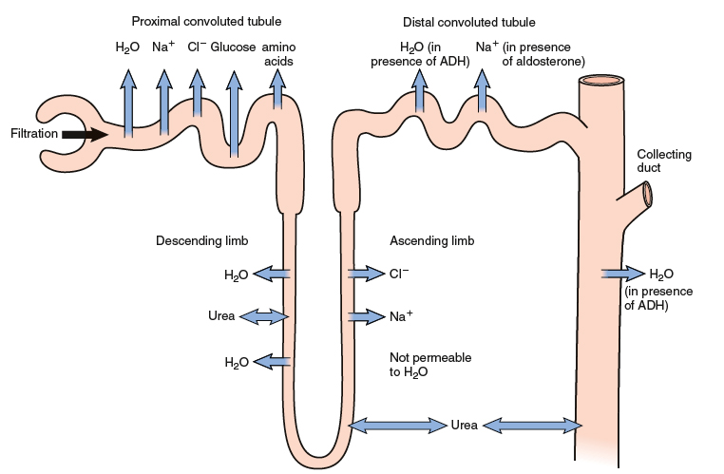
From Applegate E: The anatomy and physiology learning system, ed 4, Philadelphia, 2011, Saunders.

