Slide 1
Chapter 4
Renal Function

Slide 2
Urine Composition
Normal ranges are wide as urine volume and solute composition can vary greatly depending on:
Diet
Physical activity
Health
Kidneys are principal organ for regulating body fluid composition
Renal excretion is primary elimination route of soluble metabolic wastes
Wastes exclusively excreted by kidneys can be used to assess kidney function (creatinine, urea)

Slide 3
Measures of Concentration
Osmolality
Osmoles per kilogram (Os/kg) (milliosmoles used for convenience)
Affected by solute number, not size or weight
Final osmolality determined in distal and collecting tubules when antidiuretic hormone (ADH) is present
Normally urine osmolality is 1 to 3 times that of plasma
Specific gravity
Comparison of density of urine to that of water
Normally ranges from 1.002 to 1.035
Depends on number of particles and mass

Slide 4
Urine Volume
Polyuria—greater than 3 L/day
Conditions with water diuresis (osmolality <200 mOsm/kg)
ADH secretion inadequate or receptors ineffective
Conditions with solute diuresis (osmolality ≥300 mOsm/kg)
No common feature, but involve glucose, urea, or sodium
Oliguria—less than 400 mL/day
Urinary obstruction, tubular dysfunction, fluid loss
Anuria—absence or cessation of urine excretion
Progressive renal disease or renal failure

Slide 5
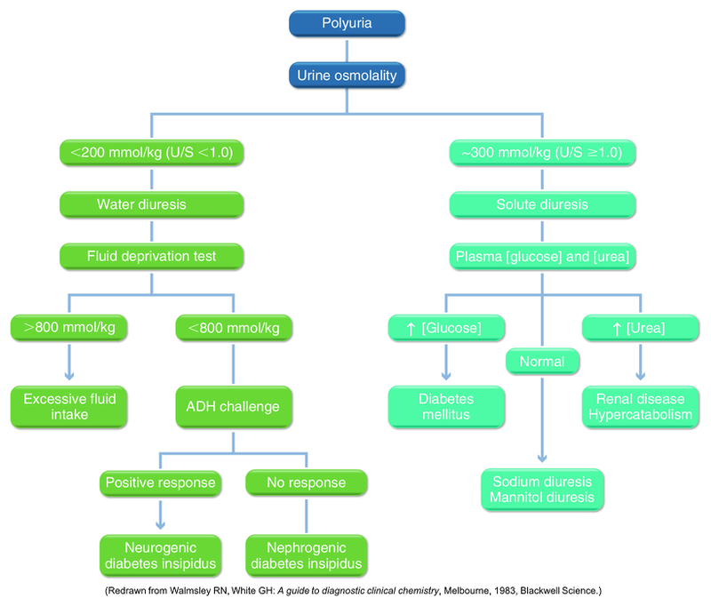
A flowchart for the evaluation of polyuria. ADH, Antidiuretic hormone; U/S, urine-to-serum osmolality ratio. (Redrawn from Walmsley RN, White GH: A guide to diagnostic clinical chemistry, Melbourne, 1983, Blackwell Science.)

Slide 6
Testing Renal Concentrating Ability
Assess tubular reabsorptive function by demonstrating tubules can produce concentrated urine specimen (osmolality >800 mOsm or specific gravity >1.025)
Osmolality preferred
More accurate reflection of kidney’s concentrating ability, since only solute number affects it
Three most prevalent solutes:
Urea
Chloride
Sodium

Slide 7
Fixation of Solute Concentration
In some chronic renal diseases, concentrating ability slowly diminishes until specific gravity or osmolality are unchanging
Urine concentration same as ultrafiltrate
Specific gravity of 1.010 or approximately 300 mOsm/kg
Causes polyuria and nocturia

Slide 8
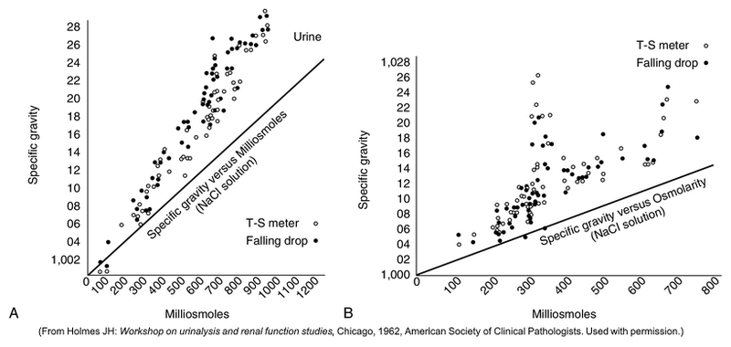
Figure 4-4. A comparison of urine specific gravity and urine osmolality. Specific gravity measurements were determined by a direct method (falling drop) and an indirect method (refractometry). The straight lines represent the specific gravity and osmolality results obtained with solutions of varying sodium chloride concentrations. (A) A comparison of urines obtained from healthy medical students. (B) A comparison of urines obtained from patients on renal service. (From Holmes JH: Workshop on urinalysis and renal function studies, Chicago, 1962, American Society of Clinical Pathologists. Used with permission.)

Slide 9
Fluid Deprivation Tests
Used to differentiate causes of polyuria due to water diuresis
“Neurogenic” diabetes insipidus
ADH decreased
“Nephrogenic” diabetes insipidus
Lack of renal response to ADH
Water consumption restricted
Urine specimen checked about 12 hours later
If concentrated, test is ended. If not, test continues.
Can compare with plasma concentration or administer ADH to see if that helps

Slide 10
Renal Clearance Tests to Assess Glomerular Filtration Rate (GFR)
Volume of plasma in milliliters that is completely cleared of a substance per unit of time
Volume of plasma filtered directly affects volume and composition of urine excreted
Calculate renal clearance (C) using plasma concentration of substance (P), urine concentration (U), and volume of urine (V)

Slide 11
Clearance Tests
Tests for GFR use substances removed solely by glomerular filtration (inulin)
Tests for tubular secretion use substances removed solely by tubular secretion (phenolsulfonphthalein [PSP] or p-aminohippurate)
Can use endogenous or exogenous substances
Inulin is reference method for GFR testing, although rarely used
Creatinine clearance is most commonly used

Slide 12
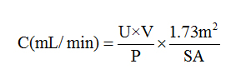
Creatinine Clearance
Creatinine is a waste product of creatine in muscles, produced at a relatively constant rate and excreted by kidneys
Requires a 24-hour urine creatinine (U) and serum creatinine (P) drawn sometime during urine collection period, urine volume (V), and an estimate of body surface area (from height and weight using a nomogram)

Slide 13
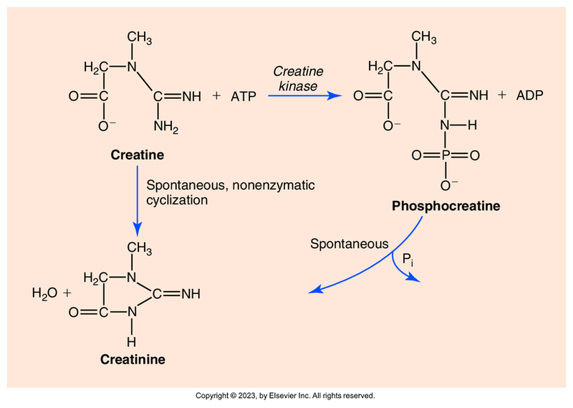
Figure 4-5. The formation of creatinine from creatine and phosphocreatine. ADP, Adenosine diphosphate; ATP, adenosine triphosphate.

Slide 14
Advantages/Disadvantages of Creatinine Clearance
Plasma and urine creatinine tests easily performed
Accuracy and precision of methods well studied
Small amount of creatinine secreted by tubules (7% to 10%), resulting in an increased urine concentration of creatinine
If nonspecific Jaffe method is used to measure, P creatinine will be overestimated, offsetting increased U value, giving values close to inulin clearance results

Slide 15
Estimated Glomerular Filtration Rate (eGFR)
Simple, effective tool that helps to detect chronic kidney disease
Used for high-risk individuals with diabetes, hypertension, heart disease, or family history of kidney disease
Calculation based on serum creatinine level and patient’s age, gender, and ethnicity
Most accurate values are less than or equal to 60 mL/min, so values greater than 60 are reported simply as greater than 60. Numerical values are reported for values less than or equal to 60 mL/min.

Slide 16
Beta₂-Microglobulin
A low-molecular-weight protein found on surface of nucleated cells and shed into plasma
Readily passes through glomeruli and is 99.9% reabsorbed by proximal tubules
Marker of reduced tubular function when it increases in urine
Used clinically to:
Identify early kidney transplant rejection
Differentiate tubular and glomerular diseases

Slide 17
Cystatin C
Low-molecular-weight protein that has potential as a marker for long-term monitoring of renal function
Produced by nucleated cells and filtered by glomerulus and is catabolized by tubular cells
Increased plasma levels reflect decreased glomerular function
Not yet used routinely

Slide 18
Screening for Albuminuria
Albuminuria appears early in diabetic nephropathy
Early detection of low levels of albumin in urine (microalbuminuria) signals need for additional testing and aggressive intervention
Presence of albumin is caused by increased glomerular permeability due to changes in glomerular filtration barrier
Single most important factor associated with glomerular proteinuria is hyperglycemia

Slide 19
Other Tests
p-Aminohippurate clearance
Exogenous nontoxic weak acid secreted almost exclusively by proximal tubules, used as indicator of renal tubular secretory function
Measurement of titratable acid versus urinary ammonia
Assess tubular function for removing acids
Oral ammonium chloride test
Give ammonium chloride, and measure series of urine pH and plasma bicarbonate. Used to diagnose renal tubular acidosis

Slide 20
Most Commonly Used Tests for Evaluating Renal Function
Creatinine clearance for assessment of GFR
Urine osmolality for tubular concentrating ability
Urine protein electrophoresis to evaluate glomerular permeability to plasma proteins
Plasma creatinine
eGFR calculation

