Slide 1
Clinical Laboratory Hematology
Hematopoiesis I

Slide 2
Hematopoiesis
Blood cell production is a relatively large and complex process.
Hematopoiesis is the cellular formation, proliferation, differentiation, and maturation of all blood cells and their associated organ(s).

Slide 3
Hematopoiesis
In embryogenesis—hematopoiesis occurs in a spatial and temporal manner in 3 distinct site(s)—
Mesoblastic stage: 2nd week of embryogenesis, occurs in ‘blood islands’ located in the extraembryonic yolk sac—arises via hemangioblast precursor(s).
RBCs
Gower 1 Hgb (ζ2ε2), Gower 2 Hgb (α2ε2), and Portland Hgb (ζ2γ2).

Slide 4
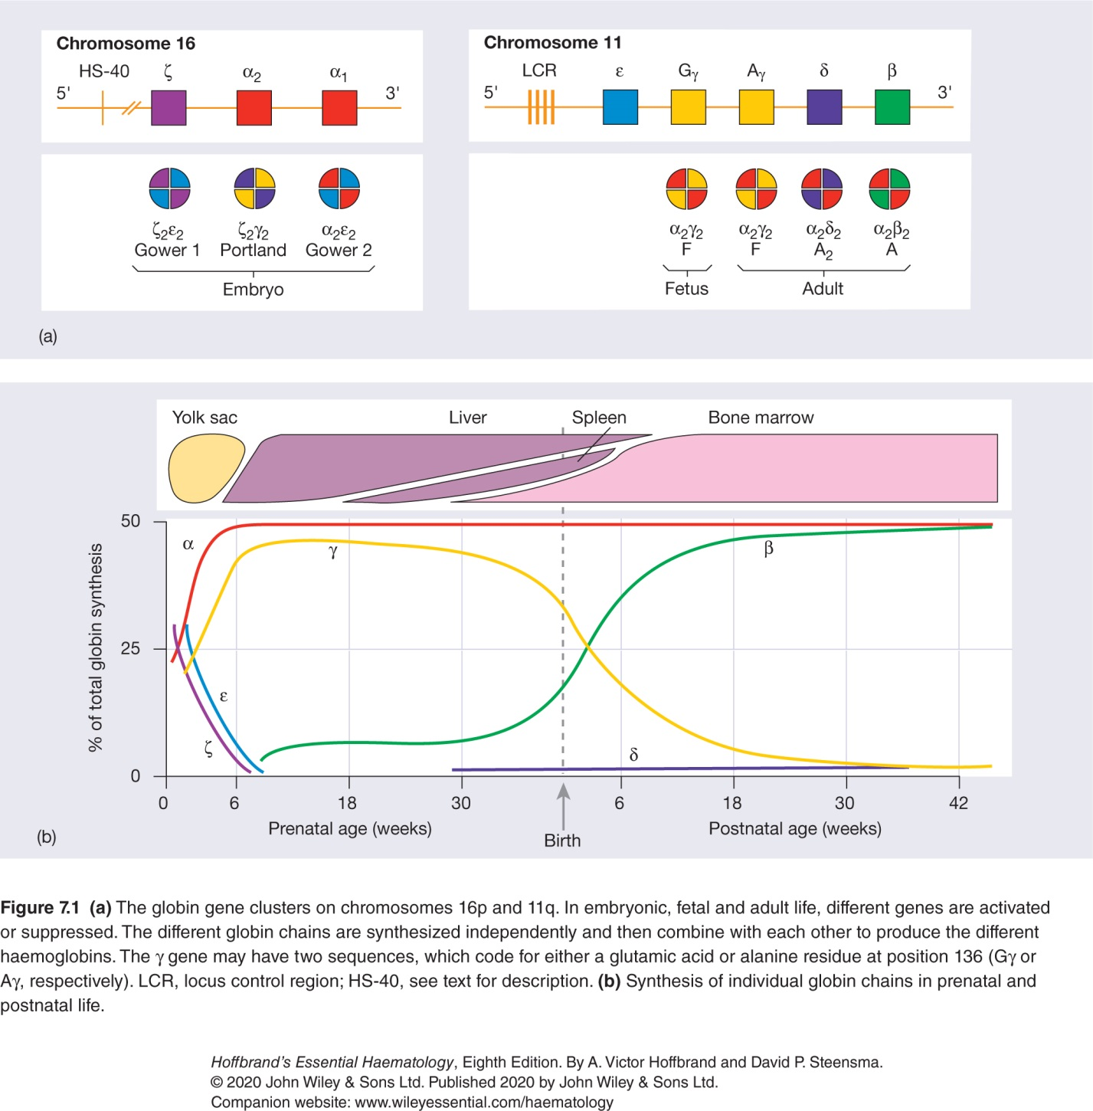

Slide 5
Hematopoiesis (cont’d)
2. Hepatic – 3rd to 6th month – the fetal liver is the principle hematopoietic organ; spleen, thymus, and lymph nodes are also involved—
RBCs and PMNs like neutrophils;
F Hgb (α2γ2), A Hgb (α2β2), A2 (α2δ2) Hgb, and A1C Hgb.

Slide 7
Hematopoiesis (cont’d)
3. Myeloid – by 3rd trimester, the BONE MARROW is the dominant site (after fetal liver stage) it is the only site of hematopoiesis (medullary site; pelvis; vertebrae, sternum, ribs, skull, proximal ends of femur, and humerus).
Normal BM% cellularity (the rest is lipid) – production sites depend on AGE and HEALTH of the individual—
100% infant
70% young adult;
50% young adult;
30% senior adult.

Slide 8
Hematopoiesis (cont’d)
Mature HSCs are found in the bone marrow are capable of differentiation, capable of self-renewal, but not morphologically (CD34 – flow).
HSC becomes differentiated PROGENITOR cells which are capable of limited self-renewal (CD34 – Flow). (Ex. CFU-GM, CFU-GEMM, CFU = Colony Forming Unit)
Progenitor cells become morphologically recognizable precursor cells.
Process is requested by hematopoietic growth factors = HGF = cytokines = colony stimulating factors (e.g., EPO, GM-CSF).

Slide 9
Hematopoiesis (cont’d)
Hematopoietic growth factors = cytokines = colony stimulating factors (CSFs) regulate all hematopoietic processes.
Function as hormones (autocrine, paracrine, endocrine) [cell, tissue, &c.];
Exhibit pleiotropy;
Synergistic (in tandem with others);
Direct/indirect actions
Minutely produced by Monocytes. T-lymphocytes; MØ, and endothelial cells.
Biopharma – recombinant DNA tech;
Can be used as therapeutic agents (EPO, GM-CSF, thrombopoietin, &c.

Slide 10
Erythropoiesis
1. The Erythron: all circulating RBCs and their precursors in the body.
2. Primary function: adequate tissue oxygenation – accomplished by maintaining the appropriate number of circulating RBCs which carry oxygen to tissues and cells.

Slide 11
Erythropoietin (EPO)
Function: stimulates erythroid proliferation and maturation.
The concentration is related to the degree of tissue hypoxia which is influenced by tissue oxygen pressure.
Hypoxia – attributable to high altitude, lung disease, anemia – EPO can increase RBC concentration up to ~10x max.
Primary site of EPO production is the kidney—other secondary sites.

Slide 12
Erythropoietin (cont’d)
Initiated a coordinated development program in EPO sensitive cells (precursors to normoblasts in BM in eyrthroblastic islands) including—
Stimulation of RNA and protein synthesis;
Cell-cycle progression (DNA replication and mitosis);
Co-transcriptional processing of RNA transcripts for Hgb required for developing erythroblasts;
Net effect; recruit more stem cells into the erythropoietic sequence.

Slide 13
Control of Erythropoiesis
Reciprocally-regulated (balanced)—each day, the exact number are replaced and destroyed. (1% normal).
Age – decreases at birth, pulmonary more efficient than placental oxygenation.
Gender—male higher RBC count than female.
Genetic factors: 2,3-BPG – determines how well oxygen dissociates from Hgb in RBCs (Bohr effect).
Normal ranges for an individual are consistent except for the above factors and circumstances (i.e., pregnancy).

Slide 14
Hgb Metabolism
Hgb anabolic and catabolic pathways
Anabolic (synthesis) – in 3 coordinated events;
Iron transport (adequate supply and delivery);
Synthesis of cyclic tetrapyrroles (protoporphyrins) [which are precursors of heme]
Globin chain synthesis.

Slide 15
Hgb Synthesis & Heme
Iron transport and incorporation into Heme.
Transferrin – protein carrier which delivers Ferrous cations (Fe2+) to RBC precursors;
Ferrous cations enter the cytosol of the RBC precursor;
Enters the inner mitochondrial membrane;
Inserted into the protoporphyrin ring via ferrochelatase to form heme.

Slide 16
Hgb Synthesis & Heme (cont’d)
Excess ferrous cations aggregate as ferritin;
2/3rd of total body iron in heme of Hgb;
The amount of ferrous cations as ferritin depends on plasma iron/amount of Fe2+ needed by RBCs for Hgb synthesis;
Ringed sideroblasts – pathologic increase in Fe2+ as ferritin in erythroblasts.

Slide 17
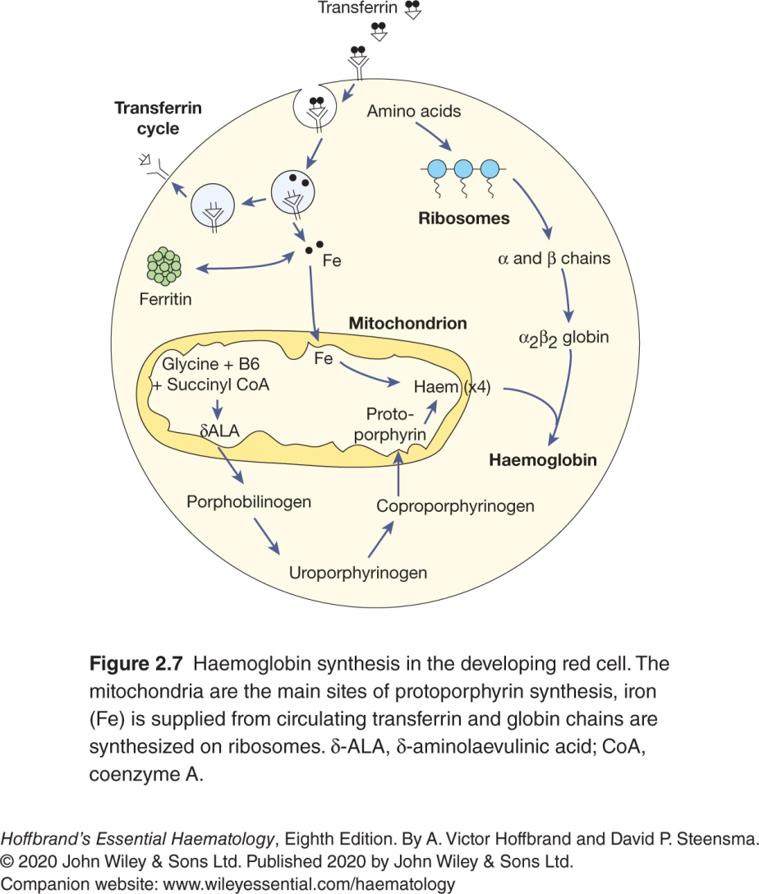

Slide 18
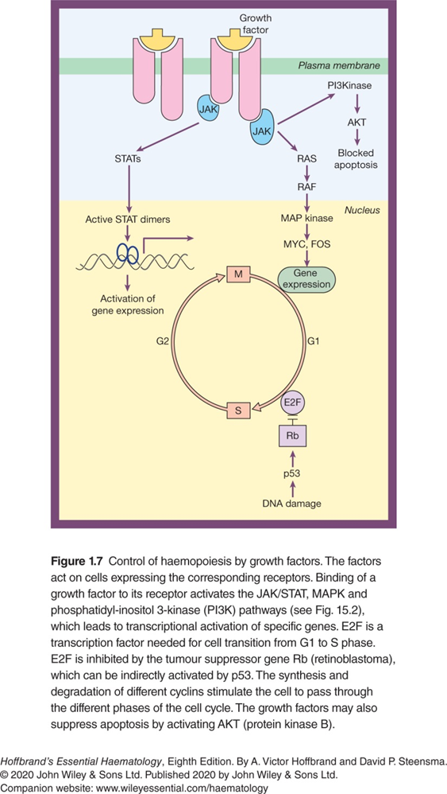
Protoporphyrin Synthesis
In the mitochondria—
δ-ALA (delta-amino-levulonic acid)
Produced by glycine and succinyl CoA (Citrate cycle)
δ-ALA synthase is a mitochondrial enzyme;
Requires Vitamin-B6 as a co-factor.
Transcription of δ-ALA synthase holoenzyme is regulated by EPO (Jak-STAT pathway);
Initial rate-limiting step (the pathway only moves as quickly as its slowest enzyme), compound(s) must commit to the pathway.

Slide 19
Protoporphyrin Synthesis (cont’d)
In the cytosol—
2 molecules of δ-ALA are joined → Pyrrole Porphobilinogen (PBG);
A monopyrrole is generated;
4 molecules of PBG → Hydroxymethylbilane → Uroporphyrinogen III (UPG-III)
A cyclic tetrapyrrole is generated;
4 possible isomers but heme only (UPG-III);
UPG-III → Coproporphyrinogen-III (CPG-III).

Slide 20
Protoporphyrin Synthesis (cont’d)
Back in the mitochondria—
CPG-III → Protoporphyrinogen – IX;
Protoporphyrinogen – IX → Protoporphyrin – IX
Protoporphyrin—IX incorporates a single Fe2+ (ferrous) cation → Ferroprotoporphyrin—IX = Heme
Back to the cytosol:
HEME leaves the mitochondria to go to cytoplasm to combine with globin protein(s) to form hemoglobin (Hgb).

Slide 21
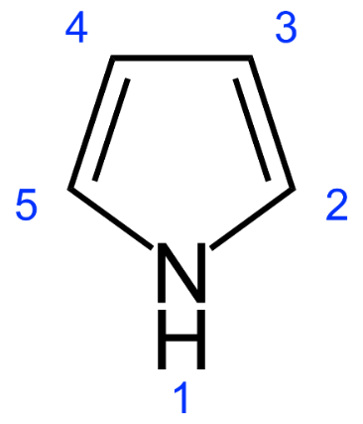
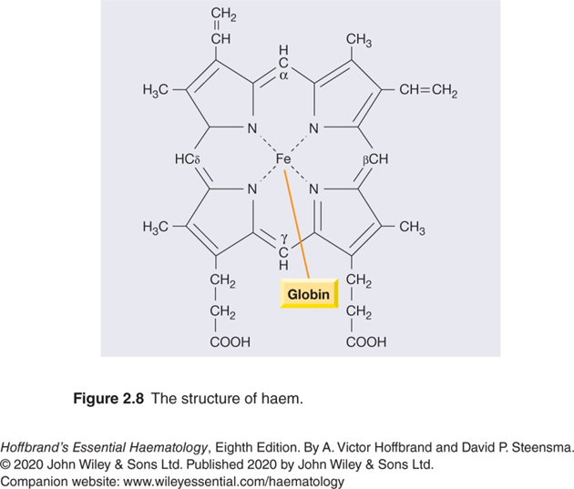
Pyrroles
Linked by methine (=(CH)-CH2-R) groups;
Can be linear (bilanes) [~bilirubin/biliverdin];
Can be cyclic (porphyrins) [~heme].
Heme is a cyclic tetrapyrrole.

Slide 22
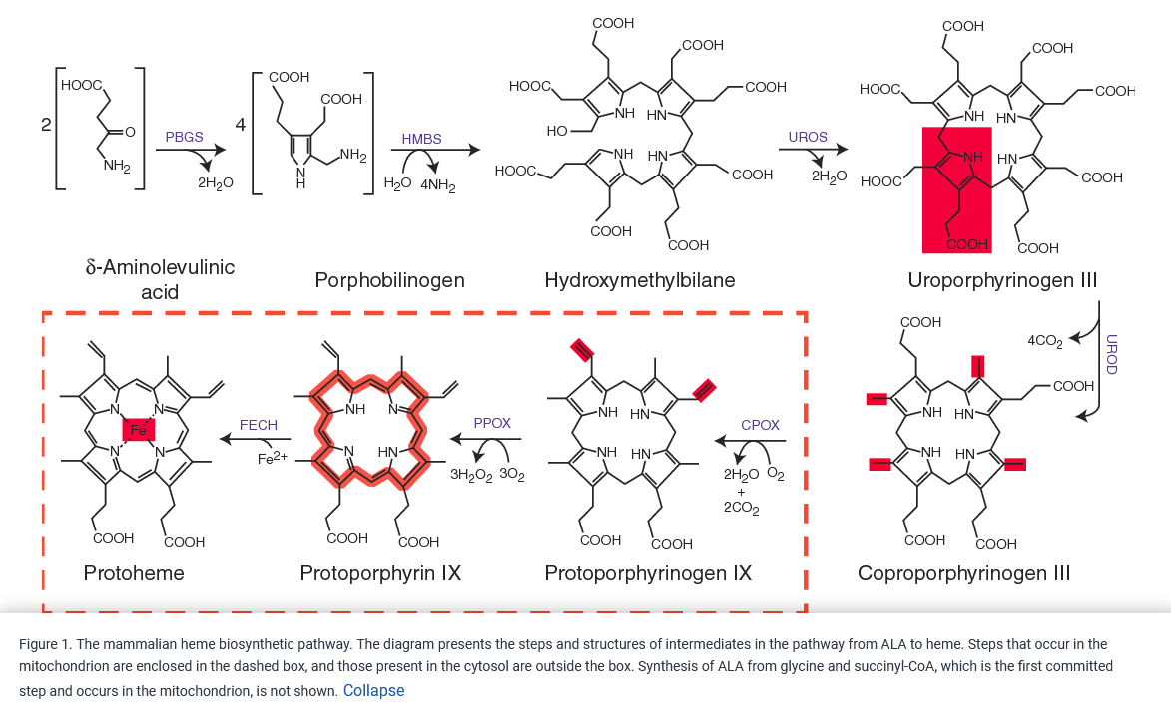

Slide 23
Protoporphyrin Synthesis (cont’d)
Porphyrins—
Normal in small amounts due to catabolic pathways that degrade RBCs;
Excess porphyrins may accumulate due to genetic defects in porphyrin degradation and/or acute toxicity;
Inherited – porphyrias;
Acute toxicity (acquired) – lead poisoning, or chronic liver disease.

Slide 24
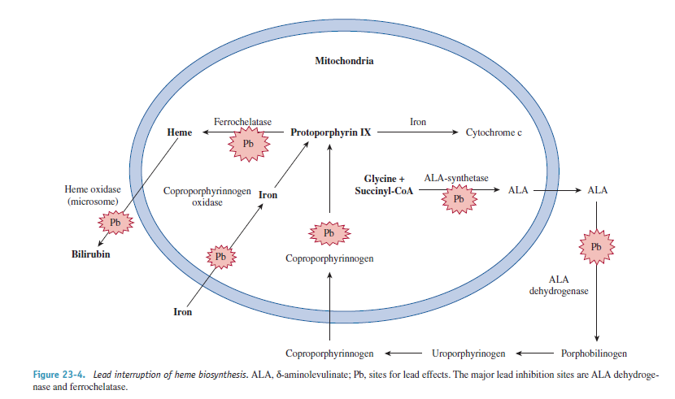
Protoporphyrin Synthesis (cont’d) Hematologic effects of Lead (Pb) toxicity

Slide 25
Hemoglobin
Primary hemoglobin synthesis –BM
Secondary hemoglobin synthesis – liver
Feedback control mechanisms:
EPO and δ-ALA are the rate-limiting step;
DIRECT end product inhibition.

Slide 26
Hemoglobin
Globin = protein; transcription and translation
Resulting gene products in RBCs precursors are alpha-α, beta-β, gamma-γ, delta-δ, epsilon-ε, and zeta-ζ.
RBCs form dimers and then tetramers (groups of 4 but 2 different pairs).

Slide 27
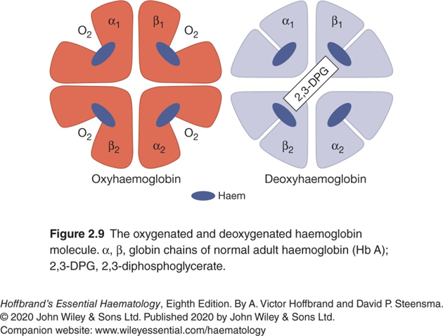
Hemoglobin
Normal Adult Hgb
Hemoglobin A (α2β2) = 2 alpha/2 beta chains. 95-97%
Hemoglobin A1C = glycosylated 3-5%
Hemoglobin A2 (α2δ2) = 2 alpha and delta 2 chains 2-3%;
Hemoglobin F (fetal) [α2γ2] = 2 alpha and 2 gamma chains 2%.

Slide 29
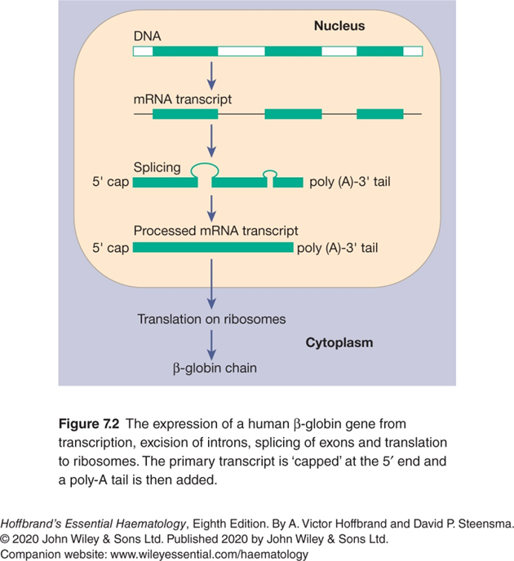
Hemoglobin Synthesis

Slide 30
Normal Hemoglobin
All normal Hgb is a heterotetramer of 2 alpha and 2 other globin chains;
Hemoglobin A (α2β2) = 97%;
Hemoglobin A2 (α2δ2) = 2%;
Hemoglobin F (fetal) [α2γ2] =2%; except neonates.

Slide 31
Abnormal Hemoglobin
Normal: 4 globins + 4 Heme (each with ferrous [Fe2+]);
Abnormal globin = HEMOGLOBINOPATHY
Amino acid substitution of Valine for normal Glutamate in the 6th position of the β globin polypeptide;
Substitution leads to → HGB ‘S’ = sickle cell.
Decreased globin production → Thalassemia (decreased β chain gene) → β-Thalassemia

Slide 32
Rate of Hgb Synthesis
Rate of globin synthesis is proportional to the rate of porphyrin synthesis and vice versa (i.e., negative feedback loop).
Iron different; if either globin or porphyrin production is impaired Fe2+ will → ferritin aggregation.

Slide 33
RBC Metabolic Pathways
RBCs need energy for metabolic processes of approximately ~120/day, a 200-300 mile trek through the body via circulation;
Main pathway – Glycolysis
~90% of energy generated for RBCs is through anaerobic breakdown of glucose;
Primary source of ATP with net gain of 2 molecules of ATP per glucose molecule.

Slide 34
RBC Metabolic Pathways
Efficiency low but adequate for RBCs;
Minute ability to metabolize fatty acids or amino acids;
Mature RBCs – no mitochondria for respiratory chain phosphorylation;
Also generates NADH useful to RBCs;
RBC function is to deliver oxygen so it would defeat the purpose if degraded for energetic purposes.

Slide 35
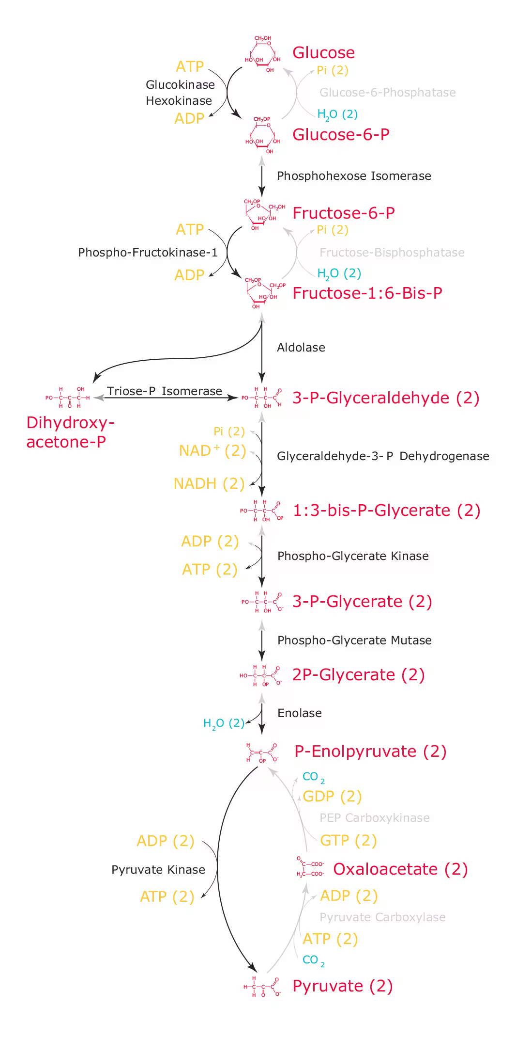
Energetic needs of RBCs
ATPases (i.e., Na+/K+ ATPase) and other pumps of the RBC membrane (Na+, K+, Ca2+ flux).
Maintain lipid composition of membrane.
Maintain membrane resilience and bi-concave shape.
Review Embden-Myerhoff Pathway (glycolysis) →

Slide 36
3 Ancillary EMP Pathways in RBCs
1. Hexose monophosphate shunt (pentose phosphate pathway)
Primary defense when ameliorating oxidative stress.
Increased shunting of hexoses from glycolytic pathway.
Specific enzymes → G6PD key enzyme and G6PD (common)
Oxidative drugs (such as anti-malarial drugs);
Hgb ppt in presence of oxidative injury → Heinz bodies.

Slide 37
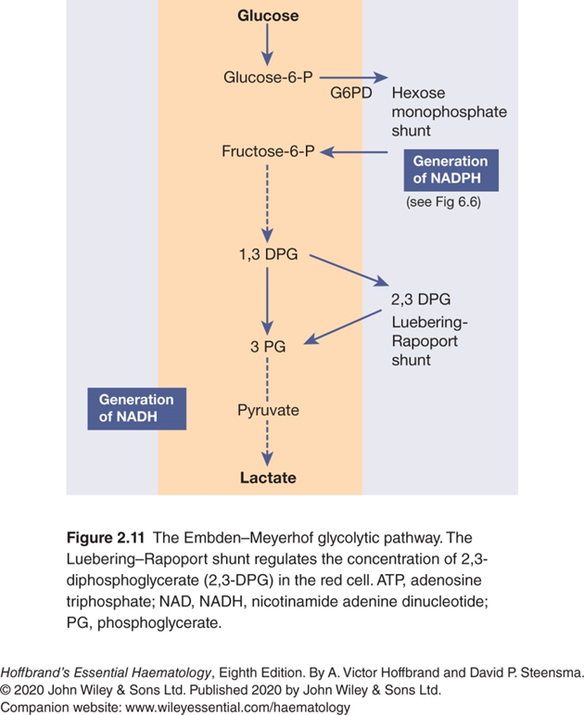
Energetic needs of RBCs

Slide 38
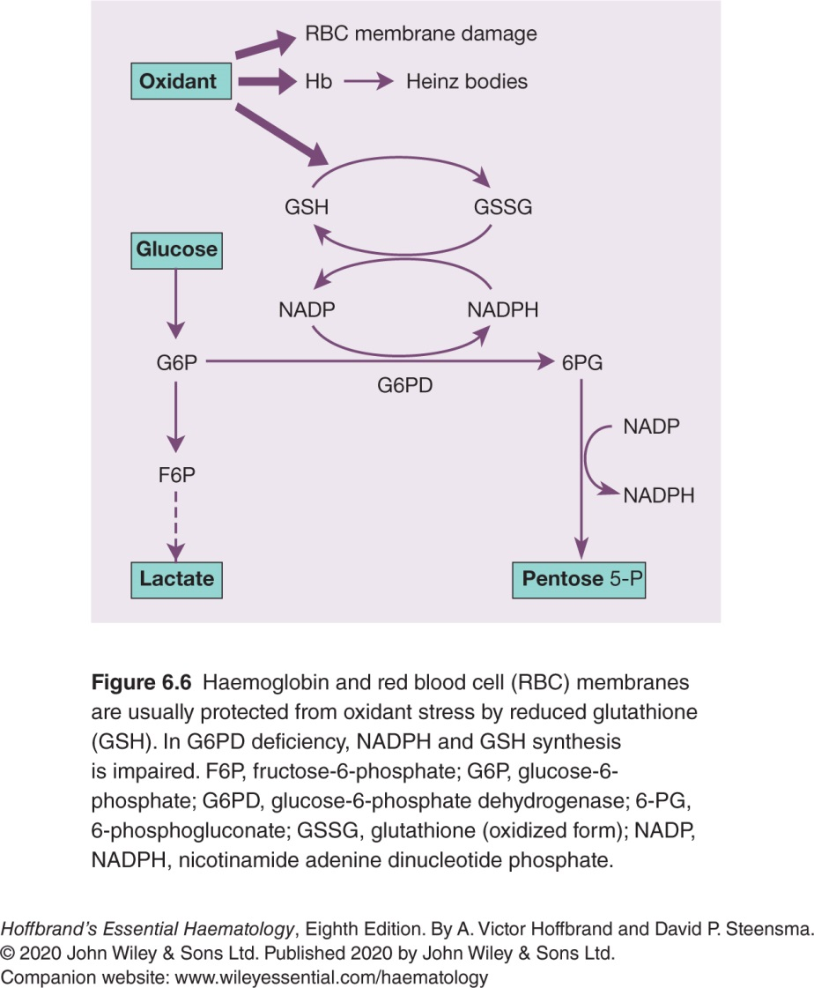

Slide 39
3 Ancillary EMP Pathways in RBCs
2. Methemoglobin reductase pathway (Cyt-B5 reductase) [major pathway]
NADH methemoglobin reductase (minor pathway).
Trace amounts of Met-Hgb is continuously formed in the RBCs (this is normal as it is further reduced)
Hgb → Fe2+ (ferrous/oxidized state) → Met-Hgb (ferric/reduced state) Fe3+.
Met-Hgb is nonfunctional form of Hgb (deoxy- Hgb).
Normally < 1%.
Lesser extent—Vitamin C and glutathione enzyme systems.

Slide 40
3 Ancillary EMP Pathways in RBCs
3. Luebering-Rapaport
Hgb → Fe2+ (ferrous/oxidized state) → Met-Hgb (ferric/reduced state) Fe3+.
Met-Hgb is nonfunctional form of Hgb (deoxy Hgb).
Normally < 1%.
2,3 B/DPG (allosteric regulator and determinant of oxygen dissociation from Hgb).

Slide 41
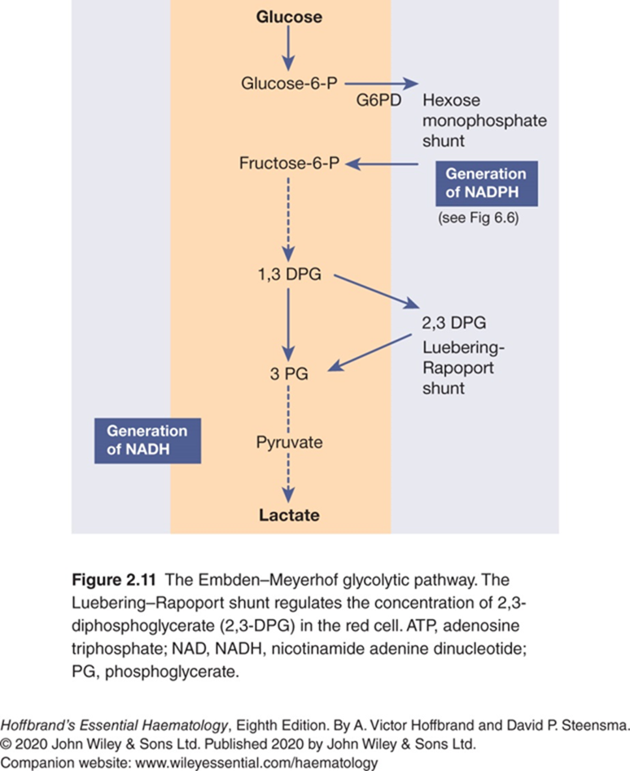

Slide 42
Extravascular RBC Catabolism
Site of extravascular RBC destruction
RES phagocytes (fixed macrophages) in various organs and throughout the body.
RES cells in spleen ‘LITTORAL CELLS’ are most sensitive to age changes (accum Ab, molecules, debris inclusions, &c.) → less pliable.
Sinusoids of spleen 2-3 microns – smallest.
90% aged RBCs removed by extravascular destruction—most efficient and recovery of Fe2+ and amino acids.

Slide 43
Extravascular RBC Catabolism
Heme and globin dissociate
Globin degraded via proteolysis to maintain a.a. pool;
Heme broken down to Fe2+ and protoporphyrin
Fe2+ by transferrin to erythroid precursors in BM and/or stored as ferritin.
Protoporphyrin ring of heme broken down and CO expelled.
Linear pyrroles—
Biliverden;
Bilirubin (indirect, pre-hepatic, unconjugated) w/albumin.
In liver → direct, hepatic, conjugated bilirubin.
Bile → intestinal epithelium as mesobilinogen →
Urobilinogen and Stercobilinogen → urine and stool (as stool pigment (Biliverden).

Slide 44
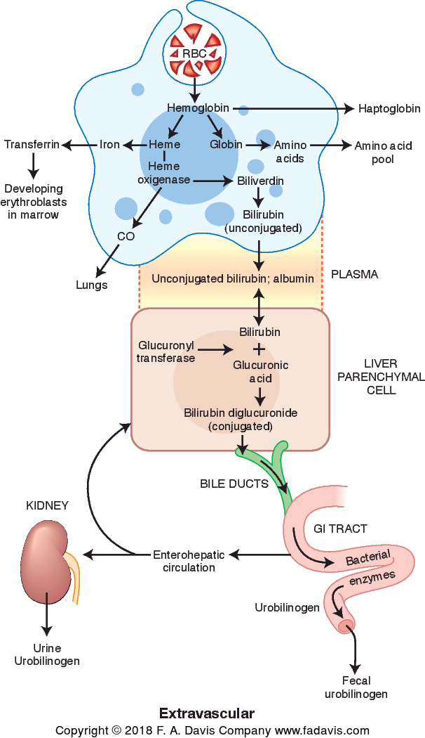
The Normal Erythrocyte
Extravascular Hemolysis
The major pathways of red cell distribution and hemoglobin degradation involving the reticuloendothelial system. This takes place primarily in the spleen.

Slide 45
Intravascular RBC Catabolism
1. 10% of RBCS are destroyed by spontaneous lysis within the lumen of the blood vessels 5-10%
2. Hemoglobin tetramer is unstable so Hgb dissociates into alpha-beta dimers which are picked up by Haptoglobin. The Haptoglobin-Hemoglobin complex prevents renal excretion and carries to the liver.
3. Once in Liver RES—macrophages ingest and process in a manner similar to extravascular.

Slide 46
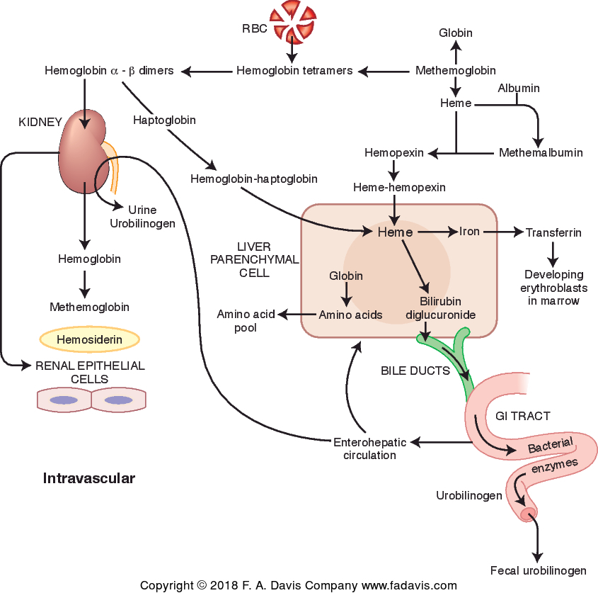
The Normal Erythrocyte
Intravascular Hemolysis
Pathways of hemoglobin transport resulting from red cell destruction in the blood vessels. After the hemoglobin and heme arrive at the hepatic macrophages, degradation follows essentially the same pattern as seen in extravascular hemolysis.

Slide 47
Anticoagulants
EDTA – Hematology
Removes Ca2+ so blood will not clot (Ca2+ necessary for normal clotting)
EDTA preserves cell morphology
EDTA causes platelet clumping with some patients and some medications.
Blood Bank & Chemistry use the tube additive for plasma testing.

Slide 48
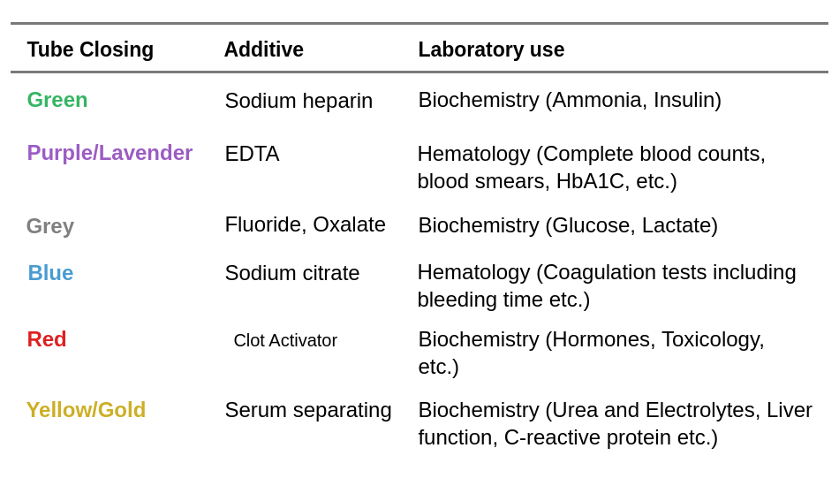
Anticoagulants

Slide 49
Serum vs. Plasma
Plasma – clear, yellowish fluid that contains approx. 55% of the total volume of blood and consists of 92% H2O, 7% proteins, dissolved gases, hormones, &c.
Serum – plasma from which primarily FIBRINOGEN and the COAGULATION FACTORS have been removed. Clear, yellowish fluid that separates from blood when it is allowed to clot.

Slide 50
Oxygen Dissociation Curve
Normal curve – note the shape of the curve; a considerable amount of oxygen can be delivered to the tissues with a small drop in oxygen tension. (Also known as the Bohr effect).
Shifted curve –
Decreased pH – decreased Oxygen affinity – increased BPG
Increased pH – increased oxygen affinity and decreased BPG.

Slide 51
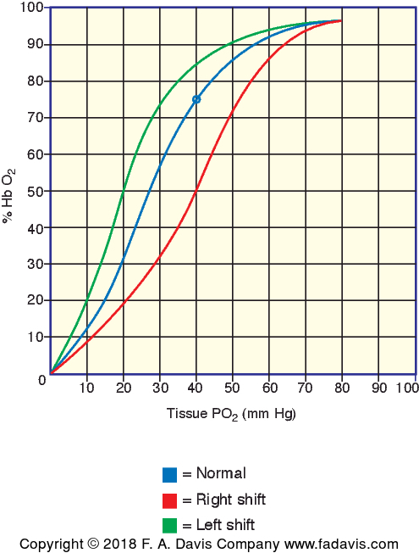

Slide 52
Chapter Review
What are the three phases of hematopoiesis?
What types of hemoglobin are present in each phase?
At what age of development is each phase?
What are the primary and secondary lymphatic tissues?
Outline the major divisions of monophyletic hematopoiesis.
What is EPO? How does it affect hematopoiesis?

