Slide 1
Clinical Laboratory Hematology
Erythropoiesis

Slide 2
Site(s) of Production - Adults
Bone marrow cavities of axial skeleton and flat bones of normal adult humans.
  Replaced by lipids as a person matures.
  Structure of BM = special environment for—
    Hematopoietic cell proliferation and maturation;
    Cells in a fine reticulin mesh—vascular sinuses give access to plasma nutrients;
    Retains cells until properties allow penetration of endothelial barrier.

Slide 3
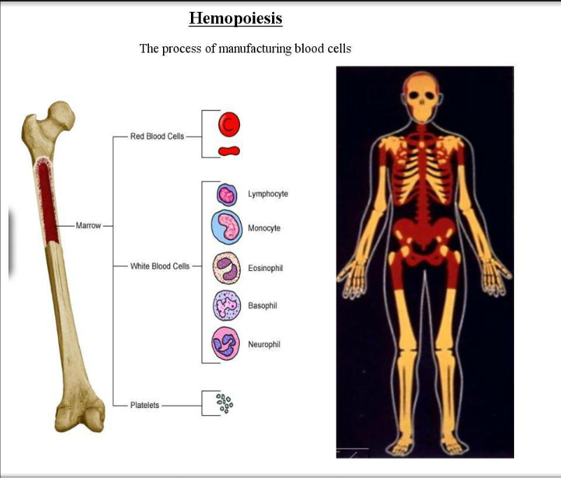

Slide 4
Pluripotent(ial) Stem Cells
Induced by certain micro-environmental influences to become the committed erythroid progenitor cell.
BFU-E → Burst forming units – RBC proliferation controlled by growth conditioning from lymphocytes and macrophages (no EPO);
1 = 1000 RBCs
CFU → Colony forming units – RBC under EPO control; results in morphologically recognizable RBCs; 1=100 RBCs.

Slide 5
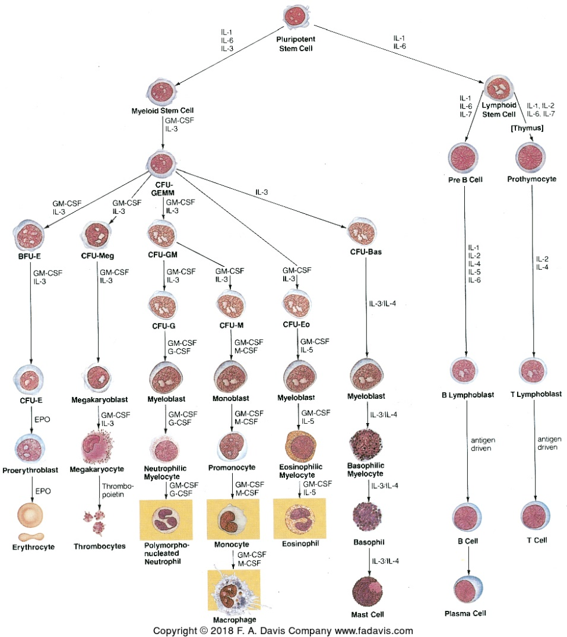
Hematopoiesis is regulated by CSFs and interleukins
CSF – colony stimulating factor
Burst forming units – less potential for mitosis
Colony forming units

Slide 6
Regulation of Erythropoiesis
Source primarily in the kidneys;
10% elsewhere; without EPO, RBC production is supported but at a reduced level (H&H = 6/18) normally 12/16.
Can stimulate DIFFERENTIATION of committed stem cells into RBC precursors.
Can stimulate committed erythroid stem cells to PROLIFERATE;
Can decrease RBC maturation time;
  Can release BM reticulocytes early; SHIFT RETICS;
  Can modify walls of the BM to facilitate early release.
  Maturation occurs from Rubriblast stages, onward as there is no need to continue mitotic division.

Slide 7
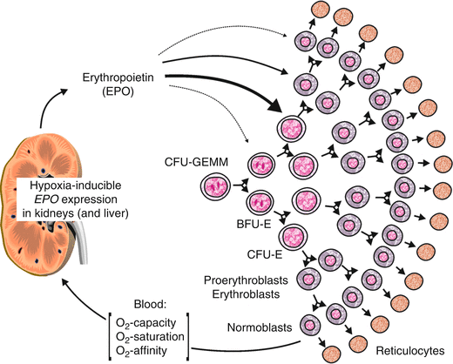

Slide 8
Feedback Mechanisms
Prostaglandins – enhance EPO activity;
Androgens – stimulate EPO activity (higher RBC count in males)
Estrogens – inhibit EPO activity
EPOGEN (Procrit) = recombinant DNA EPO (synthetic EPO made in the laboratory).

Slide 9
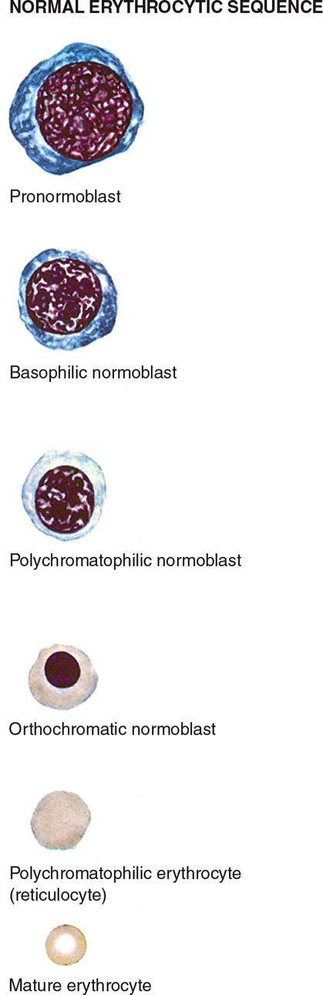
Rubriblast = Erythroblast = Pronormoblast
Prorubricyte = Basophilic normoblast
Rubricyte = Polychromatophilic normoblast
Metarubricyte = Orthochormic normoblast
Reticulocyte = Polychromatophilic erythrocyte
Erythrocyte (bi-concave RBC)

Slide 10
Erythropoiesis – Sequence of Maturation
Rubriblast to mature RBC = 4 to 6 days.
  3 days rubriblast to metarubricyte.
  Retics 1-2 days in BM.
  Retics 1-2 days in PB → mature RBC.
3 or 4 mitoses from Rubriblast to metarubricyte PYKNOTIC nucleus at metarubricyte state; NO MORE MITOSIS FFROM THIS STAGE ON.

Slide 11
Erythropoiesis – Nutritional Reqs.
Vitamin B12 (Cobalamin)
  Essential for nuclear maturation.
  Deficiency results in ASYNCHRONY stunted nuclear growth but normal cytoplasmic growth.
  Megaloblastic anemia (enlarged cytoplasm)
  Diet – sole method of obtaining sufficient B12 for Hematopoiesis
  Liver, muscle, eggs, cheese, milk.
  2-5 years stored.
  Deficiency and nerves.
  Normally absorbed in stomach with INTRINSIC FACTOR.
  PERNICIOUS ANEMIA and SCHILLING TEST.

Slide 12
Erythropoiesis – Nutritional Reqs.
Folic Acid – key step in mitosis as it is required.
  Deficiency → megaloblastic anemia.
  Dietary – green, leafy vegetables.
  Alcohol – interferes with folate metabolism.
  Some chemotherapeutic drugs are anti-folates.
  Folates/neural tube disorders/fortified prenatal vitamins.
  1-3 months storage in body.

Slide 13
Erythropoiesis – Nutritional Reqs.
Vitamin B6 – cofactor for δ-ALA synthase.
  Deficiency microcytic/hypochromic anemia, iron overload, and neurological findings.
  Diet – especially meats and grains.
Heavy metals
  IRON → most abundant heavy metal in the body and used primarily for Hgb synthesis.
    Source – Hgb catabolism and recycling
      Dietary
      Deficiency – microcytic/hypochromic anemia.
      Removed from most 1 a day vitamins – to much → hemochromatosis (overload of iron).

Slide 14
Erythropoiesis – Nutritional Reqs.
Trace Metals
  Copper → required for optimal iron transport.
  Cobalt → component of B12.

Slide 15
Erythrocyte Function
Primarily – to efficiently transport oxygen to the tissues throughout the body and to transport CO2- to the respiratory organs for elimination;
Serves as a vehicle of Hgb;
120 days then → extravascular or intravascular.

Slide 16
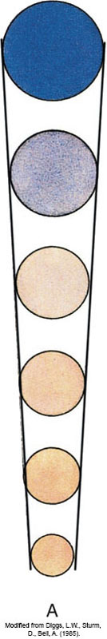
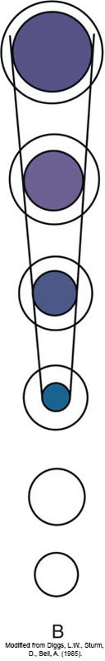
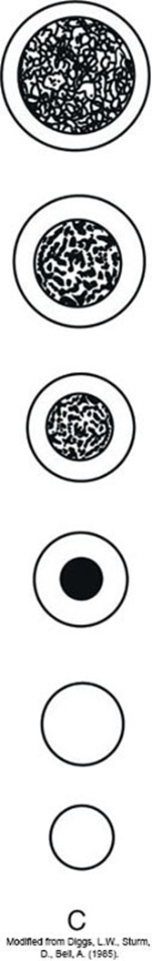
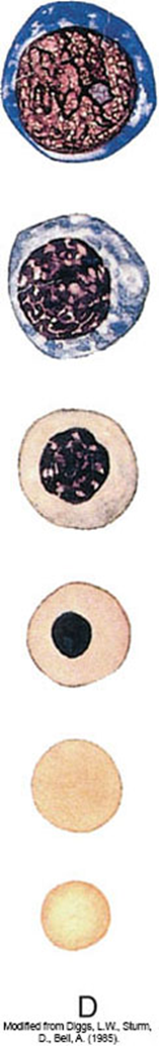
Cell size/cytosol stain/color.
Nuclei size stain/color
Nuclear chromatin structure
Composite of all changes occuring
Rubriblast
Prorubricyte
Rubriblast – cytosol is blue in color when stained [A].
Pro-Rubricyte – in process of synthesizing hemoglobin.
Rubricyte
Meta-Rubricyte
Rubricyte – (Acid stain) purple (nuclei) [B], sand colored (cytosol) [A].
Metarubricyte – when stained (cytosol salmon-like hue). Pyknotic (no more mitotic division(s)).
Reticulocyte (R1/R2)
Erythrocyte
Trace amounts of nucleic acid from previous mitotic divisions.
Mostly Hgb, no nucleic acid → mature bi-concave RBC. [A=D]

Slide 17
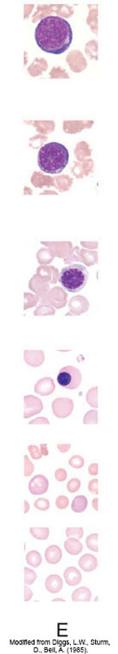
Rubriblast = Erythroblast = Pronormoblast
Prorubricyte = Basophilic normoblast
Rubricyte = Polychromatophilic normoblast
Metarubricyte = Orthochormic normoblast
Reticulocyte = Polychromatophilic erythrocyte
Erythrocyte (bi-concave RBC)

Slide 18
Erythrocyte Maturation - Normal
Rubricytic and normoblastic nomenclature (both are imperative).
RUBRIBLAST → PRONORMOBLAST → ERYTHROBLAST
  Cell size: Avg. 20-25μm
  Cell shape: Irregular or round.
  Cytoplasm: N/C ratio about 8:1;
    Basophilic stain, no granules, no vacuoles.
    Perinuclear HALO.

Slide 19
Prorubricyte – Basophilic Normoblast
Cell size: 16-18 μm
Cell shape: Irregular or round.
Cytoplasm: N/C ratio 6:1
  Staining: Less basophilic, but no red.
  No granules, no vacuoles.
  Nucleus: central
  Shape: Oval or round
  Structure: Coarse, lumpy, radial, may be a sharp contrast between chromatin and parachromatin.
  Nuceloli: no longer visible.

Slide 20
Rubriblast (cont’d)
Nucleus:
  Position: Central/Occ Eccentric;
  Shape: Oval or Round;
  Structure: fine, dense and uniformly close meshed chromatin network;
  Stain: Reddish/Purple;
  Nucleoli – not very distinct.

Slide 21
RUBRICYTE – Polychromatic Normoblast
Cell size: 12-15μm;
Cell shape: irregular;
Cytoplasm
  N/C varies 2:1;
  Polychromatic stain;
  No granules, no vacuoles, no perinuclear halo;
Nucleus
  Central
  Round
  Deeply staining, coarse/clumped chromatin;
  No nucleoli;
  Last stage capable of mitosis.

Slide 22
Metarubricyte = Orthochromatic Normoblast
Cell size: 10-12μm;
Cell shape: round;
Cytoplasm
  N/C varies 2:1;
  Stain: more red;
  No granules, no vacuoles, no perinuclear halo;
Nucleus
  Central, eccentric, and/or partially extruded;
  Round
  Pyknotic – no chromatin pattern/homogenous;
  No nucleoli.

Slide 23
Reticulocyte = Polychromatic Erythrocyte
Cell size: 7-10μm;
Round
Cytoplasm is 2/3rd Hgb;
No nuclei – extruded;
Slightly polychromatophilic (Polychromasia on smear(s));
Released from the bone marrow.
Membrane:
  Lipid bilayer – phospholipids with hydrophilic ends oriented to the outside (outer leaflet) of the cell and hydrophobic ends facing the inside (inner leaflet).
  Intrinsic membrane proteins embedded in the phospholipid bilayer.
  Cytoskeleton – mesh network of proteins contained within the cytosol (Spectrin/maj protein attached to the membrane and protrudes in cell—closely related to filamentous actin (f-actin) and attached via ankrin.
  Anion transport channel – H2O, Cl-, HCO3-; freely permeable.

Slide 24
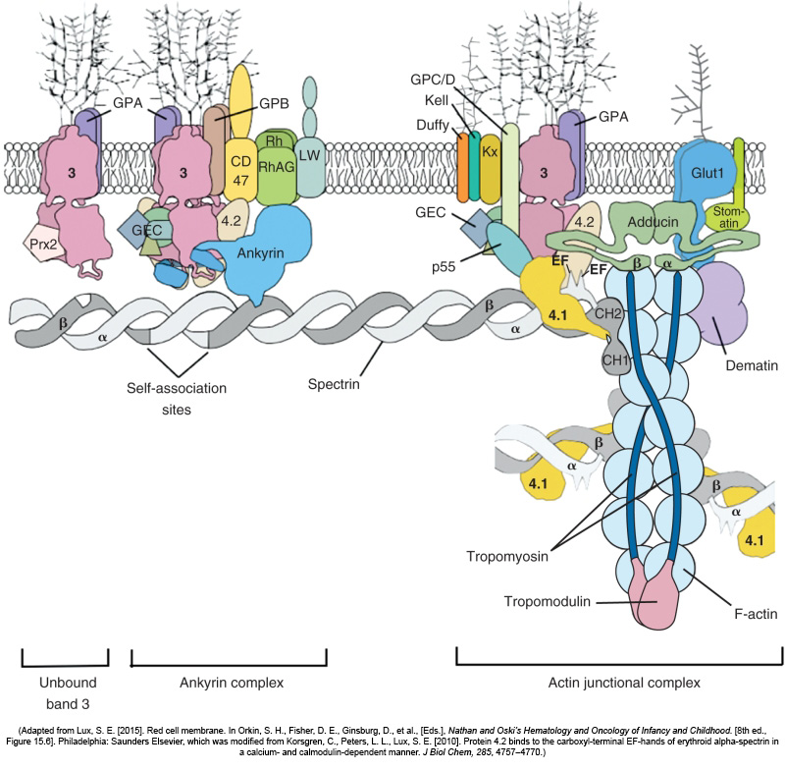

Slide 25
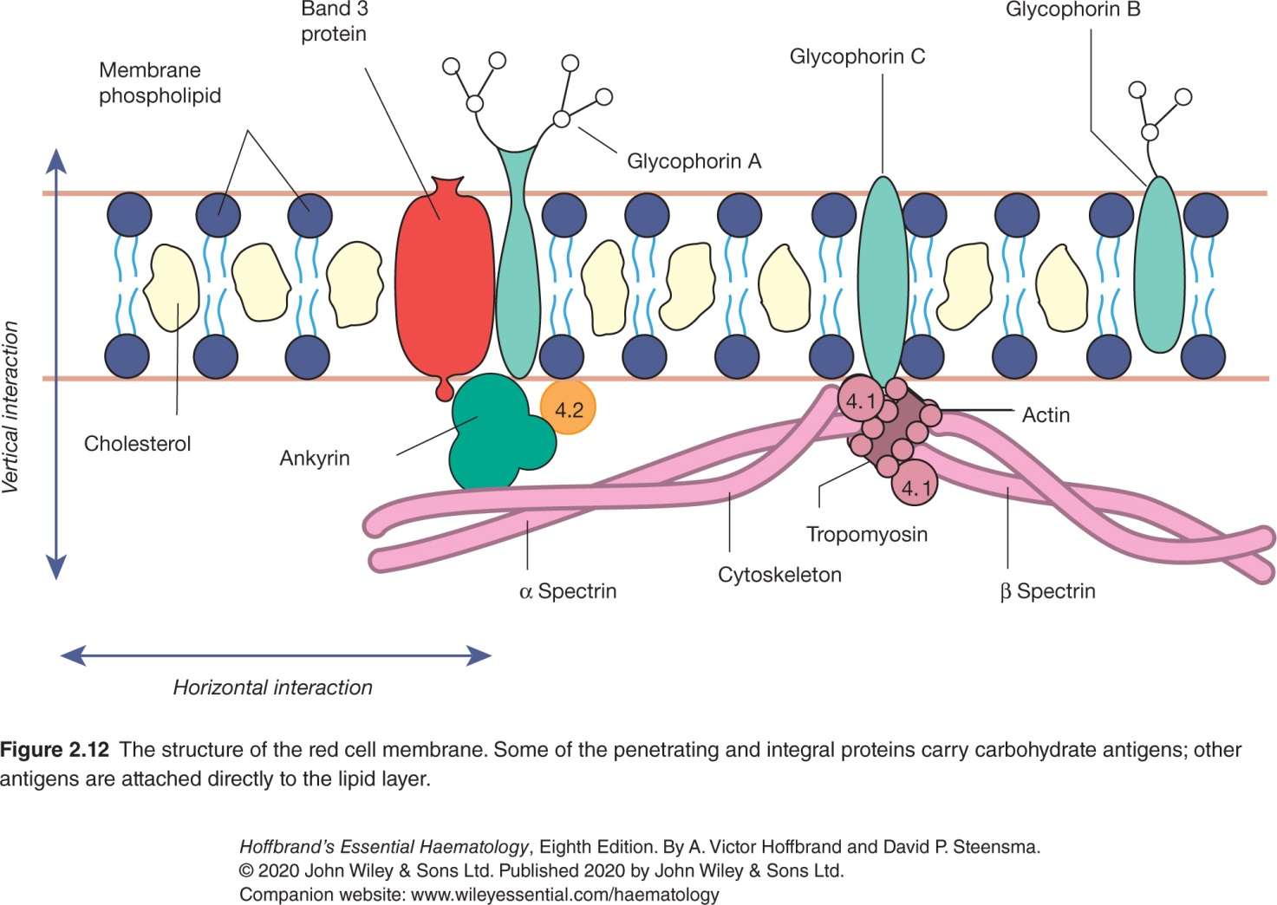

Slide 26
Mature Erythrocyte
Cell size: 6-8μm;
Bi-concave disk (2μm thick)
Mean vol. 90 fL (femtoliters)
Membrane:
  Lipid bilayer – phospholipids with hydrophilic ends oriented to the outside (outer leaflet) of the cell and hydrophobic ends facing the inside (inner leaflet).
  Intrinsic membrane proteins embedded in the phospholipid bilayer.
  Cytoskeleton – mesh network of proteins contained within the cytosol (Spectrin/maj protein attached to the membrane and protrudes in cell—closely related to filamentous actin (f-actin) and attached via ankrin.
  Anion transport channel – H2O, Cl-, HCO3-; freely permeable.

Slide 27
Mature Erythrocyte (Membrane)
  Na+/K+ energy dependent active ion transport system (Na,K ATPase mediated via primary active transport. Na+ passively enters the cells, actively pumped out and K+ actively pumped in, and passively diffuses out.
  Cholesterol – dynamic – present 1:1 with phospholipids and in rapid exchange with the cholesterol of the plasma.
  Zeta potential – the net negative charge on the outer surface.
  Carbohydrates/antigenic structure/blood types.
  Changes in spectrin, lipids, or sugars may result in changes in cell shape affecting survival.

Slide 28
Mature Erythrocyte (cont’d)
  RBC deformability and physical characteristics—
    Resilient and capable of extreme changes in shape;
    Young RBCs are more pliable than older RBCs;
    Chemical composition—
      Devoid of nuclei and mitochondria so lost ability to synthesize protein;
      Hgb
      EMP and 3 ancillary pathways.

Slide 29
