Slide 1
Clinical Laboratory Hematology
Leukopoiesis

Slide 2
LEUKOPOIESIS
Leukopoiesis – production of leucocyte(s) → white blood cells (WBCs)
Origin – from pluripotent stem cells
  Myeloid stem cell
    Granulocyte macrophage line (neutrophils, eosinophiles, basophils, monocytes, erythrocytes, and platelets).
    Lymphoid stem cell.

Slide 3
LEUKOPOIESIS
Leukopoiesis – production of leucocyte(s) → white blood cells (WBCs)
Origin – from pluripotent stem cells
  Myeloid stem cell
    Granulocyte macrophage line (neutrophils, eosinophiles, basophils, monocytes, erythrocytes, and platelets).
    Lymphoid stem cell.

Slide 4
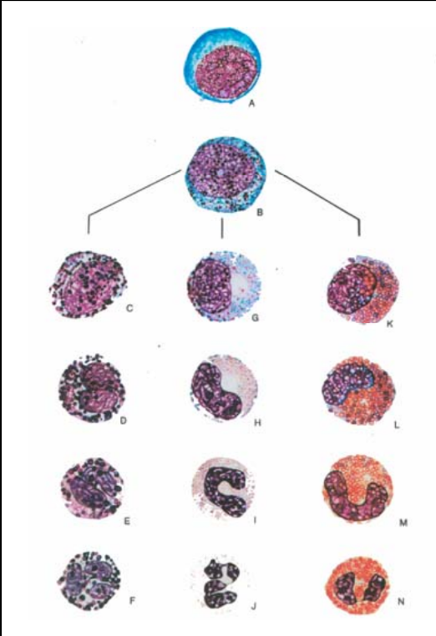
Myeloblast
B. Promyelocyte = progranulocyte
C. Basophilic myelocyte
G. Neutrophilic myelocyte
K. Eosinophilic myelocyte
D. Basophilic metamyelocyte
H. Neutrophilic metamyelocyte
L. Eosinophilic metamyelocyte
E. Basophilic Band
I. Neutrophilic Band
M. Eosinophilic Band
F. segmented basophil,
J. Segmented neutrophil
N. Segmented eosinophil

Slide 5
Myeloid maturation
Granulocyte
  Myeloblast
    In bone marrow (BM), not normally in peripheral blood (PB)
    Size – large – 10-20 uM
    Nucleus – large, round to oval, dark purple in color, possibly indented on one side.
    Chromatin – fine strands with no clumping, open reticulum evenly stained;
    Nucleoli – 1-5 distinct, uniform in size, round/oval and blue – may fuse.

Slide 6
Myeloid maturation
Granulocyte
  Myeloblast – not normally in PB
  Cytoplasm – scant with high N/C ratio of about 5:1 – 7:1, basophilic in color
    Granulation – generally none:
      In U.S., no granules in blast, by definition
      In Europe – will classify cells as blasts with up to 22 granules (so, who’s counting?)

Slide 7
Myeloid maturation
Granulocyte
  Promyelocyte – not mornally in PB;
  Size – 12-21 uM usually larger than myeloblast;
  Largest in this maturation series;
    Nucleus – similar in size and shape and color to myeloblast
    Chromatin – fine with some clumping;
    Nucleolus – fewer, 1-3 present, distinctly visible
  Cytoplasm – more than blast, lower N/C ratio, medium blue in color;
  Granulation – NONSPECIFIC = primary granules
  Red-blue/red purple (depends on stain) round or irregular in shape;
  These granules are lysosomal and contain myeloperoxidase, acid phosphatase, hydrolytic enzymes.

Slide 8
Myeloid maturation
Granulocyte
  Myelocyte – not normally in PB
  Size- 10-18 uM, smaller than promyelocyte;
  Nucleus- see centrally or eccentric, medium, round to oval, blue in color – last stage capable of mitosis.
    May be flattened on one side by the Golgi;
  Chromatin – coarser, more clumping
    Nucleoli, 1 may be present in early myelocyte but absent in the late myelocyte (usually indistinct at this point if visible.
    Cytoplasm – moderate amount, blush pink or light pink depending on stage;
  Granulation – early myelocyte still has primary granules but they appear less in number as the myelocytes approaches the late stage (actually they are still there, but staining characteristics decrease). Myelocyte is the 1st stage to have specific, secondary granules (neutral, eosinophilic, or basophilic depending on the cell type).

Slide 9
Myeloid maturation
    • GRANULOCYTE
    – METAMYELOCYTE – normally in BM, rarely PB
    • Size: 10-16 uM, smaller than myelocyte
    • Nucleus: lower N/C ratio
    – Kidney or bean shaped, blue-purple color, slight “V” indent
    – Nucleolus – none. Chromatin – coarse and compact, noticeable clumping, more than the myelocyte.
    • Cytoplasm – abundant and pink/beige/salmon in color
    • Granulation – full complement of secondary, specific
    granules (neutral, eos, baso).

Slide 10
Myeloid maturation
  GRANULOCYTE
  – BAND NEUTROPHIL – stays in BM for a while then to
  PB - <10% is normal
  • Size: 10-15 uM (avg 12)
  • Nucleus: indentation is greater than half the width of the
  nucleus; parachromatin present at the narrowest point where two parts of membrane come together.
  – Usually resemble a C or an S
  – Chromatin – dense and clumpy
  • Cytoplasm (pink to violet) to beige in color (neutral)
  • Granulation – large amt of small secondary granules.

Slide 11
Myeloid maturation
  • GRANULOCYTE
  – Segmented Neutrophil – mature form, in PB
  • Differentiated by the type of specific secondary granules –
  neutrophilic granules.
  • Neutrophil protects body from infection by phagocytosis of
  bacteria and other foreign organisms. They also remove
  damaged or dead cells and cellular debris.
  • Size – 10-15 uM, 2X normal RBC (ave. 12)
  • Nucleus – segmented/lobulated, 1-5 lobes normal with a
  FILAMENT (def: filament = thin area of chromatin with no
  parachromatin), dark purple chromatin, coarse and clumped
  with pyknotic areas.

Slide 12

Phagocytosis

Slide 13
Myeloid maturation
GRANULOCYTE
– Segmented Neutrophil cont...
– BARR BODY = “Sex Chromatin” described as drumstick or
tennis racquet, seen normally in females (part of X chromosome) seen in males with Klinefelter’s syndrome (XXY chromosome)
- Cytoplasm – abundant pink/beige, very neutral color
- Granulation – abundant secondary granules which are small and
pink/beige in color, evenly distributed. These granules contain collagenase, lysozyme, lactoferrin, plasminogen activators, aminopeptidase, and alkaline phosphatase.
- SHIFT TO THE LEFT = increase in immature neutrophils.

Slide 14
Myeloid maturation
GRANULOCYTE
– Segmented EOSINOPHIL – protects body by ingestion of
parasites and cellular activation in allergic and inflammatory
reactions, modulates chemotaxis. There is a direct correlation
between the degree of eosinophilia and the ability for eosinophils
to kill parasites.
• About size of neutrophils or slightly larger
• Nucleus – segmented/lobed, 1-2 normally, may be found along with
band eosinophils in PB but nucleus may be obscured by secondary specific eosinophilic granules
• Cytoplasm – abundant and pink/orange in color
• Granules – large, round, orange abundant
– Crystalloid core composed mainly of Major Basic Protein, granules contain peroxidase, acid phosphatase, aryl sulfatase, b-glucuronidase, phospholipase, cationic proteins, and alkaline phosphatase.

Slide 15
Chemotaxis - I

Slide 16
Chemotaxis - II

Slide 17
Chemotaxis - III

Slide 18
Myeloid maturation
SEGMENTED
- BASOPHIL - involved with immediate hypersensitivity
reaction by release of histamine and heparin from its granules
• Size - 10-15 uM, approx size of neutrophils
• Nucleus - segmented or lobed with 1 -3 lobes, often 1 (rarely
more than 2 segments), dark purple/black , chromatin coarse
and clumped, often masked by secondary, specific,
basophilic granules
• Cytoplasm- abundant pale blue with burgundy smudging
from chromatin in nucleus
• Granules- large blue-black granules, water soluble so may
dissolve in certain stains. Coarse, unevenly distributed,
varying in number, shape, and color. Less numerous than
eos granules. Contain histamine and heparin.

Slide 19
Myeloid maturation
(Granulopoiesis)
• DEF: production of neutrophils, eosinophils, and
basophils
- Blast -> mature cells in 7-11 days
- Production occurs after stem cell commitment
occurs
-Cellular production and maturation occur in response to colony stimulating factors (CSFs)
• CSFs (specifically GM-CSF) amplifies leukopoiesis by increasing division in previously committed stem cells. They also enhance microbicidal activity.

Slide 20
Myeloid maturation
(Granulopoiesis)
-Mitotic/proliferative pool
• Committed stem cells, myeloblasts, promyelocytes, and myelocytes. These cells actively divide and mature
• 1-2 days per cell cycle
-Maturation pool
• Metamyelocytes and bands. At this point, there is no more division of cells i.e. the end of DNA synthesis
• Maturation from myelocyte to meta to band takes 8-9 hours after entry into the maturation pool.

Slide 21
Myeloid maturation
(Granulopoiesis)
-Storage Pool
• Mature cells (bands and segs) for release to PB
• Diapedesis = movement of cells through pores in
BM endothelial lining to PB or PB lining to the tissue.
-Functional Pool
• 1/2 of the cells are circulating and 1⁄2 are in the
MARGINAL POOL (lines the blood vessel walls especially the lungs, liver, and spleen)
• After a few hours, these cells leave the PB to enter tissues and body fluids, thus becoming tissue cells - they are drawn to the tissue by chemotaxis.

Slide 22
Myeloid maturation
(Granulopoiesis)
Functional Pool cont.
• Neutrophils leave the PB for the tissue in a random fashion after a circulation 1/2 life of approx. 7 hours, and do not return. Once the neutrophil enters the tissue, it's life span is short.
• Eosinophils - may return to the PB and BM from tissue.
• Basophils and eosinophils show diurnal variations, increasing in number at night and decreasing in the morning
- Basos and Eos often seen together on a smear.

Slide 23
Tissue Neutrophil
FYI
• Fixed or semi-fixed tissue variant of the neutrophil which have developed neutrophilic granules; immobile end stage cells from progenitor of neutrophils
• Infrequent in normal BM
• Large, narrow cells, ample cytoplasm which is irregular with blunt pseudopods. Not phagocytic/no vacuoles.
• Cytoplasm light blue, varying number of granules (red to
blue in color) arranged in chains
• Nucleus is large and round to oval, with coarse chromatin, nucleoli are conspicuous, and are light blue

Slide 24
Tissue Neutrophil
FYI
• Fixed tissue variant of the eosinophil, from the same progenitor
• Large cell with elongated and tapering cytoplasm
• Large pinkish/reddish/orange granules
• Nucleus round or oval with well defined reticular chromatin and often nucleoli.

Slide 25
Tissue Neutrophil
FYI
• Mast Cell - fixed tissue cell similar in function and biochemistry to circulating basophil
• Similar in appearance to circulating cell except the nucleus is round
• Seen widely scattered through connective tissue of various organs (BM, mucosal areas of serous membranes).

Slide 26
Myeloid Maturation
MONOCYTE- general
- No reserve pool; released from the BM within a day
- In PB, there is a circulating pool and a marginal pool (marginal is 3X size of circulating)
- In PB 12-14 hours before entering tissue
- Once in tissue monocytes become tissue macrophages and can live months to years; both cells (monocyte and macrophage) are
part of the Mononuclear Phagocytic System.

Slide 27
Myeloid maturation
• MONOCYTE FUNCTION:
- Phagocytosis - protects the body
- Helps the neutrophil; after the neutrophil numbers increase in infections, the monocyte numbers tend to rise (garbage disposals of the body)
- Role in processing antigens for the lymphocytes to recognize and transform for future reactions
- Antitumor agent for surveillance & self or non-self recognition
- Produces and secretes various substances: lysosomes, CSF, thromboplastin, platelet activating substances, and complement.

Slide 28
Myeloid maturation
• MONOCYTE MATURATION
- Monoblast
• Size-12-20uM
• Nucleus - round to oval, central/eccentrically placed, slight indentation
- Pale blue to red-purple
- Chromatin - fine and lacey
- Nucleoli 1-3, large and prominent
• Cytoplasm - Regular border, moderate in amount, deep blue, homogeneous, agranular (without granules)
• Similar to Myeloblast- some think it is the same cell.(Slide #4)

Slide 29
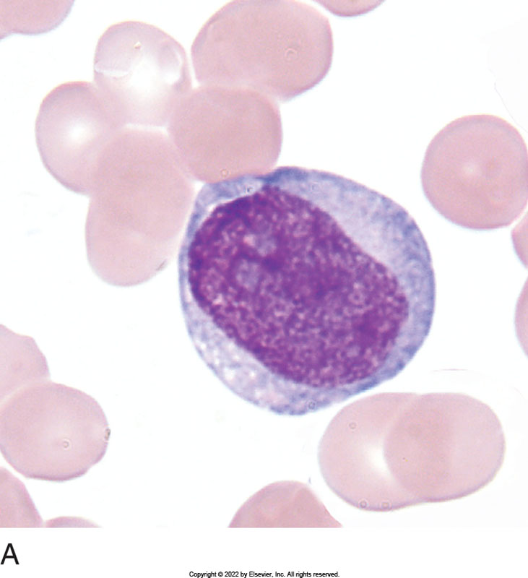
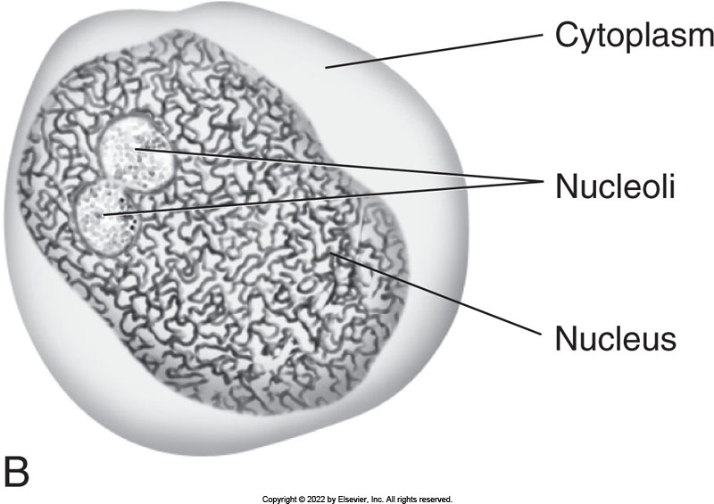
Monoblast

Slide 30
Myeloid maturation
MONOCYTE MATURATION
- Promonocyte
• Size-14-18uM
• Nucleus - large indentation, folding may be present, pale red purple, chromatin slightly clumped following contours of nucleus, nucleoli 0-2
• Cytoplasm - moderate in amount with irregular border (may infrequently take part in phagocytosis), blue-gray granules; very small fine pink/red dust-like particles (ground glass)

Slide 31
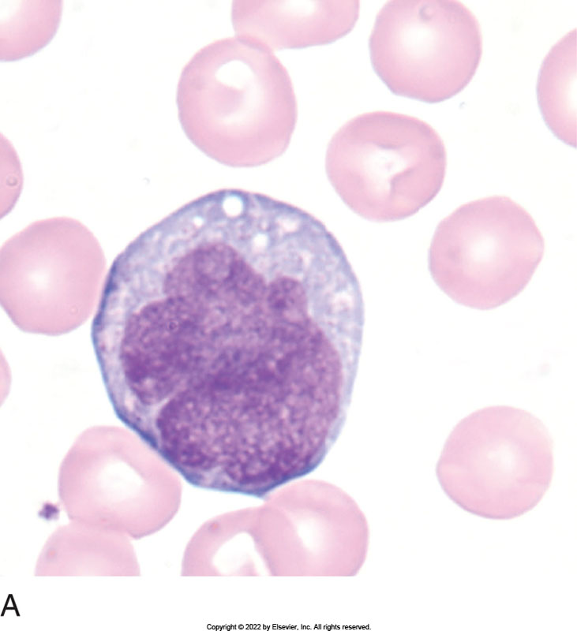
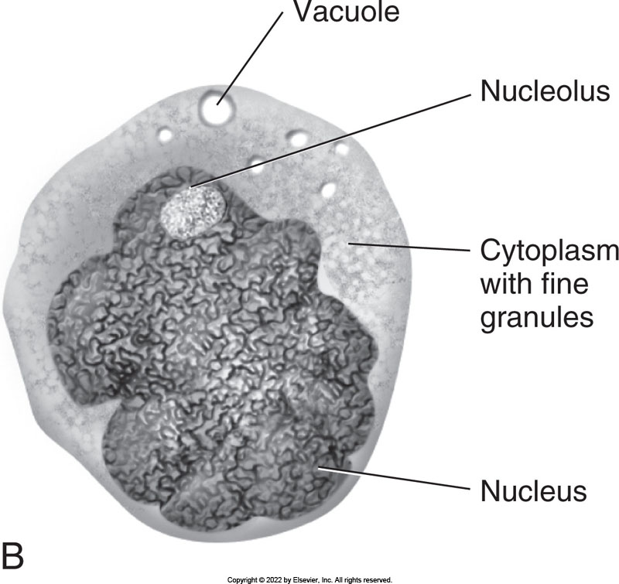
Promonocyte

Slide 32
Myeloid maturation
MONOCYTE - MATURE
- N/C ratio = 1/1
- Size 12-20uM, larger than a neutrophil (which ave 12)
- Nucleus - increased folding, often horseshoe, kidney shaped, lobular, brain-like convolutions Blue purple- irregular shapes
- Lacey chromatin intermingled with small chromatin clumps parallel to contours of membrane; least clumping of mature cells (except for lymphs)
- No nucleoli
Cytoplasm - abundant with ruffled plasma membrane, dull/pale blue-gray, granules ( fine red dust-like particles) and vacuoles;
- ground glass appearance- may have varying amounts of prominent but tiny granules along with the fine granules “Elephant feet”

Slide 33
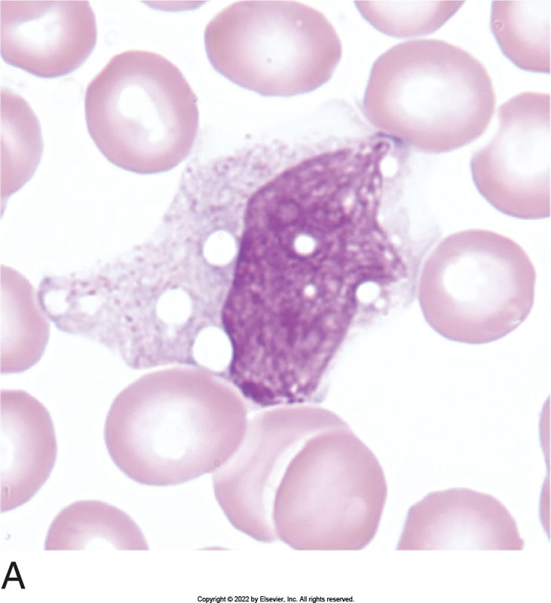
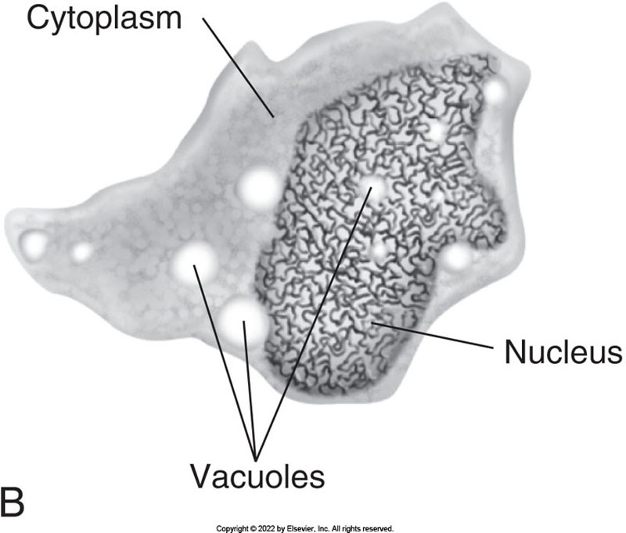
Mature Monocyte

Slide 34
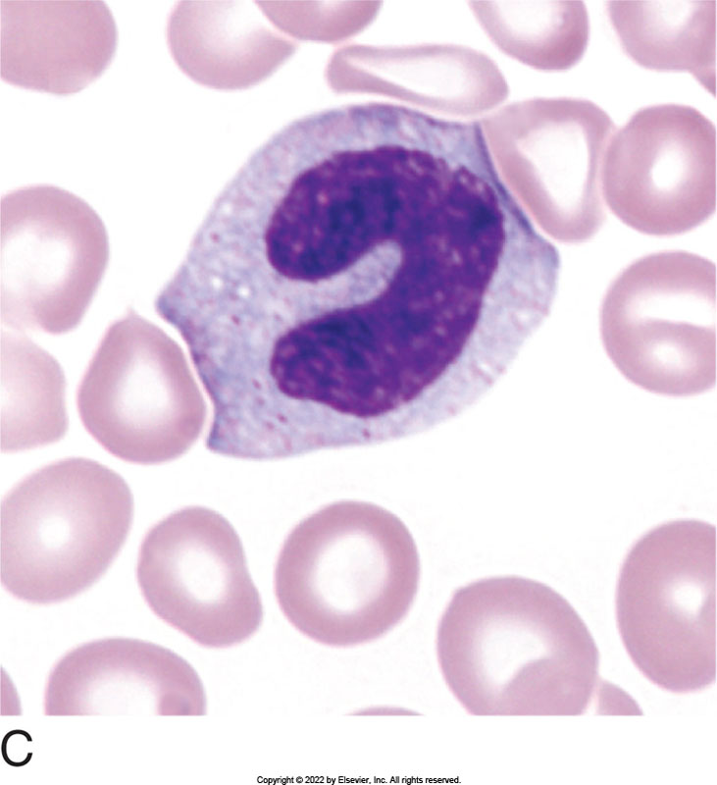
Mature Monocyte
Monocyte with no vacuoles.

Slide 35
Macrophage
FYI
• Size 20-50uM
• Nucleus - round to oval, indented and eccentric/reniform
- Blue/ purple
- 1-2 nucleoli
- Chromatin - spongy reticulum, clumped
• Cytoplasm- abundant, vacuolated, and irregular, sky
blue, numerous coarse azure granules
• Do not normally reenter the blood stream
• Line the sinusoids of the spleen (Littoral cells) and the
Bone Marrow
• Kupfer's cells = macrophages that line the liver
• Remember: Monocytes become Macrophages in the
Tissues.

Slide 36
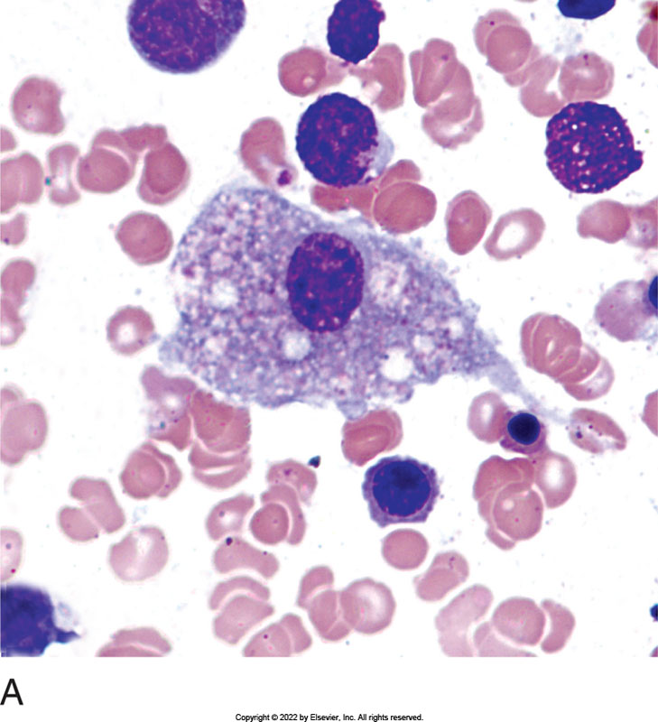
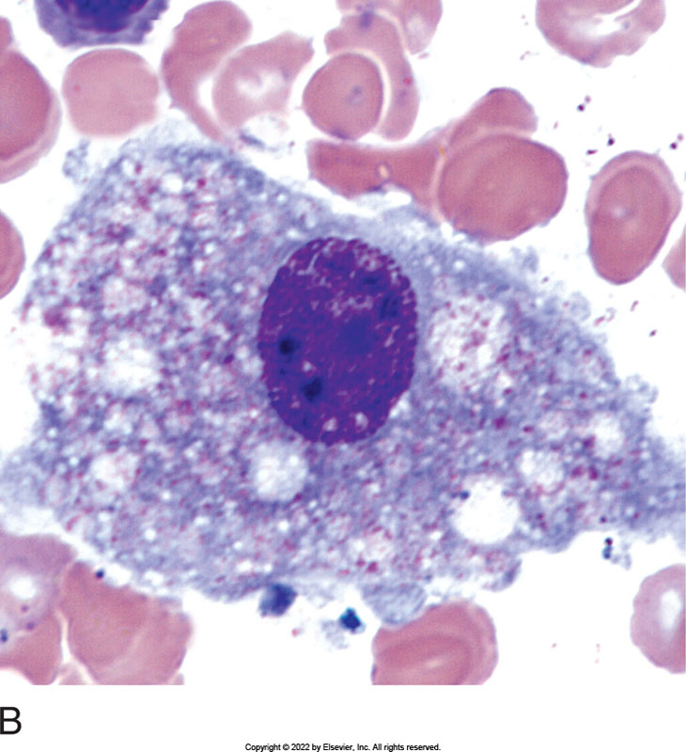
Macrophage/Mϕ
500x (from BM).
1000x (from BM).

Slide 37
Hematopoiesis - WBCs
• LYMPHOID MATURATION
- LYMPHOBLAST
• Size-10-20uM
• Nucleus - round or oval with definite nuclear membrane
- Staining - blue/purple
- Nucleoli - 0-3
- Chromatin - thin, evenly stained, no clumping, thicker/rougher i.e.
not as fine as the myeloblast
• Cytoplasm - small/scant amount i.e. high N/C ratio (higher than other
blasts.
- Staining - moderately basophilic/ lighter near the nucleus and
darker at the periphery
- Granulation - none

Slide 38
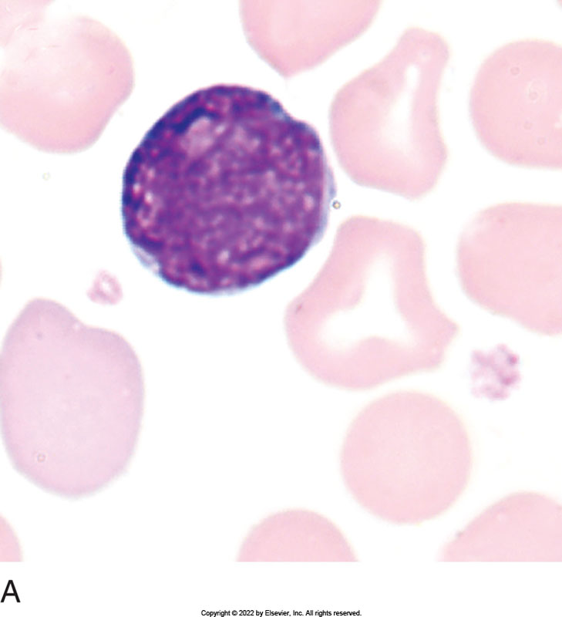
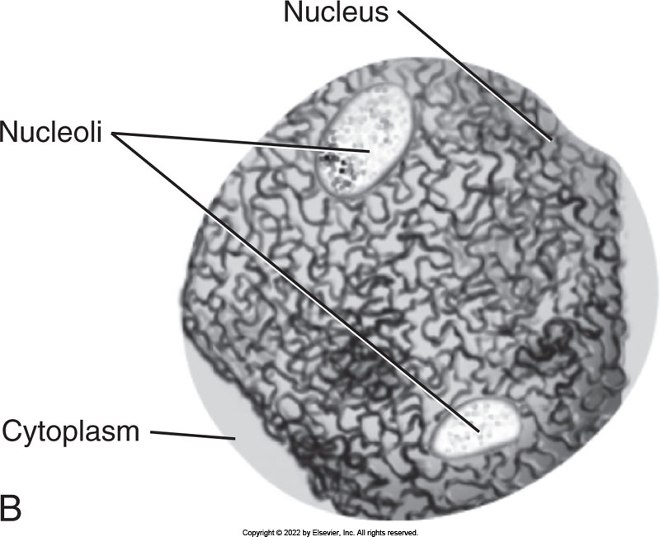
Lymphoblast

Slide 39
Hematopoiesis - WBCs
• LYMPHOID MATURATION
- PROLYMPHOCYTE
• Size-9-18 uM
• Nucleus - ovoid, round, or sl indented
- Staining - blue/purple to red/purple
- Nucleoli - 0-1, less distinct
- Chromatin - intermediate; some clumping seen, more
coarse than lymphoblast
• Cytoplasm - moderate amount; lower N/C ratio
- Staining - clear basophilic
- Granulation - none

Slide 40
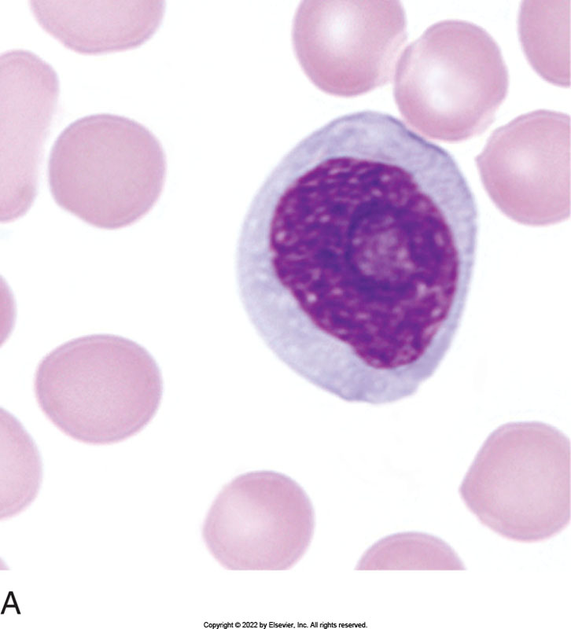
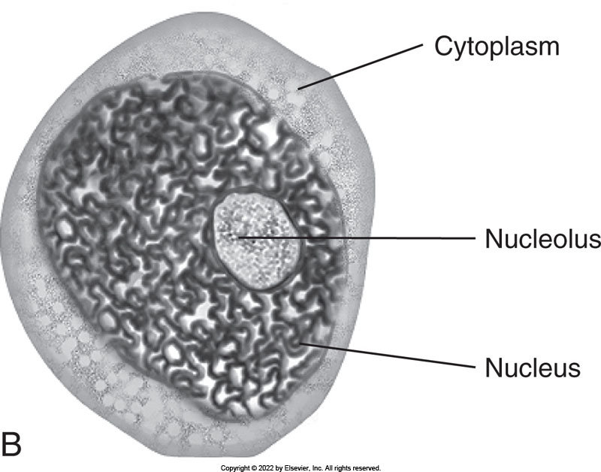
Prolymphocyte

Slide 41
Hematopoiesis - WBCs
• LYMPHOID MATURATION
- Mature Lymphocyte (Small and Large)
• SMALL MATURE LYMPHOCYTE
-Size 7-10 uM
- Nucleus - round to oval with slight indention possible
» Staining - blue/purple
» Nucleoli - present but not visible i.e. not end stage
» Chromatin - coarse and clumpy - pattern
- Cytoplasm - scant in amount i.e. high N/C ratio
» Staining - moderate to dark blue
» Granulation - not usually present, rarely moderate size azurophilic granules.

Slide 42
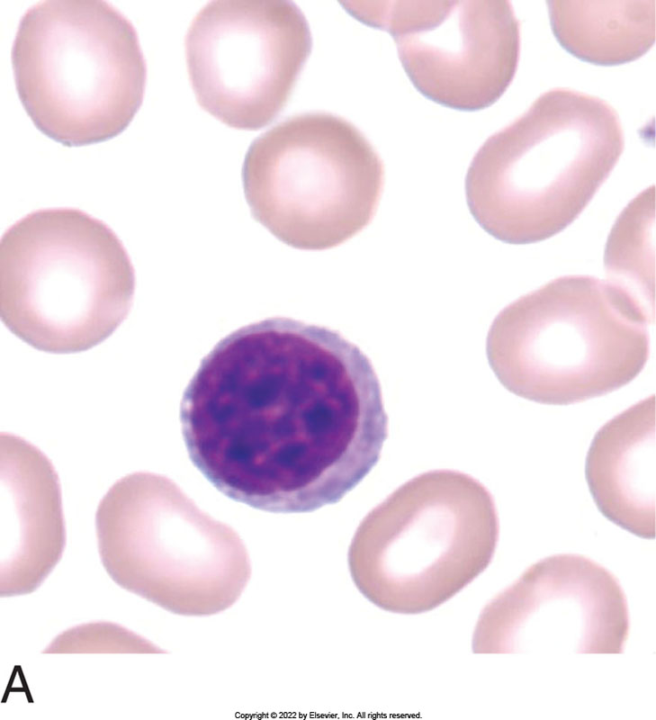
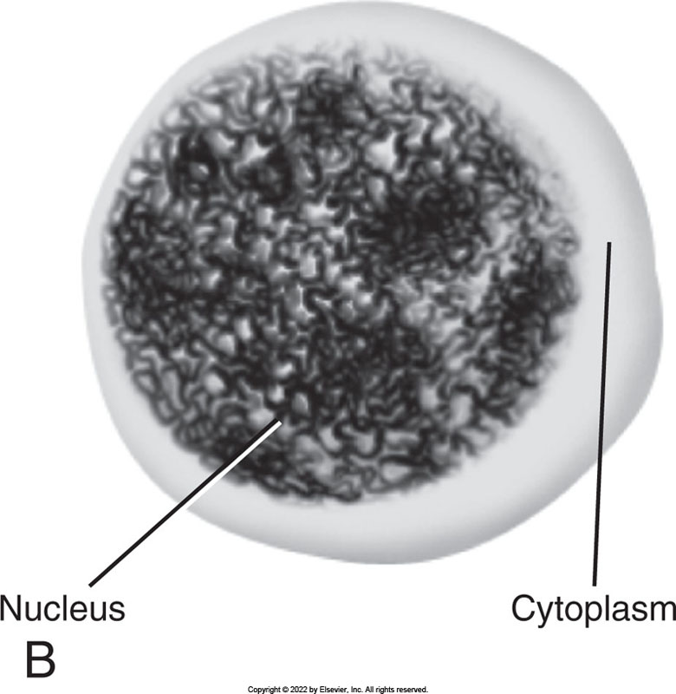
Small Lymphocyte

Slide 43
Hematopoiesis - WBCs
• LYMPHOID MATURATION
-MATURE LYMPHOCYTE (Small and Large)
• Large Mature lymphocyte
- Size-12-16uM
- Nucleus - round to oval with slight indentation
» Staining - blue/purple
» Nucleoli - present but not visible
» Chromatin - coarse and clumpy
- Cytoplasm - abundant
» Staining - clear pale blue
» Granulation - may contain few azurophilic granules.

Slide 44
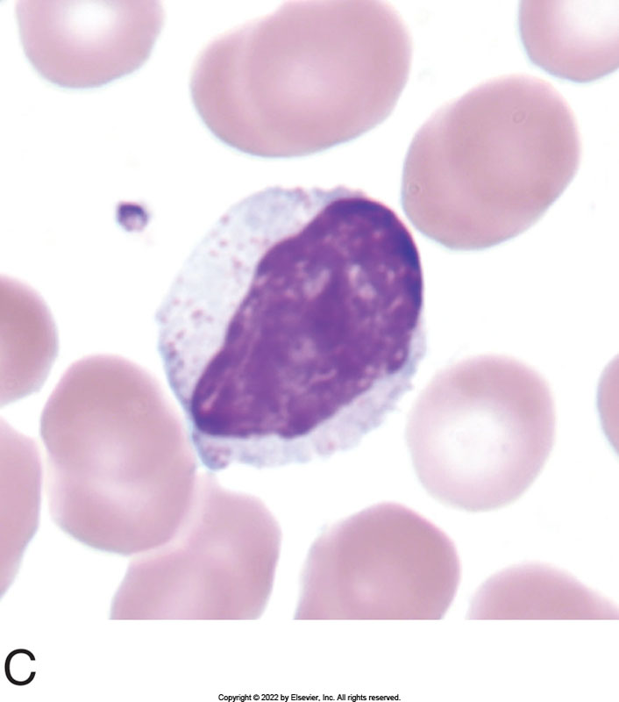
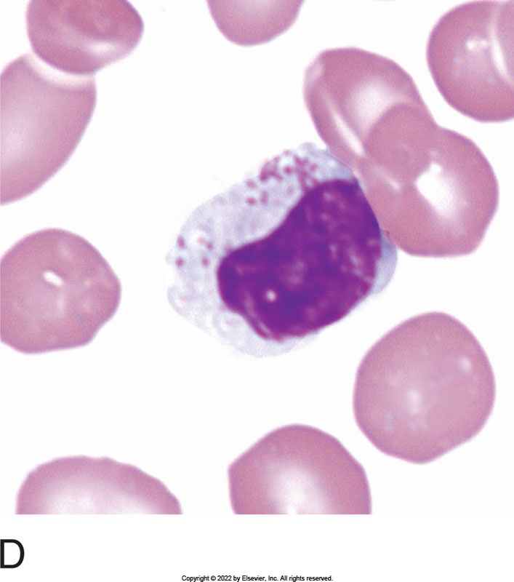
Large Lymphocyte
Large lymphocyte with irregular nucleus and abundant cytosol than small lymph.
Large lymphocyte with prominent azurophilic granules in the cytosol.

Slide 45
Lymphopoiesis
• LYMPHOPOIESIS
• Life Span - 4-10 years, some have a short life span of 3-4 days
• Committed lymphoid stem cell becomes
lymphoblast
• Lymphocyte precursor undergo maturation before migration to extrameduallary site
- Immature T lymphocytes migrate to the thymus and from there fully mature T lymphs migrate to the secondary peripheral lymph tissue, incl. the lymph node
- B lymphocytes mature fully in the BM before migration to the lymph nodes, spleen, and other lymphoid tissue.

Slide 46
Lymphopoiesis
• Lymphoid Cells enter the peripheral blood from the lymph node via the lymphatic fluid system.
• Function: to provide recognition and elimination of foreign stimuli.
- Identification is based on surface markers on the membrane of the cell, use of monoclonal antibody technique for ID (flow cytometry).

Slide 47
Lymphopoiesis
•Secondary Lymphoid tissue:
- Lymph nodes - form the bulk of the secondary lymphoid tissue where filtration, phagocytosis, and immune functions take place:
Foreign material enters through afferent Lymphatics, are filtered in the cortex, where the macrophages and B lymphs (follicles) are located.
Antigenic stimulation occurs and the follicles form
germinal centers
T cell response occurs in the paracortical area.

Slide 48
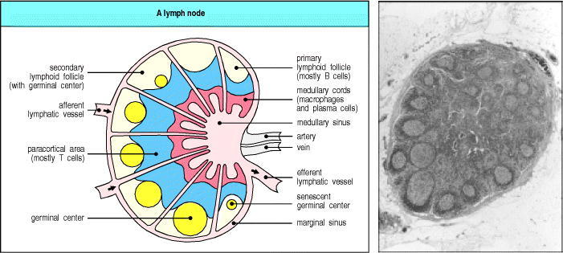
Normal Lymph Node

Slide 49
Lymphopoiesis
Secondary lymphoid tissue:
- Spleen - largest reservoir in the body for lymphocytes and macrophages
- Periarteriolar area: area where the blood enters the spleen from the peripheral blood; this is where T lymphocytes are located
- Pulp area: where the B-cells are located in follicles,
which are made up of a mantle zone and the follicle center.

Slide 50
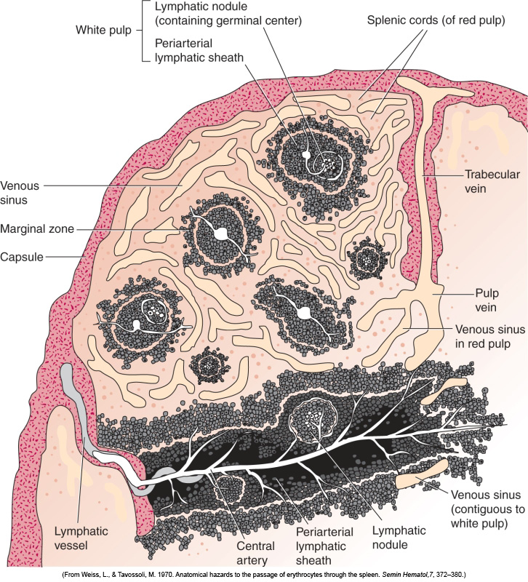
Splenic Structure

Slide 51
Lymphopoiesis
T lymphocytes - (cannot tell the difference from B lymphocytes
morphologically)
- Mature in the thymus
- 60-80% of the lymphocyte pool:
Loci in the lymph nodes - paracortex
Loci in the spleen - periarteriolar
- Cellular Immunity
Tumor suppression
Graft rejection, protection against intracellular organisms,
and delayed hypersensitivity.
- Possess surface receptors for sheep RBCs

Slide 52
Lymphopoiesis
• T Lymphs
- 3 types of T lymphs
• Cytotoxic killer T cells - delayed hypersensitivity,
secrete lymphokines (soluble secretion which
mediates lymphocyte interaction), and kill some
cellular targets that have abnormal or altered
membranes
• Suppressor T cells - inhibit the expression of
other lymphocyte subsets
• Helper T cells - interact with other T cell
substrates and assists B cells in humoral immunity

Slide 53
Lymphopoiesis
• B Lymphocytes - (cannot tell the difference morphologically from T lymphs)
- Mature in the Bone Marrow (BM)
-10-20% of lymphoid pool
- Responsible for humoral immunity i.e. production of Antibodies (Ab) which mark foreign substances for destruction by phagocytic cells
- Life span - days to weeks

Slide 54
Lymphopoiesis
• B Lymphocytes - (cannot tell the difference morphologically from T lymphs)
- Mature in the Bone Marrow (BM)
-10-20% of lymphoid pool
- Responsible for humoral immunity i.e. production of Antibodies (Ab) which mark foreign substances for destruction by phagocytic cells
- Life span - days to weeks

Slide 55
Lymphopoiesis
• B Lymphocytes
- Loci in the spleen: red pulp: germinal centers
- Loci in the lymph node: germinal centers in
the cortex and medulla
- Produce Ab - macrophages present antigen to the B cells and with the help of helper T cells, the B cells are sensitized. (Only rare Antigens (Ag) are able to stimulate B cells without helper cells (neutrophils, macrophages, T lymphocytes)

Slide 56
Lymphocytes – Ag stimulation
• Mature lymphocyte undergoes blastogenesis which then proceed to develop into plasma cells (B cells)characterized by proliferation of RNA and synthesis of Immune globulin (Ab) or Blast like cells called Viral Lymphs
- Mature form of B cell is the plasma cell,
which produces antigen specific antibodies
-T lymphs thought to become Natural killer
cells (Viral Lymphs)

Slide 57
Lymphocytes – Null Cells
• Null Cells are also called Natural Killer Cells (NK); contain neither B-cell or T-cell surface markers
• Large granular lymphocytes
- 3% of peripheral lymphocyte pool
- Able to kill some abnormal cells without Ab or T-cell interaction
- Effector lymphocyte - manifests spontaneous
cytotoxicity against a variety of target cells
– Still debatable whether they are considered “reactive lymphs”

Slide 58
Lymphocytes – Blast Transformation
• Includes the ability for the lymphocytes to actively divide (even though we don’t normally see the nucleoli in the lymphocyte, it is there)
• Changes that the lymphocytes go through cause changes in their physical appearance (morphology) as they move forward to the blast and then to the Plasma Cell or viral lymph.
Blast-like changes in their nuclei; sometimes called Immunoblast
- REACTIVE LYMPHOCYTE
Immunologically competent, changes in the cells are due to increases in the DNA & RNA in the cell; these are all the morphological changes from the mature lymph to the Immunoblast to the end stage plasma cell and end stage viral lymph.
B lymphs have a plasmacytoid morphology and T lymphs have a viral reactive morphology. They are all considered “Reactive”

Slide 59
Reactive Lymphs
• Wide spectrum of morphological variants:
- Viral Reactive Lymphs
• IncIuded in these are the "Downey" cells seen in Infectious Mono
• Also seen in other viral infections such as CMV, infectious hepatitis, as well as post transfusion reaction, organ transplants, and serum sickness
• Size10-20uM
• Nucleus - round or oval in shape, central or eccentric, may have 1
nucleoli
• Cytoplasm - abundant, may surround the adjacent RBCs
- Stain - may be dk blue, often darker at the periphery
- Granulation - azurophilc granules may or may not be
present
Summary: all stages from mature T lymph to Immunoblast and
end stage viral lymphocyte.

Slide 60
Lymphocytes – Reactive Lymphs
• Plasmacytoid Reactive Lymph:
- Changes that the lymphocytes go through, to produce
antibodies, causes changes in the physical appearance of the
lymphocytes.
Size-10-20uM
Nucleus - round or oval, central or eccentric
Staining - red/purple
Nucleoli - may be seen
Chromatin - variation from fine and blast-like to coarse and clumped
Cytoplasm Staining - blue, may be dark blue, often darker at the periphery
Summary: all stages from mature B lymph to Immunoblast and end stage
plasma cell are plasmacytoid reactive lymphs.

Slide 61
Lymphocytes – Reactive Lymphs
• Plasma Cell - End Stage B-Cell Lymphocyte in reactive situation
- Seen during immune response to antigenic material
-Mfg immunoglobulins
• Benign - allergic states and viral and bacterial infections
• Malignant - in abundance in Multiple Myeloma

Slide 62
Plasma Cell Morphology
• Size: 10-20 uM - Oval cell with oval nucleus oriented at right angles
• Nucleus- round to oval, eccentrically located
- Staining - dark blue/purple
- Nucleoli - none
- Chromatin - dense, coarse, and clumpy (cartwheel pattern)
• Cytoplasm - moderate amount
- Staining - dark blue i.e. deeply basophilic with a perinuclear clear zone (Golgi which does not stain)
- Granulation - none
• During Ab production, a proteinaceous material may be seen in the form of a round globule which stain red, pink, blue or maybe colorless - called Grape cells/Mott cells/ or Russell bodies if they stain blue.

Slide 63
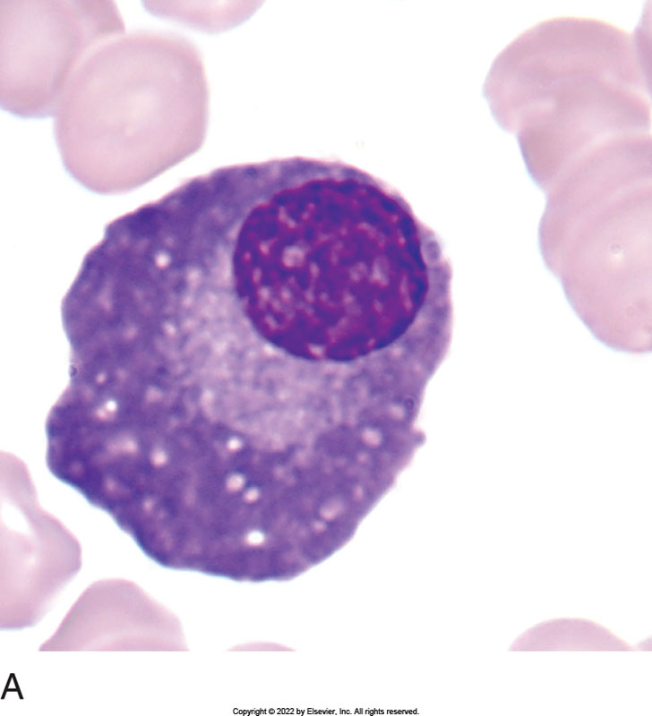
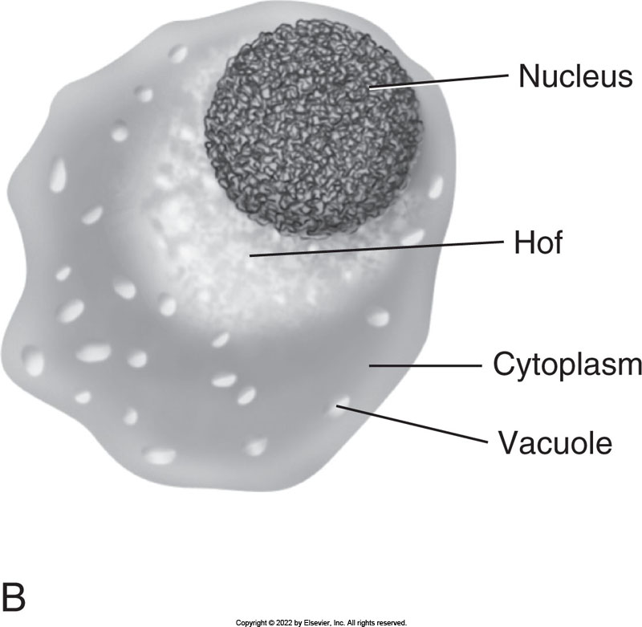
Plasma Cell

Slide 64
WBC Non-Neoplastic (Benign) Disorders
• WBCs primary function is defense against infection
-Acquired Disorders:
• Quantitative disorders
- Leukocytosis i.e. increase in the number of WBCs >10K but <50K
» Due to infection and/or inflammation
» Cells have normal function and morphology
» Neutrophilia = an increase in neutrophils caused mainly by bacterial infection. Other causes: fungal and viral infection and inflammation due to tissue damage, Myocardial infarct (Ml), trauma, surgery

Slide 65
WBC Non-Neoplastic (Benign) Disorders
- Acquired Disorders:
• Quantitative disorders (Leukocytosis/Neutrophilia)
- Marginal pool called into action 1st*; WBC doubles in minutes.
- May cause a Shift to the Left = release of younger granulocytes from the bone marrow storage pool, primarily bands and metamyelocytes. Acute infection can rapidly mobilize these neutrophilic nondividing marrow storage pool. It is unusual to find cells as early as myelocyte in PB.
- Toxic Changes may be seen in the neutrophils:
» Toxic Granulation - Medium to large purple granules which are scattered through the cytoplasm. These are primary nonspecific granules which remain visible when the cell is going through maturation during a toxic condition
» Besides infections/toxic states, seen in bums, malignancy, and chemical poisoning.

Slide 66
WBC Non-Neoplastic (Benign) Disorders
- Toxic Changes cont...
    » Dohle Bodies : Single or multiple light blue (Robin's egg blue) cytoplasmic inclusions. They are aggregates of free ribosomes of rough endoplasmic reticulum and RNA from immature cells. Seen in severe infections, burns, or toxic states. Also in some inherited disorders (ex May Hegglin).
  Toxic granulation and Dohle Bodies- can be see together as they are an indication that the maturation process has been sped up and Primary granules and RNA are persisting in the Mature cells from their immature state.
» Toxic Vacuolization= large empty white areas within the cytoplasm. They represent end stage phagocytosis i.e. something has been ingested leaving a vacuole. They are seen mainly in cases of overwhelming bacterial infection.

Slide 67
WBC Non-Neoplastic (Benign) Disorders
• Def: Leukemoid Reaction = increased WBC with Shift to the left of neutrophils, and toxic changes.
(Extreme neutrophilic reaction to severe stimulation of the neutrophil such as bacterial infection)
- Sometimes confused with CGL (CML) - LAP test differentiates
Eosinophilia: Increase in eosinophils due to allergic reactions or parasites
- Also dermatitis, TB, and recovery phase of acute infections.

Slide 68
WBC Non-Neoplastic (Benign) Disorders
• Basophilia - inceased basos seen in some infections and
hypersensitivity reactions.
• Monocytosis - increased monos seen in fungal infections
especially TB, some bacterial infections, and recovery
phases from various disorders (1st cell to show recovery in BM)
• Lymphocytosis - increase in lymphocytes in acute viral
infections, some chronic bacterial infections. Also, toxins,
drug sensitivity, autoimmune disease, dermatitis, and
graft rejection.

Slide 69
Leukopenia
• Def: decrease in the number of WBCs <3K/uL
- Neutropenia- some infections and overwhelming
infections. Mostly due to physical agents - drugs, chemicals (chemo), antibiotics. Also, some immunological diseases like L.E. and arthritis
- Agranulocytosis - Severe and total reduction in the
number of all granulocytes; neutrophil count
<0.5K/UL
- Lymphocytopenia - Inherited immunodeficiencies,
AIDS

Slide 70
WBC Normal Ranges (Reference Ranges)
• Normal ranges for WBC count: 3-8K/uL 4-10
- Relative number = % of a subtype of wbcs compared to other subtypes of wbcs
EX: Relative neutrophilia = >75%
- Absolute number = multiplying WBC count by the percentage of the subtype of white blood cells to get the # of cells per cubic mm.
Ex: Absolute Neutrophilia would show an increase in the absolute count i.e. >8K/uL
• Note: It is possible to have one without the other. It is also possible to have a relative decrease in a subpopulation while having a normal absolute value.
For ex: Incr. WBC with Relative and absolute incr. in neutrophils due to a bacterial infection. The lymphocytes will show a relative lymphopenia but the absolute is normal.

Slide 71
WBC Normal Ranges (Reference Ranges)
• Examples:
-WBC 15.0K/UI = Leukocytosis
- Neutrophil% 85 = Relative Neutrophilia
-Absolute number of neutrophils 15,000 x 85%
= 12,750 neutrophils/uL i.e. absolute Neutrophilia
- Lymphocyte%10 = Relative Lymphocytopenia absolute number of lymphs 15,000 x 10% = 1,500 i.e. normal absolute lymph number
Make sure You have a handout of normal ranges.

Slide 72
Inherited WBC Disorders
• Inherited quantitative disorders, functional, structural, or morphologic abnormalities of the cytoplasm and nucleus
• Not as common as the acquired disorders
• WBC Anomalies:
– May Hegglin
– Chediak-Higashi
– Alder-Reilly
– Pelger-Huet
– Chronic Granulomatous Disease
Also:
– Leukocyte Adhesion Deficiency
– Myeloperoxidase Deficiency

Slide 73
Physiological Leukocytosis
• Def: An increase in WBC without a shift to the left or any morphologic changes.
• Due to a physical cause: exercise, intense emotional stress, or the administration of epinephrine or glucocorticoids.
• Transient

