Slide 1
Clinical Laboratory Hematology
Thrombocytes – I

Slide 2
MATURE PLATELETS
Description – only form normally in P.B.
  Disk shaped
  Non-nucleated cell structure
  2 microns in diameter
  10 femtoliters in volume
  Formed in the Bone Marrow from GIANT POLYPLOID MEGAKARYOCYTES
  Small blue-grey with red/purple granules.

Slide 3
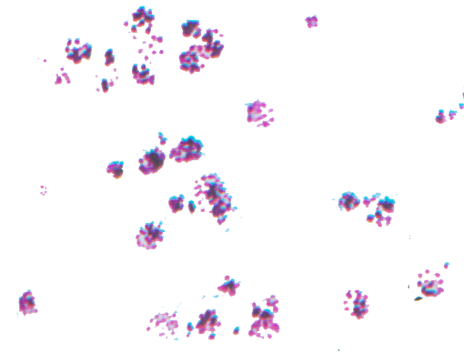
MATURE PLATELETS (THROMBOCYTES)

Slide 4
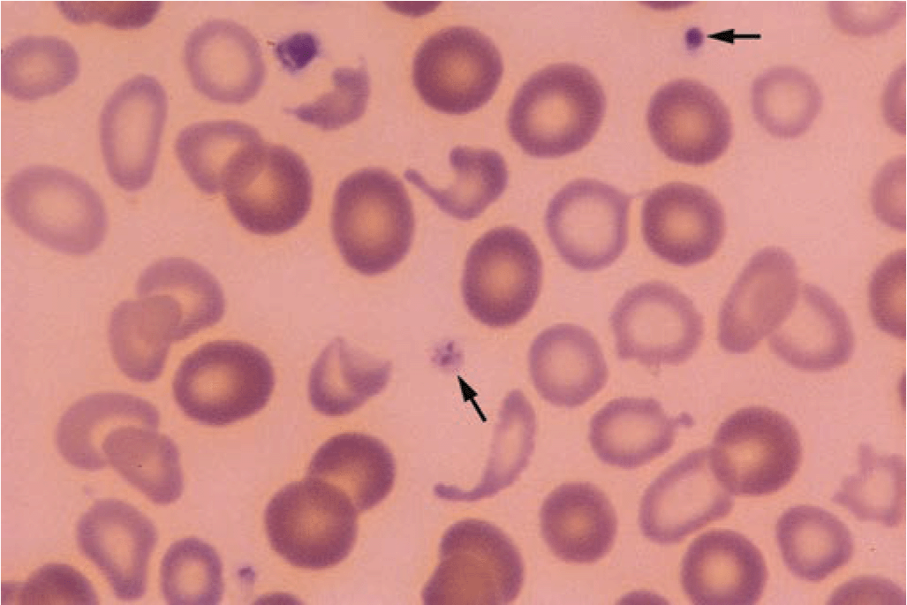
MATURE PLATELETS (THROMBOCYTES)

Slide 5
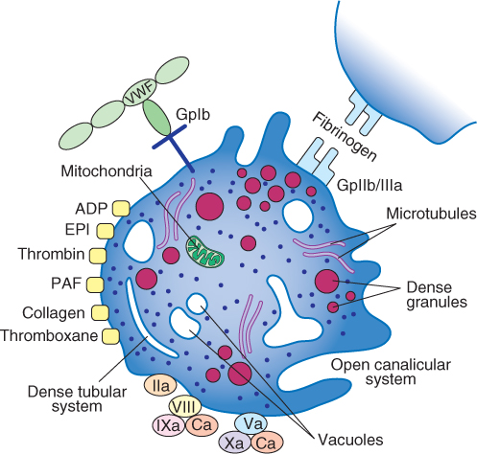
MATURE PLATELETS (THROMBOCYTES)

Slide 6
PLATELET FUNCTION
Maintaining vascular integrity i.e. initiates and concludes hemostasis
  Platelet Plug, Adhesion, Aggregation
  Thrombin, platelet activation, shape change, release of intracellular granules
  Surface activation of clotting factors
  Clot retraction

Slide 7
PLATELET MATURATION- general
Pluripotential stem cell in the Bone Marrow, CSF (colony stimulating factor) and thrombopoietin
ENDOMITOSIS = nuclear division without cell cytoplasm division until you have a multinucleated giant cell with 8 to 16 nuclei.
Maturation sequence – 5 days

Slide 8
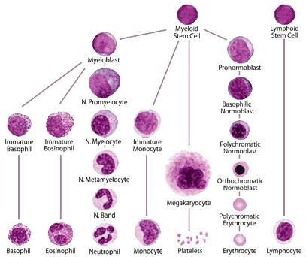
Note Platelets

Slide 9
PLATELET MATURATION general…
Platelets produced directly from the megakaryocyte cytoplasm
Each megakaryocyte produces 2000 – 4000 platelets
Circulating platelets represent 2/3 of all platelets; other 1/3 stored in spleen (splenic platelet pool)
Platelets live in circulation (P.B.) for 9-12 days
Normal range 150,000 – 400,000 (138K->350K)
Platelet = thrombocyte (-cyte though no nucleus)

Slide 10
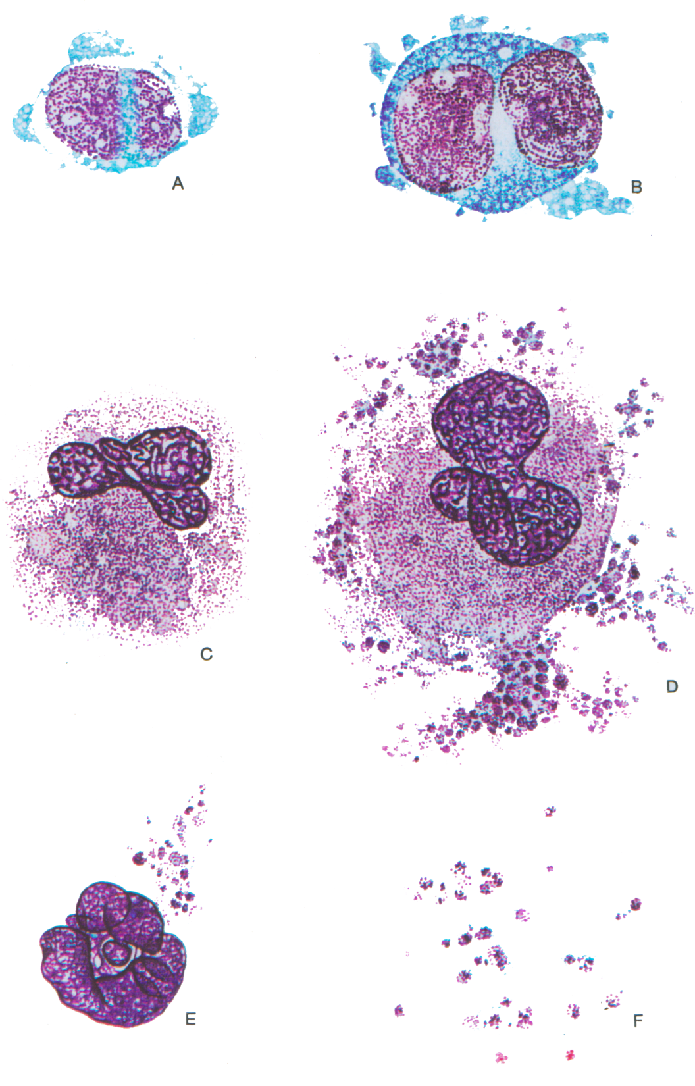
Megakaryoblast with single oval nucleus, nucleoli, and bluish foamy marginal cytoplasmic structures
Promegakaryocyte with 2 nuclei, granular blue cytoplasm, and marginal bubbly cytoplasmic structures.
Megakaryocyte with granular cytoplasm and without discrete thrombocytes (platelets)
Metamegakaryocyte with multiple nuclei, granular cytoplasm, and with thrombocytes(platelets)
Metamegakaryocyte nucleus with attached thrombocytes
Thrombocytes (platelets)

Slide 11
PLATELET MATURATION- MEGAKARYOBLAST
0-1% in BM
15-35 microns
Nucleus round/oval – sometimes indented and lobed
N/C ration 8:1- 10:1
Chromatin – red/purple varying in density
0-6 small nucleoli
Cytoplasm – small to moderate with pseudopod projections, blue/basophilic, no granulation

Slide 12
PLATELET MATURATION-
PROMEGAKARYOCYTE
Also called BASOPHILIC MEGAKARYOCYTE
0-1% in BM
Nucleus round/ indented with 2-4 lobes
N/C ratio about 6:1
0-2 nucleoli
Coarse red/purple chromatin
Cytoplasm – abundant, blue, with fine azurophilic granules

Slide 13
PLATELET MATURATION-
GRANULAR MEGAKARYOCYTE
Also called Megakaryocyte
0-1% in BM
40-90 microns
Nucleus = multilobed
N/C ratio about 2:1 – 1:3
Cytoplasm – abundant, pink to blue, numerous and diffuse azurophilic granules, without discrete thrombocytes (platelets) but coarse clumps of granules aggregating into bundles from which platelets will bud off = “platelet forming fields”

Slide 14
PLATELET MATURATION
MATURE MEGAKARYOCYTE
Also called Metamegakaryocyte
0-1% in BM
40-100 microns
Nucleus – multinucleated, red/purple, coarse chromatin
N/C ratio – 2:1 – 1:1
No nucleoli
Cytoplasm – abundant, light blue to pink, with
thrombocytes (platelets) budding off.

Slide 15
PLATELET MATURATION
PLATELET
Also called mature thromobocyte
Disk Shape
2-3 microns diameter, 10 fl volume
> 7 microns = GIANT PLATELET – results from accelerated production and maturation due to need. Seen in Myeloproliferative disorders and May Hegglin
Non-nucleated:
  Hyalomere = blue-grey background
  Granulomere = bunch of granules in center

Slide 16
MORPHOLOGICALLY ABNORMAL PLATELETS
Megaloblastic- hypersegmented nuclei with hypoclumped chromatin = asynchrony--> nuclei and chromatin do not segment at the same pace (more nuclei than chromatin)
Megaloblastoid = hyposegmented nuclei with hyperclumped chromatin, uninucleate – dysplastic (Myelodysplastic Syndrome, CGL, chemotherapy) (more chromatin, than nuclei)

Slide 17
IMPAIRED PLATELET FUNCTION
Quantitative vs Qualitative
Quantitative – more frequent
  Decreased circulating platelets = THROMBOCYTOPENIA
  Increased circulating platelets = THROMBOCYTOSIS
Quality – platelet function abnormality – THROMBOCYTHEMIA and THROMBOSTHENIA

Slide 18
THROMBOCYTOPENIA
Def: <100,000 platelets/mm3
Bleeding Time – increases inversely with a decrease in platelets < 100K
Note: patients with <20,000 platelets/mm3 can bleed spontaneously
Falsely or pseudo- thrombocytopenia:
  Platelet clumps – poor mixing, certain medications
  Uneven distribution -poorly made smear
  PLATELET SATELLITISM = EDTA related, platelets sticking to the outer cell membrane of neutrophils

Slide 19
THROMBOCYTOPENIA…
Decreased platelet production
  Acquired or hereditary
  Aplasia
  Infiltration of the BM (MF or Leukemia)
  B12 deficiency
Increased consumption or destruction – underlying disease cases platelet destruction -> thrombocytopenia
  TTP = THROMBOTIC THROMBOCYTOPENIC PURPURA
    White clots – mostly platelets-arterial
    shistocytes
    Increased consumption
  DIC = DISSEMINATED INTRAVASCULAR COAGULATION
    Secondary to another disease process
    Systemic clot formation
    Results in consumption of platelets and coagulation factors
    Possibly shistocytes
    Increased consumption

Slide 20
THROMBOCYTOPENIA…
ITP= IMMUNOLOGIC THROMBOCYTOPENIA
PURPURA
  No longer “IDIOPATHIC”= unknown cause
  Platelets coated with Ab and complement which marks them for destruction by macrophages primarily in the spleen i.e. AUTOMIMMUNE
  Decreased platelets due to increased immune destruction
  Disorder classified by mechanism of destruction (Immune vs Non-Immune)
  Following a viral infection, the thrombocytopenia is transient

Slide 21
THROMBOCYTOPENIA…
DRUG INDUCED – can be an immune response or complement destruction of platelets
  Ex. Heparin/ heparin induced thrombocytopenia (HIT)

Slide 22
THROMBOCYTOPENIA…
Abnormal distribution and dilution
  Dilution:
    Pregnancy 3rd trimester
    Cirrhosis of the liver – alters fluid distribution thus platelets may look decreased
    Massive transfusion of packed rbcs/FFP – adds rbc volume/plasma but not platelets
  Distribution:
    SPLENOMEGALY – large spleen because it sequesters/pools more than the normal 1/3 of the platelets.
    ------------------------------------------------------------------
    REFRACTORY THROMBOCYTOPENIA

Slide 23
THROMBOCYTOSIS
Def: > 450,000 platelets/mm3
REACTIVE THROMBOCYTOSIS = normal, healthy response to blood loss i.e.
  Splenic pool released
  BM releases most mature platelets available
  BM increases platelet production
  BENIGN
  Asymptomatic
  Normal Platelet Function Tests

Slide 24
THROMBOCYTOSIS…
Causes of Reactive Thrombocytosis:
  Hemorrhage, trauma, postsurgery, malignancy, chronic infections, chronic iron deficiency, connective tissue disease such as Rheumatoid Arthritis
  Giant platelets – often inverse relation between the size of the platelet and the platelet count
  Reactive rarely > 1 million

Slide 25
THROMBOCYTOSIS…
MYELOPROLIFERATIVE DISEASES – increases in rbcs, wbcs, and platelets
  NEOPLASTIC
  Often > 1 million especially ESSENTIAL THROMOCYTHEMIA (ET) which is uncontrolled proliferation of megakaryocytes and platelets

Slide 26
THROMBOCYTOSIS…
ACUTE MEGAKARYOCTYIC LEUKEMIA (FAB F7) – rare NEOPLASTIC
POST SPLENECTOMY – since 1/3 of platelets are normally sequestered by the spleen, if the spleen is removed the platelet count will go up by 1/3 – abnormal distribution

Slide 27
QUALITATIVELY ABNORMAL PLATELETS
Much less common than quantitative
Hereditary
  Platelet type Von Willebrand’s – adhesion, BT, platelet aggregation abnormal
  THROMBASTHENIA (Glanzmann’s disease) – platelet function is abnormal (platelet aggregation and clot retraction abnormal) but platelet # is normal
  BERNARD-SOULIER SYNDROME – abnormal platelet aggregation
  STORAGE POOL DISEASE = GRAY PLATELET SYNDROME ie no granules and abnormal platelet aggregation
Acquired
  Aspirin ingestion -> deficient aggregation
  Hyperglobulinemia
  Secondary to Myeloproliferative disorders
  Uremia – secondary to kidney failure
  Chemical toxicity – high conc heparin, alcohol, xray contrast media, dextrans
  List of medications affect platelets

Slide 28
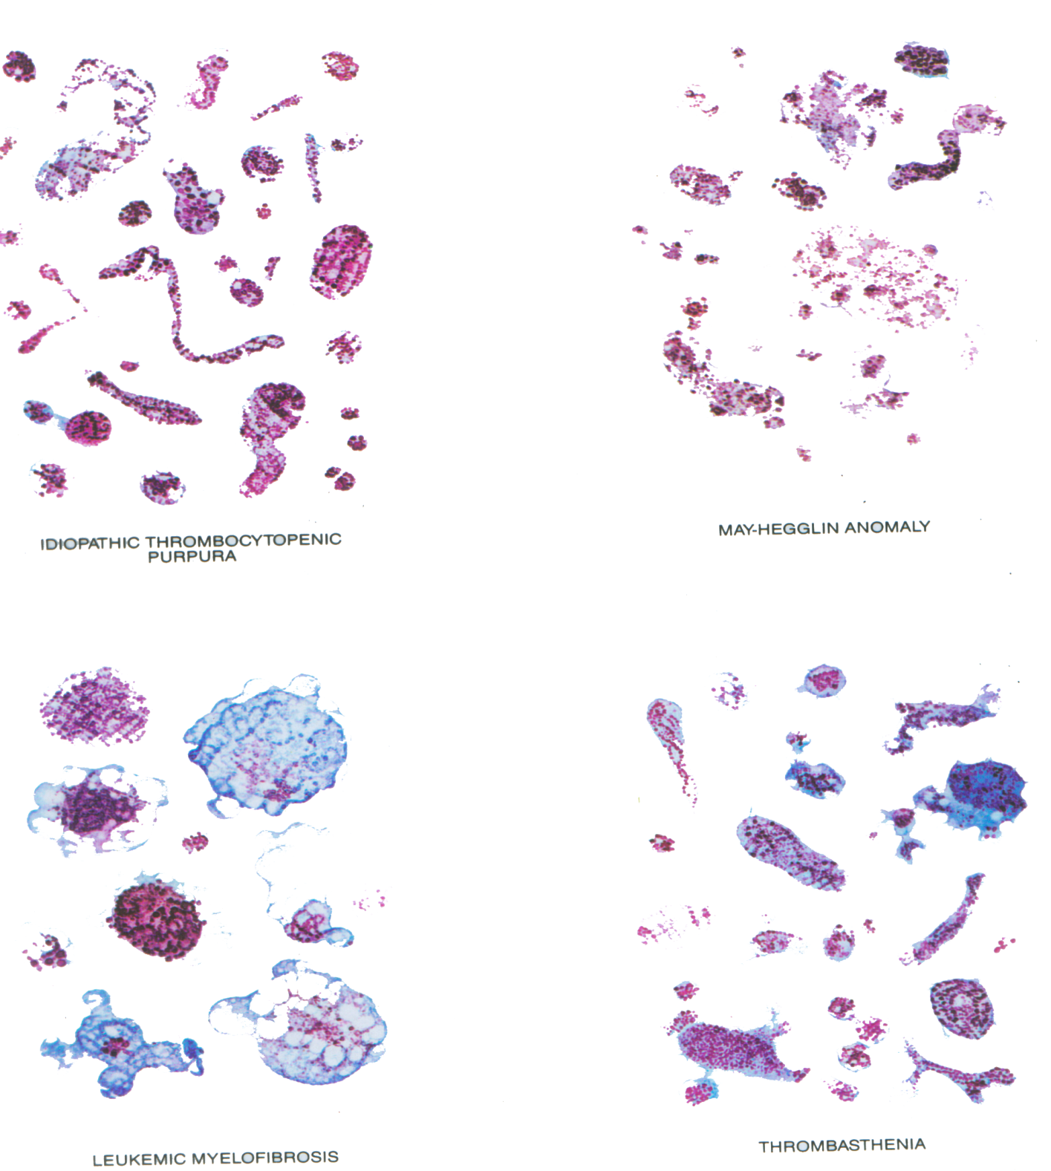
Pathological Thrombocytes (platelets)

Slide 29
Clinical Laboratory Hematology
Thrombocytes – II

Slide 30
Manual Platelet Counting
• Specimen – EDTA (lavender top)
• Diluting fluid – Ammonium Oxalate, a Rees-Eker fluid (platelets remain
unaltered while rbcs are lysed)
• Dilution = 1:100
– RBC Thoma pipette
– Platelet UNOPETTES
• Hemocytometer (Improved Neubauer)
– Basic math skills assumed (It is assumed that you are able to
add/subtract/multiply/divide fractions/decimals/percentages)
– Areas of hemocytometer – 9 lg squares, each 1mm x1mm x.1mm deep = 9
mm3
• Large center square subdivided into 25 small squares, each of which is
0.2mmx0.2mmx0.1 deep = .004mm3. This is area of choice for manual platelet
counting.
• Hemocytometer charged and placed in a MOISTURE CHAMBER for at least 10
minutes to allow platelets to settle down on the surface for accurate counting in 1 plane
of focus.

Slide 31
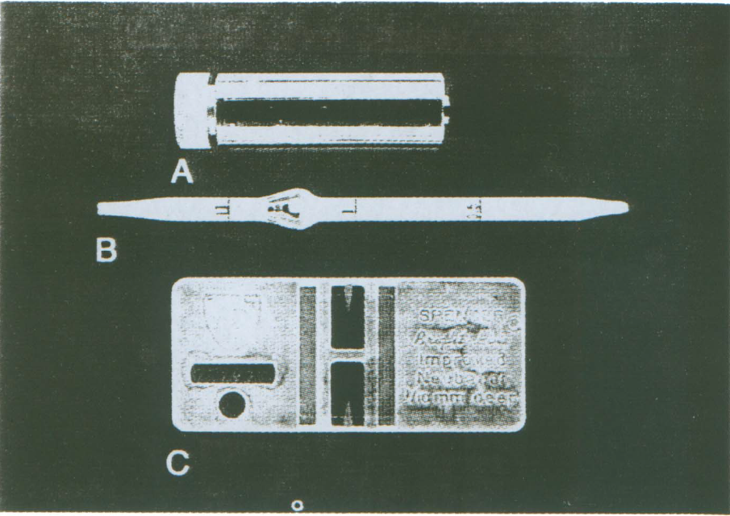
Diluting Methods

Slide 32
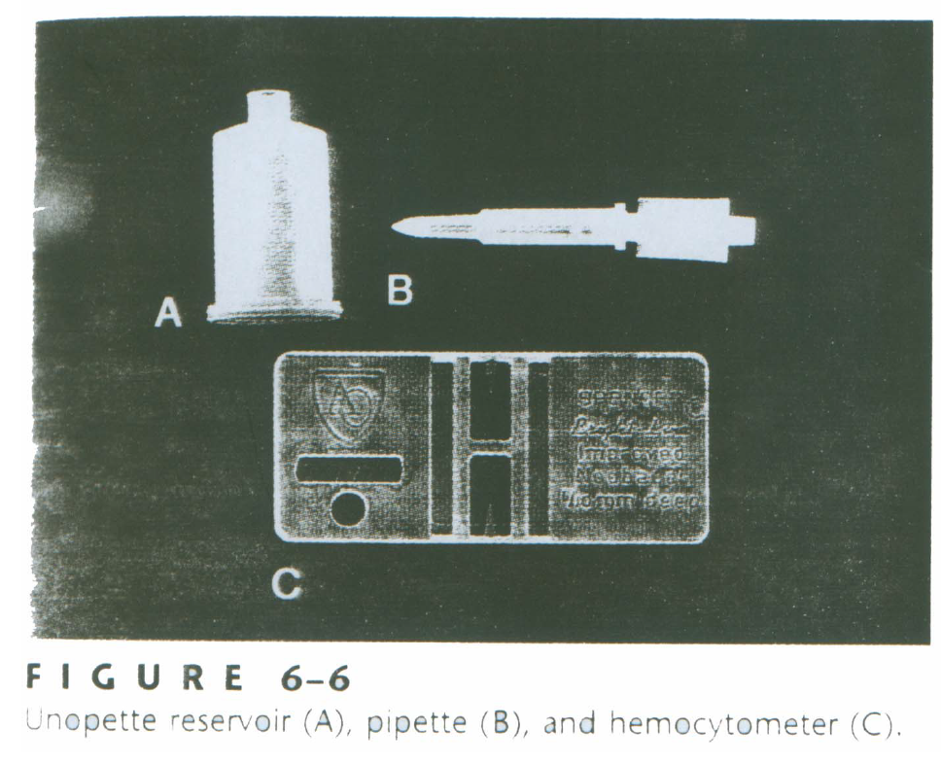
Diluting Methods

Slide 33
Manual Platelet Counting
Microscopy
LIGHT MICROSCOPE – difficult to differentiate debris from platelets
PHASE MICROSCOPE – Brecker-Cronkite allows unstained objects invisible under bright light such as platelets, to be seen.
Slight differences in thickness and refractive index is converted into intensity or brightness differences that are detectable by the eye.
Depending on the equipment used, the object appears either bright against a dark background (DARK PHASE) OR dark against a bright background (LIGHT PHASE)

Slide 34
PLATELETS UNDER DARK
PHASE MICROSCOPE
DARK PHASE – platelets are dense, round, oval bodies
– light object against a dark background
– Halo
– Brownian movement
– RBC stroma – ghosts in background
– Debris highly refractive and irregular in shape and can mimic platelets
– Air bubbles can mimic platelets also
– Debris and Air bubbles change size as focus up and down
but platelets do not
– Bacteria will demonstrate DIRECTIONAL movement and are
generally smaller than platelets.

Slide 35
MANUAL PLATELETS – OTHER
CONSIDERATIONS
• FLUID contamination - generally refrigerated or airtight containers to prevent interfering contamination
• DUST
• FINGER OILS
• FINGERSTICK SPECIMEN = least desirable (adhesion and aggregation); need knowledge of platelet plug formation
– Thoma pipette
– Unopette

Slide 36
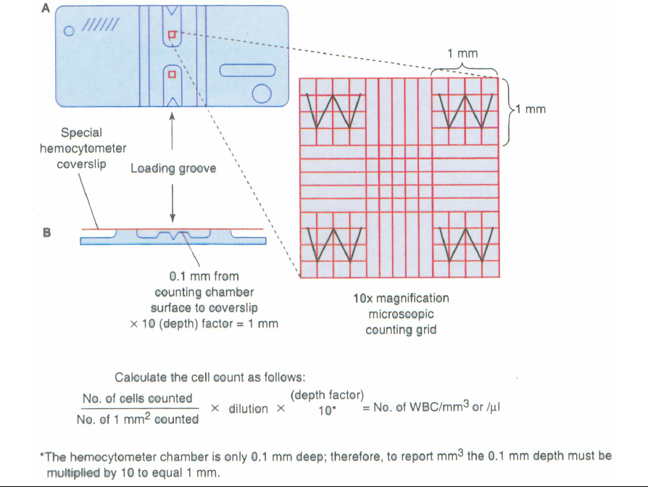
MANUAL PLATELETS – OTHER
CONSIDERATIONS

Slide 37
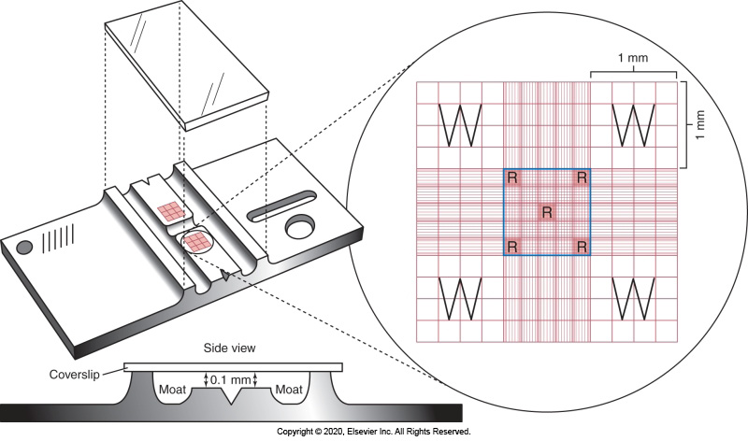
MANUAL PLATELETS – OTHER
CONSIDERATIONS
The Neubauer Hemocytometer

Slide 38
MANUAL PLATELET COUNTS
• Counts on both sides of Hemocytometer should agree within 10%.
• Normal Range 150,000- 450,000/ul or /mm3 or 150-450 K/ul or /mm3.
• Manual platelet counts compared with smear estimate.
• The CV for most manual platelet counts is 22% which is high.

Slide 39
MANUAL PLATELET COUNTS
• EDTA is diluent of choice but beware of SATELLITOSIS/
CLUMPING
  – If clumping is consistently present because of medication or medical condition, use a blue top tube (citrate) but add 10% because of the 1/10 dilution.
• Count more area for low count.
• Patients with low platelet counts (<100K) may have increased bleeding, oozing, and bruising of skin and mucous membrane
  – Platelets dynamically cover the openings between endothelial cells lining capillaries and can do it less efficiently when platelets are low, allowing blood cells to ooze out.

Slide 40
MANUAL PLATELET COUNTS
Sources of Error
• Incorrect or inadequate specimen
• Inadequate mixing pre-dilution
• Incorrect dilutions or diluting fluid
• Incorrect calculation
• Improper counting i.e. not recognize platelets or not follow top/right, bottom/left rule.

Slide 41
MANUAL PLATELET COUNTS
Hemocytometer Formula
• #cells x reciprocal depth x reciprocal dilution
AREA (THE ABOVE # OF CELLS COUNTED IN)
DEPTH CONSTANT 0.1 SO RECIPRICOL IS 10 DILUTION IS 1/100 USUALLY SO RECIPRICOL IS 100.
AREA = LENGTH X WIDTH SO IF COUNT LARGE CENTER SQUARE IT IS 1MM X 1MM = 1MM2.
# CELLS OF COURSE IS WHAT IS COUNTED IN THE LARGE CENTER SQUARE IN THIS CASE.
MAKE SURE NUMBER OF CELLS AND AREA ARE BOTH AN AVERAGE OF 2 SIDES OR BOTH A TOTAL OF 2 SIDES (depends on whether a total or average is used for the #cells, area should be the same i.e. total or average).

Slide 42
MANUAL PLATELET COUNTS
Example Calculation
• Ex. 65 platelets were counted in the large center square on 1 side of the hemocytometer. 71 platelets were counted on the other side. They are within 10%.
• The average # of cells on 1side is 68 and the area on one side is 1mm2, therefore
• 68 x 10 x 100 = 68,000 platelets / mm3
    1mm2
• The total # of cells counted is 136 and the total area is 2mm2, therefore
136 x 10 x 100 = 68,000 platelets/mm3
    2mm2

Slide 43
Automatic Platelet Counting - IMPEDANCE
• Impedance counting = Coulter Principle
– inner and outer electrode
– Electrical current in an isotonic solution through an aperture (hole)
– Cells don’t carry electricity and when go through the aperture they create a break in the current proportional to their SIZE.
– Threshold is set and anything below 35fl in size is counted as a platelet (rbcs have been lysed so only wbcs and platelets are in the counting bath)
– Histogram

Slide 44
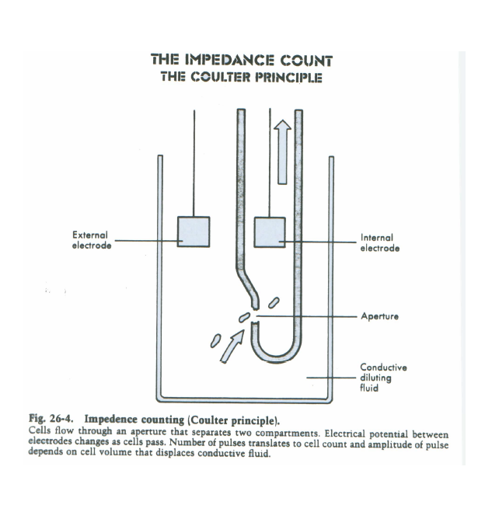
Automatic Platelet Counting – IMPEDANCE – Coulter Principle

Slide 45
Automatic Platelet Counting – IMPEDANCE – Coulter Principle

Slide 46
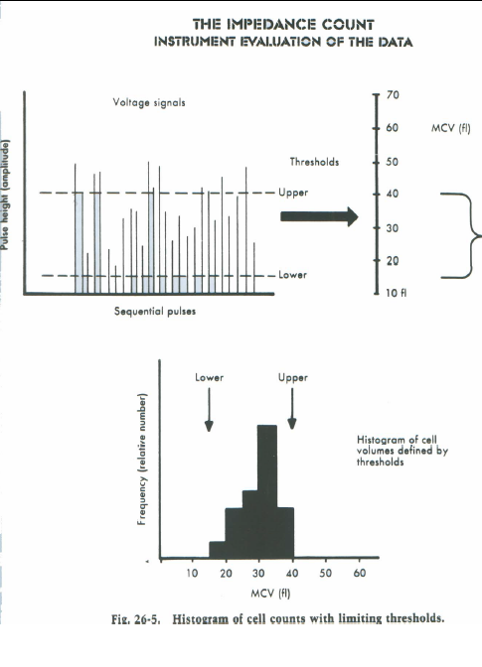
Automatic Platelet Counting – IMPEDANCE – Coulter Principle
Instrument Evaluation –
Impedance Counting is
used for WBCs, RBCs
and Platelets. The
thresholds used are
different for each. The
threshold for platelets
is generally < 15 or 20fL

Slide 47
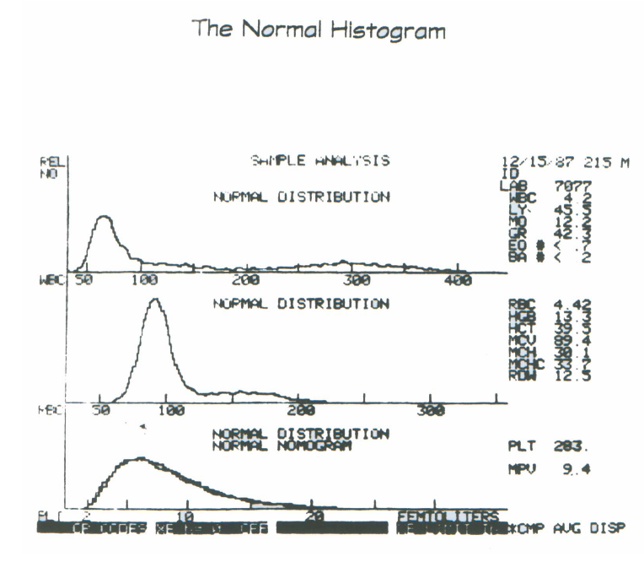
Automatic Platelet Counting – IMPEDANCE – Coulter Principle

Slide 48
Impedance Counting – Drawbacks (Size Only Methodology)
• GIANT PLATELETS – as big as rbcs therefore counted as rbcs (false increase but millions so insignif), but not insignificant for the platelets (falsely decr).
• SHISTOCYTES/MICROSPHEROCYTES as small as platelets so may give falsely increased platelet count.
• PLATELET CLUMPS may be as large as rbcs or wbcs and may falsely increase either while falsely decreasing platelets.
• POORLY MIXED specimen would results in a less than random count.
• COINCIDENCE = more than 1 platelet through aperture at a time.

Slide 49
Automated Platelet Count - Optical
• OPTICAL PLATLELETS ARE COUNTED BY FLOW CYTOMETRY (methodology)
• Cells in a dilution travel 1 at a time and are subjected to radio frequency or laser light which is defracted, reflected, or refracted.
• Several laser angles on the instrument and the scattering qualities determine the complexity of the cell being analyzed. Information about the cell structure and cytoplasmic components can be obtained in this manner – more data than size.

Slide 50
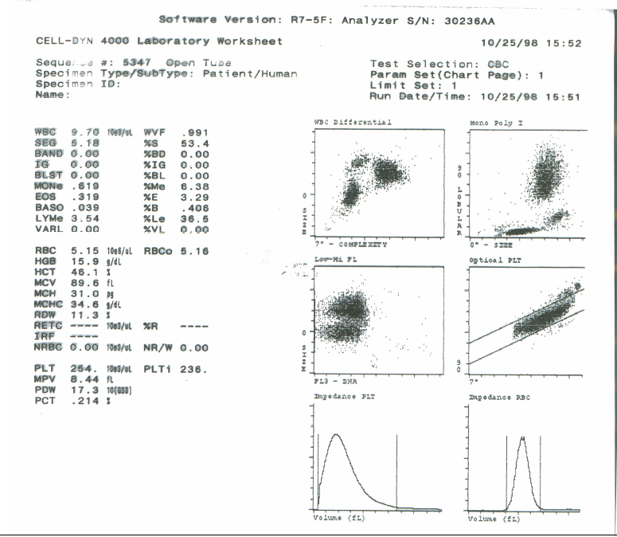
Automated Platelet Count - Optical

Slide 51
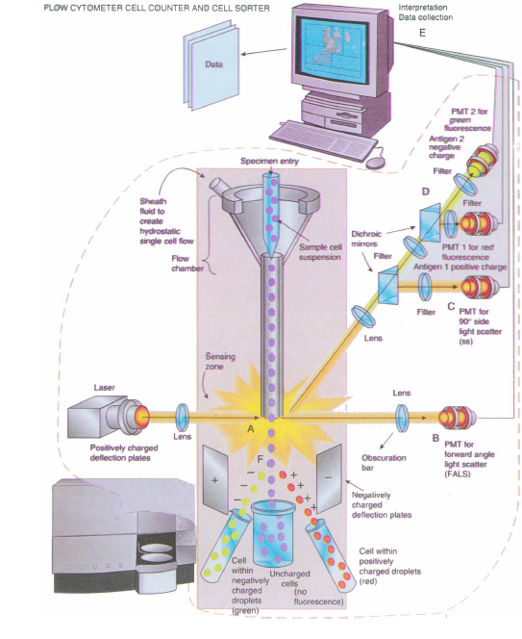
A Flow Cytometer Particle Counter and Cell Sorter.
This instrument, also called a Fluorescence Activated
Cell Sorter (FACS) is used
to identify and count cells
(A), collect or sort specific
cells (F), evaluated the
amount of DNA or RNA, and detect platelet aggregation and platelet factor release.

Slide 52
Automated Platelet Count – Optical (Limitations)
• Giant Platelets not usually interfere
• Shistocytes and microcytes – no longer a problems because no nucleus, no granules.
• Clumps are recognized as platelets because they are granular with no nucleus
• Platelet scattergrams
• Quantitative
• Est → manual → auto (impedance->flow) and occasionally Ag/Ab interference → CD61

Slide 53
Platelet Estimates
• Check edges and body of peripheral blood smear for PLATELET CLUMPS first.
• Used to confirm a manual or questionable automated platelet count.
• If RBC count is available:
– Method used before automated platelet counting
– Uses the THIN area of the smear
– Count the TOTAL number of platelets in 5 fields
– Multiply that by the 1st 4 significant digits of the RBC count
  • Ex; 125 platelets total counted in 5 fields in the thin area of the PB smear with even distribution.
  • RBC = 3.56 x 106 /uL (uL = mm3 ) the 1st 4 significant digits are
  3560
  • 125 x 3560 = 445,000 platelets /uL (uL = mm3)

Slide 54
Platelet Estimates
• If RBC count is not available
  – Works well with normal platelet counts only
  – Diff area or middle area of the PB smear
  – Count the average number of platelets in 5 fields.
  – Multiply that by 15,000 or 20,000 depending on your instrument (with which you are comparing your numbers).

Slide 55
Platelet Estimates
• 38 platelets are counted on 1 side of thehemocytometer and 40 are counted on the other on a 1/100 dilution. The entire large center square was counted on each side.
– Are the 2 sides acceptably close? 2/40 = 5% i.e. < 10%
– 38+40 = 78 total count
78 x 100 (recip of dilution) x 10 (recip of depth) =
  2 x 1 mm2 (total area)
=> 78000/2 = 39000 platelet

Slide 56
Clinical Laboratory Hematology
Thrombocytes – II

Slide 57
Manual Platelet Counting
• Specimen – EDTA (lavender top)
• Diluting fluid – Ammonium Oxalate, a Rees-Eker fluid (platelets remain
unaltered while rbcs are lysed)
• Dilution = 1:100
– RBC Thoma pipette
– Platelet UNOPETTES
• Hemocytometer (Improved Neubauer)
– Basic math skills assumed (It is assumed that you are able to
add/subtract/multiply/divide fractions/decimals/percentages)
– Areas of hemocytometer – 9 lg squares, each 1mm x1mm x.1mm deep = 9
mm3
• Large center square subdivided into 25 small squares, each of which is
0.2mmx0.2mmx0.1 deep = .004mm3. This is area of choice for manual platelet
counting.
• Hemocytometer charged and placed in a MOISTURE CHAMBER for at least 10
minutes to allow platelets to settle down on the surface for accurate counting in 1 plane
of focus.

Slide 58
Diluting Methods

Slide 59
Diluting Methods

Slide 60
Manual Platelet Counting
Microscopy
LIGHT MICROSCOPE – difficult to differentiate debris from platelets
PHASE MICROSCOPE – Brecker-Cronkite allows unstained objects invisible under bright light such as platelets, to be seen.
Slight differences in thickness and refractive index is converted into intensity or brightness differences that are detectable by the eye.
Depending on the equipment used, the object appears either bright against a dark background (DARK PHASE) OR dark against a bright background (LIGHT PHASE)

Slide 61
PLATELETS UNDER DARK
PHASE MICROSCOPE
DARK PHASE – platelets are dense, round, oval bodies
– light object against a dark background
– Halo
– Brownian movement
– RBC stroma – ghosts in background
– Debris highly refractive and irregular in shape and can mimic platelets
– Air bubbles can mimic platelets also
– Debris and Air bubbles change size as focus up and down
but platelets do not
– Bacteria will demonstrate DIRECTIONAL movement and are
generally smaller than platelets.

Slide 62
MANUAL PLATELETS – OTHER
CONSIDERATIONS
• FLUID contamination - generally refrigerated or airtight containers to prevent interfering contamination
• DUST
• FINGER OILS
• FINGERSTICK SPECIMEN = least desirable (adhesion and aggregation); need knowledge of platelet plug formation
– Thoma pipette
– Unopette

Slide 63
MANUAL PLATELETS – OTHER
CONSIDERATIONS

Slide 64
MANUAL PLATELETS – OTHER
CONSIDERATIONS
The Neubauer Hemocytometer

Slide 65
MANUAL PLATELET COUNTS
• Counts on both sides of Hemocytometer should agree within 10%.
• Normal Range 150,000- 450,000/ul or /mm3 or 150-450 K/ul or /mm3.
• Manual platelet counts compared with smear estimate.
• The CV for most manual platelet counts is 22% which is high.

Slide 66
MANUAL PLATELET COUNTS
• EDTA is diluent of choice but beware of SATELLITOSIS/
CLUMPING
  – If clumping is consistently present because of medication or medical condition, use a blue top tube (citrate) but add 10% because of the 1/10 dilution.
• Count more area for low count.
• Patients with low platelet counts (<100K) may have increased bleeding, oozing, and bruising of skin and mucous membrane
  – Platelets dynamically cover the openings between endothelial cells lining capillaries and can do it less efficiently when platelets are low, allowing blood cells to ooze out.

Slide 67
MANUAL PLATELET COUNTS
Sources of Error
• Incorrect or inadequate specimen
• Inadequate mixing pre-dilution
• Incorrect dilutions or diluting fluid
• Incorrect calculation
• Improper counting i.e. not recognize platelets or not follow top/right, bottom/left rule.

Slide 68
MANUAL PLATELET COUNTS
Hemocytometer Formula
• #cells x reciprocal depth x reciprocal dilution
AREA (THE ABOVE # OF CELLS COUNTED IN)
DEPTH CONSTANT 0.1 SO RECIPRICOL IS 10 DILUTION IS 1/100 USUALLY SO RECIPRICOL IS 100.
AREA = LENGTH X WIDTH SO IF COUNT LARGE CENTER SQUARE IT IS 1MM X 1MM = 1MM2.
# CELLS OF COURSE IS WHAT IS COUNTED IN THE LARGE CENTER SQUARE IN THIS CASE.
MAKE SURE NUMBER OF CELLS AND AREA ARE BOTH AN AVERAGE OF 2 SIDES OR BOTH A TOTAL OF 2 SIDES (depends on whether a total or average is used for the #cells, area should be the same i.e. total or average).

Slide 69
MANUAL PLATELET COUNTS
Example Calculation
• Ex. 65 platelets were counted in the large center square on 1 side of the hemocytometer. 71 platelets were counted on the other side. They are within 10%.
• The average # of cells on 1side is 68 and the area on one side is 1mm2, therefore
• 68 x 10 x 100 = 68,000 platelets / mm3
    1mm2
• The total # of cells counted is 136 and the total area is 2mm2, therefore
136 x 10 x 100 = 68,000 platelets/mm3
    2mm2

Slide 70
Automatic Platelet Counting - IMPEDANCE
• Impedance counting = Coulter Principle
– inner and outer electrode
– Electrical current in an isotonic solution through an aperture (hole)
– Cells don’t carry electricity and when go through the aperture they create a break in the current proportional to their SIZE.
– Threshold is set and anything below 35fl in size is counted as a platelet (rbcs have been lysed so only wbcs and platelets are in the counting bath)
– Histogram

Slide 71
Automatic Platelet Counting – IMPEDANCE – Coulter Principle

Slide 72
Automatic Platelet Counting – IMPEDANCE – Coulter Principle

Slide 73
Automatic Platelet Counting – IMPEDANCE – Coulter Principle
Instrument Evaluation –
Impedance Counting is
used for WBCs, RBCs
and Platelets. The
thresholds used are
different for each. The
threshold for platelets
is generally < 15 or 20fL

Slide 74
Automatic Platelet Counting – IMPEDANCE – Coulter Principle

Slide 75
Impedance Counting – Drawbacks (Size Only Methodology)
• GIANT PLATELETS – as big as rbcs therefore counted as rbcs (false increase but millions so insignif), but not insignificant for the platelets (falsely decr).
• SHISTOCYTES/MICROSPHEROCYTES as small as platelets so may give falsely increased platelet count.
• PLATELET CLUMPS may be as large as rbcs or wbcs and may falsely increase either while falsely decreasing platelets.
• POORLY MIXED specimen would results in a less than random count.
• COINCIDENCE = more than 1 platelet through aperture at a time.

Slide 76
Automated Platelet Count - Optical
• OPTICAL PLATLELETS ARE COUNTED BY FLOW CYTOMETRY (methodology)
• Cells in a dilution travel 1 at a time and are subjected to radio frequency or laser light which is defracted, reflected, or refracted.
• Several laser angles on the instrument and the scattering qualities determine the complexity of the cell being analyzed. Information about the cell structure and cytoplasmic components can be obtained in this manner – more data than size.

Slide 77
Automated Platelet Count - Optical

Slide 78
A Flow Cytometer Particle Counter and Cell Sorter.
This instrument, also called a Fluorescence Activated
Cell Sorter (FACS) is used
to identify and count cells
(A), collect or sort specific
cells (F), evaluated the
amount of DNA or RNA, and detect platelet aggregation and platelet factor release.

Slide 79
Automated Platelet Count – Optical (Limitations)
• Giant Platelets not usually interfere
• Shistocytes and microcytes – no longer a problems because no nucleus, no granules.
• Clumps are recognized as platelets because they are granular with no nucleus
• Platelet scattergrams
• Quantitative
• Est → manual → auto (impedance->flow) and occasionally Ag/Ab interference → CD61

Slide 80
Platelet Estimates
• Check edges and body of peripheral blood smear for PLATELET CLUMPS first.
• Used to confirm a manual or questionable automated platelet count.
• If RBC count is available:
– Method used before automated platelet counting
– Uses the THIN area of the smear
– Count the TOTAL number of platelets in 5 fields
– Multiply that by the 1st 4 significant digits of the RBC count
  • Ex; 125 platelets total counted in 5 fields in the thin area of the PB smear with even distribution.
  • RBC = 3.56 x 106 /uL (uL = mm3 ) the 1st 4 significant digits are
  3560
  • 125 x 3560 = 445,000 platelets /uL (uL = mm3)

Slide 81
Platelet Estimates
• If RBC count is not available
  – Works well with normal platelet counts only
  – Diff area or middle area of the PB smear
  – Count the average number of platelets in 5 fields.
  – Multiply that by 15,000 or 20,000 depending on your instrument (with which you are comparing your numbers).

Slide 82
Platelet Estimates
• 38 platelets are counted on 1 side of thehemocytometer and 40 are counted on the other on a 1/100 dilution. The entire large center square was counted on each side.
– Are the 2 sides acceptably close? 2/40 = 5% i.e. < 10%
– 38+40 = 78 total count
78 x 100 (recip of dilution) x 10 (recip of depth) =
  2 x 1 mm2 (total area)
=> 78000/2 = 39000 platelet

