Slide 1
Clinical Laboratory Hematology
Enumerative Procedure(s) & Indices: Erythrocytes
(RBC Counting & Indices)

Slide 2
ENUMERATIVE PROCEDURES AND INDICES: ERYTHROCYTES
This presentation, along with the YouTube videos, will explain and demonstrate the various methods for counting RBC’s and will review the RBC indices.
Please refer to the Evolve website for additional information.

Slide 3
Enumerative procedures
Include:
Manual methods of counting RBC’s
Automated methods of counting RBC’s
Counting reticulocytes

Slide 4
Enumerative procedures
1. Manual RBC counts
Why do we perform manual counts?
What do we use to perform manual counts?

Slide 5
Neubauer Hemocytometer
A calibrated tool with two chambers used to manually count RBC’s, WBC’s, and PLT’s.

Slide 6
How to prepare dilutions
Unopettes: prepackaged vials filled with a premeasured amount of diluent. The standard RBC unopette dilution is 1:200 (1.99 ml diluent and 0.01 ml blood).

Slide 7
Performing RBC counts
Once your specimen has mixed, you’re ready to charge the hemocytometer.
Wait a few minutes for the cells to settle before counting.

Slide 8
Counting on the hemocytometer
Now that the cells have settled, you are ready to start counting.

Slide 9
Counting on the hemocytometer
The standard RBC counting area is the four corner and one center square of the center primary square.

Slide 10
Calculation
The number of cells per microliter equals the number of cells counted x depth factor (always 10) x dilution factor divided by the area counted.
#cells/ul= # cells counted x 10 x dilution
area counted

Slide 11
Calculation
*The area is 9 if counting entire side of hemacytometer (9 squares x 1.0 mm2=9).
*The area is 4 if counting the four primary corner squares (4 x 1.0 mm2=4).
*The area is 1 if counting the entire center primary square (has 25 teeny squares- 25/25=1)
*The area is 0.2 if counting 5 out of the 25 teeny squares in the center primary square (5 x 0.4 mmx2 =0.2)

Slide 12
A tip for counting
Cells are counted in a serpentine manner. Count the cells that are completely in the square or touching the top or left sides. This formula for counting eliminates counting the same cells more than once.

Slide 13
2. Automated RBC counts
Impedance (Coulter principle)
Analyzers use a degree of impedance produced by blood cells or particles to count and determine the size of the RBC, PLT, and WBC.
When a cell or particle passes thru an aperature, the cell/particle blocks the current that is flowing.

Slide 14
Impedance
This is one of the chambers in which the impedance counting is performed. Most analyzers have one for counting RBC’s/PLT’s and one for counting WBC’s.

Slide 15
Impedance
The voltage increases to maintain a constant current. When the voltage rises above then falls below a certain threshold level, it indicates that a cell or particle has passed through the sensing zone. The count is monitored by the number of voltage pulses during a preset measuring interval.

Slide 16
Impedance - II
The volume (size) of the cells is determined by the magnitude of the pulses (how high above and below the threshold the voltage moves).
The results are displayed on the screen and printed in the form of histograms and scatterplots. Flags are displayed if something is outside the preset limits.

Slide 17
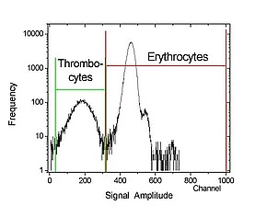
Impedance
On this particular plot, the red cells and platelets are counted at the same time. Because RBC’s are so much larger than PLT’s, this is usually not a problem.
When would it be?

Slide 18
Impedance
Benefits of impedance counting:
improved precision over manual
shorter count time

Slide 19
Optical counts
Analyzers use an argon-ion laser to detect and categorize fluorescent-dye stained cells. WBC, RBC, PLT can all be detected.
The laser is directed at the sample. The beam hits a cell and bounces off that cell at a different angle than it came in at. The different angles helps to categorize the cells (ex. 90, 7, 0).

Slide 20
Optical Counting
The particles which scatter light and those which take up the fluorescent dye are categorized and displayed on a scatterplot.

Slide 21
Optical counts
In addition to the angles of light scatter, the instrument uses fluorescent dyes. The dyes stain the DNA and RNA in the cells to help identify and classify them.
The dyes stain differently, which creates a type of marker or signal on the cell allowing it to be categorized.

Slide 22
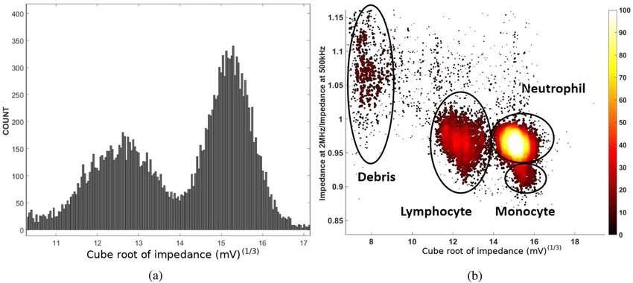
Optical counts
Different scatterplots indicate different types of cells or markers.
The larger the population, the higher the count.
(Above figure) - The histogram of the WBC count as a function of the cube root of the impedance at 500 Hz (a) and a scatter plot of the opacity as a function of the impedance.

Slide 23
Optical counts
The markers give information about the presence and characteristics of retics and nRBC’s.
RNA: found in retics, stains green, FL-1 marker
DNA: found in nRBC’s, stains red, marker is FL-3

Slide 24
Optical counts
Mature RBC’s have neither RNA or DNA, so mature and immature RBC’s can be easily differentiated from each other.
Retics contain RNA; mature RBC’s do not, so FL1 can be used to separate the two populations.

Slide 25
Optical counts
The dye used to stain DNA (FL3) is found in the WBC reagent. The reagent strips the membrane and cytoplasm from the nRBC’s so that only the nuclei remain. These are accessible to the dye.
FL3 is used to identify nRBC’s and to determine the % relative to WBC’s
(# nRBC’s per 100 WBC)

Slide 26
Automated Counting Methods
Most hematology analyzers utilize both
impedance and optical counting for accuracy
and precision.

Slide 27
3. Manual reticulocyte counts
Reticulocytes: immature RBC’s that contain remnant RNA.
Can be seen using a vital stain such as methylene blue which precipates the RNA to form visible dark blue clusters and filaments (reticulum).
Why is a retic count important?
It is a means of assessing erythropoietic activity of the bone marrow.

Slide 28
Retic procedure
Take equal amounts of stain and specimen; let mix for about 5 minutes.
Using a capillary tube, place one drop on a glass slide and make a few wedge smears.
Once the slides have dried, the retics are ready to be counted.

Slide 29
Retic procedure
Count 1000 red cells in consecutive oil fields and record the number of reticulocytes seen. You may count 500 cells on two separate slides.
The % retic is:
# retics counted/1000 cells X 100

Slide 30
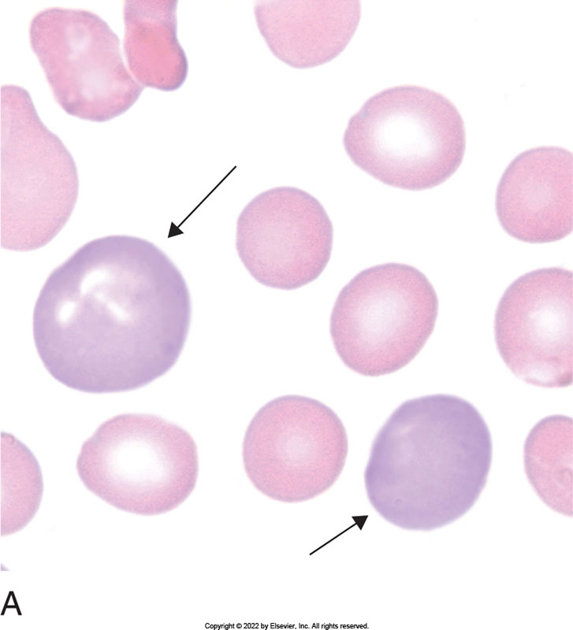
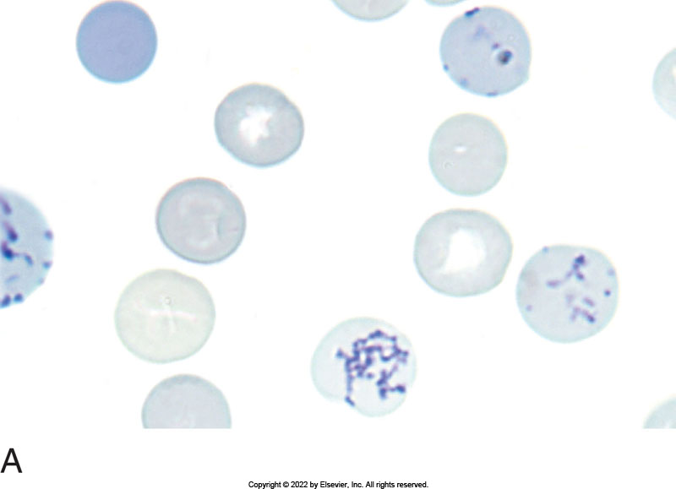
Retic Counting
Count the total number of RBC’s and the number of retics per field until you reach 1000 red cells.

Slide 31
Corrected retic count
The retic count is a % of total red cells. In states of anemia, the retic % is not a true reflection of retic production. A correction factor must be used so that marrow production is not overestimated. Low RBC and HCT will increase the % retic.

Slide 32
Corrected retic count
Corrected retic count= retic% x Pt HCT
Avg. normal HCT
Average normal HCT is 45 for men, 42 for women

Slide 33
Interpretation of results
Retic count is elevated in patients with hemolytic anemia, acute/chronic hemorrhage, following treatment for iron deficiency and megaloblastic anemias, and in patients with uremia.
Retic count is decreased in aplastic anemia, aplastic crises of hemolytic anemia, and ineffective erythropoiesis (thal, PA, SA)

Slide 34
Sources of error
A refractile appearance to the RBC’s should not be confused with retics. Stain debris can cause refractile material. Focus up and down on the scope- the refractile material will remain shiny and the reticulum will remain blue.

Slide 35
Sources of error
RBC inclusions should not be mistaken for reticulocytes. Be able to recognize Howell Jolly bodies, Heinz bodies, Pappenheimer bodies and Hemoglobin H inclusions.

Slide 36
4. RBC Indices
The values obtained for RBC count, HCT, and HGB can be used to calculate the RBC indices which define size and HGB content of an average RBC in a given specimen of blood. These indices are useful tools in classifying anemias.

Slide 37
RBC Indices
MCV = HCT x 10
RBC
MCV is the average volume of RBC in femtoliters (fl)
Normal range is 80-100
Results below 80 indicate microcytosis
Results above 100 indicate macrocytosis

Slide 38
RBC Indices
MCH = Hgb x 10
RBC
MCH is the average weight of Hgb in RBC. Results give the Hgb content per red cell in picograms (pg).
Normal range for adults: 27-32
Newborns/infants higher due to high MCV

Slide 39
RBC Indices
MCHC = Hgb x 100
HCT
MCHC is the average concentration of Hgb in each individual RBC. Ratio of weight Hgb to volume of RBC.
Normal range is 32-36
Helps to classify RBC’s as normo, hypo, hyperchromic.

Slide 40
RBC Indices
RDW = standard deviation of RBC volume
mean MCV
RDW is the red cell distribution width.
This parameter used on analyzers indicates anisocytosis.
Normal range is 11.5-14.5
An increased RDW indicates aniso on smears.

