Slide 1
Clinical Laboratory Hematology
Basic Assays for RBCs & Cytochemistry

Slide 2
Basic Tests
This presentation, along with the YouTube videos, will explain the various manual tests performed in the lab.
ESR
HCT
Osmotic Fragility
Sickle Solubility
Heinz Body Prep
Sugar Water Test
Ham’s Test
Kleithaur-Betke

Slide 3
A. Basic tests
1. Erythrocyte Sedimentation Rate (ESR) measures the rate of settling of RBC’s in anticoagulated plasma.
This is a non-specific indicator of inflammation.

Slide 4
ESR, continued
ESR depends on several factors:
1. RBC properties
Changes in the size and shape of the RBC’s will interfere with their ability to form rouleaux, therefore slowing down the ESR. (sickles, spheros, acantho)
2. Plasma properties
Increasing amounts of macroglobulins such as fibrinogen and gammaglobulins weaken the zeta potential between the RBC’s so that they rouleaux and settle quickly.
3. Mechanical or technical factors. Sources of error include improperly drawn tubes, improperly mixed samples, tubes in less than a vertical position, improper timing, and age of specimen.

Slide 5
Measuring the ESR: Westergren Method
Blood must be diluted with trisodium citrate prior to testing if EDTA is the anticoagulant. Test needs to be performed within 4 hours of collection; within 6 hours if specimen is refrigerated. Fill Westergren tube to 0 mark, approx. 1 ml of blood. Place in rack in vertical position, making sure to avoid direct sunlight, drafts, and vibrations.

Slide 6
Westergren Method
At exactly 1 hour, read the number at the top of the packed red cells.
Advantages: most sensitive method
Disadvantages: source of error involved when making the dilution with trisodium citrate
Normal range: Men 0-15 mm/hr, women 0-20 mm/hr

Slide 7
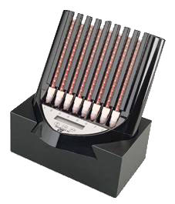
ESR
Increased ESR:
infections, tuberculosis, multiple myeloma.
Decreased ESR:
sickle cell anemia, h. spherocytosis.

Slide 8
2. Hematocrit (HCT)
The hematocrit (packed cell volume) is the ratio of the volume of erythrocytes to that of whole blood and is expressed as a percent. The instrument HCT is a calculation of the RBC number and the RBC size or MCV.
Remember: HCT = RBC x MCV

Slide 9
Hematocrit
A manual hematocrit is determined by centrifuging an EDTA blood sample under standardized conditions of speed of the centrifuge and the time the sample is spun.
To perform a manual HCT, fill 2 microhematocrit tubes with well mixed EDTA blood to approx. 3/4 full. Seal one end of the tube and let sit 15 seconds. Place both tubes in the centrifuge for 5 min at 10,000 rpm.

Slide 10
Hematocrit
When the 5 minutes is up, read the hematocrit tube in the HCT reader. Make sure to examine the plasma for jaundice (yellow color), hemolysis (red/pink color), or lipemia (cloudy/white color).
Normal range: newborn 53-65%, infant/child 30-43%, men 42-52%, women 37-47%.

Slide 11
Hematocrit
Increased HCT
hemoconcentration seen in shock, surgery, trauma, burns, polycythemia vera.
Decreased HCT
anemia, leukemia, IV’s, excessive administration of fluids.

Slide 12
3. Osmotic Fragility (no longer performed)
The osmotic fragility test roughly evaluates the surface to volume ratio of normal and abnormal red cells and can indicate if spherocytes are present.
Spherocytes rupture quickly in hypotonic saline, whereas normal RBC’s do not. Therefore they are increasingly fragile. This is due to the high surface to volume ratio. *Recall that spherocytes have no central pallor.

Slide 13
Osmotic Fragility
Conversely, target cells can withstand higher concentrations than normal cells due to the low surface to volume ratio. They are decreasingly fragile.
*Recall that target cells have a large area of central pallor.
This test is no longer necessary as careful examination of well stained, well prepared smears can provide the information.

Slide 14
4. Sickle Cell Solubility Test
Sickle Cell Anemia is an inherited disease caused by the substitution of valine for glutamic acid on the 6th position of the B chain characterized by abnormal hemoglobin S (HgbS).
Sickle Cell Disease represents the homozygous form of the disease, in which both genes are abnormal.

Slide 15
Sickle Solubility Test
Sickle Cell Trait represents the heterozygous form, in which the individual inherits one normal B globin gene and one abnormal sickle-globin gene. The solubility test cannot differentiate between the disease and trait; the test is specific for sickling hemoglobins. Hemoglobin electrophoresis is the confirmatory test following a positive solubility test.

Slide 16
Sickle Solubility Test
Principle: HgbS is more insoluble than normal hemoglobin in a reducing solution. The test reagent consists of a reducing substance, a lysing reagent, and a strong inorganic buffer. When cells containing HgbS are added to the reagent mixture, a turbidity occurs due to the insolubility of the reduced HgbS. Normal Hgb is more soluble and shows a clear endpoint.

Slide 17
Sickle Solubility Test
The concentration of Hgb in this test is critical. If the patient’s Hgb is less than 7 g/dl, the amount of blood should be doubled. A false positive can be seen in patients with dysglobulinemias. All positive specimens should have the red cells washed to remove any abnormal proteins and the test repeated. Any detection of the lined background is considered negative. Positives need to be confirmed by electrophoresis.

Slide 18
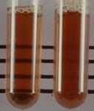
Sickle Solubility Test
A negative result is on the left- the lines can be seen clearly.
A positive result is on the right- the lines are not visible.

Slide 19
5. Heinz Body Prep
Heinz bodies are red cell inclusions that can be produced as a result of unstable hemoglobin or chemical poisons. Oxidant drugs as well as infections can cause the formation of the inclusions. These hemoglobin precipitates (Heinz bodies) can only be seen using a supravital stain such as methylene blue or crystal violet.

Slide 20
Heinz Body Prep
Heinz bodies are seen in:
G6PD deficiency, unstable hemoglobinopathies such as Hgb Koln, Hgb Zurich, alpha thalassemia, and following exposure to oxidizing drugs.
Test Principle: Heinz bodies are precipitates of denatured Hgb which attach themselves to the membrane of the red cell.

Slide 21
Heinz Body Prep
They are not normally seen and cannot be seen on Wright’s stain because they are dissolved by methanol (a component of the Wright’s stain).
Results: Heinz bodies appear as irregular, refractile purple inclusions about 1-3 u in diameter. They appear near the edge of the cell and may even protrude from the cell.

Slide 22
Heinz Bodies
The presence of Heinz Bodies usually indicates one of the following:
The patient has been exposed to an oxidizing agent such as phenylhydrazine or a nitro or amino compound.
The patient has G6PD deficiency and either has received an oxidative drug (primaquine) or been exposed to fava beans.
The patient has a hemolytic anemia associated with an unstable hemoglobin.

Slide 23
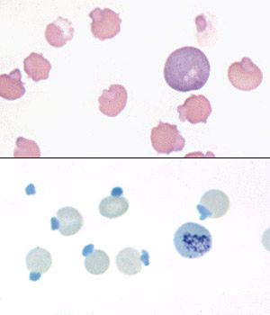
Heinz Body Prep
The picture on the top is with Wright’s stain. Notice the protrusions from the RBC’s.
The picture on the bottom is the HBP.

Slide 24
6. Sugar Water Test
The Sugar Water Test is used as a screening procedure when the diagnosis of Paroxysmal Nocturnal Hemoglobinuria is suspected.

Slide 25
7. Ham’s Test (acidified serum test)
The diagnosis of PNH is dependent upon a positive Ham’s test.
This is the confirmatory test.

Slide 26
8. Kleithaur-Betke or Acid Elution
This is a test for the presence of Hgb F.
Normal Hgb A is eluted by the acid and the RBC’s appear as ghost cells. Hgb F resists the acid and stain pink.
Inc. Hgb F: HPFH, Sickle Cell, thalassemia

Slide 27
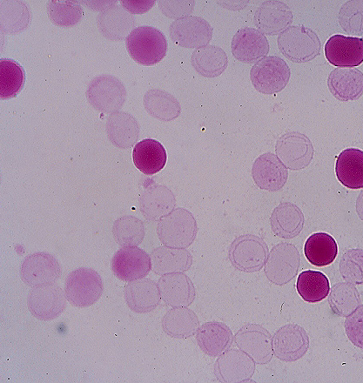
Kleithaur Betke
The pale pink cells are the normal RBC’s.
The dark pink cells are the ones containing fetal hemoglobin.

Slide 28
B. Cytochemistry for RBC’s
1. Wright’s or Wright-Giemsa Stain
Used for peripheral blood smears
2. Prussian Blue
Iron stain
3. New Methylene Blue
Used for manual reticulocytes and Heinz bodies

