Slide 1
Clinical & Diagnostic Microbiology
Introduction to Microbiology

Slide 2
HISTORY OF MICROBIOLOGY
Marcus Taurentius Varro (116-27 BCE)
Minute animals, undetected by the human eye, grow in marshy areas. They get inside the nostrils and “give rise to sudden distempers”
Fracastorius (16th Century)
Antonie van Leeuwenhoek (17th Century)
First to describe and draw microbes
Kircher (17th Century)
Notes:
Advances in applied microbiology /
By Wayne W. Umbreit, Allen I. Laskin, Joan W. Bennett, Geoffrey M. Gadd
Pgs 333-334
Fracastorius:
In 1546 he proposed that epidemic diseases are caused by transferable tiny particles or "spores" that could transmit infection by direct or indirect contact or even without contact over long distances. In his writing, the "spores" of disease may refer to chemicals rather than to any living entities.
"I call fomites [from the Latin fomes, meaning "tinder"] such things as clothes, linen, etc., which although not themselves corrupt, can nevertheless foster the essential seeds of the contagion and thus cause infection."[1]
His theory remained influential for nearly three centuries, before being displaced by germ theory.[2]
Leeuwenhoek is credited with being the first to see microbes with his primitive microscopes
Kircher, a Jesuit priest, described “worms” invisible to the human eye abounded with innumberable multitude in a mixture of vinegar and milk—could have been first description of bacteria, but he didn’t draw pictures, and he was a strong believer in spontaneous generation.

Slide 3
HISTORY CONT.
Disproval of Spontaneous Generation
Francesco Redi
Germ Theory of Disease
Germs cause disease, not vapors
Louis Pastueur
Notes:
To disprove Spontaneous generation, Francesco Redi did an experiment with three jars:
1. jar with meatloaf, tightly sealed: no maggots
2. jar with meatloaf covered with gauze: maggots on gauze
3. jar with meatloaf uncovered: maggots in meat
He exposed freshly boiled broth to air in vessels that contained a filter to stop all particles passing through to the growth medium: and even with no filter at all, with air being admitted via a long tortuous tube that would not pass dust particles. Nothing grew in the broths, therefore the living organisms that grew in such broths came from outside, as spores on dust, rather than being generated within the broth.

Slide 4
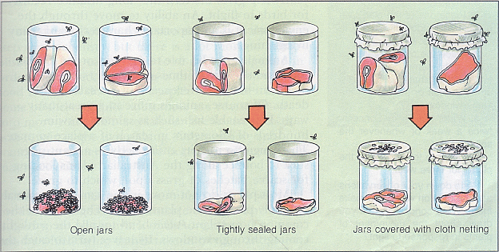
Redi’s Experiment
Schematic for Redi's Experiment
Notes:
To disprove Spontaneous generation, Francesco Redi did an experiment with three jars:
1. jar with meatloaf, tightly sealed: no maggots
2. jar with meatloaf covered with gauze: maggots on gauze
3. jar with meatloaf uncovered: maggots in meat
He exposed freshly boiled broth to air in vessels that contained a filter to stop all particles passing through to the growth medium: and even with no filter at all, with air being admitted via a long tortuous tube that would not pass dust particles. Nothing grew in the broths, therefore the living organisms that grew in such broths came from outside, as spores on dust, rather than being generated within the broth.

Slide 5
Louis Pasteur
Fermentation
Occurs as a consequence of the actions of microorganisms
Formation of alcohol or acetic acid in grape juice to form wine or vinegar.

Slide 6
Louis Pasteur
PASTEURIZATION
Method of prevention of spoilage
Utilizes heating
Used for liquid food products (milk, wine, beer)
Notes:
For centuries wine was produced and enjoyed with little thought for and no true understanding of its underlying science, wine evolved through "spontaneous generation," as far as anyone knew. French chemist Louis Pasteur, among many discoveries relating to his germ theory of diseases, first proposed and proved, in 1857, that wine is made by microscopic organisms, yeasts. This led to the discovery and development of different yeast types and properties and ultimately to better hygiene, less spoilage, and greater efficiency in wine production.

Slide 7
VACCINES
1778 JENNER’S COWPOX OBSERVATION
PASTEUR’S MAJOR CONTRIBUTION
1ST VACCINE WITH CHICKEN CHOLERAE
DISCOVERED HOW TO ATTENUATE BACTERIA
Notes:
In the summer of 1880, he found a vaccine by chance. Chamberland had inoculated some chickens with chicken cholera germs from an old culture that had been around for some time. The chickens did not die. Pasteur asked Chamberland to repeat what he had done but with a fresh culture of chicken cholera germs. Pasteur reasoned that a new culture would provide more potent germs.
Two groups of chickens were inoculated; one that had been given the old culture and one group that had not. Those chickens that had been given the old culture survived, those that had not died. The chickens that had been inoculated with the old culture had become immune to chicken cholera. Pasteur believed that their bodies had used the weaker strain of germ to form a defence against the more powerful germs in the fresher culture.
In April 1881, Pasteur announced that his team had found a way to weaken anthrax

Slide 8
VACCINE ATTENUATION:
Process of reducing virulence
Several ways to accomplish attenuation: Vaccine attenuation
Grow in a host other than what the organism is used to (cell culture adaptation) (MMR, Chickenpox, rotavirus)
Use part of the organism
Piece of a virus (HPV and Hep B vaccines)
Use the toxin from the bacteria
Treat the toxin with a chemical to inactivate it.
Inactivated toxins are called “toxoids”
Use the polysaccharide coating (Hib, pneumococcal, meningococcal vaccines)
Inactivate the virus (polio shot, hep A, flu)

Slide 9
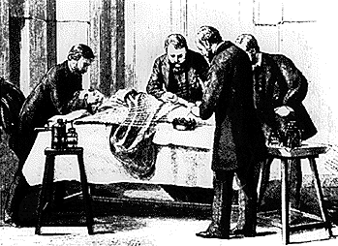
JOSEPH LISTER
ASEPTIC TECHNIQUE
CHEMICAL INHIBITION OF INFECTION DURING SURGERY
FATHER OF ANTISEPTIC SURGERY

Slide 10
ROBERT KOCH
KOCH DISCOVERED:
Bacillus anthracis
Mycobacterium tuberculosis
Vibrio cholera
Koch also played an important role in the development of the use of agar as solid medium. He also invented nutrient broth and nutrient agar.
Koch’s Postulates:
A series of proofs to verify The Germ Theory of Disease
Notes:
Robert Koch was the first scientist to devise a series of proofs used to verify the germ theory of disease.[1] Koch's Postulates were first used in 1875 to demonstrate anthrax was caused by the bacterium Bacillus anthrasis. These postulates are still used today to help determine if a newly discovered disease is caused by a microorganism.

Slide 11
Koch’s Postulates
A given organism must be present in ever case of a given infectious disease.
The microorganism can be isolated from specimens with that disease state.

Slide 12
Koch’s Postulates
Inoculation of the isolate into a susceptible animal produces a similar disease.
The same organism that is associated with the disease state can be recovered from representative specimens from the experimentally infected animal.

Slide 13
CHRISTIAN GRAM
IN1884 DEVELOPED IMPORTANT STAINING METHOD
STILL MOST WIDELY USED STAINING TECHNIQUE

Slide 14
CLASSIFICATION
KINGDOM -PROKARYOTE(BACTERIA)
PHYLUM / DIVISION
CLASS
ORDER (-ALES)
FAMILY (ACEAE)
TRIBE (-EAE)
GENUS
SPECIES

Slide 15
CLASSIFICATION CRITERIA OF MICROORGANISMS IN THE MICROBIOLOGY LAB.
MORPHOLOGY
CULTURAL CHARACTERISTICS
BIOCHEMICAL CHARACTERISTICS
CHEMICAL AND GENETIC COMPOSITION
MOTILITY

Slide 16
KINGDOM (PROKARYOTES)
UNICELLULAR MICROBE
MOST HAVE CELL WALL
REPRODUCE ASEXUALLY
MOST ARE SMALLER THAN EUKARYOTES

Slide 17
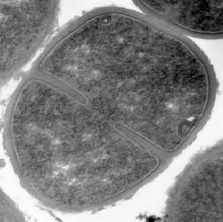
PROKARYOTES CONT’D
PROKARYOTE
NO ORGANIZED NUCLEUS
NO MITOSIS
NO MITOCHONDRIA, CHLOROPLASTS, GOLGI COMPLEX, ENDOPLASMIC RETICULUM

Slide 18
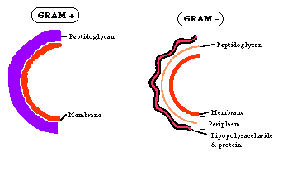
BACTERIAL STRUCTURE
CELL WALL-RIGIDITY
CELL MEMBRANE
OSMOTIC BALANCE
TRANSPORT OF SOLUTES

Slide 19
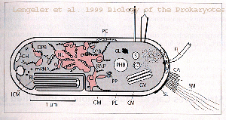
BACTERIAL STRUCTURE
CYTOPLASM
CYTOPLASM- INTERNAL TO CELL MEMBRANE
CONTAINS NUCLEAR MATERIAL, ENZYMES, WATER, ETC.

Slide 20
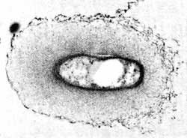
BACTERIAL SURFACE STRUCTURES
CAPSULE
ANTIPHAGOCYTIC
GLYCOCALYX

Slide 21
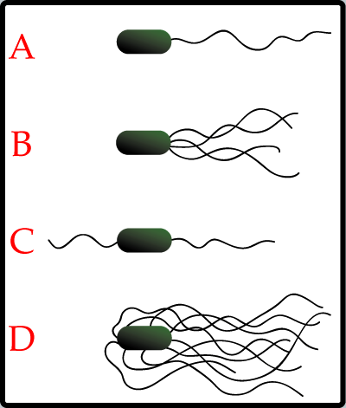
BACTERIAL SURFACE STRUCTURES CONT’D
FLAGELLA
A:MONOTRICHOUS
B: LOPHOTRICHOUS
C: AMPHITRICHOUS
D: PERITRICHOUS

Slide 22
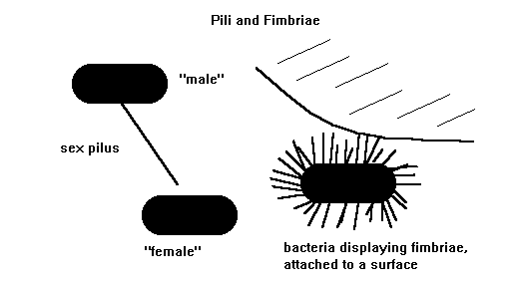
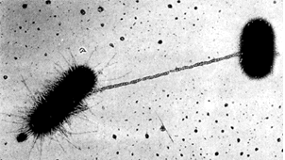
BACTERIAL SURFACE STRUCTURE
PILI/FIMBRIAE
SOMATIC-attachment to cells
CONJUGAL/SEX-exchange of genetic material during conjugation

Slide 23
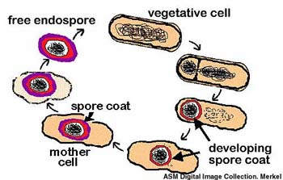
BACTERIAL STRUCTURE
ENDOSPORES
DIPICOLINIC ACID (helps in dehydrating the cell)
RESISTANCE

Slide 24
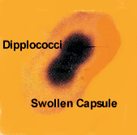
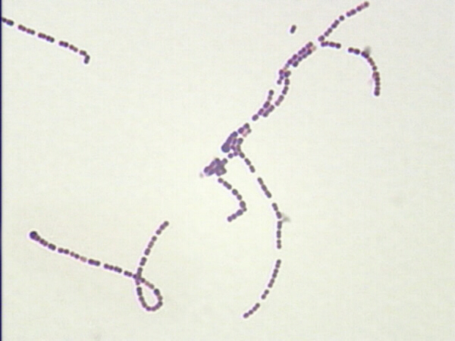
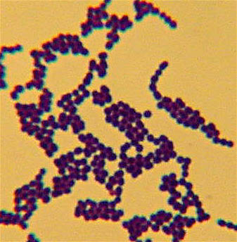
Microscopic Morphology
Arrangement
Diplococci
Chains
Tetrads
Clusters
Packets of 8

Slide 25
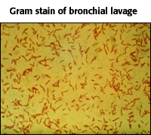
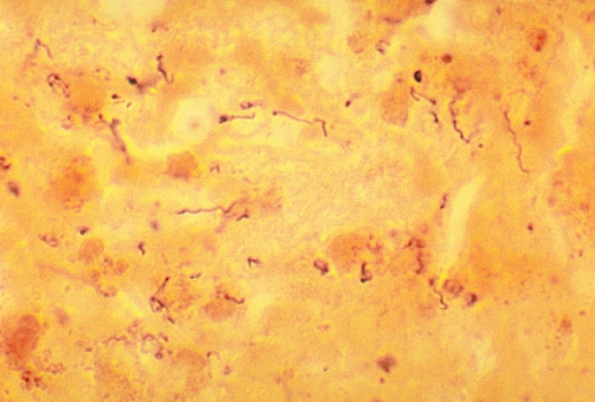
Microscopic Morphology
Shape
Coccus
Bacillus
Spirillum

Slide 26
Roles of Microbes in the Biosphere
Microbes Contribute
Nitrogen to Plants
Decompose dead plants and animals
Convert substances into nutrients
Degrade environmental substances
Destructive
Spoilage
Disease

Slide 27
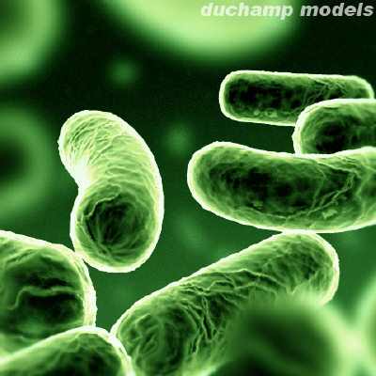
Role of Enzymes
Organic Catalysts
Uptake and Use of Raw Materials
Synthesis
Degradation

Slide 28
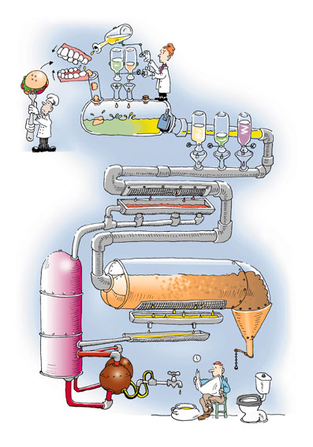
Role of Enzymes
Constitutive or Inducible
Clinical and Medical Uses

Slide 29
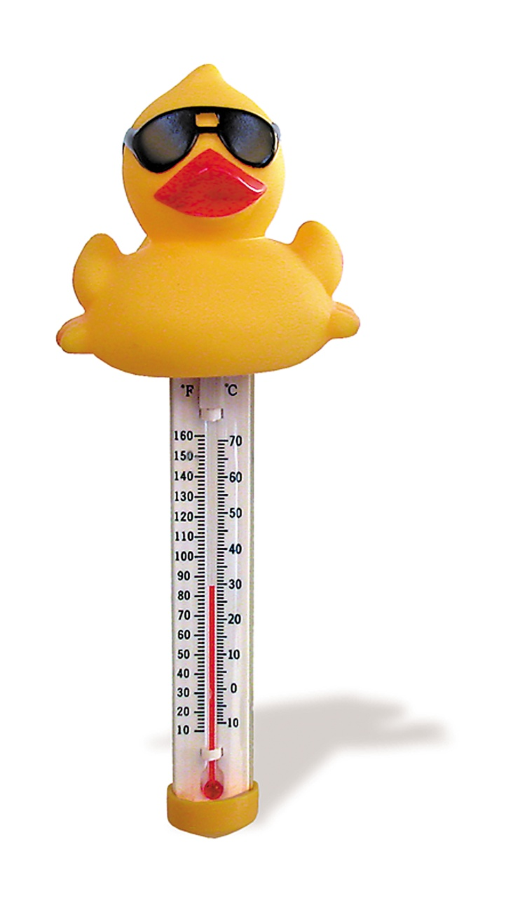
Physical Growth Requirements
Temperature
Psycrophile: 5-30ºC
Mesophile: 25-40ºC (optimum 35-37ºC)
Thermophile: 45-60ºC

Slide 30
Physical Growth Requirements
pH
Most bacteria grow between pH 6.5 - pH 7.5
Very few can grow at below pH 4.0
many foods, such as sauerkraut, pickles, and cheeses are preserved from spoilage by acids produced during fermentation

Slide 31
Physical Growth Requirements
Respiratory Requirements
Strict aerobe: unable to grow in the absence of oxygen
Obligate Aerobe: require oxygen. Most bacteria are aerobic.
Microaerophile: requires oxygen, but in amounts lower than the atmospheric level (<20%).
Facultative anaerobe: can grow with or without oxygen.
Obligate Anaerobe: unable to grow in the presence of oxygen.

Slide 32
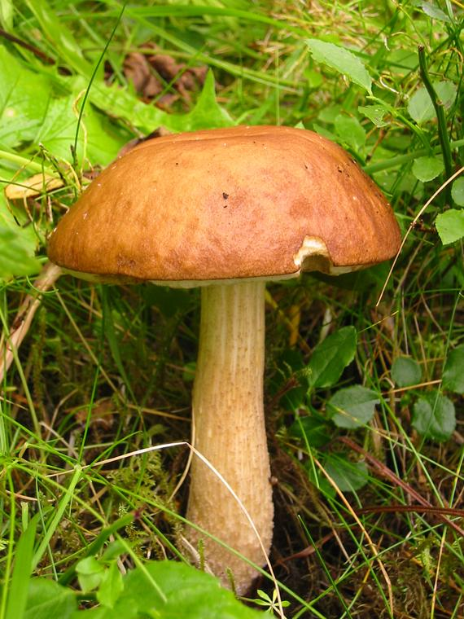
Nutrient Requirements
Chemosynthetic
Heterotrophs
Saprophytic
Parasitic
Mutualistic

Slide 33
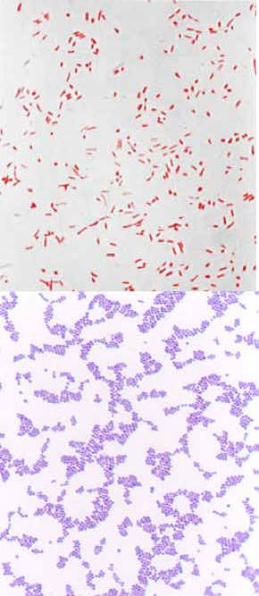
Stains
Bacterial
GRAM STAIN
Crystal Violet
Gram’s Iodine (mordant)
Acetone
Safranin

Slide 34
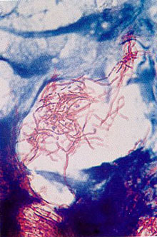
Stains
Mycobacteria
Kinyoun’s Carbolfuschin
Basic Fuschin
3% Acid Alcohol
Methylene Blue

Slide 35
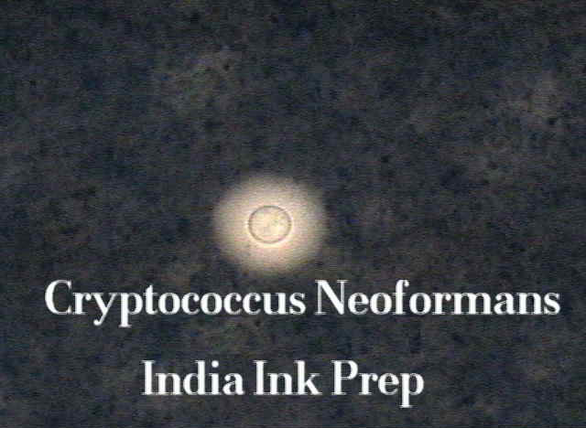
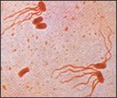
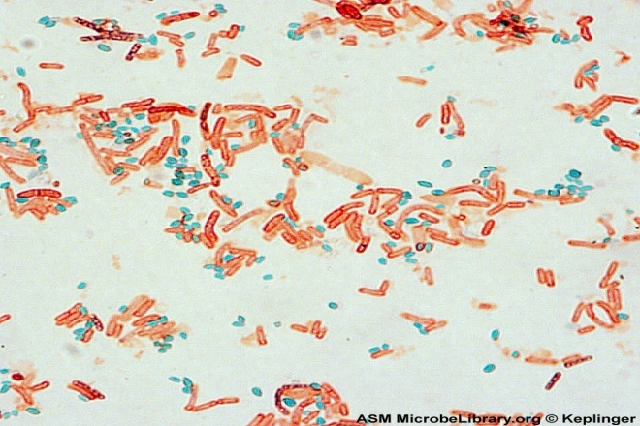
Special Stains
Capsule
India Ink
Flagella Stain - Leifson
Basic Fuschin with Tannic Acid
Endospore
Malachite Green
Safranin

Slide 36
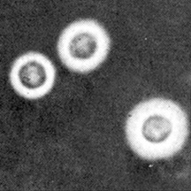
Special Stains
CAPSULE – INDIA INK

Slide 37
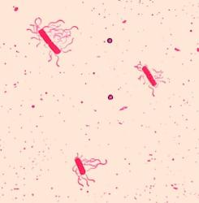
Special Stains
FLAGELLA STAIN – LEIFSON
BASIC FUCHSIN WITH TANNIC ACID

Slide 38
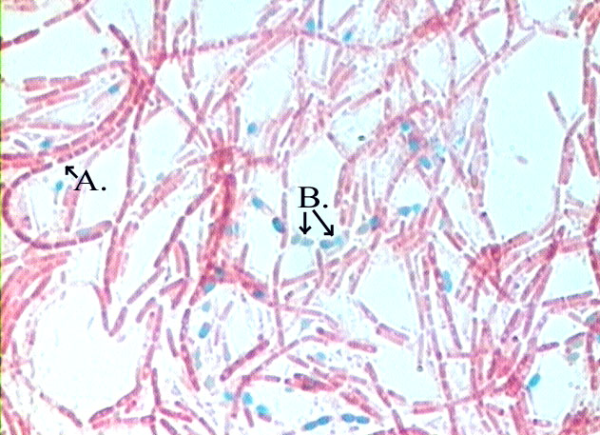
Special Stains
ENDOSPORE
MALACHITE GREEN
SAFRANIN

Slide 39
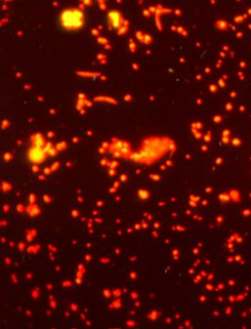
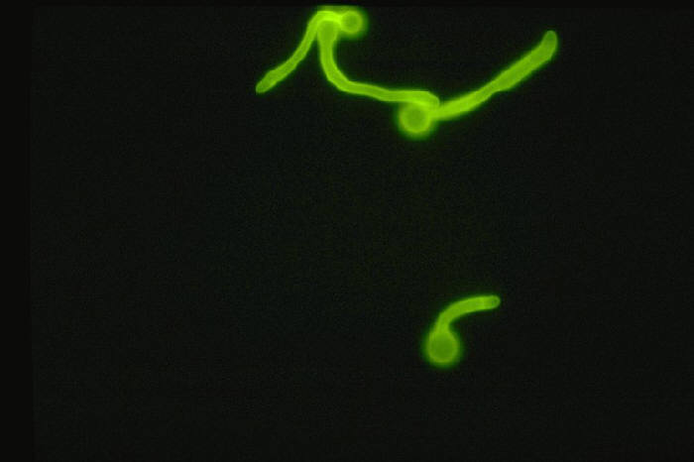
Fluorescent Stains
Acridine Orange
Bacteria
Calcofluor White
Fungus

Slide 40
Fungi and Parasite Stains
Periodic Acid Schiff (PAS)
Gomori Methamine Silver Stain (GMS)
Giemsa: parasites, inclusion bodies
Trichrome

Slide 41
Agar Ingredients
Agar
solidifier
Nutrients
Buffers
To maintain pH
Monopotassium Phosphate: KH₂PO₄
Dipotassium Phosphate: K₂HPO₄

Slide 42
Agar Ingredients
Inhibitors
Selective
e.g., dyes, bile salts, antibiotics
Indicators
Indicator | Acid pH | Alkaline pH
Neutral Red | Red | Colorless
Phenol Red | Yellow | Red
Bromcresol Purple | Yellow | Purple
Bromthymol Blue | Yellow | Blue

Slide 43
Types of Media
Enriched
Grows most bacteria
Blood Agar, Chocolate Agar
Selective
Selects for a specific population
Using an inhibitor
MacConkey, Mannitol

Slide 44
Types of Media
Differential
Differentiates between like organisms
Using an indicator
MacConkey, Chromagar

Slide 45
Other Types of Media
Media used for bacterial ID
e.g., TSI, Citrate, MIO, Urea
BROTH : backup for culture
e.g., Thioglycollate Broth
Enrichment Broth: increases the growth of small number of organisms
e.g., Selinite Broth, Blood Culture

Slide 46
TYPES OF MEDIA RECAP
ENRICHED - CHOCOLATE, BAP, TSA
SELECTIVE - MAC, MANN
HIGHLY SELECTIVE - HE, ML
DIFFERENTIAL
ENRICHMENT
BIOCHEMICAL TEST MEDIA
LIQUID MEDIA

Slide 47
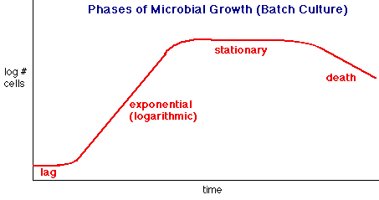
Reproduction and Growth

Slide 48
Reproduction and Growth
Lag
No growth
Preparing enzymes, etc.
Log
Growth faster than death
Metabolically active
Time to study bacteria

Slide 49
Reproduction and Growth
Stationary
Number of organisms dying equals number that are growing
Death
Death greater than growth

Slide 50
How to Identify Bacteria
Cultural Morphology
SIZE
SHAPE
MARGIN
ELEVATION
PIGMENTATION
Optical Features
OPAQUE
TRANSLUCENT
OPALESCENT
METALLIC SHEEN
FLUORESCENCE

Slide 51
How to Identify Bacteria
CONSISTENCY
ODOR
APPEARANCE IN BROTH
MICROSCOPIC MORPHOLOGY
CULTURAL MORPHOLOGY
PHYSIOLOGICAL REQUIREMENTS
ANTIGENS
HABITAT/SOURCE
DNA TYPING

Slide 52
Physical Control of Bacteria: Sterilization
Heat
Dry
Oven
Moist
AUTOCLAVE
FRACTIONAL STERILIZATION
INSPISSATION - LOWENSTEIN-JENSEN
BOILING WATER
PASTEURIZATION

Slide 53
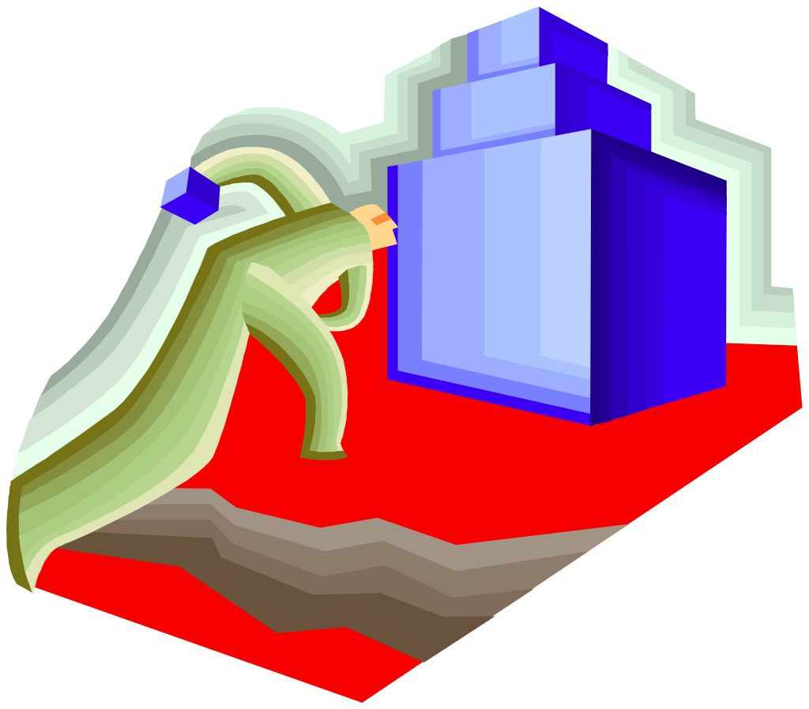
STERILIZATION- TIMED TO KILL SPORES
Process whereby all forms of microbial life including spores are killed. (Kills vegetative cells)
DRY HEAT (OVEN)
- 1 HR AT 175-180C
- 1 ½ HR AT 165-170C

Slide 54
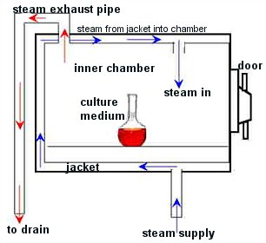
STERILIZATION CONT.
AUTOCLAVE
High pressure device used to allow the application of moist heat above the normal-atmosphere boiling point of water
SOP - 121C, 15 LB. 15 MIN
QC WITH GEOBACILLUS STEROTHER-MOPHILUS

Slide 55
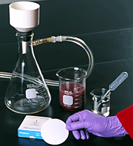
STERILIZATION CONT.
ETHYLENE OXIDE
- used to sterilize prepackaged laboratory equipment that is otherwise destroyed by heat (e.g., plastic Petri dishes)
FILTRATION
SUCTION PUMP SHOWN HERE
MILIPORE (0.22μm)

Slide 56
Physical Control of Bacteria
Autoclave
Steam under pressure
Hotter than boiling water
Combined gas law
Better penetration
Fractional Sterilization
Substances degraded at >100ºC
Steam Used
Notes:
Bacteria are killed, spores remain. Spores germinate after several days and are then killed by subsequent heating.

Slide 57
Physical Control of Bacteria
Inspissation
Thickening by dehydration
Lowenstein-Jensen Media
Milk and egg media
Pasteurization
Does not rid substance of all bacteria
Gets rid of pathogens

Slide 58
Physical Control of Bacteria
Cold
Storage
Dessication, Lyophilization
Osmotic Pressure
Radiation
UV Light
Sonification
Filtration

Slide 59
Chemical Control of Bacteria
Disinfectant
Antiseptics
Sanitizers

Slide 60
Chemical Control of Bacteria
Phenol
O-Cresol
Hexyl-Resorcinal
Denatures Protein, Damages Cell Membrane
carcinogenic
Alcohol
Ethanol
Coagulates Protein

Slide 61
Chemical Control of Bacteria
Halogens
Iodine
Chlorine
Acts against proteins, oxidizers
Heavy Metals
Silver Nitrate
Copper Sulfate
Precipitates Proteins

Slide 62
Chemical Control of Bacteria
Dyes
Detergents and Soaps
Destroys lipid membranes
Hydrogen Peroxide
oxidizer
Acids and Bases
Cessation of metabolism
Gases
Ethylene Oxide
Formaldehyde

Slide 63
Specifications of an Ideal Disinfectant
Toxic at low concentration
Stored at room temperature but effective at body temperature
Soluble in Water
Non-Toxic to man or beast
Stable
Non-Corrosive
Inexpensive

Slide 64
Factors Influencing Antimicrobial Action
Concentration
Time of Exposure
Number of Organisms
Vegetative Cell or Spore
Presence of extraneous protein
Temperature

Slide 65
Mode of Action
Cell wall disruption
Alteration of cell permeability
Alteration of nuclear material or protoplasm
Inhibition of protein synthesis

