Slide 1
Clinical & Diagnostic Microbiology
Collection, Transport, and Processing of Specimens

Slide 2
Introduction
Chief function of the clinical laboratory is to help the physician diagnose infectious disease as rapidly, accurately, and precisely as possible.
Nursing responsible for collection and transportation of laboratory specimens.
Lab responsible for processing specimens, analyzing, and educating the public on infectiology.

Slide 3
Transportation
Ensure no delay in processing and analysis;
Ensure culture will still reflect the current infectious process in the patient (snapshot of disease state)
Transport media is used for myriad clinical specimen collection.

Slide 4
Function of Transport Media
Inhibits enzymes and biochemical pathways (during the log growth phase)
Prevents the oxidation (loss of electrons)
Maintains pH
Retains moisture—dry environments do not lend themselves to successful culture.

Slide 5
Transportation (cont.)
Culture Swab (Culturette)
Polyester-tipped swab(s)
Holding medium
- Ex. Stuart’s transport media
Used for myriad specimen types.
Can also be used for fungi and/or acid fast bacilli (AFB) culture.

Slide 6
Transportation (cont.)
Aerobic routine culture transport system
Culture Swab is inserted into holding media.

Slide 7
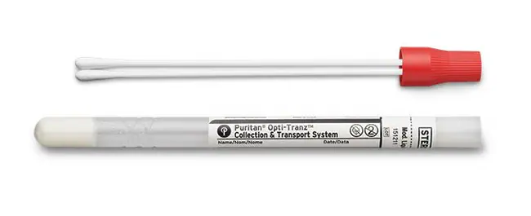
Transportation (cont.)
Stuart’s Transport Medium
Buffered semi-solid agar with sodium thioglycolate – A reducing agent to maintain pH
No nutrients.
Good for ~72 hours at ambient (room temperature).

Slide 8
Transportation (cont.)
Special transport media
Urine – special tube containing Boric acid;
Feces – Plastic container containing 0.3 M phosphate buffer with equal amounts of glycerol.
Special transport media confers bacteriostatic properties (i.e., inhibits bacterial growth and propagation without killing the organism).

Slide 9
Transportation (cont.)
Genital – culture swab, Jembec plate, Transgrow tube.
Plate and tube contain Martin-Lewis agar for Neisseria gonorrhoeae.
Anaerobes – Port-a-cul, gassed-out vial, ‘Culturette’ syringe.
Maintains an anaerobic environment.
Viral – plastic vial containing Viral Transport or Universal Transport Medium (UTM/VTM).
Chlamydia – especially for PCR assay (Genprobe)
Parasites – usually follows the 2-tube system.

Slide 10
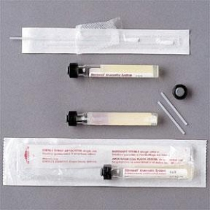
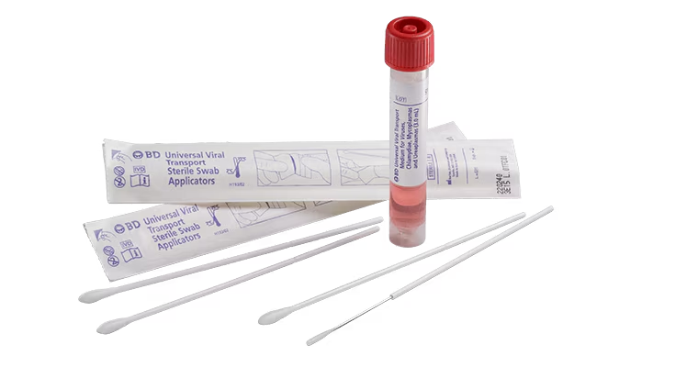
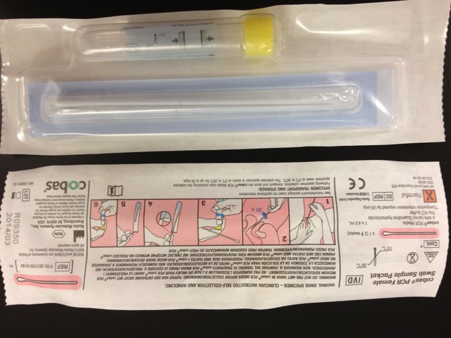
Transportation (cont.)
Anaerobic
Viral
Chlamydia culture

Slide 11
Refrigeration
Refrigerate specimens at 2°-8°C if there is a delay in specimen processing.
Urine in a sterile container without preservative is stable at refrigeration for only 24 hours.
Never REFRIGERATE—
Cerebral Spinal Fluid (CSF);
Blood Cultures,
Genital Cultures; or
Eye Cultures.

Slide 12
Collection of Specimens in General
Prior to giving the patient antibiotic treatment.
Use techniques to avid contamination (i.e., aseptic technique and cleaning the area with the appropriate disinfectant with iodine before aspiration of the specimen).
Collect at the right stage of disease (i.e., blood culture in the event of pyrexia).
Submit sufficient quantity and quality of specimen.
Ensure prompt delivery.

Slide 13
Collection of Specimens in General (cont.)
Specimen collected must have sufficient data and identifiers—
Patient name;
Physician’s name;
Collection time;
Identifying number (e.g. SSN, MRN, FIN, or DoB).
Helpful but not requires
Diagnosis of animal bites and stings (may grow Pasteurella multocida
Suspected agent – ex. Legionella spp.
May require special culture media and/or special handling precautions.

Slide 14
Collection, Transport, and Processing of Specimens
Specific Sources

Slide 15
Blood Cultures
Bacterial endocarditis – infection of the inner lining of the heart and its valves.
Septicemia – patient exhibiting toxicity due to bacteria present in the bloodstream and/or toxic microbial byproducts.
Bacteremia – VIABLE bacteria present within the bloodstream.

Slide 16
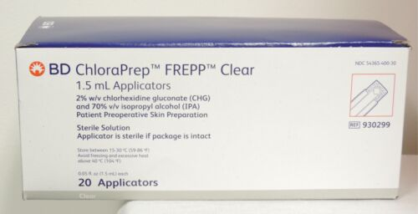
Blood Cultures (cont.)
Time appropriately
Endocarditis – draw 3-4 cultures in a 24 hr. period.
Septicemia – while symptomatic.
These cultures can be no growth for bacteria.
Bacteremia – draw prior to spike in temperature (pyrexia).
Draw aseptically
Alcohol wash;
2% iodine or iodophor;
Venipuncture;
De-germ (clean site with alcohol or other appropriate aseptic solution).

Slide 17
Blood Cultures (cont.)
10% v/v draw – Blood volume to media volume.
Sodium Polyanethole Sulfonate (SPS)
Acts as an anti-coagulant, anti-phagocytic agent, and anti-antibiotic agent.
With this preservative, under filling the culture tube can result in false negative results; conversely, over filling can result in false positives.
Media
Formulated to grow all expected organisms;
Needs CO2- environment (5%+ is ideal) for aerobic cultures.
May use anaerobic media and atmosphere.
0.025% SPS additive
Certain resins may be used – in any case where antibiotics need to be sequestered/chelated from the patient’s blood.

Slide 18
Blood Cultures (Conventional)
Conventional
Gram stain all visible positives (based upon what you can visibly see).
Blind smear negatives
Blind subculture negatives (when unsure on whether sample is positive or negative .
Gram stain smear of all visually positive bottles
Turbidity of media (cloudy);
Stalactite/stalagmite (top down/bottom up growth in culture media);
Puff balls;
Hemolytic;
Growth on top of settled layer(s) of RBCs; and
Observation of gas production.
Blind smear all negative cultures at 18-24 hrs.
Methylene Blue; Acridine Orange
Blind subculture all negative bottles at 16, 18, and 48 hrs. – some bacterial species are difficult to detect by smear.

Slide 19
Blood Cultures (Non-conventional)
Usually smear increasing CO2- levels are due to bacterial respiration.
Continual sampling of bottles replaces smears and subcultures – via automation.
Incubate bottles at 35°C.
Can program the testing protocol – usually 5 days.

Slide 20
Blood Cultures (Non-conventional) BacTec
BacTec high volume with or without resin – 8-10 cm3/or mL draw.
Increases bacterial recovery by 30%.
Measures CO2- using fluorescent technology.
Other BacTec Media
Lytic (anaerobic) – 5 cm3/or mL draw.
Fungal/Acid Fast Bacilli
Peds – 0.5-3 cm3/or mL

Slide 21
Blood Cultures (Non-conventional) BacT/Alert
BacT/Alert – Automated Blood Culture System
CO2- diffused through a membrane;
H2 ions made change an indicator.

Slide 22
Blood Cultures (Non-conventional) Non-Conventional Isolator
Lysis of RBCs and WBCs;
Centrifuge to pellet bacteria or fungus.
Inoculate media with pellet.

Slide 23
Blood Cultures (Non-conventional) Non-Conventional Isolator
Common Contaminants – Diptheroids, Proprionebacterium (Cutibacterium acnes, coagulase negative Staph (present on the skin);
Questionable contaminants – coagulase negative staph or Viridans streptococci (one bottle).
Significant – enteric gram negative rods, S. aureus, S. pneumonia, P. aeruginosa, Enterococcus spp. and coag negative staph.
Polymicrobial – more than 1 organism present.

Slide 24
Collection, Transport, and Processing of Specimens
Other Specimen Types – Head-to-Toe

Slide 25
Respiratory
Throat culture
Culture swab
Performed directly at bedside
GP A Strep (GAS)
Diphtheria
Nasopharyngeal swab (NP Swab)
Carrier state of N. meningitidis and GAS;
Whooping cough (Bordetella pertussis)
Some respiratory viruses (SARS-CoV-1/-2, RSV A&B, and Flu A&B).

Slide 26
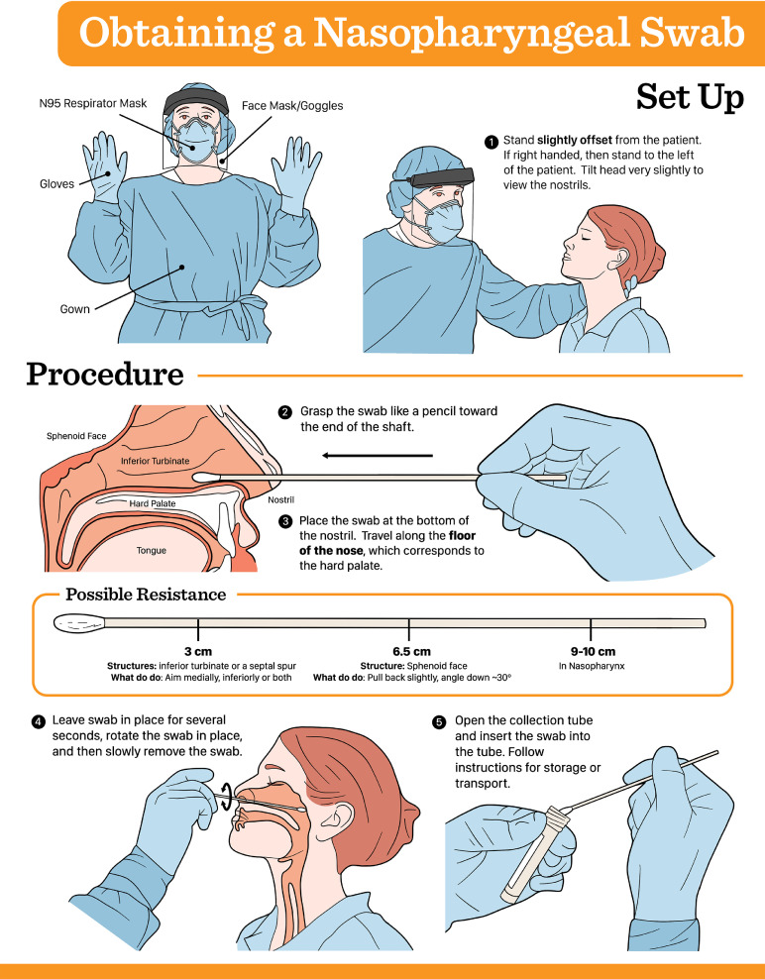

Slide 27
Respiratory
Nasal Swab
Rotate swab inside the anterior nares;
Can be indicative of infection elsewhere in the body;
Primarily for detection of Methicillin-resistant S. aureus (MRSA).
Eye
Conjunctivitis (pink eye) – collect pus and secretions on swab;
Corneal scrapings – usage of a 10 blade after anesthetic administered.
Media inoculated directly;
Smears made for Gram and Giemsa stains;
Also screened for fungal pathogens, Chlamydia, and Trachomatis.
Aqueous/Vitreous Humor – aspirated from the eye
Proprionebacterium (Cutibacterium acnes)
Bacillus spp. post-trauma.

Slide 28
Respiratory
Bronchial Alveolar Lavage (BAL) – Bronchial Wash
When sputum cultures are negative for fungus and AFB or to rule out parasitic infections and cancer.
Propensity to be contaminated by normal oral flora.
Transtracheal aspirate – only respiratory specimens for anaerobes.
Local anesthetic – insert catheter through a needle kept in place.

Slide 29
Respiratory
Sputum (Expectorant)
Expectorated (coughed up);
Deep coughing, early morning collection is best, avoid saliva—reject for culture.
Can be induced;
Nebulized saline solution acts as an irritant to the mucosa;
Use of positive pressure respirator.
Quality assessed.
Based on the number of squamous cell epithelia;
≥10 squamous epithelial cells/lpf is indicative of saliva, not expectorant.

Slide 30
Urine
Urinary Tract Infection (UTI) – involves the urethra and kidney(s).
E. coli – number 1 isolate.
Importance of routine testing for pregnant women – asymptomatic presentation.
Clean-Catch & Mid-Stream Void
Cleanse urethra with soap;
Instruct patient to urinate;
Collect in sterile cup midway through urination (clean-catch);
Avoid bacteria colonizing the urethra.
Cystoscopy – examination of the bladder and kidneys.
Suprapubic tap – needle directly into bladder.

Slide 31
Urine
Colony counts
Performed using a calibrated (.001) 1/1000 mL [1μL] inoculation loop.
Count number of colonies x 1000
Kidney urine – use a .01 1/100 mL [10μL] inoculation loop.
Colony count significance
≥100,000 CFUs/mL – universally considered positive for UTI.
10-50,000 CFUs/mL – consider symptomatology and results from urinalysis.
100 CFUs/mL – acute urethral syndrome (AUS) in sexually active females. In males--urethritis, including nongonococcal urethritis.

Slide 32
Urine
Rapid testing
Gram stain – 1 organism /oil field indicate colony count ~>104 CFUs/mL
Performed on un-centrifuged urine (why?) Bacteria of interest will pelletize/coalesce at bottom of the tube. Some studies suggest this has little to no affect on the sensitivity regarding pathogenic analysis.
Not performed often.
Nitrite/Leukocyte Esterase
≥10 WBCs/HPF from U/A.

Slide 33
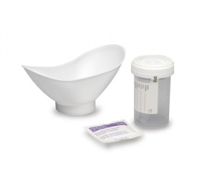
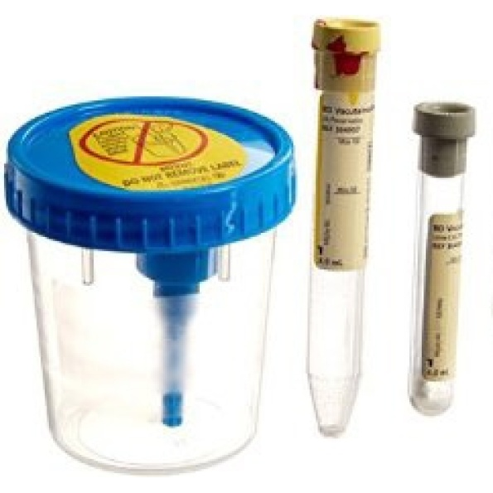
Urine
Clean Catch
Good for 2 hours if not refrigerated.
Good for 24 hours when refrigerated.
Preservative – Boric Acid/Sodium Formate/Sodium Borate
Good at room temperature for 24 hours.

Slide 34
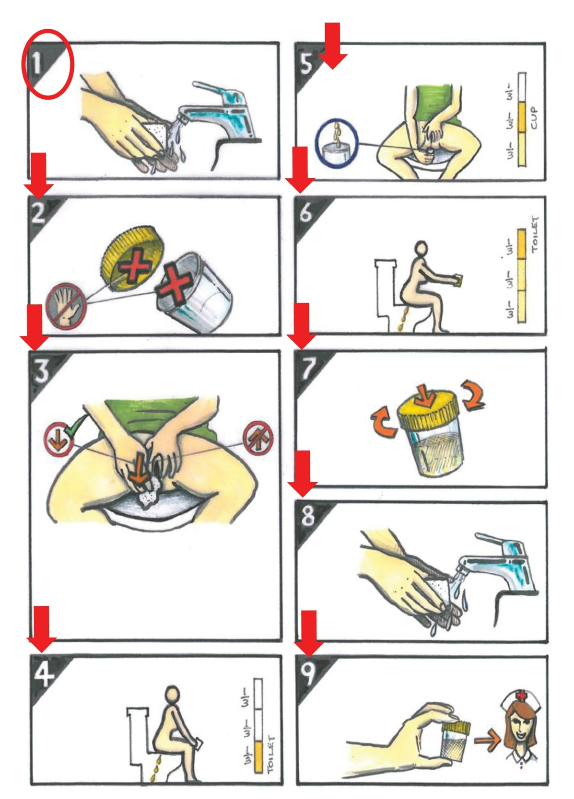
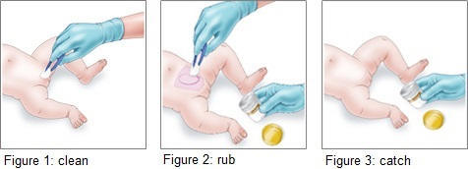
Urine
Clean Catch

Slide 35
Feces
Cup (stool goes directly into)
Rectal swab;
Transport Media
0.33M Phosphate buffer with equal volume of glycerol (referred to as Cary-Blair Media)

Slide 36
Genital Specimens
Neisseria gonorrhoeae
Martin-Lewis
Transglow, Jembec
Also rectal, throat, urine, eye, and synovial fluid from joints.
Chlamydia
Need cellular scrapings;
Genprobe, PCR, ChlamydiaZYME.
Group B Strep (GBS)
Lim broth.
Herpes Simplex Virus (HSV-1/-2)
Viral or universal transport medium (VTM/UTM).
Trichomonas
Wet prep and microscopic analysis.
Syphilis
Dark field – inverted light source—white appears on black background (field).

Slide 37
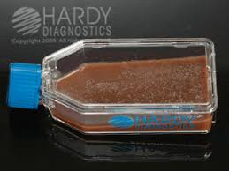
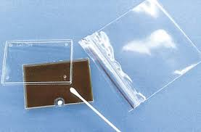
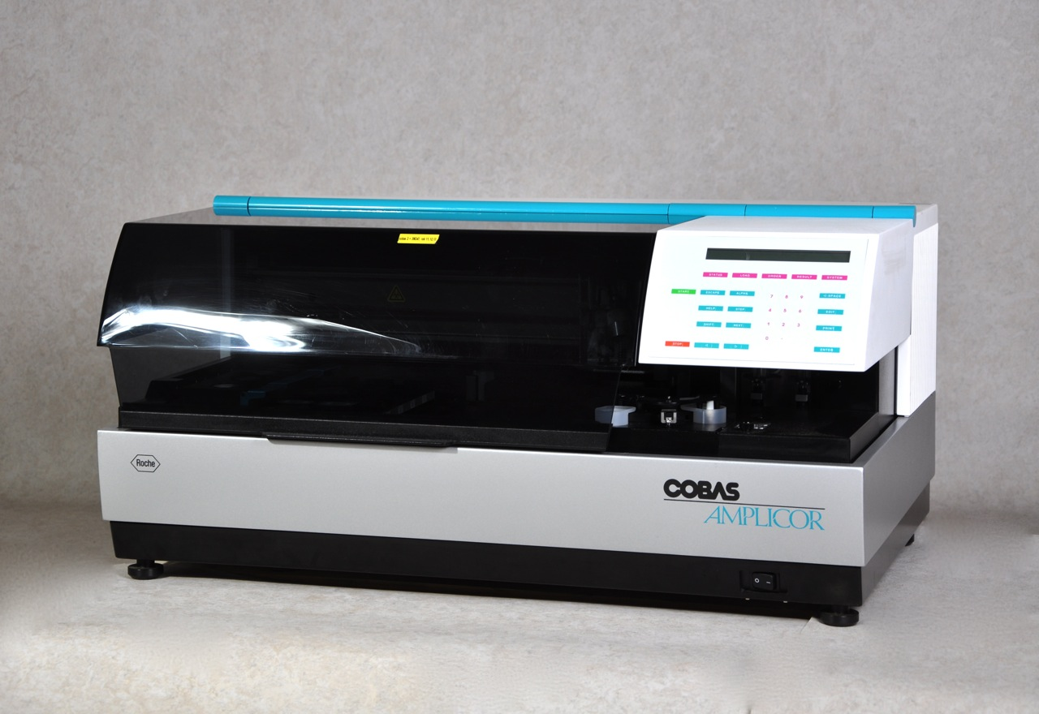
Gonorrhea
Transglow
Jembec Plate
Amplicor, Genprobe, PCR.

Slide 38
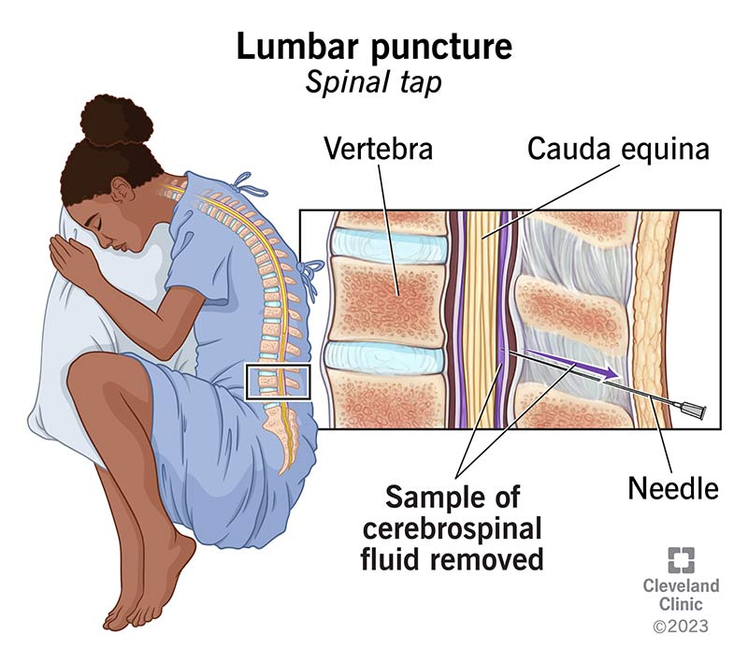
CSF
CSF Lumbar Puncture
Process STAT
Centrifuge or cytospin for smears
Typically 1-4 tubes are collected.
2 for Hematologic analysis;
1 for Chemistry analysis;
1 for Microbiological analysis.
Presence of neutrophils (PMNs) and macrophages are indicative of bacterial infection. Leukocytes are typically indicative of viral infection.

Slide 39
Other Spec Cont.
Sterile body fluids;
Wounds, abscesses
Culture swab (Amies media)
Anaerobes
Syringe, anaerobic transport
Anatomical, Surgical pathology
Cannot be recollected (CSF and/or resected tissues).

Slide 40
Specimen Processing
Safety – universal (standard) precautions [i.e., assume all Biospecimens are hazardous and potentially infectious].
Centrifugation;
Sharps;
Electrical leakage checks;
Lifting – back injuries;
Spills, splashes, and aerosols.

Slide 41
Specimen Processing
Accessioning
Time of collection, specimen source;
Proper patient identification;
Rejection of unacceptable specimens; and
Criteria for rejection.

Slide 42
Criteria for Rejection
Formalin (tissue fixative ☺ ; bactericidal ☹)
24 hour specimens;
Female genital smears for GC (Gonococci)
QNS (quantity not sufficient)
Not in appropriate transport media;
Specimen leakage;
Desiccated specimen and/or plate;
Foreign matter in sample;
Inappropriate anaerobic spec plate;
Mislabeled/Red Rule Violation.

Slide 43
Specimen Processing
Plating of specimens
Using the appropriate media;
Using the appropriate technique;
Colony count on urine;
Centrifuge CSF;
Macerate/grind tissue;
Cath tip roll plate;
Dialysate water.

Slide 44
Microscopic Exam
Gram stain – Bacteria
Potassium Hydroxide (KOH), Calcofluor White, Lactophenol Cotton Blue – Fungi
Trich wet prep – Tricohmonas;
Acid Fast Bacilli – Mycobacterium
Acridine Orange, Methylene Blue – Blood Cultures
Direct/Indirect Fluorescence – (e.g. Legionella spp.)

Slide 45
Gram Stain Exam
Sputum/Expectorant
WBCs
Squamous cell epithelia
Bronchial epithelia
Predominant morphology;
MMF; and
Quality

Slide 46
Sputum Quality
Determine if specimen is contaminated with upper oral flora;
Specimen is of good quality when typically ~≤10 squamous cell epithelia/lpf.
Reject specimen if poor quality.

Slide 47
Gram Stain Exam
Throat/Oropharyngeal – Thrush only;
Urethral – Dx for GC in males;
Cervical – primarily for yeast, not GC.
Feces, WBC, predominant pathogen = Campylobacter spp.
Fluids/Wounds – WBCs, bacteria, anaerobes, and sterility;
Urine – unspun, WBCs, 1-2 organisms/field indicative of UTI;
CSF – India Ink, Cytospin.

Slide 48
Review
Holding media;
Boric acid/Sodium borate;
Phosphate buffer w/glycerol;
Q.N.S.;
Cytospin;
Expectorate/ant
Prenatal screening;
Bacterial endocarditis;
Bacteremia/Septicemia;
Blind smear;
Blind sub-culture;
Cutibacterium acnes.

