Slide 1
Clinical & Diagnostic Microbiology
Blood Infections (Bacteremia & Septicemia)

Slide 2
Bacteremia
The presence of viable bacteria in the bloodstream
May occur as
Transient
Self-limiting phenomenon without clinical consequences
Serious infection
Important in patients who are immunocompromised through drug or chemotherapeutic intervention or as the result of preexisting disease and subsequent immunosuppression
Often associated with hospitalization, catheters into blood vessels and other procedures

Slide 3
Clinical & Diagnostic Microbiology
General Concepts Related to Bacteremic Infections

Slide 4
What’s Ahead?
General concepts pertinent bacteremic infections
Definitions of conditions
How each condition is manifested
Epidemiology of risk factors and pathogenesis
Associated infections
Diagnostic laboratory procedures
Treatment modalities

Slide 5
Definitions
Bacteremia
Presence of viable bacteria in the blood
Pseudobacteremia
Contamination of blood through phlebotomy
Occult (unsuspected) bacteremia
Bacteremia present with absence of physical signs or symptoms
Septicemia
Bacteremia plus clinical presentation of signs and symptoms of bacterial invasion and toxin production

Slide 6
Definitions (Cont.)
Systemic inflammatory response syndrome (SIRS)
Spectrum of increasingly severe conditions
Ranges from noninfectious inflammatory response to sepsis
Sepsis
Systemic inflammatory response to infection, sometimes accompanied by organ involvement
Septic shock
Sepsis accompanied by refractory hypotension

Slide 7
Definition of Terms Related to Severe Infections

Slide 8
Classification of Bacteremia
There are several bacteremia classification schemes
Site of origin
Causative agent
Place of acquisition
Duration

Slide 9
Site of Origin
Primary bacteremia
Arises from an endovascular source
E.g., infected cardiac valve
Secondary bacteremia
Arises from an extravascular source
E.g., lungs in patients with pneumonia
Bacteremia of unknown origin
When the source of bacteremia remains undefined

Slide 10
Causative Agent
Gram-positive bacteremia
Streptococcus pneumoniae, Staphylococcus aureus, Enterococcus spp.
Gram-negative bacteremia
Escherichia coli, Pseudomonas aeruginosa, Bacteroides fragilis
Polymicrobial bacteremia
Mixture of organisms

Slide 11
Place of Acquisition
Community-acquired bacteremia
Occurs in individuals living in the general community
S. pneumoniae
Healthcare-associated bacteremia
Defined as any bloodstream infection occurring more than 72 hours after hospital admission
Occurs in patients who are hospitalized or living in a nursing home or other facility.
P. aeruginosa, Enterococcus spp.

Slide 12
Duration
Transient bacteremia
Occurs as a result of a procedural manipulation of a specific body site
Indigenous microbiota
Intermittent bacteremia
Occurs as a result of abscesses or as a manifestation of certain infections
Meningococcemia, gonococcemia, pneumonia
Continuous bacteremia
Intravascular source and are consistently present

Slide 13
Clinical & Diagnostic Microbiology
Epidemiology

Slide 14
Incidence and Mortality
Factors associated with an unfavorable outcome in bacteremia
Elderly, greater than 70 years old
Polymicrobial bacteremia
Presence of malignancy
Acquired immunodeficiency syndrome (AIDS)
Unknown origin of bacteriemia
Origin of bacteremia in the respiratory tract or bowel
Renal failure
Delayed or inappropriate antimicrobial therapy

Slide 15
Risk Factors
Decreased immunocompetency of select patient populations
Increased use of invasive procedures
Young or old age of the patient
Antimicrobial resistance
Diagnostic criteria and coding practices
Injection drug use
Nasal colonization
S. aureus bacteremia

Slide 16
Decreased Immunocompetency of Select Patient Populations
Hematologic malignancies
Those undergoing immunosuppressive chemotherapy
Those undergoing bone marrow transplantations
Those with underlying diseases

Slide 17
Increased Use of Invasive Procedures
Examples
Indwelling devices
Respirators
Invasive diagnostic procedures
Semi-permenant vascular catheters

Slide 18
Age of Patient
Bacteremias are more prevalent in people at the extremes of age
Infants
Young children
Adults over 55 years of age
Presence of comorbid conditions significantly increase the incident of bacteremia in these age groups

Slide 19
Antimicrobial Resistance
Indiscriminate administration of broad-spectrum antimicrobials
Reduces susceptible normal microbiota and favors colonization and invasion of resistant bacteria
Increasing population of antimicrobial-resistant organisms
Bacteremias are harder to treat leading to increased morbidity and mortality
Patients with hospital-acquired infections

Slide 20
Diagnositic Criteria and Coding Practices
Variations in the diagnostic criteria of bacteremia and how they are coded in the patient record may result in an artificial increase in the incidence of bacteremia.
Rates of infection are difficult to compare because of
Changes in criteria and coding over time
Changes in protocols from hospital to hospital and physician to physician

Slide 21
Clinical & Diagnostic Microbiology
Etiology

Slide 22
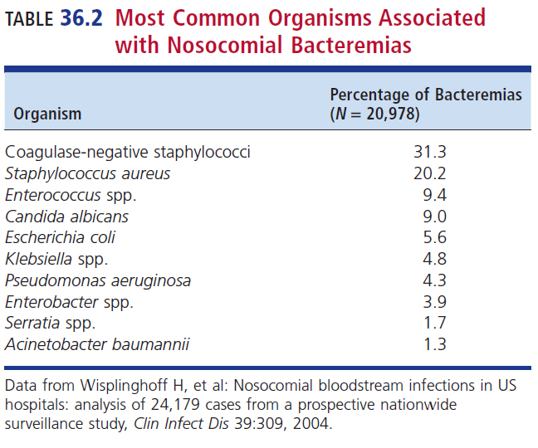
Most Common Organisms Associated with Nosocomial Bacteremias

Slide 23
Microbiology of Bacteremia
Marked by increasing incidence of polymicrobial bacteremia due to multidrug-resistant bacteria
These shifts are thought to be caused by increasing use (and misuse) of broad-spectrum antimicrobials.

Slide 24
Shifting Susceptibility Patterns of Causative Agents
Antimicrobial resistance
Bacteremia
Methicillin-resistant S. aureus (MRSA)
Vancomycin-resistant Enterococcus (VRE)
(Hetero-)Vancomycin-resistant S. aureus (VRSA)
Extended spectrum β-lactamases (ESBLs)
Carbapenem-resistant Enterobacterales (CRE)

Slide 25
Clinical & Diagnostic Microbiology
Pathogenesis

Slide 26
Pathogenesis
The pathogenesis of bacteremia depends in part on the
Infecting pathogen
Portal of entry
Immune status of the patient
Bacteremia often occurs because of disruption of normal skin or mucosal barriers, leading to bacterial invasion of the bloodstream.

Slide 27
Pathogenesis (Cont.)
Once bacteremia occurs, the patient’s immune system attempts to control infection via
Antibodies that opsonize organisms and activate complement-mediated killing by phagocytosis
Filtering mechanisms in the body, e.g., spleen, that may sequester organisms and facilitate their destruction by phagocytic cells

Slide 28
Pathogenesis (Cont.)
Two major complications when normal immunologic defenses are unsuccessful
Metastatic infection
Seeding multiple sites leading to abscesses, endocarditis, osteomyelitis
Sepsis and septic shock
Imbalance in regulation leads to an unopposed proinflammatory state.
Inflammatory response leading to decreased tissue perfusion, complement activation and diffuse intravascular coagulation (DIC) which can cause multiorgan dysfunction, eventually leading to septic shock and death

Slide 29
Clinical & Diagnostic Microbiology
Clinical Aspects & Presentation of Bacteremia

Slide 30
Associated Syndromes
Catheter-related bloodstream infections
When catheters remain in place over extended periods of time
Increase infections and biofilms
E.g., CoNS, S. aureus, Enterococcus
Urinary tract infections (UTIs)
Most common in the elderly–most common cause E. coli

Slide 31
Associated Syndromes (Cont.)
Pneumonias
S. pneumoniae, S. aureus, P. aeruginosa, and Klebsiella/Enterobacter spp.
Intra-abdominal infections
Primary peritonitis
Enterococci, E. coli, K. pneumoniae
Secondary peritonitis
E. coli, anaerobes, enterococci
S. aureus under appropriate conditions

Slide 32
Associated Syndromes (Cont.)
Skin infections
Bedridden patients and diabetics with peripheral vascular disease
S. aureus, S. pyogenes, S. agalactiae
Infected skin ulcers may result in polymicrobial bacteremia
P. mirabilis, E. coli, S. aureus, B. fragilis, Pseudomonas spp., Clostridium spp., anaerobic gram-positive cocci
Patients with severe burns
P. aeruginosa, K. pneumoniae

Slide 33
Associated Syndromes (Cont.)
Infective endocarditis
Transient bacteremia colonizing heart valves
Acute, sudden-onset endocarditis
Virulent bacteria: S. aureus, enterococci, S. pneumoniae
Slowly progressing subacute endocarditis
Less virulent bacteria: viridans streptococci, nutritionally variant streptococci (Abiotrophia and Granulicatella), and CoNS

Slide 34
Associated Syndromes (Cont.)
Musculoskeletal infections
Organisms seed loop capillaries in bone where they begin to multiply causing destruction of bone giving rise to intermittent bacteremia.
Prosthetic joints, especially the hip
S. aureus, CoNS, group A β-hemolytic streptococci
Acute septic arthritis
S. aureus
N. gonorrhoeae
An infectious disease emergency than requires prompt action

Slide 35
Associated Syndromes (Cont.)
Central nervous system (CNS) infections
Acute bacterial meningitis
Result of transient bacteremia caused by S. pneumoniae or N. meningitis
Organisms may colonize the nasopharynx in normal individuals and occasionally invade the bloodstream to case disease.
Meningitis is known to be caused by S. pneumoniae resulting from sinusitis or otitis.

Slide 36
Classic and Other Signs and Symptoms
Classic signs and symptoms
Abrupt onset of shaking chills, fever, or hypothermia
Sometimes hypotension, prostration, diaphoresis, tachypnea, and adult respiratory distress
Other symptoms
Delirium, stupor, agitation, nausea, vomiting
Possible complication is acute renal failure with oliguria or anuria.

Slide 37
Clinical Conditions with Altered Laboratory Values that may be Indicative of Bacteremia
Thrombocytopenia
Leukocytosis or leukopenia
Lactic acidosis
Hypoglycemia or hyperglycemia
Abnormal liver function tests
Especially hyperbilirubinemia
Coagulopathy
DIC
Elevations of C-reactive protein, haptoglobin, and fibrinogen

Slide 38
Clinical & Diagnostic Microbiology
Laboratory Diagnosis of Blood Infections: Determining volume, frequency, and number of blood cultures

Slide 39
Specimen Type
Blood culture
One of the most important cultures to obtain rapid accurate results
Critical values
Laboratory test results that are outside of the reference range and indicate a potentially fatal outcome
Health care providers must be notified immediately of all critical values to provide immediate treatment
Gram stain results of a positive blood culture should be called to the health care provider immediately.

Slide 40
Critical Values

Slide 41
Specimen Collection
1% to 3% of blood cultures become contaminated.
CoNS, Corynebacterium spp., Bacillus spp. (not B. anthracis), α-hemolytic streptococci, and Cutibacterium (Propionibacterium) acnes
Aseptic technique must be used to ensure that the sample is not contaminated.

Slide 42
Specimen Collection (Cont.)
Venipuncture process–aseptic technique for collecting blood cultures
Correct preparation of skin is required.
Palpitation of venipuncture site with a gloved finger
Cleanse the skin with 70% to 95% alcohol
Iodine-based compound (2%) scrubbed in a concentric fashion
Must be on skin for at least 30 seconds
Remove disinfecting agent with an alcohol pad after venipuncture
Blood may be directly inoculated into blood culture bottles at the bedside or, although not recommended, may be collected in test tubes containing 0.025% to 0.050% of sodium polyanetholsulfonate (SPS).

Slide 43
Specimen Collection (Cont.)
Good Idea | Bad Idea
Blood for blood culture should be obtained by venipuncture. | Blood collected from indwelling IV or intraarterial lines
If | Then
If blood is collected from an indwelling line | A second sample collected via venipuncture should be cultured for comparison
If patient has IV lines | Blood must be drawn below the line
Best Practice
Perform venipuncture on an extremity that does not have an indwelling line

Slide 44
Density of Bacteremia in Adults Versus Neonates
Bacteremia may involve
A many microorganisms in the blood
More commonly, only a relatively small number of bacteria per unit volume of blood (as low as 1 bacterium/mL)
Detection methods
Positive results in adults with bacteremia if organisms are present in the range of 10 to 15 bacteria/mL of blood

Slide 45
Density of Bacteremia in Adults Versus Neonates (Cont.)
Age volume protocol, Clinical and Laboratory Standards Institute (CLSI) 2007
Increases from 2 to 20 mL increase yield from 30% to 50%
Weight volume protocol, American Society for Microbiology [ASM] 2005
Adults–up to 4% of blood volume can safely be obtained

Slide 46
Density of Bacteremia in Adults Versus Neonates (Cont.)
Newborns
Bacteremia tends to be more severe because of their immature defense mechanisms.
Generally, have high numbers of microorganisms per mL of blood
2 mL of blood can safely be collected from a newborn weighing less than 1 kg (<2.2 lb)
4 mL of blood from newborn weighing up to 2 kg (up to 4.4 lb)

Slide 47
Density of Bacteremia in Adults Versus Neonates (Cont.)
Newborns
6 mL of blood can safely be collected from a newborn weighing less than 12.7 kg (27 lb)
4 mL of blood from newborn weighing up to 36.3 kg (up to 80 lb)
A child who weighs more than 36.3 kg (>80 lb) can have as much blood drawn as an adult (20-30 mlL)

Slide 48
Frequency Versus Time and Collection Frequency
Bacteremia can be
Transient, intermittent, or continuous
It is recommended that blood culture specimens be collected before an anticipated temperature rise to ensure maximum recovery.
In patients with infective endocarditis who have continuous bacteremia
Organisms are constantly released into the bloodstream; cultures should yield growth whenever specimens are collected.

Slide 49
Multiple Blood Collections
Rationale for multiple blood collections
Eighty percent of bacteremias are discovered on first set of cultures.
Ninety percent are detected if two sets are cultured.
Ninety-nine percent are detected if three sets are cultured.
At least 60 mL of blood in a 24-hour period
Three sets of two bottles (one aerobic and one anaerobic), 10mL of blood in each bottle

Slide 50
Multiple Blood Collections
Multiple blood cultures are recommended to document bacteremia
There is a limit to the number that should be collected
Repeated blood cultures or daily collections of blood for culture are not necessary
If at least 40 mL of blood has been cultured, and antimicrobial therapy has begun, it is best to wait for the results of the initial sets of cultures before collecting more blood.

Slide 51
Culture Media Used in Conventional Broth Systems
Aerobic blood culture bottle contents
Nutritionally enriched with ingredients such as
Peptone broth, tryptic or trypicase soy broth, brain-heart infusion broth, others
Anaerobic blood culture bottle contents
Same basic media as that in the aerobic bottle with additives such as
0.5% Cysteine, to permit growth of certain thiol-requiring organisms
Media may be pre-reduced to decrease oxidation-reduction potential to support growth of anaerobes.

Slide 52
Neutralization of Inhibitors
In specimens from patients receiving β-lactam antimicrobial agents
Penicillinase may be added to the medium to inactivate these agents.
Rarely done today
Current practice
Commercially available automated blood culture systems generally contain antimicrobial neutralization substances such as resin or charcoal to absorb/inactivate any antimicrobial substances present.

Slide 53
Anticoagulants and Other Additives
Sodium SPS performs these functions
Anticoagulation
Neutralization of the bactericidal activity of human serum
Prevention of phagocytosis
Inactivation of certain antimicrobial agents
SPS does inhibit certain organisms including
N. gonnorhoeae
N. meningitidis
G. vaginalis
1.2% gelatin can be added to the blood culture to help neutralize the inhibitory effect of SPS

Slide 54
Anticoagulants and Other Additives
Examples of other additives
Sodium amylosulfate (SAS)
Less effective than SPS, inhibits K. pneumoniae
Sodium citrate (0.5% to 1.0%)
Inhibitory to some gram-positive cocci
Sucrose (10% to 30%)
Sometime used as an osmotic stabilizer in dealing with damaged bacteria
Other additives that are not recommended
Ammonium-potassium, sodium oxalate, EDTA

Slide 55
Incubation Conditions
Continuous-monitoring blood culture instruments include an incubator.
Bottles incubated at 35° ± 2° C for 5 days
An incubator used to incubate culture plates can also be used for blood culture bottles
Bottles typically held for 7 days
In some systems, the aerobic bottles may be agitated during incubation.
Increases oxygenation of the broth, enhancing microorganism detection

Slide 56
Incubation Conditions
The head space of bottles contains ambient air, sometimes with an increased concentration of carbon dioxide (CO₂) in the aerobic bottles.
Anaerobic bottles have an increased concentration of nitrogen (N₂) and CO₂ replacing all the oxygen (O₂) in the bottle
Facilitates isolation of obligate anaerobes

Slide 57
Manual Blood Culture Systems
Rarely used in the United States
Easy to use
Inexpensive
Generally adequate for detection of common bacteria and fungi
Example Systems
Broth-slide system
Septi-Chek
Oxoid Signal system
Lysis centrifugation (Isolator tube) method

Slide 58
Examination of Blood Culture Bottles in a Manual System
Bottles examined macroscopically with transmitted and reflected light for evidence of
Turbidity, hemolysis, gas production, bacterial colonies in or on the blood layer
If growth is present or suspected
Perform direct Gram stain and plate to solid media
Septi-Chek system
Additional examination–paddle should be examined daily
Oxoid bottle signal device is examined daily
Positive results should be reported according to laboratory protocol

Slide 59
Continuous-Monitoring Blood Culture Systems
BACTEC 9000 Series and BD FX
Uses fluorescence to detect CO₂
VersaTREK
Detects the consumption or production of multiple gases (CO_{2,} H₂, O₂) by organisms growing in the medium

Slide 60
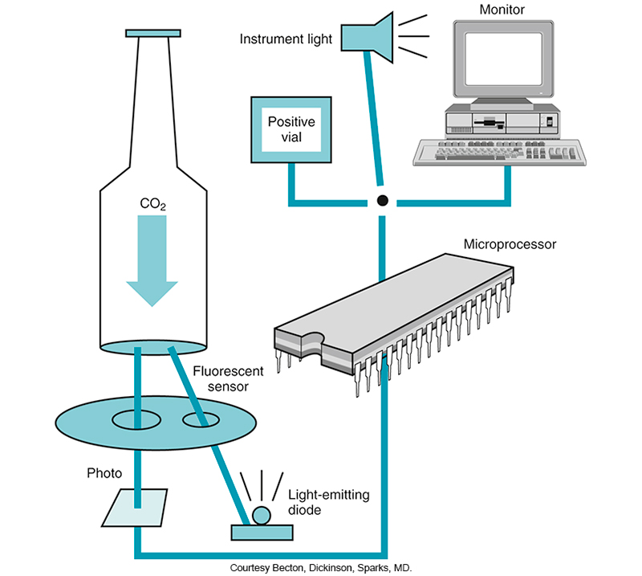
Bactec 9000 Schematic

Slide 61
Continuous-Monitoring Blood Culture Systems (Cont.)
BacT/ALERT 3D System
Fully, automated, nonradiometric blood culture system (aerobic and anaerobic bottles) utilizes pH-sensitive membranes in the bottom of the blood culture bottles and release of CO₂ by microbial growth

Slide 62
Clinical & Diagnostic Microbiology
Laboratory Diagnosis of Blood Infections: Recovering other Organisms from Blood

Slide 63
Most Common Organisms Associated with Nosocomial Bacteremias

Slide 64
Organisms that Require Special Conditions to be Detected
Francisella tularensis
Leptospira spp.
Brucella spp.
Nutritionally variant streptococci (NVS)
Campylobacter spp.

Slide 65
Organisms that Require Special Conditions to be Detected (Cont.)
Coxiella burnetii
Bartonella spp.
HACEK group of gram-negative bacilli
Mycobacteria from the blood
Fungemia
Viremia

Slide 66
Clinical & Diagnostic Microbiology
Laboratory Diagnosis of Blood Infections: Contamination in Blood Cultures

Slide 67
Contamination in Blood Cultures
Skin biota contamination
1% to 3% is expected
IV catheters
Contamination of disinfectant solutions
Benzalkonium chloride
Povidone-iodine
E.g., Burkholderia cepacia
Contamination or true pathogen
Identify isolate: Is it a likely pathogen?
Has more than one blood culture bottle isolated the organism?
Has it been isolated from another normally sterile site?

Slide 68
Criteria to Determine Blood Culture Pathogen Versus Contamination
Identity of microorganisms isolated
Examples of pathogens: S. aureus, E. coli, S. pneumonia, P. aeruginosa, C. albicans
Examples of contaminates: CoNS, diphtheroids, other skin microbiota
More than one blood culture bottle growing the same organism usually indicates that the isolate is significant.

Slide 69
Criteria to Determine Blood Culture Pathogen Versus Contamination (Cont.)
Growth of known skin microbiota in only 1 bottle out of several is usually a contaminant.
Isolation of the same organism from the blood and from a normally sterile site in the same patient indicates the blood isolate is a pathogen.

Slide 70
Clinical & Diagnostic Microbiology
Laboratory Diagnosis of Blood Infections: Rapid ID of Microbes Growing in Blood

Slide 71
Rapid Identification in Blood Cultures
Automated methods flag bottles for further workup
Gram stain smear from positive bottle
Provide preliminary report
Subculture to plate
Usually takes 24 to 48 hours for colonies to grow

Slide 72
Conventional Rapid Diagnostic Tests
Biochemical and enzymatic tests and stains can be performed directly from the blood culture bottles.
Direct tube coagulase
Thermonuclease
Oxidase
Bile solubility
Quellung capsule stain
These are presumptive tests; confirmatory testing must be done.

Slide 73
Fluorescence in situ Hybridization
Targets ribosomal ribonucleic acid (rRNA) in an organism by
Using an oligonucleotide or peptide nucleic acid (PNA) probe with a fluorescent label
There is no amplification of nucleic acid involved.
Procedure takes 1.5 to 3 hours to perform.
Probes that target common organisms available
S. aureus, Enterococcus spp., Candida spp.

Slide 74
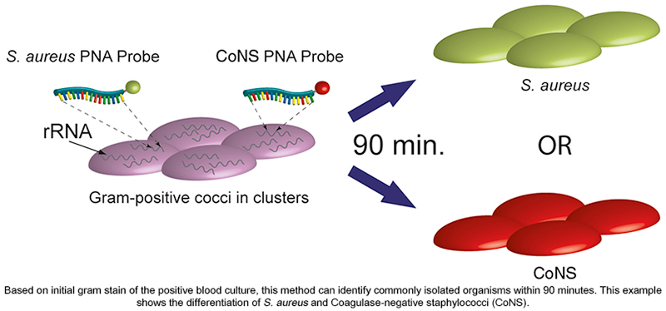
Peptide Nucleic Acid (PNA) Fluorescent in situ Hybridization (FISH)

Slide 75
Nucleic Acid Amplification Methods (NAATs)
Uses PCR to directly identify microorganisms growing in a blood culture
Verigene system amplifies nucleic acid targets that are then detected by hybridization of oligonucleotides bound to nanosphere particles with a silver staining process.

Slide 76
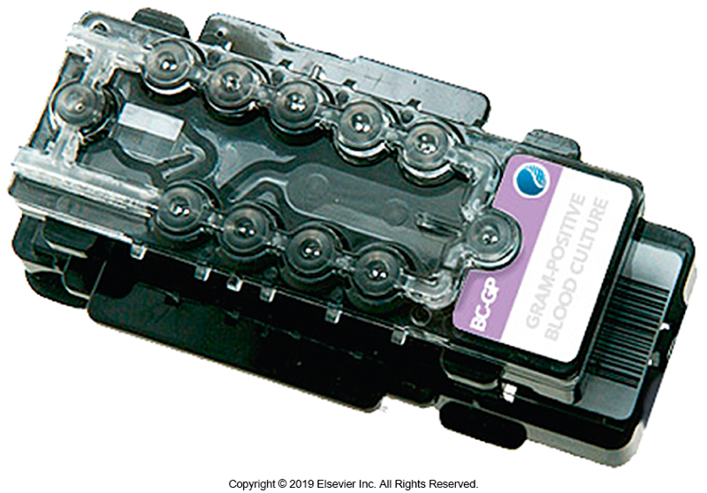
Verigene Test Cartridge

Slide 77
NAATs (Cont.)
FilmArray systems are
Multiplex assays that can identify a group of gram-positive and gram-negative organisms and yeasts, along with several resistance genes within 1.5 to a few hours
GeneXpert system
Offers assays that detect resistance genes and is evaluating a molecular assay to detect M. tuberculosis directly from blood

Slide 78
Matrix-Assisted Laser Desorption/ Ionization-Time-of-Flight Mass Spectrometry [MALDI-TOF]
Identifies a wide variety of organisms in a matter of minutes including:
Fungi, fastidious bacteria, and anaerobes
Organisms must first be subcultured from the blood and isolated in pure culture
Direct detection from blood is not yet FDA approved.
There is no way to determine antimicrobial susceptibility by using this method.
Example method: Microflex

Slide 79
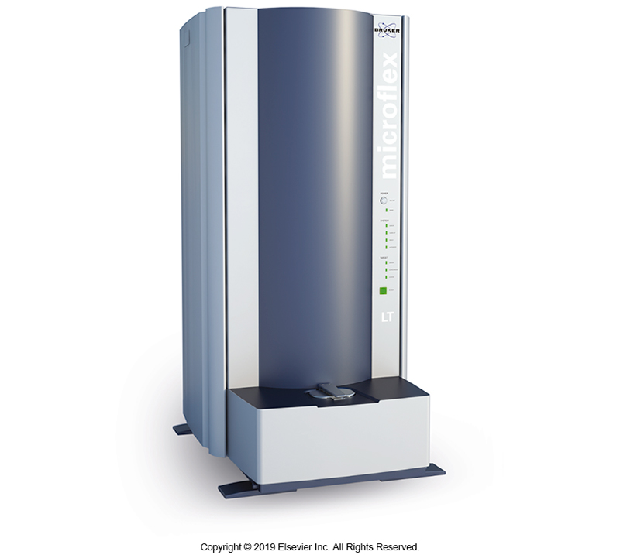
Microflex MALDI-TOF Instrument

Slide 80
Clinical & Diagnostic Microbiology
Laboratory Diagnosis of Blood Infections: Biomarkers

Slide 81
Sepsis
Sepsis is the most common cause of admissions and death in intensive care units.
Rates are increasing.
Sepsis is difficult to diagnose using clinical signs and symptoms.
Rapid accurate diagnosis of sepsis is critical for appropriate lifesaving treatment.

Slide 82
Classic Indicators of Sepsis
Elevated white blood cell (WBC) count
Fever
Elevated C-reactive protein (CRP)
Additional indicators on the next slide
Note
These indicators can occur in other systemic inflammatory conditions during trauma and surgery, as well as from a response to various drugs and blood product transfusions.

Slide 83
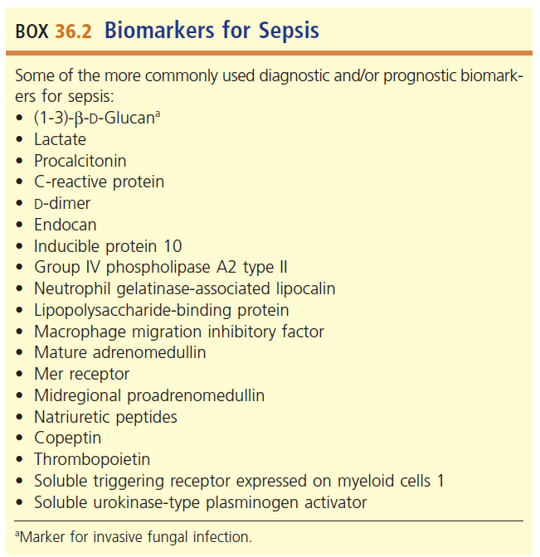
Biomarkers for Sepsis

Slide 84
Biomarkers (Cont.)
Current practice
Health care providers use clinical signs and symptoms along with the results of a select number of biomarkers to guide therapy.
Research is still needed to determine which markers and which combination provide the best diagnostic value.

Slide 85
Clinical & Diagnostic Microbiology
Laboratory Diagnosis of Blood Infections: Treatment

Slide 86
Treatment Options
Antimicrobial therapy
Broad-spectrum antimicrobial agents are frequently used for initial empiric therapy.
Identification of organism
Allows switch to most effective agent
β-Lactams are often combined with an aminoglycoside
Synergistic effect
Antisepsis therapy
Aimed at blocking the cascade of events that result in sepsis
Used in conjunction with antimicrobials
Does not prevent death because of underlying illnesses present in addition to sepsis

Slide 87
Treatment Options (Cont.)
Physiologic support
IV fluids
Anticoagulation agents
Aim to curb DIC
Glucocorticoids
Try to curb inflammation
Anticytokine therapies
Investigational agent aimed at blocking the action of tumor necrosis factor and other cytokine mediators
Showing promise in animal models

Slide 88
Clinical & Diagnostic Microbiology
Laboratory Diagnosis of Blood Infections: Prevention

Slide 89
Prevention
Community-acquired bacteremias
Immunizations
Healthcare-associated bacteremias
Minimizing iatrogenic infections
Replace indwelling catheters more frequently
Important that recommended infection control practices occur
Use of antimicrobial-coated central venous catheters has shown to be effective.

Slide 90
Points to Remember
Patients who are immunocompromised are at greatest risk for bacteremia and the systemic complications that may follow.
Most bacteremia cases in the United States are caused by gram-positive organisms, although gram-negative organisms are increasing and represent a large proportion of cases.

Slide 91
Points to Remember (Cont.)
Fungal agents are significant causes of bloodstream infections (fungemia).
Time of collection, frequency of obtaining, and volume of blood for culture are critical components for optimal recovery of microorganisms.

Slide 92
Points to Remember (Cont.)
Instrumentation for laboratory diagnosis of bacteremia continues to become more rapid and sensitive for the detection of organisms present in blood cultures.
Rapid diagnostic tests for the identification of organisms in blood are widely available.

Slide 93
Points to Remember (Cont.)
A combination of biomarker test results along with clinical signs and symptoms might provide a rapid and accurate diagnosis of sepsis.
Antimicrobial agents remain the mainstay of treatment of bacteremia.

