Slide 1
Clinical & Diagnostic Microbiology
Respiratory Infections

Slide 2
What’s Ahead?
Description of respiratory tract infections from the clinical microbiologist perspective working with the clinician who must make the differential diagnosis of these infections
General concepts of infectious diseases of the respiratory tract
The role of normal microbiota in preventing infection
Importance of the host’s immune status in determining the pathogens likely to cause disease

Slide 3
What’s Ahead? (Cont.)
An outline of the respiratory tract anatomy with consideration given to natural barriers of infection
Discussion of specific respiratory tract infections organized by anatomic site
Causes, pathogenesis, clinical manifestations, and complications of specific diagnoses
Emphasis on appropriate methods of laboratory diagnosis

Slide 4
What’s Ahead? (Cont.)
Respiratory tract infections in immunocompromised hosts
Patients who are immunosuppressed as a result of HIV infection
Respiratory tract infections caused by agents considered to be the most likely to be used in acts of bioterrorism

Slide 5
Clinical & Diagnostic Microbiology
Respiratory Infections
General Concepts

Slide 6
Anatomy of the Respiratory Tract
Function of the respiratory tract
Perform respiration
The exchange of oxygen and carbon dioxide
Deliver air from outside of the body to the alveoli where gas exchange occurs
Respiratory tract includes entire course that air must travel.
The components of the respiratory tract participate in defending itself against infection.

Slide 7
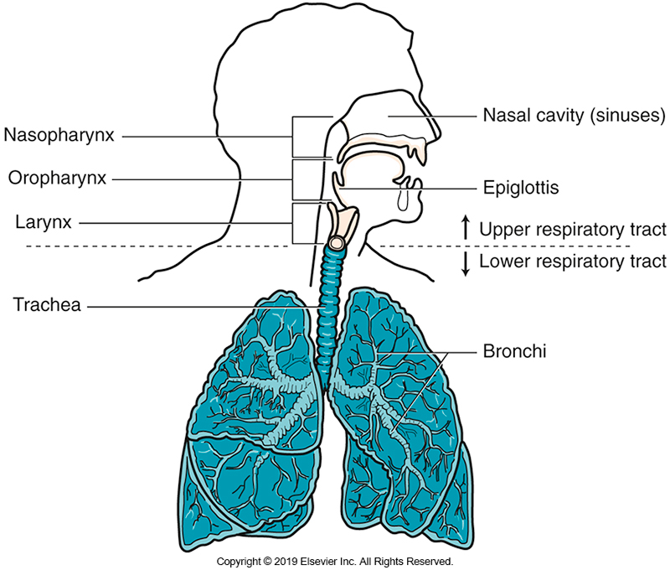
Anatomy of the Respiratory Tract (Cont.)

Slide 8
Barriers to Infection
Nasal hair
Filter air
Mucous membranes
Contains immunoglobulin and other antimicrobial substances, e.g., defensins
Mucociliary cells
Clear particulates and secrete antimicrobial substances
Coughing
Aids in clearance and expulsion of particulates

Slide 9
Barriers to Infection (Cont.)
Normal biota
Prevent colonization by pathogenic organisms
Phagocytic inflammatory cells
Polymorphonuclear leukocytes (PMNs) and monocytes engulf particles.
Alterations can impair barriers.

Slide 10
Role of Normal Biota
Types of organisms normally found at specimen site
Protect against pathogenic microorganisms
Stimulate the immune system
Under normal conditions, a balance of organisms is maintained that limits the quantity or dominance of any one type of organism.

Slide 11
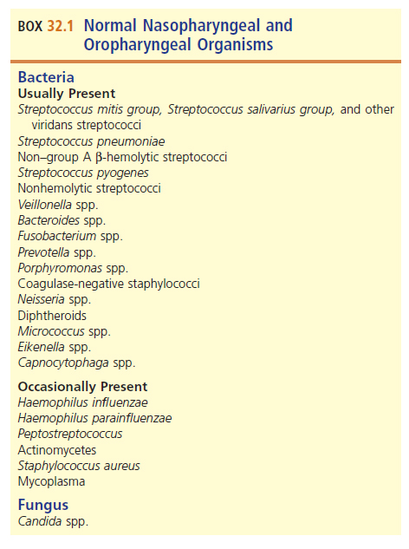
Normal Nasopharyngeal and Oropharyngeal Organisms

Slide 12
The Role of Normal Biota (Cont.)
Normal biota changes with time.
Moraxella catarrhalis, once considered part of normal biota, is associated with some infections.
Isolation of α-hemolytic colonies
Pharyngeal culture: normal
Sputum specimen or bronchial aspirate in the clinical setting of lobar pneumonia: full identification

Slide 13
Discriminating Between Normal Biota and Pathogenic Microorganisms
Changes in upper respiratory tract (URT) biota may occur due to
broad-spectrum antimicrobial use
hospitalization
chronic illnesses
It is important to distinguish an organism that is a potential pathogen colonizing the RT and the clinical disease state caused by that organism.

Slide 14
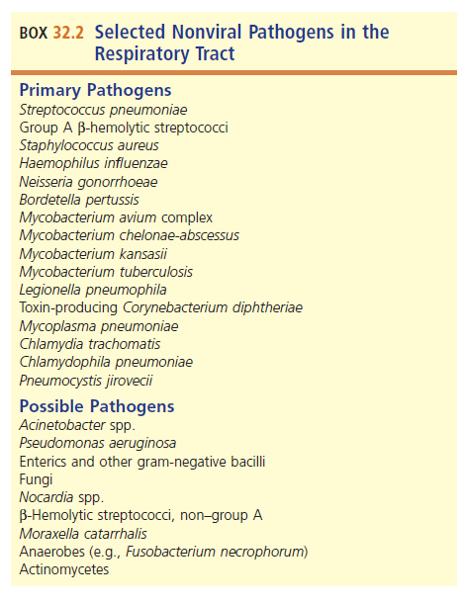
Selected Nonviral Pathogens in the Respiratory Tract

Slide 15
Distinguishing Among Normal Biota, Colonizing, and Pathogenic Microorganisms
Differentiating colonization from infection
Interpretation
Method and site of collection
Presence of white blood cells (WBCs)
Number of organisms present
Compatible clinical syndrome present
Some bacteria are always considered pathogenic.
E.g., Streptococcus pyogenes, Mycobacterium tuberculosis

Slide 16
Clinical & Diagnostic Microbiology
Respiratory Infections
Host Risk Factors

Slide 17
Immune Status of the Host
Suspected infection
Evaluate
Based on virulence of organism
Immune defenses available
Immunocompetent
Infections follow the normal course.
Generally, less severe and results in immunity
Immunocompromised
Infections are usually more severe and rapidly progressive.
Often infected by opportunistic pathogens

Slide 18
Age as a Risk Factor
Infants and the older adults are more susceptible to certain respiratory infections.
Functional immunodeficiency
To determine the significance of an isolate, the following must be considered:
Specimen source
Age
Immunologic status
Clinical setting of the patient

Slide 19
Reduced Clearance of Secretions
Reduced clearance of secretions or obstruction of an area in the upper or lower respiratory tract predispose one to
Infection
Seriously compromised respiratory tract function
Mechanical clearance is important in limiting the numbers of potential pathogens and in the associated inflammatory response.

Slide 20
Reduced Clearance of Secretions (Cont.)
Decreased clearance of respiratory secretions may result from:
Immature anatomic development
Transient reduction in mucociliary mechanism
Obstruction by a foreign body
Disease that alters the normal respiratory tract anatomy
Alterations in the viscosity of mucus

Slide 21
Infection-Induced Airway Obstruction
Obstruction may be a consequence of infection.
The anatomy of the area dictates the urgency with which treatment is initiated.
Example: acute epiglottitis with Haemophilus influenzae
Can cause life-threatening upper airway obstruction and is considered a medical emergency
Other infections with same pathogens (such as sinusitis) can be treated more deliberately.

Slide 22
Seasonal and Community Trends in Infections
Seasonal patterns dictate the likelihood of infection.
Viral respiratory tract infections (RTIs)
More common in winter, e.g., influenza
Mycoplasma pneumoniae typically has no seasonality.
Since viral and secondary infections are decreased in summer, RT infections more likely to be M. pneumoniae.

Slide 23
Empiric Antimicrobial Therapy
Antimicrobials should be administered before culture in some cases.
Seriously ill patients with pneumonia
Infections in difficult-to-reach specimens or with infections of typically known pathogens
E.g., middle ear infections
Periodically review susceptibility patterns
Keeps empirical therapy accurate and helpful

Slide 24
Clinical & Diagnostic Microbiology
Respiratory Infections
Virulence Factors of Pathogenic Organisms

Slide 25
Virulence Factors of Pathogenic Organisms
Attachment of bacterial pathogen to the mucous membranes is a primary step in the initiation of infection.
Attachment via adhesins or other microbial surface molecules or structures that bind the organism to a host surface
Specific bacterial adhesions interact with specific cellular receptors
E.g., Streptococcus pyogenes possess fimbriae that bind to epithelial cells

Slide 26
Virulence Factors of Pathogenic Organisms
Microorganisms may elaborate toxins that produce different pathogenic effects depending on
Activity of toxin
The target cell with which it interacts in the host
Evasion of host defenses enables microorganisms to proliferate and cause damage to the host

Slide 27
Virulence Factors of Pathogenic Organisms
Example of mechanisms that prevent microbial detection or elimination
Prevent phagocytosis
Capsules
Leukocidins
Hide
Intracellular pathogens
Proteases
Cleave antibodies

Slide 28
Clinical & Diagnostic Microbiology
Respiratory Infections
Upper Respiratory Tract (URT) Infections

Slide 29
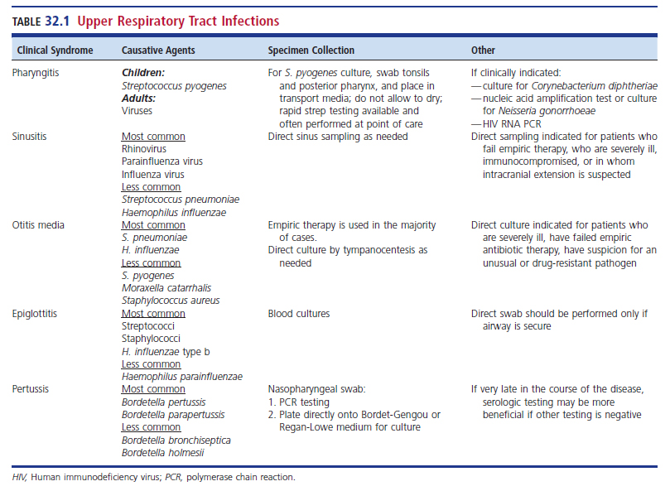
URT Infections

Slide 30
Pharyngitis Epidemiology
Commonly known as a sore throat
Bacterial
Most commonly group A streptococci (GAS)
Most infections occur in the winter and early spring.
Mode of transmission in most cases is by inhalation of droplet aerosols or hand-to-mouth contamination.

Slide 31
Pharyngitis Pathogenesis
Infections can range from asymptomatic to symptomatic disease.
Some viruses that infect the pharyngeal mucosa cause cellular destruction.
Other viruses symptoms with little mucosal cell destruction.

Slide 32
Pharyngitis Pathogenesis (Cont.)
The pathogenesis of streptococcal pharyngitis may be caused mainly by the inflammatory effects of a variety of extracellular products elaborated by the bacteria.
These products exhibit various activities, including toxicity to a variety of cells, pyrogenicity, and enhancement of the spread of streptococci through infected tissues.

Slide 33
Pharyngitis Clinical Manifestations (Cont.)
Clinically, differentiation between viral and streptococcal pharyngitis is difficult.
General symptoms of streptococcal pharyngitis
Acute onset of a sore throat with tonsillar exudate
Fever
Tender anterior cervical lymphadenopathy
Absence of a cough
Other likely signs of viral infection

Slide 34
Pharyngitis Clinical Manifestations (Cont.)
General symptoms of viral pharyngitis
Rhinorrhea
Conjunctivitis
Cough
Fever
Diffuse myalgias (muscle aches)
Profound fatigue

Slide 35
Pharyngitis Complications
Complications of viral infections
Caused by systemic manifestations of the infections or secondary bacterial infections
Sinusitis, otitis media, pneumonia

Slide 36
Pharyngitis Complications
Complications of GAS pharyngitis
Suppurative complications
Abscesses
Soft tissue infections
Otitis media
Sinusitis,
Cervical adenitis
Meningitis (rare)

Slide 37
Pharyngitis Complications (Cont.)
Nonsuppurative complications of GAS pharyngitis
Poststreptococcal acute glomerulonephritis
Acute rheumatic fever (damage to the heart valves)
Scarlet fever
Streptococcal toxic shock syndrome
Reactive arthritis
Pediatric autoimmune neurosychiatric disorder associated with GAS (PANDAS)

Slide 38
Pharyngitis Laboratory Diagnosis
Laboratory diagnosis
Primary goal
Differentiate between viral and bacterial
Secondary goal
Detect uncommon causes of bacterial pharyngitis
Testing for GAS is not recommended for
Children or adults with pharyngitis that is likely due to a virus based on clinical and epidemiologic clues
Children younger than 3 years of age in the absence of an epidemiologic contact

Slide 39
Pharyngitis Laboratory Diagnosis (Cont.)
Throat culture for GAS is the diagnostic gold standard
In collecting specimens for streptococcal cultures
It is important to adequately swab both tonsillar areas as well as the posterior pharynx.
If any tonsillar exudate is seen, specific efforts should be made to swab involved areas directly.
The tongue and other oral structures should be avoided with the swab to minimize contamination with oral biota and dilution of the specimen.

Slide 40
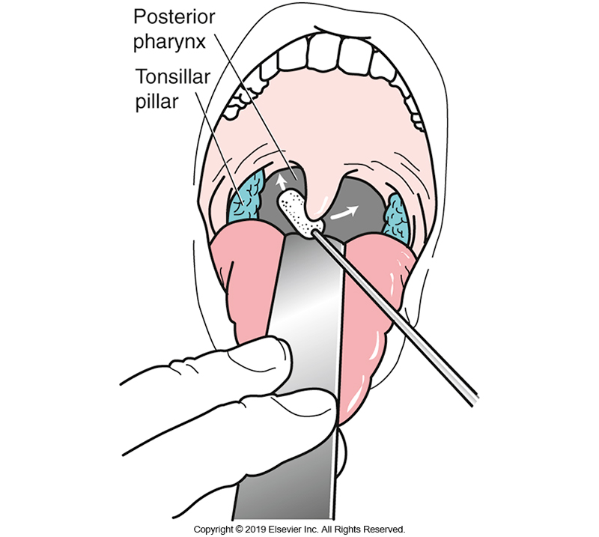
Specimen Collection from the Oropharynx (Throat)

Slide 41
Pharyngitis Laboratory Diagnosis (Cont.)
Culture
Sheep blood agar (SBA) is commonly used.
May use media with antimicrobials to reduce normal biota
Other methods
Rapid antigen detection tests (RADTs)

Slide 42
Pharyngitis Treatment
Viral pharyngitis
Supportive care
Exception—influenza
Specific antiviral agents are available
Bacterial pharyngitis caused by GAS
Most cases are self-limiting with resolution in 3 to 4 days, even without antimicrobial therapy.

Slide 43
Pharyngitis Treatment (Cont.)
Bacterial pharyngitis caused by GAS
Antimicrobial therapy
Drugs of choice: penicillin or amoxicillin
Alternates for patients who are allergic to penicillin
Macrolides, clindamycin, first-generation cephalosporins
Antimicrobials have been shown to shorten duration and in some cases the severity of symptoms.
Effect is usually modest.

Slide 44
Sinusitis Epidemiology
Also known as infectious sinusitis or rhinosinusitis
Acute sinusitis
Infectious in origin as opposed to chronic sinusitis which can have diverse causes
Acute cases are usually preceded by acute viral URTs that occur predominantly in the winter and spring months.
Less common in children that in adults

Slide 45
Acute Sinusitis Causes
Common viral agents
Rhinovirus, coronavirus, parainfluenza, adenovirus, and influenza virus
Common bacterial agents
Streptococcus pneumoniae, H. influenzae (most common)
Streptococcus pyogenes, M. catarrhalis, Staphylococcus aureus
Fungal sinusitis is uncommon.
More likely in immunocompromised patients

Slide 46
Acute Sinusitis Pathogenesis
Under normal conditions
Sinuses undergo continuous cleansing process through the action of ciliated epithelial cells.
Bacteria are ultimately cleared from the nasopharynx.
In acute rhinosinusitis
Mucosal swelling can partially or completely obstruct the sinus ostia interrupting normal processes.
Creates environment for bacterial overgrowth

Slide 47
Acute Sinusitis Pathogenesis (Cont.)
In acute rhinosinusitis (cont.)
Viral infection and bacterial toxins can alter the normal cleansing function of the ciliated epithelial cells.
Noninfectious obstructions can also cause similar disruption of normal operations.

Slide 48
Acute Sinusitis Clinical Manifestations
Typical clinical presentation
Purulent nasal discharge and pain in the face
Headache with referred pain from upper teeth
Possible drainage obstructions
Cough, low-grade fever

Slide 49
Acute Sinusitis Clinical Manifestations (Cont.)
Three criteria for the diagnosis of bacterial sinusitis
Persistent symptoms without improvement for more than 10 days
Severe symptoms present for 3 to 4 days at the beginning of the illness
High fever, purulent discharge, facial pain
Initial improvement followed by a subsequent worsening of symptoms

Slide 50
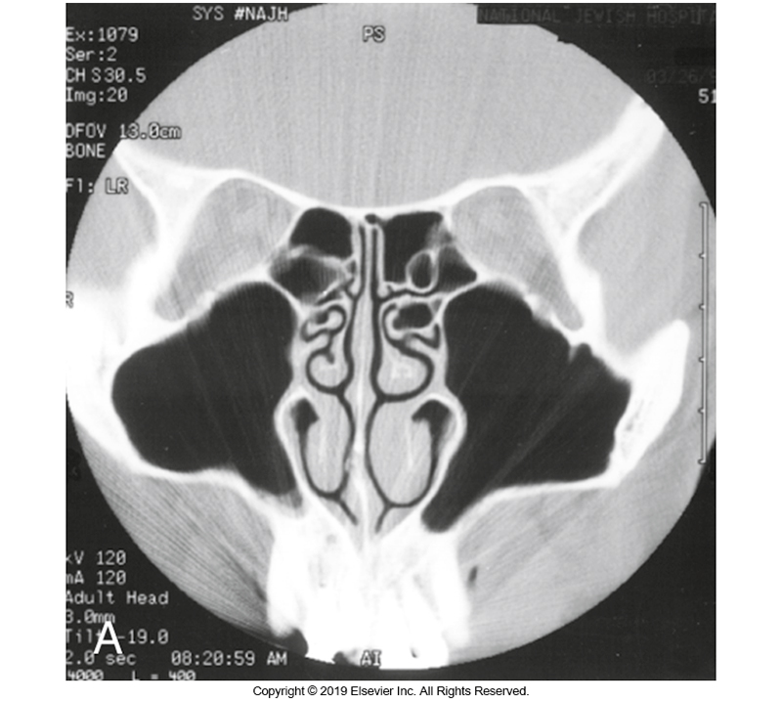
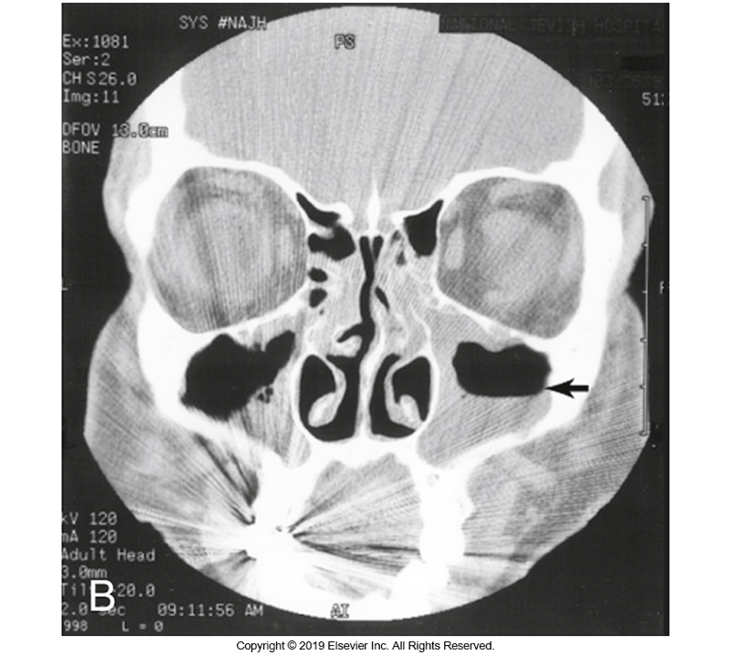
Detection of Sinusitis Using Computed Tomography (CT) Scans
A. Normal
B. Showing sinusitis

Slide 51
Acute Sinusitis Complications
Orbital cellulitis or retroorbital abscess
Protrusion of the eye (proptosis) or limitation of ocular movements possible
Osteomyelitis of frontal bone with abscess
Pott’s puffy tumor
Meningitis
Brain abscess
Cavernous sinus thrombosis
Neurologic involvement

Slide 52
Acute Sinusitis Laboratory Diagnosis and Treatment
Laboratory diagnosis
Direct sinus puncture and aspiration
Gold standard
Culture
SBA, chocolate (CHOC), MacConkey (MAC) agar
Treatment
Viral sinusitis
Antimicrobial therapy not required or appropriate
Bacterial sinusitis
Varies based on causative agent

Slide 53
Acute Otitis Media (AOM) Epidemiology
Infection of the middle ear
Most common bacterial infection in children between 3 and 24 months of age
Most children have had at least one episode by the age of 3 years.
Risk factors
Prior history of AOM, exposure to passive tobacco smoke, nasopharyngeal colonization with otopathogens, presence of anatomic nasopharyngeal disorders, attendance at daycares

Slide 54
AOM Causes
Numerous causes of viral AOM
Adenoviruses, rhinoviruses, coronaviruses, respiratory syncytial virus (RSV), influenza virus, etc.
RSV seems to be particularly associated with AOM.
Causes of bacterial AOM
S. pneumoniae accounts for a significant proportion of isolates.
H. influenzae, M. catarrhalis
S. pyogenes, S. aureus less common

Slide 55
AOM Pathogenesis
Resembles acute bacterial sinusitis in that
Viral URT infection generally precedes or occurs concurrently with most cases of AOM
Infection is established when there is subsequent impairment of the normal host defense and drainage mechanisms.
Middle ear and Eustachian tube
Suppurative infection may result in hearing issues.

Slide 56
AOM Clinical Manifestations
In young children
Fever and irritability may be the only signs of illness
In older children
Tugging at the involved ear may be noticed during or at the end of the course of an URT infection.
Changes in hearing and later drainage of purulent secretions from the ear canal

Slide 57
AOM Complications
Damage to the tympanic membrane resulting in perforation
Chronic middle ear effusions
In younger children—subsequent hearing loss can affect speech development and education
Severe suppurative complications of AOM are rare.

Slide 58
AOM Laboratory Diagnosis and Treatment
Laboratory diagnosis
Laboratory studies are not recommended
Treatment
Necessity of treating older children with AOM has been a matter of great debate
Adults are generally treated at diagnosis because of lack of data regarding complications.

Slide 59
AOM Laboratory Diagnosis and Treatment
Immediate antimicrobial treatment is indicated for children in these categories:
High-risk of complications
Younger than 6 years
Those with severe or persistent symptoms
Those with otorrhea
Children 6 to 23 months of age with bilateral non-severe AOM

Slide 60
Epiglottitis Epidemiology
Epiglottis definition and location
A cartilaginous structure positioned at the anterior aspect of the opening of the trachea
Function—to prevent aspiration of secretions and food during swallowing
Epiglottitis (known as supraglottitis in adults)
Can be rapidly progressive infection of the epiglottis and adjacent soft tissues in the upper airway.
Can result in airway obstruction and respiratory failure, a life-threatening emergency.

Slide 61
Epiglottitis Epidemiology
Historically, primarily a disease of children aged 2 to 7 years
The use of the vaccine for H. influenzae type b (Hib) has resulted in a decline of childhood incidence.
Now, most cases are in older children and adults.

Slide 62
Epiglottitis Causes
Uncommon disease
Causes
Hib
Group A streptococci
Streptococcus pneumoniae
Staphylococcus aureus (including MRSA)
Hemophilus parainfluenzae
Klebsiella spp.
SARS-CoV-2
Chemical and thermal irritants

Slide 63
Epiglottitis Pathogenesis
Soft tissues and surrounding structures
Are susceptible to accumulation of edematous fluid during the inflammatory process incited by infection
Along with the critical location of the epiglottis at the opening of the trachea, this creates danger of partial or complete airway obstruction as disease progresses.

Slide 64
Epiglottitis Pathogenesis (Cont.)
In adults, other structures in the supraglottic region may be involved
Vallecula
Arytenoids
Aryepiglottic folds
Epiglottitis has been linked to sudden infant death syndrome.

Slide 65
Epiglottitis Clinical Manifestations
In childhood cases
The hallmark of epiglottitis is
Severe sore throat
Pain on swallowing (odynophagia)
No sign of inflammation in the oropharynx on physical examination
High-grade fever and toxic appearance are common
Onset of symptoms is abrupt.

Slide 66
Epiglottitis Clinical Manifestations
Stridor, a high-pitched sound noted during breathing, indicates an upper airway obstruction
Medical emergency
Adults commonly present in a more indolent fashion.
Sore throat and odynophagia are common.
Stridor and respiratory distress is seen less often.
Underlying patient comorbidities such as diabetes mellitus can increase risk of severe disease.

Slide 67
Epiglottitis Clinical Manifestations (Cont.)
Croup
Tends to have a more insidious onset
Viral prodrome of rhinorrhea, congestion, and harsh, barking cough
Causative agents: S. aureus, S. pneumoniae, other streptococci, M. catarrhalis

Slide 68
Epiglottitis Clinical Manifestations (Cont.)
Bacterial tracheitis
Uncommon and occurs mostly in children
Causative agents: S. aureus, S. pneumoniae, other streptococci, M. catarrhalis
Disease starts with viral prodrome like croup then progresses to a more toxic appearance with fever and respiratory distress.
Subglottic edema and thick tracheal secretions develop.

Slide 69
Epiglottitis Complications
Most important complication
Respiratory compromise progressing to respiratory failure
Airway obstruction from edema of the supraglottic structures
Other complications
Development of epiglottic abscess, necrotizing epiglottitis, pneumonia
In patients who are bacteremic
Meningitis and septic shock

Slide 70
Epiglottitis Laboratory Diagnosis
Gold standard for diagnosis
Direct visualization of the epiglottitis with laryngoscopy
Laboratory diagnosis
Direct swab cultures of epiglottis only when airway secure
Blood cultures
Direct smear
WBCs; pleomorphic, gram-negative bacilli (H. influenzae)
Culture on CHOC agar at 5% to 10% CO₂

Slide 71
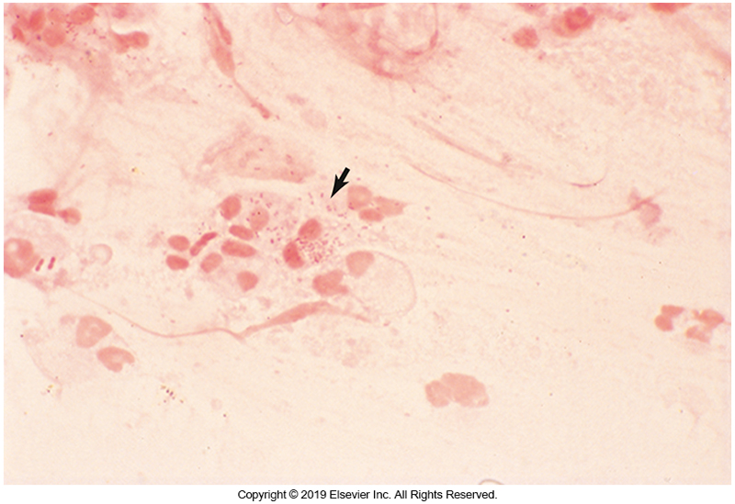
Gram-Stained Sputum—Exudate with Haemophilus organisms

Slide 72
Epiglottitis Treatment
IV antimicrobials should be administered
Third-generation cephalosporins
Ampicillin-sulbactam
Coverage for methicillin-resistant S. aureus (MRSA) should be added when risk factors exist.
Patients should be monitored closely if immediate air securement is not required at the time of initial evaluation.

Slide 73
Pertussis Epidemiology
Commonly called whooping cough
Highly communicable respiratory illness in susceptible patient populations
Transmitted from person to person via aerosolized droplets or direct contact with secretions
More common in infants and young children
Serious complications are seen more in this age group.

Slide 74
Pertussis Epidemiology (Cont.)
Pertussis vaccine introduced in the 1940s.
Significant declined by the 1970s
Recently, incidence has again begun to increase.
Large outbreaks in several states with notable infant mortality.
Increased incidence in adults/adolescents due to waning immunity.

Slide 75
Pertussis Causes and Pathogenesis
Causes
Bordetella pertussis, Bordetella parapertussis, Bordetella bronchiseptica, Bordetella holmesii
Pathogenesis
Not completely understood
Numerous studies suggest a significant role for pertussis toxin (PT)
Interrupts transduction signals from cell surface receptors to intracellular systems in the clinical presentations of the infection

Slide 76
Pertussis Key Clinical Manifestations and Complications
Key clinical manifestations
Exhausting paroxysms of coughing
Whooping sound by inspiration through a narrowed airway
Complications
Pneumonia in young children
Complications as a result of severe and forceful coughing episodes
Pneumothorax, hemorrhages, epistaxis, alveolar rupture, and other tissues as a result of forceful coughing

Slide 77
Pertussis Laboratory Diagnosis
CBC may show lymphocytosis—reaction to PT
Culture recovery of B. pertussis can be difficult.
Bordet-Gengou or Regan-Lowe (RL) media
Labs now favor polymerase chain reaction (PCR).
Serologic testing may be helpful 2 to 12 weeks after the onset of cough, when culture and PCR results are negative, and in outbreak investigation.

Slide 78
Pertussis Prevention and Treatment
Prevention
Vaccination
Treatment
Antimicrobials often do little to help with symptom resolution, unless given early in the course of illness.
Macrolide antibiotics including clarithromycin and azithromycin
Alternative is trimethoprim-sulfamethoxazole.

Slide 79
Clinical & Diagnostic Microbiology
Respiratory Infections
Lower Respiratory Tract (LRT) Infections

Slide 80
Introduction
LRT infections usually occur when infecting organisms reach the lower airways or pulmonary parenchyma via bypassing the mechanical and other barriers of the URT.
Infections may result from
inhalation of infectious aerosols
aspiration of oral or gastric contents
hematogenous spread

Slide 81
Introduction (Cont.)
For a LRT infection to establish itself, a series of host defenses must be overcome.
Different sequence of events for respiratory viruses as opposed to bacterial pathogens
Lung infections by bacterial pathogens occur via
Direct inoculation of organisms through aspiration from the URT

Slide 82
Introduction (Cont.)
Progression of viral pathogens
Involves spread among adjacent cells and distant inoculation of susceptible cells by aspiration of infectious secretions
To a lesser extent, hematogenous transmission of the virus

Slide 83
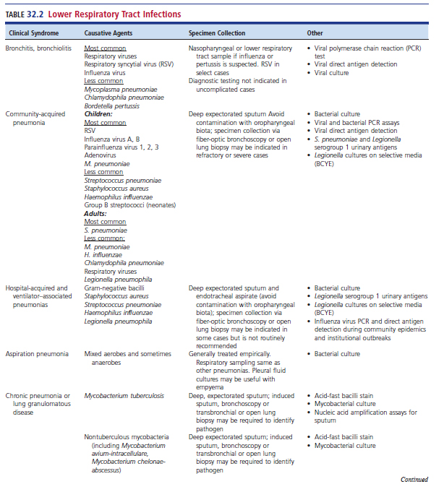
LRT Infections

Slide 84
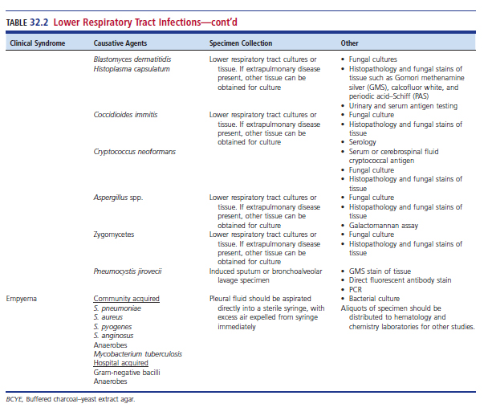
LRT Infections (Cont.)

Slide 85
Bronchitis and Bronchiolitis Definitions and Epidemiology
Acute Bronchitis
Infection and inflammation of the bronchi without involvement of the lung parenchyma (pneumonia)
Peak season is the winter months.
Acute Bronchiolitis
Infection and inflammation of the smaller bronchioles
Most common LRT infection in children younger than 2 years

Slide 86
Bronchitis and Bronchiolitis Causes
During seasons when influenza is epidemic in the community, it is the most common cause of acute bronchitis in the general population.
During nonepidemic periods viral pathogens casing bronchitis include
Rhinovirus, coronavirus, human metapneumovirus (hMPV), parainfluenza virus

Slide 87
Bronchitis and Bronchiolitis Causes (Cont.)
Bacterial respiratory tract pathogens include
Mycoplasma pneumoniae
Chlamydophila pneumoniae
Bordetella pertussis
Predominate cause of bronchiolitis
RSV

Slide 88
Bronchitis and Bronchiolitis Pathogenesis
Evidence almost always exists of an antecedent or coexistent URT infection in patients with acute bronchitis.
Infection
Damage to respiratory epithelial cells by the same pathogens
Spread of URT infections to the lower airways manifests as acute bronchitis

Slide 89
Bronchitis and Bronchiolitis Clinical Manifestations (Cont.)
Hallmark of acute bronchitis
Persistent cough for as long as 6 weeks
The amount and color of sputum from these patients do not reliable distinguish bacterial from viral bronchitis.

Slide 90
Bronchitis and Bronchiolitis Clinical Manifestations
Hallmark of acute bronchiolitis
Signs of LRT airway obstruction
Expiratory wheezing
Respiratory distress
Acute bronchiolitis
Infectious disease in infants
Signs above and apnea
Persistent cough is common

Slide 91
Bronchitis and Bronchiolitis Complications
Complications
Secondary bacterial infections
Bacterial bronchitis or pneumonia
Example pathogens—S. pneumoniae, H. influenzae, M. catarrhalis
Severe bronchiolitis
More common in younger, especially premature infants
Also at risk, infants with cardiac and pulmonary disease
Concurrent otitis media may be present.

Slide 92
Bronchitis and Bronchiolitis Diagnosis
Infections with viruses with no available direct therapy
Diagnostic testing was not previously recommended in uncomplicated cases that follow expected, self-limiting course unless there is another indication for testing.
During the COVID-19 pandemic
Viral diagnostic testing for epidemiologic purposes or to complement therapeutic decision making.
Patients in whom there are signs of secondary bacterial bronchitis, pertussis is suspected, or pneumonia is a concern
Diagnostic testing could be useful in guiding therapy

Slide 93
Bronchitis and Bronchiolitis Diagnosis (Cont.)
In cases of suspected influenza virus infection of the LRT
Identification of the virus in respiratory tract secretions may be useful in guiding antiviral therapy.
Test of choice for most viral pathogens is PCR.
Viral cultures generally have low sensitivity and are rarely performed.

Slide 94
Bronchitis and Bronchiolitis Laboratory Diagnosis (Cont.)
For patients with RSV
Diagnosis should be based on patient history and physical examination.
Viral antigen or PCR assay testing is recommended.

Slide 95
Bronchitis and Bronchiolitis Treatment
Type of Infection | Treatment
Acute bronchitis viral infection in otherwise healthy adults | Antimicrobial therapy is not recommended Anti-influenza therapy should be started ideally within 48 hours of symptom onset but can be given at other times
Secondary bacterial bronchitis and/or pneumonia | Antimicrobial treatment regimens can be designed using the same appropriate used for acute bacterial pneumonia Pertussis can be treated with macrolide therapy
RSV infection | Supportive – maintenance of hydration, supplemental oxygen

Slide 96
Influenza Epidemiology and Causes
Epidemiology
Late fall and early winter and persist into the spring; pandemics can occur outside of typical season
Causes
Influenza A and B
Influenza A categorized into subtypes based on two surface antigens
Hemagglutinin (H) and neuraminidase (N)
Influenza B categorized into lineages
Influenza A is responsible for pandemics

Slide 97
Influenza Pathogenesis
Continuously undergoes antigenic drift which allows amino acid substitution
Allows the virus to evade preexisting host immunity
Antigen drift is responsible for annual worldwide outbreaks and occurs more commonly in influenza A viruses.
Two or more strains of influenza A can combine genetic material.
Results in the generation of new reassorted virus.
Little population (herd) immunity

Slide 98
Influenza Pathogenesis
The process of genetic reassortment is termed antigen shift.
Pandemics in 1957 and 1968
Caused by genetic reassortment between influenza viruses from humans and birds
2009 H1N1 pandemic
Caused by reassortment of genetic elements of human, swine, and avian strains.

Slide 99
Influenza Clinical Manifestations and Complications
Clinical manifestations
Fever, myalgias, and fatigue
Complications
Populations at increased risk for severe disease
Young children, pregnant women, patients with underlying comorbidities
Secondary bacterial pneumonias
S. pneumoniae, S. aureus (including community-associated strains of MRSA), and H. influenzae

Slide 100
Influenza Diagnosis
Diagnosis
In the setting of an influenza outbreak, acute febrile respiratory illnesses can be diagnosed with relative certainty by clinical criteria alone.
Detection of virus, viral antigen, or viral nucleic acid
Pharyngeal swabs, nasal washes, sputum, or bronchoalveolar lavage (BAL)
Antigen detection can be performed quickly with a high specificity but is insufficiently sensitive to rule out influenza.
Current standard of care
Molecular assays, e.g., reverse-transcription polymerase chain reaction (RT-PCR)

Slide 101
Influenza Prevention and Treatment
Annual vaccination in the fall of each year
Antiviral drugs
Neuraminidase inhibitors
Choice of treatment depends on the susceptibility of currently circulating influenza strains along with patient characteristics.

Slide 102
Emerging Viral Respiratory Infections
Over the past few decades
Avian influenza strains
Pandemic H1N1 influenza A
hMPV
Reemerging adenoviruses
Novel human coronaviruses have arguably had the most wide-reaching global consequences

Slide 103
Severe Acute and Middle East Respiratory Syndromes
Members
SARS-CoV
Middle East respiratory syndrome (MERS)
MERS-CoV
Diagnosis
NAAT-SARS
RT-PCR (NAATS)

Slide 104
COVID-19
Transmission–airborne, exposure to large respiratory droplets, contact with contaminated objects and secretions/excretions
Clinical presentation
Spectrum from asymptomatic to severe pneumonia with respiratory failure, acute respiratory distress syndrome and multisystem organ failure

Slide 105
COVID-19 (Cont.)
Risk factors for severe disease
Older age
Obesity
Diabetes
Chronic lung, heart, or kidney disease
Immunocompromised state
Signs and symptoms include
Cough, shortness of breath, flulike symptoms, gastrointestinal manifestations, altered sense of taste or smell, coagulopathy

Slide 106
COVID-19 (Cont.)
Complications are still incompletely understood
Examples include but are not limited to
Respiratory failure
ARDS
Involvement of organ systems
Hypotension
Myocardial inflammatory syndrome in children

Slide 107
COVID-19 (Cont.)
Diagnosis
Cannot reliably be differentiated from other infections based on clinical manifestations alone.
Standard testing–NAATs
Antibody tests
Treatment
Antiviral agents, supportive therapy
Prevention
Vaccination

Slide 108
Acute Pneumonia
Distinction between acute bronchitis and acute pneumonia may be subtle.
Depends on the extent of involvement of the LRT with the infectious process
Patients who have bronchitis do not exhibit the physical, radiographic, and pathologic findings of pulmonary parenchymal involvement outside of the airways—this type of involvement with the infectious process defines pneumonia.

Slide 109
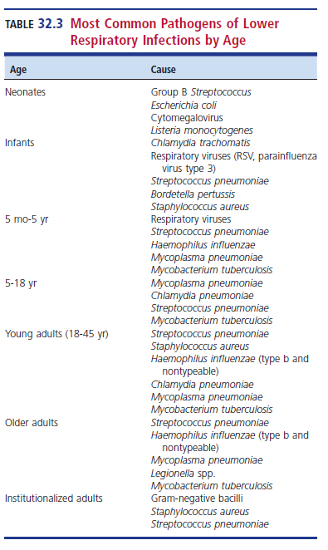
Most Common Pathogens of Lower Respiratory Infections by Age

Slide 110
Community-Acquired Pneumonia (CAP) Definition and Epidemiology
Definition
The onset of symptoms is in the community or within the first two days after admission to the hospital.
Epidemiology
S. pneumoniae most common bacterial pathogen in children and adults
Vaccination resulted in decreases in invasive pneumococcal disease.
Despite advances in diagnostics and therapeutics in recent years, mortality rates have remained unacceptably high.

Slide 111
CAP Causes
The same viral pathogens that cause URT infections in the community during the winter months are detectable in over 70% of CAP cases in children.
RSV–most common viral pneumonia in children, especially infants
Viruses identified in more than 25% of adult pneumonia in one multicenter study.
Influenza virus can cause primary pneumonia
Subsequent bacterial superinfections possible

Slide 112
CAP Causes (Cont.)
Most common bacterial cause of CAP in children and adults is S. pneumoniae
Other causes in children
Nontypable H. influenzae, M. catarrhalis, M. pneumoniae
Group B streptococci in neonates
Other causes in adults
H. influenzae, M. catarrhalis, M. pneumoniae, C. pneumoniae, L. pneumophila
Small percentage S. aureus

Slide 113
CAP Pathogenesis
It is now realized that the lung is not a sterile site as previously thought.
Disruption in the balance of the microbes can lead to pneumonia.
In most cases
Defense mechanisms of the lung, including the ciliated epithelial cells and innate immune system phagocytic cells can clear aspirated bacteria before infection is established

Slide 114
CAP Pathogenesis
LRT infections could occur if the bacteria involved are particularly virulent, the inoculum of inhaled microorganisms is high, or the immune system is compromised.
Other mechanisms
Local extension from a contagious source of infection or hematogenous spread from a remote source of infection
Host variables

Slide 115
CAP Clinical Manifestations
Clinical manifestations
Varies with the age and immunologic status of the host
Most infected patients experience
Fever associated with chills
Cough with purulent sputum that may be blood-tinged
Left shift WBC count
Localized area of the lung involvement that may be associated with hypoxia or reduced oxygenation
Lobar consolidation

Slide 116
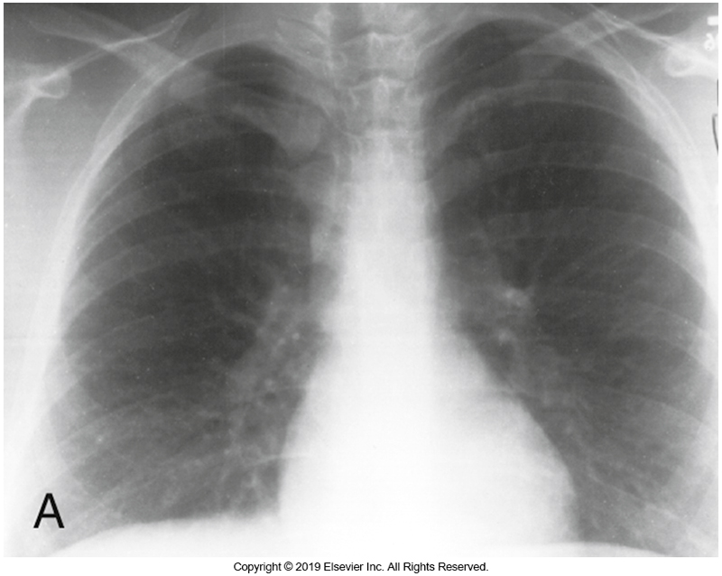
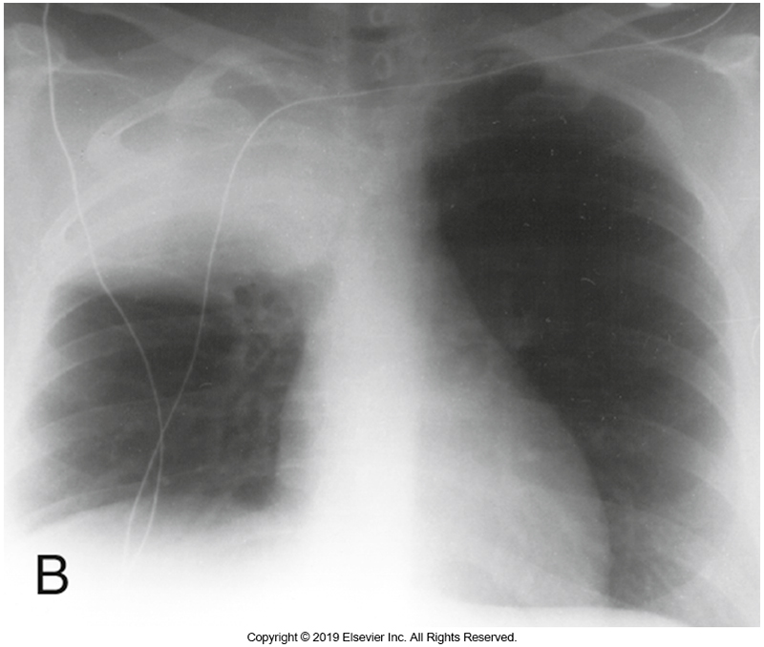
Chest Radiographs Without (A) and With (B) CAP

Slide 117
CAP Complications
Parapneumonic effusions (PPEs)
The accumulation of fluid in the pleural space caused by inflammation from the parenchymal lung infection
Less severe instances resolve with antimicrobial therapy.
If patients become heavily infected, empyemas form.
Collections of purulent fluid in the pleural space that require drainage.

Slide 118
CAP Complications (Cont.)
Respiratory failure
Including the need for mechanical ventilation
Acute respiratory distress syndrome (ARDS)
Septic shock with multisystem organ failure
In a minority of atypical pneumonia cases encephalitis may occur.

Slide 119
CAP Laboratory Diagnosis
Therapy is usually empirical.
Hospitalized patients
Blood cultures and sputum
Molecular tests such as PCR
Antigen tests
Direct examination of sputum
10 or fewer squamous epithelial cells/low-power field (LPF)
25 or more polymorphonuclear cells/LPF

Slide 120
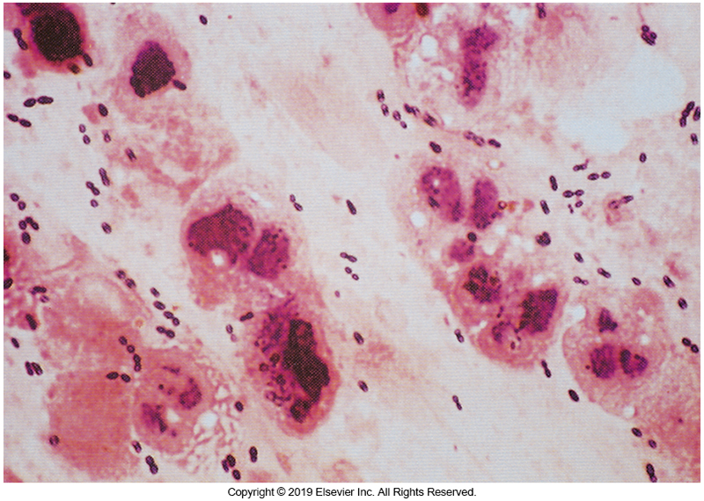
Gram Stained Sputum Smear Acceptable for Culture

Slide 121
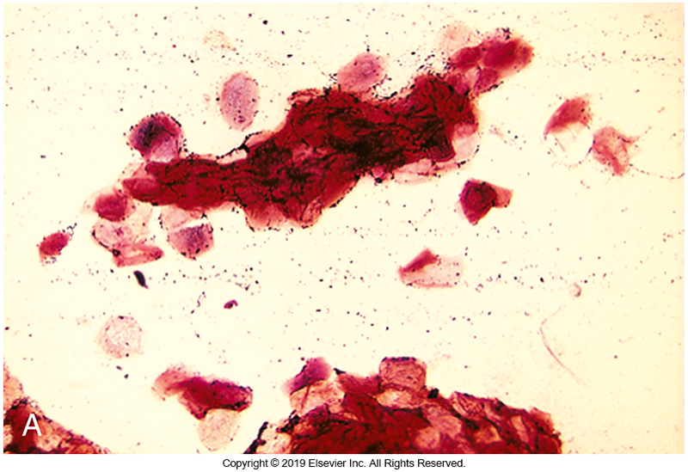
Expectorated Sputum

Slide 122
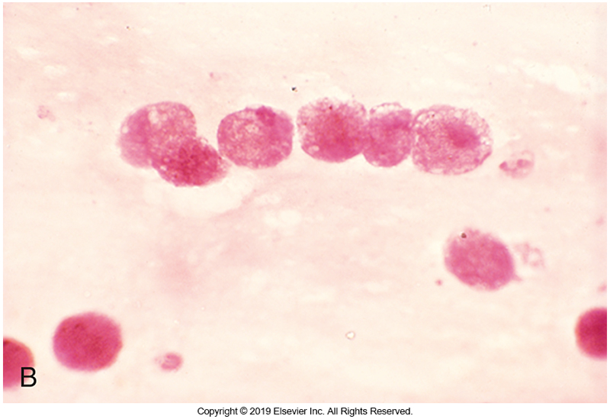
Aspirated Sputum

Slide 123
CAP Laboratory Diagnosis (Cont.)
More invasive methods
Tracheal needle aspiration
Rarely used
Bronchoscopic methods
For patients who require mechanical ventilation
Also used in cases of refractory or recurrent pneumonia when empiric therapy is in doubt
Legionella cases challenging to diagnose from sputum or bronchial aspirates
Requires special media
Organisms do not stain well with Gram stain

Slide 124
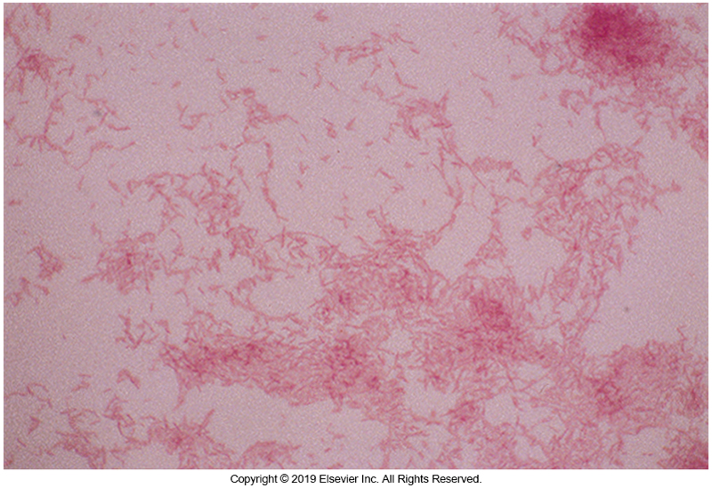
Gram Stained Smear of Legionella Species Taken From Culture

Slide 125
CAP Laboratory Diagnosis (Cont.)
Molecular diagnostic tools
PCR assays
Have been used to identify pathogens in cases otherwise negative for culture
Multiplex assays detects a variety of pathogens in one test.
Have been used to provide rapid test results to allow better targeting of therapy
Sensitivities have significantly improved.
Specificity problems do exist and as such results must be interpreted in context.
True pathogen or asymptomatic colonization?

Slide 126
CAP Laboratory Diagnosis (Cont.)
Pneumococcal pneumonia
S. pneumoniae
Biochemical tests
Bile solubility and optochin sensitivity
Used to distinguish S. pneumoniae from other α-hemolytic streptococci
Cultures from blood and pleural fluid may also contain the S. pneumonia.
Other methods, used when appropriate
PCR, urinary antigen testing, PCR

Slide 127
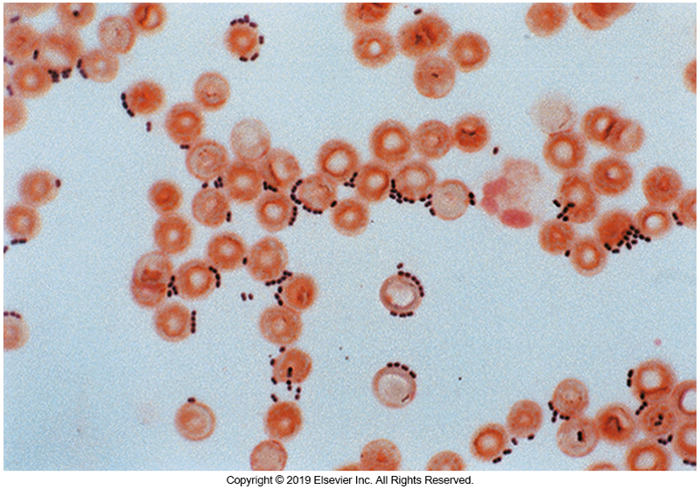
Gram-Stained Smear of S. pneumoniae

Slide 128
CAP Treatment
An initial decision about the management of CAP is whether the patient should be hospitalized or can be treated as an outpatient.
A commonly used index can be used to make this determination.
CURB-65 criteria and Pneumonia Severity Index (PSI)

Slide 129
CAP Treatment (Cont.)
The potential of drug-resistant pneumococcal infection must be considered.
Treatment varies with each patient and several factors must be taken into consideration including
Patient’s age
Duration of illness
Contraindications

Slide 130
CAP Treatment (Cont.)
Patient scenario | Example treatments
ICU Patient with suspected Pseudomonas or community-acquired MRSA | Empiric therapy should be modified to cover these pathogens
Most cases of pneumonia in young children | Viral in nature and thus antimicrobial therapy is not recommended
Young children with pneumonia when antimicrobial therapy is warranted | Amoxicillin or ampicillin third-generation cephalosporins
Patients diagnosed with influenza A and B | Antiviral therapy

Slide 131
Hospital-Acquired (HAPs) and Ventilator-Associated Pneumonias (VAPs)
Definitions
HAP
Pneumonia acquired 48 hours or more after hospital admission and not associated with mechanical ventilation
VAP
A pneumonia episode diagnosed at least 48 hours after airway intubation and initiation of mechanical ventilation
Nosocomial
Originating in a hospital
Aka healthcare-associated infection

Slide 132
HAPs and VAPs Epidemiology and Causes
Epidemiology
VAP occurs in 10% of patients requiring mechanical ventilation more than 48 hours. Carries substantial morbidity and mortality risk.
Causes
Great risk of multidrug-resistant pathogens (MDRPs)—examples include
Pseudomonas aeruginosa, Klebsiella pneumoniae, Acinetobacter baumannii, MRSA, Klebsiella spp., Enterobacter spp., E. coli

Slide 133
HAPs and VAPs Pathogenesis
Acquired from patient’s own respiratory biota, GI tract, or hospital microbiota
Aspiration of bacteria
Intubation of the lower airway
Bypasses the normal mechanical defenses provided by the glottis and cough reflex
Nasogastric intubation
Interferes with glottic function
Increased reflux of gastric secretions into the oropharynx

Slide 134
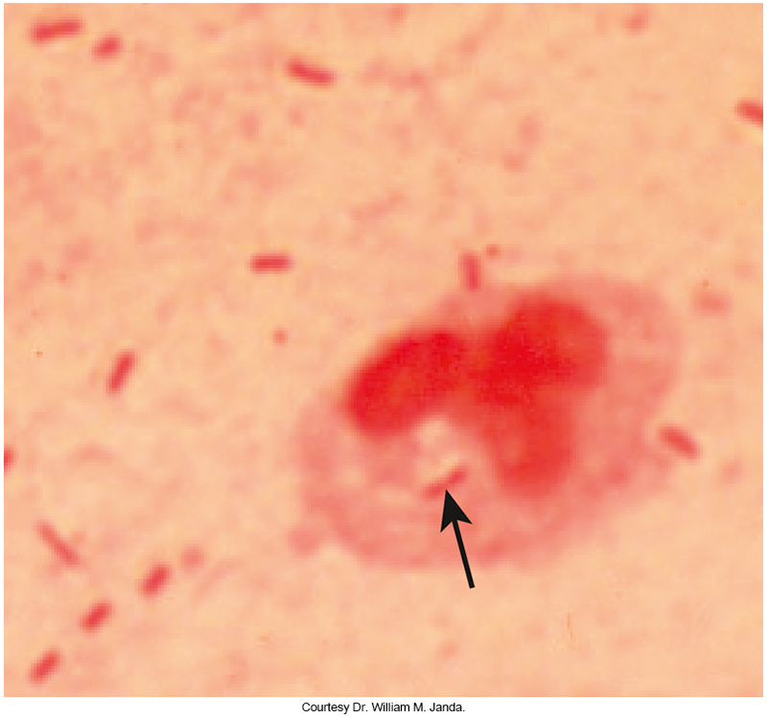
Gram Stain of Gram-Negative Bacilli in a Tracheal Aspirate

Slide 135
HAPs and VAPs Clinical Manifestations and Complications
Clinical manifestations
A new or persistent infiltrate on chest imaging that is accompanied by any of the following
Fever
Elevated or depressed WBC count
Increased oxygen requirements
Production of purulent sputum

Slide 136
HAPs and VAPs Clinical Manifestations and Complications
Complications
Rapidly progressing pneumonia requires ventilators
Due to overwhelming infection or lung injury-ARDS
Bacteremia
If gram-negative, then possible shock

Slide 137
HAPs and VAPs Laboratory Diagnosis
Same principles for microbiological diagnosis apply as discussed for CAP.
Expectorated sputum, endotracheal aspiration, bronchoscopy, blood
Except for blood, must be a quality specimen that is not contaminated from the oropharynx
Culture
SBA, MAC, and CHOC agar
If no contamination, can perform anaerobic cultures
Nasal PCR screening for MRSA
SARS-CoV-2 testing when warranted

Slide 138
HAPs and VAPs Treatment
HAP
Antimicrobial treatment empirically with modification based on culture data and clinical response
Treatment regimens vary based on causative agent(s)
VAP bundles
Elevating the head of the bed to prevent aspiration
Weaning sedation daily to decrease time on the ventilator and prevent complete suppression of the protective cough reflex
Oral care with chlorhexidine to decrease oral colonization

Slide 139
Empyema Epidemiology
Collection of purulent fluid in the pleural cavity
Between the lung and the pleura
Epidemiology
Most empyemas occur in association with concurrent acute (CAP).
Risk factors
Advanced or very young age, male gender, debilitation, comorbid disease(s), and longer duration of symptoms prior to receiving appropriate therapy
Increased incidence in children noted after seasonal and pandemic influenza epidemics.

Slide 140
Empyema Causes
Most common pathogen isolated from empyemas in children
S. pneumoniae
Other common causes in patients with CAP
S. pyogenes
Other streptococcal species
S. aureus
Anerobic bacteria
M. tuberculosis
Main cause in hospitalized patients
Aerobic gram-negative bacilli, S. aureus

Slide 141
Empyema Pathogenesis
Usually, a consequence of extension of infection directly from the underlying lung to the pleural space.
In patients with chronic pneumonias, such as those caused by M. tuberculosis, empyema may occur as a result of rupture of an underlying cavity into the pleural space.
May complicate chest surgery or chest trauma
Provides direct route of infection into the pleural space

Slide 142
Empyema Pathogenesis (Cont.)
Untreated pneumonia results in fluid accumulation in the pleural space.
Characteristics of the empyema fluid create an environment in which elimination of offending pathogens is compromised.
The usefulness of antimicrobials in treating empyema is limited by the blood supply to the area
Reduced drug delivery, lower pH of fluid that can reduce antimicrobial activity.

Slide 143
Empyema Clinical Manifestations
Symptoms
Chest pain on affected side
Fever, chills, night sweats
Sepsis may develop
Complications
Persistent empyema is difficult to eliminate.
Unresolved sepsis
Thick encapsulation of the lung, resulting in loss of function

Slide 144
Empyema Laboratory Diagnosis
Laboratory diagnosis
Aspirates of pleural fluid collected from a thoracentesis
Evacuate the air in syringe to help isolate anaerobes
Save aliquot for special studies if needed
Testing–cell count with differential, total protein, lactate dehydrogenase (LDH) concentration, pH, direct smears and cultures for bacteria, fungi, and mycobacteria
Multiplex PCR testing for common bacteria and M. tuberculosis

Slide 145
Empyema Prevention and Treatment
Prevention
Vaccination against S. pneumoniae
Treatment
Drainage of infected fluid
Treatment with antimicrobials
Early therapy for pneumonia

Slide 146
Aspiration Pneumonia Epidemiology
Aspiration occurs when gastric or oropharyngeal contents are inhaled into the larynx or LRT.
Occurs in children and adults and more common in hospitalized patients
Risk factors
Poor oral hygiene periodontal disease
Dysphagia
Reduced level of alertness for a variety of reasons
Esophageal dysmotility disorders
Enteral feeding
Ineffective cough reflux
Use of gastric acid-blocking medications

Slide 147
Aspiration Pneumonia Causes
Community acquired
S. pneumoniae, H. influenzae, staphylococci, and Enterobacterales
Nosocomial
Predominantly gram-negative pathogens including P. aeruginosa
Possible anaerobic causes
Bacteroides spp., Prevotella, peptostreptococci, Fusobacterium spp.

Slide 148
Aspiration Pneumonia Pathogenesis
Key concepts
Factors of disease
Frequency of aspiration
Quality and quantity of material aspirated
Host defenses
Underlying disease
Immunocompromised patients
Increased risk of infection after aspiration of a bacterial inoculum
Chemical aspiration
Occurs when inhaled gastric acid causes injury
Severe inflammatory response, edema, decreased lung capacity, hypoxia

Slide 149
Aspiration Pneumonia Clinical Manifestations
Coughing while eating food or drinking liquids after an episode of emesis
Increased coughing, wheezing, hypoxia, progression to respiratory failure, fever
Aspiration pneumonia may present in a similar fashion with acute onset of fever, cough, and shortness of breath, or it may be more subtle.

Slide 150
Aspiration Pneumonia Complications
If treatment fails
Progression to a necrotizing pneumonia and lung abscess possible
Patients with lung abscesses usually
Have a longer history of illness
More subtle onset of symptoms
Have a putrid sputum
Complain of halitosis

Slide 151
Aspiration Pneumonia Diagnosis and Prevention
Diagnosis
Specimen collection methods resemble those for CAP and nosocomial infections.
Difficulty lies in determining whether therapy is warranted.
Preventative measure–oral hygiene, positional feeding

Slide 152
Aspiration Pneumonia Treatment
Treatment
Airway clearance
Oxygen and respiratory support
Treatment of bronchospasm and airway edema
Empiric therapy for community acquired aspiration pneumonia should cover similar pathogens as in the other CAPs.

Slide 153
Aspiration Pneumonia Treatment
Hospitalized patients
Broad-spectrum antimicrobials that provide coverage for aerobic gram-negative organisms
Anerobic coverage
Evaluation by a speech therapist

Slide 154
Tuberculosis and Other Chronic Pneumonias
Bacterial pneumonias usually resolve completely over a period of weeks.
On occasion, resolution is delayed.
Radiographic lung abnormalities that persist beyond the improvement of symptoms
Necrotizing processes in the lung may occur.
Some pneumonias are inherently slow in progression and chronic in nature.
E.g., mycobacterial and fungal infections of the lung

Slide 155
Tuberculosis and Other Chronic Pneumonias Epidemiology and Causes
Mycobacteria
In immunocompetent patients
Nontuberculous mycobacteria (NTM)
Immunocompromised and socially disadvantaged
M. avium complex, M. kansasii, and M. abscessus
Opportunistic fungal pathogens
Aspergillus, Cryptococcus
Fungal pathogens
Histoplasma capsulatum, Blastomyces dermatitidis, and Coccidioides immitis

Slide 156
Tuberculosis and Other Chronic Pneumonias Pathogenesis
Most organisms in this category are acquired via inhalation
Microorganism | Pathogenesis
M. tuberculosis (MTB) | Acquired when infected person coughs, sneezes, speaks
NMT (not M.Tb), Fungal pathogens | Granulomatous response in the lung Humoral and cellular responses are elicited

Slide 157
Tuberculosis and Other Chronic Pneumonias Clinical Manifestations
Symptoms vary by responsible microorganism present.
Organism | Key symptoms
Blastomycosis | Protracted cough, fevers, sweats, night sweats, others* Pulmonary mass lesion mimicking lung cancer
Histoplasmosis | *Same as above plus hilar and mediastinal lymphadenopathy

Slide 158
Tuberculosis and Other Chronic Pneumonias Clinical Manifestations (Cont.)
Mycobacterial and fungal infections are likely to be the most severe and disseminated in immunocompromised patients.

Slide 159
Tuberculosis and Other Chronic Pneumonias Complications
If late, inappropriate or failed medical intervention
Progressive debility
Respiratory insufficiency
Infection dissemination beyond the lung in immunocompromised patients
Other organ involvement
Generally, increases the morbidity and mortality of these infections

Slide 160
Tuberculosis and Other Chronic Pneumonias Laboratory Diagnosis
Mycobacterial culture of sputum remains the gold standard for diagnosis of TB.
Both automated liquid media and solid media cultures are recommended.
Kinyon or Zeihl-Neelsen staining
Rapid fluorochrome stain
MALDI-TOF for identification
NAATs

Slide 161
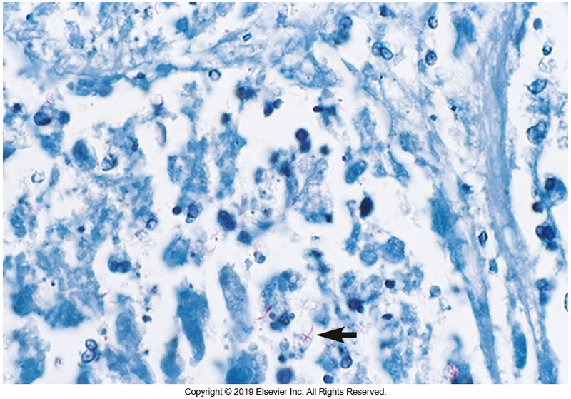
Acid-Fast Stain of Sputum

Slide 162
Tuberculosis and Other Chronic Pneumonias Diagnosis
Fungal infections–isolation in culture is the gold standard
Brain heart infusion agar with 10% sheep blood
Sabouraud’s dextrose agar
Direct microscopic exam
Potassium hydroxide (KOH)
Calcofluor white
Fungal antigen and antibody testing

Slide 163
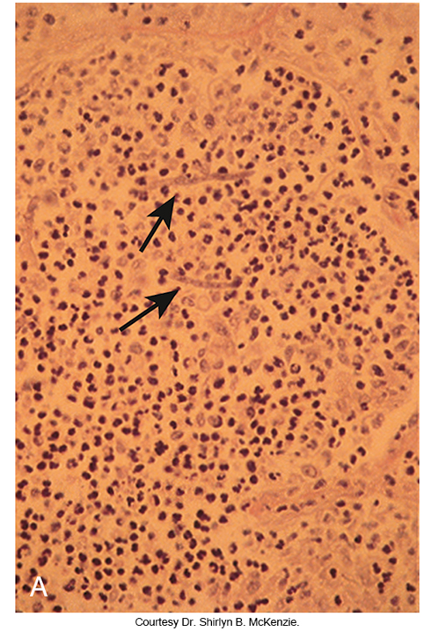
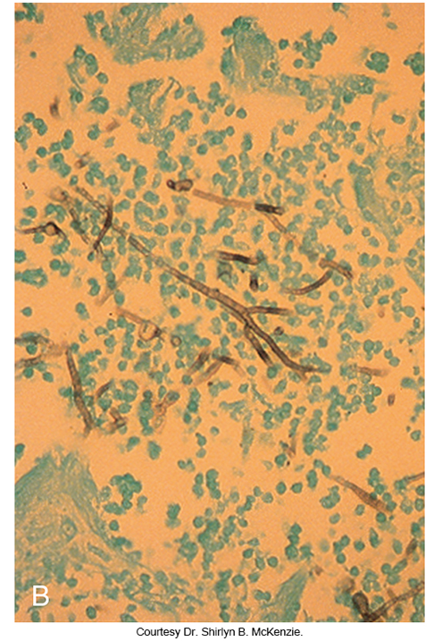
Lung Exudates From Patient with a Hematologic Disorder

Slide 164
Tuberculosis and Other Chronic Pneumonias Treatment
Treatment varies by responsible agent
Example #1: Pansusceptible tuberculosis
4-drug regimen of rifampin, isoniazid, pyrazinamide, ethambutol for 2-month induction period
Once the isolate is confirmed to be susceptible to all 4 drugs, therapy can be discontinued before…
2-drug regimen of isoniazid and rifampin for an additional 4 to 7 months
Therapy is delivered by using directly observed therapy (DOT)

Slide 165
Tuberculosis and Other Chronic Pneumonias Treatment (Cont.)
Treatment varies by responsible agent.
Example #2: Fungal infections
Severe illness–IV lipid amphotericin B preparation and then followed with an oral azole for prolonged treatment (12 to 24 months)
Mild to moderate illness-oral therapy

Slide 166
Clinical & Diagnostic Microbiology
Respiratory Infections
Respiratory Tract Infections in the Immunocompromised Patient

Slide 167
Description
Opportunistic infection (OI) pathogens
Generally, do not cause disease in hosts with normal immune system function
Require an impairment of host defense mechanisms to cause disease
Patients susceptible to such opportunistic infections are referred to as immunocompromised hosts.

Slide 168
Patients with HIV Description
Occurrence is a combined function of
The extent of underlying host immunodeficency
Pathogen virulence
CD4 cell count remains the best surrogate marker for assessing the host immune system and associated risk of infectious complications.

Slide 169
Patients with HIV Description (Cont.)
CD4 counts- high versus low
High CD4 cell counts | More likely to be caused by more virulent organisms that cause disease in immunocompetent patients. Examples: S. pneumoniae, M. tuberculosis
Low CD4 cell counts | Risks increases for infection with environmentally ubiquitous opportunistic pathogens that rarely case disease in normal hosts. Example: Pneumocystis jiroveci

Slide 170
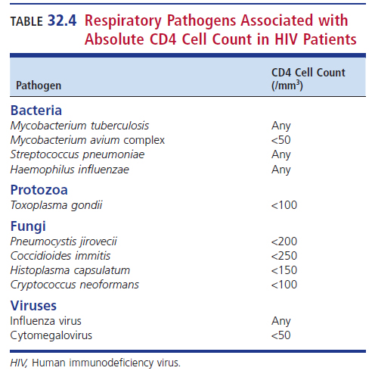
Respiratory Pathogens in HIV Infection in Relation to CD4 Count

Slide 171
Patients with HIV Epidemiology
The incidence of HIV-infected patients has significantly declined due to
Availability of highly active antiretroviral therapy (HAART) and preventative antibiotic therapy
Respiratory infections remain a common occurrence, especially in patients with very low CD4 cell counts who are not receiving effective antiretroviral therapy (ART).

Slide 172
Patients with HIV Epidemiology (Cont.)
Pneumocystis remains the most AIDS-associated common opportunistic infection
Only rarely causes clinical pneumonia in persons with advanced HIV infection in the absence of other risk factors
Patients with HIV infection with preserved CD4 cell counts still have an increased risk of several respiratory infections compared with individuals not infected with HIV.

Slide 173
Patients with HIV Epidemiology (Cont.)
Histoplasma capsulatum and Coccidioides immitis/C. posadasii are some of the most common HIV-related opportunistic infections worldwide and are a major cause of death, especially among those with advanced HIV disease.

Slide 174
Patients with HIV Example Clinical Manifestations
Pneumocystis jirovecii pneumonia (PCP)
Progressive symptoms including dyspnea, dry cough, fever.
Hypoxemia is characteristic and helps categorize the severity of disease.
Infection may involve other areas.
Lungs, skin, bone marrow, reticuloendothelial system, GI tract, CNS
Fever, weight loss, cough dyspnea, diarrhea, abdominal pain, headaches possible

Slide 175
Patients with HIV Example Clinical Manifestations (Cont.)
Bacterial pneumonias
Acute onset of respiratory symptoms
Fever, chest pain, productive cough
Coccidioidomycosis
Various presentations
Focal or diffuse respiratory disease leading to meningitis and other systemic involvement
Disseminated disease more common with advanced immunosuppression

Slide 176
Patients with HIV Example Clinical Manifestations (Cont.)
Cryptococcal pulmonary infection
Cough and dyspnea
ARDS possible

Slide 177
Patients with HIV Laboratory Diagnosis
Example specimen types
Sputum, bronchoalveolar lavage
Examples of available tests—depending on the type of infection suspected
Gram stain, acid-fast stain, direct immunofluorescent antibody (DFA), Gomori methenimine silver (GMS) stain
Acid-fast, fungal tests, bacterial culture
Antigen tests
PCR

Slide 178
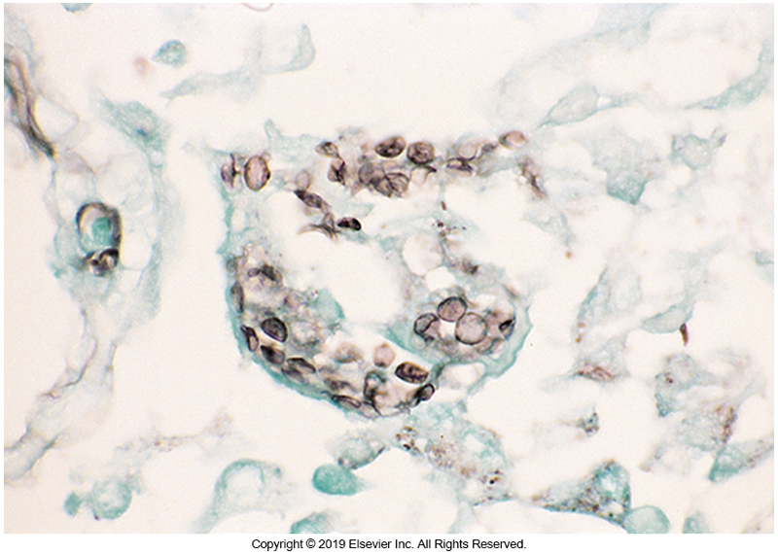
GMS Stain of Bronchioalveolar Lavage with P. jirovecii cysts

Slide 179
Patients with HIV Treatment
PCP (Pneumocystis pneumonia)
Trimethoprim-sulfamethoxazole with adjunctive steroids in patients with moderate to severe disease (depending on degree of hypoxemia)
Mechanical ventilator support may be required during therapy.
Once treatment is completed, antimicrobial prophylaxis (preferably low dose trimethoprim-sulfamethoxazole) until persistent reconstitution of the immune system occurs

Slide 180
Patients with HIV Treatment (Cont.)
Pulmonary coccidioidomycosis and cryptococcal infections
Fluconazole
Other available treatments for use as indicated
Histoplasmosis—itraconazole
Severe fungal infections—lipid amphotericin B preparations with subsequent transition to oral azole

Slide 181
Patients with HIV Treatment (Cont.)
TB
Same medications as for non-HIV-infected individuals with one exception involving drug interactions and thus adjustments may need to be made
Opportunistic infections
Start HAART, the most important strategy

Slide 182
Patients with Other Immunocompromised States
Infections in immunocompromised patients depend on the interplay of several factors.
Specific deficiencies in immune system function
Particular exposures of the patient
In the case of transplantation, the donor
Measures taken to mitigate infection risk
Including antimicrobial prophylaxis

Slide 183
Patients with Other Immunocompromised States (Cont.)
Epidemiology
Patients are at risk for all the typical infections as well as opportunistic pathogens that are not clinically significant in the presence of an intact immune system.
Example causes
S. aureus, P. aeruginosa, Aspergillus, Mucorales, Candida, S. pneumoniae, H. influenzae
H. capsulatum, Legionella, Nocardia spp., CMV, others

Slide 184
Patients with Other Immunocompromised States (Cont.)
Clinical manifestations
Patients experience the same symptoms as those who are immunocompetent.
Manifestations may be muted or atypical.
A variety of infections may occur that correspond to the microorganisms present.

Slide 185
Patients with Other Immunocompromised States (Cont.)
Examples for increase likelihood of infections
Leukemias
Reduced granulocytes
Chemotherapy damage to immune system and tissues
Transplantation complications
Graft vs. host disease (GVHD)

Slide 186
Patients with Other Immunocompromised States (Cont.)
Laboratory diagnosis
Like that used for patients with HIV and, in many cases, immunocompetent hosts
Differentiation of GVHD and graft rejection from infection is also critical.
For viremia, including CMV
Quantitative serum PCR

Slide 187
Patients with Other Immunocompromised States (Cont.)
Treatment
Similar treatments as previously indicated
Use of prophylactic antimicrobials
In general, immunocompromised patients may become worse much more quickly compared with immunocompetent hosts.
Empiric therapy is generally warranted.
Its important to identify antimicrobial resistance and risk factors for drug resistance when considering an empiric regimen.

Slide 188
Patients with Other Immunocompromised States (Cont.)
Treatment (Cont.)
Prophylactic antimicrobials to prevent PCP, fungal infections, CMV, other herpesvirus infections often used when chemotherapy is given or when transplantation is performed.
Infection control measures
Protective environment room
Handwashing
Contact precautions

Slide 189
Clinical & Diagnostic Microbiology
Respiratory Infections
Bioterrorism & Respiratory Infections

Slide 190
Historical Perspective and CDC Category A Bacterial Agents
Historic perspective
Threat of biologic agents as weapons to cause mass mortality have become increasing important in the wake of the anthrax attack in United States (2001).
CDC Category A bacterial agents
E.g., anthrax, tularemia, plague
Category A bacterial agents-pose the highest level of threat
Fulminant and rapidly fatal disease

Slide 191
Diagnostic Challenge and Handling
The greatest diagnostic challenge is clinical suspicion of these rare pathogens in the differential diagnosis of pneumonia and the related use of appropriate diagnostic studies or resources.
It is important for the clinician to discuss the possibility of these agents with the laboratory because infection can be transmitted to laboratory personnel with manipulation of the culture if it is not handled properly.

Slide 192
Handling Protocols
Importance of establishing handling protocols
To prevent infection from being transmitted to laboratory staff with manipulation of corresponding culture(s)
Send suspicious specimens/isolates to the laboratory response network facility
For confirmatory testing
Molecular diagnostic testing such as PCR

Slide 193
Points to Remember
The method and site of collection, quality of the clinical specimen, and clinical context are all important factors to consider when distinguishing between colonization and infection.
The age and immune status of the host will help determine likely infectious pathogens.

Slide 194
Points to Remember (Cont.)
The normal microbiota and specific anatomic structures play a role in defending the host from respiratory tract infection.
Virulence factors of disease-producing organisms enable them to evade host defense mechanisms, cause clinical infection, and induce tissue disease.

Slide 195
Points to Remember (Cont.)
The prevalence of different viral respiratory pathogens varies according to seasonal changes in epidemiology.
Newer pathogens such as SARS-CoV, MERS-CoV, SARSCoV-2 can cause severe and sometimes fatal illness. It is important to be aware of their existence and clinical significance.

Slide 196
Points to Remember (Cont.)
Healthcare-associated pathogens are often resistant to multiple antimicrobial agents, and it is important to have a working knowledge of local antimicrobial resistance patterns.
The occurrence of opportunistic disease in patients with HIV infection is a function of underlying host immunodeficiency and pathogen virulence.

Slide 197
Points to Remember (Cont.)
Immunocompromised patients, including those who have undergone hematopoietic cell or organ transplantation, are at increased risk for serious pneumonias caused by a wider range of pathogens (opportunistic agents) than that observed with immunocompetent patients.

Slide 198
Points to Remember (Cont.)
Awareness of potential agents of bioterrorism, as listed by the CDC, is important. Consider these uncommon pathogens on the list of possible causes in the differential diagnosis.

