Slide 1
Clinical & Diagnostic Microbiology
Ocular Infections

Slide 2
Ocular Infections
Range from relatively mild, self-limiting to more severe and sight-threatening conditions
Mild infection examples
Conjunctivitis
Blepharitis (inflammation of the eyelids)
Severe and sight-threatening infection examples
Keratitis (inflammation of the cornea)
Endophthalmitis (inflammation of the inside lining and cavities of the eye)

Slide 3
What’s Ahead?
General concepts related to ocular infections
Infections of the:
Conjunctivae
Eyelids
Cornea
Sclera and episcleral
Orbit
Lacrimal apparatus

Slide 4
What’s Ahead? (Cont.)
Infections of the:
Intraocular chambers
Retinitis
Biofilm-centered ocular infections
Laboratory diagnosis of ocular infections

Slide 5
Clinical & Diagnostic Microbiology
Ocular Infections
General Concepts

Slide 6
Visual System Components
Eyeball (globe)
Muscles
Fat
Nerves
Orbital bones
Neural pathways that carry electric impulses that are converted to vision

Slide 7
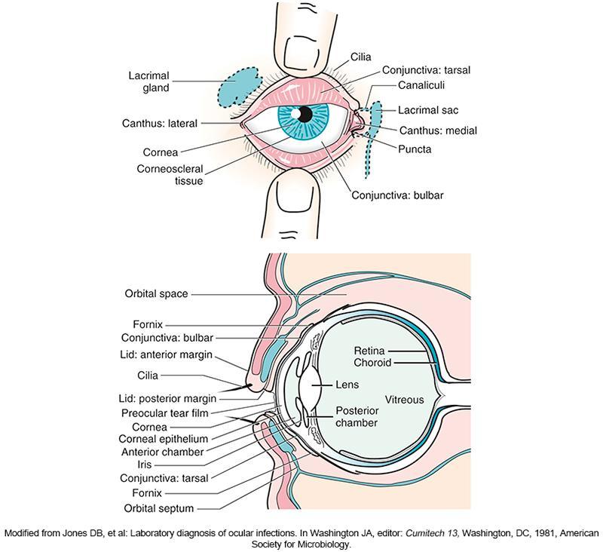
Common Ocular Structures

Slide 8
Ocular Structures
Conjunctiva
Mucous membrane covering inside lining of the eyelids and white covering of the eyeballs (sclera)
Like the membranes in the mouth and nose
Provides first line of defense against invading organisms
The tears that keep the conjunctiva moist contain many enzymes and other factors that protect the conjunctiva from microbial invasion

Slide 9
Ocular Structures (Cont.)
Eyelids
Thin elastic layers or folds of tissue that protect the structures of the orbit
Thinnest skin covering in the body
Blinking action of eyelids and conjunctivae
Helps keep cornea and sclera lubricated and sweeps away debris and potential pathogen
The eyelashes act as a filtering and monitoring system that alerts the brain to potentially harmful agents.

Slide 10
Ocular Structures (Cont.)
Cornea
Window of the eye (like a crystal on a wristwatch)
Internal ocular structures can be viewed through the cornea
Function of curved cornea surface
To refract, collect, and focus light onto the retina
Layer of tears (the tear film) blankets the cornea to provide optical clarity, lubrication and nutrition

Slide 11
Ocular Structures (Cont.)
Cornea
There are many free nerve endings located in the corneal epithelium
When there is a break in or injury to the epithelium, patient usually complains of considerable pain
Infections and injury to the cornea are considered to be true ocular emergencies

Slide 12
Ocular Microbial Biota
Primary residents
Coagulase-negative staphylococci (CoNS)
Corynebacterium spp.
Organisms that may be recovered from uninfected eyes depending on the individual’s age, season, location, underlying conditions
S. aureus, S. pneumoniae, H. influenzae, others
Other potential pathogens may be recovered from noninfected eyes

Slide 13
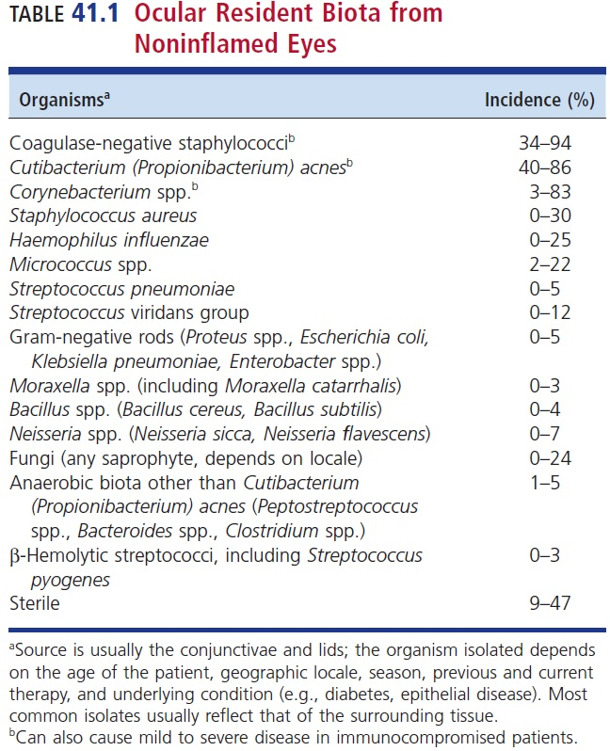
Ocular Resident Flora from Non-inflamed Eyes

Slide 14
Ocular Microbial Biota (Cont.)
The presence of a resistant biota on the conjunctivae and eyelids can be a protective mechanism
May inhibit invasion and colonization by more harmful organisms
The normal resident conjunctival and eyelid microbiota change with age

Slide 15
Ocular Microbial Biota (Cont.)
Discriminating between indigenous flora and ocular pathogens can be “blurred”
Organisms responsible for intraocular and corneal infections
CoNS, Propionibacterium acnes, and Staphylococcus aureus
The presence of biomaterials and the use of steroids, antimicrobials and contact lenses can predispose ocular tissues to infection with indigenous microbiota

Slide 16
Ocular Microbial Biota (Cont.)
Although contact lenses pose a substantial risk for eye infections, such infections are relatively uncommon in individuals wearing them.
Daily disposable contact lenses pose a lower risk of infection than reusable lenses. The presence of an unapparent biofilm poses risk.
The storage case has been cited as a source of contact lens contamination.
The antimicrobial agents used in storage solutions might not be effective against certain bacteria
Pseudomonas aeruginosa or Acanthamoeba spp.

Slide 17
Ocular Microbial Biota (Cont.)
Quantitative ocular cultures have been used to establish a threshold to differentiate between infection and colonization.
A threshold is set for each organisms.
Infection is established when the organism reach or exceed the threshold number
Keep in mind that once the epithelium of the conjunctiva or cornea is compromised, any organisms gaining entrance can result in disease
When present in any amount, indicative of infection

Slide 18
Host Protective Mechanisms
Due to location and external structures
Frequently challenged with a variety of organisms
Factors that affect whether an infection or damage ensues are
Immune status and response of the host
Integrity of the underlying tissues
Pathogenesis of the invading organism
Ocular structure defense system support mechanisms
Local and systemic; specific and nonspecific; humoral and cellular

Slide 19
Host Protective Mechanisms (Cont.)
Intact epithelium of the eyelid, conjunctiva and cornea serve as a protective barrier
Tears
Contain immunoglobulin A (IgA), lysozyme, and lactoferrin
Coats bacteria, breaks down bacteria cell wall, and chelate iron
Risk factors
Age, sex, race, socioeconomic status, behavior, geographic location, occupation, and underlying disease

Slide 20
Ocular Pathogenic Organisms Virulence Factors
Direct penetration of intact epithelium
Neisseria gonorrhoeae, Neisseria meningitidis, Streptococcus pneumoniae, Listeria monocytogenes, Corynebacterium diphtheriae
Many ocular pathogens have adhesions and enzymes that aid in adherence
Biofilm production
Protects them from immune cells and antimicrobials

Slide 21
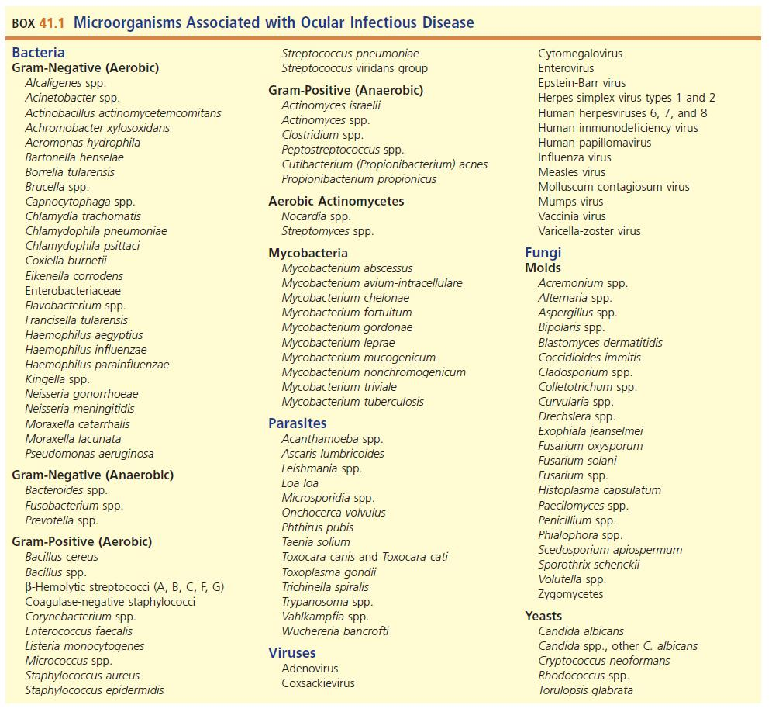
Microorganisms Associated with Ocular Infectious Disease

Slide 22
Clinical & Diagnostic Microbiology
Ocular Infections
Infections of the Conjunctivae

Slide 23
Infections of the Conjunctivae
The most common ocular complaint
May affect all age groups and occurs worldwide
Symptoms may include
Itching, tearing, a foreign body sensation, discharge (purulent or watery), hyperemia, increased blood flow resulting in red eye

Slide 24
Infections of the Conjunctivae (Cont.)
Onset categories
Acute
Hyper acute
Subacute
Chronic
Causative agents
Viruses (most common cause of infectious form)
Bacteria (second most common cause)
Fungi and parasites (less frequently seen)

Slide 25
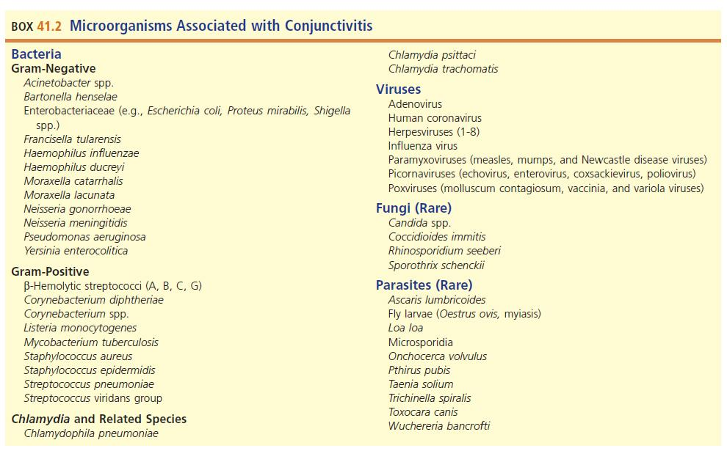
Microorganisms Associated with Conjunctivitis

Slide 26
Infections of the Conjunctivae (Cont.)
Uncomplicated acute viral and bacterial conjunctivitis is generally self-limiting and does not require treatment.
Hyper acute infections by N. gonorrhoeae and C. trachomatis should be treated.

Slide 27
Infections of the Conjunctivae (Cont.)
Chronic infections are more difficult to manage and can result in long-term ocular morbidity and compromised vision.
Majority of people with allergic conjunctivitis do not seek treatment.

Slide 28
Infections of the Conjunctivae Bacteria
Acute bacterial conjunctivitis
Adults—S. aureus, S. pneumoniae, Haemophilus influenzae
Children—H. influenzae, S. pneumoniae, M. catarrhalis
Hyperacute conjunctivitis
N. gonorrhoeae and C. trachomatis
Large amounts of exudate

Slide 29
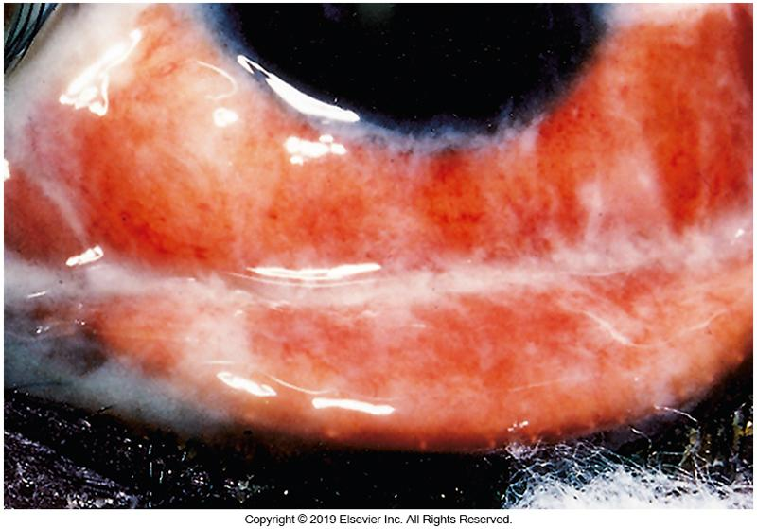
Gonococcal Conjunctivitis

Slide 30
Infections of the Conjunctivae Bacteria (Cont.)
Chronic bacterial conjunctivitis
Most frequently isolated
S. aureus, M. lacunata, enteric bacteria
Can be caused by contaminated cosmetics or medications
S. aureus, epidermidis, Corynebacterium spp., Pseudomonas aeruginosa, and Proteus mirabilis
Allergic and chemical conjunctivitis can sometimes be confused with microbial infections.

Slide 31
Infections of the Conjunctivae Bacteria (Cont.)
Specimens
Conjunctival scrapings plated on cultures and placed on slides
Collect using Kimura spatula, blade, or sterile swab
Workup guidelines
All cases of purulent, membranous, and pseudomembranous conjunctivitis should have workups.
Especially neonatal and infant infection

Slide 32
Infections of the( Conjunctivae Bacteria Cont.)
Generally self-limiting and resolve without treatment
Antimicrobial agents can reduce symptoms and prevent secondary infections.
Initial, empiric topical therapy is often sufficient.
Therapy is then adjusted based on the organism isolated and antimicrobial susceptibility testing.

Slide 33
Infections of the Conjunctivae Chlamydial Ocular Infections
Chlamydia causes several ocular infections.
Neonatal conjunctivitis
Infection occurs during birth.
Apparent with 8 to 10 days of birth
Inclusion conjunctivitis
Pharyngitis, otitis media, interstitial pneumonia in newborns
Chronic conjunctivitis with corneal involvement
Consequence of untreated or inadequately treated inclusion conjunctivitis
May lead to scarring and chronic keratitis
Blindness is irreversible

Slide 34
Infections of the Conjunctivae Chlamydial Ocular Infections (Cont.)
Chlamydia pneumoniae
Originally isolated from the conjunctiva of a child
Most adults have antibodies against this organism
Acute ocular infections are rare
Isolated most often in lower respiratory tract infections
C. trachomatis and C. pneumoniae
Can be isolated in tissue culture
Molecular detection and serology are generally used for confirmation
Treatment options
Erythromycin, doxycycline and tetracycline

Slide 35
Infections of the Conjunctivae Chlamydial Ocular Infections (Cont.)
Laboratory diagnosis
Scrapings or impression cytology
Elementary bodies
Cultures
McCoy cells, Hep-2 cells
Polymerase chain reaction (PCR), direct fluorescent antibody (DFA), enzyme immunoassay (EIA), and nucleic acid amplification tests (NAATs)
Treatment
Adults: Azithromycin or doxycycline
Neonates: Erythromycin or azithromycin

Slide 36
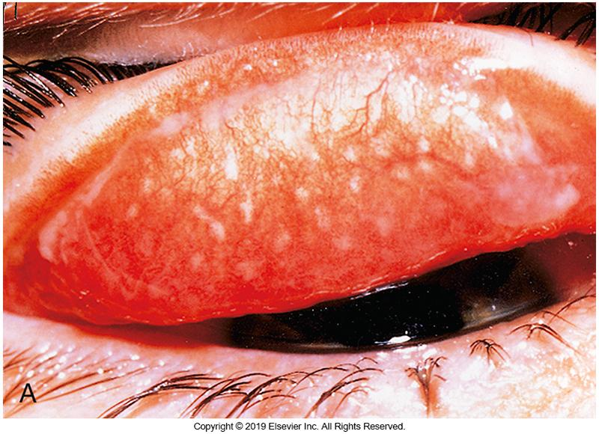
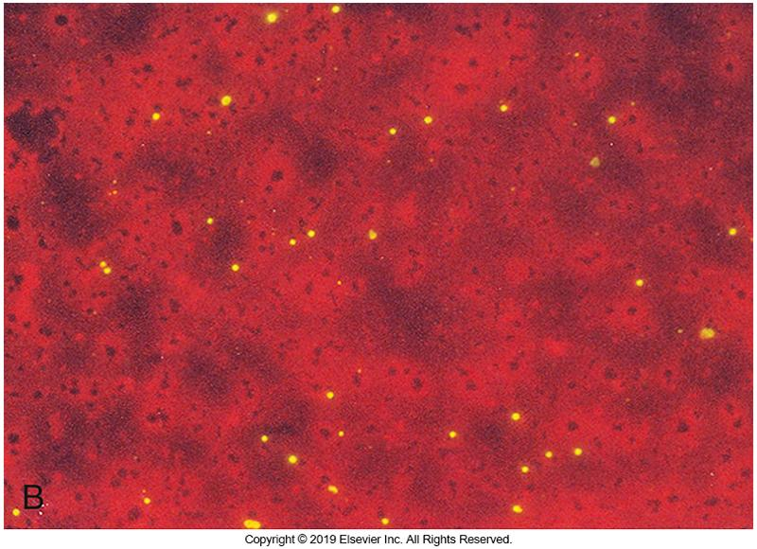
Chlamydia Organisms in Tissue and Scrapings

Slide 37
Infections of the Conjunctivae Viruses
Categories
Acute or chronic illness
Mild, self-limiting to severe destructive disease resulting in impaired vision
Nosocomial transmission
Causative agents: Adenoviruses
Contaminated fluids, fomites, or vesicular fluids
Increased risk for infection with HSV, varicella zoster virus (VZV), epidemic kerato-conjunctivitis (EKC) (infection of the cornea and conjunctiva)

Slide 38
Infections of the Conjunctivae: Viruses (Cont.)
Mainly attributed to adenoviruses, herpesviruses, enteroviruses
Adenoviruses responsible for two distinct viral syndromes
EKC- contagious and associated with types 8 and 19
Lasts 3 to 4 weeks
PCF-pharyngoconjunctival fever (PCF)
Frequently caused by type 3
Lasts about 10 days
Self-limiting, no specific treatment

Slide 39
Infections of the Conjunctivae: Viruses (Cont.)
Acute hemorrhagic conjunctivitis (a.k.a. epidemic hemorrhagic conjunctivitis or EHC)
Short-lived infection caused by enterovirus 70, coxsackievirus 24, and on rare occasions adenovirus type 11
Symptoms appear 8 to 48 hours after exposure
Pain, sensitivity to light, copious tears, subconjunctival hemorrhages
Recovery occurs 5 to 7 days
Highly contagious, patient should be isolated until the condition has resolved

Slide 40
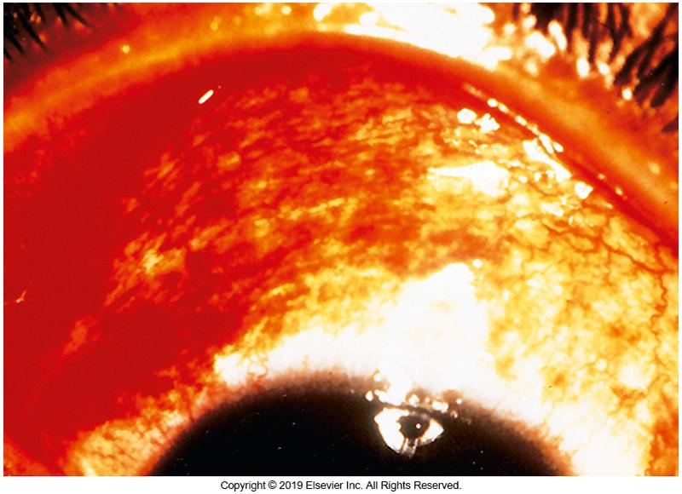
Acute Hemorrhagic Conjunctivitis

Slide 41
Infections of the Conjunctivae: Viruses (Cont.)
Herpes simplex virus (HSV) blepharo-conjunctivitis
90% caused by HSV-1
Can be HSV-2 or VZV
Treated with antiviral medications (acyclovir)
Others
CMV, EBV, chronic viral conjunctivitis

Slide 42
Infections of the Conjunctivae: Viruses (Cont.)
Laboratory Diagnosis of conjunctival scrapings
Direct stain with monoclonal antibodies
Grown in cell culture
Confirm with monoclonal antibodies or neutralization tests
NAATs
Treatment
Cold compress to reduce inflammation
Oral acyclovir/valacyclovir to treat HSV and VZV infections
No treatment for adenoviral or enteroviral infections

Slide 43
Infections of the Conjunctivae: Fungi
Relatively rare
Agents
Candida spp., Sporothrix schenckii, Coccidioides immitis, Histoplasma capsulatum, Cryptococcus neoformans
Stain and culture
Gram and Giemsa stains
Culture on routine fungal media
Treatment
Natamycin and amphotericin B

Slide 44
Infections of the Conjunctivae: Parasites
Generally rare
Onchocerciasis (river blindness)
Transmitted by bite of black flies
Laboratory diagnosis
Observe and remove larvae
Confirm ID through histologic stains, serologic tests
Treatment: ivermectin
Kills the larvae and prevents them from causing damage but does not kill the adult worms
Must be given every 6 months for the life span of the adult worms/as long as there is evidence of infection.

Slide 45
Clinical & Diagnostic Microbiology
Ocular Infections
Infections of the Eyelids

Slide 46
Infections of the Eyelids
Blepharitis and conjunctivitis are not mutually exclusive
Conjunctivitis usually presents as blepharoconjunctivitis
Any organism that causes conjunctivitis can affect the eyelids
Each site has unique organisms and conditions
Any organism capable of initiating skin infections can also cause blepharitis

Slide 47
Infections of the Lids (Blepharitis)
Bacteria
S. aureus and CoNS
Generally, inflammation resulting from infection of the seborrheic glands
Scales attached to lashes
Ulcerations can cause lashes to fall out.
Treatment
Antibiotics and medicated shampoo

Slide 48
Infections of the Eyelids Bacteria
Most frequently isolated bacteria from the eyelids
S. aureus
Coagulase-negative staphylococci
Blepharitis involving these organisms is a low-grade inflammation associated with functional disease of the seborrheic glands (seborrheic blepharitis)

Slide 49
Infections of the Eyelids Bacteria (Cont.)
Four eyelid glands
Meibomian gland
Moll gland
Zeis gland
Accessory lacrimal glands
Acute infection of glands of Moll or Zeis
When staphylococci present, results in an external hordeolum (stye)
Hot soaks assist with drainage of the abscess.
Erythromycin or tetracycline can be topically applied along with hot soaks
Notes:
49

Slide 50
Infections of the Eyelids Bacteria (Cont.)
Internal hordeolum caused by staphylococcus
Larger than a stye and affects the meibomian gland
Request for eyelid culture- rare
If received, the purpose is to confirm the presence of staphylococci and determine whether therapy is adequate
Vaccinia infection of the eyelids

Slide 51
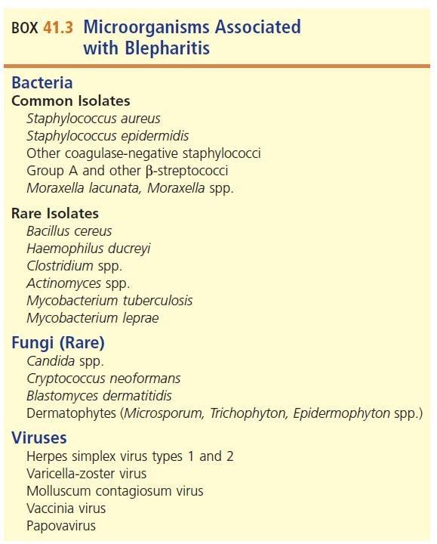
Microorganisms Associated with Blepharitis

Slide 52
Infections of the Eyelids Viruses
Viruses
HSV-1, HSV-2, VZV, poxviruses, papovaviruses
Form vesicles on the lid margins
Vesicles break, allowing secondary infection
Direct detection: immunofluorescence or immunoperoxidase can be done by scraping the base of a freshly opened vesicle
Vesicular fluids for culture
95% or more of cultures grow HSV within 72 hours or less

Slide 53
Infections of the Eyelids Viruses (Cont.)
Involvement of the eyelids
Chickenpox- vesicles may appear on the upper and lower eyelids
Poxvirus-moluscum contagiosum is a wartlike lesion of the eyelid margins
Lesion is waxy and pearly white, with umbilicated center
Squeezing of the white center to allow blood flow into the lesion is usually adequate management
Vaccinia infection-results from direct inoculation from smallpox vaccination

Slide 54
Clinical & Diagnostic Microbiology
Ocular Infections
Infections of the Cornea

Slide 55
Infections of the Cornea
Microbial keratitis
Ocular emergency
Trauma, contact lens insertion, surgery
Organisms can enter and cause infections
Risk factors for bacterial keratitis
Contact lens use
Especially those for extended wear
Trauma
Refractive surgery
Poor hygiene when handling lenses

Slide 56
Infections of the Cornea Bacteria
The most frequently recovered bacteria from patients with contact lens-associated keratitis
Pseudomonas aeruginosa
Other causative agents
Staphylococcus aureus
Mycobacterium chelonae
Mycobacterium absessus
Other rapid-growing mycobacteria
Risk factors: LASIK, trauma, contact lens use
Reservoirs: contaminated instruments, soil, water

Slide 57
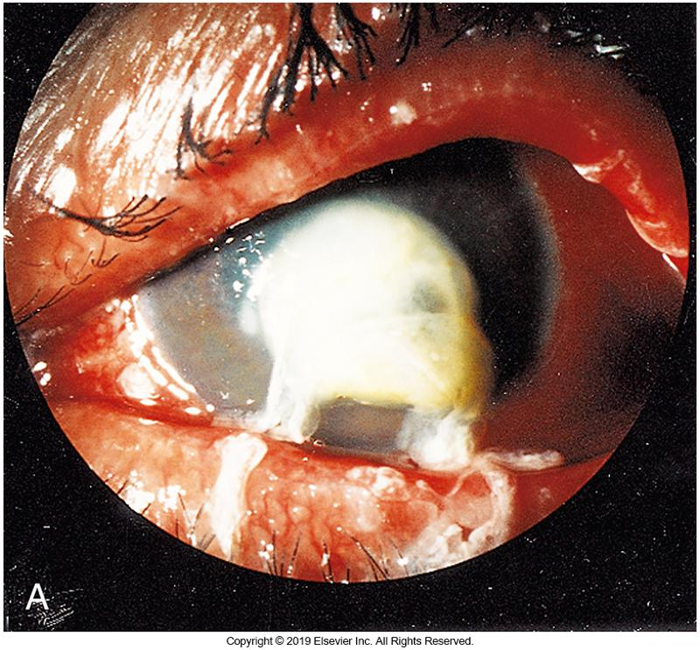
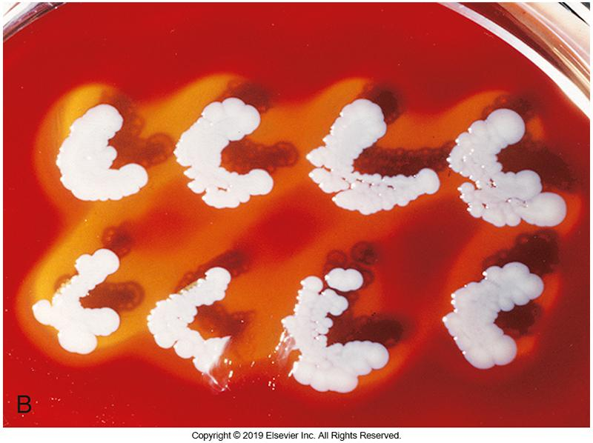
Corneal Melt by Bacterial Invasion

Slide 58
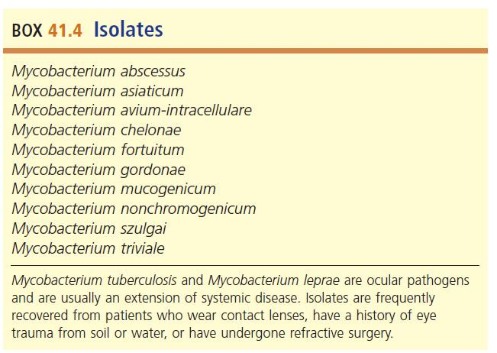
Microorganisms Associated with Keratitis

Slide 59
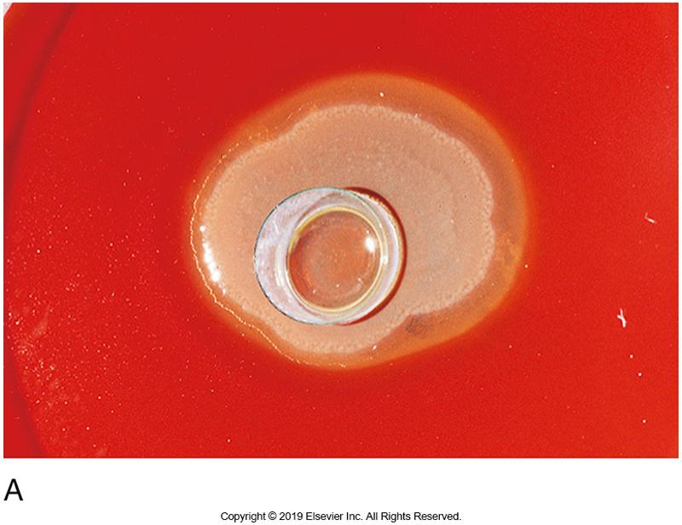
Growth of P. aeruginosa from Daily Wear (soft) Contact Lens

Slide 60
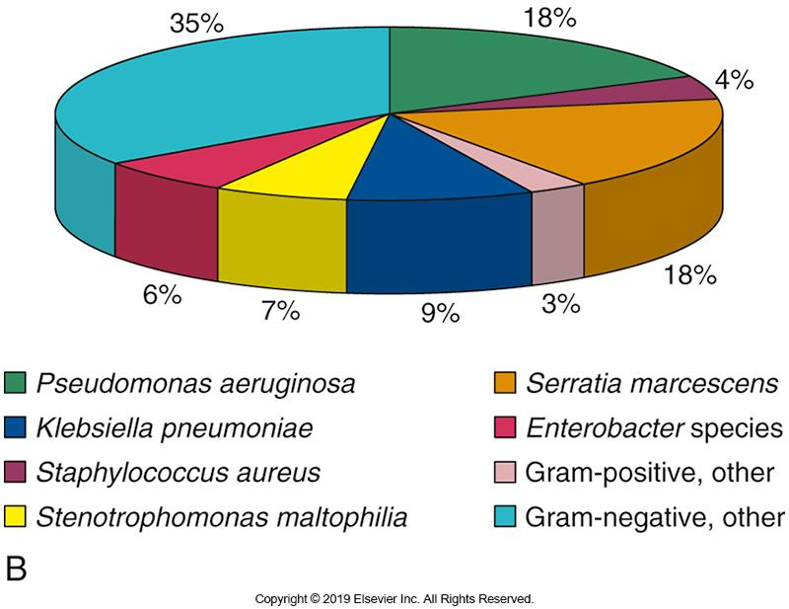
Recent Trends in Bacteria Recovered from Contact Lens and Solutions

Slide 61
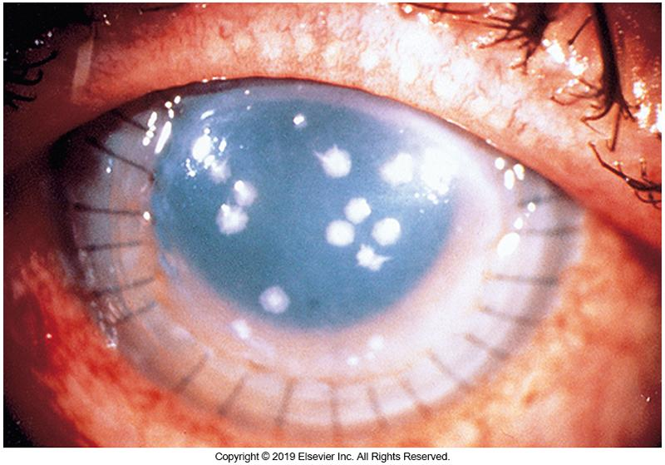
M. fortuitum Growing on Infected Corneal Graft Tissue

Slide 62
Infections of the Cornea Bacteria (Cont’d)
Bacterial Keratitis
Laboratory diagnosis
Scrapings
Direct smears
Cultures
Treatment
Often empirical for most likely pathogen
Topical antibiotic drops or ointment

Slide 63
Infections of the Cornea Viruses
HSV is the leading cause of infectious blindness and ocular morbidity in the United States.
Direct inoculation or reactivation of latent virus
Disease
Scarring and blindness result from repeated outbreaks and surgical interventions
Examples of laboratory diagnosis
Direct detection using DNA probes, PCR, cell culture, commercial kits
Treatment
Debridement, topical antivirals, and corneal transplants

Slide 64
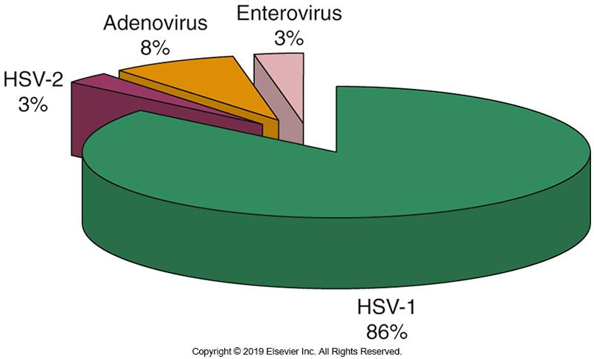
Frequency of Common Keratitis Viral Isolates in Southern Florida

Slide 65
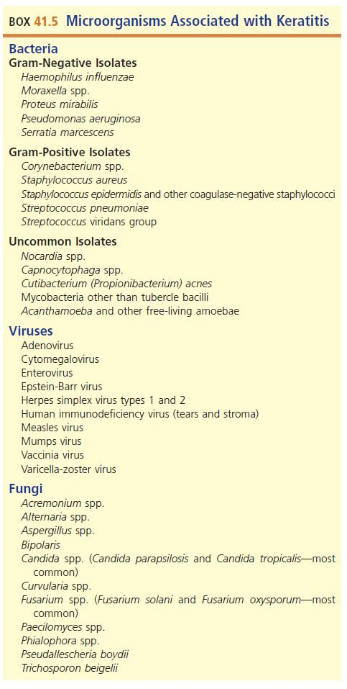
Microorganisms Associated with Keratitis

Slide 66
Infections of the Cornea Fungi
Fungi
Opportunistic infection or saprophytic organisms
Trauma with exposure to soil or plant material
Laboratory diagnosis
Scrapings of the advancing edges of the ulcer
Giemsa and calcofluor white preparations
Confirm hyphal elements and yeast
Treatment Examples
Amphotericin, natamycin, nystatin, and imidazole

Slide 67
Infections of the Cornea Parasites
Amoebae
Acanthamoeba spp., Naegleria spp., Vahlkampfia spp.
Modes of transmission
Injury or exposure to contaminated water, contact lenses, or soil
Wearing contacts in contaminated water or showering
Topping off new solution with old
Not following proper protocol in handling, disinfecting, and storing contact lenses can lead to biofilm production

Slide 68
Infections of the Cornea: Parasites (Cont.)
Laboratory diagnosis
Scrapings collected and placed on nutrient agar
Add a few drops of heavy suspension of E. coli or E. aerogenes as a food source on to plate containing nonnutrient media of 1.5% Difco agar made with Page’s saline
Drops are spread out using sterile bacteriologic loop
Ocular material added to the center of the plate and incubate
If present, acanthamoeba trophozoites will form tracts on the media surface (generated as parasites ingest the bacteria

Slide 69
Infections of the Cornea: Parasites (Cont.)
Laboratory diagnosis
Direct smears with Giemsa or calcofluor white reveal the polygonal, double-walled cysts
Trophozoites are less discernable on smears
Scrapings collected and placed into cell cultures
Molecular techniques are available for parasite confirmation

Slide 70
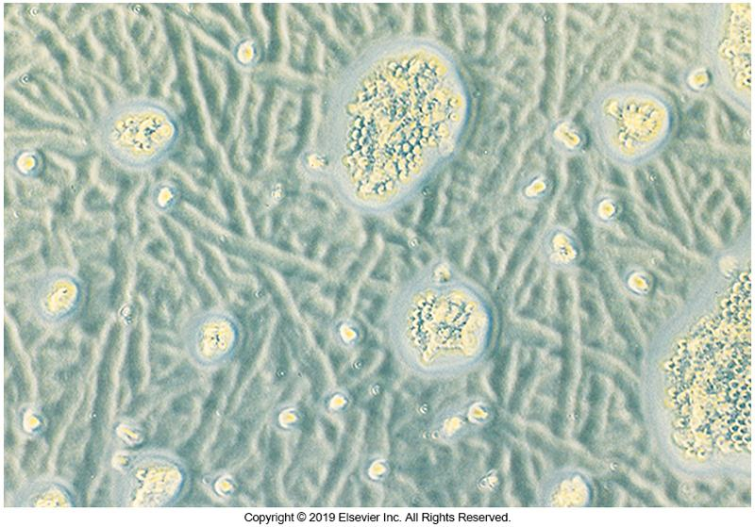
“Tracts” of Acanthamoeba Trophozoites

Slide 71
Infections of the Cornea: Parasites (Cont.)
Treatment
Debridement
Topical isethionate solution with neomycin
Corneal transplantation is often necessary

Slide 72
Infections of the Cornea Parasites
Microsporidia
Microsporidian keratitis
Emerging disease in acquired immunodeficiency syndrome (AIDS) patients
Causative agent: Microsporidium species
Round or spherical shape ranging from 1 to 20 μm in size
Usually associated with contact with bees or other species

Slide 73
Infections of the Cornea Parasites (Cont.)
Microsporidia
Obligate, intracellular
Size range: from 1 µm to 20 µm
Round or spherical
Spore-forming
Believed to be related to fungi
Ocular conjunctivae and nonocular diseases reported
Two stages: schizogenic phase and the sporulation or sporogenic phase

Slide 74
Infections of the Cornea Parasites (Cont.)
Microsporidia
Spores may be detected with hematoxylin and eosin, Gram, Giemsa, acid-fast, or calcofluor white stains
Some prefer Brown-Brenn or Brown-Hopps Gram stain
Blue or reddish against a faint yellow-brown background

Slide 75
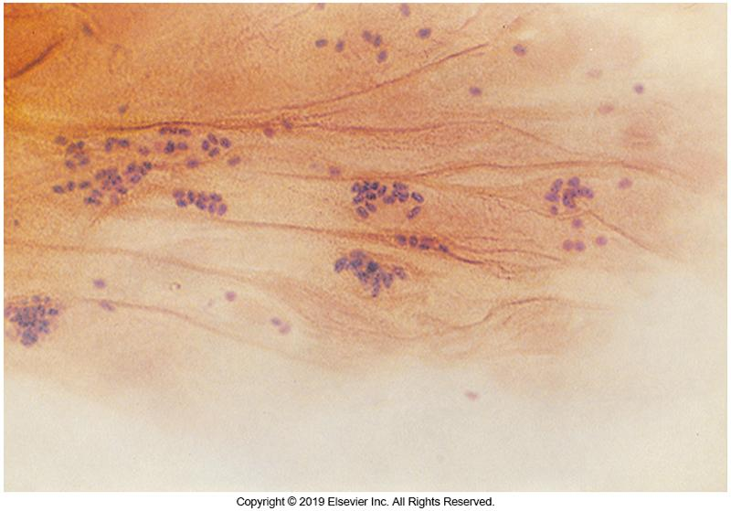
Gram Stain Revealing the Oval Cyst of Microsporidia spp.

Slide 76
Infections of the Cornea Parasites (Cont.)
Detection of ocular parasites is based on:
Observing the organism
Confirming the presence of the organism with histologic or other staining methods
Isolating the organism from blood, tissues, or body fluids
No uniform treatment is available and depends on several factors

Slide 77
Clinical & Diagnostic Microbiology
Ocular Infections
Infections of the Sclera & Episclera

Slide 78
Infections of the Sclera and Episclera
Sclera
Strong protective coat that few organisms can penetrate
Composed of tough collagen fibers
Infections are protracted, painful, quite destructive
Scleritis
Usually, a local manifestation of systemic connective tissue disease
May be acute or chronic

Slide 79
Infections of the Sclera and Episclera (Cont.)
Inflammation of the episcleral (the outer most layer of the sclera) is termed episcleritis.
Episcleritis is more common than scleritis and has undetermined cause in 70% of cases.
Laboratory diagnosis
Collection of tissue or discharge from the site
Plate on routine and special media
Treatment
Dependent on organisms present; surgical intervention may be necessary.

Slide 80
Clinical & Diagnostic Microbiology
Ocular Infections
Infections of the Orbit

Slide 81
Infections of the Orbit
PreceptaI Cellulitis
Infection of the eyelids and soft tissues surrounding the orbit
Medical emergency in children
If not treated immediately blindness and or death may occur

Slide 82
Infections of the Orbit (Cont.)
Risk factors
Trauma, lower respiratory infections, impetigo, and herpetic diseases
S. aureus, H. influenzae, S. pyogenes, and S. pneumoniae are most common bacteria in preseptal cellulitis cases.
Increased risk of invading other tissues of the eye
Treatment
Broad-spectrum coverage for the bacteria named above is recommended.

Slide 83
Infections of the Orbit (Cont.)
Orbital Cellulitis
Majority of causative agents are bacterial.
Chronic infections may be caused by
Mycobacterium spp., Nocardia spp., and Actinomyces spp.
Bacterial infections may be caused by
M. chelonae, Nocardia spp., S. epidermidis, Capnocytophaga spp., Candida parapsilosis, C. acnes
Other causes: any organisms that initiate sinusitis
Sometimes saprophytic fungi
Parasitic infections
Trichinella spiralis (causative agent of trichinosis)

Slide 84
Infections of the Orbit (Cont.)
Laboratory diagnosis
Aspirations
Smears and cultures
Allow early indications of organism identification
Assist in treatment recommendations
Treatment
Systemic therapy should be instituted as soon as appropriate culture samples (conjunctiva, nasal, blood) are collected and should provide coverage for aerobic and anaerobic pathogens

Slide 85
Clinical & Diagnostic Microbiology
Ocular Infections
Infections of the Lacrimal Apparatus

Slide 86
Infections of the Lacrimal Apparatus
Lacrimal apparatus is comprised of:
Lacrimal glands
Accessory glands
Puncta
Canaliculi
Tear sac
Nasolacrimal duct
Disorders and infections
Caused by blockage, under- or overproduction of tears

Slide 87
Infections of the Lacrimal Apparatus (Cont.)
Dacryocystitis
Inflammation of the lacrimal or tear sac
Usually seen in infants and are associated with obstruction of the nasolacrimal sac
Symptoms
Tearing and discharge from the eye, inflamed sac, pain
Causative agents
Any organism that colonizes the nasolacrimal sac could be responsible for infection
Examples: C. trachomatis, Aspergillus, Candida, Actinomyces

Slide 88
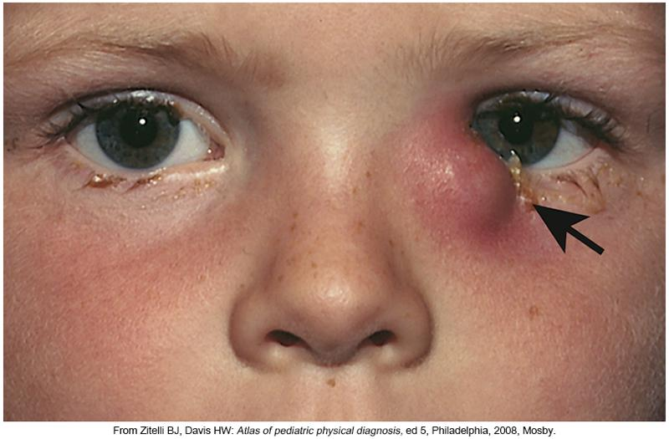
Dacryocystitis in the Left Eye

Slide 89
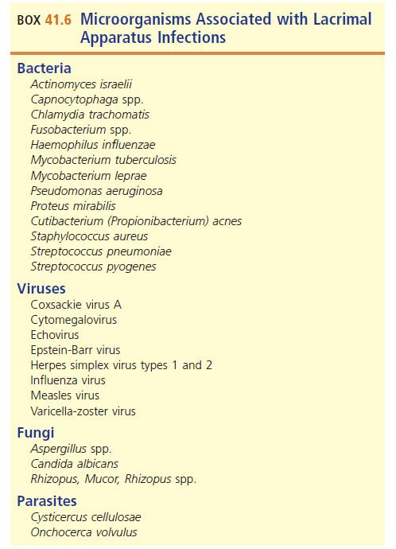
Microorganisms Associated with Lacrimal Apparatus Infections

Slide 90
Infections of the Lacrimal Apparatus (Cont.)
Dacryoadenitis
Inflammation of the main lacrimal gland
May be infectious or noninfectious
Organisms are seeded into the gland via the bloodstream.
Blunt trauma predisposes gland to infection.
Bacterial causative agents
N. gonorrhoeae, S. aureus, Streptococcus spp.

Slide 91
Infections of the Lacrimal Apparatus (Cont.)
Dacroadenitis
Other causative agents
Chronic bacterial infections of the gland involve:
TB, syphilis, leprosy, mumps, infectious mononucleosis
Subclinical or inapparent infections in patients with
HSV, CMV, coxsackievirus A, echovirus
Measles and influenzae

Slide 92
Infections of the Lacrimal Apparatus (Cont.)
Canaliculitis
Found exclusively in adults
Low-grade inflammation that affects the lower canaliculus
Purulent, cheesy material expressed from the lumen
Etiologic agents are diverse.
Bacteria, fungi, and viruses
Predominant aerobes—S. aureus, streptococci
Other species recovered include
Actinomyces israelii, C. albicans, Aspergillus spp., P. acnes, Nocardia, Fusobacterium
HSV and VZV may inflame the canaliculi

Slide 93
Infections of the Lacrimal Apparatus (Cont.)
Laboratory diagnosis
Specimens
Drainage material, pus, cheesy exudate
Direct smears
Culture media for aerobic and anaerobic bacteria and fungi

Slide 94
Clinical & Diagnostic Microbiology
Ocular Infections
Infections of the Intraocular Chambers

Slide 95
Infections of the Intraocular Chambers
Endophthalmitis
Inflammation of intraocular tissues or cavities
A catastrophic complication of
Surgery, contiguous spread of infection from infected tissues, use of contaminated medications, penetrating ocular trauma
Other causes
Installation of contaminated eye drops and implantation of contaminated bio-materials
The most serious and sight-threatening of all ocular infections
Notes:
95

Slide 96
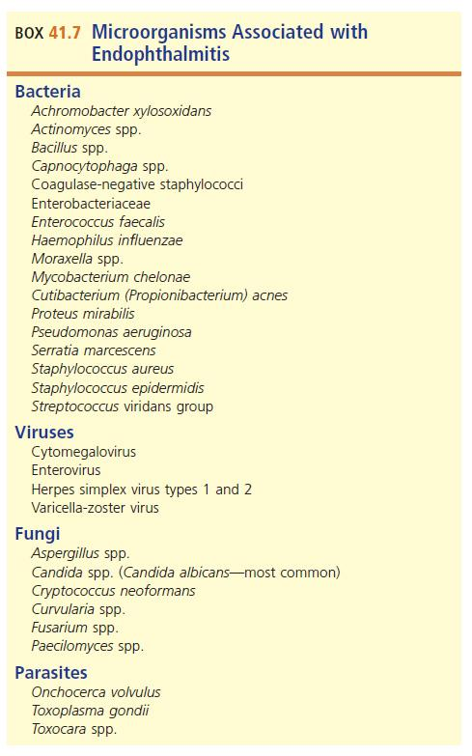
Microorganisms Associated with Endophthalmitis

Slide 97
Infections of the Intraocular Chambers (Cont.)
Laboratory diagnosis
Requires rapid recovery and identification
Early specific aggressive therapy
Specimens
Aspirated anterior chamber or vitreous fluids
Washings from the flushing of vitreous chamber
Specimen volumes are typically small
Care should be used when handling these samples to ensure that all media and stains can be done on the small sample size
Include chocolate agar in set up

Slide 98
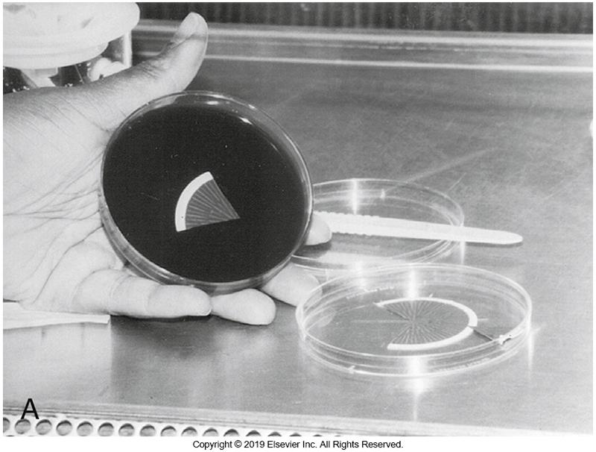
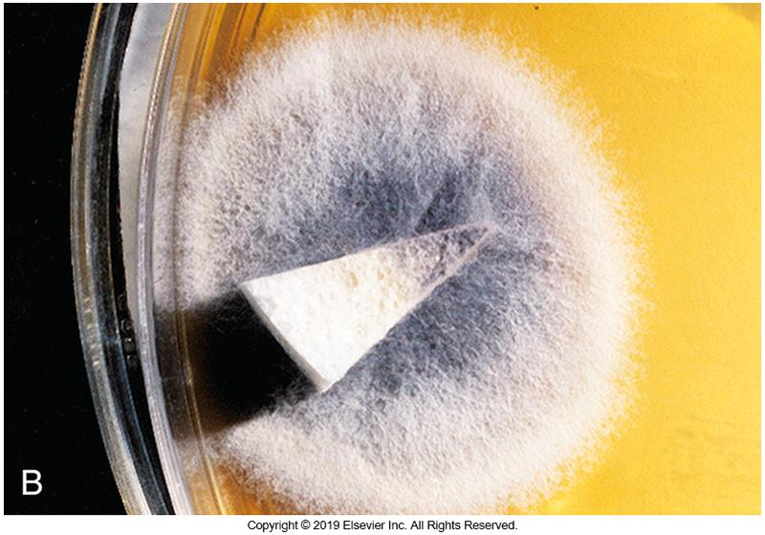
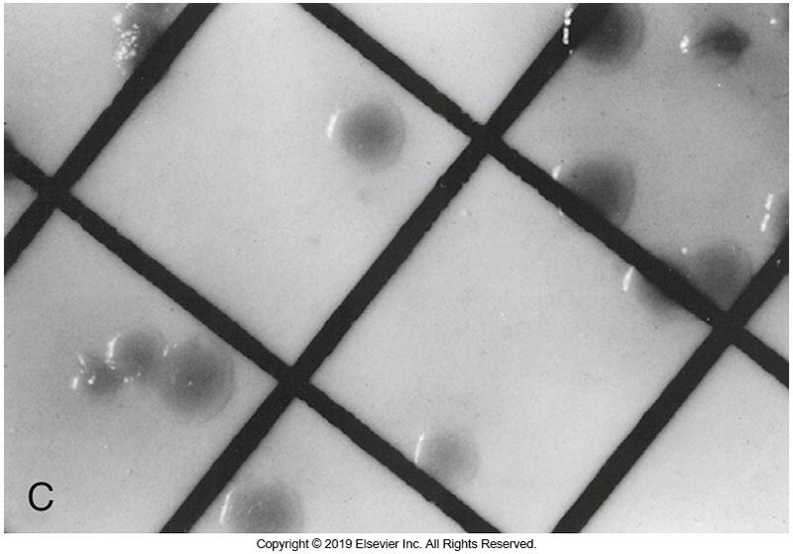
Section from Filter Used to Concentrate Vitreous Fluids

Slide 99
Retinitis
Inflammation of the retina
Often associated with viral infection
HSV, VZV, CMV
Other causative agents
Candida spp.
No ophthalmic samples are acquired
Diagnosis is made with ophthalmologic examination with possible blood cultures

Slide 100
Clinical & Diagnostic Microbiology
Ocular Infections
Biofilm-Centered Ocular Infections

Slide 101
Biofilm-Centered Ocular Infections
Microorganisms in biofilms are causative agents in a variety of ocular infections
Contact lens-associated and crystalline keratitis
Late-onset post-operative endophthalmitis
Orbital implant
Ocular keratoprosthesis
Glaucoma shunts
Ocular sutures

Slide 102
Biofilm-Centered Ocular Infections (Cont.)
Biofilms form on a variety of ocular biomaterials and/or on damaged ocular tissues
Some examples
Contact lenses, intraocular lenses, corneal and orbital implants
Common pathogens
Coagulase-negative staphylococci, S. aureus, C. acnes, C. albicans, P, aeruginosa

Slide 103
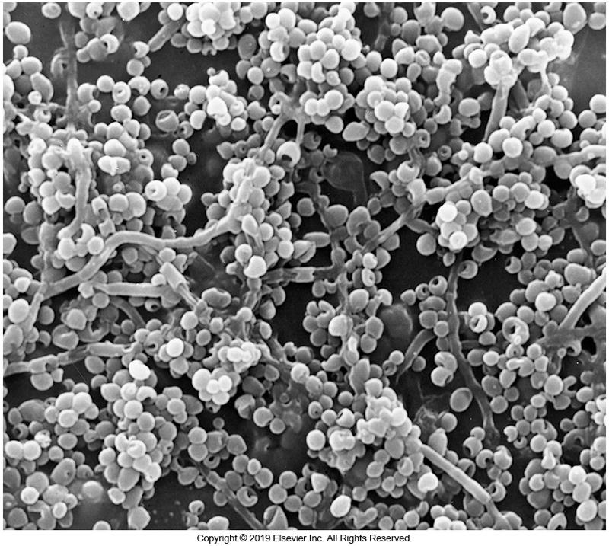
Yeast Biofilm on a Contact Lens

Slide 104
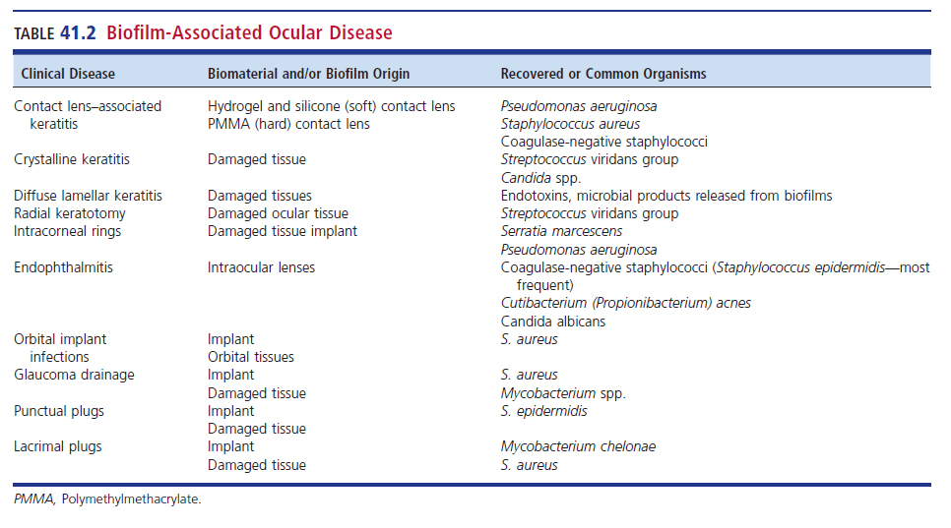
Biofilm-Associated Ocular Disease

Slide 105
Biofilm-Centered Ocular Infections (Cont.)
Effect of antimicrobial therapy
Recalcitrant (uncooperative, no response to therapy)
The sequestered biofilm-encased organisms are protected against the host’s humoral and cellular immunity.
Complications
Chronic infections
Decreased vision
Blindness
Removal of the biomaterial is often necessary to resolve the infection/inflammation.

Slide 106
Clinical & Diagnostic Microbiology
Ocular Infections
Laboratory Diagnosis of Ocular Infections

Slide 107
Specimen Collection, Culture, and Smears
Scrapings collected before treatment
Must be collected from actual site of infection
Must note if patient is a contact lens wearer
Culture
Inoculate directly onto appropriate media
If swabs use Dacron or calcium alginate swabs
Alginate swabs are toxic to some viruses.
Smears
Detect organisms present for presumptive treatment

Slide 108
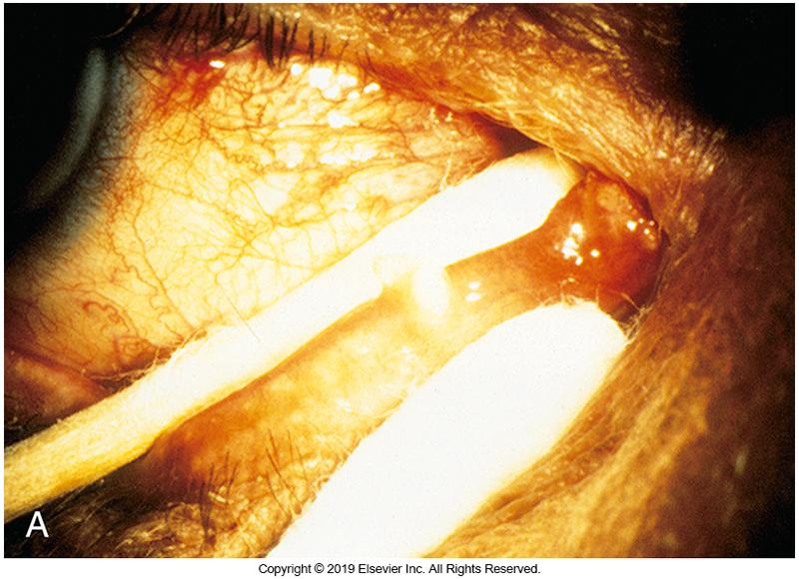
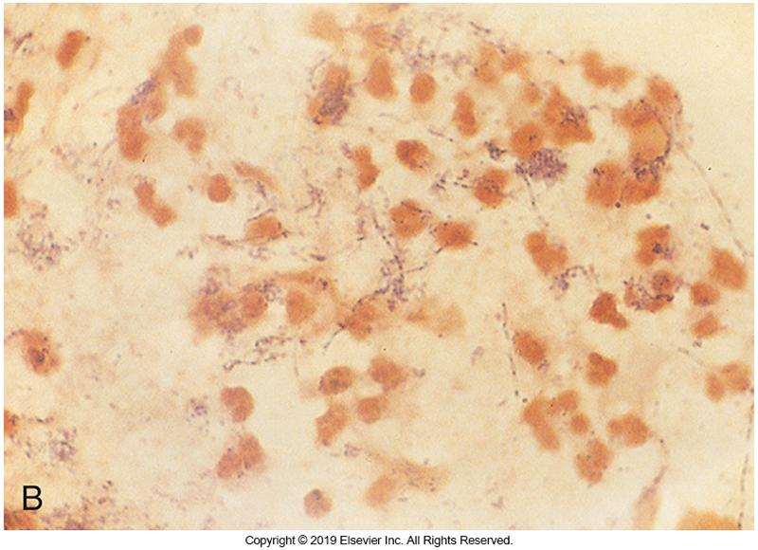
Concretions Expressed from Canaliculi

Slide 109
Direct Microscopic Examination
Scrapings, fluids, or swabs
Smear for direct examination
Stain with Gram, Giemsa, calcofluor white
Fluorescent or acid-fast stains can aid in detection of acid-fast organisms
Membranes filter large amounts of fluid collected to concentrate sample
Impression cytology
Using 0.45-µm Teflon-coated membrane filters to collect conjunctival and corneal tissue may increase causative agents by as much as 50%

Slide 110
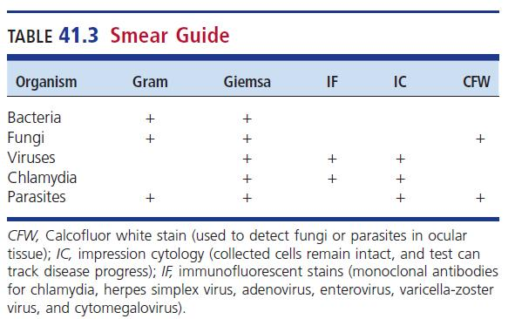
Smear Guide

Slide 111
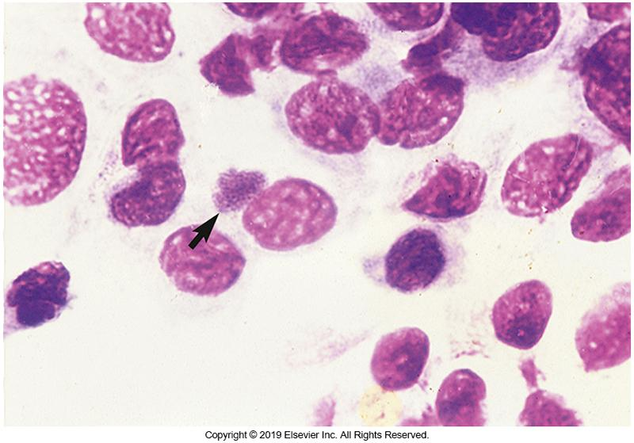
Giemsa Stain of Conjunctival Epithelial Cells with Chlamydial Inclusions

Slide 112
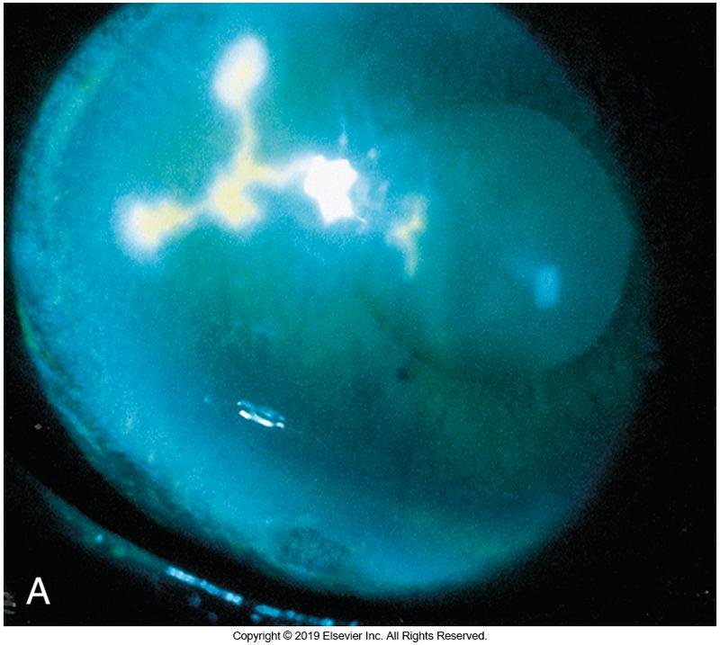
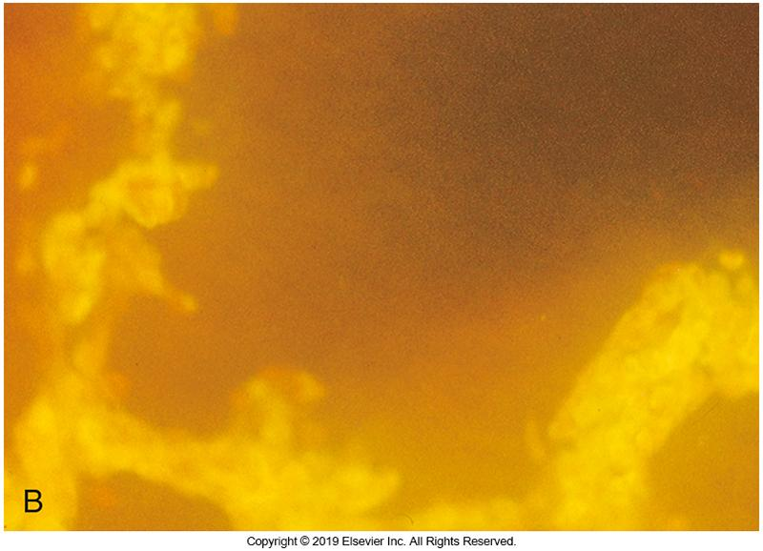
Cornea Stained with Rose Bengal

Slide 113
Culture and Identification
Plating media
Chocolate and blood agar
35 to 37° C and 5% to 10% carbon dioxide (CO₂)
Grow most fungi and aerobic bacteria
Additional media can be added depending on the suspected causative agent
Anaerobic bacteria, fungi, parasites, acid-fast organisms
Cell culture
Transport media for chlamydia and viruses

Slide 114
Culture and Identification (Cont.)
Biopsy tissue
Minced or ground
Inoculated to media to isolate aerobic or anaerobic pathogens, fungi, and mycobacteria
If amebae are suspected
Two non-nutrient agar plates should be inoculated.

Slide 115
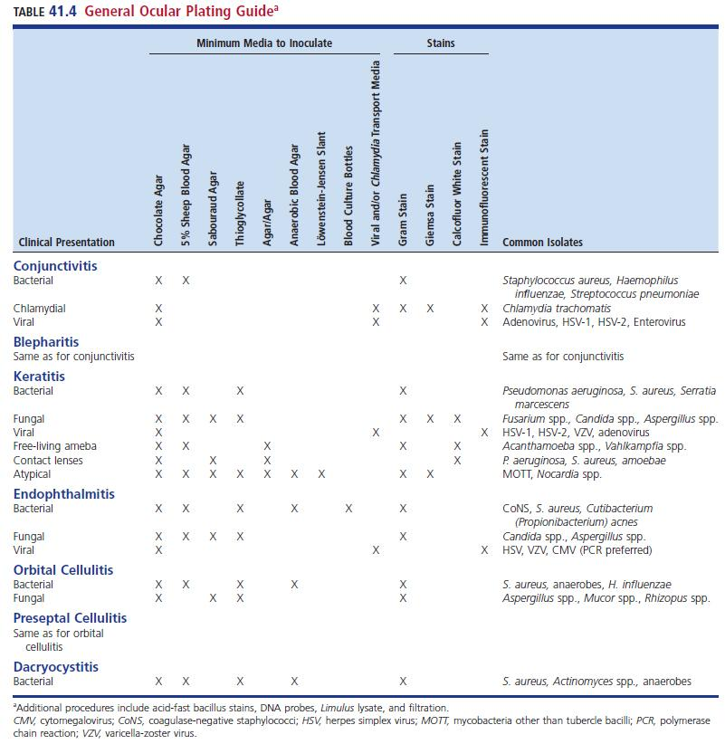
General Ocular Plating Guide

Slide 116
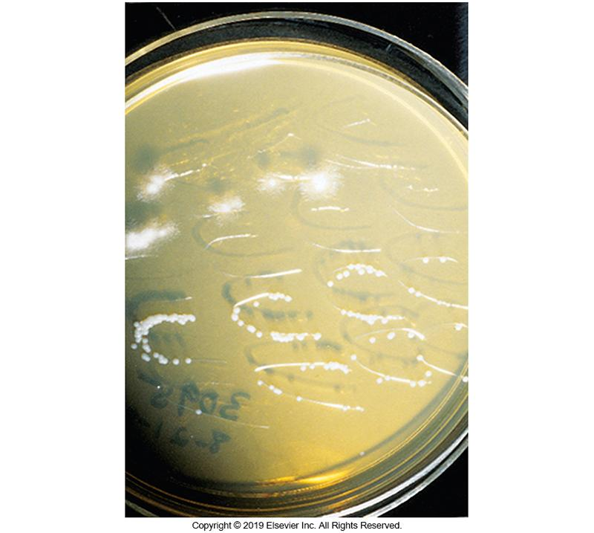
Sabouraud Plate with Mold and Yeast

Slide 117
Culture and Identification (Cont.)
Quantitation
May have reduced microbial growth due to treatment
Special considerations
C streak of cornea scrapings
Each C corresponds to a deeper level of the cornea
Approximates the depth of infection
Molecular techniques
NAATs
Ideal for small volume samples

Slide 118
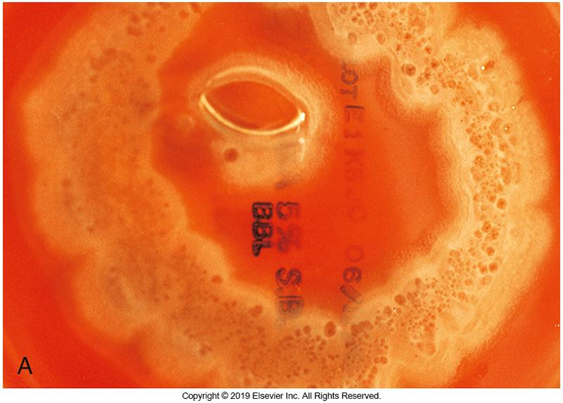
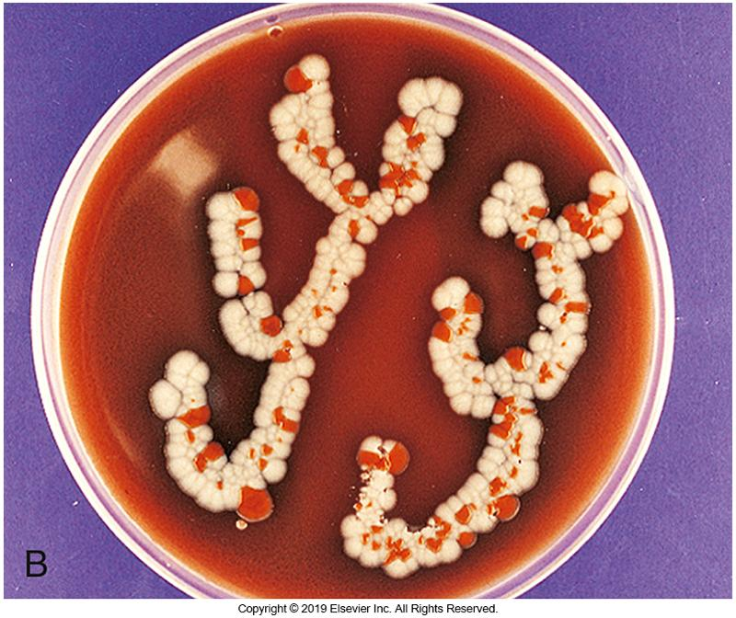
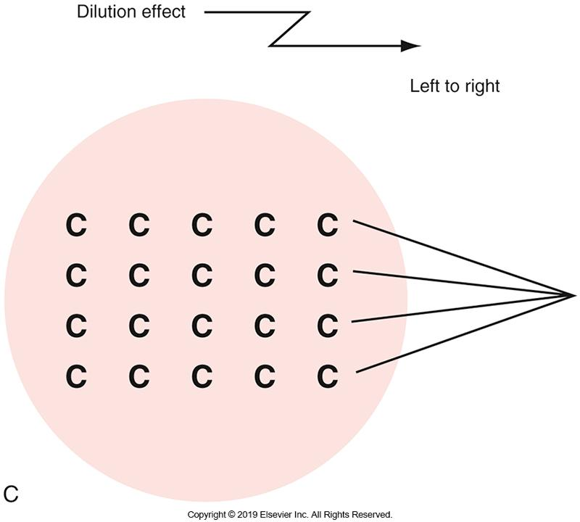
Contact Lens and Solution Containing P. aeruginosa
Notes:
118

Slide 119
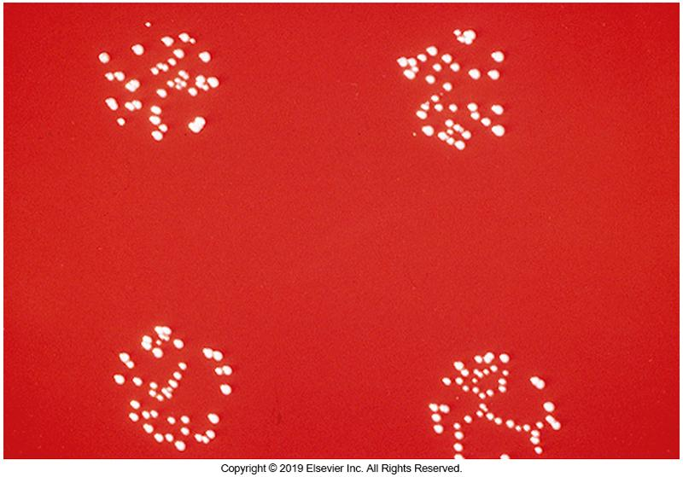
S. epidermidis Recovered from Vitreous Fluids

Slide 120
Special Culture Techniques Contaminated Ocular Medications
Ophthalmic drops are easily contaminated when improperly handled by patients or ophthalmic personnel including
Antimicrobials
Analgesics
Artificial tears
Contaminated medications should be sent to the laboratory for culture.

Slide 121
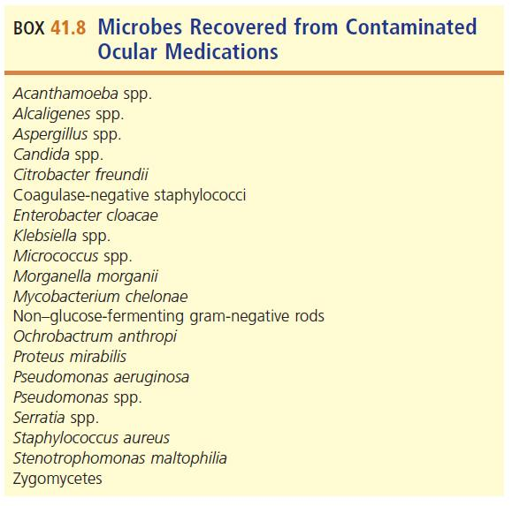
Microbes Recovered from Contaminated Ocular Medications

Slide 122
Special Culture Techniques Contact Lenses and Solutions
Risk factors for microbial keratitis
Failure to follow manufacturer’s guidelines
Poor hygiene
Prone to biofilms

Slide 123
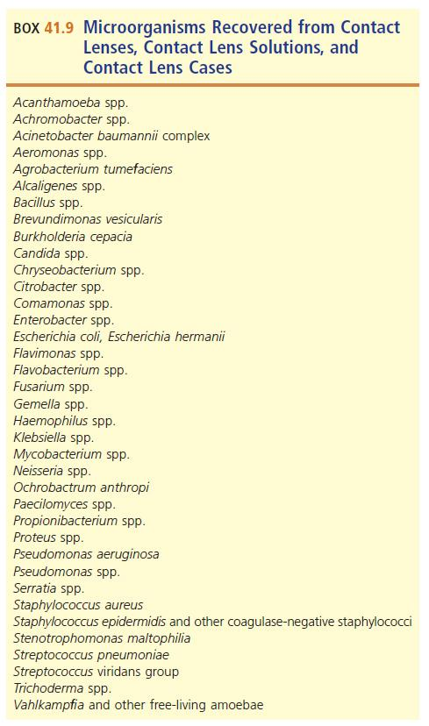
Microorganisms Recovered from Contact Lenses, Solutions, and Cases

Slide 124
Corneal Storage Media and Tissue Culture
Corneal replacement surgeries
Cadaver cornea preserved in McCarey and Kaufman or Dexsol medium
Culture remaining corneal rim
Most common pathogens
Gram-positive organisms
Most frequently isolated—Staphylococci and P. acnes

Slide 125
Points to Remember
The external ocular surface is constantly challenged by microbes.
Ocular infections may be mild or sight-threatening.
Surface defenses and an intact cornea and globe prevent invasion by most microorganisms.

Slide 126
Points to Remember (Cont.)
Any organism gaining entry to the eye can establish infection.
Inflammatory response can damage ocular structures.
Contact lens wear is considered the greatest risk factor for developing microbial keratitis.

Slide 127
Points to Remember (Cont.)
P. aeruginosa, S. aureus, coagulase-negative staphylococci, H. influenzae, and S. pneumoniae are bacteria commonly associated with eye infections.
Infections of the cornea and intraocular structures are medical emergencies.

