Slide 1
Clinical & Diagnostic Microbiology
Genitourinary Infections - I

Slide 2
What’s Ahead?
All things UTI
Anatomic considerations
Epidemiology and risk factors
Clinical signs and symptoms
Causes of UTIs
Laboratory diagnosis
Microbial detection
Interpretation of results
Susceptibility reporting

Slide 3
Urinary Tract Infections (UTIs) Characteristics
One of the most common bacterial infections
It is thought that UTIs account for up to 7 million episodes of cystitis and 250,000 episodes of pyelonephritis in the United States per year.
Accurate assessment is difficult because UTIs are not reportable diseases.
Most common presentation
Blood in the urine (hematuria)
Pain during urination (dysuria)
Increased urinary frequency

Slide 4
Urinary Tract Infections (UTIs) Characteristics
Diagnosis is typically made via
Symptoms, urinalysis, and urine culture (inpatient setting)
Symptoms and urinalysis (outpatient setting)
Two clinical schemes for classifying UTIs
Single versus recurrent episode
Complicated versus uncomplicated episode

Slide 5
UTI Classification: Single versus Recurrent Episode
 | Single Episode | Recurrent Episode
Description | UTI occurs once | UTIs occur repeatedly caused by bacteria with or without clinical manifestations.
Recurrent Relapse | N/A | Involves same causative organism; implies focus of infection in renal or prostatic parenchyma General rule–if prior UTIs within 6 months or less from current episode they are likely caused by the same organism. This can be helpful in deciding empiric treatment.
Recurrent Reinfection | N/A | Implies a different causative organism and is usually limited to the bladder

Slide 6
UTIs Affected Populations
More frequent in women than men
Anatomic differences
Older adults
Pregnant women
Renal transplant patients
Patients with spinal cord injuries
Patients with catheters
Genitourinary (GU) tract abnormalities

Slide 7
Asymptomatic Bacteriuria (ABS)
Presence of bacteria in urine in significant quantities, but without genitourinary (GU) signs or symptoms of infection
Requires treatment in only some populations
E.g., pregnant women, patients about to undergo instrumentation of the GU tract
Disease occurs when
Multiplication of organisms in urinary tract interferes with normal function of involved organ

Slide 8
Asymptomatic Bacteriuria (ABS)
Important note
Infection is defined by clinical parameters and urinalysis, not solely by quantitation or identification of microbes.
As more organisms are discovered, there may be several fastidious or unculturable microbes causing ABS and UTIs identified.

Slide 9
Clinical & Diagnostic Microbiology
Genitourinary Infections
Anatomic Considerations

Slide 10
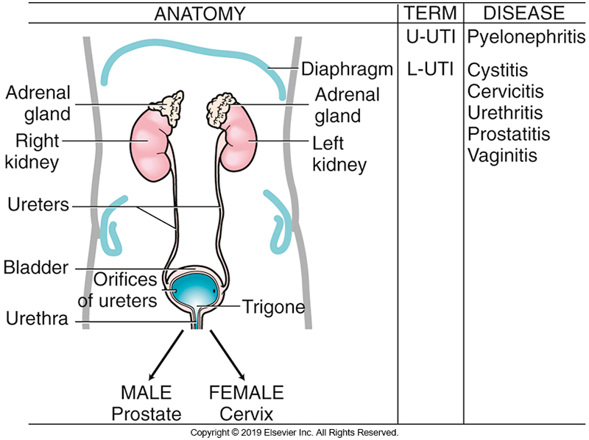
Anatomy of the Urinary Tract

Slide 11
Urine Characteristics
The urinary system is normally resistant to colonization and subsequent bacterial infection.
Urine characteristics
Extremely high osmolarity (concentration)
Low pH
Very dilute urine fails to grow most bacteria.
Men have prostatic fluid that is inhibitory.
Urine flow has a washing effect.

Slide 12
Select Anatomic Considerations “Fun Facts”
In normal conditions the urinary tract efficiently and rapidly eliminates virulent and avirulent microorganisms; this system is normally regarded as a sterile site.
The urethra can be transiently colonized by microorganisms.
Urine is frequently considered a good “medium” for bacterial growth.

Slide 13
Select Anatomic Considerations “Fun Facts” (Cont.)
Several factors contribute to the lowered resistance to urinary infection by contributing to reduced leukocyte chemotaxis and bactericidal activity of white blood cells (WBCs).
High ammonia concentration
Hyperosmolarity
Lowered pH
Sluggish blood flow in the renal medulla

Slide 14
Select Anatomic Considerations “Fun Facts” (Cont.)
Urine has been shown to inhibit the migrating, adhering, activation, and killing functions of polymorphonuclear cells.
These immunosuppressive effect can be reversed due to the presence of acid-labile mucopolysaccharides that inhibit bacterial adherence along the lining of the bladder.

Slide 15
Anatomical Considerations
The pathogenesis and course of UTIs are determined by the anatomy of the organs involved; two categories–upper and lower UTIs.
Upper UTIs [L-UTIs] & Associated Diseases | Lower UTIs [L-UTIs] & Associated Diseases
Renal parenchyma–pyleonephritis | Bladder (Cystitis)
Ureters–ureteritis | Urethra–urethritis
 | Prostate–prostatitis

Slide 16
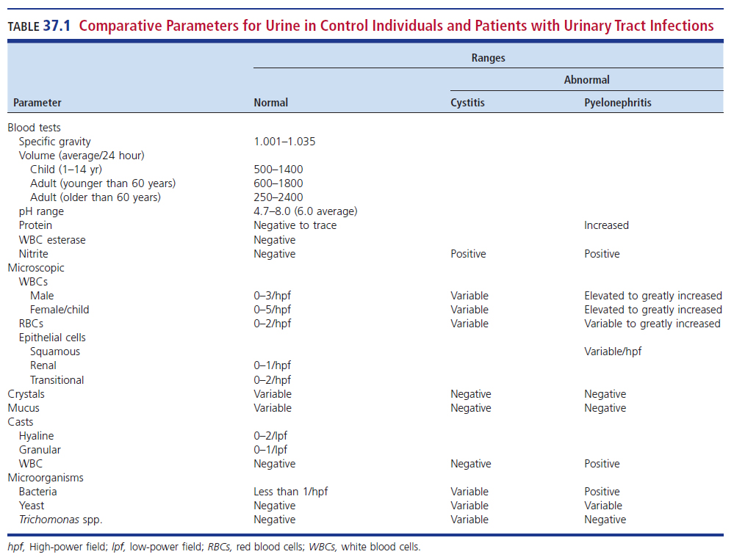
Comparative Parameters for Urine in Control Subjects and Patients with UTIs

Slide 17
Terms and Abbreviations Commonly Used for UT Diseases

Slide 18
Clinical & Diagnostic Microbiology
Genitourinary Infections
Epidemiology & Risk Factors

Slide 19
Age
Pediatrics
UTIs are associated with long-term medical problems.
Hypertension, impaired renal function
Adults to age 65
Low incidence in men unless GU abnormalities
As many as 20% of women experience UTIs
Geriatrics
Increased risk, especially with comorbidities
Increased instrumentation
Men: uropathogenic conditions caused by prostate
Women: bladder prolapse and fecal incontinence

Slide 20
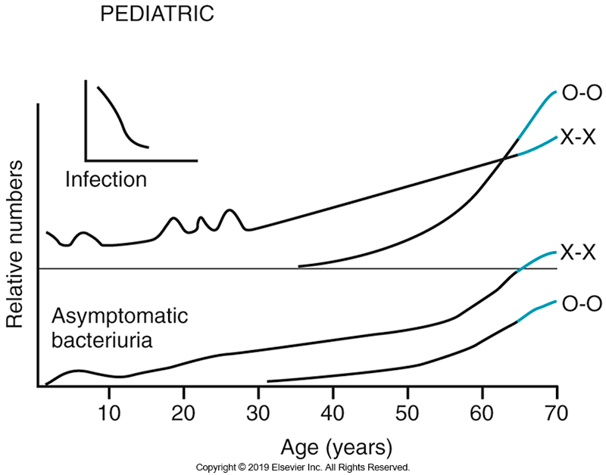
Frequency of UTIs Over Time
X-X: female
O-O: male

Slide 21
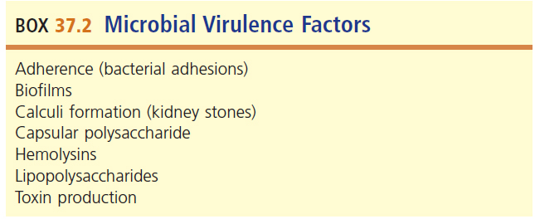
Microbial Virulence Factors

Slide 22
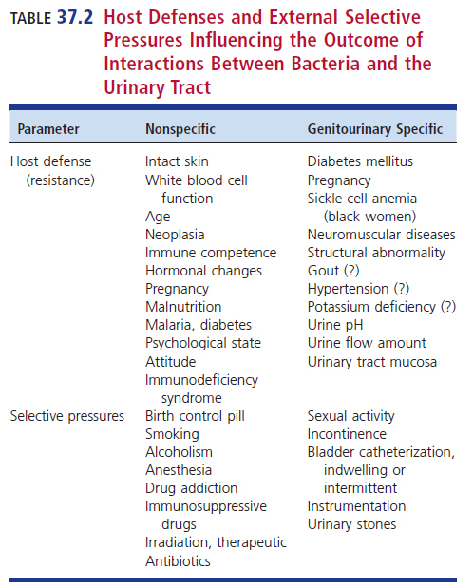
Host Defenses and Selective Pressures Influencing UTIs

Slide 23
Institutionalized Care and Pregnancy
Institutionalized care
Increase in UTIs
Urinary tract instrumentation
GU tract abnormalities (anatomic or functional)
Increase in frequency of ASB (asymptomatic bacteriuria)
Pregnancy
Physical and hormonal changes
Increase bacterial adherence and impair urinary flow

Slide 24
Renal Transplantation and Bladder Catheterization
Renal transplantation
Factors contributing to UTIs in these patients
Immunosuppression, foreign bodies, stricture, obstruction, scarring, other abnormalities, diabetes mellitus
Can lead to septicemia
Bladder catheterization
Colonization of patient through catheters
Factors contributing to UTIs in these patients
Duration of catheterization, appropriate catheter care, and host susceptibility

Slide 25
Sexually Transmitted Diseases
Sexually transmitted infections (STIs)
Involve the genital tract
Women–the anatomic proximity to the vagina
The shared tract (urethra) in males
UTIs caused by the same agents of STI
Most STIs are due to fastidious infectious agents; routine urine cultures may not recover these organisms.

Slide 26
Clinical & Diagnostic Microbiology
Genitourinary Infections
Clinical Signs & Symptoms

Slide 27
Variation in Signs and Symptoms Due to Age
Neonates and children under 2 years old
Failure to thrive, vomiting, lethargy, fever
Children older than 2 years
Dysuria, urine frequency, and abdominal or flank pain
Adults with uncomplicated lower UTIs limited to the urethra or bladder
Dysuria with frequency, urgency, suprapubic pain, and hematuria

Slide 28
Upper UTIs and Dysuria in UTIs
Upper UTIs [U-UTIs]
Flank pain, nausea, vomiting, fevers, chills, night sweats, and costovertebral angle tenderness
Most older adult patients have atypical presentation.
Dysuria may be seen in UTIs caused by:
Herpes simplex virus (HSV)
Chlamydia trachomatis
Neisseria gonorrhoeae

Slide 29
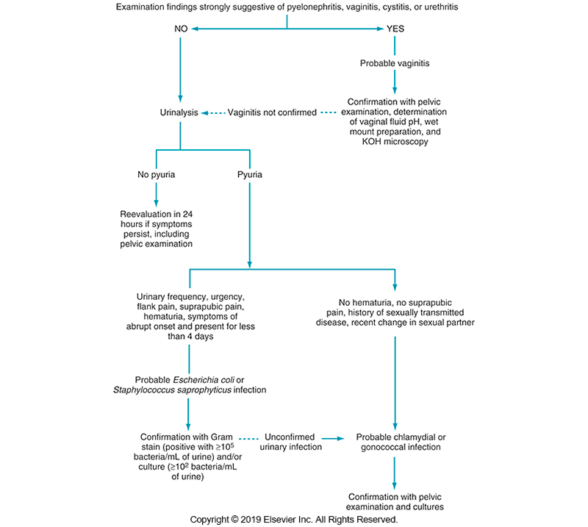
Evaluation of Women with Acute Dysuria

Slide 30
Clinical & Diagnostic Microbiology
Genitourinary Infections
Etiology of Urinary Tract Infections

Slide 31
Access Routes
Bacteria may gain access to the urinary tract by three routes
Ascending route
Main route for UTIs in women due to shorter uretha creating an environment for easy introduction via sexual intercourse
Hematogenous route
Lymphatic pathways

Slide 32
Etiology of UTIs
U-UTIs
Gram-positive bacteria, mycobacteria, fungi
Occur via hematogenous spread
Gram-negative bacteria via hematogenous spread
More difficult to assess
The ascending route is of paramount importance and is most often associated with gram-negative bacteria

Slide 33
Clinical & Diagnostic Microbiology
Genitourinary Infections
Causative Agents

Slide 34
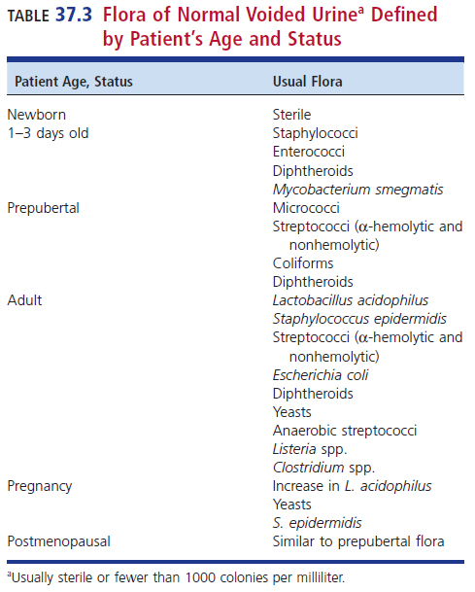
Biota of Normal Voided Urine

Slide 35
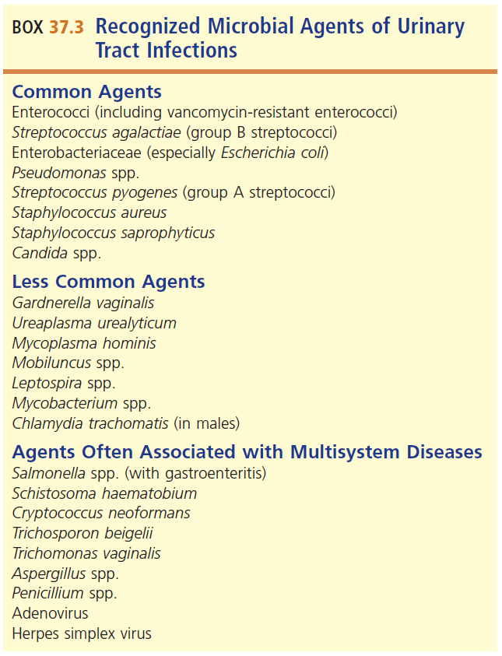
Recognized Microbial Agents of UTIs

Slide 36
Categories of UTI Causative Agents
Gram-negative bacilli
E. coli causes most uncomplicated UTIs.
Hospitalization and catheterization
Pseudomonas, Proteus, Klebsiella, Acinetobacter, and Enterobacter spp.;
Infections can be polymicrobial.
Gram-positive cocci
Group B streptococci, important in pregnancy
Enterococci, primarily in older men
Staphylococcus saprophyticus
Sexually active women under 40 years
Staphylococcus epidermidis, Staphylococcus aureus

Slide 37
UTIs Caused by Coagulase-Negative Staphylococci

Slide 38
Other Causative Agents
Gram-positive bacilli
Bacillus spp. are almost always contaminants
Diphtheroids
Listeria monocytogenes in infants
Fungi
Candida
Rare in healthy adults
More common in hospitalized patients

Slide 39
Other Causative Agents (Cont.)
Mycobacteria
In human immunodeficiency virus (HIV)-positive patients
Chlamydia trachomatis and Neisseria gonorrhoeae
Both present with urethritis, cystitis, and prostatitis

Slide 40
Other Causative Agents (Cont.)
Mycoplasma and ureaplasma
Neonates from lower socioeconomic groups
Gardnerella vaginalis
Emerging pathogen
Adenovirus and HSV
Can cause cystitis
Viral agents associated with cystitis
Herpes simplex
Adenovirus

Slide 41
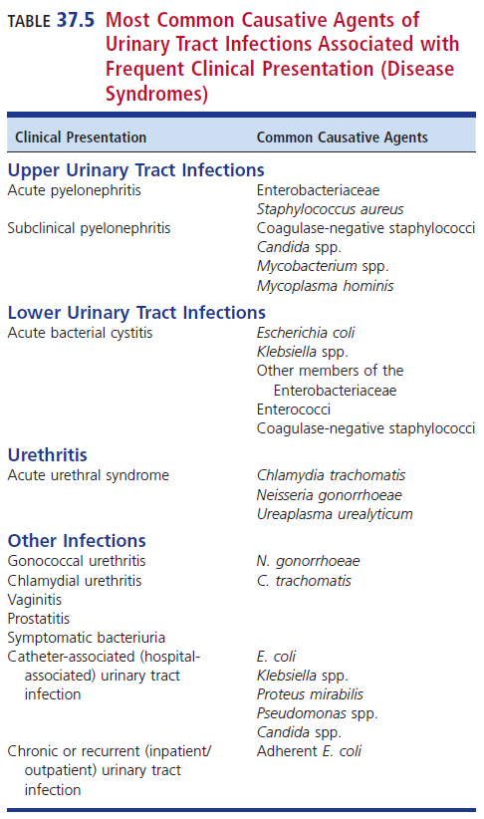
Most Common UTI Etiologic Agents Associated with Frequent Clinical Presentation

Slide 42
Clinical & Diagnostic Microbiology
Genitourinary Infections
Laboratory Diagnosis

Slide 43
Significance of Colony Counts: Historic Background
The urinary tract above the urethra in normal healthy individuals is sterile.
Vaginal biota can contaminate urine.
Organisms that colonize the vagina are also implicated in UTIs.
It is difficult to know whether urine culture growth is indicative of infection or contamination.
A series of studies done over the years focused on quantitative urine culture determination.

Slide 44
Conclusions from Clinical Studies Aimed at Determining Pyuria
Urine leukocyte count of at least 10/mm³
Occurs in less than 1% of asymptomatic, nonbacteriuric patients
Occurs in more than 96% of symptomatic men and women with bacteriuria
Symptomatic women with pyuria without bacteriuria
UTIs with counts between 10² and 10⁵ colony-forming unit (CFU)/mL or have infections with C. trachomatis, Ureaplasma urealyticum

Slide 45
Conclusions from Clinical Studies Aimed at Determining Pyuria
Women with ASB divided into two groups
True asymptomatic infection associated with pyuria
Transient self-limited bladder colonization and no pyuria
Most patients with catheter-associated bacteriuria also have pyuria.
Diagnosis requires urine culture together with other laboratory data.
Leukocyte esterase test (LET)

Slide 46
Conclusions from Clinical Studies Aimed at Determining Pyuria
Until recently, the gold standard for determining whether a patient had a real and treatable UTI was the colony count.
The thought now–colony count cannot be the only criterion. Additional criteria must be considered.
Predisposing factors, patient population, organism(s) recovered, etc.

Slide 47
Specimen Collection and Transport
Most important consideration when collecting a clinically relevant urine specimen
Prevention of contamination by
Normal vaginal, perianal, and interior urethral biota
All necessary precautions should be taken to ensure that the colony count represents the number of organisms present when specimen was collected.

Slide 48
Specimen Collection and Transport (Cont.)
Sample labeling upon receipt in the laboratory should include
Location or timing of sample collection as this information must accompany the results for proper interpretation
Specific criteria for specimen collection and transport must be in place and within the realm of responsibility, ensure that these protocols are followed.
Culture media and pathogen reporting can vary depending on the source of the urine.

Slide 49
Specimen Collection and Transport (Cont.)
Urine supports the growth of most uropathogens.
Must be immediately refrigerated or preserved–boric acid extends urine viability for 24 hours
Process within 2 hours
Due to detection of pyuria
Processing after 2 hours may adversely affect urine.
pH extremes, urea concentration, and antimicrobial agents

Slide 50
Types of Urine Specimens
Voided midstream specimen collection (clean catch)
Clean the genital area with an antimicrobial wipe
Discard first portion of urine
Collect mid-portion of urine into specimen cup
Discard the last portion of urine
Patient and healthcare team member education is paramount to the success of collecting these urine samples.
Catheterized specimen collection
Clean urethral opening or vaginal vault with a soap solution
Initial flow is discarded to reduce contamination.
Indwelling catheter
Clean port with alcohol pad
Puncture with a needle and syringe

Slide 51
Types of Urine Specimens
Suprapubic aspiration
Definitive method for collecting uncontaminated specimens
Collected primarily on infants or patients where obtaining voided urine is difficult
Antisepsis of the skin followed by needle aspiration of the bladder

Slide 52
Other Urine Specimen Considerations
Urine volume
10 to 20 mL of urine preferred
24-hour collections are unsatisfactory specimens.
Number of specimens and timing of collection
Single specimens usually suffice
First morning urine is best.
If not available, incubate urine in bladder as long as possible before collection.
Minimum of 4 hours

Slide 53
Additives
Preservatives
Help maintain colony counts similar to original specimen
Sodium borate (boric acid)
Hold integrity for up to 48 hours at room temperature
Samples should be tested within 24 hours.
Leukocyte counts may not be preserved.
Thus, difficult to determine pyuria.

Slide 54
Clinical & Diagnostic Microbiology
Genitourinary Infections
Microbial Detection

Slide 55
Specimen Screening: Rapid Nonculture Methodologies
Ideal system should work well.
High negative predictive values
Rapid and cost-effective
Preliminary reports should consist of
Identify the degree of pyuria
Presence of nitrites, blood, and/or leukocyte esterase.
Presence or absence bacteria or fungi
Preliminary results should be reported within 2 hours after the collection of a urine specimen.
Direct specimen Gram stain and urinalysis dipstick

Slide 56
Specimen Screening: Rapid Nonculture Methodologies (Cont.)
When appropriate, laboratory report should
Indicate whether additional identification methods are being used
Turnaround of additional identification methods when used
Guides to appropriate antimicrobial therapy based on in-house laboratory antibiograms tabulated over the past 6 months

Slide 57
Specimen Screening: Rapid Nonculture Methodologies (Cont.)
Key considerations when using screening methods
Bacterial densities of 10⁵ CFU/mL or higher are appropriate for the detection of ASB
False-positive results occur more often with methods that test for more than one parameter, e.g., bacteria and white blood cell (WBC) count.

Slide 58
Specimen Screening: Rapid Nonculture Methodologies (Cont.)
Key considerations when using screening methods
Methods of detecting significant pyuria and bacteriuria with sensitivities of 50 to 100 leukocytes/mm³ and 10² CFU/mL may be appropriate for screening voided urine or indwelling catheters in symptomatic patients.
Screening methods are not appropriate for urine collected by straight catheterization, cystoscopy, suprapubic aspiration, or bladder washout.

Slide 59
Manual Urine Screening Methods
Detection of bacteria when pyelonephritis is suspected
Gram staining of urine samples is debatable because of low sensitivity
It is not recommended to report the Gram stain reaction because of low sensitivity and the inability to distinguish viable from nonviable organism and pathogens from contaminates.
Gram stains can reveal presence or absence of bacteria/yeast but cannot distinguish between mono- or polymicrobial infections.

Slide 60
Manual Urine Screening Methods (Cont.)
Microscopic analysis of urine should be performed on urine concentration, and sediment analysis or cytospin technology is best.
The presence of one or more bacterial cells per oil immersion field in at least five fields in a smear of uncentrifuged urine correlates with more than 10⁵ CFU/mL.

Slide 61
Manual Urine Screening Methods (Cont.)
If uncentrifuged urine is negative for bacterial cells, the urine sediment preparation for leukocyte examination should be stained.
Bacterial cells seen in this preparation indicate a density of fewer than 10⁵ organisms /mL and the presence of clinical findings of acute pyelonephritis, may suggest urinary obstruction or perinephric abscess.

Slide 62
Various Manual Screening Methods

Slide 63
Manual Urine Screening Methods (Cont.)
Detection of pyuria
Pyuria often indicates urethritis, cystitis, or pyelonephritis.
Leukocyte detection may be performed by a urine dipstick or microscopic examination of a wet mount of urinary sediment.
Sedimented urine: leukocytes 5 to 10 WBCs/HPF (high power field) is upper limit of normal, representing at least 50,000 cell/mL
A more precise method using unconcentrated urine is using a hemocytometer.

Slide 64
Manual Urine Screening Methods (Cont.)
Detection of fungi and mycobacteria–first morning specimen recommended
Fungi suspected
Yeast readily seen and identified by Gram stain
Use calcofluor white and ultraviolet (UV) light
Detect chitin in fungal cell walls and contributes to visualization and easier identification.
Do not use cotton swabs
Calcofluor white binds to cotton and fluoresces.
Mycobacteria suspected
Acid-fast stain
Must confirm with culture

Slide 65
Manual Urine Screening Methods (Cont.)
Detection of fungi and mycobacteria
First morning specimen recommended
Large sample volumes (10 mL to 50 mL) give best results
Centrifuge urine at 2000 X g for 10 minutes
Scan sample wet mount at 100X and 400X magnifications before using 1000X
Sediment can be stained with calcofluor white and auramine stains and examined via fluorescent microscopy.

Slide 66
Manual Urine Screening Methods (Cont.)
Detection of fungi and mycobacteria
Calcofluor white stain
Binds to chitin present in the cells walls of fungi and makes visualization easier
Also binds to cellulose, which chemically resembles chitin; cotton swabs should not be used because they too will fluoresce
Quantitative colony counts are not used for fungi
Auramine stains mycobacteria.

Slide 67
Automated Urine Screening Methods
May be expensive
Frequently require batching of specimens causing time delays
Have not been adequately evaluated for their efficacy in detecting low-grade bacteruria and funguria

Slide 68
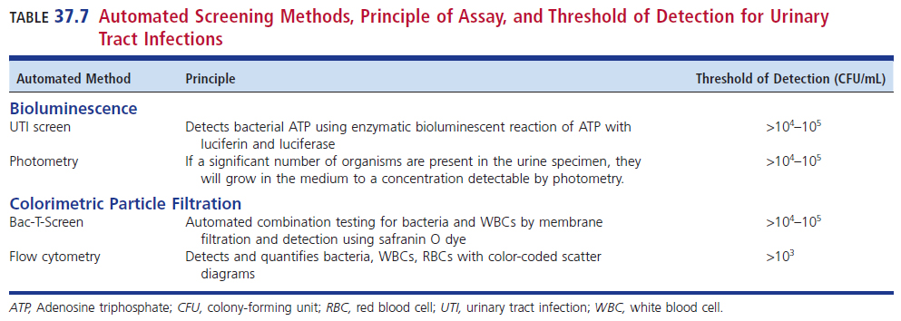
Various Automated Urine Screening Methods

Slide 69
Urine Molecular Screening and Identification Methods
Provides faster microbial identification than traditional culture techniques
Incapable of discerning organism viability
Shows promise with identification of the most common infectious organisms–E. coli
Not useful for uncommon infectious organisms
There are other drawbacks to using these methods as described in the textbook.

Slide 70
Rejection Criteria
Specimens may be rejected because of
Inadequate or inappropriate method of collection or transport.
Laboratory should inform the service or physician as soon as possible to allow for possible recollection
Specimens not appropriate for analysis
24-hour urine
Foley catheter tips

Slide 71
Culture for Etiologic Agents of UTIs
Routine culture–vary by laboratory
Plate to one nonselective and one selective medium (for gram-negative organisms)
Use calibrated loop: 0.001 mL (1 μL) or 0.01 mL
Ideal for quantitation
Incubate for 24 hours
More than 24 hours will yield background urethral biota.
This can increase cost and impair clinical usefulness.
Fastidious organisms
Require specific plating media for detection

Slide 72
Culture for Etiologic Agents of UTIs (Cont.)
Asymptomatic bacteruria (ASB)
Conventional or automated methods
Colony count should accompany any positive culture result to indicate ASB.
E. coli is the most frequently identified etiologic agent.
Pyelonephritis
Microscopic examination of urine for leukocytes and bacteria
Drop of specimen may be inoculated into trypticase soy broth (TSB) for optimal recovery.
Lower UTIs
Same processing as for pyelonephritis

Slide 73
Culture for Etiologic Agents of UTIs (Cont.)
Suprapubic aspirates
May have low numbers of bacteria and possibly anaerobes
Catheterized specimens
Inoculate agar plates for maximum recovery
Prostatic secretions
Usually recovered from catheterized specimens
Require quantitative culture for proper interpretation

Slide 74
Clinical & Diagnostic Microbiology
Genitourinary Infections
Interpretation of Results

Slide 75
Interpretations of Urine Culture Results
Colony count of a pure or predominant organism
Measurement of pyuria
Presence or absence of symptoms
Dysuria
These criteria allow physician to make final decision.
And remind the physician that specific agents may require special culture

Slide 76
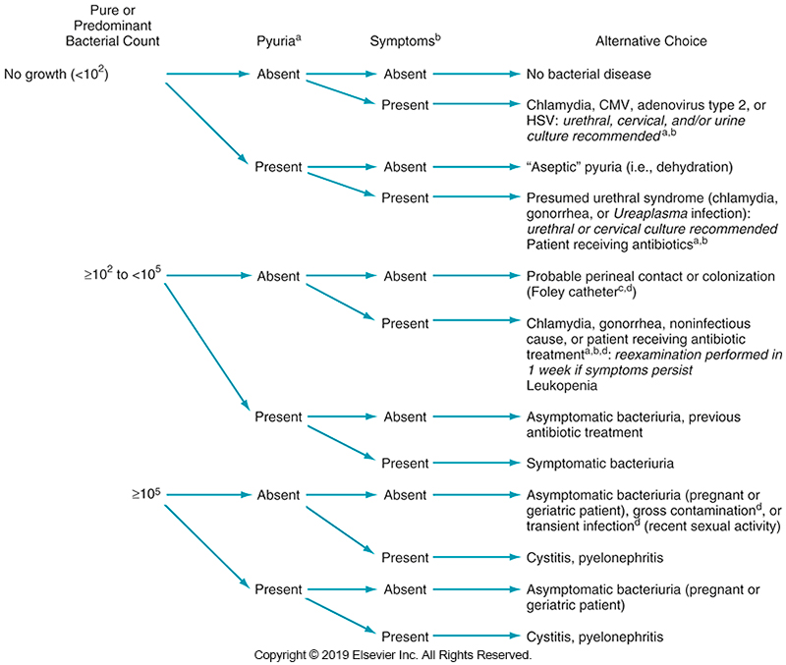
Interpretation of Urine Culture Results

Slide 77
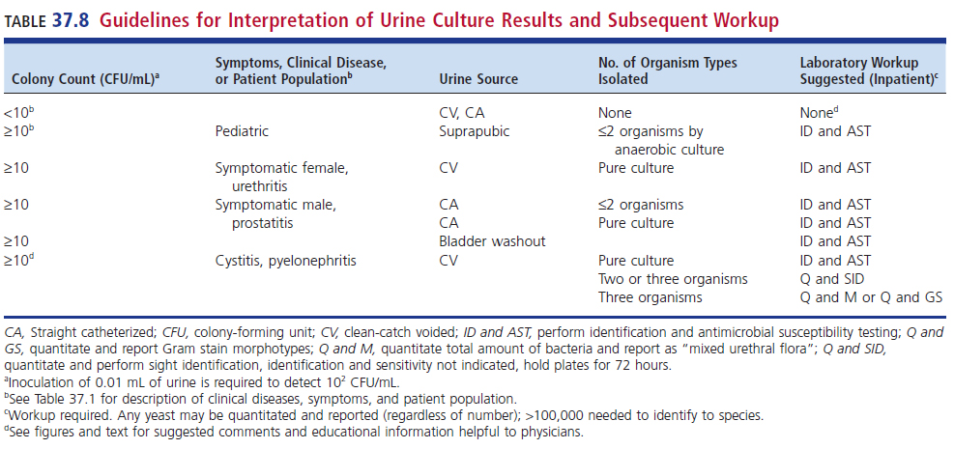
Guidelines for Interpretation of Urine Culture Results and Subsequent Workup

Slide 78
Interpretations of Urine Culture Results (Cont.)
Interpretation Guidelines
Specimens with multiple uropathogens–three or more
Probably contamination
One or two significant uropathogens
Identify
Perform susceptibility
One or two uropathogens present in small numbers
Identify if clinical situation warrants

Slide 79
Clinical & Diagnostic Microbiology
Genitourinary Infections
Susceptibility Testing

Slide 80
Susceptibility Reporting
Report only appropriate antimicrobials for UTIs
Group U supplemental for urine
Clinical and Laboratory Standards Institute (CLSI) document M100 document, updated annually
Provides interpretations of antimicrobial susceptibilities based on MIC and disk diffusion methods
Rationale
Attainable antimicrobial blood levels and urine levels are often different.

Slide 81
Urinary Tract Infection Antibiograms
A primary function of the clinical microbiology laboratory has historically been to measure antimicrobial resistance trends.
Accomplished by development of an annual antibiogram that contains
Cumulative percentage susceptibilities for selected UTI bacteria-antimicrobial combinations
Selected populations
Inpatient versus outpatient status
Disease type
Age

Slide 82
Points to Remember
UTIs occur frequently, especially in women; 50% of all women will have a UTI in their lifetime.
The pathogenesis and course of a UTI depends on the organs involved and the patient’s state of health.

Slide 83
Points to Remember (Cont.)
L-UTIs involve the bladder (cystitis), urethra (urethritis), or prostate (prostatitis). Symptoms can include dysuria, hematuria, and changes in urinary frequency.
U-UTIs involve the kidneys (pyelonephritis) or ureters (ureteritis). Symptoms can include fevers, chills, night sweats, nausea, vomiting, flank pain, and costovertebral angle tenderness.

Slide 84
Points to Remember (Cont.)
Common causative agents of UTIs include coagulase-negative staphylococci, E. coli, Klebsiella spp., other Enterobacterales, and enterococci. Pseudomonas spp., Proteus spp., and Candida spp. are also seen, especially in healthcare- or catheter-associated UTIs.

Slide 85
Points to Remember (Cont.)
Urinalysis and culture are important components in the evaluation of UTIs. The presence of bacteriuria and pyuria indicates infection.
Results of a urinalysis dipstick (i.e., positive leukocyte esterase and nitrites) often will result in a reflex to a urine culture by most clinical laboratories.

Slide 86
Points to Remember (Cont.)
Interpretation of urine cultures depends on several factors including number and types of isolates, colony counts, type of specimen, and patients’ history.

