Slide 1
Clinical & Diagnostic Microbiology
Genitourinary Infections – II
Genital Infections & Sexually Transmitted Infections (STIs)

Slide 2
Sexually Transmitted Infections (STIs)
Caused by organisms present in the reproductive tract or from the outside during sexual contact.
Modes of transmission
  Person-to-person sexual contact
    Vaginal intercourse, oral sex, anal sex
  During childbirth
  Transfusion of blood products
  Tissue transfer
    Broader range of meaning
      A person may be infective, and may potentially infect others, without showing signs of disease.

Slide 3
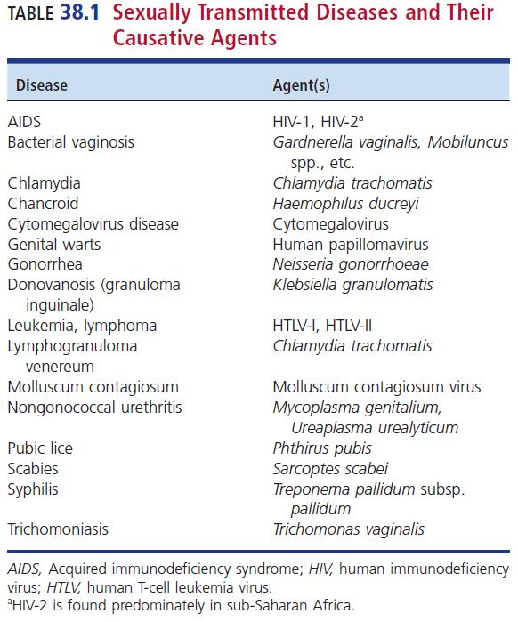
STIs and Their Causative Agents

Slide 4
Sexually Transmitted Diseases (STDs)
Sexually transmitted diseases (STDs)
  Diverse group of infectious diseases with a wide variety of pathogens and wide-ranging clinical manifestations
Preferred terminology: STIs

Slide 5
CDC Recommendations
Centers for Disease Control and Prevention (CDC) recommendations
  Annual chlamydia and gonorrhea screening for:
    Sexually active women younger than age 25
    Older women with risk factors
      New or multiple sex partners
      Living in communities with a high burden of Disease
  Testing for chlamydia, gonorrhea, syphilis, HIV, hepatitis B
    Pregnant women

Slide 6
CDC Recommendations
Centers for Disease Control and Prevention (CDC) recommendations
  For men having sex with men (MSM), annual screening for
    Syphilis, gonnorhea, chlamydia
  For everyone between 13 and 64 years old
    HIV screening at least once

Slide 7
Top Reportable Diseases in 2018

Slide 8
What’s Ahead?
Common symptoms of STIs
Review exudative infections (gonorrhea, chlamydia, vulvovaginitis),
Review ulcerative infections (syphilis, chancroid, genital herpes)
HIV infection
Other STIs

Slide 9
Clinical & Diagnostic Microbiology
Genitourinary Infections – II
Genital Infections & Sexually Transmitted Infections Urethritis

Slide 10
Urethritis
Inflammation of the urethra
Causes
  Mechanical injury (catheterization), chemical irritation (antiseptics), or infectious disease
Infectious urethritis
  More commonly associated with organisms that cause STIs but can be others
    Gonococcal urethritis
      Neisseria gonorrhoeae
    Nongonococcal urethritis (NGU)
      Chlamydia trachomatis

Slide 11
TYPE OF URETHRITIS | SPECIMEN OF CHOICE | DIRECT GRAM-STAIN FINDINGS | NOTES
Gonococcal urethritis | Urethral exudates | WBCs and gram-negative diplococci suggestive of N. gonorrhoeae | Diagnostic for the presence of N. gonorrhoeae
Gonococcal urethritis | Endocervical exudates | WBCs and gram-negative diplococci suggestive of N. gonorrhoeae | Since women have normal biota resembling N. gonorrhoeae, culture or nonculture assay necessary to confirm
Nongonococcal urethritis (NGU) | Urethral exudates | WBCs, no organisms seen | Most likely causative agent- Chlamydia trachomatis
 |  |  | Co-infections with gonorrhea and chlamydia are common

Slide 12
Epidemiology
Gonorrhea
  Second most commonly reported infectious disease in the U.S.
  It is estimated that only 50% of new infections are reported
  Highest incidence
    Sexually active adolescents and young adults from 15 to 24 years of age
    Approximately 80% of women and 10% of men with gonorrhea are asymptomatic

Slide 13
Epidemiology (Cont.)
Chlamydia
  Most commonly reported infectious disease in the United States
    Serovars A, B, Ba, and C are isolated from trachoma (an eye infection leading to blindness).
      Endemic in developing countries (mainly Africa)
    Serovars D through K are those associated with the genital tract disease.
    Serovars L1, L2, L2b, L2a, and L3 are associated with lymphogranuloma venereum (LGV).

Slide 14
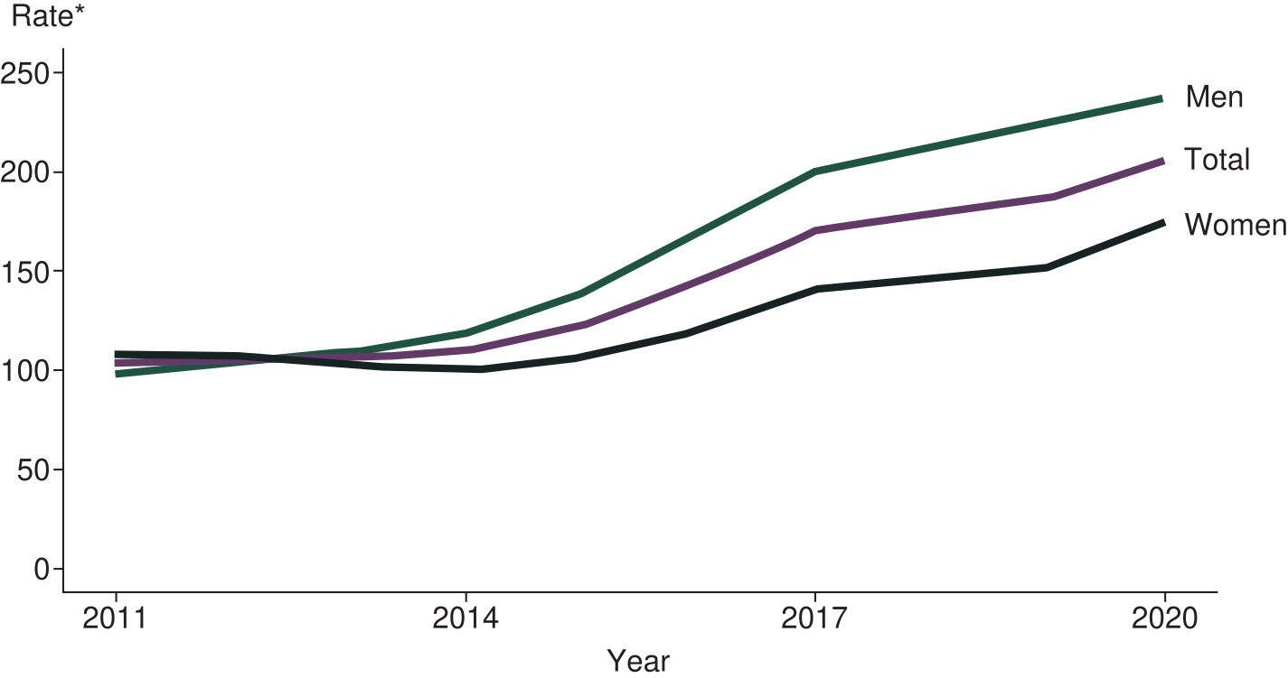
Rates of Reported Cases of Gonorrhea by Sex 2011-2020

Slide 15
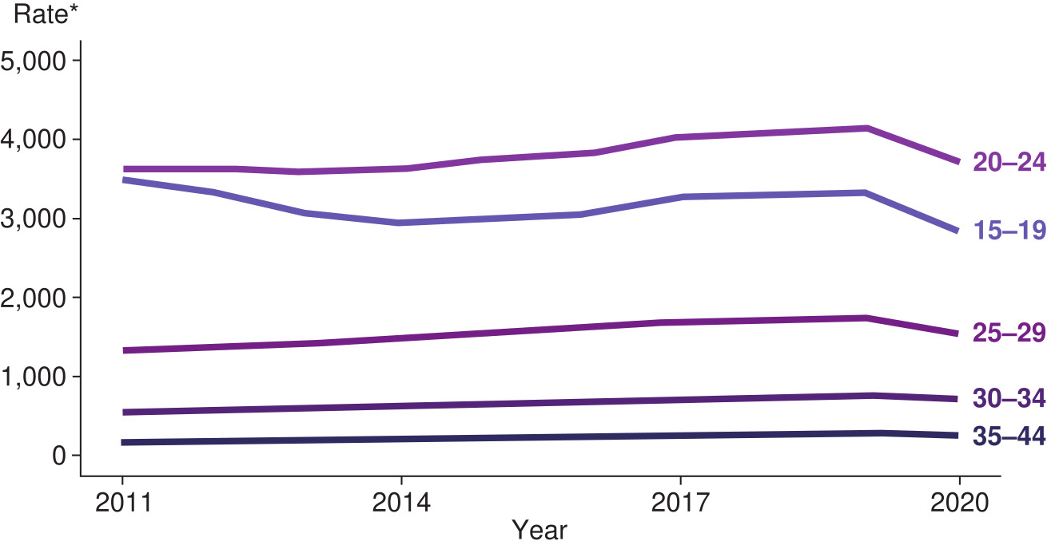
Chlamydia Rates of Reported Cases by Sex, United States, 2011-2020

Slide 16
Clinical Manifestations
Gonococcal urethritis
  Dysuria and urethral discharge without urinary frequency or urgency
    N. gonorrhoeae binds specifically to columnar epithelial cells of the genitourinary (GU) tract, including the urethra, cervix, endocervix, Bartholin glands, anal canal, pharynx, and conjunctiva.
      Incubation averages 2 to 7 days
    90% or more of males experience a purulent urethral discharge, whereas women often have no symptoms for weeks or month. Diagnosis is only made after examination.

Slide 17
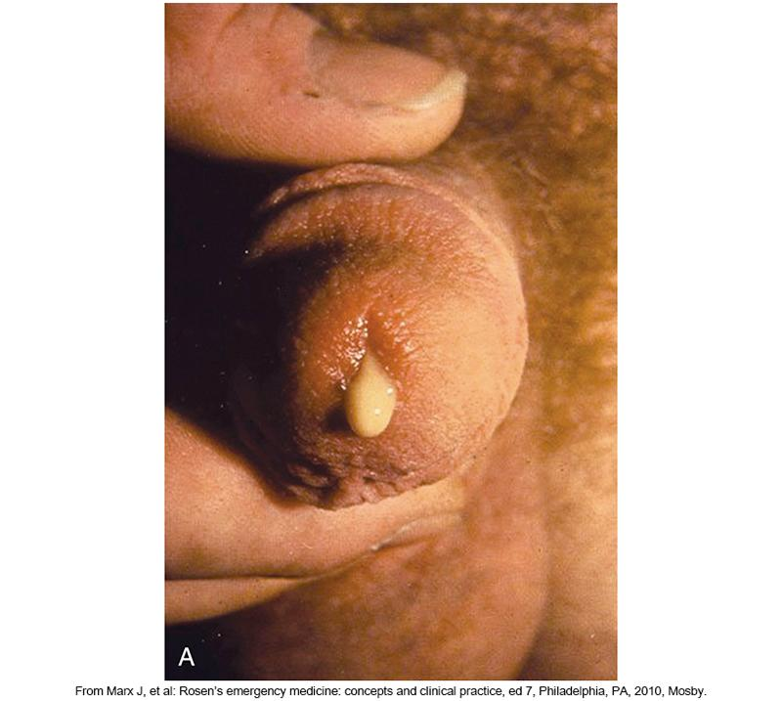
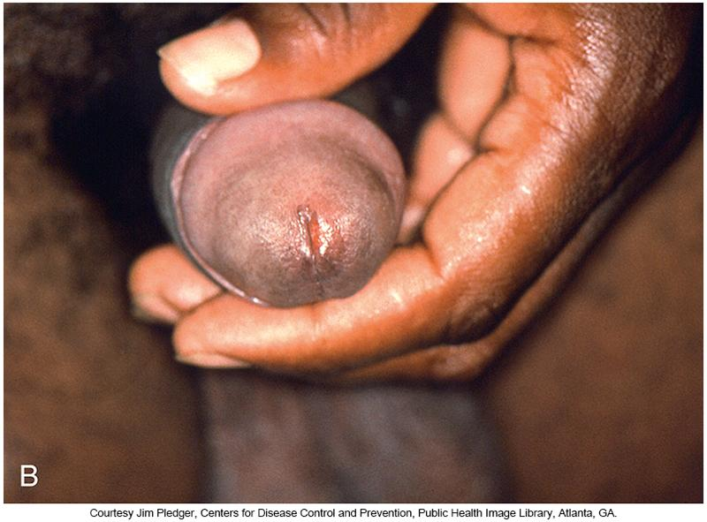
Purulent Urethral Discharge in a Patient with Gonorrhea

Slide 18
Clinical Manifestations (Cont.)
NGU
  Incubation is 7 to 21 days
  Symptoms arise less abruptly
  Symptoms in women
    Dysuria or pyuria and less often, urethral discharge
    When accompanied by cervicitis (70%-90%) a woman may experience abnormal cervicovaginal discharge, intermenstrual bleeding, pain during vaginal sex
  Patients are much more likely to be asymptomatic than those with gonococcal urethritis

Slide 19
Clinical Manifestations (Cont.)
In most cases of urethritis in men that are left untreated
  Spontaneous resolution occurs
  There can be complications of the ascending infection
    Acute prostatitis, epididymitis, urethral stricture
Ascending infection occurs in 10% to 20% of undiagnosed women
  Can trigger PID presenting as salpingitis, endometritis, internal abscesses, chronic pelvic pain

Slide 20
Clinical Manifestations (Cont.)
Perinatal exposure to either N. gonorrhoeae and C. trachomatis can result in severe disease in newborns
  Sepsis
  Pneumonia
  Inclusion conjunctivitis
  Ophthalmia neonatorum, which can result in perforation of the globe of the eye and blindness

Slide 21
Laboratory Diagnosis
Based on the presence of:
  Mucopurulent or purulent urethral discharge
  Demonstration of two or more leukocytes/high-power field (HPF) in a smear of urethral exudate
  Positive leukocyte esterase test on first-void urine or
    Microscopic examination of more than 10 white blood cells (WBC)/HPF of first-void urine sediment

Slide 22
Laboratory Diagnosis
Gram stain of male urethral exudate
  WBC with gram-negative intracellular diplococci is considered diagnostic for N. gonorrhoeae in symptomatic men.
Specimen collection
  Pass a small swab a few centimeters into the urethra or by “milking” any exudate onto a slide for staining
A negative Gram-stained smear should not rule out gonococcal infection in asymptomatic patients
  Follow-up testing is recommended

Slide 23
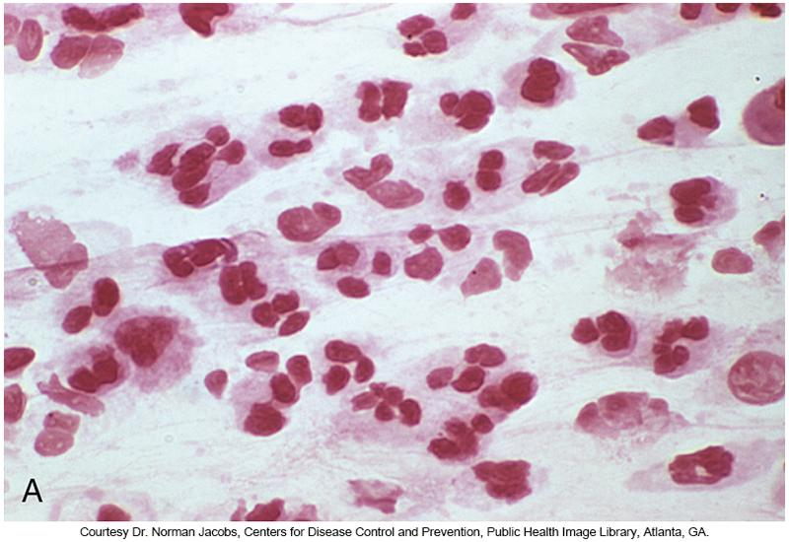
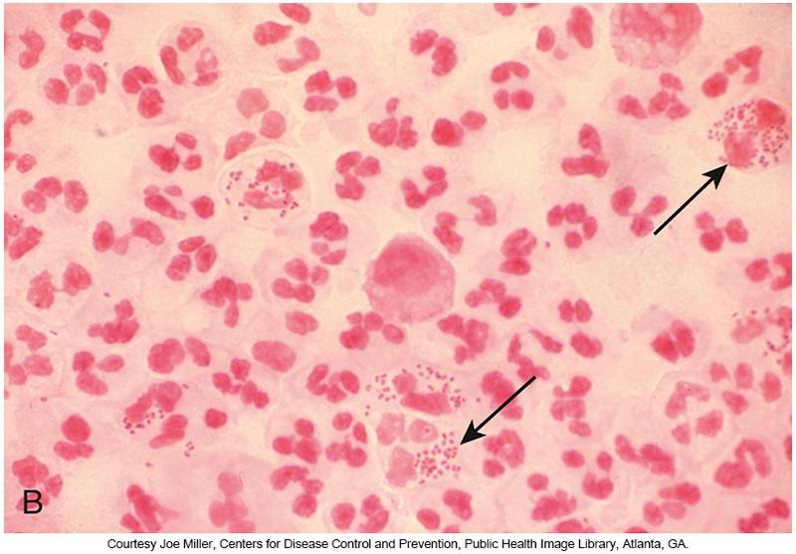
Gram Stain of Urethral Exudate

Slide 24
Food and Drug Administration (FDA)—Approved Assays

Slide 25
Treatment
Should be initiated immediately to eradicate the organism quickly
Original treatment of choice was penicillin
Penicillinase-producing N. gonorrhoeae strains developed
As resistance mounted, other agents were used
The CDC currently recommends intramuscularly administered ceftriaxone for uncomplicated gonococcal infections

Slide 26
Treatment
CDC recommendations for dual infections with N. gonorroheae and C. trachomatis
  Dual therapy
    Ceftriazone plus single dose of azithromycin or doxycycline for 7 days
    Alternate therapies include erthyromycin, levofloxacin, and ofloxacin.

Slide 27
Treatment (Cont.)
Recent reports indicate development of resistance against azithromycin and extended-spectrum cephalosporins. This is a cause of great concern because most therapeutic options for treatment may no longer be useful.
There are few actual specimens submitted for culture so susceptibility testing can not be done

Slide 28
Treatment (Cont.)
With no susceptibility testing available, it becomes difficult to estimate accurately the antimicrobial resistance burden until initial therapy fails
There is a need to collect more specimens for culture and susceptibility testing and the development of molecular tests for known antimicrobial resistance markers
  In the meantime, patients should return for follow-up evaluation if therapy does not work

Slide 29
Clinical & Diagnostic Microbiology
Genitourinary Infections – II
Genital Infections & Sexually Transmitted Infections Cervicitis

Slide 30
Cervicitis
Inflammation of the columnar and subepithelial cells of the endocervix
Causes of infectious cases
  Most cases- C. trachomatis and/or N. gonorrhoeae
  Other causes include trichomoniasis, genital herpes, or infections with Mycoplasma and Ureaplasma

Slide 31
Causes
Causes of noninfectious route of inflammation:
  Injury to the cervix, usually from a foreign object inserted into the vagina
    Birth control devise, douche, tampon
  Chemical irritation may also occur from using products noted above

Slide 32
Epidemiology
More than 50% of all women develop this condition at some point in their adult lives.
Most common STIs in adolescent females
Risk factors
  Sexual activity at an early age
  Engaging in high-risk sexual behaviors
  Having a previous history of STIs
  Having multiple sex partners

Slide 33
Epidemiology (Cont.)
Cervicitis is considered the “silent partner” of male urethritis because
  Symptoms not always obvious
  Women not feel the need to seek health care from a licensed provider
Complications of unrecognized infections
  PID, infertility, ectopic pregnancy, chronic pelvic pain, spontaneous abortion, cervical cancer

Slide 34
Clinical Manifestations
Symptoms may be mild initially and progress over time
Symptom
  Most common-vaginal discharge that may be grayish or yellow, possibly with an odor
  Other symptoms- abnormal bleeding, itching, irritation of the external genitalia, pain during intercourse, bleeding or spotting after intercourse, dysuria, and sometimes lower back or abdominal pain
  Symptoms in severe cases-profuse, almost puslike discharge accompanied by vaginal itchiness or abdominal pain

Slide 35
Laboratory Diagnosis
Usually performed clinically
Direct examination usually shows
  More than 10 WBC/HPF of exudate
    Associated with chlamydial and gonococcal infection of the cervix
Patients with symptoms of cervicitis are usually assessed for signs of PID and tested for
C. trachomatis and N. gonorrhoeae.
  Patients may also test for bacterial vaginosis (BV) and trichomoniasis

Slide 36
Laboratory Diagnosis (Cont.)
Cultures lack sensitivity compared with nucleic acid-based assays
  Most common assays- amplified tests with high rates of sensitivity and specificity (>95%)
FDA-approved assays are available in automated and nonautomated formats
Rapid antigen tests are often used in point-of-care (POC) settings
  Additional testing may be necessary to confirm rapid test findings

Slide 37
Treatment
Vary according to the organism suspected or detected
Empiric therapy is recommended for high-risk patients.
Same general antimicrobial agents as in urethritis
Trichomoniasis or BV will usually be treated with metronidazole.
Sexual partners should be informed and treated

Slide 38
Clinical & Diagnostic Microbiology
Genitourinary Infections – II
Genital Infections & Sexually Transmitted Infections Vulvovaginitis

Slide 39
Vaginitis
Occurs when the mucosal lining of the vagina becomes inflamed and irritated.
Causes
  Bacteria, yeast, viruses
  Chemical or mechanical irritants
    Feminine hygiene products, soaps, contraceptives, some clothing

Slide 40
Symptoms
Typical signs
  Vaginal discharge
  Vulvar itching and irritation
  Often odor
Associated diseases
  Bacterial vaginosis (BV), trichomoniasis, candidiasis
  Distinction among these diseases can initially be made by observations of the vaginal discharge.

Slide 41
Bacterial Vaginosis
Epidemiology
Most common vaginal infection in women of childbearing age
Risk factors
  Sexual activity at an early age
  Having numerous, anonymous, or frequent changes of sex partners
  Having female sex partners
  Ethnicity (African- American and Mexican -Americans are at higher risk)
  Frequent douching
    Thought to eliminate much of the normal protective lactobacilli

Slide 42
Bacterial Vaginosis
Clinical Manifestations
BV occurs when the delicate balance of normal vaginal microbiota is disrupted and replaced by an overgrowth of specific organisms.
In healthy women, normal microbiota is mainly Lactobacillus spp.
  Maintains pH between 3.8 and 4.5 to prevent overgrowth and invasion of pathogenic bacteria

Slide 43
Bacterial Vaginosis
Clinical Manifestations (Cont.)
Under infectious conditions, vaginal lactobacilli are depleted.
  Vaginal pH increases.
  Allows for overgrowth of various bacterial species
    Aerobes: Gardnerella vaginalis, Mycoplasma hominis, Ureaplasma spp.
    Anerobes: Prevotella, Porphyromonas, Peptostreptococcus, Mobiluncus
  Distinct unpleasant odor like that of rotting fish without a true inflammatory reaction

Slide 44
Bacterial Vaginosis
Clinical Manifestations (Cont.)
Patients with BV demonstrate a discharge that is usually
  Milky
  Homogenous
  Thin liquid adhering to the walls of the vagina
Discharge is often more apparent and odorous after intercourse (exposure to male ejaculate)

Slide 45
Bacterial Vaginosis
Laboratory Diagnosis
Clinical criteria (i.e., Amsel’s Diagnostic Criteria)
  Three of these four criteria must be met
    Clue cells on microscopy
    A thin, white, and homogenous vaginal discharge
    Vaginal discharge
    A vaginal pH of greater than 4.5
    Fishy odor when 10% potassium hydroxide (KOH) solution is added to the vaginal secretions (whiff test)

Slide 46
Bacterial Vaginosis
Laboratory Diagnosis (Cont.)
Gram stain (considered the gold standard) of the vaginal discharge
  Examine vaginal saline wet preparation or Gram stain for the presence of clue cells
    Vaginal epithelial cells typically coated with gram-variable Gardnerella vaginalis
    Normal vaginal squamous epithelial cells have distinct cell margins and lack granularity
    Clue cells have sheets of coccobacillary organisms attached in clusters on the cell surface, making the border indistinct or stippled

Slide 47
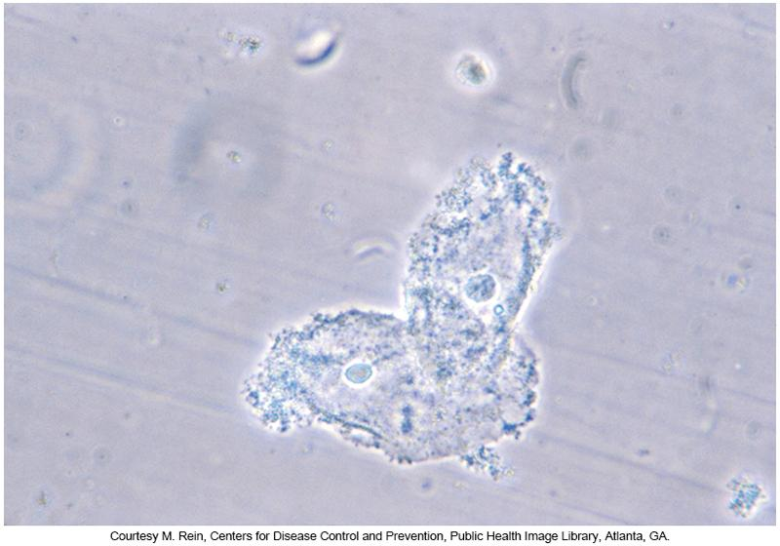
Microscopic Saline Prep of Clue Cells

Slide 48
Bacterial Vaginosis
Laboratory Diagnosis (Cont.)
Other laboratory diagnosis methods
  pH test paper to test vaginal pH
  Culture
  DNA hybridization test
  Rapid antigen tests

Slide 49
Bacterial Vaginosis
Treatment
Oral or a topical antimicrobial agent
  Metronidazole
  Clindamycin
Treatment is provided to relieve the symptoms and reduce the risk of infectious complications with other organisms
  BV in pregnancy can lead to preterm labor, low birth weight, premature rupture of membranes, and miscarriage

Slide 50
Trichomoniasis
Epidemiology
Caused by the parasitic protozoan
  Trichomonas vaginalis
Most common STI worldwide
Approximately 70% of infected people in the U.S. show no signs or symptoms
Infections occur mostly in women
Commonly associated with other STIs
  BV or gonorrhea
Easily curable and not a reportable disease

Slide 51
Trichomoniasis
Clinical Manifestations
Typical clinical manifestations women experience
  Itching, burning, dysuria, lower abdominal pain, genital redness or soreness, and a smelly vaginal discharge that can be clear, white, yellowish, or greenish
    Cervix is punctate and papilliform in appearance
      “Strawberry cervix”
  Males present with symptoms of NGU.

Slide 52
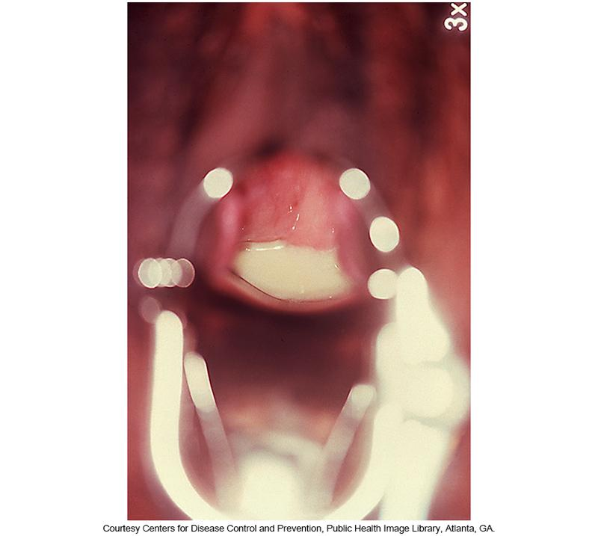
Purulent Discharge Demonstrative of Trichomoniasis

Slide 53
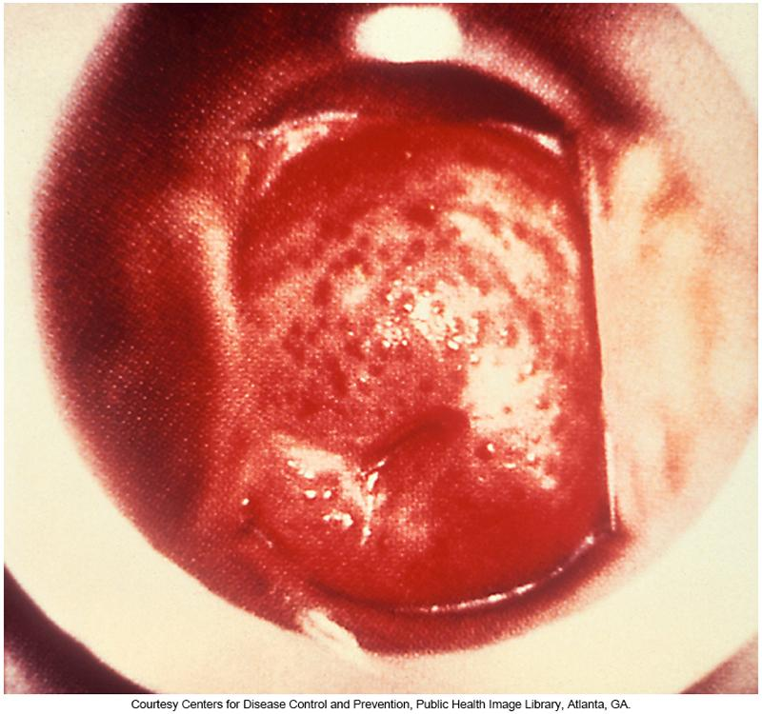
Strawberry Cervix Caused by Trichomonas vaginalis

Slide 54
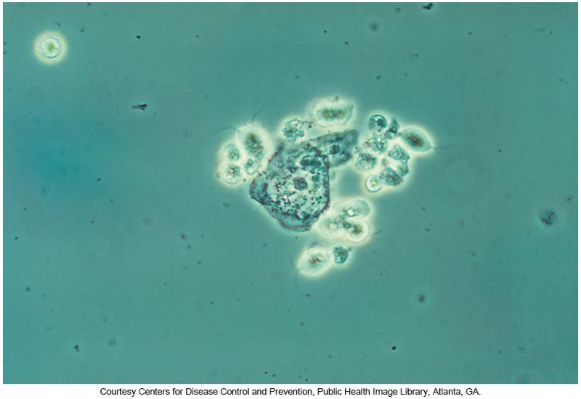
Phase Contrast Wet Mount
Showing Trichomoniasis

Slide 55
Trichomoniasis
Laboratory Diagnosis
Laboratory diagnosis
  Visualization of motile trichomonads in a saline preparation of the vaginal fluid
  Pouch inoculation (self-contained culture media device)
  Oligonucleotide probe test, point-of-care (POC) rapid antigen detection test

Slide 56
Trichomoniasis
Laboratory Diagnosis (Cont.)
FDA-approved high-throughput nucleic acid amplification platforms
  BD Probe Tec TC Q^{X} Amplified DNA assay
  Aptima TV Assay
  Xpert TV Assay
  AmpliVue Trichomonas Assay

Slide 57
Trichomoniasis
Treatment
Treatment
  Metronidazole is the drug of choice for treating trichomoniasis cases.
    Approximately 4%-10% of all cases display some level of resistance to treatment; patients can usually overcome with higher oral doses
Alternative Treatment
  In cases of metronidazole, tinidazole may be used
All sexual partners and asymptomatic patients should be treated to avoid symptoms and continuation of the infection transmission

Slide 58
Candidiasis
Epidemiology
Vulvovaginal candidiasis
  Symptomatic vaginitis usually caused by infection with the yeast Candida
  Most common culprit: Candida albicans
Yeast infections may be referred to as vaginal thrush or moniliasis.
Almost 75% of all adult women have at least one genital yeast infection in their lifetime.

Slide 59
Candidiasis
Epidemiology (Cont.)
Candida is always present in the body in small amounts
  When imbalance occurs, like changes in vaginal acidity, symptoms manifest
Vaginal candidiasis is not considered as a true STI but because it causes similar symptoms in the female genital tract as other organisms described here, it is included here.

Slide 60
Candidiasis
Epidemiology (Cont.)
Men are rarely infected
  When present, infections are not serious and respond well to treatment
Yeast infections are the most common genital infections affecting women
Infections occur
  When there are changes in the vaginal biota
  Following a course of antibiotics administered for another purpose and in the process wipes normal biota

Slide 61
Candidiasis
Epidemiology (Cont.)
Hormonal causes of yeast infections
  Pregnancy
  Ovulation
  Menopause
  Oral contraceptives
  Estrogen replacement therapy

Slide 62
Candidiasis
Epidemiology (Cont.)
Causes related to immunosuppressive conditions
  Diabetes mellitus
  Iron deficiency
  HIV infection
Causes related to skin conditions
  Psoriasis, lichen planus, lichen sclerosus
Highest prevalence
  Women of childbearing age who are producing ample amounts of estrogen, which causes the vaginal lining to mature and contain glycogen, a preferred substrate for C. albicans.

Slide 63
Candidiasis
Clinical Manifestations
Women: Vulvar itching, burning, swelling, or redness with an abnormal vaginal discharge
  Discharge ranges from slightly watery to a white discharge to a thick, white, cottage cheese curd-like discharge
  Examples of other symptoms
    Vulvar inflammation and redness
    Pain with intercourse
    Painful urination
Men: Itchy rash or burning at the tip of the penis, known as balanitis

Slide 64
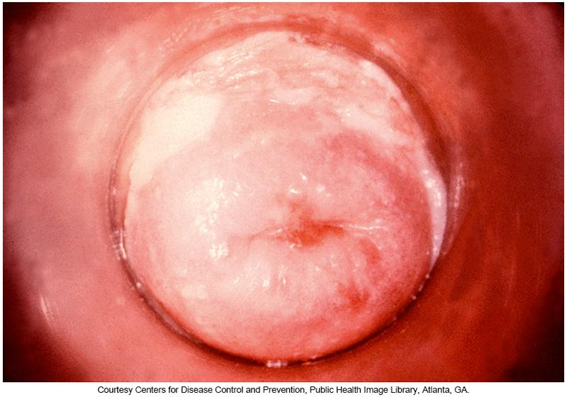
Candidal Cervicitis

Slide 65
Candidiasis
Laboratory Diagnosis
Laboratory diagnosis
  Diagnosis of yeast infections is typically done clinically.
  Discharge may be sent to the laboratory to rule out other causative agents of vaginosis.
  Budding yeast forms on both the Gram stain and the KOH prep.
  The pH of the vaginal fluid remains unchanged as opposed to an elevated pH with BV and trichomoniasis

Slide 66
Candidiasis
Treatment
There are numerous antifungal drugs by prescription or over the counter that work well
  Over-the-counter (OTC) medications or prescription antifungal agents
    Key ingredient: Azole agents
      Antifungal agents that inhibit ergosterol production, which is an important component of the fungal plasma membrane
    Available as suppositories, topical creams or lotions, or oral pills
In most cases, symptoms disappear completely with adequate treatment

Slide 67
Clinical & Diagnostic Microbiology
Genitourinary Infections – II
Genital Infections & Sexually Transmitted Infections Genital Ulcer Disease(s)

Slide 68
Genital Ulcer Disease
Disruption of the skin and/or mucosal layer of the genital region
Most genital ulcers diagnosed in the United States are attributed to
  Herpes, syphilis, or chancroid.
Less common causes
  LGV and donovanosis
Multiple infections are possible

Slide 69
Genital Herpes
Epidemiology
Chronic viral infection caused by the herpes simplex virus (HSV)
  Two serotypes: HSV-1 (primarily oral) and HSV-2 (primarily genital)
HSV-1
  Mainly associated with an oral infection of the lips, gums, tongue, and other areas inside the mouth
    Cold sores, fever blisters
HSV-2
  Affects the genital area via sexual contact

Slide 70
Genital Herpes
Epidemiology (Cont.)
Most common request for treatment of symptomatic genital ulcers in the U.S.
More common in women than men
  Disparity most likely due to male-to-female transmission is more prevalent than female-to-male transmission
From 70% to 90% of infected individuals are unaware of their infections
  Asymptomatic or only vague symptoms

Slide 71
Genital Herpes
Clinical Manifestations
HSV infection of oral or genital tissue is initiated by mucosal contact with an active (primary or recurrent) infection of another individual
Virus enters the body through direct
  Sexual contact of skin
  Mucous membranes with secretions or mucosal surfaces of an infected person
Incubation period
  Ranges from 2 to 14 days after initial exposure

Slide 72
Genital Herpes
Clinical Manifestations (Cont.)
Symptomatic patients with a primary HSV-2 infection show
    Extensive, painful vesicles
    Fever
    Myalgia
    Malaise
    Dysuria
    Inguinal lymphadenopathy
  Infection usually resolves in 1 week
  Primary lesions last 2 to 6 weeks

Slide 73
Genital Herpes
Clinical Manifestations (Cont.)
Women tend to have more severe disease than men including constitutional symptoms and complications
  Disparity may be because of the larger affected surface area of the female genital tract and the ability of HSV to spread more easily over the abundant moist surfaces

Slide 74
Genital Herpes
Clinical Manifestations (Cont.)
After recovery from primary infection
  HSV ascends along the sensory nerve roots to the dorsal root ganglion and establishes latency
Reactivation of the virus occurs on exposure to stressors
  Sunlight, menstruation, malnutrition, fatigue, anxiety, subsequent viral infections

Slide 75
Genital Herpes
Clinical Manifestations (Cont.)
Most serious complication-Neonatal Transmission
  Occurs
    Congenitally (5%)
    During delivery (85%)
    Postnatally (10%)
  Symptoms appear 9 to 11 days of life
  Vaginal secretions containing HSV can result in
      Localized disease of the skin, eyes, and mucosa; central nervous system (CNS) involvement; or disseminated disease
Other serious complications
  Corneal infection, fatal sporadic encephalitis in immunocompromised hosts

Slide 76
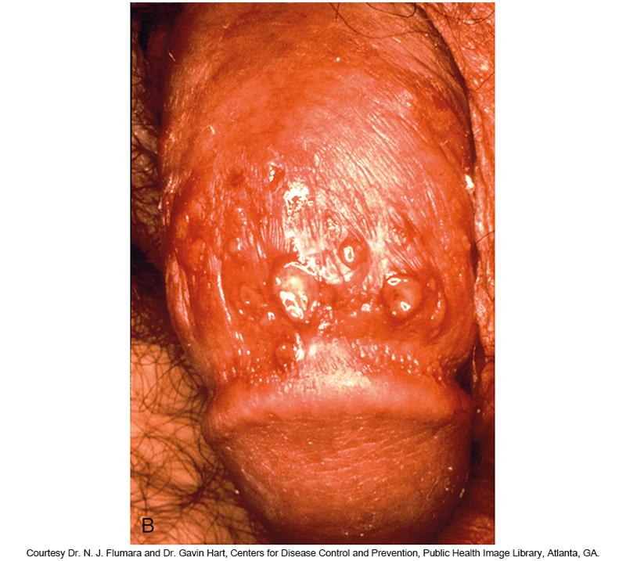
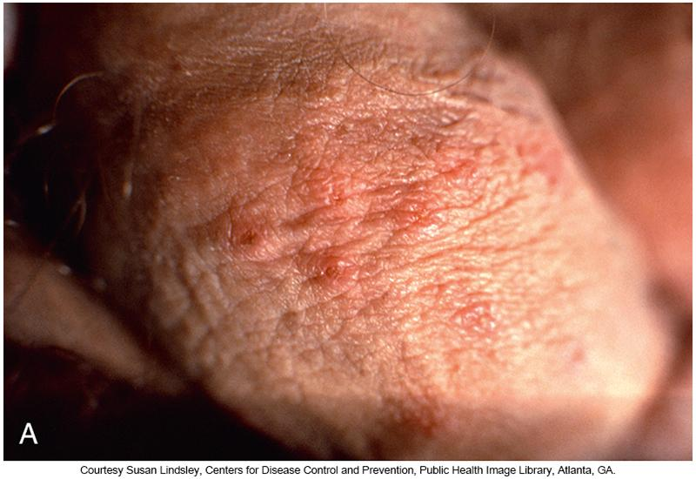
HSV Lesions

Slide 77
Genital Herpes
Laboratory Diagnosis
Vesicle fluids collected with a syringe or swab
  Culture
    Cytopathogenic effect (CPE)
    Develop intracellular granulations, enlarge, and then display intracellular inclusions
    Being replaced by nucleic acid amplification test (NAATs)
  Direct fluorescent antibody (DFA) can type
  Indirect fluorescent antibody (IFA)
  Cytospin DFA
  Serologic assays

Slide 78
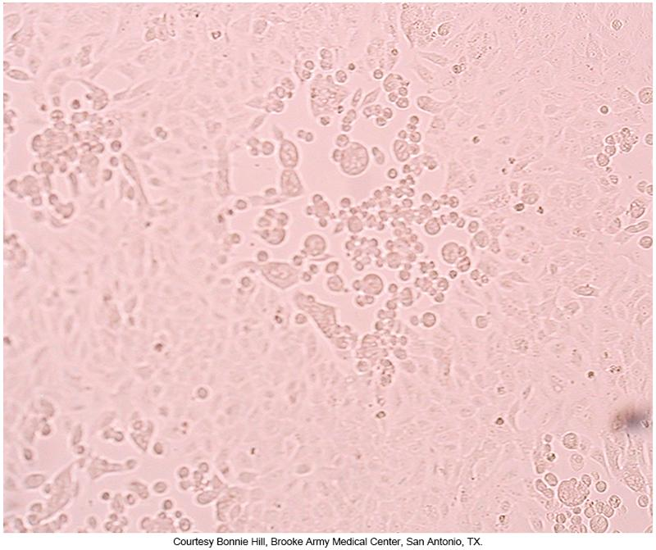
Culture Results of Genital Specimen Showing Cytopathic Effect

Slide 79
Genital Herpes
Treatment
Life-long viral infection of which there is no cure
Clinical trials have demonstrated that acyclovir, valacyclovir, and famciclovir are effective antivirals for the treatment of genital herpes.
  Control signs and symptoms
For Neonates
  IV antiviral chemotherapy (acyclovir) can reduce overall morbidity and mortality

Slide 80
Syphilis
Genital ulcer disease caused by the spirochete Treponema pallidum subsp. pallidum
  Obligate parasite of humans
  No other known animal hosts or environmental reservoirs
Epidemiology
  ~12 million people infected each year

Slide 81
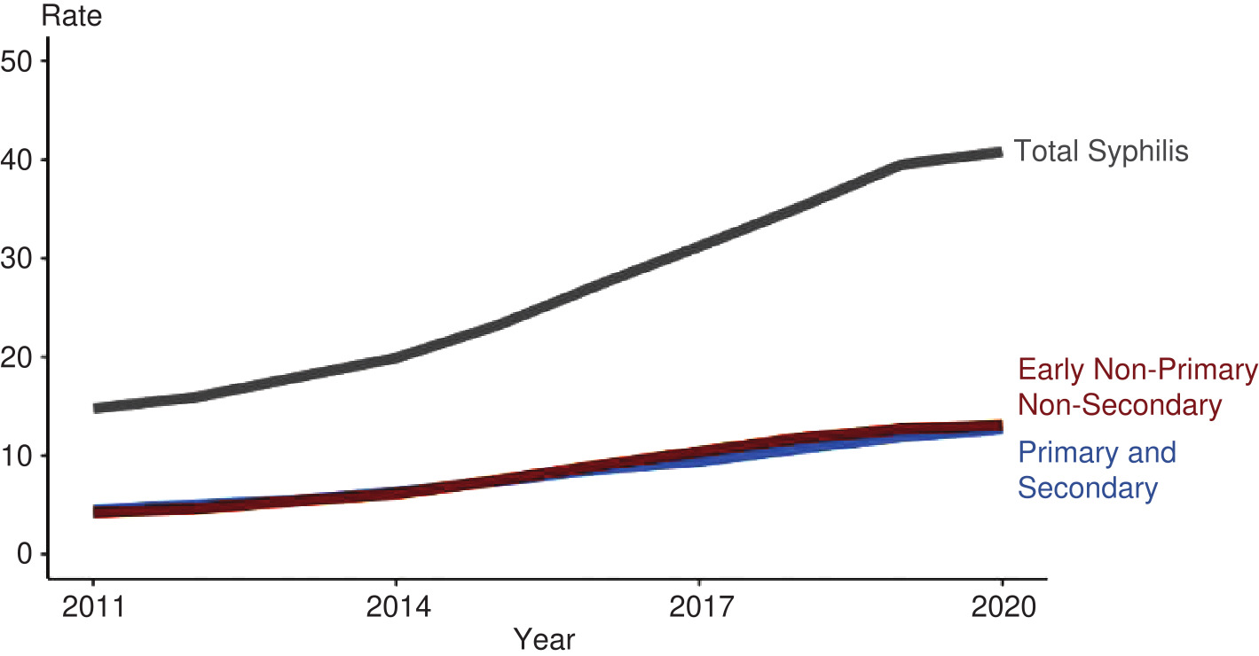
Rates of Reported Cases of Syphilis By Stages of Infection

Slide 82
Syphilis
Clinical Manifestations
Primary
  Initial chancre, usually in the anogenital region
Secondary
  Skin rash, mucocutaneous lesions, lymphadenopathy, others
  Organ involvement possible
    Hepatitis, osteitis, keratitis
  CNS involvement may also occur.
  Condylomata lata-mucoid, wartlike growths

Slide 83
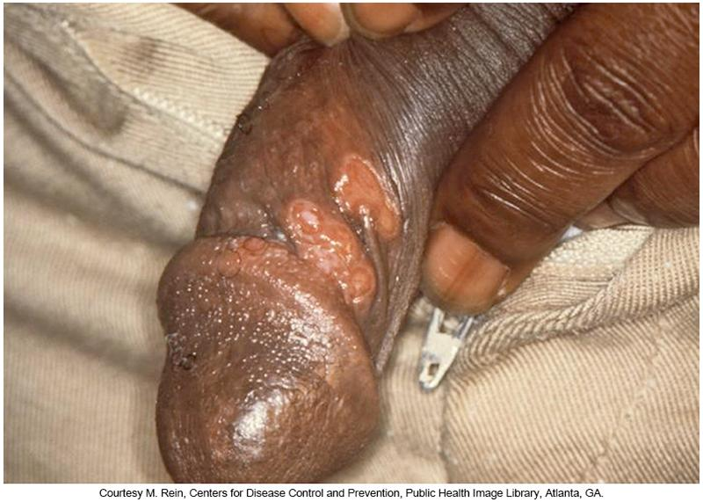
Primary Syphilis

Slide 84
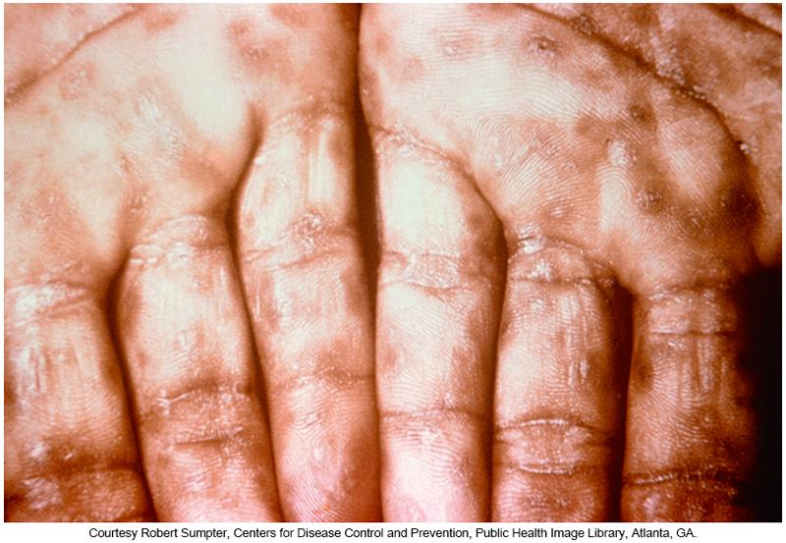
Secondary Syphilis

Slide 85
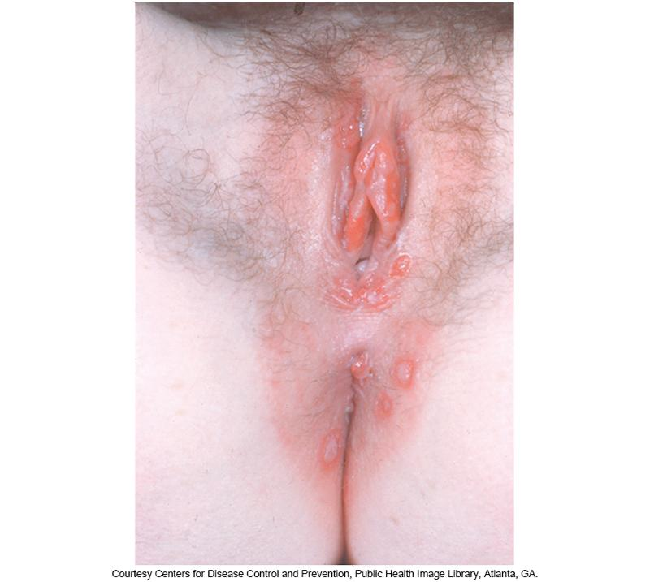
Condylomata Lata Lesion Seen in Secondary Syphilis

Slide 86
Syphilis
Clinical Manifestations (Cont.)
Latent syphilis is divided into two stages
  Early latent
  Late latent
Latent syphilis is characterized by
  CSF abnormalities in the absence of symptoms
  Indicators
    Elevated protein, depressed glucose, lymphocytic pleocytosis (presence of WBCs)
Untreated patients will relapse during the first year of the latent period

Slide 87
Syphilis
Clinical Manifestations (Cont.)
Tertiary
  Immune sequelae of the primary and secondary syphilis
    Neurologic symptoms, cardiovascular effects, or late benign syphilis in which gummas (nonspecific granulomatous lesions) develop
Congenital
  Deformities, rash, jaundice, meningitis, deformed bones, deafness, blindness, others

Slide 88
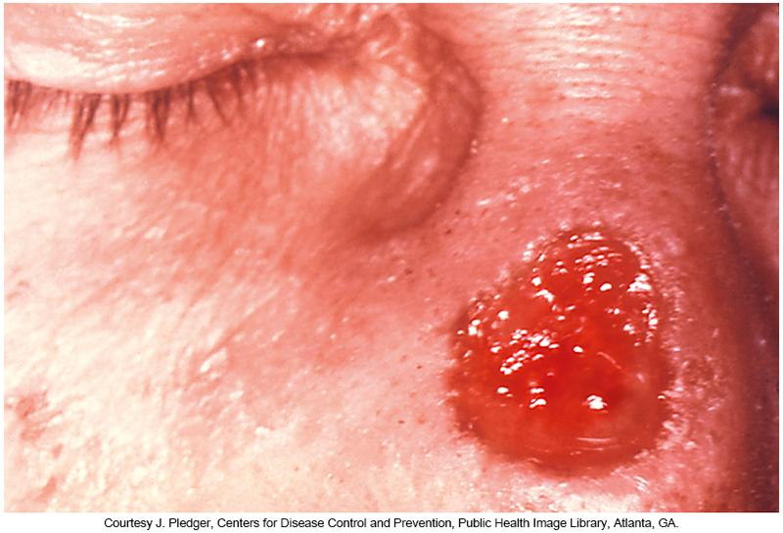
Tertiary Syphilis Lesion
Known as a Gumma

Slide 89
Syphilis
Laboratory Diagnosis
Dark-field microscopy and DFA
Nontreponemal (nonspecific) antibody tests
  Rapid plasma reagin (RPR), regin screen test (RST), unheated serum reagin (USR), toluidine red unheated serum test (TRUST), Venereal Disease Research Laboratory (VDRL)
Treponemal (specific) antibody tests include
  EIAs, fluorescent treponemal antibody-absorbed (FTA-ABS), Treponema pallidum particle agglutination (TP-PA)

Slide 90
Syphilis
Laboratory Diagnosis (Cont.)
Diagnosis of congenital syphilis
  Complicated by the ability of maternal nontreponemal and treponemal IgG antibodies to cross the placenta
  To differentiate maternal antibody from infant antibody
    IgM-specific FTA-ABS may be useful
  Current testing recommendations
    Infants born to mother who have reactive serologic tests results be evaluated with RPR or VDRL
    Confirmation includes clinical suspicions

Slide 91
Syphilis
Treatment
Primary and secondary syphilis
  Single intramuscular dose of benzathine penicillin G
Suspected cases of neurosyphilis
  Multiple doses of aqueous or procaine penicillin G
Alternate treatments for primary syphilis
  Ceftriaxone, amoxicillin, ampicillin
For non-pregnant patients allergic to penicillin
  Doxycycline or tetracycline
For pregnant patients allergic to penicillin
  Desensitize patient and treat with penicillin

Slide 92
Chancroid
Epidemiology and Clinical Manifestations
Epidemiology
  Caused by the fastidious gram-negative bacteria Haemophilus ducreyi
    Major cause of genital ulcerative disease in Africa, Southeast Asia, the Caribbean, and Latin America
    Incidence increasing U.S.
  Potential cofactor in the transmission of HIV.
Clinical manifestations
  Painful genital ulceration, inflammatory inguinal adenopathy, and bubo formation
    Ragged or uneven soft edges and a gray to yellow purulent exudate

Slide 93
Chancroid
Clinical Manifestations (Cont.)
Pathogen enters through the microabrasions in skin after sexual intercourse
Erythematous papule develops 4 to 7 days after exposure
Develops into pustule that ruptures 2 to 3 days later and forms painful, shallow ulcers
  External genitalia
Painful, tender inguinal lymphadenitis occurs in nearly 50% of patients

Slide 94

Early Chancroid Lesions

Slide 95
Chancroid
Laboratory Diagnosis
Specimen-ulcer lesion material and/or bubo aspirate
Culture media
  GC agar base, hemoglobin, IsoVitalex, and fetal calf serum
  Mueller-Hinton agar with chocolate horse blood and IsoVitalex
H. ducreyi are pleomorphic, gram-negative coccobacilli that occasionally occur in characteristic chains or “school-of-fish.”

Slide 96
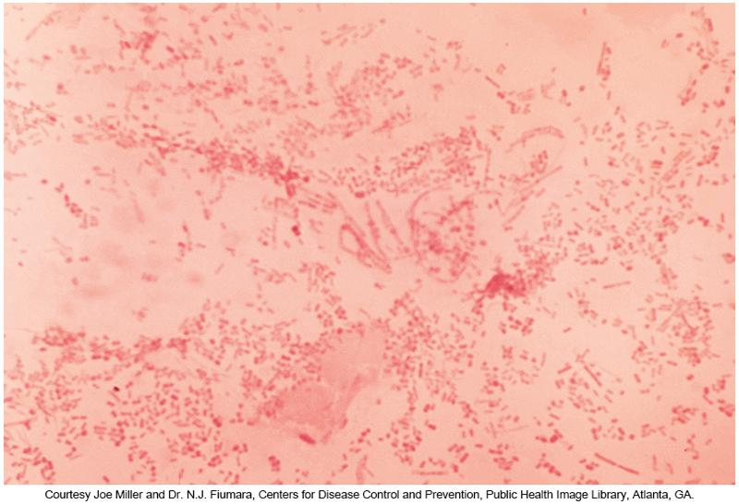
Gram Stain of H. ducreyi

Slide 97
Chancroid
Laboratory Diagnosis (Cont.)
Testing methods that are alternatives to culture
  PCR and immunoassays- being developed
  No FDA-approved PCR assays are commercially available
  Serologic detection has been demonstrated by EIAs that contain antibodies against H. ducreyi lipooligosaccharide and antigen detection using DFA
    Not widely available, have cross-reactivity problems
Culture remains the gold standard

Slide 98
Chancroid Treatment
Antibiotic therapy resolves the clinical symptoms, prevents transmission to others, and cures the disease.
CDC Treatment Guidelines
  Single oral dose of azithromycin
  Oral ciprofloxacin (twice a day for 3 days)
  Oral erythromycin base (three times a day for 7 days)
  Single intramuscular dose of ceftriaxone

Slide 99
Lymphogranuloma venereum (LGV) Epidemiology
STD caused by serovars
L1, L2, L2a, L2b, and L3 of the intracellular bacterium C. trachomatis
LGV strains appear to be quire virulent.
Most cases occur in
  Africa, Southeast Asia, Central and South America, Caribbean countries.

Slide 100
LGV - Clinical Manifestations
Primary
  Small genital or rectal lesion that ulcerates at the site of transmission
Secondary
  Spreads to regional lymph nodes
    Very painful unilateral inguinal and/or femoral lymphadenopathy
Tertiary
  Can lead to chronic inflammation and destruction of affected tissues

Slide 101
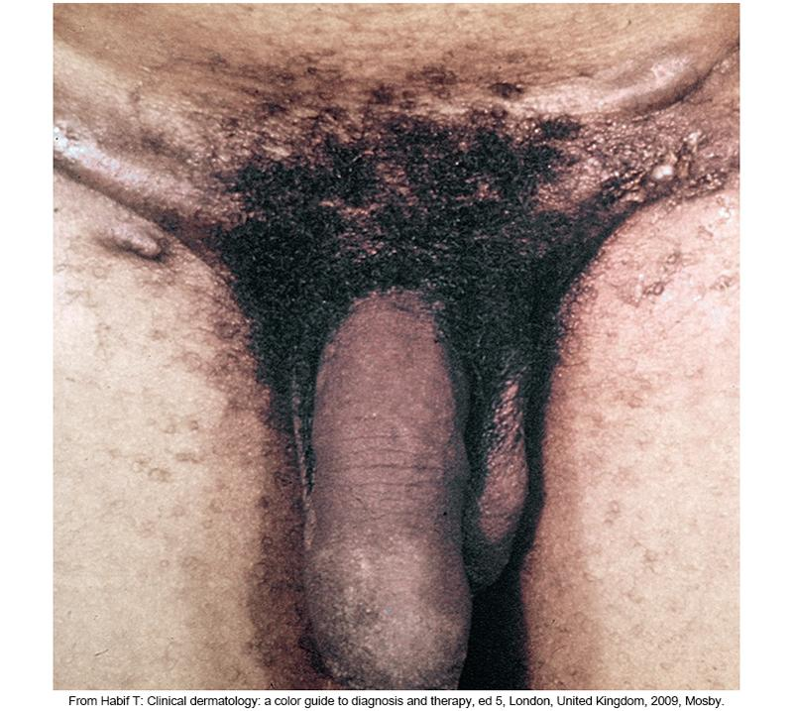
Presentation of LGV

Slide 102
LGV - Laboratory Diagnosis
Laboratory diagnosis
  Typically based on clinical presentation, epidemiologic information, and the exclusion of other causes of genital or rectal ulcers, inguinal lymphadenopathy, and/or proctitis
  Specimens: bubo aspirates or ulcer material by tissue culture
    Must be cell cultured to obtain viable C. trachomatis
    DFA, serologic tests, or NAAT
      NAAT is the preferred method for detecting genital C. trachomatis—high sensitivity and specificity.

Slide 103
LGV - Treatment
CDC recommendation
  Oral doxycycline, twice a day for 21 days
Alternative
  Oral erythromycin, four times daily for 21 days
For LGV in pregnancy
  Azithromycin may prove useful.
Delayed treatment may result in serious complications.
  Abscesses, fistulae, rectal stricture

Slide 104
LGV
Treatment (Cont.)
Patients with both LGV and HIV infection
  Should receive the same treatment regimen as that for HIV-negative individuals
  Prolonged antimicrobial therapy may be required for HIV-positive patients and symptoms may resolve slowly.
  Prompt treatment can prevent symptom development and lessens the risk of the original patient becoming reinfected

Slide 105
Donovanosis
Epidemiology
Also known as granuloma inguinale
  Genital ulcerative disease caused by Klebsiella granulomatis
    Extremely fastidious
  Endemic in India, Papua New Guinea, central Australia, Brazil, and southern Africa
Ulcers are most common in uncircumcised men with poor standards of genital hygiene
Disseminated donovanosis may spread to bone and liver.
  Associated with pregnancy complications and cervical infections

Slide 106
Donovanosis
Clinical Manifestations
Thought to be spread by direct contact during sexual activity
Nonsexual transmission has been documented.
Produces a firm papule or subcutaneous nodule that ulcerates at the primary site of inoculation, usually in the genital region

Slide 107
Donovanosis
Clinical Manifestations (Cont.)
Four types
  Ulcerogranulomatous (most common)
    Painless, beefy red ulcers that bleed to the touch that are well-defined , friable, nontender, nonindurated ulcers with profuse granulation tissue
  Hypertrophic
    Raised irregular edge, sometimes completely dry
  Necrotic
    Offensive-smelling ulcer causing tissue destruction, common in patients with longstanding donovanosis
  Sclerotic or cicatricial
    With fibrous or scar tissue

Slide 108
Donovanosis Affected Areas in
Men and Women
Men
Women
Penis
Scrotum
Glans
Anus
Labia minora
Fourchette
Less often:
  Cervix
  Upper genital tract
Pregnant women
  At risk for disseminated infection
  Mainly in bone and liver

Slide 109
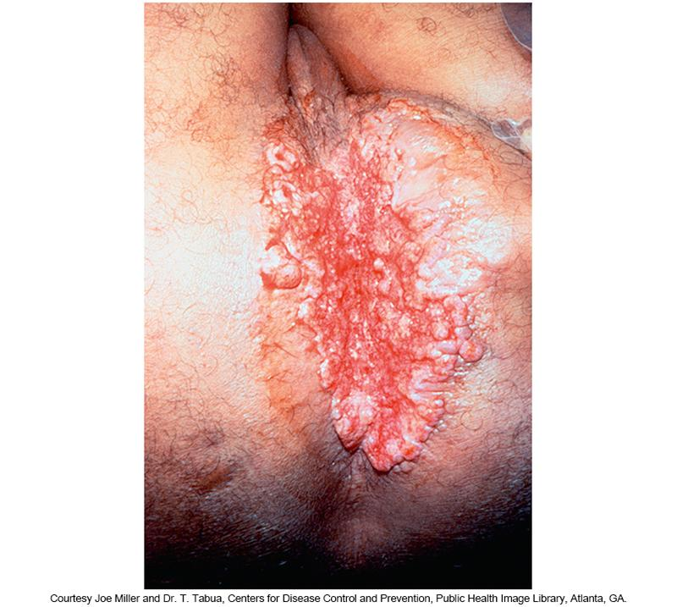
Donovanosis
Ulcerogranulomatous

Slide 110
Donovanosis
Laboratory Diagnosis
Laboratory diagnosis
  Determined clinically based on a detailed history and physical examination findings of ulcerative lesions on a patient with sexual contact in an endemic region
  Giemsa or Wright staining of tissue
    Identifying characteristic intracellular Donovan bodies within macrophages
  Culture-beyond capability of most labs
  PCR-developed but not FDA-approved

Slide 111
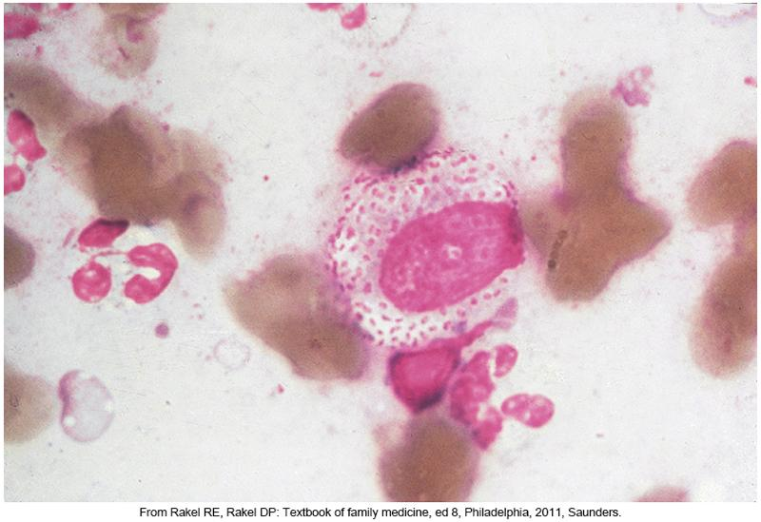
Donovan Bodies

Slide 112
Donovanosis
Treatment
CDC treatment recommendation
  Azithromycin taken orally once a week for 3 weeks, until all symptoms resolve
  Alternative antimicrobials
    Doxycycline
    Ciprofloxicin
    Erythromycin
    Trimethoprim-sulfamethoxazole
  Pregnant and lactating women
    Erythromycin or azithromycin

Slide 113
Clinical & Diagnostic Microbiology
Genitourinary Infections – II
Genital Infections & Sexually Transmitted Infections
Human Immunodeficiency Virus (HIV) & Acquired Immunodeficiency Syndrome (AIDS)

Slide 114
HIV
Causative agent of AIDS
Lentivirus in the family Retroviridae
Non-icosahedral, enveloped virus with two copies of a single-stranded RNA genome
Mainly targets CD+4 lymphocytes
  Cells become depleted over time leaving the body susceptible to many opportunistic infections because of the impaired immune system.
Notes:
114

Slide 115
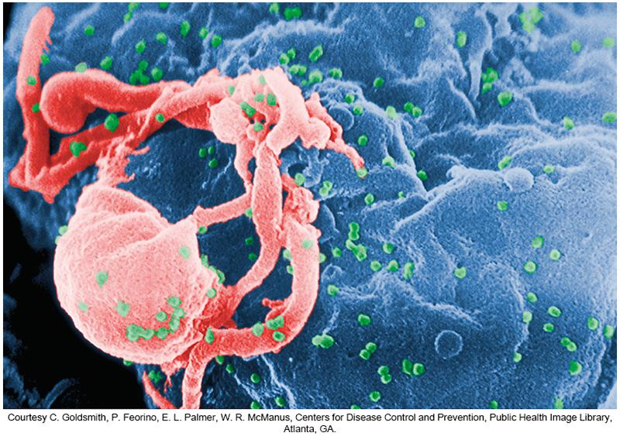
Colorized Scanning Electron Micrograph of HIV-1

Slide 116
HIV
Routes of HIV transmission
  Cervicovaginal, penile, rectal, oral, percutaneous, intravenous (IV), in utero
How HIV infects a cell
  Viral surface glycoproteins bind to receptors on the CD⁺⁴ lymphocyte
  Viral envelope fuses with the plasma cell membrane
  Viral contents released into the cell

Slide 117
HIV (Cont.)
How HIV infects a cell
  The viral RNA genome is reverse-transcribed into DNA, transported to the cell’s nucleus, and integrated into the host cell DNA as a provirus
  The HIV provirus produces HIV proteins and enzymes to form new viral particles
  The HIV particles are released by budding from the cell to infect other cells throughout the body

Slide 118
HIV
Epidemiology
Two known types of HIV: HIV-1 and HIV-2
  HIV-1 is the predominant type worldwide
Pandemic began in early 1980s
  Affected mostly the male homosexual/MSM population (was originally termed GRID [Gay-related immunodeficiency]).
  Originally designated as HTLV-3 in its early discovery.

Slide 119
HIV
Epidemiology (Cont.)
Risk factors in the early 1980s
  IV drug use
  Persons of Haitian origin
  Patients with hemophilia A receiving blood transfusions
Almost 33 million people worldwide have died from AIDS-related causes
The advent of combination antiretroviral therapy that achieved widespread, the number of AIDS deaths declined
  Mainly in developed countries

Slide 120
HIV
Clinical Manifestations
Progressive disease noted by three specific phases
  Acute infection
    Fever, maculopapular rash, oral ulcers, lymphadenopathy, malaise, weight loss, arthralgia, pharyngitis, and night sweats
  Clinically Latent infection
    Asymptomatic period may last several years before the development of clinical immunodeficiency.
  Progression to AIDS
    AIDS—defining illness
Notes:
120

Slide 121
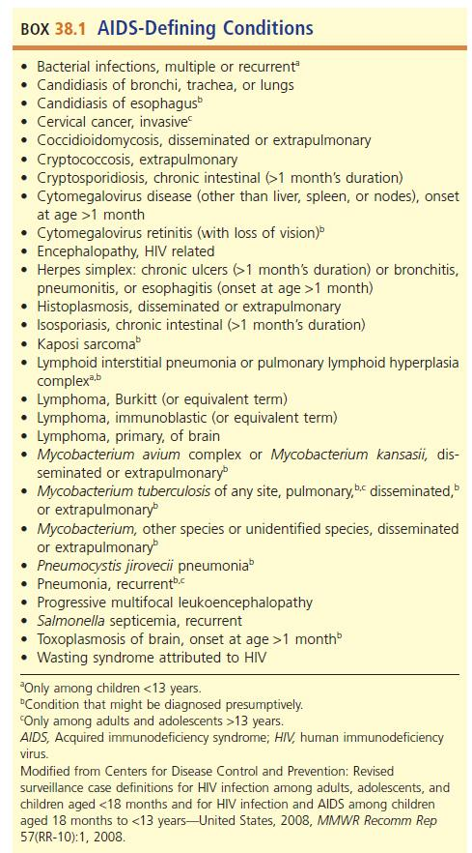
AIDS—Defining Conditions

Slide 122
HIV Case Definition, 2014

Slide 123
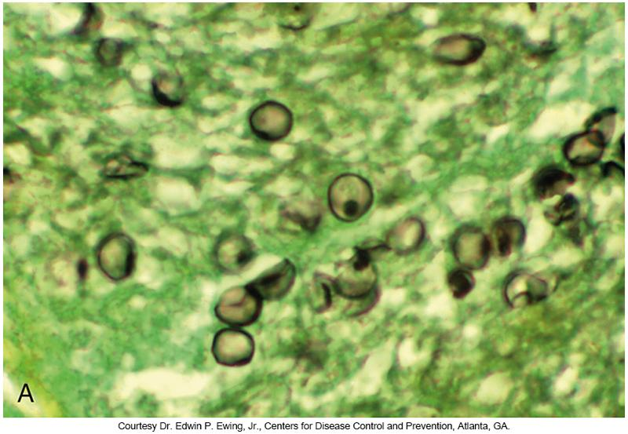
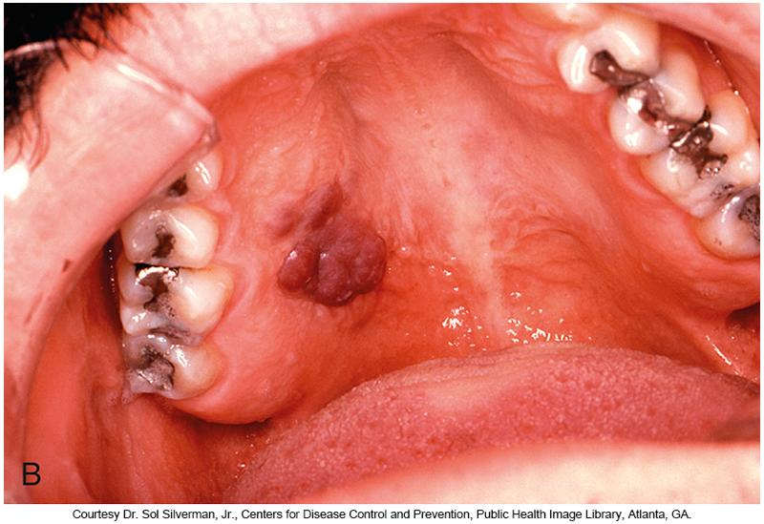
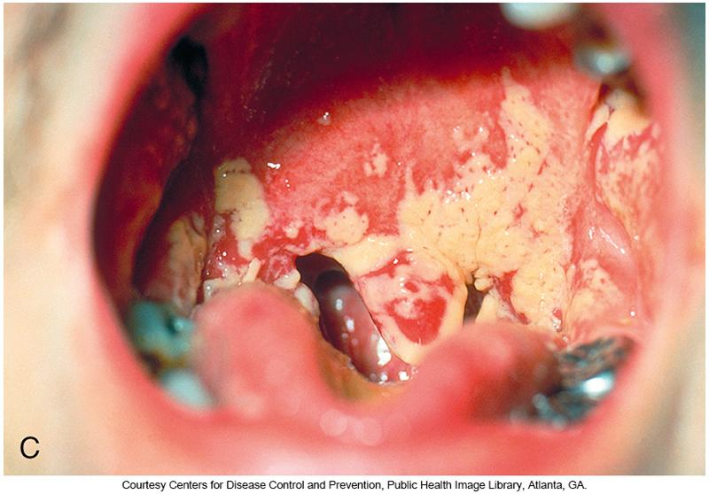
AIDS—Defining Illness

Slide 124
HIV
Laboratory Diagnosis
Specimen types
  Blood, serum, plasma, urine, oral fluid
Repeated positive screening results (EIA) followed by confirmatory testing
    Western blot or IFA detection
Antibodies against HIV are not detectable until 4.5 to 6 weeks after initial infection
Newer screening assays detect anti-HIV IgG and IgM – detectable within 2 weeks after infection

Slide 125
HIV
Laboratory Diagnosis (Cont.)
August 2013- first FDA-approved rapid test
  Determine HIV-1/2Ag/Ab Combo assay
  Detects HIV-1 p24 antigens and HIV-1 and HIV-2 antibodies
  Test does not distinguish HIV-1 from HIV-2
2013-first FDA-approved home testing kit
  OraQuick in-home HIV test
  Specimen: saliva
The FDA does not have published guidelines for Point of Care (POC) testing
See textbook for more details on these tests

Slide 126
HIV
Treatment
Current protocol
  Begin aggressive antiviral therapy when infection is diagnosed, even in the absence of symptoms
  Patient counseling to encourage lifestyle changes
    Quit smoking
    Reduce alcohol intake
    Eliminate the use of illegal drugs
    Practice safe sex
    Avoid spreading HIV
    Avoid acquiring other infectious agents
Advances in treatment improved prognosis
  Highly reactive antiviral therapy (HAART)

Slide 127
HIV Medicines

Slide 128
Clinical & Diagnostic Microbiology
Genitourinary Infections – II
Genital Infections & Sexually Transmitted Infections
Other Sexually Transmitted Diseases (STDs)

Slide 129
Genital Warts
Cause
  Human papillomavirus (HPV)
Epidemiology
  Most common sexually transmitted viral STI in the United States
  Two separate genotype groupings
    Genital warts
      HPV types 6 and 11
    Cervical cancer

Slide 130
Genital Warts
Clinical Manifestations
Development of warts in the moist and dry areas of the genitals
  Small bumps that can be raised or flat, single or in groups, small or large, and sometimes cauliflower shaped
  Cauliflower-shaped genital warts in moist regions
    Condylomata accuminata
Wart locations
  Vulva, vagina, anus, cervix, penis, scrotum, and groin or thigh

Slide 131
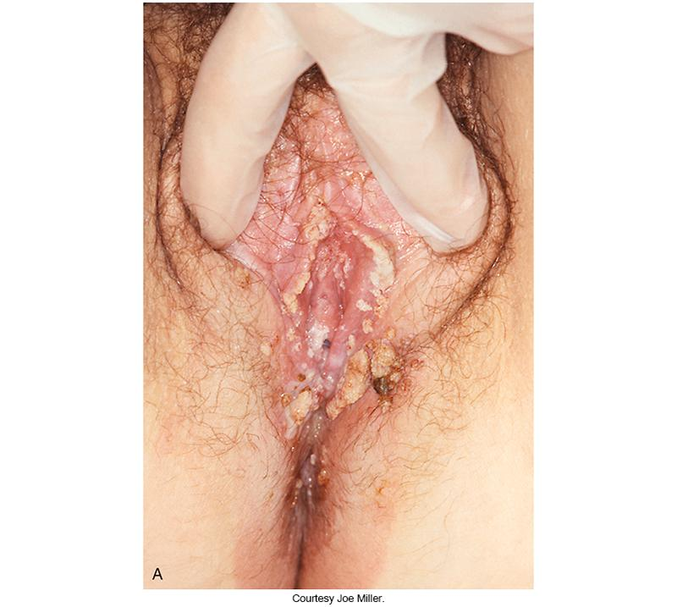
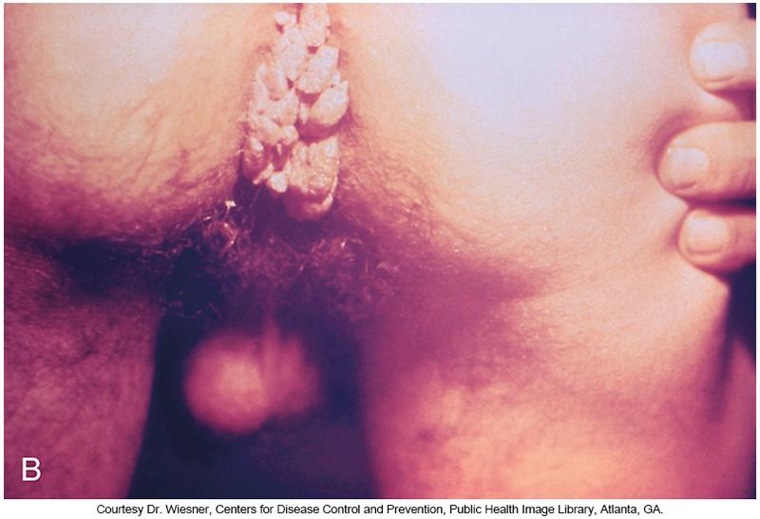
Genital Warts on the Labia
Caused by HPV

Slide 132
Genital Warts
Laboratory Diagnosis
Diagnosis
  Diagnosis of genital warts is made on physical examination.
    Flat warts can be diagnosed by applying a weak acetic acid solution to suspected areas
      Causes infected areas to whiten and become more visible
      Not a very sensitive means of diagnosis
  Tissue biopsies may be performed as confirmation.

Slide 133
Genital Warts
Treatment
There is no permanent cure for HVP.
  Recurrences may be found in skin near the initial site.
Treatment methods
  Cryotherapy with liquid nitrogen
  Bichloroacetic or trichloroacetic acid
  Topical medications
  Routine screenings

Slide 134
Genital Warts
Treatment (Cont.)
To reduce risk of acquiring genital warts
  Abstinence
  Practice safe sex
  Regular Pap smear screening for women
  Vaccination
    Licensed in the U.S.-Cervarix and Gardasil, Gardasil 9; only Gardasil 9 is currently available
    Approved for females and males ages 9 to 26 years

Slide 135
Viral Hepatitis
Epidemiology
Viral hepatitis
  Spread via contact with blood, semen, vaginal secretions, and other body fluids of an infected individual.
  Affects liver functions
  May progress to hepatocellular cancer or liver failure
Three hepatitis viruses can be sexually transmitted.
  Hepatitis A (HAV)—Spread via fecal-oral contact
  Hepatitis B (HBV)—Spread via contact with blood, semen, vaginal secretions, and other body fluids of an infected individual
  Hepatitis C (HCV)—Spread via contact with an infected person’s blood

Slide 136
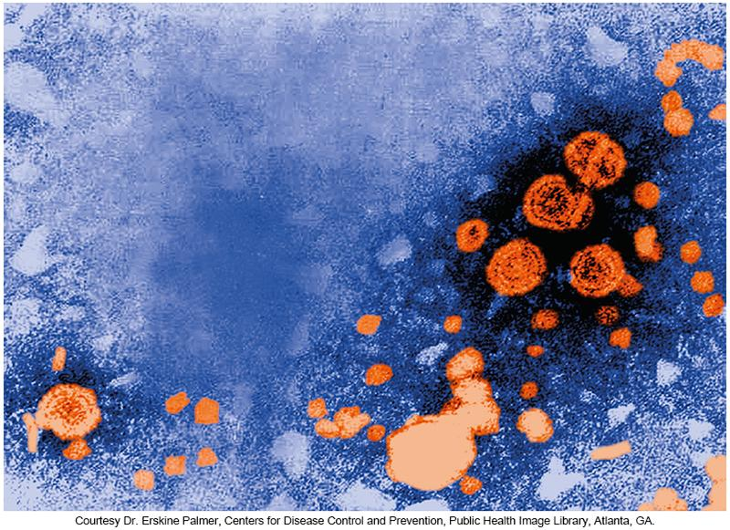
Digitally Colorized Transmission Electron Micrograph of HBV Virions

Slide 137
Viral Hepatitis
Clinical Manifestations
Acutely infected patients are often asymptomatic or have mild self-limiting symptoms that are hard to recognize
Symptoms when present
  Short, mild, flulike illness along with fatigue, nausea, vomiting, and diarrhea
    May recognize a loss of appetite, unintentional weight loss, and abdominal pain
    Hallmark feature—jaundice
      Skin and the whites of eyes appear yellow.
    Patients produce darker yellow urine and pale or clay-colored stools.

Slide 138
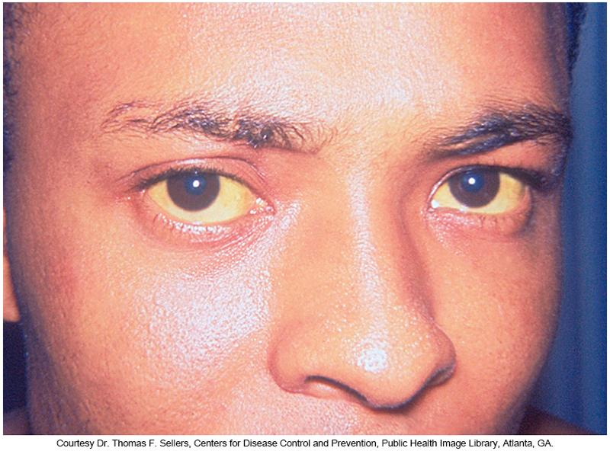
Patient Infected by Hepatitis A

Slide 139
Viral Hepatitis
Diagnosis
Initial screening tests are performed to diagnose infection.
  Acute hepatitis panel
    IgM anti-HAV, IgM anti-HBc, HBsAg, anti-HCV, HIV RNA
If screening result is positive for IgM anti-HAV, infection can be diagnosed
HBV testing relies on two tests
  Detection of anti-HBc
    Antibodies against the core= previous exposure
  Detection of HBsAG
    Antigens indicate HBV virions are circulating

Slide 140
Viral Hepatitis
Diagnosis
In patients with HCV, HCV RNA is detectable before the appearance of anti-HCV
Additional serology tests are used to identify the status of infection for HBV or HCV such as
  Acute or chronic infection.
  Whether or not an individual was previously vaccinated against HBV.
Molecular testing may also be done.
  Determines the presence of viral nucleic acid
  Confirmatory test for HCV infection
Viral load testing for HBV or HCV- therapy monitoring

Slide 141
Viral Hepatitis
Treatment
HAV
  No specific treatment
  Acute infections is typically self-limiting and only requires supportive therapy.
  A vaccine is available and recommended for those at greatest risk of disease.
HBV and HCV
  Antiviral agents
  HBV vaccine is available.
  Supportive therapy when indicated

Slide 142
Pelvic Inflammatory Disease (PID)
PID
  A group of diseases affecting the female reproductive organs
  Common complication of cervicitis in women who have mainly acquired the bacterial STIs chlamydia and gonorrhea
Epidemiology
  More than 1 million women annually are estimated to develop PID; of them, over 100,000 may become infertile.

Slide 143
PID
Clinical Manifestations
May present as a conglomeration of several diseases of the female upper genital tract
  Endometriosis, salpingitis, tubo-ovarian abscess, and pelvic peritonitis
Commonly recognized symptoms
  Lower abdominal pain, fever, vaginal discharge, painful intercourse, pain on urination, irregular menstrual bleeding
Serious complications if PID is unrecognized
  Caused by permanent damage to the reproductive organs

Slide 144
PID
Diagnosis
Difficult to diagnose because of a lack of specific symptoms
No specific tests for PID
Diagnosis is usually made based on a physical examination and clinical findings.
Laboratory tests should be ordered to confirm infection with causative agents.
CDC recommends annual screening for all sexually active women 25 years and younger, all women in high-risk categories, all pregnant women

Slide 145
PID
Treatment
Antimicrobial agents that are active against the specific causative organisms
Broad-spectrum antimicrobials are used to promote action against multiple infections.
Regimen should include agents active against gonorrhea and chlamydia

Slide 146
Molluscum Contagiosum
Common skin disease caused by the molluscum contagiosum virus
Poxvirus that can easily be spread through direct skin-to-skin contact or through contact with contaminated objects
When located in the genital area, it is considered an STI.
Common manifestation in patients with HIV infection-may signal immunosuppression

Slide 147
Molluscum Contagiosum (Cont.)
Common symptom
  Small umbilicated papule that can become red and inflamed
  Papules can be easily removed when scratched or rubbed, spreading the infection to other body areas
Diagnosis
  Clinical, confirmed by microscopic analysis
Treatment
  Removal of papules-scraping, freezing, laser therapy

Slide 148
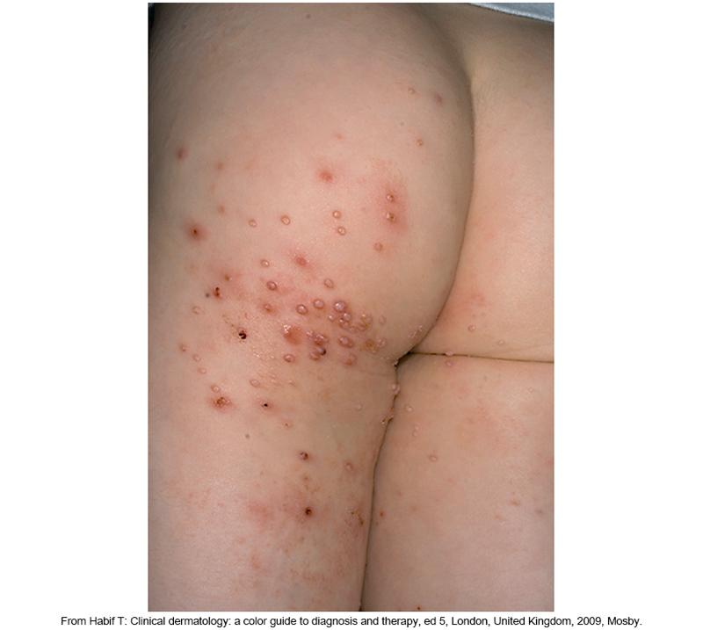
Lesions of Molluscum Contagiosum on the Leg and Buttocks
Notes:
148

Slide 149
Epididymitis
Inflammation of the epididymis
  Affects men usually between the ages of 19 and 35 years
Generally, a complication of infection with chlamydia or gonorrhea
Common signs and symptoms
  Scrotal inflammation, testicular pain and tenderness, pain on urination or intercourse, chills and fever, lymphadenopathy, penile discharge, blood in the semen
Copyright © 2015 by Saunders, an imprint of Elsevier Inc.

Slide 150
Epididymitis (Cont.)
Men who engage in high-risk sexual behaviors and previously had STIs are at the greatest risk of developing epididymitis
Diagnosis
  Based on clinical findings and Gram-stained smears of urethral secretions, positive leukocyte esterase urine test, or >10 WBCs per high-power field
Treatment
  Antimicrobial agents

Slide 151
Proctitis
Inflammation of the rectal lining mainly caused by the STIs.
  Chlamydia, gonorrhea, syphilis, HSV, HPV
Most common in people who engage in anal or oral-anal intercourse.
Symptoms
  Rectal bleeding, mucus passage, anal and rectal pain, diarrhea, pain with bowel movements
Treatment
  Antibacterial or antiviral agents

Slide 152
Points to Remember
STIs are caused by a wide variety and diverse group of organisms including bacteria, viruses, protozoa, epizoa, and fungi.
Many patients can be infected by more than one STI-related organism. Therefore, it is recommended to perform an HIV test on all patients suspected of having an STI.

Slide 153
Points to Remember (Cont.)
Testing for syphilis requires positive nontreponemal and treponemal test results before infection is confirmed. Some facilities may perform the tests in reverse order.
Clinical manifestations and presentations of the diseases are varied; some may be described as exudative, while others produce non-exudative lesions.

Slide 154
Points to Remember (Cont.)
Some STIs are asymptomatic.
STIs are the main preventable cause of infertility in women.
The epidemiology and pathogenesis of each infection may serve as useful tools in providing guidance with regard to specimen collection, transport, and handling, as well as methods for identification.

Slide 155
Points to Remember (Cont.)
The method and site of collection, quality of the clinical specimen, and clinical presentation are all important factors to consider when determining the causative agent of STIs.
HAART, when properly prescribed and used, can improve the quality of life and increase the longevity of those infected.

Slide 156
Points to Remember (Cont.)
Molecular testing methods demonstrate increasing sensitivity of detection. By using noninvasive sampling, such as voided urine, more patients and contacts will present for screening assays, with the potential to reduce the sequelae of long-term infection through earlier treatment.

