Slide 1
Clinical & Diagnostic Microbiology
GI, Skin, Soft Tissue & Wound
Skin/Soft Tissue (Wound) Infections - I

Slide 2
Skin Description and Functions
The body’s first line of defense against microbial invasion
A dynamic physical barrier
Undergoes continual epithelial cell turnover
Removes substances as well as potentially pathogenic microorganisms on its surface
Colonized with a variety of resident microbes that perform a protective function

Slide 3
What’s Ahead?
The role of indigenous skin biota and other organisms in the pathogenesis of skin infection
The clinical features and causes of systemic infections
The dermatologic manifestations of systemic infections
The diagnosis and treatment of specific skin and soft tissue infections

Slide 4
Clinical & Diagnostic Microbiology
Skin/Soft Tissue (Wound) Infections
Anatomy of the Skin

Slide 5
Anatomy of the Skin
Epidermis
Outer most layer (stratum corneum) is composed of several layers of epithelial cells
Contains dead cells consisting of a protein called keratin
Dermis
Second skin layer
Thick layer composed of connective tissue
Contains sweat gland ducts, hair follicles, and oil gland ducts

Slide 6
Anatomy of the Skin (Cont.)
Sebum and perspiration provide moisture and nutrients necessary for the growth of certain microbes.
The salt and lysozymes contained in perspiration and fatty acids found in the sebum can inhibit the proliferation of pathogenic microorganisms.

Slide 7
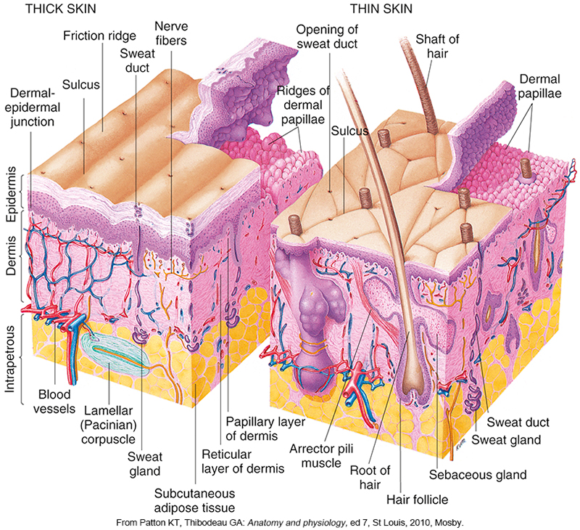
Anatomy of the Skin

Slide 8
Skin Microbiota
The usual biota of the skin adapt to high salt, exposure to the elements and relative lack of nutrients.
Normal residents of skin biota
An array of bacteria, fungi, and viruses
These microbes may act as competitive inhibitors of pathogenic organisms.
Breaks in the skin allow normal biota to cause infection and transient organisms to enter and cause disease.

Slide 9
Skin Biota (Cont.)
Typical resident members of skin biota
Gram-positive cocci
Staphylococcus epidermidis
Streptococci
Gram-positive bacilli
Cutibacterium acnes
Corynebacterium
Fungi
Candida and Malassezia
Staphylococcus aureus
Transient colonizer

Slide 10
Skin Biota (Cont.)
Resident microbiota colonization is not eliminated during vigorous washing.
The acidic pH of skin (~5.0) inhibits many common skin pathogens.

Slide 11
Clinical & Diagnostic Microbiology
Skin/Soft Tissue (Wound) Infections
Localized Bacterial & Fungal Infections

Slide 12
Introduction
Bacteria are the cause of most skin infections.
Antimicrobial resistance has made them more difficult to treat.
Staphylococcus aureus is one of the most common.
Other bacteria that display multidrug resistance include Pseudomonas aeruginosa, Enterococcus, beta-hemolytic Streptococcus, Escherichia coli, and Enterobacter spp.

Slide 13
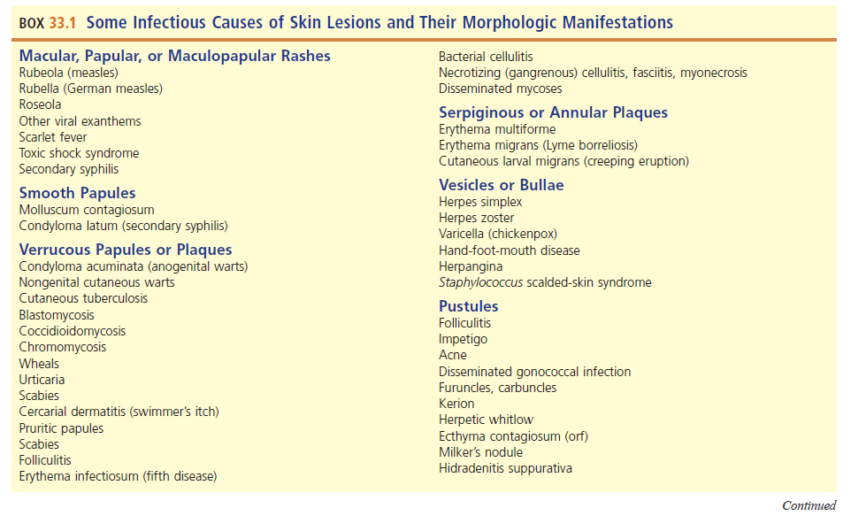
Some Infectious Causes of Skin Lesions and their Morphologic Manifestations

Slide 14
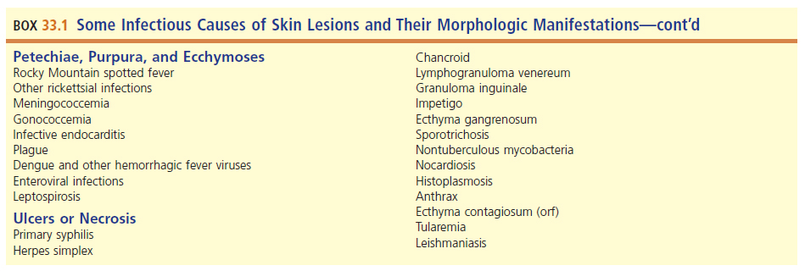
Some Infectious Causes of Skin Lesions and their Morphologic Manifestations (Cont.)

Slide 15
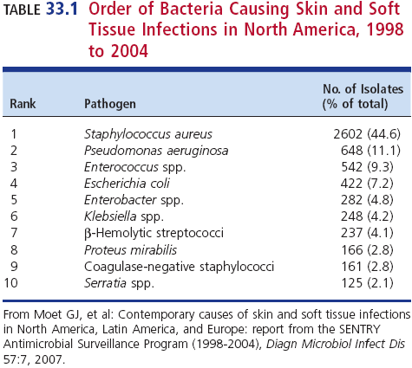
Order of Bacteria Causing Skin and Soft Tissue Infections in North America 1998 to 2004

Slide 16
Classification of Skin and Soft Tissue Infections
There are multiple classification methods.
Appearance of the skin lesion, which provides an important clue about possible causative organisms
How the infections manifest themselves
Systemic disease
Primary skin process
May be further categorized by structure affected and further subdivided by causative organism (bacteria, viral, mycobacterial, fungal, parasitic)

Slide 17
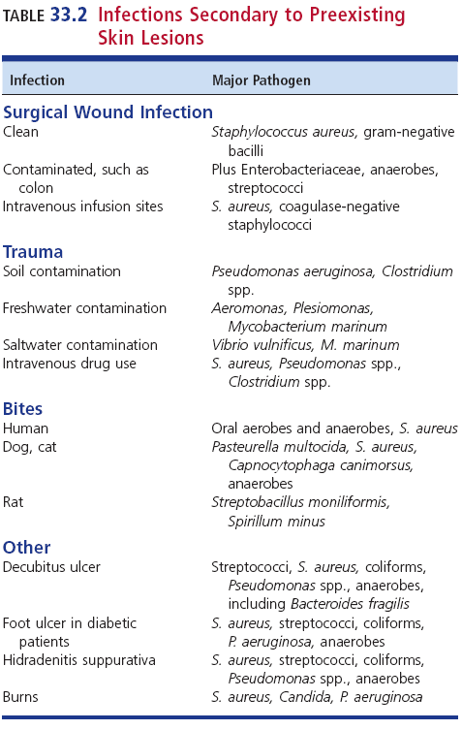
Infections Secondary to Preexisting Skin Lesions

Slide 18
Organization of this Discussion
Examination of clinically important and prevalent infections of skin and soft tissues that typically occur in localized areas of the body
Presented in order from most superficial infection to the deeper, more serious infections
Primarily bacterial and fungal in nature
Skin manifestations of systemic infections
Bacteria, fungi, viruses, parasites
Immune- or toxin-mediated dermatologic diseases triggered by pathogens

Slide 19
Dermatitis
A general term that describes an inflammation of the skin
Characterized by areas of redness, swelling, and sometimes scaling of the skin and pruritus
Many causes, only some of which are related to infection

Slide 20
Intertrigo and Superficial Candidiasis
Intertrigo
Inflammatory cutaneous condition that occurs in body areas subjected to heat, moisture, and friction, which work together to cause maceration and skin breakdown
E.g., diaper rash due to Candida albicans
Occurs in the skin folds, typically the axillae, perineum, beneath the breasts, and in abdominal folds
Risk factors: obesity, incontinence, diabetes, compromised immunity, extremes of age

Slide 21
Thrush and Erythrasma
Thrush
Candidiasis involving the oral mucosa; characterized by white, curdlike patches on the tongue, palate, or buccal mucosa
Vaginitis is similar in the vulvovaginal area.
Balanitis–an inflammation of the glans penis that can spread to the thighs, scrotum, and buttocks

Slide 22
Erythrasma
A superficial, chronic skin infection that manifests as pruritic reddish-brown macules that are lightly scaled and wrinkled
Groin, inner thighs, tow webs
Occurs more often in men, obese individuals, patients with diabetes
Causative agent: Corynebacterium minutissimum
Normal skin resident

Slide 23
Dermatophytoses
Fungi that colonize only keratinized surfaces of the body including hair, nails, and skin
Epidermophyton, Trichophyton, Microsporum, and Nannizzia
Commonly called ringworm or tinea, followed by site
Tinea pedis—athlete’s foot
Tinea cruris—jock itch
Tinea capitis—scalp
Tinea corporis– body in general, often in trunk and legs
Tinea versicolor-caused by normal skin commensals

Slide 24
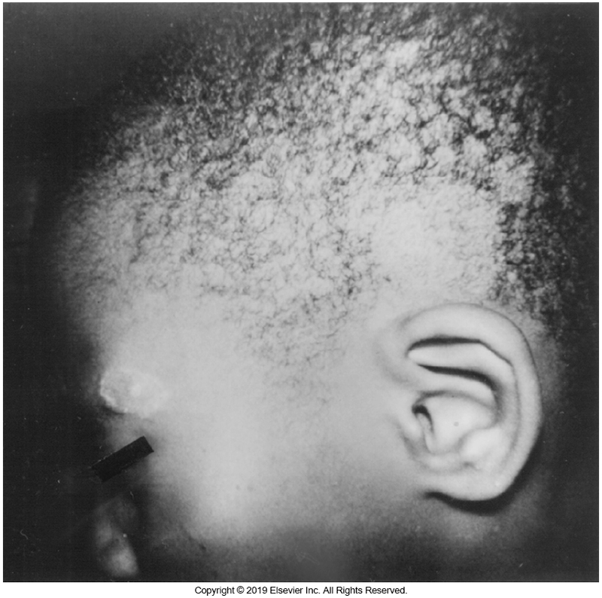
Tinea Capitis

Slide 25
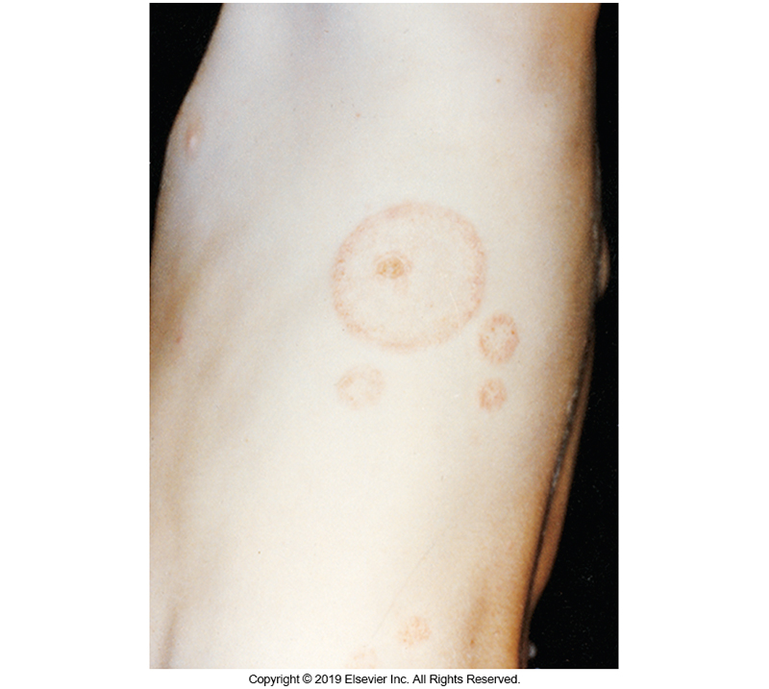
Tinea Corporis

Slide 26
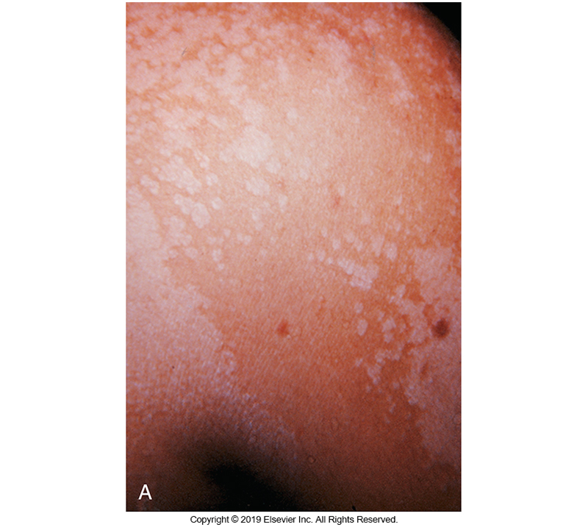
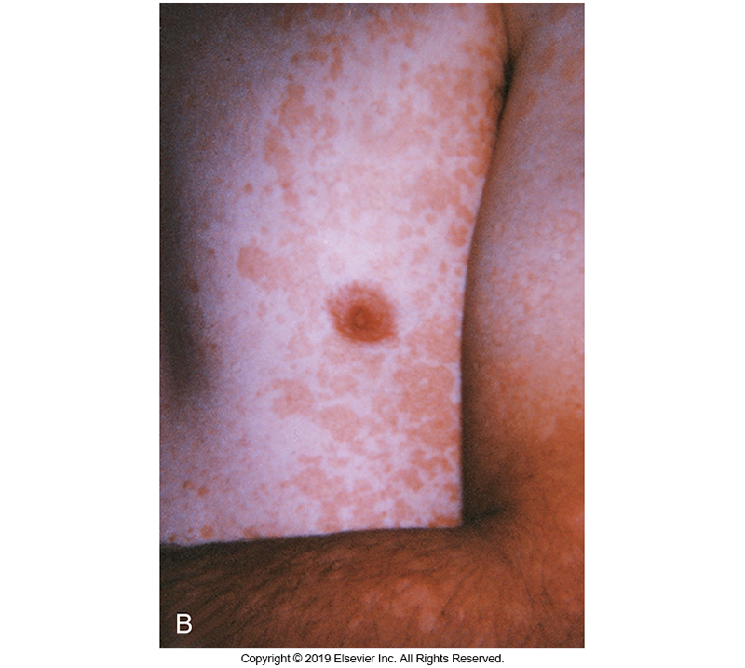
Tinea Versicolor Hypopigmented (L), Hyperpigmented (R)

Slide 27
Pyrodermas
Primary pyodermas
A group of inflammatory skin disorders caused by bacteria that produce pus
Impetigo is often used interchangeably with pyoderma.
Note: There are other forms of pyoderma.

Slide 28
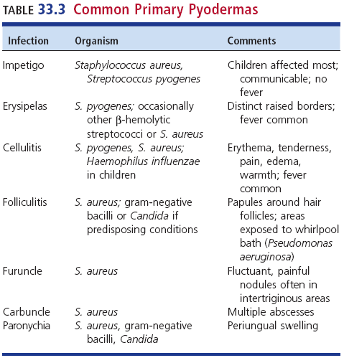
Common Primary Pyodermas

Slide 29
Impetigo
Causes
Group A streptococci (GASs)
Staphylococcus aureus (including MRSA)
Symptoms
Small vesicles that become pustules that rupture
Discharge is thick and yellow and dries to form a classic golden crust.
Superficial, painless, but pruritic
Bullous impetigo
Caused by strains of S. aureus that produce exfoliative toxins

Slide 30
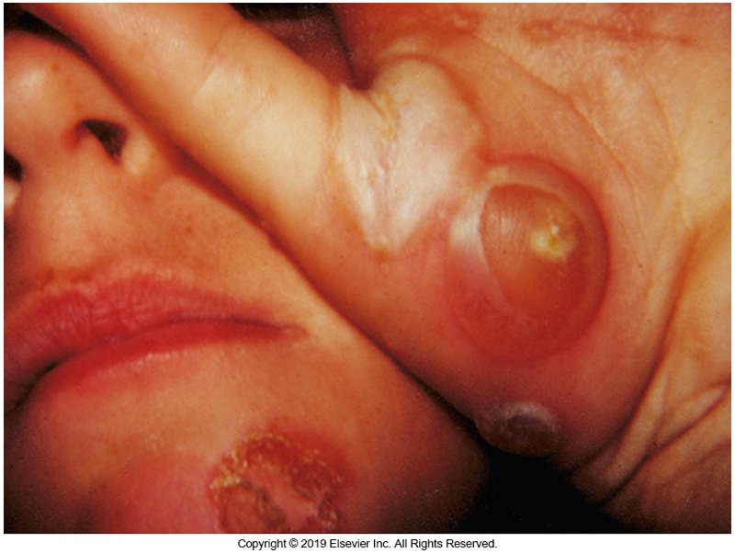
Bullous Impetigo Caused By Staphylococcus aureus

Slide 31
Erysipelas
Superficial cellulitis that involves the epidermis, dermis, and lymphatic channels
Painful, indurated areas of inflammation with raised borders that are sharply demarcated from adjacent normal skin
Bright red to crimson hue with fever
Most cases caused by GAS
Other causes, other β-streptococci and Staphylococcus aureus

Slide 32
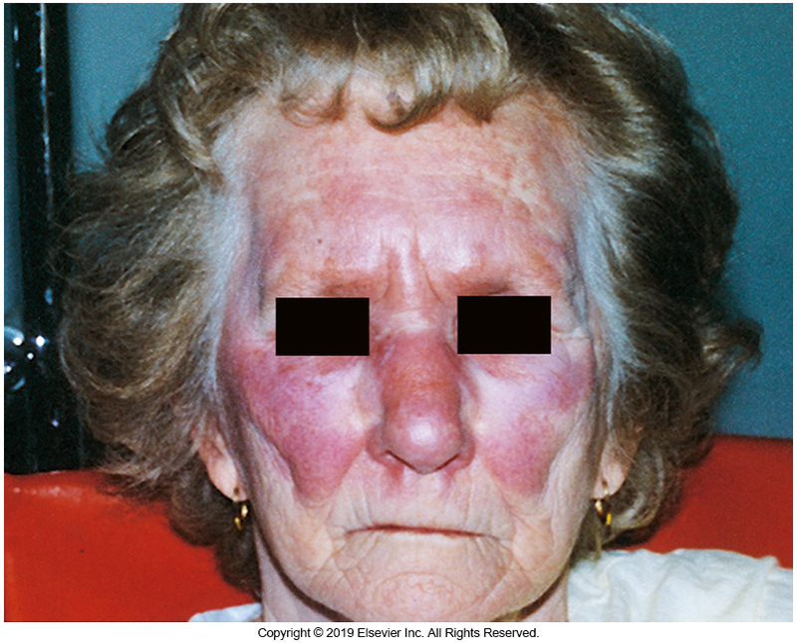
Erysipelas caused by Staphylococcus aureus

Slide 33
Erysipeloid
Superficial soft tissue infection caused by Erysipelothrix rhusiopathiae
Usually through traumatic break in the skin
Occupational hazard of handlers of animals, meat, poultry, hides, and saltwater fish
Fingers and dorsum of hand are most frequent sites of infection.
Mimics erysipelas
Possible complications–septic arthritis, bacteremia

Slide 34
Anthrax
Causative agent
Bacillus anthracis
Acute febrile illness that causes skin lesions
Types of anthrax
Cutaneous–ulcerative disease
Pulmonary or systemic infections
Skin lesions
Face, neck, arms, sites of minor abrasions
Painless and evolve causing possible regional lymphadenopathy and bacteremia with fever and hypotension

Slide 35
Anthrax (Cont.)
Caused by Bacillus anthracis, a gram-positive rod that can cause ulcerative skin lesions called eschars
Associated with people working with animal products that are contaminated with Bacillus anthracis spores
Skin lesions often seen on the face, neck, arms

Slide 36
Cellulitis
Diffuse inflammation and infection of
Superficial skin layers
Subcutaneous tissue
Extends deeper in the soft tissues than erysipelas
Appears as painful erythema, warmth, edema of the skin with poorly defined margins
Drainage of pus may occur (purulent cellulitis)
Usually caused by S. aureus, GAS (group A streptococci)

Slide 37
Cellulitis (Cont.)
Possible symptoms
May or may not be accompanied by fever or other symptoms of systemic infection
Malaise, rigors, headache, elevated WBC count
Predisposing factors
Surgery
Other trauma
Underlying skin disorders
E.g., ulcers or dermatitis

Slide 38
Cellulitis (Cont.)
Blood cultures are usually negative
Diagnosis is often made clinically based on the appearance of the affected area.
Needle aspirations may be done on select patients.
Immunocompromised
Individuals who do no respond to empiric antimicrobial therapies

Slide 39
Recurrent Cellulitis
Risk factors
Obesity, venous status, untreated tinea pedis
Mode of entry
Breaks in the skin
Patients with frequent recurrent cellulitis may be treated with long-term suppressive antimicrobial regimens to decrease infection rate.

Slide 40
MRSA Infections and Paronychia
MRSA infections
Community acquired
Hospital acquired
Paronychia
Infection of the cuticle surrounding the nail bed
Usually through minor skin wound
Removing a hangnail
Nail margin becomes painful, red, warm, and swollen, and pus may be expressed.

Slide 41
Folliculitis
Folliculitis
Inflammation and infection of hair follicles
S. aureus, Pseudomonas aeruginosa
In immunocompromised hosts—Candida, Malassezia, or gram-negative bacteria
Lesions appear small, erythematous papules may be pruritic, and they often evolve to form pustules with a whitish or yellowish central zone

Slide 42
Furuncles
Furuncles
Occurs when folliculitis progresses to form deeper inflammatory nodules.
Prefers warm, moist areas of the body and areas subject to friction
Initially red and firm but soon become painful and fluctuant and generally drain spontaneously
Most common pathogen: S. aureus

Slide 43
Staphylococcus aureus Furuncle of the Breast

Slide 44
Carbuncles
Carbuncles
Serious lesion that extends into the subcutaneous fat and consists of multiple coalescing abscesses that can drain at several adjacent sites along hair follicles
Commonly occur at the nape of the neck and back of the thighs
Symptoms–fever and other symptomatic symptoms
Complication–bacteremia
Causative agent–S. aureus -MRSA

Slide 45
Hidradenitis Suppurativa
Hidradenitis suppurativa
Difficult-to-treat recurrent infection of the apocrine sweat glands
Nodular, tender, erythematous swellings that become fluctuant and drain
Often associated with fever and tender lymphadenitis, can also cause scarring

Slide 46
Bite Infections
May be from humans or animals
Often quite severe and polymicrobial
Examples of common aerobic and anaerobic pathogens
S. aureus, Streptococcus anginosis, Eikenella corrodens, Fusobacterium nucleatum, Prevotella melaninogenica

Slide 47
Diabetic Foot Infection Risk Factors
Peripheral neuropathy
Trauma to the feet
Inadequate blood sugar control
Compromised peripheral vascular circulation caused by diabetes
Impairment of kidney function
Improper foot care
Walking barefoot
Ill-fitting shoes

Slide 48
Diabetic Foot Infection Manifestations
Cellulitis
Typically caused by staphylococci or streptococci
Acute or chronic soft tissue ulceration
With or without underlying bone infection
Gas gangrene
May be caused by staphylococci or streptococci, or mixed infections of other bacteria such as Enterobacterales, Pseudomonas, gram-positive bacilli, and anaerobes (notably Clostridium perfringens).

Slide 49
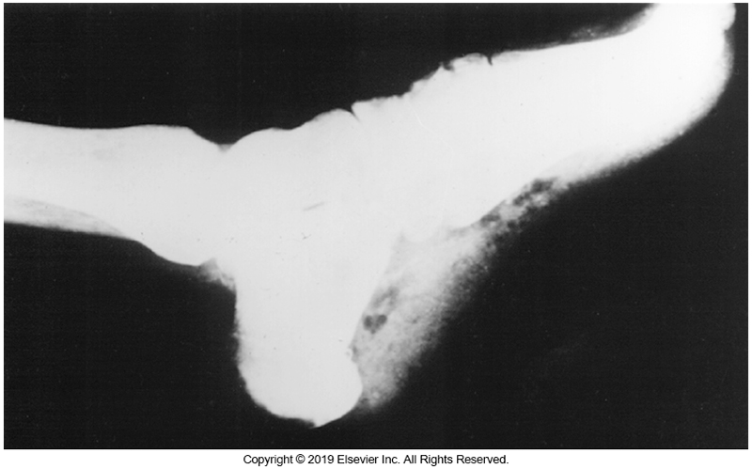
Diabetic Foot Infection with Soft Tissue Gas Formation

Slide 50
Necrotizing Soft Tissue Infection
Infections that produce tissue necrosis and soft tissue gas can be life-threatening.
Categories based on level of tissue involvement
Superficial, epidermal or dermal structures
Fascia
Muscle
Subtypes of infections (infectious gas gangrene)
Polymicrobial fasciitis
Enterobacterales and anaerobes

Slide 51
Necrotizing Soft Tissue Infection (Cont.)
Subtypes of infections (infectious gas gangrene)
Monomicrobial fasciitis
S. pyogenes
Type II less common–S. aureus, younger, previously healthy individuals, infections often involve the extremities
Gas gangrene (type III, a.k.a. clostridial myonecrosis)
Clostridium spp., especially Clostridium perfringens
Other possible causative agents
Vibrio vulnificus, Aeromonas hydrophila

Slide 52
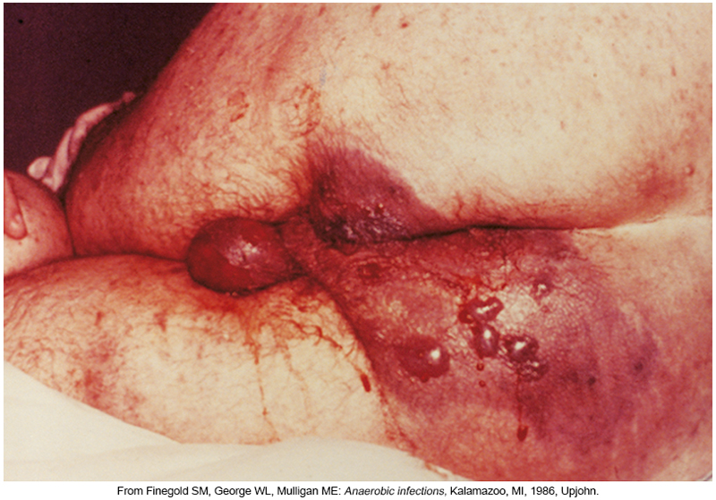
Clostridial Myonecrosis (Gas Gangrene)

Slide 53
Mycetoma
Madura foot or maduromycosis
Chronic skin/subcutaneous infection caused by bacteria or fungi
Known as eumycetoma or true fungal infection
Causes
Madurella spp., Aspergillus spp. or Pseudallescheria boydii, Nocardia spp., or Actinomadura spp.

Slide 54
Mycetoma (Cont.)
Symptoms
Swelling and suppuration of subcutaneous tissues and formation of sinus tracts, with visible granules formed by aggregates of organisms in the pus draining from these fistulae
Slowly progressive and destructive with extension to muscle and bone
Diagnosis
Based on clinical appearance, microscopic examination, culture

Slide 55
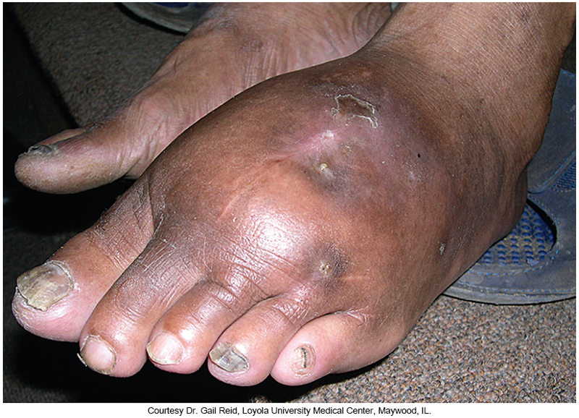
Madura Foot

Slide 56
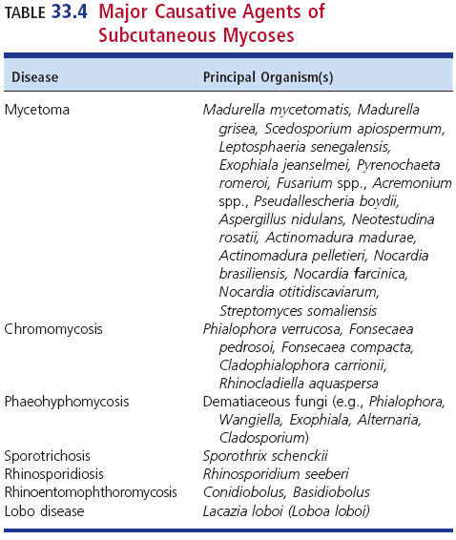
Major Causative Agents of Subcutaneous Mycoses

Slide 57
Chromoblastomycosis (a.k.a. Chromomycosis)
Chronic spreading mycosis of the skin and subcutaneous tissues
Tropical and subtropical regions of the world
Symptoms
Localized, scaly lesions, usually of a lower extremity from minor trauma
Progression is slow (years) with eventual large warty or cauliflower-like masses and obstruction of lymphatic drainage, leading to swelling

Slide 58
Chromoblastomycosis (a.k.a. Chromomycosis)
Chronic spreading mycosis of the skin and subcutaneous tissues
Causative fungi include: Fonsecaea pedrosoi, Fonsecaea compacta, Phialophora verrucosa, Cladophialophora carrionii, and Rhinocladiella aquaspersa

Slide 59
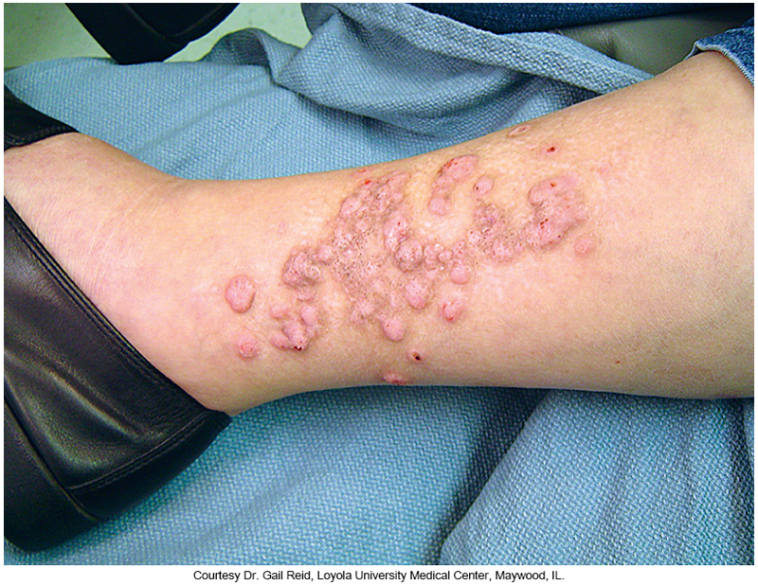
Chromomycosis of the Leg

Slide 60
Phaeohyphomycosis
Infections caused by fungi that produce dark cell walls
Also known as dematiaceous fungi
Referring to brown or black pigmentation
Subcutaneous nodules of skin lesions
Deeper infections-brain abscess, septic pneumonia, sinusitis
Bipolaris, Exophiala, Phialophora, and Curvularia
Found in soil and decaying organic material
Found on plants

Slide 61
Mucormycosis
Disease resulting from members of the order Mucorales
Most common pathogens
Rhizopus, followed by Mucor spp., Rhizomucor, Cunninghamella, Apophysomyces, Lichtheimia
Manifests as a localized cutaneous infection via skin inoculation, sometimes by dissemination by another source (i.e., lung, sinuses, brain or GI tract)

Slide 62
Other Uncommon Fungi Entomophthoromycosis
Members of this fungal order may cause a subcutaneous form of infection
Results from traumatic implantation of the organisms in the skin
Conidiobolus coronatus, Conidiobolus incongruous, and Basidiobolus ranarum
Diagnosis
Clinically based on the typical skin and soft tissue findings, with confirmation via biopsy

Slide 63
Rhinosporidiosis
Chronic, usually painless infection of humans and animals that occurs as mucosal polyps of the nasopharynx and conjunctiva
Causative agent is Rhinosporidium seeberi.
Organism has never been cultured.
Nucleic acid analysis has shown that this organism is a protist that is related to other protist parasites.
Found in freshwater

Slide 64
Lobomycosis
Chronic fungal infection of the skin caused by Lacazia loboi
Manifest as slowly forming skin nodules of various sizes
Organism has never been isolated in culture.
Reside in soil, vegetation, or water and infect humans via skin trauma
Have been known to infect farmers, hunters, and jungle workers

Slide 65
Nodular Lymphangitis Characteristics
Also known as lymphocutaneous syndrome
Inflammatory nodules that occur along lymphatic vessels that drain an area of primary skin infection
Organisms associated with nodular lymphangitis include
Sporothrix schenckii, Nocardia, and mycobacteria.

Slide 66
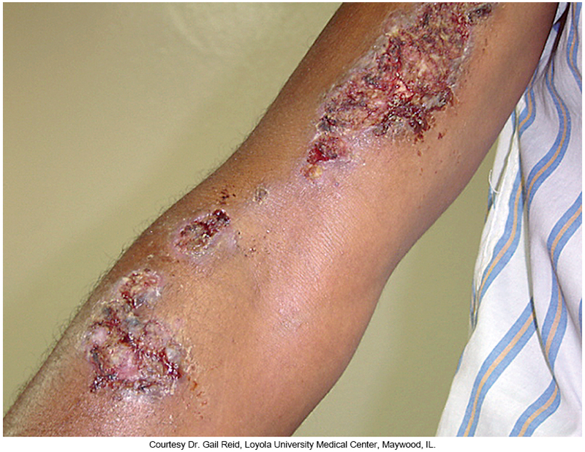
Nodular Lymphangitis Caused by Sporotrichosis with Ulceration

Slide 67
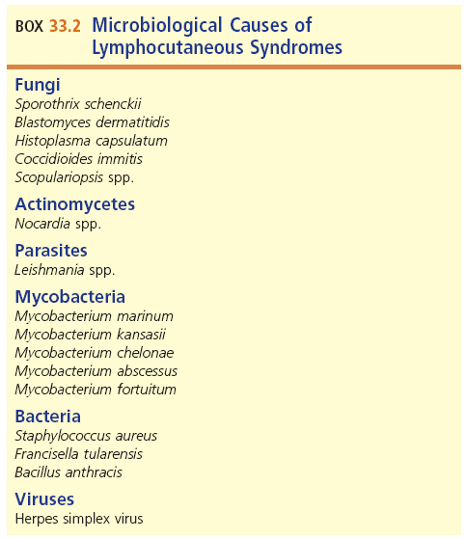
Agents of Nodular Lymphangitis

Slide 68
Sporotrichosis
Causative agents
Sporothrix schenckii complex–S. schenckii, S.brasiliensis, S. globose, S. Mexicana, and S. luriei
Most frequently recognized cause of nodular lymphangitis through inoculation of the skin
Dimorphic fungus
Classically an occupational disease of gardeners, farmers, and horticulturalists

Slide 69
Sporotrichosis (Cont.)
Usually localized to skin and subcutaneous tissue
Dissemination to bone, lungs, brain, and other organs can occur in immunocompromised person.
Pulmonary disease can occur via inhaling S. schenckii complex conidia are inhaled.

Slide 70
Nocardiosis
Causative agent—Nocardia spp.
Ubiquitous in the environment and may be found in soil, water, and vegetation
Mode of transmission
Direct cutaneous inoculation
Manifestation ranges from lymphocutaneous syndrome to subcutaneous abscesses, cellulitis, and mycetoma.

Slide 71
Mycobacterial Infection Nontuberculosus Mycobacteria (NTM)
Causes cutaneous disease including nodular lymphangitis
Transmission occurs via
Puncture wounds, motor vehicle accidents, injections, and surgery
Skin infections may result from the hematogenous spread of infection.

Slide 72
Mycobacterial Infection (Cont.)
M. marinum
Swimming pool or fish tank granuloma
Enters through wound or traumatic break in the skin
Solitary red-purple lesions appear 2 to 3 weeks post exposure.
Arms and legs
Papular or nodular–can become wartlike or ulcerated
Infection can progress to lymphcutaneous syndrome.
Diagnosis–biopsy and culture of skin lesion and patient history

Slide 73
Mycobacterial Infection (Cont.)
M. chelonae
Usually seen in immunocompromised patients
M. fortuitum
Usually occurs in otherwise healthy persons
M. abscessus complex
Seen in immunocompromised and otherwise healthy presons
Modes of transmission include
Acupuncture, nail salons, tattooing

Slide 74
Mycobacterial Infection (Cont.)
M. ulcerans
Associated with swamps
Single, pruritic ulcer with undermined edges
Called a Buruli ulcer
May be chronic infection with limb deformity in tropic climates
Slow grower in culture–can take up to 12 weeks of incubation

Slide 75
Mycobacterial Infection (Cont.)
M. tuberculosis
Cutaneous tuberculosis
Uncommon
Inoculation of the skin can lead to tuberculosis verrucosa cutis (TVC)
Red or purple papules that become wartlike
Occur in areas of the body prone to trauma

Slide 76
Actinomycosis
Actinomyces spp.
Chronic disease characterized by the formation of abscesses, fibrosis of tissues, and draining sinuses that discharge sulfur granules (masses of organisms)
Primary cause is A. israelii.
Part of normal biota in the mouth and GI and genital tracts
Most common manifestation
Involvement with the face and neck

Slide 77
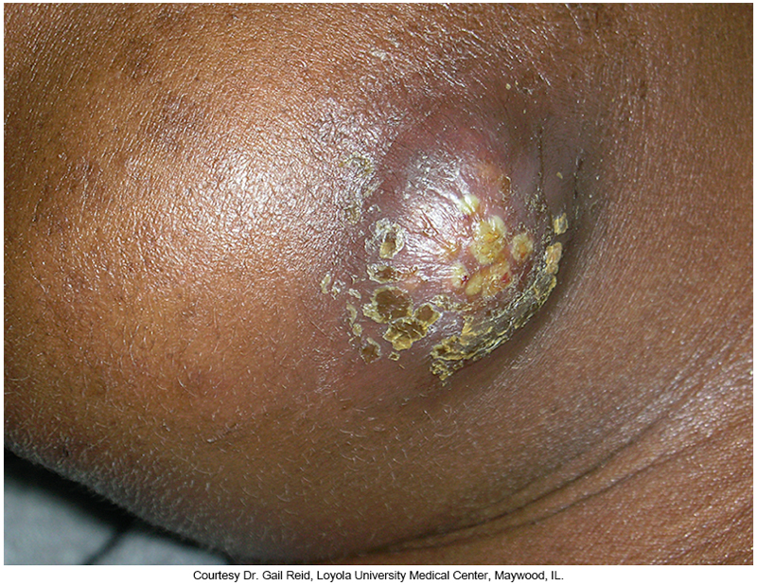
Actinomycosis of the Jaw Following Dental Infection

Slide 78
Clinical & Diagnostic Microbiology
Skin/Soft Tissue (Wound) Infections
Dermatological Manifestations of Systemic Bacteria & Fungal Infections

Slide 79
Overview
Systemic infections can produce skin lesions that may provide diagnostic clues
Bacterial, fungal, parasitic, viral

Slide 80
Bacteria
Pseudomonas infection
Ecthyma gangrenosum
Vibrio infection
V. vulnificus
Hemorrhagic bullae that evolve into ulcers with skin necrosis
Aeromonas spp. infection
Water contamination
Cause a variety of infections beyond cellulitis
Rapidly progressing
Hemorrhagic bullae and skin necrosis
Medicinal leech therapy

Slide 81
Bacteria (Cont.)
Borreliosis–Lyme disease
B. burgdorferi
Erythema migrans (EM)
Treponema infection–Syphilis
T. pallidium subsp. palladium
Primary syphilis–painless chancre
Secondary syphilis–maculopapular rash involving skin and mucous membranes
Mycoplasma
M. pneumoniae
Maculopapular and vesicular rashes
Erythema nodosum and erythema multiforme

Slide 82
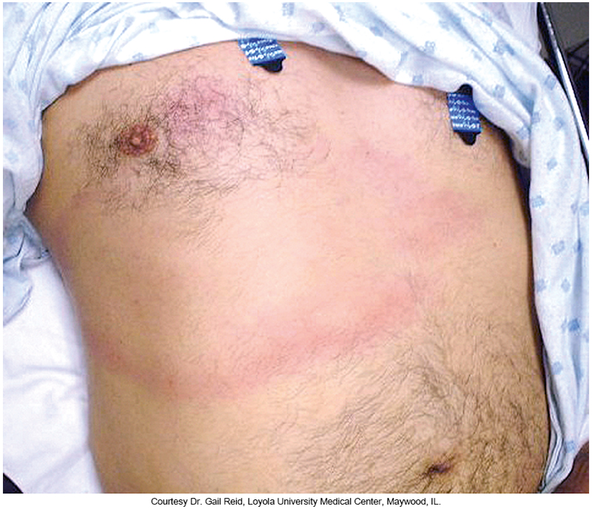
EM Rash of Lyme Disease

Slide 83
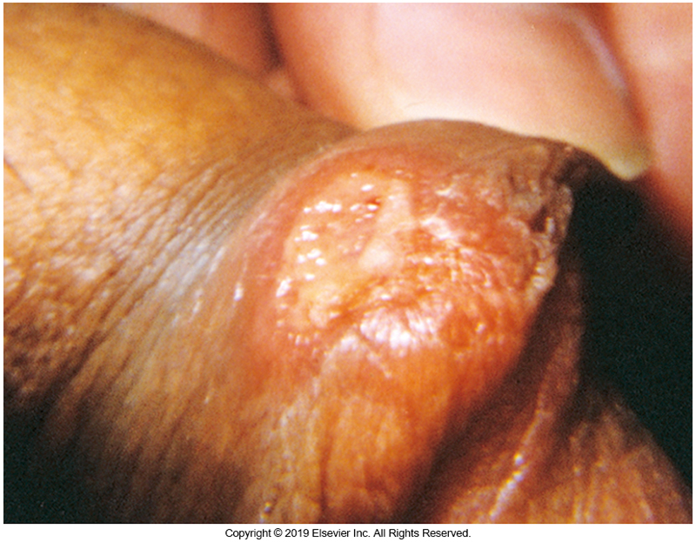
Penile Syphilitic Chancre Caused by T. pallidium spp. pallidum

Slide 84
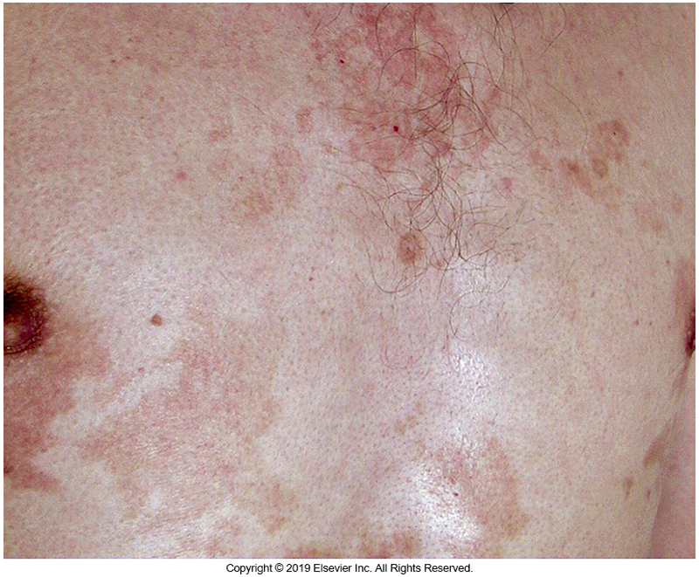
The Rash of Secondary Syphilis

Slide 85
Zoonoses
Diseases transmitted to humans by wild or domestic animals
This section examines the more common systemic bacterial zoonoses that have significant dermatologic manifestations.

Slide 86
Rickettsiosis
Causative agent–Rickettsiae
Characterized by the type and distribution of the associated skin rash and presence or absence of a black eschar at the vector bite site
R. rickettsii: Rocky mountain spotted fever (RMSF)
R. conorii: Boutonneuse fever (Mediterranean spotted fever)
R. akari : Rickettsialpox
R. prowazekii, R. typhi: Typhus fever
Orientia tsutsugamushi: Scrub fever

Slide 87
Rickettsiosis
Common symptoms—high fever, chills, malaise, headache, myalgias, skin rash, and conjunctival injection

Slide 88
Leptospirosis
Causative agent–Leptospira interrogans
Carried in the renal systems of rodents and other mammals including dogs and livestock
Maculopapular rash that may become hemorrhagic
Commonly involves the kidneys, liver and CNS
Can be self-limited illness or fatal with renal and liver failure and pneumonia

Slide 89
Bartonellosis
Most common causative agents
Bartonella henselae–cause of cat scratch disease (CSD)
Bartonella quintana
Both species can cause bacteremia, endocarditis, dermatologic disease of bartonellosis, bacillary angiomatosis (BA)

Slide 90
Rat Bite Fever
Also known as streptobacillosis
Caused by Streptobacillus moniliformis
Spirillosis caused by Streptobacillus minus
Both organisms are normal rodent oral biota.
An abrupt onset of fever and chills, headache, and muscle pain if followed by rash (petechial, vesicular, or pustular) mostly in extremities

Slide 91
Tularemia
Also known as rabbit fever
Caused by Francisella tularensis
Six forms
Glandular
Ulceroglandular
Oculoglandular
Pneumonic
Oropharyngeal
Septic or typhoidal

Slide 92
Tularemia (Cont.)
Type and severity of disease varies and is dependent on
Strain of infecting bacteria, dose, and route of infection
Most common form is ulceroglandular.
Infection is inoculated directly into the skin after handling infected animals or after insect bite.
Painless indolent ulcer often on the hand that may evolve in several directions

Slide 93
Mycobacteria Nontuberculous Mycobacteria
Nontuberculous mycobacteria (NTM) infections may become disseminated.
Usually occurs in the setting of impaired immune function as in patients with HIV and cancer
Patients with central venous catheters may develop NTM catheter-related infections and can disseminate hematogenously to various organs including the skin.
Causative agents
M. fortuitum, M. chelonae, M. abscessus, and M. mucogenicum

Slide 94
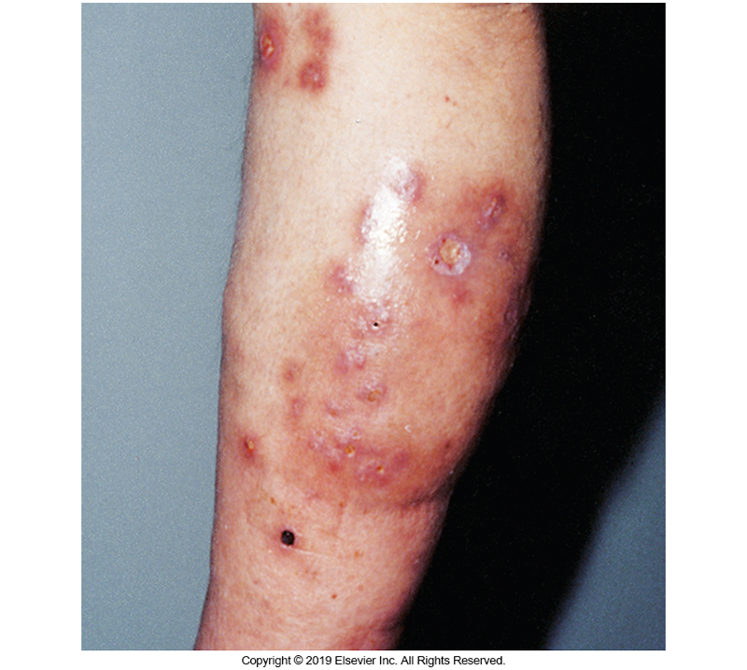
Subcutaneous Nodules and Cellulitis Caused by Disseminated M. chelonae

Slide 95
Mycobacteria Tuberculosis
Mycobacterium tuberculosis (MTB) can spread to the skin through the lymphatic system and bloodstream to distant sites and cause a variety of skin manifestations.
Characteristics
Nodule swellings of the skin forming tuberculosis gummas (skin abscesses) or lupus vulgaris (sharply circumscribed, red-brown plaques or ulcers of the head and neck)
Can destroy cartilage of the nose or ears

Slide 96
Leprosy
Also known as Hansen disease
Caused by M. leprae
There appears to be genetic factors that influence susceptibility to leprosy and the disease manifestations.
Classic skin manifestation
Circumscribed, hypopigmented, or less commonly, hyperpigmented macule

Slide 97
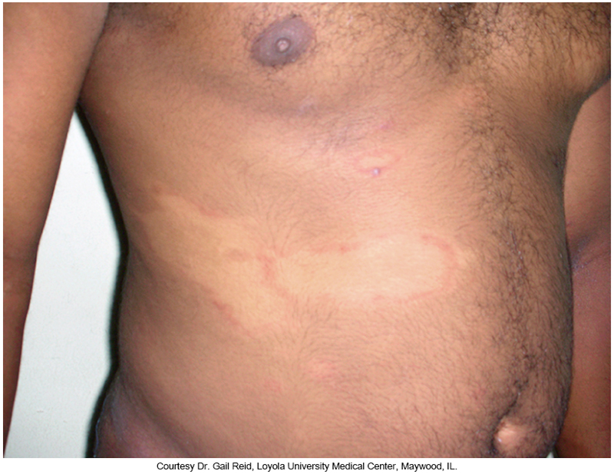
Hypopigmented Macules of Leprosy

Slide 98
Mycobacteria Leprosy (Cont.)
Two polar types of Hansen disease
Tuberculoid or lepromatus
Three recognized gradations between the two polar types
Classification is based on
Number and appearance of skin lesions, nerve involvement, and systemic or mucosal involvement

Slide 99
Mycobacteria Leprosy (Cont.)
Tuberculoid
Few skin lesions with paucity of mycobacteria in the lesions
Strong host cell-mediated immune response with extensive lymphocytic infiltration and granulomas
Lepromatous
Several lesions with many mycobacteria
Infiltration of peripheral nerves
Poor cell-mediated response with fewer lymphocytes and granulomas

Slide 100
Candidiasis
Skin lesions can be a clue to the diagnosis of invasive forms of Candida infection.
Appearance of associated rash
An erythematous maculopapular, pustular, or nodular rash that represent subcutaneous Candida abscesses
Skin biopsy will reveal fungal pseudohyphae with inflammatory cells.
Specimens of choice for ID–aspirate/biopsy

Slide 101
Systemic Dimorphic Fungi and Molds
Sporothrix schenckii, Histoplasma capsulatum, Blastomyces dermatitidis, and Coccidioides immitis
Cause disease in healthy hosts
Aspergillus–opportunistic dimorphic fungi
Histoplasma, Blastomyces, and Coccidioides
Enter via the respiratory tract and cause pneumonia and can become systemic
Skin is the most common extrapulmonary site of Blastomyces infection.

Slide 102
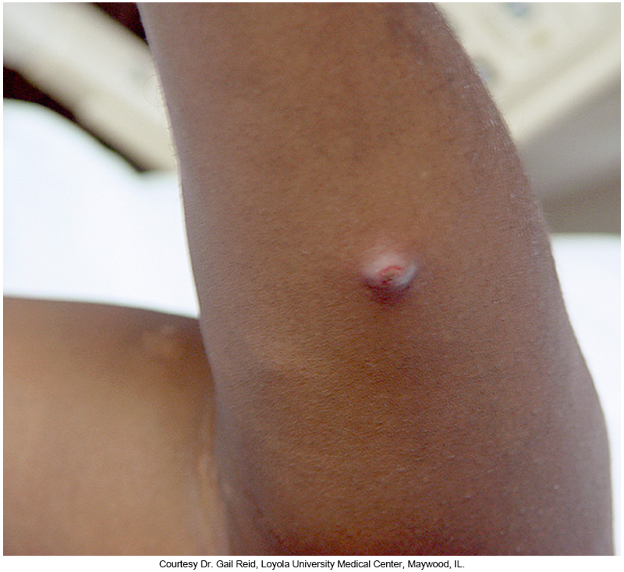
Nodular Skin Lesion Caused by Blastomyces dermatitidis

Slide 103
Clinical & Diagnostic Microbiology
Skin/Soft Tissue (Wound) Infections
Viral Infections

Slide 104
Overview
Viruses can produce localized or disseminated disease.
In some cases, viruses cause chronic infection by evading the host immune system (e.g., HIV, hepatitis C virus).
Can cause direct damage to tissues or evoke an immune response that leads to disease manifestations

Slide 105
Rubeola and Rubella
Rubeola
Measles–paramyxovirus
Koplik’s spots –small red patches with central bluish-gray specks on the buccal mucosa
Rubella
German measles
Nonspecific maculopapular rash begins on the face and moves down the body.

Slide 106
Parvovirus B19 and Enteroviral Infections
Parvovirus B19–one of the most common exanthems of childhood
Erythema infectiosum (Fifth’s disease)
Bright red rash of the face: “slapped cheek”
Followed by a fine lacelike rash on the trunk or extremities
Enteroviral infections
Coxsackieviruses and echoviruses
Cause of many different exanthems primarily in children and infants
Associated rashes are grouped as rubelliform (resembling rubella or measles) or, roseoliform (resembling roseola) or herpetiform resembling herpes.

Slide 107
Varicella-Zoster Viral Infections
Causative agent of chickenpox
Infection progression
Skin lesions become apparent about 2 weeks after exposure.
Lesions begin as vesicles or small blisters and become pustular or rupture and form eschar over a few days.

Slide 108
Varicella-Zoster Viral Infections
Infection progression
Rash starts on the trunk and face and spreads to the extremities.
More severe and systemic in adults.
Reactivation later in life is called shingles.

Slide 109
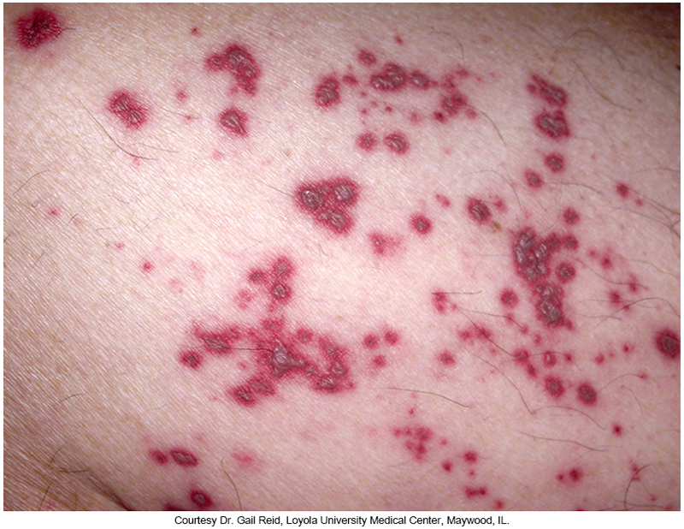
Hemorrhagic Vesicular Lesions of Herpes Zoster

Slide 110
Herpes Simplex Viral Infection
Vesicular skin lesions at the site of infection
Herpes simplex 1 (HSV-1) and herpes simplex 2 (HSV-2)
Initial infection may lead to
Characteristic vesicular skin lesions at the site of infection or may be asymptomatic
Virus enters nearby neurons and leads to a livelong latent infection in neuronal ganglia that can reactivate under various conditions.

Slide 111
Herpes Simplex Viral Infection (Cont.)
HSV-1
May present as severe ulcerative gingivostomatitis and pharyngitis and occurs in children younger than age 5 years
Fever with systemic toxicity
Common manifestation of HSV reactivation
Fever blisters or cold sores
Other notable example of cutaneous manifestations
Eczema herpeticum, erythema multiforme, herptic whitlow or primary herpetic lesions of the finger

Slide 112
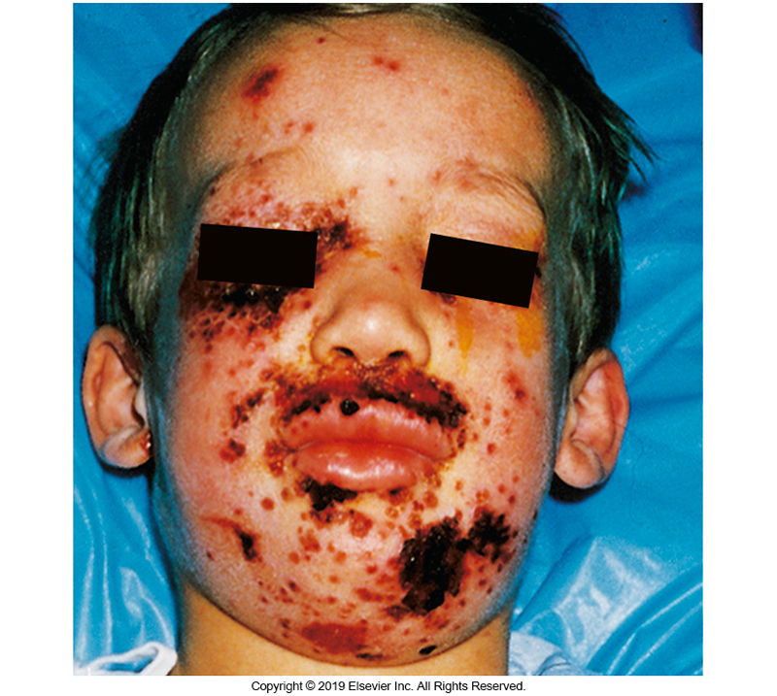
Eczema Herpeticum Caused by Herpes Simplex Virus

Slide 113
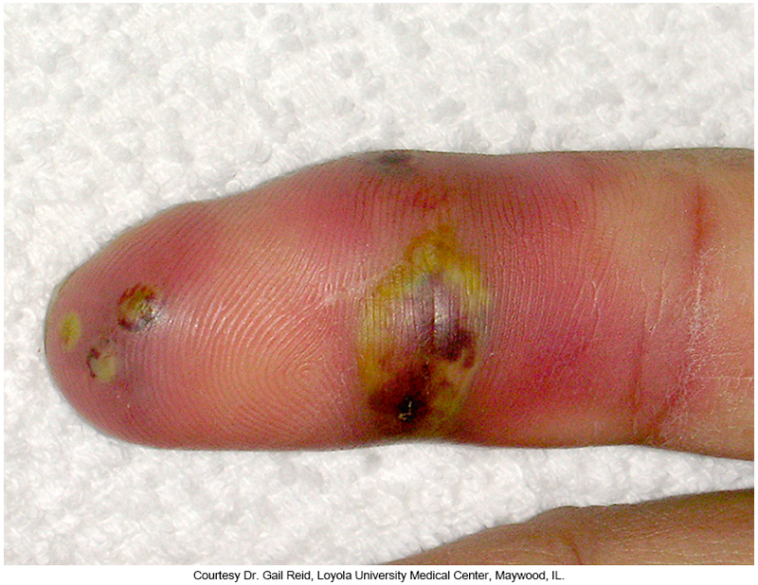
Herpes Whitlow (Herpetic Lesions of the Finger)

Slide 114
Herpes Simplex Viral Infection (Cont.)
HSV-2
Transmitted by sexual contact and results in primary and secondary recurrent herpes genitalis and perirectal infections
Primary infection
Symptoms: fever, myalgias, inguinal lymphadopathy
Potential complications: urethritis and meningitis

Slide 115
Other Herpesviruses
Mononucleosis syndrome
Causative agents
Epstein-Barr virus (EBV)
Cytomegalovirus (CMV)
Sometimes associated with nonspecific rashes
Usually maculopapular
EBV can also cause petechial or urticarial rashes and may be a trigger for erythema multiforme

Slide 116
HHV-6
Human herpes virus 6 (HHV-6)
Roseola infantum (exanthem subitum or sixth’s disease)–febrile syndrome in infants and children
Maculopapular rash begins on the trunk and spreads outward.

Slide 117
KSHV
Kaposi sarcoma-associated herpesvirus (KSHV)–associated with HIV
Also known as human herpesvirus 8 (HHV-8)
Vascular neoplasm
Appearance of erythematous or purplish nodules and plaques that are indurated

Slide 118
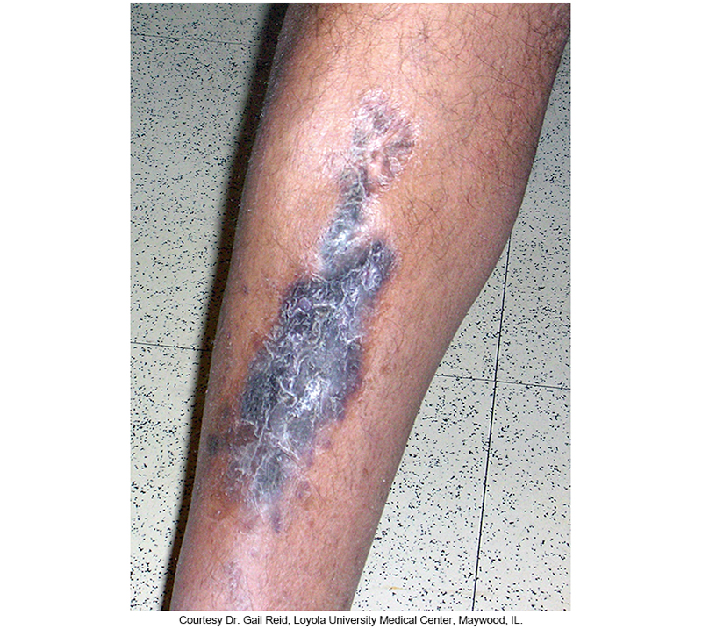
Large Hyperpigmented Plaque of Kaposi Sarcoma

Slide 119
Molluscum Contagiosum
Poxvirus
Common skin disease
Causes small, firm, waxy papules
Occasional giant lesions form
Transmitted person-to-person
Via sexual contact
One body area to another by contact
Appears on the genitalia, face, or perirectal area

Slide 120
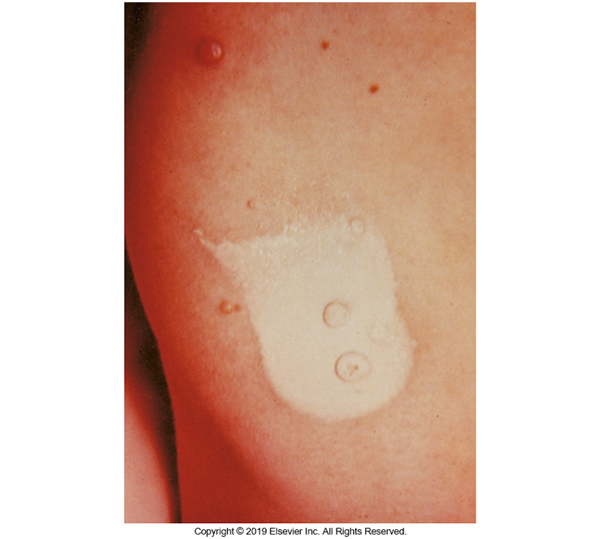
Giant Molluscum Contagiosum

Slide 121
Orf and Milker Nodule
Parapoxviruses
Common pathogens of animals
Zoonotic occupational diseases
Skin lesions are identical
Solitary papule, pustule, or nodule that can drain and develops central crusting
Can be associated with local lymphadenitis
Present on hands, arms, face

Slide 122
Human Papillomavirus
Papillomaviruses cause a variety of skin and mucous membrane lesions that range in severity from benign growths to malignancies.
Over 200 types of human papillomaviruses (HPVs) with more than 40 types that infect the oropharyngeal or genital regions
Infections may be asymptomatic or lead to warts of benign skin or mucosal cell proliferations.

Slide 123
Human Papillomavirus (Cont.)
Genital lesions associated with HPV
Condyloma acuminata–cauliflower-like fleshy growths seen in moist genital and perianal regions-and flat papillomas of the cervix
Transmission of HPV from mother to infant via the birth canal can lead to
Laryngeal papillomas on the vocal cords and epiglottis of children
Connection to cancers
Penile, vaginal, cervical, oral, anorectal

Slide 124
Alphaviruses
Several members are mosquito-borne and cause clinically indistinguishable syndromes of fever, arthralgia and rash.
Rash usually starts on the face and neck and as it spreads, it becomes macular or maculopapular and may be pruritic.
Other symptoms include headache, severe arthralgias, retro-orbital pain, pharyngitis, and vomiting.

Slide 125
Hemorrhagic Fever Viruses
Flaviviridae
Yellow fever, dengue virus, Zika virus
Arenaviridae
Junín, Lassa, Machupo viruses
Bunyaviridae
Hantavirus, Crimean-Congo hemorrhagic fever (CCHF), Rift Valley fever viruses
Filoviridae
Ebola, Marburg viruses

Slide 126
Hemorrhagic Fever Viruses
General symptoms of characteristic viral syndrome
Fever, headache, myalgias, arthralgias, nausea and vomiting, abdominal pain, and skin manifestations
Other possible symptoms
Severe bleeding (nasal or GI)
Bleeding into the skin resulting in petechiae, purpura, ecchymoses

Slide 127
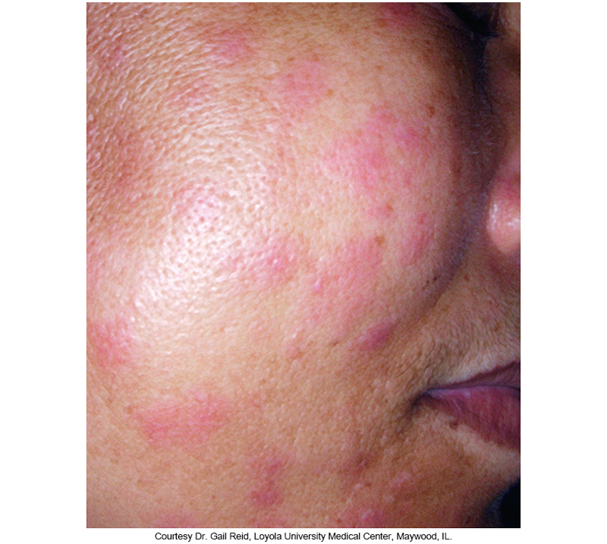
Facial Rash of Dengue Fever

Slide 128
Severe Acute Respiratory Syndrome-Cornoavirus-2 (SARS-CoV-2)
First reported in Wuhan, China in 2019
Spread around the world and resulted in a global pandemic known as Coronavirus Disease 2019 (COVID-19)
RNA coronavirus
Infects the respiratory tract and can cause severe pneumonia
Can affect many extrapulmonary organ systems including the skin

Slide 129
Severe Acute Respiratory Syndrome-Cornoavirus-2 (SARS-CoV-2)-(Cont.)
Dermatologic manifestations
Non-specific maculopapular exanthems
Urticaria
Erythema multiforme
Purpura
Livedo reticularis (varicella-like lacy pattern of red-blue skin discoloration
Chillblain-like lesions (COVID-toes)- characteristic finding that involves the feet and less commonly the hands

Slide 130
Clinical & Diagnostic Microbiology
Skin/Soft Tissue (Wound) Infections
Parasitic Infections

Slide 131
Overview
Three main parasitic infection categories
Helminthic
Protozoal
Ectoparasitic
Some of these infections have major or minor dermatologic manifestations as part of the illnesses they cause.
Common infections, mainly involving helminths and ectoparasites, are covered here.

Slide 132
Helminths - Schistosomiasis
Trematodes (flatworms or flukes)
Dermatitis at the entrance site usually seen when parasites infect humans (in water)
Pruritic popular eruption known as cercarial dermatitis or swimmer’s itch
Dermatitis is usually self-limited

Slide 133
Helminths - Schistosomiasis
Acute schistosomiasis caused by human schistosomes (Katayama fever)
Sometimes associated with a similar pruritic rash as the site of skin penetration by cerceriae

Slide 134
Helminths – Strongyloides Infection
Causative agent
Strongyloides stercoralis (roundworm or nematode)
Transient dermatitis
Occurs when free-living larvae in soil penetrate the skin of humans migrate to the vasculature on the way to the lung and then on to the GI tract
Autoinfections may affect the skin causing a rash called larva currens.
Migratory, serpiginous, and pruritic eruption
Urticaria may appear as larvae penetrate the skin in the perianal area.

Slide 135
Helminths - Lymphatic Filariasis
Causative agents
Wuchereria bancrofti, Brugia malayi, Brugia timori
Infective stage–larvae
Transmitted by mosquito bites
Adult worms reside in the lymph nodes and lymphatic vessels of the legs and male genitalia (elephantiasis).
Fever and inflammation of associated lymph nodes can occur and may be the result of secondary bacterial or fungal infection.

Slide 136
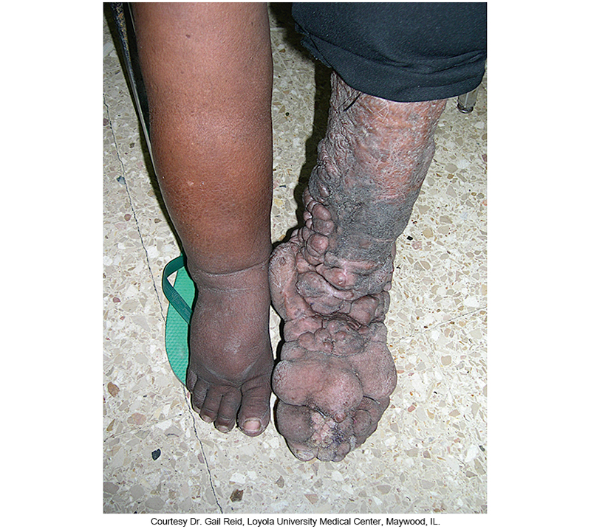
Lymphatic Filariasis (Elephantiasis)

Slide 137
Helminths - Filariasis (Cont.)
Onchocerciasis, also known as river blindness
Causative agent–Onchocerca volvulus
Transmitted by blackflies
Causes subcutaneous nodules and river blindness
After larval transmission, larvae develop into adult worms in the subcutaneous tissues forming subdermal nodules (onchocercomata).
Microfilariae migration through the skin causes an intensely itchy rash and skin edema.

Slide 138
Heliminths - Filariasis (Cont.)
Most important manifestation of onchocerciasis
Results from larval infiltration of the eye
An inflammatory response occurs on death of parasite larvae, leading to visual disturbances and blindness

Slide 139
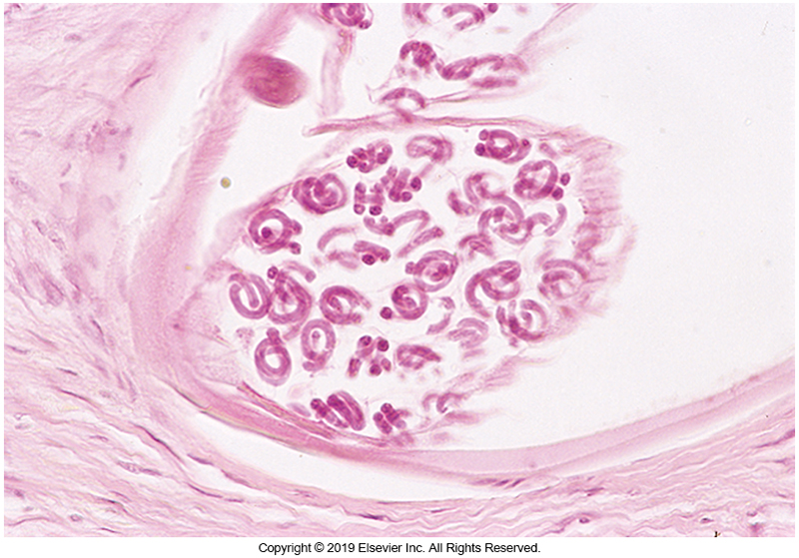
Tissue Cross Section of Nodule Containing Onchocerca volvulus Microfilariae

Slide 140
Helminths - Drancunculiasis
Causative agent–Drancunculus medinensis
After parasite ingestion, larvae migrate to small intestine where they penetrate the intestinal wall and reside in peritoneal and retroperitoneal spaces.
Adult worms migrate to the skin, particularly the legs, where the cause painful blisters and can emerge through the skin.
Cellulitis resulting from secondary infection can develop.

Slide 141
Helminths - Hookworm Infection
Causative agents
Ancylostoma duodenale
Necator americanus
Ancylostoma ceylanicum, a zoonosis
Larvae penetrate the skin to initiative infection.
Results in ground itch at entrance site
Dog and cat hookworms can also penetrate the skin but are unable to develop further.
Causes dermatitis known as cutaneous larva migrans (CLM) or creeping eruption

Slide 142
Helminths - Leishmaniasis
Most Leishmania infections are limited to the skin and adjacent lymph nodes.
Cutaneous leishmaniasis develops days to months after bite of an infected sandfly.
Painless papule that enlarges and may ulcerate
Lesions vary in appearance.
Local dissemination of infection can occur.
Widespread hematogenous lesions of the skin are associated with mucosal involvement.
Disfiguring scarring and secondary infection possible.

Slide 143
Helminths -Leishmaniasis
Visceral leishmaniasis
Also known as kala-azar
Severe form of disease with certain species
Leishmania infantum and Leishmania donovani
Dissemination of parasite to bone marrow, liver, spleen, other organs
Transmission from mother to child or through transfusion has occurred

Slide 144
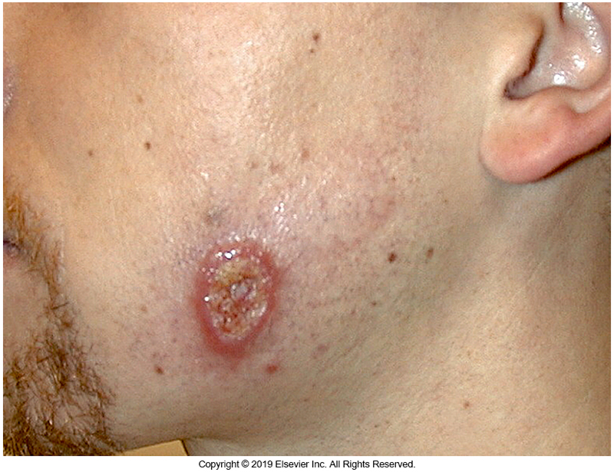
Facial Ulceration Caused by Leishmania infection

Slide 145
Ectoparasites
Examples
Lice (pediculosis)
Mites (scabies)
Fleas
Flies
Ticks
Bedbugs
Chiggers

Slide 146
Ectoparasites (Cont.)
Ectoparasites attach to or burrow in the skin and can remain there for weeks to months.
Dermatologic features of ectoparasite infestation include
Severe itching
Formation of papules, vesicles, nodules, linear burrows, excoriations of the skin and scalp

Slide 147
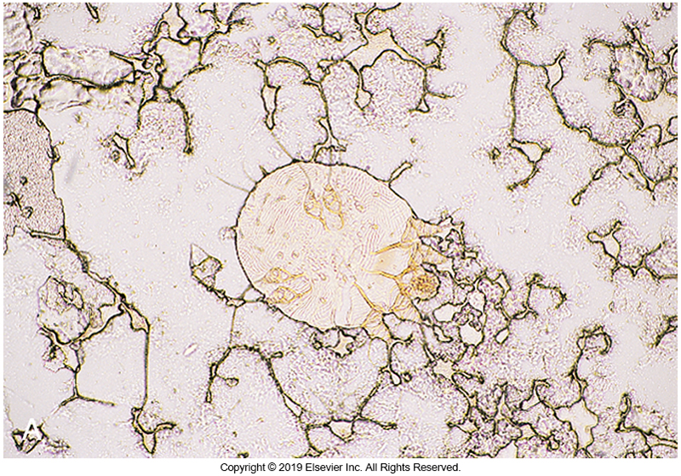
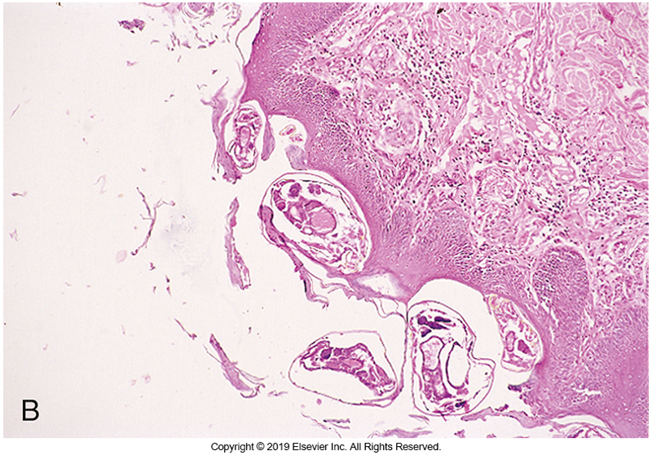
Sarcoptes scabiei Adult and Lesion

Slide 148
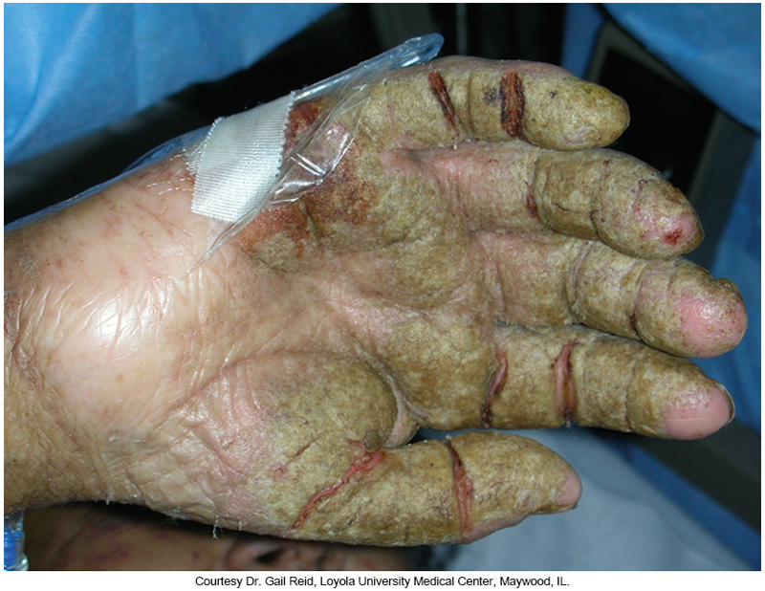
Thick, Scaly Plaques of Norwegian Scabies

Slide 149
Morphology Consistent with Phthirus pubis (Crab Louse)

Slide 150
Clinical & Diagnostic Microbiology
Skin/Soft Tissue (Wound) Infections
Immune or Toxin-Mediated Dermatologic Manifestations of Infectious Agents

Slide 151
Immune-Mediated Cutaneous Disease Disseminated Intravascular Coagulation (Cont.)
Skin manifestations
Petechiae of the skin resulting from thrombi development in organs
Purpura fulminans can occur in
Meningococcemia
Septicemia with S. aureus, S. pneumoniae, H. influenzae
Characterized by rapidly developing skin hemorrhage, skin necrosis, peripheral gangrene accompanied by shock syndrome resulting in death or amputation.

Slide 152
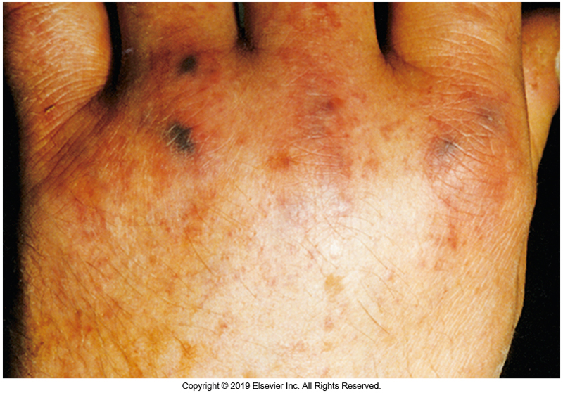
Petechial Lesions in Meningococcemia

Slide 153
Immune-Mediated Cutaneous Disease Disseminated Intravascular Coagulation (Cont.)
Vasculitis
Palpable purpura over the lower extremities
Infection-related immune complex-induced disease
Often seen in endocarditis with cutaneous purpura
Painful, small skin nodules located on finger pads and toes possible (Osler’s nodes)
Causative agents
Staphylococci, streptococci
Less frequent: gram-negative bacteria, Candida

Slide 154
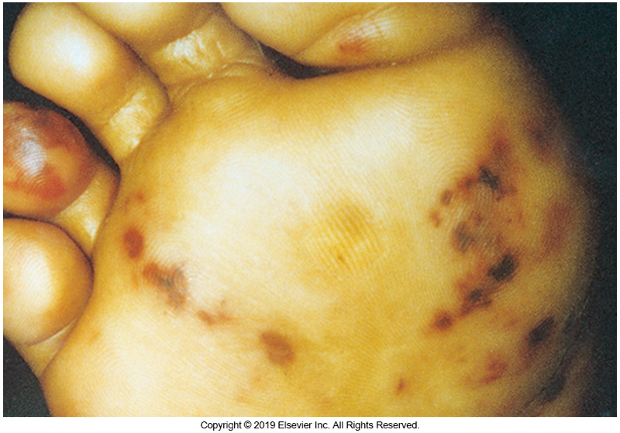
Hemorrhagic Vasculitic Lesions of Staphylococcus aureus Endocarditis

Slide 155
Toxin-Mediated Cutaneous Disease
Certain bacteria can produce toxins that affect the skin, resulting in distinct clinical syndromes
Staphylococci and streptococci
Infections may start as primary skin and soft tissue infections or may initially affect another site, with subsequent involvement of the skin caused by the effects of circulating toxin.

Slide 156
Toxin-Mediated Cutaneous Disease Staphylococcal Scalded Skin Syndrome
Abbreviated SSSS
Blistering skin condition mostly seen in children under age 5 years
Causative agents–certain strains of S. aureus that can produce exfoliative toxins
Clinical features
Fever, skin tenderness, a scarlatiniform rash followed by extensive formation of bullae and exfoliation

Slide 157
Toxin-Mediated Cutaneous Disease SSSS (Cont.)
Sometimes occurs in adults with underlying illness such as
Renal disease, cancer, IV drug use, HIV, diabetes mellitus
Toxins act on stratum granulosum of epidermis and thus does not affect mucosal tissue
Characteristic–Nikolsky sign
Separation of the epidermal layer on gentile stroking

Slide 158
Toxin-Mediated Cutaneous Disease SSSS (Cont.)
Large flaccid blisters form and rupture
Causes the skin to denude and peel off in sheets leaving bright red underlying skin exposed
Secondary bacterial infection and fluid loss occur.
Skin generally heals without scarring.
Nosocomial epidemics of SSS have been reported in nurseries.

Slide 159
Toxin-Mediated Cutaneous Disease Toxic Shock Syndrome (TSS)
Caused by production of staphylococcal exotoxins, referred to as superantigens
They can cause widespread non-antigen-specific activation of T lymphocytes.
Superantigens include toxic shock syndrome toxin 1 (TSST-1) and staphylococcal enterotoxins.
Once activated by these superantigens, cytokines are released by lymphocytes and macrophages.

Slide 160
Toxin-Mediated Cutaneous DiseaseTSS (Cont.)
Settings in which nonmenstrual TSS occurs
Postpartum
After influenza infection
In association with surgical wound infections
Contaminated nasal packing in patients with nosebleeds
TSS clinical presentation
A diffuse sunburn-like erythroderma appears early on accompanied by fever, hypotension, evidence of multiorgan dysfunction

Slide 161
Toxin-Mediated Cutaneous Disease TSS (Cont.)
TSS clinical presentation
Desquamation of the skin, especially on the palms and soles occurs during the convalescent stage of illness
S. aureus may be recovered in blood cultures and staphylcocci may be cultured from the initial site of infection.

Slide 162
Toxin-Mediated Cutaneous Disease TSS (Cont.)
Streptococcal TSS caused by GAS (S. pyogenes)
Occurs whenever exotoxin-producing strains of GAS infect or colonize the skin or mucous membranes, particularly strains producing streptococcal pyrogenic exotoxins (SPEs).
Most cases have been in young, otherwise healthy adults.
Lack of protective immunity may be a risk factor.

Slide 163
Toxin-Mediated Cutaneous Disease TSS (Cont.)
Streptococcal TSS caused by GAS (S. pyogenes)
Portal of entry is typically the skin with cellulitis that progresses rapidly.
Many invasive streptococcal infections do not have a recognized portal of entry.
Subsequent signs and symptoms are like that of staphylococcal TSS.
Blood cultures are more often positive in GAS TSS than in staphylococcal TSS.

Slide 164
Toxin-Mediated Cutaneous Disease Scarlet Fever
Scarlet fever–a form of GAS disease when the infecting strain produces SPEs
Occurs mostly in children, concomitantly with pharyngeal infection
Fever is typically present.
The rash starts on the chest and spreads outward.

Slide 165
Toxin-Mediated Cutaneous Disease Scarlet Fever (Cont.)
Red, sandpaper-textured rash often on the neck and chest and in skin folds
Rash does not involve the face but there is flushing of the skin with circumoral pallor.
Strawberry tongue
Convalescence
Desquamation of the skin occurs, especially on the hands and feet.

Slide 166
Clinical & Diagnostic Microbiology
Skin/Soft Tissue (Wound) Infections
Laboratory Diagnosis

Slide 167
Laboratory Diagnosis Specimens
Swabs
Generally yield colonizing or contaminating bacteria
Deep aspirates and biopsies
Better specimens
Pustules and vesicles
Exudates produce better results.

Slide 168
Laboratory Diagnosis Direct Examination and Culture
Direct examination
Gram stain if bacteria suspected
Potassium hydroxide (KOH) and/or calcofluor white if fungi suspected
Acid fast if mycobacteria suspected
Modified acid fast if Nocardia spp. is suspected
Fluorescent stains
Culture
Enriched media to isolate all organisms
Selective media to detect specific pathogens

Slide 169
Laboratory Diagnosis Viruses and Nonculture Tests
Nonculture-based tests
PCR
Antigen detection
MALDI-TOF on isolates
Serum antibody tests

Slide 170
Points to Remember
The skin, skin structures, and normal microbiota play a significant role in protecting the host against microbial invasion and disease.
The normal skin biota can be involved in the pathogenesis of skin and skin structure infections, particularly if the integrity of the skin is compromised.

Slide 171
Points to Remember (Cont.)
There is an extensive variety of skin and soft tissue infections, which can be classified according to the type of skin lesion produced, the causative organism, or the pathogenesis of the infection (e.g., as a primary entity or secondary to a preexisting infection or systemic manifestation).

Slide 172
Points to Remember (Cont.)
Bacteria, viruses, fungi, and parasites are all important causes of skin and soft tissue infections.
S. aureus and S. pyogenes are common causes of pyoderma.
Virulence factors of disease-producing organisms (e.g., toxins) can enable the organisms to evade host defense mechanisms, which can result in severe manifestations of infection.

Slide 173
Points to Remember (Cont.)
A compromised immune system can lead to more severe or unusual manifestations of infection and can allow normally innocuous organisms to be pathogenic.
The occurrence of disease in a host is a function of the underlying host’s immunity and virulence of the pathogen.

Slide 174
Points to Remember (Cont.)
The method and site of laboratory specimen collection, quality of the clinical specimen, and clinical context are all important factors to consider when distinguishing between colonization and infection by microorganisms.

Slide 175
Points to Remember (Cont.)
Proper specimen collection and laboratory processing of specimens are factors critical to the success of making a microbiological diagnosis of infection.

