Slide 1
Clinical & Diagnostic Microbiology
GI, Skin, Soft Tissue & Wound
Gastrointestinal Infections & Food Poisoning - II

Slide 2
Acute Diarrheal Illness
One of the most common problems evaluated by clinicians
Infectious agents transmitted via ingestion of contaminated food or beverage.
Other names
Montezuma’s revenge
Delhi belly
Greek gallop
Rome runs
Aztec two-step
Back door sprint

Slide 3
General Clinical Manifestations
In healthy individuals
A self-limiting illness, lasting only a few days
Some people experience chronic symptoms.
Bacteremia
Dehydration
Serious sequelae
Malnutrition, severe dehydration, death

Slide 4
What’s Ahead?
Review of host and pathogen factors that lead to illness
A clinical and laboratory approach to making a diagnosis
Discussion of common bacterial, viral, and parasitic pathogens
Summarizes treatment and prevention strategies

Slide 5
Clinical & Diagnostic Microbiology
GI, Skin, Soft Tissue & Wound
Gastrointestinal Infections & Food Poisoning – II
Anatomic Considerations

Slide 6
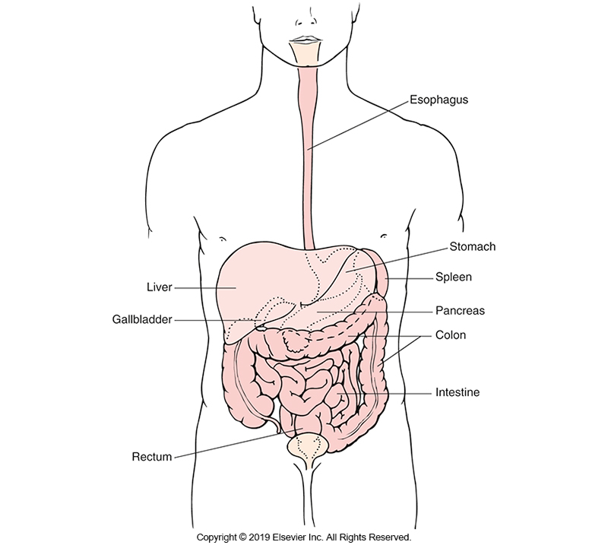
Anatomy of the GI Tract

Slide 7
Anatomic Considerations (Cont.)
Host defenses
Stomach acidity (pH of lower than 4)
Kills more than 99.9% of coliform bacteria within 30 minutes
Some pathogens are resistant.
Small intestine
Peristalsis (constant motion)
Small intestine and colon
Possess lymphoid tissue that produces antibody, primarily IgA

Slide 8
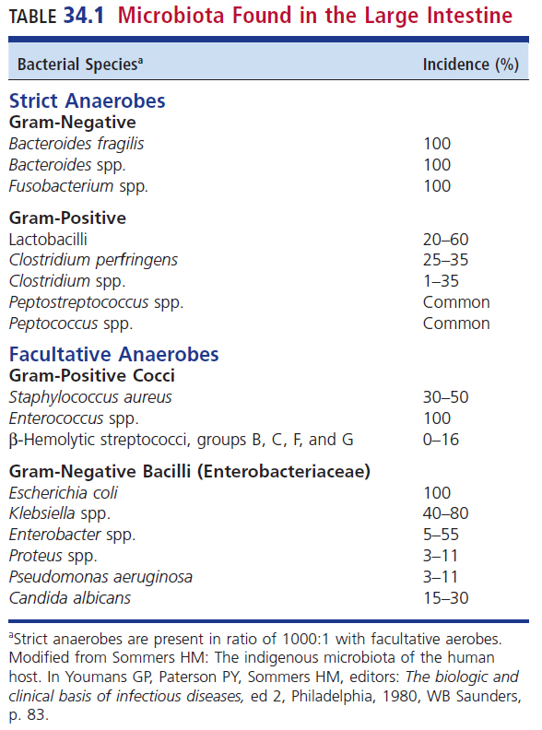
Microbiota Found in the Large Intestine

Slide 9
Differential Diagnosis Considerations
Chronicity of disease may help narrow the differential.
A variety of viral, bacterial and parasitic pathogens are involved.
Causes of diarrhea
Toxin-mediated, invasion by infectious agent
Numerous noninfectious causes including but not limited to
Laxative use, tumor-related, malabsorption, inflammatory bowel disease

Slide 10
Risk Factors for GI Infection
Number of ingested organisms
Median infectious dose (ID₅₀)
Number of organisms ingested to cause disease in 50% of exposed individuals
Achlorhydria (absence of hydrochloric acid in gastric secretion)
Reduction in normal biota
Antibiotic exposure

Slide 11
Clinical & Diagnostic Microbiology
GI, Skin, Soft Tissue & Wound
Gastrointestinal Infections & Food Poisoning – II
Approach To Diagnosis of the Patient w/Diarrhea

Slide 12
Determination of the Cause of Patient with Diarrhea
Patient history
Patient physical examination
Laboratory analysis of a stool specimen

Slide 13
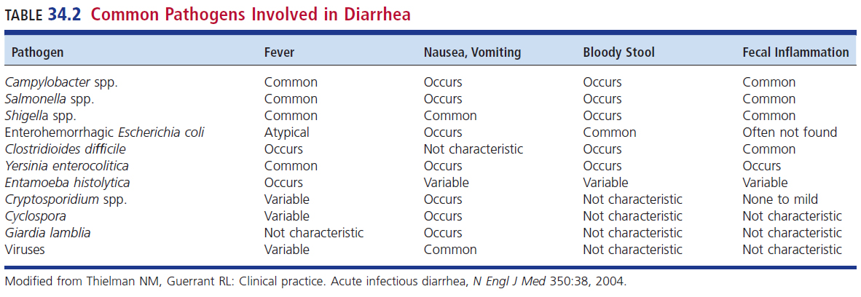
Common Pathogens Involved in Diarrhea

Slide 14
History
Definition of diarrhea
An “alteration in normal bowel movement characterized by an increase in the water content, volume, or frequency of stools”
Many epidemiologic investigations consider diarrhea as more than 3 bowel movements/day.
Accurate travel and dietary history can point to causative diagnosis and direct microbiologic workup.

Slide 15
Key Questions to Ask Patients Suspected of GI Infections
What is the duration of symptoms?
Are there associated symptoms of inflammation?
Does the patient have a history of previous GI symptoms?
Does the patient have an underlying illness?
Is the patient taking any medications?
A recent history of antimicrobial use may also suggest an infection with Clostridioides difficile.

Slide 16
History
Food ingestion, travel, recreational activities
Traveler’s diarrhea
Enterotoxigenic Escherichia coli (ETEC)
Parasitic infections
Giardiasis–Giardia duodenalis (a.k.a. G lamblia and G. intestinalis)
Entamebiasis–Entamoeba histolytica

Slide 17
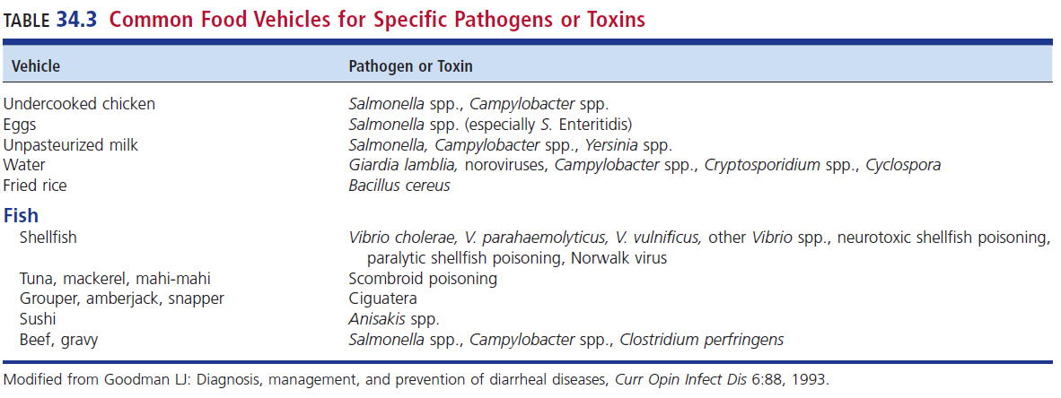
Common Food Vehicles for Specific Pathogens or Toxins

Slide 18
History (Cont.)
Other Medical Conditions that may cause diarrhea
Inflammatory bowel disease
Malabsorption
Radiation therapy
Consider opportunistic pathogens
Immunosuppressed from AIDS, chemotherapy, or organ transplantation

Slide 19
Physical Examination
State of hydration
Sunken eyes
Dry oral membranes
Skin tenting
Orthostatic changes in blood pressure
Examination of the abdomen
Hyperactive
Pain
Diffuse or localized can help determine disease process

Slide 20
Laboratory Studies
Leukocytosis
Anemia
Thrombocytopenia
Electrolyte abnormalities
Fecal examination
Red blood cells (RBCs)
Fecal leukocytes
Help differentiate invasive from toxigenic disease
Fecal lactoferrin testing
Neutrophil marker associated with inflammation

Slide 21
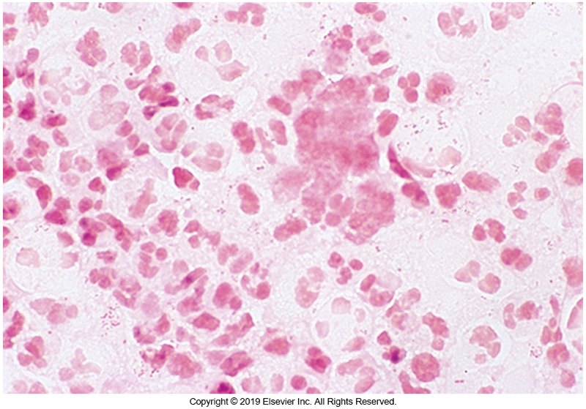
Gram Stain of Direct Fecal Smear

Slide 22
Clinical & Diagnostic Microbiology
GI, Skin, Soft Tissue & Wound
Gastrointestinal Infections & Food Poisoning – II
Clinical Presentation & Pathogenic Mechanisms of Acute Diarrhea

Slide 23
Enterotoxin-Mediated Diarrhea Symptoms
Abdominal cramps and vomiting
Rapid onset of diarrhea
Lack of fever
Absence of blood or pus in stool
Point to enterotoxin-mediated illness
Large number of nonbloody, watery stools
Sometimes more than 20 per day

Slide 24
Enterotoxin-Mediated Diarrhea Causative Agents
Bacterial
ETEC
Vibrio cholerae
Staphylococcus aureus
Clostridium perfringens
Bacillus cereus
Parasitic
Cryptosporidium spp.
Cystoisospora belli

Slide 25
Clinical & Diagnostic Microbiology
GI, Skin, Soft Tissue & Wound
Gastrointestinal Infections & Food Poisoning – II
Diarrhea Mediated by Invasion of the Mucosal Surface

Slide 26
Symptoms and Causative Agents
Symptoms
Fecal leukocytes
Fever
Leukocytosis
Causative agents
Salmonella enterica
Campylobacter spp.
Shigella spp.
E. coli
Entamoeba histolytica

Slide 27
Clinical & Diagnostic Microbiology
GI, Skin, Soft Tissue & Wound
Gastrointestinal Infections & Food Poisoning – II
Diarrhea Mediated by Invasion of Full-Bowel Thickness w/Lymphatic Spread

Slide 28
Causes, Incubation Time, and Stool Findings
Most common causes
Salmonella Typhi
Yersinia enterocolitis
Incubation time is about 1 to 3 days
Findings in stool
RBCs present
WBCs present

Slide 29
Symptoms and Causative Agents
Symptoms
Often diarrhea is not the presenting symptom.
Constipation
Fecal leukocytes and RBCs
Septicemia
Enteric lymphadenitis
Gross blood seen in the stool of 25% of patients with Y. enterocolitis
S. Typhi–infection become chronic, patients may become carriers and unknowingly spread infection to others.

Slide 30
Clinical & Diagnostic Microbiology
GI, Skin, Soft Tissue & Wound
Gastrointestinal Infections & Food Poisoning – II
Common Viral, Bacterial & Parasitic Pathogens

Slide 31
Viral Pathogens
Rotaviruses
Generally children under 5 years old
Enteric adenoviruses
Serotypes 40 and 41 associated with infectious diarrhea
Caliciviruses
Norovirus
Recent cruise ship outbreaks
Sapovirus
Astroviruses
Older adults and very young

Slide 32
Other Viral Pathogens
Diarrhea may be present as systematic manifestations of other viral infections
SARS-CoV-2

Slide 33
Bacterial Pathogens
Campylobacter jejuni
Most common cause of gastroenteritis in the world
Salmonella spp.
Gastroenteritis and food poisoning
Enteric fever of S. Typhi
Shigella spp.
Gross blood and pus in the stool
Four species
Low inoculum (100 organisms)

Slide 34
Bacterial Pathogens Escherichia coli
Several diarrheagenic strains of E. coli
Enterotoxigenic E. coli (ETEC)
Produces adhesins that bind to intestinal mucosa and enterotoxins
Patients have watery diarrhea that lacks RBCs and WBCs
Common cause of traveler’s diarrhea

Slide 35
Bacterial Pathogens E.coli (Cont.)
Enteroinvasive E.coli (EIEC)
Produces infection resembling Shigella infection
Patients have watery diarrhea then progress to an invasive-type diarrheal syndrome with fever, abdominal cramping, and bloody stools
Fecal leukocytes are abundant followed by
Increasing abdominal pain
Bloody stools

Slide 36
Bacterial Pathogens E.coli (Cont.)
Enterohemorrhagic E. coli (EHEC)
This is also referred to as Shiga-toxin producing E. coli (STEC).
Produces Shiga toxin 1 and/or Shiga toxin 2
Produces a locus of enterocyte effacement that mediates attachment to enterocyte membrane and destruction of the brush border microvilli
Infection starts with watery diarrhea
E. coli 0157:H7 the principal causes of EIEC

Slide 37
Bacterial Pathogens E.coli (Cont.)
Enteropathogenic E. coli (EPEC)
Organisms seem to express various factors that facilitate their adherence to intestinal cells
Causes disruption and destruction of the brush border of cells and other intestinal cell derangements
Leads to electrolyte abnormalities and diarrhea
Most commonly affect children in nurseries and daycare centers
Symptoms: low-grade fever, vomiting, diarrhea

Slide 38
Bacterial Pathogens E.coli (Cont.)
Enteroaggregative E. coli (EAEC)
Organism adheres to the intestinal surface but in a more clumped or aggregate fashion.
Appear to adhere to the intestinal wall first causing the production of mucus, then an inflammatory response
A recognized cause of traveler’s diarrhea.
Symptoms can range from asymptomatic to chronic watery diarrhea.

Slide 39
Bacterial Pathogens E.coli (Cont.)
Diffusely adherent E. coli
Characterized by a diffuse adherence pattern on cultured HeLa or HEp-2 cells.
Strains can be part of the asymptomatic intestinal microbiota in older children and adults.
Symptoms in children include
Diarrhea
Abdominal pain
Vomiting

Slide 40
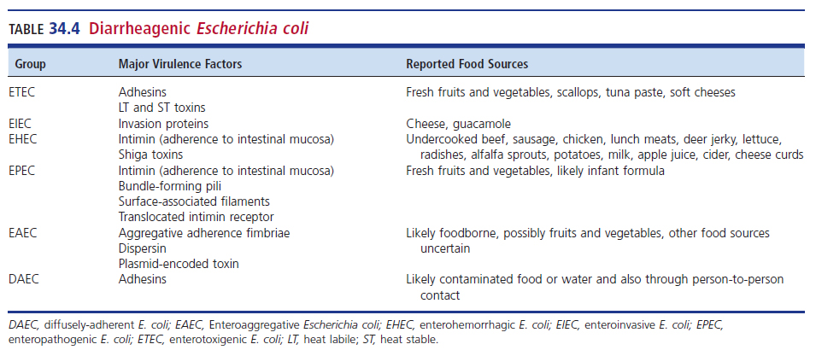
Diarrheagenic E. coli

Slide 41
Bacterial Pathogens (Cont.)
Vibrio spp.
Cholera
Noncholera Vibrio illness
Y. enterocolitica
Self-limiting enteritis with possible invasion of the mesenteric lymph nodes
Sometimes mistaken for appendicitis
Clostridioides difficile
Antibiotic-associated diarrhea
Pseudomembranous colitis
Mild to severe disease

Slide 42
Bacterial Pathogens (Cont.)
Listeria monocytogenes
Of concern when isolated in stool of symptomatic patient
Helicobacter spp.
Association with peptic ulcers: H. pylori
Diarrhea: H. cinaedi and H. fennelliae
Aeromonas spp., Plesiomonas shigelloides
Watery diarrhea
Edwardsiella tarda
Associated with fish and shellfish

Slide 43
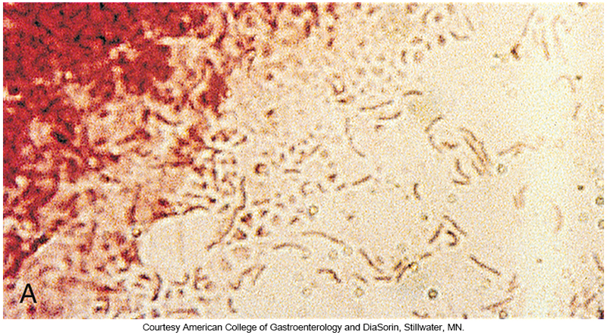
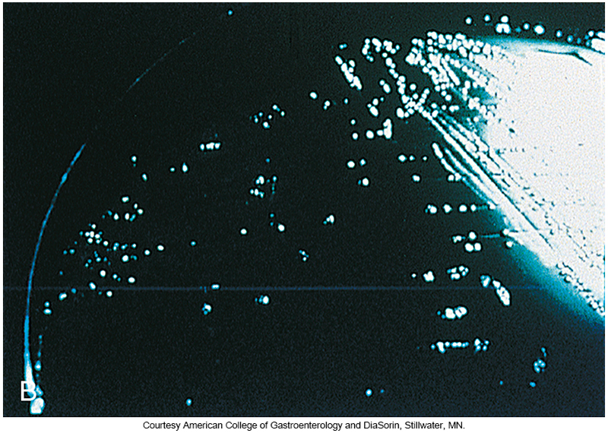
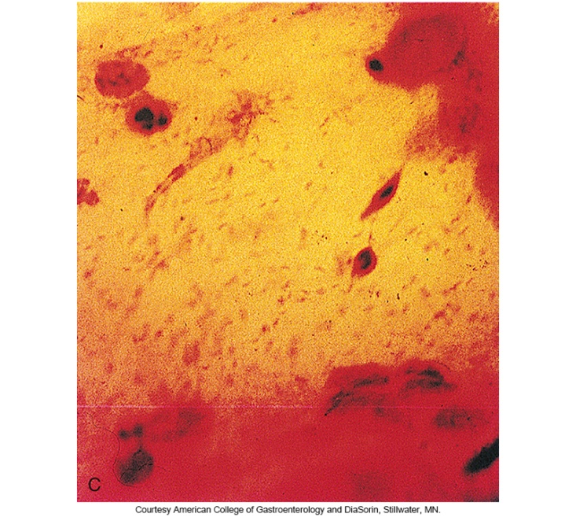
Microscopic Morphology of Helicobacter pylori

Slide 44
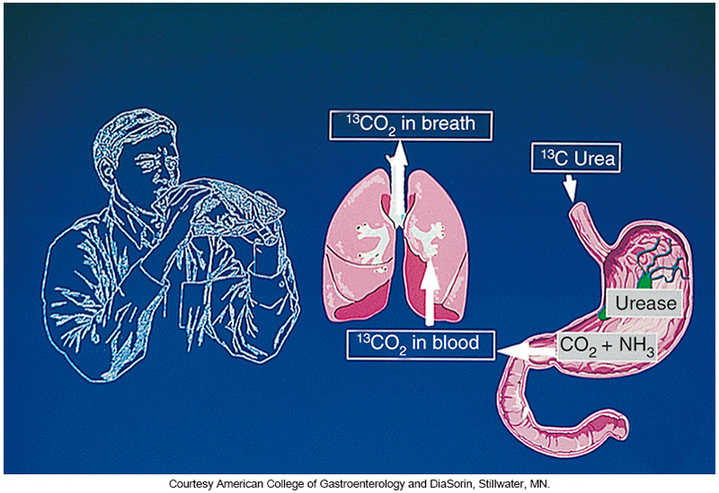
Urea Breath Test

Slide 45
Bacterial Pathogens (Cont.)
Sexually transmitted diseases causing GI disease
Neisseria gonorrhoeae
Chlamydia trachomatis
Treponema pallidum
Herpes simplex virus (HSV)
All can cause proctitis with loose stools and pain on defecation
Most common in patients with receptive anal intercourse

Slide 46
Parasitic Pathogens
Giardia intestinalis
Nausea, vomiting, flatulence, cramping, and diarrhea
E. histolytica
Fever and bloody diarrhea
Cryptosporidium parvum and Cryptosporidium hominis
Abdominal cramping, watery diarrhea, vomiting, fever, and anorexia
Stain of choice–acid fast

Slide 47
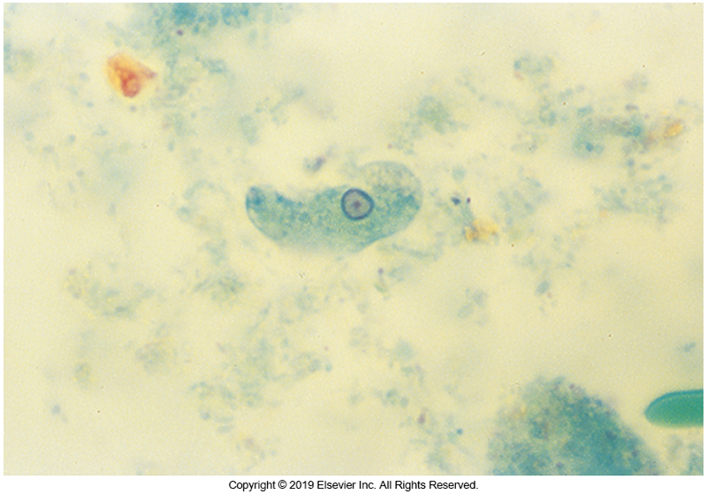
E. histolytica Trophozoites

Slide 48
Parasitic Pathogens (Cont.)
Cyclospora cayetanensis and Cystoisospora belli
Watery diarrhea and abdominal cramps
Cramping, fever, profound fatigue, nausea, vomiting also possible
Microsporidia
Enterocytozoon bieneusi and Encephalitozoon intestinalis
Asymptomatic to self-limiting diarrhea in healthy individuals

Slide 49
Other Parasitic Infections
Representative parasitic agents
Ascaris lumbricoides (common roundworm)
Strongyloides stercoralis (threadworm)
Ancylostoma and Necator (hookworms)
Trichuris trichiura (whipworm)
Enterobius vermicularis (pinworm)
Trichinella spiralis (pork worm)

Slide 50
Clinical & Diagnostic Microbiology
GI, Skin, Soft Tissue & Wound
Gastrointestinal Infections & Food Poisoning – II
Diarrhea in Special Circumstances

Slide 51
Toxic Agents of Food Poisoning
Chemical intoxications
Scombroid
Flushing, headache, crampy abdominal pain, and diarrhea
Tissues of fish contain histamine and enzyme inhibitors, which are responsible for symptoms.
Ciguatera
Red tide toxin accumulates in fish
Diarrhea, abdominal pain, weakness, paresthesias, and headache
May progress to respiratory failure and hypotension
Paralytic shellfish poisoning
Toxin- tetrodotoxin

Slide 52
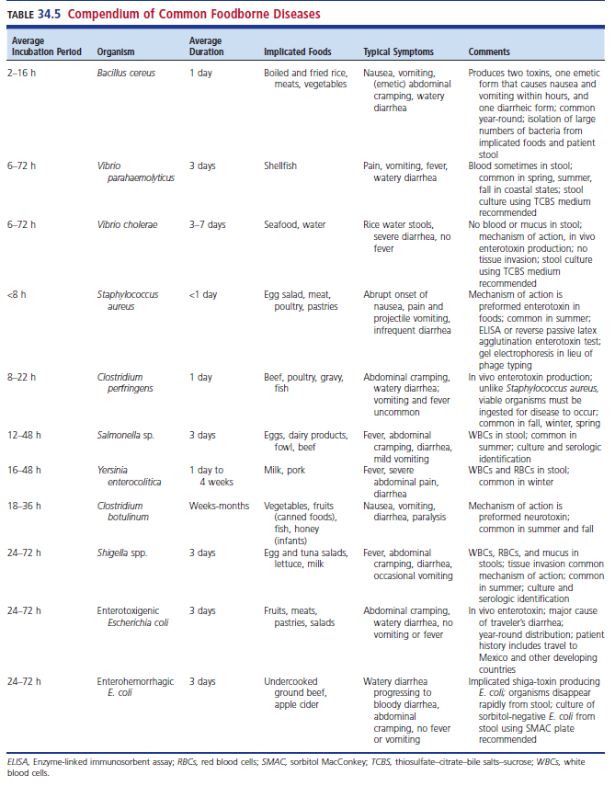
Compendium of Common Foodborne Diseases

Slide 53
Returning Travelers
Common problem in patients visiting developing countries
Most cases are often mild and self-limiting.
Significant morbidity possible
May disrupt traveler’s itinerary
Diarrhea usually occurs within the first 2 weeks of travel.
Symptoms
Malaise, abdominal pain, fever, nausea, vomiting, and occasionally blood in the stool

Slide 54
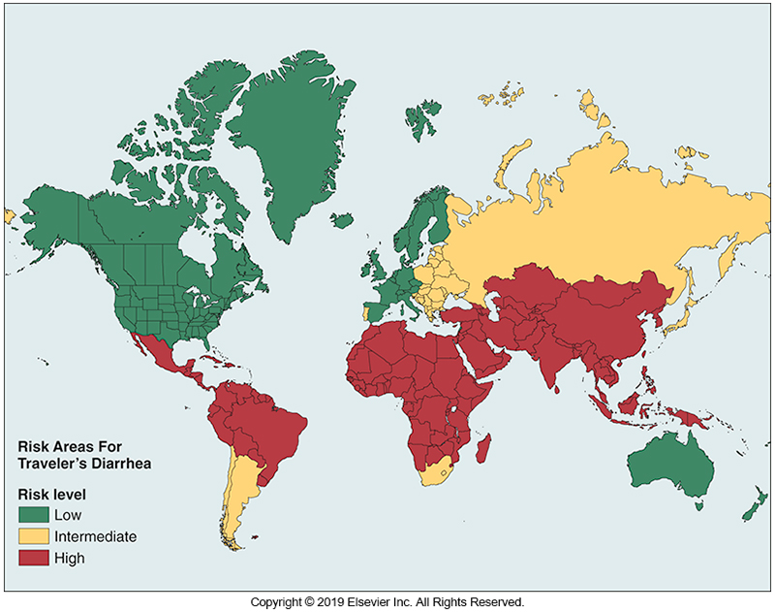
Geographic Distribution of Risk for Traveler’s Diarrhea

Slide 55
Immunocompromised Hosts
Immunocompromised individuals increasing because of better treatments for chronic diseases
Lupus erythematosus
Crohn disease
Other immunocompromising conditions
AIDS
Cancer patients
Transplantation recipients

Slide 56
Immunocompromised Hosts
Higher risk for opportunistic pathogens causing disease
Bacteria
Mycobacterium tuberculosis, Mycobacterium avium complex
Virus
Cytomegalovirus (CMV)
GI histoplamosis
Parasites
Cryptosporidium (associated with HAART), Cyclospora, Cystoisospora, and Microsporidia, and Strongyloides

Slide 57
Clinical & Diagnostic Microbiology
GI, Skin, Soft Tissue & Wound
Gastrointestinal Infections & Food Poisoning – II
Laboratory Diagnosis of Gastrointestinal Pathogens

Slide 58
Specimen Collection and Handling/Direct Examination
Fresh specimens are best for bacterial culture.
Fresh or properly preserved for ova and parasite detection
Direct microscopic examination
Fecal leukocytes
RBCs
Seagull-wing appearance suggests presence of
Campylobacter or Vibrio.

Slide 59
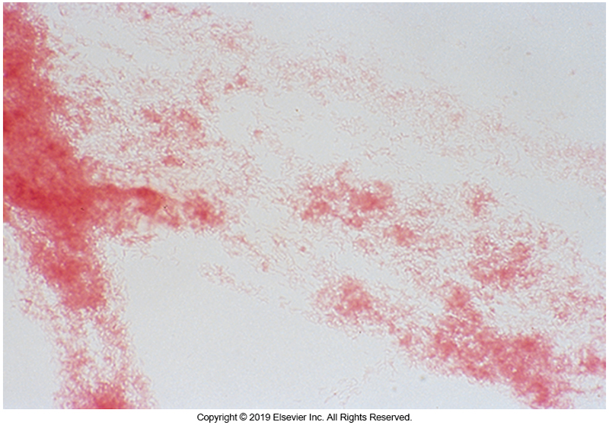
Gram Stain of Campylobacter Colony

Slide 60
Culture
Selective and differential culture media
Normal biota can mask pathogens; using appropriate media reduces normal biota.
Selective media
Contains antimicrobials or chemical
Differential media
Allows differentiation of bacterial species based on colony morphology
E.g., MacConkey (MAC), XLD, sorbitol MAC, Hektoen Enteric, and Salmonella-Shigella agars

Slide 61
Organisms That Grow in Culture
Campylobacter jejuni
Salmonella spp.
Shigella spp.
E. coli
Yersinia spp.
Vibrio spp.
C. difficile
Usually identified via toxin testing

Slide 62
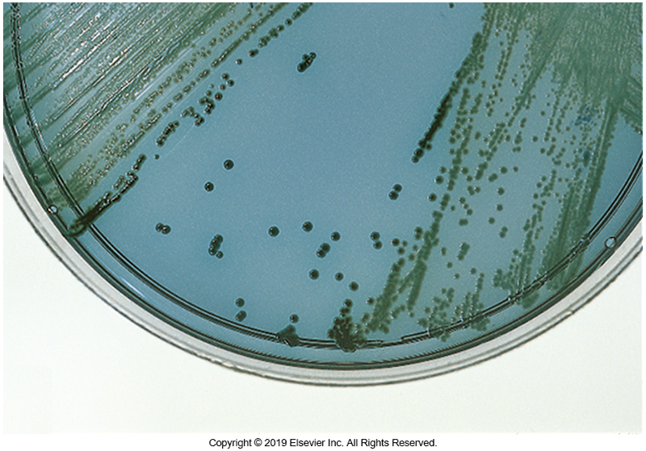
Salmonella on Hektoen Enteric Agar

Slide 63
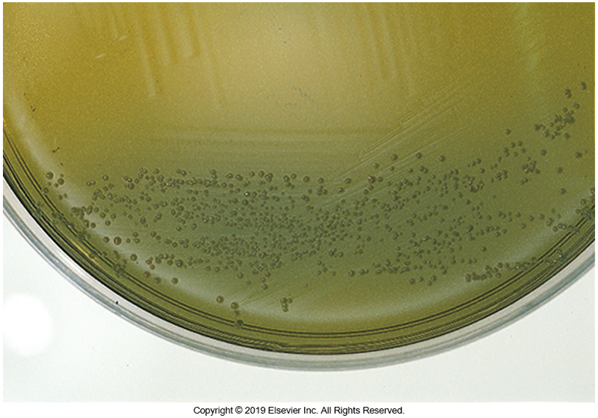
Shigella Growing on Hektoen Enteric Agar

Slide 64
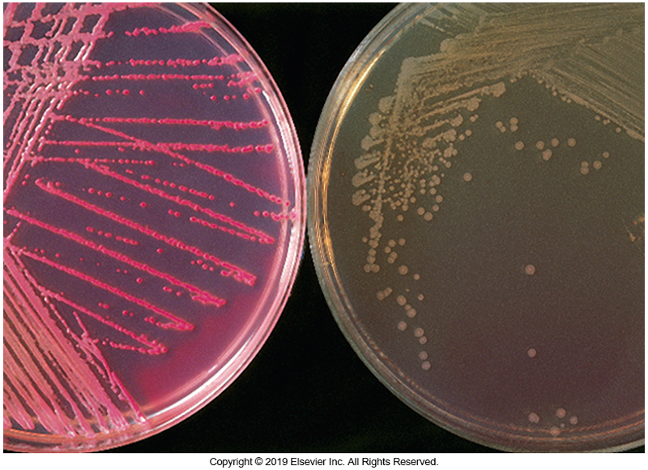
E. coli O157:H7 on MAC and SMAC

Slide 65
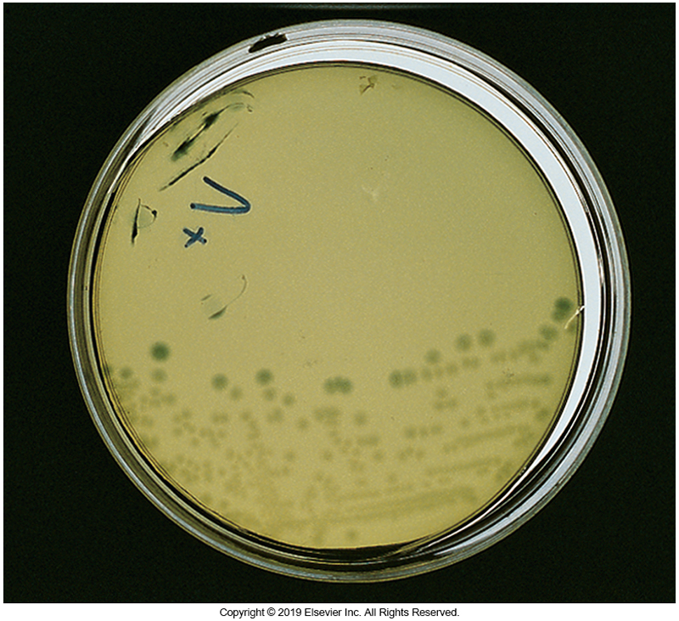
Vibrio vulnificus on TCBS

Slide 66
Clinical & Diagnostic Microbiology
GI, Skin, Soft Tissue & Wound
Gastrointestinal Infections & Food Poisoning – II
Treatment & Prevention for Diarrhea

Slide 67
Treatment Options
Replenish electrolytes
Solution containing glucose and sodium
Occasionally intravenous fluids
Antidiarrheal medications
Decrease symptoms
Antimicrobial agents
Prophylaxis
May alleviate symptoms
Bismuth subsalicylate (Pepto-Bismol)
May shorten disease course

Slide 68
Prevention Measures
Prevention
Avoid high-risk foods and ice
Avoid foods prepared by another person and served undercooked or raw
Avoid dips and other foods left at room temperature
Properly cook foods such as poultry
Thoroughly wash all raw fruits and vegetables
Vaccination
Rotavirus
S. Typhi

Slide 69
Points to Remember
Factors that predispose patients to diarrheal illnesses include lack of clean drinking water, travel to endemic countries, history of GI disease, immunocompromised state, and medication intake.

Slide 70
Points to Remember (Cont.)
Travel history and a detailed dietary history provide significant information when determining the cause of the diarrheal disease. Certain foods such as meat, shellfish, and poultry serve as vehicles of foodborne disease.
Foodborne diseases are transmitted and acquired by ingestion of contaminated food and beverages.

Slide 71
Points to Remember (Cont.)
Clinical presentations can be characterized as enterotoxin-mediated diarrhea, invasion of bowel mucosa, or invasion with lymphatic or metastatic spread of infection.
Food poisoning may be caused by chemical intoxications from fish or shellfish consumption, as well as bacterial toxins.

Slide 72
Points to Remember (Cont.)
Appropriate laboratory diagnosis may include the use of direct microscopy and selective culture media to recover and identify the suspected causative agent.

