Slide 1
Clinical & Diagnostic Microbiology
Staphylococcus & Similar Organisms
Introduction

Slide 2
Introduction
Gram-positive cocci (GPC) are common isolates in the clinical microbiology laboratory.
Most GPC are members of indigenous microbiota.
Some species are causative agents of serious infectious disease.

Slide 3
What’s Ahead?
Discussion of commonly encountered staphylococci
Characteristics
The infections they produce
Laboratory identification
Antimicrobial susceptibility

Slide 4
Clinical & Diagnostic Microbiology
Staphylococcus & Similar Organisms
General Characteristics

Slide 5
Catalase Reaction and Appearance
Members of the staphylococci
Catalase positive
On stained smears appear singly, in pairs, and in clusters often referred to as “bunches of grapes”
Colony Morphology
Appear creamy, white, or, rarely, light gold
Buttery-looking
Some species produce β-hemolysis
S. aureus

Slide 6
Other Characteristics
Characteristics
Non-motile
Non-spore forming
Non-encapsulated
Aerobic or facultative anaerobe
One exception S. saccharolyticus (obligate anaerobe)
Rare strains
Small colony variants (SCVs)
1/10 size, some are β-hemolytic

Slide 7
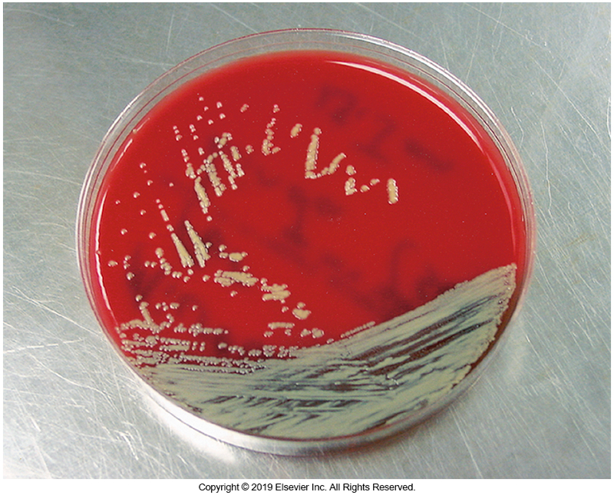
Micrococcus-Resemble Staphylococci
Micrococcus luteus
GPC
Catalase positive
Note: modified catalase containing a mild detergent
Coagulase negative
Morphology
Distinct yellow pigmented colony
Generally considered a nonpathogen
Micrococcus growing on sheep blood agar (SBA)

Slide 8
Differentiating Staphylococci and Micrococci

Slide 9
Coagulase Test
Staphylocoagulase enzyme clots plasma
Coagulase-positive staphylococci
S. aureus: human pathogen
S. delphini, S. intermedius, S. lutrae, S. hyicus: animal pathogens
Coagulase-negative staphylococci (CoNS)
S. epidermidis: hospital-acquired infections
S. saprophyticus: urinary tract infections (UTIs) in young, sexually active females
Important in urine samples

Slide 10
Coagulase Test
Isolates such as S. lugdunensis and S. Scheiferi can be mistaken for coagulase-positive due to the presence of clumping factor.
Clumping factor causes bacterial cells to agglutinate in plasma and was the basis of a test known as slide coagulase test (now considered obsolete)

Slide 11
Clinical Significance of S. aureus
The most clinically significant staphylococci
Causes various cutaneous infections and purulent abscesses
Common cause of
Infective endocarditis
Toxin-induced diseases
Food poisoning
Scalded skin syndrome (SSS)
Toxic shock syndrome (TSS)

Slide 12
Coagulase-Negative Staphylococci
Abbreviated as CoNS
Most significant species
S. epidermidis-causes various healthcare-acquired infections
S. saprophyticus- causes urinary tract infection in girls and young women
S. lugundensis-catheter-related bacteremia and endocarditis
S. haemolyticus- recovered from wounds, septicemia, UTIs, native valve infections

Slide 13
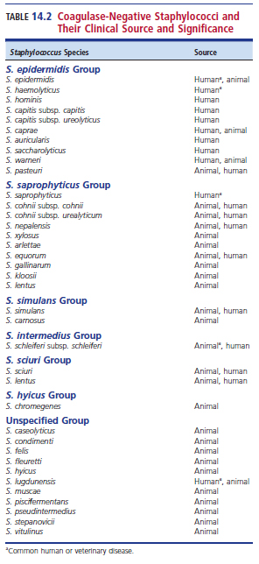
CoNA-Clinical Source and Significance

Slide 14
S. Lugdunensis vs. S. aureus
Both are slide coagulase positive
Tube coagulase test is crucial in differentiating

Slide 15
Clinical & Diagnostic Microbiology
Staphylococcus & Similar Organisms
Clinically Significant Species

Slide 16
Virulence Factors of S. aureus
Enterotoxins
Cytolytic toxins
Cellular components such as protein A
Exfoliate toxins
Despite these virulence factors, innate resistance to S. aureus is high, and the organism is regarded as an opportunistic pathogen

Slide 17
S. aureus Enterotoxins
Heat-stable exotoxins that cause diarrhea and vomiting
Toxins A through E and G through J (nine total)
Resistant to gastric acid
A, B, and D are associated with food poisoning.

Slide 18
Virulence Factors of S. aureus: TSST-1 and Exfoliative Toxin
Toxic shock syndrome toxin-1 (TSST-1)
Chromosomal-mediated toxin
TSST-1 and B, C, G, and I are superantigens.
Causes toxic shock syndrome
Exfoliative toxin (epidermolytic toxin)
Two types: exfoliative toxin A & exfoliative toxin B
Causes the epidermal layer of the skin to slough off and is known to cause scalded skin syndrome (SSS) or Ritter’s disease
Also implicated in bullous impetigo

Slide 19
S. aureus Virulence Factors: Cytolytic Toxins
Extracellular proteins that affect red blood cells (RBCs) and leukocytes
Hemolysins and leukocidins
S. aureus produces four hemolysins
Alpha (α), beta (β), gamma (δ), and delta (γ)
α-hemolysin lyses RBCs and damages platelets and tissues
β-hemolysin shows enhanced activity by acting on the sphingomyelin of RBC membranes, causing lysis
Hot-cold lysin because it works best at 37° C and very well when stored at 4° C

Slide 20
S. aureus Virulence Factors: Cytolytic Toxins
S. aureus produces four hemolysins
Alpha (α), beta (β), gamma (δ), and delta (γ)
δ-hemolysin causes injury to cells and leukocytes but is less lethal
γ-hemolysin
Also called Panton-Valentine leukocidin (PVL)
Exotoxin kills polymorphonuclear leukocytes
Helps suppress phagocytosis
Often associated with community-acquired infections

Slide 21
S. aureus Virulence Factors: Enzymes
Exact role of enzymes is uncertain but considered as a virulence marker
Coagulase
Very diagnostic but importance in virulence is not completely understood
Hyaluronidase
Hydrolyzes the hyaluronic acid present in connective tissues, helping spread of infection
Lipase
Breakdown of the fats and oil created by the sebaceous glands on skin surfaces

Slide 22
S. aureus Virulence Factors: Protein A
Binds the fragment crystallizable (Fc) portion of antibodies to avoid phagocytosis
Masking of its immunogenic proteins with host proteins to look like “self”
Assists in blocking phagocytosis
Negates the protective effects of immunoglobulin G (IgG)

Slide 23
Virulence Factors of S. aureus

Slide 24
Epidemiology of S. aureus
Primary reservoir
Nares
Other reservoirs
Axillae, vagina, pharynx, and other skin surfaces
Occur in hospital outbreaks
Nurseries
Burn units
Surgical patients
Transmission
Unwashed hands, inanimate objects (fomites)

Slide 25
Mode of Transmission and Predisposing Conditions of S. aureus Infections
Mode of transmission: traumatic introduction
Needle stick
Destruction of skin layers (burns, road rash)
Medical procedures
Predisposing conditions
Chronic infections
Indwelling devices
Skin injuries
Immune response defects

Slide 26
Infections Caused by S. aureus: Skin and Wound Infections
Opportunistic that can be the result of
Previous skin injuries (e.g., cuts, burns, surgical incisions)
Pus formers
Furuncle (boil)
A painful inflammation of the skin and subcutaneous tissue
Carbuncles
Boils that have multiple lesions and may progress into deeper tissues

Slide 27
Infections Caused by S. aureus: Skin and Wound Infections
Folliculitis
Mild inflammation of a hair follicle or oil gland
Bullous impetigo
Large pustules surrounded by small zone of erythema (redness)
Spread by direct contact and fomites; highly contagious
Sometimes secondary to skin diseases
occur due to blocked follicles, sebaceous glands, and sweat glands

Slide 28
Infections Caused by S. aureus: Scalding Skin Syndrome (SSS)
Bullous exfoliative dermatitis
Occurs primarily in newborns and previously healthy young children
May occur in adults
More likely to occur in renal failure patients
Immunocompromised

Slide 29
Infections Caused by S. aureus: Scalding Skin Syndrome (SSS)
Severity of disease ranges from localized skin lesion in the form of a few blisters, pemphigus neonatorum, to a more extensive condition
Affects 90% of the body
Called Ritter disease
Spontaneous recovery incidence in children is high

Slide 30
Infections caused by S. aureus: Toxic Epidermal Necrolysis
Abbreviated as TEN
Serious, potentially fatal disease
Multiple causes
Drug induced
Antimicrobial agents
Anticonvulsive drugs
Cause officially not known
Similar to SSS
Treatment with steroids helpful
Unlike SSS
High mortality rate

Slide 31
Infections Caused by S. aureus: Toxic Shock Syndrome
Rare multisystem disease
Association with super-absorbent tampons
Clinical presentation-sudden onset of
Fever, chills, vomiting
Diarrhea, muscle aches, rash
Extreme cases lead to hypotension and shock.
Fatal in 2% to 5% of cases due to multiorgan system failure

Slide 32
Infections caused by S. aureus: Food Poisoning
Enterotoxins, not bacterial growth, cause disease
Enterotoxins A, B, D associated with GI upset
Source of infection usually food handler
Toxin ingested in contaminated food
Modes of transmission
Improper food handling and storage
Food stored in room temperature

Slide 33
Infections caused by S. aureus: Food Poisoning
Commonly contaminated foods
Salads (especially those with mayonnaise)
Meat or meat products
Poultry
Egg products
Select bakery products with cream fillings
Sandwich fillings
Dairy products

Slide 34
Infections caused by S. aureus: Food Poisoning
No obvious signs of contamination when present
Symptoms
Appear rapidly about 2 to 8 hours after ingesting food
Usually resolve in 24 to 48 hours, sometimes less
Nausea, vomiting, abdominal pain, and cramping
Diarrhea and headache also possible
Death is rare but may occur among older patient, infants, severely debilitated people

Slide 35
Infections caused by S. aureus: Other Infections
Bacteremia and endocarditis
Intravenous (IV)—drug addicts presenting with fever
Enter through injection site
Secondary pneumonia
After influenza virus infection
High mortality rate
Osteomyelitis
Occurs secondary to bacteremia and results in bacteria invading the bone
Fever, chills, swelling, and pain around the infected area
Septic arthritis

Slide 36
S. epidermidis
(Usually) considered normal skin biota
Common source of healthcare-acquired infections
Predisposing factors: skin flora gets introduced in catheters, heart valves, cerebrospinal fluid (CSF) shunts.
Organisms often produce a slime layer (biofilm) that helps adherence to prosthetics and avoidance of phagocytosis.

Slide 37
S. saprophyticus
UTIs in young, sexually active women
Due in part to increased adherence to epithelial cells lining the urogenital tract
2nd most common cause of uncomplicated cystitis
Rarely present in other skin areas or mucous membranes
Urine cultures
Considered significant even when present in low amounts (<10,000 CFU/mL)

Slide 38
Staphylococcus lugdunensis
Can cause both community-associated and hospital-acquired infections
Can be more virulent than S. aureus and can clinically mimic S. aureus infections
Known to carry mecA (that encodes oxacillin resistance)

Slide 39
Staphylococcus lugdunensis
Important pathogen in infective endocarditis, septicemia, meningitis, skin and soft tissue infections, UTIs, and septic shock
Aggressive in endocarditis, causing valve replacement
Infections have high mortality rate

Slide 40
Other Coagulase-Negative (CoNS)
Opportunistic pathogens
S. warneri, S. capitis, S. simulans, S. hominis, and S. schleiferi
Normal flora but can be involved in endocarditis, septicemia, and wound infections
S. haemolyticus
Common CoNS
Can be found in wounds, bacteremia, endocarditis and UTIs
May have resistance to vancomycin

Slide 41
Other CoNS
S. pseudointermedius
Common cause of pyroderma in dogs and skin, ear, and postoperative infections in dogs and cats
Has been linked to human infection
Infections known to occur in humans
Surgical site infections
Rhinosinusitis
Catheter-associated bacteremia
Veterinary staff and pet owners are at risk of zoonotic transmission
Known to be resistant to oxacillin and other antibiotics

Slide 42
Clinical & Diagnostic Microbiology
Staphylococcus & Similar Organisms
Laboratory Diagnosis

Slide 43
Specimen Collection and Handling
Requires no special procedures
Specimens should be taken from the site of infection
Cleanse surrounding area to avoid contamination
Transport to the laboratory without delay
Prevents drying
Maintains the proper environment
Minimizes the growth of contaminating organisms

Slide 44
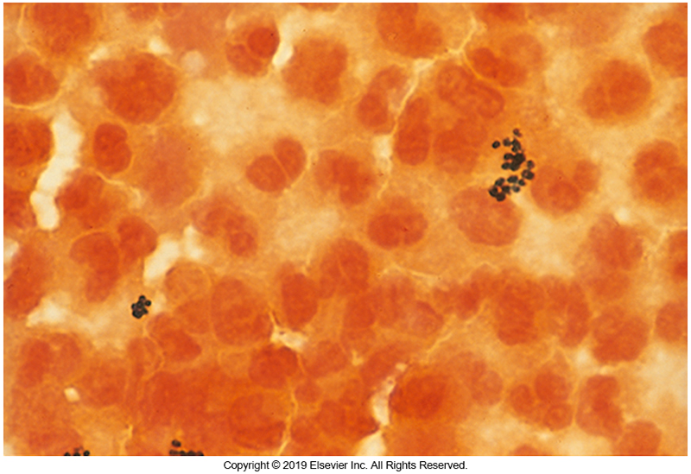
Microscopic Examination
Aspirated abscess showing GPC and PMNs
Numerous gram-positive cocci (GPC)
Polymorphonuclear leukocytes (PMNs)
Purulent exudates, joint fluids, aspirated secretions
Aspirate is best
If swabs, clinicians should send two

Slide 45
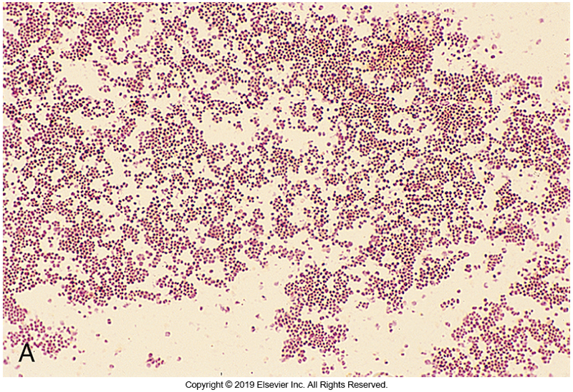
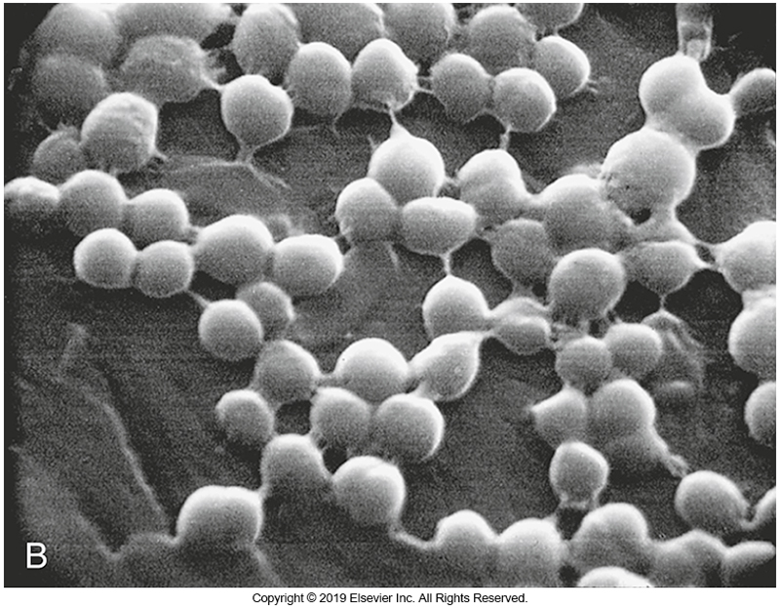
Microscopic Morphology of Staphylococcus spp.

Slide 46
Isolation and Identification of Staphylococci
Grow easily on SBA plates and thioglycolate
If heavily contaminated, use one or more of the following selective media:
Mannitol salt agar (MSA)
Columbia colistin-nalidixic acid agar (CNA)
Phenylethyl alcohol agar (PEA)
CHROMagar Staph aureus
Selective media

Slide 47
Cultural Characteristics
Round, smooth, white, creamy colonies on SBA after 18 to 24 hours incubation at 35°C to 37°C
S. aureus can produce β-hemolytic zones around the colonies
Rarely exhibits yellow pigment with extended incubation
SCVs
Nonpigmented, nonhemolytic, pinpoint colonies

Slide 48
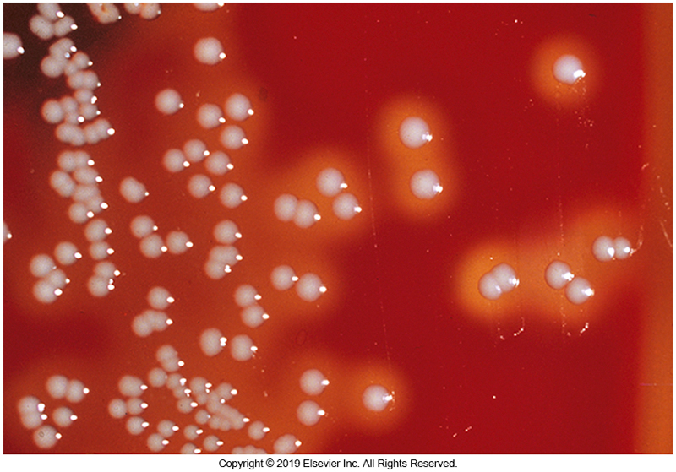
S. aureus Growing on SBA

Slide 49
Cultural Characteristics
S. epidermidis colonies are small- to medium-sized, nonhemolytic, and gray-to-white
Some strains may be weakly hemolytic
S. saprophyticus produces slightly larger colonies with about 50% producing yellow pigment

Slide 50
Cultural Characteristics
S. haemolyticus grows as medium-sized colonies with weak or moderate hemolysis and variable pigment production
S. lugdunensis colonies are often hemolytic and medium size
Colony variants can occur
Identification of staphylococci should not be done on the basis of colony morphology alone

Slide 51
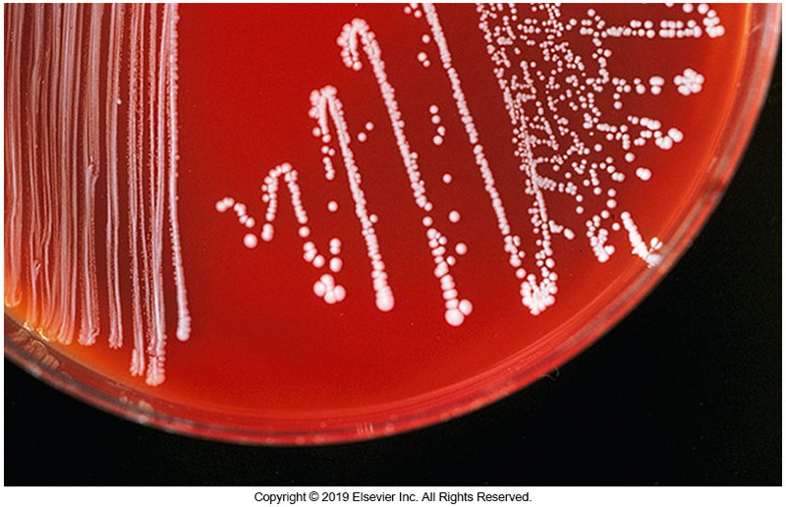
CoNS on SBA

Slide 52
Identification (ID) Methods
Traditional method: oxidative–fermentative (O/F) glucose medium
Most staphylococci ferment glucose
Micrococci fail to ferment glucose anaerobically
O/F testing does not work for all staphylococci
Modified oxidase (e.g., Microdase Disk)
Rapid test to differentiate staphylococci from microccoci
Positive for micrococci
Most staphylococci are negative
Copyright © 2015 by Saunders, an imprint of Elsevier Inc.

Slide 53
Identification (ID) Methods
Multitest systems have incorporated the traditional biochemical tests
Other methods for species and strain identification
Molecular testing
Plasmid typing
MALDI-TOF mass spectrometry

Slide 54
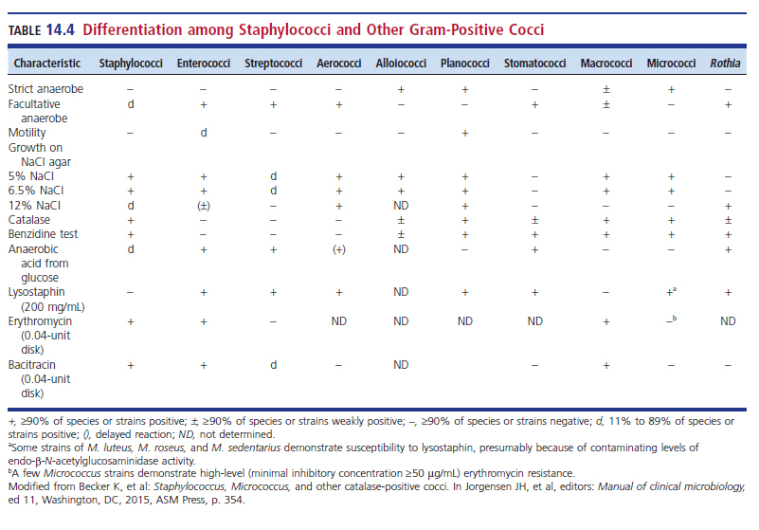
Differentiation Among Staphylococci and other GPC

Slide 55
Tube Coagulase Method
Detects staphylocoagulase or free coagulase
Staphylocoagulase
Extracellular molecule that causes a clot to form when bacterial cells are incubated with the plasma
Reacts with a thermostable, thrombin-like molecule called coagulase-reacting factor (CRF) to form a coagulase-CRF complex
The CRF complex resembles thrombin and indirectly converts fibrinogen to fibrin (cont. next slide)

Slide 56
Coagulase Tube Method
Staphylocoagulase
The clot formed in the tube may undergo autolysis caused by fibrinolysin giving the appearance of a negative result
Look for clot formation after 4 hours incubation at 37°C
If no clot appears, the tube should be left at room temperature and checked the next day
It is important to note that staphylococci other than S. aureus produce clumping factor or staphylocoagulase

Slide 57
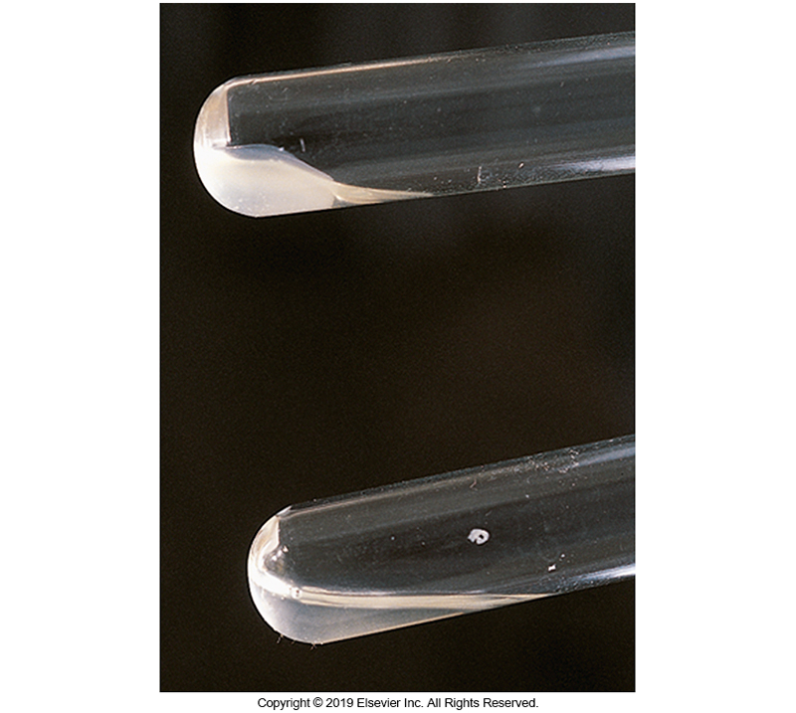
Tube Coagulase Test

Slide 58
Coagulase-Positive Staphylococcus: Clinical Source and Significance

Slide 59
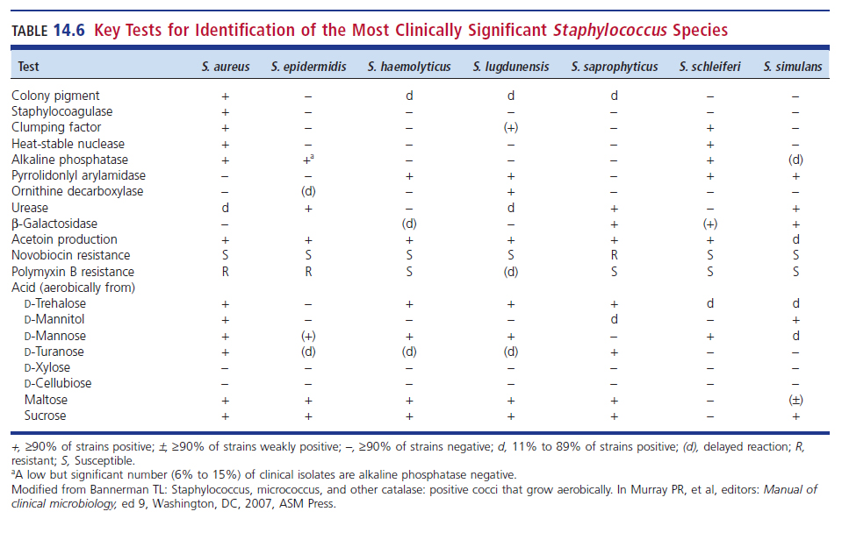
Key Tests for ID of the Most Clinically Significant Staphylococci

Slide 60
Pyrrolidonyl Arylamidase Activity (PYR)
Differentiates
S. aureus (negative)
S. lugdunensis, S. intermedius, S. schleifer (positive)
The test
The substrate pyroglutamyl-β-naphthylamide (l-pyrrolidonyl-β-naphthylamide) is hydrolyzed to l-pyrrolidone and β-naphthylamine, which combines with p-dimethylaminocinnamaldehyde to form a red compound.

Slide 61
Voges-Proskauer (VP) Test
Some laboratory scientists obtain more reliable results with VP
S. aureus (positive)
S. intermedius (negative)-most human infections are associated with animal bites
S. lugdunensis, S. haemolyticus, S. schleiferi (positive)
In the VP test, a positive result is the formation of acetoin from glucose or pyruvate

Slide 62
ID Tests: Differentiating Isolates that do not Produce Staphylocoagulase (CoNS)
If it is a urine sample
Test for S. saprophyticus
Presumptive ID can be done using novobiocin (5 μg)
Streak organism onto plate and add novobiocin disk to heavy growth quadrant
If resistant, S. saprophyticus
If susceptible, likely S. epidermidis
Can be others, additional testing may be required

Slide 63
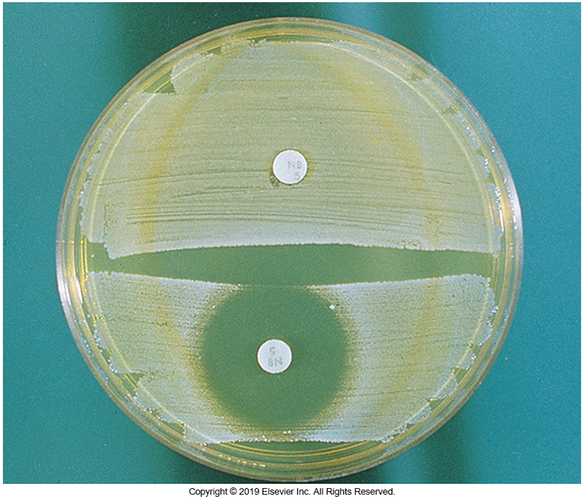
Novobiocin Susceptibility Test

Slide 64
Key Tests for Identification of the most clinically Signifigant staphyloccus species

Slide 65
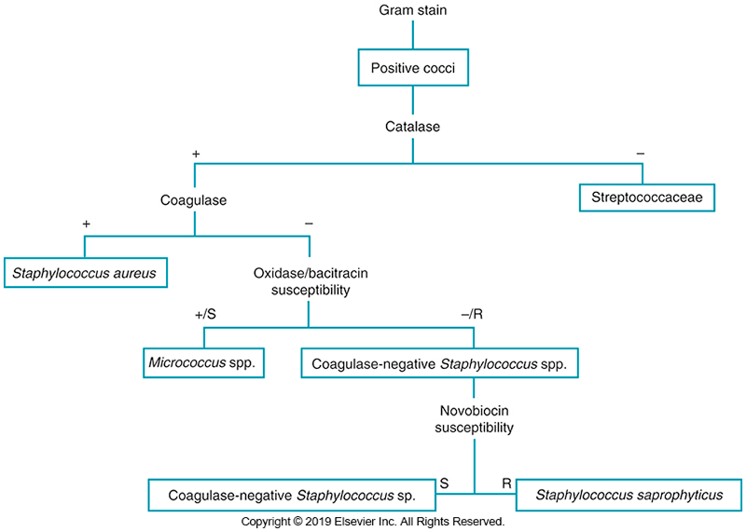
Staphylococcal Schematic

Slide 66
Rapid Methods of ID
Numerous commercial rapid agglutination test kits available for differentiating S. aureus from CoNS
BBL™ staphyloslide
Staphaurex®
BactiStaph® - Slide coagulase test

Slide 67
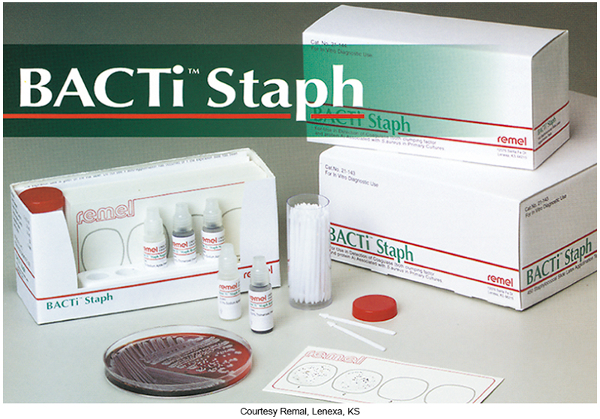
Slide Coagulase Test

Slide 68
Rapid Methods of ID
Kits use plasma-coated carrier particles (e.g., latex) detect both clumping factor and protein A
Particularly useful for ID of methicillin-resistant S. aureus (MRSA), which are weakly positive or negative in slide coagulase test
Negative results should be confirmed with the tube coagulase test, nucleic acid amplification test, or MALDI-TOF mass spectrometry

Slide 69
Rapid Methods of ID
Third-generation agglutination kits
Detect protein A, clumping factor, and antibodies that bind capsular antigens 5 and 8, or other surface molecules
More sensitive, less specific
False-positive can occur; careful consideration of source, colony morphology and susceptibility pattern can eliminate some errors

Slide 70
Rapid Methods of ID
Real-time polymerase chain reaction (PCR)
For MRSA and methicillin-sensitive S. aureus (MSSA)
Used as an adjunct to infection control practices to reduce MRSA infections
Especially in select targeted populations that would benefit from rapid test results
Molecular methods directly identify staphylococci from a positive blood culture
Aids in diagnosis of sepsis and for targeted antimicrobial therapy treatment

Slide 71
Rapid Methods of ID
Newer technologies being evaluated
Non-PCR-based molecular techniques
Examples
T2 Biosystems
Possible use
Direct detection from patient blood samples without incubation
MALDI-TOF Mass Spectrometry
Continues to gain momentum

Slide 72
Clinical & Diagnostic Microbiology
Staphylococcus & Similar Organisms
Antimicrobial Susceptibility

Slide 73
Characteristics
Standard guidelines issued by Clinical and Laboratory Standards Institute (CLSI)
Most S. aureus isolates are resistant to penicillin.
β-Lactamase testing should be done.
Serious infections
Require susceptibility testing

Slide 74
Methicillin-Resistant Staphylococci
Methicillin-resistant S. aureus (MRSA)
Methicillin-resistant S. epidermidis (MRSE)
Community-acquired MRSA (CA-MRSA)
Can be greater than 50% of isolates in some areas
Health care–associated/community onset MRSA (HACO-MRSA)
Hospital-associated MRSA (HA-MRSA)
Pose serious threats to health institutions

Slide 75
Methicillin-Resistant Staphylococci (Cont.)
Control of MRSA infections
Barrier protection
Contact isolation
Handwashing
Treatment of choice: vancomycin
Concerns remain because of resistance to glycopeptides call for restrictive use of these drugs and selective laboratory reporting

Slide 76
Methicillin-Resistant Staphylococci (Cont.)
Laboratory scientists must always refer to the latest susceptibility guidelines for correct antimicrobial agent interpretations
MRSA heterogeneous resistance to β-lactams does occur
One subpopulation is susceptible
Another subpopulation is resistant
Growth of resistant subpopulation is enhanced at:
Neutral pH, sodium chloride concentration of 2% to 4%, lower incubation temperature (30° to 32° C), prolonged incubation (up to 48 hours)

Slide 77
Methicillin-Resistant Staphylococci (Cont.)
Media containing oxacillin, or preferably cefoxitin, can be used to screen for MRSA in clinical specimens (i.e., nasal specimens)
These media can also differentiate MRSA isolates from isolates that are hyperproducers of β-lactamase or borderline oxacillin-resistant S. aureus (BORSA) that do not grow on these plates.

Slide 78
Methicillin-Resistant Staphylococci (Cont.)
Chromogenic selective media
Used to identify MRSA directly from clinical samples
MRSA select
CHROMagar
Media contain high sodium chloride concentration and antimicrobial compounds such as cefoxitin
Inhibits non-staphylococci and non-MRSA isolates
After 24 or 48 hours of incubation, MRSA isolates produce a colored colony; other organisms show no color on the media

Slide 79
Methicillin-Resistant Staphylococci (Cont.)
Automated antimicrobial susceptibility systems using cefoxitin
Generally able to identify MRSA
Most oxacillin resistance is caused by the mecA gene
Carried on a mobile cassette known as SCCmec
This gene codes for an altered penicillin-binding protein (PBP) that does not bind to oxacillin, rendering the drug ineffective

Slide 80
Methicillin-Resistant Staphylococci (Cont.)
Most oxacillin resistance is caused by the mecA gene
Latex agglutination tests are available to detect the altered PBPs
Test can be performed on CoNS and S. aureus
Gold standard for mecA gene detection is nucleic acid probes or PCR amplification

Slide 81
Vancomycin-Resistant Staphylococci
Vancomycin-resistant S. aureus (VRSA) and vancomycin-intermediate S. aureus (VISA)
Often in patients with underlying conditions (VRSA)
Important to adhere to infection control practices and guidelines to limit the emergence of this highly resistant organism

Slide 82
Vancomycin-Resistant Staphylococci (Cont.)
Laboratories should consider using more than one method to detect VISA
Important to confirm VRSAs by a reference method and adhere to CDC guidelines
The hope is following the guidelines may limit the emergence of this highly resistant organism

Slide 83
Macrolide Resistance
Resistance to the macrolide clindamycin may not be obvious
Erythromycin and clindamycin normally have same resistance patterns
If the susceptibility patterns of these two antimicrobials are different by standard testing methods
Additional testing using a modified double-disk diffusion test (D-zone test) might be useful

Slide 84
Macrolide Resistance (Cont.)
Staphylococci resistance to clindamycin is occasionally “inducible”, meaning it is detectable in vitro only when the bacteria are also exposed to erythromycin
Inducible resistance in this case can be detected by the D-zone test
Place an erythromycin disk near a clindamycin disk and use the latest performance standards for susceptibility testing

Slide 85
Macrolide Resistance (Cont.)
If the isolate possesses inducible clindamycin resistance, there is flattening of the clindamycin zone between the two disks, giving a “D-shape” zone of inhibition.
Some automated systems have the ability to detect this resistance.

Slide 86
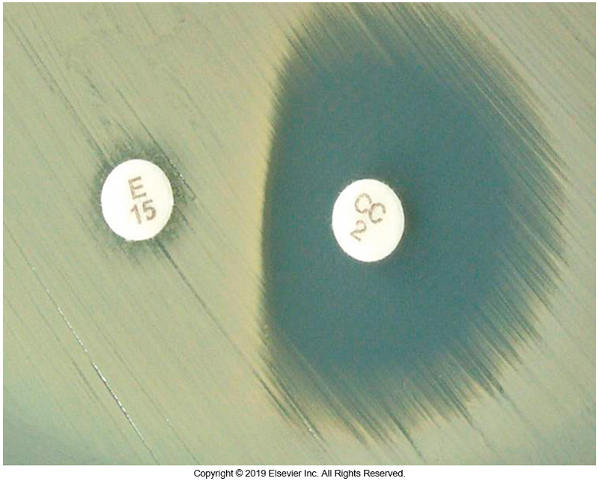
D-ZoneTest Positive Isolate

Slide 87
Points to Remember
The staphylococci are catalase-positive, gram-positive cocci
Staphylococcus aureus is the primary pathogen within this genus, and the isolation of S. aureus from any source should be considered clinically significant

Slide 88
Points to Remember (Cont.)
S. aureus produces many virulence factors, including protein A, enterotoxins, toxic shock syndrome toxin-1, exfoliative toxin, cytolytic toxins, and numerous exoenzymes
S. aureus is associated with numerous diseases, including skin infections, scalded skin syndrome, toxic shock syndrome, food poisoning, bacteremia, osteomyelitis, and pneumonia

Slide 89
Points to Remember (Cont.)
Staphylococcus epidermidis and other coagulase-negative staphylococci (CoNS) have been linked to important hospital- acquired infections, often associated with foreign body implants
CoNS recovered from sterile sites and sites with indwelling devices should be considered potential pathogens

Slide 90
Points to Remember (Cont.)
HA-MRSA and CA-MRSA are important and costly health care concerns.
Staphylococcus saprophyticus is an important cause of urinary tract infections, especially in younger women. S. saprophyticus from urine specimens should be identified, especially if the bacteria are predominant, because even low counts can be significant.

Slide 91
Points to Remember (Cont.)
S. aureus is frequently differentiated from less pathogenic species by being tube coagulase positive.
S. saprophyticus is resistant to novobiocin, whereas many other CoNS are susceptible.
Increasing antimicrobial resistance is a problem with the staphylococci, particularly S. aureus.

