Slide 1
Clinical & Diagnostic Microbiology
Staphylococcus & Similar Organisms
Streptococcus, Enterococcus, and Other Catalase-Negative, Gram-Positive Cocci
Introduction

Slide 2
Taxonomy
Numerous taxonomy changes to Streptococcaceae due to DNA homology and DNA sequencing studies.
Formerly Group D
Now classified as Enterococcus
Group N streptococci
Now Lactococcus
Currently there are 5 genera
Streptococcus, Floricoccus, Lactococcus, Lactovum, and Okadaella.

Slide 3
Lancefield Classification of the Streptococci
After recognition of the antigen (C carbohydrate, polysaccharide) in the cell wall of β-hemolytic streptococci, these streptococci were able to be divided into serologic groups designated by letters.
Organisms in the A group possess the same antigenic C carbohydrate, those in the B group possess the same antigenic carbohydrate, and so on.

Slide 4
What’s Ahead?
The role of Streptococcus spp., Enterococcus spp., and other catalase-negative, gram-positive cocci in human disease
Characteristics of the members in each genus
How isolates are identified in the clinical microbiology laboratory

Slide 5
Clinical & Diagnostic Microbiology
Staphylococcus & Similar Organisms
Streptococcus, Enterococcus, and Other Catalase-Negative, Gram-Positive Cocci
General Characteristics

Slide 6
General Characteristics
Catalase-negative
Catalase test differentiates streptococci and enterococci from staphylococci (which are catalase positive)
Weak positive catalase tests may occur when growth is taken from media containing blood
Gram-positive cocci usually arranged in pairs or chains

Slide 7
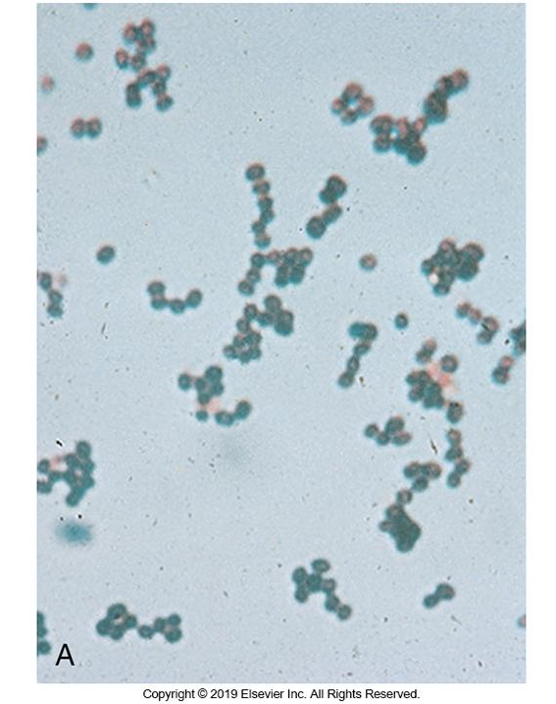
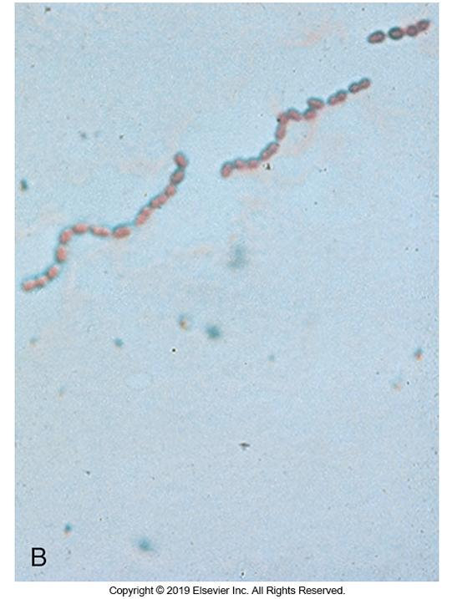
Gram Stain Morphology of Streptococci in Medium—Left Solid, Right Liquid

Slide 8
General Characteristics
Most behave like facultative anaerobes
Aerotolerant anaerobes
Grow in the presence of oxygen but do not use it for respiration
Carbohydrates are metabolized fermentatively with lactic acid as the major end-product; gas is not produced
Some species are capnophilic, requiring an increased concentration of CO₂
Grow best on enriched media with blood or serum
Colonies are usually small and transparent

Slide 9
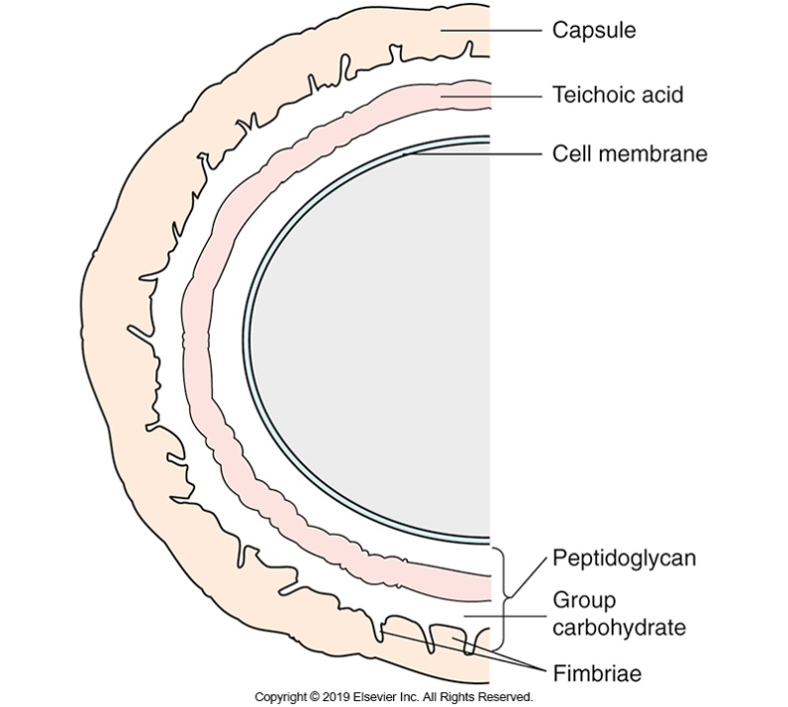
Cell Wall Structure
Thick peptidoglycan layer
Teichoic acid
C = carbohydrate layer present except in viridans group
Capsule in S. pneumoniae and in young cultures of most species
Streptococcal Cell Wall

Slide 10
Hemolysis
Streptococci and similar organisms can produce numerous exotoxins that damage intact red blood cells (RBCs).
Damaged RBCs form the basis for hemolysis
The term hemolysis is used to describe the destruction of RBCs

Slide 11
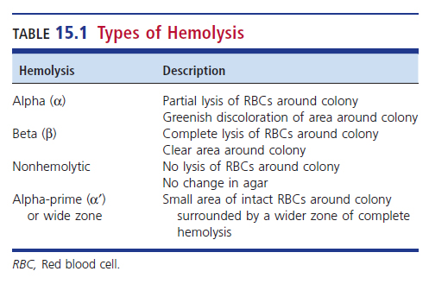
Types of Hemolysis

Slide 12
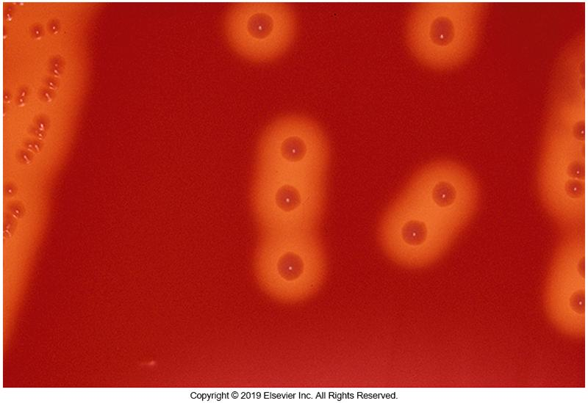
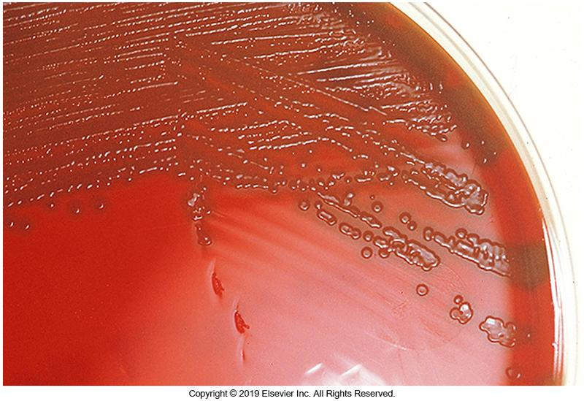
Streptococci Colonies on Sheep Blood Agar: Left β-hemolytic, Right α-hemolytic

Slide 13
Clinical & Diagnostic Microbiology
Staphylococcus & Similar Organisms
Streptococcus, Enterococcus, and Other Catalase-Negative, Gram-Positive Cocci
CLINICALLY SIGNIFICANT STREPTOCOCCI AND STREPTOCOCCUS-LIKE ORGANISMS

Slide 14
General Comments
Association of clinically significant Streptococci and Streptococcus-like organisms in disease has been known for more than 100 years.
Historically these organisms were separated into categories as follows:
β-hemolytic or pyogenic (pus-producing)
Non β-hemolytic or nonpyogenic
Use of the term pyogenic streptococci is precise
Contains some species that are not β-hemolytic, and some β-hemolytic streptococci are not part of the pyogenic group.

Slide 15
Clinically Significant Streptococci and Streptococcus-Like Organisms

Slide 16
S. pyogenes (Group A) Antigen Structure
Lancefield Group A
Also known as Group A Streptococcus (GAS)
M protein attached to peptidoglycan of the cell wall
Extends to the cell surface

Slide 17
S. pyogenes (Group A) Virulence Factors
M protein
Essential for virulence
Evasion of phagocytosis
More than 200 different serotypes and subtypes exist
Examples: M1 (emm1), M2 (emm2)
Resistance to infection with S. pyogenes appears to be related to the presence of type-specific antibodies to the M protein.
M1 serotype is the most common serotype seen in pharyngitis
Notes:
17

Slide 18
S. pyogenes (Group A) Virulence Factors
Products produced by S. pyogenes that have been postulated to play a role in virulence, the exact role each has in an infection is unclear
Streptolysin O (SLO)
Streptolysin S
Deoxyribonuclease (DNase)
Streptokinase
Hyaluronidase
Erythrogenic exotoxins

Slide 19
S. pyogenes (Group A) Virulence Factors (Cont.)
Additional virulence factors associated with Group A Streptococcus (GAS)
Fibronectin-binding protein (Protein F) and lipoteichoic acid are adhesion molecules.
Mediate attachment to host cells
Hyaluronic acid capsule prevents opsonized phagocytosis by neutrophils or macrophages.
Allows the bacterium to mask its antigens and remain unrecognized by its host’s immune system

Slide 20
S. pyogenes (Group A) Virulence Factors (Cont.)
Streptolysin O
Responsible for hemolysis on blood agar plate (BAP)
“O” means oxygen labile: only active under anaerobic conditions
Destroys white blood cells (WBCs), platelets, RBCs, and other cells
Antistreptolysin O tests are used to check for recent exposure to S. pygenes

Slide 21
S. pyogenes (Group A) Virulence Factors (Cont.)
Streptolysin S
S-responsible for hemolysis seen around colonies incubated aerobically
Oxygen stable
Can lyse RBCs and WBCs
Nonimmunogenic
GAS cause the lysis of fibrin clots through the action of streptokinase on plasminogen

Slide 22
S. pyogenes (Group A) Virulence Factors (Cont.)
DNases A–D
All strains of S. pyogenes produce at least one DNase: the most common is DNase B
Hyaluronidase (spreading factor)
Believed to solubilize ground substance of mammalian connective tissues (hyaluronic acid)
It is postulated that the bacteria use this enzyme to separate the tissue and spread the infection
No evidence to support this hypothesis to date

Slide 23
S. pyogenes (Group A) Virulence Factors (Cont.)
Some strains of S. pyogenes cause a red spreading rash known as scarlet fever
Caused by streptococcal pyrogenic exotoxins, formerly called erythrogenic toxins
These toxins function as superantigens
Four immunologically distinct exotoxin types (proteins)
SpeA, SpeB, SpeC, SpeF
Able to stimulate T-lymphocyte proliferation by interaction with class II major histocompatibility complex (MHC) molecules on antigen-presenting cells; results in production of interleukin-1

Slide 24
S. pyogenes (Group A) Clinical Infections
Primary sources of transmission
Throat
Skin
Examples of infection caused by S. pyogenes
Pharyngitis
Scarlet fever
Pyodermal/skin infections
Other septic infections

Slide 25
S. pyogenes (Group A) Bacterial Pharyngitis
Also known as “Strep throat”
Most often seen in children between 5 and 15 years of age
Characteristics
Incubation period of 1 to 4 days then abrupt illness ensues
Sore throat, malaise, fever, headache
Disease varies in intensity and symptoms.
Symptoms usually subside in 3 to 5 day unless complications.

Slide 26
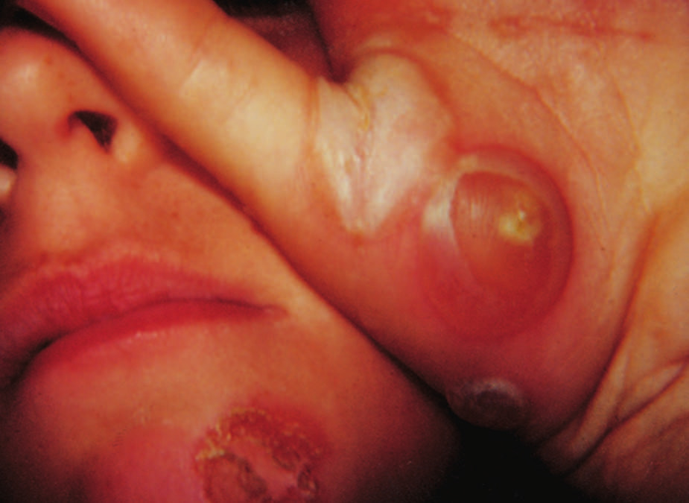
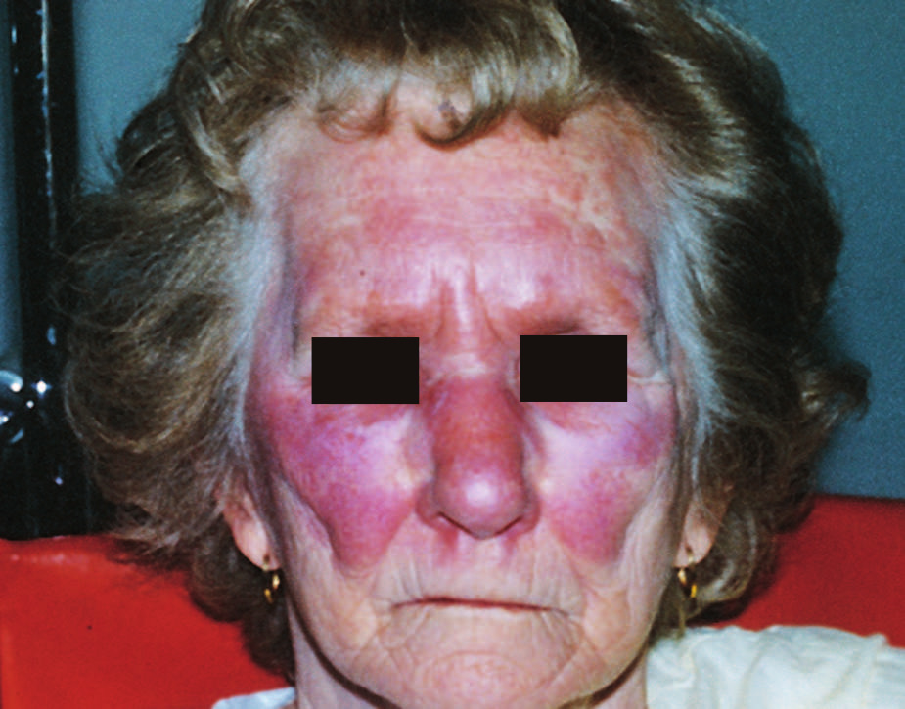
S. pyogenes (Group A) Pyodermal Infections
Impetigo—localized skin disease
Small vesicles that progress to weeping lesions
Usually in very young children
Erysipelas (rare)
Skin infection with a spreading red rash with a demarcated but irregular edge
Mostly older adults

Slide 27
S. pyogenes (Group A) Pyodermal Infections (Cont.)
Skin or pyodermal infections
Cellulitis
Deep invasion of GAS leading to necrosis and gangrene.

Slide 28
S. pyogenes (Group A) Pyodermal Infection: Scarlet Fever
Strains that are infected with the temperate bacteriophage T12 produce streptococcal pyrogenic exotoxins
Appears 1 to 2 days after bacterial infection
Diffuse red rash that appears on the upper chest and spreads to the trunk and limbs
Rash disappears over the next 5 to 7 days
Followed by desquamation

Slide 29
S. pyogenes (Group A) Necrotizing Fasciitis (NF)
Infection characterized by rapidly progressing inflammation and necrosis of the skin, subcutaneous tissue, and fascia
Described as life-threatening infection-“flesh-eating disease”
Occur in young, healthy individuals
Good wound care is a must to minimize risk of NF
Most common serotypes: M1, M3, M12, M28
Characterized as Types 1, 2, and 3
Group 2 is only GAS

Slide 30
S. pyogenes (Group A) Streptococcal TSS
Streptococcal toxic shock syndrome (TSS)
Exact portal of entry is unknown
Entire organ system collapses leading to death
Initial severe streptococcal infection occurs
Patients are often bacteremic and have NF
At risk populations
Young children, especially those with chicken pox (varicella) and older adults
Associated with pyrogenic exotoxin- notably SpeA
Toxins function as superantigens

Slide 31
S. pyogenes (Group A) Post-Strep Sequelae
Post-Streptococcal Sequelae—two serious complications
Rheumatic fever
Occurs after pharyngitis-attacks
Usually begins 1 month after infection
Inflammation of the joints, heart, blood vessels, and subcutaneous tissues occurs
Can cause serious damage to the heart valves
Repeated infections can produce further valve damage

Slide 32
S. pyogenes (Group A) Post-Strep Sequelae
Post-Streptococcal Sequelae—two serious complications
Rheumatic fever
In some instances, antibodies from streptococcal sequelae cross-react with the brain to produce a neurologic manifestation of acute rheumatic fever called Sydenham chorea.
Rare in most developed countries; remains problematic in developing countries and in some poor populations in industrialized countries
Pathogenesis is caused by antigenic cross-reactivity between streptococcal antigens and heart tissue

Slide 33
S. pyogenes (Group A) Post-Strep Sequelae
Post-Streptococcal Sequelae—two serious complications of GAS
Acute glomerulonephritis (AGN)
Can occur after pharyngitis or cutaneous infection
Pathogenesis appears to be immunologically mediated
Circling complexes are found in the plasma of AGN patients
It is postulated that these antigen-antibody complexes deposit in the glomeruli resulting in kidney damage
More common in children than in adults
Drug of choice – penicillin; erythromycin as an alternative

Slide 34
S. pyogenes (Group A) Specimen Collection and Recovery
Specimen collection
Swab rubbed over the posterior pharynx and each tonsillar area
If exudate is present, it should also be touched with the swab
Avoid contamination by tongue and uvula
Recovery
Direct Gram-stained s smears are of little value since nonpathogenic gram-positive cocci are part of normal bacterial biota
Sheep blood agar (SBA) plate is inoculated and streaked for isolation

Slide 35
S. pyogenes (Group A) Specimen Collection and Recovery (Cont.)
Recovery
Example of selective agar plate that may be used- SBA containing sulfamethoxazole (SMZ)
Improves recovery of β-hemolytic streptococci from throat cultures
Observe after 24 hours at 35°C (anaerobic or ambient air conditions) for the presence of β-hemolytic colonies.
If none, incubate for an additional 24 hours.
False-negative results can occur from overgrowth of normal microbiota and lack of β-hemolysis

Slide 36
S. pyogenes (Group A) Specimen Collection and Recovery (Cont.)
Recovery
On BAP, GAS colonies are small, transparent, and smooth with a well-defined area of β-hemolysis
Gram–stained smear reveals
Gram-positive cocci with some short chains
Suspected colonies can be examined further via
Lancefield-typed using serologic methods
Definitive, rapid identification method
Rapid identification
Biochemical methods

Slide 37
S. pyogenes (Group A) Traditional and Rapid Detection Methods
Key traditional tests
For throat specimens-Bacitracin susceptibility or, pyrrolidonyl-α- naphthylamide (PYR) hydrolysis
GAS is susceptible to bacitracin and hydrolyzes PYR
Most other groups are bacitracin resistant and PYR-negative
Differentiate group C and G streptococci from GAS with Lancefield typing

Slide 38
S. pyogenes (Group A) Traditional and Rapid Detection Methods
Key traditional tests
For specimens other than throat: hippurate hydrolysis, Christie Atkins Munch-Petersen (CAMP) test, bile esculin test, 6.5% sodium chloride (NaCl) broth
Rapid detection tests (RADTs) for detection of GAS in throat swabs
Enzyme immunoassays (EIAs)
Optical immunoassays (OIAs)
Rapid polymerase chain reaction (PCR)

Slide 39
S. pyogenes (Group A) Commercial ID Systems
Commercial systems for direct ID from blood cultures
Verigene Gram-positive blood-culture (BC-GP) nucleic acid test
FilmArray blood culture identification (BCID)
Matrix-assisted laser desorption ionization–time-of-flight (MALDI-TOF) bacterial identification systems

Slide 40
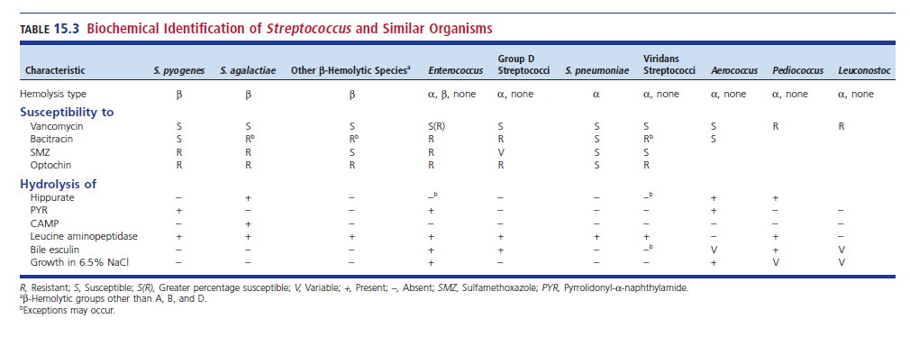
Biochemical ID of Streptococcus and Similar Organisms

Slide 41
S. agalactiae (Group B) (GBS) Antigenic Structure
Possess the Group B specific antigen
Acid-stable polysaccharide in cell wall
Also known as Group B Streptococcus (GBS)
Nine recognized capsular polysaccharide serotypes
Three major serotypes: Ia, Ib, II
Contain a terminal residue of sialic acid
Weakly immunogenic and can inhibit activation of alternative complement pathway

Slide 42
S. agalactiae (Group B) Virulence Factors
Capsule—prevents phagocytosis but is ineffective after opsonization
Sialic acid—most significant component of capsule and critical virulence determinant
Studies with mutant strains showed loss of capsular sialic acid was associated with loss of virulence

Slide 43
Products Produced by S. agalactiae (Group B)
Other products produced by GBS
Hemolysin
CAMP factor
Neuraminidase
DNases
Hyaluronidase
Protease
No evidence that any of these products plays a role in virulence.

Slide 44
S. agalactiae (Group B) Clinical Infections
Significant cause of invasive disease in newborns
Known as the leading cause of death in infants in the United States even though the incidence decreased dramatically from the 1990s to 2008

Slide 45
S. agalactiae (Group B) Early and Late Onset Infections
Early onset infection
Less than 7 days old
80% of cases vertical transmission from mother during birth
Premature birth, membrane rupture, develops into pneumonia or meningitis with bacteremia.
Late onset infection
1 week to 3 months after birth-meningitis
Mortality rate is of serious concern, death occurs if treatment is not started immediately

Slide 46
S. agalactiae (Group B) Adult Infections and Treatment
Adult infections
Mother after childbirth or abortion
Endometritis or wound infections
Endocarditis
Older adults
Immunodeficiency
Skin and soft tissue infections, intraabdominal abscess, bacteremia, pneumonia
Treatment
Drug of choice is penicillin

Slide 47
S. agalactiae (Group B) Morphology and ID Tests
On SBA, grayish white mucoid colonies surrounded by a small zone of β-hemolysis after 24 to 48 hours incubation at 35° C
Gram-positive cocci in chains
Short chains in clinical specimens
Longer chains in culture
Presumptive ID based on antigen detection or biochemical reactions.

Slide 48
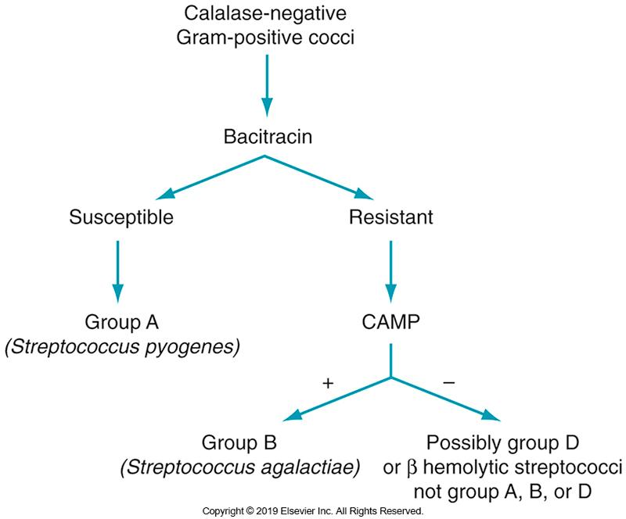
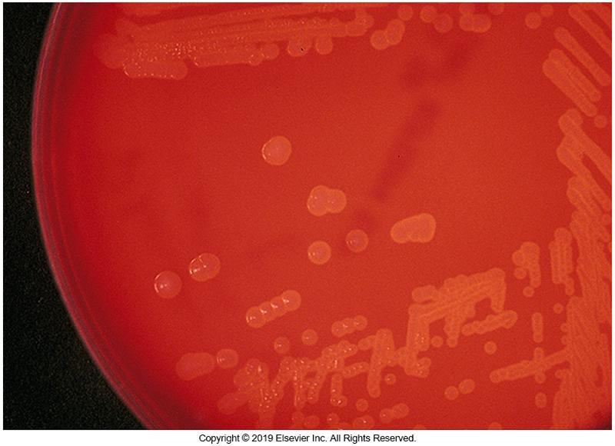
S. agalactiae (Group B) Laboratory Diagnosis
Small zone β-hemolysis
Bacitracin, Hippurate hydrolysis, and CAMP test

Slide 49
S. agalactiae (Group B) Laboratory Diagnosis (Cont.)
In pregnant women
Collect vaginal and rectal material during the 35 to 37 weeks gestation
Inoculate to selective broth, such as Todd Hewitt broth with antimicrobials (Lim), TransVag broth, StrepBCarrot broth
Subculture to SBA
Numerous nucleic acid amplification tests for nonenriched clinical specimens and culture-enriched specimens are available

Slide 50
S. agalactiae (Group B) CDC Recommendations
Universal vaginal and rectal screening of all pregnant females late in the 3rd trimester
Screen pregnant women with asymptomatic bacteriuria
Prophylactic antimicrobial therapy for women whose samples test positive:
Vaginal and rectal screenings
Urine culture
Women with previous history
An unknown status of GBS at time of delivery

Slide 51
Groups C and G Streptococci Large and Small Colony Isolates
β-hemolytic
Large colony isolates
S. dysgalactiae, subspecies equisimilis
Sometimes type Group A and L antigens are classified with the pyogenic streptococci
Spectrum of infections resemble that of Group A Streptococcus
Small colony isolates
S. anginosus group

Slide 52
S. pneumoniae Antigenic Structure
Also known as pneumococcus
Isolated from a variety of clinical specimens
Member of the S. mitis group
Cell wall contains an antigen, called C substance that is similar to the C carbohydrate of the various Lancefield groups
C-reactive protein (CRP), a β-globulin in human serum, reacts with C substance to form a precipitate
This is not a chemical reaction, not an antigen-antibody combination
CRP increases during inflammation and infection

Slide 53
S. pneumoniae Antigenic Structure
S. pneumoniae
Can express 1 of 90 different capsular types based on chemical variations of the capsular polysaccharide
Antibody directed against the capsular antigen is protective
The capsule is antigenic and can be identified with appropriate antisera in the Neufeld test
Presence of specific anticapsular serum causes the capsule to swell (Quellung reaction).
This test allows for identification and serotyping

Slide 54
S. pneumoniae Virulence Factors
Capsule
Capsular polysaccharide
Strains with no capsule are nonpathogenic
Toxins produced
Hemolysins
Immunoglobulin A protease
Neuraminidase
Hyaluronidase
None of these toxins have shown to have a role in disease production

Slide 55
S. Pneumoniae Clinical Infections
Important human pathogen that causes
Pneumonia-prevalent in older adults and in patients with underlying disease
Sinusitis
Otitis media-frequent isolate in children younger than 3 years of age
Bacteremia
Meningitis

Slide 56
S. pneumoniae Clinical Infections (Cont.)
There are over 100 capsular serotypes
About ¼ of these accounts for most pneumococcal pneumonia cases
Conditions required for developing pneumococcal pneumonia
Organism must be present in the nasopharynx
The individuals must be deficient in the specific circulating antibody against the capsular type of the colonizing strain of S. pneumoniae

Slide 57
S. Pneumoniae Clinical Infections (Cont.)
After colonization, the bacteria can persist for weeks or months without causing disease
In some individuals, invasive disease occurs that leads to community-acquired pneumonia
Usually occurs as a result of disturbance of the normal defense barriers, not a primary infection

Slide 58
S. Pneumoniae Clinical Infections (Cont.)
Predisposing conditions
Alcoholism
Anesthesia
Malnutrition
Viral infections of the upper respiratory tract
Age- older adults at increased risk

Slide 59
S. pneumoniae Clinical Infections (Cont.)
Infection begins with aspiration of respiratory secretions, which often contain pneumococci
The infecting organisms in the alveoli stimulate an outpouring of fluid that
Serves to facilitate the spread of the organism to adjacent alveoli
Process stops when fluid reaches fibrous septa that separate the major lung lobes
Hence the use of the term “lobar”

Slide 60
S. pneumoniae Clinical Infections (Cont.)
Pneumococcal (lobar) pneumoniae
Chills, cough, dyspnea (shortness of breath)
Pneumonia may be complicated by a pleural effusion that is usually sterile (empyema)
Infected effusion usually contains many white blood cells (WBCs) and pneumococci, which are visible on Gram-stained smears

Slide 61
S. pneumoniae Clinical Infections (Cont.)
Can also be involved in
endocarditis
peritonitis
Bacteremia often occurs during the course of a serious infection. Consequently, samples for blood culture are often taken simultaneously with sputum or a fluid aspirate

Slide 62
S. pneumoniae Clinical Infections (Cont.)
There are two pneumococcal vaccines currently available
PCV13- protects against 13 serotypes commonly affecting young children
Part of routine pediatric immunization
Involves four doses beginning at 2 months of age
PPSV23 (23-valent pneumococcal polysaccharide vaccine
Recommended for older adults- those older than 65 years of age or patients with a long-term health problem

Slide 63
S. pneumoniae Laboratory Diagnosis
Characteristic gram-positive diplococci with lancet shape in pairs (mostly) or short chains
As culture ages, Gram stain reaction becomes variable
Capsule stain
Can reveal the capsule

Slide 64
S. Pneumoniae Culture Media
Culture
Complex media required
Brain-heart infusion
Trypticase soy agar with 5% sheep RBCs
Chocolate agar
Some strains need increased CO₂ concentration for growth during primary isolation

Slide 65
S. Pneumoniae Colony Appearance
Isolates produce a typical large zone of α-hemolysis on blood agar surrounding the colonies
Young Cultures
Round, glistening, wet, mucoid, dome-shaped appearance
As colonies in culture grow older
Autolytic changes result in a collapse of each colony’s center giving it the appearance of a coin with a raised rim.

Slide 66
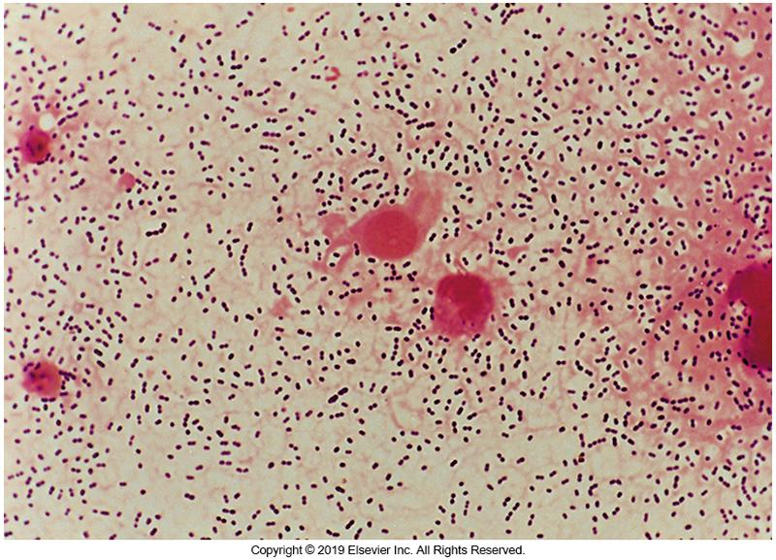
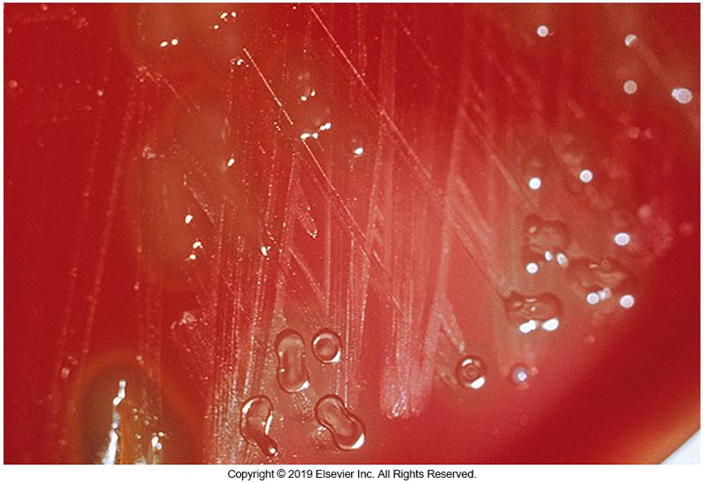
S. Pneumoniae Laboratory Diagnosis

Slide 67
Distinguishing S. pneumoniae from the viridans streptococci
Colonies may look strikingly similar
Techniques to distinguish such colonies
Optochin susceptibility (more commonly used)
S. pneumoniae is susceptible
Other α-hemolytic species are resistant
Bile solubility test- determines the lysis of S. pneumoniae in the presence of bile salts
S. pneumoniae is bile soluble
Other α-hemolytic species are not bile soluble

Slide 68
S. Pneumoniae Identification Methods
Phadebact Pneumococcus Test (rapid test)
Coagglutination assay uses anticapsular antibodies produced in rabbits
MALDI-TOF MS
BinaxNOW-immunochromatographic test
Designed to detect a C polysaccharide common to all S. pneumoniae
FilmArray BCID Panel—for ID in blood cultures

Slide 69
S. pneumoniae Antimicrobial Resistance
Penicillin remains the drug of choice even though resistant strains exist
Resistance is caused by altered penicillin-binding proteins
When penicillin is resistant, other classes of antimicrobials show resistance as well
b-lactams, macrolides, tetracyclines
Resistance to extended-spectrum cephalosporins has increased but can still be used to treat serious infections.

Slide 70
S. pneumoniae Antimicrobial Resistance (Cont.)
Multidrug-resistant strains occur
Defined as resistant in vitro to two or more classes of antimicrobials
Can occur in the presence or absence of penicillin resistance

Slide 71
Viridans Streptococci Characteristics
Normal biota of
Upper respiratory tract (URT), female genital tract, and gastrointestinal (GI) tract
Viridans means “green”
Many show α-hemolysis
Fastidious, with some requiring CO₂
Viridans streptococci have more than 30 species in five groups (several species remain unclassified)
S. mitis group
S. mutans group
S. salvarius group
S. bovis group
S. anginosus group

Slide 72
Viridans Streptococci Characteristics (Cont.)
S. bovis groups belong to group D streptococci
Possess the group D antigen
S. bovis is no longer a valid species name
DNA studies found that S. bovis and S. equinus are the same, S. equinus was adopted as the new name
Now, all human isolates of S. bovis are identical assuming the name S. gallolyticus

Slide 73
Viridans Streptococci Characteristics (Cont.)
Group D streptococci: historically two groups
Enterococcal – bile positive, growth in 6.5% NaCL
Nonenterococcal- bile positive, no growth in 6.5% NaCL
More is now known about the molecular characteristics of the two groups
Enterococcal group is now in the genus Enterococcus
Nonenterococcal group is still part of group D streptococci

Slide 74
Viridians Streptococci Clinical Infections (Cont.)
Oropharyngeal commensals that are considered opportunistic pathogens
Virulence is low but they can cause disease if host defenses are compromised
Most common cause of subacute bacterial endocarditis
Associate with transient bacteremia

Slide 75
Viridians Streptococci Clinical Infections (Cont.)
Bacteremia is more common in children than in adults and more prevalent in patients with hematologic malignancies
Fatal cases have been characterized by fulminant cardiovascular collapse or meningitis
Course of endocarditis is slow
Individuals whose heart valves have been damaged by rheumatic fever are especially susceptible to endocarditis from viridans streptococci

Slide 76
Viridans Streptococci Clinical Infections
Other infections
Gingivitis
Tooth decay
Meningitis
Abscesses
Osteomyelitis
Empyema
Most are penicillin susceptible
Some resistant strains have been reported

Slide 77
Viridans Streptococci Virulence Factors
Not well established
A polysaccharide capsule and cytolysin have been identified in some members of the S. anginosus group.
Other factors with possible virulence tendencies
Extracellular dextran
Cell surface-associated proteins
Extracellular enzymes

Slide 78
Viridans Streptococci Laboratory Diagnosis
Extremely difficult to identify isolates
Laboratories should be satisfied to place isolates into one of the five groups.
Typical characteristics on Gram-stained smears
Culture colonies are small and surrounded by a zone of α-hemolysis.
Some strains may be either β-hemolytic or nonhemolytic.

Slide 79
Viridans Streptococci Laboratory Diagnosis (Cont.)
The lack of β-hemolysis separates the viridans streptococci from groups A, B, C, and G
Differentiate α-hemolytic viridans streptococci from S. pneumoniae, also α-hemolytic based on
Optochin sensitivity
Bile solubility
Anticapsular antibody tests.

Slide 80
Viridans Streptococci Laboratory Diagnosis (Cont.)
Tests to differentiate species within the viridans group
Voges-Proskauer (VP) reaction
b D-glucuronidase activity
Hippurate hydrolysis
Multitest kits available to identify the more commonly isolated species

Slide 81
Viridans Streptococci Laboratory Diagnosis (Cont.)
All members are PYR negative and leucine aminopeptidase (LAP) positive

Slide 82
Enterococci General Characteristics
Enterococci
Natural inhabitants of human and animal intestinal tracts
Two most common species: E. faecalis and E. faecium
All species produce D antigen and thus belong to the Lancefield D group.
Weak bubbling in catalase test (pseudocatalase reaction)
Can grow under extreme conditions like bile, salt, or alkaline pH

Slide 83
Viridans Streptococci Newer Identification Methods
Development of molecular methods (e.g., DNA hybridization and PCR) for the identification of viridans streptococci has been challenging.
Multilocus sequence analysis may be used to ID unknown streptococci species
MALDI-TOF systems are in the evaluation stage.

Slide 84
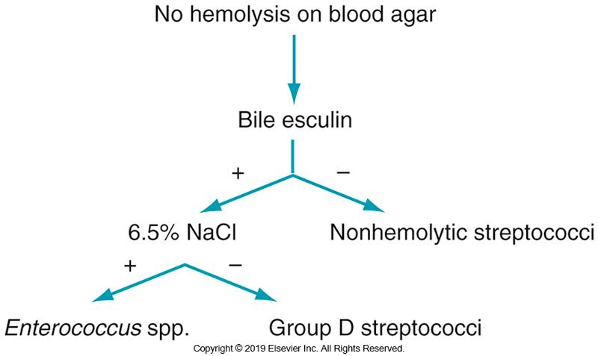
Schematic for the ID of Nonhemolytic Streptococci

Slide 85
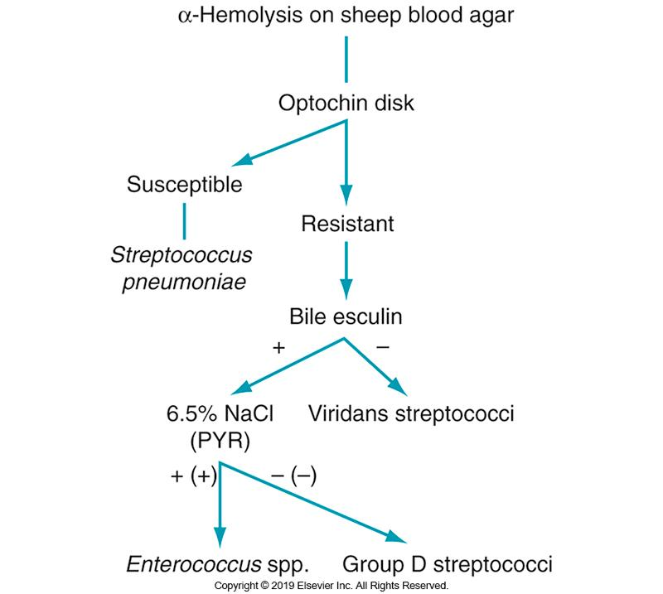
Differentiation of α-Hemolytic Streptococci from Enterococci

Slide 86
Enterococci Virulence Factors
Virulence factors that contribute to pathogenicity are incompletely understood
Can grow in extreme conditions
Resistant to multiple antimicrobial agents

Slide 87
Enterococci Virulence Factors (Cont.)
Possible virulence factors of E. faecalis that might play a role in colonization and adherence to heart valves and renal epithelial cells
Surface adhesin proteins
Extracellular protease
Gelantinase

Slide 88
Enterococci Virulence Factors (Cont.)
E. faecalis also produces a two-subunit toxin, termed cytolysin
Shows similarity to bacteriocins produced by other gram-positive bacteria and is expressed by a quorum-sensing mechanism

Slide 89
Enterococcus Clinical Infections
Nosocomial infections
UTI is most common, often associated with urinary catheterization or other urologic manipulations
Prolonged hospitalization
Bacteremia may occur in:
Hemodialysis patients
Immunocompromised patients with underlying disease
Patients who have undergone a prior surgical procedure
Endocarditis
Accounts for 5% to 10% of bacterial endocarditis

Slide 90
Enterococcus Growth Criteria and Characteristics
Standard collection and handling procedures
Specimens should be cultured ASAP
Trypticase soy or BHI agar supplemented with 5% sheep blood often used
Organisms grow well at 35° C in the presence of low level of CO_{2.}
Selective media can be used if clinical specimen is obtained from contaminated site or if multiple microorganisms (gram-negative) are likely

Slide 91
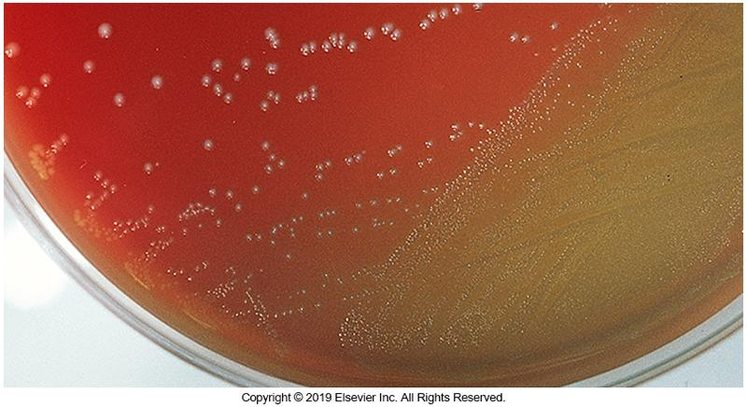
Enterococci on Blood Agar

Slide 92
Enterococcus Identification Methods
Biochemical tests
Commercially available multitest kits may be useful for the identification of E. faecalis
Molecular typing methods
Used mainly to type Enterococcus spp. in epidemiologic studies and investigations of vancomycin-resistant enterococci (VRE)

Slide 93
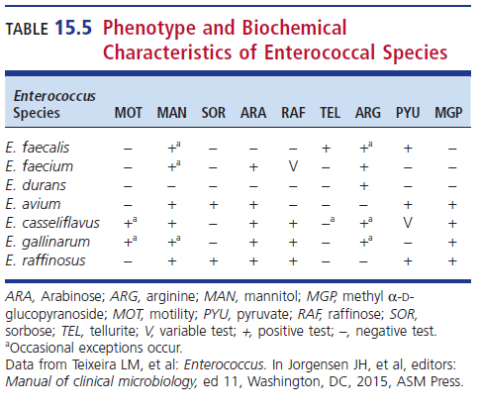
Laboratory Diagnosis of Enterococcus

Slide 94
Enterococcus and Antimicrobial Resistance
Resistance to several agents
Acquired resistance to aminoglycosides, β-lactams, and glycopeptides
Vancomycin-resistant enterococci (VRE)
Nine phenotypes have been described
VanA and VanB most frequently encountered
PCR-based assays have been used to detect VRE

Slide 95
Streptococcus-like Organisms General Characteristics
Five genera in this group consist of organisms that resemble viridans streptococci
Aerococcus, Gemella, Lactococcus, Leuconostoc, Pediococcus
Isolated in clinical specimens
Vancomycin resistant
Associated with infections resembling enterococci and streptococci
Notes:
95

Slide 96
Abiotrophia and Granulicatella
Bacteria grow as satellite colonies
Media supplemented with 10 mg/L pyridoxal hydrochloride alternative to BAP
Formerly known as nutritionally variant streptococci (NVS)
Part of human oral and gastrointestinal microbiota
Significant cause of
Bacteremia, endocarditis, otitis media

Slide 97
Aerococcus
Aerococcus—common airborne organism
Opportunistic pathogen
Bacteremia, endocarditis, and UTI in immunocompromised patients
Resembles viridans streptococci on culture
Resembles staphylococci on Gram-stained smears
Gram-positive cocci in tetrads or clusters
Weak catalase (a.k.a. pseudocatalase reaction)
Susceptibility patterns similar to enterococci

Slide 98
Dolosicoccus and Globicatella
Minor genera in the family Aerococcaceae
Dolosicococcus paucivoran
Single species in the genus
Isolated in blood specimens
Biochemical and molecular tests differentiate this species from Globicatella spp.

Slide 99
Dolosicoccus and Globicatella
Minor genera in the family Aerococcaceae
Globicatella spp.
Isolated from blood, urine, and CSF in patients with bacteremia, UTI, and meningitis
Facultative anaerobic
Catalase negative
α-hemolytic, gram-positive cocci
Rarely isolated, often misidentified
One known species: G. sanguinis

Slide 100
Dolosigranulum and Facklamia
Dolosigranulum
Facultative anaerobic, non-motile cocci that occur in pairs, tetrads, or clusters
D. pigrum has been associated with several infections, including nosocomial pneumonia
Facklamia
α-hemolytic, catalase-negative, facultative anaerobic cocci seen in pairs or chains
Has been misidentified as viridans streptococci
Associated with infective endocarditis and bacteremia

Slide 101
Gemella
Colony morphology and habitat similar to viridans streptococci
Either produce α-hemolysis or are nonhemolytic
Decolorize easily during Gram staining
Often appear as gram-negative cocci in tetrads, pairs, clusters, or short chains
Isolated in cases of endocardititis, wounds and abscesses
Most significant species is G. haemolysans

Slide 102
Lactococcus
Gram-positive cocci appear singly, in pairs, or in chains
Physiologically similar to enterococci
Are either α-hemolytic or nonhemolytic
Previously classified as Group N streptococci
Associated with UTI and endocarditis
These microorganisms do not react with the genetic probe in the AccuProbe Enterococcus culture confirmation test

Slide 103
Leuconostoc
Gram-positive, catalase-negative
Irregular coccoid morphology
Share phenotypic and biochemical characteristics with Lactobacillus spp., viridans streptococci, Pediococcus spp., and Enterococcus spp.
Associated with bacteremia, UTIs, meningitis, pulmonary infections
Intrinsically resistant to vancomycin

Slide 104
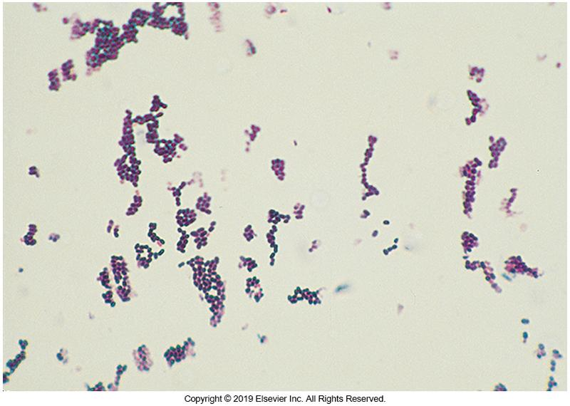
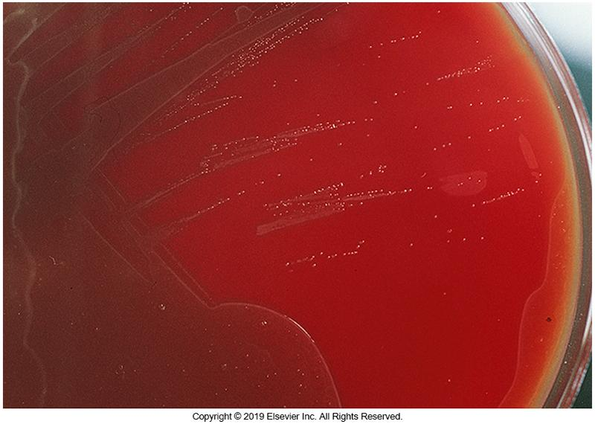
Leuconostoc (Cont.)
Gram stain morphology of Leuconostoc species
Colonies of Leuconostoc species growing on SBA

Slide 105
Pediococcus
Arranged in tetrads, pairs, and clusters
Can grow at 45° C
Resembles viridans streptococci or enterococci
Associated infections
Bacteremia, abscess, meningitis
In patients who have underlying GI abnormalities or previously had abdominal surgery
Intrinsically resistant to vancomycin

Slide 106
Vagococcus
Commonly found in animals
Pigs, cattle, horses, cats
Uncommonly found in humans but has been isolated in
Blood, CSF, wounds
Most common human isolate is V. fluvialis
Facultative anaerobic, catalase-negative, motile, gram-positive cocci
Best methods for identification
MALDI-TOF mass spectrometry or 16 s rRNA

Slide 107
Clinical & Diagnostic Microbiology
Staphylococcus & Similar Organisms
Streptococcus, Enterococcus, and Other Catalase-Negative, Gram-Positive Cocci
Laboratory Diagnosis

Slide 108
Classification Schemes
Hemolytic pattern on SBA
Physiologic characteristics
Surface typing
Serologic grouping or typing of C carbohydrate (Lancefield classification)
Capsular polysaccharide
Surface protein
Biochemical characteristics

Slide 109
Hemolytic Patterns

Slide 110
Physiologic Characteristics
This classification divides the streptococcal species into four groups:
Pyogenic streptococci—produces pus, mostly β-hemolytic and constitute most of the Lancefield groups
Lactococci—nonhemolytic with Lancefield Group N antigen; often found in dairy products
Enterococci—part of normal intestinal biota
Viridans streptococci—widely found in URT
(upper respiratory tract)

Slide 111
Lancefield Classification Scheme
Most commonly used scheme
System is based on extraction of C carbohydrate from the streptococcal cell
Achieved by placing organisms in dilute acid and heating for 10 minutes
The soluble antigen is used to immunize rabbits to obtain anti-sera to the various C carbohydrate groups

Slide 112
Biochemical Identification
Hemolytic reaction of the isolate determines which select identification tests should be done
Exhaustive testing not always needed

Slide 113
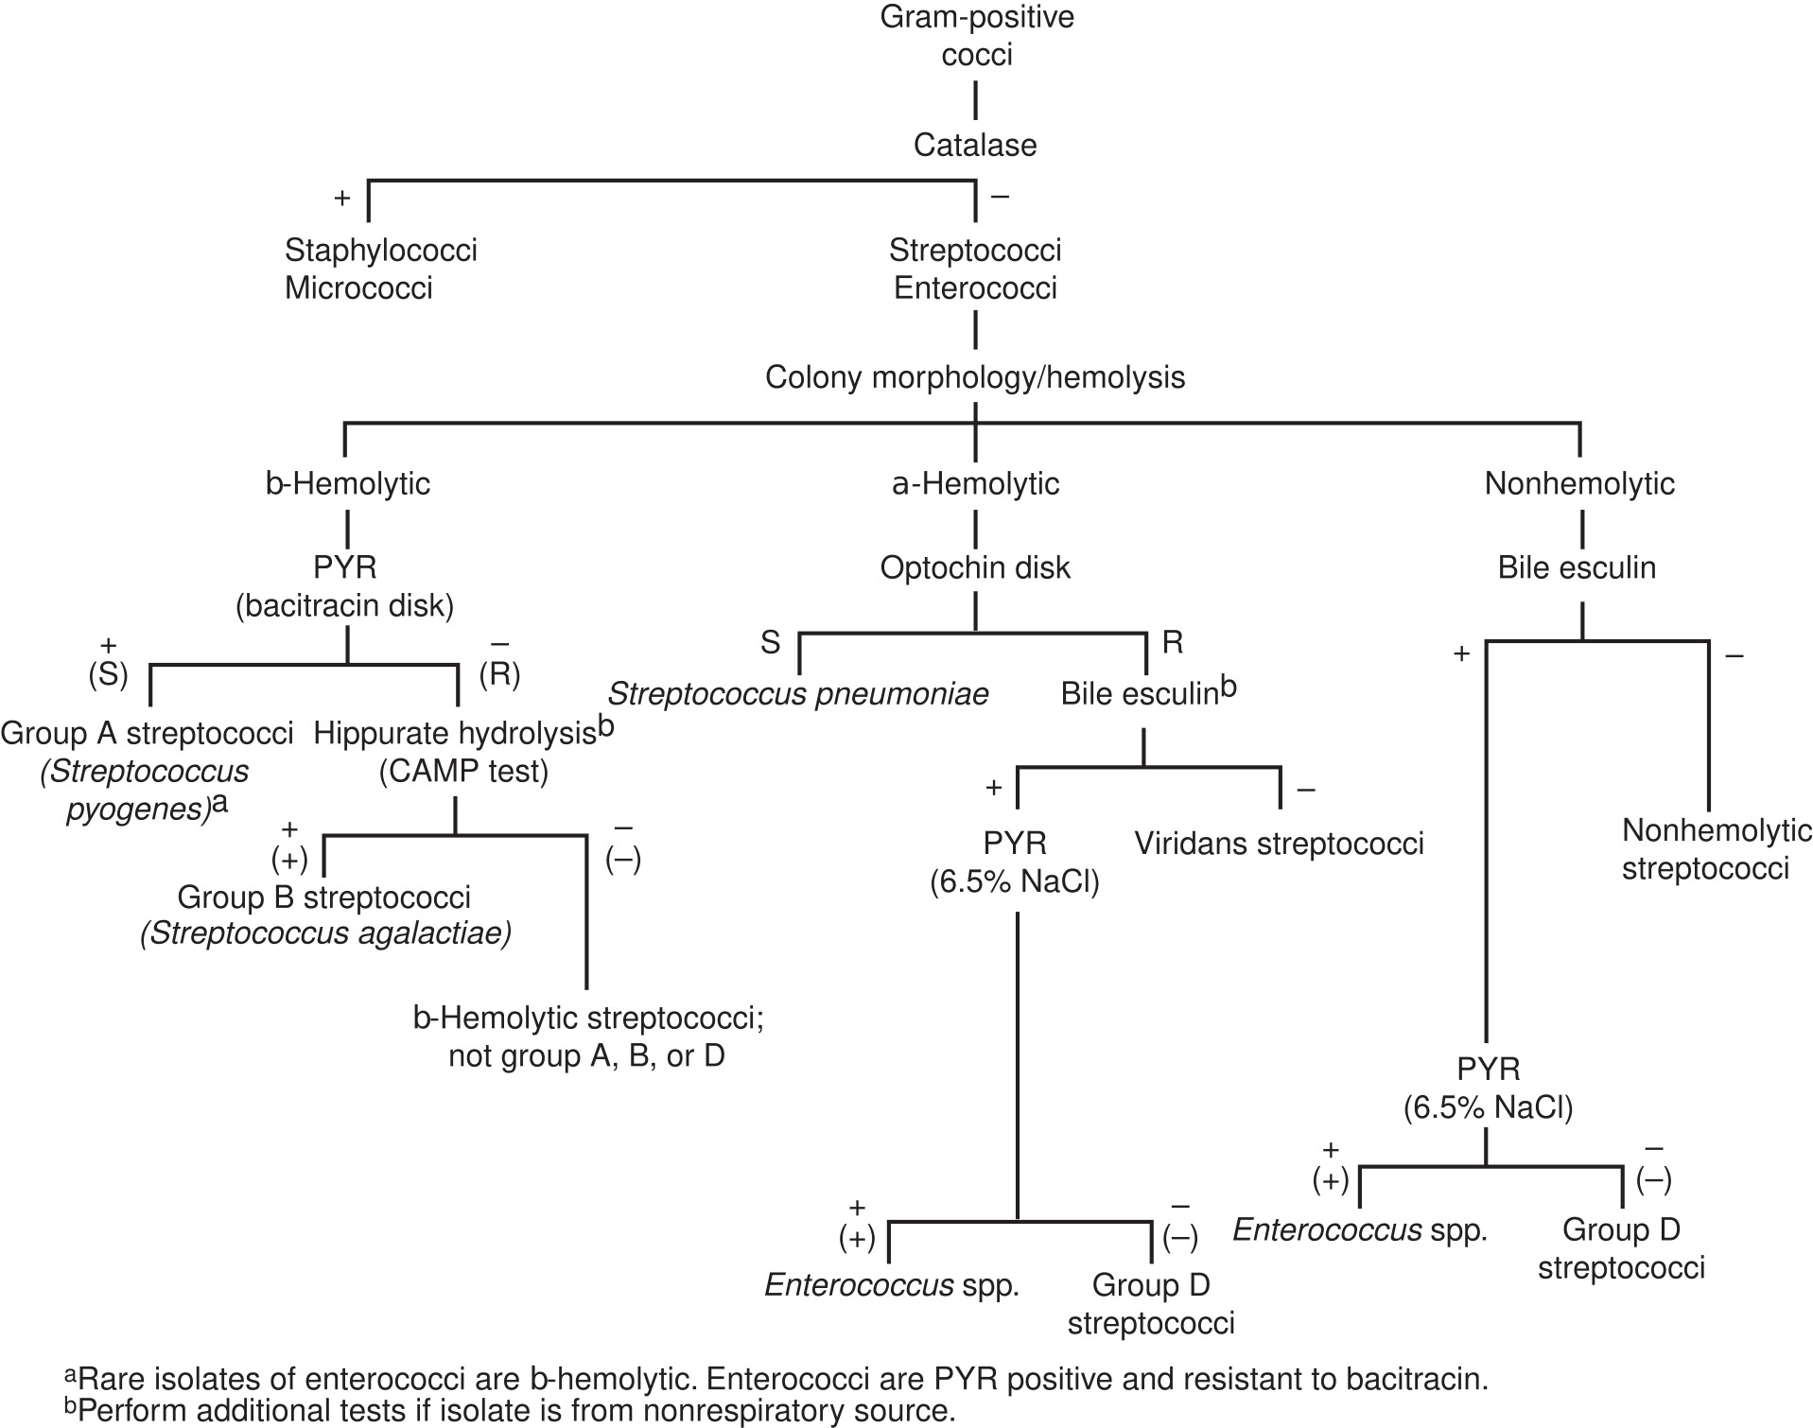
Biochemical Identification (Cont.)

Slide 114
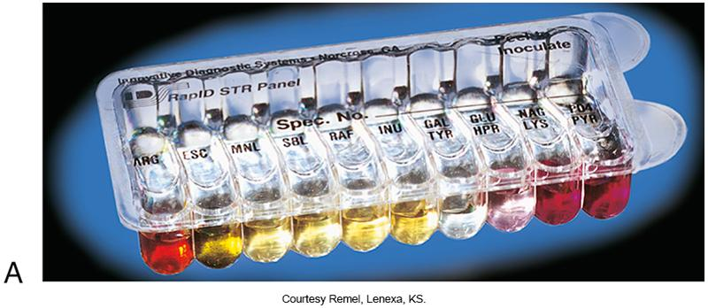
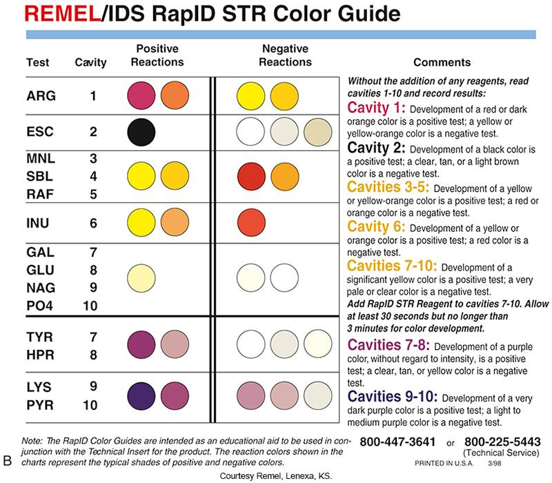
RapID STR Panel for Identification of Streptococcus spp.

Slide 115
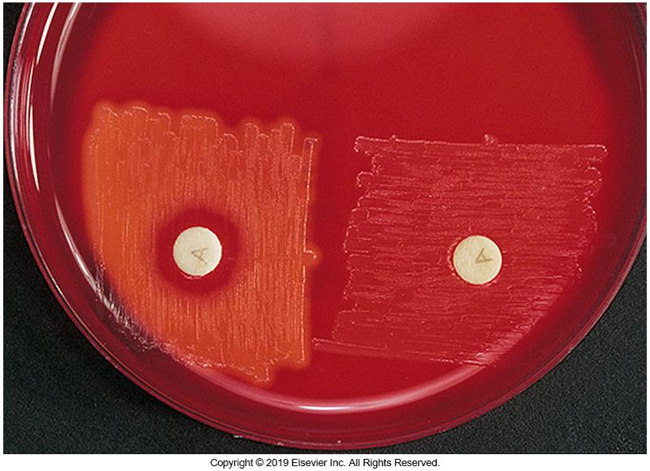
Bacitracin Susceptibility
Used as presumptive test for S. pyogenes
Helpful in screening for GAS in throat cultures
GAS is susceptible to “A” disk. (left)

Slide 116
CAMP Test Description
CAMP is an acronym derived from the first letters of the surnames of the individuals who first described the reaction:
Camp, Atkins, Munch-Petersen
Three ways to perform the test
Use of β-lysin-producing S. aureus
Use of a disk impregnated with the β-lysin
Rapid CAMP test (a.k.a. spot CAMP test)

Slide 117
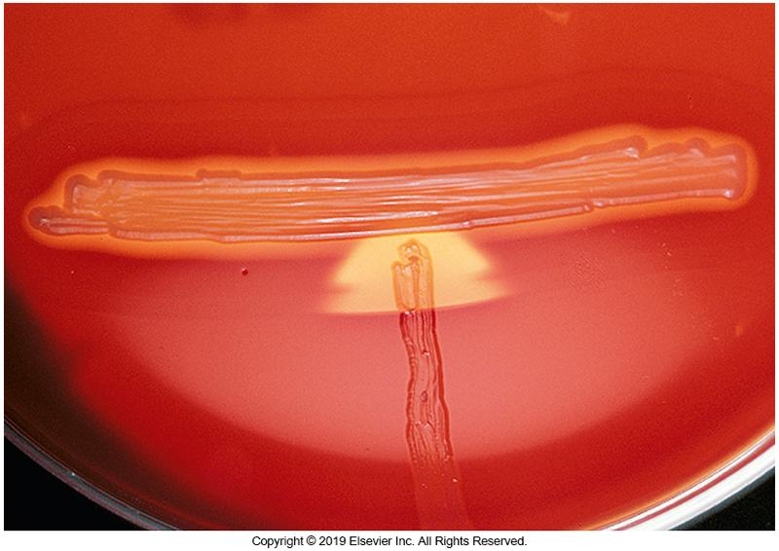
CAMP Test Principle
Detects the production of enhanced hemolysis
Occurs when β-lysins come in contact with the hemolysins of Group B streptococci
May use purified β-lysin on confluent streptococci colony
Disks containing β-lysin also work
Group B streptococci showing the classical “arrow-shaped” hemolysis near the staphylococcus streak

Slide 118
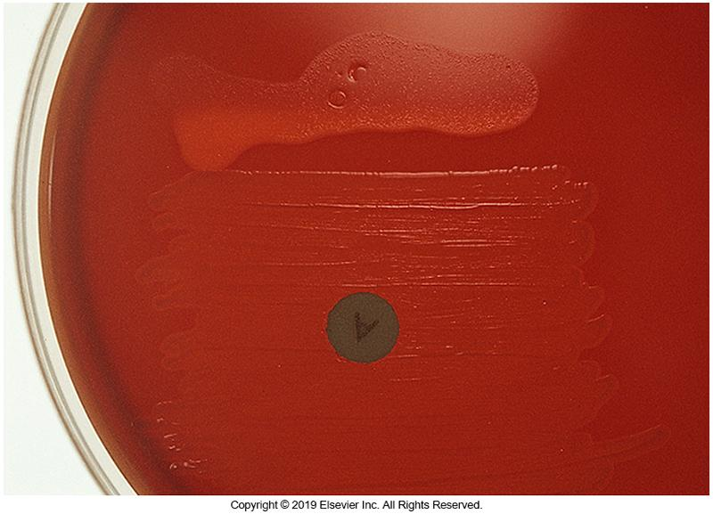
Rapid CAMP Test
The enhanced hemolysis shown here is produced by S. agalactiae when a drop of extract β-lysin is placed on the colony

Slide 119
Hippurate Hydrolysis Test
Differentiates Group B streptococci from other β-hemolytic streptococci
Group B streptococci possess the enzyme hippuricase (hippurate hydrolase) which hydrolyzes sodium hippurate forming sodium benzoate and glycine.
A rapid 2-hour test is available

Slide 120
Pyrrolidonyl-α-Naphthylamide Hydrolysis (PYR)
Presumptive ID of GAS and nonhemolytic Enterococci
Streptococcus pyogenes (GAS) is the only streptococci that is PYR-positive
Other PYR-positive genera
Enterococcus, Aerococcus, Gemella

Slide 121
Pyrrolidonyl-α-Naphthylamide Hydrolysis (PYR) (Cont.)
PYR test detects the activity of
Substrate L-pyrrolidonyl arylamidase
Also called pyrrolidonyl aminopeptidase
Hydrolyzed by GAS and Enterococcus sp.
As specific as that of bile esculin and salt tolerance tests for Enterococcus sp.
More specific than bacitracin disk susceptibility test for GAS

Slide 122
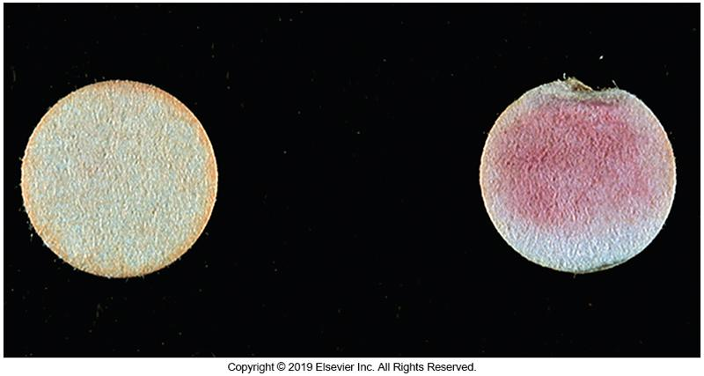
PYR Test
Left: Negative test, Right: Positive test

Slide 123
Leucine Aminopeptidase (LAP)
LAP is a peptidase that hydrolyzes peptide bonds adjacent to a free amino group
The substrate, leucine-β-naphthylamide, is hydrolyzed to β-naphthylamine. After the addition of p-dimethylaminocinnamaldehyde reagent, a red color develops

Slide 124
Leucine Aminopeptidase (LAP)
Rapid commercial tests that use filter paper disks impregnated with substrate are available
The LAP test is often used with the PYR test and helpful in differentiating Aerococcus and Leuconostoc spp. from other gram-positive cocci
Streptococcus, Enterococcus, and Pediococcus spp. are LAP positive, and Aerococcus and Leuconostoc spp. are LAP negative

Slide 125
Voges-Proskauer Test
Used to distinguish the small-colony–forming β-hemolytic S. anginosus group containing group A or C antigens from large-colony–forming pyogenic strains with the same antigens
Detects acetoin production from glucose

Slide 126
Voges-Proskauer (VP) Test
In modified VP test, a heavy suspension of bacteria is incubated in 2 mL VP broth for 6 hours
Add a few drops of 5% α-naphthol and 40% potassium hydroxide.
Shake to increase dissolved oxygen
Incubate for 30 minutes at room temperature
The formation of a red or pink color is positive

Slide 127
β-D-Glucuronidase (BGUR)
Detects action of β-glucuronidase
Enzyme found in isolates of large-colony-forming Group C and Group G β-hemolytic streptococci
Not found in small colony isolates
Commercially prepared rapid assays are available.

Slide 128
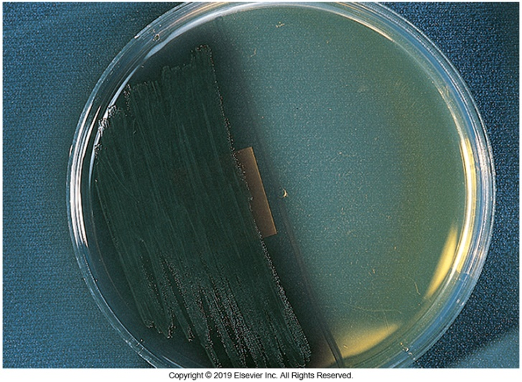
Bile Esculin Test
Bile esculin hydrolysis
Ability to grow in 40% bile and hydrolyze esculin are features of streptococci that possess Group D antigen.
Enterococcus spp. and Group D streptococci test positive.

Slide 129
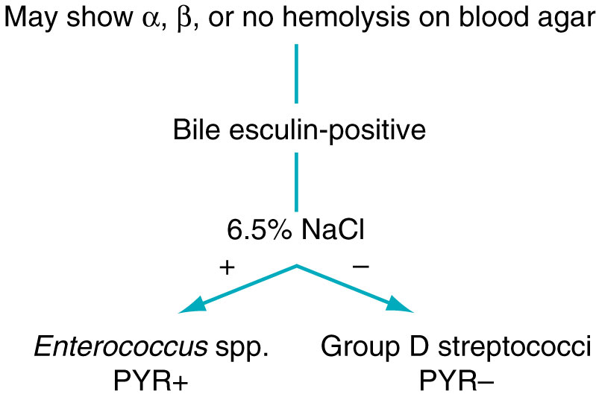
Salt-Tolerance Test
Growth in 6.5% NaCl broth
Differentiates Group D streptococci from enterococci
Enterococci grows; Group D streptococci do not

Slide 130
Optochin Susceptibility Test
Optochin (p disk)
Ethylhydrocuprein hydrochloride
Add disk to surface of SBA inoculated with an α-hemolytic streptococci colony
Incubate overnight then examine for zone of inhibition
Zone sizes: Susceptible
Greater than 14 mm with 6-mm disk
Greater than 16 mm with 10-mm disk
Presumptive identification of S. pneumoniae

Slide 131
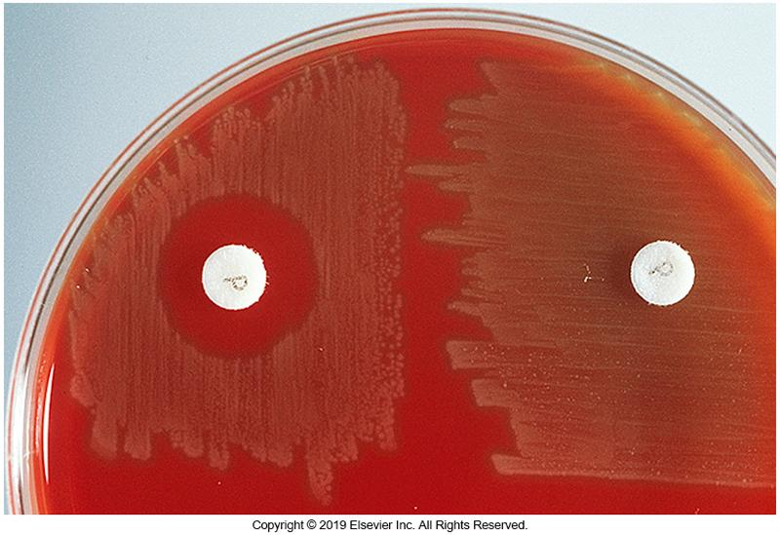
Optochin Susceptibility Test (Cont.)
Left: Susceptible S. pneumoniae
Right: Resistant S. pneumoniae

Slide 132
Bile Solubility Test
Takes advantage of the S. pneumoniae autocatalytic enzyme amidase
Under influence of bile salt or detergent cell wall lyses during cell division
Suspension of colony in sodium deoxycholate
Clearing through lysis of colonies
Diagnostic for S. pneumoniae

Slide 133
Immunoassays
Direct clinical specimens
Throat swab
Isolated colonies
Extract C carbohydrate
Use in agglutination test or capillary precipitin test
Examples of other available immunoassays
Latex agglutination
Slide agglutination
Enzyme-linked immunosorbent assay (ELISA), OIA

Slide 134
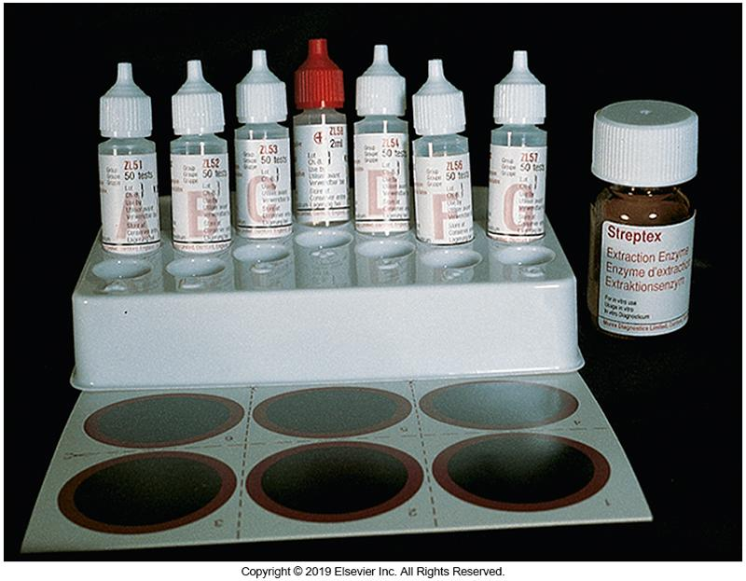
Slide Agglutination Test

Slide 135
Nucleic Acid Probes
Real-time PCR
LightCycler
Smart Cycler
DNA probe test
AccuProbe
Detects pneumococcus
16S rRNA

Slide 136
Susceptibility Testing
Penicillin is the drug of choice
Resistant isolates have been reported
Incidence of penicillin-resistant strains on the increase
Possible alternative choices: erythromycin and narrow-spectrum cephalosporins

Slide 137
Susceptibility Testing Resistance
Multidrug-resistant strains have been reported
S. pneumoniae
Vancomycin resistance increasing
VRE
Select combinations of drugs can be effective and are based on susceptibility patterns and body sites of specimen origin

Slide 138
Points to Remember
The organisms included in the family Streptococcaceae and the Streptococcus-like organisms are catalase-negative, gram-positive cocci usually arranged in pairs or chains.
Hemolysis on SBA is often a starting point for the identification of streptococci and similar organisms.
Many streptococci can be categorized based on Lancefield group antigens.

Slide 139
Points to Remember (Cont.)
Key tests for the identification of streptococci and similar organisms include bacitracin susceptibility, CAMP, hippurate hydrolysis, pyrrolidonyl-α-naphthylamide (PYR) hydrolysis, leucine aminopeptidase (LAP), Voges-Proskauer (VP), β-D-glucuronidase, bile esculin, salt tolerance, optochin susceptibility, and bile solubility tests.

Slide 140
Points to Remember (Cont.)
Many clinical microbiology laboratories use group antigen detection to identify the streptococci.
Group A streptococci are important pathogens that cause acute bacterial pharyngitis, skin and soft tissue infections, and invasive infections, including necrotizing fasciitis.
Emerging resistance of Streptococcus pneumoniae to numerous antimicrobials is becoming a major health concern.

Slide 141
Points to Remember (Cont.)
Viridans streptococci, although usually nonpathogenic, can cause bacteremias, abscesses, and oral infections such as gingivitis and dental caries.
Nutritionally variant streptococci are classified within the genera Granulicatella and Abiotrophia.

Slide 142
Points to Remember (Cont.)
Enterococci cause approximately 5% to 10% of infections in patients with bacterial endocarditis.
Streptococcus agalactiae is a significant cause of invasive disease in newborns.
Group C and G streptococci are important human pathogens associated with infections such as endocarditis, meningitis, primary bacteremia, necrotizing fasciitis, and myositis.

