Slide 1
Aerobic Gram Positive Bacilli Human pathogens

Slide 2
Aerobic Gram Positive Bacilli
Corynebacteria
Bacillus species
Lactobacillus
Erysipilothrix rusiopathiae
Listeria

Slide 3
Corynebacteria
General description
Microscopic
Straight to curved rods, often club-shaped
“Chinese” letters and pallisading
Snapping of bacilli after division
Irregular staining segments of granules that stain deeply with aniline dyes.

Slide 4
Corynebacteria
Cultural
Non-motile
Catalase positive
Aerobic to facultative anaerobe

Slide 5
Corynebacteria
C. diptheriae
Other possible pathogens
C. jeikeium (JK bacilli)
C. urealyticum
C. ulcerans
C. pseudotuberculosis (zoonosis)
C. pseudodiptheriticum (zoonosis)

Slide 6
Corynebacteria C. diphtheria
C. diphtheriae - “Klebs-Loeffler” bacilli
Disease - diphtheria
Non-invasive - a toxemia
Reservoir- man
spread by droplet infection or direct contact
carried in naso-pharynx
skin diphtheria- now best reservoir
Organisms have affinity to the throat mucosal
membranes - colonization
Incubation period of 2-7 days

Slide 7
Corynebacteria C. diphtheria
Pharyngeal symptoms
headache
sore throat
low grade fever with prostration unequal to fever
plaques form in throat
cervical lymph nodes swollen

Slide 8
Corynebacteria C. diphtheria
Pseudomembrane formation
necrotic epithelial, white blood cells (WBC’s), red blood cells (RBC’s), fibrin
initial colonization ==> damage
excretion of exotoxin
WBC’s and fibrin = inflammatory response
plaques coalesce to form pseudomembrane,
originate on tonsils but spread to posterior pharynx, nodes, uvula, soft palate larynx and trachea

Slide 9
Corynebacteria C. diphtheria
PSEUDOMEMBRANE

Slide 10
Corynebacteria C. diphtheria
Systemic intoxication
parenchymatous degeneration
fatty infiltration
Necrosis - especially
Heart, liver, kidney, and adrenals
may have gross hemorrhage
nerve damage and paralysis of soft palate, eye muscles or extremities
Notes:
Parenchymatous degeneration: “cloudy swelling” early stage of toxic degenerative changes, especially in protein constituents of organs in infectious diseases. Tissue appears swollen, parboiled, and opaque but reverts to normal when cause is removed.

Slide 11
Corynebacteria C. diphtheria
Cause of death
Suffocation by dislodged membrane
Suffocation by edema caused by tissue damage
Cardiac and respiratory failure as a result of the toxin

Slide 12
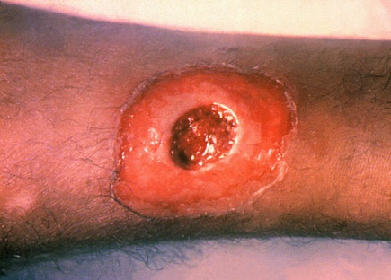
Corynebacteria C. diphtheria
Other diseases caused by C. diphtheria
Skin diphtheria
Primarily in the tropics and sub-tropics
- rare in the US
More often from non-toxigenic strains
Formation of chronic spreading punched-out ulcer covered by a gray membrane
Non- toxigenic pharyngitis
Occasional lesions form in middle ear and conjunctiva
Notes:
http://en.wikipedia.org/wiki/File:A_diphtheria_skin_lesion_on_the_leg._PHIL_1941_lores.jpg

Slide 13
Corynebacteria C. diphtheria
Pathogenicity - exotoxin
A protein that splits into two fragments
A - enzyme- toxic, heat stable
B - non toxic, heat labile, enables A to bind to cell
Affinity to cells of:
peripheral nerves, heart muscle, pericardium, diaphragm, liver, kidneys
Unable to save cell once toxin enters
Notes:
B-binds
A-blocks protein synthesis

Slide 14
Corynebacteria C. diphtheria
Toxin production due to bacterial phage
Tox gene fragment enters into the cell by lysogenization
Without phage - no toxin produced.
inhibits protein synthesis by inhibiting elongation factor 2 (EF2)
Fragment A catalyzes ADP ribosylation of EF2, blocking the transfer of amino acids from tRNA to peptide chain
Viral gene enters bacterium genome and is hereditary

Slide 15
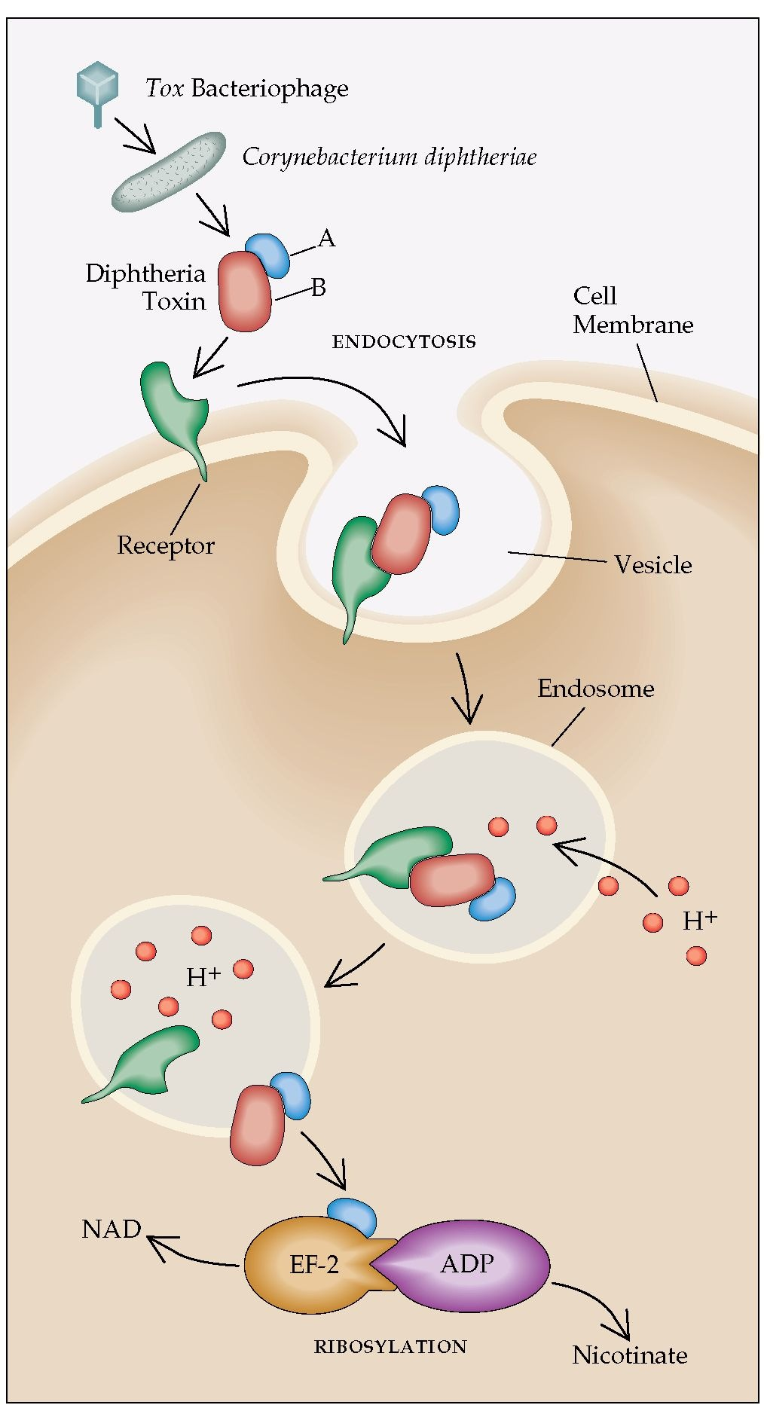
Notes:
Picture on left: http://what-when-how.com/acp-medicine/infections-dues-to-gram-positive-bacilli-part-1/
Figure 1 Mechanism of action of diphtheria toxin. Diphtheria toxin production is encoded by a bacteriophage carrying the tox gene that gains entry into Corynebacterium diphtheriae. The toxin consists of an A fragment and a B fragment. The B fragment binds to the receptor (heparin-binding epidermal growth factor precursor) on the cell surface, and the whole molecule is then taken into the cell by endocytosis. In the closed environment of the endosome, acidification occurs (H+). The low pH level causes the B region to unfold and form a membrane channel, allowing the A domain to pass through the membrane into the cytoplasm. The disulfide bond linking the A and B regions is reduced, and the A subunit is then freed to bind to ADP-ribosylate elongation factor-2 (EF-2). Ribosylation interferes with the ability of EF-2 to add amino acids to a peptide chain, blocking protein synthesis and causing cell death. (A—A fragment; B—B fragment; NAD—nicotinamide adenine dinucleotide; ADP—adenosine diphosphate)
Picture on Right: http://www.wwnorton.com/college/biology/microbiology2/ch/25/etopics.aspx

Slide 16
Corynebacteria C. diphtheria
Prevention
Active artificial immunization - toxoid vaccination
Test for susceptible individuals - Schick test
Injection of toxin into forearm
Injection of toxoid into other arm for control (allergic rxn)
Inflammation (positive test)- no antibodies present, patient susceptible to diphtheria
Notes:
The Schick test, invented between 1910 and 1911^{[1]} is a test used to determine whether or not a person is susceptible todiphtheria.^{[2]} It was named after its inventor, Béla Schick (1877–1967), a Hungarian-born American pediatrician.
The test is a simple procedure. A small amount (0.1 ml) of diluted (1/50 MLD) diphtheria toxin is injected intradermally into the arm of the person. If a person does not have enough antibodies to fight it off, the skin around the injection will become red and swollen, indicating a positive result. This swelling disappears after a few days. If the person has an immunity, then little or no swelling and redness will occur, indicating a negative result.
Results can be interpreted as:
Positive: when the test results in a wheal of 5–10 mm diameter
Pseudo-positive: when there is only a red colored inflammation and it disappears rapidly
Negative reaction:
pseudo negative reaction:
The test was created when immunizing agents were scarce and not very safe, however as newer and safer toxoids were made available there was no more requirement for susceptibility tests.

Slide 17
Corynebacteria C. diphtheria
Treatment
Passive immunization with anti-sera on day of diagnosis (irreversible bonding of toxin to cells)
Give antibiotics that prevent a carrier state and decrease numbers of bacteria and toxin amount - penicillin, erythromycin and tetracycline

Slide 18
Corynebacteria C. diphtheria
Laboratory Diagnosis
(physician needs to inform lab to R/O C. dipth)
What type of specimen.
Pseudomembrane
Throat or nasopharyngeal swab
Wound material
Microscopic exam.
Gram stain to R/O Vincent’s Angina (fusiforms & spirochetes)
Albert’s or alkaline methylene blue.
Beading or banding
Babes-Ernst bodies - metachromatic granules (polyphosphates)
“Chinese” letters or pallisading, club shaped, pleomorphic GPR

Slide 19
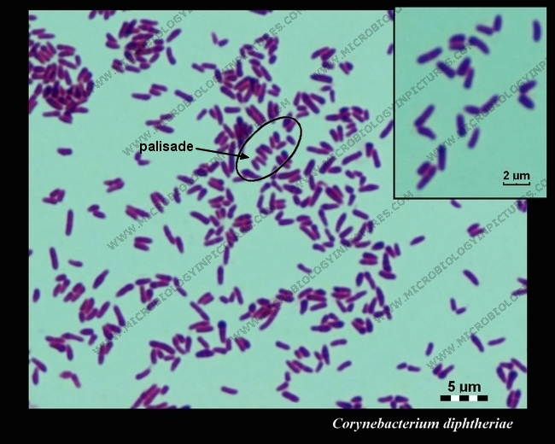
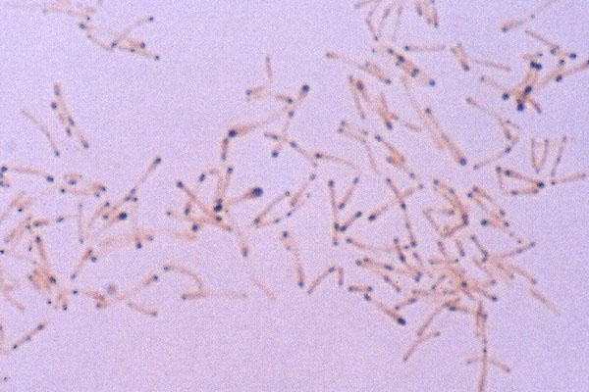
Corynebacteria C. diptheria
Notes:
Picture on left: http://www.microbiologyinpictures.com/corynebacterium%20diphtheriae.html

Slide 20
Corynebacteria C. diphtheria
Primary isolation
Sheep Blood agar plate (BAP)
R/O Group A strep (beta) infection
C. dipth - 1-3 mm, variable hemolysis, resembles Strep
Tellurite medium
Tellurite is reduced to tellurium intracellularly- => black colony
Selective for C. dipth- Group D strep and staph can grow however other bacteria are inhibited
May be differential - that depends upon media choice
Loeffler medium (tubed media)- contains serum to promote growth and formation of metachromatic granules.
Prepare a methylene blue stain after overnight incubation at 35C

Slide 21
Corynebacteria C. diptheria
Preferred media is blood cystine-tellurite agar
colonies are black or gun-metal gray
Suspect colonies are gram stained and replated (subbed) to a SBAP for biochemicals
Tinsdale tellurite media
C. dipth has a black halo, diptheroids have none
4 day shelf life, and may not grow some strains

Slide 22
Corynebacteria C. diptheria
Blood tellurite next to a BAP

Slide 23
Corynebacteria C. diptheria
Tinsdale tellurite
Note halo
C. diphtheria positive

Slide 24
Notes:
http://www.microbiologyinpictures.com/corynebacterium%20diphtheriae.html

Slide 25
Corynebacteria C. diptheria
Loeffler’s serum agar
Inhibits normal resp. flora
Colonies look grayish to cream colored
The pleomorphism is enhanced
The bacteria will stain with methylene blue for Babe-Ernst bodies
Biochemical confirmation
Toxin detection- necessary.
In vitro - Elek test - reference lab only
Proteose - peptone media with tellurite
Paper strip impregnated with anti-toxin, Place sub-surface
Look for precipitationat 45 degree angle

Slide 26
Corynebacteria C. diptheria
Toxin production detection cont.
In vivo- Fraser-Weld
Inject suspension of organism intracutaneously into a white laboratory rabbit
After 5 hours - give anti-toxin
Inject suspension as post-toxin control( allergy)
Positive test- necrosis only at first injection site

Slide 27
Corynebacteria C. diptheria
ELEK TEST

Slide 28
Corynebacteria other
C. jeikeium- immunocompromised patients
Endocarditis, foreign body infections
Resistant to many antibiotics
Morphology: Tiny, glistening colonies on sBAP
Urease negative
C. urealyticum- immunocompromised patients
UTI
Resistant to many antibiotics
Morphology - Tiny, glistening colonies on sBAP
Strongly urease positive
C. ulcerans -
“normal flora”
may cause diphtheria-like sore throat

Slide 29
Corynebacteria Other
C. pseudotuberculosis
can cause suppurative granulomatous lymphadenitis
C. pseudodiptheriticum -
can cause endocarditus, pneumonia and lung abscesses
C. xerosis -
can cause endocarditis or septicemia in immunocompromised patients
Diptheroids

Slide 30
Bacillus anthracis
Human disease classified according to the route
of entry

Slide 31
Bacillus B. anthracis
General description
Large spore forming gram positive bacilli.
Aerobic.
Catalase positive.
>60 species
Bacillus anthracis -
Anthrax (primarily an animal pathogen rare in the USA.
An agent of bioterrorism
Enzootic in Turkey, Iran, Pakistan and the Sudan. Rare to naturally occur in the US.
The spores are infectious for >30 years.
There is a problem when importing products from endemic areas.
And from areas that use infected dead animals as fertilizer.

Slide 32
Bacillus B. anthracis
Cutaneous (Malignant pustule) - 95% cases in the US.
A. The spores enter a cut which forms a pustule which forms a hemorrhagic vesicle that ruptures and forms an ulcer with a Black Eschar and thick edema
It can involve regional lymph nodes
Rarely cause septicemia
Usually long healing, but not painful
20% mortality if not treated

Slide 33
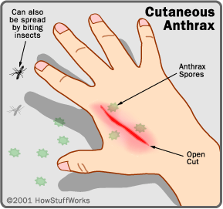
Bacillus B. anthracis
CUTANEOUS ANTHRAX
BLACK ESCHAR

Slide 34
Bacillus B. anthracis
Inhalation (Wool sorter's disease ) 5% cases in the US.
The spores are inhaled in an aerosol .
The spores are engulfed by the alveolar macrophages and migrate to the mediastinal lymph nodes where the spores germinate. The spores grow at a rapid rate overwhelming the macrophages and causing hemorrhage, edema and can result in overwhelming septicemia
The infection is usually fatal

Slide 35
Bacillus B. anthracis
INHALATION ANTHRAX

Slide 36
Bacillus B. anthracis
Gastrointestinal ( never reported in the US)
This involves the lymphnodes of the small intestines
The person ingests contaminated food.
This is usually fatal

Slide 37
Pathogenicity.
The exotoxin produced causes irreversible damage.
causes edema.
injures phagocytes
Primary site of toxin unknown
Capsule – antiphagocytic
Needs both to be virulent
Death.
From toxemia
From overwhelming septicemia (log-jam theory)

Slide 38
Bacillus B. anthracis
Incidence
20,000-100,000 case per year worldwide
Occupational hazard-esp contact with wools and hides
90% cases are industrial esp. imported goat hair
vet and agricultural

Slide 39
Bacillus species
Other Bacillus species
Bacillus cereus - food poisoning
Two types- based on which enterotoxin produced
Emetic form incubation 1-6 hours
primarily associated with fried rice. Spores on rice germinate upon boiling and organism grows in rice if left unrefrigerated.
Diarrheal form 10-13 hours
associated with meat, soups, vegetables, etc
Diagnosis
>10⁵ organisms/gram of food

Slide 40
Bacillus species
Rare - endophthalmitis
Trauma to eye or spread hematological
Very rapid with loss of vision or eye
Normal organism in stool - need to demonstrate >100,000 orgs/gram to prove food poisoning

Slide 41
Bacillus species
Virtually impossible to eradicate spores from all foods so do not store at room temperature

Slide 42
Bacillus species
Other Bacillus sp.
Ubiquitous - primarily saprophytic
a. Spores survive in all sorts of environmental conditions such as rubbing alcohol used for phlebotomy or cleaning instruments
B. subtilis is one common species

Slide 43
Bacillus species
Diseases – when isolated, organisms cannot be assumed to be a contaminant
Pulmonary and dissemination in compromised host which can be life threatening
Localized infections of closed speces( meningitis, endopthalmitis)
Wound infections post trauma, surgery prosthesis
Bacteremia drug addicts

Slide 44
Bacillus species
Industrial uses
ex Bacitracin
(from B. subtilis, B. lichenformis)
Commercial insecticides
Ex B. popilliae

Slide 45
Diagnosis
B. anthracis - contagious
if suspected use extreme caution
use biological hood, gloves , gown, & mask.
CDC and Public Health Department needs to be notified
Notify FBI if bioterrorism is suspected

Slide 46
Bacillus B. anthracis Lab
Direct exam of material organisms
large boxy 1 x 3-10um in chains,
India ink: Capsule
Wet prep: non-motile
BAP: colony characteristics
aerobic “ground glass”
“Medusa head” colony
Non - hemolytic, Non - motile, ovoid sub terminal spores
Tenacity-You can lift colony up and it will stay in peaks like stiff egg whites

Slide 47
Bacillus B. anthracis Lab
Animal inoculation -
culture organism from liver, spleen, blood on autopsy
Bicarbonate/serum agar + CO2 => capsule produced
Other plates => no capsule
Only virulent strains produce this capsule
Paired sera to CDC to perform indirect hemagglutination

Slide 48
Bacillus B. anthracis Lab
Spring of pearls
add organisms + 10u penG disc =>
incubate for 6-8 hours
view under 100x
look for spherical cells .
B. anthracis is sensitive to Pen
Others are resistant

Slide 49
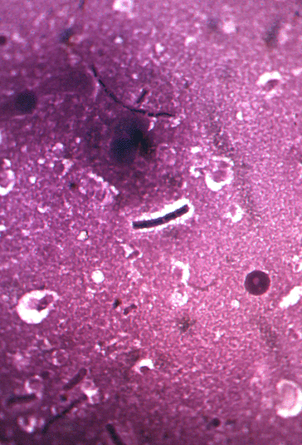
Bacillus B. anthracis Lab
Encapsulated – india ink
Large gpr in chains
Non-motile – wet prep

Slide 50
Bacillus B. anthracis Lab
BAP
Non-hemolytic
Tenacious
Medusa head colonies

Slide 51
BACILLUS SPECIES NOT B.ANTHRACIS
Other Bacillus species
Beta- hemolytic, motile
Some can produce spores aerobically
Many are oxidase and catalase positive
Some atypical can be confused with non-fermentative gram negative bacilli
stain gram negative & do not Id on usual gm = tests
Induce spore formation- TSI
Vancomycin disc susceptibility Basp sensative, gram negative resisistant
String test – non-lactose fermenting gram negative rods become stringy when mixed with 3% KOH for 60 seconds, Basp do not

Slide 52
BACILLUS SPECIES
Large gram positive rods with spores
Motile

Slide 53
BACILLUS SPECIES
BAP – Variety of colonial morphologies
Beta-hemolytic

Slide 54
Lactobacillus
I. Organism
gram positive, non spore-forming rod
Family- Lactobacilliaceae- no clinical reason to speciate
L. acidophilus- industrial use in milk and yogurt
Name from amounts of lactic acid produced
from homofermentative glucose fermentation
(heterofermentative = 50% lactic acid + CO2 + acetic + ETOH)

Slide 55
Lactobacillus
Usually medium rods, long & slender
may chain
non-motile catalase neg
grows well on SBAP & CHOC
Rogosa selective tomato juice agar
Often listed under anaerobic gram positive rods
Vancomycin resistant

Slide 56
Lactobacillus
Disease
Rare cases of meningitis and endocarditis.
Note: a patient in this hospital with many Lactobacillus in an abdominal wound(with other flora) and another patient with it in the blood stream.
Considered part of “normal flora” ex. Mouth (NRF), GI, Vaginal (doderlein’s bacillus)

Slide 57
Lactobacillus
In infant female - the vaginal tract become colonized with LASP from the mother at birth. As the mother’s progesterone stimulation decreases the LASP decreases and only returns after menarche.
Keeps vaginal tract acid (pH 4.4-4.6) inhibits GNR’s , GC and other vaginal pathogens
Level of organism varies with menstrual cycle

Slide 58
Erysipilothrix rusiopathiae
Disease
A. Erysipelas in swine, polyarthritis in sheep primarily see this organism in veterinary
medicine
Acute fatal septicemia
Skin lesions
Endocarditis
Inflammatory disease of the skin & joints- erysipelas in swine
Has major economic importance

Slide 59
Erysipelothrix
Erysipoloid skin infection in man
Mostly found on fingers and hands
Skin lesions are erythemous & edematous
Often have superficial vesicles
Arthritis of nearly every joint is common
Usually self-limiting
Obtained through contact wit infected animals esp. fish and swine.
Pathogenicity factor have not been determined, possibly a neuraminidase
Gp A Strep (erysipelas) has a spreading cellulitis of the face

Slide 60
Erysipeloid

Slide 61
Erysipelothrix
Laboratory identification
Primary isolation
skin biopsy (infusion broth with 1% glucose incubated overnight in 5-10% CO2 then subbed to a SBA at 24 hour intervals
Microscopic Characteristics:
rod shaped, tend to be filamentous
easily decolorized
filaments may thicken and show granules
non-motile
non spore forming

Slide 62
Erysipelothrix
Cultural Characteristics:
on SBAP- 2 forms
Smooth, clear, very small (0.1mm-1.0mm =>R 48H
Rough, 0.2-0.4mm, long branching filamentous GPR
Greening of the media after a few days
Microaerophile to facultative anaerobe
Requires serum or other highly nutritive additives for optimum growth

Slide 63
Erysipelothrix
Biochemical tests
catalase: negative
bile esculin: negative
H2S in TSI (A/A)
Hemolytic (alpha or gamma)
Test tube brush test : growth in semi-solid media at room temperature indicating motility

Slide 64
Listeria monocytogenes
General description
Microscopic
Small, coccoid GPR
Tendency to form chains in broth
After 18-24 h incubation V & L forms and pallisades
Cultural
Beta-hemolytic colonies that resemble beta-streptococcus
Motile at room temperature, non-motile at 35C
Catalase positive
Aerobic to facultative anaerobic

Slide 65
Listeria
Disease - Listeriosis
Sepsis and meningitis in compromised host
Primarily cancer patients, alcoholics, diabetics, transplant (esp. heart)
Bacteriema : host has lymph node enlargement, fever, monocytosis
no heterophile antibodies
need to differentiate from toxoplasmosis

Slide 66
Listeria
Other sequellae:
pneumonia, endocarditis, bacterial aortic aneurysm, papular or pustular cutaneous lesion, localized abscesses, conjunctivitis, urethritis, and possible habitual abortions

Slide 67
Listeria
Neonatal sepsis or meningitis
Early onset
primarily septic
associated with low birth weight, OB complications and colonization of the mother’s genital tract with Listeria
May get disseminated listeriosis with abscesses and granulomas primarily of the liver and meningesmother high infant mortality
likely had bacteremia following enteritis leading to transplacental infection
Late onset - 4 weeks post- partum
Primarily meningitis - if the infant survives high probability of brain damage
associated with normal birth weight, no OB complications or colonization of the mother

Slide 68
Listeria
Puerperal sepsis or flu-like illness during pregnancy
Usually in the third trimester
In some women may precipitate labor
premature or stillborn infant
infected fetus = granulamatosis infantiseptica

Slide 69
Listeria
Food borne disease
Listeria is found in the feces of many animals
Listeria is found on plants and vegetables
ex. Cabbage fertilized with sheep manure- the sheep had had listeriosis the year before
Found in milk products
ex. Mexican style cheese – in California pasteurized milk contaminated with unpasteurized milk

Slide 70
Listeria
Host susceptibility
Host may have decreased acidity in the stomach (taking antacids)
GI symptoms often precede other infections
Fecal WBC’s noted

Slide 71
Listeria
Pathogenicity
an intracelluar parasite involves RES
(reticulo-endothelium system)
Septicemia => granulomas and suppuration (pus)
Delayed hypersensitivity may contribute to the disease - Listeria is studied frequently for this property
Hemolysin present

Slide 72
Listeria
Laboratory diagnosis
Type of specimen
CSF
blood
Merconium of infant - wet prep often show motile organisms with tumbling motility
Genital
Feces -especially neonates
Amniotic fluid
Tissues

Slide 73
Listeria
Microscopic
Small gpr, often confused with strep in chains
May have x & y forms
Direct wet prep-
tumbling motility - head over head

Slide 74
Listeria
Primary isolation
Cold enrichment may be needed (esp. OR and autopsy tissues) - release of intracellular organisms?
BAP - aerobic to facultative anaerobic, may need CO2
Narrow zone of beta hemolysis; resembles gamma strep, may have to remove colony to see hemolysis
McBride Agar- blue-green, watery colonies when examined with oblique light
Biochemical
Catalase +, Bile esculin +, Camp +, Hip + CHO fermented
Umbrella-shaped motility at RT, non-motile at 35C

Slide 75
Listeria
Antisera available
Anton test for pathogenicity
a. suspension of listeria in conjunctival sac of young rabbit or guinea pig => severe purulent conjunctivitus
Other Listeria species, not clinically important

Slide 76
Listeria
BAP – Beta-hemolytic

Slide 77
Listeria
Bacteremia

Slide 78
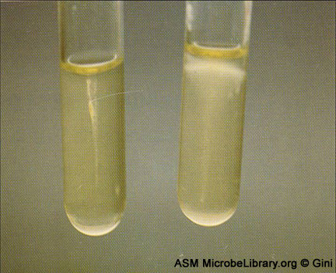
Listeria
Microscopic – small gram positive rods
Tumbling motility
Umbrella shaped motility in MIO

Slide 79
Biochemical tests for small gpo
ID test | Limo | Gp B strep | Coryne
Gram stain | Rods, cb | cocci | Rods, cb
Hemolysis | Beta | Beta/gamma | gamma
Catalase | pos | neg | pos
Motility | Pos (25C) | neg | neg
Bile esculin | pos | neg | neg
Hipp hydrolysis | pos | pos | N/A
CAMP | pos | pos

Slide 80
ID of common non-spore forming gpr’s
Organism | Coryne | Limo | Erysip | Lacto
Motility | neg | Neg at 35C Pos at 25C | neg | neg
Catalase | pos | pos | neg | neg
Hemolysis | gamma | Beta | Alpha or gamma | Alpha or gamma
Other tests | GS” chinese” Colony: small, whiteish: | BE + Mot: umbrella Tumbling | TSI H2S + | GS: chains of rods

Slide 81
KEY WORD(S)
Pallisading
Pseudomembrane
Toxoid
Malignant pustule
Tenacious
Erysipieloid
Erysipelas

Slide 82
Aerobic gram positive rods
The End
Thank you

