Slide 1
Chapter 23
The Spirochetes

Slide 2
INTRODUCTION
CHAPTER TWENTY-THREE

Slide 3
Spirochetes General Characteristics
Morphology
Slender, flexuous, helically-shaped, unicellular bacteria
0.1- to 3.0-µm wide by 5- to 20-µm long
Possess one or more complete turns in the helix
Flexible cell with several fibrils is wound
Termed periplasmic flagella
Exhibit various types of motion in liquid media

Slide 4
Spirochetes General Characteristics (Cont.)
Possess a multilayer outer sheath similar to that of the outer membrane of gram-negative bacteria
Metabolism is species dependent.
Use carbohydrates, amino acids, or long-fatty alcohols as carbon and energy sources.
Reproduction varies and can be transverse or binary fission

Slide 5
Classification and Clinical Significance
Classification
Order: Spirochaetales
Families: Leptospiraceae and Spirochaetaceae
Genera: Leptospira, Borrelia, and Treponema
Clinical significance
Responsible for sexually transmitted syphilis, zoonoses, lyme disease, and relapsing fever

Slide 6
What’s Ahead?
A discussion of the members of leptospira and the treponemes that includes:
General characteristics
Clinical infections and significance
Genera and organism-specific content

Slide 7
LEPTOSPIRA
CHAPTER TWENTY-THREE

Slide 8
Leptospira General Characteristics
Obligate aerobic helical rods 0.1 µm by 5- to 15-µm long that are tightly coiled, thin, and flexible.
May appear to be a chain of cocci
One or both ends have hooks rather than tapering off.
Motion is rapid translational and rotational.
Historically, over 200 different serovars of L. interrogans sensu lato have been reported.

Slide 9
Leptospira Microscopic Appearance
Electron Microscopy
A long axial filament covered by a very fine sheath, like treponemes and borreliae
All species have two periplasmic flagella
Stains
Cannot be readily stained
Can be impregnated with silver and visualized
Unstained cell
Not visible under bright-field
Visible by dark-field, phase-contrast, immunofluorescent

Slide 10
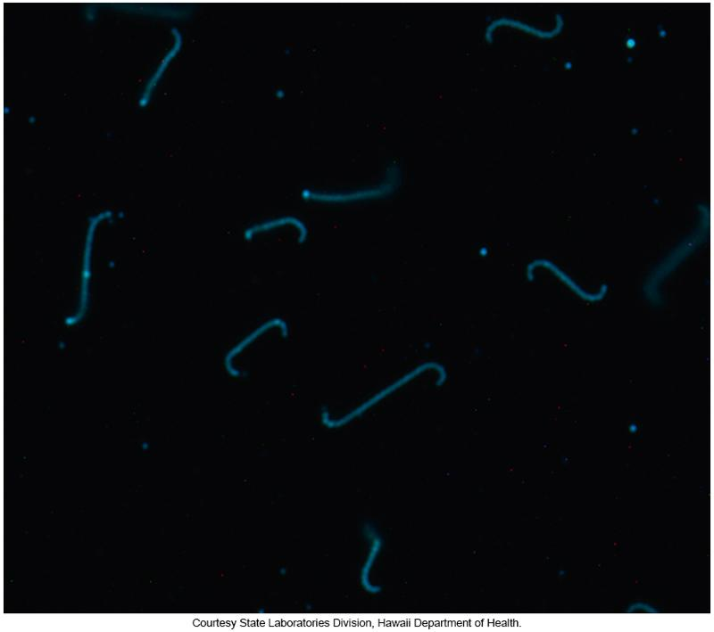
Electron Micrograph Photograph of L. interrogans
Notes:
10

Slide 11
Leptospira Virulence Factors and Pathogenicity
Virulence Factors
Reduced phagocytosis in the host
A soluble hemolysin produced by some virulent strains
Cell-mediated sensitivity to leptospiral antigen by the host
Small amounts of endotoxins produced by some strains
Clinical findings in animals with leptospirosis suggest the presence of endotoxemia

Slide 12
Infections Cause by Leptospires
Organisms contaminate mud or water
when shed in the urine of infected animals.
Often enter humans through small breaks in the skin or intact mucosa.
Non-specific host defenses do not stop multiplication of leptospires and leptospiremia occurs during acute illness

Slide 13
Infections cause by Leptospires (Cont.)
Incubation period of leptospirosis ranges from 3 to 30 days (usually 10 to 12 days)
Symptoms
Initial phase comes on usually abruptly.
Fever, chills, headache, malaise, and severe myalgia
Subsequent phase is protean, frequently biphasic
Can involve hepatic, renal, and central nervous systems
Renal lesions are interstitial nephritis with glomerular swelling and hyperplasia.
Conjunctival suffusion seen in less than half
Illness lasts from less than 1 week to 3 weeks.

Slide 14
Infections Caused by Leptospires (Cont.)
Weil’s disease
Severe systemic disease
Jaundice, acute renal failure, hepatic failure, intravascular disease
Can be fatal
Late manifestations
Caused by host immunologic response to infection.

Slide 15
Infections Caused by Leptospires (Cont.)
Patients with a leptospiral bacteremia
IgM antibodies detected within 1 week after onset of disease and can persist in high titers for many months
IgG antibodies are usually detectable 1 month or more after infection
Convalescent serum contains protective antibodies

Slide 16
Epidemiology
Zoonosis primarily associated with occupational or recreational exposure
Dogs, rats, other rodents are the principal animal reservoirs
Humans at risk for disease
Veterinarians
Dairy workers
Swine workers
Fish and poultry processors

Slide 17
Epidemiology (Cont.)
In natural hosts, leptospires live in the lumen of the renal tubules and excreted in urine
Most cases in the US result from recreational sources
Direct contact with urine of carriers
Indirect by contact with bodies of water contaminated with the urine of carriers
Leptospires can survive in neutral or slightly alkaline water for months

Slide 18
Epidemiology (Cont.)
Control Measures
Rodent elimination
Drainage of contaminated waters
Vaccination of dogs and livestock
Short-term prophylaxis consisting of weekly doxycycline therapy in high-risk groups with expected occupational exposure

Slide 19
Specimen Collection and Handling
Specimen collection
Collect blood or cerebrospinal fluid (CSF) toward end of first week of illness
Collect urine: yield higher after first week
Direct microscopic detection is not recommended.
Optimal recovery occurs if
Fresh specimens are inoculated directly into laboratory media.

Slide 20
Specimen Collection and Handling (Cont.)
Ideal submission
Whole blood and serum during first week of acute illness
Serum, urine optional, during convalescent illness

Slide 21
Microscopic Examination
Direct examination using special stains, dark field, or phase contrast microscopy not recommended.
Only successful in a small percentage of cases
False-positive results may be reported because of the presence of artifacts, especially in urine.
Notes:
21

Slide 22
Isolation
Recommended protocol
Direct inoculation of 1 to 2 drops fresh patient sample (blood or CSF) into
Fletcher’s, Stuart’s, or EMJH medium.
Incubate media in the dark at room temperature.
Dilution of urine should be used to minimize effects of inhibitory substances.
Tubes examined weekly for evidence of growth
A drop taken from a few millimeters below the surface can be examined by dark field microscopy for the presence of characteristic spirochetes.

Slide 23
Isolation (Cont.)
PCR testing for leptospire DNA in blood, plasma, serum, urine, CSF and tissue is as sensitive or more so than culture methods
PCR Advantage
Provides a diagnosis in the acute stage, when treatment is most beneficial.
Real-time PCR can also quantify the infection burden.

Slide 24
Identification (Cont.)
Serologic tests
Most cases diagnosed by serology
IgM antibodies are detected within 1 week after disease onset
IgG antibodies can be detected in some patients one month or more after disease onset
Visually read IgM enzyme-linked immunosorbant assay [ELISA]
Macroscopic slide agglutination test for rapid screening and a gold standard for microscopic agglutination antibody detection

Slide 25
Antimicrobial Susceptibility
Typically not performed in the clinical laboratory
Organisms shown to be susceptible to
Streptomycin
Tetracycline
Doxycycline-shown to shorten the course of the disease and reduce incidence of convalescent leptospiruria
Macrolides
Intravenous penicillin and ceftriaxone (severe disease)

Slide 26
BORRELIA
CHAPTER TWENTY-THREE

Slide 27
BORRELIA Characteristics
Contains several species
Morphologically similar but have different pathogenic properties and host ranges
Some strains cause relapsing fever.
Lyme borreliosis (disease) is caused by Borrelia burgdorferi sensu lato complex
All pathogenic species are arthropod-borne.

Slide 28
BORRELIA Characteristics (Cont.)
Morphology
Flexible organisms varying in thickness
Helical bacteria 0.2 to 0.5 µm by 3 to 20 µm in length
Spirals vary between 3 and 10 per organism.
Less tightly coiled than leptospires and treponemes
Stain easily and can be visualized by bright field microscopy.
Electron microscopy may also be used.

Slide 29
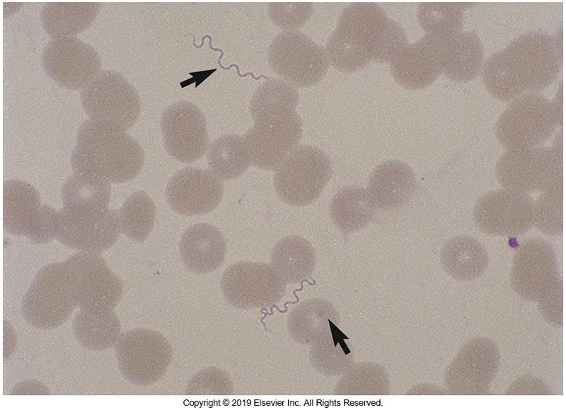
Photograph of B. recurrentis

Slide 30
Borrelia recurrentis and Similar Borreliae
Borrelia spp.
Causes relapsing fever (tick or louseborne)
Relapsing fever first evades complement regulators, C4b-binding protein, Factor H
Relapsing fever characterized by acute febrile episodes that subside spontaneously but tend to recur over a period of weeks
Relapses are potentiated by antigenic variation
Renders specific antibody production ineffective

Slide 31
B. recurrentis and Similar Borreliae Clinical Manifestations
Incubation period is 2 to 15 days.
Massive spirochetemia develops and remains high throughout course of infection.
Symptoms
High temperature, rigors, severe headache, muscle pain, weakness
Febrile period lasts about 3 to 7 days then ends abruptly with the development of an adequate immune system.

Slide 32
B. recurrentis and Similar Organisms Epidemiology
Two varieties of relapsing fever
Tickborne—endemic relapsing fever
Transmitted by bite of soft ticks of the genus Ornithodoros
Louseborne—epidemic relapsing fever
Transmitted by body louse, Pediculus humanus, crushed and scratched into the skin
Humans are the only reservoir.
Best prevention and control measure
Control exposure to the arthropod vectors

Slide 33
B. recurrentis and Similar Organisms Microscopic Examination
Microscopic examination
Direct examination of spirochetes in blood
Thick and thin films of Giemsa or Wright-stained smears
Use blood collected in EDTA anticoagulant
Use bright field microscopy; spirochetes commonly seen among the red cells present.

Slide 34
B. recurrentis and Similar Organisms: Isolation and Identification
Blood collected in EDTA can be used for culture and PCR testing, but citrate-treated blood may prove to be superior
Antigenic variation in the spirochetes that cause relapsing fever, makes serodiagnosis of their disease difficult and impractical
Because the borrelia can be readily detected microscopically and by PCR, serologic methods have limited use

Slide 35
B. recurrentis and Similar Organisms Treatment
Antimicrobial susceptibility
Susceptible to many antimicrobial agents
Tetracyclines are the drugs of choice.
Death of spirochetes can cause sudden endotoxin release (Jarisch—Herxheimer reaction).
Fever, chills, headache, myalgia

Slide 36
B. Burgdorferi sensu lato
Cause of Lyme borreliosis or Lyme disease
Bacterial spread depends on the organism’s ability to
Bind plasminogen and urokinase-type plasminogen activator to its surface
Could act as a protease to promote tissue invasion
This binding can convert plasminogen to plasmin
A potent protease that could facilitate tissue invasion

Slide 37
B. Burgdorferi sensu lato Virulence Factors
Binding factor H allows complement evasion and immune system suppression
Might explain why IgM antibody titer does not peak for 3 to 6 weeks
In vitro, the organism can stimulate proinflammatory cytokines (i.e., tumor factor necrosis factor and interferons)
May be important in controlling disease
May contribute to inflammatory manifestations as untreated disease progresses

Slide 38
B. Burgdorferi sensu lato Clinical Manifestations
Lyme borreliosis is complex.
Three stages
Early infection includes two stages
Late infection consists of one stage
Stage 1
About 60% of patients exhibit erythema migrans (EM), a classic skin lesion at the site of the tick bite.
Red macule that expands to form larger annular erythema-target appearance

Slide 39
B. Burgdorferi sensu lato Clinical Infection
Stage 2
Early disseminated, produces widely variable symptoms
Secondary skin lesions, migratory joint and bone pain, alarming neurologic and cardiac pathology, splenomegaly, severe malaise and fatigue
Stage 3
Late persistent infections
Cardiac, musculoskeletal, and neurologic involvement
Arthritis is most common symptom, occurring weeks to years later.

Slide 40
B. Burgdorferi sensu lato Epidemiology
Organisms are transmitted via bite of infected Ixodes ticks.
At least three species of B. burgdorferi sensu lato cause Lyme disease.
B. burgdorferi stricto
Occurs in North America & Europe
B. garinii and B. afzelii and B. garinii
Occur in Asia and Europe
Prevention measures
Protective clothing, repellents, remove attached ticks

Slide 41
B. Burgdorferi sensu lato Specimen Collection and Handling
Most common and productive sample is serum for serology.
Other tests have too many limitations or have not been adequately validated.
Large-volume plasma cultures have been shown to be positive in about 50% of adult patients with erythema migrans.

Slide 42
B. Burgdorferi sensu lato Serologic Tests
Two-tiered approach to achieve diagnosis
Step 1—sensitive screening test that detects IgM and IgG
IFA or EIA
If this test is negative, no further testing is needed.
Step 2—confirmation test
IgM and/or IgG—depending on whether symptoms were present for longer than 30 days (IgG only).
Western blot confirmation of IgM antibody presence.
Performed when step 1 yields positive or equivocal results.

Slide 43
B. Burgdorferi sensu lato Serologic Tests (Cont.)
Western blot to verify specificity
Detection of 2 of 3 IgM bands
24, 39, and 41 kilodaltons (kDas)
Detection of 5 of 10 immunoglobulin G (IgG) bands
18, 21, 28, 30, 39, 41, 45, 58, 66, 93 kDa
If serology is negative and symptoms are consistent with Lyme disease, a convalescent serum should be obtained and tested.

Slide 44
B. Burgdorferi sensu lato Antimicrobial Susceptibility
Early diagnosis and treatment are important for preventing neurologic, cardiac, and joint abnormalities that occur late in disease.
Early stages of Lyme disease without complications
Macrolides, doxycycline (recommended) and β-lactams typically effective
Refractile or late stages—ceftriaxone effective
Antimicrobial susceptibility testing is not warranted.

Slide 45
TREPONEMES
CHAPTER TWENTY-THREE

Slide 46
Treponemes General Characteristics
Morphology
Thin, spiral organisms
0.1 to 0.2 μm in thickness and 6 to 20 μm in length
Difficult to visualize with bright field microscope
Spirals are regular and angular with 4 to 14 spirals per organism.
Three periplasmic flagella are inserted into each end of the cell.
Ends are pointed and covered with a sheath.
Graceful flexuous movements in liquid

Slide 47
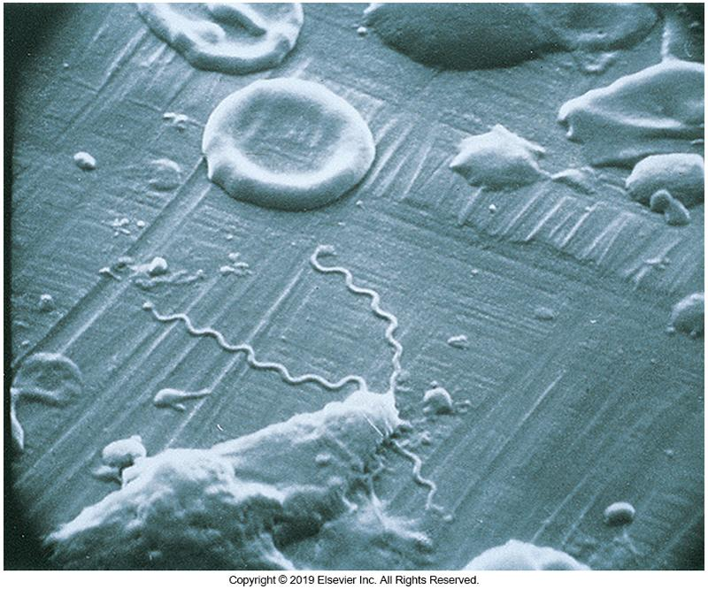
Scanning Electron Micrograph of Treponema pallidum

Slide 48
Treponemes Clinically Significant Species
Treponema pallidum subsp. pallidum
Syphilis
Treponema pallidum subsp. pertenue
Yaws
Treponema pallidum subsp. endemicum
Endemic syphilis
Treponema pallidum subsp. carateum
Pinta

Slide 49
TREPONEMES: TREPONEMA PALLIDIUM SUBSP. PALLIDUM
CHAPTER TWENTY-THREE

Slide 50
T. pallidum subsp. pallidum Virulence Factors
Penetrates intact mucous membranes
Crosses placenta
Dissemination throughout the body and organ systems
Antigenic variation of cell surface proteins
May help evade host immune system and establish persistent infection

Slide 51
T. pallidum subsp. pallidum Clinical Manifestations
Causative agent of syphilis
The word syphilis comes from a poem in 1530!
Transmission
Infection caused by sexual contact (mucous membranes)
Can enter via cuts, abrasions, or directly through intact mucous membranes
Can enter other sites such as the lip or transplacentally

Slide 52
T. pallidum subsp. pallidum Clinical Manifestations (Cont.)
Co-infection with human immunodeficiency virus (HIV) can result in variation of the natural course of the disease.
Ulcers caused by syphilis may contribute to the efficiency of HIV transmission in populations with high rates of both infections.
Considered as the “great imitator”
Wide variety of clinical manifestations

Slide 53
T. pallidum subsp. pallidum Primary Stage of Syphilis
Primary chancre at infection site
Usually one but sometimes several in HIV–positive patients 10 to 90 days after infection
Result of inflammatory response to infection at the site of inoculation
Erythematous lesion
Nontender but firm, clean surface, raised border
In women—found in cervix or vaginal wall—may not be obvious; also found in anal canal
In men—found in penis or anal canal
No systemic signs or symptoms are evident.

Slide 54
T. pallidum subsp. pallidum Secondary Stage of Syphilis
Begins 4 to 12 weeks after chancre appearance
Secondary disease possible with clinical symptoms
Fever, sore throat, generalized lymphadenopathy, headache, lesions of the mucous membranes, and rash
Rash can be present as macular, popular, follicular, papulosquamous, or pustular and can occur on the palms and soles.

Slide 55
T. pallidum subsp. pallidum Secondary Stage of Syphilis (Cont.)
Secondary lesions
Condylomata lata
Moist, gray-white plaques teeming with spirochetes
Highly infectious
May last for several weeks and can relapse
May also be mild and go unnoticed by the patient

Slide 56
T. pallidum subsp. pallidum Tertiary Stage of Syphilis
After secondary stage heals
Individuals are not contagious.
Relapses of secondary syphilis occur in about 25% of untreated patients.
Patients enter latent syphilis.
Clinical manifestations are absent.
Latency within 1 year of infection— early latent
Latency greater than 1 year of infection—late latent

Slide 57
T. pallidum subsp. pallidum Tertiary Stage of Syphilis (Cont.)
One third of untreated patients
Exhibit a biological cure, losing serologic activity
Another one third of untreated patients
Remain latent for life but have reactive serology
The remaining one third of untreated patients
Ultimately develop tertiary or late syphilis, generally decades later

Slide 58
T. pallidum subsp. pallidum Tertiary Stage of Syphilis (Cont.)
Symptoms
Development of granulomatous lesions (gummas) in skin, bones, and liver (benign tertiary syphilis)
Degenerative changes in the central nervous system (neurosyphilis)
Syphilitic cardiovascular lesions
Aortitis, aneurysms, aortic valve insufficiency

Slide 59
T. pallidum subsp. pallidum Tertiary Stage of Syphilis (Cont.)
Asymptomatic CNS disease
CSF abnormalities without symptoms
Pleocytosis, elevated protein levels, depressed glucose
Patients are usually not infectious.
Not often seen in areas where patients are adequately treated before this stage is reached.
Notes:
59

Slide 60
T. pallidum subsp. pallidum Congenital Syphilis
Severely affects many body systems
Early onset disease and onset at less than 2 years of age resembles secondary syphilis in adults.
Mucocutaneous lesions, osteochondritis, anemia, hepatosplenomegaly, CNS involvement
Occurs when mothers have early syphilis during pregnancy

Slide 61
T. pallidum subsp. pallidum Congenital Syphilis (Cont.)
Late-onset congenital syphilis corresponding to tertiary syphilis in adults
Occurs when pregnant women have chronic, untreated infections
Symptoms occur after 2 years of age but are generally not apparent until the second decade of life.
Interstitial keratitis, bone and tooth deformities, cranial nerve VIII deafness, neurosyphilis, and other tertiary manifestations
Notes:
61

Slide 62
T. pallidum subsp. pallidum Epidemiology
Under natural conditions, this bacterium is an exclusively human pathogen
In the US
Incidence decreased through the 1990s
Since 2000, the incidence of the disease has been increasing almost every year
From 2016-2022, cases of primary syphilis increased the majority of cases being men who have sex with men and an increase in heterosexual and congenital incidence

Slide 63
T. pallidum subsp. pallidum Epidemiology
High risk sexual behavior and co-infection with HIV continue to complicate syphilis control efforts
Prevention and control strategies
Education
Reporting positive cases to authorities
Treating all contacts of positive person
Perform screening of high-risk populations
To avoid congenital transmission

Slide 64
T. pallidum subsp. pallidum Collection/Handling
Specimen collection for dark-field microscopy
Primary or secondary lesion is cleaned with saline and gently abraded with dry, sterile gauze.
Avoid introducing blood
Transfer serous fluid to slide with saline
Coverslip and examine using dark-field microscopy
Do not use oral lesions because of nonpathogenic oral flora.
Culture methods not available

Slide 65
T. pallidum subsp. pallidum Collection/Handling
Serology is the primary method for diagnosis
Nucleic acid amplification tests are not commonly used
There are no FDA-cleared commercial assays available
Gold standard
Rabbit inoculation
Not practical for routine diagnosis

Slide 66
T. pallidum subsp. pallidum Microscopic Examination
Organisms are too thin for bright field microscopy.
In dark field microscopy- spirochetes are illuminated against a dark background.
Requires considerable skill and experience
Presence of motile treponemes in material from the chancre is diagnostic for primary syphilis.

Slide 67
T. pallidum subsp. pallidum Serologic Tests
Serologic assays can detect the presence of Treponema strains but cannot distinguish them.
Two types of testing available
Treponemal tests
Nontreponemal tests
Both tests have lower sensitivities in the primary stage but approach 100% in the secondary stage of syphilis.

Slide 68
T. pallidum subsp. pallidum Nontreponemal Tests
Detect reaginic antibodies develop against lipids released from damaged cells
Tests are biologically nonspecific and known to react with organisms of other diseases and conditions causing false-positive reactions
Excellent screening tests
Antigen used cardiolipin-lecithin-cholesterol complex made from bovine hearts

Slide 69
T. pallidum subsp. pallidum Nontreponemal Tests (Cont.)
Two tests widely used today:
Venereal disease research laboratory (VDRL)
Cardiolipin antigen is mixed with patient serum or CSF.
If positive, flocculation occurs and can be read microscopically.
Rapid plasma reagin (RPR)
Black carbon particles are bound to cardiolipin and mixed with patient sera.
Particles agglutinate, thus indicating a positive test.

Slide 70
T. pallidum subsp. pallidum Treponemal Tests
Used to confirm positive nontreponemal antigen test results
Helpful in the detection of late-stage infections
Titers remain high and do not decrease in response to therapy
Not useful in following therapy or reinfection

Slide 71
T. pallidum subsp. pallidum Treponemal Tests (Cont.)
Detect antibodies for specific treponemal antigens.
Also helpful in the detection of late-stage infections
Not useful in following therapy or detecting reinfection

Slide 72
T. pallidum subsp. pallidum Treponemal Tests (Cont.)
Treponema pallidum—particulate agglutination (TP-PA) test
Uses gelatin particles sensitized with T. palladium antigens
Agglutinations indicate the presence of antitreponemal antibodies.

Slide 73
T. pallidum subsp. pallidum Treponemal Tests (Cont.)
EIA
Simple to perform, commercially available
Fluorescent-labeled antihuman antibody
Detects patient antitreponemal antibodies bound to treponema affixed to a commercially prepared slide

Slide 74
Neurosyphilis Detection
Based on clinical and laboratory findings
VDRL on CSF—high specificity, low sensitivity
A negative test cannot rule out neurosyphilis
FTA-ABS on CSF—low specificity, high sensitivity
A negative test is a strong indicator against neurosyphilis.

Slide 75
T. pallidum subsp. pallidum Other Detection Methods
Rapid immunochromatographic tests
Reactive samples need a nontreponemal antigen follow-up.
Utilizes recombinant T. pallidum antigens to IgG and IgM
Useful in sexually transmitted disease and antenatal clinics
Immunoblot assays are commercially available
Can differentiate between IgG and IgM if a separate anti-human immunoglobulin antibody is used

Slide 76
T. pallidum subsp. pallidum Antimicrobial Susceptibility
Susceptibility testing is not available
Penicillin
Long-acting is preferred.
Benzathine penicillin
Doxycycline and tetracycline
If patient is allergic to penicillin allergies and not pregnant
Can develop Jarisch—Herxheimer reactions and exacerbation of cutaneous lesions can occur within hours following treatment

Slide 77
TREPONEMES: OTHER TREPONEMAL DISEASES
CHAPTER TWENTY-THREE

Slide 78
Other (Nonvenereal) Treponemal Diseases General Characteristics
Yaws, pinta, and endemic syphilis
Occur in different geographic locations
Developing countries in which hygiene is poor, little clothing is worn, and direct skin contact is common because of overcrowding
These diseases have primary and secondary stages; tertiary manifestations are not always seen.
Respond well to penicillin or tetracycline
Rarely transmitted by sexual contact
Congenital infections do not occur.

Slide 79
Other (Nonvenereal) Treponemal Diseases Yaws
Yaws: T. pertenue
Found in Central Africa, South America, India, Indonesia, and many of the Pacific Islands
Produces a chronic nonvenereal disease
Primary, secondary, and tertiary stages
Early stage lesions are elevated granulomatous nodules

Slide 80
Other (Nonvenereal) Treponemal Diseases Endemic Syphilis
T. pallidum subsp. endemicum
Resembles yaws in clinical manifestations
Also known as “bejel”
Ulcerative lesions on the oropharyngeal mucosa with split papules in the corners of the mouth
Found in arid, hot areas of the world
i.e., Middle East

Slide 81
Other (Nonvenereal) Treponemal Diseases Endemic Syphilis
T. pallidum subsp. endemicum
Primary and secondary lesions are usually papules that often go unnoticed
They can progress to gummas of the skin, bones, and nasopharynx
Poor hygiene perpetuates these infections
Transmitted by direct contact or sharing contaminated eating utensils
Dark-field microscopy is not helpful because of normal oral spirochetal biota

Slide 82
Other Treponemal Diseases Pinta
T. pallidum subsp. carateum
Found in the tropical regions of Central and South America
Spread by person-to-person contact (rarely by sexual relations)
Lesions begin as scaling, painless papules followed by an erythematous rash that becomes hypopigmented with time.

Slide 83
Other Treponemal Diseases Pinta
T. pallidum subsp. carateum
Tertiary stage presents with hyperchromic, hypochromic, achromic, or dyschromic plaques
Unique among the pathogenic treponemes in being limited to the skin

Slide 84
Points to Remember
Spirochetes are slender, flexuous, helically shaped, motile bacteria.
Leptospires are most likely to enter the human host through small breaks in the skin or intact mucosa.

Slide 85
Points to Remember (Cont.)
The pathogenic borreliae are commonly arthropod borne (by a tick or louse) and cause relapsing fever and Lyme borreliosis (disease).
B. recurrentis and similar species cause relapsing fever.

Slide 86
Points to Remember (Cont.)
Relapsing fever is the only spirochetal disease in which the organisms are visible in blood with bright-field microscopy.

Slide 87
Points to Remember (Cont.)
Laboratory diagnosis of Lyme borreliosis caused by B. burgdorferi sensu lato is accomplished by two-tiered serology.
Serologic assays are the most common method for diagnosing syphilis. However, these assays cannot distinguish among the four pathogenic treponemes

Slide 88
Points to Remember (Cont.)
Among adults, treponemes are transmitted by close, intimate contact.
Treponemes can cross the placenta and be transmitted from an infected mother to her fetus.
Congenital syphilis affects many body systems
All pregnant women should have serologic testing for syphilis early in pregnancy

