Slide 1
Chapter 19
Enterobacterales

Slide 2
CASE IN POINT
CHAPTER NINETEEN

Slide 3
Highlights
The Patient | 71-year-old male
Patient History | Hospitalized for diabetic ketoacidosis
Patient Complaints | Flank pain Painful urination
The Sample | Urine for culture
Growth on Culture Plates | MacConkey plate- moderate lactose- fermenting organisms

Slide 4
Highlights (Cont.)
Growth on Sheep Blood Agar (SBA) Plate | Nonhemolytic colonies Oxidase positive
IMViC Biochemical Results | Indole + Methyl red + Voges-Poskauer – Citrate +
Other Biochemical Results | H₂S negative Urea hydrolyzed Arginine and ornithine both decarboxylated
Antimicrobial Susceptibility Test | Resistant to cefotaxime, norfloxacin, ciprofloxacin, and the aminoglycosides

Slide 5
Issues to Consider
After reading the patient’s case history, consider:
The significance of this patient’s health status and medical history
The colony morphology feature that provides clues about the identity of the organism
The biochemical tests that are the most specific for identification of this organism

Slide 6
INTRODUCTION
CHAPTER NINETEEN

Slide 7
Setting the Stage
Comprehensive genomic analysis with phylogenetic reconstructions of members of the heterogenous family Enterobacteriaceae resulted in the creation of a new order, Enterobacterales.
  All members of the original family Enterobacteriaceae were placed in the new order

Slide 8
Setting the Stage (Cont.)
The order Enterobacterales was divided into nine families
Bruguierivoraceae | Morganellaceae
Budviciaceae | Pectobacteriaceae
Enterobacteriaceae | Thorselliaceae
Erwiniaceae | Yersiniaceae
Hafniaceae

Slide 9
Setting the Stage (Cont.)
The family Enterobacteriaceae include the following genera:
Citrobacter | Kluyvera
Cronobacter | Raoultella
Enterobacter | Salmonella
Escherichia | Shigella
Klebsiella | Several others

Slide 10
What’s Ahead?
Clinically significant enteric species that cause opportunistic infections in humans
Primary intestinal pathogens and their related human infections
Methods of identification of these organisms
Notes:
10

Slide 11
GENERAL CHARACTERISTICS
CHAPTER NINETEEN

Slide 12
Introduction
The order Enterobacterales consists of numerous diverse organisms.
They have several key laboratory features in common.

Slide 13
Key Characteristics of the Order Enterobacterales

Slide 14
Microscopic and Colony Morphology
Gram-negative
Non-spore-forming
Facultatively anaerobic bacilli
On Gram stain
  Coccobacilli or as straight rods
Colony morphology on nonselective media (i.e., chocolate or sheep blood agar)
  Are of little value in initial identification

Slide 15
Tip to Remember
To help remember key characteristics of the Enterobacteriaceae family, remember this fun statement:
  GOFers move at nite—rite?
    G: for gram negative bacilli/coccibacilli
    O: for oxidase negative
    F: for ferments glucose
    Move: they are motile except for Klebsiella, Shigella, and Yersinia
    Nite—rite: they reduce nitrate to nitrite

Slide 16
Microscopic and Colony Morphology (Cont.)
General macroscopic morphology
  Large moist, gray colonies on nonselective media and are indistinguishable
    Many isolates of E. coli are β-hemolytic
  Exception- certain members produce characteristically large and very mucoid colonies
    Klebsiella and sometimes Enterobacter
Selective and differential media are available for presumptive identification of clinical pathogens

Slide 17
Classification of Selected Species within the Order of Enterobacterales

Slide 18
Biochemical Characteristics of Select Genera of Enterobacterales

Slide 19
Virulence and Antigenic Factors
The ability to
  Adhere
  Colonize
  Produce toxins
  Evade host defenses
Many pathogenic species of this order possess antigens that can be used in the identification of different serologic groups
  See list on next slide

Slide 20
Virulence and Antigenic Factors (Cont.)
Antigen or somatic antigen
  Heat-stable antigen located in the cell wall
H antigen or flagellar antigen
  Heat-labile antigen found on the surface of flagella
  The structures are responsible for motility
K antigen or capsular antigen
  Heat-labile polysaccharide found only in certain encapsulated species
    Examples: K1 antigen of E. coli, Vi antigen of Salmonella typhi

Slide 21
Virulence and Antigenic Factors (Cont.)
Lipopolysaccharide – LPS
  Consists of 3 regions
    Antigenic O-Specific polysaccharide
      Provides attachment sites
      Enhances attachment to host cells
    Core polysaccharide
    Inner lipid
      Lipid A
        Endotoxin
        Fiver: Release of pyrogens from WBCs acts on hypothalamus
        Hypotension: Release of vasoactive substances
          Bradykinin
          Serotonin

Slide 22
Virulence and Antigenic Factors (Cont.)
Lipopolysaccharide – LPS
  Lipid A
    Endotoxin
    Fever: Release of pyrogens from WBCs acts on hypothalamus
    Hypotension: Release of vasoactive substances
      Bradykinin
      Serotonin
    Activation of complement
      Generates inflammatory factors
      Consequences to cell membrane?
        Activates to destroy cells in vivo
    DIC
    Leucopenia
    Hypoglycemia

Slide 23
Clinical Significance
Two major types
  Opportunistic pathogens
    Often part of usual intestinal microbiota in humans and animals
      Best studied—member of the group—E. coli can cause, septicemia, wounds, urinary tract infections (UTIs), meningitis
    Primary pathogens
      Salmonella spp.
      Shigella spp.
      Yersinia spp.
    Generally, from ingesting contaminated food and water

Slide 24
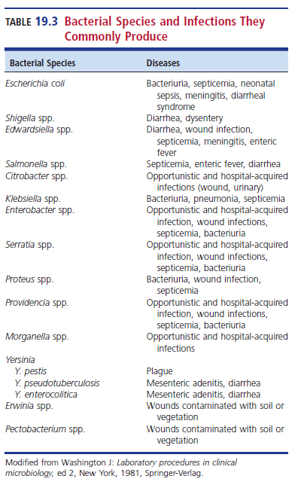
Bacterial Species and the Infections They Commonly Produce

Slide 25
Antimicrobial Resistance in the Enterobacterales
In 2019, the CDC listed 18 drug-resistant threats to the U.S. based on level of concern:
  Urgent
    CRE- Carbapenem-resistant Enterobacteriaceae
    referring to the original family of same name
  Serious
  Concerning

Slide 26
Antimicrobial Resistance in the Enterobacterales (Cont.)
CRE definition
  Resistance to imipenem, meropenem, doripenem, ore ertapenem
  Documentation that the isolate possesses a carbapenemase
    Real-time multiplex PCR assay rapidly detects 5 genes for carbapenemases
      100% sensitivity
      >99% specificity
    Screening of hospitalized patients is recommended to help contain the spread of carbapenemase-producing bacteria

Slide 27
Antimicrobial Resistance in the Enterobacterales (Cont.)
2016
  Discovery of plasmid-transmissible colistin marker mcr-1 in a CRE strain
Antimicrobial resistance continues to grow more serious
Example of clinical strains that produce plasmid-mediated extended-spectrum-β-lactamases
  E. coli, K. pneumoniae, K. oxytoca

Slide 28
OPPORTUNISTIC MEMBERS OF THE ORDER ENTEROBACTERALES AND ASSOCIATED INFECTIONS
CHAPTER NINETEEN

Slide 29
E. coli Characteristics
Most strains
  Lactose-positive(pink colonies with surrounding area of precipitated bile salts on MAC plates
  β-hemolysis on blood agar plate (BAP)
  Green metallic sheen on EMB
  Motile and possess adhesive fimbriae and sex pili
  Possess O, H, K antigens
Commonly isolated from colon biota
  Used as primary marker of fecal contamination in water quality testing

Slide 30
E. Coli Biochemical Reactions
Fermentation of glucose, lactose, trehalose, and xylose
Indole production from tryptophan
Glucose fermentation via mixed acid pathway
  MR positive and VP negative
Does not produce H₂S, DNase, urease, or phenylalanine deaminase (PAD)
IMVC pattern
  positive; positive; negative; negative
Cannot use citrate as sole carbon source
Notes:
30

Slide 31
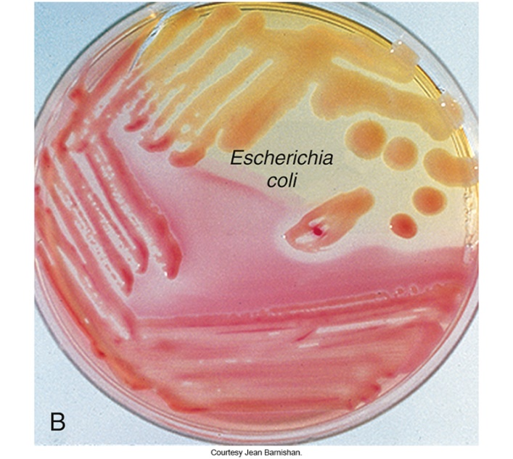
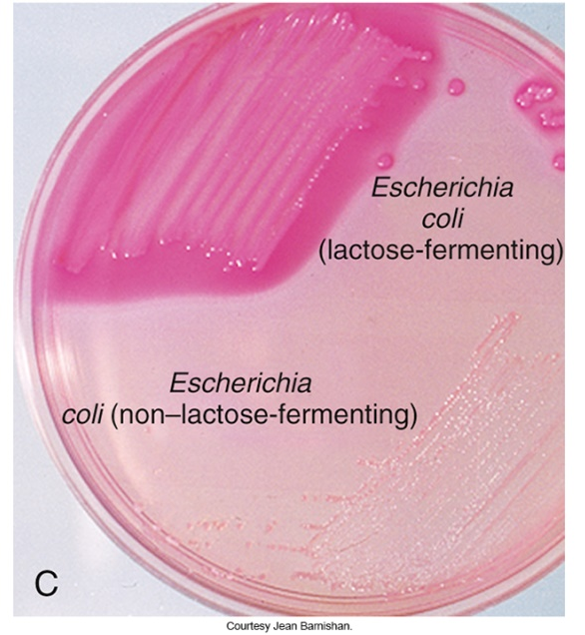
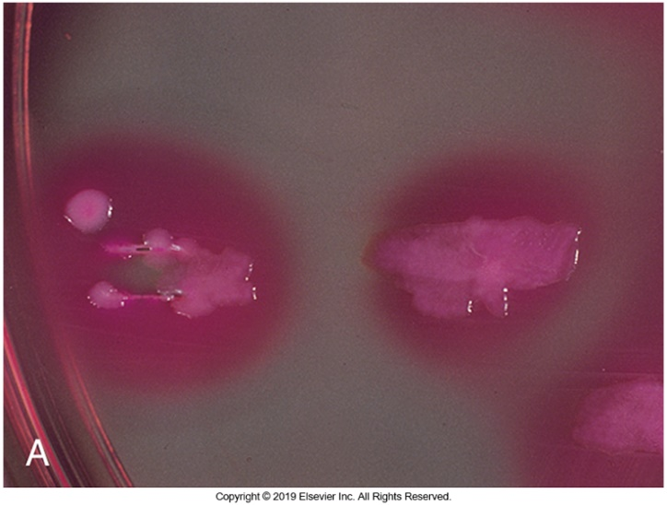
Colonies Growth of E. coli

Slide 32
Extraintestinal E. coli Infections
One of the most common causes of septicemia and meningitis in neonates
  Some strains have the capsular antigen K1
    Documented virulence factor, high fatality rates
Similar infections are uncommon in older children
In adults
  Bacteremia as a result of urogenital infection or from a GI source
Other sources:
  Colonization of birth canal just before or during delivery, contamination of the amniotic fluid

Slide 33
Extraintestinal Infections of E. coli
Septicemia and meningitis
  Most common in neonates and very young children
  Gain infection just before or during delivery, and when there is contamination of amniotic fluid
  Capsule antigen K1
    Predisposition for meningitis

Slide 34
Uropathogenic E. coli
Most common cause of UTIs in humans
Primary virulence factor
  Production of pili allow attachment to epithelial cells and washed out with urine flow
Cytolysins (hemolysins) can kill immune cells and inhibit phagocytosis.
Aerobactin allows bacteria to chelate iron.

Slide 35
Gastrointestinal Pathogenic
E. coli
Five major categories
  Enterotoxigenic E. coli (ETEC)
  Enteropathogenic E. coli (EPEC)
  Enteroinvasive E. coli (EIEC)
  Shiga toxin-producing E. coli (STEC)
  Enteroaggregative E. coli (EAEC)
These five categories are sometimes collectively referred to as enterovirulent or diarrheagenic E. coli
It is often difficult to distinguish diarrheagenic strains from E. coli strains that are part of the normal microbiota by culture

Slide 36
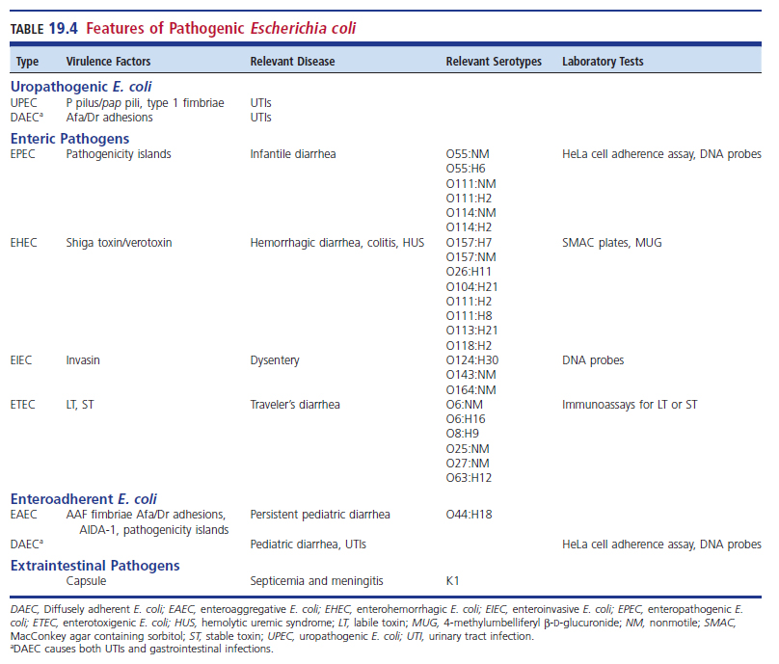
Features of Pathogenic E. coli

Slide 37
Enterotoxigenic E. coli (ETEC)
Diarrhea in infants and adults in tropics and subtropics
Traveler’s diarrhea (requires large inoculum 10⁶–10¹⁰ organisms) lasts 1 to 5 days.
Transmitted via contaminated food and drink
Organisms can colonize the small intestine.

Slide 38
ETEC (Cont.)
Established organisms release toxins
  Heat labile toxin (LT): A and B subunits; follow A/B model of bacterial toxins
    A portion is the enzymatically active portion
    B portion binds to GM₁ ganglioside of the intestinal mucosa, providing entry for the A portion
    Heat-stable toxin (ST) stimulates guanylate cyclase, increasing cyclic guanosine monophosphate (cGMP), leading to accumulation which in turn causes hypersecretion.

Slide 39
ETEC (Cont.)
Clinical manifestations
  Mild, self-limiting
  Watery diarrhea, abdominal cramps, occasional nausea
  No vomiting or fever
  Like other diarrheal illnesses but must be differentiated
Typical diagnosis
  Characteristic symptoms and isolation of solely lactose-fermenting organisms on differential media
  Immunologic assays
  Multiplex PCR

Slide 40
Enteropathogenic E. coli (EPEC) (Cont.)
Associated with
  Severe diarrhea in children younger than 1 year of age
  Nurseries and daycares
Rare in adults
Symptoms
  Low-grade fever
  Malaise
  Vomiting
  Diarrhea
    Persistent watery diarrhea
    Large amounts of mucus without apparent blood
Detection is based primarily on the suspicion of the physician

Slide 41
Enteroinvasive E. coli (EIEC)
Affects adults and children
  Rare in the United States
Dysentery with direct penetration, invasion, and destruction of intestinal mucosa
Very similar to Shigella (coming up soon) but require higher amounts of inoculum

Slide 42
EIEC (Cont.)
Clinical infection symptoms
  Fever
  Severe abdominal cramps
  Malaise
Generally, does not ferment lactose (thus very similar to shigellae)

Slide 43
Shiga Toxin-Producing E. coli (STEC)
STEC refers to E. coli strains that produce Shiga toxin 1 (Stx1) and/or Shiga toxin 2 (Stx2).
  Toxins are named because of their similarity to Shiga toxin produced by Shigella dysenteriae type 1
  Stx is also referred to as verotoxin because this cytotoxin produces damage to Vero cells (African green monkey kidney cells)
  Stx 1 and Stx 2 are immunologically distinct
  Stx follows the A/B model of bacterial toxins

Slide 44
STEC (Cont.)
Shiga toxins preferentially affect endothelial cells of the GI tract and renal glomeruli.
In 1982, the O157:H7 strain of E. coli was first recognized during an outbreak of hemorrhagic diarrhea and colitis.
These isolates are referred to as enterohemorrhagic E. coli (EHEC)-a subset of STEC
EHEC is associated with
    Hemorrhagic diarrhea
    Colitis
    Hemolytic uremic syndrome (HUS)-see next slide

Slide 45
STEC- EHEC
Hemolytic uremic syndrome (HUS) is characterized by
  Low platelet count
  Hemolytic anemia
  Kidney failure
Classic illness caused by EHEC
  Watery diarrhea that progresses to bloody diarrhea with abdominal cramps and low-grade fever
  No leukocytes in stool samples
  Symptoms range from mild to life-threatening HUS
  Can be fatal in young children and older adults

Slide 46
STEC-EHEC (Cont.)
Mode of transmission
  Processed meats
    Undercooked ground beef
    Unpasteurized dairy products
    Apple cider
    Bean sprouts
    Spinach
    Romaine lettuce

Slide 47
STEC (Cont.)
Laboratory diagnosis
  Stool culture on selective and highly differential medium with subsequent serotyping
  Screening stool filtrates for toxin
  Demonstrate a fourfold increase in toxin-neutralizing antibody titer

Slide 48
STEC (Cont.)
Culture media choices
  Stool cultures should incorporate MAC containing sorbitol (SMAC) instead of lactose or SMAC with cefixime and tellurite (SMAC-CT)
  Some strains are sensitive to tellurite
E. coli O157:7 strain does not ferment sorbitol in 24 hours

Slide 49
STEC (Cont.)
An emergent phenotype, the sorbitol-fermenting, nonmotile E. coli O157:NM (NM indicates nonmotile)
Other laboratory diagnosis methods
  ELISA
  Latex agglutination
  Testing for flagella antigens
  After serotyping, isolates may be tested for Stx or stx genes
  Cell cultures using Vero cells
  EIA
  Molecular diagnostic tests

Slide 50
Enteroaggregative E. coli (EAEC)
EAEC cells stick together, cultured on cell monolayers, plastic surfaces, and the surface of the intestinal mucosa
  “Stacked-brick” pattern on the cells and between the cells by means of fimbriae and can lead to biofilm formation
Symptoms-mostly in children
  Watery diarrhea, vomiting, dehydration, occasional abdominal pain
  Persistent for at least 2 or more weeks

Slide 51
EAEC (Cont.)
No WBCs or RBCs in the stool
Important cause of diarrhea in infants
Should be considered a cause of diarrhea in patients with HIV infection
Stacked-brick growth pattern on monolayer cell cultures is suggestive of EAEC
  DNA probes for virulence genes offer a definitive identification
EAEC also contains several toxin-encoding genes, on plasmids and the chromosome, that can be found on other diarrheagenic E. coli strains.

Slide 52
Other Escherichia Species
Escherichia fergusonii
  Has been isolated from urine, blood, wounds, feces, and gallbladder
Escherichia albertii
  Associated with diarrheal disease
  Some isolates care the stx2f gene, which codes for a Shiga-like toxin and the cdtB gene, which codes for a toxin found in Clostridioides difficile. These isolates can cause a condition resembling HUS

Slide 53
Klebsiella
Found in the intestinal tract of humans as normal microbiota
Associated with opportunistic and health-care associated infections, particularly
  Pneumonia, wound infections, UTIs
The genus Klebsiella comprises several species, including K. aerogenes, K. michiganensis, K. oxytoca, K. pneumoniae subsp. ozaenae, K. pneumoniae subsp. pneumoniae, K. pneumoniae subsp. rhinoscleromatis, and K. variicola.

Slide 54
Klebsiella (Cont.)
Common characteristics include the following:
  Most grow on Simmons citrate and in potassium cyanide (KCN) broth.
  None produce H₂S.
  A few hydrolyze urea slowly.
  All are methyl red test negative and Voges-Proskauer positive.
  With a few exceptions, no indole is produced from tryptophan.
  Motility is variable

Slide 55
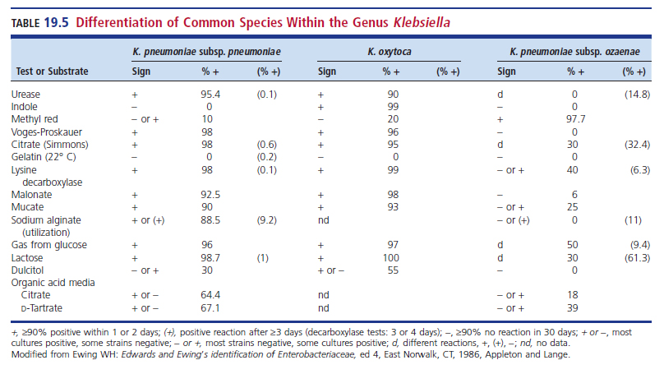
Differentiating Commonly Encountered Klebsiella Species

Slide 56
Klebsiella pneumoniae
Most common isolate
  Respiratory tract infection of hospitalized patients
  Also wound, UTIs, liver abscesses, and bacteremia
    Increased resistance, including carbapenemase
Moist gray mucoid colonies
Virulence factor
  Polysaccharide capsule-responsible for mucoid colonies
    Prevents phagocytosis and some antimicrobials

Slide 57
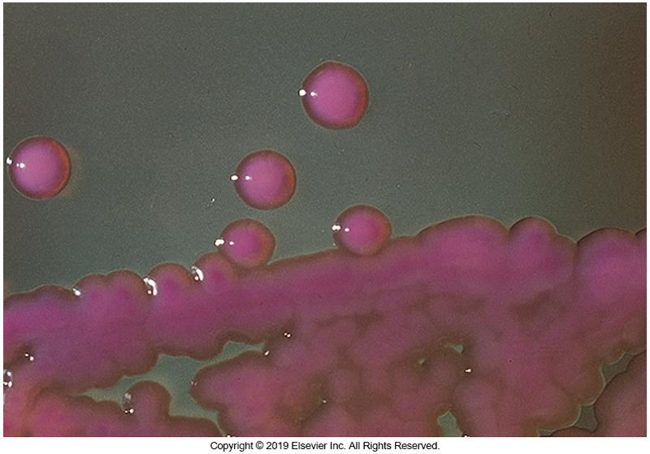
Colonies of K. pneumoniae

Slide 58
Other Klebsiella Species
K. oxytoca
  Similar to K. pneumoniae except indole positive
  Affects similar sites
K. pneumonia subsp. ozaenae
  Isolated from nasal secretions and cerebral abscesses
    Plasmid-mediated ESBLs
K. pneumoniae subsp. rhinoscleromatis
  Rhinoscleroma-infection of the nasal cavity
    Intense swelling and malformation of the entire face and neck
  Africa and South America

Slide 59
Other Species of Klebsiella (Cont.)
K. aerogenes (formerly Enterobacter aerogenes)
  Healthcare-associated infections such as respiratory infections, UTIs, sepsis, post-neurosurgical meningitis
  Linked to poor clinical outcomes in patients with bloodstream infections relative to those caused by Enterobacter spp.
  Organism as become a multidrug-resistant pathogen

Slide 60
Raoultella
Reclassification of some Klebsiella spp. to Raoultella spp.
    R. ornithinolytica
      Indole and ornithine decarboxylase positive
    R. terrogena**
    R. planticola**
    **Both species found in urine, respiratory tracts, and blood

Slide 61
Enterobacter and Cronobacter
Clinically relevant species include
  E. asburiae**, E. cancerogenus, E. cloacae, E. ludwigii, and E. hormaechei
Common healthcare-associated pathogens
  Increasing multidrug resistance
Infection sites-E. asburiae
  Wound, urine, blood, feces
Osteomyelitis after traumatic wounds- E. cancerogenus

Slide 62
Enterobacter Species Characteristics
Citrate positive, potassium cyanide broth positive
MR negative, VP positive
Usually produce ornithine decarboxylase
  Lysine decarboxylase produced by most (not E. cloacae or E. gergoviae)

Slide 63
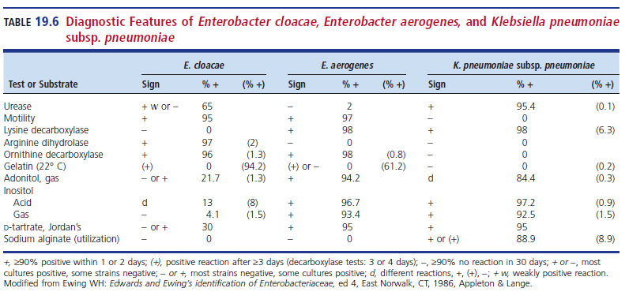
Diagnostic Features of Select Enterobacter Species

Slide 64
Cronobacter
Most common isolates
  C. sakazakii
    Documented as a pathogen in neonates
    Causes meningitis, bacteremia, necrotizing enterocolitis
    Associated with powdered milk
    Isolated from brain abscesses, respiratory and wound infections
    Produces yellow pigment
  C. malonaticus
    Found in adults
Most accurate diagnosis method is DNA sequencing of fusA and rpoB genes

Slide 65
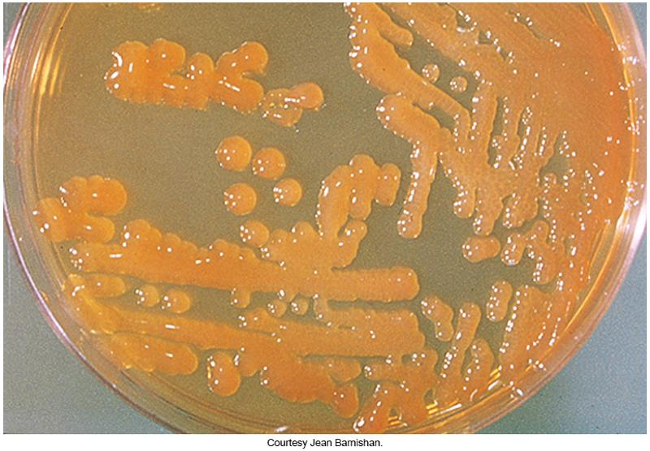
Photograph of C. sakazakii

Slide 66
Citrobacter
Consists of at least 19 species
Inhabitants of the GI tract
Associated with infectious disease in healthcare-associated infections,
  Most frequently causes UTIs
The species most often isolated are
  C. freundii complex (includes C. freundii, C. braakii, and C. youngae, among others) and C. koseri
    Can be isolated in diarrheal stools

Slide 67
Citrobacter (Cont.)
C. freundii has been associated with
  UTIs, pneumonias, septicemia, intraabdominal abscesses, endocarditis in IV drug users
It is difficult to speciate Citrobacter
  Hence the term Citrobacter freundii complex
Most species:
  Hydrolyze urea slowly
  Positive methyl red
  Ferment lactose
  Grow on Simmons citrate medium

Slide 68
Differential Tests to Identify
C. freundii from Salmonella
 | Citrobacter freundii | Salmonella
Colony morphology when isolated from stool cultures | On primary selective media may be mistaken for Salmonella | On primary selective media, resembles Citrobacter
Decarboxylate lysine | No | Yes (most strains)
Hydrolyze urea | 70% yes | No

Slide 69
Citrobacter (Cont.)
C. koseri
  Documented as the cause of nursery outbreaks of
    Neonatal meningitis, pneumonia, brain abscesses
C. braakii
  Associated with community-acquired infections
    Including septicemia in a patient with cervical cancer

Slide 70
Kluyvera
Five closely related species
  K. ascorbata, K. cryocrescens, K. georgiana, K. intermedia, and K. sichuanensis.
Found in respiratory, urine, CSF and blood cultures
Most strains are nonpigmented

Slide 71
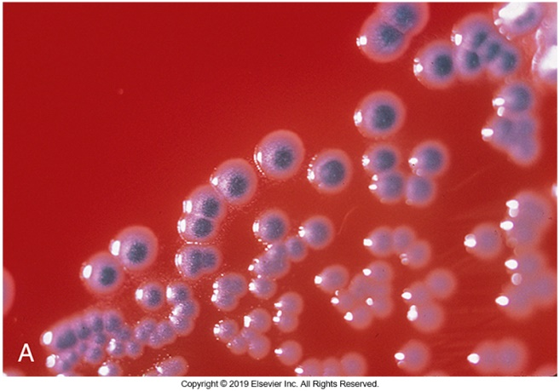
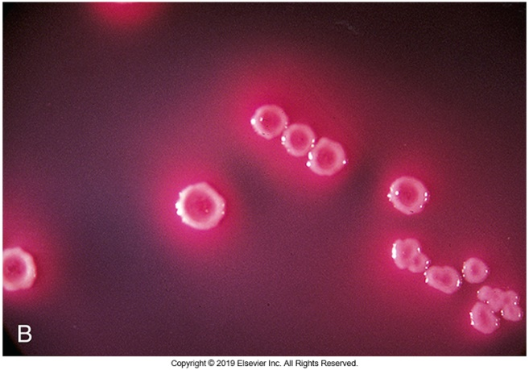
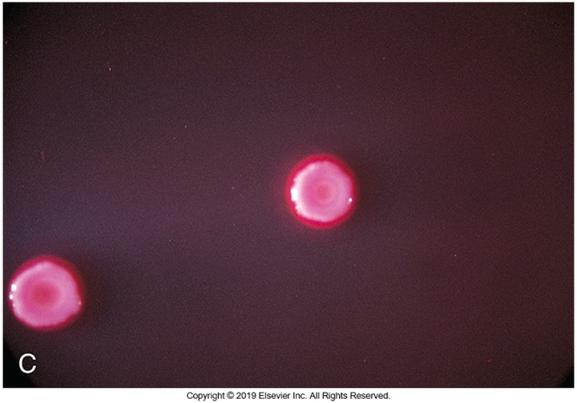
Kluyvera Colony Morphology

Slide 72
Plesiomonas
Formerly in the family Vibrionaceae
Oxidase-positive
Glucose-fermenting
Facultatively anaerobic
Straight gram-negative bacilli
  Singly, pairs, short chains, filamentous form
No capsule formation

Slide 73
Plesiomonas (Cont.)
The genera Plesiomonas and Shigella share
  Biochemical and antigenic features.
Plesiomonads often cross-agglutinate with
  Shigella sonnei, S. dysenteriae, and even S. boydii antisera, hence the species name shigelloides.
P. shigelloides possess a much lower virulence potential than Shigella, with a low symptomatic carriage rate among humans.

Slide 74
Plesiomonas (Cont.)
Plesiomonas can be serotyped by somatic O antigens and their flagellar H antigen.
P. shigelloides
  Found in soil and aquatic environments
  Fresh and estuarine waters of tropical and subtropical climates
  Widely distributed among warm- and cold-blooded animals
  Mode of transmission
    Undercooked seafood, particularly shellfish
    Untreated water

Slide 75
Plesiomonas (Cont.)
Three major clinical types of gastroenteritis
  The more common watery or secretory diarrhea
  A subacute or chronic disease that lasts from 14 days to 2 to 3 months
  A more invasive, dysenteric form that resembles colitis

Slide 76
Plesiomonas
Epidemiology
Found in soil and aquatic environments
  Found in fresh and estuarine waters, subtropical climates
Widely distributed among warm- and cold-blood animals

Slide 77
Plesiomonas
25% to 40% of all infected patients present with
  Fever, vomiting, or both
  Most common clinical symptom—abdominal pain
Most cases self-limiting
Antimicrobial therapy is indicated in severe and prolonged cases.

Slide 78
Erwiniacea
Pantoea
A diverse group of about two dozen species of yellow-pigmented organisms containing many plant pathogens.
Environmental isolates
Rarely recovered in human specimens
Several strains have been isolated from clinical specimens
  Blood, CSF, sputum, urine
  P. agglomerans-nationwide outbreak of septicemia resulting from contaminated IV fluids

Slide 79
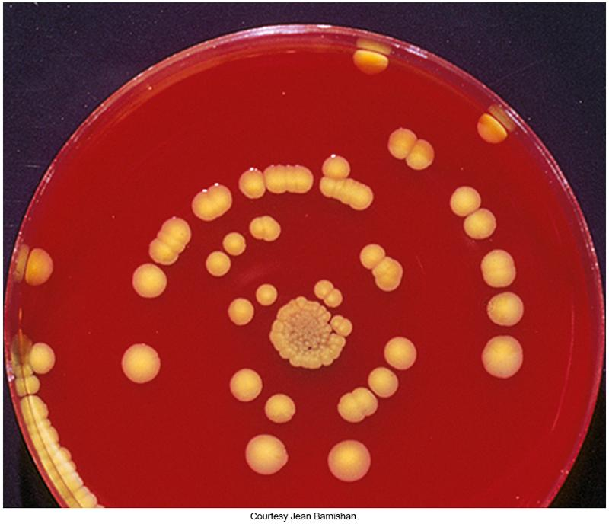
Photograph of P. agglomerans

Slide 80
Morganellaceae
Consists of three genera
  Proteus
  Morganella
  Providencia
Widely disseminated in the environment, normal intestinal microbiota
Recognized as opportunistic pathogens
All genera are non-lactose fermenting
All genera deaminate phenylalanine

Slide 81
Proteus
At least 13 species
  P. mirabilis and P.vulgaris widely recognized human pathogens
    P. mirabilis is the more common isolate
Both species have been isolated from
  Urine, wounds, and ear and bacteremic infections
The urease activity of P. mirabilis results in an increased urine pH and can lead to struvite kidney stones (calculi)

Slide 82
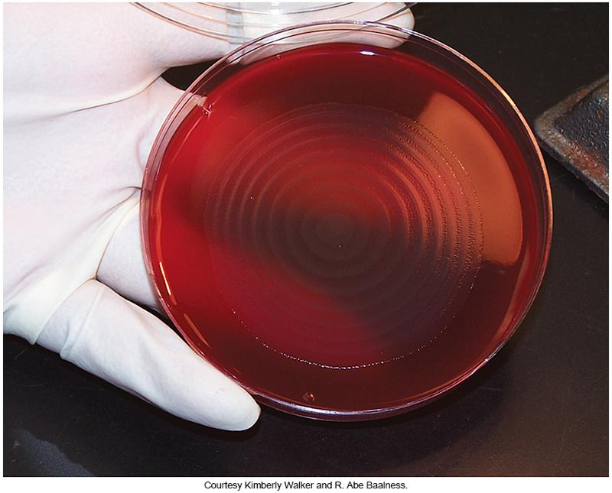
Swarming Proteus

Slide 83
Differential Tests to Identify P. mirabilis and P. vulgaris
 | Proteus mirabilis | Proteus vulgaris
Production of indole from tryptophan | No | Yes
Ornithine decarboxylase | Positive | Negative
Other tests of importance |  | Ferments sucrose Acid/acid in triple sugar iron (TSI) agar

Slide 84
Morganella
M. morganii
  Multidrug resistant, increased virulence
  Healthcare-associated pathogen
  UTIs, occasional wound infections and bacteremia
  Non-swarmer
  Motile

Slide 85
Providencia
Four clinical notable species, two of which are below
  P. rettgeri
    Urinary tract pathogen
    Occasionally nosocomial outbreaks
    Implicated in diarrheal disease among travelers
  P. stuartii
    Nosocomial burn unit outbreaks
    Also isolated in urine cultures
  Both have high resistance to antimicrobials.

Slide 86
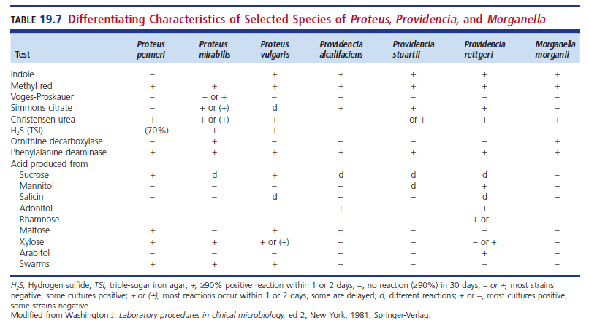
Differentiating Characteristics of Proteus, Providencia, and Morganella

Slide 87
Hafniaceae
Genus- Hafnea
  Can produce a verocytotoxin
  Linked to gastroenteritis
  Occasionally isolated from stool cultures
  Delayed citrate reaction
  H. alvei is more likely to be toxigenic, and have been linked to gastroenteritis and are occasionally isolated in stool cultures

Slide 88
Edwardsiella
E. tarda is the only recognized pathogen.
  Urea negative
  Lysine decarboxylase positive
  H₂S positive
  Indole positive
  No growth on Simmons citrate medium
Clinical manifestations
  Bacteremia, GI infections, wound infections
  Reported to have significant mortality rate

Slide 89
Serratia
Diverse group with at least 25 named species
Widespread in the environment
Opportunistic pathogens isolated from outbreaks in health care settings.
S. marcescens, S. rubidaea, and S. plymuthica are noted for
  producing a characteristic pink-to-red pigment, prodigiosin, especially when the cultures are incubated at room temperature

Slide 90
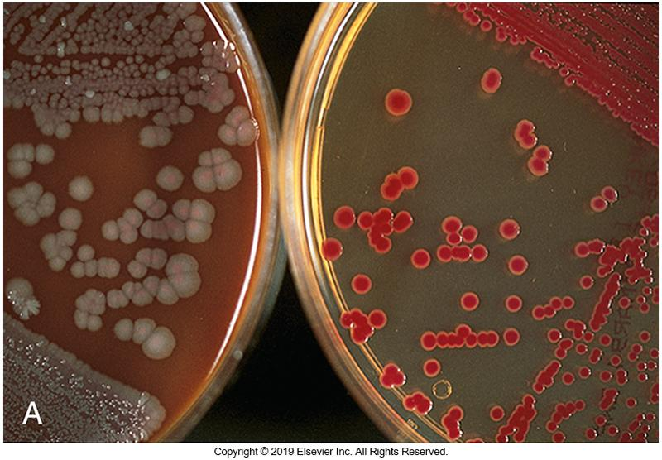
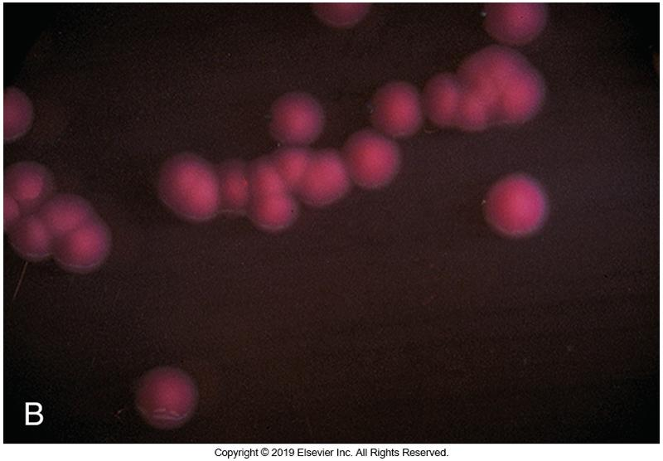
Colonies of Serratia
Left: S. marcescens on chocolate (CHOC) agar
Right: S. rubidaea on MAC

Slide 91
Serratia marcescens
Opportunistic pathogens associated with outbreaks in health care settings
  Urinary and respiratory tract infections
  Nursery, cardiac surgery, burn unit outbreaks
  Contamination of antiseptic solution
    Resulted in an epidemic of septic arthritis
  Ophthalmic infections.

Slide 92
Serratia odorifera
S. odorifera
  Dirty, musty odor resembling that of rotten potatoes
Isolated predominantly from
  Sputum
  Blood
  Urine
Other species that have been isolated in humans
  S. liquefaciens, S. rubidaea, S. ficaria, S. fonticola, and S. quinivorans

Slide 93
Serratia Species
General characteristics
  Ferment lactose slowly
  ONPG positive
  Typically VP positive
  Resistance to a wide range of antimicrobials
  Susceptibility tests must be performed on each isolate to determine appropriate antimicrobial therapy

Slide 94
PRIMARY PATHOGENS IN THE ORDER ENTEROBACTERALES
CHAPTER NINETEEN

Slide 95
Overview
Primary human intestinal pathogens that are not normal biota of the intestinal tract
  Salmonella
    Inhabit the gastrointestinal (GI) tracts of animals
    Human infection occurs via contaminated or undercooked animal food products.
  Shigella
    Human carriers coupled with improper sanitary conditions and poor personal hygiene
  Yersinia
    Transmitted by wide variety of animals

Slide 96
Salmonella
Gram-negative bacilli, facultatively anaerobic
Clear, colorless, nonlactose-fermenting on MAC and colonies with black centers on HE or XLD
  Negative for indole, phenyalanine deaminase, urease, and VP
  Most produce H₂S
    Exception: Salmonella paratyphi A
  No growth in potassium cyanide

Slide 97
Salmonella (Cont.)
Classification
  Two species based on DNA homology and sequencing
  S. enterica- accounts for most all human infections
    Six subspecies
  S. bongori-rarely isolated

Slide 98
Salmonellae Virulence Factors
Capsule production
Fimbriae used in adherence in initiating intestinal infection
Ability to traverse intestinal mucosa and survive inside host cells
Enterotoxins involved in gastroenteritis
  Implicated as a significant virulence factor

Slide 99
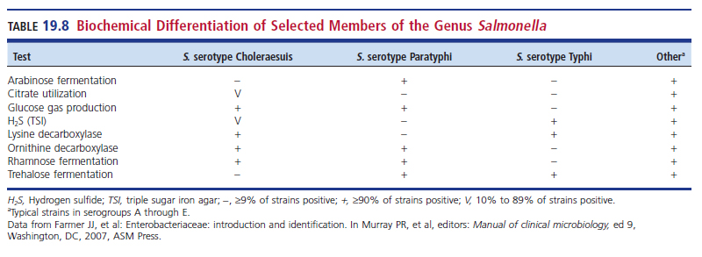
Biochemical Differentiation of Select Salmonella

Slide 100
Antigenic Structures
Primary
  Somatic O and flagellar H antigens
  O is heat-stable, H heat labile
H antigens occur in 2 phases
  The specific stage-determines the immunologic identity of a particular serotype- agglutinate only with homologous antisera
  The nonspecific stage
Other
  Capsular (K), designated Vi antigen
  Vi is important in identifying Salmonella serotype Typhi

Slide 101
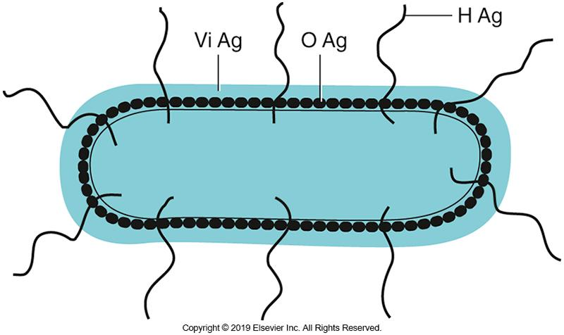
Antigenic Structures of Salmonellae Used in Serologic Typing

Slide 102
Salmonella
Clinical Infections
Forms of salmonellosis
  Acute gastroenteritis/food poisoning
    Vomiting and diarrhea
  Typhoid fever, most severe form of enteric fever
  Nontyphoid bacteremia and other extraintestinal complicatons
  Carrier state following Salmonella infection

Slide 103
Salmonella
Gastroenteritis
Food poisoning
Sources of infection
  Primarily poultry, eggs, milk, egg products, handling pets
  Ingestion of foodstuffs
    Examples- papayas, tahini, chicken, ground beef, cereal, peaches, mushrooms
  Calves and poultry at petting zoos
  Direct person to person
  Cooking utensils

Slide 104
Salmonella
Gastroenteritis (Cont.)
Symptoms appear 8 to 36 hours after ingestion of contaminated food.
  Nausea, vomiting, fever, chills
  Accompanied by watery or blood-tinged diarrhea and abdominal pain
Most infections are self-limiting.
Antimicrobials of choice in most cases include
  fluoroquinolone, azithromycin, and ceftriaxone

Slide 105
Enteric Fevers
Clinical features
  Prolonged fever
  Bacteremia
  Involvement of the reticuloendothelial system (RES), particularly the liver, spleen, intestines, and mesentery
  Dissemination to multiple organs
Enteric fever caused by Salmonella typhi is called typhoid fever.

Slide 106
Typhoid Fever
Transmission and Epidemiology
Transmission
  Improper disposal of sewage
  Poor sanitation lack of a modern potable water system
Epidemiology highlights
  Tropical and subtropical areas where international travelers are more likely to acquire the infection

Slide 107
Typhoid Fever
Disease Course
Symptoms develop 7 to 14 days after ingestion of organisms.
  The larger the inoculum, the shorter the incubation time.
  First week of disease patients typically develop
    Sustained fever, malaise, anorexia, lethargy, myalgia, and a dull headache

Slide 108
Typhoid Fever
Disease Course (Cont.)
Organisms appear to be resistant to gastric acids.
  Reach the small intestine, invade, and penetrate the intestinal mucosa
  Leads to constipation
Organisms gain access to the lymphatic system and are sustained in mesenteric lymph nodes.
Organisms reach bloodstream and spread to liver, spleen, bone marrow
  Immediately engulfed by mononuclear phagocytes

Slide 109
Typhoid Fever (Cont.)
The organisms multiply intracellularly; later they are released into the bloodstream a second time.
The febrile episode becomes more evident during this release of the organisms into the circulatory system.
At this time, the organisms may be isolated easily from the blood.

Slide 110
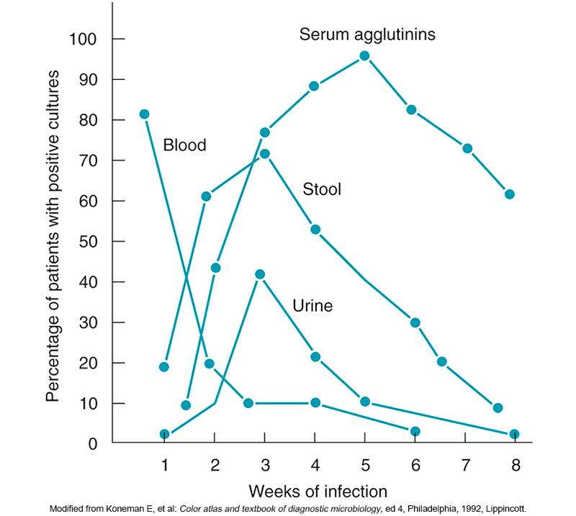
Culture and Serologic Diagnosis of Typhoid Fever

Slide 111
Typhoid Fever
Disease Course (Cont.)
Weeks 2 and 3 of the disease (without treatment)
  Patient experiences sustained fever with prolonged bacteremia.
  Organisms invade the gallbladder and Peyer’s patches of the bowel; they also reach the intestinal tract via the biliary tract.
  “Rose spots” appear during week 2 of the fever.
  Infection of the intestinal tract typically transpires resulting in large numbers of organisms.
    May be isolated from the stool

Slide 112
Typhoid Fever
Disease Course (Cont.)
Invasion of the gallbladder and Peyer’s patches; release of bacteria into the bowel via the biliary duct
  Gallbladder is the foci in long-term infections.
  Severe infections can cause necrosis of gallbladder and/or Peyer’s patches.
    Hemorrhage and perforation of the bowel

Slide 113
Typhoid Fever
Disease Course (Cont.)
The gallbladder becomes the foci of long-term carriage of the organism
  Necrosis in the gallbladder may lead to necrotizing cholecystitis and necrosis of the Peyer’s patches.
  Hemorrhage and perforation of the bowel may occur as serious complications.
Other complications that may occur
  Pneumonia, thrombophlebitis, meningitis, osteomyelitis, endocarditis, abscesses

Slide 114
Salmonella Bacteremia
Without extraintestinal foci of infection caused by nontyphoidal Salmonella
  Characterized by prolonged fever and intermittent bacteremia
Two groups at risk for developing infection
  Young children
    Fever and gastroenteritis with brief episodes of bacteremia
  Adults
    Transient bacteremia during episodes of gastroenteritis or develop symptoms of septicemia without gastroenteritis

Slide 115
Salmonella Carrier State
Individuals who recover from infection may harbor the organisms in the gallbladder.
  Gallbladder becomes the site of chronic carriage.
  Organisms are excreted in the feces either continuously or intermittently.
Carrier state may be terminated by antimicrobial therapy if gallbladder infection is not evident.
Cholecystectomy has been the only solution to chronic state of enteric carriers.

Slide 116
Shigella Species
Characteristics
Nonmotile, most are slow lactose fermenters
Generally do not produce gas from glucose
  Except some types of S. flexneri
No urease production
No H₂S in TSI
No decarboxylation of lysine
Cannot utilize acetate or mucate as carbon source
S. sonnei is positive for ONPG and ornithine decarboxylase.
S. flexneri is negative for these tests.

Slide 117
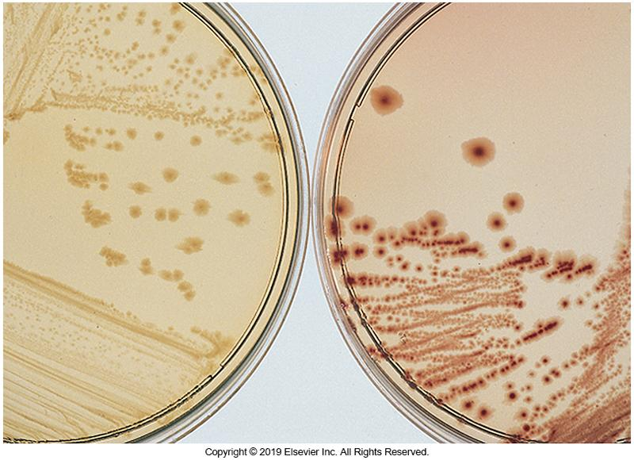
Shigella Colony Morphology
Clear, nonlactose-fermenting colonies

Slide 118
Shigella
Antigenic Structures
O antigens are separated by serologic grouping.
K antigens
  Must be removed to type O antigen
  Heat labile
Lack H antigens
  Nonmotile

Slide 119
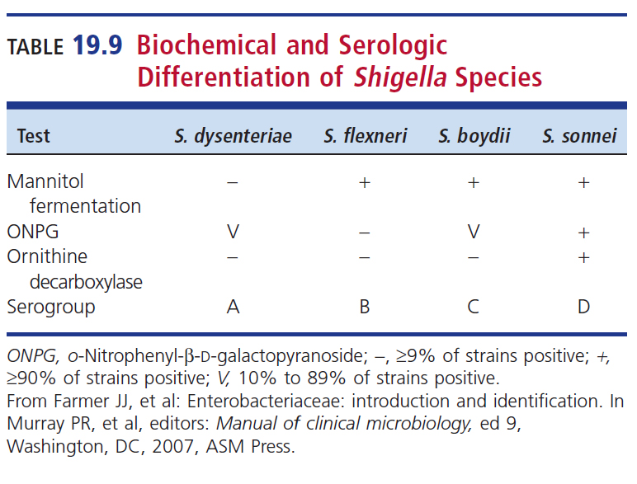
Biochemical and Serologic Differentiation of Shigella Species

Slide 120
Shigella
Epidemiology
Human and large primates are only known reservoirs.
Transmission
  Direct person-to-person
  Fecal–oral route with carriers as the source
  Transmitted by flies, fingers, and food or water contaminated by infected persons
  Personal hygiene

Slide 121
Shigella
Epidemiology (Cont.)
Personal hygiene plays a major role in transmitting organisms.
Groups at risk
  Children in daycare centers (particularly infants younger than 1 year of age)
  Individuals living in crowded and inadequate housing
  Individuals who practice anal–oral sexual activity
  Known to cause outbreaks on cruise ships

Slide 122
Shigella
Clinical Infections
Shigellosis
  Important cause of bloody diarrhea worldwide
  Responsible species vary in epidemiology, mortality rate, and severity of disease
  Predominant isolate in the U.S. and Europe
    S. sonnei followed by S. flexneri
  S. sonnei characterized by fever and watery or bloody diarrhea
  Initial symptoms
    High fever, chills, abdominal cramps, pain accompanied by tenesmus 24 to 48 hours after ingestion of organisms

Slide 123
Shigella
Clinical Infections (Cont.)
Shigellosis
  The organisms, which originally multiply in the small intestine, move toward the colon, where they may be isolated 1 to 3 days after the infection develops
  Bloody stools containing mucus and numerous leukocytes follow the watery diarrhea
  The organisms invade the colonic tissues and cause an inflammatory response

Slide 124
Shigella
Clinical Infections (Cont.)
Shigellosis
  Marked by penetration of intestinal epithelial cells after attachment of the organisms to mucosal surfaces, local inflammation, shedding of the intestinal lining, and formation of ulcers after epithelial penetration.
  Clinical manifestations are caused by penetration of gastric epithelial cells and production of toxins.

Slide 125
Shigella
Clinical Infections (Cont.)
Dysentery caused by S. dysenteriae type 1
  Patients experience severe symptoms
    Bloody diarrhea progresses to dysentery within a few hours to a few days
    Painful bowel movements, which contain predominately mucus and blood
    May become life-threatening as extraintestinal complications develop
      Example- ileus, an obstruction of the intestines, with marked abdominal dilation, possibly leading to toxic megacolon

Slide 126
Yersinia
25 named species; most are considered environmental isolates
3 species are considered as human pathogens
  Y. pestis- causative agent of the plague
  Y. pseudotuberculosis and Y. enterolitica- known to cause sporadic cases gastroenteritis, mesenteric lymphadenitis (especially in children); generalized septicemia infections in immunocopromised hosts
  All 3 species are zoonotic agents

Slide 127
Yersinia pestis
Y. pestis
  Causative agent of plague
    Bubonic or glandular, septicemic, and pneumonic forms
  Plague is transmitted through bite of infected fleas
  Pneumonic plague transmitted through respiratory droplets
  Gram-negative coccobacilli resembling a safety pin appearance (bipolar staining)
    Preferential growth at 25 to 30° C
  Class A bioterrorism agent

Slide 128
Y. Pestis
Clinical Manifestations
Symptoms of bubonic plague-most common
  Sudden onset (2 to 6 days after infection) of high fever, chills, and headache with swollen, painful regional lymph nodes known as buboes
Pneumonic plague
  Can be a primary infection if bacteria are inhaled, or it can be secondary to bubonic plague
Septicemic plague
  Fever, chills, shock, extreme weakness, abdominal pain, sometimes bleeding leading to a rash

Slide 129
Y. pestis (Cont.)
Nonmotile, gram-negative, short, plump bacillus
Bipolar staining at each end of the bacillus that resembles a “safety pin” appearance
  Methylene blue or Wayson stain
Grows on routine media at optimal temperature of 25° to 30°C

Slide 130
Yersinia enterocolitica
Mode of transmission
  Contact with household pets
  Fecal-oral route
  After ingestion of contaminated food
    Often pork, vacuum-packed deli meat, beef, lamb, chicken
  Major concern- organism survives in cold temperatures; food refrigeration becomes an ineffective preventive measure
  Associated with transfusion of contaminated packed red blood cells

Slide 131
Y. enterocolitica (Cont.)
Most common forms of infection
  Gastroenteritis
  Appendicitis-like syndrome (mesenteric lymphadenitis)
  Terminal ileitis
  Septicemia
  Arthritis
  Erythema nodosum
  *Tender red nodules with itching and burning on lower legs (shins)

Slide 132
Y. enterocolitica
Acute Enteritis
Often affects infants and young children between the ages of 1 and 5 years
Symptoms
  Acute gastroenteritis with fever accompanied by headaches, abdominal pain, nausea, diarrhea
Stools often contain blood.
Usually mild and self-limiting

Slide 133
Y. enterocolitica
Appendicitis-like Syndrome
Occurs primarily in older children and adults
Possible symptoms
  Severe abdominal pain concentrated in right lower quadrant
  Fever
  Enlarged mesenteric lymph nodes
  Inflamed ileum and appendix

Slide 134
Y. enterocolitica (Cont.)
Arthritis form
  Uncommon extraintestinal form
  Usually after GI episode or an appendicitis-like syndrome
  Reported more often in adults than in children
Erythema nodosum
  Inflammatory reaction caused by Y. enterocolitica
    Red nodules that may be accompanied by itching and burning
    Mainly affects anterior portion of the legs
    More common in women than in men

Slide 135
Y. enterocolitica
Appearance and Culture Media
Gram-negative coccobacilli appearance (bipolar staining)
  Preferential growth at 25 to 30° C
Motile at 25°C but not at 35°C
Cold enrichment can be used to increase recovery in fecal samples.
Selective media available
  Cefsulodin–irgasan–novobiocin (CIN)

Slide 136
Yersinia pseudotuberculosis
Primary pathogen of rodents (especially guinea pigs), farm animals, birds
Human infection rare
  Associated with close contact with infected animals or their fecal material or ingestion of contaminated drink and foodstuff

Slide 137
Y. pseudotuberculosis
Clinical Manifestations
Ingested organisms spread to the mesenteric lymph nodes.
  General infection that is usually self-limiting
May include septicemia accompanied by mesenteric lymphadenitis
  Presentation similar to appendicitis
Infections most common in children and young adults

Slide 138
Y. pseudotuberculosis
Typical-looking plague bacillus
Motility at 18° to 22°C
Produces urease
Ferments rhamnose

Slide 139
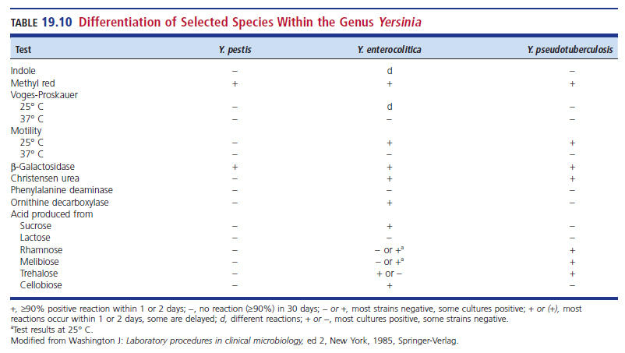
Differentiation Within the Genus Yersinia

Slide 140
OTHER GENERA OF THE ORDER ENTEROBACTERALES
CHAPTER NINETEEN

Slide 141
New Genera of
Enterobacteriaceae
Budivicia
Buttiauxella
Cedecea
Ewingella
Leclercia
Leminorella

Slide 142
New Genera of
Enterobacteriaceae (Cont.)
Moellerella
Photorhabdus
Rahnella
Tatumella

Slide 143
LABORATORY DIAGNOSIS OF ENTEROBACTERALES
CHAPTER NINETEEN

Slide 144
Specimen Collection and Transport
Organisms can be isolated from a wide variety of clinical samples.
  Most often isolated with other organisms including more fastidious pathogens
Appropriate and immediate transport media important for isolation

Slide 145
Isolation and Identification
Consider site of origin
Generally enteric opportunistic organisms isolated from sites that are normally sterile are highly significant
Complete identification should be directed only toward true intestinal pathogens.
Multiplex PCR assays can detect multiple pathogens in clinical specimens
  FilmArray can detect up to 22 common GI pathogens including bacteria, parasites and viruses in 1 hour(ish)

Slide 146
Direct Microscopic Examination
Microscopic characteristics of enteric bacteria are indistinguishable from other gram-negative bacilli
Sterile sites can be examined for the presence of gram-negative bacteria
A presumptive results can aid the clinician in the preliminary diagnosis of the infection, appropriate empiric therapy can be instituted immediately

Slide 147
Direct Microscopic Examination (Cont.)
Direct smears prepared from samples containing endogenous microbiota, such as sputum, do not provide valuable information.
Direct smear examination of stool sample is not helpful either but may reveal the presence of inflammatory cells
  May be helpful in determining whether a GI disease is a toxin-mediated or invasive process

Slide 148
Screening Stool Cultures for Pathogens
Fecal samples
  Salmonella, Shigella, STEC, and Campylobacter
  Protocols and media should be available for
    Yersinia, Aeromonas, Vibrio, P. shigelloides
  Laboratories should develop protocols for the maximum recovery of enteric pathogens
  Media to consider
    MAC, SMAC, HE, XLD, CIN II, others as appropriate

Slide 149
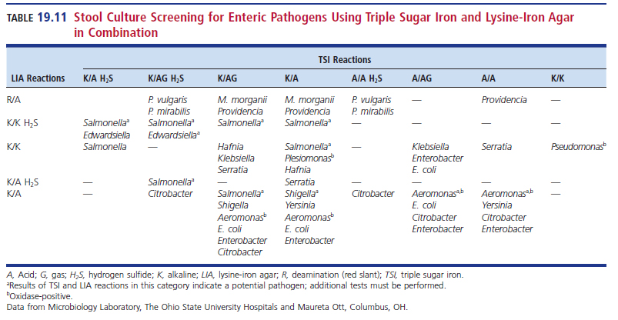
Lysine Iron Agar (LIA) and TSI Screening

Slide 150
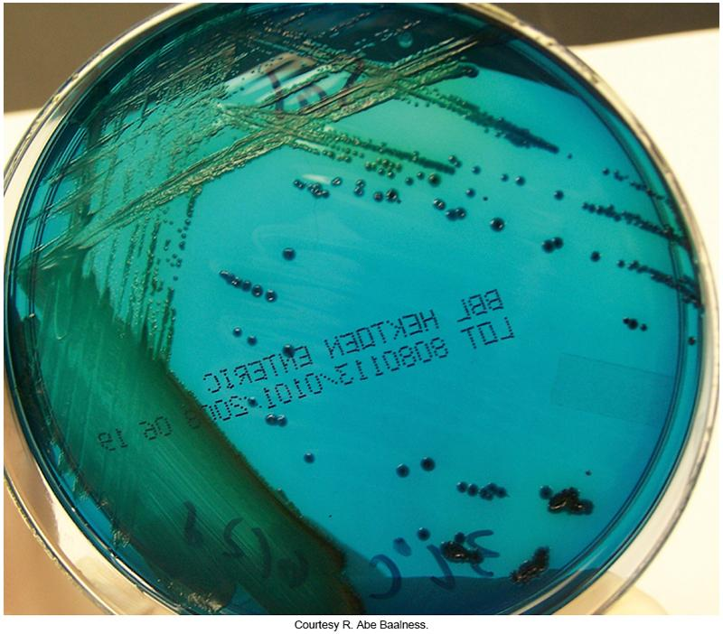
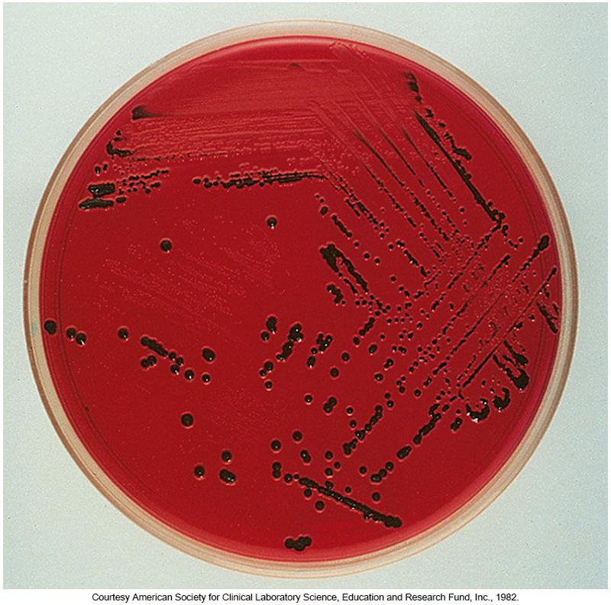
HE and XLD Agar

Slide 151
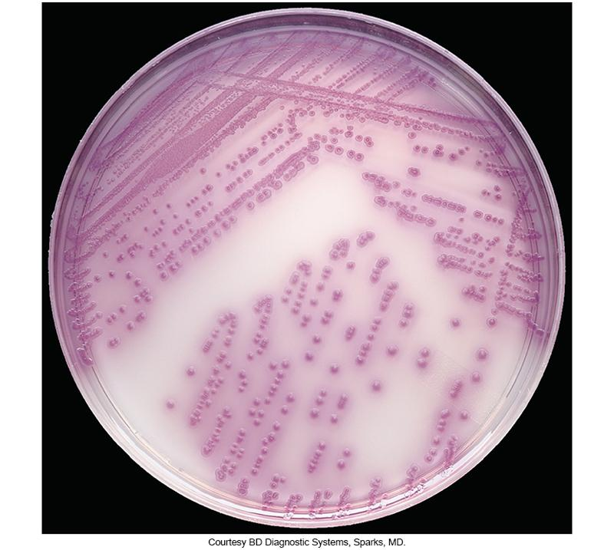
Salmonella on CHROMagar™

Slide 152
Identification
Determine if the isolate belongs to the order Enterobacter
  Gram-negative
  Oxidase negative
    Except for P. shigelloides
    Always use young colonies from sheep blood agar (SBA) plates
  Ferment glucose
  Reduce nitrate to nitrite
    Except Photorhabdus (rare human isolate) and Xenorhabdus (environmental isolate)
  Molecular biology assays now available

Slide 153
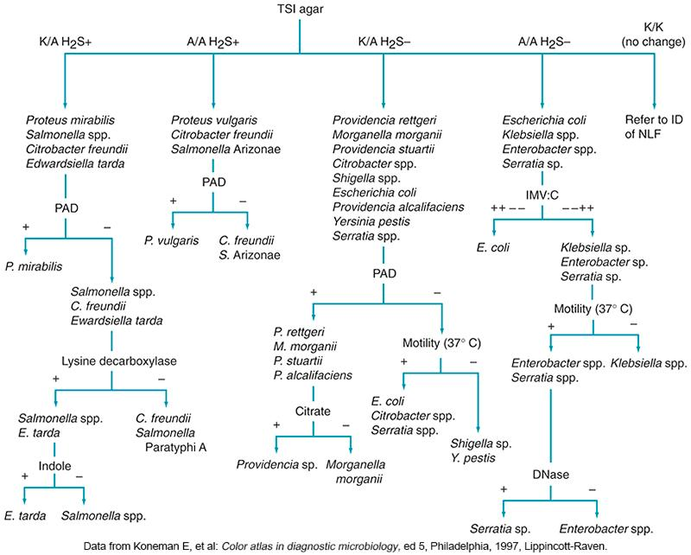
Schematic Diagram for Enterobacterales Identification

Slide 154
Differentiating Characteristics of Enterobacterales

Slide 155
Serologic Grouping
Serologic grouping
  Salmonella
    60 types of O antigens
      95% are serogroups A through E1
    Imperative for laboratories to be able to identify Salmonella serotype Typhi
    Slide technique, agglutination test
  Shigella
    A through D serogroups
    Agglutination test, procedure may need to be altered to ensure accurate results

Slide 156
Antigenic Formulae of the
Salmonella Serovars

Slide 157
LET’S REVISIT THE CASE IN POINT
CHAPTER NINETEEN

Slide 158
Highlights
The Patient | 71-year-old male
Patient History | Hospitalized for diabetic ketoacidosis
Patient Complaints | Flank pain Painful urination
The Sample | Urine for culture
Growth on Culture Plates | MacConkey plate- moderate lactose- fermenting organisms

Slide 159
Highlights (Cont.)
Growth on Sheep Blood Agar (SBA) Plate | Nonhemolytic colonies Oxidase positive
IMViC Biochemical Results | Indole + Methyl red + Voges-Poskauer – Citrate +
Other Biochemical Results | H₂S negative Urea hydrolyzed Arginine and ornithinine both decarboxylated
Antimicrobial Susceptibility Test | Resistant to cefotaxime, norfloxacin, ciprofloxacin, and the aminoglycosides

Slide 160
Issues to Consider
After reading the patient’s case history, consider:
The significance of this patient’s health status and medical history
The colony morphology feature that provides clues about the identity of the organism
The biochemical tests that are the most specific for identification of this organism

Slide 161
POINTS TO REMEMBER
CHAPTER NINETEEN

Slide 162
Points to Remember
Most of the genera discussed in this chapter could conceivably be isolated from almost any clinical specimen, especially when dealing with immunocompromised patients.
ETEC strains can produce LT and/or ST.
EIEC strains genetically and phenotypically resemble Shigella spp.

Slide 163
Points to Remember (Cont.)
Although most isolates of E. coli are considered normal fecal microbiota, several strains (enterovirulent E. coli) are known to cause intestinal tract infections; in the United States STEC is the most notable.
E. coli is the most significant cause of UTIs.

Slide 164
Points to Remember (Cont.)
STEC strains produce Shiga toxin 1 and/or Shiga toxin 2. Some of these strains, referred to as EHEC, produce a more severe infection called HUS.
Salmonella and Shigella are enteric pathogens and are not considered normal fecal biota.

Slide 165
Points to Remember (Cont.)
Yersinia pestis, causes plague.
A good patient history combined with proper selective screening agar (e.g., HE, XLD, and SMAC agars) can be very helpful in the timely and accurate identification of enteric pathogens associated with diarrheal disease.

Slide 166
Points to Remember (Cont.)
Presumptive genus identification may include a battery of selective agar media and key biochemical tests
  Oxidase test, TSI, urea, LIA, IMViC
  Confirm with additional conventional biochemical tests, one of several multitest or rapid and automated identification systems, or a molecular biology assay.
Serogrouping is an important aspect in the identification of enteric pathogens.

