Slide 1
Clinical & Diagnostic Microbiology
Zoonotic Diseases
Introduction

Slide 2
Zoonotic Diseases Definition and Transmission
Zoonotic diseases are those that can naturally jump from animals to humans
Transmission can occur via different routes
Vectors
Skin to skin
Animal bites
Inhalation of respiratory droplets
Ingestion of contaminated animal products
Food-borne or waterborne (bacterial)

Slide 3
Zoonotic Diseases Characteristics
According to CDC, more than 6 of every 10 infectious diseases in people are spread from animals.
Some infections occur naturally in their animal host populations and are able to jump to humans.
Human to human disease transmission is possible.
In other infections, humans are dead-end hosts.

Slide 4
Clinical & Diagnostic Microbiology
Zoonotic Diseases
Transmission via Scratches & Bites from Domestic & Wild Animals

Slide 5
Pasteurellosis
Causative agent
Pasteurella multocida
Pleomorphic ovoid to filamentous gram-negative bacillus
0.5 to 1.0 μm in size
Wide range of hosts
Reservoirs are oral cavities of most dogs and cats.
Can be primary pathogen or secondary invader

Slide 6
Pasteurellosis Clinical Manifestations
Most common—wound and soft tissue primarily from bites or scratches from dogs or cats
Cats more involved than dogs
In most cases patient is afebrile, has inflamed infected site (usually within 48 hours), and no inflammation of lymph nodes.
Can also be infected by animals licking wounds
Rarely infections can occur in absence of scratches or bites.

Slide 7
Pasteurellosis Clinical Manifestations (Cont.)
Examples of other manifestations
Pericarditis, corneal ulcers, upper and lower respiratory tract infections, endophthalmitis, and GI tract infections including pyelonephritis and renal abscess
Examples of rarely occurring manifestations
Sepsis, meningitis, septic arthritis, peritonitis, and osteomyelitis

Slide 8
Pasteurellosis (Cont.)
Pathogenesis of P. multocida in humans is not fully understood.
The antiphagocytic capsule and outer membrane antiphagocytic protein appear to play a key role in dissemination of the pathogen
Some strains, including some from humans, produce:
Exotoxin, sialidase, hyaluronidase, surface adhesions, and siderophores

Slide 9
Pasteurellosis (Cont.)
Identification of P. multocida
Clinical presentation
Gram stain
Bacterial cultures
Biochemical tests
Imaging studies (i.e., MRI)
Lumbar puncture
Arthrocentesis
Paracentesis

Slide 10
Pasteurellosis (Cont.)
General antimicrobial susceptibility pattern
Susceptible to
Oral antimicrobial agents including amoxicillin, amoxicillin-clavulanic acid, and fluoroquinolones

Slide 11
Erysipeloid-Erysipelas
Causative agent of the zoonosis erysipelas
Erysipelothrix rhusiopathiae
Thin, non-spore forming, facultatively anaerobic, gram-positive bacillus
0.2 to 0.4 μm by 0.8 to 2.5 μm
Can grow singly, in short chains, or in long filaments

Slide 12
Erysipelas Human Infection Names and Epidemiology
Other human infection names
Erysipeloid of Rosenbach
Erysipelotrichosis
Rose disease
Fish handler’s disease
Epidemiology
Primarily in pigs
Also in poultry, dogs, cats, sheep, fish, small mammals, crustaceans
Isolated from contaminated water and soil

Slide 13
Erysipeloid Clinical Manifestations
Three manifestations
Localized cutaneous form
Infection of an abrasion of the hand or fingers
Handling infected animals or animal products
Edematous lesion 2 to 7 days after infection
Erythema and itching may also be present
Generally, heals without treatment
Diffuse cutaneous form
Systemic form with bacteremia
Predisposition for septicemia and endocarditis those with structural valvular disease, alcoholism

Slide 14
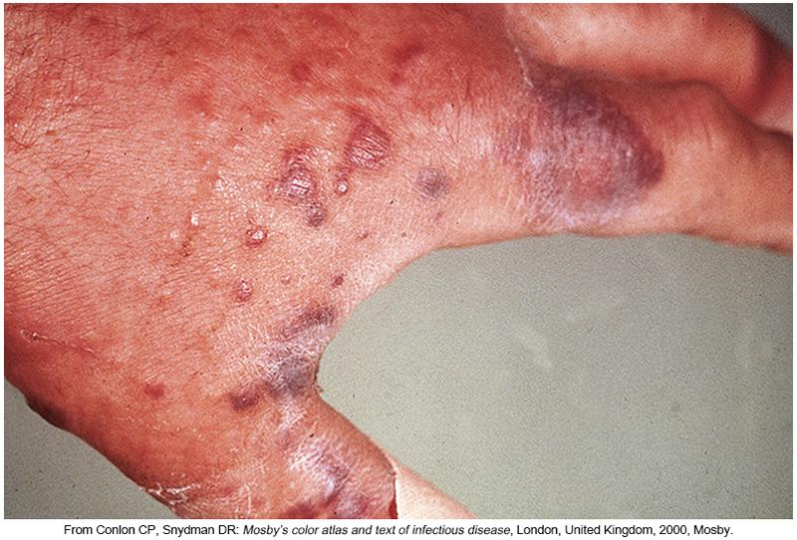
Erysipeloid

Slide 15
Capnocytophaga canimorsus Infection
C. canimorsus
Formerly known as dysgonic fermenter-2 (CDC group DF-2)
Thin, nonsporing, nonmotile, oxidase- and catalase-positive gram-negative bacilli
1-3 μm in size
Grows poorly on laboratory media

Slide 16
Capnocytophaga canimorsus Infection (Cont.)
Clinical manifestations
Infections
Vary from mild, self-limiting infection to fulminant septicemia with involvement of several organs
Normal inhabitant of canine and feline oral flora
Most patients have predisposing factor
Splenectomy
Cancer diagnosis
Drug abuse
Severe Infection Symptoms
Purpura, septic shock, and diffuse intravascular coagulation (DIC)

Slide 17
Cat Scratch Disease
Causative agent
Bartonella species—B. henselae, most common
Transmission—Bite by arthropod vector
Cat fleas, vole ear mites, ticks of canines
Clinical manifestations
Usually mild and self-limiting, lasting 6 to 12 weeks in untreated patients
Lesion at scratch, lick, or bite
Lymphadenopathy with flulike symptoms, such as fever, malaise, and anorexia

Slide 18
Clinical & Diagnostic Microbiology
Zoonotic Diseases
Transmission by Direct Contact or Inhalation

Slide 19
Anthrax Causative Agent
Causative agent (Etiological)
Bacillus anthracis
Gram-positive, spore-forming bacillus
2.5 × 10 μm in size
Anthrax is also known as
Woolsorter disease.
Malignant pustule.

Slide 20
Anthrax Epidemiology
Occurs worldwide, commonly in agricultural regions
Survives well in soil that is neutral or mildly alkaline
Development enhanced in areas with alternating dry and wet seasons
Floods tend to concentrate spores
Spores have been known to last in fields for as long as 20 years.

Slide 21
Anthrax Epidemiology (Cont.)
Animals are infected by grazing in contaminated areas.
Grazing animals at most risk of anthrax infection
Vaccines available for humans and cattle
Used in people in high-risk occupations
Human infections occur as the result of direct or indirect contact with animals or animal products

Slide 22
Anthrax Clinical Manifestations
Cutaneous anthrax
Most common form, mimics many other cutaneous infections
Spores enter through abraded skin and then germinate
Forms a painless black eschar that heals without scarring
Gastrointestinal anthrax
Ingestion of contaminated meats/meat products
Spores germinate in intestines and gain entry through preexisting intestinal mucosa lesions—to the lymphatics.
Febrile, bloody stools, may lose 12 L of fluid per day.
Most cases result in septicemia.

Slide 23
Anthrax Clinical Manifestations (Cont.)
Pulmonary (inhalation) anthrax
Inhalation of spores from contaminated animal products
Macrophages ingest spores and concentrate them in the lymph nodes.
Spores germinate and sepsis occurs.
Symptoms include fever, chills, malaise, fatigue
Death usually occurs rapidly within 24 hours in untreated cases.
Treatment only seems to be effective if given before the onset of respiratory symptoms.

Slide 24
Anthrax Treatment and Management

Slide 25
Tularemia Causative agent
Francisella tularensis
Strictly aerobic gram-negative bacillus
0.2 × 0.2 to 0.7 μm in size
Causes plague-like ground squirrel disease

Slide 26
Tularemia Epidemiology
Epidemiology
Two biovars
Type A—More virulent in humans in North America
Transmission—Rabbits or ticks
Type B—Less virulent in humans in North America
Transmission—Rodents or mosquitoes
Types A and B differ from each other biochemically and genetically but not serologically

Slide 27
Tularemia Clinical Manifestations
Clinical manifestations
Acute, febrile, granulomatous disease with rapid onset and flulike symptoms
Common presentations, each with lymphadenopathy
Ulceroglandular (ulcers)
Oropharyngeal (pharyngeal ulcer)
Oculoglandular (conjunctival ulcer)

Slide 28
Tularemia Clinical Manifestations
Other common presentations
Glandular (lymphadenopathy without ulcer)
Pleuropulmonary (no ulcer, possible lymphadenopathy)
Typhoidal (no ulcers or lymphadenopathy)

Slide 29
Tularemia Clinical Manifestations
Clinical manifestations
Pneumonic tularemia
May result from exposure to aerosols
Fever, chills, headache, and myalgia
Typhoidal tularemia
High fatality rate when complicated with pneumonia
Incubation period –typically 3 to 5 days
Papule forms at the infection site eventually ulcerates
Usually only one papule
Disease is rare, no characteristic symptoms
Treatment of choice: streptomycin

Slide 30
Brucellosis - Causative Agents and Synonyms
Causative agents
Brucella—Four species
B. melitensis (goats), B. abortus (swine), B. canis (cattle), B. suis (canines)
Exposure to urine or milk of infected animals
Septicemia with spontaneous abortion
Synonyms
Mediterranean fever, Malta fever, Gibraltar fever, Bang disease, Neapolitan fever, Cypress fever, and undulant fever

Slide 31
Brucellosis Clinical Manifestations
Infection in the United States is usually through eating undercooked meat or consuming unpasteurized (raw) dairy products
Contact with infected animals and animal products results in the highest risk of infection
Organism can enter through wounds, mucous membrane, or conjunctiva
May even penetrate intact skin

Slide 32
Brucellosis Clinical Manifestations (Cont.)
Incubation period- 1 to 3 weeks
Brucellae are disseminated hematogenously
Ingested by circulating monocytes
Monocytes transport bacteria to lymph nodes and then spread to the spleen and the liver
Granuloma formation and microabscesses
Features depend on specific species present
Considered as facultative intracellular parasites
Symptoms of acute infection
Chills, fever, sweating, weakness, fatigue

Slide 33
Leptospirosis Causative Agent
Leptospires—Spirochetes
Motile with two subterminal flagella
Characteristic hooks on the ends
6 to 20 μm by 0.1 μm in size
Nearly 70 species and 250 serovars
Organized into 23 serogroups

Slide 34
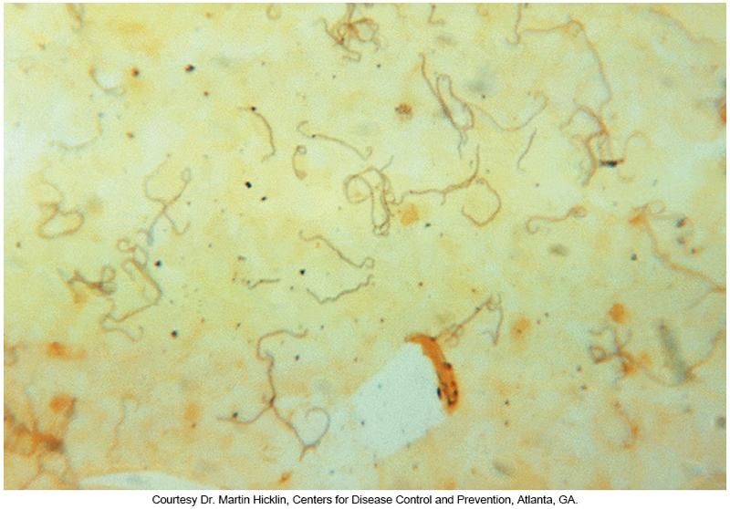
Photomicrograph of Leptospira

Slide 35
Leptospirosis Epidemiology
Found in the United States from Southern, Gulf, and Pacific coastal states, Hawaii and Puerto Rico
Exposure during recreational activities
Contact with water or moist soil
Rainwater catchment systems have been known to be a source of infection in Hawaii.
Rodents and domestic animals are primary reservoir.

Slide 36
Leptospirosis Clinical Manifestations
Spectrum of infections: range from subclinical to lethal
Mode of transmission: entry through mucous membranes of abraded skin
Incubation period: 5 to 14 days
Most cares: subclinical to mild.

Slide 37
Leptospirosis Clinical Manifestations (Cont.)
Anicteric leptospirosis is usually a biphasic disease
Phase 1: Leptospiremic or febrile phase
Lasts about 1 week
Patient experiences sudden temperature spikes, severe headaches, nausea, vomiting, muscle aches with confusion secondary to dehydration
Patients develop vivid pink eyes
Leptospires can be recovered from the patient’s blood and CSF

Slide 38
Leptospirosis Clinical Manifestations (Cont.)
Anicteric leptospirosis is usually a biphasic disease
Phase 2: convalescent or immune phase
Leptospires disappear from the circulatory system and CSF often after the appearance of specific immunoglobulin M antibodies
Symptoms may subside for a few days; a limited febrile episode may follow
Patients can develop aseptic meningitis and severe headaches
Urine contains bacteria but blood does not
Length of this stage varies but is usually between 4-30 days

Slide 39
Leptospirosis Clinical Manifestations (Cont.)
Icteric leptospirosis (a.k.a. Weil syndrome)
Caused by L. interrogans serovar icterohaemmorrhagiae
More life-threatening than the anicteric form
Starts out like anicteric leptospirosis
Third day of illness, patient develops:
Hemolysis, jaundice, renal failure
Leptospires are multiplying in the liver & kidney during this time

Slide 40
Leptospirosis Clinical Manifestations (Cont.)
Icteric leptospirosis (a.k.a. Weil syndrome)
Mortality rate 5% to 15%
In fatal cases, renal failure is the usual cause of death
In nonfatal cases, as antibodies are produced, leptospires clear from the patient’s kidneys, brain, and eyes
Treatment of choice
Mild- doxycycline, ampicillin, amoxicillin
Severe- intravenously administered penicillin G

Slide 41
Clinical & Diagnostic Microbiology
Zoonotic Diseases
Transmission by Arthropod Vectors

Slide 42
Plague
Causative agent | Yersinia pestis Gram-negative bacillus
Vector(s) | Fleas (Xenopsylla cheopis)
Natural host | Rats
Route of transmission | When contaminated rural areas come in contact with areas of human habitation Human contact with infected rats (or cats who hunt infected rats)
Responsible pandemics | “Black Death,” the notorious second pandemic

Slide 43
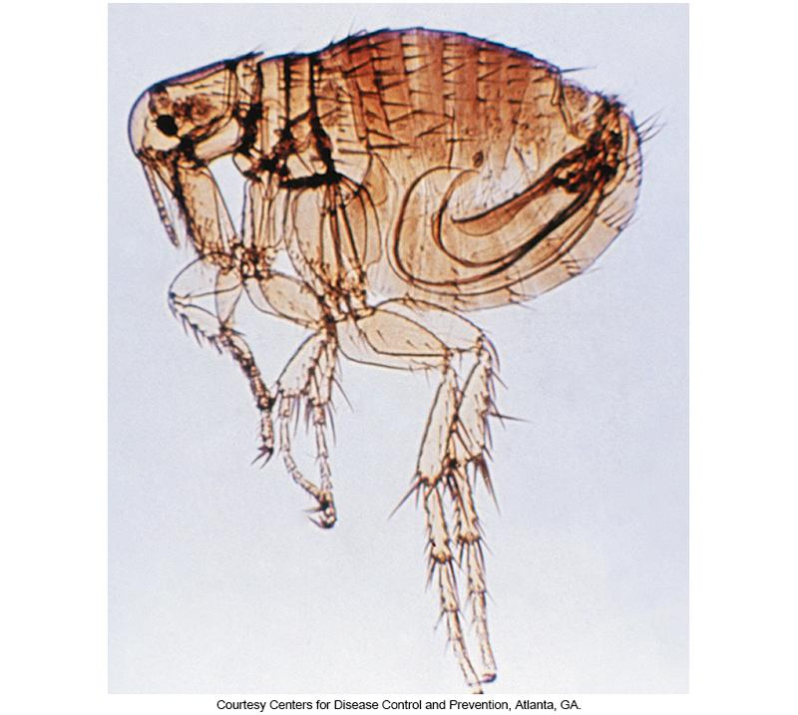
Xenopsylla cheopis

Slide 44
Plague Life Cycle Notes and Clinical Manifestations
Life cycle
Flea bite regurgitating bacilli into bite wound
Clinical manifestations
Bubonic plague
Febrile disease with 1-to-7-day incubation period
Buboes in lymph nodes
Groin, axillae, subauricular
If untreated, organism is disseminated hematogenously leading to septicemia.
Death occurs in 1 to 3 days; mortality rate- almost 100%
Septicemic plague may occur without the bubonic form.

Slide 45
Plague Clinical Manifestations
Pneumonic plague
Usually as a result of septicemia
Can be passed person to person in blood containing respiratory aerosols
Increased risk of person-to-person spread
Primary pneumonic plague
Organism acquired by infectious droplets
Secondary pneumonic plague
Plague bacillus enters lungs of some patients who have bubonic or septicemic plague.
In absence of respiratory precautions
Localized or devastating outbreaks possible

Slide 46
Lyme Borreliosis
Causative agent | Borrelia burgdorferi Gram-negative spirochete 0.18 to 0.25 μm by 4 to 30 μm in size
Vector(s) | Ixodid ticks Other insects can harbor the organisms
Natural host | White-footed mice | white-tailed deer
Route of transmission | Human contact with infected rats or cats who ingest infected rats
Synonym | Lyme disease

Slide 47
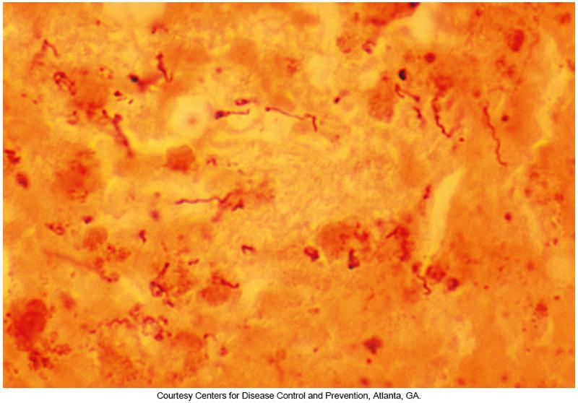
Spirochetes of Borrelia burgdorferi

Slide 48
Lyme Borreliosis Life Cycle and Clinical Manifestations
Life cycle
Ixodid ticks have 2-year life cycle
Tick bite regurgitating spirochete into bite wound
Clinical manifestations
Three stages—difficult to distinguish due to varying patient presentations
Early localized
Early disseminated
Late persistent

Slide 49
Lyme Borreliosis Clinical Manifestations (Cont.)
Early localized stage in most people
Red papule (erythema migrans known as EM) that appears at the bite site within the first 30 days of infection
EM can expand to form erythematous concentric rings with central clearing.
Nonspecific flulike symptoms
Malaise, lymphadenopathy, low-grade fever, headache, neck stiffness

Slide 50
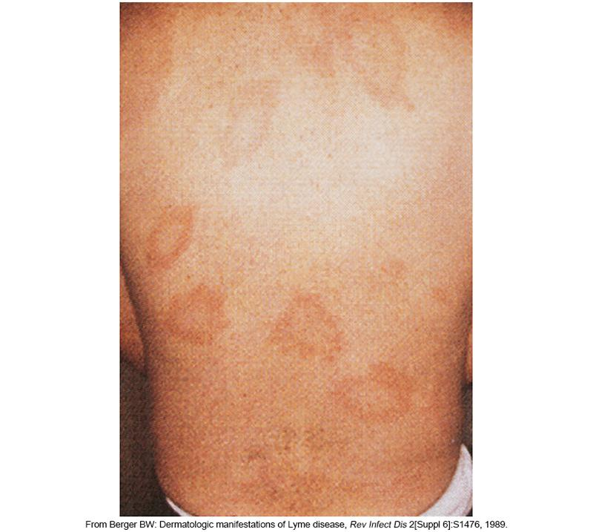
EMs Lesions

Slide 51
Lyme Borreliosis Clinical Manifestations (Cont.)
Early disseminated stage
Neurologic symptoms to include Bell palsy, neurologic deficits, meningitis, and possible oligoarthritis and carditis
Late persistent
Relapsing arthritis (months to years after initial symptoms)
Knees, shoulders, and elbows
With time, symptoms eventually disappear.
Treatment and management varies based on numerous factors

Slide 52
Rickettsia Infection General Characteristics
Rickettsiae or Rickettsiales
Obligate intracellular bacteria
Anaplasmataceae
Ehrlichia, Anaplasma, Cowdria, Wolbachia, Neorickettsia
Transmitted by arthropods
Transovarian transmission makes them a reservoir.

Slide 53
Rickettsia Infection
Causative agent | Rickettsia Short, nonmotile, gram-negative bacilli About 0.8 to 2.0 μm × 0.3 to 0.5 μm in size
Description | Obligate intracellular bacteria that can grow only in the cytoplasm of host cells
Two groups | Based on type of infection produced: Spotted fever group Typhus group
Life cycle notes | Arthropods host serves as both reservoirs and vectors

Slide 54
Spotted Fever Group
Rocky Mountain spotted fever (RMSF)
The most severe infection
The most common in the US
Spotted fever rickettsiosis (SFR)
Members are those species that can be tested via serological means
Bacteria preferentially infect endothelial cells where they replicate primarily in the host cell cytoplasm

Slide 55
Rocky Mountain Spotted Fever (RMSF)
Humans are accidental hosts.
Usually transmitted by Dermacentor variabilis and Dermacentor andersoni ticks
Clinical manifestations
Most severe of the rickettsial infections
Flulike symptoms
Fever, headache, myalgia, nausea, and vomiting
Rash
Erythematous patch on ankles or wrists
May extend to hands and soles of the feet but not the face
Hypotension and DIC possible
Mortality rate without treatment: 20% or higher

Slide 56
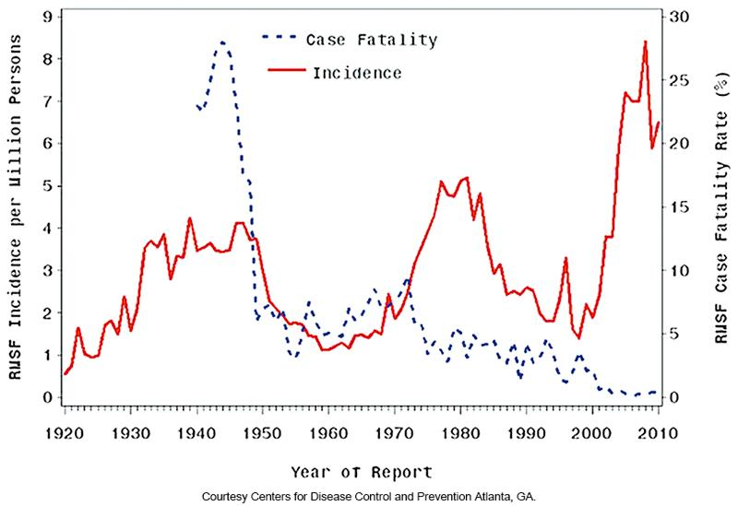
Incidence and Case Fatality of RMSF in the United States

Slide 57
Boutonneuse Fever (BF)
Also known as Mediterranean spotted fever
Reservoirs include ticks and dogs
Like RMSF
Rash involves the palms and soles of the feet and the body and face.
Taches noires
Black spots at primary site of infection
Severe complications with neurologic involvement occur in about 6% to 10% of infections

Slide 58
Rickettsialpox
Caused by R. akari
Reservoir is the common house mouse.
Vector is the mouse mite.
Like RMSF but milder, incubation period, 10 days
Appears on face, trunk, and extremities, not the palms of hands or soles of feet
Papule progressed to pustule to an indurated eschar
Other symptoms
Headache, nausea, chills
Symptoms resolve without medical attention

Slide 59
Typhus Groups
Endemic typhus
Also known as murine typhus
R. typhi
Epidemic louseborne typhus
Also known as Brill-Zinsser disease (recrudescent typhus, a reactivation of louseborne typhus)
R. prowazekii

Slide 60
Endemic Typhus
Vector
Oriental rat flea—Xenopsylla cheopis
Cat flea—Ctenocephalides felis
Reservoir
Rat and transovarian transmission
Infection
Occurs when flea defecates on skin
Scratching infects the bite
Symptoms
Fever, headache, and rash

Slide 61
Louseborne Typhus
Caused by R. prowazekii
Vectors
Human louse, squirrel flea, squirrel louse
Occurs in areas of sanitation disruption
Infection
Defecates into the bite wound via scratching
Symptoms
Rash affects the body including the face
Recrudescent typhus
Remains dormant in lymph tissue and reactivates occasionally
Death is rare

Slide 62
Scrub Typhus
Orientia tsutsugamushi
Phylogenetically distinct from the rickettsiae
Vector: chigger mites
Rodents are the principal reservoirs in Asia and oriental region of the world
Associated with rural area where human risk is elevated when conducting nonmechanized agricultural practices of field sanitation or harvest

Slide 63
Scrub Typhus (Cont.)
Life cycle
Chiggers do not take a bloodmeal
They use their saliva to dissolve tissue to create a stylostome (“drinking straw”)
Bacteria are transmitted during stylostome development and feeding
Pathogen survives the human immune response
Interaction with host cells causes the pathogens to create a coated vesicle that transport them into the host cytoplasm to “set-up shop”

Slide 64
Scrub Typhus (Cont.)
Humans are considered an incidental host
The stylostome leaves a pustule that is often itchy
Other symptoms like other rickettsial infections
If left untreated, patients can develop organ failure and bleeding, which can be fatal

Slide 65
Anaplasmataceae Infection
Taxonomy
Family Anaplasmataceae
Genera Ehrlichia, Anaplasma
Characteristics
Organisms multiply in the phagosomes of host leukocytes and not in the cytoplasm of endothelial cells like other members of the rickettsiae
Members do not appear to be transmitted transovarially in ticks.
Transstadial transmission is known to occur
Now known as Ehrlichia and not Rickettsia

Slide 66
Ehrlichiae Life Cycle Notes
Infective form- elementary body which replicates in the phagosome
Bacteria divide to form a morulae (mulberry-like bodies)
Host cell ruptures, the morulae break into many individual elementary bodies that continue the infective life cycle.

Slide 67
Human Monocytic Ehrlichiosis (HME) Epidemiology
Seasonal with most cases occurring in June and July
Causative agent: Ehrlichia chaffeensis
Worldwide including United States
Natural hosts—dogs, deer, humans
Transmitted by the Lone Star tick (A. americanum)

Slide 68
Human Granulocytic Anaplasmosis (HGA) Epidemiology
Causative agent: Anaplasma phagocytophilum
Worldwide including United States
Natural hosts—Deer, rodents, horses, cattle, humans
Transmitted by ticks
Ixodes scapularis, Ixodes pacificus

Slide 69
HME and HGA Clinical Manifestations
Organisms have an incubation period of 5 to 10 days.
Disease is clinically variable, but most patients have a moderately severe febrile illness.
The most frequent manifestations
Malaise, fever, myalgia, headache
Less common symptoms include
Arthralgia, involvement of GI or RT, others.

Slide 70
Human Ehrlichiosis Clinical Manifestations
Pediatric patients: nausea, vomiting, diarrhea, cough, joint pains, confusion, and occasionally rash
Adult patients: rarely have a rash
Leukopenia, thrombocytopenia, and elevated liver enzymes
Sometimes toxic-shock–like symptoms, central nervous system (CNS) involvement, and adult respiratory distress

Slide 71
Trypanosomiasis
Caused by hemoflagellate parasites in the genus Trypanosoma
Associate diseases
Chagas disease (T. cruzi), vector-kissing bug
Sleeping sickness (T. brucei)- tsetse flies
Modes of Transmission
Kissing bug-pass T. cruzi through feces to host
Tsetse flies-pass T. brucei during blood meal

Slide 72
Trypanosomiasis (Cont.)
Clinical manifestations
African trypanosomiasis has two stages
Stage 1- fever, headaches, enlarged lymph nodes, joint pain
Stage 2 (the neurologic stage)- parasites cross the blood-brain barrier and infect the CNS
Confusion, sensory disturbances lack of coordination, changes in behavior, disturbance of the sleep cycle

Slide 73
Trypanosomiasis (Cont.)
Clinical Manifestations
Chagas disease has two stages
Acute phase: fever, headaches, enlarged lymph nodes, joint pain, nausea, vomiting , loss of appetite, enlargement of liver or spleen, and in some patients, eyelid swelling
These symptoms will pass
Chronic stage (occurs in untreated patients): stomach pain, constipation from an enlarged colon, difficulty swallowing caused by enlarged esophagus, irregular heartbeat, heart failure, and sudden cardiac arrest.

Slide 74
Clinical & Diagnostic Microbiology
Zoonotic Diseases
Viral Zoonotic Diseases

Slide 75
Viral Zoonotic Diseases
Rabies
Humans acquire infection by inhalation
Linked to transplant tissue such as cornea
Virus replicates locally for several weeks to months
Virus preferentially infects nerve cells and progresses into the brain producing encephalitis
Virus infects highly innervated tissue (i.e. scalp, salivary glands, retina, cornea, nasal mucosa)
Neurologic signs occur after 2 to 10 days
No specific therapy, disease is nearly always fatal

Slide 76
Viral Zoonotic Diseases (Cont.)
SARS-CoV-2
Coronavirus-associated acute respiratory disease outbreak in 2019
Rapidly spread worldwide and was declared pandemic in March 2020
Researchers believe that this virus has zoonotic origins
Possibly emerged from a bat-borne or pangolin-borne virus because of its close genetic similarity to these coronaviruses

Slide 77
Viral Zoonotic Diseases (Cont.)
Monkeypox
Worldwide outbreak began in 2022
Before the outbreak, most cases were linked to international travel or imported animals
The actual source remains unknown
African rodents may transmit the disease to humans
First case of monkeypox was described in 1970

Slide 78
Viral Zoonotic Diseases (Cont.)
Chapter 29 in the textbook discusses other viral zoonotic agents including but not limited to:
Lake Victoria Marburg virus
Ebola viruses
SARS-associated virus
West Nile virus

Slide 79
Clinical & Diagnostic Microbiology
Zoonotic Diseases
Emerging Zoonotic Diseases

Slide 80
Emerging Zoonoses
Emerging zoonoses the discovery of a:
New agent
Known agent that has moved to a new geographic location
Known pathogen that has become drug resistant, or some other modification

Slide 81
Emerging Zoonoses (Cont.)
Examples of emerging zoonoses
Avian flu
Swine flu
SARS
Examples of zoonotic agents in this chapter
B. burgdorferi
E. chaffeensis
A. phagocytophilum
B. henselae
T. cruzi

Slide 82
Points to Remember
Zoonotic infections represent a significant percentage of the workload in a clinical microbiology laboratory.
Animal exposure and insect bites are important clues about possible causes of a patient’s infection.
Zoonotic agents can be bacterial or viral as well as parasitic or mycotic.

Slide 83
Points to Remember (Cont.)
Not all zoonotic infections are contagious. In several zoonotic infections, the pathogens spread efficiently to humans but do not spread easily from person to person. Many zoonotic infections are arthropod borne.
For the past 30 years, emerging infections have been recorded, including the discovery of previously unknown pathogens. Of these, 75% have a zoonotic origin.

